Slide 1
Perkins Overview for Business Office Personnel
January 22, 2024

Slide 2
Career & Technical Education Team
Bob Witchger
Tony Reggi
Patti Coultas
Mary Olvera
Stefanie Schroeder
Darice McDougald
Lane Freeman
Jennifer McLean
Aaron Mabe

Slide 3
Workshop Agenda
What is Perkins?
Comprehensive Local Needs Assessment
Perkins V required uses and Voc Codes
Optional Voc Codes (Voc Codes 10, 17-19, 28)
Perkins Admin (Voc Code 10)
WIOA Infrastructure contribution
The Perkins Process
Approved plans, budgets, and modifications
Budget reports and what we review

Slide 4
What is Perkins V?
Perkins V is a federal program meant to improve and enhance CTE curriculum programs.​
The Perkins Act was originally authorized in 1984; the most recent authorization is Perkins V in 2018​
Perkins is federal money – The state and local grantees must follow Perkins V grant guidelines and EDGAR ​

Slide 5
Purpose of Perkins V
Develop more fully the academic knowledge and technical and employability skills of secondary education students and postsecondary education students who elect to enroll in CTE curriculum programs and programs of study
Notes:
The Strengthening Career and Technical Education for the 21st Century Act reauthorized and updated the Carl D. Perkins Career and Technical Education Act of 2006 to become the current Carl D. Perkins Career and Technical Education Act of 2006 as amended by the Strengthening Career and Technical Education for the 21st Century Act (Perkins V)
This updated act stresses:
- Academic, Technical, and Employability Skills
- Funding Secondary and Postsecondary CTE
- Focusing on Students who elect to enroll in CTE Programs of Study

Slide 6
Special Populations – Perkins V, Section 3(48)
Individuals with disabilities;
Individuals from economically disadvantaged families, including low-income youth and adults;
Individuals preparing for non-traditional fields;
Single-parents, including single pregnant women;
Out-of-workforce individuals;
English learners;
Homeless individuals described in section 725 of the McKinney-Vento Homeless Assistance Act (42 U.S.C. 11434a);
Youth who are in, or have aged out of, the foster care system; and
Youth with a parent who –
Is a member of the armed forces (as such term is defined in section 101(a)(4) of title 10, U.S.C.); and
Is on active duty (as such term is defined in section 101(d)(10 of such title).

Slide 7
ESEA Sub-groups of Students
(A) Economically disadvantaged students;
(B) Students from major racial and ethnic groups;
(C) Children with disabilities; and
(D) English language learners.
Additional group
Elementary & Secondary Education Act of 1965, Section 1111(c)(2)(B)
Referenced in Perkins Section 114(e)(8)(B)(i)

Slide 8
Perkins Allocation Formula
Determine the number of curriculum CTE Students, with CTE as their primary program code, who have completed at least 12 credits in CTE courses who receive a Pell Grant or a grant from the Bureau of Indian Affairs
Determine each college’s percentage in relation to the total in all colleges
The percentage is then used to calculate the basic grant allotted to each college

Slide 9
Carry Over from previous year
Perkins Basic Grant funds are allocated and spent in the program year
Unspent funds are “returned” and reallocated based on the distribution formula for current fiscal year.

Slide 10
Performance Indicators
1P1 – Post-program Placement
CTE graduates who remain enrolled in postsecondary education, are in military service, or are employed.
2P1 - Earned Recognized Postsecondary Credential
Student attainment of a curriculum certificate, diploma, or a degree.
3P1 - Nontraditional Program Concentration
CTE concentrators in programs and that lead to occupations that are nontraditional for their gender.

Slide 11
Perkins Process Summarized
Colleges identify needs/gaps in their Comprehensive Local Needs Assessment (CLNA)​ every 2 years
Review needs and gaps and determine goals for the college in addressing them
Determine if activities to address needs and gaps can be addressed by Perkins V (Allowed by a Required Use as defined in Perkins V Section 135)
Complete Perkins Application every 4 years
Complete annual Perkins Plan and Budget
Submit plan and budget modifications as necessary
Submit mid-year and end-of-year reports as required

Slide 12
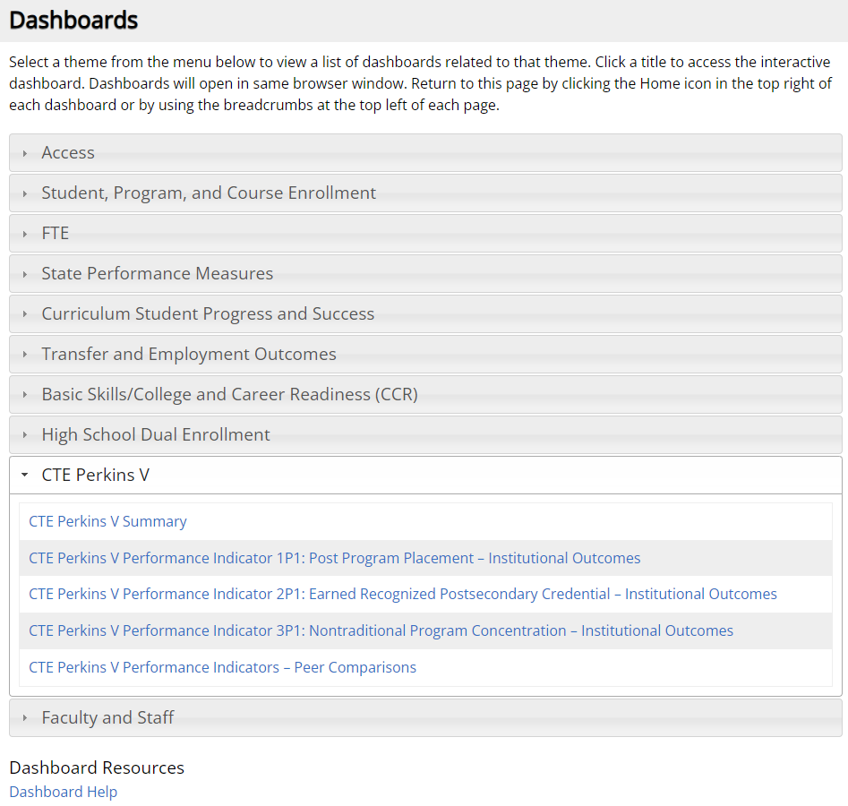
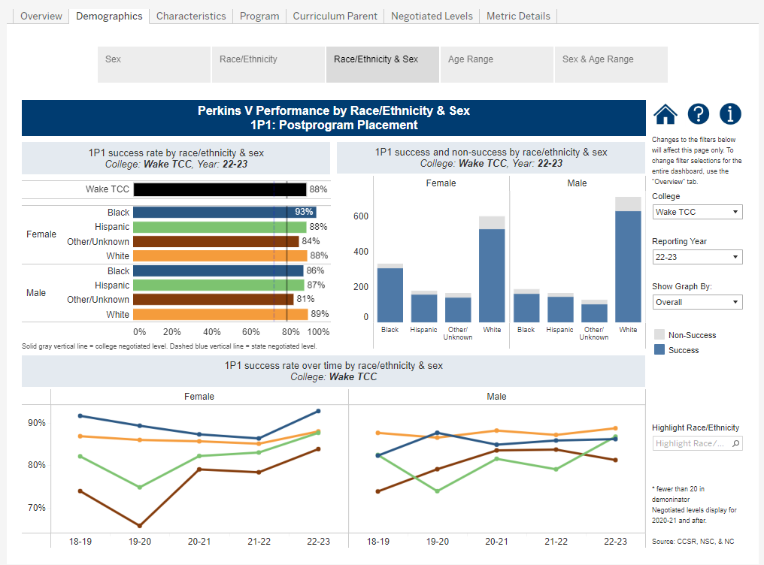
NCCCS Dashboards
Data on the public-facing dashboards can be disaggregated by many of the special populations.

Slide 13
Comprehensive Local Needs Assessment
Identify gaps and needs through the:
Evaluation of student performance by special population on Perkins core indicators.
Evaluation of the CTE programs offered (size, scope, quality)
The alignment to workforce needs
Evaluation of the progress toward implementing CTE 9-14 Programs of Study.
Evaluation of CTE educators and support professionals: recruitment, retention and training activities.
Evaluation of progress toward implementing equal access to CTE for all students.

Slide 14
Required Stakeholder involvement in CLNA
CTE program representatives at the secondary and postsecondary levels including teachers, faculty, administrators, career guidance and advisement professionals, and other staff
State or local workforce development board representatives, chambers of commerce, economic development representatives
Representatives from a range of local businesses and industries, as well as non-profit agencies
Parents and students
Representatives of special populations
Representatives from agencies serving at-risk, homeless, and out-of-school youth
Representatives from Indian Tribes or Tribal organizations, where applicable

Slide 15
College Use of Perkins Funds
College's Perkins Plan and Budget
Must meet needs/gaps identified by the Comprehensive Local Needs Assessment (CLNA)
Must address the required uses of the grant funds are outlined in Perkins V, Section 135
In addressing the gaps, colleges supplement state and local funds but not supplant them

Slide 16
Supplementing Versus Supplanting
In accordance with Perkins V, Title II, Part A, Section 211(a), funds made available under the Act must supplement and not supplant nonfederal funds expended to carry out CTE activities. In other words, federal Perkins funds are to be used to enhance career and technical education programs and activities and cannot be used when non‐Perkins funds are available or have previously supported these CTE programs or activities.
It will be presumed that supplanting has occurred where:
Colleges use Perkins funds to provide services that the college is required to make available under another federal, state, or local law; or
Colleges use Perkins funds to provide services that the college provided with non-Perkins funds in the prior year
College provides services for non‐CTE programs with non‐federal funds and provides the same services to CTE programs using Perkins funds.

Slide 17
Perkins V Required Uses (Section 135)
Perkins V Section 135 lists 5 required activities the college must address to receive a Perkins Basic Grant.
Colleges must list activities for each required use, even if Perkins funds are not used to support it.
The gaps identified in the CLNA must fit into a required use if Perkins is used to address it.
The required uses are aligned with Voc Codes for budgeting purposes.

Slide 18
Accounting Budget Codes
General Ledger Coding
11-220-12-531250-20020
Voc Codes (10 – 19 and 28) have specific Perkins definitions
See the Accounting Procedures Manual for additional information
https://www.nccommunitycolleges.edu/sites/default/files/finance-operations/budget-accounting/accounting-procedures-manual/apm_section_2_2022.01_final.pdf

Slide 19
Perkins Required Uses & Voc Codes
(1) provide career exploration and career development activities through an organized, systematic framework designed to aid students, including in the middle grades, before enrolling and while participating in a career and technical education program, in making informed plans and decisions about future education and career opportunities and programs of study. For information on specific activities, see pages 202-205 of Perkins V- The Official Guide (Hyslop) – Voc Code 11
(2) provide professional development for teachers, faculty, school leaders, administrators, specialized instructional support personnel, career guidance and academic counselors, or paraprofessionals. For specific details on allowable professional development, see page 203 of Perkins V- The Official Guide. Voc Code 12

Slide 20
Required uses continued
(3) provide within career and technical education the skills necessary to pursue careers in high-skill, high-wage, or in-demand industry sectors or occupations; Voc Code 13
(4) support integration of academic skills into career and technical education programs and programs of study to support: Voc Code 14
CTE participants at the postsecondary level in achieving academic skills (i.e. Math and English)

Slide 21
Required uses continued again
(5) plan and carry out elements that support the implementation of career and technical education programs and programs of study and that result in increasing student achievement of the local levels of performance established under section 113. For specific elements, see pages 204-205 in the Perkins V- The Official Guide. Voc Code 15
(6) develop and implement evaluations of the activities carried out with funds under this part, including evaluations necessary to complete the comprehensive needs assessment required under section 134(c) and the local report required under section 113(b)(4)(B). Voc Code 16

Slide 22
Additional Voc Codes
Voc Code 10 – Administration
Voc Code 17 – Equipment
Voc Code 18 – Employees
Voc Code 19 – CTSOs – only SkillsUSA or FBLA-PBL Other conferences, clubs, and organization expenditures would go in Skill Attainment or Increase Student Achievement
Voc Code 28 – Reserve Fund and other special funding

Slide 23
Perkins Administration (Voc Code 10)
Perkins V section 135(d) states that a college shall use not more than 5 percent of its allotment for administrative expenses. Administrative activities are those necessary for the effective and efficient performance of the eligible college’s duties under Perkins V, including the supervision of such activities. Any cost that supports the management of the Perkins V program is administrative in nature. Examples of allowable administrative costs include, but are not limited to, salary costs associated with the development of the local plan.
It is important to note that administrative expenses may be used only in proportion to the grant expenditures. For example, if after the first quarter 25 percent of the grant has been spent, then 25 percent of the administrative funds may be billed to the grant.

Slide 24
WIOA Infrastructure contribution
The college’s 5 percent maximum administrative expenses is reduced by the Workforce Innovation and Opportunity Act (WIOA) Section 121(h), which requires all required partner programs of the one-stop delivery system to contribute to the infrastructure costs of this system based on proportionate use and relative benefit received.
The total allotment approved by the State Board will be reduced by this amount, therefore the infrastructure contribution should not be in the local plan and budget. It is important that colleges pay attention to the total amount they can budget for administration (Voc Code 10) as listed on the State Board item as “Admin Costs Available”).

Slide 25
Admin Costs Available example
In this example, the CTE Allotment is $218,367 ($65,510+$152,857).
The WIOA infrastructure cost has been calculated to be $208 and is taken out before the balance is allotted to the college (Total Allotment = $218,159).
The WIOA amount is deducted from the Admin 5% to give the Admin Costs Available ($10,918 – $208 = $10,710). Therefore, a maximum amount that can be spent in Voc Code 10 is $10,710.
+
218,367

Slide 26
Equipment (voc code 17)
Capitalized Equipment with a $5,000 unit cost
Non-capitalized equipment should be in either Technical Skill Achievement (voc code 13) or Student Achievement (voc code 15)
Equipment vs instructional supplies
Instructional supplies should be voc code 13 or 15
Each expenditure in Voc Code 19 must have a corresponding activity in a Required Use, either Voc Code 13 or 15

Slide 27
Paying people with Perkins V (voc code 18)
Except for Admin (voc code 10), ALL payroll items should be coded to Voc Code 18
This may include wages, social security, health insurance, retirement, longevity, etc.
These positions must also have a corresponding activity in a Required Use Voc Code (11-16)
For example: Career Coaches would have a corresponding activity in the required use for career exploration and career development (voc code 11)

Slide 28
Extra-duty pay contracts vs. stipends
Stipends are not permissible because they do not have specific outcomes – EDGAR 200.430 (h) (4)
Extra-duty Contacts must describe the scope of work, deliverables, and have a deadline no later than June 30th
The extra duty contract description must be submitted in the job descriptions area the NCPerkins Moodle.

Slide 29
Types of Employees
Spends 100% of their time on CTE/Perkins approved activities.
May be paid in full or part with Perkins funds
Must complete a Semi-Annual Time Certification
Spends less than 100% of their time on CTE/Perkins approved activities (Called “Split Time and Effort Employee”
Must be paid with other funding when spending time on non-CTE/Perkins activities
Must keep documentation of their actual time spent
Split time and effort employee records are monitored each year

Slide 30
CTSOs Voc Code 19
We currently track 2 Career and Technical Student Organizations (CTSOs) that have postsecondary chapters in Voc Code 19
Future Business Leaders of America /Phi Beta Lambda FBLA-PBL
SkillsUSA – Many program areas
These activities must also have a corresponding activity in a Required Use in Student Achievement (Voc Code 15)

Slide 31
VOC 28: Reserve Fund and other Special Funding (Optional)
Not used for the 2023-24 year
Funds may be allocated to this VOC Code based upon a formula established by the State CTE Director and approved by the NCCC State Board.
This includes Reserve Funds and special projects, except for leadership projects.

Slide 32
Submitting paperwork via NCPerkins.org
Each college has a Primary Perkins Contact who is responsible for submitting documents into the Moodle.
There is a Moodle Course for each academic year.
Purpose is for easy management of paperwork. Each entry is time stamped, stored, and “graded”

Slide 33
Approved plans, budgets, and modifications
Planning Budget is submitted and approved the spring before fiscal (academic) year starts. Colleges may start spending/obligating funds July 1st if approved.
Initial Allotment approved by State Board of Community Colleges (In 2023-24 it was in October 2023 meeting)
Carry Forward approved by State Board of Community Colleges (also approved at the October 2023 meeting)
Modification deadline is May 15th.

Slide 34
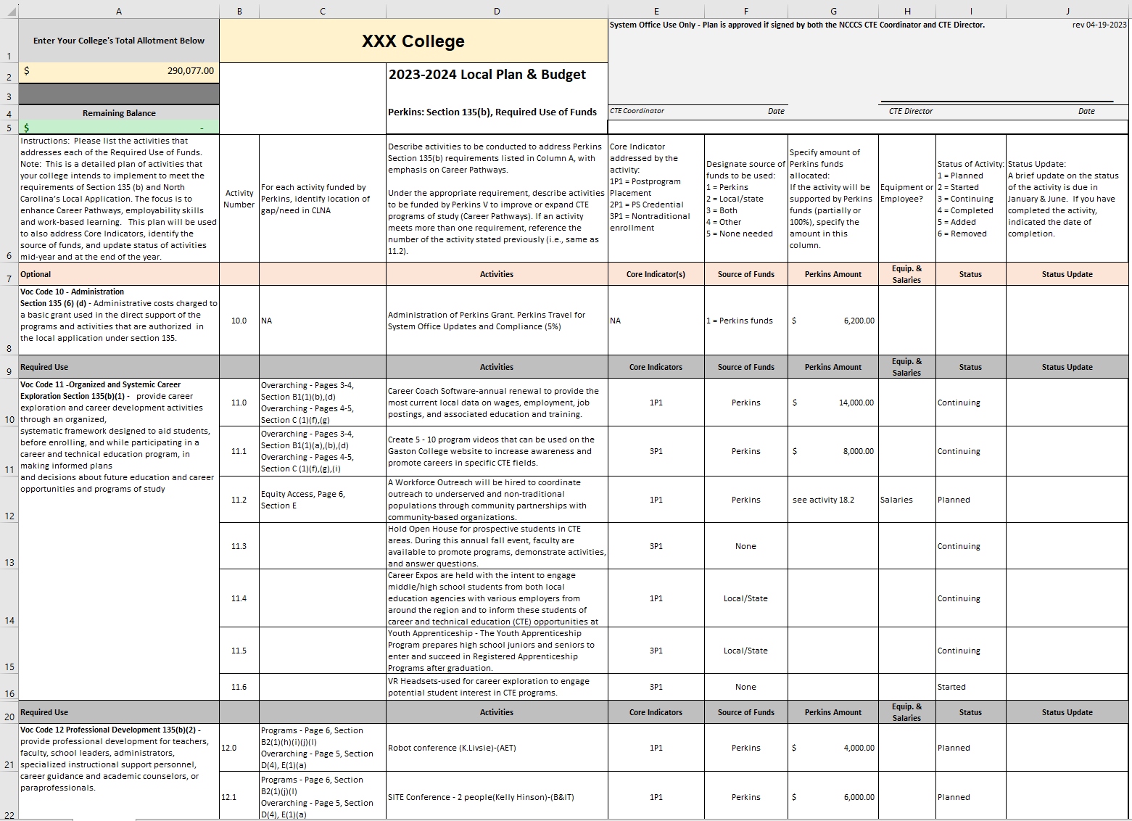
Local Plan template

Slide 35
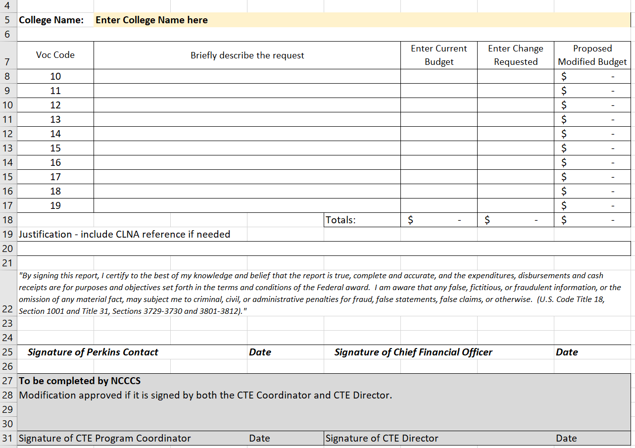
Budget Modification Form
Download from the current NCPerkins.org course

Slide 36
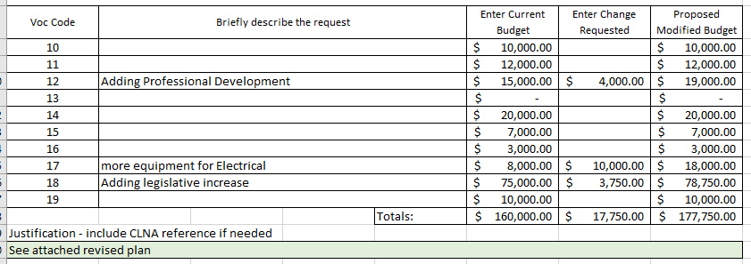
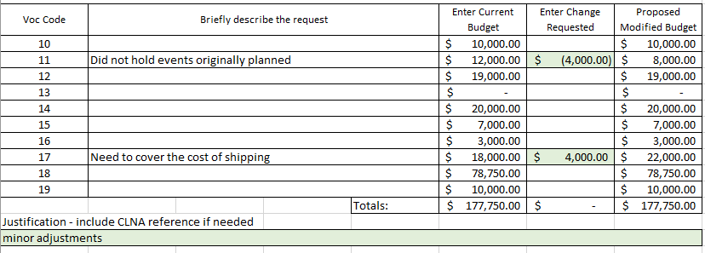
Enter Current Budget
Modification 1
for Carry-forward
Approved Planning Budget
Modification 2
Always start a new modification with the most recently approved budget

Slide 37
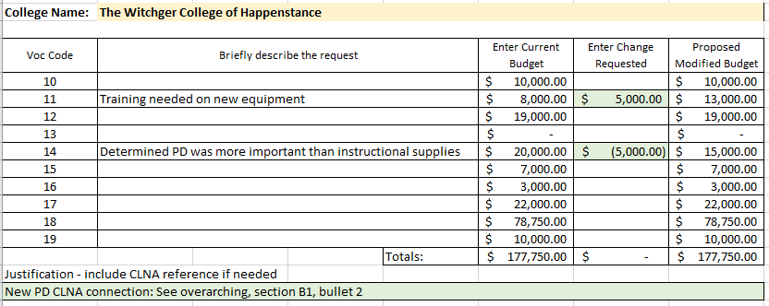
Modification to add a new activity
Connect to your CLNA
Change requested must total $0.00

Slide 38
Is an updated Plan needed too?
An updated plan is required when making significant changes or adding carry-forward.
It must include the connection to a gap or need in your CLNA.
Enter a status so it is easier for the change to be identified and feel free to highlight that activity too.
The budget page of the plan does not have to be signed, just the modification form
Even if you don't submit it, update it internally so you can submit it in your mid-year or end-of-year plan update

Slide 39
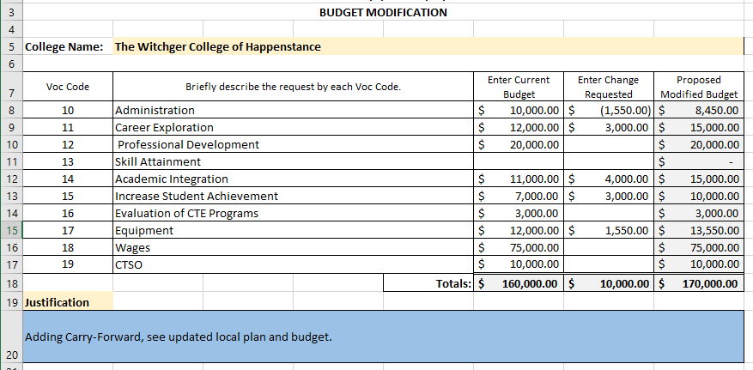
Modification adding Carry-over
Total Allotment
Must include updated plan
Change requested must total the difference between planning budget and total allotment

Slide 40
Carry-over Modification Calculation
Planning Budget $217,955.77
Initial Allotment $218,159
Carry Over $ 29,116
Total Allotment $247,275
Modification needed once approved by State Board
Total Allotment – Planning Budget = $29,319.23
247,275.00
- 217,955.77
29,319.23

Slide 41
Budget Reports and what we review
XDBRs are submitted to NCCCS for December 31 and June 30
*We recommend reviewing the October XDBR internally to ensure budget and activities are recorded correctly
Issues we’ve seen with XDBRs
XDBR Budget (by voc code) on report does not match NCCCS approved Perkins budget
Expenses recorded in voc codes that do not have a budget
Payroll items in voc codes other than 18 and 10
Non-payroll items in voc code 18
Expenses listed on report with other voc codes (often 97)
Voc Code 10 fully expensed, but the grant was not

Slide 42
Being Monitored by NCCCS
Three categories:
Split Time and Effort Employee time documentation
Equipment (for those who spend a large percentage on equipment)
On-Site
Calculating Risk for on-site monitoring
Meeting attendance (identified by a blue star in NCPerkins)
New Perkins Coordinator
Employees paid by Perkins
All contacts listed
Large Grants (more than $500,000)
Submitting documents by due date in NCPerkins

Slide 43
Perkins Monthly Webinars
Perkins Update Webinar. 2nd Tuesday of the month from 9-10am The registration link for each one is at www.ncperkins.org/presentations
Feb 13, 2024
Mar 12, 2024
Apr 9, 2024
May 14, 2024
Jun 11, 2024
 Register now so they are on your calendar!

Slide 44
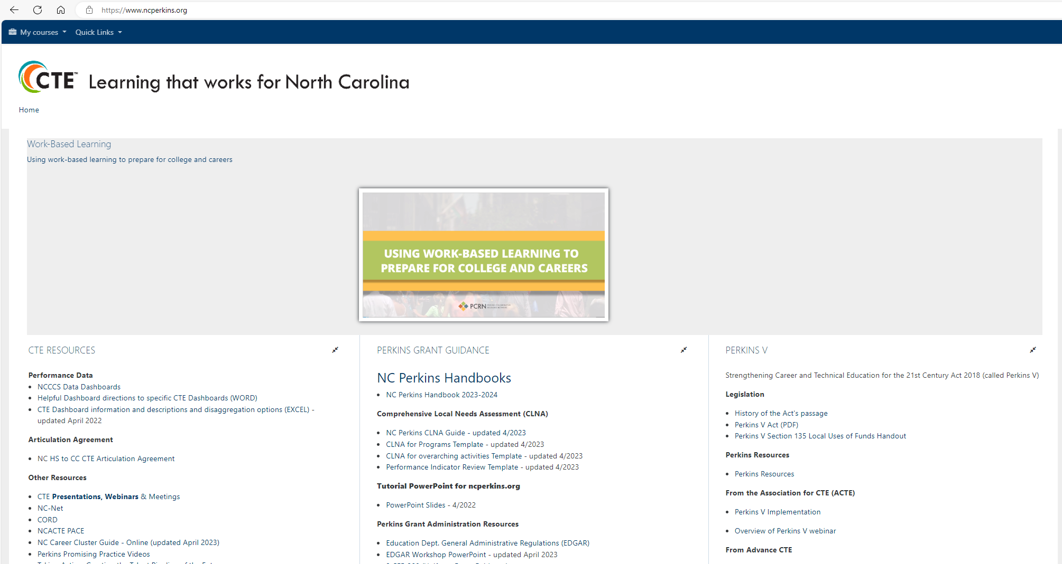
NCPerkins.org
There is information on the front page of www.ncperkins.org that may be useful, including
The Perkins Handbook (updated each Academic Year) is at the top of the middle column.
The Perkins V Act and Perkins V Local Uses of Funds Voc Codes handout is at the top of the right column under the Legislation heading

Slide 45
Technical Assistance is available
We are here to help!
Team Perkins is available by phone, email, virtually, or in-person

