Slide 1
Perkins End of Year Video
2022 2023
Notes:
Durham Tech is pleased to present this year’s end of year presentation for Perkins.

Slide 2
Results of scaling Success Coach model
Over 400 students were supported by our success coaches this year to include career exploration, early alert retention/success strategies, and/or resource needs​ (data duplicated for some categories)
This data represents 3 metamajors: Health and Wellness, IT, and Business and Entrepreneurship
Students with disabilities 7​
Students with economic disadvantages 86
Students preparing for non-traditional fields 81
Single parents/pregnant women 30
English learners 33
Veterans and relatives of veterans 12 ​
Notes:
This slide summarizes our success coach work this year including our work with students categorized as special populations. These numbers represent three of our CTE guided pathways. We continue to expand this work annually and improve ways to support and track these students using our Care Connect system and other resources.

Slide 3
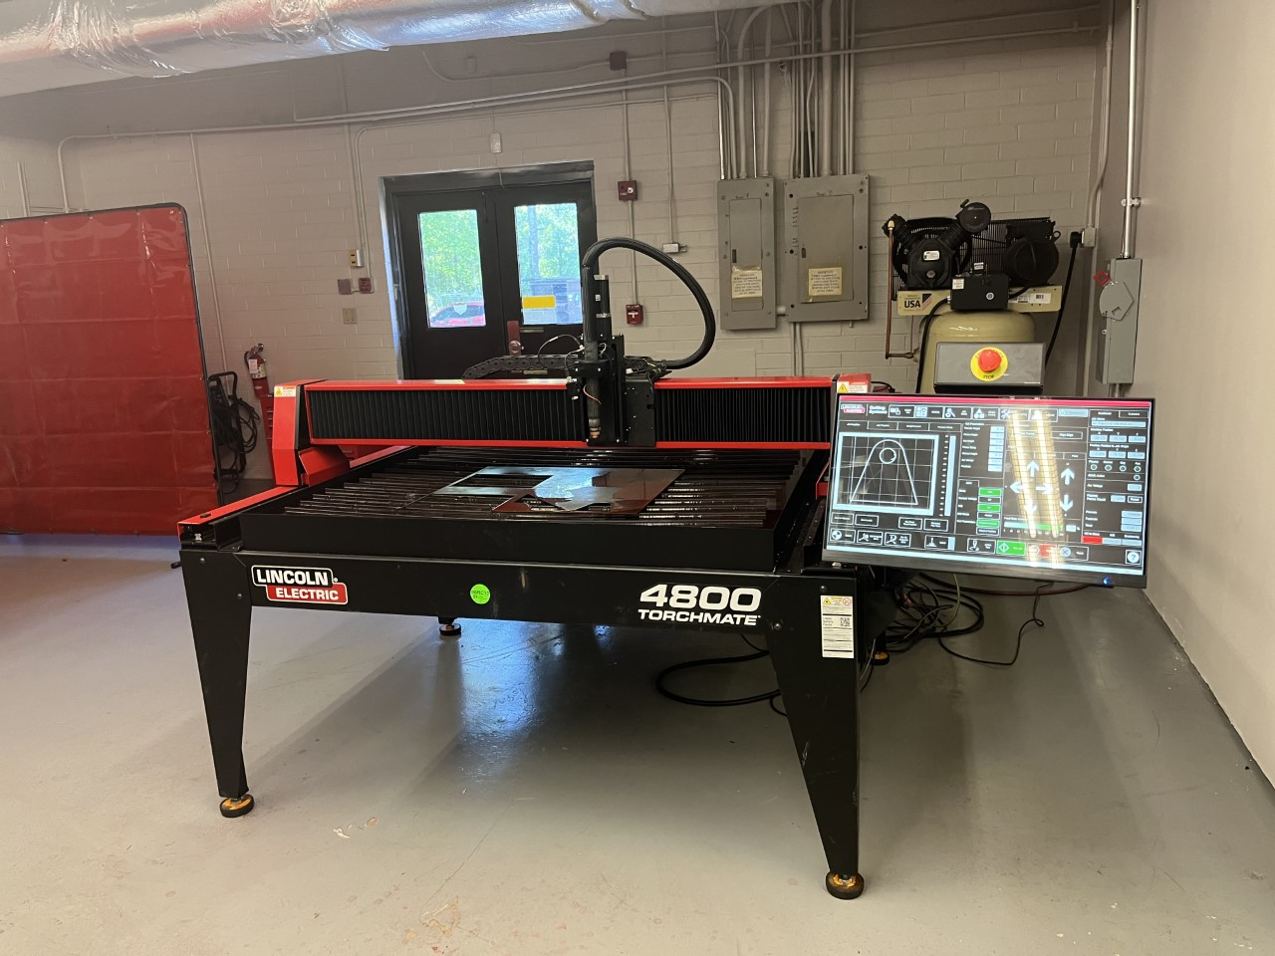
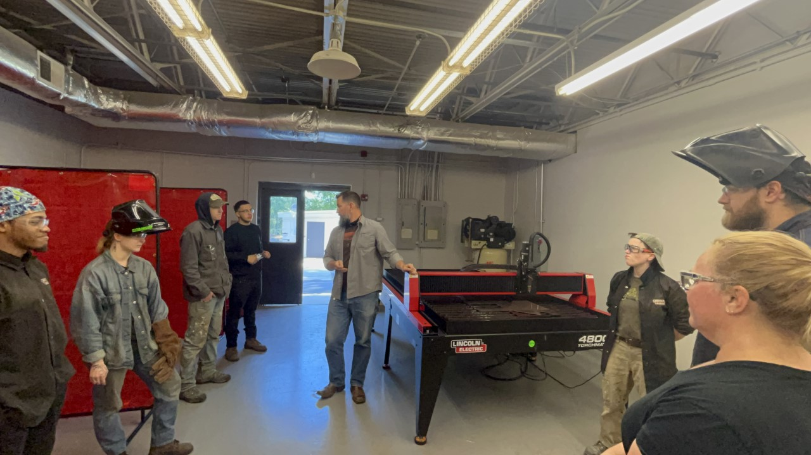
Perkins Highlight: Welding Technology
Notes:
This year, Durham Tech would like to highlight an example of a program that has been a model of how Perkins funding can make a difference in the lives of our students. Ben Lock is the new Program Director of Welding Technology. When he arrived at Durham Tech, he immediately found gaps in the program that he wanted to improve. One area he wanted to address was the lack of state of the art equipment to improve the skills of students to meet the demands of the current workforce.
Thanks to Perkins funding, Ben was able to meet significant equipment needs for the program including the purchase of the Torchmate 4800 CNC plasma cutting system. Ben says that this impressive piece of equipment will allow students to learn skills never accessible to them before.

Slide 4
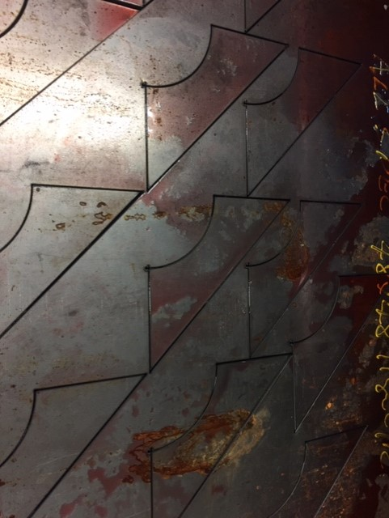
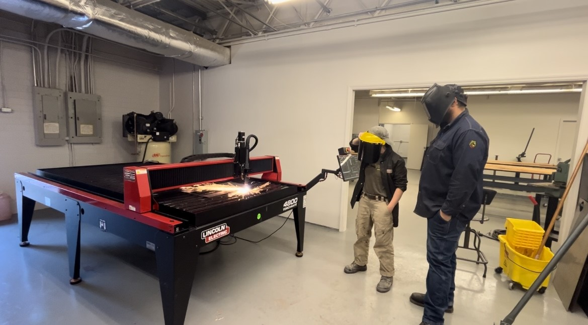
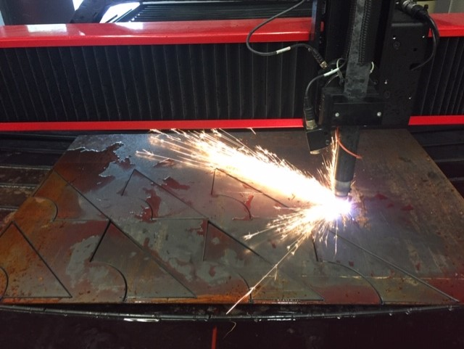
Identifying and Addressing Gaps
Evaluated what skills were being taught in the program
Evaluated labor market needs
Focused on full enrollment and growth
Recruits heavily in the high school and into the Career and College Program
Notes:
Not only has Ben identified equipment gaps in the program, but also evaluated labor market needs in the area, enrollment and growth opportunities, and student success. He is actively engaging with local high schools including Southern High School and Cedar Ridge High School. His efforts and those of his faculty have resulted in full enrollment and opportunity to grow.

Slide 5
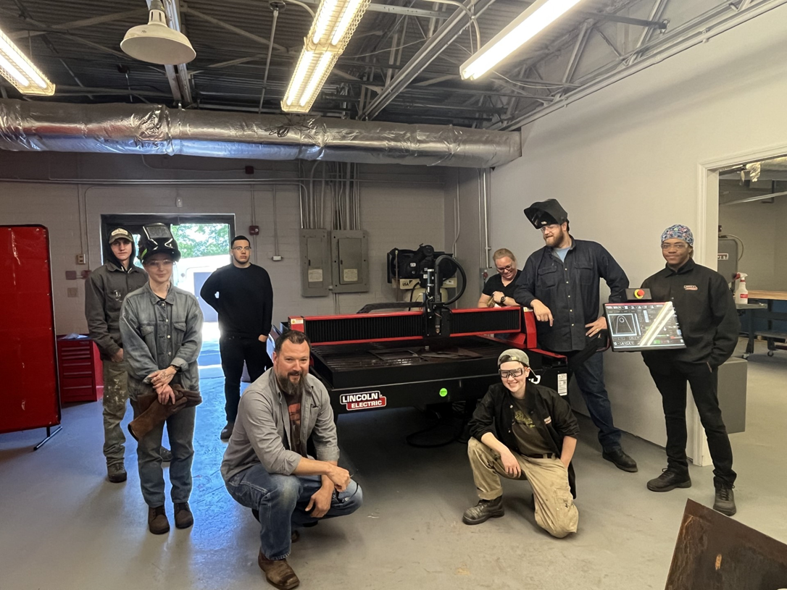
Creating a Highly Trained and Diverse Workforce
“Welding is for everyone”
Connecting students with the opportunities in the field
Notes:
The welding technology program is focused on diversity within the profession and including more female students. The program’s focus…”Welding is for Everyone”. The program teaches a wide range of skills to prepare students for a variety of jobs. The program also assists students with connecting with jobs.

Slide 6
Meet Abby!
Notes:
Abby is one such student that discovered a love for welding.

Slide 8
Supporting Student Success and Completion

Slide 9
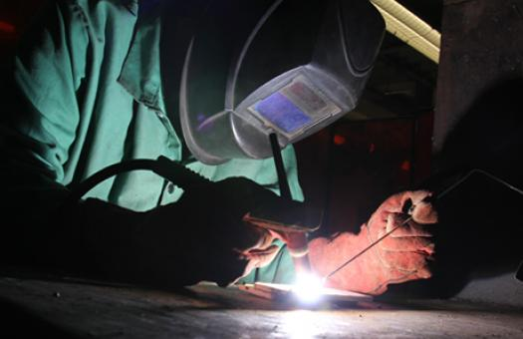
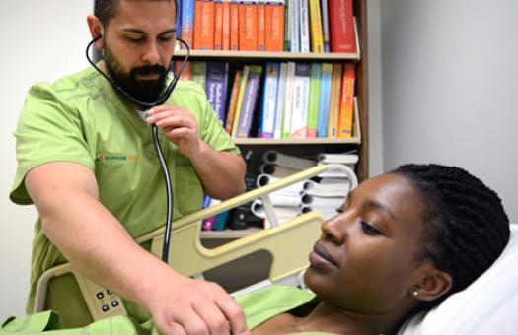
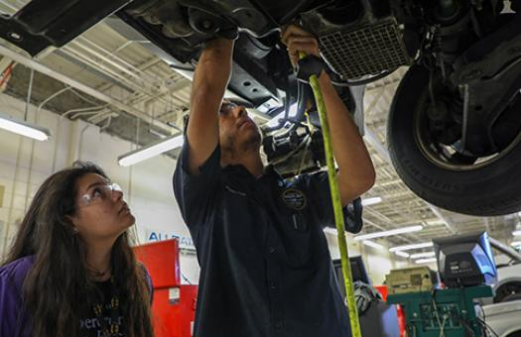
Thank you!
Notes:
Thank you for your support this year so that Durham Tech can “Do Great Things”!

