Slide 1
Perkins Update
October 10, 2023

Slide 2
Career & Technical Education Team
Bob Witchger
Tony Reggi
Patti Coultas
Mary Olvera
vacant
Darice McDougald
Lane Freeman
Jennifer McLean
Aaron Mabe

Slide 3
In Process to hire a CTE Coordinator

Slide 4
Purpose of Perkins
Develop more fully the academic knowledge and technical and employability skills of secondary education students and postsecondary education students who elect to enroll in CTE curriculum programs and programs of study
Notes:
The Strengthening Career and Technical Education for the 21st Century Act reauthorized and updated the Carl D. Perkins Career and Technical Education Act of 2006 to become the current Carl D. Perkins Career and Technical Education Act of 2006 as amended by the Strengthening Career and Technical Education for the 21st Century Act (Perkins V)
This updated act stresses:
- Academic, Technical, and Employability Skills
- Funding Secondary and Postsecondary CTE
- Focusing on Students who elect to enroll in CTE Programs of Study

Slide 5
Perkins 2023-24 Budgets by Voc Code
P.D. 7.67%
Wages
45.25%
Equipment 32.63%

Slide 6
Carryover from 2022-23
To be used in Perkins Approved Activities, with emphasis on
Professional Development,
Building Career Pathways,
Integrating Academics into Technical Programs,
Serving Special Populations,
Activities as informed by each college’s CLNA.

Slide 7
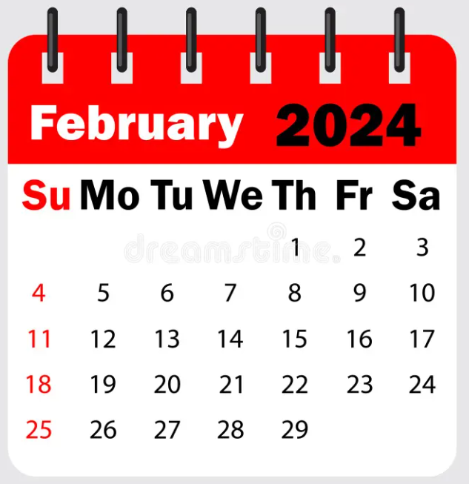
Mid-Year Review and Grant Technical Assistance
Caraway Conference Center
Room & dinner will be available starting February 5th
Please plan on staying the entire time to network and listen to other college’s promising practices.
Room and board paid by Perkins Leadership.
Colleges must pay for mileage

Slide 8
Mid-Year Reviews
Series of round tables to better share information from each other
Small group discussions with report outs, topics such as
CLNA
9-14 Pathways
Professional Development
Identification and supporting special populations

Slide 9
NAPE's Equity in Perkins V Workshop
Stay tuned!
Plans are in the works to offer this 2-day workshop around the state.

Slide 10
PowerBi for Special Pops Un-suppressed Data
Perkins data coming soon!
Make sure your Data Coordinator (IR/IE) has access!

Slide 11
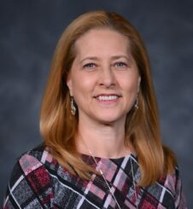
NCACTE PACE
PACE = Postsecondary, Adult & Career Education
Pam Gibson
Dean of Engineering & Applied Technologies
Fayetteville Technical Community College
Discussion on joining NCACTE/ACTE
Notes:
https://www.acteonline.org/about/structure/divisions/postsecondary-adult-and-career-education-division/

Slide 12
ll-perkins Listserv

Slide 13
Career Exploration Guides
Let us know if you need any!
40 guides per case
Contact Darice to order them
Mcdougaldd@nccommunitycolleges.edu
Available online at https://nccareers.org/printables-tools

Slide 14
Digging Deep in Career Exploration Workshops
November 20 – Catawba Valley
December 5 – Wayne Community College
9am – 2pm
Who should attend?
Career Coaches and Career Counselors
*Lunch $10 cash only at the door

Slide 15
Promising Practice Video from 2022-2023
Southwestern Community College
Supporting all students
Video won’t show during a viewing of the recording. The link is https://www.youtube.com/watch?v=e_9kOF5RaM8

Slide 16
Virtual Office Hours for Technical Assistance
2nd Tuesday of the month 1-2pm
4th Wednesday of the month 9-10
** See NCPerkins course announcements for TEAMS link
Need help?
Let's meet.
CTE Team Perkins
Virtual
Office Hours
Drop in to ask a CTE Coordinator your questions

Slide 17
Fall 2024 System Conference
Start planning now to submit a proposal to present!
Ideas and Topics for a CTE Strand
October 13-15, 2024
Convention Center, Raleigh
Notes:
Put in chat ideas and topics

Slide 18
Perkins Monthly Updates 2023-24
Nov 14, 2023
Dec 12, 2023
Jan 9, 2024
Feb 13, 2024
Mar 12, 2024
Apr 9, 2024
May 14, 2024
Jun 11, 2024
 Register now so they are on your calendar! www.ncperkins.org/presentations
Attendance (or viewing the recording within 30 days) is recorded on monitoring rubric. Recording may be accessed at the same link as the registration.
Notes:
Register now and let the system remind you.

Slide 19
Raising the Awareness of Career Pathways Monthly Webinars
Oct. 18 – Disability Awareness Month
Nov. 15 – Dental Assisting and Hygiene
Jan. 17 – Engineering Technology
Feb. 21 – Biotechnology & Clinical Trials Research Associate
Mar. 20 – Business Administration
Apr. 17 – Public Safety
May 15 – Cyber Crime Technology
Register for all webinars at www.ncperkins.org/presentations

Slide 20
National Disability Employment Awareness Month – October 18, 2023 9am-10am
October 18, 9am-10am
Webinar
To Register: www.ncperkins.org/presentations or https://register.gotowebinar.com/register/4883145972769091420

Slide 21
Technical Assistance is available
We are here to help!
Team Perkins is available by phone, email, virtually, or in-person

