Slide 1

A Changing World: Helping people prepare for life in a scary world that we know little about
Chris Droessler, Consultant, NCDPI
www.ctpnc.org/presentations
Notes:
The job market has changed considerably from when we graduated from high school.
Good morning. I am Chris Droessler, an education consultant from North Carolina Public Schools.
If you have a smart phone, and you are smart enough to use it, you can capture that QR code, and your phone takes you to the webpage where you can download a copy of this PowerPoint file.
Or you can just go to ctpnc.org and click on the “presentations” link.
That web address is on the handout that you should have received.
How many of you have already downloaded my presentation??
Warning: I talk fast and have lots of information to cover. My goal is to get the information to you so that you can go back and digest it later.
I have documented my information sources in the notes section of the PowerPoint, to allow you to further research anything that you see here.
In fact, the notes from which I am reading are there as well.
Download the PowerPoint and use it any way you wish if it will help people discover their perfect career. --
This presentation takes a hard look at where we are -- and where we should be -- in preparing people for the future job market.
So buckle up, you are in for a fast ride into the future!
=====
NCETA Board Meeting
Greensboro
January 29, 2015

Slide 2
N.C. Division of Workforce Solutions
We help people find jobs and achieve their career goals, and we help employers find and retain a qualified workforce.
Notes:
2
Here is the mission statement for the N.C. Division of Workforce Solutions
We help people find jobs and achieve their career goals, and we help employers find and retain a qualified workforce.
I am usually talking to high school teachers, but much of what I am presenting here applies to helping adults find work as well.
===
http://www.nccommerce.com/wf/about-us/commission-on-workforce-development

Slide 3
NCCCS Mission
The mission of the North Carolina Community College System is to …
… develop a globally and multi-culturally competent workforce …
Notes:
3
I pulled this line from the North Carolina Community College System mission statement.
,,,
What does it really mean to be globally and multi-culturally competent?
=====
The mission of the North Carolina Community College System is to open the door to high-quality, accessible educational opportunities that minimize barriers to post-secondary education, maximize student success, develop a globally and multi-culturally competent workforce, and improve the lives and well-being of individuals by providing:
Education, training and retraining for the workforce including basic skills and literacy education, occupational and pre-baccalaureate programs.
Support for economic development through services to and in partnership with business and industry and in collaboration with the University of North Carolina System and private colleges and universities.
Services to communities and individuals which improve the quality of life.
=======
http://www.nccommunitycolleges.edu/mission-history

Slide 4

NC Education Plan
All students must graduate from
high school and be career,
college, and citizenship
READY.
Notes:
4
And here is the simplified version of our state school board mission.
It does not matter whether you are working with high school students or adults, Everyone must be career, college, and citizenship ready.
Notice the “and.” That means we recognize that everyone needs to be ready for all three.
Career ready means they have the technical skills and soft skills for which the employer is looking, and they are ready to get and keep the job.
I have been saying for many years that “College ready” does not mean that everyone needs a four-year college degree. It means life-long learning. The learning does not stop after high school graduation.
With the ever-changing world in which we live, everyone must continuously learn to keep up with the latest in your chosen profession.
Today I’m focusing on the Career-Ready part.
===
http://legislative.ncpublicschools.gov/resources-for-legislation/2012/20120608-sup-howmeasure.pdf

Slide 5
Surprises
Future Demand
Changing World
New Ideas
www.ctpnc.org/presentations
Notes:
Here is what we will be covering today.
Surprises in the job market,
Future Demand in occupations and the business world,
Our Changing World,
And some New Ideas about careers,
→
We will start with a few facts that might surprise you.

Slide 6
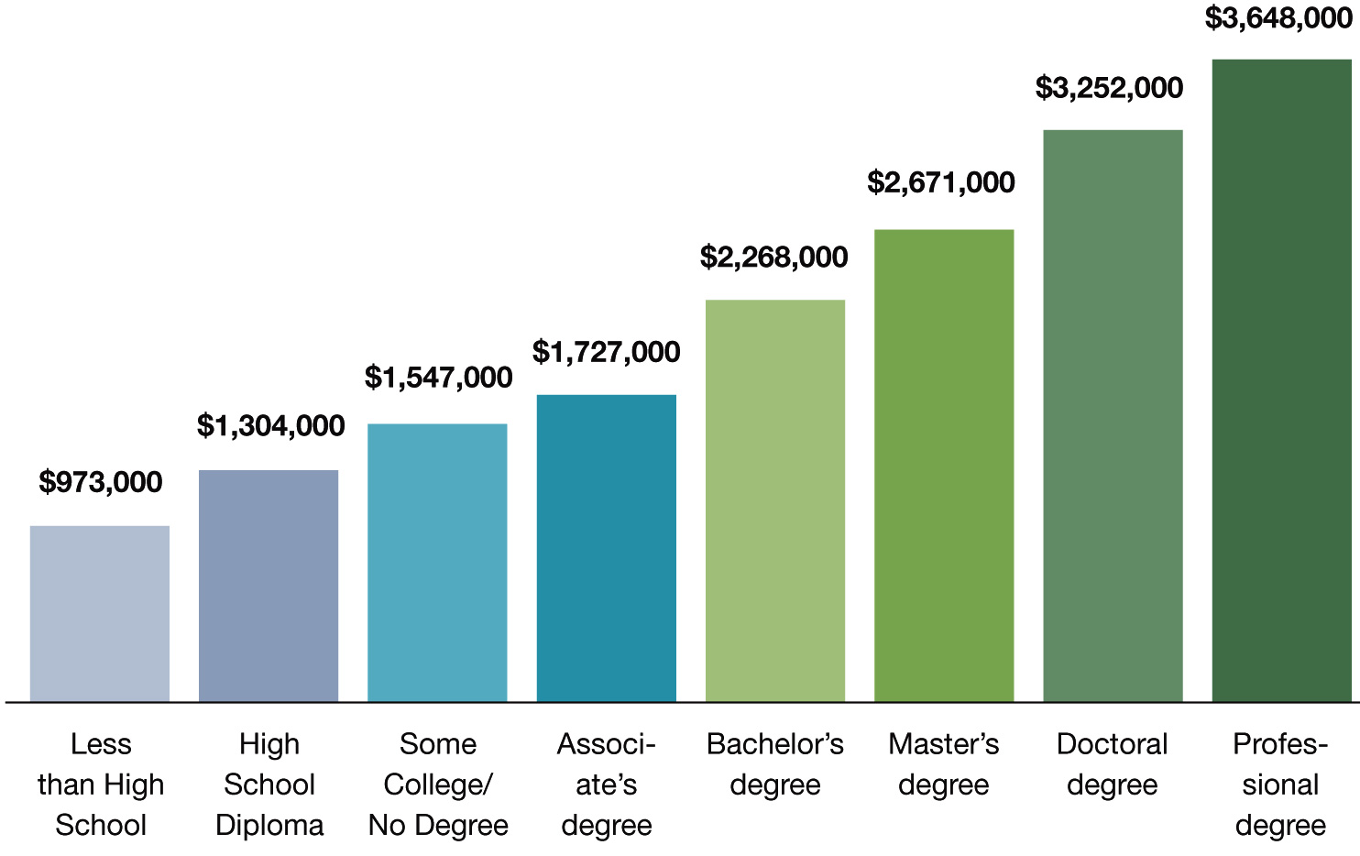
Degree Level Matters
People with more education make more money than those with less education
Notes:
This chart shows that, on average, people earn more over their lifetime if they have a higher level of education.
There’s no surprise here. But the reason I include this chart is to remind you that this chart shows people who are currently employed.
What does this say to our students who will be employed five to ten years from now? Will the chart look different for them?
What if lifetime education costs and student loan interest is figured in? Does that narrow the gap?
What about the cost of business attire, business social expenses, club memberships, and other expenses that might be different at different levels of employment?
What if all of that is figured in?
What about a lifestyle choice?
What does this chart tell our kids about their future?
====
http://cew.georgetown.edu/collegepayoff/
http://www9.georgetown.edu/grad/gppi/hpi/cew/pdfs/collegepayoff-summary.pdf
Page 4, 5
6

Slide 7
Average Starting Salaries for
2009 College Graduates in FL
$47,708 Associate in Science (community college)
$44,558 Bachelor degree (private college)
$39,108 Certificate (community college)
$36,552 Bachelor degree (state college)
Miami Herald - Jan 1, 2011
Notes:
This study in Florida looked at the actual starting salaries of college graduates. What they discovered was that the community college graduates earned more money than the folks who earned a Bachelor’s degree.
The stark reality is that there is a high demand for jobs for which you prepare by attending community college. And those jobs being in high demand, often command surprisingly high salaries.
I assume that many of the bachelor-degree graduates in this study could not find a job in their field and settled for much less.
Compare this slide with the previous slide, and you can see that the data can be very confusing. The previous slide tells were we were for past graduates, this slide shows were we are now for our current graduates.
I’m about to show you where we will be in the future, which is when our high school students will be employed.
But first, -- let’s look at a few more states.
====
http://www.miamiherald.com/2011/01/01/1996875/study-less-earn-more-at-least.html#ixzz1BP94m3Nj
http://www.miamiherald.com/2011/01/01/1996875/study-less-earn-more-at-least.html
7

Slide 8
Average Starting Salaries for
2005 College Graduates in OH
$35,648 Associate degree
$33,218 Bachelor degree
Notes:
Ohio found similar results when they polled their college graduates.
Associate degree pays more then bachelor degree.
===
I’m not down on Bachelor degrees,
it’s just that associate degrees have been the Rodney Dangerfield of the education world.
It’s time they get the respect they deserve.
====
http://www.ohiocommunitycolleges.org/public-page.php?s=community-college-facts
8

Slide 9
Average Salaries
TN CC earn $1,300 higher than 4-year grads.
VA CC - occupational and technical degree
programs earn $2,500 more than bachelor's.
Notes:
Recent Tennessee Community College graduates earn more than the graduates of the state's four-year institutions.
Similar for Virginia.
I have seen data for several more states that all show that the folks earning a two-year technical degree on average start out making more money than the folks with a four-year degree.
Unfortunately, I can not find the data for North Carolina.
-----
http://money.cnn.com/2013/02/26/pf/college/community-college-earnings/index.html
9

Slide 10
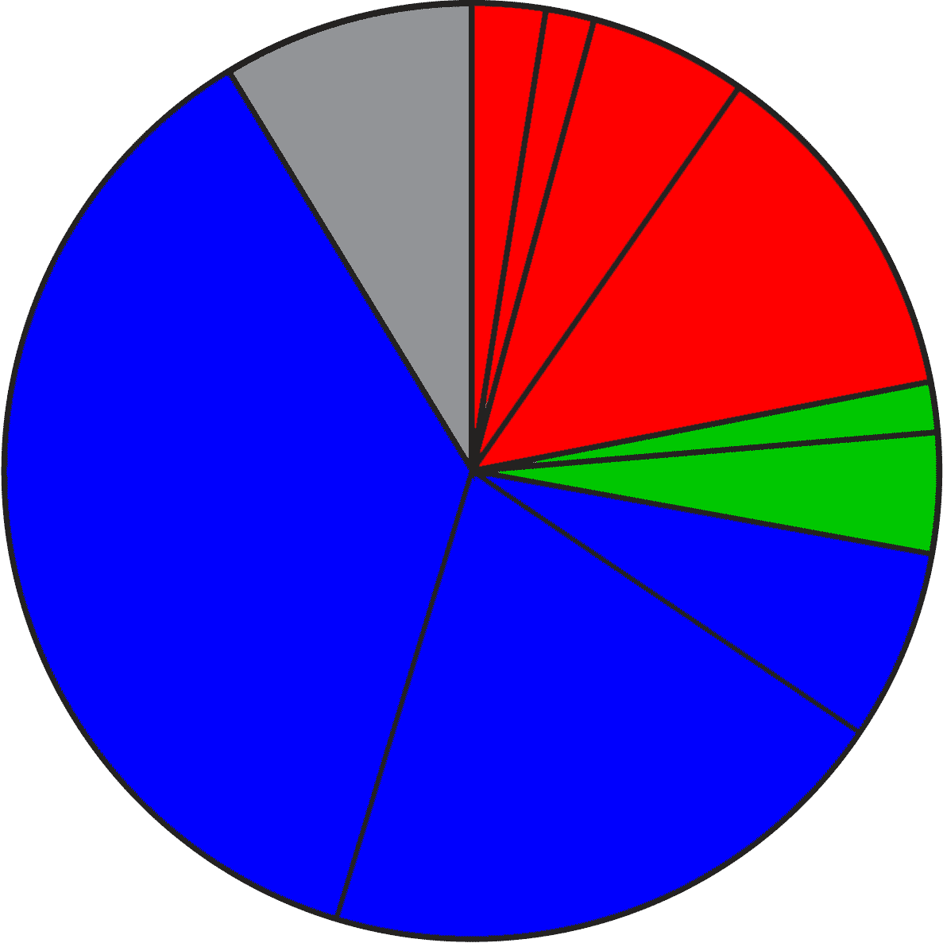
2020 Projected NC Employment:
Education Required
Doctorate & Professional degree
work exp.
Master’s degree
8.7%
Bachelor + work exp.
5.5%
Bachelor’s degree
12.3%
1.7%
Associate degree
4.2%
36.6%
1,2 year college
short OJT
6.6%
long OJT
20.2%
moderate OJT
Notes:
Here is the breakdown of the minimum education required for all jobs projected in North Carolina in the year 2020.
The red jobs require four or more years of college.
Green jobs require one or two years of college.
You will notice that the largest portion, in blue, are the jobs that do not require any education past high school in order to get the job. They require various amounts of On The Job Training.
The 8.7 percent in the gray slice of the pie requires previous work experience. Think of this as the worker who rises up to become the shop foreman or a manager.
====
NC Employment Security Commission data via www.CareerOutlook.US
http://careeroutlook.us/
These are for all jobs that get a paycheck, not for contracted positions, or small business owners who do not write themselves a paycheck.
NC Projections for 2020
2.54% Doctoral or professional degree
1.68% Master's Degree
5.47% Bachelor's Degree plus work experience
12.25% Bachelor's Degree
1.74% Associate Degree
4.17% One/two years of college
6.59% Long-term on-the-job (OJT) training
20.24% Moderate-term on-the-job (OJT) training
36.6% Short-term on-the-job (OJT) training
8.72% Work experience in a related occupation

Slide 11
2013 NC High School
Graduate Intentions
Other
Employment
8.9%
Military
Trade and
Business
Schools
5.0%
Public Senior
Institutions
35.1%
Private
Junior
Colleges
37.4%
Community and
Technical Colleges
9.9%
Private Senior
Institutions
Notes:
And here you see the breakdown of the postsecondary intentions of our North Carolina high school graduates.
The red shows that almost half of them say they are going to a four-year college program.
The green is one or two years at a community college, junior college, or trade school.
The blue is joining the military or going directly into employment.
The Other category is the one-and-a-half percent of our graduates who plan to sit on Mom’s couch the rest of their lives playing Nintendo.
=====
http://www.ncpublicschools.org/fbs/resources/data/
NC Public Schools Statistical Profile 2012-2013
Of the 95,268 graduates in the class of 2013, here is where they say they are going after high school.
35.1% Public Senior Institutions
9.9% Private Senior Institutions
37.4% Community/Technical College
0.5% Private Junior College
1.6% Trade/Business School
5.0% Military
8.9% Employment
1.6% Other

Slide 12
Postsecondary Intentions vs. Reality
Graduate Intentions
Education Required
8.7%
OJT
4 year
13.9%
21.9%
4 year
5.9%
45.0%
1-2 year
1-2 year
OJT
39.5%
63.4%
Notes:
Here we can compare these two charts.
On the left is where the students say they are going, and on the right is what kind of education the jobs require.
→45 percent of our students say they are going to a four-year college program, which will prepare them for 22 percent of the job openings. Do you see that in the red part of the two charts?
If you do the math, it looks like half of them will be left holding a sheepskin with no job to show for it.
→Likewise, in green you see that almost 40 percent of our high school graduates say they are going to a one- or two-year program at a community college or private training facility.
This prepares them for almost 6 percent of the jobs.
Whether you use old math or new math, you still see that there is some disparity between the number of people going into a postsecondary education program and the number of jobs that will demand that kind of education.
→Though the blue on the right shows that 63 percent of the jobs do not require postsecondary education (that means that you can get any of those jobs right out of high school), there are community college and technical school programs for most of these jobs, which means that the education is not required, but in these days of high unemployment, the postsecondary education is preferred, and you will be more likely to get hired, and might start at a higher salary.
=============

Slide 13
Associate Degree Required
(2011 NC Starting Salaries - 2018 High Demand)
$62,210 Construction Managers
$51,360 Dental Hygienists
$46,040 Registered Nurses
$42,350 Respiratory Therapists
$40,690 Radiologic Technologists and Technicians
$40,420 Physical Therapist Assistants
$28,030 Paralegals and Legal Assistants
$26,840 Medical and Clinical Laboratory Technicians
$19,810 Veterinary Technologists and Technicians
$17,400 Preschool Teachers, except Special Education
Notes:
Here are High Demand jobs in North Carolina that require a 2-year associate degree.
Getting your foot in the door with one of these entry-level jobs can lead to other jobs. Some employers may even pay for the education you need to advance.
I’ve underlined the word Manager to remind you that this occupation requires previous work in the industry as well as the associate degree, so that is one reason why the starting salary is higher then many of the others.
Look at all of the health professionals!
Go to college for two years and start making some good money.
All of the jobs on this list can relate to the Healthcare industry.
Many people are convinced that community college graduates don’t make good salaries. That just is not so.
Times have changed.
===============
www.CareerOutlook.us based on NC Employment Security Commission data
High Demand is above the Mean of all Average Total Annual Openings, which for 2008-2018 is above 60 openings per year.

Slide 14
Bachelor Degree Required
(2011 NC Starting Salaries - 2018 High Demand)
$86,820 Computer and Information Systems Managers
$72,800 Financial Managers
$71,430 Software Developers, Systems Software
$63,180 Medical and Health Services Managers
$61,140 Software Developers, Applications
$54,740 Sales Managers
$54,430 Computer Systems Analysts
$49,890 Financial Analysts
$49,270 Network and Computer Systems Administrators
$47,950 Management Analysts
$46,380 Civil Engineers
$43,880 Accountants and Auditors
$43,360 Securities, Commodities, and Financial Services Sales Agents
$40,950 Financial Specialists, All Other
$40,830 Environmental Scientists and Specialists, Including Health
$40,790 Compensation, Benefits, and Job Analysis Specialists
$39,040 Sales Representatives, Wholesale and Manufacturing, Technical and Scientific Products
$38,140 Training and Development Specialists
$38,040 Compliance Officers
$37,160 Cost Estimators
$36,990 Market Research Analysts and Marketing Specialists
$36,230 Personal Financial Advisors
$35,500 Public Relations Specialists
$34,770 Secondary School Teachers, Except Special and Career/Technical Education
$34,060 Special Education Teachers, Preschool, Kindergarten, and Elementary School
$33,750 Elementary School Teachers, Except Special Education
$33,710 Middle School Teachers, Except Special and Career/Technical Education
$33,630 Kindergarten Teachers, Except Special Education
$33,380 Mental Health and Substance Abuse Social Workers
$32,890 Child, Family, and School Social Workers
$32,160 Adult Basic and Secondary Education and Literacy Teachers and Instructors
$28,300 Clergy
$28,100 Graphic Designers
$16,890 Recreation Workers
Notes:
Here we are looking at the high demand jobs in North Carolina that require a bachelor degree, starting with the highest starting salaries. Below the bottom of the page, down near the floor, are the school teachers.
Here again the underlined occupations are in management, which means that not only does the job require a bachelor degree, but also requires some years of work experience in that field. These are not jobs that you get four years out of high school.
Unfortunately, more schooling does not always mean more money.
A Dental Hygienist with only two years of college, makes more money the first year than many of these jobs that require a 4-year degree.
Considering the student loans to pay back, who will be able to afford that fancy sports car the soonest?
=============
www.CareerOutlook.us based on NC Employment Security Commission data
High Demand is above the Mean of all Average Total Annual Openings, which for 2008-2018 is above 60 openings per year.

Slide 15
Surprises
Future Demand
Changing World
New Ideas
www.ctpnc.org/presentations
Notes:
Now --- let’s look towards the future.
Unfortunately I don’t have a budget code for a crystal ball, so I have to divine the future using Google.

Slide 16

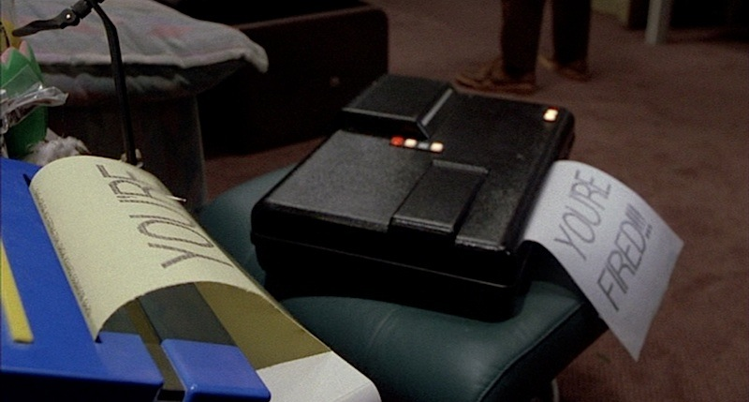


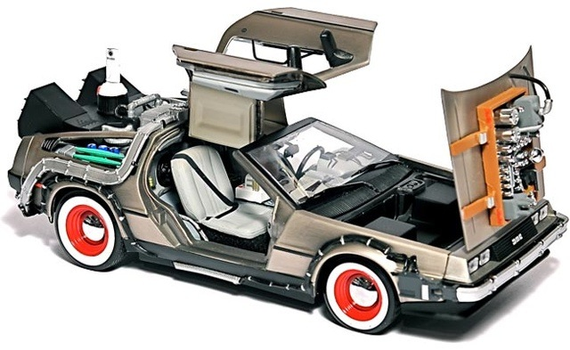
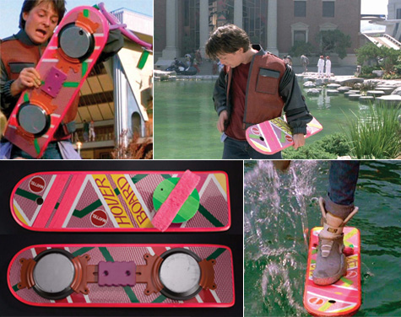

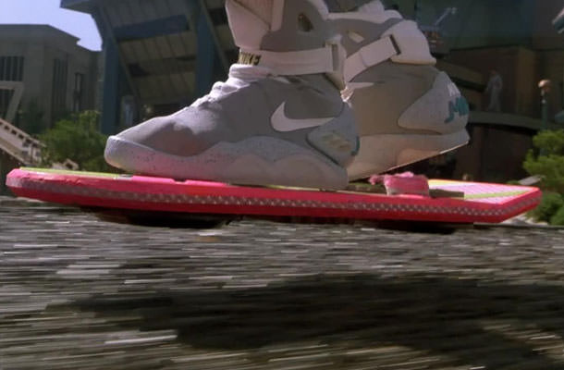
Notes:
16
This is the year 2015, the year to which Marty McFly traveled in Back to the Future II.
How well did they predict the future?
The year is not over yet!
========
http://static6.businessinsider.com/image/54a8b647ecad040d3b68d5bc-1200/we-also-dont-have-automatic-dog-walkers-to-take-sparky-for-a-stroll-around-the-block.jpg
http://25.media.tumblr.com/tumblr_m13y12wUqk1qf7kwgo1_500.jpg
http://boxofficescoop.first.netdna-cdn.com/wp-content/uploads/2014/03/back-to-the-future-hoverboard.jpg
admintell.napco.com/ee/images/uploads/gadgetell/delorean-external-harddrive-02-640.jpg
https://sp.yimg.com/ib/th?id=HN.607990799156251306&pid=15.1&P=0
http://mentalfloss.com/sites/default/files/hill-valley.png
https://www.screenused.com/images/auction_nov13/13946_5.jpg

Slide 17
If we really want to prepare our students for successful careers, we need to know all we can about the rapidly changing job market.
Emil Barnabas
Notes:
17
The job market has changed considerably from when we graduated from high school.
Many of the careers our current students will have - have yet to be thought of, which makes career preparation an even bigger challenge.
People get most of their career guidance from their parents.
But, do our parents keep up with the rapidly changing job market?
What do the parents of our job seekers know about bioinformatics and nanotechnology?
====
Emil Barnabas

Slide 18
Fastest Growing Occupations in NC
Requiring Postsecondary Education
(Total Change in Positions Projected from 2010 - 2020)
17,250 Registered Nurses
9,930 Postsecondary Teachers
8,640 Elementary School Teachers, Except Special Education
4,400 Accountants and Auditors
4,160 Middle School Teachers, Except Special and Career/Technical Education
3,870 Teachers and Instructors, All Other
3,830 Market Research Analysts and Marketing Specialists
3,730 Business Operations Specialists, All Other
3,360 Physicans and Surgeons
3,240 Secondary School Teachers, Except Special and Career/Technical Education
3,100 Police and Sheriff's Patrol Officers
3,010 Medical Secretaries
2,860 Emergency Medical Technicians and Paramedics
2,530 Paralegals and Legal Assistants
2,430 Heating, Air Conditioning, and Refrigeration Mechanics and Installers
2,280 Medical Scientists, Except Epidemiologists
2220 Special Education Teachers, Preschool, Kindergarten, and Elementary School
2210 Firefighters
2120 Computer Systems Analysts
2110 Human Resources, Training, and Labor Relations Specialists, All Other
1980 Lawyers
1920 Construction Managers
1920 Information Security Analysts, Web Developers, and Computer Network Architects
1830 Network and Computer Systems Administrators
1770 Dental Hygienists
Notes:
18
Not counting the occupations that require less than a year of on-the-job-training (OJT),
here are the high-demand occupations in North Carolina that require some kind of postsecondary education.
The number listed is the projected change in the number of positions in North Carolina over the ten-year projection period.
In 2020, North Carolina will need 17,250 more registered nurses than we had in 2010.
And you should notice that we need a lot of teachers. They are split out into several categories.
=========
These data are from www.CareerOutlook.US
http://www.bls.gov/emp/ep_table_112.htm
Education and training assignments
updated January 13, 2012

Slide 19
Fastest Growing Occupations in NC
(Total Change in Positions Projected from 2010 - 2020)
18,610 Combined Food Preparation and Serving Workers, Including Fast Food
17,250 Registered Nurses
14,260 Retail Salespersons
12,010 Home Health Aides
10,100 Customer Service Representatives
9,930 Postsecondary Teachers
9,840 Landscaping and Groundskeeping Workers
8,870 Janitors and Cleaners, Except Maids and Housekeeping Cleaners
8,790 Cashiers
8,640 Elementary School Teachers, Except Special Education
7,350 Office Clerks, General
6,360 Receptionists and Information Clerks
5,680 Waiters and Waitresses
5,660 Teacher Assistants
5530 Bookkeeping, Accounting, and Auditing Clerks
5360 Laborers and Freight, Stock, and Material Movers, Hand
4920 Childcare Workers
4900 Nursing Aides, Orderlies, and Attendants
4810 First-Line Supervisors of Office and Administrative Support Workers
4590 Personal Care Aides
4400 Accountants and Auditors
4340 Maintenance and Repair Workers, General
4320 Security Guards
4160 Middle School Teachers, Except Special and Career/Technical Education
3870 Teachers and Instructors, All Other
3830 Market Research Analysts and Marketing Specialists
3800 Sales Representatives, Wholesale and Manufacturing, Except Technical and Scientific Products
3730 Business Operations Specialists, All Other
3620 Executive Secretaries and Executive Administrative Assistants
3490 First-Line Supervisors of Construction Trades and Extraction Workers
3440 Cooks, Restaurant
3360 Physicans and Surgeons
3280 Team Assemblers
3240 Secondary School Teachers, Except Special and Career/Technical Education
3160 Software Developers, Applications
3100 Police and Sheriff's Patrol Officers
3020 First-Line Supervisors of Food Preparation and Serving Workers
3010 Medical Secretaries
2900 First-Line Supervisors of Retail Sales Workers
2860 Emergency Medical Technicians and Paramedics
2850 Construction Laborers
2810 Hairdressers, Hairstylists, and Cosmetologists
2770 Medical Assistants
2690 Food Preparation Workers
2630 Maids and Housekeeping Cleaners
2590 Pharmacy Technicians
2560 Carpenters
2530 Paralegals and Legal Assistants
2430 Heating, Air Conditioning, and Refrigeration Mechanics and Installers
2310 Secretaries and Administrative Assistants, Except Legal, Medical, and Executive
2280 Medical Scientists, Except Epidemiologists
2240 Coaches and Scouts
2240 Billing and Posting Clerks
2220 Special Education Teachers, Preschool, Kindergarten, and Elementary School
2210 Firefighters
2160 Sales Representatives, Services, All Other
2130 Heavy and Tractor-Trailer Truck Drivers
2120 Computer Systems Analysts
2110 Human Resources, Training, and Labor Relations Specialists, All Other
2070 Painters, Construction and Maintenance
2010 Tellers
1980 Lawyers
1980 Dental Assistants
1980 Packers and Packagers, Hand
1920 Construction Managers
1920 Information Security Analysts, Web Developers, and Computer Network Architects
1910 Machinists
1840 Amusement and Recreation Attendants
1830 Network and Computer Systems Administrators
1780 Industrial Machinery Mechanics
1770 Dental Hygienists
1760 Insurance Sales Agents
1730 Management Analysts
1700 Radiologic Technologists and Technicians
1680 Managers, All Other
1680 Operating Engineers and Other Construction Equipment Operators
1670 Financial Analysts
1670 Software Developers, Systems Software
1670 Licensed Practical and Licensed Vocational Nurses
1660 Helpers--Production Workers
1620 Training and Development Specialists
1600 Personal Financial Advisors
1600 Automotive Service Technicians and Mechanics
1580 Meat, Poultry, and Fish Cutters and Trimmers
1550 Preschool Teachers, Except Special Education
1530 Child, Family, and School Social Workers
1530 Fitness Trainers and Aerobics Instructors
1520 Pharmacists
1480 Telecommunications Equipment Installers and Repairers, Except Line Installers
1470 Electricians
1440 Securities, Commodities, and Financial Services Sales Agents
1440 First-Line Supervisors of Mechanics, Installers, and Repairers
1420 Plumbers, Pipefitters, and Steamfitters
1400 First-Line Supervisors of Landscaping, Lawn Service, and Groundskeeping Workers
1370 Cost Estimators
1350 Civil Engineers
1340 Computer and Information Systems Managers
1330 Nonfarm Animal Caretakers
1270 Sales Representatives, Wholesale and Manufacturing, Technical and Scientific Products
1240 Veterinary Technologists and Technicians
1240 Correctional Officers and Jailers
1240 Real Estate Sales Agents
1220 Educational, Guidance, School, and Vocational Counselors
1210 Interpreters and Translators
1160 Self-Enrichment Education Teachers
1160 Recreation Workers
1160 Real Estate Brokers
1140 Financial Managers
1140 Social and Human Service Assistants
1130 Education Administrators, Elementary and Secondary School
1120 Loan Officers
1120 Counter and Rental Clerks
1110 Inspectors, Testers, Sorters, Samplers, and Weighers
1100 Assemblers and Fabricators, All Other
1100 Computer-Controlled Machine Tool Operators, Metal and Plastic
1100 Light Truck or Delivery Services Drivers
1090 Education, Training, and Library Workers, All Other
1080 Bill and Account Collectors
1030 Education Administrators, Postsecondary
1020 Slaughterers and Meat Packers
1020 Driver/Sales Workers
1010 Graphic Designers
Notes:
19
Here I’ve added to the list the short and moderate on-the-job-training occupations in green so you can compare their demand with the others. Thus the green jobs are the ones you can get right out of high school, whereas the blue ones require some college work.
This list shows all occupations in North Carolina that require the most new workers projected through 2020.
Only two occupations on this list requires a 4-year degree! And once you get past the bottom of the page you find a variety of education occupations that also require the 4-year degree.
In 2020, North Carolina will need 17,250 more registered nurses than we had in 2010.
From Where will they all come?
We are importing trained nurses from other countries, because we can’t create them fast enough in this country.
Other countries saw this demand coming and told their kids that they need to prepare for nursing careers in the United States.
…
--------
These data are from www.CareerOutlook.US
http://www.bls.gov/emp/ep_table_112.htm
Education and training assignments
updated January 13, 2012

Slide 20
Fastest Growing Occupations in NC
(Percent Change in Positions Projected from 2010 - 2020)
90.5 Biomedical Engineers
53.4 Medical Scientists, Except Epidemiologists
44.9 Biochemists and Biophysicists
40.6 Interpreters and Translators
40.4 Veterinary Technologists and Technicians
39.3 Market Research Analysts and Marketing Specialists
38.8 Helpers--Brickmasons, Blockmasons, Stonemasons, and Tile and Marble Setters
38.4 Helpers--Carpenters
37.3 Diagnostic Medical Sonographers
35.7 Radio, Cellular, and Tower Equipment Installers and Repairs
33.6 Audiologists
33.1 Meeting, Convention, and Event Planners
33.0 Personal Financial Advisors
32.6 Financial Examiners
32.4 Medical Equipment Repairers
31.5 Coaches and Scouts
31.5 Logisticians
31.2 Personal Care Aides
31.2 Tree Trimmers and Pruners
30.8 Emergency Medical Technicians and Paramedics
30.5 Reinforcing Iron and Rebar Workers
30.1 Dental Hygienists
29.9 Engine and Other Machine Assemblers
29.7 Helpers--Pipelayers, Plumbers, Pipefitters, and Steamfitters
29.6 Computer-Controlled Machine Tool Operators, Metal and Plastic
29.3 Landscaping and Groundskeeping Workers
28.6 Anthropologists and Archeologists
28 Medical Secretaries
27.8 Skincare Specialists
27.7 Brickmasons and Blockmasons
26.9 Special Education Teachers, Middle School
26.8 Environmental Engineers
26.5 Veterinarians
26.4 Training and Development Specialists
26.3 Special Education Teachers, Preschool, Kindergarten, and Elementary School
26.3 Occupational Therapy Assistants
26.2 Surveyors
26.2 Umpires, Referees, and Other Sports Officials
25.9 Athletic Trainers
25.7 Rock Splitters, Quarry
25.6 Database Administrators
25.6 Glaziers
25.4 Cost Estimators
25.4 Transportation Security Screeners (Federal Only)
25.3 Architects, Except Landscape and Naval
24.6 Paralegals and Legal Assistants
24.6 Financial Analysts
24.6 Microbiologists
24.6 Cartographers and Photogrammetrists
24.4 Environmental Science and Protection Technicians, Including Health
24.4 Forensic Science Technicians
24.3 Physicists
24 Network and Computer Systems Administrators
23.9 Dental Assistants
23.7 Kindergarten Teachers, Except Special Education
23.7 Technical Writers
23.7 Insulation Workers, Mechanical
23.7 Geoscientists, Except Hydrologists and Geographers
23.4 Middle School Teachers, Except Special and Career/Technical Education
23.3 Elementary School Teachers, Except Special Education
23.3 Nonfarm Animal Caretakers
23.3 Cardiovascular Technologists and Technicians
23.2 Bicycle Repairers
23 Pharmacy Technicians
23 Survey Researchers
22.9 Health Educators
22.9 Aerospace Engineers
22.8 Physical Therapist Assistants
22.7 Physician Assistants
22.6 Biological Technicians
22.6 Athletes and Sports Competitors
22.5 Statisticians
22.4 Drywall and Ceiling Tile Installers
22.3 Instructional Coordinators
22.2 Radiologic Technologists and Technicians
22.1 Environmental Scientists and Specialists, Including Health
22.1 Civil Engineering Technicians
21.9 Industrial Machinery Mechanics
21.9 Paving, Surfacing, and Tamping Equipment Operators
21.8 Telecommunications Equipment Installers and Repairers, Except Line Installers
21.7 Compliance Officers
21.6 Home Health Aides
21.6 Securities, Commodities, and Financial Services Sales Agents
21.3 Natural Sciences Managers
21.2 Heating, Air Conditioning, and Refrigeration Mechanics and Installers
21.2 Education Administrators, Postsecondary
21.2 Forging Machine Setters, Operators, and Tenders, Metal and Plastic
21.2 Metal-Refining Furnace Operators and Tenders
21.2 Materials Scientists
21.1 Medical Assistants
21 Credit Counselors
20.9 Software Developers, Applications
20.9 Self-Enrichment Education Teachers
20.9 Respiratory Therapists
20.8 Fitness Trainers and Aerobics Instructors
20.7 Receptionists and Information Clerks
20.7 Marriage and Family Therapists
20.6 Engineering Technicians, Except Drafters, All Other
20.5 Actuaries
20.2 Construction and Building Inspectors
20.2 Credit Analysts
20.2 Manicurists and Pedicurists
20.2 Tour Guides and Escorts
20.1 Psychologists, All Other
20 Stonemasons
250 in 2010 :: 230 increase
9,750 in 2010 :: 3,830 increase
Notes:
20
Here you see the projected percentage change over the same ten-year period.
Sometimes you might have a small number of workers in a particular occupation, but the percentage change might be high, which means that the industry is expanding.
->For example: There were only 250 Biomedical Engineers in North Carolina in 2010, so a 90 percent increase is an additional 230 positions.
Compare that with the Market Research Analysts with almost ten thousand positions in 2010, so a 39 percent increase is an additional 38 hundred positions.
When looking at the job projections, You need to look at both the numbers of positions and the percentage increase.
========
These data are from www.CareerOutlook.US
http://www.bls.gov/emp/ep_table_112.htm
Education and training assignments
updated January 13, 2012

Slide 21
Fastest Declining Occupations in NC
(Total Change in Positions Projected from 2010 - 2020)
-8,380 Farmers, Ranchers, and Other Agricultural Managers
-1,690 Sewing Machine Operators
-1,090 Switchboard Operators, Including Answering Service
-1,040 Textile Knitting and Weaving Machine Setters, Operators, and Tenders
-1,010 Textile Winding, Twisting, and Drawing Out Machine Setters, Operators, and Tenders
-740 Machine Feeders and Offbearers
-720 Textile Bleaching and Dyeing Machine Operators and Tenders
-700 Upholsterers
-660 Shipping, Receiving, and Traffic Clerks
-560 Data Entry Keyers
-450 Food Service Managers
-400 Loan Interviewers and Clerks
-270 Postal Service Mail Carriers
-250 Extruding, Forming, Pressing, and Compacting Machine Setters, Operators, and Tenders
-240 Office Machine Operators, Except Computer
-240 Extruding and Forming Machine Setters, Operators, and Tenders, Synthetic and Glass Fibers
-230 Textile Cutting Machine Setters, Operators, and Tenders
-230 Textile, Apparel, and Furnishings Workers, All Other
-220 Logging Equipment Operators
-210 Furnace, Kiln, Oven, Drier, and Kettle Operators and Tenders
-200 Photographic Process Workers and Processing Machine Operators
-190 Furniture Finishers
-160 Computer Operators
-160 Prepress Technicians and Workers
-160 Printing Press Operators
-160 Cutters and Trimmers, Hand
-150 Travel Agents
-140 Reporters and Correspondents
-140 Fiberglass Laminators and Fabricators
-120 Claims Adjusters, Examiners, and Investigators
-120 Chemical Plant and System Operators
-110 Millwrights
-110 Semiconductor Processors
-100 Postal Service Mail Sorters, Processors, and Processing Machine Operators
-100 Fabric and Apparel Patternmakers
-90 Cooks, Fast Food
-90 Desktop Publishers
-90 First-Line Supervisors of Farming, Fishing, and Forestry Workers
-90 Pressers, Textile, Garment, and Related Materials
-80 Chefs and Head Cooks
-80 File Clerks
-80 Word Processors and Typists
-80 Maintenance Workers, Machinery
-80 Jewelers and Precious Stone and Metal Workers
-70 Insurance Underwriters
-70 Postal Service Clerks
-70 Fallers
-70 Parking Lot Attendants
-60 Floral Designers
-60 Lathe and Turning Machine Tool Setters, Operators, and Tenders, Metal and Plastic
-60 Molding, Coremaking, and Casting Machine Setters, Operators, and Tenders, Metal and Plastic
-50 Helpers--Roofers
-50 Sewers, Hand
-50 Grinding and Polishing Workers, Hand
-40 Insurance Claims and Policy Processing Clerks
-40 Painters, Transportation Equipment
-40 Rail Yard Engineers, Dinkey Operators, and Hostlers
-30 Insurance Appraisers, Auto Damage
-30 Funeral Attendants
-30 Reservation and Transportation Ticket Agents and Travel Clerks
-30 Drilling and Boring Machine Tool Setters, Operators, and Tenders, Metal and Plastic
-30 Tailors, Dressmakers, and Custom Sewers
-20 Postmasters and Mail Superintendents
-20 Actors
-20 Correspondence Clerks
-20 Elevator Installers and Repairers
-20 Fabric Menders, Except Garment
-20 Coil Winders, Tapers, and Finishers
-20 Plating and Coating Machine Setters, Operators, and Tenders, Metal and Plastic
-20 Model Makers, Wood
-20 Conveyor Operators and Tenders
-10 Computer Hardware Engineers
-10 Drafters, All Other
-10 Respiratory Therapy Technicians
-10 Food Preparation and Serving Related Workers, All Other
-10 Animal Trainers
-10 Motion Picture Projectionists
-10 Shampooers
-10 Electric Motor, Power Tool, and Related Repairers
-10 Patternmakers, Metal and Plastic
-10 Print Binding and Finishing Workers
-10 Patternmakers, Wood
-10 Power Plant Operators
-10 Stationary Engineers and Boiler Operators
-10 Etchers and Engravers
-10 Pump Operators, Except Wellhead Pumpers
-10 Tank Car, Truck, and Ship Loaders
Notes:
21
And here are the jobs to stay away from.
We need this many less of each of these jobs over this projection period.
For most of these positions, machines are replacing humans.
=======
These data are from www.CareerOutlook.US
http://www.bls.gov/emp/ep_table_112.htm
Education and training assignments
updated January 13, 2012
Textiles – socks in NC
http://www.nctextileconnect.com/connect_detail.cfm?valuechain_catid=38
Socks made in USA
http://www.americansworking.com/socks.html

Slide 22
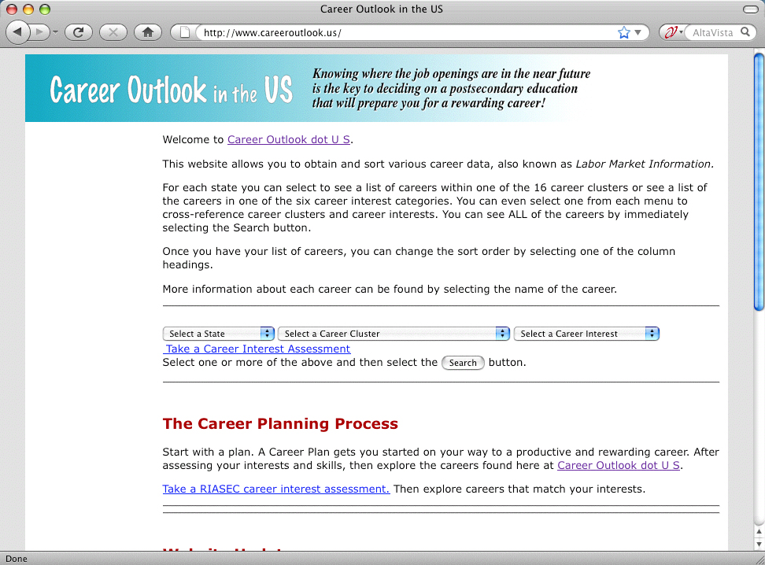
www.CareerOutlook.US
Notes:
Here is where I get my data -- at Career Outlook dot US. You can see the job projections and salaries for each occupation for each state.
There is also a career interest assessment to help you get started. And as you know, we have to help our students discover who they are first -- before we can help them find the career that is best suited for them.
See the details about this website on the other handout. This website is all free, because it was created by educators.
====
www.CareerOutlook.US
22

Slide 23
States with Most New Jobs
(Total Change in Positions Projected from 2008 - 2018)
15,273,900 United States
1,996,020 Texas
1,652,300 California
679,770 Georgia
597,930 Virginia
548,420 Illinois
438,110 Florida
419,680 North Carolina
310,090 Utah
304,670 Washington
287,050 New York
266,410 Indiana
257,640 Michigan
251,750 Maryland
249,000 Ohio
233,930 Alabama
195,660 Mississippi
195,000 Minnesota
178,670 Oklahoma
172,990 Tennessee
172,610 Iowa
164,870 Colorado
163,520 Louisiana
159,950 Oregon
158,480 Arizona
157,310 South Carolina
148,690 Kentucky
147,720 Kansas
145,900 Pennsylvania
120,400 New Jersey
112,430 Massachusetts
111,300 Idaho
110,840 Nebraska
95,420 Missouri
95,210 Arkansas
93,900 Nevada
83,670 Wisconsin
82,950 Connecticut
73,140 New Mexico
61,050 New Hampshire
59,384 Puerto Rico
54,370 D.C.
52,320 Montana
48,850 Hawaii
41,145 South Dakota
39,670 Rhode Island
38,530 North Dakota
34,450 Delaware
33,670 Alaska
31,180 Vermont
26,520 Wyoming
25,830 West Virginia
14,390 Maine
% change
21.41 Utah
17.04 Texas
15.58 Idaho
15.41 Georgia
14.90 Virginia
14.32 Mississippi
11.03 Montana
10.61 Alabama
10.46 Alaska
10.21 Oklahoma
10.15 Nebraska
10.12 United States
9.82 Kansas
9.79 Iowa
9.71 California
9.44 North Carolina
9.17 North Dakota
9.15 Maryland
9.06 Oregon
9.03 Washington
8.89 South Dakota
8.78 New Hampshire
8.66 Illinois
8.65 Wyoming
8.60 Indiana
8.51 Vermont
8.20 New Mexico
8.01 Louisiana
7.81 South Carolina
7.79 Rhode Island
7.58 Delaware
7.45 Kentucky
7.12 Hawaii
6.98 Arkansas
6.94 Nevada
6.91 D.C.
6.59 Minnesota
6.53 Colorado
5.66 Tennessee
5.65 Michigan
5.55 Arizona
5.31 Puerto Rico
5.15 Florida
4.56 Connecticut
4.35 Ohio
3.27 West Virginia
3.22 Missouri
3.20 Massachusetts
3.04 New York
2.75 New Jersey
2.72 Wisconsin
2.34 Pennsylvania
2.13 Maine
Notes:
If you are looking for work, it should make sense to move where the jobs are going to be.
On the left you see the number of job openings projected over the ten years for each state.
On the right you see the percentage change in jobs over the ten years for each state.
Some states are predicting a large number of job openings, but for our highly populated states, it might not be a large percentage of jobs based on the size of the population.
You see states that I’ve highlighted in red - like Utah, Texas, Georgia, and Virginia are near the top of both sides. That means they are expecting a large number of job openings, which is also a large percentage of their current workforce. Those are the states that are growing the fastest.
Maine is at the bottom of both lists. 14,000 job openings projected over the ten-year period with a 2.1 percentage increase.
============
“Total, All Occupations” for each state.
“Numeric Employment Change” is the number of new jobs projected over the ten year period.
www.projectionscentral.com/

Slide 24
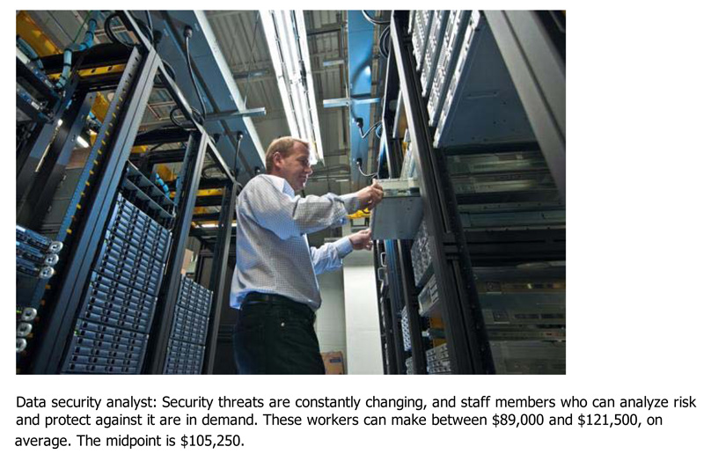
Notes:
Let’s look at a few new careers…
Here is the Data Security Analyst who works hard to keep our computer networks safe. The average salary is over 100,000 dollars.
And if you can figure out how to keep our credit card numbers safe, you’ll probably get paid over a million dollars!
===
Some surprising six-figure jobs
====
http://www.bizjournals.com/triangle/blog/2012/06/slideshow-six-surprising-six-figure.html?ana=e_du_pap&s=article_du&ed=2012-06-27

Slide 25
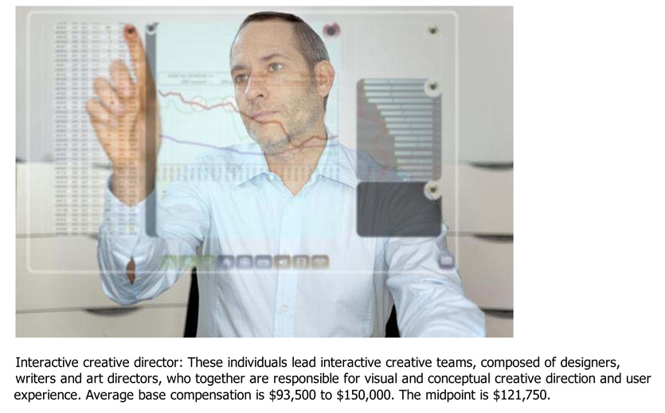
Notes:
How about an Interactive Creative Director?
They create the user interface that allows you to use computers without having to know binary numbers.
Once again, the average salary is over 100,000 dollars.
====
Some surprising six-figure jobs
====
http://www.bizjournals.com/triangle/blog/2012/06/slideshow-six-surprising-six-figure.html?ana=e_du_pap&s=article_du&ed=2012-06-27

Slide 26

1. Registered Nurses
2. Automotive Service Technicians and Mechanics
3. Carpenters
4. Electricians
5. Computer Systems Analysts
6. Machinists
7. Plumbers, Pipefitters, Steamfitters
8. Welders, Cutters, Solderers and Brazers
Notes:
There are lots of different hot job lists out there.
This particular list shows the top jobs that don’t require a four-year degree.
All high-demand jobs.
====
The average STEM job available to workers without a bachelor’s degree paid $53,000, 10% higher than other jobs requiring similar educational attainment.
1. Registered Nurses
2. Automotive Service Technicians and Mechanics
3. Carpenters
4. Electricians
5. Computer Systems Analysts
6. Machinists
7. Plumbers, Pipefitters, Steamfitters
8. Welders, Cutters, Solderers and Brazers
====
http://247wallst.com/2013/06/26/high-tech-jobs-that-do-not-require-a-college-degree/
High-Tech Jobs That Don’t Need a College Degree
Read more: High-Tech Jobs That Don’t Need a College Degree - 24/7 Wall St. http://247wallst.com/2013/06/26/high-tech-jobs-that-do-not-require-a-college-degree/#ixzz2XQ7hpswB
June 26, 2013
The average STEM job available to workers without a bachelor’s degree paid $53,000, 10% higher than other jobs requiring similar educational attainment. Among the eight most popular STEM jobs that do not require a college degree, six paid more than the national annual average wage of $45,230. There were nearly 500,000 people working as computer systems analysts in 2011, a position that does not require a bachelor’s degree and paid $82,320, on average.
Though a four-year college degree is not a prerequisite, many of these jobs still have rigorous requirements. Most plumbers, pipefitters and steamfitters go through a four or five year apprenticeship program, which includes studying math, physics and chemistry, according to the Bureau of Labor Statistics (BLS). Registered nurses, by far the fastest growing STEM job that does not require a bachelor’s degree, need to take courses in anatomy, chemistry and microbiology.
Read more: High-Tech Jobs That Don’t Need a College Degree - 24/7 Wall St. http://247wallst.com/2013/06/26/high-tech-jobs-that-do-not-require-a-college-degree/#ixzz2XQ7ptbo3

Slide 27

Notes:
This hot jobs list shows the Top ten unusual jobs that pay surprisingly well.
-- like running a hot dog cart.
Everyone needs to know that there is no one best list.
======
http://www.forbes.com/pictures/efkk45ejgdm/10-unusual-jobs-that-pay-surprisingly-well/#gallerycontent

Slide 28

10 Hardest to Fill Jobs in America
Notes:
Here is a list of the top ten hardest-to-fill jobs.
Teachers are on the list at number ten.
Teachers of all kinds are the occupation that requires a bachelor degree -- that is in the highest demand.
Who will teach the next generation?
======
Forbes recently looked at the 10 Hardest to Fill Jobs in America
===
http://www.forbes.com/sites/jacquelynsmith/2013/05/28/the-10-hardest-jobs-to-fill-in-2013/

Slide 29

10 Hardest to Fill Jobs in America
Notes:
Mechanics are in high demand. We depend on our cars and want them fixed fast and correctly.
Top mechanics can make over $100,000 working at the large dealerships.
======
Forbes recently looked at the 10 Hardest to Fill Jobs in America
===
http://www.forbes.com/sites/jacquelynsmith/2013/05/28/the-10-hardest-jobs-to-fill-in-2013/

Slide 30

10 Hardest to Fill Jobs in America
Notes:
Technicians are in high demand.
This is the Science and Technology side of the STEM that we keep hearing about.
======
Forbes recently looked at the 10 Hardest to Fill Jobs in America
===
http://www.forbes.com/sites/jacquelynsmith/2013/05/28/the-10-hardest-jobs-to-fill-in-2013/

Slide 31

10 Hardest to Fill Jobs in America
Notes:
Engineers
Not just engineers who can design buildings that don’t fall down, but engineers who can think outside the box and create something exciting and new.
======
Forbes recently looked at the 10 Hardest to Fill Jobs in America
===
http://www.forbes.com/sites/jacquelynsmith/2013/05/28/the-10-hardest-jobs-to-fill-in-2013/

Slide 32
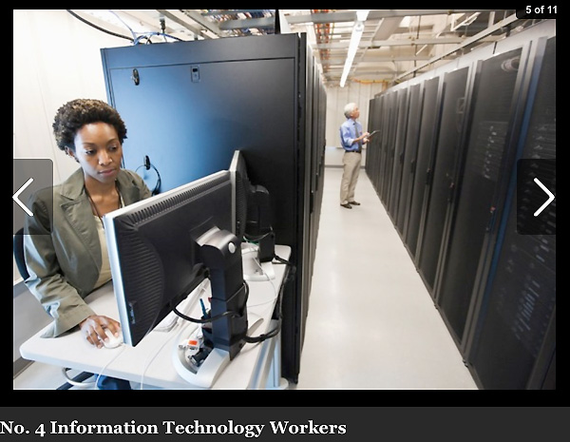
10 Hardest to Fill Jobs in America
Notes:
IT workers at all levels.
Notice that we are seeing a lot of the STEM jobs in these lists.
======
Forbes recently looked at the 10 Hardest to Fill Jobs in America
===
http://www.forbes.com/sites/jacquelynsmith/2013/05/28/the-10-hardest-jobs-to-fill-in-2013/

Slide 33

10 Hardest to Fill Jobs in America
Notes:
Sales Representatives are in high demand because businesses need to sell their products and services.
======
Forbes recently looked at the 10 Hardest to Fill Jobs in America
===
http://www.forbes.com/sites/jacquelynsmith/2013/05/28/the-10-hardest-jobs-to-fill-in-2013/

Slide 34

10 Hardest to Fill Jobs in America
Notes:
One reason that skilled trades are in high demand is because years ago we started discouraging kids from going into blue-collar jobs.
And now that we are coming out of the recession, -- the building boom is set to begin with no one to do the work.
======
Forbes recently looked at the 10 Hardest to Fill Jobs in America
===
http://www.forbes.com/sites/jacquelynsmith/2013/05/28/the-10-hardest-jobs-to-fill-in-2013/

Slide 35
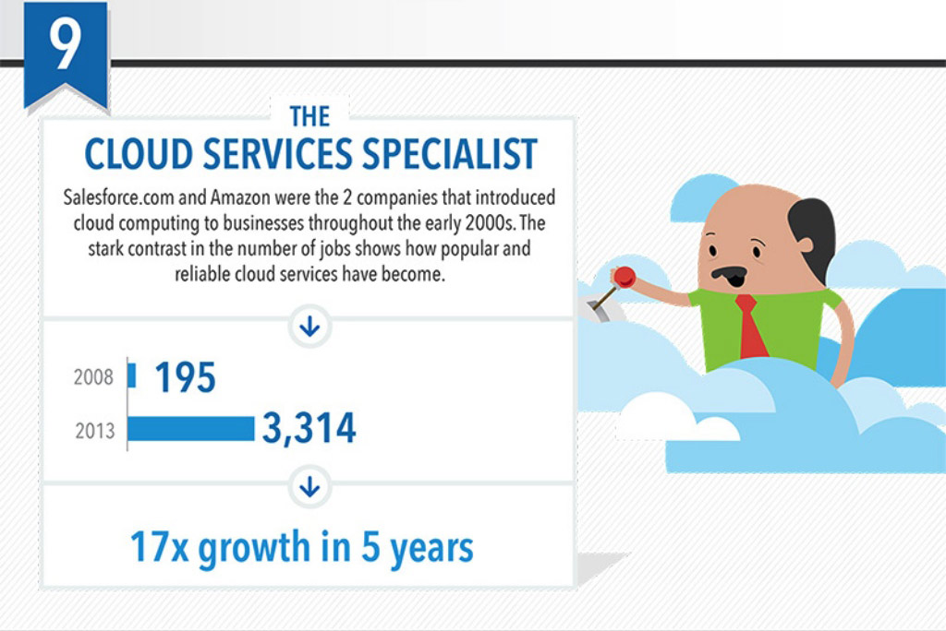
Top 10 Job Titles that Didn’t Exist Five Years Ago
Notes:
You’ve heard about the cloud … Now someone has to maintain it and keep it going.
I found this list of Top Ten Job Titles that Didn’t Exist Five Years Ago.
My dad spent his whole career working on clouds, but then he was a meteorologist. The clouds have changed.
=====
http://talent.linkedin.com/blog/index.php/2014/01/top-10-job-titles-that-didnt-exist-5-years-ago-infographic
Top 10 Job Titles That Didn’t Exist 5 Years Ago
Methodological details: We counted the frequencies of all English words and phrases used in job titles that were held in 2013 and compared the results to job titles that were held in 2008. We then took the top titles that saw the largest growth in frequency in that 5 year period and ranked them by their relative size in 2013. “Big data” and “cloud services” were the root phrases used to determine frequencies for “big data architect” and “cloud services manager” (which had many permutations, e.g. “big data architect/analyst/engineer” etc.). For simplicity’s sake, the titles you see above were used as examples. Data is current as of November 26, 2013.

Slide 36
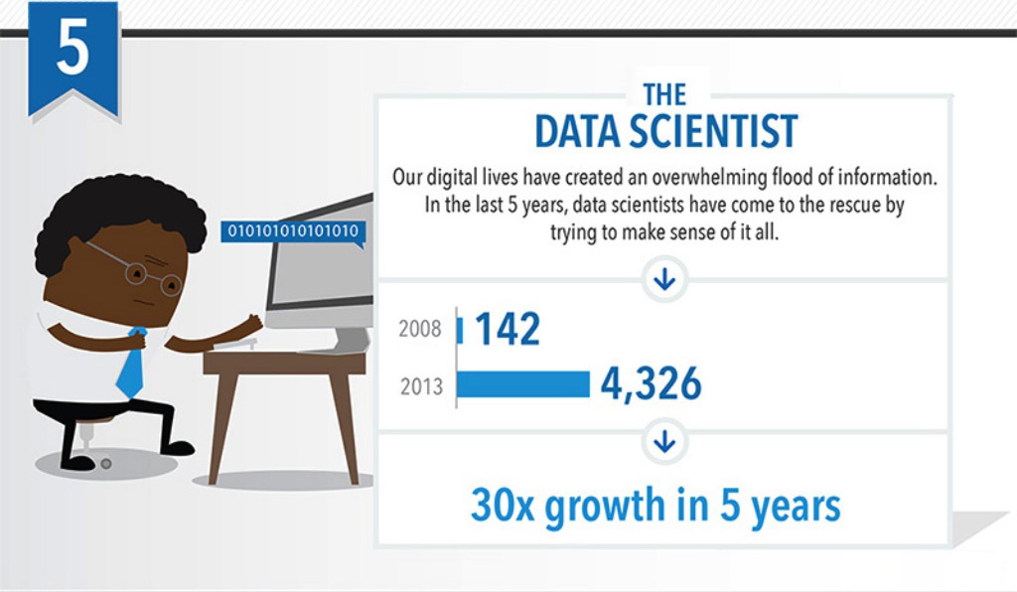
Top 10 Job Titles that Didn’t Exist Five Years Ago
Notes:
Someone needs to take all that data we’ve collected and turn it into information.
That’s the Data Scientist.
=====
http://talent.linkedin.com/blog/index.php/2014/01/top-10-job-titles-that-didnt-exist-5-years-ago-infographic
Top 10 Job Titles That Didn’t Exist 5 Years Ago
Methodological details: We counted the frequencies of all English words and phrases used in job titles that were held in 2013 and compared the results to job titles that were held in 2008. We then took the top titles that saw the largest growth in frequency in that 5 year period and ranked them by their relative size in 2013. “Big data” and “cloud services” were the root phrases used to determine frequencies for “big data architect” and “cloud services manager” (which had many permutations, e.g. “big data architect/analyst/engineer” etc.). For simplicity’s sake, the titles you see above were used as examples. Data is current as of November 26, 2013.

Slide 37
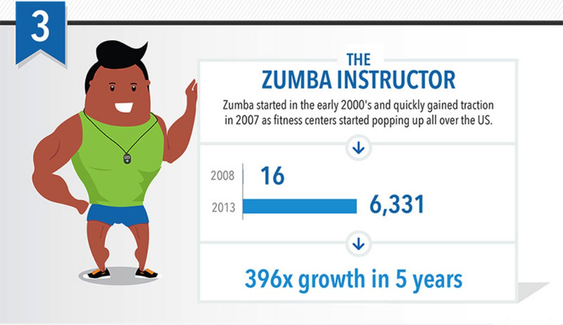
Top 10 Job Titles that Didn’t Exist Five Years Ago
Notes:
Look! It’s a high demand job that does not require a computer!
Raise your hand if you Zumba.
Sometimes we need to get away from our computers for a little while, and that’s why Zumba instructors are in high demand.
=====
http://talent.linkedin.com/blog/index.php/2014/01/top-10-job-titles-that-didnt-exist-5-years-ago-infographic
Top 10 Job Titles That Didn’t Exist 5 Years Ago
Methodological details: We counted the frequencies of all English words and phrases used in job titles that were held in 2013 and compared the results to job titles that were held in 2008. We then took the top titles that saw the largest growth in frequency in that 5 year period and ranked them by their relative size in 2013. “Big data” and “cloud services” were the root phrases used to determine frequencies for “big data architect” and “cloud services manager” (which had many permutations, e.g. “big data architect/analyst/engineer” etc.). For simplicity’s sake, the titles you see above were used as examples. Data is current as of November 26, 2013.

Slide 38
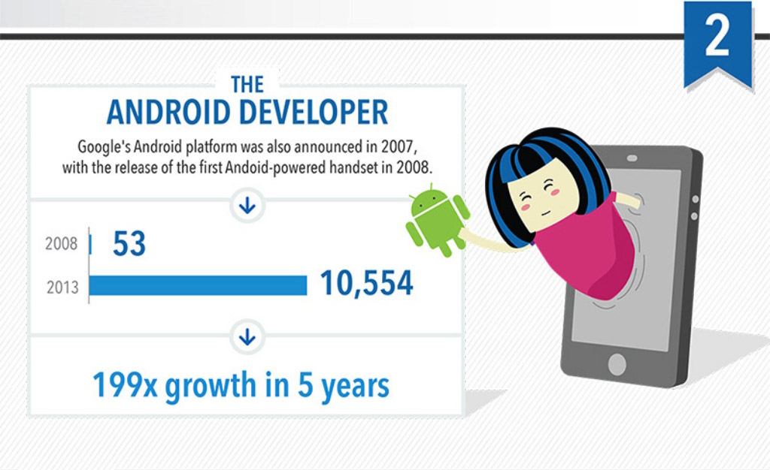
Top 10 Job Titles that Didn’t Exist Five Years Ago
Notes:
The Apple iPhone has been around for 7 years --- now the competition is heating up.
Someone needs to write the code for these smart phone aps that we can’t live without.
=====
http://talent.linkedin.com/blog/index.php/2014/01/top-10-job-titles-that-didnt-exist-5-years-ago-infographic
Top 10 Job Titles That Didn’t Exist 5 Years Ago
Methodological details: We counted the frequencies of all English words and phrases used in job titles that were held in 2013 and compared the results to job titles that were held in 2008. We then took the top titles that saw the largest growth in frequency in that 5 year period and ranked them by their relative size in 2013. “Big data” and “cloud services” were the root phrases used to determine frequencies for “big data architect” and “cloud services manager” (which had many permutations, e.g. “big data architect/analyst/engineer” etc.). For simplicity’s sake, the titles you see above were used as examples. Data is current as of November 26, 2013.

Slide 39
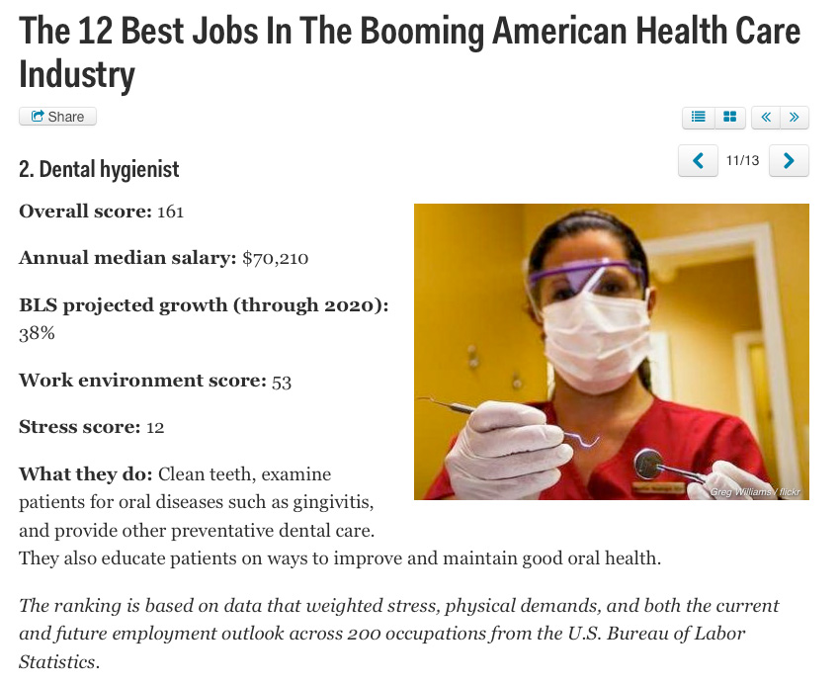
Notes:
I believe the most recession-proof jobs that pay well are the “assisting-type” jobs in healthcare.
That includes the dental hygienists and dental assistants, surgical technologists, medical assistants, sonographers, and many others.
These are the folks that are assisting the medical doctors.
All of these jobs are in high demand, and will be until the baby boomers die off.
And at that time we will need more mortician assistants.
=====
http://www.businessinsider.com/best-health-care-jobs-2013-12
The 12 Best Jobs In The Booming American Health Care Industry
To find out which jobs offer the best opportunities in health care, job search site CareerCast analyzed survey data that weighed stress, physical demands, and both the current and future employment outlook of 200 occupations.
"What's similar for the jobs on this list, with the exception of biomedical engineer, is that they work individually one-on-one with another person," Tony Lee, publisher at CareerCast.com, tells Business Insider. "When you're working with someone else, the job satisfaction is pretty high because you see someone often and they're giving you feedback, as opposed to having very few people thanking you."
Lee predicts that the need for these professionals will last for years to come. "Baby boomers are entering retirement, and as our body ages, the type of medical professionals that are needed to help people deal with that are going to be in greater demand."
The overall score for each job takes into account the pay; hiring outlook; stress; emotional factors, including the level of competitiveness and degree of public contact; and physical demands, such as stamina required and work conditions, that normally come with a job. Once the categories are combined, a lower overall score signals that the job is more desirable to employees.

Slide 40
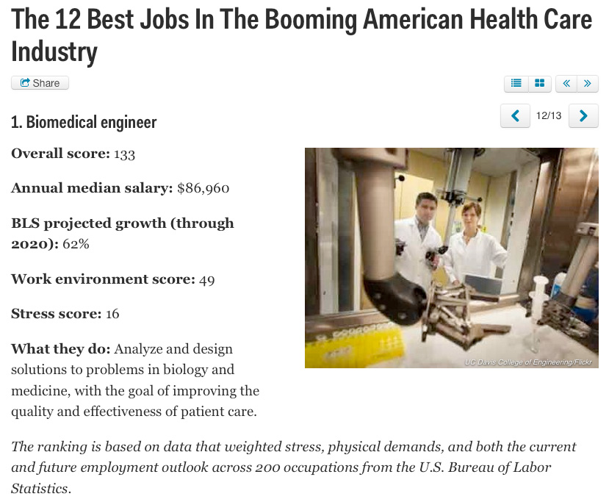
Notes:
New forms of engineering emerge every year.
The Biomedical Engineer combines engineering principals with medicine and biology to create better healthcare for all of us.
And as you saw at the beginning of this presentation, Biomedical Engineer is the fastest growing occupation by percentage growth in North Carolina, with a 90 percent projected increase in positions over the ten-year projection period.
=====
http://www.businessinsider.com/best-health-care-jobs-2013-12
The 12 Best Jobs In The Booming American Health Care Industry
To find out which jobs offer the best opportunities in health care, job search site CareerCast analyzed survey data that weighed stress, physical demands, and both the current and future employment outlook of 200 occupations.
"What's similar for the jobs on this list, with the exception of biomedical engineer, is that they work individually one-on-one with another person," Tony Lee, publisher at CareerCast.com, tells Business Insider. "When you're working with someone else, the job satisfaction is pretty high because you see someone often and they're giving you feedback, as opposed to having very few people thanking you."
Lee predicts that the need for these professionals will last for years to come. "Baby boomers are entering retirement, and as our body ages, the type of medical professionals that are needed to help people deal with that are going to be in greater demand."
The overall score for each job takes into account the pay; hiring outlook; stress; emotional factors, including the level of competitiveness and degree of public contact; and physical demands, such as stamina required and work conditions, that normally come with a job. Once the categories are combined, a lower overall score signals that the job is more desirable to employees.
Definition: http://en.wikipedia.org/wiki/Biomedical_engineer

Slide 41
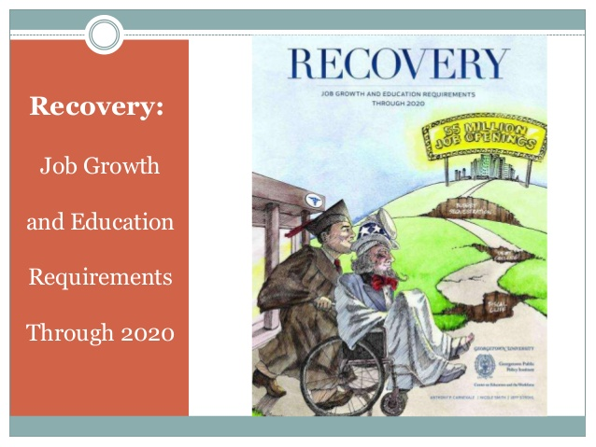
Notes:
A recent study from Georgetown.
Job Growth and Education Requirements Through 2020
=====
http://cew.georgetown.edu/recovery2020/
Recovery 2020: Job Growth and Education Requirements Through 2020
June 26, 2013
Recovery 2020 finds that:
There will be 55 million job openings in the economy through 2020: 24 million openings from newly created jobs and 31 million openings due to baby boom retirements.
By educational attainment: 35 percent of the job openings will require at least a bachelor’s degree, 30 percent of the job openings will require some college or an associate’s degree and 36 percent of the job openings will not require education beyond high school.
STEM, Healthcare Professions, Healthcare Support, and Community Services will be the fastest growing occupations, but also will require high levels of post-secondary education.
Most jobs will require some type of post-secondary education, and individuals that only posses a high school diploma will have fewer employment options.
Employers will seek cognitive skills such as communication and analytics from job applicants rather than physical skills traditionally associated with manufacturing.
The United States will fall short by 5 million workers with postsecondary education – at the current production rate – by 2020.

Slide 42
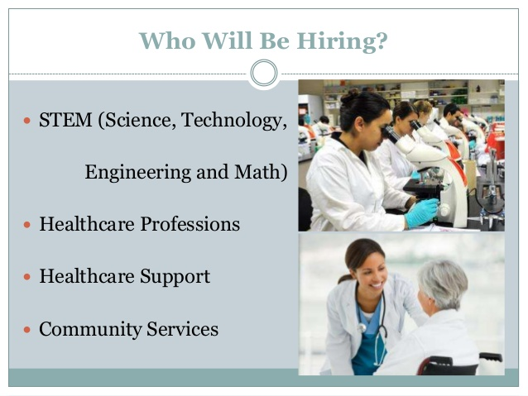
Notes:
Here are the job areas that their research says will be hiring.
We hear a lot about STEM jobs and healthcare.
Community services is an area that is growing in demand.
=====
http://cew.georgetown.edu/recovery2020/
Recovery 2020: Job Growth and Education Requirements Through 2020
June 26, 2013
Recovery 2020 finds that:
There will be 55 million job openings in the economy through 2020: 24 million openings from newly created jobs and 31 million openings due to baby boom retirements.
By educational attainment: 35 percent of the job openings will require at least a bachelor’s degree, 30 percent of the job openings will require some college or an associate’s degree and 36 percent of the job openings will not require education beyond high school.
STEM, Healthcare Professions, Healthcare Support, and Community Services will be the fastest growing occupations, but also will require high levels of post-secondary education.
Most jobs will require some type of post-secondary education, and individuals that only posses a high school diploma will have fewer employment options.
Employers will seek cognitive skills such as communication and analytics from job applicants rather than physical skills traditionally associated with manufacturing.
The United States will fall short by 5 million workers with postsecondary education – at the current production rate – by 2020.

Slide 43
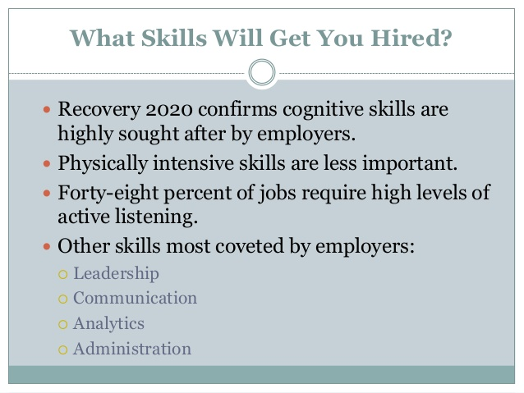
Notes:
Here are some skills these researchers found that businesses were looking for in their new recruits.
Where do people learn these skills in school?
The one thing that businesses are all asking for -- is new recruits who can communicate.
=====
Recovery 2020 confirms cognitive skills are highly sought after by employers.? Physically intensive skills are less important.? Forty-eight percent of jobs require high levels of active listening.? Other skills most coveted by employers:? Leadership? Communication? Analytics? Administration
What Skills Will Get You Hired?
=====
http://cew.georgetown.edu/recovery2020/
Recovery 2020: Job Growth and Education Requirements Through 2020
June 26, 2013
Recovery 2020 finds that:
There will be 55 million job openings in the economy through 2020: 24 million openings from newly created jobs and 31 million openings due to baby boom retirements.
By educational attainment: 35 percent of the job openings will require at least a bachelor’s degree, 30 percent of the job openings will require some college or an associate’s degree and 36 percent of the job openings will not require education beyond high school.
STEM, Healthcare Professions, Healthcare Support, and Community Services will be the fastest growing occupations, but also will require high levels of post-secondary education.
Most jobs will require some type of post-secondary education, and individuals that only posses a high school diploma will have fewer employment options.
Employers will seek cognitive skills such as communication and analytics from job applicants rather than physical skills traditionally associated with manufacturing.
The United States will fall short by 5 million workers with postsecondary education – at the current production rate – by 2020.

Slide 44
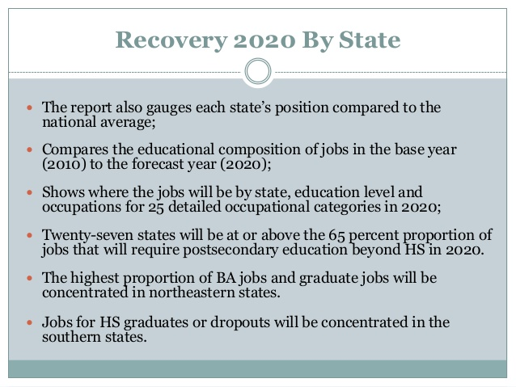
Notes:
This report has details by state. Check it out.
Remember that I list the source for my information in the notes section of the slide, so download my PowerPoint, and you can access the full report.
====
13. Recovery 2020 By State? The report also gauges each state’s position compared to the national average;
Compares the educational composition of jobs in the base year (2010) to the forecast year (2020);
Shows where the jobs will be by state, education level and occupations for 25 detailed occupational categories in 2020;
Twenty-seven states will be at or above the 65 percent proportion of jobs that will require postsecondary education beyond HS in 2020.
The highest proportion of BA jobs and graduate jobs will be concentrated in northeastern states.
Jobs for HS graduates or dropouts will be concentrated in the southern states.
=====
http://cew.georgetown.edu/recovery2020/
Recovery 2020: Job Growth and Education Requirements Through 2020
June 26, 2013
Recovery 2020 finds that:
There will be 55 million job openings in the economy through 2020: 24 million openings from newly created jobs and 31 million openings due to baby boom retirements.
By educational attainment: 35 percent of the job openings will require at least a bachelor’s degree, 30 percent of the job openings will require some college or an associate’s degree and 36 percent of the job openings will not require education beyond high school.
STEM, Healthcare Professions, Healthcare Support, and Community Services will be the fastest growing occupations, but also will require high levels of post-secondary education.
Most jobs will require some type of post-secondary education, and individuals that only posses a high school diploma will have fewer employment options.
Employers will seek cognitive skills such as communication and analytics from job applicants rather than physical skills traditionally associated with manufacturing.
The United States will fall short by 5 million workers with postsecondary education – at the current production rate – by 2020.

Slide 45
Surprises
Future Demand
Changing World
New Ideas
www.ctpnc.org/presentations
Notes:
→
Next we will look at the rapidly changing world in which we are preparing folks to live and work.

Slide 46
Upsetting the Projection Data
Recession
Natural Disasters
Immigration
Automation / Technology
Job relocation
Elections
Notes:
All of that projection data I showed you earlier can be easily upset by a variety of conditions.
The current recession swooped in just after those data were published.
Natural disasters, such as hurricanes, can drastically change which jobs are in high demand and which ones are not.
And we don’t have to talk about how elections and politics can change the job market.

Slide 47
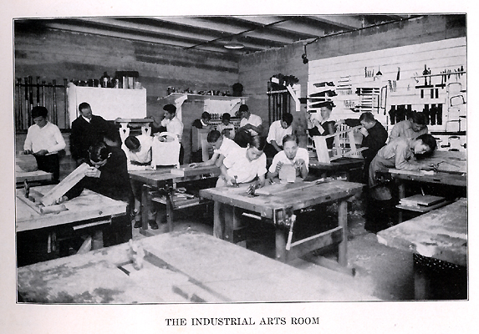
Notes:
I’m certified to teach Industrial Arts Education.
How many of you took Industrial Arts, or Shop class while in high school?
Unfortunately, some of our high schools are still teaching classes like this.
Some because a lack of funds to modernize,
Some because the same teacher is still there after 30 years.
=====
http://www.rootsweb.ancestry.com/~innwigs/ImageArchive/LibertyTownship/LibertyTwpPorterCoIndiana-LibertyCenterHighSchool-IndustrialArtsRoom-1931-SS.jpg

Slide 48
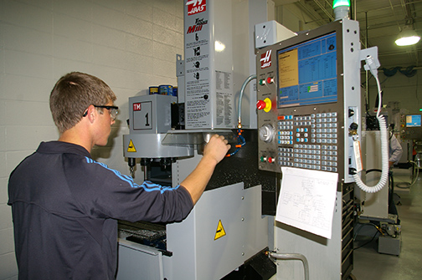
Notes:
But our modern shop classes should look like this. And many of them do.
We’ve had to modernize to keep up with business and industry.
Fortunately in North Carolina, we can send our high school students to a community college to learn in shops like this.
====
http://www.caboces.org/sites/default/files/images/John%20Gethicker/AMPBabb8744LR.jpg

Slide 49

Notes:
Why would a school counselor allow a young lady to take a manufacturing class knowing that she could end up with a job like this?
Compare the cleanliness of the work environment in this OLD picture with …
====
https://dwd.wisconsin.gov/dwd/dwdhistory/images/women_in_factory_big.jpg

Slide 50
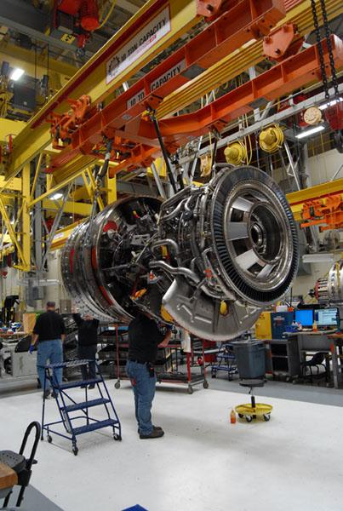
Notes:
…this one, where they are building jet engines in Durham, North Carolina.
You could eat off of that floor!
====
http://www.bizjournals.com/triangle/news/2012/08/03/slideshow-a-look-at-ge-aviations.html?ana=e_du_pap&s=article_du&ed=2012-08-03
Slideshow: A look at General Electric Aviation engine plant
The Durham plant, just off Miami Boulevard, is beginning to retool as the company triples its production of GEnx turbofan engines for Boeing Co.’s (NYSE: BA) new 787 Dreamliner. It has also recently expanded production of the giant GE90 engine and several lines of smaller engines, all of which are aimed at replacing older designs that are less fuel efficient.
photo shows:
A GE90 engine nears completion at the GE Aviation factory off South Miami Boulevard in Durham. The GE90 is used for large commercial aircraft such as the Boeing 777. More than 1,000 777s have been built over the years, incorporating a total of more than 2,000 engines from Boeing, Rolls-Royce and United Technologies' Pratt & Whitney division.

Slide 51
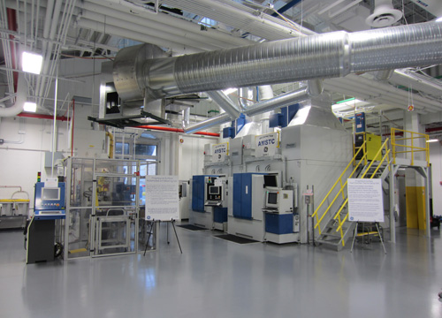
Notes:
The reality is that most educators, students, and their parents have no idea of what is happening in today’s factories.
Name one TV show that shows employees working in a modern factory.
How can students, teachers, and everyone else learn about modern industry?
Field trips, job shadowing, internships, open houses?
=====
http://files.gereports.com/wp-content/uploads/2012/04/AMSTC3.jpg

Slide 52
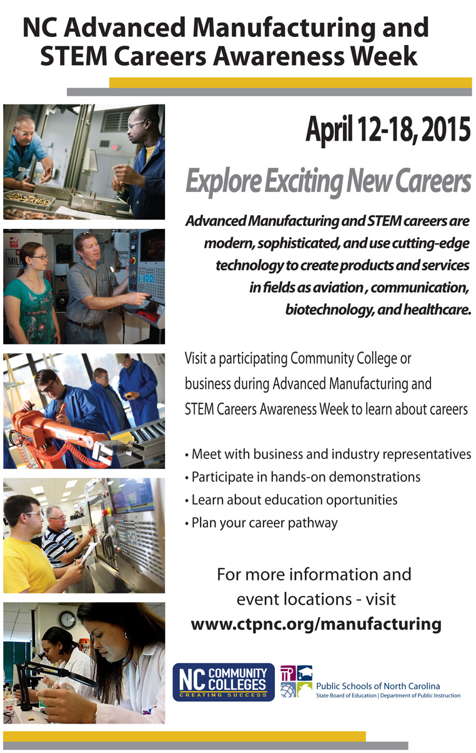
Notes:
You have this on the back of your handout.
North Carolina Advanced Manufacturing and STEM Careers Awareness Week is in April.
It’s a joint venture between North Carolina Public Schools, the Community College System, and the Department of Commerce.
We expect over 60 open houses all across the state helping people learn about the modern careers in Advanced Manufacturing.
Make sure your students and clients know about these open houses.
They are not just for high school students, they are for college students and adults who are still refining their career pathway.
======
www.ctpnc.org/manufacturing

Slide 53
We are currently preparing people for jobs that don’t yet exist …
Notes:
You may have seen this quote that is spread across the next three slides.
It profoundly reminds us that we are preparing people for jobs that don’t yet exist…

Slide 54
… using technologies that haven’t yet been invented …
Notes:
… Using technologies that have not yet been invented …

Slide 55
… in order to solve problems we don’t even know are problems yet.
Notes:
… In order to solve the problems that we do not yet know are problems.
Have we enabled the next generation with the knowledge and tools they will need to do this?

Slide 56
Who predicted these?
Cell phones for everyone
iPads, Kindles
Smart phones
iPod - portable music and videos
Hand-held GPS
Text messaging
Blogs, Twitter
MySpace, FaceBook
Wikipedia, YouTube
Notes:
Think back 20 years ago.
Would you have predicted any of these?
What’s next?
How soon will these become obsolete? Yes, these will all be obsolete someday soon!

Slide 57
Old technologies making a comeback
Vegetable powered-Diesel engines
Wind power
Rain barrels
Recycling building materials
Biofuel (Moonshine)
Notes:
Some of the latest trends are actually old technologies making a comeback.
Over 100 years ago. When Rudolph Diesel first demonstrated his diesel engine, he powered it with peanut oil.
Then along came this cheap stuff called petroleum that even Jed Clampett didn't want at first, and Rudolph Diesel quickly switched over to the newly created Diesel fuel because it was so cheap to make.
Now people are paying McDonalds to let them take away their waste cooking oil, so they can use it to fuel their Diesel-powered vehicle.
And the Biofuels Center of North Carolina is helping people build government-approved stills to create legal moonshine that we can burn in our cars.
(And for those of you who don’t know, stock car racing was invented in North Carolina by the folks with the fastest cars who transported moonshine around the state.)
Yes, some old technologies are coming back around again.

Slide 58
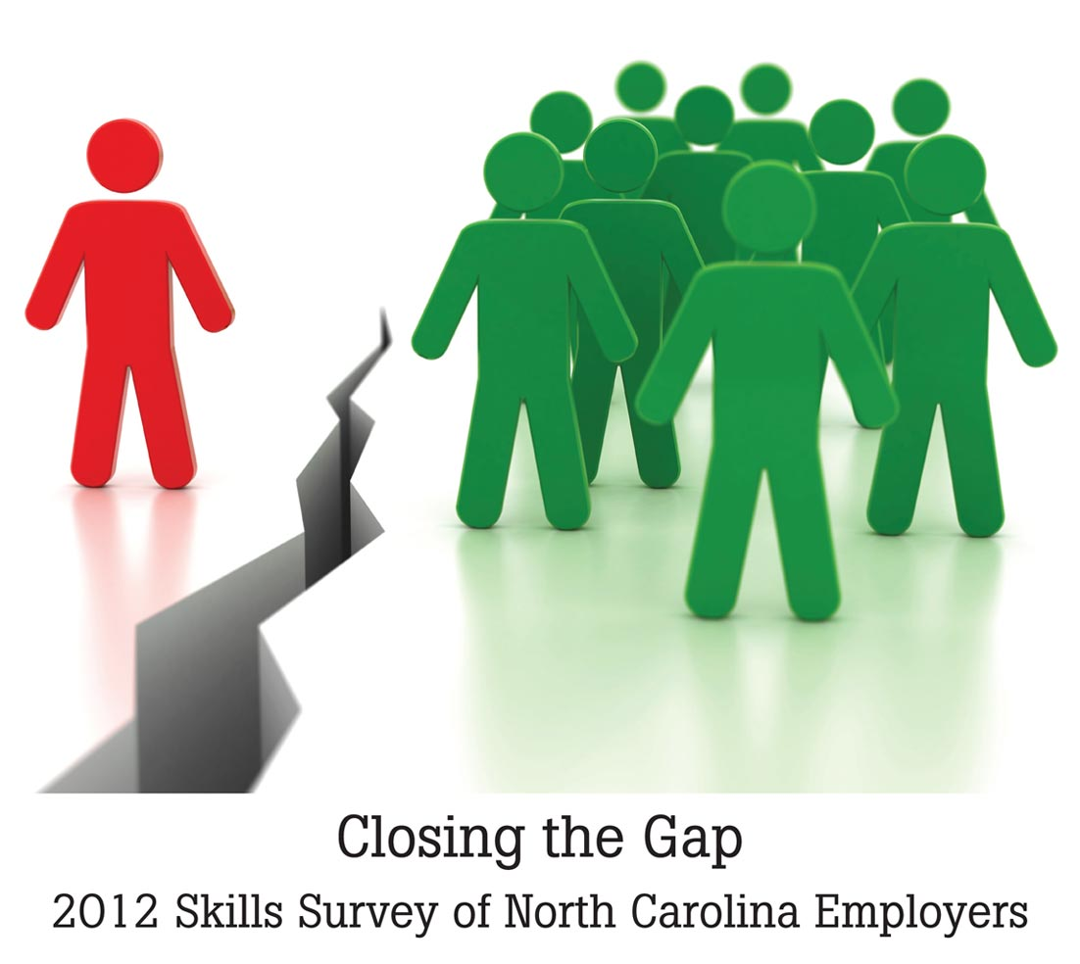
Notes:
The North Carolina Association of Workforce Development Boards surveyed employers in all of our 100 counties.
=======
Survey Conducted by North Carolina Business Services Representatives representing the Workforce Development Boards of North Carolina
They surveyed employers in all 100 counties.
Skills Survey
http://www.agreatworkforce.com/newsstory.cfm?NewsID=13
news article, news video
http://triangle.news14.com/content/top_stories/652523/survey-shows-n-c--workforce-skills-lacking

Slide 59
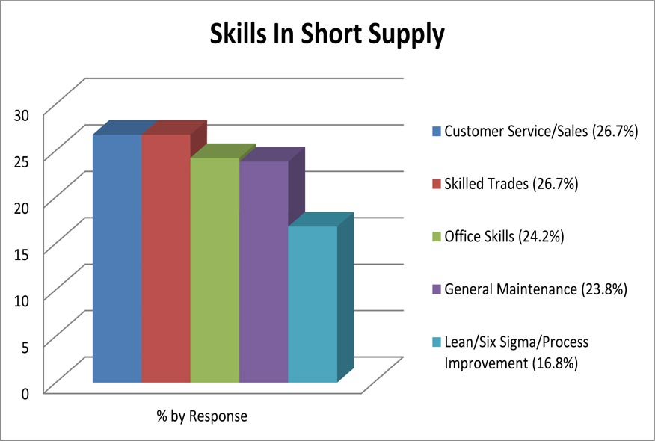
xx
Notes:
Here is what the employers say are the skills lacking in their new recruits.
Where do people go to learn these skills for which employers are looking?
We are fortunate in North Carolina to have a great community college system where these skills are taught.
=======
Skills Survey
http://www.agreatworkforce.com/newsstory.cfm?NewsID=13
news article, news video
http://triangle.news14.com/content/top_stories/652523/survey-shows-n-c--workforce-skills-lacking

Slide 60
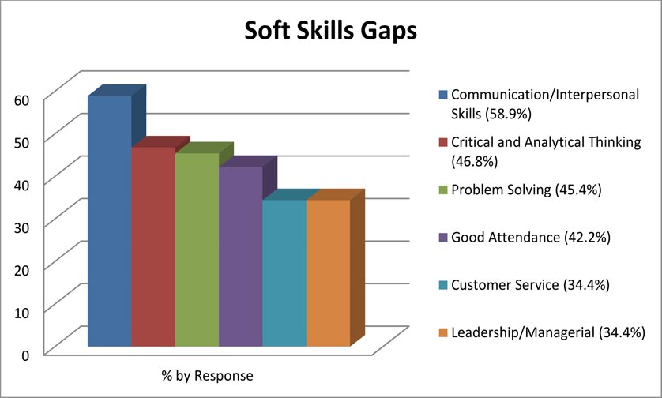
xx
Notes:
And as far as soft skills go – the new recruits don’t seem to know how to communicate.
An employer told me that when interviewing new recruits, he determines if this would be someone with whom he would like to have lunch.
His reasoning was that if you can’t hold up your end of a casual lunch conversation, then you probably can’t communicate on the job.
How do people learn these soft skills?
These skills are not easily taught in a class. They must be learned through personal experiences.
But we at least need to let folks know they are important skills to learn.
=======
Skills Survey
http://www.agreatworkforce.com/newsstory.cfm?NewsID=13
news article, news video
http://triangle.news14.com/content/top_stories/652523/survey-shows-n-c--workforce-skills-lacking

Slide 61
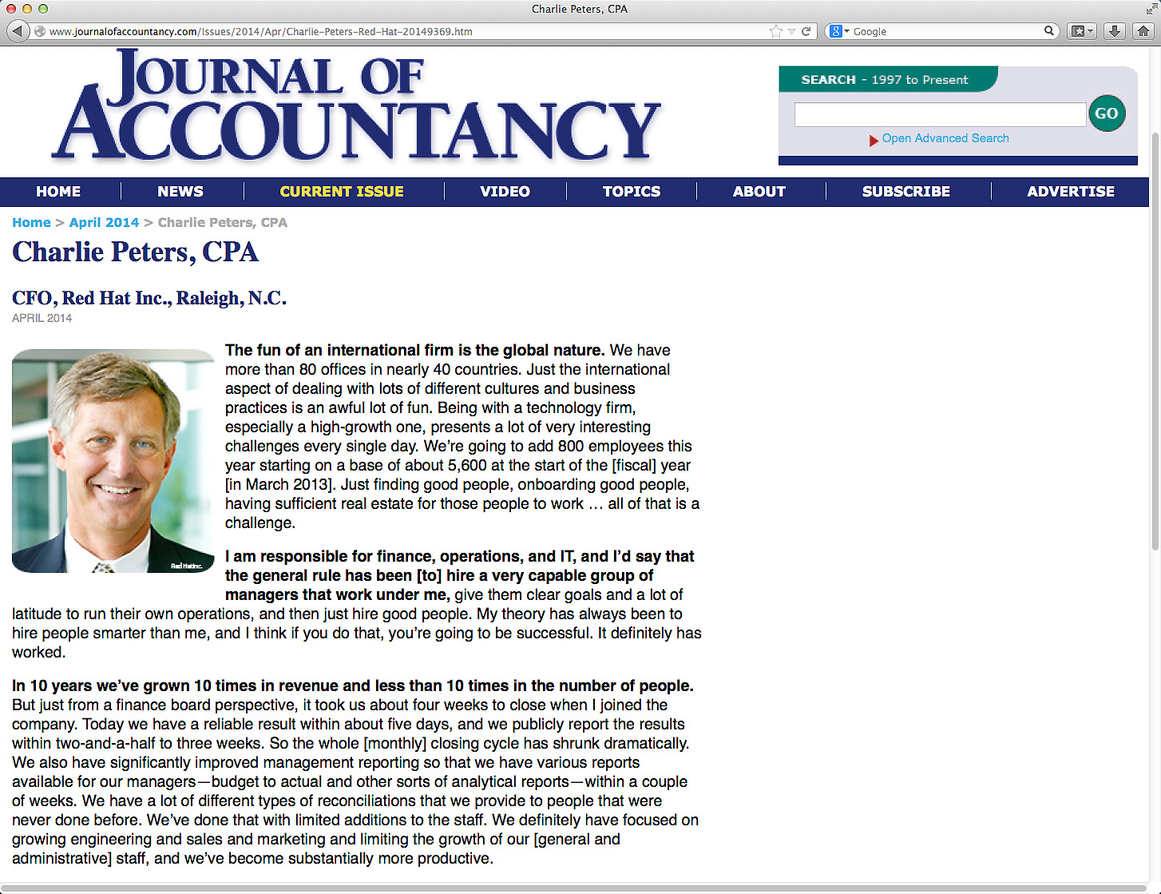
Notes:
Charlie Peters is the Chief Financial Officer at Red Hat. In this recent article he said that many people in technical fields lack good communication skills right out of school.
He says “It’s great to be a technician, but if you can’t deal with people, then it’s not going to help your career in the long run.”
How do we get job seekers to become better communicators. First, we need to become better communicators ourselves, and then get the job seekers to practice communicating.
==========
http://www.journalofaccountancy.com/Issues/2014/Apr/Charlie-Peters-Red-Hat-20149369.htm
Charlie Peters, CPACFO, Red Hat Inc., Raleigh, N.C.
April 2014
We hire a lot of the younger folks here. The thing that many people in technical professions seem to lack straight out of school is good communication skills, whether it is written communication skills, oral communication skills, [or] public speaking skills. These skills generally aren’t taught in accounting programs or business schools, and I think it’s an oversight. I would say, “Make sure you focus on some of those soft skills, even people skills.” It’s great to be a technician, but if you can’t deal with people, then it’s not going to help your career in the long run.

Slide 62
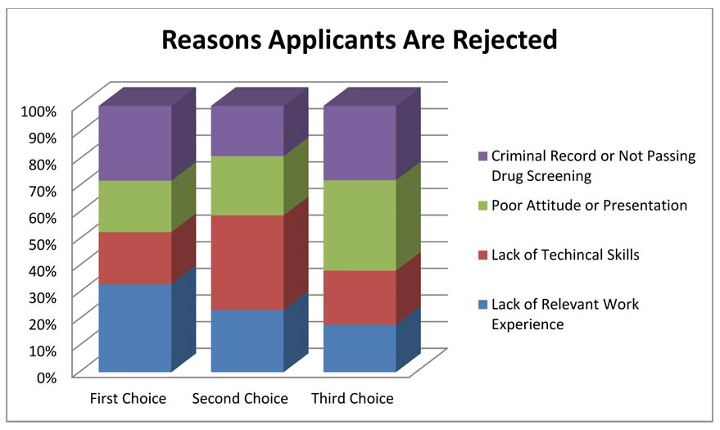
xx
Notes:
- Over forty-six percent of the business respondents indicated the primary reason for rejecting job applications was due to Lack of Relevant Work Experience.
In high school we are promoting our work-based-learning programs like job shadowing and internships. Whatever it takes to get the kids in the workplace applying what they learn in school.
- Lack of Technical Skills was indicated more frequently as a second choice at 46 percent.
People are applying for jobs without the prerequisite skills. Where can they go to get the skills they need to be hired?
- Businesses indicated a strong third choice at 44 percent as being Applicants with Poor Attitude or Presentation.
That means more practice standing in front of the classroom or other group of people giving presentations. When I was in high school I hated presenting before the class, and I was not very good at it. But through repeated attempts, and lots of constructive criticism, this shy introvert has become a decent public speaker.
- Criminal record is an often overlooked item. A single drug conviction can lock you out of the entire healthcare industry, and that’s were most of the jobs are. Even the military is not recruiting anyone with the criminal background. I know several ex-offenders who are having a hard time finding employment.
- One thing you don’t see on this list is high school or college grade point average or class rank.
=======
Skills Survey
http://www.agreatworkforce.com/newsstory.cfm?NewsID=13
news article, news video
http://triangle.news14.com/content/top_stories/652523/survey-shows-n-c--workforce-skills-lacking

Slide 63

Notes:
We educators place a great emphasis on grades, class rank, and being valedictorian.
These create parental bragging rights for the parents, but what do they mean outside of high school and college?
Many colleges are saying that GPA, that’s grade point average, and high school grades are not important when deciding to accept a student.
======
http://www.usatoday.com/story/news/nation/2013/02/27/college-grade-point-averages/1947415/

Slide 64
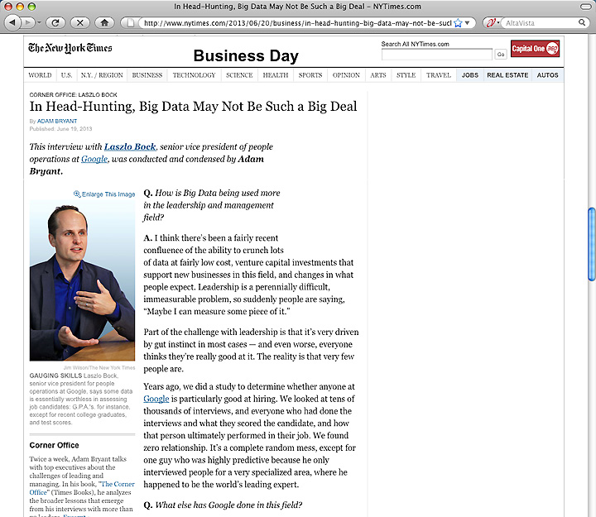
Notes:
Google has crunched the numbers and found that GPA is a worthless criteria for hiring. They compared the GPA of the new recruits with how well they were performing years later and found no correlation.
You can imaging how well this news goes over in our high schools and colleges where grades appear to be everything.
=======
http://www.nytimes.com/2013/06/20/business/in-head-hunting-big-data-may-not-be-such-a-big-deal.html?pagewanted=all&_r=1&
In Head-Hunting, Big Data May Not Be Such a Big Deal
June 19, 2013
One of the things we’ve seen from all our data crunching is that G.P.A.’s are worthless as a criteria for hiring, and test scores are worthless — no correlation at all except for brand-new college grads, where there’s a slight correlation. Google famously used to ask everyone for a transcript and G.P.A.’s and test scores, but we don’t anymore, unless you’re just a few years out of school. We found that they don’t predict anything.
What’s interesting is the proportion of people without any college education at Google has increased over time as well. So we have teams where you have 14 percent of the team made up of people who’ve never gone to college.
After two or three years, your ability to perform at Google is completely unrelated to how you performed when you were in school, because the skills you required in college are very different. You’re also fundamentally a different person. You learn and grow, you think about things differently.
Another reason is that I think academic environments are artificial environments. People who succeed there are sort of finely trained, they’re conditioned to succeed in that environment. One of my own frustrations when I was in college and grad school is that you knew the professor was looking for a specific answer. You could figure that out, but it’s much more interesting to solve problems where there isn’t an obvious answer. You want people who like figuring out stuff where there is no obvious answer.
===
Google no longer hires based on GPA or test scores
"One of the things we’ve seen from all our data crunching is that G.P.A.’s are worthless as a criteria for hiring, and test scores are worthless"
Google also said that "academic environments are artificial environments." Students are "conditioned to succeed in that environment ... looking for a specific answer." Google wants "people who like figuring out stuff where there is no obvious answer."
These problem-solving skills that Google and others are looking for can be taught in our CTE classes, but the learning can be hard to measure, which makes it tough to convice the administration that these skills need to be taught.
http://www.nytimes.com/2013/06/20/business/in-head-hunting-big-data-may-not-be-such-a-big-deal.html?pagewanted=all&_r=1&

Slide 65

Notes:
Besides saying that GPAs are a worthless hiring criteria, Google says that test scores, and even college degree don’t matter much when hiring.
Google says the No. 1 thing they look for is general cognitive ability, and it’s not I.Q. It’s learning ability. It’s the ability to process on the fly. It’s the ability to pull together disparate bits of information and form a conclusion.
Businesses want people who can grab a bunch of data, quickly turn it into useful information, and use that information to solve a problem.
Google says the second thing they are looking for is leadership –
--in particular, emergent leadership as opposed to traditional leadership. Traditional leadership is if you were president of the chess club? That’s not what they are looking for.
What they are looking for is: when faced with a problem, and you’re a member of a team, do you, at the appropriate time, step in and lead.
And just as critically, do you step back at the right time and stop leading, and let someone else lead?
An effective leader is willing to relinquish power at the right time.
How do people learn to take the leadership reigns when necessary and to relinquish when it’s time for someone else to lead?
Google also said that underlying these qualities are humility and ownership.
“It’s feeling the sense of responsibility, the sense of ownership, to step in,” to try to solve any problem – and the humility to step back and embrace the better ideas of others.
The end goal is group problem-solving. How do people learn that?
======
http://www.wnd.com/2014/02/google-calls-these-talents-worthless/

Slide 66
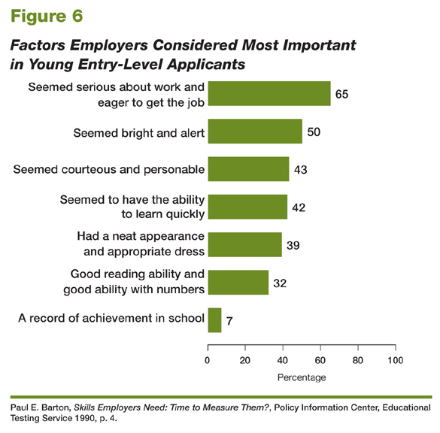
Educational Testing Service, 2006
Notes:
66
66
Even here you see student grades at the bottom of the list of factors considered when hiring. Only seven percent of these business respondents even mentioned it.
Which of these factors do we teach?
Can we help our students with these employment factors?
====
High School Reform and Work: Facing Labor Market Realities
Written by Paul E. Barton, Educational Testing Service, 2006
http://www.ets.org/research/researcher/PIC-HSWORK.html

Slide 67
Vs
CompTIA
ServSafe
ProStart
CNA
ASE
NCCER
NIMS
PrintEd
AWS
HS Diploma
2-year Certificate
Associate Degree
Bachelor Degree
Master Degree
Doctoral Degree
Professional Degree
Notes:
We asked industry what they wanted, and they said they would like for us to teach our students to their standards.
Many of our Career and Technical Education courses now use industry-written curriculum that prepares kids to pass industry certification exams.
Who or what is driving education?
What are the important credentials?
Which is better, -- the education credentials that you see on the left, or industry credentials that you see on the right?
Better for whom? -- better for educators, business, parents, etc?
Do you think there will come a time when the education credentials on the left don’t mean anything and the businesses will look only for their credentials in their new recruits?
Is that good or bad?

Slide 68
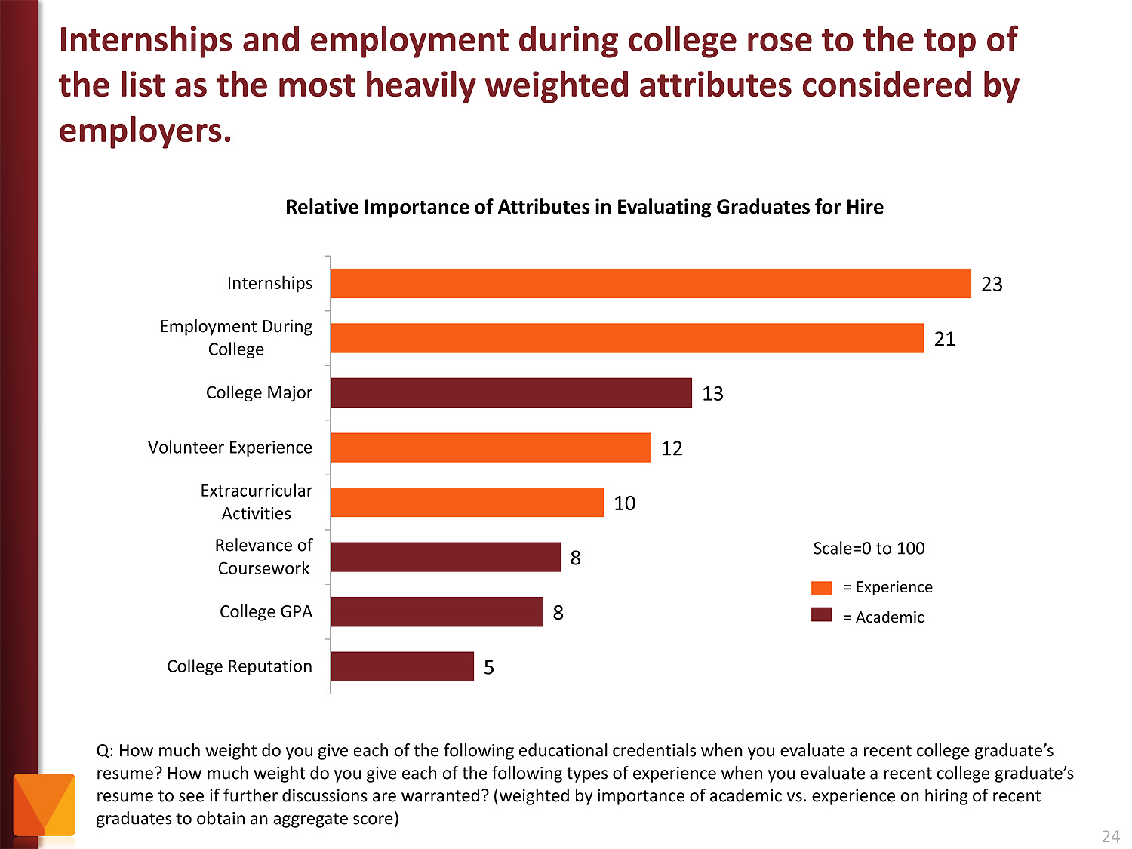
Notes:
Employers value Internships and other employment while in school as more important than college major and GPA.
Even volunteer work and extra-curricular activities are more important to the business community than grades.
Yet, -- most students are too focused on getting good grades -- and are missing out on the experiences that really matter.
======
http://chronicle.com/article/The-Employment-Mismatch/137625/#id=overview
The Employment Mismatch: A College Degree Sorts Job Applicants, but Employers Wish It Meant More
Employers value a four-year college degree, many of them more than ever.
Yet half of those surveyed recently by The Chronicle and American Public Media's Marketplace said they had trouble finding recent graduates qualified to fill positions at their company or organization. Nearly a third gave colleges just fair to poor marks for producing successful employees. And they dinged bachelor's-degree holders for lacking basic workplace proficiencies, like adaptability, communication skills, and the ability to solve complex problems.
The report
The Role of Higher Education in Career Development: Employer Perceptions
http://chronicle.com/items/biz/pdf/Employers%20Survey.pdf

Slide 69
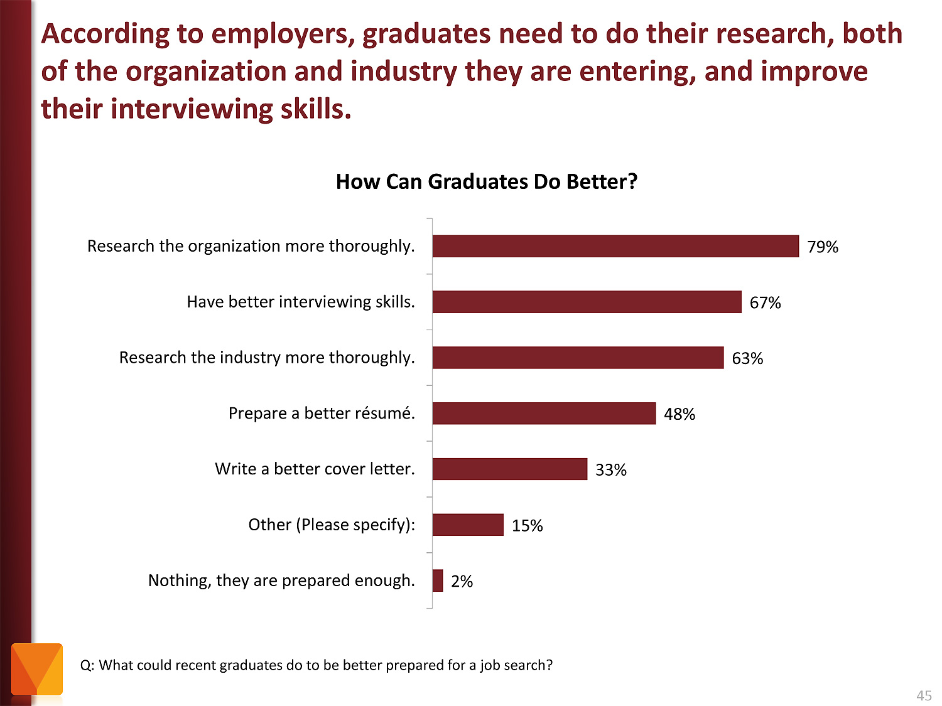
Notes:
Tell your students to research the companies where they are applying for work. And learn about the interview process.
It just amazes me that folks would try to get a job at a company they know nothing about.
The focus of the job interview should be on what you can do for the company.
======
http://chronicle.com/article/The-Employment-Mismatch/137625/#id=overview
The Employment Mismatch: A College Degree Sorts Job Applicants, but Employers Wish It Meant More
Employers value a four-year college degree, many of them more than ever.
Yet half of those surveyed recently by The Chronicle and American Public Media's Marketplace said they had trouble finding recent graduates qualified to fill positions at their company or organization. Nearly a third gave colleges just fair to poor marks for producing successful employees. And they dinged bachelor's-degree holders for lacking basic workplace proficiencies, like adaptability, communication skills, and the ability to solve complex problems.
The report
The Role of Higher Education in Career Development: Employer Perceptions
http://chronicle.com/items/biz/pdf/Employers%20Survey.pdf

Slide 70

Notes:
70
Here is a recent publication from the US Chamber of Commerce
===
http://icw.uschamber.com/publication/life-21st-century-workforce-national-perspective
Life in the 21st Century Workforce: A National Perspective
Posted September 27, 2011

Slide 71
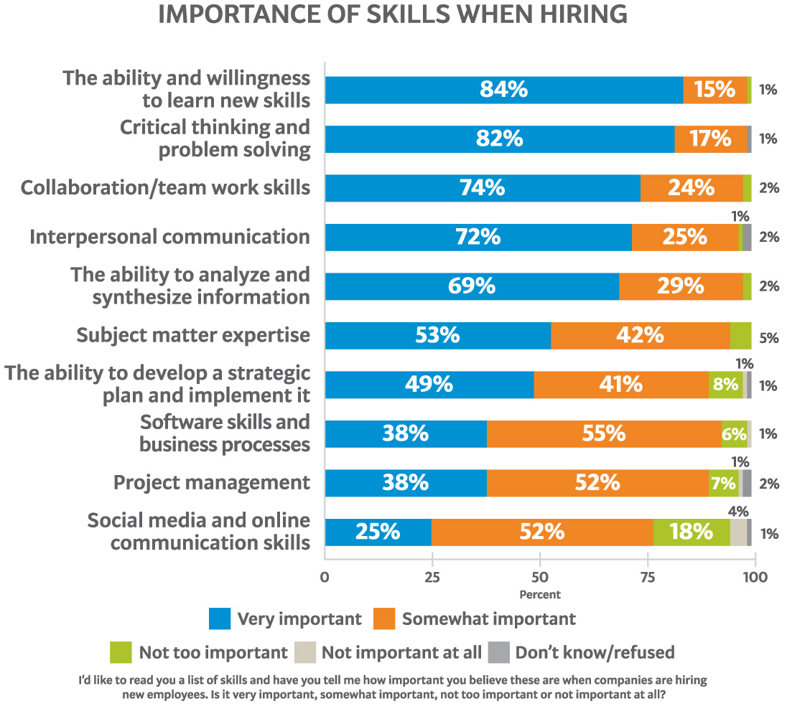
Notes:
71
Here is their list of skills that employers said were important when hiring their new recruits. Do you think our students should know this information?
Where in our K-12 schools and colleges are we teaching these skills that the employers say are the most important when hiring new employees?
===
http://icw.uschamber.com/publication/life-21st-century-workforce-national-perspective
Life in the 21st Century Workforce: A National Perspective
Posted September 27, 2011

Slide 72
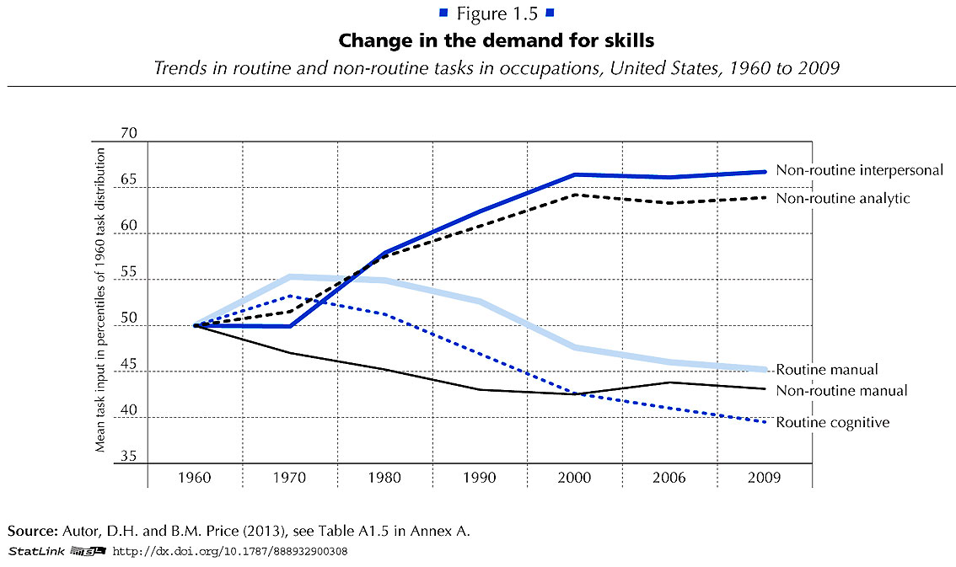

Notes:
Employers want employees that can do non-routine work. They want folks that can identify and solve new problems.
Gone are the jobs that required routine manual labor.
The computers and robots can take care of that.
===
http://www.oecd.org/site/piaac/
https://www.oecd.org/site/piaac/
-----
OECD Skills Outlook 2013
http://skills.oecd.org/skillsoutlook.html
First Results from the Survey of Adult Skills
OECD_Skills_Outlook_2013.pdf
Key Findings
SkillsOutlook_2013_KeyFindings.pdf
Summary
9789264204256-sum-en.pdf
-----
PIAAC Results Released
On Oct. 8, 2013, the Organization for Economic Cooperation and Development (OECD) released the results of the Program for International Assessment of Adult Competencies, (PIAAC). This direct assessment was conducted with nationally representative samples from 23 countries from adults ages 16 through 65. It is an international household survey to assess the cognitive and workplace skills needed for success in the 21st-century global economy. The results are designed to help public, private, educational, and philanthropic sectors work with a shared language and set of benchmarks to enhance cooperation around the development and implementation of economic, education, and social policies that strengthen adult skills. The survey is intended to be administered every 10 years, making this a baseline report to set benchmarks against which countries and sectors can measure their improvement efforts. Multiple reports, datasets, and several data tools were released with the results, including:
The OECD Skills Outlook 2013: First Results from the Survey of Adult Skills, a freely available book in PDF form;
a summary, Skilled for Life? Key Findings;
a brief U.S. report, Survey of Adult Skills, First Results: United States; and
a report from the U.S. Department of Education’s National Center for Educational Statistics, Literacy, Numeracy, and Problem Solving in Technology-Rich Environments Among U.S. Adults: Results from the Program for the International Assessment of Adult Competencies 2012: First Look, was published on Oct. 18, once the U.S. federal government was re-opened. This report highlights the U.S. performance in the international data and unique U.S. demographic characteristics.
On Nov. 12, 2013, the OECD-authored report, Time for the United States to Reskill? What the Survey of Adult Skills Says, will be released. This report was funded by OVAE to offer a more detailed profile of low-skilled adults in the U.S. It will also identify policy implications and offer broad policy recommendations for the U.S.
Links to all of these resources, as well as events and press coverage, may be found at www.piaacgateway.com.
This article relies heavily on data included in the NCES “First Look” report. Further analysis of the PIAAC data will appear in future issues of OVAE Connection.
The Survey
The PIAAC assessment focuses on the working-age adult population, and measures cognitive and workplace skills necessary for successful participation in the 21st century society and global economy. In the U.S., as in all of the countries participating, 5,000 individuals were surveyed to create a nationally representative dataset. An additional 5,000 people will be surveyed for a supplement that will be added to the data set in 2015.
Drawing from a rich background questionnaire, the PIAAC measures relationships among respondents’ educational background, parental educational attainment, work history and skills, occupational attainment, use of information and communications technology, and cognitive skills in the domains of literacy, numeracy, and problem solving in technology-rich environments.
Findings are presented in the First Look report as country averages, and tables are used to place countries’ performances above, at, or below the international average. Within each domain, performance is also reported as a percentage of the population that performs in five levels of proficiency: Below Level 1, Level 1, Level 2, Level 3, and combined Levels 4/5, Level descriptors can be found in the First Look report in Exhibit B-1 for literacy, B-3 for numeracy, and B-5 for problem-solving in a technology-rich environment. Performance below Level 2 is considered “weak” or “low.”
The assessment is unique in that it is the first international literacy survey that is both adaptive and administered on a laptop computer. Given as a household survey, respondents were allowed to choose whether to take the assessment on a laptop or with pencil and paper. In the U.S., nearly 80 percent of respondents completed the survey on the computer, which means that they passed an initial screening test on basic computer use and navigation.
The direct measure of cognitive and workplace skills in this study creates a much more nuanced perspective on skills than the more commonly reported measure of educational attainment. For example, the attainment category of “some college,” which appears on many surveys of adult skills, says very little about the knowledge, skills, and abilities of an individual, and is rarely accompanied by information on the courses taken, training completed, and skills gained. Having more information about skills, including where they are learned and how they are used, as this survey provides, will inform educators, workforce development stakeholders, human resource personnel, employers, and policymakers about the mechanisms that are effective in increasing the skill and talent inventory in regions, sectors, and across the country.
Key Findings
On three domains (literacy, numeracy, and problem-solving in a technology-rich environment) the U.S. average performance is significantly lower than the international average. Within domains, the U.S. profile shows a large portion of adults with skills below Level 2, and small percentages of adults with strong skills in the upper level.
In the literacy domain, the U.S. average percentile performance is 270; the international average is 273. Within the domain, the U.S. profile shows 4 percent at Below Level 1, 14 percent at Level 1, 34 percent at Level 2, 36 percent at Level 3, and 12 percent at the combined Level 4/5. The U.S. has an equivalent percentage of adults in the highest level as the international average, 12 percent (see First Look, Figure 2A).
In the numeracy domain, the U.S. average performance is 253; the international average is 269. Within the domain, the U.S. profile shows 10 percent at Below Level 1, 20 percent at Level 1, 34 percent at Level 2, 27 percent at Level 3, and 9 percent at the combined Level 4/5. The U.S. has a lower percentage of adults in the highest level than the international average, which is 12 percent (see First Look, Figure 2B).
In problem-solving in a technology-rich environment, the U.S. average performance is 277; the international average is 283. Within the domain, which reports only four levels, the U.S. profile shows 20 percent at Below Level 1, 41 percent at Level 1, 33 percent at Level 2, and 6 percent at Level 3. The U.S. has a lower percentage of adults in the highest level than the international average, which is 8 percent (see First Look, Figure 2C).
The PIAAC item framework is aligned to previous international literacy assessments, allowing trend analysis for the past 20 years. The First Look report shows that the average U.S. literacy score for adults on the PIAAC is not significantly lower than it was in 2003-08 as reported on the International Adult Literacy Survey (IALS), but is lower than the average score was in 1994-98 as reported on the Adult Literacy and Lifeskills Survey (ALL) (Tables 1-A and 1-B). The average U.S. numeracy score on the PIAAC is lower than it was in 2003-08 as reported in the IALS.
Implications
These survey findings show that the U.S. has significant basic skill weaknesses within the adult working-age population in comparison to other industrialized countries. This skill profile has negative implications for the growth and strength of the U.S. economy and middle class. Although two-thirds of the low-skilled respondents in the U.S. sample are employed, they are not employed in jobs with high wages.
The findings show that work tasks influence skills. Adults who report frequently using literacy, numeracy, and problem-solving skills in their daily work routines have greater proficiencies in those skills. The reverse is also shown in the data: Workers in low-skilled jobs may have fewer opportunities to use and enhance their skills (see First Look, Figures 8 A, B, and C).
Weak skills have implications for civic life as well, as has been demonstrated in previous surveys of adult literacy. Adults with weak skills are less likely to vote or volunteer in their communities, and more likely to suffer poor health. In fact, adults with low skills are four times more likely to report “fair” or “poor” health than those with strong skills (see First Look, Figures 10 A, B, and C). This relationship is twice as strong as the international average.
Moreover, a concerning trend emerges in this data set. Unlike most other countries surveyed, in the U.S., younger cohorts’ skills are not surpassing the older cohorts’ skills. This has serious implications for the future of our workforce and underscores the need for continuing education and training.

Slide 73
Myth # 1
All of the manufacturing is
moving to China.
Notes:
73
If you read the front page of the newspaper you might still believe this.
But if you read the Business section like I do …

Slide 74
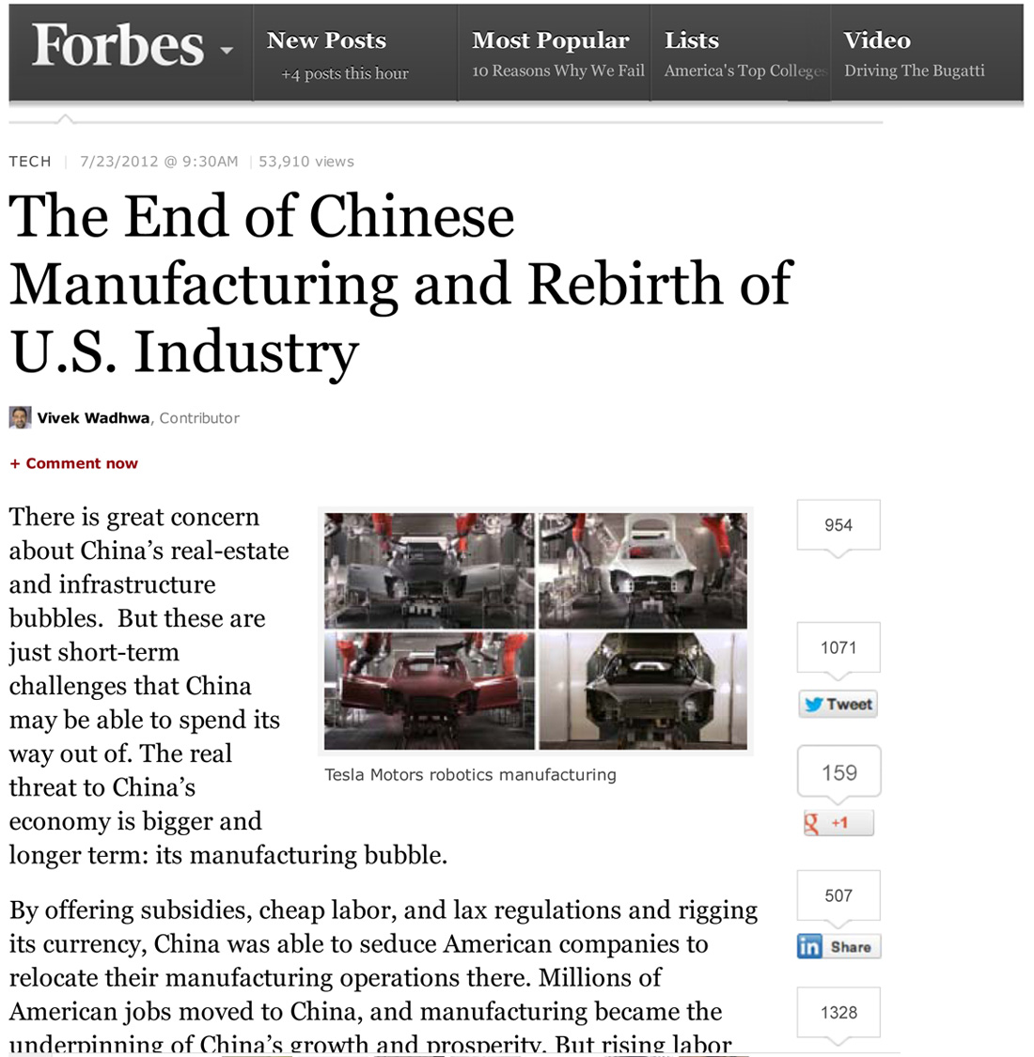
Notes:
… you will find that times have changed -- and the manufacturing is coming back home.
=====
http://www.forbes.com/sites/singularity/2012/07/23/the-end-of-chinese-manufacturing-and-rebirth-of-u-s-industry/
The End of Chinese Manufacturing and Rebirth of U.S. Industry

Slide 75
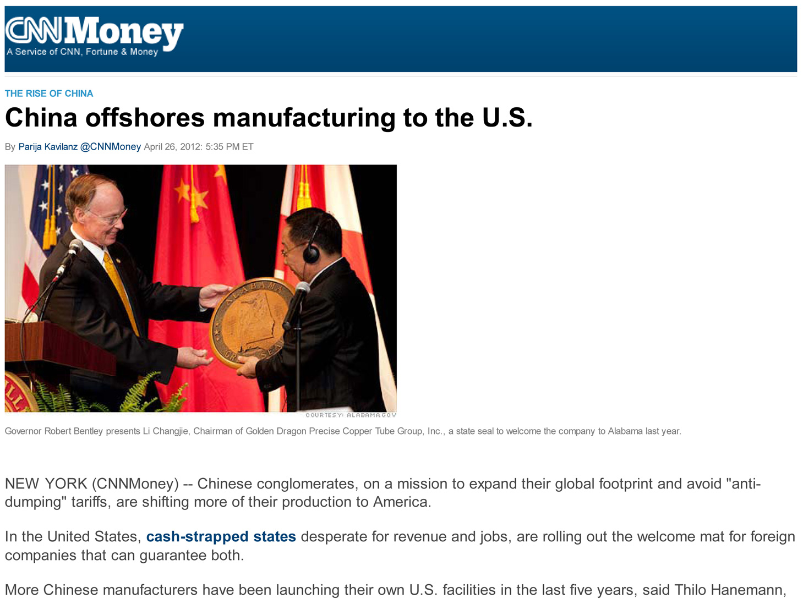
Notes:
People don’t believe me when I tell them that Chinese companies have moved some of their manufacturing to North Carolina.
=====
http://money.cnn.com/2012/04/24/smallbusiness/china-us-manufacturing/index.htm
China offshores manufacturing to the U.S.

Slide 76
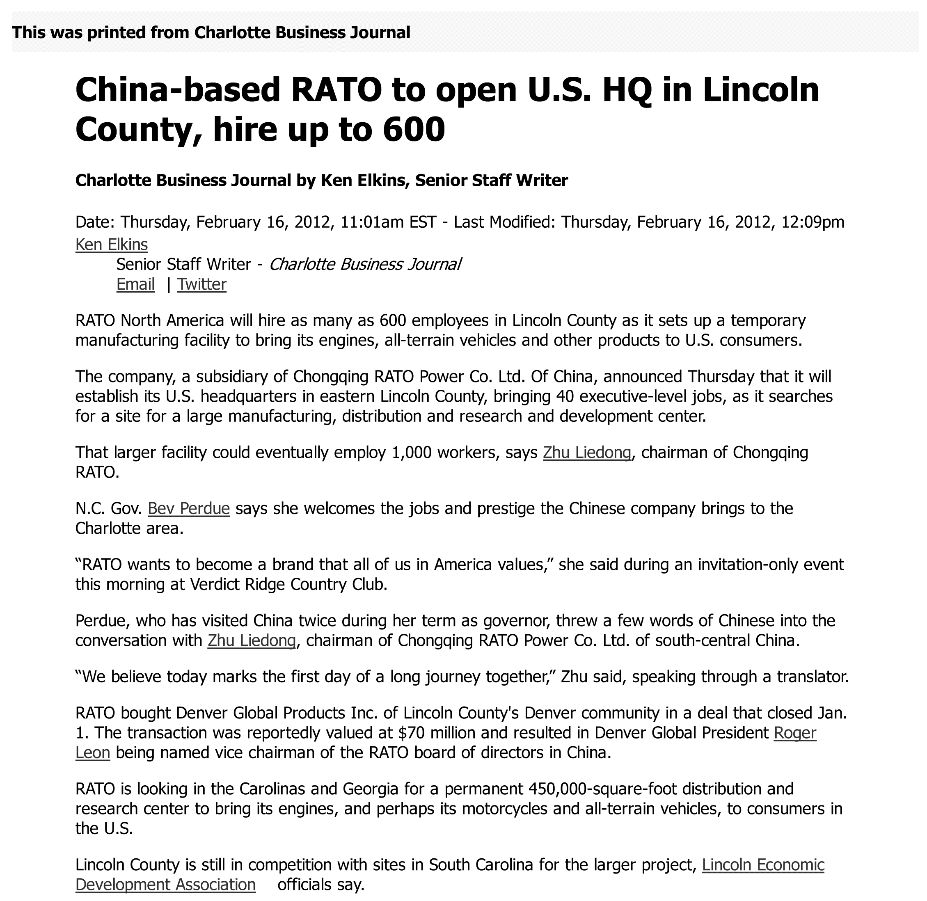
Notes:
76
Here we have a Chinese all-terrain vehicle company that is building a manufacturing plant in North Carolina that will hire 600, and maybe 1,000 workers by the time they complete the facility.
====
China-based RATO to open U.S. HQ in Lincoln County, hire up to 600 (maybe 1000 jobs)
Feb 16, 2012
http://www.bizjournals.com/charlotte/blog/outside_the_loop/2012/02/chinese-company-to-open-in-lincoln.html

Slide 77

Notes:
Another Chinese company is bringing their solar panel factory to Charlotte, North Carolina.
====
International company will bring up to 36 jobs; site will serve as main manufacturing
plant.
http://www.charlotteobserver.com/2011/06/24/2402136/solar-panel-jobs-coming-to-charlotte.html#storylink=misearch
77

Slide 78

Notes:
And Lenovo, who makes the IBM ThinkPads, is setting up manufacturing in the United States.
=====
http://www.bloomberg.com/news/2013-07-11/chinese-pc-giant-lenovo-starts-manufacturing-in-u-s-.html
Chinese PC Giant Lenovo Starts Manufacturing in U.S.
The Chinese electronics giant, now the world's largest PC maker, recently opened a manufacturing plant in North Carolina. Bloomberg Television was given a tour of the facility.
The world's largest electronics companies, including those in the U.S., instinctively use Asian labor for assembly. The operations, led by Foxconn Technology Group, are typically cheap and highly skilled. But the practice of sending that work overseas has made these companies punching bags for politicians and pundits trying to explain America's long-term unemployment crisis.

Slide 79

Notes:
79
And Wind Power technologies coming to Raleigh.
What should we be doing to prepare our current students for these jobs, and the jobs that will follow?
How are we preparing people to work for a company with cultural norms that our different from ours?
===
China Ming Yang Wind Power Group Limited, a wind turbine manufacturer in China, opened a North American research and development center on N.C. State’s Centennial Campus on Tuesday.
The center will focus on offshore wind turbine research and development. Shu Ching Quek, president of Ming Yang Wind Power USA Inc. (NYSE: MY), will lead the center.
Initially, the company will employ about five people at Centennial Campus, according to Gene Pinder, the campus’ marketing director. It has leased space formerly occupied by WebAssign in the Venture Center IV building at Centennial Campus.
http://www.bizjournals.com/triangle/news/2012/03/13/ncsus-centennial-campus-lands-new.html

Slide 80
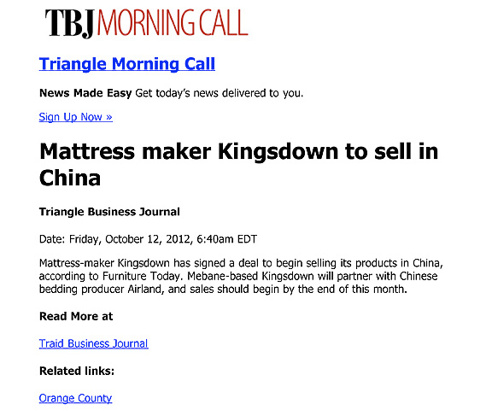
Notes:
And here it works the other way around.
Here is an American manufacturing company in North Carolina that is shipping it’s high-quality mattresses to China.
Yes, products made in America being sold in China.
===
http://www.bizjournals.com/triangle/morning_call/2012/10/mattress-maker-kingsdown-to-sell-in.html?ana=e_trig_rdup&s=newsletter&ed=2012-10-12
80

Slide 81
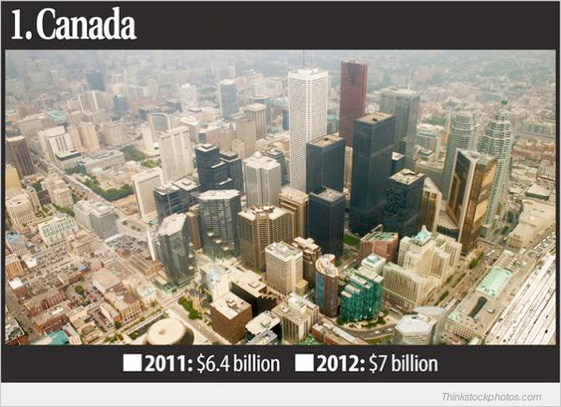
Who’s Buying North Carolina’s Goods
Notes:
The country that buys the most goods made in North Carolina is Canada.
They buy Seven billion dollars of stuff from us each year.
=====
Who’s Buying North Carolina’s Goods
Feb 26, 2013
Triangle Business Journal
http://www.bizjournals.com/triangle/news/2013/02/26/slideshow-whos-buying-north.html

Slide 82
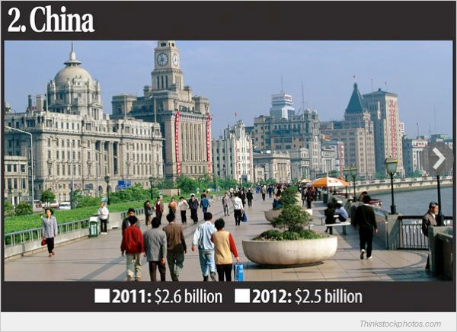
Who’s Buying North Carolina’s Goods
Notes:
And number two is China, buying two and a half billion dollars worth of stuff from North Carolina each year.
Who knew that?
And we need skilled workers to keep making this stuff that the Chinese, and others are buying from us.
=====
Who’s Buying North Carolina’s Goods
Feb 26, 2013
Triangle Business Journal
http://www.bizjournals.com/triangle/news/2013/02/26/slideshow-whos-buying-north.html

Slide 83
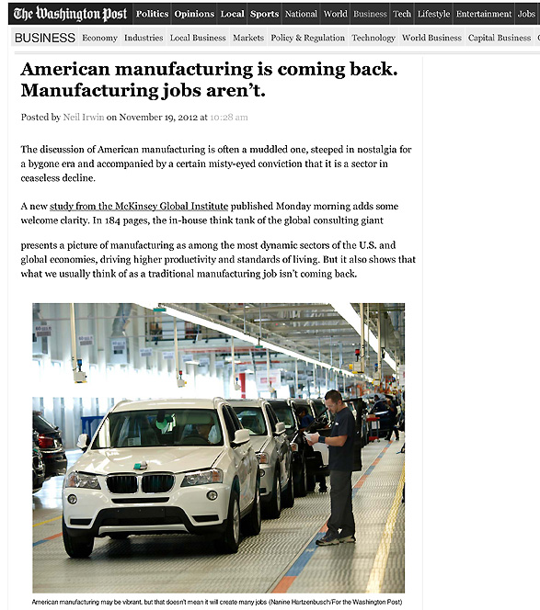
Notes:
As American manufacturing is making its comeback, we find that the old Manufacturing jobs that required a strong back and no education are not coming back.
=====
http://www.washingtonpost.com/blogs/wonkblog/wp/2012/11/19/american-manufacturing-is-coming-back-manufacturing-jobs-arent/
83

Slide 84
Notes:
Make sure your students and clients know about these Manufacturing and STEM open houses in April.
They might find they want to redirect their career pathway.
The online calendar of events should be filling up at the end of March, so check it out in early April.
The web address is at the bottom of your handout.
======
www.ctpnc.org/manufacturing

Slide 85
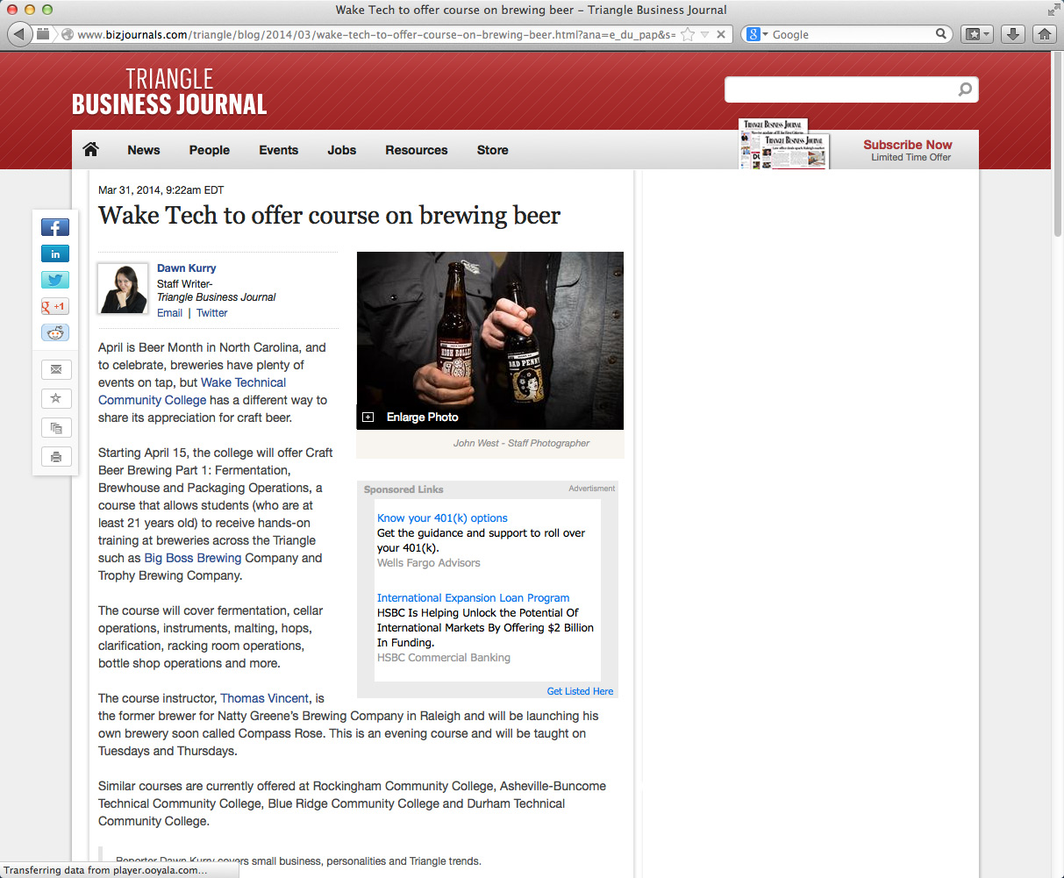
Notes:
We giggle when we think that college students are taking classes to learn how to make beer.
What’s next, classes on how to drink beer?
======
http://www.bizjournals.com/triangle/blog/2014/03/wake-tech-to-offer-course-on-brewing-beer.html?ana=e_du_pap&s=article_du&ed=2014-03-31
Mar 31, 2014, 9:22am EDT
Wake Tech to offer course on brewing beer
Starting April 15, the college will offer Craft Beer Brewing Part 1: Fermentation, Brewhouse and Packaging Operations, a course that allows students (who are at least 21 years old) to receive hands-on training at breweries across the Triangle such as Big Boss Brewing Company and Trophy Brewing Company.

Slide 86
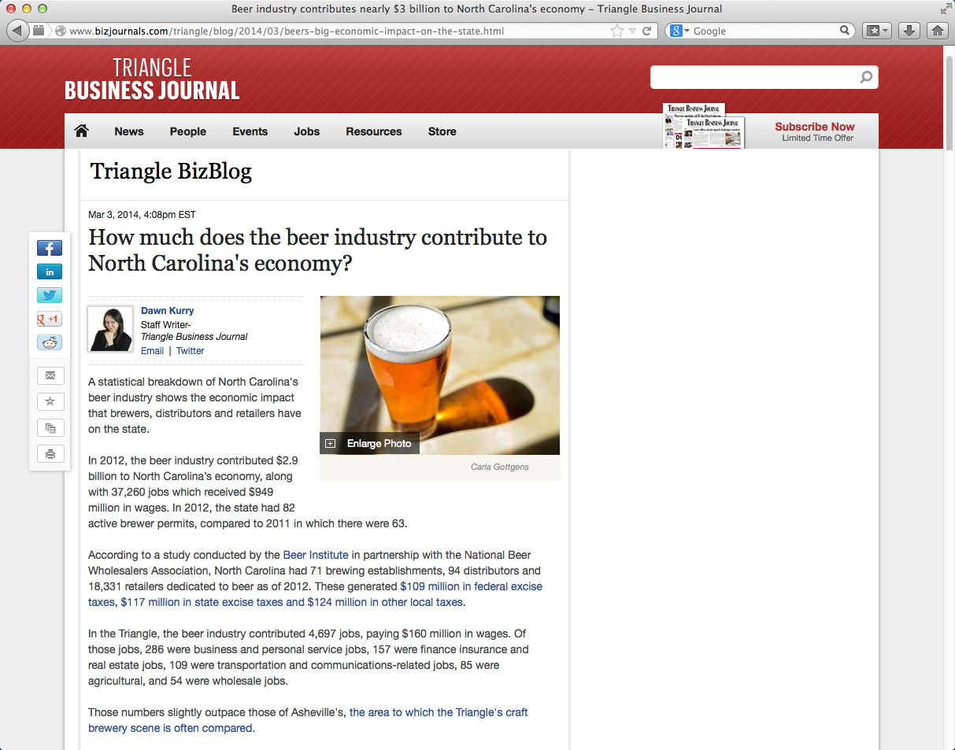
Notes:
Seriously though, beer making is becoming big business in North Carolina, especially in the Triangle region and in Asheville.
In 2012 the beer industry contributed 2.9 billion dollars to North Carolina’s economy, which included 37,260 jobs.
In federal, state and local taxes, North Carolina beer contributed 350 million dollars.
This is manufacturing, and it is not like the beer making factories of old.
=============
http://www.bizjournals.com/triangle/blog/2014/03/beers-big-economic-impact-on-the-state.html
Mar 3, 2014, 4:08pm EST
How much does the beer industry contribute to North Carolina's economy?
In 2012, the beer industry contributed $2.9 billion to North Carolina’s economy, along with 37,260 jobs which received $949 million in wages. In 2012, the state had 82 active brewer permits, compared to 2011 in which there were 63.
According to a study conducted by the Beer Institute in partnership with the National Beer Wholesalers Association, North Carolina had 71 brewing establishments, 94 distributors and 18,331 retailers dedicated to beer as of 2012. These generated $109 million in federal excise taxes, $117 million in state excise taxes and $124 million in other local taxes.

Slide 87
Does it matter if your child is blue-collar or white-collar?
white-collar
The real questions should be :
Are they happy?
Can they support themselves and their family?
Gold-collar means that they earn enough to maintain their standard of living.
Notes:
--
Does it matter?
Too many parents have bought into the notion that university degrees are the guarantee for their child’s future.
That has always been the middle-class mentality. “It’s all about Education.”
The blue-collar jobs of tomorrow are not like the blue collar jobs of yesterday.
Enjoying the work you do -- should be important.

Slide 88
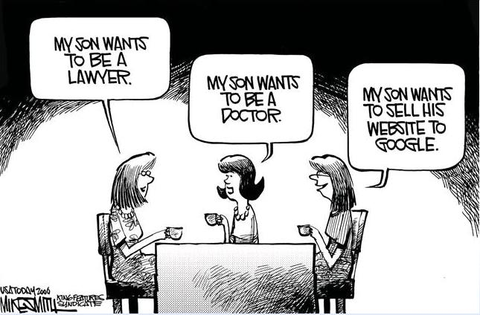
Notes:
--
It’s a different world.
Many moms want to wave their child’s university sheepskin high in the air at the country club and would not see eye to eye with the mom on the right.
====
http://www.kingfeatures.com/features/edcar/smith/bio.htm

Slide 89
Surprises
Future Demand
Changing World
New Ideas
www.ctpnc.org/presentations
Notes:
Let’s look at some new ideas.

Slide 90

Notes:
Sometimes we have to think outside the box.
This is not just for our students, but it’s for us as well.
====
http://cdn.elev8.com/files/2010/07/think-outside-the-box.jpg

Slide 91


Notes:
Some people don’t like wearing a motorcycle helmet. Or wearing a helmet while bicycling or skateboarding. It’s not cool at all.
Someone thought way outside the box and created the head protection that you see here.
Look closely at the fabric around the neck.
======
http://www.hovding.com/

Slide 92
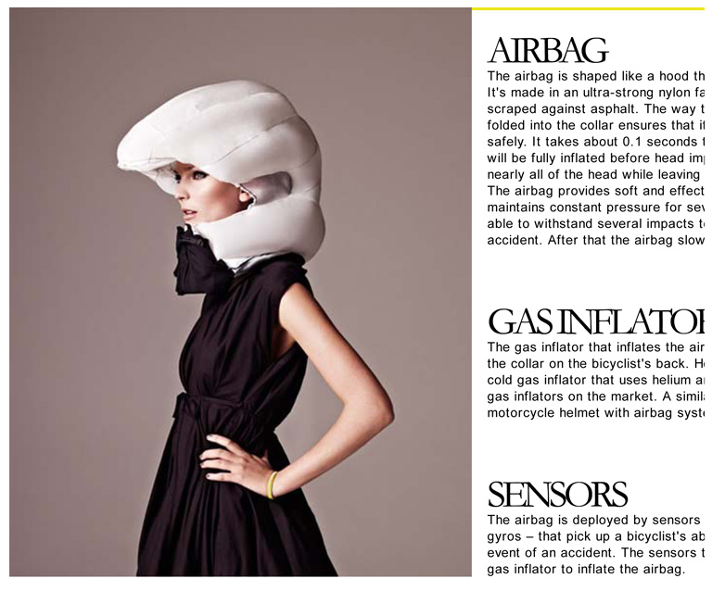
Notes:
It’s an airbag helmet for cyclists. Similar to the airbags that you have in your car and hope that you never have to use.
It even has a “black box,” like they have on airplanes that will record the last 10 seconds of data.
The company even recycles the used airbag helmets and gives the rider a discount on a new one.
Are we teaching our kids to collaborate with others to solve real problems like this?
======
http://www.hovding.com/

Slide 93


Notes:
Soul Stix Surfboards had a problem like many other companies about what to do with it’s waste material when they cut a new surfboard from a block of polyurethane foam.
It creates plastic flakes like snowflakes that are hard enough just to capture out of the air, much less dispose of.
What they found is that this special plastic “saw dust” is very good at sopping up chemicals, like spilled oil in the ocean. Yes -- what was once a waste product is now helping to clean up oil spills.
You know the saying – “One man’s trash is another man’s treasure.”
Are we teaching people to recycle? and then to go one step further to look for new things to recycle?
In my house, the recycle bin always has more in it than the garbage bin.
Can we ever get to the point where everything is recyclable and nothing goes to the landfill?
We have to get people to get outside of the box and look for new ways to make money. One way is by selling trash.
=====
http://www.forbes.com/forbes/2011/1024/entrepreneurs-green-technology-surfboards-monarch-todd-woody.html
Photo
http://www.degree33surfboards.com/blog/surf-education/sell-surfboard-craigslist/

Slide 94
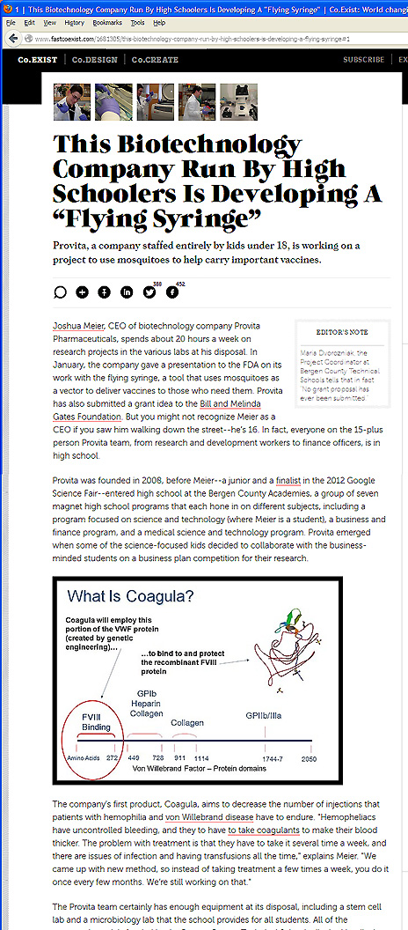
Notes:
You know how mosquitos can spread malaria and other diseases?
Here is a company comprised of kids under the age of 18 who are going to get the mosquitos to instead carry vaccines.
Imagine being able to vaccinate an entire village without a single syringe?
Their first goal is to combat the West Nile Virus.
Who’s got kids like this in their school, and what are we doing to help them learn.
Sometimes we just have to point them to the lab and then get out of their way.
=====
http://www.fastcoexist.com/1681305/this-biotechnology-company-run-by-high-schoolers-is-developing-a-flying-syringe#1

Slide 95
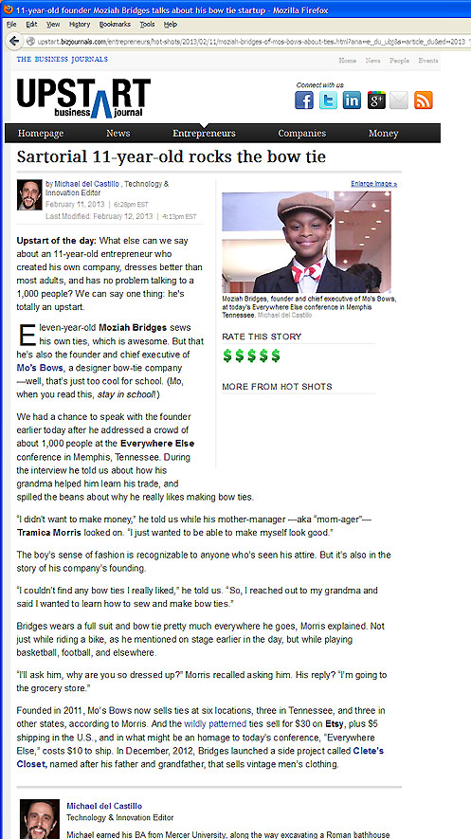
Notes:
Here is an 11-year old kid who couldn‘t find the kind of bowties that he wanted to wear, so he got his grandmother to teach him how to make his own.
Now his ties are sold at six stores in multiple states.
Entrepreneurship.
It’s Americans starting their own company so they can do it their way.
It’s small businesses like these that are bringing the economy out of the recession.
=====
http://upstart.bizjournals.com/entrepreneurs/hot-shots/2013/02/11/moziah-bridges-of-mos-bows-about-ties.html?ana=e_du_ubj&s=article_du&ed=2013-02-12&page=all
Sartorial 11-year-old rocks the bow tie
February 11, 2013

Slide 96
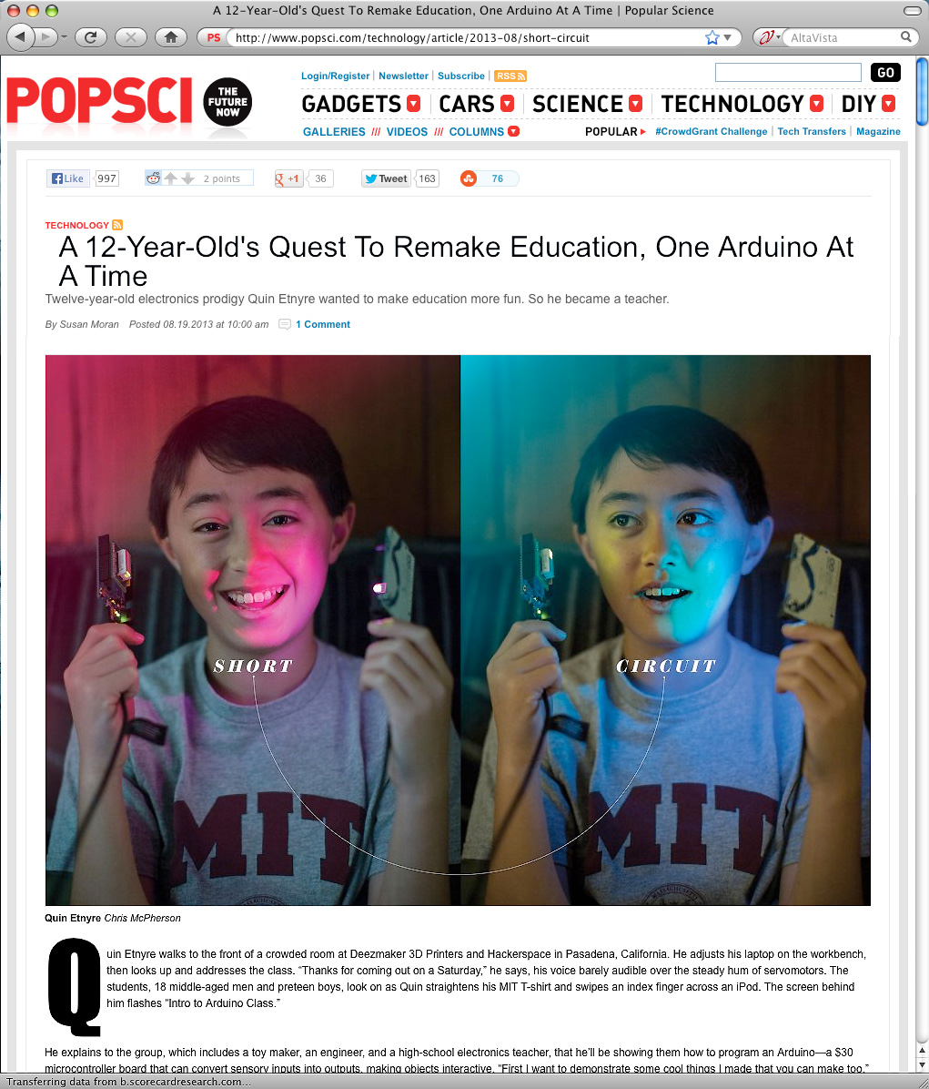
Notes:
An Arduino is a small circuit board with a microprocessor that can be used to build almost anything.
Here is a 12-year old who has unleashed the potential and is building useful products.
======
http://www.popsci.com/technology/article/2013-08/short-circuit
A 12-Year-Old's Quest To Remake Education, One Arduino At A Time

Slide 97

Notes:
Here is a close up of this circuit board that costs about $30.
Think of this as an electronic version of the tinker toys or erector sets that we grew up with.
======
http://www.popsci.com/technology/article/2013-08/short-circuit
A 12-Year-Old's Quest To Remake Education, One Arduino At A Time

Slide 98

Notes:
What does a typical 12 year old build with all this technology? . . .
Here is a small robot that is built around one of these Arduino circuits that has a built-in methane detector.
In plain language--- this 12-year old boy has built a remote-controlled fart detector.
======
http://www.popsci.com/technology/article/2013-08/short-circuit
A 12-Year-Old's Quest To Remake Education, One Arduino At A Time

Slide 99

Notes:
Here is the same 12-year old teaching a class on a Saturday morning to people that want to learn how to make and program things with the Arduino microprocessor.
This kid might just end up at MIT.
======
http://www.popsci.com/technology/article/2013-08/short-circuit
A 12-Year-Old's Quest To Remake Education, One Arduino At A Time

Slide 100

Notes:
And here is a cell phone that you can make using the Arduino microprocessor and a 3D-printed case.
Are we setting up our students (and even adults) to be this creative -- and giving them the tools they need to start their own business?
===
http://www.engadget.com/2013/07/22/arduino-hackaphone/
This Arduino hackaphone was never going to be pretty, but it does the job

Slide 101

Notes:
Pizza Hut has developed this new computer-topped table that allows you to see what your food will look like before you order.
You just decide how big you want your pizza, drag over the ingredients, pay with your smart phone, and hit send.
No need for a person to take your order.
After you order, you can use the table top to play games while you wait.
Technology like this could eliminate many waiter and order-taker positions.
But it creates high-tech positions to design, build, install, and maintain these technologies.
And best of all for the guys --- this eliminates all reasons to have to talk on a date. Just point and click! ;-)
====
http://www.adweek.com/adfreak/pizza-huts-swipe-order-table-cool-and-useful-or-gross-and-inefficient-156080
Pizza Hut's Swipe-to-Order Table: Cool and Useful, or Gross and Inefficient? When talking to a human just won't cut it
Video: http://www.youtube.com/watch?v=xvT0MCugb58#t=13

Slide 102


The way of doing business is changing
Competitiveness is not working and is going away.
Collaboration is the way of the future. Businesses creating a niche market and working with other businesses to help each other.
We need to change the focus from self-centered learning to group-centered learning.
Notes:
We need more diversity of thought. With more women entering the higher levels of business, we are seeing a shift in the way of doing business. And I like it.
The traditional male version of running a business, built upon a platform of competitiveness, is now evolving.
Collaboration is the new way of life in the business world. Small businesses supporting each other rather than trying to buy out the competition or acquire the supply line.
So how does this affect what we are doing in the classroom?
Our education system is set up to encourage students to compete with each other for the best grades, class rank, and the honor of being the valedictorian. Is this preparing them for the future workplace?
In schools, we have traditionally called collaboration “cheating.”
Kids are collaborating with each other on their smart phones, but rather than trying to stop it, we should be encouraging it.
And we should be teaching them the proper way of using technology and the proper way of collaborating that brings about synergistic results.
We need to change the focus from self-centered learning to group-centered learning.
From individuals doing great on individualized assessments to students working together to solve a relevant problem.
We need to change our schools to reflect this change in the work environment.
This is assuming that one of the purposes of education is to prepare kids for the workplace.
102

Slide 103

Notes:
North Carolina ranks No. 3 for growth in women entrepreneurship
The number of women-owned businesses has increased 68 percent since 1997.
Entrepreneurship, or starting your own business, is what is building the economy.
But when someone walks into a NCWorks Career Center and says they need a job, it’s hard to tell them to become an entrepreneur.
=====
http://www.bizjournals.com/triangle/blog/2014/03/north-carolina-ranks-no-3-for-growth-in-women.html?ana=e_du_pap&s=article_du&ed=2014-03-31
Mar 28, 2014, 4:45pm EDT Updated: Mar 28, 2014, 4:57pm EDT
North Carolina ranks No. 3 for growth in women entrepreneurship
In North Carolina, women own 267,800 firms and employ 268,300 people, according to a new report from American Express OPEN, which ranks the state third in the growth of women-owned firms over the last 17 years.
The number of women-owned businesses has increased 68 percent since 1997, the report says, while women-owned businesses in 2007 generated $32 million in sales, a figure that grew to $35.9 million in 2014.
The report shows an estimated 1,288 women start new businesses every day, which is double the rate from three years ago. There are more than 9.1 million women-owned businesses in the United States, compared to 8.6 million in 2013. These businesses generate more than $1.4 trillion in revenues, employ 7.9 million people and account for 30 percent of all enterprises.
"The report clearly shows that women are choosing the path of entrepreneurship at record rates," said Randi Schochet, vice president of brand strategy and activation, American Express OPEN. "Imagine the economic impact if more of these new ventures were transformed into thriving businesses. This is why American Express OPEN remains so passionately dedicated to helping women entrepreneurs become successful business owners."

Slide 104

Notes:
Speaking of Collaboration,
Here is a middle school engineering class that is designing a prosthetic hand for a classmate -- who wants to be a cheerleader, -- but couldn’t hold the pompoms.
So far they have built a working prototype of a finger.
This class is not about kids individually learning engineering principles and then releasing them on a summative assessment.
It’s about kids working together as a team to solve a real, and personal problem that does not have a textbook answer.
This is what the business community is looking for. They want new recruits that can work in teams to solve new problems.
====
http://www.sj-r.com/article/20131230/ENTERTAINMENTLIFE/131239999/10298/LIFESTYLE
Students build prosthetic hand for classmate
By Amy Scalf
The Kentucky Enquirer
Posted Dec. 30, 2013 @ 9:50 pm
Dec 30, 2013 at 11:27 PM
EDGEWOOD, Ky. (AP) — A Turkey Foot Middle School engineering class is working on a unique hands-on project.
Teacher Dwayne Humphrey teaches sixth- and seventh-graders how to use engineering design and modeling software, starting with toys and video games, then moving into biomedical design in the eighth grade.
This year, his older students are using those skills and a 3-D printer to build a prosthetic hand for a fellow student who was born without the lower part of her left arm.
“Each year, the students make some kind of prosthetic, a leg or a hand, and someone has to walk on the leg or use the hand to do specific tasks. My students have the skills and ability to do this, but they’re not medical professionals. We’re not licensed to create prosthetics for students,” said Humphrey. “Instead of making something that would just be discarded, I thought, ‘Why can’t we find someone who could really use this?’”
Then, a new seventh-grade student enrolled at the school.
When Makayla Murphy entered Humphrey’s engineering class, the teacher noticed she has only one hand.
Makayla was born without the lower part of her left arm, and she quickly agreed to be the model for the eighth-grade class project.
“I have difficulties getting dressed and carrying books and stuff,” she said.
She wanted to be a cheerleader, but said she couldn’t hold the pompoms.
“I’m really excited about it because having an arm that can actually move is going to be really cool,” Makayla said.
“We’re on a journey here. We don’t know how it’s going to end. We do know we’re going to give it our best effort and it’s coming together pretty nicely,” said Humphrey. “It’s incredible how quickly things are changing. As we look into the future, we realize we haven’t seen anything yet.”
He also said the project has sparked a special interest among the students.
“Middle-schoolers want to influence the world and they get frustrated over lack of control in their lives. With this project, they get to change someone’s real life. There’s a real opportunity in class to design lessons that have real-world connections,” Humphrey said. “Around the world, kids between the ages of 11-14 are adding to the well of human knowledge and invention. We’re trying to engage students in work that is meaningful.”
Josh Suedkamp and Malachi Pike said that’s exactly why they like this project.
“It’s better because you’re actually affecting someone’s life,” said Malachi. “It’s cool because it helps a real person and it’s not just a school project.”
“I think we’re setting the right kind of tone to really get kids to consider their future careers and giving opportunities to research many of them,” Humphrey said. “Hopefully, we’ll spark something great.”
Read more: http://www.sj-r.com/article/20131230/ENTERTAINMENTLIFE/131239999/10298/LIFESTYLE#ixzz2pGvV3D3y

Slide 105

Notes:
This leads us to what this author has proposed as the number one job skill that employers are looking for in 2020.
It’s getting past the computer screen and really getting to know your customer as a person, not just a number. It’s getting to know them so well that you truly feel their pain.
This crucial career skill is called Empathy.
Not to just feel sorry for someone, like Sympathy, but to truly feel their pain is Empathy.
When do we get to know our students or clients so well we feel their pain?
How can we teach this highly prized skill to get folks ready for a career?
=====
http://www.linkedin.com/today/post/article/20130611180041-59549-the-no-1-job-skill-in-2020
The Number One Job Skill in 2020
June 11, 2013
Empathy
Dictionary: the intellectual identification with or vicarious experiencing of the feelings, thoughts, or attitudes of another.
Cultural Dictionary:
Identifying oneself completely with an object or person, sometimes even to the point of responding physically, as when, watching a baseball player swing at a pitch, one feels one's own muscles flex.

Slide 106

Notes:
People like to do what they like to do.
How can we find out what our students and clients really like, and then how can we use that information to help them plan a career pathway?
===
http://blogs.kqed.org/mindshift/2013/11/how-the-power-of-interest-drives-learning/
How the Power of Interest Drives Learning
In recent years researchers have begun to build a science of interest, investigating what interest is, how interest develops, what makes things interesting, and how we can cultivate interest in ourselves and others. They are finding that interest can help us think more clearly, understand more deeply, and remember more accurately. Interest has the power to transform struggling performers, and to lift high achievers to a new plane.
So what is interest? Interest is a psychological state of engagement, experienced in the moment, and also a predisposition to engage repeatedly with particular ideas, events, or objects over time. Why do we have it? Paul Silvia of the University of North Carolina speculates that interest acts as an Òapproach urgeÓ that pushes back against the Òavoid urgesÓ that would keep us in the realm of the safe and familiar. Interest pulls us toward the new, the edgy, the exotic. As Silvia puts it, interest Òdiversifies experience.Ó But interest also focuses experience. In a world too full of information, interests usefully narrow our choices: they lead us to pay attention to this and not to that.

Slide 107

The 10 key skills for the future of work
Sense-making
Social intelligence
Novel and adaptive thinking
Cross-cultural competency
Computational thinking
New-media literacy
Transdisciplinarity
Design mind-set
Cognitive load management
Virtual collaboration
Notes:
Here are some broad skills that will help workers adapt to the changing career landscape:
Sense-making is the ability to determine the deeper meaning or significance of what is being expressed
Social intelligence is the ability to connect to others in a deep and direct way, to sense and stimulate reactions and desired interactions
Novel and adaptive thinking is proficiency at thinking and coming up with solutions and responses beyond that which is rote or rule-based
Cross-cultural competency is the ability to operate in different cultural settings
Download my PowerPoint and read the descriptions for the rest of these
------
Computational thinking is the ability to translate vast amounts of data into abstract concepts and to understand data-based reasoning
New-media literacy is the ability to critically assess and develop content that uses new media forms and to leverage these media for persuasive communication
Transdisciplinarity is literacy in, and ability to understand concepts across multiple disciplines
Design mind-set is the ability to represent and develop tasks and work processes for desired outcomes
Cognitive load management is the ability to discriminate and filter information for importance and to understand how to maximize cognitive functioning using a variety of tools and techniques, and
Virtual collaboration is the ability to work productively, drive engagement, and demonstrate presence as a member of a virtual team
Are we teaching these skills to our students? If not, then who will?
========
GigaOM
Dec. 16, 2011,
http://gigaom.com/collaboration/the-10-key-skills-for-the-future-of-work/?utm_source=General%20Users&utm_campaign=9bd9bdcde9-c%3Atec%20d%3A12-17&utm_medium=email
What are the jobs of the future? The demographics of an aging population suggests health care will be big, say some.
Broad skills that will help workers adapt to the changing career landscape:
Sense-making. The ability to determine the deeper meaning or significance of what is being expressed
Social intelligence. The ability to connect to others in a deep and direct way, to sense and stimulate reactions and desired interactions
Novel and adaptive thinking. Proficiency at thinking and coming up with solutions and responses beyond that which is rote or rule-based
Cross-cultural competency. The ability to operate in different cultural settings
Computational thinking. The ability to translate vast amounts of data into abstract concepts and to understand data-based reasoning
New-media literacy. The ability to critically assess and develop content that uses new media forms and to leverage these media for persuasive communication
Transdisciplinarity. Literacy in and ability to understand concepts across multiple disciplines
Design mind-set. Ability to represent and develop tasks and work processes for desired outcomes
Cognitive load management. The ability to discriminate and filter information for importance and to understand how to maximize cognitive functioning using a variety of tools and techniques
Virtual collaboration. The ability to work productively, drive engagement and demonstrate presence as a member of a virtual team

Slide 108
Questions before I conclude?
Chris Droessler, Consultant, NCDPI
www.ctpnc.org/presentations
Notes:
Before I conclude my presentation, I will pause here to see if anyone has any questions.
Usually by this time most of the audience is overwhelmed and just need a break to digest what I’ve said.
Remember that you can download the PowerPoint and use it however you can.
Qs?

Slide 109
Passion and Purpose
Thriving in your work, not just surviving.
Leaving the world a little better off because you cared to make a difference in your work.
Helping people discover their passion and then helping them turn that passion into an educational pathway that will lead to a rewarding career.
Notes:
→What makes you want to get up in the morning?
→Are you passionate about your own career?
→How can we help our students and clients discover their passion, and put them on an education pathway, to turning their passion into a career?
--
======
Chris Droessler

Slide 110
Help people discover their passion, then help them get on a pathway where they can turn that passion into a career.
CLD
Notes:
Though the term “vocational” has earned a bad reputation in the last few decades, the original meaning of the term is clear that your “vocation” is your life’s calling.
Our vocation as educators and workforce professionals is preparing folks for careers.
What is your student’s or client’s vocation?
What is life calling them to do?
What is their purpose in life?
We need to help people discover their passion.
What makes them get up in the morning and want to learn something new?
It’s more than just working for a paycheck.
It’s doing satisfying work, making a difference in the world, feeling needed.
And we need to help them to turn that passion into a rewarding career.
--
In the future -- when our students and clients are employed, and someone asks them what they do for a living, --
wouldn’t it be great if they could say –
“I get to make a difference in the world.”
===
Chris Droessler
110

Slide 111
Thanks for listening!
Chris Droessler, Consultant, NCDPI
www.ctpnc.org/presentations
Notes:
Thanks for inviting me to come speak today.
=====
Chris Droessler, Consultant, NCDPI
www.ctpnc.org/presentations

