Slide 1
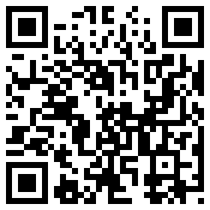
Important
Stuff
Chris Droessler,
CTE Support Services Consultant, NCDPI
www.ctpnc.org/presentations
Notes:
I am Chris Droessler (silent O, no Q)
I am your CTE Support Services consultant at the North Carolina Department of Public Instruction.
I hope that you all recognize the QR code on the right side of the screen.
If you have a smart phone, and you are smart enough to use it, you can capture that QR code, and your phone takes you to the webpage where you can download a copy of this PowerPoint file.
Or you can just go to ctpnc.org and click on the “presentations” link.
How many of you have already downloaded my presentation??
Today I am going to talk to you about some Important Stuff.
===============
www.ctpnc.org/presentations

Slide 2
Purpose of School
Work-based Learning
Articulation Agreement
Manufacturing & STEM Careers
www.ctpnc.org/presentations
Notes:
Here is what we will be covering today.
The Purpose of School – That’s Why do we do what we do,
Work-based Learning,
Our Articulation Agreement with the community colleges,
And Promoting Manufacturing and STEM Careers
I am going to go through all of this today at lighting speed, but feel free to download the PowerPoint file and use it any way you need.
I have included the references to where I got the data in the notes section of each slide, and even the notes from which I am reading are there as well.
Please download the PowerPoint and use it anyway you need to help our next generation get ready for their careers.
→
Let’s look at the purpose of school.

Slide 3
The primary aim of education is not to enable students to do well in school, but to help them do well in the lives they lead outside of school.
Elliot W. Eisner
Notes:
Sometimes we get too caught up in how well kids do in school --
and we loose sight of the goal to produce adult citizens who can function outside of school.
We have to get back to the true purpose of education.
===
This line is often quoted without any reference. Here are two people who claim the quote and a school district that uses it as their motto.
Elliot W. Eisner
http://www.ascd.org/publications/educational-leadership/dec03/vol61/num04/Preparing-for-Today-and-Tomorrow.aspx
Raymond McNulty
http://unioneagle.com/2012/01/education-leader-challenges-teachers-to-be-different/
Bellevue Community School District
http://bellevue.k12.ia.us/

Slide 4

What is the Purpose of School?
Learning how to sit in rows.
Learning how to get up and move en masse at the sound of a bell.
Learning how to stay in place for 45-minute increments.
Learning how to override your bodily functions.
Learning how to answer the questions that the person standing in front of the room already knows the answer to.
It’s a training ground for behavioral management.
It’s the place where kids go to watch adults work really hard!
Notes:
Let’s start by looking at the purpose of school.
It often seems that this is the de facto purpose for school.
--
But learning these skills will not really prepare kids for a career.
Learning these skills will not grow the economy.
Let’s look at the mission of public education in North Carolina.
=====
http://mindshift.kqed.org/feature/school-day-of-the-future/

Slide 5
NC Board of Education Mission
Every public school student will graduate from high school, globally competitive for work and postsecondary education and prepared for life in the 21st Century.
Notes:
5
5
Here is the public school board mission in North Carolina.
We are all charged with fulfilling this mission.
It’s full of a lot of big words -- talking about things like kids being globally competitive for work.
Let me show you the simplified version.

Slide 6

Education Plan
All students must graduate from
high school and be career,
college, and citizenship
READY.
Notes:
6
6
All students must graduate from high school --
and be career, college, and citizenship ready.
Kids need to be ready for all three. Our future depends on it!
They all eventually need a career.
They all need some kind of education beyond high school, which we generically call college,
and they all need the skills necessary to be a good citizen.
Today I’m focusing mostly on the Career-Ready part.
===
http://legislative.ncpublicschools.gov/resources-for-legislation/2012/20120608-sup-howmeasure.pdf

Slide 7

Boosting Teen Employment Prospects
Teen unemployment dropped 53% from 1999 to 2012
Working at an early age generates a set of benefits that are manifest in improved lifetime employment and earnings outcomes as well as improved educational attainment outcomes.
Notes:
Here’s a recent study that studied the teens in Massachusetts.
They found that Teens are not working jobs like they did a generation ago,
Studies show that internships, or other work while in school, helps prepare for future employment.
And the report found that working at an early age improves lifetime earnings.
I had lots of different jobs while in high school and bought my first car while in high school with the money I earned.
=====
http://www.commcorp.org/resources/detail.cfm?ID=988
Commonwealth Corporation
Signaling Success: Boosting Teen Employment Prospects
Since 1999, the share of employed teens in Massachusetts plummeted from 53 percent to 26.8 percent during 2012. This reflects a national trend in declining teen employment rates over the last decade.
While working certainly has the ability to bolster the consumption of teens and their families, working at an early age generates a set of additional and longer lasting benefits that are manifest in improved lifetime employment and earnings outcomes as well as improved educational attainment outcomes.
Through this study, we have learned that employers of entry level workers such as teens take recruitment and hiring very seriously and engage in a variety of activities to find prospective workers they believe will contribute to output and profitability in their organizations. The findings of this study can inform the ways that schools, community based organizations, workforce boards, career centers and businesses can intervene to help increase youth employment.

Slide 8
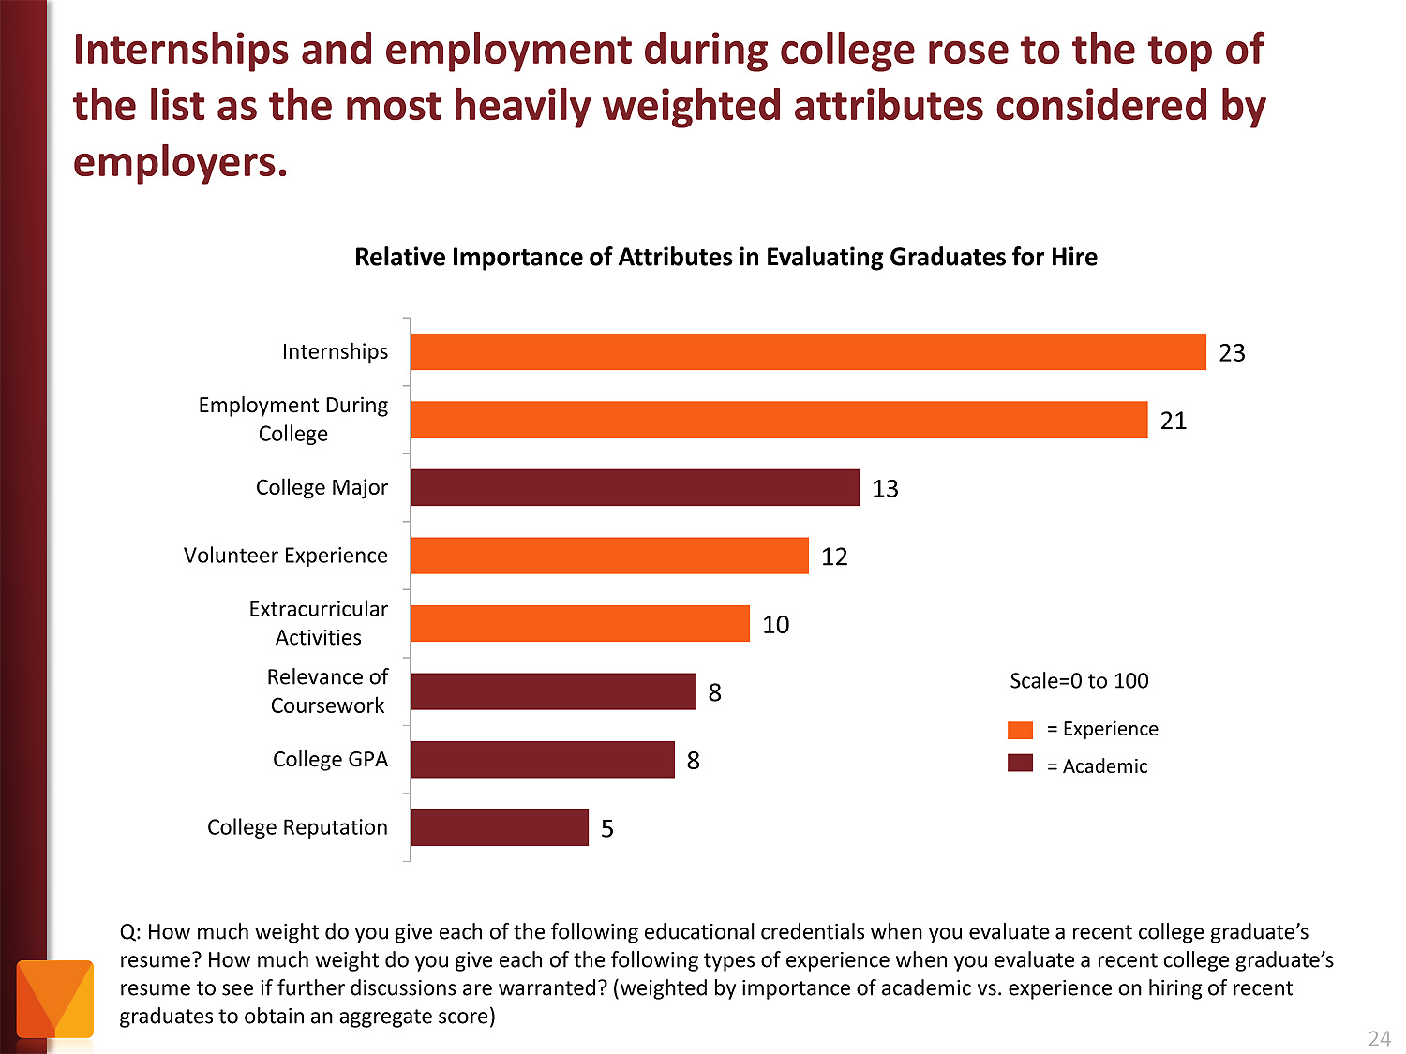
Notes:
Employers value Internships and other employment while in school as more important than college major and GPA.
Even volunteer work and extra-curricular activities are more important to the business community than grades.
Did you know this?
Does this change the way you think about high school?
======
http://chronicle.com/article/The-Employment-Mismatch/137625/#id=overview
The Employment Mismatch: A College Degree Sorts Job Applicants, but Employers Wish It Meant More
Employers value a four-year college degree, many of them more than ever.
Yet half of those surveyed recently by The Chronicle and American Public Media's Marketplace said they had trouble finding recent graduates qualified to fill positions at their company or organization. Nearly a third gave colleges just fair to poor marks for producing successful employees. And they dinged bachelor's-degree holders for lacking basic workplace proficiencies, like adaptability, communication skills, and the ability to solve complex problems.
The report
The Role of Higher Education in Career Development: Employer Perceptions
http://chronicle.com/items/biz/pdf/Employers%20Survey.pdf

Slide 9


CTE in NC
CTE Coursework
Career Technical Student Organizations (CTSOs)
Work-based Learning (WBL)
Notes:
There are three main components of a quality
Career and Technical Education program.
The most obvious is the coursework where we teach academic and technical skills.
We teach leadership and other soft skills thought our CTSOs.
And then there is work-based learning …

Slide 10
Purpose of School
Work-based Learning
Articulation Agreement
Manufacturing & STEM Careers
www.ctpnc.org/presentations
Notes:
So let’s talk about Work-based Learning.

Slide 11
Work-based Learning
Goal - get students into the workplace so they can learn about the world of work.
Why - kids need to watch employers work throughout the entire workday in order to learn the many facets of a job.
Vision - students connecting what they are learning in the classroom with what they experience on the job.
Notes:
The goal of work-based learning is to get students into the workplace so they can learn about the world of work.
Kids need to watch employers work throughout the entire workday in order to learn the many facets of a job.
It is hoped that students will connect what they are learning in the classroom with what they experience on the job.
All students participating in work-based learning have a mentor teacher who is responsible for helping them make those important connections between school and work.
As the CDC, you are probably the person at your school who is in charge of work-based learning.

Slide 12

Benefit for Students
Application of classroom learning
Connect education and work
Assess interests, aptitudes, abilities
Explore possible careers
Develop positive work habits
Gain professional contacts
Motivation to stay in school
Notes:
Work-based learning benefits everyone.
There are lots of benefits for the students.
Connecting what the kids learn in the classroom -- with what they will be doing when they later enter the workforce -- is essential.
For many kids, work-based learning gives them a reason for staying in school.

Slide 13
Benefit for Employers
Tryout potential employees
Shape potential employees
Reduce recruitment costs
Provide community service
Notes:
Employers get to have a positive impact on their future recruits.
They get to try out workers and see if they want to hire them permanently.

Slide 14

Benefit for Teachers
Improve student motivation to learn in class
Improve teacher’s understanding
of the real world
Networking with subject matter
experts
Find new resources
Notes:
Work-based learning should eliminate many of the -- “Why do we have to learn this?” kind of questions.
Connecting with the business community through students in work-based learning can also help the teacher keep up with the latest trends in the business or industry that they are teaching.

Slide 15
Benefit for Community
Collaboration among school, employers, and community
Build local economy
Foster public confidence in
public schools
Notes:
If work-based learning can keep kids in school and help produce motivated employees, then the whole community wins.
Yes, -- we have the power to change the economy just by getting our students out into the workplace.

Slide 16
Job Shadowing
1 day or less
Student watches worker(s)
Develops awareness of:
  Work
  Variety of jobs
  Work environment
Students@Work
Online shadowing
Notes:
Let’s look at some different types of work-based learning.
Job Shadowing is a short-term educational experience that introduces a student to a particular occupation by pairing the student with an employee of a business, industry, or agency.
By following, or "shadowing" the employee, the student becomes familiar with the duties associated with that occupation, the physical setting of the occupation, and the compatibility of the occupation with his or her own career goals.
Job Shadowing is typically a half or whole day, but could last longer if a student wishes to see every department in a large business.

Slide 17
Cooperative Education
Technical classroom instruction combined with paid employment.
Work is directly related to classroom instruction.
Planned by school & employer
Work and class contributes to
student’s career objective.
Connect to almost any CTE
course.
Notes:
Cooperative Education is a method of instruction where technical classroom instruction is combined with paid employment that is directly related to the classroom instruction.
The two experiences must be planned and supervised by the school and the employer so that each contributes to the student's career objective.
Written cooperative agreements showing the instruction to be provided -- are developed by the school and employer providing the training.
School credit is received for both the on-the-job training and the classroom components.

Slide 18

Internship
Students:
  observe and participate in daily operations
  develop direct contact with job personnel
  ask questions about particular careers
  perform certain job tasks
Internships may be paid or unpaid.
Work experience is directly
related to the student’s
career pathway.
Notes:
Through an internship, a student learns by taking on a responsible role as a worker in a company or organization.
The internship allows students to observe and participate in daily operations, develop direct contact with job personnel, ask questions about particular careers, and perform certain job tasks.
The work experience should be directly related to the student’s chosen career pathway.
Internships may be paid or unpaid.
It is not possible to do an internship through self-employment. You must be working under the constant supervision of a supervisor.
Since internship work does not have to be paid, it is possible to do internship hours through …

Slide 19
Service Learning
Since internship does not have to be paid, it is possible to do internship hours through Service Learning.
Doing work that is considered a service to the community and would often
be done by a volunteer.
Students can see a purpose
to their work.
Notes:
… Service learning, which is where students do work that is considered to be a service to the community and would often be done by a volunteer.
Construction students could work for Habitat for Humanity.
Business Ed and Marketing Ed students could work for practically any non-profit organization.
Houses of Worship are a great place to work internship hours. I know one student who did an internship at his church creating a series of videos.
Service learning is great because students can see a purpose to their work and have a good feeling that their work is appreciated and is helping to make the world a better place.
In a traditional work environment, it is sometimes hard to see the fruits of your labor.

Slide 20
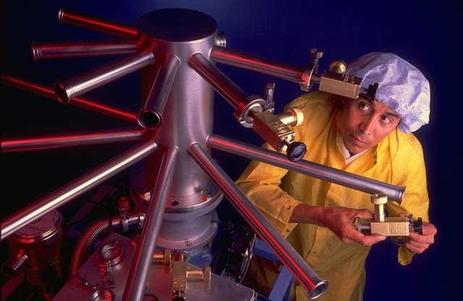
Apprenticeship
NC Department of Commerce program.
Combines practical work experiences with related academic and technical instruction.
“Preapprenticeship” for
HS students
Can be added to
Internship or
Cooperative Education
Notes:
Apprenticeship is a system of skilled occupational training that combines practical work experiences with related academic and technical instruction.
An apprentice works on the job for an employer and is taught and supervised by an experienced person in the chosen occupation.
This preplanned, progressively challenging work-based learning experience extends for two to four years, depending on the occupation.
Upon completion of the work and the related instruction, the apprentice receives certification as a journeyman in the field.
Apprenticeship programs are registered and monitored by the NC Department of Commerce.
For students who are not ready to make a multi-year commitment, they have a Pre-Apprenticeship program, which can be turned into a Registered Apprenticeship at anytime.
Think of Apprenticeship as a credential that can be added to internships and cooperative education.

Slide 21
Credit for WBL
Internships and Cooperative Education can receive academic credit.
  135 hours - block schedule
  150 hours - traditional calendar
Work should occur away from school.
Notes:
Internships and Cooperative Education can receive academic credit based upon the number of hours spent in the workplace.
The minimum hours required to receive 1 credit for students on a block schedule is 135 hours.
For traditional calendars, the minimum is 150 hours.
Your LEA may require more hours.
Students should not receive academic credit for work done at their own school. The work should be done at a business or at another school.

Slide 22
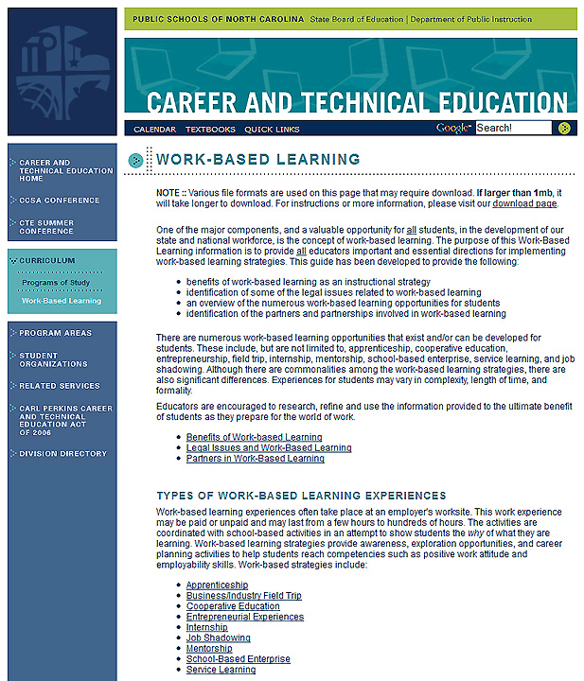
www.ncpublicschools.org/cte/curriculum/work-based
Notes:
If you want to learn more about Work-Based Learning and see all the rules and regulations, you can go to the state Career and Technical Education website.
Select the Curriculum button on the left-side navigation bar.
And then select the Work-Based Learning button that appears below that.
And there in yellow, you see the full web address.
I recently updated and reorganized all of the work-based learning web pages. If you have any questions or suggestions for improvement, please let me know.
======
www.ncpublicschools.org/cte/curriculum/work-based

Slide 23
Purpose of School
Work-based Learning
Articulation Agreement
Manufacturing & STEM Careers
www.ctpnc.org/presentations
Notes:
Let’s talk about ar-tic-u-la-tion

Slide 24
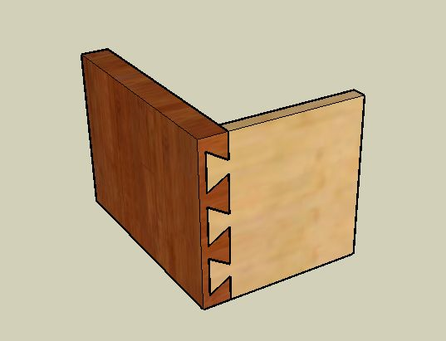
Articulation = Joining Parts Together
Articulation is a seamless process that joins secondary and postsecondary education and minimizes duplication of effort.
Articulation connects high school coursework with community college coursework.
Notes:
The word Articulation has changed over time to typically mean someone who speaks well.
The original definition means to join parts together, such as an “Articulate person is good at joining words together, or they clearly enunciate each syllable or part of each word.”
Here we are using the classic definition or Articulation to describe joining the parts of an education pathway.

Slide 25


Articulation joins together
Work
High School
Notes:
Articulation connects high school programs with community college programs, and the workplace.

Slide 26
High School to Community College Articulation Agreement
55 high school CTE courses match the essential standards (learning objectives) found in similar community college courses.
48 articulated course matches.
Sometimes 1-to-2 or 2-to-1 match.
Notes:
Here’s how it works
If a student is proficient in a high school course that is equivalent in learning objectives and rigor as a community college course, then there is no reason the student should have to repeat the same course when they get to college.
Through this agreement, the credit is transferred from high school to the community college.
We have a statewide agreement that is updated every two years that states which high school course articulate to which community college course.
Sometimes it is not a direct one to one match.
==================
http://www.ctpnc.org/articulation/

Slide 27
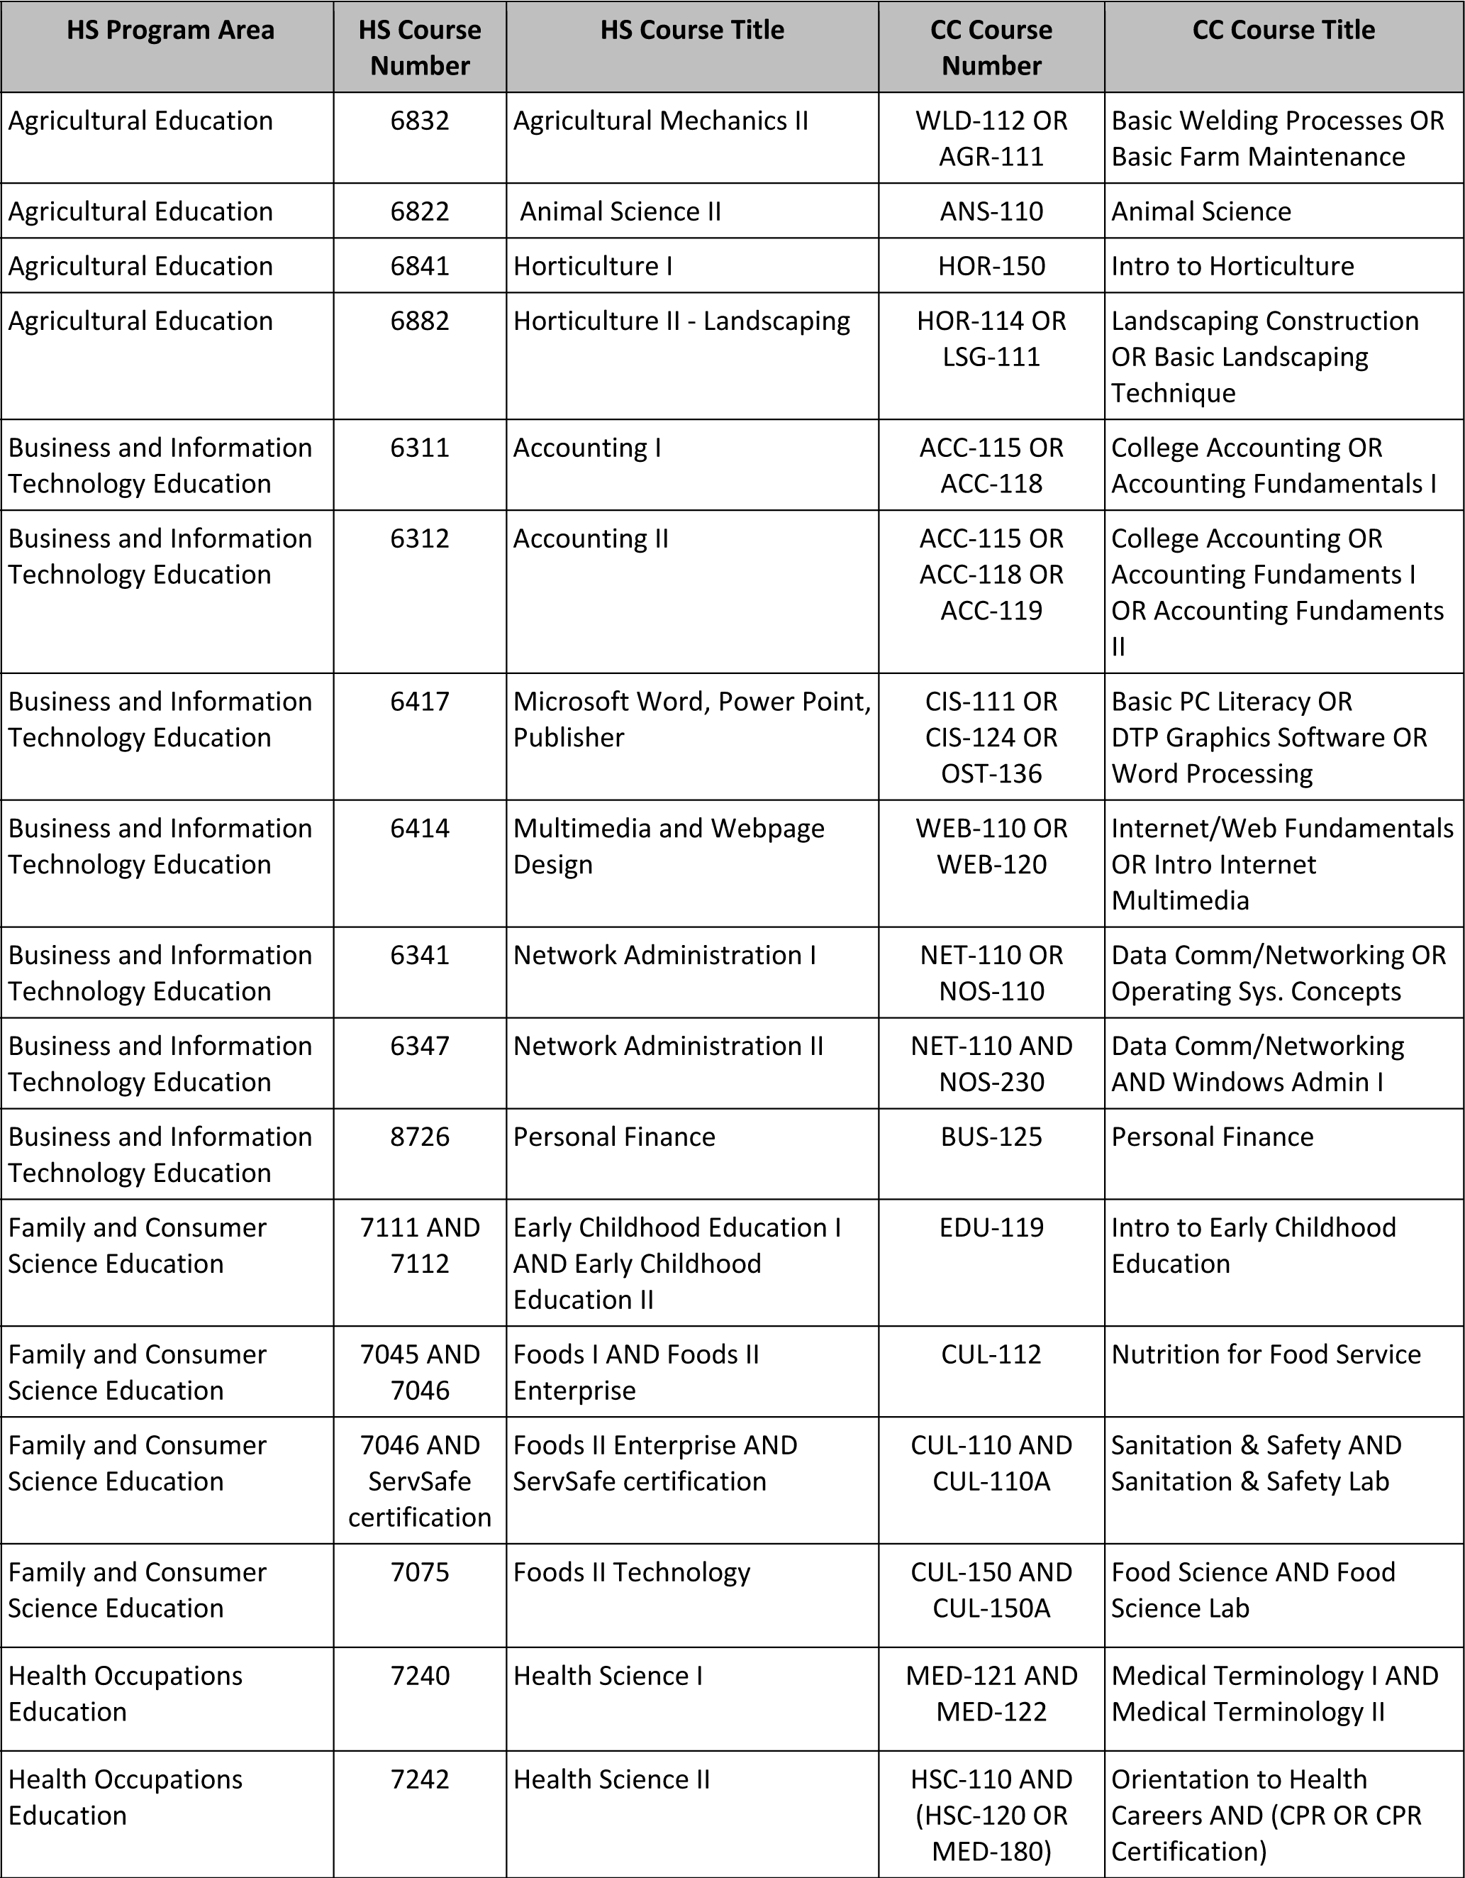
2012 Articulation Agreement
Notes:
Sometimes the proficiency in the high school course leads to a choice of which college course to earn credit -- depending on the academic program you choose at the college.

Slide 28
Criteria to Award Articulation Credit
  Final grade of B or higher in the course
  AND
  A score of 93 or higher on the
  standardized CTE postassessment
Notes:
To earn the articulated credit, the student must earn a final grade of B or higher in the course
and a score of 93 or higher on the CTE postassessment.

Slide 29
Two Different Articulation Agreements
Comprehensive Articulation Agreement Between The University Of North Carolina and The North Carolina Community College System – CAA
North Carolina High School To Community College Articulation Agreement
Notes:
I don’t mean to confuse you, but I do need to point out that there are two different Articulation Agreements.
The Comprehensive Articulation Agreement Between The University Of North Carolina and The North Carolina Community College System – otherwise known as the CAA, is to transfer community college credits to a university. That is not the agreement I am talking about today.
→
I am talking about the North Carolina High School To Community College Articulation Agreement -- where proficiency in high school CTE courses earns community college credit.
===============
CAA
http://www.northcarolina.edu/aa/articulation/index.htm

Slide 30
Benefits to Students & Others
Free college credit
Uses standard high school CTE curriculum
Confidence in doing college-level work
Notes:
I wish I could go back in time and earn college credits for FREE in high school.
One nice thing about this agreement is that these high school courses use the standard CTE curriculum -- that the community colleges have acknowledged is comparable to there’s.
When a student earns articulated credit in high school, it shows that that student is capable of doing college-level work. That student needs to know that -- and be encouraged to continue studies in college.

Slide 31
Field Tests
State-wide CTE postassessment scores are not available.
LEA scales the midterm and final field tests.
Average the midterm and final field test scores to get the combined field test score.
Follow the Process to Document and Award Articulated Credit. (B & 93)
Notes:
There is a special process when we change the postassessment, and it is in field-test status.
=====
http://ctpnc.org/articulation/index.shtml

Slide 32
Articulation Agreement Website
Link on www.ctpnc.org
Soon link on NCDPI/CTE website
Articulated course list
Criteria to award credit
Local articulation agreements
Field tests & other special cases
History of the articulation agreement
Notes:
Right now the easiest way to get to the Articulation Agreement is to go to ctpnc.org and select the Articulation Agreement link.
Soon it will be on the CTE website.

Slide 33
Purpose of School
Work-based Learning
Articulation Agreement
Manufacturing & STEM Careers
www.ctpnc.org/presentations
Notes:
Let’s talk about promoting manufacturing and STEM careers.

Slide 34
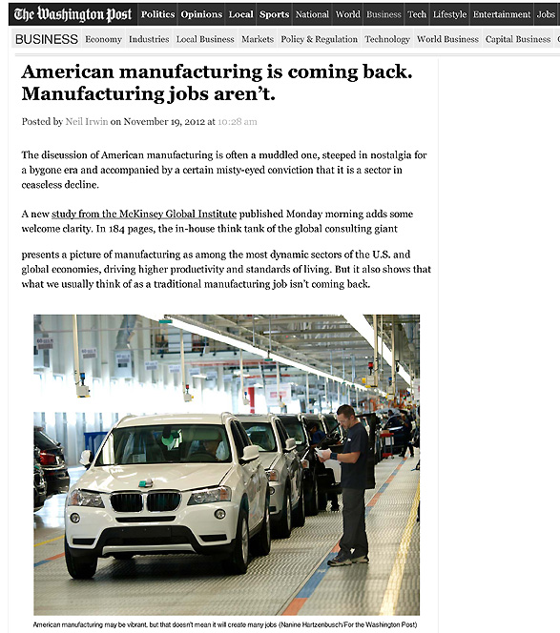
Notes:
As American manufacturing is making its comeback, we find that the old Manufacturing jobs -- that required a strong back and no education -- are not coming back.
=====
http://www.washingtonpost.com/blogs/wonkblog/wp/2012/11/19/american-manufacturing-is-coming-back-manufacturing-jobs-arent/
34

Slide 35

Notes:
So we created the Advanced Manufacturing and STEM Careers Awareness Week, which is coming up soon in April.
It is a joint venture between NC Public Schools and the community college system.
Make sure your students and clients know about these Manufacturing and STEM open houses in April.
They might find they want to redirect their career pathway.
The online calendar of events should be filling up at the end of March, so check it out in early April.
You can access this from the same ctpnc.org website.
======
www.ctpnc.org/manufacturing

Slide 36
Important
Stuff
Chris Droessler,
CTE Support Services Consultant, NCDPI
www.ctpnc.org/presentations
Notes:
Remember to go to the ctpnc.org website to download the PowerPoint.
Do we have time for an activity??
Thank you for your time.
===============
www.ctpnc.org/presentations

Slide 37
Activity
First step to starting or improving your WBL program.
First step to marketing your WBL
program to the students.
Notes:
→
What is the first thing you need to do to start, or to improve, your work-based learning program?
Share this with a neighbor, then we will share with the large group.
→
How do you get the students to want to participate in work-based learning? How do you market your program?

Slide 38
Important
Stuff
Chris Droessler,
CTE Support Services Consultant, NCDPI
www.ctpnc.org/presentations
Notes:
Remember to go to this website to download the PowerPoint.
Do we have time for an activity??
Thank you for your time.
===============
www.ctpnc.org/presentations

Slide 39
Help students discover their passion, then help them get on a pathway where they can turn that passion into a career.
Notes:
Chris Droessler said that.

