Slide 1
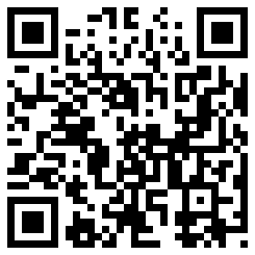
Work-based Learning
Chris Droessler,
CTE Support Services Consultant, NCDPI
www.ctpnc.org/presentations
Notes:
I am Chris Droessler (silent O, no Q)
I am your CTE Support Services consultant at the North Carolina Department of Public Instruction.
If you have a smart phone, and you are smart enough to use it, you can capture that QR code, and your phone takes you to the webpage where you can download a copy of this PowerPoint file.
Or you can just go to ctpnc.org and click on the “presentations” link.
How many of you have already downloaded my presentation??
Today I am going to talk to you about Work-based Learning.
===============
www.ctpnc.org/presentations

Slide 2
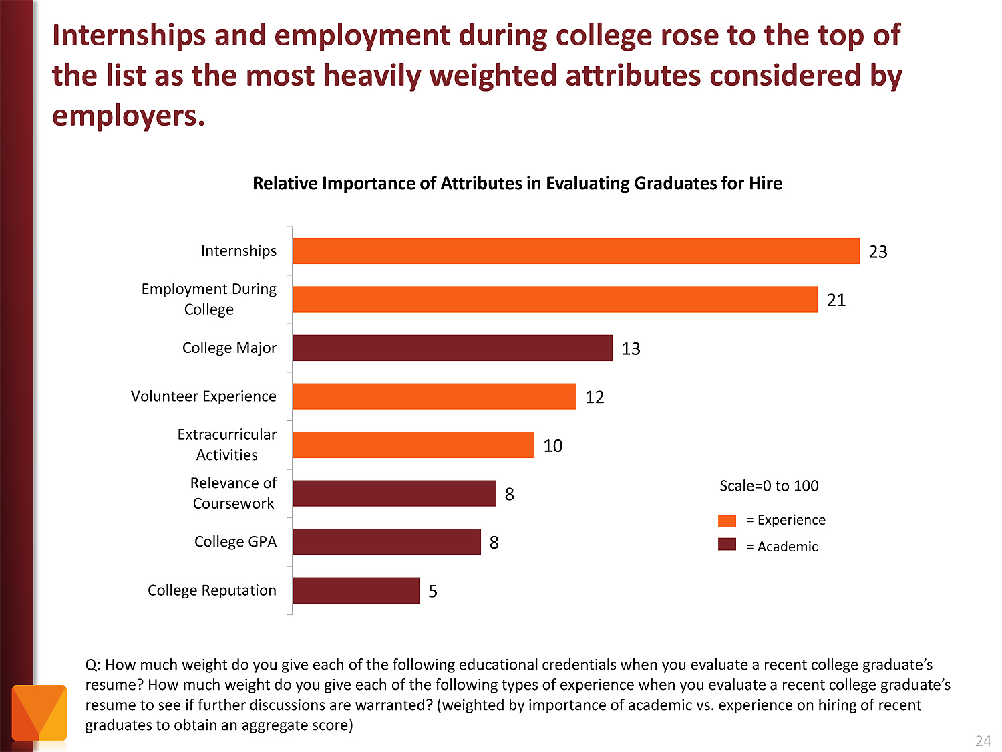
Notes:
Employers value Internships and other employment while in school as more important than college major and GPA.
Even volunteer work and extra-curricular activities are more important to the business community than grades.
======
http://chronicle.com/article/The-Employment-Mismatch/137625/#id=overview
The Employment Mismatch: A College Degree Sorts Job Applicants, but Employers Wish It Meant More
Employers value a four-year college degree, many of them more than ever.
Yet half of those surveyed recently by The Chronicle and American Public Media's Marketplace said they had trouble finding recent graduates qualified to fill positions at their company or organization. Nearly a third gave colleges just fair to poor marks for producing successful employees. And they dinged bachelor's-degree holders for lacking basic workplace proficiencies, like adaptability, communication skills, and the ability to solve complex problems.
The report
The Role of Higher Education in Career Development: Employer Perceptions
http://chronicle.com/items/biz/pdf/Employers%20Survey.pdf

Slide 3


CTE in NC
CTE Coursework
Career Technical Student Organizations (CTSOs)
Work-based Learning (WBL)
Notes:
There are three main components of a quality
Career and Technical Education program.
The most obvious is the coursework where we teach academic and technical skills.
We teach leadership and other soft skills though our CTSOs.
And then there is work-based learning …

Slide 4
Work-based Learning
Goal - get students into the workplace so they can learn about the world of work.
Why - kids need to watch employers work throughout the entire workday in order to learn the many facets of a job.
Vision - students connecting what they are learning in the classroom with what they experience on the job.
Notes:
The goal of work-based learning is to get students into the workplace so they can learn about the world of work.
Kids need to watch employers work throughout the entire workday in order to learn the many facets of a job.
It is hoped that students will connect what they are learning in the classroom with what they experience on the job.
All students participating in work-based learning have a mentor teacher who is responsible for helping them make those important connections between school and work.
Typically, the CDC is the person in the school who is in charge of work-based learning.

Slide 5

Benefit for Students
Application of classroom learning
Connect education and work
Assess interests, aptitudes, abilities
Explore possible careers
Develop positive work habits
Gain professional contacts
Motivation to stay in school
Notes:
Work-based learning benefits everyone.
There are lots of benefits for the students.
Connecting what the kids learn in the classroom -- with what they will be doing when they later enter the workforce -- is essential.
For many kids, work-based learning gives them a reason for staying in school.

Slide 6
Benefit for Employers
Tryout potential employees
Shape potential employees
Reduce recruitment costs
Provide community service
Notes:
Employers get to have a positive impact on their future recruits.
They get to try out workers and see if they want to hire them permanently.

Slide 7

Benefit for Teachers
Improve student motivation to learn in class
Improve teacher’s understanding
of the real world
Networking with subject matter
experts
Find new resources
Notes:
Work-based learning should eliminate many of the -- “Why do we have to learn this?” kind of questions.
Connecting with the business community through students in work-based learning can also help the teacher keep up with the latest trends in the business or industry that they are teaching.

Slide 8
Benefit for Community
Collaboration among school, employers, and community
Build local economy
Foster public confidence in
public schools
Notes:
If work-based learning can keep kids in school and help produce motivated employees, then the whole community wins.
Yes, -- we have the power to change the economy just by getting our students out into the workplace.

Slide 9
Job Shadowing
1 day or less
Student watches worker(s)
Develops awareness of:
  Work
  Variety of jobs
  Work environment
Students@Work
Online shadowing
Notes:
Let’s look at some different types of work-based learning.
Job Shadowing is a short-term educational experience that introduces a student to a particular occupation by pairing the student with an employee of a business, industry, or agency.
By following, or "shadowing" the employee, the student becomes familiar with the duties associated with that occupation, the physical setting of the occupation, and the compatibility of the occupation with his or her own career goals.
Job Shadowing is typically a half or whole day, but could last longer if a student wishes to see every department in a large business.

Slide 10

Long-term WBL
Cooperative Education
Internship
Apprenticeship
Pre-apprenticeship
Notes:
So what’s the difference between these kinds of long-term work-based learning?
From our perspective, the work-based experience could look the same for all of these.
We recently moved the apprenticeship and pre-apprenticeship to work like adding a credential to either internship or cooperative education. More on that in a few minutes.
====
http://gecd.mit.edu/sites/default/files/images/landing/2nd-level-header-image.jpg?1315239382
http://gecd.mit.edu/jobs

Slide 11
Cooperative Ed. vs Internship
Cooperative Education
Internship
Must be tied to a course
Paid
Training Agreement
Training Plan
Journal
135 hours
Add Apprenticeship
Does not have to be tied to a course
Paid or unpaid
Training Agreement
Training Plan
Journal
135 hours
Add Apprenticeship
Notes:
Cooperative Education must be tied to a CTE course, internship does not.
Coop must be paid, internship does not.
The rest of the requirements are the same.

Slide 12
Cooperative Education
Technical classroom instruction combined with paid employment.
Work is directly related to classroom instruction.
Planned by school & employer
Work and class contributes to
student’s career objective.
Connect to almost any CTE
course.
Notes:
Cooperative Education is a method of instruction where technical classroom instruction is combined with paid employment that is directly related to the classroom instruction.
The two experiences must be planned and supervised by the school and the employer so that each contributes to the student's career objective.
School credit is received for both the on-the-job training and the classroom components.

Slide 13

Internship
Students:
  observe and participate in daily operations
  develop direct contact with job personnel
  ask questions about particular careers
  perform certain job tasks
Internships may be paid or unpaid.
Work experience is directly
related to the student’s
career pathway.
Notes:
Through an internship, a student learns by taking on a responsible role as a worker in a company or organization.
The internship allows students to observe and participate in daily operations, develop direct contact with job personnel, ask questions about particular careers, and perform certain job tasks.
The work experience should be directly related to the student’s chosen career pathway.
Internships may be paid or unpaid.
It is not possible to do an internship through self-employment. You must be working under the constant supervision of a supervisor.
Since internship work does not have to be paid, it is possible to do internship hours through …

Slide 14
Service Learning
Since internship does not have to be paid, it is possible to do internship hours through Service Learning.
Doing work that is considered a service to the community and would often
be done by a volunteer.
Students can see a purpose
to their work.
Notes:
… Service learning, which is where students do work that is considered to be a service to the community and would often be done by a volunteer.
Construction students could work for Habitat for Humanity.
Business Ed and Marketing Ed students could work for practically any non-profit organization.
Houses of Worship are a great place to work internship hours. I know one student who did an internship at his church creating a series of videos.
Service learning is great because students can see a purpose to their work and have a good feeling that their work is appreciated and is helping to make the world a better place.
In a traditional work environment, it is sometimes hard to see the fruits of your labor.

Slide 15

Apprenticeship
NC Department of Commerce program.
Combines practical work experiences with related academic and technical instruction.
“Pre-apprenticeship” for
HS students
Can be added to
Internship or
Cooperative Education
Notes:
Apprenticeship is a system of skilled occupational training that combines practical work experiences with related academic and technical instruction.
An apprentice works on the job for an employer and is taught and supervised by an experienced person in the chosen occupation.
This preplanned, progressively challenging work-based learning experience extends for two to four years, depending on the occupation.
Upon completion of the work and the related instruction, the apprentice receives certification as a journeyman in the field.
Apprenticeship programs are registered and monitored by the NC Department of Commerce.
For students who are not ready to make a multi-year commitment, they have a Pre-Apprenticeship program, which can be turned into a Registered Apprenticeship at anytime.
High school students can be in either a pre-apprenticeship or a full registered apprenticeship. The difference is the commitment the student wants to make. A full apprenticeship requires a 3-4 year commitment. Pre-apprenticeship does not.
Any work done in a pre-apprenticeship can be used toward a registered apprenticeship. So a student could start as a pre-apprentice, then later make the commitment to change to a full apprenticeship.
Think of Apprenticeship as a credential that can be added to internships and cooperative education.

Slide 16

Mentorship
Pair student with Mentor
One-to-One relationship
Should include hands-on activities
No required hours
No course credit
Notes:
Mentorship pairs a student with a community professional (mentor) in a one-to-one relationship with the intent of providing first-hand experience in a career field of the student's choice.
Mentors are encouraged to provide as much hands-on experience as possible and to give learners a view of all aspects of the career, including routine tasks, as well as creative and challenging opportunities.
The mentorship differs primarily from an internship experience in that it is a one-to-one relationship and does not require a minimum number of hours.
Mentorship is great for entrepreneurial students or students who are self-employed to learn from an experienced professional.
Just remember - Wax on – wax off.
=====
https://southernadventuress.files.wordpress.com/2012/11/116486.jpg

Slide 17

Credit for WBL
Internships and Cooperative Education can receive academic credit.
  135 hours - block schedule
  150 hours - traditional calendar
Work should occur away from school.
Notes:
Internships and Cooperative Education can receive academic credit based upon the number of hours spent in the workplace.
The minimum hours required to receive 1 credit for students on a block schedule is 135 hours.
For traditional calendars, the minimum is 150 hours.
LEAs may require more hours if they are consistent for both internship and cooperative education.
Students should not receive academic credit for work done at their own school. The work should be done at a business or at another school.
======
http://www.irasmithinc.com/blog/wp-content/uploads/2013/04/bad-credit-credit-report-secured-credit-card-secured-credit-cards-credit-repair-fix-bad-credit-how-to-fix-bad-credit.jpeg
http://www.eventbrite.com/e/credit-repair-bootcamp-build-a-strong-credit-profile-registration-8784610005

Slide 18
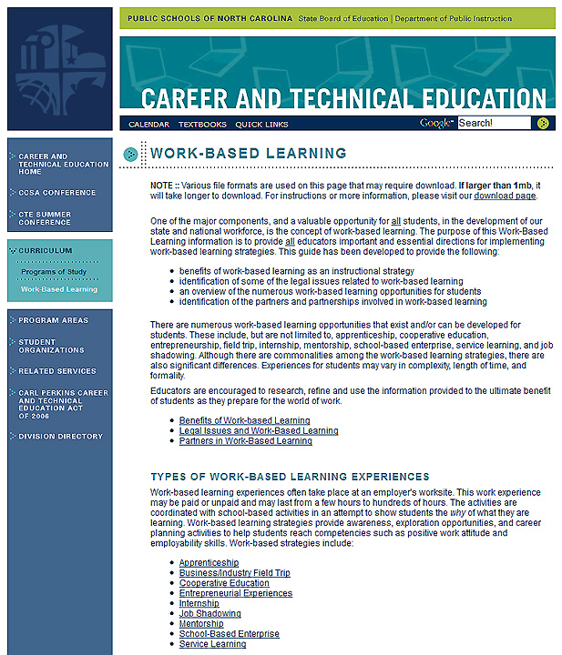
www.ncpublicschools.org/cte/curriculum/work-based
Notes:
If you want to learn more about Work-Based Learning and see all the rules and regulations, you can go to the state Career and Technical Education website.
Select the Curriculum button on the left-side navigation bar.
And then select the Work-Based Learning button that appears below that.
And there in yellow, you see the full web address.
I recently updated and reorganized all of the work-based learning web pages. If you have any questions or suggestions for improvement, please let me know.
======
www.ncpublicschools.org/cte/curriculum/work-based

Slide 19
Work-based Learning
Chris Droessler,
CTE Support Services Consultant, NCDPI
www.ctpnc.org/presentations
Notes:
Remember to go to this website to download the PowerPoint.
Thank you for your time.
===============
www.ctpnc.org/presentations

