Slide 1
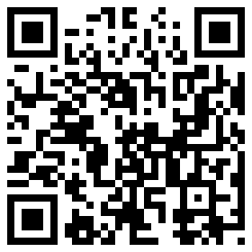
Help Kids Discover Their Passion and Turn it into a Career
Chris Droessler, Consultant, NCDPI
www.ctpnc.org/presentations
Notes:
Good morning. I am Chris Droessler, an education consultant from North Carolina Public Schools.
If you have a smart phone, and you are smart enough to use it, you can capture that QR code, and your phone takes you to the webpage where you can download a copy of this PowerPoint file.
Or you can just go to ctpnc.org and click on the “presentations” link.
That web address is on the handout that you should have received.
How many of you have already downloaded my presentation??
I have documented my information sources in the notes section of the PowerPoint, to allow you to further research anything that you see here.
In fact the notes I’m reading from are there as well.
Download the PowerPoint and use it any way you wish if it will help our children learn. --
We are going to talk today about what gets folks out of bed in the morning with a determination to go to work.

Slide 2
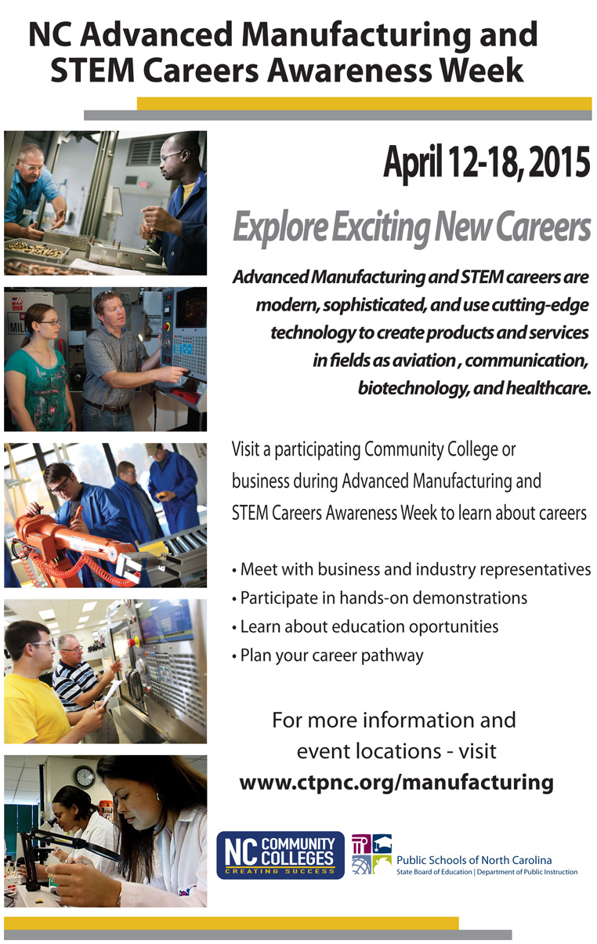
Notes:
Before I get started, let me draw you attention to something about which I am passionate.
You have this on the back of your handout.
North Carolina Advanced Manufacturing and STEM Careers Awareness Week starts in a few days.
It’s a joint venture between North Carolina Public Schools, the Community College System, and the Department of Commerce.
We expect over 60 open houses all across the state helping people learn about the modern careers in Advanced Manufacturing and STEM.
Make sure your students know about these many open houses.
They are not just for high school students, they are for college students and adults who are still refining their career pathway.
======
www.ctpnc.org/manufacturing

Slide 3
NC State Board of Education
Guiding Mission
Every public school student will graduate from high school, globally competitive for work and postsecondary education and prepared for life in the 21st Century.
Notes:
3
3
Here is the state school board mission in North Carolina.
We are all charged with fulfilling this mission.
It’s full of a lot of big words -- talking about things like kids being globally competitive.
Let me show you the simplified version.

Slide 4

Education Plan
All students must graduate from
high school and be career,
college, and citizenship
READY.
Notes:
4
Two years ago, our own state school board paraphrased the mission you see here.
All students must graduate from high school -- and be career,
college, and citizenship ready.
Notice the “and.” That means our mission is to prepare the students entrusted to our care to be ready for all three.
We tend to focus mostly on the college ready -- and don’t seem to place an emphasis on the other two.
I think we can all agree that there is no way to truly prepare our high school graduates to be completely career, college, and citizenship ready. Readiness is formed through our high school experiences with many years of daily life added in. In fact, in my fifties I am still learning how to be career, college, and citizenship ready.
But - If we can take some of what we have learned - and communicate that to our students, it will hopefully make them more ready than we were, which should give them a competitive advantage in this global society.
===
http://legislative.ncpublicschools.gov/resources-for-legislation/2012/20120608-sup-howmeasure.pdf

Slide 5
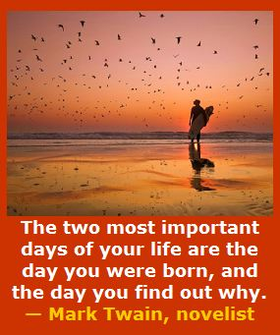
Notes:
Too many people go through life not knowing who they are -- and why they are here.
For some -- the revelation comes late in life.
Today we are talking about helping kids figure out who they are, -- and why they are here.
Somewhere along the road -- all of us found out we were educators -- and we were supposed to be right here –
this morning -- listening to an old shop teacher talk about passion.
========
http://www.goodreads.com/quotes/505050-the-two-most-important-days-in-your-life-are-the
“The two most important days in your life are the day you are born and the day you find out why.”
― Mark Twain
http://www.huffingtonpost.com/karen-ann-kennedy/the-two-most-important-days-of-your-life_b_5229311.html
Photo
http://myincrediblewebsite.com/mark-twain-on-the-days-of-your-life/

Slide 6

What is the Purpose of School?
Learning how to sit in rows.
Learning how to get up and move en masse at the sound of a bell.
Learning how to stay in place for 45-minute increments.
Learning how to override your bodily functions.
Learning how to answer the questions that the person standing in front of the room already knows the answer to.
It’s a training ground for behavioral management.
It’s the place where kids go to watch adults work really hard!
Notes:
It often seems that this is the de facto purpose for school.
--
Do you think that these are the skills the employers are looking for in their new recruits?
But this is what we are teaching our students -- the next generation of world leaders.
Learning these skills will not grow the economy.
=====
http://mindshift.kqed.org/feature/school-day-of-the-future/

Slide 7
The primary aim of education is not to enable students to do well in school, but to help them do well in the lives they lead outside of school.
Elliot W. Eisner
Notes:
Sometimes we get too caught up in how well kids do in school --
and we loose sight of the goal to produce adult citizens who can function well outside of school.
Being able to perform well in school does not always translate in being able to perform well outside of school.
We have to get back to the true purpose of education.
=======
This line is often quoted without any reference. Here are two people who claim the quote and a school district that uses it as their motto.
Elliot W. Eisner
http://www.ascd.org/publications/educational-leadership/dec03/vol61/num04/Preparing-for-Today-and-Tomorrow.aspx
Raymond McNulty
http://unioneagle.com/2012/01/education-leader-challenges-teachers-to-be-different/
Bellevue Community School District
http://bellevue.k12.ia.us/

Slide 8
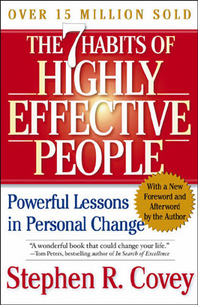
Begin with the
end in mind.
Does education prepare for a career, or the next level of education?
Notes:
One of Stephen Covey’s habits is
“Begin with the end in mind.”
If your goal is a job that you look forward to going to on Monday morning, then you have to do a little planning.
And we need to help kids discover this at an earlier age to compete in this fast-paced world that we created for them.

Slide 9
Discover These
Interests
Skills
Passion
Job market
Lifestyle choice ($$)
Notes:
Here are a few things to discover along the way.
First, we have to discover who we are.

Slide 10
Discover Your Interests
Realistic (Doers)
Investigative (Thinkers)
Artistic (Creators)
Social (Helpers)
Enterprising (Persuaders)
Conventional (Organizers)
Notes:
I hope you are all familiar with the Holland Codes or Holland Types.
Most folks fall into one or more of these categories.
It is not just using a computer to match you to a career, it’s finding out who you are, and realizing that you are not good at everything, and that’s OK.
(handout)
Once you have discovered who you are through an interest assessment, then you can start looking at the careers that match your interests.
FYI – I am naturally Realistic and Conventional, though I have learned how to function well in the other areas.
======
http://en.wikipedia.org/wiki/Holland_Codes

Slide 11
Discover Your Skills
Basic Skills (three Rs)
Problem Solving Skills
Resource Management Skills
Social Skills
Systems Skills
Technical Skills
Notes:
Most people do not know what skills they possess until they have had work experiences.
Arts Education courses, and Career and Technical Education courses in middle school and high school are a great place to test out these skills without making a formal work commitment.
You will not know you have a skill in some area until you try it out.
======
http://www.onetonline.org/skills/

Slide 12
Fastest Growing Occupations in NC
Requiring Postsecondary Education
(Total Change in Positions Projected from 2010 - 2020)
17,250 Registered Nurses
9,930 Postsecondary Teachers
8,640 Elementary School Teachers, Except Special Education
4,400 Accountants and Auditors
4,160 Middle School Teachers, Except Special and Career/Technical Education
3,870 Teachers and Instructors, All Other
3,830 Market Research Analysts and Marketing Specialists
3,730 Business Operations Specialists, All Other
3,360 Physicans and Surgeons
3,240 Secondary School Teachers, Except Special and Career/Technical Education
3,100 Police and Sheriff's Patrol Officers
3,010 Medical Secretaries
2,860 Emergency Medical Technicians and Paramedics
2,530 Paralegals and Legal Assistants
2,430 Heating, Air Conditioning, and Refrigeration Mechanics and Installers
2,280 Medical Scientists, Except Epidemiologists
2220 Special Education Teachers, Preschool, Kindergarten, and Elementary School
2210 Firefighters
2120 Computer Systems Analysts
2110 Human Resources, Training, and Labor Relations Specialists, All Other
1980 Lawyers
1920 Construction Managers
1920 Information Security Analysts, Web Developers, and Computer Network Architects
1830 Network and Computer Systems Administrators
1770 Dental Hygienists
Notes:
12
You also have to know the job market.
(handout)
The world of work is changing much more rapidly than decades ago, so you have to keep up with the occupation demand projections and the latest trends in work.
If you want to be a nurse, there should be no problem finding a job over the next ten years. Same for teachers, which are split out here into several categories.
If you discover your special skill is threading a textile loom, then you might want to keep looking for a career.
Or figure out how to get robots to make textiles faster, cheaper, and better.
=========
These data are from www.CareerOutlook.US
http://www.bls.gov/emp/ep_table_112.htm
Education and training assignments
updated January 13, 2012

Slide 13

Notes:
We are here today -- to talk about passion.
=====
http://hypnoticmystery.deviantart.com/art/Passion-Wallpaper-179848193

Slide 14
Passion – dictionary definition
any powerful or compelling emotion or feeling, as love or hate.
6. a strong or extravagant fondness, enthusiasm, or desire for anything: a passion for music.
7. the object of such a fondness or desire.
Notes:
I left out a few definitions that apparently referred to romance novels.
Although, -- writing romance novels could be a career, --
it is not what we are discussing here today.
I like helping people –
That’s one of my passions.
That is why I am here today.
=====
http://dictionary.reference.com/browse/passion?s=t

Slide 15
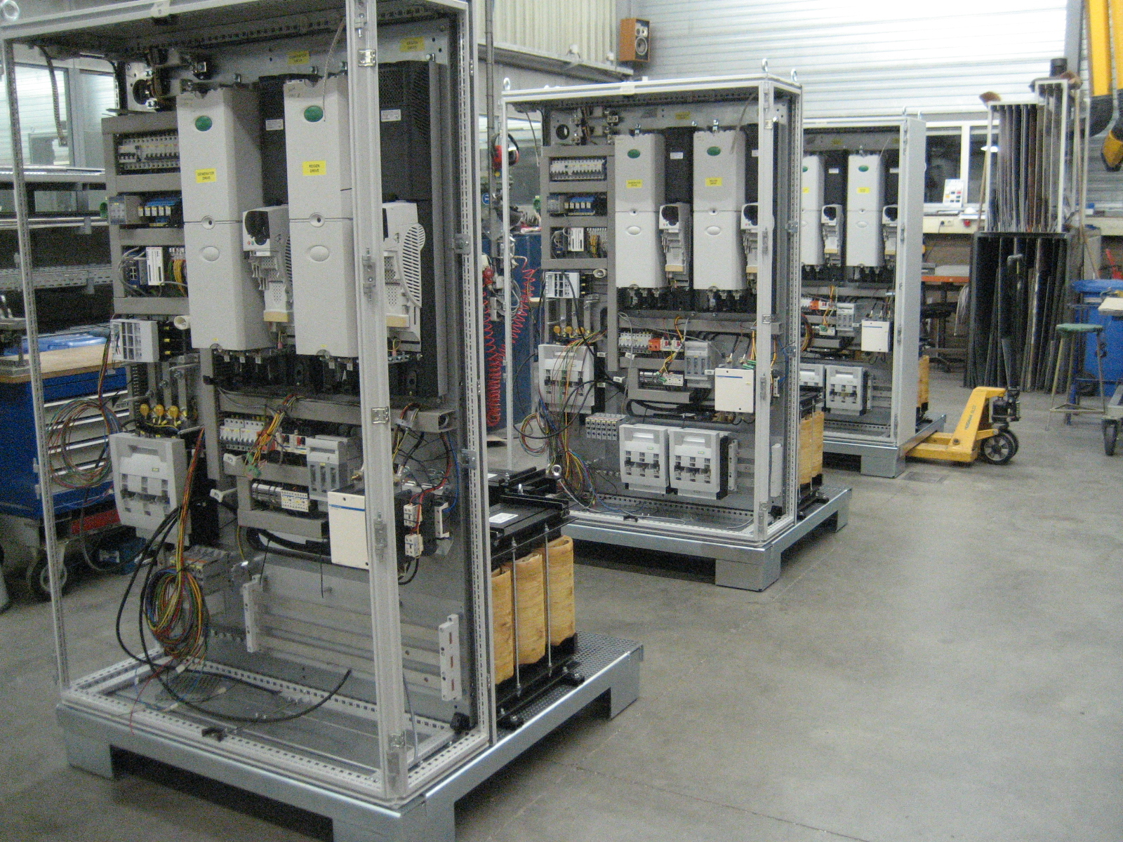
College is the Next Step ?
Notes:
Right out of of high school -- I was at NC State University for 11 years as a undergraduate in Electrical Engineering.
I never got a degree in Electrical Engineering.
I was there because I was good at math and built kits from Radio Shack.
Looking back, I realize that I did not at the time really know what an Electrical Engineer did, -- and to the best of my knowledge I never met an electrical engineer.
I was in college because it was the next thing on the list of things that my family expected me to complete.
Electrical Engineering was never my passion, and at the time, I had no idea what passion was and had no desire to get one.
=====
http://seetech-corp.com/engineering/electrical-engineering/

Slide 16

Notes:
=====
http://thepassiontest.com/wp-content/uploads/2013/07/a-passion-your-life-passion-in-life.jpg

Slide 17
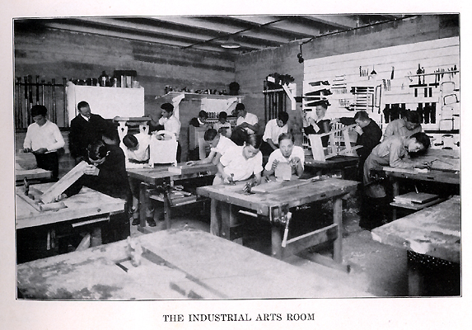
Notes:
I ended up getting a degree in Industrial Arts Education.
I got a bachelor’s degree because it was the next thing on my list.
Now that that was complete – What was next?
I had a lot of part time jobs over the years, and enjoyed parts of them.
I liked working with my hands -- building and repairing things, -- but did not know that that was a passion or even a career.
It was just what I liked to do.
Which is what passion is all about, What do you like to do?
What do the children with whom you work like to do?
=====
http://www.rootsweb.ancestry.com/~innwigs/ImageArchive/LibertyTownship/LibertyTwpPorterCoIndiana-LibertyCenterHighSchool-IndustrialArtsRoom-1931-SS.jpg

Slide 18
Passion in the Classroom
Rigor
Relevance
Relationships
Notes:
We all know the three Rs
Rigor, Relevance, and Relationships.
Let’s talk briefly about Relationships

Slide 19
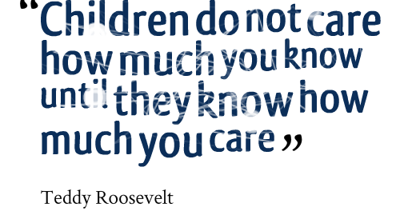
Notes:
Do the kids know you care?
Can they tell that you are passionate about teaching,
and that you are there to help them to grow as a person?
====
http://www.imagesbuddy.com/images/168/children-do-not-care-how-much-you-know-until-they-know-how-much-you-care.png

Slide 20
Passion in the Classroom
Rigor
Relevance
Relationships
Notes:
Today I am talking about forming a great relationship with your students so you can help make their education relevant.

Slide 21
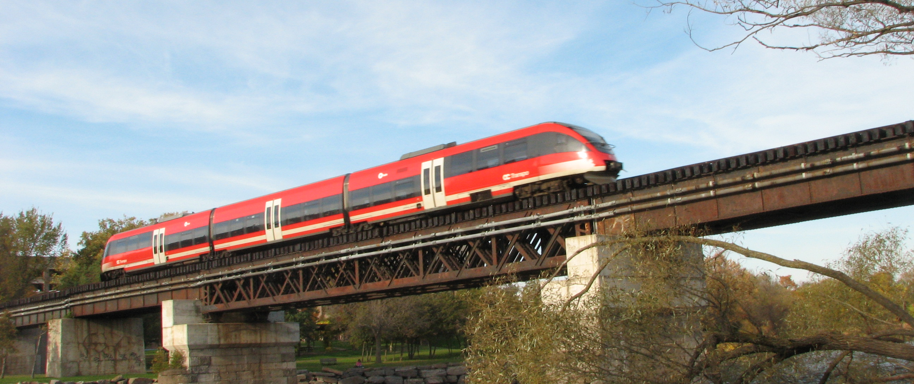
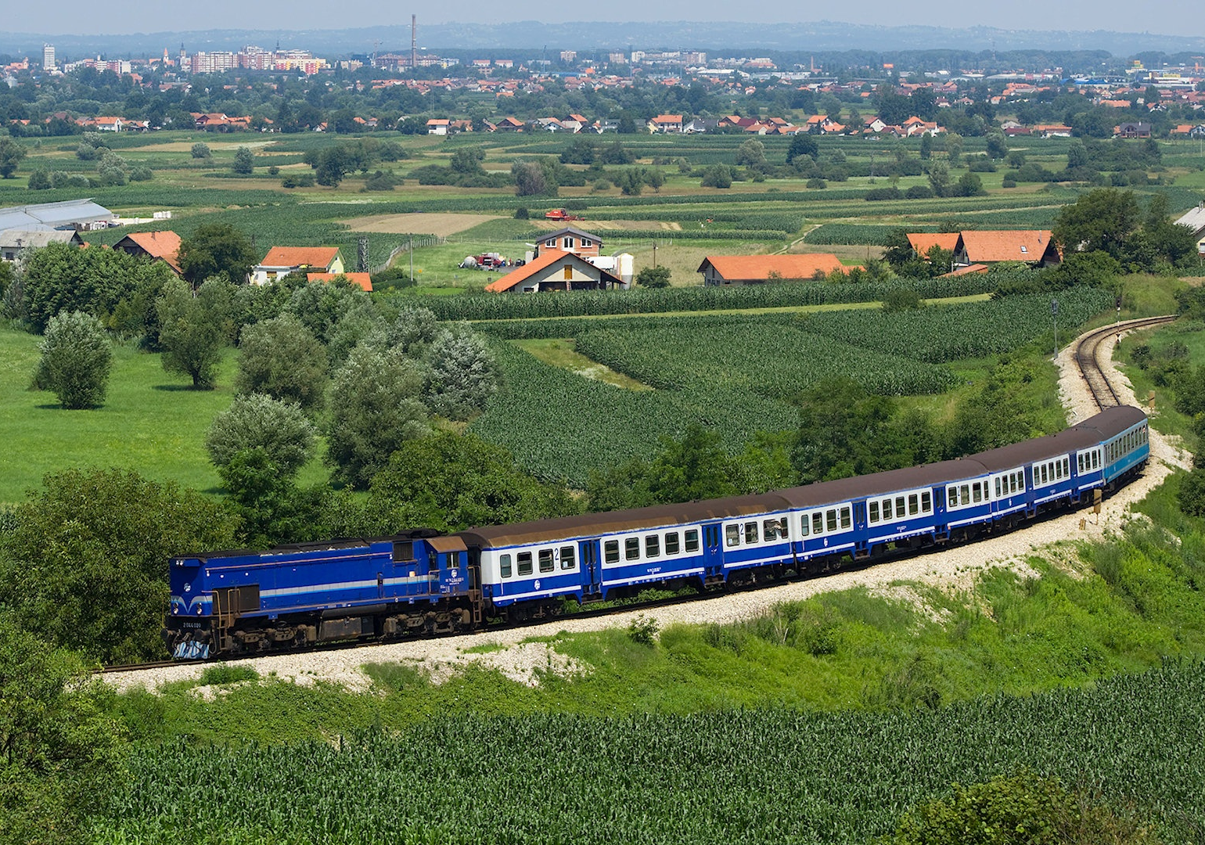
Notes:
A train going East from Chicago and another train going West from New York meet somewhere in between.
You remember that from when you learned algebra?
Those were the word problems the educators created to make math real, but it was not a real real.
Problems like this are a fake real.
How many of you have ever applied this example to your real life?
This is not really relevant. Nobody cares what the answer is.
This is a word problem, but not a real one, not relevant to the student.
======
http://www.cat-bus.com/wp-content/uploads/2013/04/O_Train_over_Rideau_by_Wilder.jpg
http://hosuronline.com/home/wp-content/uploads/2013/05/Train.jpg

Slide 22
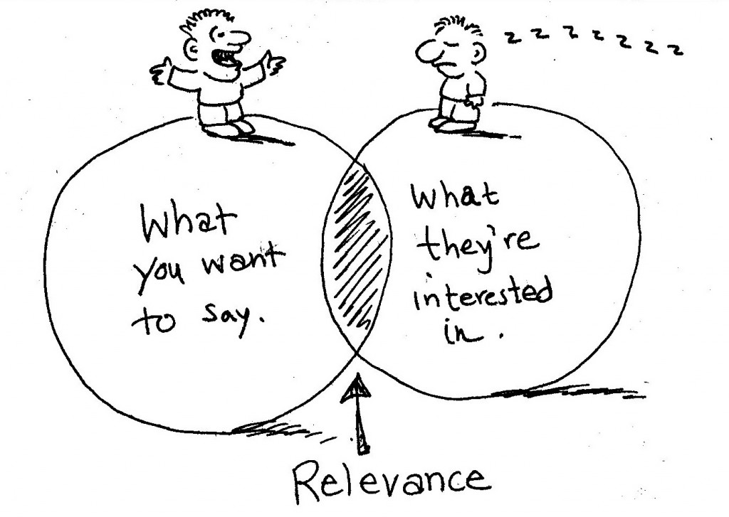
Notes:
It’s a fine balance between what you want to say
(that is - teaching the curriculum),
and in what the kids are interested.
That is the small world of Relevance.
======
http://www.fordyceletter.com/wp-content/uploads/2010/11/relevance1-1024x727.jpg

Slide 23
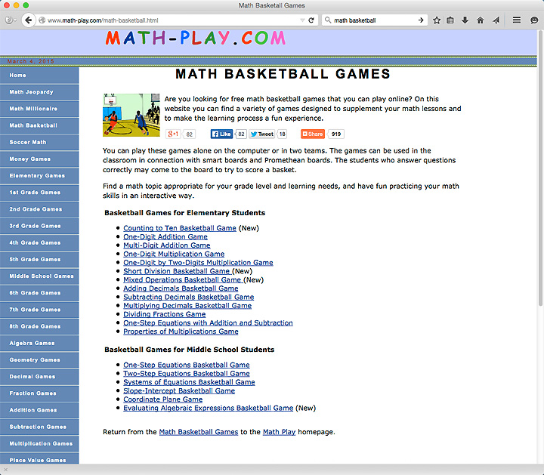
Notes:
For the kids who have a passion for basketball,
here is a website that relates basketball to math.
Does anyone remember in the movie Big, where Tom Hanks taught another kid math using basketball shot percentages.
He made it real.
He made it relevant.
The other kid learned percentages.
====
http://www.math-play.com/math-basketball.html

Slide 24
Algebra
If X=600
Y(X)=2400
2400/600 = 4
4(600) = 2400
Notes:
Basic Algebra
Boring stuff as it sit here on the screen.
Four times six hundred equals twenty four hundred.
So what?
====

Slide 25

Notes:
But if you took your students to the school auditorium and looked at how many stage lights can be connected to a single dimmer channel, you might find that the boring algebra has new meaning. And your theatre students might just start paying attention.
We are still talking basic algebra,
yet now we have placed it in the context of a real life problem. Not trains moving East and West.
Well, Dr. Sheldon Cooper would like a good train problem, but most of us would not.
====
http://www.hapihour.org/wp-content/uploads/2014/04/feature-light-track-lighting-home-lighting-lighting-design-tiny-stage-lighting-design-a-practical-guide-theatrical-lighting-design-jobstheatre-lighting-design-job-descriptiontheatrical-lighting.jpg

Slide 26
Theatre Algebra
If X=600
Y(X)=2400
2400/600 = 4
4(600) = 2400
600W per light
Y(X)=2400W per dimmer
2400/600 = 4 lights per dimmer
4(600W) = 2400W
But 80% of 2400 is 1920, so 3 lights.
Notes:
Theater Algebra
Using that same algebra problem to calculate the number of stage lights you can put on one dimmer circuit.
600 watts is a typical power draw for a stage light.
Some can be thousands of watts.
A typical dimer can power up to 2400 watts of lights.
We typically do not load a light dimmer past 80% of it’s rated capacity. That’s more math.
Straight algebra says you could put four of these lights on a single dimmer, -- but in reality you would not want to put more than three lights on the dimmer.
Here we are connecting math and physics with reality.
How does this relate to your house? Or the house the students will own someday?
How big of an extension cord do you need to power certain electrical devises.
Coffee pots, hair dryers, curling irons, space heaters can use a lot of power. Put two of those on a single circuit and you can trip a breaker. Put them on a too-small extension cord and the cord can melt -- causing a fire.
====

Slide 27

Notes:
How many holiday lights can you power off one circuit?
This is real algebra that can keep your house from burning to the ground.
Make it real for the kids, and they will want to learn.
If you teach a core subject, connect with the elective teachers in The Arts and Career and Technical Education and see where what you are teaching can relate to what they are teaching.
====
http://stevegarufi.com/xmaslights6.jpg

Slide 28
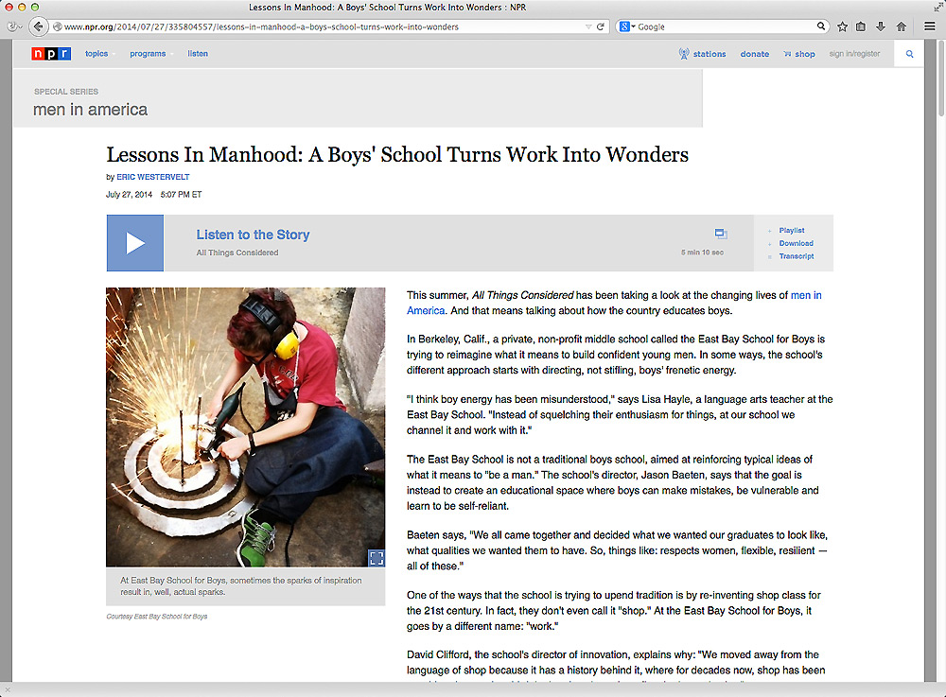
Notes:
I’ve seen a few studies that look into the way we teach boys -- squelching their enthusiasm.
We should be building on their enthusiasm, not squelching it.
=====
http://www.npr.org/2014/07/27/335804557/lessons-in-manhood-a-boys-school-turns-work-into-wonders
Lessons In Manhood: A Boys' School Turns Work Into Wonders
This summer, All Things Considered has been taking a look at the changing lives of . And that means talking about how the country educates boys.
In Berkeley, Calif., a private, non-profit middle school called the East Bay School for Boys is trying to reimagine what it means to build confident young men. In some ways, the school's different approach starts with directing, not stifling, boys' frenetic energy.
"I think boy energy has been misunderstood," says Lisa Hayle, a language arts teacher at the East Bay School. "Instead of squelching their enthusiasm for things, at our school we channel it and work with it.”
The East Bay School is not a traditional boys school, aimed at reinforcing typical ideas of what it means to "be a man." The school's director, Jason Baeten, says that the goal is instead to create an educational space where boys can make mistakes, be vulnerable and learn to be self-reliant.
Baeten says, "We all came together and decided what we wanted our graduates to look like, what qualities we wanted them to have. So, things like: respects women, flexible, resilient -- all of these.”

Slide 29
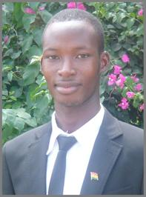
Israelmore Ayivor
“Passion is different from interest. Those who are just interested in things have the wish, but passionate people have the will.”
Israelmore Ayivor
Dream Big!: See Your Bigger Picture!
Notes:
Are your kids just interested in passing the class –
or do they have the will to really learn?
====
http://www.goodreads.com/quotes/tag/passionate-people

Slide 30
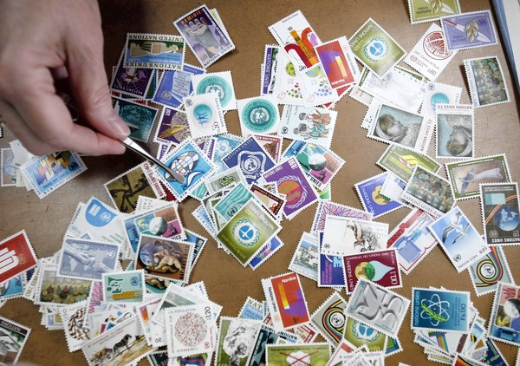
Notes:
Stamp collectors can not help but learn geography.
See if you can tie the stamps to world events in a social studies class.
What about Geometry class? – not all stamps are rectangles.
What about the Ratios of the height to the width?
Math – each stamp with different values and different currencies.
Create a pen pal to share stamps and swap stories.
Do we still call them pen pals?
And do the kids today even know about stamps?
I guess now days you could attach a photo of a stamp to a text message and send that anywhere in the world. But why are the kids looking at stamps anyway. This worked in our time, but probably not for this next generation.
For me, when I hear counties mentioned on the news, I know where they are -- because I collected stamps.
I was globally aware before Global Awareness was cool.
====
http://3.bp.blogspot.com/-jEns7kUvrzI/TtEwNIBWlOI/AAAAAAAAAXk/0QdtM6lrREQ/s1600/66193040.jpg

Slide 31

How We Can Connect School Life to Real Life
Notes:
We’ve created nice little silos of learning in our schools based on single subjects so our test scores can show the bean counters that learning is happening.
But learning for what?
How is learning how to do well in school preparing kids for the workplace?
====
http://blogs.kqed.org/mindshift/2012/10/should-kids-schoolwork-impact-the-real-world/attachment/78329346/

Slide 32
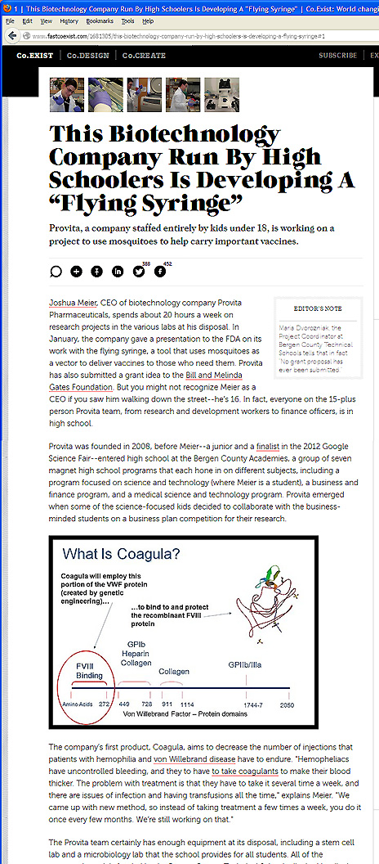
Notes:
You know how mosquitos can spread malaria and other diseases?
Here is a company comprised of kids under the age of 18 who are going to get the mosquitos to instead carry vaccines.
Imagine being able to vaccinate an entire village without a single syringe?
Their first goal is to combat the West Nile Virus.
Some high school student decided this was something they cared about -- and decided to come up with a solution.
A passion to help folks in another country.
=====
http://www.fastcoexist.com/1681305/this-biotechnology-company-run-by-high-schoolers-is-developing-a-flying-syringe#1

Slide 33
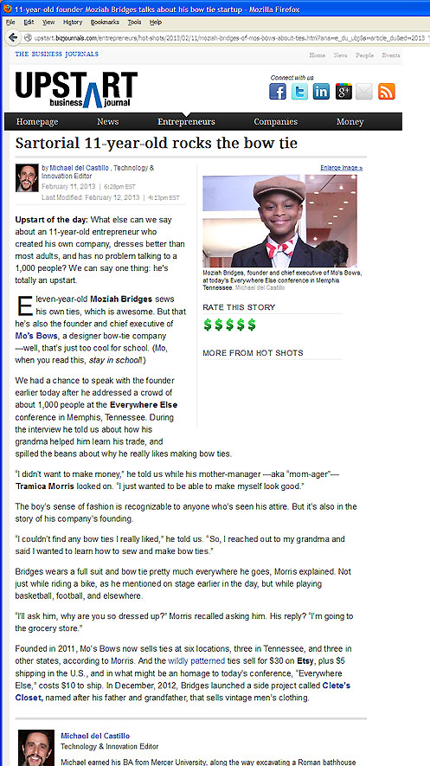
Notes:
Here is an 11-year old kid who couldn‘t find the kind of bowties that he wanted to wear, so he got his grandmother to teach him how to make his own.
Now his ties are sold at six stores in multiple states.
A passion for wearing stylish bow ties.
It takes math skills to layout the patterns, and more math skills keeping the business going.
=====
http://upstart.bizjournals.com/entrepreneurs/hot-shots/2013/02/11/moziah-bridges-of-mos-bows-about-ties.html?ana=e_du_ubj&s=article_du&ed=2013-02-12&page=all
Sartorial 11-year-old rocks the bow tie
February 11, 2013

Slide 34
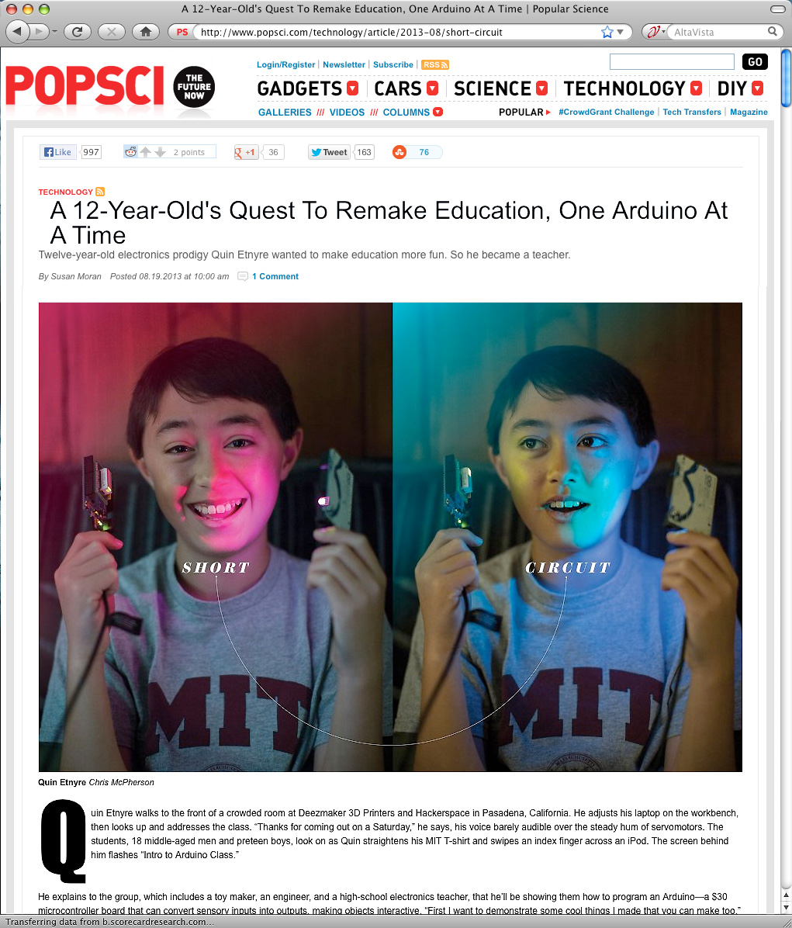
Notes:
An Arduino is a small circuit board with a microprocessor that can be used to build almost anything.
Here is a 12-year old who has unleashed the potential and is building useful products.
======
http://www.popsci.com/technology/article/2013-08/short-circuit
A 12-Year-Old's Quest To Remake Education, One Arduino At A Time

Slide 35
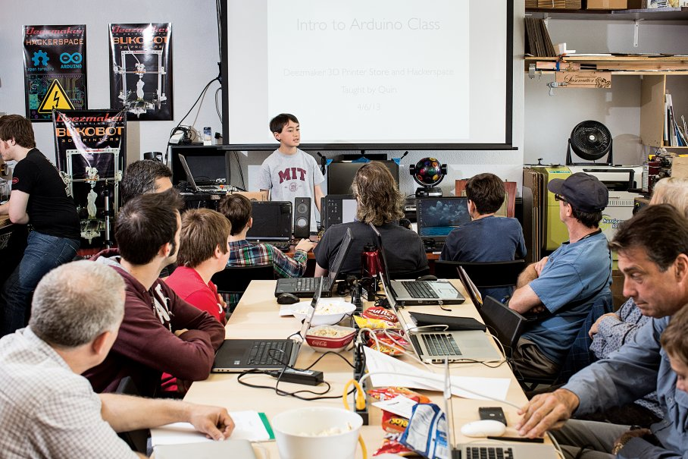
Notes:
Here is that 12-year old teaching a class on a Saturday morning to people that want to learn how to make and program things with the Arduino microprocessor.
He has a passion for creating new things and a passion for sharing his knowledge with others. Maybe he will end up as a professor at MIT someday.
======
http://www.popsci.com/technology/article/2013-08/short-circuit
A 12-Year-Old's Quest To Remake Education, One Arduino At A Time

Slide 36

Notes:
This is not my passion, but it may be yours.
Or one of the kids with whom you are working.
I do see a lot of physics at work here.
========
http://www.peppervirtualassistant.com/blog/wp-content/uploads/2011/05/passion-for-work-pepper-virtual-assistants-300x212.jpg

Slide 37
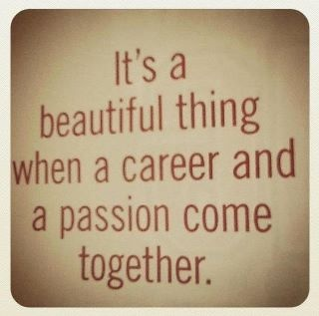
Notes:
======
http://prettyinpaisley.files.wordpress.com/2013/05/blogimage-2.jpg

Slide 38
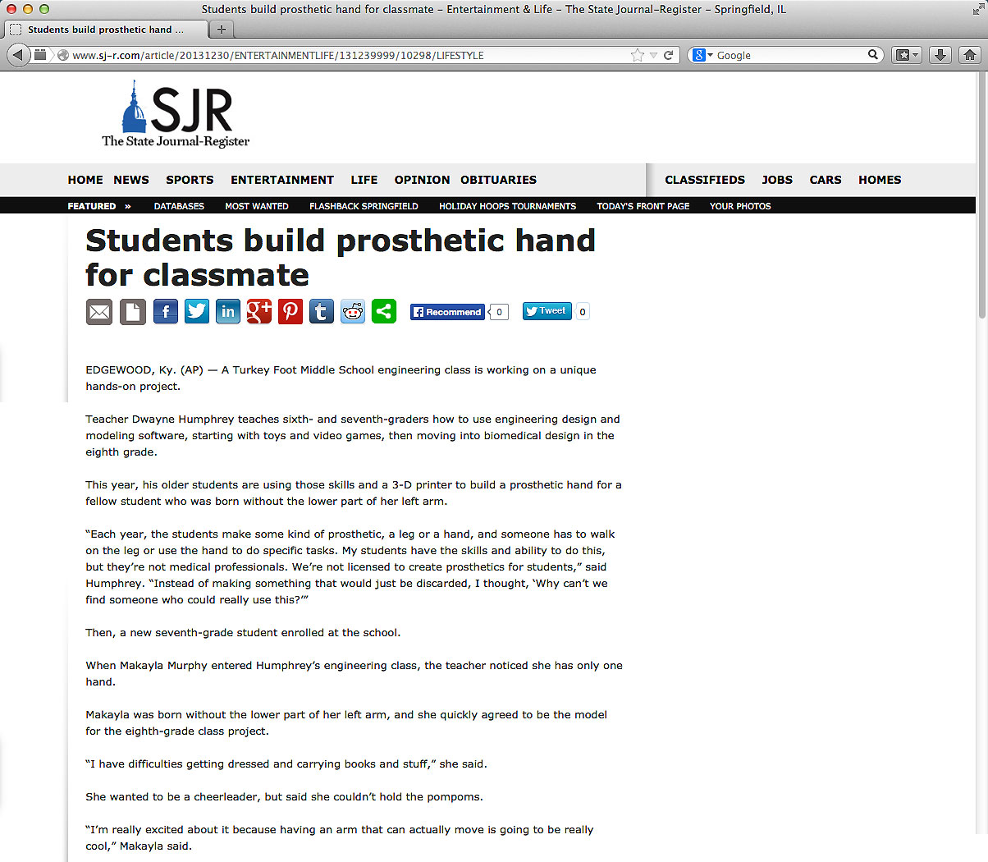
Notes:
Here is a middle school engineering class that is designing a prosthetic hand for a classmate –
who wants to be a cheerleader, --
but couldn’t hold the pompoms.
A passion for helping a fellow student, which in turn makes this engineering class more relevant for the students.
====
http://www.sj-r.com/article/20131230/ENTERTAINMENTLIFE/131239999/10298/LIFESTYLE
Students build prosthetic hand for classmate
By Amy Scalf
The Kentucky Enquirer
Posted Dec. 30, 2013 @ 9:50 pm
Dec 30, 2013 at 11:27 PM
EDGEWOOD, Ky. (AP) — A Turkey Foot Middle School engineering class is working on a unique hands-on project.
Teacher Dwayne Humphrey teaches sixth- and seventh-graders how to use engineering design and modeling software, starting with toys and video games, then moving into biomedical design in the eighth grade.
This year, his older students are using those skills and a 3-D printer to build a prosthetic hand for a fellow student who was born without the lower part of her left arm.
“Each year, the students make some kind of prosthetic, a leg or a hand, and someone has to walk on the leg or use the hand to do specific tasks. My students have the skills and ability to do this, but they’re not medical professionals. We’re not licensed to create prosthetics for students,” said Humphrey. “Instead of making something that would just be discarded, I thought, ‘Why can’t we find someone who could really use this?’”
Then, a new seventh-grade student enrolled at the school.
When Makayla Murphy entered Humphrey’s engineering class, the teacher noticed she has only one hand.
Makayla was born without the lower part of her left arm, and she quickly agreed to be the model for the eighth-grade class project.
“I have difficulties getting dressed and carrying books and stuff,” she said.
She wanted to be a cheerleader, but said she couldn’t hold the pompoms.
“I’m really excited about it because having an arm that can actually move is going to be really cool,” Makayla said.
“We’re on a journey here. We don’t know how it’s going to end. We do know we’re going to give it our best effort and it’s coming together pretty nicely,” said Humphrey. “It’s incredible how quickly things are changing. As we look into the future, we realize we haven’t seen anything yet.”
He also said the project has sparked a special interest among the students.
“Middle-schoolers want to influence the world and they get frustrated over lack of control in their lives. With this project, they get to change someone’s real life. There’s a real opportunity in class to design lessons that have real-world connections,” Humphrey said. “Around the world, kids between the ages of 11-14 are adding to the well of human knowledge and invention. We’re trying to engage students in work that is meaningful.”
Josh Suedkamp and Malachi Pike said that’s exactly why they like this project.
“It’s better because you’re actually affecting someone’s life,” said Malachi. “It’s cool because it helps a real person and it’s not just a school project.”
“I think we’re setting the right kind of tone to really get kids to consider their future careers and giving opportunities to research many of them,” Humphrey said. “Hopefully, we’ll spark something great.”
Read more: http://www.sj-r.com/article/20131230/ENTERTAINMENTLIFE/131239999/10298/LIFESTYLE#ixzz2pGvV3D3y

Slide 39
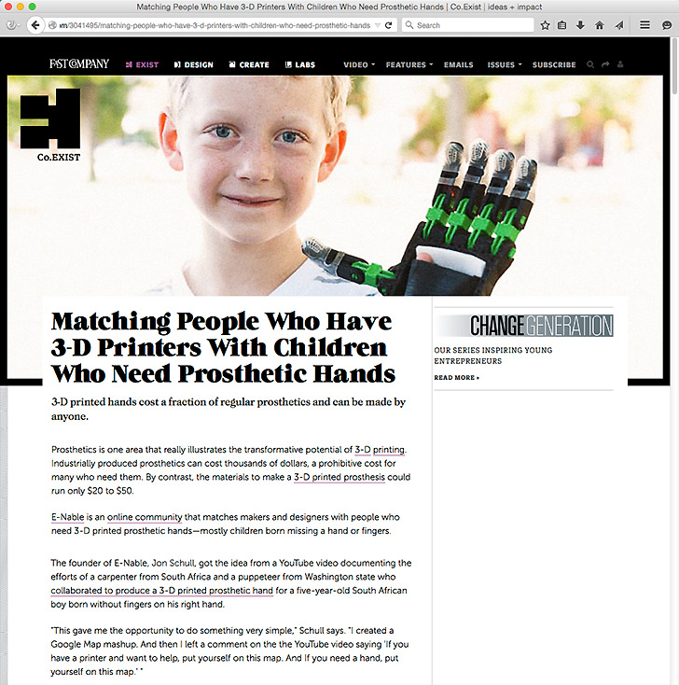
Notes:
Another story about making hands for kids who don’t have them.
=====
http://www.fastcoexist.com/3041495/matching-people-who-have-3-d-printers-with-children-who-need-prosthetic-hands
Matching People Who Have 3-D Printers With Children Who Need Prosthetic Hands
3-D printed hands cost a fraction of regular prosthetics and can be made by anyone.
Prosthetics is one area that really illustrates the transformative potential of 3-D printing. Industrially produced prosthetics can cost thousands of dollars, a prohibitive cost for many who need them. By contrast, the materials to make a 3-D printed prosthesis could run only $20 to $50.
E-Nable is an online community that matches makers and designers with people who need 3-D printed prosthetic hands—mostly children born missing a hand or fingers.
The founder of E-Nable, Jon Schull, got the idea from a YouTube video documenting the efforts of a carpenter from South Africa and a puppeteer from Washington state who collaborated to produce a 3-D printed prosthetic hand for a five-year-old South African boy born without fingers on his right hand.
"This gave me the opportunity to do something very simple," Schull says. "I created a Google Map mashup. And then I left a comment on the the YouTube video saying 'If you have a printer and want to help, put yourself on this map. And If you need a hand, put yourself on this map.' "
From that straightforward beginning 18 months ago, E-Nable has grown dramatically, with some people volunteering nearly full-time hours to coordinate the network. Schull estimates that the 3,500 members of the E-Nable community have printed and given away over 800 prosthetic hands and limbs to children in need.
Some volunteers are maker enthusiasts with 3-D printers in their homes. Others are designers, occupational therapists, and prosthetists. With their combination of skills and the adaptability of 3-D printed designs, volunteers are able to remotely collaborate to create custom prosthetics tailored for each individual
Nonetheless, Schull said he was surprised to see how many needs could be met by just their one basic model.
"In principle, every maker can tweak the design. That was our original inspiration," he says. "In truth, I'd say that 80% of the inquiries that come our way will work with a fairly standard prosthetic. So we have volunteers who are covering the general cases and volunteers who can work on those special cases."
E-Nable's next step is to expand globally. While there are members of the community from around the world, the vast majority of hands delivered so far have gone to children in the United States.
"Most of the cases we've served so far are the people who have heard about us," says Schull. "That tends to be parents of middle class children in stable environments mostly in the United States and to some extent in Europe. That is a small percentage of the population. And in some ways those guys are already among the luckiest people in the history of humanity."
As a first foray along those lines, a group of E-Nable volunteers traveled to Haiti in December to meet with prosthetists at the Hospital Albert Schweitzer in Descapelles, which provides health care to an underserved rural population. The volunteers also met with a maker space in Port au Prince and shared ideas on how to create functional 3-D printed prosthetics.
"There is a huge need among under-served populations around the world for inexpensive, robust prosthetics," says Schull.

Slide 40
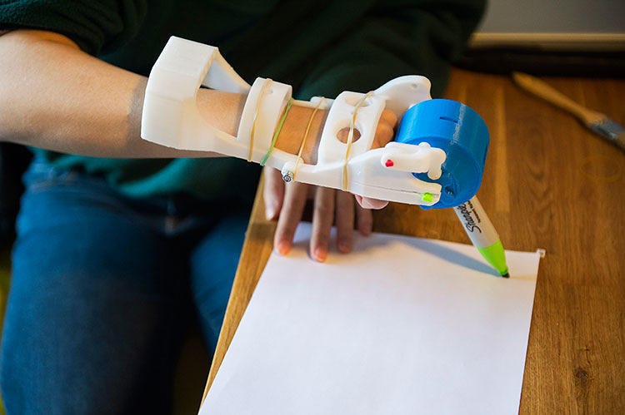
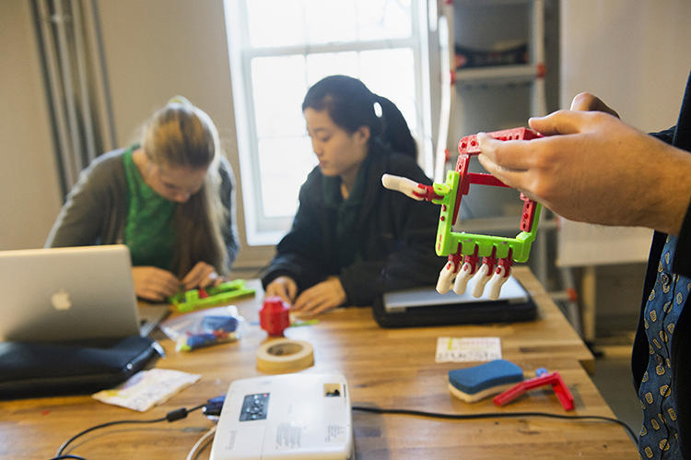
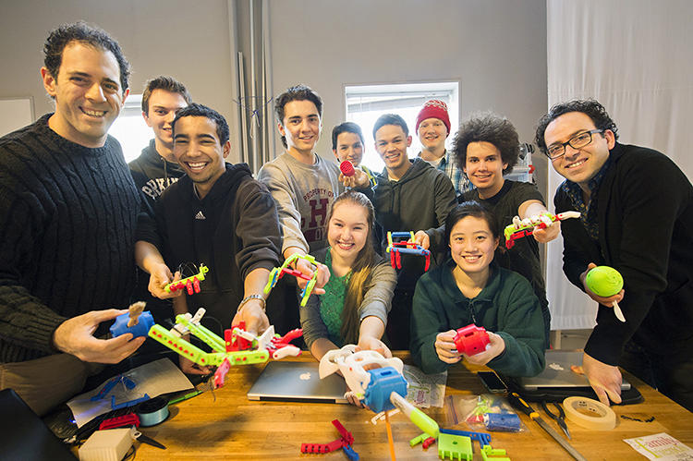
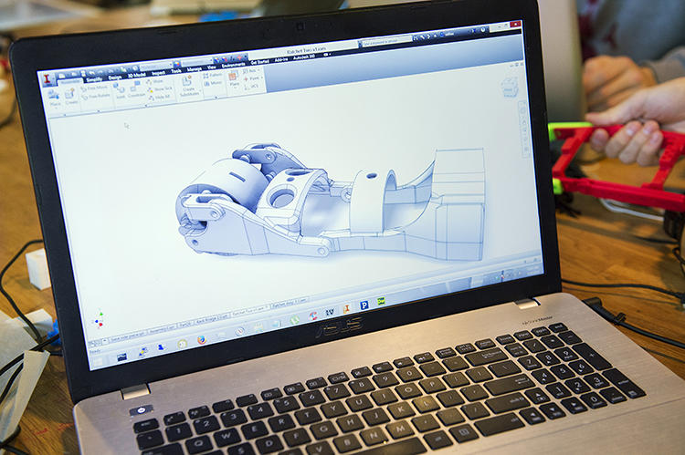
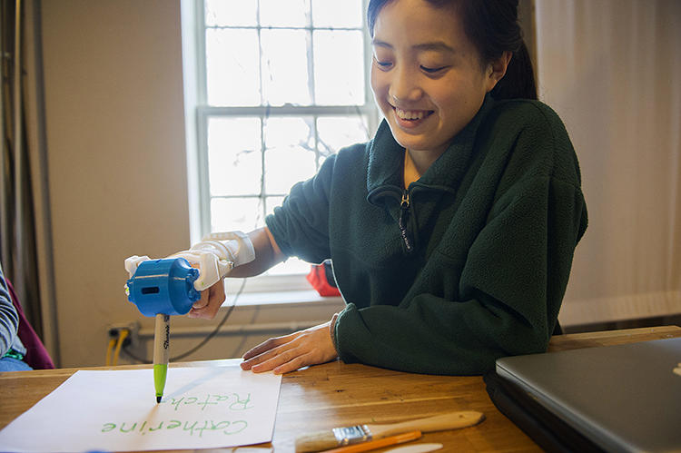
Notes:
Here are the students making hands.
It’s not just about learning engineering principles in class.
It’s about what you can do with the engineering –
that motivates the kids.
It’s not just learning for the sake of learning –
and regurgitating that knowledge on a test.
These kids want to learn –
because they see a tangible result for the acquisition of knowledge.
====
http://www.fastcoexist.com/3027325/these-amazing-prosthetic-hands-were-built-by-high-school-students

Slide 41
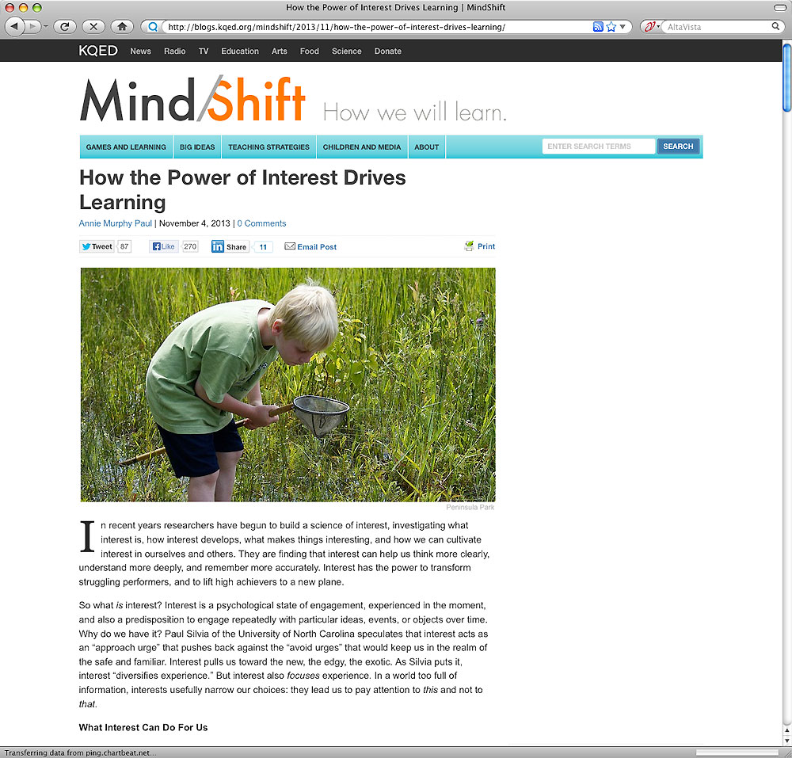
Notes:
People like to do what they like to do.
How can we find out what kids really like,
and then how can we use that information to help them plan a career pathway?
===
http://blogs.kqed.org/mindshift/2013/11/how-the-power-of-interest-drives-learning/
How the Power of Interest Drives Learning
In recent years researchers have begun to build a science of interest, investigating what interest is, how interest develops, what makes things interesting, and how we can cultivate interest in ourselves and others. They are finding that interest can help us think more clearly, understand more deeply, and remember more accurately. Interest has the power to transform struggling performers, and to lift high achievers to a new plane.
So what is interest? Interest is a psychological state of engagement, experienced in the moment, and also a predisposition to engage repeatedly with particular ideas, events, or objects over time. Why do we have it? Paul Silvia of the University of North Carolina speculates that interest acts as an Òapproach urgeÓ that pushes back against the Òavoid urgesÓ that would keep us in the realm of the safe and familiar. Interest pulls us toward the new, the edgy, the exotic. As Silvia puts it, interest Òdiversifies experience.Ó But interest also focuses experience. In a world too full of information, interests usefully narrow our choices: they lead us to pay attention to this and not to that.

Slide 42
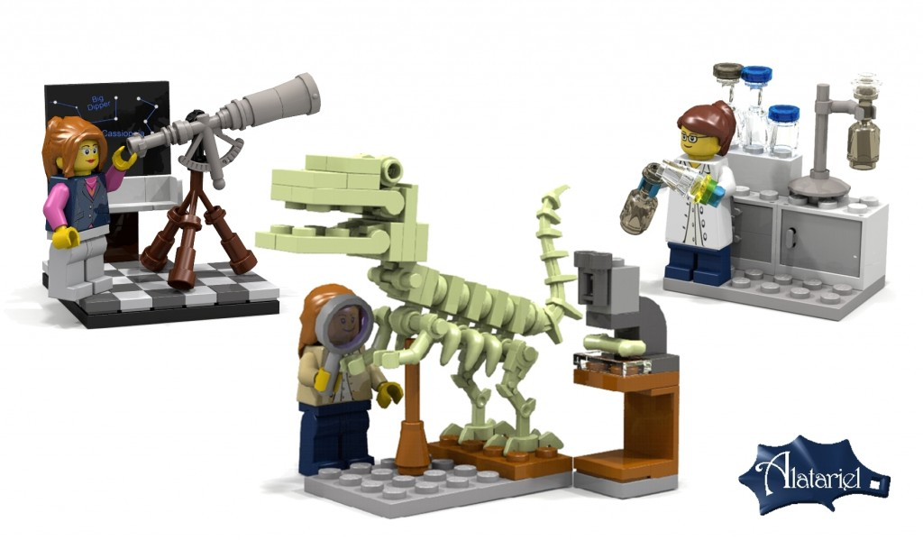
Notes:
We have to encourage folks to try out different jobs until they find the right one.
Here you see where Lego is now creating science structures with female characters to encourage girls to consider careers in science.
These are not girls in bikinis stretched out on a LEGO beach. These are depictions of real women making a real difference in the world.
One of your students might see themselves in one of these careers, but they won’t know -- until they try something out.
==========
http://www.washingtonpost.com/blogs/style-blog/wp/2014/06/05/lego-will-finally-make-female-characters-with-science-jobs/
LEGO will make new female characters with science jobs
At long last, LEGO will actually have new female figurines who do something other than bake and hang out at the beach.
The Denmark-based toy company has approved new designs for female scientist, paleontologist and astronomer characters from its LEGO Ideas online competition.
“We’re very excited to release Ellen Kooijman’s Female Mini-figure set, featuring 3 scientists, now entitled ‘Research Institute’ as our next LEGO Ideas set,” LEGO said in an official statement. “This awesome model is an inspiring set that offers a lot for kids as well as adults.”
As Kooijman put it, LEGO typically features a “stereotypical representation” of women in their figures, and she set out to change that.
“As a female scientist I had noticed two things about the available LEGO sets: a skewed male/female mini-figure ratio and a rather stereotypical representation of the available female figures,” Kooijman wrote in a post explaining her project.
“It seemed logical that I would suggest a small set of female mini-figures in interesting professions to make our LEGO city communities more diverse,” she added.
Support for the project was slow at first, but thanks to a flurry of tweets, it skyrocketed from around 2,000 supporters to 10,000 in just about one week.

Slide 43
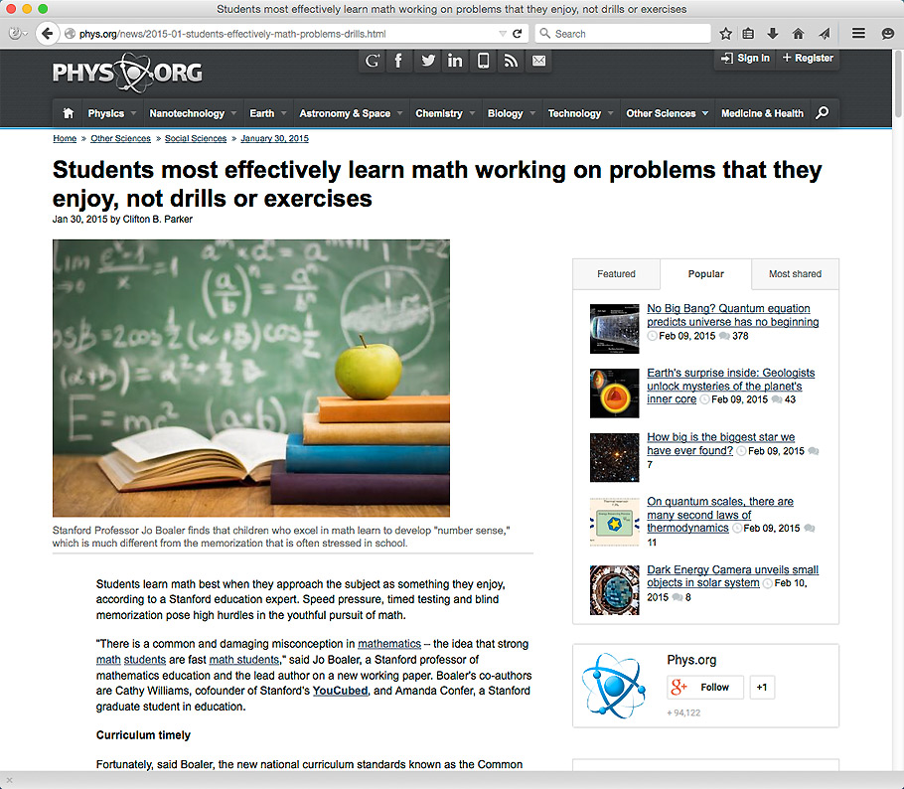
Notes:
I was good at connecting math to my world.
But I had a lot of experiences that I could draw on to make those connections.
=======
http://phys.org/news/2015-01-students-effectively-math-problems-drills.html
Students learn math best when they approach the subject as something they enjoy, according to a Stanford education expert. Speed pressure, timed testing and blind memorization pose high hurdles in the youthful pursuit of math.
"There is a common and damaging misconception mathematics – the idea that strong math students are fast math students," said Jo Boaler, a Stanford professor of mathematics education and the lead author on a new working paper. Boaler's co-authors are Cathy Williams, cofounder of Stanford's YouCubed, and Amanda Confer, a Stanford graduate student in education.
Curriculum timely
Fortunately, said Boaler, the new national curriculum standards known as the Common Core Standards for K-12 schools de-emphasize the rote memorization of math facts. Maths facts are fundamental assumptions about math, such as the times tables (2 x 2 = 4), for example. Still, the expectation of rote memorization continues in classrooms and households across the United States.
While research shows that knowledge of math facts is important, Boaler said the best way for students to know math facts is by using them regularly and developing understanding of numerical relations. Memorization, speed and test pressure can be damaging, she added.
On the other hand, people with "number sense" are those who can use numbers flexibly, she said. For example, when asked to solve the problem of 7 x 8, someone with number sense may have memorized 56, but they would also be able to use a strategy such as working out 10 x 7 and subtracting two 7s (70-14).
"They would not have to rely on a distant memory," Boaler wrote.
In fact, in one research project the investigators found that the high-achieving students actually used number sense, rather than rote memory, and the low-achieving students did not.
The conclusion was that the low achievers are often low achievers not because they know less but because they don't use numbers flexibly.
"They have been set on the wrong path, often from an early age, of trying to memorize methods instead of interacting with numbers flexibly," she wrote. Number sense is the foundation for all higher-level mathematics, she noted.

Slide 44
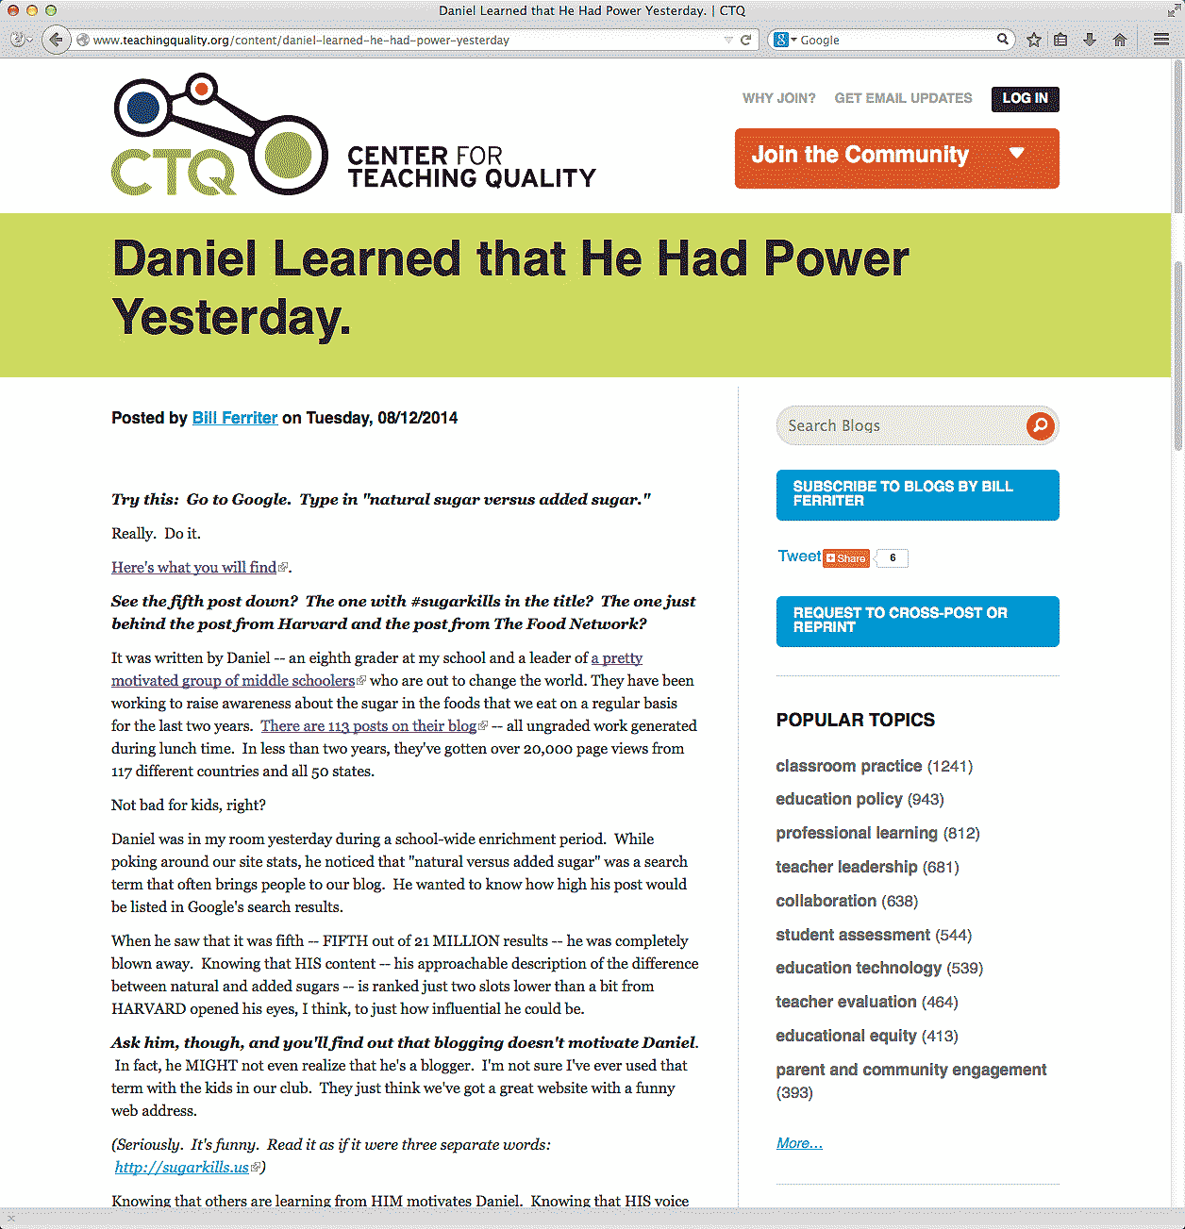
Notes:
Here is an article about an eighth grader who just discovered that he had the power to influence the world in a positive way.
That’s powerful!
========
http://www.teachingquality.org/content/daniel-learned-he-had-power-yesterday
Daniel Learned that He Had Power Yesterday.
Posted by Bill Ferriter on Tuesday, 08/12/2014
Try this: Go to Google. Type in "natural sugar versus added sugar."
Really. Do it.
Here's what you will find (link is external).
See the fifth post down? The one with #sugarkills in the title? The one just behind the post from Harvard and the post from The Food Network?
It was written by Daniel -- an eighth grader at my school and a leader of a pretty motivated group of middle schoolers (link is external) who are out to change the world. They have been working to raise awareness about the sugar in the foods that we eat on a regular basis for the last two years. There are 113 posts on their blog (link is external) -- all ungraded work generated during lunch time. In less than two years, they've gotten over 20,000 page views from 117 different countries and all 50 states.
Not bad for kids, right?
Daniel was in my room yesterday during a school-wide enrichment period. While poking around our site stats, he noticed that "natural versus added sugar" was a search term that often brings people to our blog. He wanted to know how high his post would be listed in Google's search results.
When he saw that it was fifth -- FIFTH out of 21 MILLION results -- he was completely blown away. Knowing that HIS content -- his approachable description of the difference between natural and added sugars -- is ranked just two slots lower than a bit from HARVARD opened his eyes, I think, to just how influential he could be.
Ask him, though, and you'll find out that blogging doesn't motivate Daniel. In fact, he MIGHT not even realize that he's a blogger. I'm not sure I've ever used that term with the kids in our club. They just think we've got a great website with a funny web address.
(Seriously. It's funny. Read it as if it were three separate words: http://sugarkills.us (link is external))
Knowing that others are learning from HIM motivates Daniel. Knowing that HIS voice can help others to live a healthier life motivates Daniel. Knowing that HE really does have power and that he really CAN drive change motivates Daniel.
[steppingONsoapbox]
THAT's what I love about cause-driven learning experiences, y'all -- and THAT's why I want to find ways to get MORE kids involved in opportunities to drive REAL change in the world beyond our classroom.
No offense to the entire universe, but I'm not trying to prepare kids for colleges and careers. I'm preparing kids for colleges, careers and COMMUNITIES. I want my students to take an action orientation towards the world that they live in. I want them to see problems and know that THEY can be the solvers even if they aren't old enough to drive.
Gimmie a keyboard and an internet connection and I'll show kids how they can change the world. You can too.
======
About Us
We are a group of middle schoolers who spent the better part of the 2012-2013 school year studying the New York City Soda Ban.
In the course of our studies, we decided to learn more about just how much sugar is in our foods — and just how much sugar we should be eating on a daily basis.
=====

Slide 45
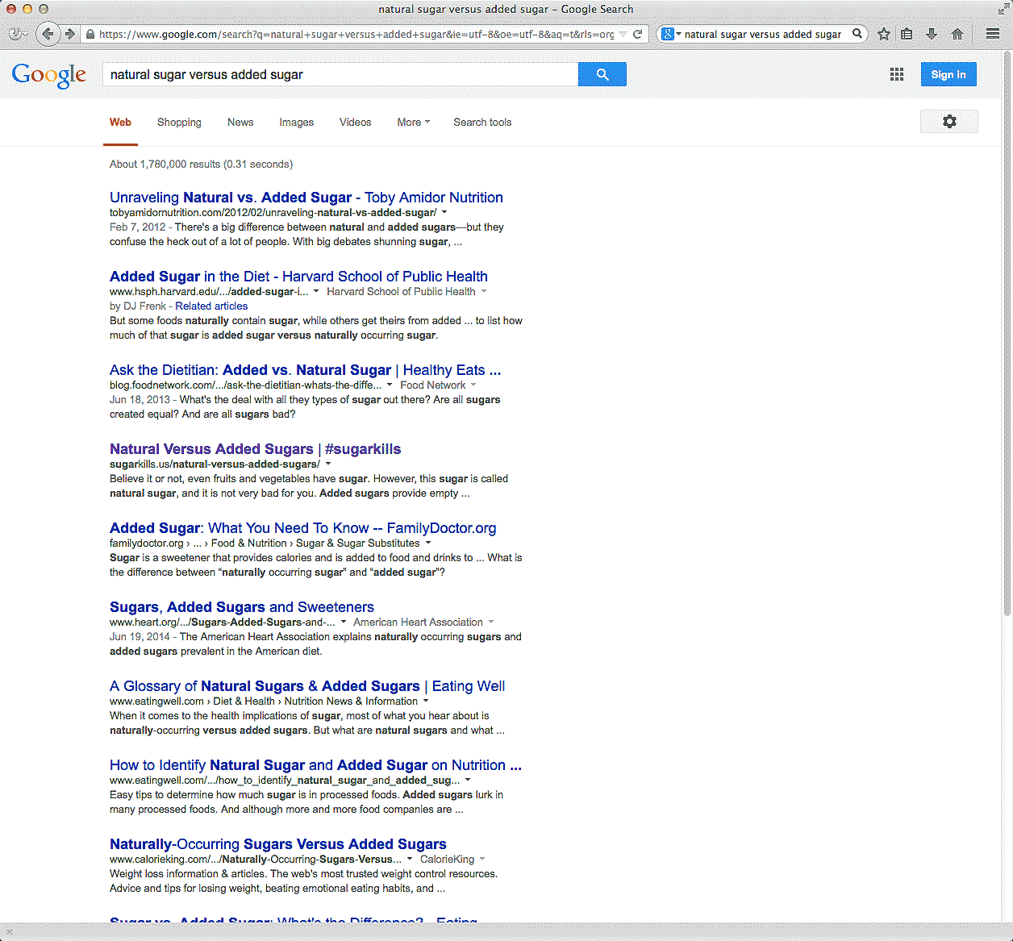
Notes:
If you Googled "natural sugar versus added sugar."
See the fourth post down?
→
just behind the post from Harvard and the post from The Food Network?
That link is to Daniel’s page, an eighth grader working with a team of classmates who are out to change the world.
========
http://www.teachingquality.org/content/daniel-learned-he-had-power-yesterday
Daniel Learned that He Had Power Yesterday.
Posted by Bill Ferriter on Tuesday, 08/12/2014
Try this: Go to Google. Type in "natural sugar versus added sugar."
Really. Do it.
Here's what you will find (link is external).
See the fifth post down? The one with #sugarkills in the title? The one just behind the post from Harvard and the post from The Food Network?
It was written by Daniel -- an eighth grader at my school and a leader of a pretty motivated group of middle schoolers (link is external) who are out to change the world. They have been working to raise awareness about the sugar in the foods that we eat on a regular basis for the last two years. There are 113 posts on their blog (link is external) -- all ungraded work generated during lunch time. In less than two years, they've gotten over 20,000 page views from 117 different countries and all 50 states.
Not bad for kids, right?
Daniel was in my room yesterday during a school-wide enrichment period. While poking around our site stats, he noticed that "natural versus added sugar" was a search term that often brings people to our blog. He wanted to know how high his post would be listed in Google's search results.
When he saw that it was fifth -- FIFTH out of 21 MILLION results -- he was completely blown away. Knowing that HIS content -- his approachable description of the difference between natural and added sugars -- is ranked just two slots lower than a bit from HARVARD opened his eyes, I think, to just how influential he could be.
Ask him, though, and you'll find out that blogging doesn't motivate Daniel. In fact, he MIGHT not even realize that he's a blogger. I'm not sure I've ever used that term with the kids in our club. They just think we've got a great website with a funny web address.
(Seriously. It's funny. Read it as if it were three separate words: http://sugarkills.us (link is external))
Knowing that others are learning from HIM motivates Daniel. Knowing that HIS voice can help others to live a healthier life motivates Daniel. Knowing that HE really does have power and that he really CAN drive change motivates Daniel.
[steppingONsoapbox]
THAT's what I love about cause-driven learning experiences, y'all -- and THAT's why I want to find ways to get MORE kids involved in opportunities to drive REAL change in the world beyond our classroom.
No offense to the entire universe, but I'm not trying to prepare kids for colleges and careers. I'm preparing kids for colleges, careers and COMMUNITIES. I want my students to take an action orientation towards the world that they live in. I want them to see problems and know that THEY can be the solvers even if they aren't old enough to drive.
Gimmie a keyboard and an internet connection and I'll show kids how they can change the world. You can too.
======
About Us
We are a group of middle schoolers who spent the better part of the 2012-2013 school year studying the New York City Soda Ban.
In the course of our studies, we decided to learn more about just how much sugar is in our foods — and just how much sugar we should be eating on a daily basis.
=====

Slide 46
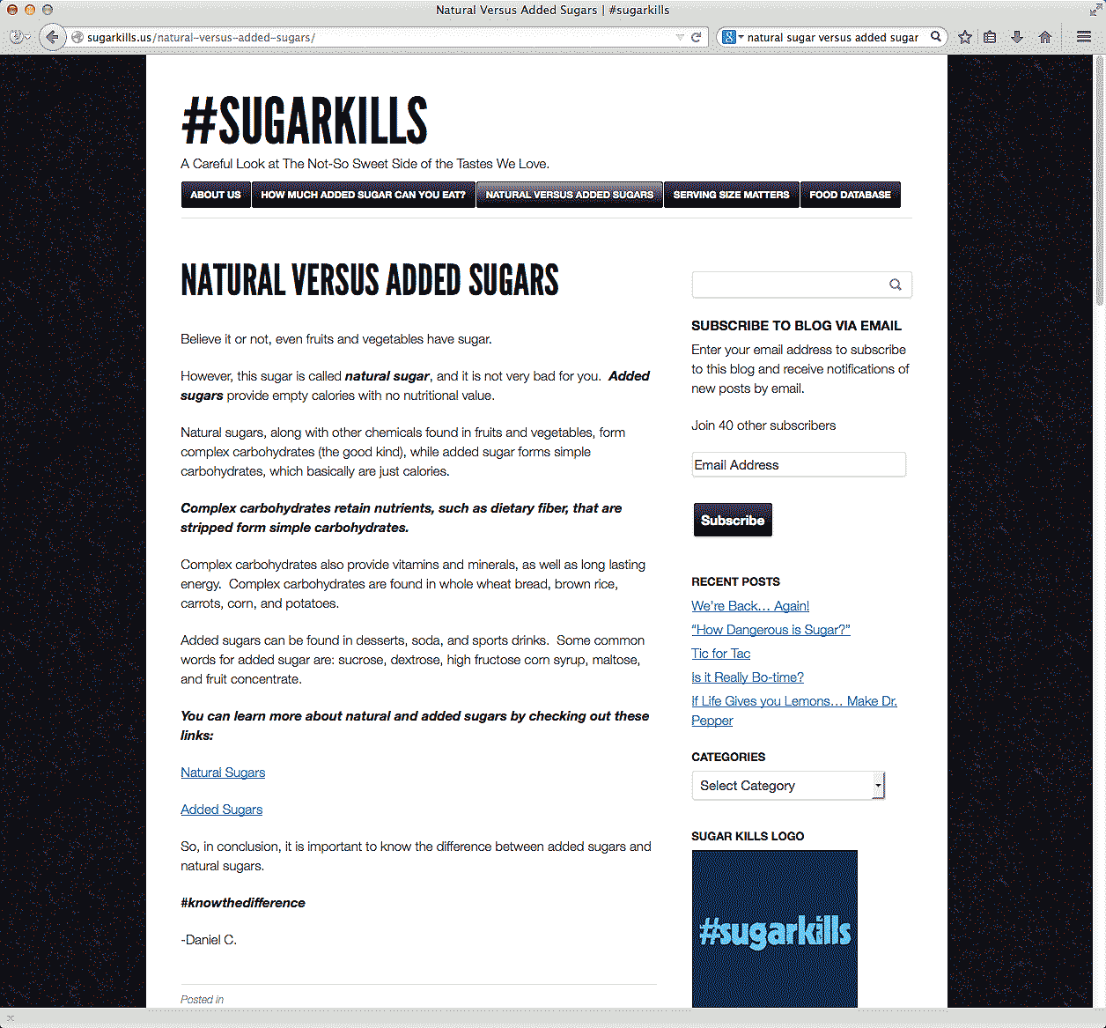
Notes:
They have been working to raise the awareness about the sugar in the foods that we eat for the last two years.
This is all all ungraded work generated during lunch time.
In less than two years, they've gotten over 20,000 page views from 117 different countries.
========
http://www.teachingquality.org/content/daniel-learned-he-had-power-yesterday
Daniel Learned that He Had Power Yesterday.
Posted by Bill Ferriter on Tuesday, 08/12/2014
Try this: Go to Google. Type in "natural sugar versus added sugar."
Really. Do it.
Here's what you will find (link is external).
See the fifth post down? The one with #sugarkills in the title? The one just behind the post from Harvard and the post from The Food Network?
It was written by Daniel -- an eighth grader at my school and a leader of a pretty motivated group of middle schoolers (link is external) who are out to change the world. They have been working to raise awareness about the sugar in the foods that we eat on a regular basis for the last two years. There are 113 posts on their blog (link is external) -- all ungraded work generated during lunch time. In less than two years, they've gotten over 20,000 page views from 117 different countries and all 50 states.
Not bad for kids, right?
Daniel was in my room yesterday during a school-wide enrichment period. While poking around our site stats, he noticed that "natural versus added sugar" was a search term that often brings people to our blog. He wanted to know how high his post would be listed in Google's search results.
When he saw that it was fifth -- FIFTH out of 21 MILLION results -- he was completely blown away. Knowing that HIS content -- his approachable description of the difference between natural and added sugars -- is ranked just two slots lower than a bit from HARVARD opened his eyes, I think, to just how influential he could be.
Ask him, though, and you'll find out that blogging doesn't motivate Daniel. In fact, he MIGHT not even realize that he's a blogger. I'm not sure I've ever used that term with the kids in our club. They just think we've got a great website with a funny web address.
(Seriously. It's funny. Read it as if it were three separate words: http://sugarkills.us (link is external))
Knowing that others are learning from HIM motivates Daniel. Knowing that HIS voice can help others to live a healthier life motivates Daniel. Knowing that HE really does have power and that he really CAN drive change motivates Daniel.
[steppingONsoapbox]
THAT's what I love about cause-driven learning experiences, y'all -- and THAT's why I want to find ways to get MORE kids involved in opportunities to drive REAL change in the world beyond our classroom.
No offense to the entire universe, but I'm not trying to prepare kids for colleges and careers. I'm preparing kids for colleges, careers and COMMUNITIES. I want my students to take an action orientation towards the world that they live in. I want them to see problems and know that THEY can be the solvers even if they aren't old enough to drive.
Gimmie a keyboard and an internet connection and I'll show kids how they can change the world. You can too.
======
About Us
We are a group of middle schoolers who spent the better part of the 2012-2013 school year studying the New York City Soda Ban.
In the course of our studies, we decided to learn more about just how much sugar is in our foods — and just how much sugar we should be eating on a daily basis.
=====

Slide 47
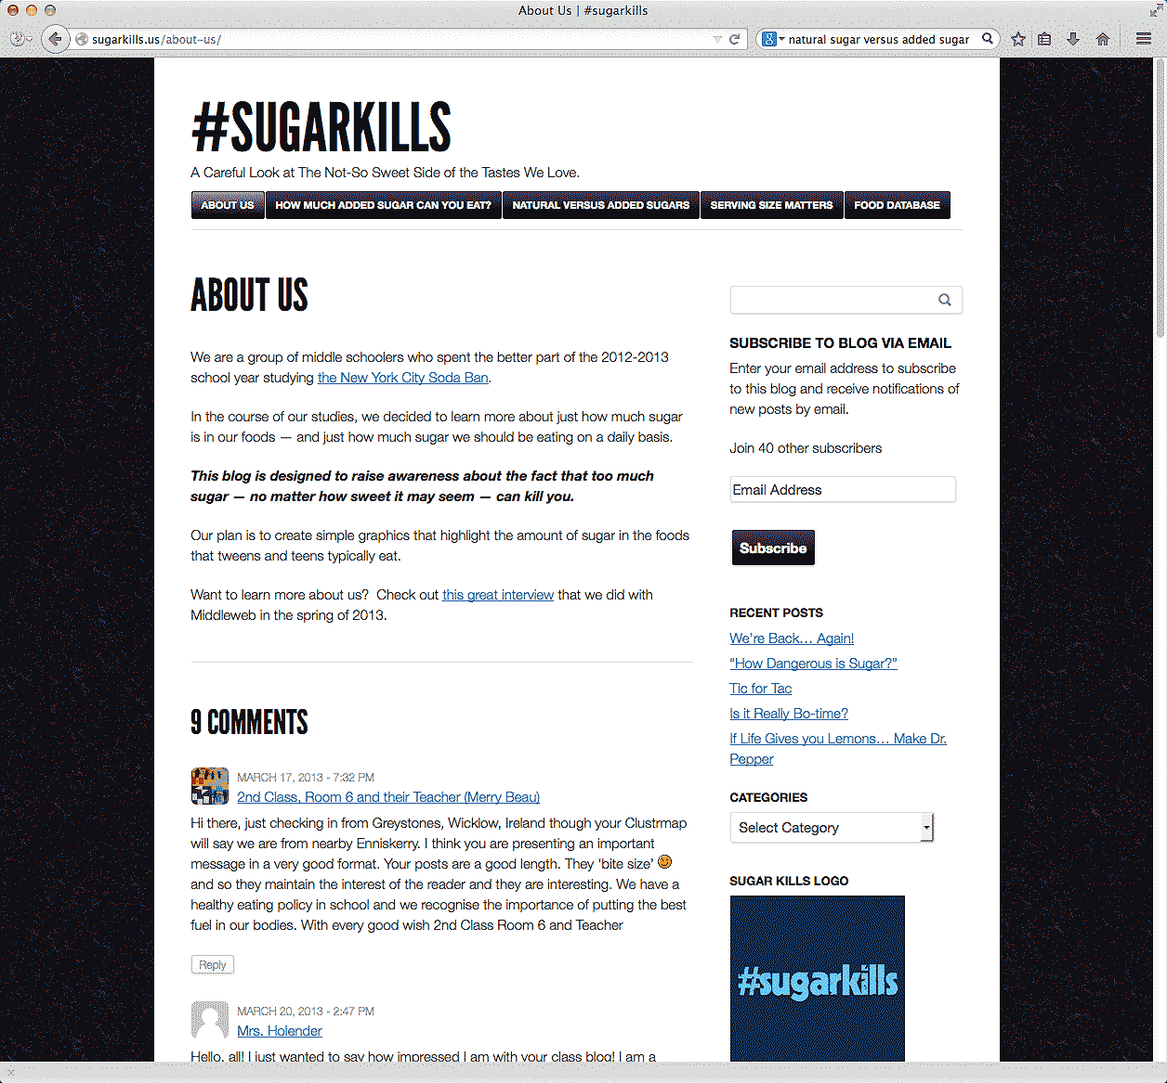
Notes:
Not bad for kids, right?
They are doing this because they want to.
They are learning about something that is important to them, and they are sharing it with the world.
They are not driven by grades, money or any other reward. They are doing this work because they believe it is the right thing to do.
It really means something to them.
========
http://www.teachingquality.org/content/daniel-learned-he-had-power-yesterday
Daniel Learned that He Had Power Yesterday.
Posted by Bill Ferriter on Tuesday, 08/12/2014
Try this: Go to Google. Type in "natural sugar versus added sugar."
Really. Do it.
Here's what you will find (link is external).
See the fifth post down? The one with #sugarkills in the title? The one just behind the post from Harvard and the post from The Food Network?
It was written by Daniel -- an eighth grader at my school and a leader of a pretty motivated group of middle schoolers (link is external) who are out to change the world. They have been working to raise awareness about the sugar in the foods that we eat on a regular basis for the last two years. There are 113 posts on their blog (link is external) -- all ungraded work generated during lunch time. In less than two years, they've gotten over 20,000 page views from 117 different countries and all 50 states.
Not bad for kids, right?
Daniel was in my room yesterday during a school-wide enrichment period. While poking around our site stats, he noticed that "natural versus added sugar" was a search term that often brings people to our blog. He wanted to know how high his post would be listed in Google's search results.
When he saw that it was fifth -- FIFTH out of 21 MILLION results -- he was completely blown away. Knowing that HIS content -- his approachable description of the difference between natural and added sugars -- is ranked just two slots lower than a bit from HARVARD opened his eyes, I think, to just how influential he could be.
Ask him, though, and you'll find out that blogging doesn't motivate Daniel. In fact, he MIGHT not even realize that he's a blogger. I'm not sure I've ever used that term with the kids in our club. They just think we've got a great website with a funny web address.
(Seriously. It's funny. Read it as if it were three separate words: http://sugarkills.us (link is external))
Knowing that others are learning from HIM motivates Daniel. Knowing that HIS voice can help others to live a healthier life motivates Daniel. Knowing that HE really does have power and that he really CAN drive change motivates Daniel.
[steppingONsoapbox]
THAT's what I love about cause-driven learning experiences, y'all -- and THAT's why I want to find ways to get MORE kids involved in opportunities to drive REAL change in the world beyond our classroom.
No offense to the entire universe, but I'm not trying to prepare kids for colleges and careers. I'm preparing kids for colleges, careers and COMMUNITIES. I want my students to take an action orientation towards the world that they live in. I want them to see problems and know that THEY can be the solvers even if they aren't old enough to drive.
Gimmie a keyboard and an internet connection and I'll show kids how they can change the world. You can too.
======
About Us
We are a group of middle schoolers who spent the better part of the 2012-2013 school year studying the New York City Soda Ban.
In the course of our studies, we decided to learn more about just how much sugar is in our foods — and just how much sugar we should be eating on a daily basis.
=====

Slide 48
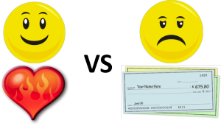
Passion vs Paycheck
Notes:
Which is more important?
Looking forward to going to work on Monday morning,
or looking forward to a paycheck on Friday afternoon?
======
http://theherowithinu.com/2013/01/23/passion-vs-paycheck/

Slide 49

Notes:
Why do people think they have to choose between the two?
OK, I did decide to become a teacher rather than an engineer! And then I married another teacher rather than an engineer.
============
http://www.beyond.com/data/articles/images/changing-careers/Passion%20for%20love%20or%20money.jpg

Slide 50
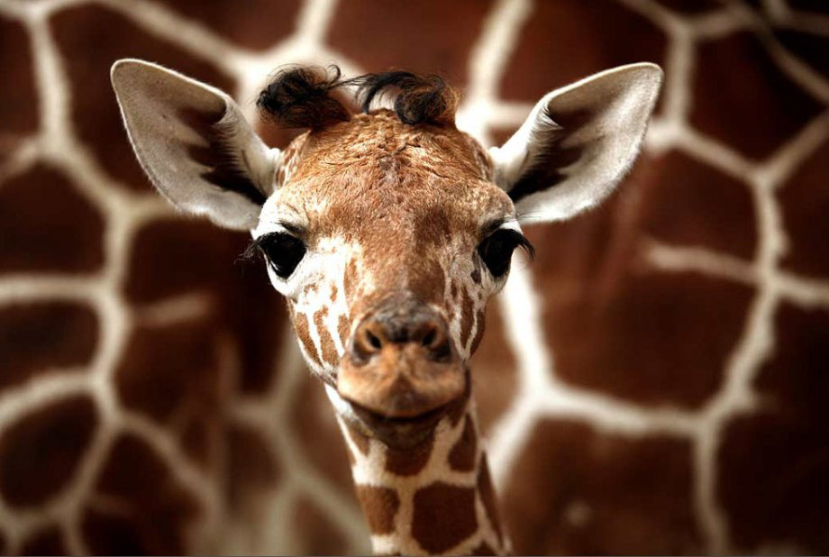
Like Animals?
Notes:
One of my passions is giraffes.
Lots of kids like animals,
and when asked what they want to do when they grow up, they say they want to work with animals.
When adults hear this they automatically respond “You should be a ----- veterinarian.”
But kids don’t really know what a veterinarian really does for a job,
Kids just know that if it involves animals they will be happy.
The problem is that when they finally get old enough to job shadow or intern with a veterinarian, they are often shocked to find out that they had no idea of the work of the veterinarian -- and want nothing to do with it.
Their dreams are now shattered.
For many years they have told everyone that they were going to be a veterinarian, and now that they have seen the work, -- they are left confused and hopeless.
=====
https://shechive.files.wordpress.com/2011/01/a-cute-animals-10.jpg?quality=94&strip=all&w=920
http://theberry.com/2011/01/04/daily-awww-whats-better-than-cute-animal-pics-hi-res-ones-30-hq-photos/#.

Slide 51
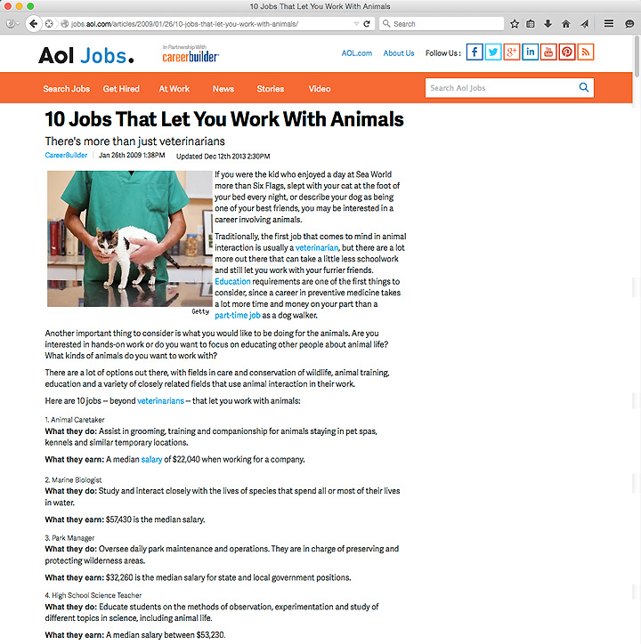
Notes:
There are lots of jobs that work with animals that do not require “fixing” them.
Here is a list of ten of them.
The American Kennel Club lists two dozen jobs that are related to working with dogs.
We need to stop telling kids that veterinarian is the answer.
Kids need to discover their own direction after doing the research.
After having the experiences.
=====
http://jobs.aol.com/articles/2009/01/26/10-jobs-that-let-you-work-with-animals/
http://www.akc.org/events/junior-showmanship/careers/

Slide 52
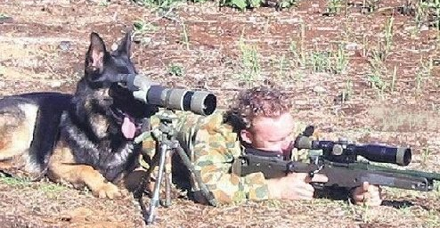
NOT Jobs For Animals
Notes:
I am talking about jobs with animals not jobs for animals.
====
http://cubiclebot.com/pictures/dogs-are-unqualified-for-everything/

Slide 53
Try it Out
Take elective courses
  Fine and Performing Arts
  Career and Technical
School Clubs
Notes:
Try it Out!
Classes in The Arts are a great place to explore your interests. Especially the performing arts like Theatre, Dance, Instrumental Music, and Chorus. You might discover a hidden talent.
Also take as many Career and Technical Education courses as you can. Some schools have an ninth-grade introductory course where you can get a sense of all of the CTE courses offered at the school.
School Clubs are another way to get hands-on experiences. My participation in the Stamp Collecting club helped me to learn geography and learn about other cultures.
And the Technical Crew in high school was my avenue to apply physics to the real world.

Slide 54
Try it Out
Work-based learning
  Job Shadowing
  Internships
Scouting
  Merit Badges
  Exploring
  Learning for Life
Notes:
Work-based learning means job shadowing where you get away from the school for a day and watch someone work --- to see if that job is for you.
Internships are longer experiences where you get to work in a real job for a few months in order to try out various occupations. You don’t know what you will like until you try.
I ran the radio station at my high school, which got me into DeeJaying, which got me into running sound for bands, and opening my own recording studio.
The Merit Badge Programs in Girl Scouts and Boy Scouts are designed to help kids explore various career interests.
Hopefully, they can connect what they are learning in school to these various career pathways.
The Exploring program is career-oriented experiences for teenagers. I was in a MultiMedia explorer post.
It helped me discover that I had a passion for helping people communicate information, which we did through sound systems, stage lighting, video projection, and print media.
I still do the sound, stage lights, and video projection for the large Boy Scout camporees and conclaves in the area.

Slide 55

Notes:
I believe that everyone has a special super power.
The first thing is to discover what your special power is.
Then you might have to hone your craft through practice.
Learn the limits of your super power.
Learn how your super power can work in concert with other’s super powers for team work. – Synergy!
Then decide if you plan to use your super power for good or evil. I hope for good.
====
http://misterjean.net/?p=178
http://misterjean.net/wp-content/uploads/2011/04/comment_superpower1.gif

Slide 56

Notes:
Superman uses his incredible strength, speed, flight, and various superpowers to fight evil and protect the innocent. His passion is to fight evil.
What is the difference between your super power or innate gift and your passion.
Hopefully you can find a way to use your natural gifts to fulfill your passion. For some people, the two never come together.
We usually do not know we have super powers until someone points them out. What is your super power?
When did you discover that you had a super power that others around you did not have? Who pointed it out to you? Was it a teacher? Someone else in the same profession? Often, it takes one to know one!
When did you discover that your super power was teaching?
We have to help the kids at our school discover their super power, help them to nourish it, help them to use it for good, and get them on track to a career where their super power is highly prized.
=====
http://www.metropolisplus.com/superman/

Slide 57
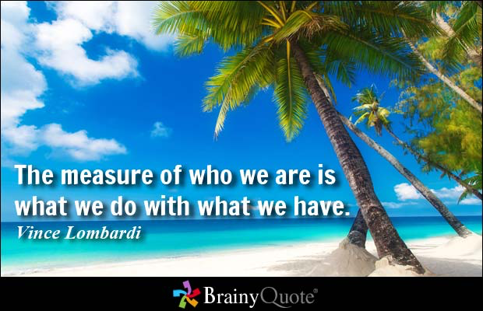
Notes:
First we have to know what we have.
Then decide what to do with what we have.
=======
“The measure of who we are is what we do with what we have."
-- Vince Lombardi, American football coach
=========
http://www.brainyquote.com/quotes/quotes/v/vincelomba382625.html

Slide 58
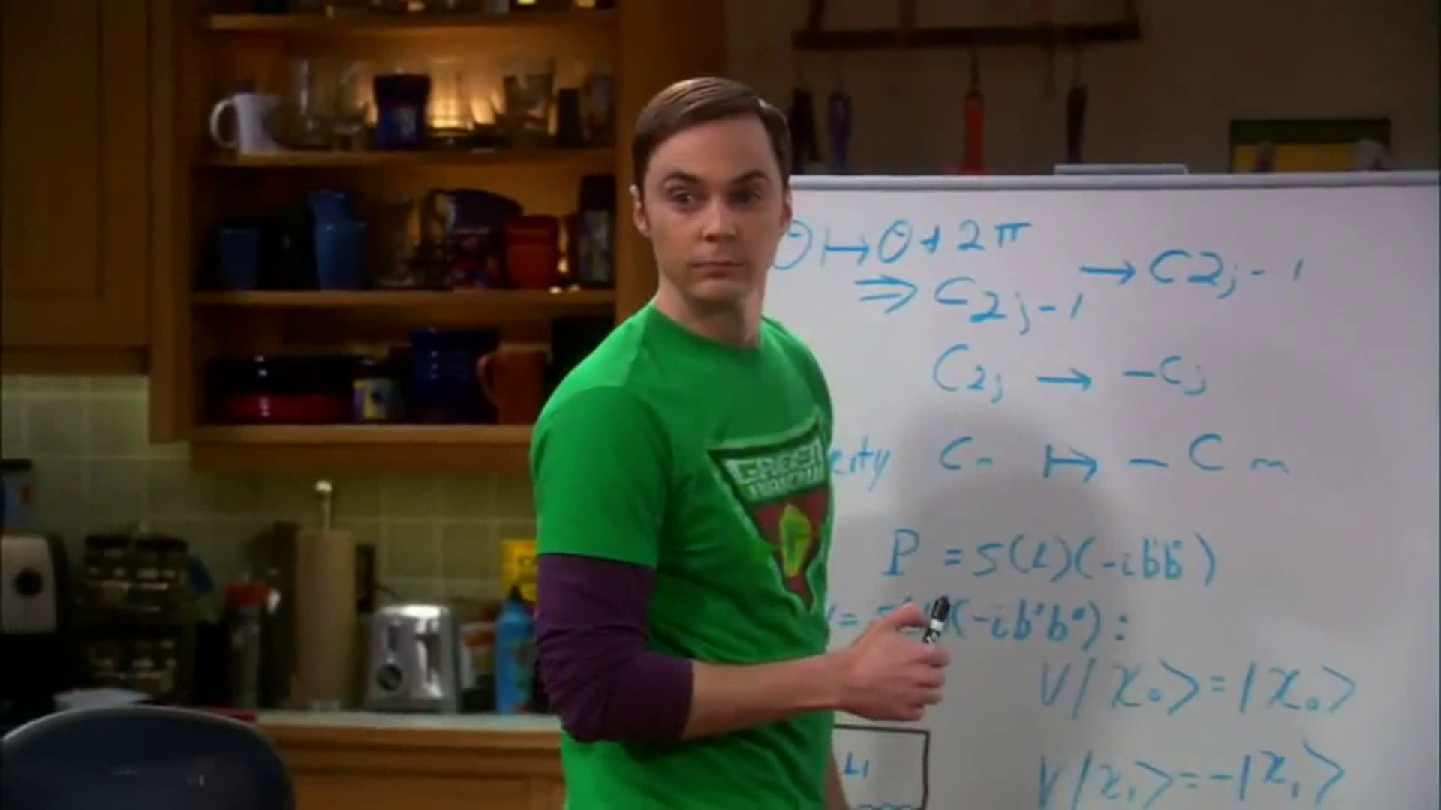
Notes:
For someone like Doctor Sheldon Cooper, it is easy to discover his passion.
He makes no attempt to hide what excites him.
He allows you to be his audience as he opens himself up on the great stage of life.
http://upload.wikimedia.org/wikipedia/it/6/65/Big_Bang_Theory,_Sheldon_Cooper,_5x20.png

Slide 59

Notes:
Sometimes super powers are very apparent and sometimes obnoxious.
Some people never discover their super power,
and it sits on a shelf like an unopened gift.
=======
http://www.gravitywear.com/sites/default/files/styles/gw_product_full/public/Dr_Sheldon_Cooper_Mind_Logo.jpg

Slide 60

Notes:
I do like to eat, and I am glad some people have the passion and the super powers for cooking.
Though I do have Cooking merit badge,
I do not have a passion nor super powers for cooking.
Luckily I married someone who does.
====
http://www.atlantic.edu/aca/index.htm

Slide 61

Notes:
One of Mary Poppins’s super powers is to get people to see the fun in everything.
In the introduction to the song “A Spoonful of Sugar” Mary Poppins reminds us how we often have to do unpleasant things.
“With every job that must be done, there is an element of fun. You find the fun and snap, the job’s a game. And every task you undertake becomes a piece of cake …”
Well, I do like cake!
When unpleasant tasks come my way at work, I just remember what Mary Poppins said, and it’s all good.
==========
http://s.ecrater.com/stores/53443/4c171b553dd23_53443n.jpg

Slide 62
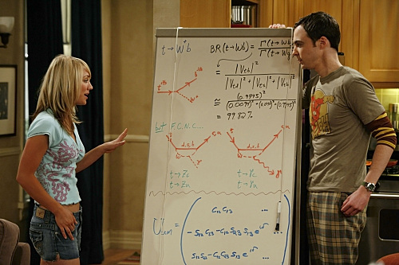
Notes:
Penny and Sheldon have different passions and different super powers. Did you notice?
=============
http://img3.wikia.nocookie.net/__cb20110728044900/bigbangtheory/images/c/c6/Big-bang-theory-penny-sheldon-photo1.jpg

Slide 63
Interests vs. Passion
Notes:
Starting at Middle School most folks can grasp their career interests. Like working indoors or outside.
Like structured work or free thinking.
Like working around people or working by themselves.
Passion is something else.
It turns out that my interests -- are not really right for my job.
This means that I have to stretch into uncomfortable areas like being extraverted, -- when I prefer to be introverted.
(point) I also don’t get to file a lot of wood in my job, which to me is fun.
An interest is “working with my hands,” but a passion is “building things for people who who can’t afford it and really need it.”
Your passion can easily override your interests.
To follow your passion, you will do almost anything.

Slide 64
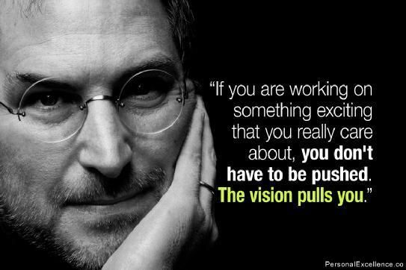
Think Different
Making Better Things
Steve Jobs
Notes:
Steve Jobs was passionate about Making Better Things.
He cared about making something that other people could benefit from.
He challenged us all to Think Different.
====
https://www.pinterest.com/pin/166422148705420451/
http://finance.yahoo.com/news/steve-jobs-destroyed-passion-myth-163000433.html;_ylt=A0LEV7_TYvdUvyQAJscnnIlQ;_ylu=X3oDMTEzamFkOTJqBHNlYwNzcgRwb3MDMgRjb2xvA2JmMQR2dGlkA1lIUzAwNF8x

Slide 65

Teamwork
Notes:
Dean Smith was passionate about teamwork.
Creating team players.
He was also passionate about the academic success of his players.
======
http://bleacherreport.com/

Slide 66
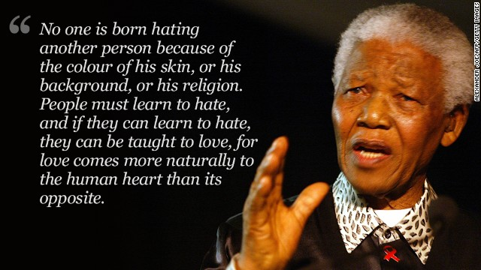
Racism, Human Rights
Notes:
Nelson Mandela was Passionate about racism and human rights.
====
http://www.cnn.com/2013/12/06/world/africa/nelson-mandela-other-side/

Slide 67
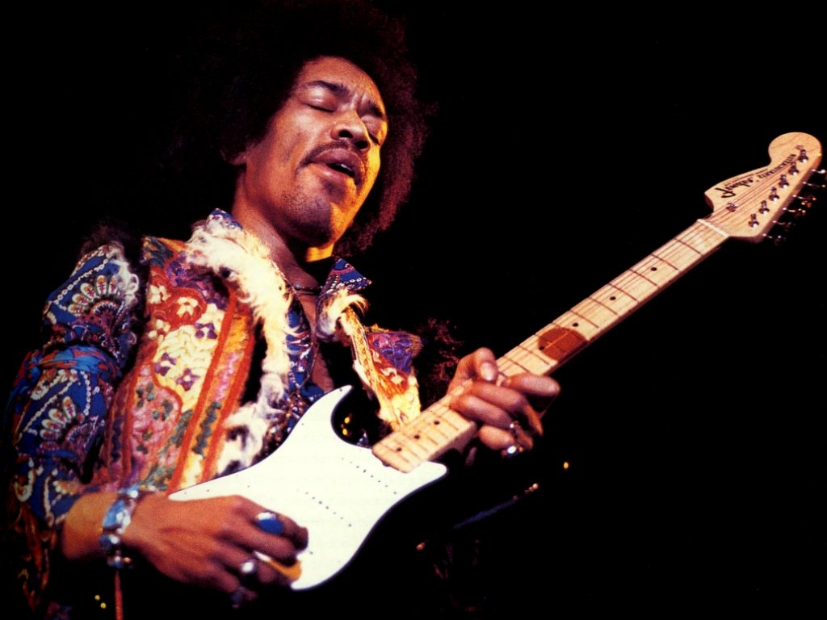
Making New Music
Notes:
Jimi Hendrix was passionate about creating musical sounds that had never been heard before.
====
http://hinter-den-schlagzeilen.de/2012/11/27/jimi-hendrix-zum-70-geburtstag/

Slide 68
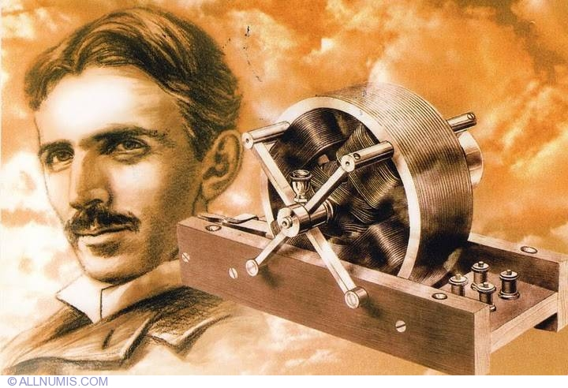
Transmission of Electricity
Notes:
Nikola Tesla was passionate about the transmission of electrical energy.
It is because of Tesla that we have electricity in our homes.
Tesla pursued technology, not fame.
=======
http://www.allnumis.com/postcard/serbia/nikola-tesla-2087

Slide 69
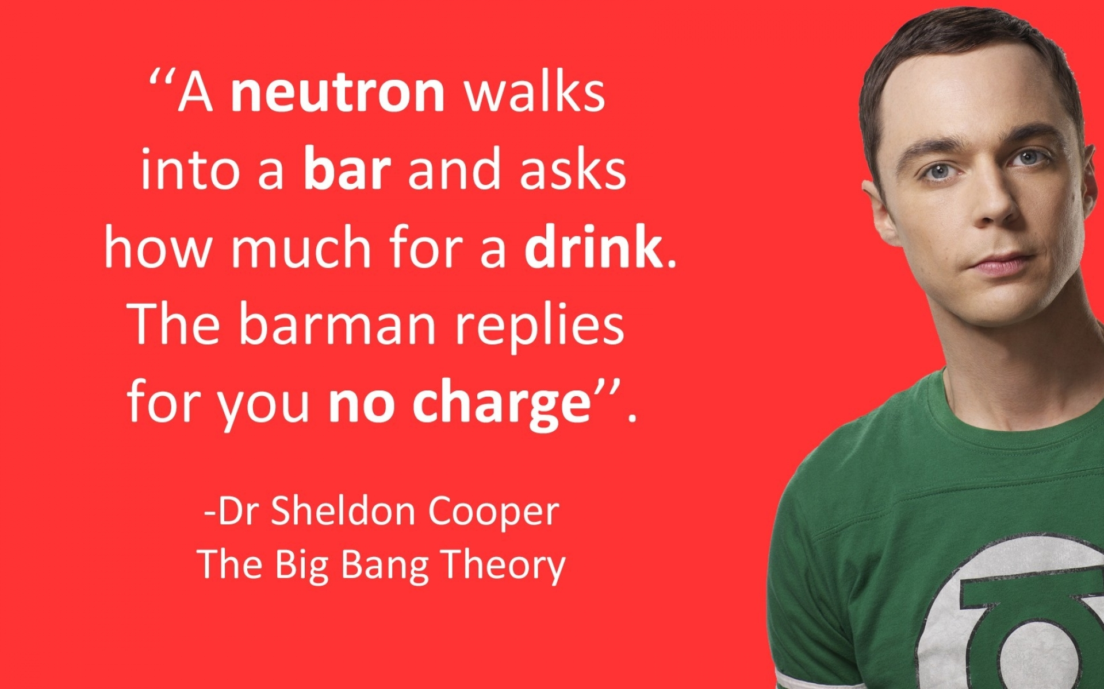
Theoretical Physics
Notes:
Dr. Sheldon Cooper is Passionate about Theoretical Physics.
And if you paid attention in Physics class,
you will have to admit
that this is one of the funniest jokes ever. -
Bazinga!
====
http://www.wallpaperhi.com/Entertainment/TV_Series/science_nerd_funny_physics_comedy_the_big_bang_theory_tv_serie_jim_parsons_sheldon_cooper_tv_shows_84078/download_1920x1200

Slide 70
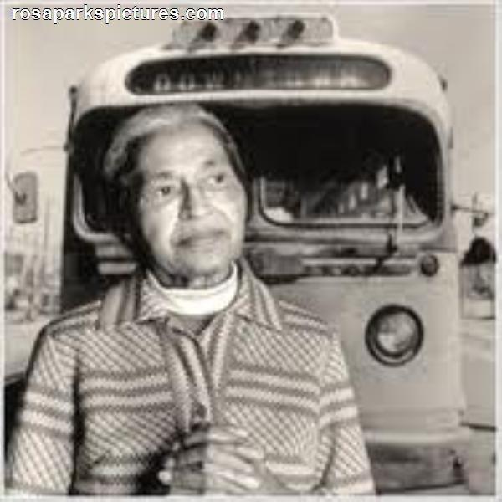
Civil Rights
Notes:
Rosa Parks refused to give up her seat on the bus.
She was passionate about civil rights.
Equality for all.
What are your students passionate about?
How can you connect their passion to the curriculum?
=====
http://rosaparkspictures.com/images/Rosa-Parks-Bus.jpg

Slide 71
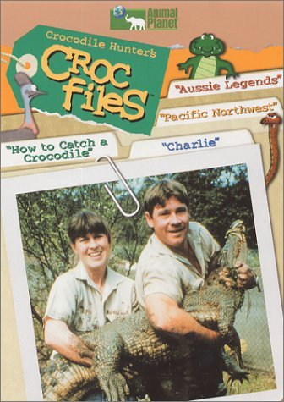
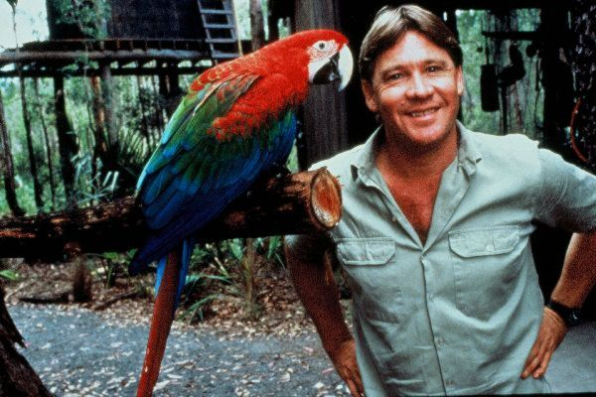
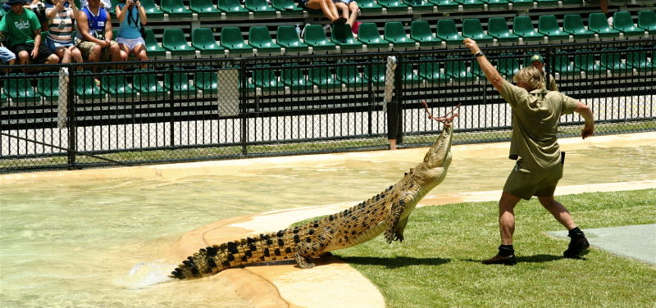
Wildlife Conservation
a passionate conservationist
Notes:
71
Steve Irwin, better known as The Crocodile Hunter was passionate about Wildlife Conservation.
Nobody had to tell him it was time to learn about a new species of animal.
He was probably the first person at work on Monday morning.

Slide 72
Questions before I conclude?
Chris Droessler, Consultant, NCDPI
www.ctpnc.org/presentations
Notes:
Before I conclude my presentation, I will pause here to see if anyone has any questions.
Remember that you can download the PowerPoint and use it however you can.
While you are thinking up some questions … (next slide)

Slide 73
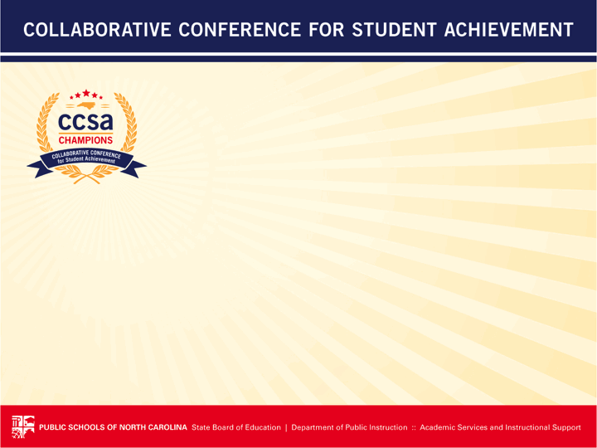

Monday
8:30
Help Kids …
Wednesday
10:00
Help Kids …
Your feedback is important.
http://www.cvent.com/d/hrq907/3B
Notes:
Please evaluate this session so we can continue to make this a valuable conference for all.
It is easy to do with a smart phone.
Go to this website and enter the information you see on the right.
Monday, 8:30, Help Kids …
Wednesday, 10:00, Help Kids …
If you have a QR code reader on your phone (and they are free) capture this QR code and start the evaluation.
Any Questions??

Slide 74

Education
Notes:
74
74
And then there is Mister Rogers – passionate about educating children.
It was so nice growing up knowing that Mr. Rogers was my neighbor, and that he liked me just the way I was.
Wouldn’t it be great if everyone could find a career about which they are passionate?
Not just a job that pays for their weekend activities, but a job that gives them a sense of purpose?
What if that sense of purpose leads to a thirst for knowledge?
A desire for life-long education.
A desire to share that passion with others.
=========
Graphic from http://pbskids.org/rogers/
Video from http://www.youtube.com/watch?v=JMFDphMXTlQ&feature=related

Slide 75
Passion and Purpose
Thriving in your work, not just surviving.
Leaving the world a little better off because you cared to make a difference in your work.
Helping kids discover their passion and then helping them turn that passion into an educational pathway that will lead to a rewarding career.
Notes:
75
What makes you want to get up in the morning?
→
Are you passionate about your own career?
→
How can we help kids discover their passion, and put them on an education pathway, to turning their passion into a career?
--
======
Chris Droessler

Slide 76
Help kids discover their passion, then help them get on a pathway where they can turn that passion into a career.
Notes:
Though the term “vocational” has earned a bad reputation in the last few decades, the original meaning of the term is clear that your “vocation” is your life’s calling.
My vocation as an educator is educating young minds and preparing them for the real world.
What is the vocation of the kids with whom you work? What is life calling them to do? What is their purpose in life?
We need to help kids discover their passion.
What makes them get up in the morning and want to learn something new?
And we need to help them to turn that passion into a rewarding career.
-- --
=======
Emil Barnabas
76

Slide 77

Notes:
In the future –
when our students are employed and someone asks them what they do for a living, --
wouldn’t it be great if they could say –
“I get to make a difference in the world.”
“I get to make a difference!”
====
http://www.iliketoquote.com/do-small-things-with-great-love-and-youll-make-a-big-difference/

Slide 78
Thanks for listening!
Chris Droessler, Consultant, NCDPI
www.ctpnc.org/presentations
Notes:
Thanks for inviting me to come speak today.

Slide 79
Monday
8:30
Help Kids …
Wednesday
10:00
Help Kids …
Your feedback is important.
http://www.cvent.com/d/hrq907/3B
Notes:
Please evaluate this session so we can continue to make this a valuable conference for all.
It is easy to do with a smart phone.
Go to this website and enter the information you see on the right.
Monday, 8:30, Help Kids …
Wednesday, 10:00, Help Kids …
If you have a QR code reader on your phone (and they are free) capture this QR code and start the evaluation.
Any Questions??

Slide 80
Thanks for listening!
Chris Droessler, Consultant, NCDPI
www.ctpnc.org/presentations
Notes:
Thanks for inviting me to come speak today.

Slide 81

Notes:
Wouldn’t it be great if people could walk into a job interview not worrying about getting the job, but instead feeling
“I feel like I have found my new home”
“A place where I will look forward to going everyday.”
You might have to force me to go home at the end of the day, because this is where I belong.
======
http://office.microsoft.com/en-us/images/business-CM079001906.aspx?qu=job+interview&ex=1#ai:MP900448576|

Slide 82

"I choose C" video
Notes:
When students go for their first job interview, they need to be ready and willing to give 100% to help the company.
Just as school should not be a place to trade learning for a grade, work should not be a place to trade work for money. Work should be a place you want to go to and do what you do even if you are not being paid to do it.
=======
"I choose C" video

Slide 83

Notes:
Tony Wagner says we need a new position in each school called the "Dream Director", who works hand-in-hand with the principal, teachers and community to help inspire students to believe in themselves and to see the world through a new lens of possibility. Dream Directors are leaders, coaches and imagineers -- people completely devoted to helping others put their dreams in action.
The Dream Directors have a number of tools they use to transform the school. Dream Directors match students with Coaches in the community who help the teenagers to explore their passions and build projects. Dream Directors run after-school workshops to teach the students the real-world skills they need to bring their ideas to life. They mobilize students to design and run school-wide campaigns that give students a chance to share who they are and what they believe in. The experience is different in each school (since no two schools are the same), but what unites all Dream Directors is their mission to unleash students and inspire them to be extraordinary.
=========
https://www.escapethecity.org/organisations/the-future-project
Tony Wagner says we need a new position in each school called the "Dream Director", who works hand-in-hand with the principal, teachers and community to help inspire students to believe in themselves and to see the world through a new lens of possibility. Dream Directors are leaders, coaches and imagineers -- people completely devoted to helping others put their dreams in action.
The Dream Directors have a number of tools they use to transform the school. Dream Directors match students with Coaches in the community who help the teenagers to explore their passions and build projects. Dream Directors run after-school workshops to teach the students the real-world skills they need to bring their ideas to life. They mobilize students to design and run school-wide campaigns that give students a chance to share who they are and what they believe in. The experience is different in each school (since no two schools are the same), but what unites all Dream Directors is their mission to unleash students and inspire them to be extraordinary.
Photo
http://amandinevanray.deviantart.com/art/Little-dreamer-290575045

Slide 84

Reaching Introverts
Notes:
I am a heavy-duty introvert.
I have found that some of the best public speakers, teachers, and entertainers are actually introverts.
An introvert is not always quiet and reserved. The main thing is that after a long day of work, Introverts would rather be by themselves to recharge their batteries.
A super power that introverts have is to understand people. We are watching them all the time deciding what we like and don’t like. We can be friendly and outgoing, it just wears us out.
Introverts like work that they can do by themselves rather than always working in a group.
===
http://hunteremkay.com/wp-content/uploads/2011/11/introverts.jpg
http://hunteremkay.com/2011/11/introvert-extrovert-does-it-matter/

Slide 85

Reaching Extroverts
Notes:
Extraverts like being around people. Extraverts prefer to work in a group constantly bouncing ideas off of others.
After a long day of work, extraverts prefer to hang out with people to recharge their batteries.
A super power is that they can easily carry on a social conversation with just about anyone. Extraverts typically have lots of friends.
Introverts have a smaller number of friends, but those friendships are usually very deep.
====
http://www.fastcodesign.com/3028421/evidence/are-extroverts-really-happier-than-introverts

Slide 86
Our Mission
Help our students find the right career:
  High demand occupations in growing industries
  ROI - Education vs. Salary
  Jobs with potential for advancement
  Future-proof occupations
  Transferable skills
  Job satisfaction
Notes:
86
Our mission is to help kids find the right career. It’s not enough to just give them 12 years of reading, writing, and arithmetic.
We have to look 5 to 10 years down the road to help kids plan their future. This means keeping up with the latest career trends, as well as teaching the students what it means to have a job.
Get them to look at the growing industries, which have jobs that are in high demand.
Look at the return on the investment of education verses wages.
Look for jobs that have a pathway to higher jobs.
We need to get past the generation of employees who do not like their jobs and only go to work to earn the money to support their hobbies and interests. Wouldn’t it be nice if people could get paid to do the thing they are most passionate about? With our guidance they can.

Slide 87
Everybody’s Working For The Weekend (Loverboy)
Take This Job And Shove It (Johnny Paycheck)
Rainy Days And Mondays Always Get Me Down (Carpenters)
I Don’t Like Mondays (Boomtown Rats)
Don’t Talk To Me About Work (Lou Reed )
The Work Song (Billy Squier)
Goin’ To Work (Martina McBride )
Off To Work (Chicago)
I’ve Been Working On The Railroad (John Denver)
I Don’t Wanna Work That Hard (Blaine Larsen)
Seven Day Weekend (Abc)
The Weekend Song (Alanis Morissette)
Living For The Weekend (Hard-Fi)
Notes:
87
What’s your attitude towards work?
Are you working for the weekend?
How do you feel about Mondays?
Why are there no songs about loving your job?

