Slide 1
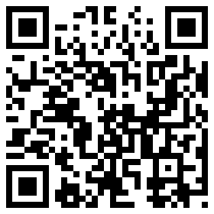
Work-Based Learning
Chris Droessler,
CTE Support Services Consultant, NCDPI
www.ctpnc.org/presentations
Notes:
I am Chris Droessler (silent O, no Q)
I am your CTE Support Services consultant at the North Carolina Department of Public Instruction.
I hope that you all recognize the QR code on the right side of the screen.
If you have a smart phone, and you are smart enough to use it, you can capture that QR code, and your phone takes you to the webpage where you can download a copy of this PowerPoint file.
Or you can just go to ctpnc.org and click on the “presentations” link.
How many of you have already downloaded my presentation??
Who is in the room today? CDC, SPC, CAC , other?
===============
CDC Induction – August 17, 2015
www.ctpnc.org/presentations

Slide 2
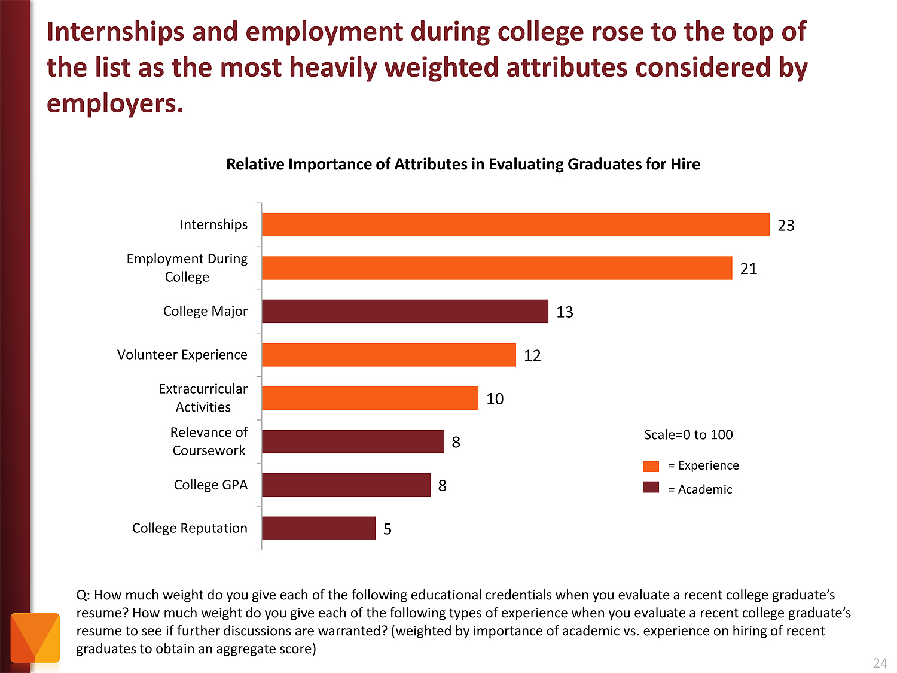
Notes:
Employers value Internships and other employment while in school as more important than college major and GPA.
Even volunteer work and extra-curricular activities are more important to the business community than grades.
Yet, this generation of teens is working less than previous generations. Some blame the economy.
We need to promote the benefits of working while in high school and college.
======
http://chronicle.com/article/The-Employment-Mismatch/137625/#id=overview
The Employment Mismatch: A College Degree Sorts Job Applicants, but Employers Wish It Meant More
Employers value a four-year college degree, many of them more than ever.
Yet half of those surveyed recently by The Chronicle and American Public Media's Marketplace said they had trouble finding recent graduates qualified to fill positions at their company or organization. Nearly a third gave colleges just fair to poor marks for producing successful employees. And they dinged bachelor's-degree holders for lacking basic workplace proficiencies, like adaptability, communication skills, and the ability to solve complex problems.
The report
The Role of Higher Education in Career Development: Employer Perceptions
http://chronicle.com/items/biz/pdf/Employers%20Survey.pdf

Slide 3


CTE in NC
CTE Coursework
Career Technical Student Organizations (CTSOs)
Work-based Learning (WBL)
Notes:
There are three main components of a quality
Career and Technical Education program.
The most obvious is the coursework where we teach academic and technical skills.
We teach leadership and other soft skills though our CTSOs.
And then there is work-based learning …

Slide 4
Work-based Learning
Goal - get students into the workplace so they can learn about the world of work.
Why - kids need to watch employers work throughout the entire workday in order to learn the many facets of a job.
Vision - students connecting what they are learning in the classroom with what they experience on the job.
Notes:
The goal of work-based learning is to get students into the workplace so they can learn about the world of work.
Kids need to watch employers work throughout the entire workday in order to learn the many facets of a job.
It is hoped that students will connect what they are learning in the classroom with what they experience on the job.
All students participating in work-based learning have a mentor teacher who is responsible for helping them make those important connections between school and work.
As the CDC, you are probably the person at your school who is in charge of work-based learning.

Slide 5

Benefit for Students
Application of classroom learning
Connect education and work
Assess interests, aptitudes, abilities
Explore possible careers
Develop positive work habits
Gain professional contacts
Motivation to stay in school
Notes:
Work-based learning benefits everyone.
There are lots of benefits for the students.
Connecting what the kids learn in the classroom -- with what they will be doing when they later enter the workforce -- is essential.
For many kids, work-based learning gives them a reason for staying in school.

Slide 6
Benefit for Employers
Tryout potential employees
Shape potential employees
Reduce recruitment costs
Provide community service
Notes:
Employers get to have a positive impact on their future recruits.
They get to try out workers and see if they want to hire them permanently.

Slide 7

Benefit for Teachers
Improve student motivation to learn in class
Improve teacher’s understanding
of the real world
Networking with subject matter
experts
Find new resources
Notes:
Work-based learning should eliminate many of the -- “Why do we have to learn this?” kind of questions.
Connecting with the business community through students in work-based learning can also help the teacher keep up with the latest trends in the business or industry that they are teaching.

Slide 8
Benefit for Community
Collaboration among school, employers, and community
Build local economy
Foster public confidence in
public schools
Notes:
If work-based learning can keep kids in school and help produce motivated employees, then the whole community wins.
Yes, -- we have the power to improve the economy just by getting our students out into the workplace.

Slide 9
Job Shadowing
1 day or less
Student watches worker(s)
Develops awareness of:
  Work
  Variety of jobs
  Work environment
Students@Work
Online shadowing
Notes:
Let’s look at some different types of work-based learning.
Job Shadowing is a short-term educational experience that introduces a student to a particular occupation by pairing the student with an employee of a business, industry, or agency.
By following, or "shadowing" the employee, the student becomes familiar with the duties associated with that occupation, the physical setting of the occupation, and the compatibility of the occupation with his or her own career goals.
Job Shadowing is typically a half or whole day, but could last longer if a student wishes to see every department in a large business.

Slide 10

Long-term WBL
Cooperative Education
Internship
Apprenticeship
Pre-apprenticeship
Notes:
So what’s the difference between these kinds of long-term work-based learning?
From our perspective, the work-based experience could look the same for all of these.
We recently moved the apprenticeship and pre-apprenticeship to work like adding a credential to either internship or cooperative education. More on that in a few minutes.
====
http://gecd.mit.edu/sites/default/files/images/landing/2nd-level-header-image.jpg?1315239382
http://gecd.mit.edu/jobs

Slide 11
Cooperative Ed. vs Internship
Cooperative Education
Internship
Must be tied to a course
Paid
Training Agreement
Training Plan
Journal
135 hours
Add Apprenticeship
Does not have to be tied to a course
Paid or unpaid
Training Agreement
Training Plan
Journal
135 hours
Add Apprenticeship
Notes:
Cooperative Education must be tied to a CTE course, internship does not.
Coop must be paid, internship does not.
The rest of the requirements are the same.
The work the student does could be exactly the same.

Slide 12
Cooperative Education
Technical classroom instruction combined with paid employment.
Work is directly related to classroom instruction.
Planned by school & employer
Work and class contributes to
student’s career objective.
Connect to almost any CTE
course.
Notes:
Cooperative Education is a method of instruction where technical classroom instruction is combined with paid employment that is directly related to the classroom instruction.
The two experiences must be planned and supervised by the school and the employer so that each contributes to the student's career objective.
Written cooperative agreements showing the instruction to be provided -- are developed by the school and employer providing the training.
School credit is received for both the on-the-job training and the classroom components.

Slide 13

Internship
Students:
  observe and participate in daily operations
  develop direct contact with job personnel
  ask questions about particular careers
  perform certain job tasks
Internships may be paid or unpaid.
Work experience is directly
related to the student’s
career pathway.
Notes:
Through an internship, a student learns by taking on a responsible role as a worker in a company or organization.
The internship allows students to observe and participate in daily operations, develop direct contact with job personnel, ask questions about particular careers, and perform certain job tasks.
The work experience should be directly related to the student’s chosen career pathway.
Internships may be paid or unpaid.
It is not possible to do an internship through self-employment. You must be working under the constant supervision of a supervisor.
Since internship work does not have to be paid, it is possible to do internship hours through …

Slide 14
Service Learning
Since internship does not have to be paid, it is possible to do internship hours through Service Learning.
Doing work that is considered a service to the community and would often
be done by a volunteer.
Students can see a purpose
to their work.
Notes:
… Service learning, which is where students do work that is considered to be a service to the community and would often be done by a volunteer.
Construction students could work for Habitat for Humanity.
Business Ed and Marketing Ed students could work for practically any non-profit organization.
Houses of Worship are a great place to work internship hours. I know one student who did an internship at his church creating a series of videos.
Service learning is great because students can see a purpose to their work and have a good feeling that their work is appreciated and is helping to make the world a better place.
In a traditional work environment, it is sometimes hard to see the fruits of your labor.

Slide 15

Apprenticeship
NC Department of Commerce program.
Combines practical work experiences with related academic and technical instruction.
“Preapprenticeship” for
HS students
Can be added to
Internship or
Cooperative Education
Notes:
Apprenticeship is a system of skilled occupational training that combines practical work experiences with related academic and technical instruction.
An apprentice works on the job for an employer and is taught and supervised by an experienced person in the chosen occupation.
This preplanned, progressively challenging work-based learning experience extends for two to four years, depending on the occupation.
Upon completion of the work and the related instruction, the apprentice receives certification as a journeyman in the field.
Apprenticeship programs are registered and monitored by the NC Department of Commerce.
For students who are not ready to make a multi-year commitment, they have a Pre-Apprenticeship program, which can be turned into a Registered Apprenticeship at anytime.
Think of Apprenticeship as a credential that can be added to internships and cooperative education.

Slide 16

Mentorship
Pair student with Mentor
One-to-One relationship
Should include hands-on activities
No required hours
No course credit
Notes:
Mentorship pairs a student with a community professional (mentor) in a one-to-one relationship with the intent of providing first-hand experience in a career field of the student's choice.
Mentors are encouraged to provide as much hands-on experience as possible and to give learners a view of all aspects of the career, including routine tasks, as well as creative and challenging opportunities.
The mentorship differs primarily from an internship experience in that it is a one-to-one relationship and does not require a minimum number of hours.
Mentorship is great for entrepreneurial students or students who are self-employed to learn from an experienced professional.
Just remember - Wax on – wax off.
=====
https://southernadventuress.files.wordpress.com/2012/11/116486.jpg

Slide 17

Credit for WBL
Internships and Cooperative Education can receive academic credit.
  135 hours - block schedule
  150 hours - traditional calendar
Work should occur away from school.
Notes:
Internships and Cooperative Education can receive academic credit based upon the number of hours spent in the workplace.
The minimum hours required to receive 1 credit for students on a block schedule is 135 hours.
For traditional calendars, the minimum is 150 hours.
LEAs may require more hours if they are consistent for both internship and cooperative education.
Students should not receive academic credit for work done at their own school. The work should be done at a business or at another school.
======
http://www.irasmithinc.com/blog/wp-content/uploads/2013/04/bad-credit-credit-report-secured-credit-card-secured-credit-cards-credit-repair-fix-bad-credit-how-to-fix-bad-credit.jpeg
http://www.eventbrite.com/e/credit-repair-bootcamp-build-a-strong-credit-profile-registration-8784610005

Slide 18
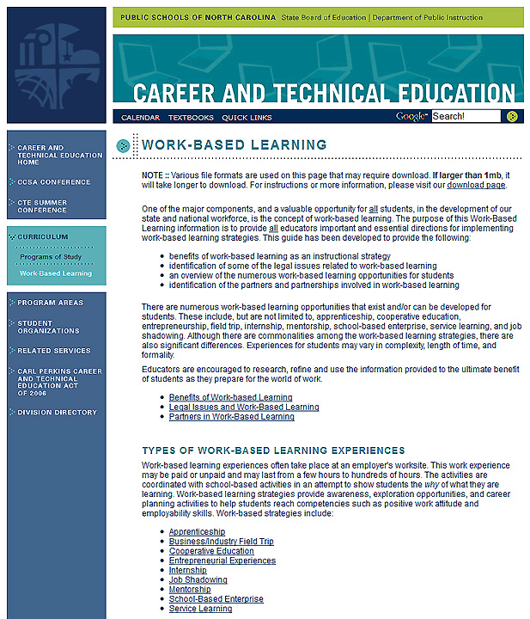
www.ncpublicschools.org/cte/curriculum/work-based
Notes:
If you want to learn more about Work-Based Learning and see all the rules and regulations, you can go to the state Career and Technical Education website.
Select the Curriculum button on the left-side navigation bar.
And then select the Work-Based Learning button that appears below that.
And there in yellow, you see the full web address.
I recently updated and reorganized all of the work-based learning web pages. If you have any questions or suggestions for improvement, please let me know.
======
www.ncpublicschools.org/cte/curriculum/work-based

Slide 19
Activity
First step to starting or improving your WBL program.
First step to marketing your WBL
program to the students.
Notes:
→
What is the first thing you need to do to start, or to improve, your work-based learning program?
Share this with a neighbor, then we will share with the large group.
→
How do you get the students to want to participate in work-based learning? How do you market your program?

Slide 20

Questions
Chris Droessler,
CTE Support Services Consultant, NCDPI
www.ctpnc.org/presentations
Notes:
Any questions before I jump into the next topic?
Remember you can download this PowerPoint at the
C T P N C dot org website.
===============
www.ctpnc.org/presentations

Slide 21
Business Partnerships
Chris Droessler,
CTE Support Services Consultant, NCDPI
www.ctpnc.org/presentations
Notes:
Let’s look at Business Partnerships
Remember you can download this PowerPoint at the C T P N C dot org website.

Slide 22

Business/Education Partnerships
Educators collaborating with business to improve student learning.
Notes:
You have heard the expression that “it takes a whole village to raise a child.”
While it sounds a little trite, there is a great message in there that relates to our business partnerships.
Working together -- we can build the community and make it better.
But that takes a clear vision and a willingness for folks who normally do not talk to each other, to actually come together and work together expecting synergistic results.
In the public schools we are creating the state’s future employees, so it should make sense for us to work with the employers to ensure that we create the future employees that they will want to hire -- five or ten years down the road.
Happy faces like these.

Slide 23
Business/Education Partnerships
Different Levels
Individual teacher
CTE program (multiple teacher)
School
LEA
Notes:
Business/Education partnerships can connect in several ways.
Every teacher should have a professional advisory team. Some of the team members should be professionals in the career area in which the teacher is teaching. This could be one-on-one discussions -- or the advisory team could meet as a team once or twice during the year.
Second is by program area. If you have multiple teachers at the same school teaching in the same CTE program area. Thus if you have two Agricultural Education teachers, you could have a group of business professionals that work as a group with the two teachers at that school.
Some schools have a group of business professionals in an advisory capacity. These are sometimes referred to as a Business Alliance, or Business/Education Advisory Team.
Or the partnership could occur at the LEA or regional level where all of the teachers in that LEA or region of the state could come together with business professionals. An example would be all of the drafting teachers in the LEA could get together once or twice a year to talk to drafting professionals.

Slide 24
Business/Education Partnerships
Professional development
Technology support/training
Resource speakers
Student leadership training
Career Fair participants
Tutor/mentor programs
Student tours
Teacher tours
Academic achievement recognition
Shared use of equipment and facilities
Business Exposition
Classroom partnerships
Student internship opportunities
Job shadowing opportunities
Apprenticeships
Summer teacher internships
Web site development
Electronic mentors
Notes:
A school-level business alliance typically meets with the school faculty a few times a year and looks at what they can do to support the school improvement plan.
They can also be a resource for classroom speakers, field trips, job shadowing. On the screen you see a few ideas.
These meetings are typically coordinated by the school’s CDC, yet run by a business person.

Slide 25
Business/Education Partnerships
First step
Find a single business person
Convene a larger group
Talk – plus/delta
Focus on building community
Notes:
The first step is to identify a single business person and sit down with them. Talk about what you two can do to build the community. Decide what kind of partnership you wish to build.
Keep the plans flexible, because you don’t know how this will all come together,-- and you certainly do not have all the answers.
The second step is to get everyone together. Explain what’s going on. Have each side do a plus/delta.
The business leaders could talk about what makes a great employee. They could talk about what is lacking in the new recruits. It could be soft skills, technical skills, or it could be a total lack of prepared, or interested job applicants.
Then have the teachers describe their successes and their struggles.
Try to keep the session from being a gripe session and keep the discussion away from budgets and politics. Focus on what needs to be done to improve student learning -- and to get these students ready for the workplace.

Slide 26
Business/Education Partnerships
First step
Find a single business person
Convene a larger group
Talk – plus/delta
Focus on building community
Notes:
When I was working in Wake County we got the six agricultural teachers together with several ag-related businesses for county-level meetings every other month. It started out slow, nobody knew what to say. -- but after a few meetings we had businesses offering internship opportunities and businesses volunteering to come teach certain lessons that the teacher was not confident teaching.
A teacher said she was not comfortable teaching the lesson on chain saws, since she did not have much experience. A small-engine business owner said “I’ve got a guy who can teach that. Let’s get together to set up a time.” It took a little honest discussion like that to get the ball rolling.
A large landscaping company said they always order an extra plant or two when they do a large landscaping project just in case one of the plants arrives dead. They said they usually discard the plants at the end of the project figuring nobody would want just one of a single kind of plant.
One of the teachers explained that in fact -- single plants were what they needed, since they have to teach plant identification. Here you had a business that had single plants it was throwing away, since their focus was on large landscaping projects.
And here you have lots of schools that want those single plants to help the students learn about all kinds of plants.
A win-win for everyone.

Slide 27
What makes a successful School/Business Alliance?
Leadership and commitment of the principal
Dedicated coordinator at the school
Support of the School/Business Alliance chair
Action and goal oriented School/Business Alliance members
Commitment to a “Win/Win” relationship
Regular attendance at alliance meetings
Commitment to the school/business alliance strategic plan
Structure that will ensure focus and sustainability where every member is involved and contributes to the alliance activities
Notes:
In order for a school alliance to be successful you need the commitment of the principal.
You need commitment by the business community.
And you need commitment by the school staff.
Ensure that everyone sees the benefit of the business-education partnership.

Slide 28
Business/Education Partnerships
Important Principles
Lead by business
Do NOT ask for money
Build Relationships
Notes:
Here are a few very important principals to create a successful business partnership.
For a school-wide or county-wide partnership, Let the business people elect a leader, and let that leader run the partnership and run the meetings, if there are any meetings.
The teacher or school should express it’s needs, but let the business people, working with the school staff, come up with the solutions. We are creating their future employees, so let them decide how best to do it.
The CDC should coordinate the meeting. This includes scheduling a meeting room, refreshments, making copies, communication.
-- The second important point that works across all kinds of business partnerships is:
Do not ask for money. Be up front with the businesses and tell them that you will not be asking for their money, you want a little bit of their time, and mostly their expertise. Let them know that you wish to engage the community to help build the community.
If they offer funding or equipment, don’t say no.
It’s about building long-term relationships. Investing in the community.
For too long we have been the educators and they have been the employers. We need to work together.

Slide 29
Questions
Chris Droessler,
CTE Support Services Consultant, NCDPI
www.ctpnc.org/presentations
Notes:
Any questions about Business Partnerships?
Any questions about anything?
Remember you can download this PowerPoint at the C T P N C dot org website.
Thank you for your time.
===============
www.ctpnc.org/presentations

Slide 30
Help students discover their passion, then help them get on a pathway where they can turn that passion into a career.
Notes:
Chris Droessler said that.

