Slide 1

The Role of Career Information and Technological Resources in Career Planning
Chris Droessler, Consultant, NCDPI
www.ctpnc.org/presentations
Notes:
Good afternoon. I am Chris Droessler, an education consultant from North Carolina Public Schools.
And I am here to talk to you about The Role of Career Information and Technological Resources in Career Planning.
It doesn’t get much more exciting than that!
Seriously, it’s a bunch of boring data and tech talk that I am going to try to bring to life -- right here before your very own eyes.
If you have a smart phone, and you are smart enough to use it, you can capture that QR code, and your phone takes you magically to the webpage where you can download a copy of this PowerPoint file.
Or you can just go to C T P N C dot org and click on the “presentations” link.
Download the PowerPoint and use it any way you wish if it will help people discover their perfect career. --
=====
CDF Pilot Class
August 18, 2015

Slide 2

CDF Pilot Training
Notes:
So I understand that you all want to be Pilots on the CDF Express.
This is the CDF Pilot Training, is it not?
Seriously…
Who do we have in the room today?
CDC, SPC, CAC , other?
====
Airplane graphic was borrowed without permission from http://samueleggleton.blogspot.com/2010/09/kirsty-mitchells-website.html
2

Slide 3

Essential
Questions
What do I want to be when I grow up?
How can I help get others on a career path?
What is my Vocation?
Notes:
I am still trying to figure out what I want to be when I grow up. At times I think I belong in the Millennial generation, since I have jumped around various industries doing a variety of different jobs.
I found over time that I am passionate about career information, but it might be because I did not have access to this kind of information when I was young.
If I did, there is no telling where I would be today.
I probably would have grown up to become Dr. Sheldon Cooper.
CDCs are people-oriented people. I’m not, so that’s why I’m not a CDC. You have an innate desire to help people. And that’s good.
We stopped using a perfectly good word when we changed from Vocational Education to Career and Technical Education.
Your Vocation is your life’s calling. What is life, the world, a higher power -- calling you to do with your life?
Someone called us all together today, so let’s make the best of it.
3

Slide 4

1. Define career and related information and its purposes.
Your book is wrong.
The middle of page 7-3 has a bad definition of Information.
Information is neither data nor knowledge.
Notes:
Learning Objective number one: Define career and related information and its purposes.
I can see the excitement building in your eyes as we begin to delve into the wonderful world of Career Information.
Actually, this could very well be the part of the CDF class that makes you fall asleep thinking -- “Will this really be on the test?”
→ But, Right now I feel like professor John Keating, played by Robin Williams in the Dead Poets Society, when I say that your textbook is wrong. We should stand on our desks and rip out the offending page.
Notice in the middle of page 7-3 where the paragraph begins with “Information can be defined as data, knowledge, or intelligence that is either given or received.”
→ Let me tell you that Information is neither data nor knowledge. These are not synonyms. Taken with a grain of salt, the rest of the definition on this page is really good.
Let’s go off topic a minute for my 60-second soapbox lecture on the difference between data, information, and knowledge.
That’s my soapbox icon in the corner of the screen to let you know that I am expressing my opinion, which should always be regarded as fact.
4

Slide 5
Wisdom
knowledge + compassion
Knowledge
information + understanding
Information
data + analysis
Data
Notes:
5
Data is just raw characters, like a list of numbers. It won’t mean anything until you put it in context. If we go back to the offending sentence, it mentions data that is given or received. If you give or receive data, the data are still data. They do not magically turn into information. -- But…
→ If you analyze the data and form them into something useful, then you have information.
But what good is information all by itself?
→ If you take that information and add understanding, you have knowledge.
We try to turn information into knowledge every day in classrooms across the state.
And when you take all of that knowledge and temper it with compassion, you end up with wisdom.
Wisdom to take the data that was turned into information, --understood to become knowledge, --and now apply it to the real problems of the world.
Adding passion means you will hopefully use that knowledge for good rather than for evil.
You have the power to use your wisdom to steer your kids away from the dark side of the force.

Slide 6
1. Define career and related information and its purposes.
Help your students make the best use of the plethora of career information.
Job outlook, salaries, education requirements, list of jobs, videos, job postings.
Get students on the right career pathway
Notes:
Back to Learning Objective number one.
→ Our essential purpose here is to help you and your students make the best use of the plethora of career information.
And then here is some of what makes up career, or occupation information.
Job outlook, salaries, education requirements, and much more.
→ We are talking about the information our students need to help get them on the career pathway that is right for them.
6

Slide 7

1. Define career and related information and its purposes.
Formative
Assessment
Notes:
Who is ready to help us with a formative assessment of learning objective number one?
Discuss it at your table, then we will report out.
Just repeat anything I just said.
Anyone?
Bueller?
….
Thank you very much.
7

Slide 8
2. Describe the role of the CDF with respect to using information and technological resources in the career development process.
Know where to find good, appropriate career information for your students.
Do not overwhelm your students with too much information.
Let the student make the decisions.
Notes:
And now Learning Objective number two.
→ This lesson is about Knowing where to find good, appropriate career information for your students.
Can we assume that all of our high school students have taken at least one trip on the Internet? If you were working with adults, it might be different.
But since we are dealing with children, -- we do have to inform the parents.
The number one source of career information is the parents. We have to remember to educate the parents.
All of us who went to college have learned about, and experienced a lot of things that less-educated people are unaware of.
People only know about the occupations with wich they have come in contact. They might think that culture or social status might keep them from certain occupations.
→ Do not overwhelm your students with too much information.
Some websites are cluttered with too much information. Start simple.
And Keep it simple -- until they are ready to take off on their own.
And remember, your job as a counselor is to help guide the student to make their own career decision. Help them to sift through the myriad of information.
Teach them the decision making process. But in the end, -- let them make the decision. -- And sometimes you have to wait until they are ready to make that decision.
It’s their life.
8

Slide 9
2. Describe the role of the CDF with respect to using information and technological resources in the career development process.
Formative
Assessment
Notes:
Who is ready to help us with a formative assessment of learning objective number two?
Discuss it at your table, then we will report out.
Just repeat anything I just said.
Anyone?
Bueller?
….
Thank you very much.
9

Slide 10




3. Identify and describe multiple types and sources of information, including career information and technological resources.
There is a lot of stuff out there.
Notes:
And now Learning Objective number three:
First – There is a lot of stuff out there.
Some formal and some informal.
Some of it is really good, and some is quite lame.
Some is detailed, and some is big picture.
Some free, and some cost big bucks.
Print, video, the Web, social media.
And even old-fashioned face-to-face discussions
There is a lot of information about careers out there.
10

Slide 11
3. Identify and describe multiple types and sources of information, including career information and technological resources.
Classification Systems
Holland RIASEC – career interests
Standard Occupational Classification System (SOC) (example: 29-1131.00 = Veterinarians)
16 Career Clusters
Notes:
Career data is classified several different ways. Categorizing data is one way of turning it into information.
John Holland came up with a way to measure your career interests in six different categories and then compare those to people who are already employed in occupations.
Has everyone done a career interest assessment?
I am high in Realistic and Conventional. Low in social and artistic.
The Standard Occupational Classification System is used to identify specific occupations. It is useful when you want to compare several government data tables. I use the term “soc codes” to refer to the number assigned to each occupation.
For years we have been using the 16 Career Clusters to help us educators classify careers. It’s a good first step to get folks to choose a broad career cluster before narrowing down to a specific career.
11

Slide 12
3. Identify and describe multiple types and sources of information, including career information and technological resources.
Career assessments
Career information sources
Salaries, projections, education requirements
Notes:
→ Start with a career assessment.
Career interests is a good place to start.
Middle- and High-school kids may not be able to complete skills assessments and work values assessments since they have not had much time to try out skills or understand work values. But they should be able to complete a career interest assessment.
The key here is that -- kids have to figure out who they are -- before they can match themselves to a occupation. And if you have been around high school kids, you know they do not know who they are.
Next is to look at career- or occupation-information sources. These could be government sources like the Occupational Handbook or the O*NET. Or could be something like Futures for Kids, Career Cruising, Bridges, or Kuder. Some cost money, and others are free.
The number one source of career information is parents, yet what do this generation’s parents know about nanotechnology and bioinformatics?
Social media, like LinkedIn, blogs, podcasts, wikis, discussion boards are modern methods of communicating, and can be used to gather occupational information.
→ Then check out the salaries, job projections, educational requirements, and other aspects of each occupation.
You will find that some web sites have different salaries and projections, and even a different list of job titles. There is no one perfect career information resource. Start with something simple, but make sure kids know before they get out of high school -- that there are lots of answers, they just have to figure out which answer is the right one for them.
12

Slide 13
Associate Degree Required
(2011 NC Starting Salaries - 2018 High Demand)
$62,210 Construction Managers
$51,360 Dental Hygienists
$46,040 Registered Nurses
$42,350 Respiratory Therapists
$40,690 Radiologic Technologists and Technicians
$40,420 Physical Therapist Assistants
$28,030 Paralegals and Legal Assistants
$26,840 Medical and Clinical Laboratory Technicians
$19,810 Veterinary Technologists and Technicians
$17,400 Preschool Teachers, except Special Education
Notes:
Let’s look at some occupation information. Remember you can download this PowerPoint and use these slides with your students and their parents.
Here are High Demand jobs in North Carolina that require a
2-year associate degree. This list shows the occupations with the highest starting salaries.
How many of you wish you had the starting salary of a dental hygienist? Or had the Dental Hygienist’s student loans to repay. Two years of community college and you start making over fifty thousand dollars. Not bad.
===============
www.CareerOutlook.us
High Demand is above the Mean of all Average Total Annual Openings, which for 2008-2018 is above 60 openings per year.

Slide 14
Bachelor Degree Required
(2011 NC Starting Salaries - 2018 High Demand)
$86,820 Computer and Information Systems Managers
$72,800 Financial Managers
$71,430 Software Developers, Systems Software
$63,180 Medical and Health Services Managers
$61,140 Software Developers, Applications
$54,740 Sales Managers
$54,430 Computer Systems Analysts
$49,890 Financial Analysts
$49,270 Network and Computer Systems Administrators
$47,950 Management Analysts
$46,380 Civil Engineers
$43,880 Accountants and Auditors
$43,360 Securities, Commodities, and Financial Services Sales Agents
$40,950 Financial Specialists, All Other
$40,830 Environmental Scientists and Specialists, Including Health
$40,790 Compensation, Benefits, and Job Analysis Specialists
$39,040 Sales Representatives, Wholesale and Manufacturing, Technical and Scientific Products
$38,140 Training and Development Specialists
$38,040 Compliance Officers
$37,160 Cost Estimators
$36,990 Market Research Analysts and Marketing Specialists
$36,230 Personal Financial Advisors
$35,500 Public Relations Specialists
$34,770 Secondary School Teachers, Except Special and Career/Technical Education
$34,060 Special Education Teachers, Preschool, Kindergarten, and Elementary School
$33,750 Elementary School Teachers, Except Special Education
$33,710 Middle School Teachers, Except Special and Career/Technical Education
$33,630 Kindergarten Teachers, Except Special Education
$33,380 Mental Health and Substance Abuse Social Workers
$32,890 Child, Family, and School Social Workers
$32,160 Adult Basic and Secondary Education and Literacy Teachers and Instructors
$28,300 Clergy
$28,100 Graphic Designers
$16,890 Recreation Workers
Notes:
Here we are looking at the high demand jobs in North Carolina that require a bachelor degree, starting with the highest starting salaries. If you follow this list below the bottom of the screen, down near the floor, are the school teachers.
The underlined occupations are in management, which means that not only does the job require a bachelor degree, but also requires some years of work experience in that field. These are not jobs that you get four years out of high school.
How could you use this information with your students?
=============
www.CareerOutlook.us
High Demand is above the Mean of all Average Total Annual Openings, which for 2008-2018 is above 60 openings per year.

Slide 15
Fastest Growing Occupations in NC
Requiring Postsecondary Education
(Total Change in Positions Projected from 2010 - 2020)
17,250 Registered Nurses
9,930 Postsecondary Teachers
8,640 Elementary School Teachers, Except Special Education
4,400 Accountants and Auditors
4,160 Middle School Teachers, Except Special and Career/Technical Education
3,870 Teachers and Instructors, All Other
3,830 Market Research Analysts and Marketing Specialists
3,730 Business Operations Specialists, All Other
3,360 Physicans and Surgeons
3,240 Secondary School Teachers, Except Special and Career/Technical Education
3,100 Police and Sheriff's Patrol Officers
3,010 Medical Secretaries
2,860 Emergency Medical Technicians and Paramedics
2,530 Paralegals and Legal Assistants
2,430 Heating, Air Conditioning, and Refrigeration Mechanics and Installers
2,280 Medical Scientists, Except Epidemiologists
2220 Special Education Teachers, Preschool, Kindergarten, and Elementary School
2210 Firefighters
2120 Computer Systems Analysts
2110 Human Resources, Training, and Labor Relations Specialists, All Other
1980 Lawyers
1920 Construction Managers
1920 Information Security Analysts, Web Developers, and Computer Network Architects
1830 Network and Computer Systems Administrators
1770 Dental Hygienists
Notes:
15
Not counting the occupations that require less than a year of on-the-job-training (OJT),
here are the high-demand occupations in North Carolina that require some kind of postsecondary education.
The number listed is the projected change in the number of positions in North Carolina over the ten-year projection period.
In 2020, North Carolina will need 17,250 more registered nurses than we had in 2010.
And you should notice that we need a lot of teachers. They are split out into several categories.
=========
These data are from www.CareerOutlook.US
http://www.bls.gov/emp/ep_table_112.htm
Education and training assignments
updated January 13, 2012

Slide 16
Fastest Growing Occupations in NC
(Total Change in Positions Projected from 2010 - 2020)
18,610 Combined Food Preparation and Serving Workers, Including Fast Food
17,250 Registered Nurses
14,260 Retail Salespersons
12,010 Home Health Aides
10,100 Customer Service Representatives
9,930 Postsecondary Teachers
9,840 Landscaping and Groundskeeping Workers
8,870 Janitors and Cleaners, Except Maids and Housekeeping Cleaners
8,790 Cashiers
8,640 Elementary School Teachers, Except Special Education
7,350 Office Clerks, General
6,360 Receptionists and Information Clerks
5,680 Waiters and Waitresses
5,660 Teacher Assistants
5530 Bookkeeping, Accounting, and Auditing Clerks
5360 Laborers and Freight, Stock, and Material Movers, Hand
4920 Childcare Workers
4900 Nursing Aides, Orderlies, and Attendants
4810 First-Line Supervisors of Office and Administrative Support Workers
4590 Personal Care Aides
4400 Accountants and Auditors
4340 Maintenance and Repair Workers, General
4320 Security Guards
4160 Middle School Teachers, Except Special and Career/Technical Education
3870 Teachers and Instructors, All Other
3830 Market Research Analysts and Marketing Specialists
3800 Sales Representatives, Wholesale and Manufacturing, Except Technical and Scientific Products
3730 Business Operations Specialists, All Other
3620 Executive Secretaries and Executive Administrative Assistants
3490 First-Line Supervisors of Construction Trades and Extraction Workers
3440 Cooks, Restaurant
3360 Physicans and Surgeons
3280 Team Assemblers
3240 Secondary School Teachers, Except Special and Career/Technical Education
3160 Software Developers, Applications
3100 Police and Sheriff's Patrol Officers
3020 First-Line Supervisors of Food Preparation and Serving Workers
3010 Medical Secretaries
2900 First-Line Supervisors of Retail Sales Workers
2860 Emergency Medical Technicians and Paramedics
2850 Construction Laborers
2810 Hairdressers, Hairstylists, and Cosmetologists
2770 Medical Assistants
2690 Food Preparation Workers
2630 Maids and Housekeeping Cleaners
2590 Pharmacy Technicians
2560 Carpenters
2530 Paralegals and Legal Assistants
2430 Heating, Air Conditioning, and Refrigeration Mechanics and Installers
2310 Secretaries and Administrative Assistants, Except Legal, Medical, and Executive
2280 Medical Scientists, Except Epidemiologists
2240 Coaches and Scouts
2240 Billing and Posting Clerks
2220 Special Education Teachers, Preschool, Kindergarten, and Elementary School
2210 Firefighters
2160 Sales Representatives, Services, All Other
2130 Heavy and Tractor-Trailer Truck Drivers
2120 Computer Systems Analysts
2110 Human Resources, Training, and Labor Relations Specialists, All Other
2070 Painters, Construction and Maintenance
2010 Tellers
1980 Lawyers
1980 Dental Assistants
1980 Packers and Packagers, Hand
1920 Construction Managers
1920 Information Security Analysts, Web Developers, and Computer Network Architects
1910 Machinists
1840 Amusement and Recreation Attendants
1830 Network and Computer Systems Administrators
1780 Industrial Machinery Mechanics
1770 Dental Hygienists
1760 Insurance Sales Agents
1730 Management Analysts
1700 Radiologic Technologists and Technicians
1680 Managers, All Other
1680 Operating Engineers and Other Construction Equipment Operators
1670 Financial Analysts
1670 Software Developers, Systems Software
1670 Licensed Practical and Licensed Vocational Nurses
1660 Helpers--Production Workers
1620 Training and Development Specialists
1600 Personal Financial Advisors
1600 Automotive Service Technicians and Mechanics
1580 Meat, Poultry, and Fish Cutters and Trimmers
1550 Preschool Teachers, Except Special Education
1530 Child, Family, and School Social Workers
1530 Fitness Trainers and Aerobics Instructors
1520 Pharmacists
1480 Telecommunications Equipment Installers and Repairers, Except Line Installers
1470 Electricians
1440 Securities, Commodities, and Financial Services Sales Agents
1440 First-Line Supervisors of Mechanics, Installers, and Repairers
1420 Plumbers, Pipefitters, and Steamfitters
1400 First-Line Supervisors of Landscaping, Lawn Service, and Groundskeeping Workers
1370 Cost Estimators
1350 Civil Engineers
1340 Computer and Information Systems Managers
1330 Nonfarm Animal Caretakers
1270 Sales Representatives, Wholesale and Manufacturing, Technical and Scientific Products
1240 Veterinary Technologists and Technicians
1240 Correctional Officers and Jailers
1240 Real Estate Sales Agents
1220 Educational, Guidance, School, and Vocational Counselors
1210 Interpreters and Translators
1160 Self-Enrichment Education Teachers
1160 Recreation Workers
1160 Real Estate Brokers
1140 Financial Managers
1140 Social and Human Service Assistants
1130 Education Administrators, Elementary and Secondary School
1120 Loan Officers
1120 Counter and Rental Clerks
1110 Inspectors, Testers, Sorters, Samplers, and Weighers
1100 Assemblers and Fabricators, All Other
1100 Computer-Controlled Machine Tool Operators, Metal and Plastic
1100 Light Truck or Delivery Services Drivers
1090 Education, Training, and Library Workers, All Other
1080 Bill and Account Collectors
1030 Education Administrators, Postsecondary
1020 Slaughterers and Meat Packers
1020 Driver/Sales Workers
1010 Graphic Designers
Notes:
16
Here I’ve added to that list the short and moderate on-the-job-training occupations in green so you can compare their demand with the others.
Thus the green jobs are the ones you can get right out of high school, whereas the blue ones require some college work.
-- This list shows all occupations in North Carolina that require the most new workers projected through 2020.
Only two occupations on this list requires a 4-year degree! And once you get past the bottom of the page you find a variety of education occupations that also require the 4-year degree.
…
--------
These data are from www.CareerOutlook.US
http://www.bls.gov/emp/ep_table_112.htm
Education and training assignments
updated January 13, 2012

Slide 17
Fastest Declining Occupations in NC
(Total Change in Positions Projected from 2010 - 2020)
-8,380 Farmers, Ranchers, and Other Agricultural Managers
-1,690 Sewing Machine Operators
-1,090 Switchboard Operators, Including Answering Service
-1,040 Textile Knitting and Weaving Machine Setters, Operators, and Tenders
-1,010 Textile Winding, Twisting, and Drawing Out Machine Setters, Operators, and Tenders
-740 Machine Feeders and Offbearers
-720 Textile Bleaching and Dyeing Machine Operators and Tenders
-700 Upholsterers
-660 Shipping, Receiving, and Traffic Clerks
-560 Data Entry Keyers
-450 Food Service Managers
-400 Loan Interviewers and Clerks
-270 Postal Service Mail Carriers
-250 Extruding, Forming, Pressing, and Compacting Machine Setters, Operators, and Tenders
-240 Office Machine Operators, Except Computer
-240 Extruding and Forming Machine Setters, Operators, and Tenders, Synthetic and Glass Fibers
-230 Textile Cutting Machine Setters, Operators, and Tenders
-230 Textile, Apparel, and Furnishings Workers, All Other
-220 Logging Equipment Operators
-210 Furnace, Kiln, Oven, Drier, and Kettle Operators and Tenders
-200 Photographic Process Workers and Processing Machine Operators
-190 Furniture Finishers
-160 Computer Operators
-160 Prepress Technicians and Workers
-160 Printing Press Operators
-160 Cutters and Trimmers, Hand
-150 Travel Agents
-140 Reporters and Correspondents
-140 Fiberglass Laminators and Fabricators
-120 Claims Adjusters, Examiners, and Investigators
-120 Chemical Plant and System Operators
-110 Millwrights
-110 Semiconductor Processors
-100 Postal Service Mail Sorters, Processors, and Processing Machine Operators
-100 Fabric and Apparel Patternmakers
-90 Cooks, Fast Food
-90 Desktop Publishers
-90 First-Line Supervisors of Farming, Fishing, and Forestry Workers
-90 Pressers, Textile, Garment, and Related Materials
-80 Chefs and Head Cooks
-80 File Clerks
-80 Word Processors and Typists
-80 Maintenance Workers, Machinery
-80 Jewelers and Precious Stone and Metal Workers
-70 Insurance Underwriters
-70 Postal Service Clerks
-70 Fallers
-70 Parking Lot Attendants
-60 Floral Designers
-60 Lathe and Turning Machine Tool Setters, Operators, and Tenders, Metal and Plastic
-60 Molding, Coremaking, and Casting Machine Setters, Operators, and Tenders, Metal and Plastic
-50 Helpers--Roofers
-50 Sewers, Hand
-50 Grinding and Polishing Workers, Hand
-40 Insurance Claims and Policy Processing Clerks
-40 Painters, Transportation Equipment
-40 Rail Yard Engineers, Dinkey Operators, and Hostlers
-30 Insurance Appraisers, Auto Damage
-30 Funeral Attendants
-30 Reservation and Transportation Ticket Agents and Travel Clerks
-30 Drilling and Boring Machine Tool Setters, Operators, and Tenders, Metal and Plastic
-30 Tailors, Dressmakers, and Custom Sewers
-20 Postmasters and Mail Superintendents
-20 Actors
-20 Correspondence Clerks
-20 Elevator Installers and Repairers
-20 Fabric Menders, Except Garment
-20 Coil Winders, Tapers, and Finishers
-20 Plating and Coating Machine Setters, Operators, and Tenders, Metal and Plastic
-20 Model Makers, Wood
-20 Conveyor Operators and Tenders
-10 Computer Hardware Engineers
-10 Drafters, All Other
-10 Respiratory Therapy Technicians
-10 Food Preparation and Serving Related Workers, All Other
-10 Animal Trainers
-10 Motion Picture Projectionists
-10 Shampooers
-10 Electric Motor, Power Tool, and Related Repairers
-10 Patternmakers, Metal and Plastic
-10 Print Binding and Finishing Workers
-10 Patternmakers, Wood
-10 Power Plant Operators
-10 Stationary Engineers and Boiler Operators
-10 Etchers and Engravers
-10 Pump Operators, Except Wellhead Pumpers
-10 Tank Car, Truck, and Ship Loaders
Notes:
17
And here are the jobs to stay away from.
We need this many less of each of these jobs over this ten-year projection period.
For most of these positions, machines are replacing humans.
=======
These data are from www.CareerOutlook.US
http://www.bls.gov/emp/ep_table_112.htm
Education and training assignments
updated January 13, 2012
Textiles – socks in NC
http://www.nctextileconnect.com/connect_detail.cfm?valuechain_catid=38
Socks made in USA
http://www.americansworking.com/socks.html

Slide 18
3. Identify and describe multiple types and sources of information, including career information and technological resources.
Formative
Assessment
Notes:
What have we learned for Objective number 3?
Discuss it at your table, then we will report out.
18

Slide 19
4. Explain how information is culture specific.
Geography
Gender
Race
Age
Disability
Notes:
If all of the information about a certain career shows pictures of a single gender or race, then kids might unconsciously steer away from that occupation.
Terms used in interest assessments or occupational information may have special meaning for certain cultures and may not be understood by all.
The projected job openings and average salaries are different across the state, across the country, and across the world.
Most of the popular career information web sites use the federal data about salaries and job projections, but some create their own data.
Who collected the data and turned it into information?
Can we trust them?
19

Slide 20
4. Explain how information is culture specific.
Formative
Assessment
Notes:
What have we learned about how information can be culture specific?
Discuss it at your table, then we will report out.
20

Slide 21
5. Critically evaluate your career information and technological literacy.
Locating information
Evaluating the information
Is it accurate, understandable, current, specific, sufficient, unbiased?
Using the information
Notes:
Can you locate and use career information?
Is it good information? How can you tell?
Then can you use the information? Or is it just a bunch of meaningless gibberish on a computer screen?
The career information should help solve the problem of creating or improving a personal career plan. If it does not do that, then it is time to move on to something else.
And since things change quickly in this fast-paced world, we have to keep re-evaluating the resources often.
From all of the available resources, you have to decide which source of information is best for the specific student with whom you are working.
Are you ready for that?
21

Slide 22
5. Critically evaluate your career information and technological literacy.
Formative
Assessment
Notes:
What have we just learned?
Objective number 5.
Discuss it at your table, then we will report out.
22

Slide 23
6. Incorporate information and technology into the career planning process.
Notes:
I have to pause here to see if we are using the same definitions of the terms information and technology.
You have already heard my definition of information.
Now sit back and enjoy my rant about the word technology.
23

Slide 24

Technology
Notes:
I’m back on my soapbox defending the classic meaning of the word technology.
Some folks think that technology means that it involves computers. Computers are a special kind of technology that we use to gather, manipulate, store, and output large amounts of information, which is why we call the field of computers “Information Technology.”
But Technology is anything that man has created to help overcome a situation -- or something created to make life better. A wooden stick is technology. It allowed our ancestors to defend themselves from wild animals.
Now days -- there’s an app for that.
24

Slide 25
6. Incorporate information and technology into the career planning process.
Communication
Analysis
Synthesis
Valuing
Execution
Communication - Revisited
Notes:
Here are the six stages in the decision-making process, which in this case is the career-planning process.
Communication is the first encounter with the student. It’s a time to figure out if the student is ready to start exploring careers.
Then Analysis is where you help the student figure out who they are, what are their interests when it comes to careers.
Synthesis is where you take the results of the assessments and come up with a short list of career options. Your students do not need to be looking at a list of 900 occupations. The self assessment will help to narrow down to a short list.
Valuing stage is where they decide which of the occupations on their list have the salary they desire, the job security, education level they wish to pursue, etc.
This will help them whittle down their list to just a few occupations. This is the stage where job shadowing and further research can help the student decide which occupations have value to them.
At the Execution stage, the student decides which occupations to pursue. This includes drafting a detailed career plan that includes all steps necessary to get that job. This step includes internships, apprenticeships, further education, and the other steps on the career plan.
Communication stage is where you take the student back to the first stage where careers were first discussed. Does the decision at the Execution stage solve the concerns at the initial Communication stage.
25

Slide 26
6. Incorporate information and technology into the career planning process.
Formative
Assessment
Notes:
What have we learned?
Objective number 6.
Discuss it at your table, then we will report out.
26

Slide 27


7. Explain unique opportunities and challenges presented by technological resources.
Notes:
There is no one perfect career exploration or planning tool.
Not everyone has the same comfort level using online tools.
You have to match the career resources to each student which whom you work.
It’s called Differentiated instruction.
In the old days, the sole source for information was the school library or the public library. Everything that went into the school or public library was vetted by a committee to judge the appropriateness of the information.
Now with the Internet 2.0, anyone can put anything on the Internet and claim it to be true. That can be a problem.
27

Slide 28

1. Registered Nurses
2. Automotive Service Technicians and Mechanics
3. Carpenters
4. Electricians
5. Computer Systems Analysts
6. Machinists
7. Plumbers, Pipefitters, Steamfitters
8. Welders, Cutters, Solderers and Brazers
Notes:
There are lots of different hot job lists out there.
This particular list shows the top jobs that don’t require a four-year degree.
All high-demand jobs.
====
The average STEM job available to workers without a bachelor’s degree paid $53,000, 10% higher than other jobs requiring similar educational attainment.
1. Registered Nurses
2. Automotive Service Technicians and Mechanics
3. Carpenters
4. Electricians
5. Computer Systems Analysts
6. Machinists
7. Plumbers, Pipefitters, Steamfitters
8. Welders, Cutters, Solderers and Brazers
====
http://247wallst.com/2013/06/26/high-tech-jobs-that-do-not-require-a-college-degree/
High-Tech Jobs That Don’t Need a College Degree
Read more: High-Tech Jobs That Don’t Need a College Degree - 24/7 Wall St. http://247wallst.com/2013/06/26/high-tech-jobs-that-do-not-require-a-college-degree/#ixzz2XQ7hpswB
June 26, 2013
The average STEM job available to workers without a bachelor’s degree paid $53,000, 10% higher than other jobs requiring similar educational attainment. Among the eight most popular STEM jobs that do not require a college degree, six paid more than the national annual average wage of $45,230. There were nearly 500,000 people working as computer systems analysts in 2011, a position that does not require a bachelor’s degree and paid $82,320, on average.
Though a four-year college degree is not a prerequisite, many of these jobs still have rigorous requirements. Most plumbers, pipefitters and steamfitters go through a four or five year apprenticeship program, which includes studying math, physics and chemistry, according to the Bureau of Labor Statistics (BLS). Registered nurses, by far the fastest growing STEM job that does not require a bachelor’s degree, need to take courses in anatomy, chemistry and microbiology.
Read more: High-Tech Jobs That Don’t Need a College Degree - 24/7 Wall St. http://247wallst.com/2013/06/26/high-tech-jobs-that-do-not-require-a-college-degree/#ixzz2XQ7ptbo3

Slide 29

Notes:
This hot jobs list shows the Top ten unusual jobs that pay surprisingly well.
-- like running a hot dog cart.
Everyone needs to know that there is no one best list.
======
http://www.forbes.com/pictures/efkk45ejgdm/10-unusual-jobs-that-pay-surprisingly-well/#gallerycontent

Slide 30

10 Hardest to Fill Jobs in America
Notes:
Here is a list of the top ten hardest-to-fill jobs.
Teachers are on the list at number ten.
Teachers, of all kinds, are the occupation that requires a bachelor degree -- that is in the highest demand.
======
Forbes recently looked at the 10 Hardest to Fill Jobs in America
===
http://www.forbes.com/sites/jacquelynsmith/2013/05/28/the-10-hardest-jobs-to-fill-in-2013/

Slide 31

10 Hardest to Fill Jobs in America
Notes:
Mechanics are in high demand. We depend on our cars and want them fixed fast and correctly.
Top mechanics can make over $100,000 working at the large dealerships.
======
Forbes recently looked at the 10 Hardest to Fill Jobs in America
===
http://www.forbes.com/sites/jacquelynsmith/2013/05/28/the-10-hardest-jobs-to-fill-in-2013/

Slide 32

10 Hardest to Fill Jobs in America
Notes:
Technicians are in high demand.
This is the Science and Technology side of the STEM that we keep hearing about.
======
Forbes recently looked at the 10 Hardest to Fill Jobs in America
===
http://www.forbes.com/sites/jacquelynsmith/2013/05/28/the-10-hardest-jobs-to-fill-in-2013/

Slide 33

10 Hardest to Fill Jobs in America
Notes:
Engineers
Not just engineers who can design buildings that don’t fall down, but engineers who can think outside the box and create something exciting and new.
======
Forbes recently looked at the 10 Hardest to Fill Jobs in America
===
http://www.forbes.com/sites/jacquelynsmith/2013/05/28/the-10-hardest-jobs-to-fill-in-2013/

Slide 34
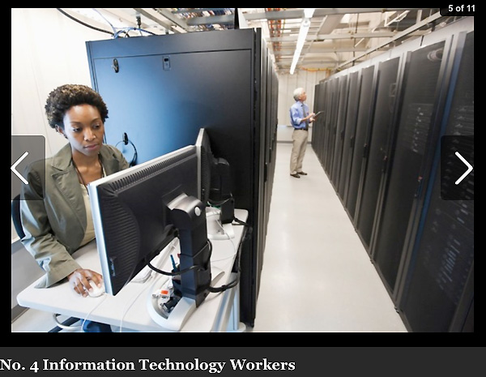
10 Hardest to Fill Jobs in America
Notes:
IT workers at all levels.
Notice that we are seeing a lot of the STEM jobs in these lists.
======
Forbes recently looked at the 10 Hardest to Fill Jobs in America
===
http://www.forbes.com/sites/jacquelynsmith/2013/05/28/the-10-hardest-jobs-to-fill-in-2013/

Slide 35

10 Hardest to Fill Jobs in America
Notes:
Sales Representatives are in high demand because businesses need to sell their products and services.
======
Forbes recently looked at the 10 Hardest to Fill Jobs in America
===
http://www.forbes.com/sites/jacquelynsmith/2013/05/28/the-10-hardest-jobs-to-fill-in-2013/

Slide 36

10 Hardest to Fill Jobs in America
Notes:
And topping this high demand list -- is Skilled Trades.
One reason that skilled trades are in high demand is because years ago we started discouraging kids from going into blue-collar jobs.
And now that we are coming out of the recession, -- the building boom is set to begin with no one to do the work.
======
Forbes recently looked at the 10 Hardest to Fill Jobs in America
===
http://www.forbes.com/sites/jacquelynsmith/2013/05/28/the-10-hardest-jobs-to-fill-in-2013/

Slide 37
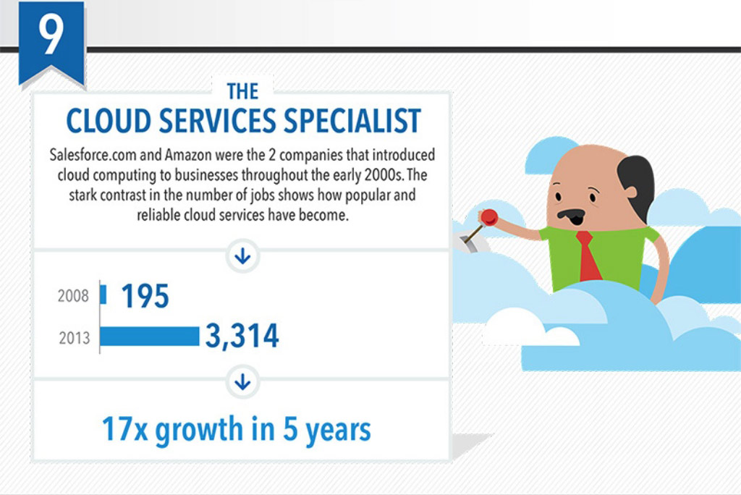
Top 10 Job Titles that Didn’t Exist Five Years Ago
Notes:
I found this list of Top Ten Job Titles that Didn’t Exist Five Years Ago.
My dad spent his whole career working on clouds, but then he was a meteorologist.
The clouds since then have changed.
=====
http://talent.linkedin.com/blog/index.php/2014/01/top-10-job-titles-that-didnt-exist-5-years-ago-infographic
Top 10 Job Titles That Didn’t Exist 5 Years Ago
Methodological details: We counted the frequencies of all English words and phrases used in job titles that were held in 2013 and compared the results to job titles that were held in 2008. We then took the top titles that saw the largest growth in frequency in that 5 year period and ranked them by their relative size in 2013. “Big data” and “cloud services” were the root phrases used to determine frequencies for “big data architect” and “cloud services manager” (which had many permutations, e.g. “big data architect/analyst/engineer” etc.). For simplicity’s sake, the titles you see above were used as examples. Data is current as of November 26, 2013.

Slide 38
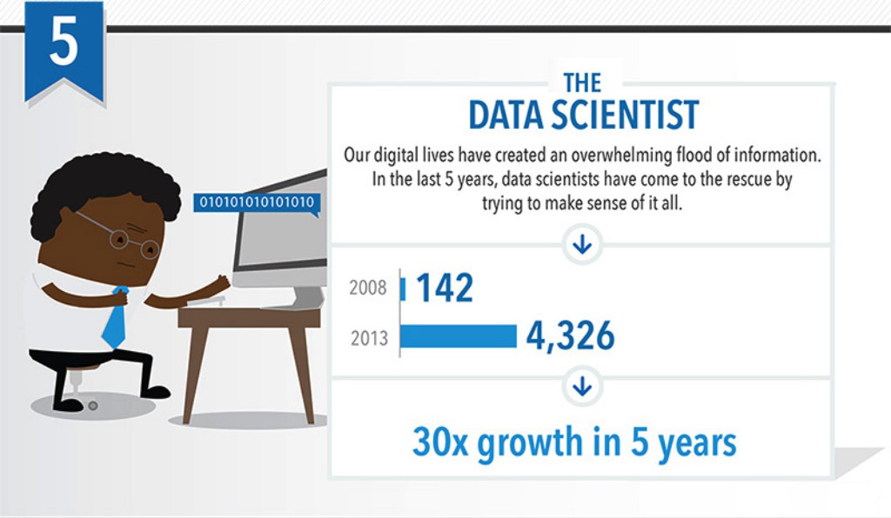
Top 10 Job Titles that Didn’t Exist Five Years Ago
Notes:
the Data Scientist
Someone needs to take all that data we’ve collected and turn it into information.
That’s the Data Scientist.
=====
http://talent.linkedin.com/blog/index.php/2014/01/top-10-job-titles-that-didnt-exist-5-years-ago-infographic
Top 10 Job Titles That Didn’t Exist 5 Years Ago
Methodological details: We counted the frequencies of all English words and phrases used in job titles that were held in 2013 and compared the results to job titles that were held in 2008. We then took the top titles that saw the largest growth in frequency in that 5 year period and ranked them by their relative size in 2013. “Big data” and “cloud services” were the root phrases used to determine frequencies for “big data architect” and “cloud services manager” (which had many permutations, e.g. “big data architect/analyst/engineer” etc.). For simplicity’s sake, the titles you see above were used as examples. Data is current as of November 26, 2013.

Slide 39
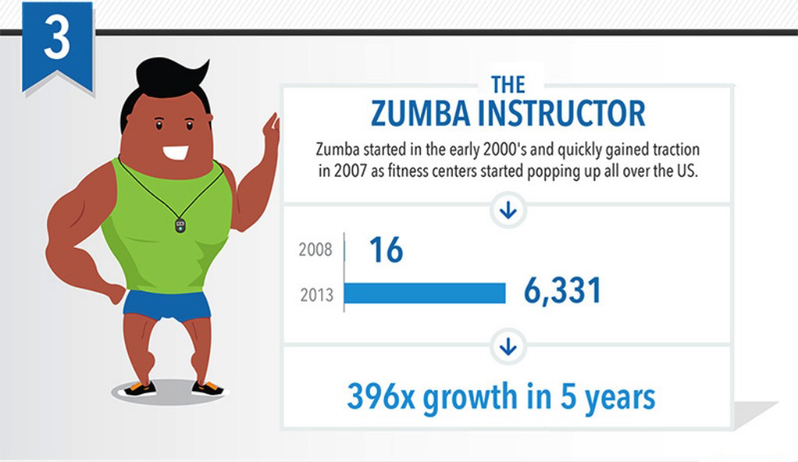
Top 10 Job Titles that Didn’t Exist Five Years Ago
Notes:
Look! It’s a high demand job that does not require a computer!
Sometimes we need to get away from our computers for a little while, and that’s why Zumba instructors are in high demand.
=====
http://talent.linkedin.com/blog/index.php/2014/01/top-10-job-titles-that-didnt-exist-5-years-ago-infographic
Top 10 Job Titles That Didn’t Exist 5 Years Ago
Methodological details: We counted the frequencies of all English words and phrases used in job titles that were held in 2013 and compared the results to job titles that were held in 2008. We then took the top titles that saw the largest growth in frequency in that 5 year period and ranked them by their relative size in 2013. “Big data” and “cloud services” were the root phrases used to determine frequencies for “big data architect” and “cloud services manager” (which had many permutations, e.g. “big data architect/analyst/engineer” etc.). For simplicity’s sake, the titles you see above were used as examples. Data is current as of November 26, 2013.

Slide 40

Notes:
A recent study from Georgetown.
====
Job Growth and Education Requirements Through 2020
=====
http://cew.georgetown.edu/recovery2020/
Recovery 2020: Job Growth and Education Requirements Through 2020
June 26, 2013
Recovery 2020 finds that:
There will be 55 million job openings in the economy through 2020: 24 million openings from newly created jobs and 31 million openings due to baby boom retirements.
By educational attainment: 35 percent of the job openings will require at least a bachelor’s degree, 30 percent of the job openings will require some college or an associate’s degree and 36 percent of the job openings will not require education beyond high school.
STEM, Healthcare Professions, Healthcare Support, and Community Services will be the fastest growing occupations, but also will require high levels of post-secondary education.
Most jobs will require some type of post-secondary education, and individuals that only posses a high school diploma will have fewer employment options.
Employers will seek cognitive skills such as communication and analytics from job applicants rather than physical skills traditionally associated with manufacturing.
The United States will fall short by 5 million workers with postsecondary education – at the current production rate – by 2020.

Slide 41

Notes:
Here are the job areas that their research says will be hiring.
There are lots of different lists of what is in demand and what is not.
How do you know which lists are appropriate for the student with whom you are working?
======
We hear a lot about STEM jobs and healthcare.
Community services is an area that is growing in demand.
=====
http://cew.georgetown.edu/recovery2020/
Recovery 2020: Job Growth and Education Requirements Through 2020
June 26, 2013
Recovery 2020 finds that:
There will be 55 million job openings in the economy through 2020: 24 million openings from newly created jobs and 31 million openings due to baby boom retirements.
By educational attainment: 35 percent of the job openings will require at least a bachelor’s degree, 30 percent of the job openings will require some college or an associate’s degree and 36 percent of the job openings will not require education beyond high school.
STEM, Healthcare Professions, Healthcare Support, and Community Services will be the fastest growing occupations, but also will require high levels of post-secondary education.
Most jobs will require some type of post-secondary education, and individuals that only posses a high school diploma will have fewer employment options.
Employers will seek cognitive skills such as communication and analytics from job applicants rather than physical skills traditionally associated with manufacturing.
The United States will fall short by 5 million workers with postsecondary education – at the current production rate – by 2020.

Slide 42
7. Explain unique opportunities and challenges presented by technological resources.
Formative
Assessment
Notes:
What have we learned in Objective number 7?
Discuss it at your table, then we will report out.
42

Slide 43
8. Identify the elements required for providing online career services.
Career information on school website
Links to career information sites
Blog, twitter, discussions
Policy about reaching students
Notes:
Do you post career information on your school website? How to write a resume, how to dress for success?
What about links to Career information sites like CFNC, Futures for Kids, the O*NET?
Do you have a career blog, do you tweet?
Any other form of social media to bring career information to your students?
The information you provide might be geared to the students, to the teachers, or to the parents.
What is your school’s policy about reaching the students?
Do you access each 9th grade English class? Or something else?
Can you be the substitute teacher some day and work with the kids on their career exploration?
Do you have regular office hours?
43

Slide 44
8. Identify the elements required for providing online career services.
Formative
Assessment
Notes:
What are the elements you need?
Let’s evaluate objective 8.
Discuss it at your table, then we will report out.
44

Slide 45
9. Evaluate the technological readiness of yourself and clients.
Are you technologically literate?
Are your students technologically literate?
Online vs Offline materials
Notes:
What about your technological readiness. Do you always know which button to push?
There is a nice chart in your manual on page 7-20 that helps you evaluate your own technological skills.
As educators we know that people don’t know what they don’t know.
This worksheet helps you to get an insight into what you don’t know.
What about the technological readiness of your students? We often assume they know more than we do. They might spend more time on the Internet than we do, but that does not make them experts at career information.
How about the technological readiness of the parents? Does that matter?
Some of your students might not have access to online resources. For some it might be a comfort level with online resources.
We have been talking a lot about online or internet resources, but what about using the school TV network?
Maybe a career of the week during morning announcements. A Digital Media class could help you put this together.
How about a career bulletin board. Maybe in the counseling office.
Handouts, pamphlets, videos. – There are a lot of resources. – You just have to figure out which is right for your students.
45

Slide 46
9. Evaluate the technological readiness of yourself and clients.
Formative
Assessment
Notes:
What have we learned about readiness?
Discuss it at your table, then we will report out.
46

Slide 47

10. Demonstrate how different informational and technological resources can be used to help clients with their career issues.
Notes:
Objective number ten!
This is where the rubber hits the road.
This is where you demonstrate what you have learned.
There are a few scenarios listed in your book.
Let’s take a look at some resources of which you may not be aware.
47

Slide 48

Notes:
We just published a new Career Clusters Guide. You might have seen the one we did in 2009.
This one has updated data and fresh stories.
We are still working out the logistics of getting a classroom set for your school. We’ll let you know.
In the meantime, lets look at what’s in here.
If you have a student who says they are thinking about something the medical field, where in the book do you send them? ---- ??
What about a student who has not a clue as to what they want to be when they grow up. Where in the book do you send them? ---- ??
What if the student has questions about work-based learning? To which page do you send them? ---- ??
48

Slide 49
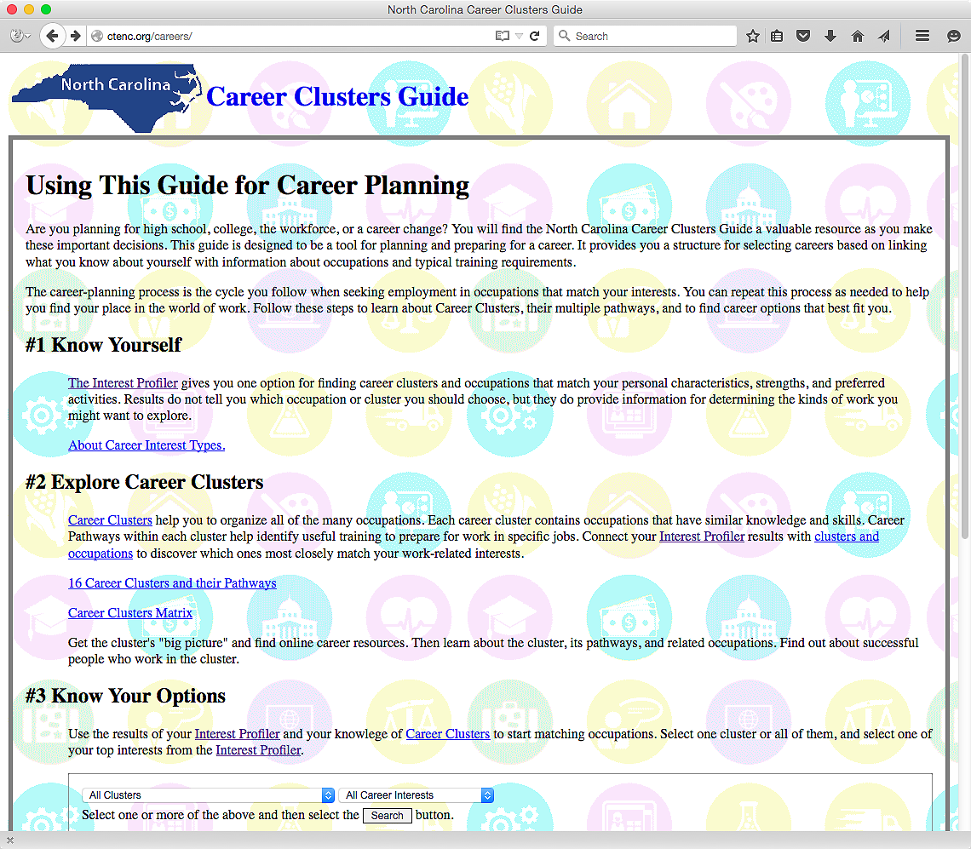
www.ctenc.org/careers
Notes:
And now look. We took the book and made it into an interactive website. How cool is that?
And you guys are the first to see it.
Here is the web address. CTENC is the same website we use for summer conference. Just add a “slash careers” after that.
We are going to start here at step number one and select the link to the Interest Assessment.
=====
www.ctenc.org/careers
49

Slide 50
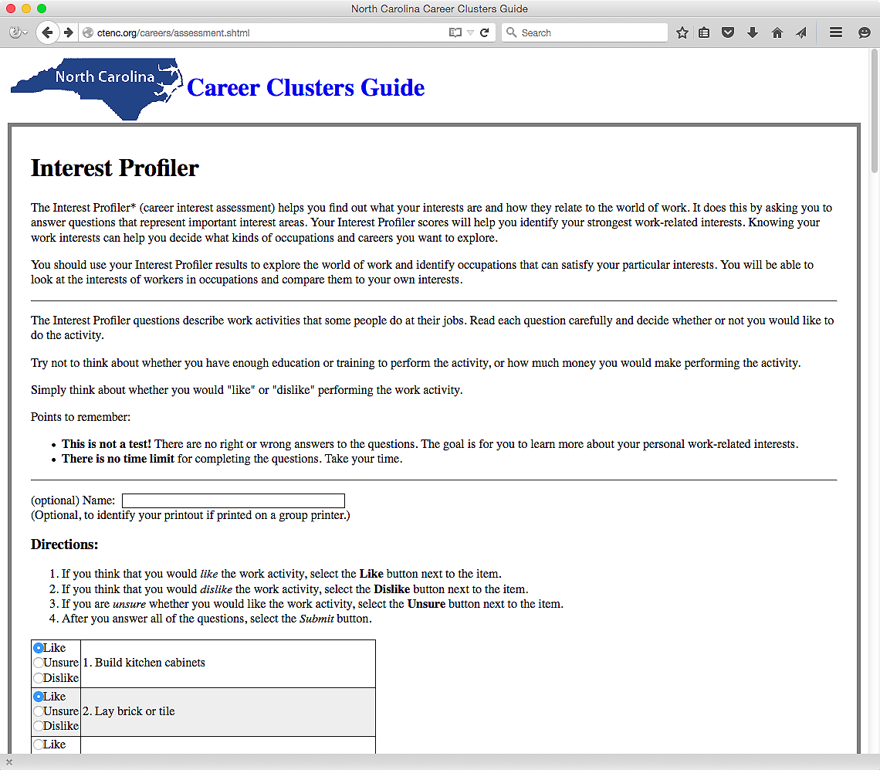
Notes:
This is the same interest assessment that is on the O*NET website.
There is a place to enter a name, which makes it handy if the result printouts are printed on a common classroom printer.
The students answer the questions with whether they like or dislike a certain action.
=====
www.ctenc.org/careers
50

Slide 51
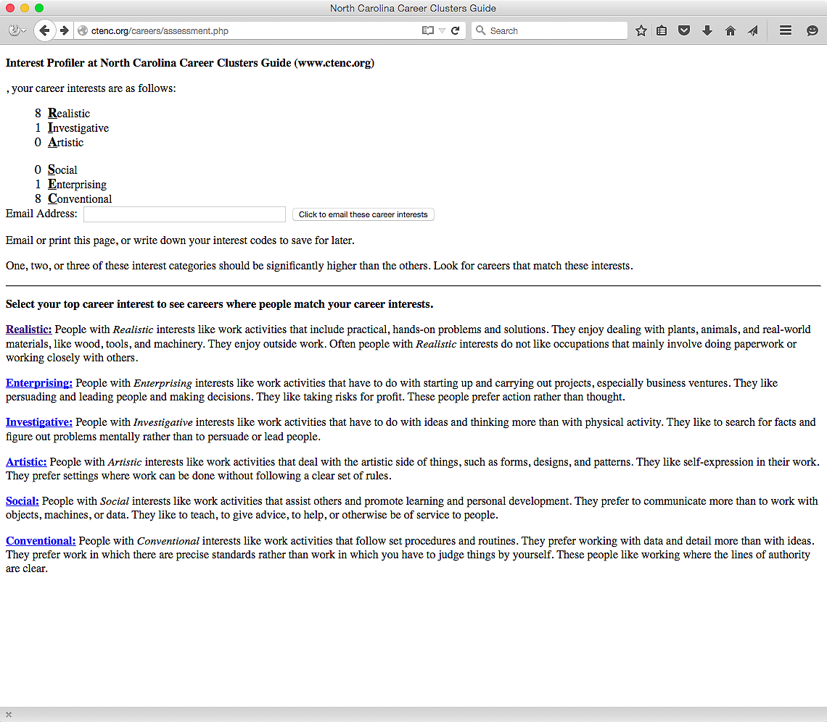
Notes:
Here are my results.
→ I am a Realistic, Conventional kind of guy.
((hide))
Notice there is a place to enter an email address, so the results can be emailed to the student for further use.
FYI - The email addresses are not saved. They are used only to send the results then discarded.
Since I rank high in Realistic interests, I can select the link to Realistic Careers …
=====
www.ctenc.org/careers
51

Slide 52
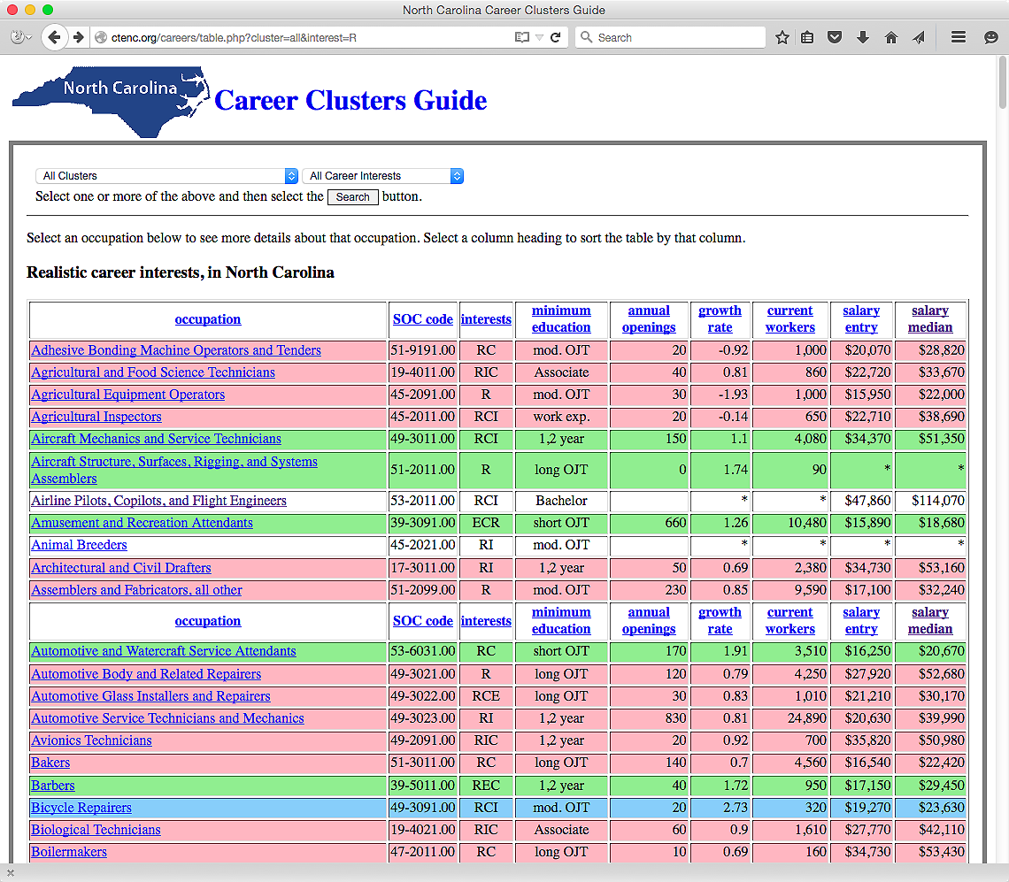
Notes:
Which takes me to this page, where we now see all of the occupations in North Carolina where the workers have a predominate Realistic career interest.
The color coding corresponds to the projected growth rate of that occupation over a ten year period.
Blue is projected high demand, red is low demand, and green are average demand.
→ If you select “Aircraft Mechanic” …
=====
www.ctenc.org/careers
52

Slide 53
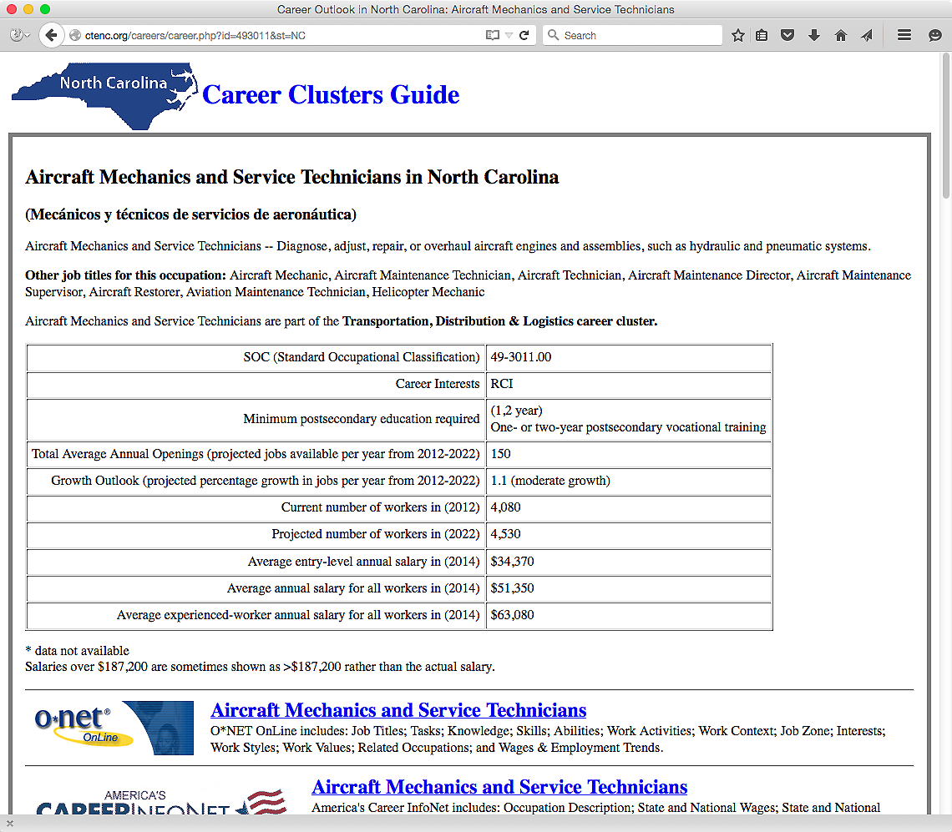
Notes:
It takes you to this web page where you can learn all about the occupation of aircraft mechanic.
If you scroll down the page, …
=====
www.ctenc.org/careers
53

Slide 54
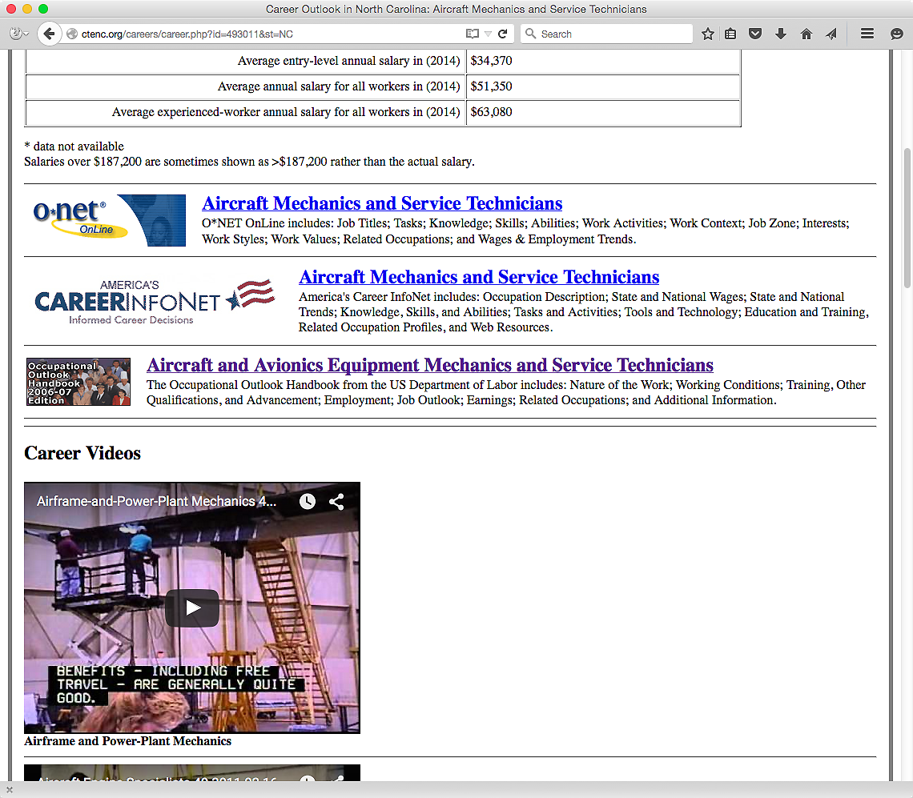
Notes:
… you see direct links to the O*NET, America’s Career Info Net, and the Occupational Outlook Handbook.
Scroll down a little further and you see career videos …
=====
www.ctenc.org/careers
54

Slide 55
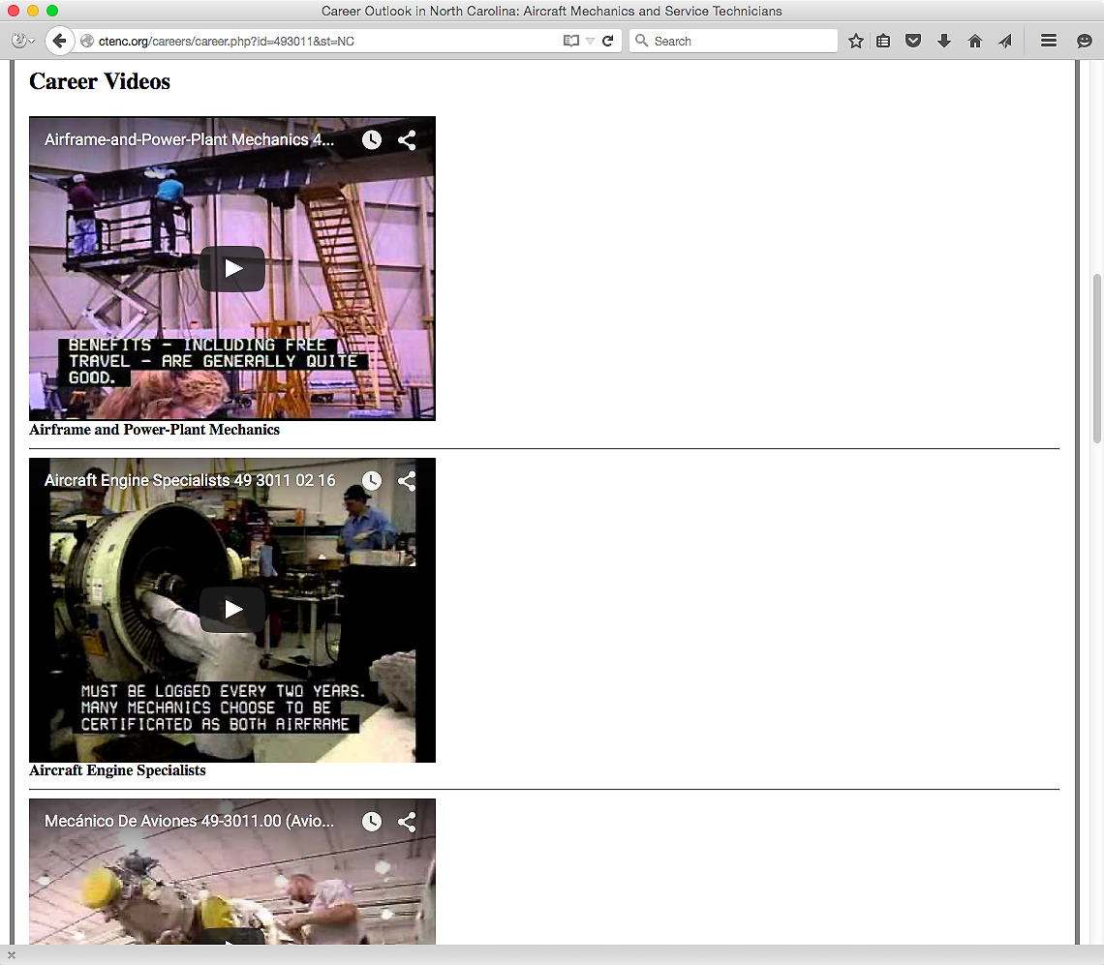
Notes:
In this case there three career videos.
One for the Airframe and Power Plant Mechanics, and another video about the Aircraft Engine Specialists.
The third video is a Spanish language video about Aircraft Mechanics.
=====
www.ctenc.org/careers
55

Slide 56
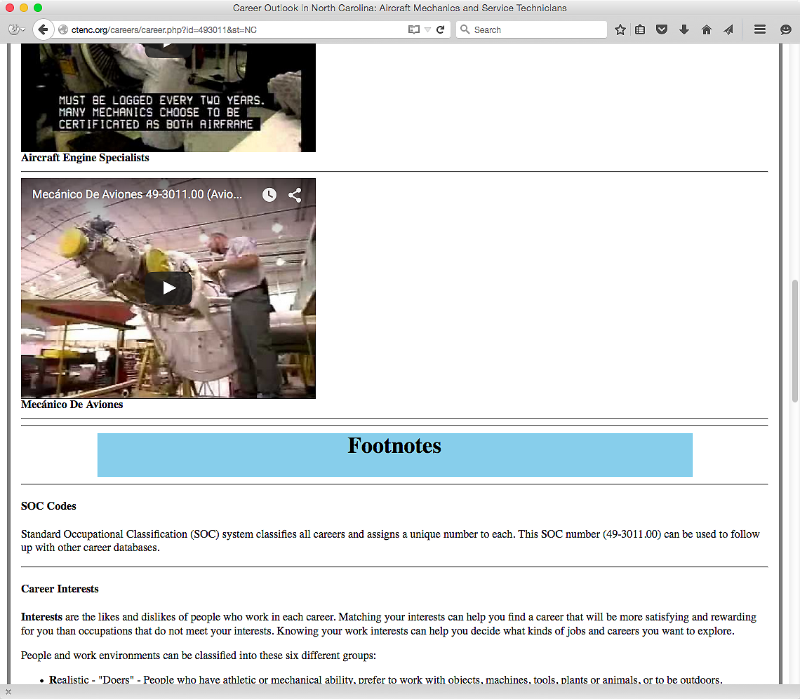
Notes:
The Footnotes at the bottom of the page explains from where all of the data came.
=====
www.ctenc.org/careers
56

Slide 57
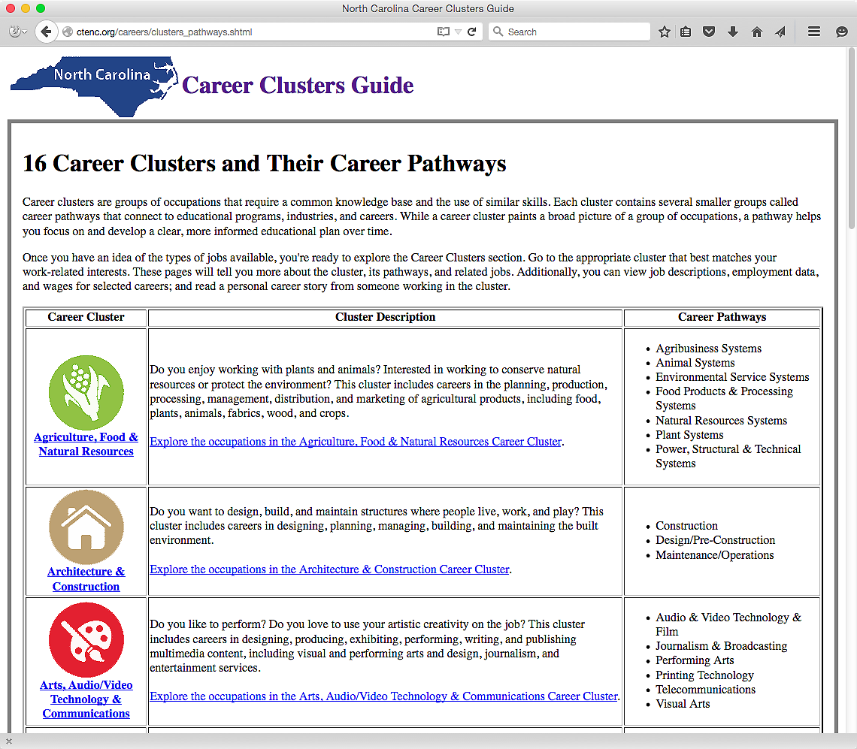
Notes:
Here is the Career Clusters page with links to more information.
→ If we select the Agriculture, Food & Natural Resources link, …
=====
www.ctenc.org/careers
57

Slide 58
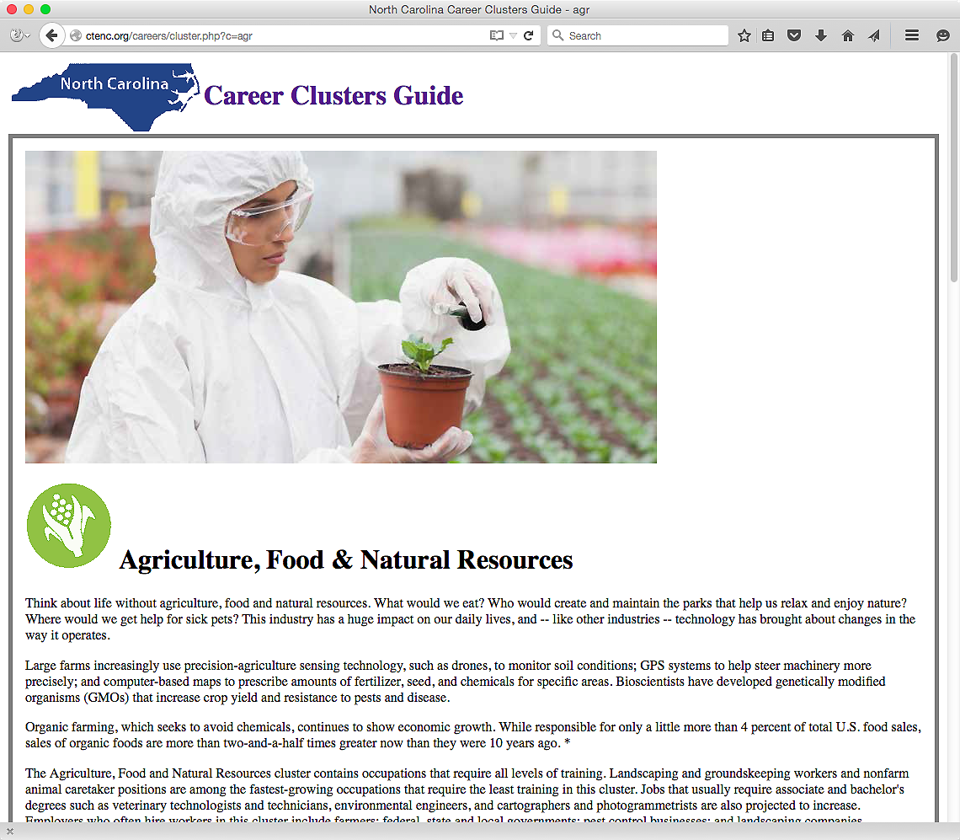
Notes:
We get to this web page with a wealth of information about this career cluster.
If we scroll down the page …
=====
www.ctenc.org/careers
58

Slide 59
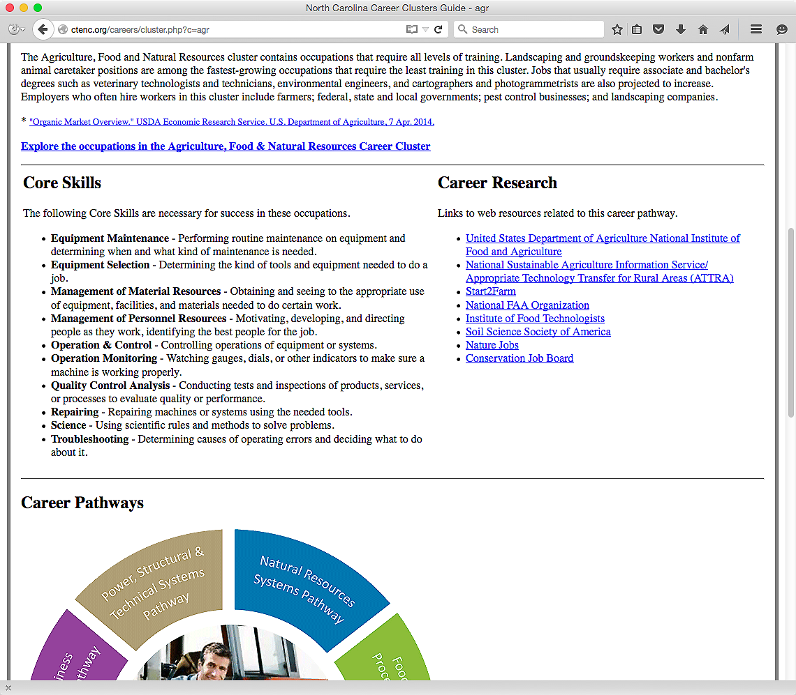
Notes:
At the top you see a link to the list of careers in the cluster.
You see a list of core skills for the cluster, and on the right, links for further career research.
Scrolling down the page further …
=====
www.ctenc.org/careers
59

Slide 60
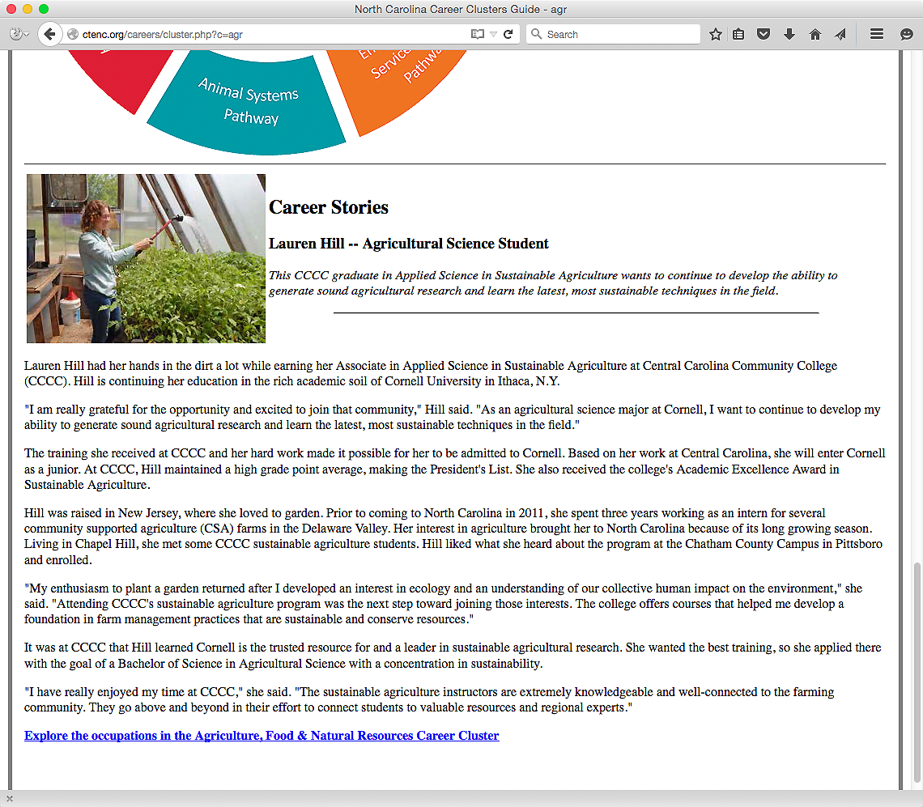
Notes:
… you find a career story about someone in North Carolina who is employed in a career in this career cluster.
=====
www.ctenc.org/careers
60

Slide 61
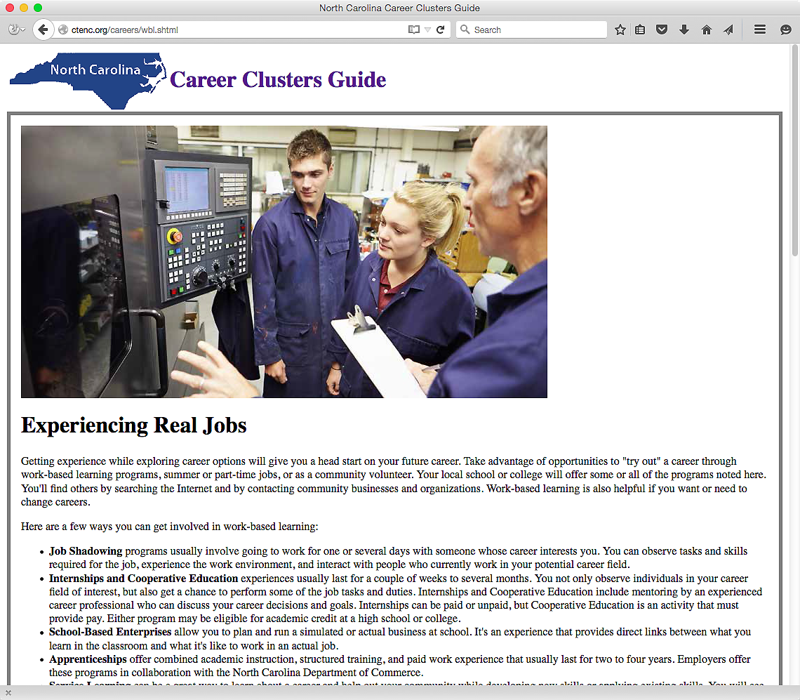
Notes:
There is a page about work-based learning.
And if you scroll down the page ….
=====
www.ctenc.org/careers
61

Slide 62
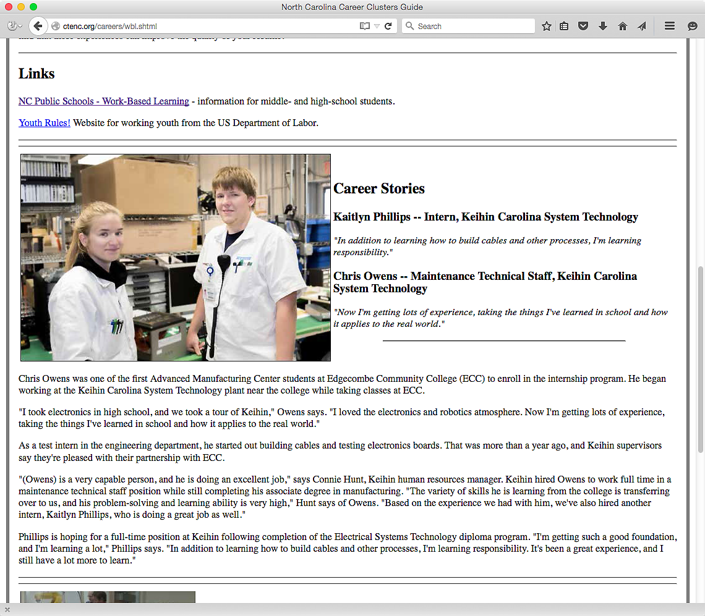
Notes:
There is the link to the NCDPI work-based learning web page as well as a link to the national rules about youth employment.
Also you see career stories about North Carolinian's who benefited from a work-based learning program.
=====
www.ctenc.org/careers
62

Slide 63
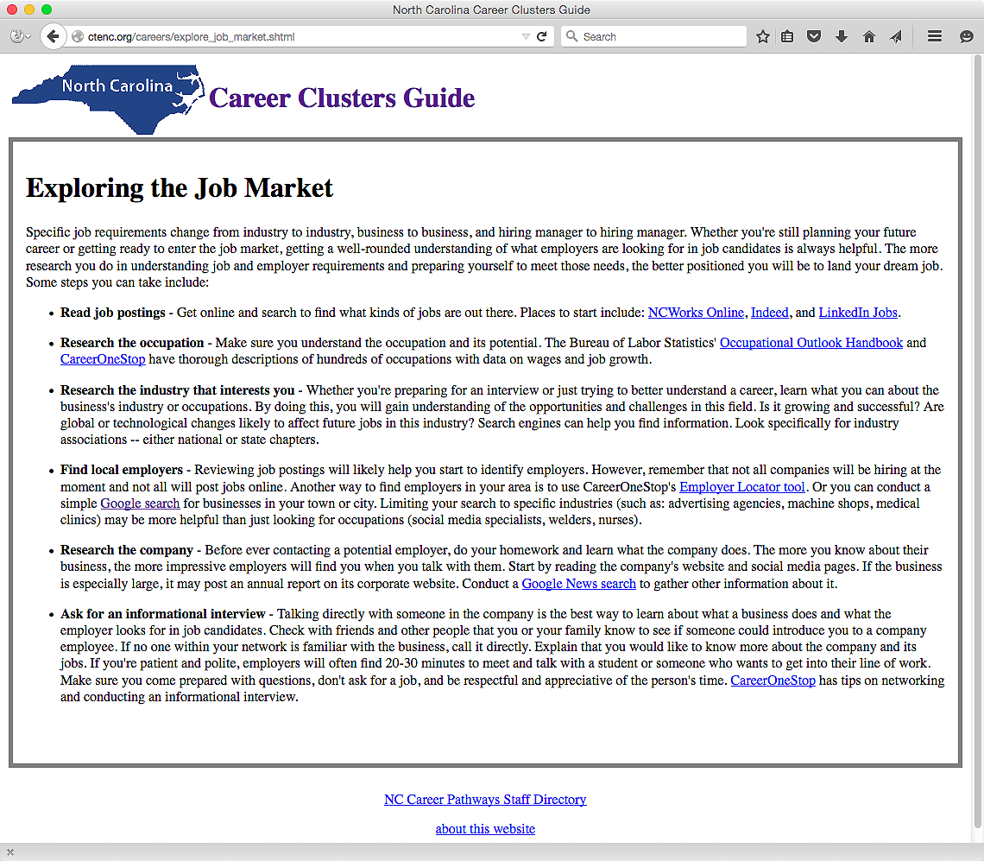
Notes:
Here is a page about exploring the job market. This is a lot of what I have been presenting to you here today.
=====
www.ctenc.org/careers
63

Slide 64
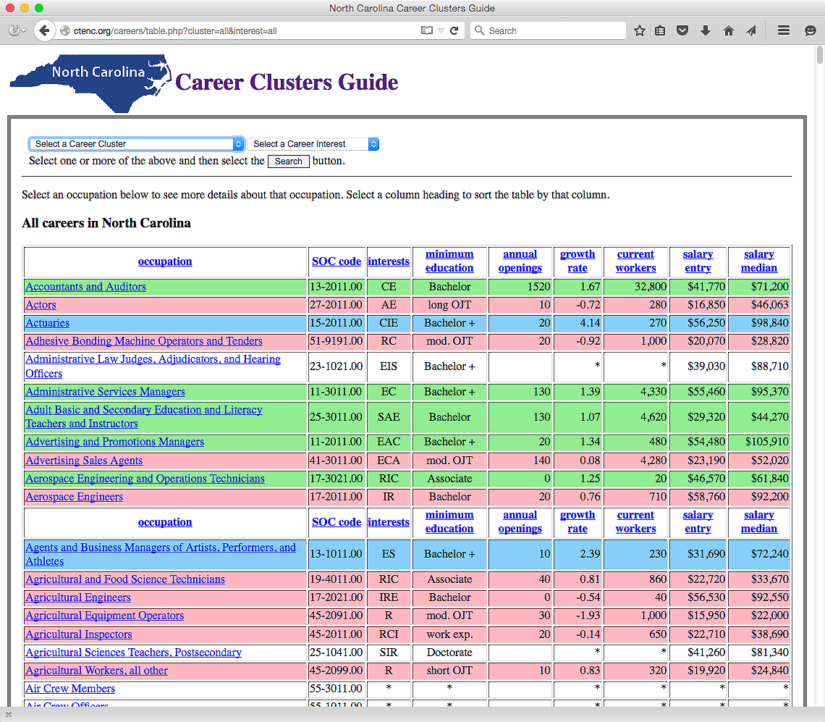
Notes:
I showed you this page earlier.
Right now it shows all occupations in North Carolina.
The drop-down menus let you select a career cluster -- or a career interest -- or both.
=====
www.ctenc.org/careers
64

Slide 65
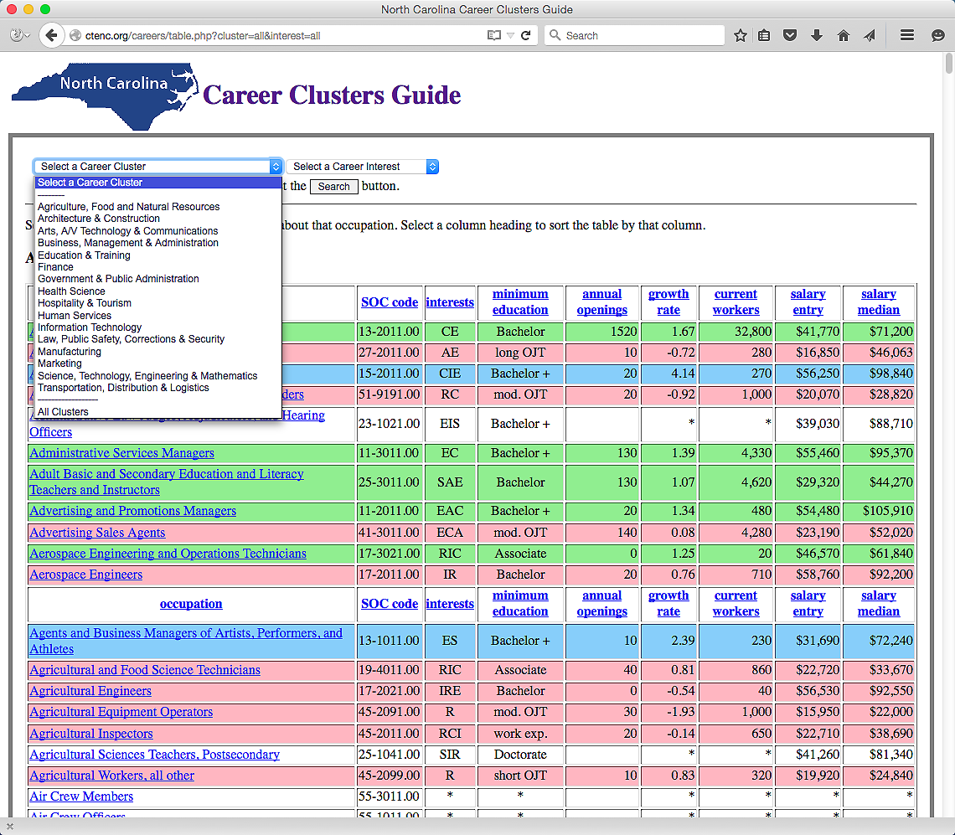
Notes:
Here is the menu to select a career cluster.
=====
www.ctenc.org/careers
65

Slide 66
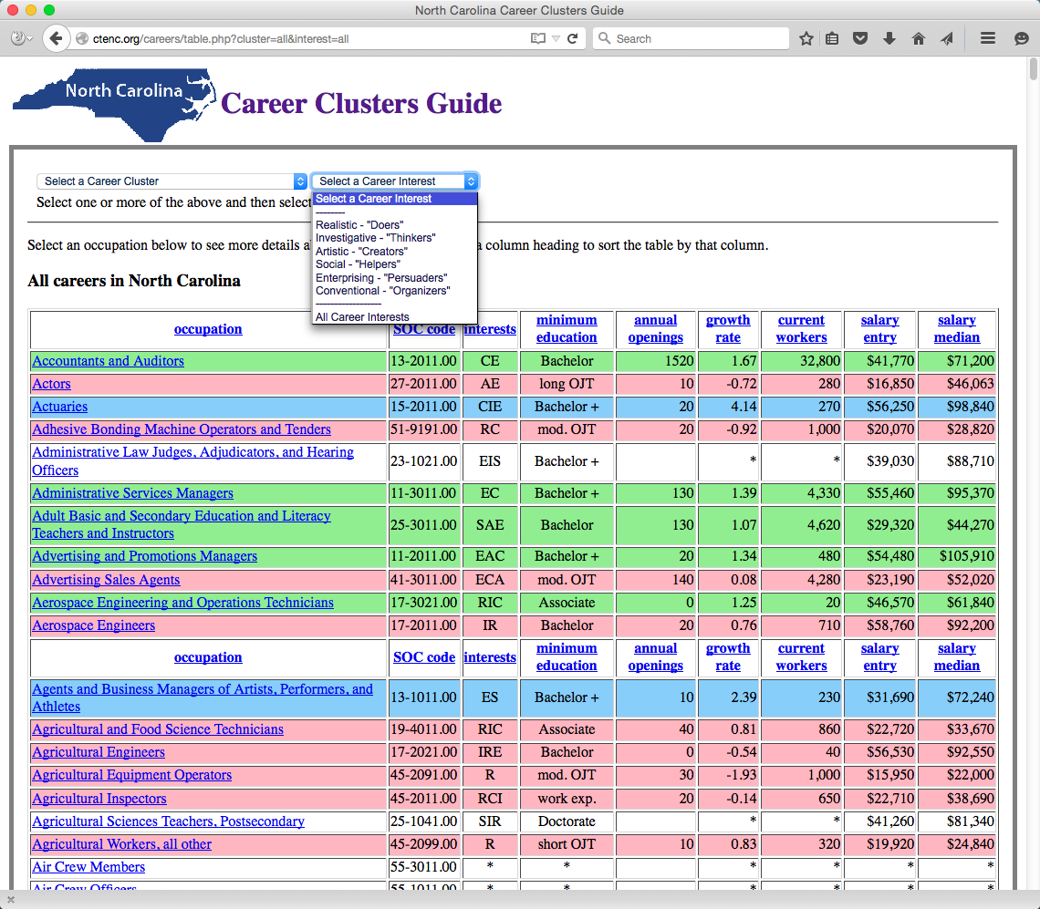
Notes:
And the drop-down menu to select a career interest.
Select a cluster and interest or just select one or the other -- and then select the Search button.
=====
www.ctenc.org/careers
66

Slide 67
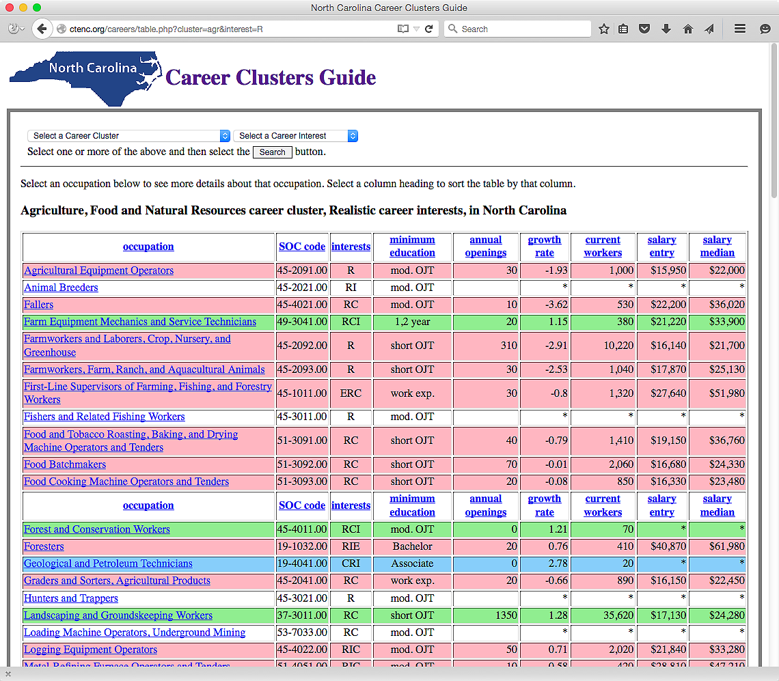
Notes:
In this case we are looking at all of the careers in North Carolina in the Agriculture, Food and Natural Resources career cluster for people who have Realistic Career interests.
From here you can select a column to sort the data and select an occupation to see more details.
=====
www.ctenc.org/careers
67

Slide 68
Notes:
Can you see where you can use this tool with your students?
Try it out and send me some feedback.
I definitely need to work on the look and feel of the pages.
=====
www.ctenc.org/careers
68

Slide 69
10. Demonstrate how different informational and technological resources can be used to help clients with their career issues.
Formative
Assessment
Notes:
Any questions about the new book or the new website?
What have you learned in Objective number 10?
Discuss it at your table, then we will report out.
69

Slide 70
11. Create a plan for staying information literate and technologically skilled.
Information literate ?
Technologically skilled ?
Notes:
We are at the last objective. Yeah!
What do we mean by “information literate”?
How can you stay “information literate”?
And how can we ever keep up with the rapidly changing technology?
The big plan you need to work on -- is how to learn what you do not already know about career information resources, and start gathering and sharing information.
The Career Development Moodle PLC is a great place to start. We have lots of CDCs who have been doing this for many years who are willing to share. Regional CDC meetings and our state CTE summer conference are other ways to network with CDCs and learn from them. Marchelle and I are at the state office ready to assist as well.
We have to stay one step ahead of the students with whom we work, which is hard to do, since, as far as computers go, they always seem to be one step ahead of us.
We have to know when information sources become dated, and keep up with the new tools. It’s not any easy task, but you are not alone in this.
70

Slide 71
If we really want to prepare our students for successful careers, we need to know all we can about the rapidly changing job market.
Notes:
71
The job market has changed considerably from when we graduated from high school.
Many of the careers our current students will have - have yet to be thought of, which makes career preparation an even bigger challenge.
====
Emil Barnabas

Slide 72
11. Create a plan for staying information literate and technologically skilled.
Formative
Assessment
Notes:
Did you learn anything here, or are you just ready to admit defeat because you will never be able to learn it all and keep up?
Discuss it at your table, then we will report out.
72

Slide 73

NC Education Plan
All students must graduate from
high school and be career,
college, and citizenship
READY.
Notes:
73
I’ll leave you with this.
Here is the simplified version of our state school board mission.
Every graduate must be career, college, and citizenship ready.
Notice the “and.” That means we recognize that everyone needs to be ready for all three.
Career ready means they have the technical skills and soft skills for which the employer is looking, and they are ready to get and keep the job.
“College ready” does not mean that everyone needs a four-year college degree. It means some kind of training after high school as well as life-long learning. The learning does not stop after high school graduation.
With the ever-changing world in which we live, everyone must continuously learn to keep up with the latest in their chosen profession.
===
http://legislative.ncpublicschools.gov/resources-for-legislation/2012/20120608-sup-howmeasure.pdf

Slide 74
Thanks for listening!
Chris Droessler, Consultant, NCDPI
www.ctpnc.org/presentations
Notes:
Any Questions.
=====
Chris Droessler, Consultant, NCDPI
www.ctpnc.org/presentations

