Slide 1
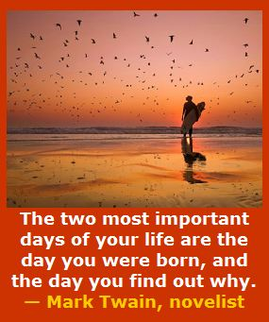
Notes:
========
http://www.goodreads.com/quotes/505050-the-two-most-important-days-in-your-life-are-the
“The two most important days in your life are the day you are born and the day you find out why.”
― Mark Twain
http://www.huffingtonpost.com/karen-ann-kennedy/the-two-most-important-days-of-your-life_b_5229311.html
Photo
http://myincrediblewebsite.com/mark-twain-on-the-days-of-your-life/

Slide 2

Notes:
We are here today to talk about passion.
=====
http://hypnoticmystery.deviantart.com/art/Passion-Wallpaper-179848193

Slide 3

Notes:
=====
http://thepassiontest.com/wp-content/uploads/2013/07/a-passion-your-life-passion-in-life.jpg

Slide 4

Notes:
This is not my passion, but it may be yours. Or one of the kids with whom you are working.
I do see a lot of physics at work here.
http://www.peppervirtualassistant.com/blog/wp-content/uploads/2011/05/passion-for-work-pepper-virtual-assistants-300x212.jpg

Slide 5
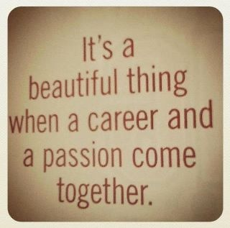
Notes:
======
http://prettyinpaisley.files.wordpress.com/2013/05/blogimage-2.jpg

Slide 6

Passion vs Paycheck
Notes:
Which is more important? Looking forward to going to work on Monday morning, or looking forward to a paycheck on Friday afternoon?
======
http://theherowithinu.com/2013/01/23/passion-vs-paycheck/

Slide 7

Notes:
First we have to know what we have. Then decide what to do with what we have.
=======
“The measure of who we are is what we do with what we have."
-- Vince Lombardi, American football coach
=========
http://www.brainyquote.com/quotes/quotes/v/vincelomba382625.html

Slide 8

Notes:
I do like to eat, and I am glad some people have the passion and the super powers for cooking.
Though I do have Cooking merit badge, I do not have a passion nor super powers for cooking. Luckily I married someone who does.
====
http://www.atlantic.edu/aca/index.htm

Slide 9

Notes:
In the future -- when our students are employed and someone asks them what they do for a living, --
wouldn’t it be great if they could say –
“I get to make a difference in the world.”
“I get to make a difference!”
====
http://www.iliketoquote.com/do-small-things-with-great-love-and-youll-make-a-big-difference/

Slide 10

Notes:
http://4.bp.blogspot.com/-uep1lh5LYPg/T55wq0rH5LI/AAAAAAAABLE/30OqN-frM1k/s1600/dream-job.jpg

Slide 11

Notes:
http://images.insidejobs.com/posts/81/photos/original/Why_Personality_Trumps_Passion_in_the_Career_Game.jpg?1378144305

Slide 12

Notes:
http://www.janneyinsurance.com/wp-content/uploads/2014/02/Love-my-career.jpg

Slide 13
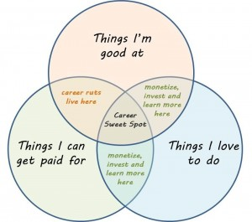
Notes:
http://www.mycareersuccessplan.com/wp-content/uploads/2013/04/mcsp_blog_sweetspotjpg-300x265.jpg

Slide 14

Notes:
The Doctor Sheldon Cooper in me wants to rephrase this to be grammatically correct., but you get the picture.
I was passionate about my job working as a technical editor. I got to make sure everyone followed the same set of rules.
“Would you like to have a career about which you can be passionate?”
=======
http://careercoachnow.com/images/Career_Passion.png

Slide 15

Notes:
Why do people think they have to choose between the two?
OK, I did decide to become a teacher rather than an engineer!
============
http://www.beyond.com/data/articles/images/changing-careers/Passion%20for%20love%20or%20money.jpg

Slide 16

Notes:
http://fcsl.edu/blogs/ac/files/2012/03/Work.jpg

Slide 17
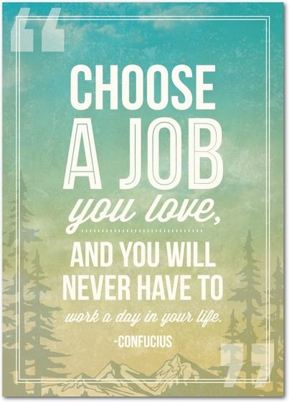
Notes:
http://blog.gotengo.com/wp-content/uploads/2013/07/pursue-passion.jpg

Slide 18

Notes:
http://www.realcareer.us/wp-content/uploads/2014/07/I-Love-My-job.jpg

Slide 19

Notes:
http://www.debbiewhitlock.com/wp-content/uploads/2010/09/Whats-Next-Book-Cover.jpg

Slide 20

Notes:
http://www.laurieburtontraining.com/wp-content/uploads/2014/04/Time-for-Change.jpg

Slide 21

Notes:
http://spicygeeks.com/wp-content/uploads/2014/03/2.-Does-it-career-Allows-you-to-follow-your-Passion.jpg

Slide 22
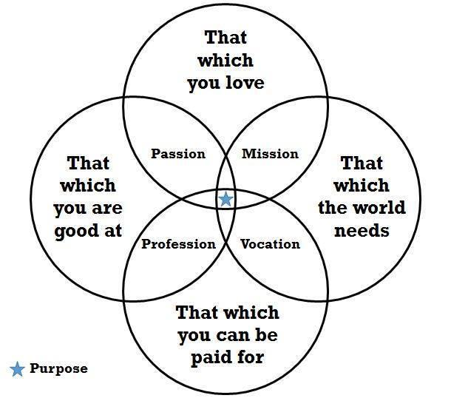
Notes:
Interesting way to put this all in a diagram.
====
http://idealistcareers.org/a-purpose-equation-to-help-you-find-meaningful-work/

Slide 23

Notes:
The first of forty quotes on this page is
“The heart of human excellence often begins to beat when you discover a pursuit that absorbs you, frees you, challenges you, and gives you a sense of meaning, joy and passion.”
===
http://lloydkathurima.com/2013/05/20/40-quotes-to-help-you-follow-your-passion/

Slide 24
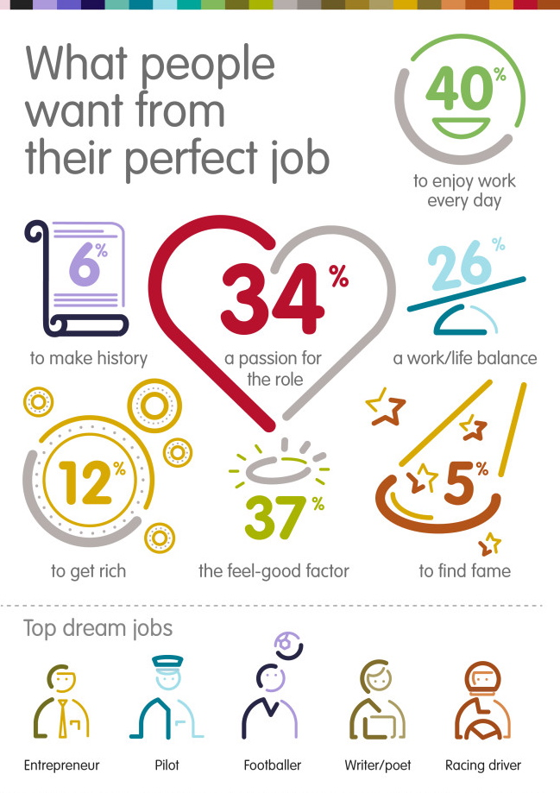
Notes:
http://www.melodyhossaini.com/wp-content/uploads/2014/01/Job-Satisfaction-InspirEngage-Careers-Social-Enterprise-Make-PASSION-YOUR-CAREER.jpg

Slide 25

Notes:
Tony Wagner says we need a new position in each school called the "Dream Director", who works hand-in-hand with the principal, teachers and community to help inspire students to believe in themselves and to see the world through a new lens of possibility. Dream Directors are leaders, coaches and imagineers -- people completely devoted to helping others put their dreams in action.
The Dream Directors have a number of tools they use to transform the school. Dream Directors match students with Coaches in the community who help the teenagers to explore their passions and build projects. Dream Directors run after-school workshops to teach the students the real-world skills they need to bring their ideas to life. They mobilize students to design and run school-wide campaigns that give students a chance to share who they are and what they believe in. The experience is different in each school (since no two schools are the same), but what unites all Dream Directors is their mission to unleash students and inspire them to be extraordinary.
=========
https://www.escapethecity.org/organisations/the-future-project
Tony Wagner says we need a new position in each school called the "Dream Director", who works hand-in-hand with the principal, teachers and community to help inspire students to believe in themselves and to see the world through a new lens of possibility. Dream Directors are leaders, coaches and imagineers -- people completely devoted to helping others put their dreams in action.
The Dream Directors have a number of tools they use to transform the school. Dream Directors match students with Coaches in the community who help the teenagers to explore their passions and build projects. Dream Directors run after-school workshops to teach the students the real-world skills they need to bring their ideas to life. They mobilize students to design and run school-wide campaigns that give students a chance to share who they are and what they believe in. The experience is different in each school (since no two schools are the same), but what unites all Dream Directors is their mission to unleash students and inspire them to be extraordinary.
Photo
http://amandinevanray.deviantart.com/art/Little-dreamer-290575045

Slide 26

Notes:
========
http://images.insidejobs.com/posts/16/photos/original/passion%20is%20the%20difference.jpg?1344397400

Slide 27

Notes:
======
http://engaginglifeandleadership.com/wp-content/uploads/2014/06/ELAL-dake-passion.jpg

