Slide 1
Bob&Chris
Robert J. Witchger – Director, Career and Technical Education NC Community College System
Chris Droessler – Consultant, Career and Technical Education NC Department of Public Instruction
Notes:
Robert J. Witchger
Director, Career and Technical Education NC Community College System
witchgerb@nccommunitycolleges.edu
919-807-7126
Chris Droessler Consultant, Career and Technical Education NC Department of Public Instruction
Chris.Droessler@dpi.nc.gov
919-807-3891
Find our contact information here:
http://www.ctpnc.org/contact.shtml

Slide 2
16 Career Clusters
Agriculture, Food & Natural Resources
Architecture & Construction
Arts, A/V Technology & Communications
Business, Management & Administration
Education & Training
Finance
Government & Public Administration
Health Science
Hospitality & Tourism
Human Services
Information Technology
Law, Public Safety, Corrections & Security
Manufacturing
Marketing, Sales & Services
Science, Technology, Engineering & Mathematics
Transportation, Distribution & Logistics
Notes:
For many years, educators have been using these 16 Career Clusters to help us classify careers.
It’s a good first step to get folks to choose a broad career cluster before narrowing down to a specific career.

Slide 3
Notes:
We just published a new Career Clusters Guide. You might have seen the one we created in 2009.
This one has updated data and fresh stories.
We want to ensure that individuals have both timely and accurate career information, thus promoting informed decisions about choosing a career path.
The economy and workforce in North Carolina is changing.
The North Carolina Department of Public Instruction and the North Carolina Community College System are committed to supporting the state’s workforce system.
This guide will assist all students, and anyone, in identifying the available career options by using individual interests, clearly defined career pathways, and timely employment projections.

Slide 4
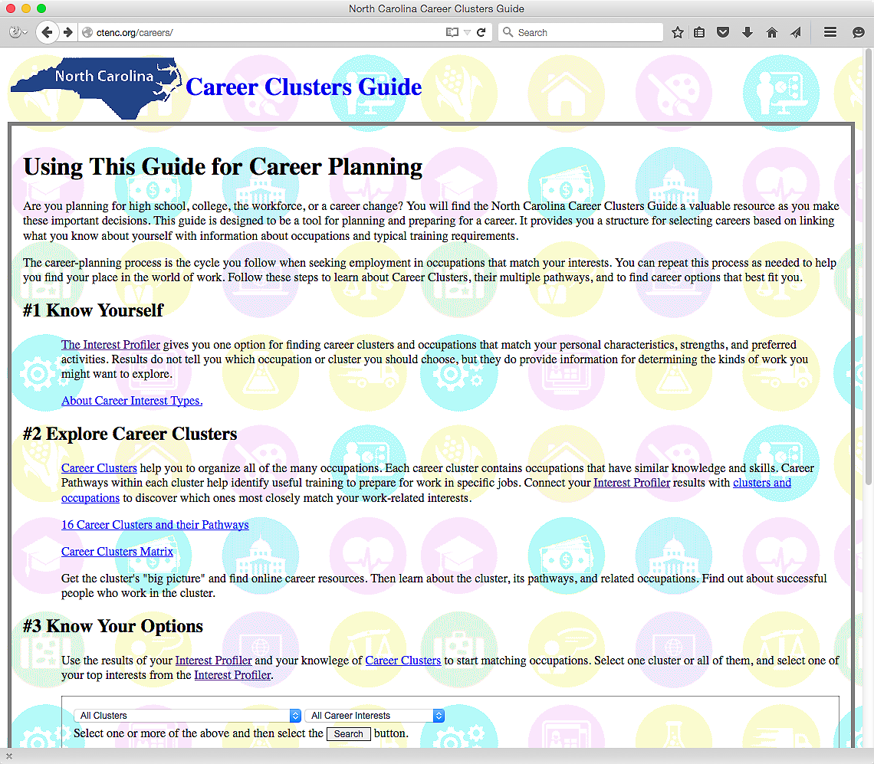
www.ctenc.org
Notes:
And now look. We took the book and made it into an interactive website. How cool is that?
Here is the web address. CTENC dot org is the same website we use for our CTE Staff Development Summer Conference.
Besides the interactive web pages, a PDF of the printed book is available at the bottom of the main page.
Let’s start here at step number one -- and select the link to the Interest Profiler.
=====
www.ctenc.org/careers

Slide 5
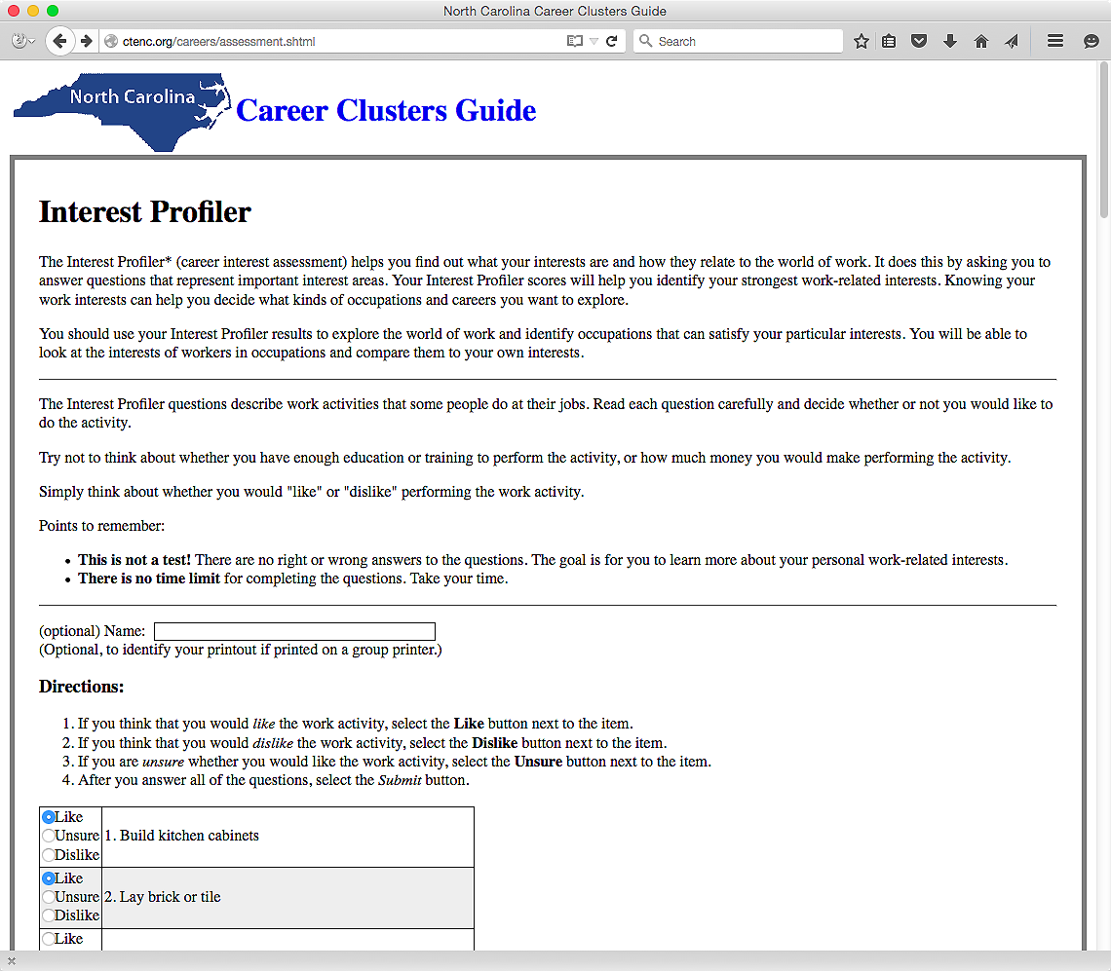
Notes:
This is the same interest assessment that is on the O*NET.
There is an optional place to enter a name, which makes it handy if the results are printed on a common classroom printer.
After all the questions are answered . . .
=====
www.ctenc.org/careers

Slide 6
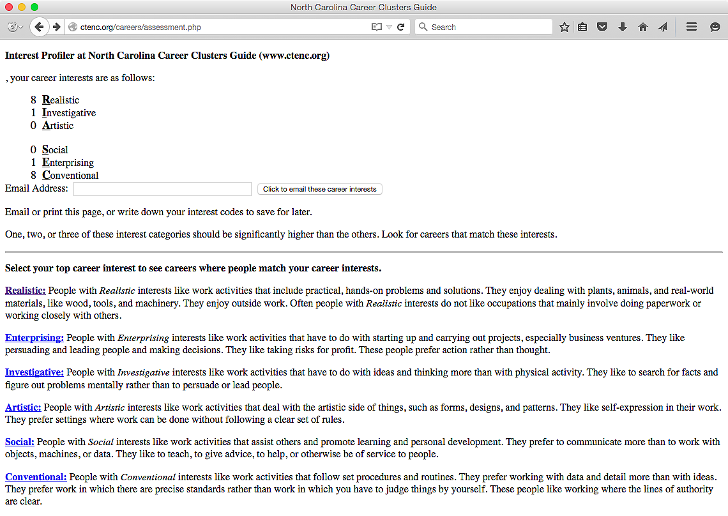
Notes:
You get a number in six career interests. The high numbers indicate a personal preference for that kind of activity.
Here are my results.
→ I am a Realistic, Conventional kind of guy.
((hide))
Notice there is a place to enter an email address, so the results can be emailed for further use.
Since I rank high in Realistic interests, I select the link to Realistic Careers …
=====
www.ctenc.org/careers

Slide 7
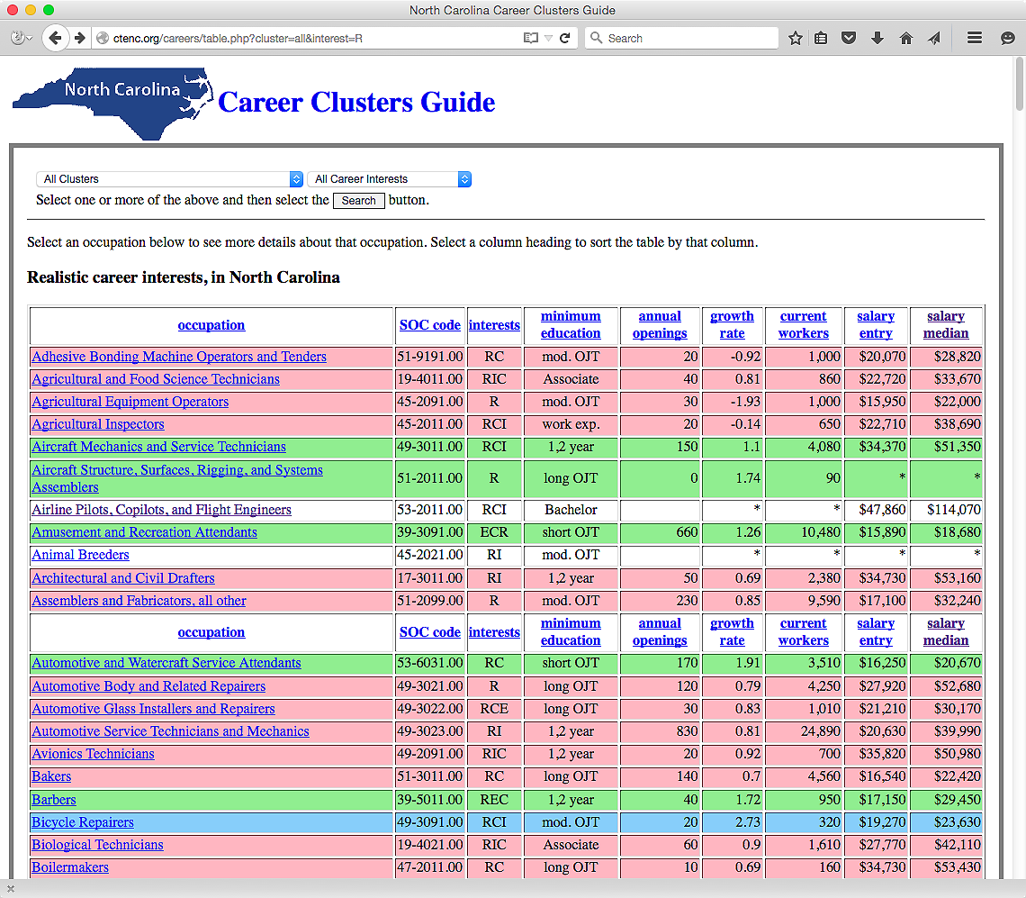
Notes:
Which takes me to this page, where we now see all of the occupations in North Carolina where the workers have a predominate Realistic career interest.
The color coding corresponds to the projected growth rate of that occupation over a ten year period.
Blue is projected high demand, red is low demand, and green are average demand.
For each occupation we have the SOC code, Career Interests, minimum education required, projected annual openings, and starting and average salary.
→ If you select the name of the occupation. I am selecting “Aircraft Mechanic” …
=====
www.ctenc.org/careers

Slide 8
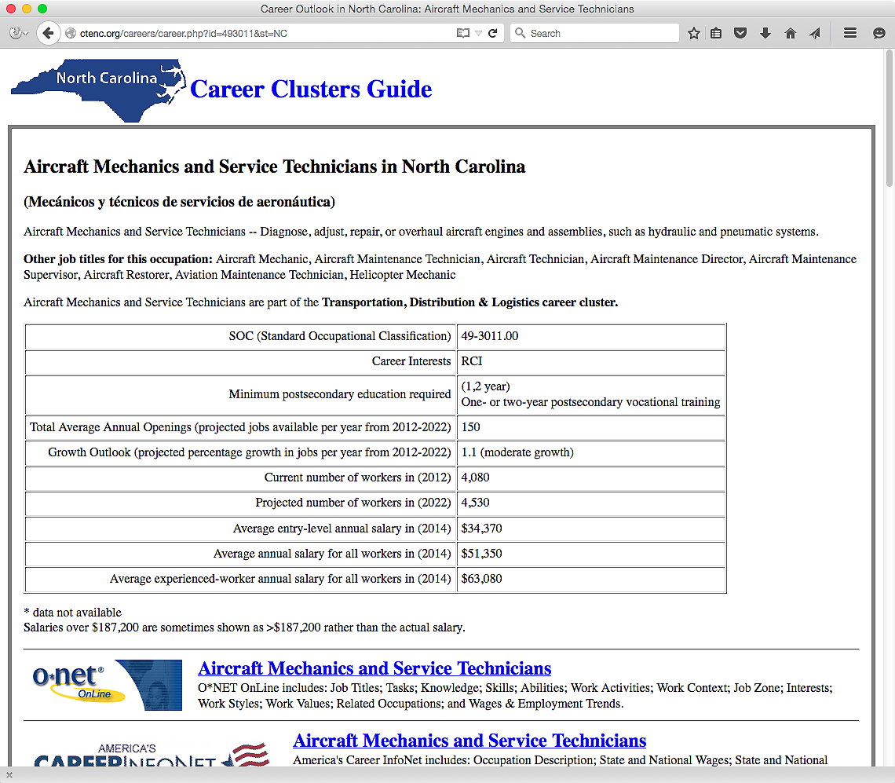
Notes:
It takes you to this web page where you can learn all about the occupation of aircraft mechanic.
If you scroll down the page, …
=====
www.ctenc.org/careers

Slide 9
Notes:
… you see direct links to the O*NET, --
America’s Career Info Net, --
and the Occupational Outlook Handbook.
Scroll down a little further and you see career videos …
=====
www.ctenc.org/careers

Slide 10
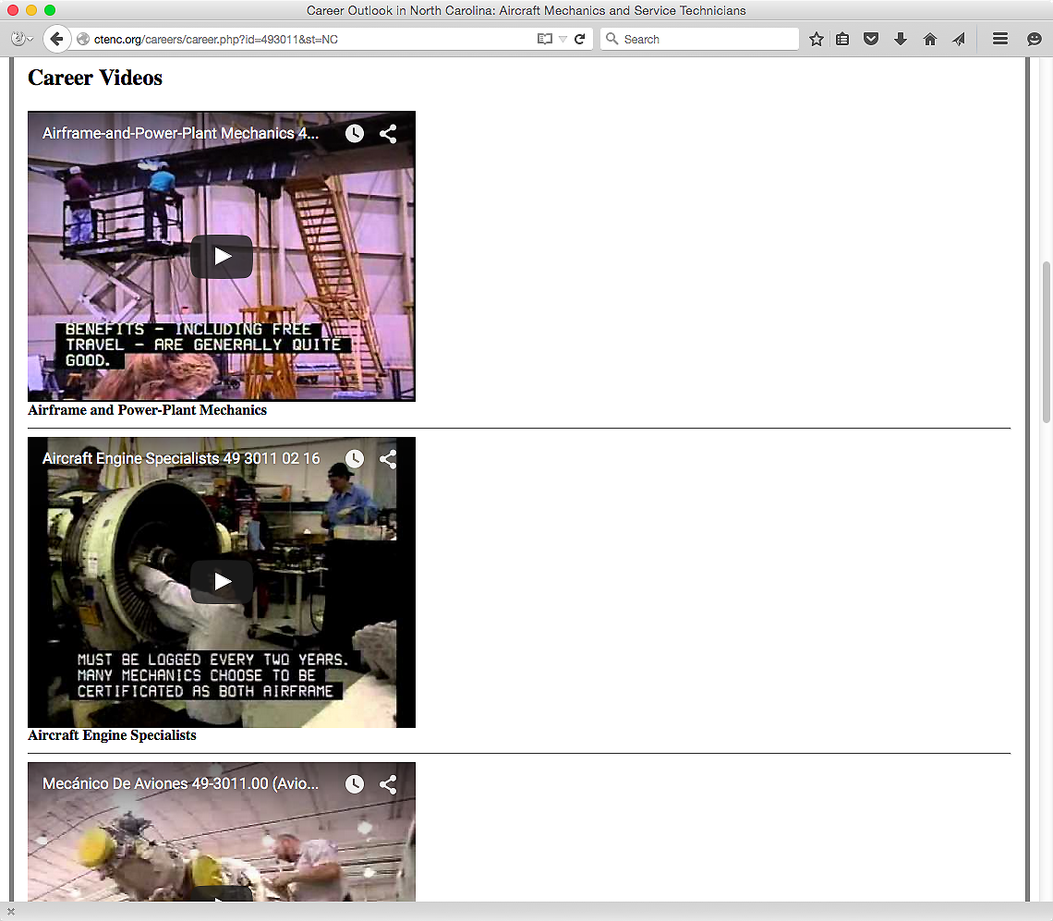
Notes:
In this case there three career videos.
One for the Airframe and Power Plant Mechanics, and another video about the Aircraft Engine Specialists.
The third video is a Spanish language video about Aircraft Mechanics.
=====
www.ctenc.org/careers

Slide 11
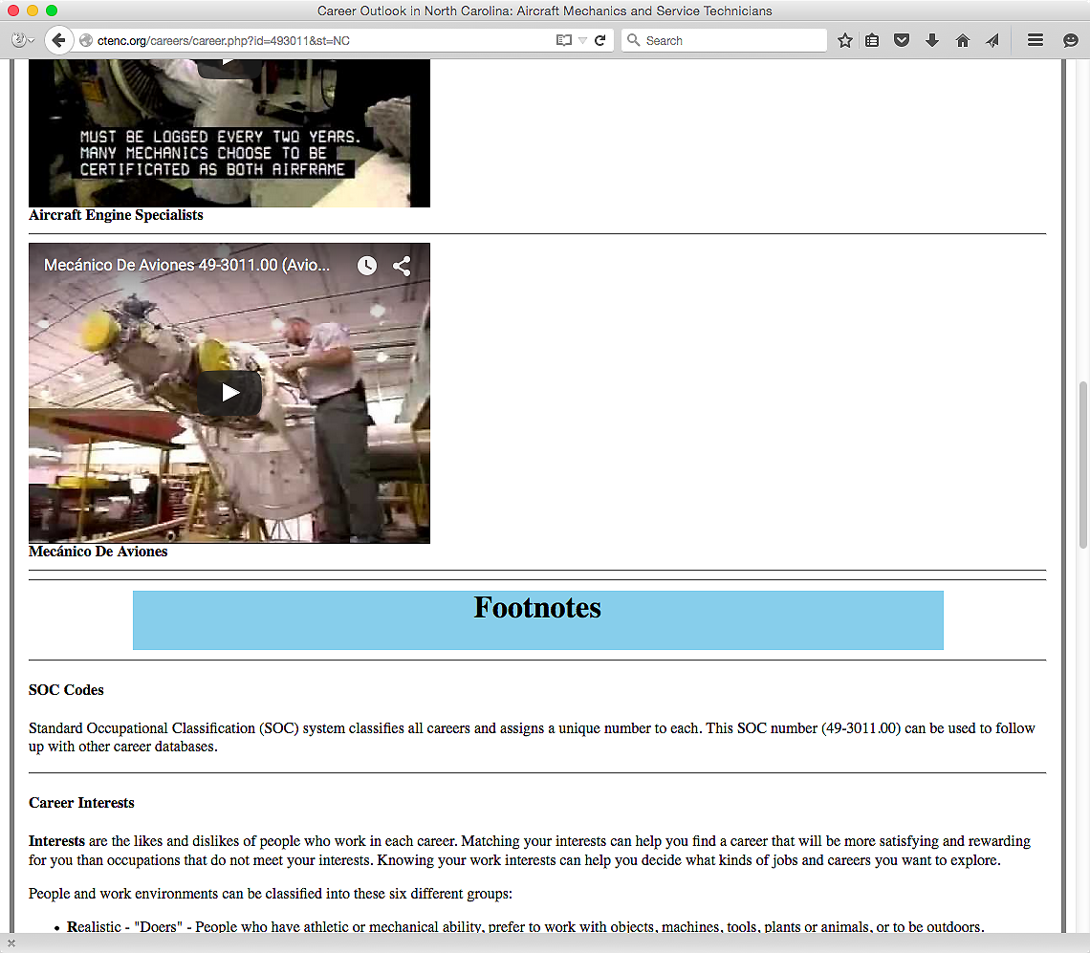
Notes:
The Footnotes at the bottom of the page explains from where all of the data came.
=====
www.ctenc.org/careers

Slide 12
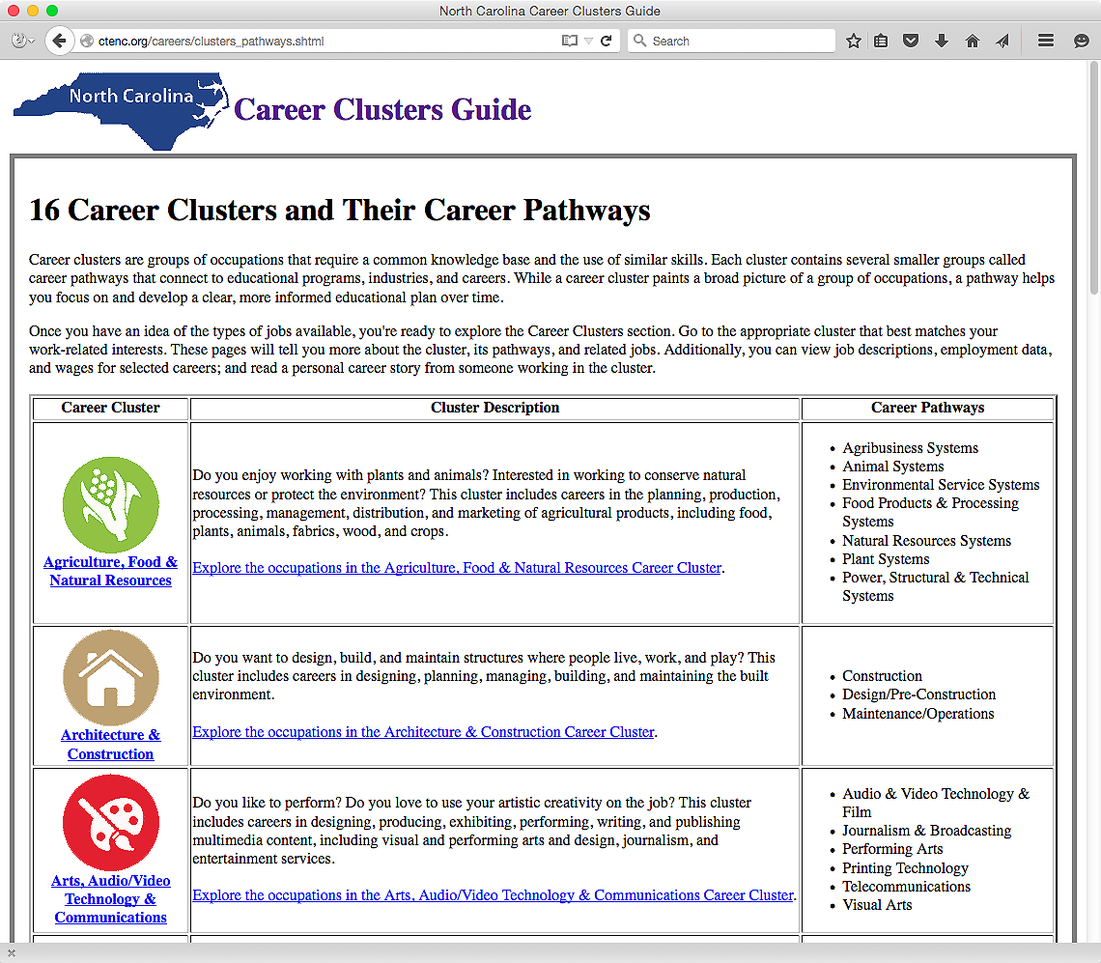
Notes:
Here is the Career Clusters page with links to information about each of the career clusters.
→ If we select the Agriculture, Food & Natural Resources link, …
=====
www.ctenc.org/careers

Slide 13
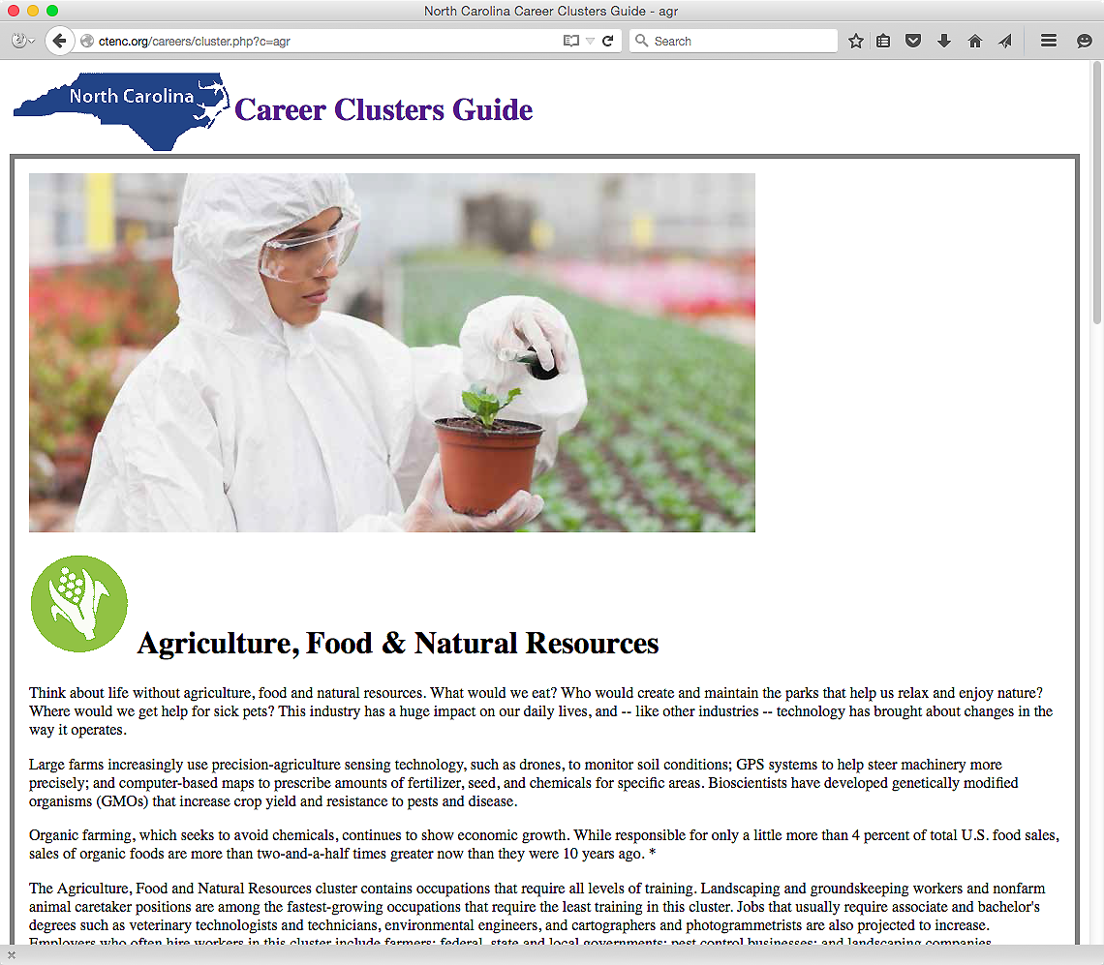
Notes:
We get to this web page with a wealth of information about this career cluster.
If we scroll down the page …
=====
www.ctenc.org/careers

Slide 14
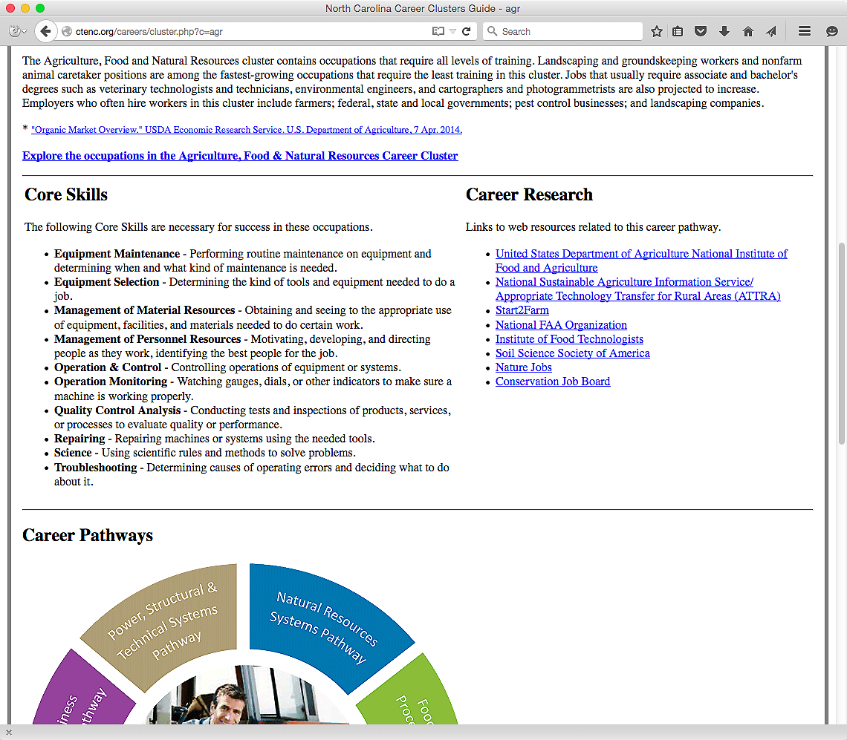
Notes:
Here at the top is a link to the list of careers in the cluster.
You see a list of core skills for the cluster, -
and on the right, links for further career research.
Scrolling down the page further …
=====
www.ctenc.org/careers

Slide 15
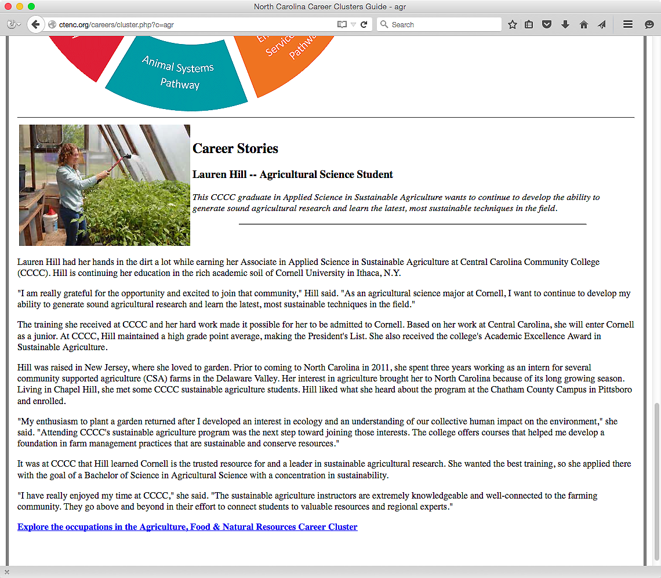
Notes:
… you find a career story about someone in North Carolina who is employed in a career in this career cluster.
This kind of information is available for each of the sixteen career clusters
=====
www.ctenc.org/careers

Slide 16
Notes:
There is also a page about work-based learning.
And if you scroll down the page ….
=====
www.ctenc.org/careers

Slide 17
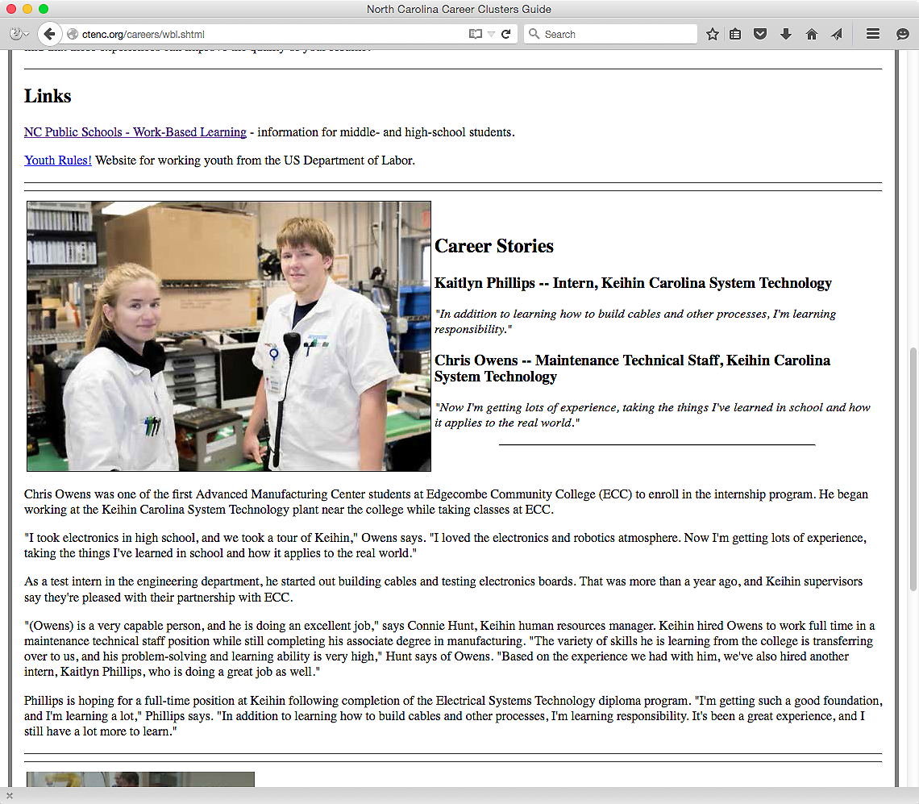
Notes:
There is the link to the NCDPI work-based learning web page as well as a link to the national rules about youth employment.
Also you see career stories about North Carolinians who benefited from a work-based learning program.
=====
www.ctenc.org/careers

Slide 18
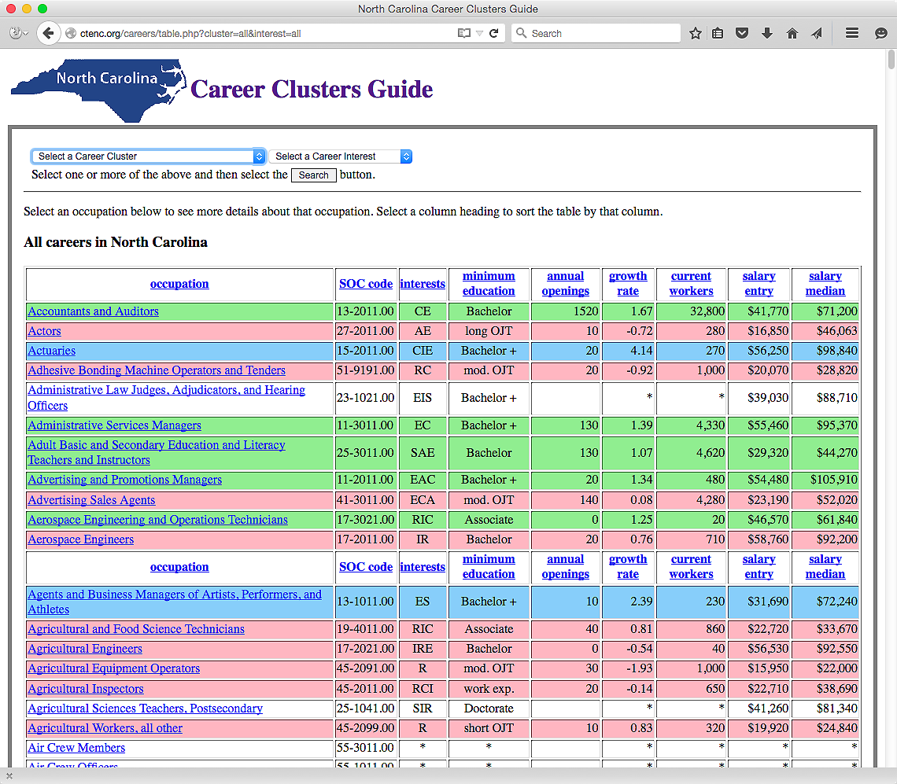
Notes:
I showed you this page earlier.
Right now it shows all occupations in North Carolina.
The drop-down menus let you select a career cluster -- or a career interest -- or both.
=====
www.ctenc.org/careers

Slide 19
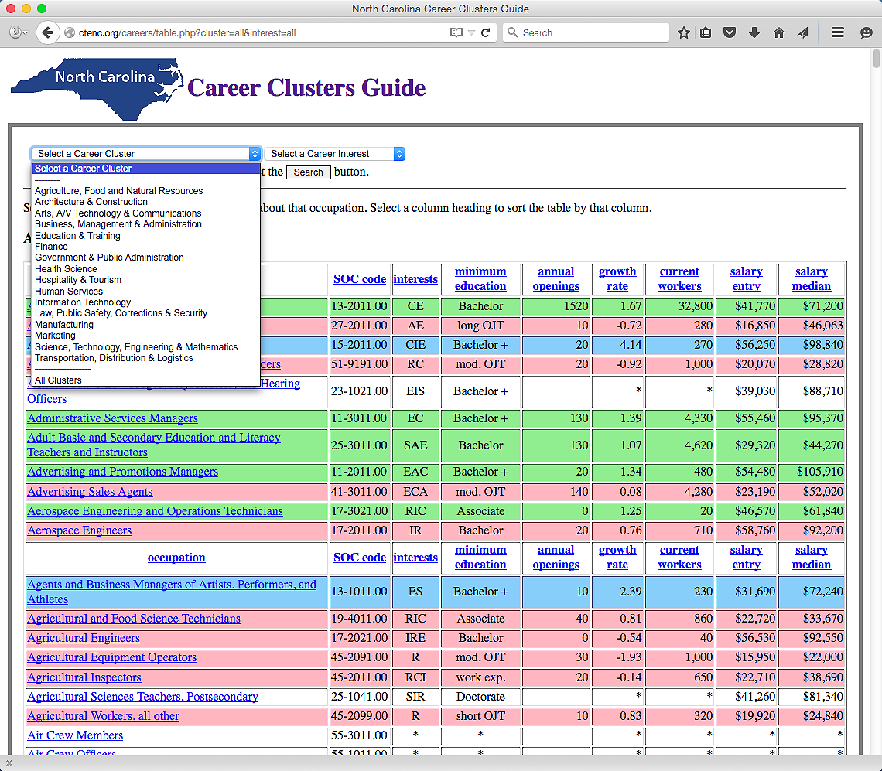
Notes:
Here is the menu to select a career cluster.
=====
www.ctenc.org/careers

Slide 20
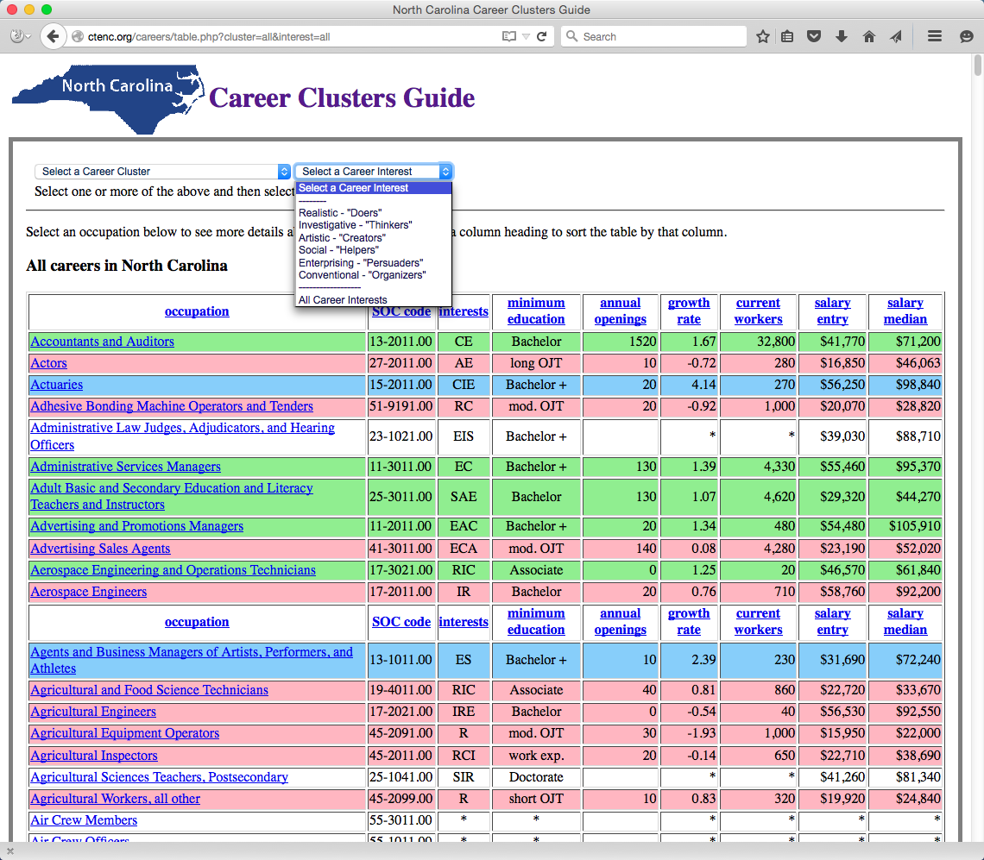
Notes:
And the drop-down menu to select a career interest.
Select a cluster and interest, or just select one or the other -- and then select the Search button.
=====
www.ctenc.org/careers

Slide 21
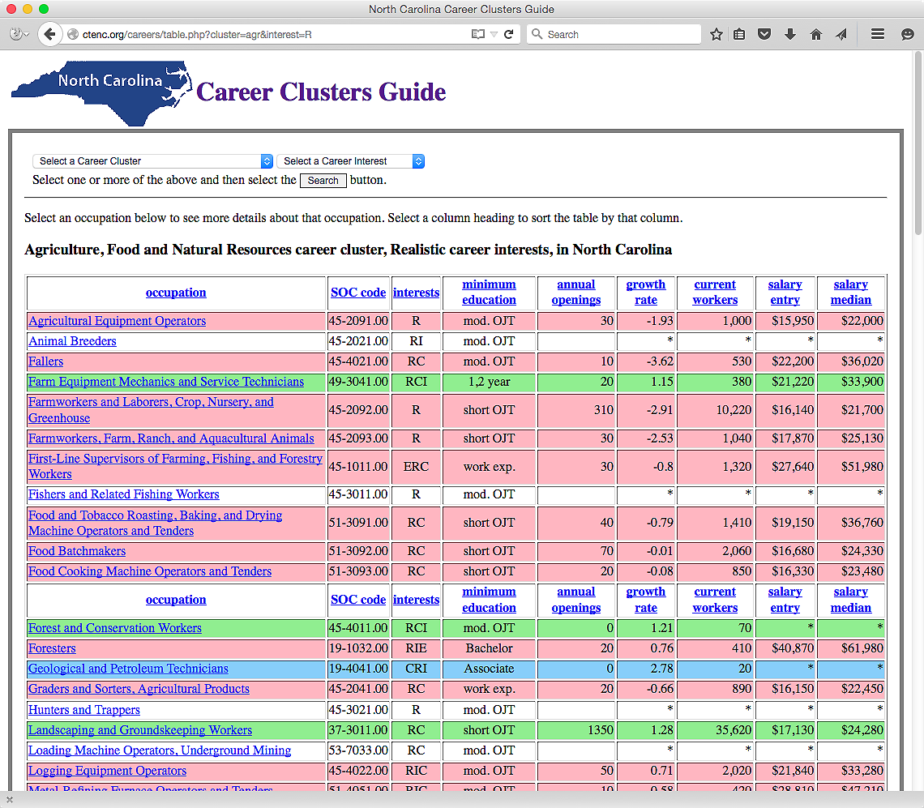
Notes:
In this case we are looking at all of the careers in North Carolina in the Agriculture, Food and Natural Resources career cluster for people who have Realistic Career interests.
From here you can select a column to sort the data and select an occupation to see more details.
=====
www.ctenc.org/careers

Slide 22
Notes:
Can you see where you can use this tool with your students or clients?
All of the information in the new Career Clusters Guide is here in an interactive website, plus much more.
Try it out and send me some feedback.
I definitely need to work on the look of the pages.
=====
www.ctenc.org/careers

