Slide 1
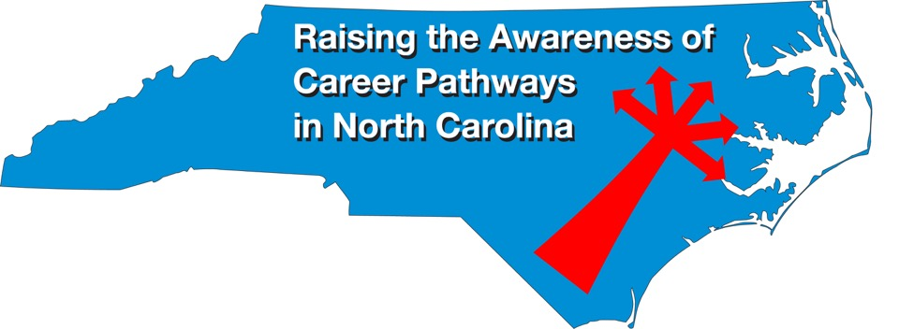
Careers in Programming
November 16, 2022
Download the PowerPoint
and access the recording:
www.ncperkins.org/presentations
Notes:
Good morning. Welcome to our monthly career pathways webinar.
We are here to help promote the great jobs, often unknown, in the great state of North Carolina.
Through these meetings, we are going to let you know about some great career opportunities in North Carolina.
And bring in special guests talk about these opportunities.
Please download this PowerPoint file and use it anyway you can to help get folks on a career pathway.
In the notes section of the PowerPoint, you will find any reference from where the information was found, as well as the contact information for the speaker.
Get the PowerPoint on our NCPerkins.org website on our Presentations and Webinars page.
The direct address is on the screen, just scroll down to today’s date.
-----
Many of the videos shown during this webinar can be found here:
https://www.ncperkins.org/video/

Slide 2
Career & Technical Education Team
Bob Witchger
Tony
Reggi
Patti Coultas
Mary Olvera
Anne Bacon
Darice McDougald
Lane Freeman
Aaron Mabe

Slide 3
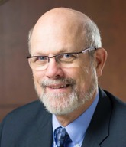

Dr. Bob Witchger
CTE Director, Team Perkins
Notes:
Dr. Robert (Bob) Witchger
NCCCS, CTE Director
919-807-7126
witchgerb@nccommunitycolleges.edu

Slide 4
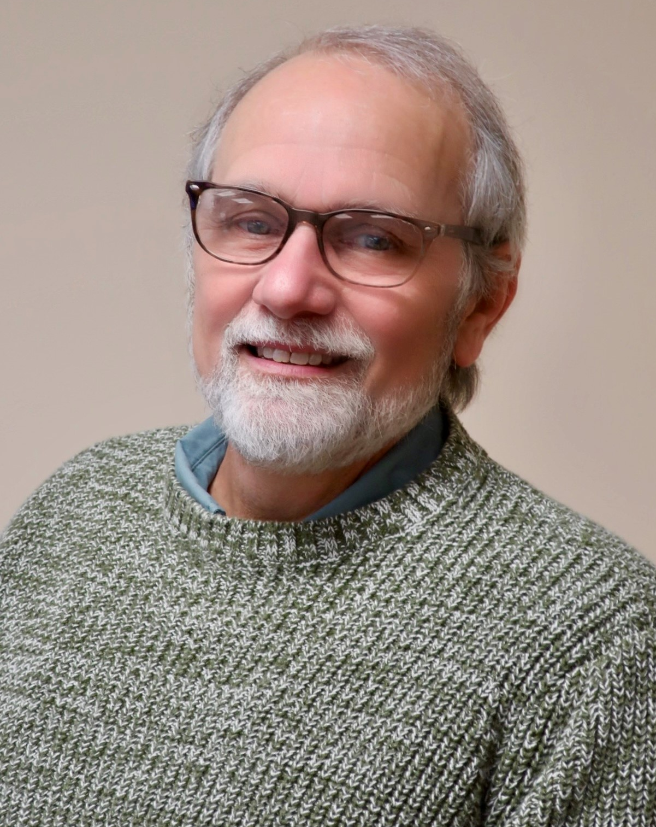
Dr. Tony Reggi
CTE Associate Director,
Notes:
Tony Reggi
919-807-7131
reggia@nccommunitycolleges.edu

Slide 5
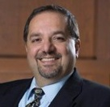
Dr. Hilmi Lahoud
Senior Program Administrator – Business and Information Technology Programs
Notes:
Hilmi A. Lahoud, Ph.D.
Senior Program Administrator, Business and Information Technology Programs
Academic and Student Services
Phone: 919-807-7116
lahoudh@nccommunitycolleges.edu

Slide 6
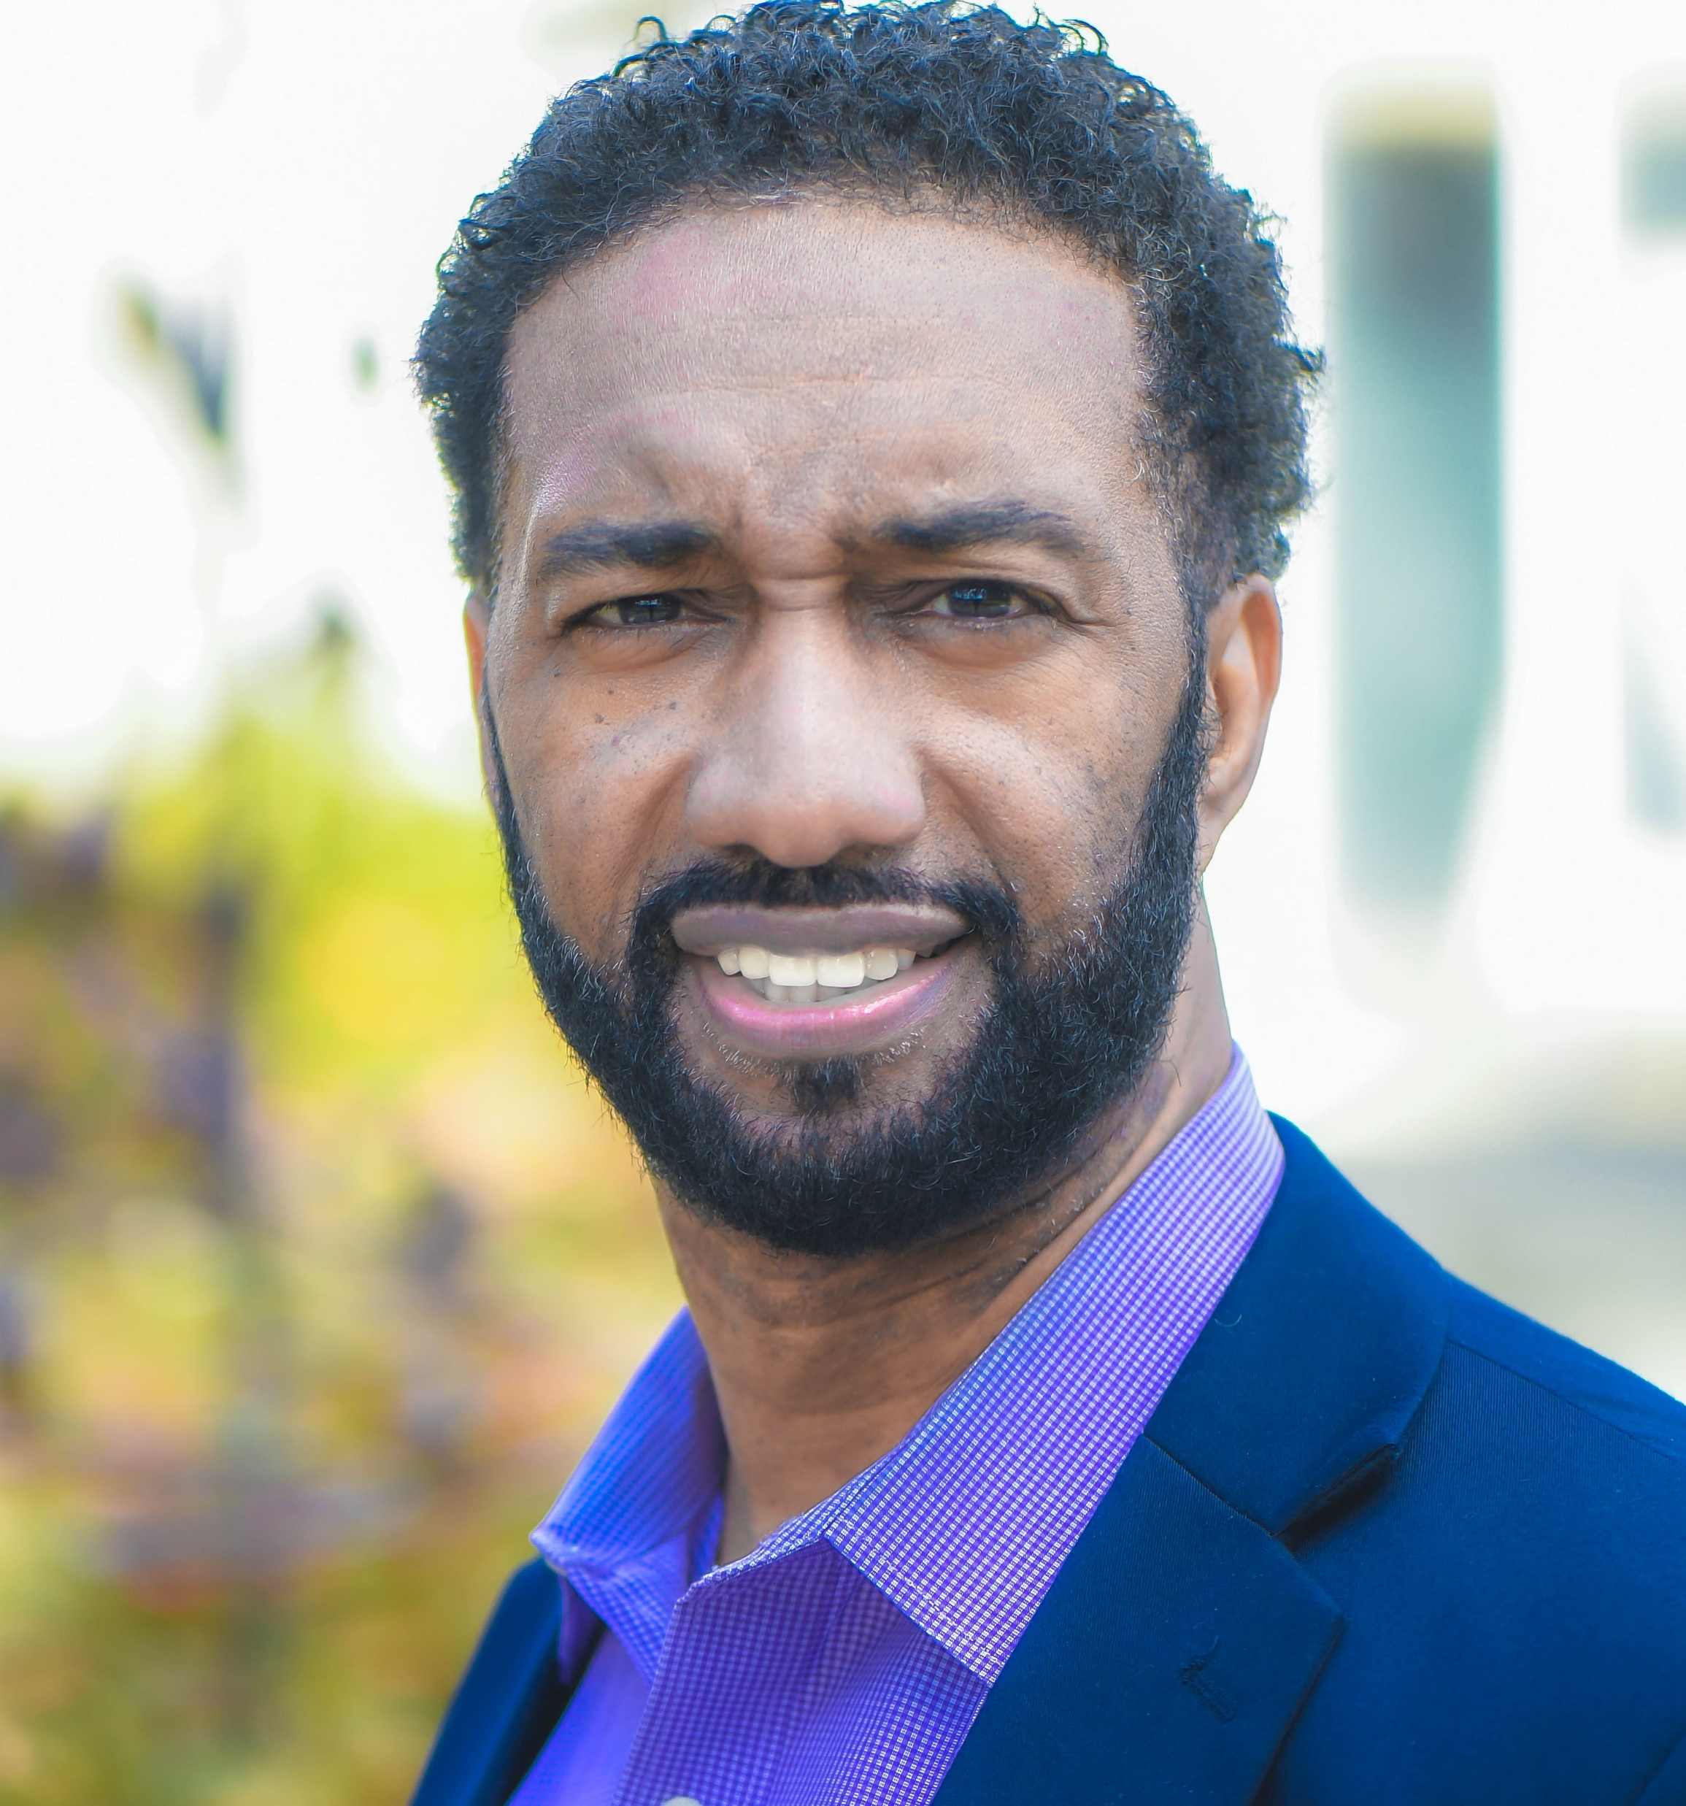

Al Leaston
Durham Technical
Community College
Assistant Dean, Business, Entrepreneurship & Information Technology
Notes:
Al Leaston
Assistant Dean, Business, Entrepreneurship &
Information Technologies -BE/IT
Durham Technical Community College
Email: Leastonj@durhamtech.edu
Phone: 919 536-7200 ext. 4314

Slide 7

Tom Murphy
Durham Technical
Community College
Program Director
IT Software
Notes:
Tom Murphy
919-536-7200 x8157
murphyt@durhamtech.edu

Slide 8


Connor Beveridge
Wayne Community College
Artificial Intelligence(AI)/
Programing Instructor
Notes:
Connor Beveridge
AI Instructor
Information Systems Technology
(919) 739-6890
crbeveridge@waynecc.edu

Slide 9
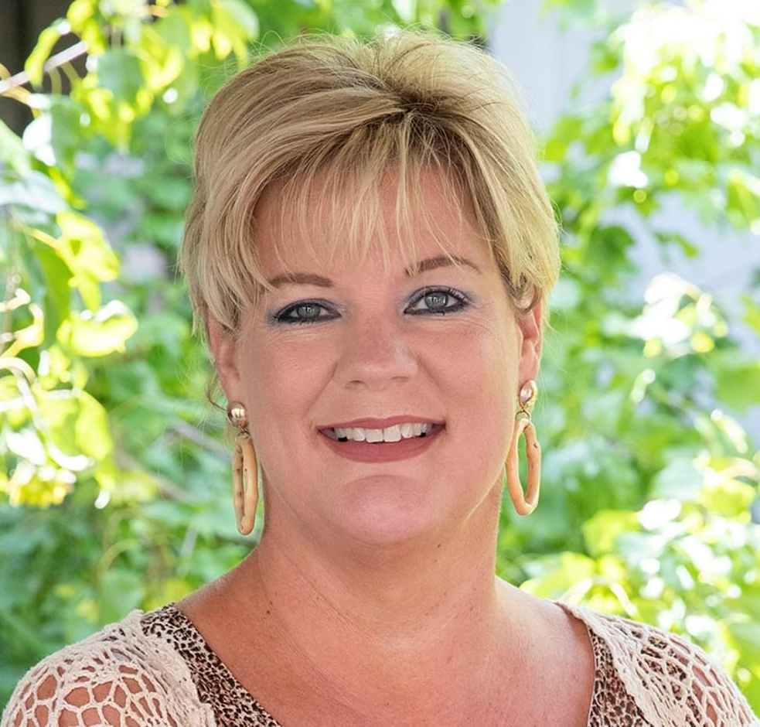
Jenneth Honeycutt
Wayne Community College
Software Development
Instructor
Notes:
Jenneth Honeycutt
Software Development Instructor
Information Systems Technology
(919) 739-6888
jmhoneycutt@waynecc.edu

Slide 10
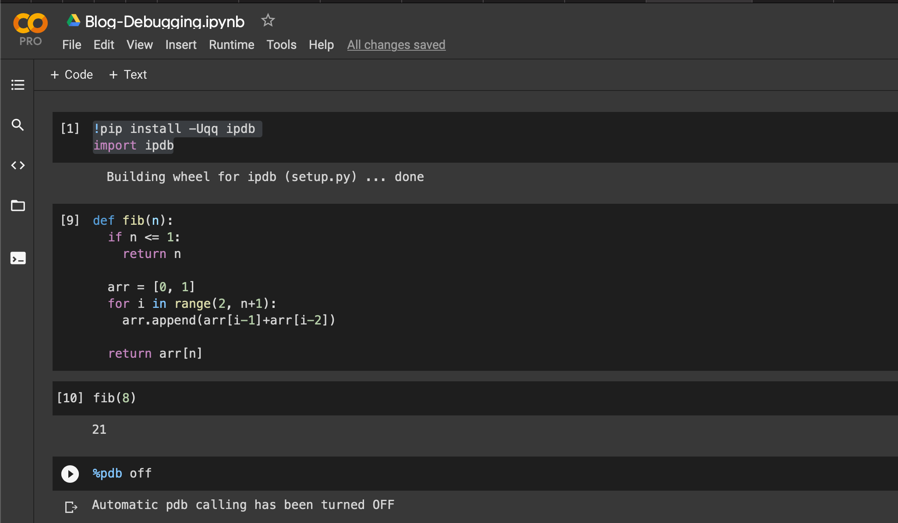
Python Programming

Slide 11

Steve Hayman
Apple, Inc.
Apple Consulting Engineer

Slide 12
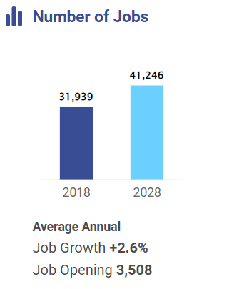
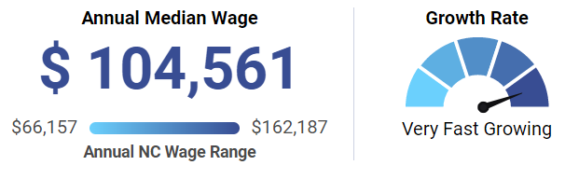

Software Programming
Notes:
Source
https://nccareers.org/occupation-profile/151132/1284
https://www.nccommunitycolleges.edu/analytics/dashboards/curriculum-program-enrollments

Slide 13
Information Technology (A25590)
Possible tracks or emphasis (concentration) in:
Computer Programming and Development
Game and Simulation Programming
Mobile Applications Developer
Software and Web Development
Systems (cyber) Security
Web Administration and Design

Slide 14

Raising the Awareness of Career Pathways Webinars
December 14 Heavy Equipment and Tractor Trailer Truck Drivers
January 18 Teacher Preparation
February 15 Machine Programming (CNC)
March 15 Occupational Therapy Assistants
April 19 Food Industry
May 17 Entrepreneurship
June 21 Nonprofit Leadership
and Management
Register for all webinars at www.ncperkins.org/presentations

