Slide 1
Help Kids Discover Their Passion and Turn it into a
Career Pathway
Chris Droessler
CTE Coordinator
NC Community Colleges
DroesslerC@NCCommunityColleges.edu
www.ctpnc.org/presentations
Notes:
I’m Chris Droessler, an educator from North Carolina.
We are going to talk today about what gets you out of bed in the morning with a determination to go to work.
You should have a half sheet of paper with information about this session. Look at the vertical side.
To get a copy of this PowerPoint, as well as the slides I was showing when you sat down, Go to C T P N C dot ORG and click on the “presentations” link.
How many of you have already downloaded my presentation??
I’ve documented my information sources in the notes section of the PowerPoint, to allow you to further research anything that you see here.
In fact the notes I’m reading from are there as well.
Download the PowerPoint and use it any way you wish if it will help people get on a pathway to a great career. --
I’ve shortened this presentation to fit the roundtable format. You can get the longer presentation I did in October at ctpnc.org.
====
ACTE CareerTech VISION Convention, 11/20/2015, 3:30 - 4:30 pm, Room 252-253, table #17

Slide 2

Scan your Smart Card
Notes:
2
Please, don’t forget to scan your conference Smart Card in order to mark your attendance at this session and allow you to complete the session evaluation.
Since there are 17 sessions in the same room, be sure to mention the name of this session in your evaluation.

Slide 3
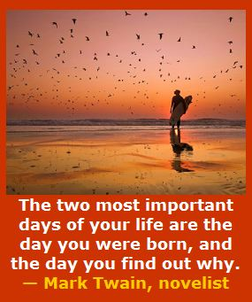
Notes:
Too many people go through life not knowing who they are -- and why they are here on planet Earth.
For some -- the revelation comes late in life.
Today we are talking about helping kids figure out who they are, -- and why they are here.
Somewhere along the road -- all of us found out that we cared about helping others–
and that we were supposed to be right here – this morning –
listening to an old high-school shop teacher talk about passion.
========
http://www.goodreads.com/quotes/505050-the-two-most-important-days-in-your-life-are-the
“The two most important days in your life are the day you are born and the day you find out why.”
― Mark Twain
http://www.huffingtonpost.com/karen-ann-kennedy/the-two-most-important-days-of-your-life_b_5229311.html
Photo
http://myincrediblewebsite.com/mark-twain-on-the-days-of-your-life/

Slide 4
The primary aim of education is not to enable students to do well in school, but to help them do well in the lives they lead outside of school.
Elliot W. Eisner
Notes:
Sometimes we get too caught up in how well kids do in school --
and we loose sight of the goal to produce adult citizens who can function well outside of school.
Being able to perform well in school does not always translate in being able to perform well outside of school.
We often squash the passion out of the kids. We force them to be good at intellectual subjects, and if they fail at the 3 Rs, we force them to of more of the same, rather than let them take electives to see if they are good at something.
We have to get back to the true purpose of education.
=======
This line is often quoted without any reference. Here are two people who claim the quote and a school district that uses it as their motto.
Elliot W. Eisner
http://www.ascd.org/publications/educational-leadership/dec03/vol61/num04/Preparing-for-Today-and-Tomorrow.aspx
Raymond McNulty
http://unioneagle.com/2012/01/education-leader-challenges-teachers-to-be-different/
Bellevue Community School District
http://bellevue.k12.ia.us/

Slide 5
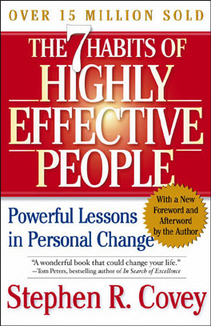
Begin with the
end in mind.
Does education prepare for a career, or the next level of education?
Notes:
One of Stephen Covey’s effective habits is
“Begin with the end in mind.”
If your goal is a job that you look forward to going to on Monday morning, then you have to do a little planning.
And we need to help kids discover this at an earlier age to compete in this fast-paced world that we created for them.

Slide 6
Discover These
Interests
Skills
Job market
Passion
Lifestyle choice ($$)
Notes:
Here are a few things to discover along the way.
All of these can influence your choice of career.
Too many folks focus only on the lifestyle choice or the money.
. .
First, we have to discover who we are.

Slide 7
Discover Your Interests
Realistic (Doers)
Investigative (Thinkers)
Artistic (Creators)
Social (Helpers)
Enterprising (Persuaders)
Conventional (Organizers)
Notes:
I hope you are all familiar with the Holland Codes or Holland career interest Types.
Most folks are high in two or three of these categories.
It’s not just using a computer to match you to a career, it’s finding out who you are, and realizing that you are not good at everything, and that’s OK.
(handout)
Once you have discovered who you are through an interest assessment, then you can start looking at the careers that match your interests.
Middle school and high school are a great place to start learning your career interests.
======
http://en.wikipedia.org/wiki/Holland_Codes

Slide 8
Discover Your Skills
Basic Skills (three Rs)
Problem Solving Skills
Resource Management Skills
Social Skills
Systems Skills
Technical Skills
Notes:
Most people do not know what skills they possess until they have had work experiences.
Arts Education courses, and Career and Technical Education courses in middle school and high school are a great place to try out these skills without making a formal work commitment.
-- You will not know you have a skill in some area until you try it out.
======
http://www.onetonline.org/skills/

Slide 9
Fastest Growing Occupations in NC
Requiring Postsecondary Education
(Total Change in Positions Projected from 2010 - 2020)
17,250 Registered Nurses
9,930 Postsecondary Teachers
8,640 Elementary School Teachers, Except Special Education
4,400 Accountants and Auditors
4,160 Middle School Teachers, Except Special and Career/Technical Education
3,870 Teachers and Instructors, All Other
3,830 Market Research Analysts and Marketing Specialists
3,730 Business Operations Specialists, All Other
3,360 Physicans and Surgeons
3,240 Secondary School Teachers, Except Special and Career/Technical Education
3,100 Police and Sheriff's Patrol Officers
3,010 Medical Secretaries
2,860 Emergency Medical Technicians and Paramedics
2,530 Paralegals and Legal Assistants
2,430 Heating, Air Conditioning, and Refrigeration Mechanics and Installers
2,280 Medical Scientists, Except Epidemiologists
2220 Special Education Teachers, Preschool, Kindergarten, and Elementary School
2210 Firefighters
2120 Computer Systems Analysts
2110 Human Resources, Training, and Labor Relations Specialists, All Other
1980 Lawyers
1920 Construction Managers
1920 Information Security Analysts, Web Developers, and Computer Network Architects
1830 Network and Computer Systems Administrators
1770 Dental Hygienists
Notes:
9
You have to know the job market.
(handout)
The world of work is changing much more rapidly than decades ago, so you have to keep up with the occupation demand projections and the latest trends in work.
If you want to be a nurse, there should be no problem finding a job over the next ten years. Same for teachers, which are split out here into several categories.
If you discover your special skill is threading a textile loom, then you might want to keep looking.
=========
These data are from www.CareerOutlook.US
http://www.bls.gov/emp/ep_table_112.htm
Education and training assignments
updated January 13, 2012

Slide 10

Notes:
All of that is great to know, but –
We are here today –
to talk about passion.
=====
http://hypnoticmystery.deviantart.com/art/Passion-Wallpaper-179848193

Slide 11
Passion – dictionary definition
any powerful or compelling emotion or feeling, as love or hate.
6. a strong or extravagant fondness, enthusiasm, or desire for anything: a passion for music.
7. the object of such a fondness or desire.
Notes:
Here is the dictionary definition of passion.
---
I left out a few definitions that apparently referred to romance novels.
Although, -- writing romance novels could be a career, --
it is not what we are discussing here today.
I like helping people –
That’s one of my passions.
That is why I am here today.
=====
http://dictionary.reference.com/browse/passion?s=t

Slide 12
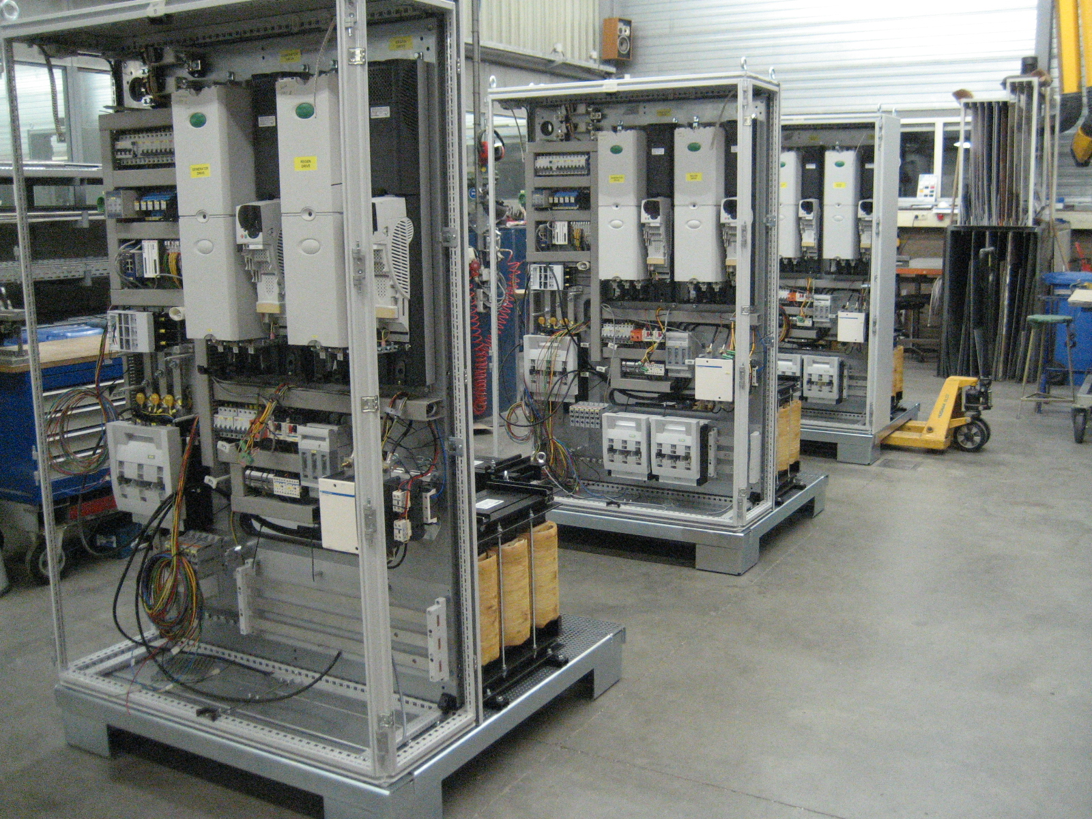
College is the Next Step ?
Notes:
Right out of of high school -- I was at NC State University for 11 years as a undergraduate in Electrical Engineering.
I never got a degree in Electrical Engineering.
I was there because I was good at math and built kits from Radio Shack.
Looking back, I realize that I did not at the time really know what an Electrical Engineer did, -- and to the best of my knowledge I never met an electrical engineer.
I was in college because it was the next thing on the list of things that my family expected me to complete.
Electrical Engineering was never my passion, and at the time, I had no idea what passion was and really had no desire to get one.
=====
http://seetech-corp.com/engineering/electrical-engineering/

Slide 13

Notes:
=====
http://thepassiontest.com/wp-content/uploads/2013/07/a-passion-your-life-passion-in-life.jpg

Slide 14
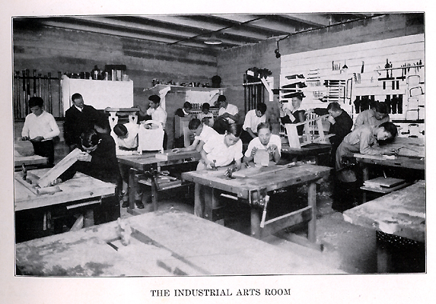
Notes:
I ended up getting a degree in Industrial Arts Education.
I got a bachelor’s degree because it was the next thing on my list.
Now that that was complete – What was next?
I had a lot of part time jobs over the years, and enjoyed parts of them.
I liked working with my hands -- building and repairing things, -- but did not know that that was a passion -- or even a career.
It was just what I liked to do.
Which is what passion is all about, What do you like to do?
What do the youth with whom you work like to do?
=====
http://www.rootsweb.ancestry.com/~innwigs/ImageArchive/LibertyTownship/LibertyTwpPorterCoIndiana-LibertyCenterHighSchool-IndustrialArtsRoom-1931-SS.jpg

Slide 15
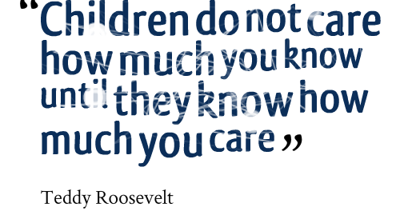
Notes:
Do the kids know you care?
Can they tell that you are passionate about your job,
and that you are there to help them to grow as a person?
====
http://www.imagesbuddy.com/images/168/children-do-not-care-how-much-you-know-until-they-know-how-much-you-care.png

Slide 16
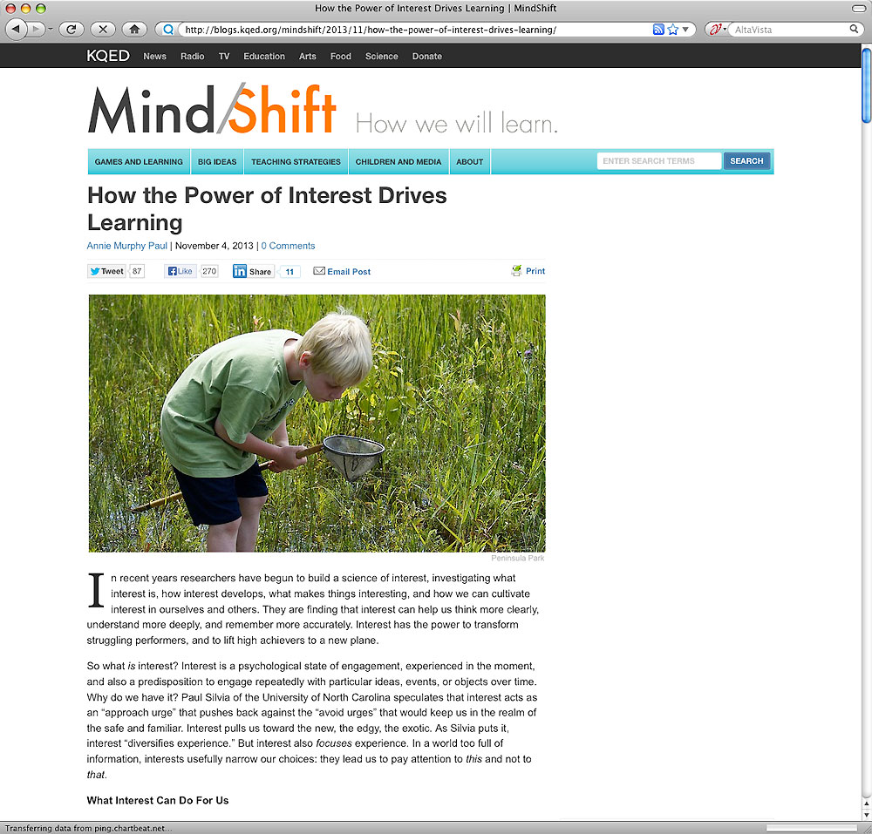
Notes:
People like to do what they like to do.
How can we find out what kids really like,
and then how can we use that information to help them plan a career pathway?
===
http://blogs.kqed.org/mindshift/2013/11/how-the-power-of-interest-drives-learning/
How the Power of Interest Drives Learning
In recent years researchers have begun to build a science of interest, investigating what interest is, how interest develops, what makes things interesting, and how we can cultivate interest in ourselves and others. They are finding that interest can help us think more clearly, understand more deeply, and remember more accurately. Interest has the power to transform struggling performers, and to lift high achievers to a new plane.
So what is interest? Interest is a psychological state of engagement, experienced in the moment, and also a predisposition to engage repeatedly with particular ideas, events, or objects over time. Why do we have it? Paul Silvia of the University of North Carolina speculates that interest acts as an Òapproach urgeÓ that pushes back against the Òavoid urgesÓ that would keep us in the realm of the safe and familiar. Interest pulls us toward the new, the edgy, the exotic. As Silvia puts it, interest Òdiversifies experience.Ó But interest also focuses experience. In a world too full of information, interests usefully narrow our choices: they lead us to pay attention to this and not to that.

Slide 17
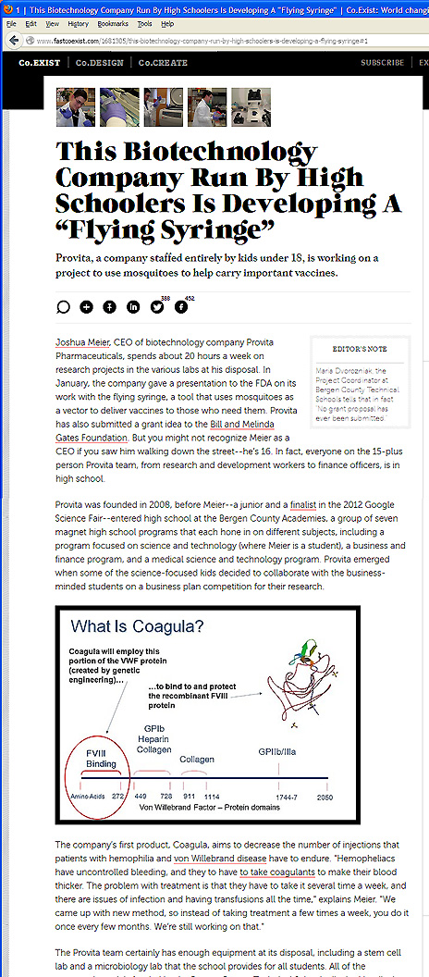
Notes:
You know how mosquitos can spread malaria and other diseases?
Here is a company comprised of kids under the age of 18 who are going to get the mosquitos to instead carry vaccines.
Imagine being able to vaccinate an entire village without a single syringe?
Their first goal is to combat the West Nile Virus.
Some high school student decided this was something they cared about and decided to come up with a solution.
-- A passion to help folks in another country.
=====
http://www.fastcoexist.com/1681305/this-biotechnology-company-run-by-high-schoolers-is-developing-a-flying-syringe#1

Slide 18
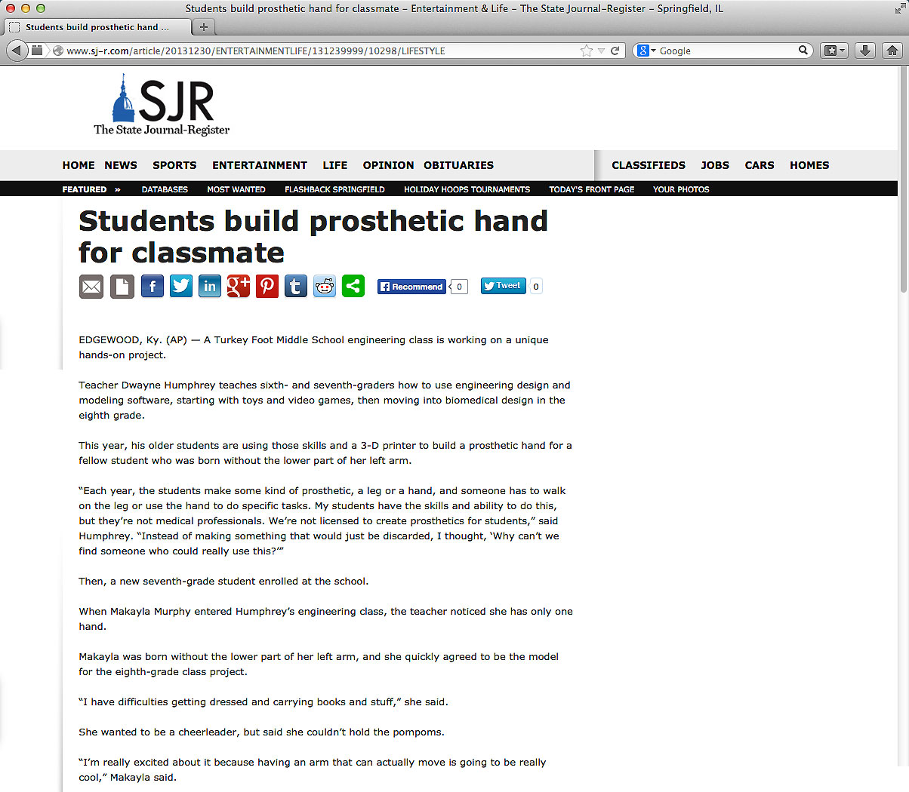
Notes:
Here is a middle school engineering class that is designing a prosthetic hand for a classmate –
who wants to be a cheerleader, --
but couldn’t hold the pompoms.
A passion for helping a fellow student, which in turn makes this engineering class more relevant for the students.
====
http://www.sj-r.com/article/20131230/ENTERTAINMENTLIFE/131239999/10298/LIFESTYLE
Students build prosthetic hand for classmate
By Amy Scalf
The Kentucky Enquirer
Posted Dec. 30, 2013 @ 9:50 pm
Dec 30, 2013 at 11:27 PM
EDGEWOOD, Ky. (AP) — A Turkey Foot Middle School engineering class is working on a unique hands-on project.
Teacher Dwayne Humphrey teaches sixth- and seventh-graders how to use engineering design and modeling software, starting with toys and video games, then moving into biomedical design in the eighth grade.
This year, his older students are using those skills and a 3-D printer to build a prosthetic hand for a fellow student who was born without the lower part of her left arm.
“Each year, the students make some kind of prosthetic, a leg or a hand, and someone has to walk on the leg or use the hand to do specific tasks. My students have the skills and ability to do this, but they’re not medical professionals. We’re not licensed to create prosthetics for students,” said Humphrey. “Instead of making something that would just be discarded, I thought, ‘Why can’t we find someone who could really use this?’”
Then, a new seventh-grade student enrolled at the school.
When Makayla Murphy entered Humphrey’s engineering class, the teacher noticed she has only one hand.
Makayla was born without the lower part of her left arm, and she quickly agreed to be the model for the eighth-grade class project.
“I have difficulties getting dressed and carrying books and stuff,” she said.
She wanted to be a cheerleader, but said she couldn’t hold the pompoms.
“I’m really excited about it because having an arm that can actually move is going to be really cool,” Makayla said.
“We’re on a journey here. We don’t know how it’s going to end. We do know we’re going to give it our best effort and it’s coming together pretty nicely,” said Humphrey. “It’s incredible how quickly things are changing. As we look into the future, we realize we haven’t seen anything yet.”
He also said the project has sparked a special interest among the students.
“Middle-schoolers want to influence the world and they get frustrated over lack of control in their lives. With this project, they get to change someone’s real life. There’s a real opportunity in class to design lessons that have real-world connections,” Humphrey said. “Around the world, kids between the ages of 11-14 are adding to the well of human knowledge and invention. We’re trying to engage students in work that is meaningful.”
Josh Suedkamp and Malachi Pike said that’s exactly why they like this project.
“It’s better because you’re actually affecting someone’s life,” said Malachi. “It’s cool because it helps a real person and it’s not just a school project.”
“I think we’re setting the right kind of tone to really get kids to consider their future careers and giving opportunities to research many of them,” Humphrey said. “Hopefully, we’ll spark something great.”
Read more: http://www.sj-r.com/article/20131230/ENTERTAINMENTLIFE/131239999/10298/LIFESTYLE#ixzz2pGvV3D3y

Slide 19
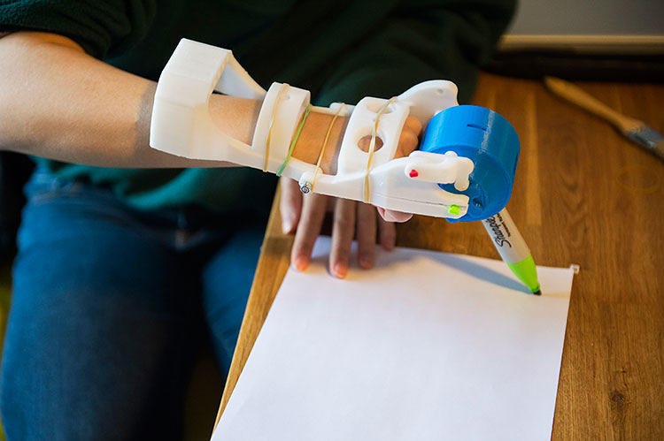
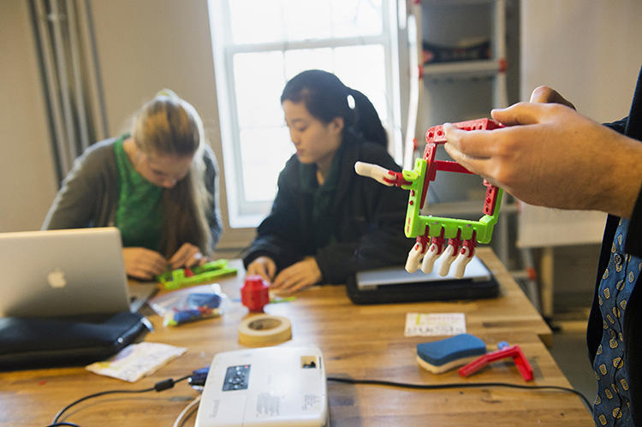
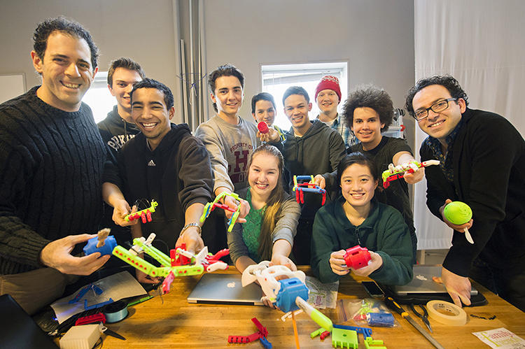
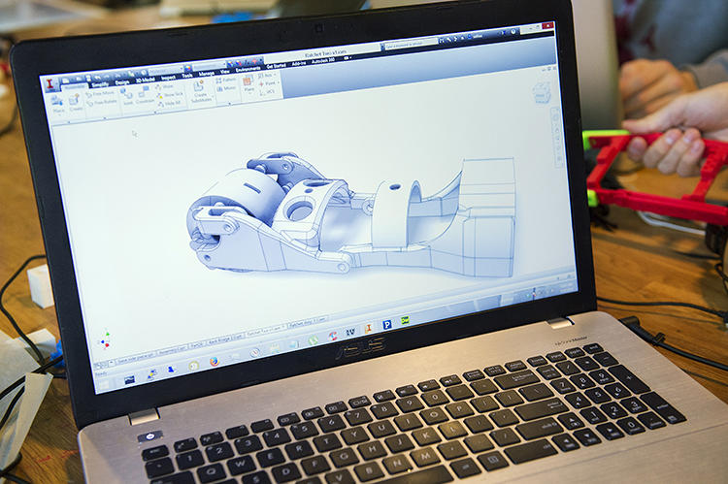
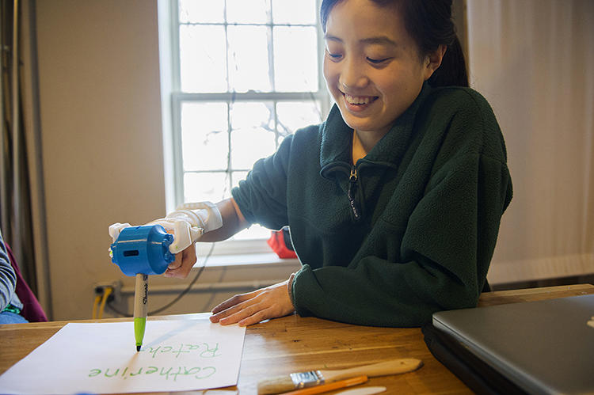
Notes:
Here are the students making hands.
It’s not just about learning engineering principles in class.
It’s about what you can do with the engineering –
that motivates the kids.
It’s not just learning for the sake of learning –
and regurgitating that knowledge on a test.
These kids want to learn –
because they see a tangible result for the acquisition of knowledge.
====
http://www.fastcoexist.com/3027325/these-amazing-prosthetic-hands-were-built-by-high-school-students

Slide 20
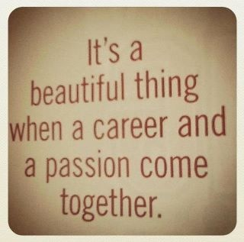
Notes:
======
http://prettyinpaisley.files.wordpress.com/2013/05/blogimage-2.jpg

Slide 21
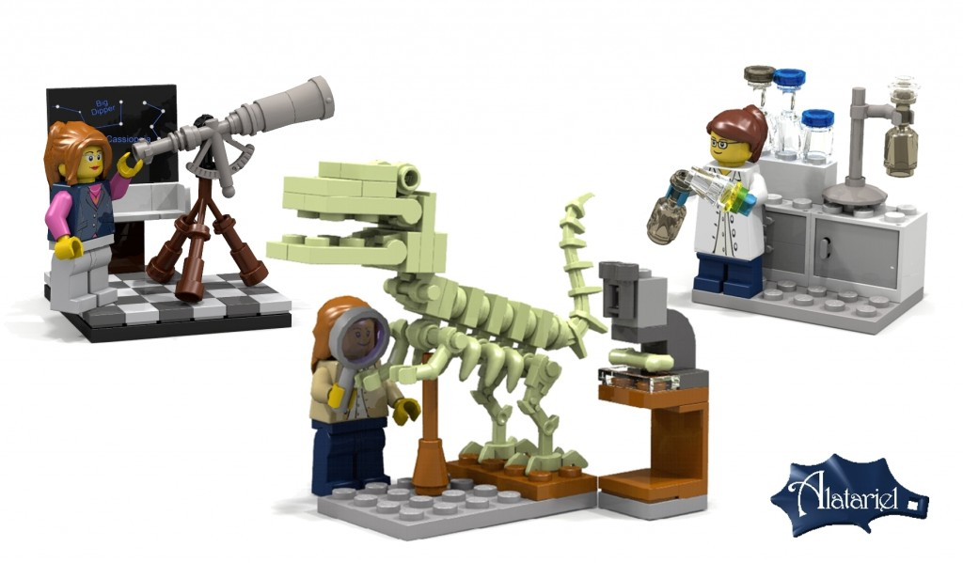
Notes:
We have to encourage folks to try out different jobs until they find the right one.
Here you see where Lego is now creating science structures with female characters to encourage girls to consider careers in science.
These are not girls in bikinis stretched out on a Lego beach. These are depictions of real women making a real difference in the world.
Kids might see themselves in one of these careers,
but they won’t know -- until they try something out.
==========
http://www.washingtonpost.com/blogs/style-blog/wp/2014/06/05/lego-will-finally-make-female-characters-with-science-jobs/
LEGO will make new female characters with science jobs
At long last, LEGO will actually have new female figurines who do something other than bake and hang out at the beach.
The Denmark-based toy company has approved new designs for female scientist, paleontologist and astronomer characters from its LEGO Ideas online competition.
“We’re very excited to release Ellen Kooijman’s Female Mini-figure set, featuring 3 scientists, now entitled ‘Research Institute’ as our next LEGO Ideas set,” LEGO said in an official statement. “This awesome model is an inspiring set that offers a lot for kids as well as adults.”
As Kooijman put it, LEGO typically features a “stereotypical representation” of women in their figures, and she set out to change that.
“As a female scientist I had noticed two things about the available LEGO sets: a skewed male/female mini-figure ratio and a rather stereotypical representation of the available female figures,” Kooijman wrote in a post explaining her project.
“It seemed logical that I would suggest a small set of female mini-figures in interesting professions to make our LEGO city communities more diverse,” she added.
Support for the project was slow at first, but thanks to a flurry of tweets, it skyrocketed from around 2,000 supporters to 10,000 in just about one week.

Slide 22
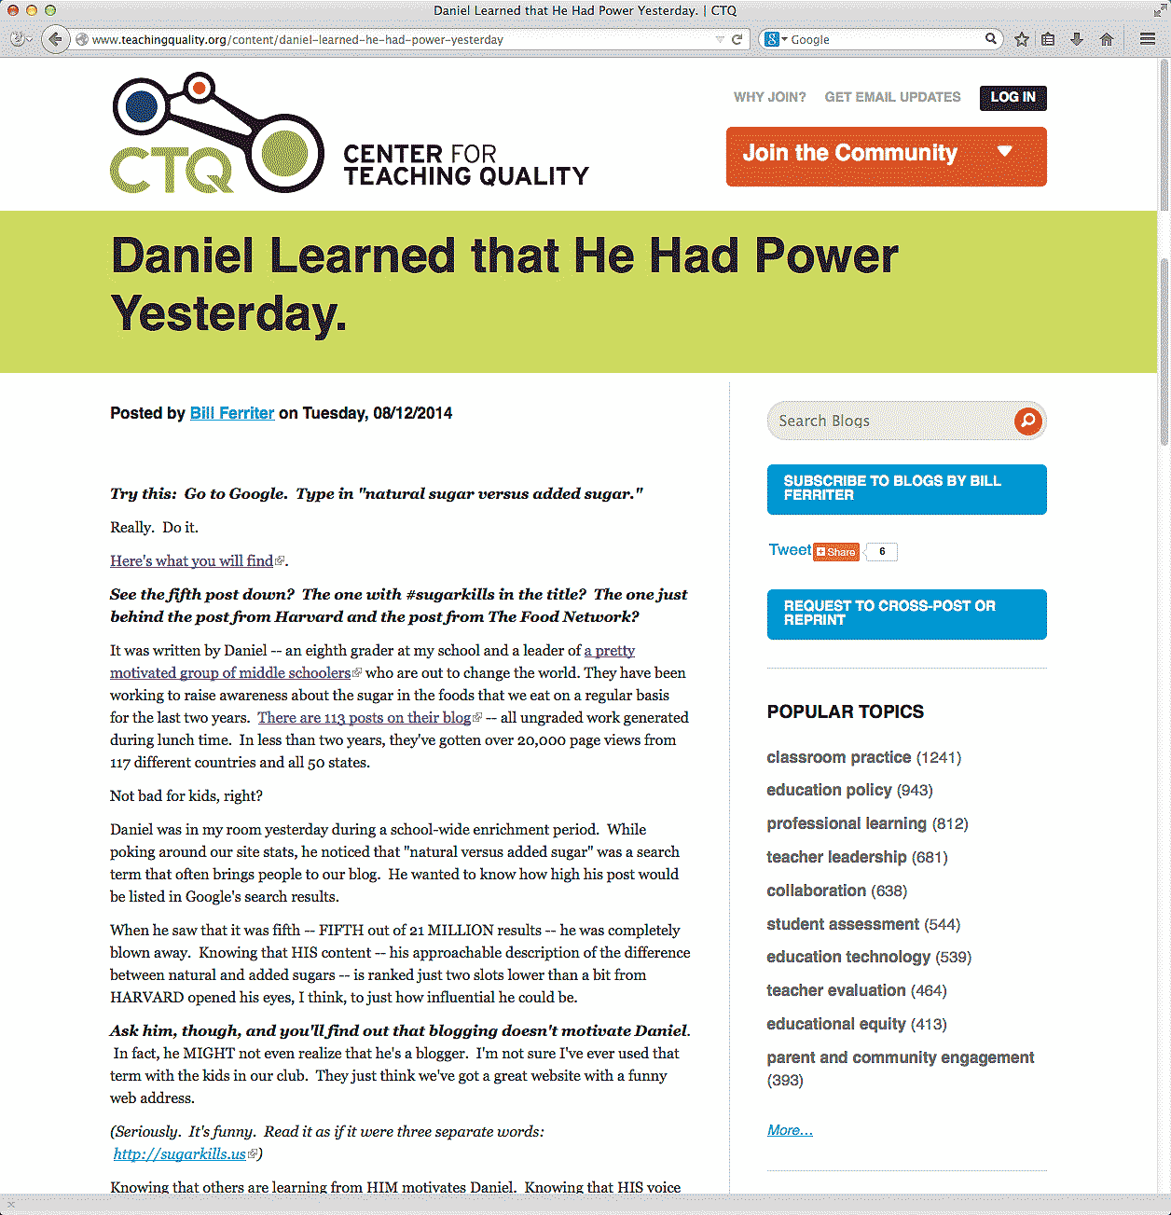
Notes:
Here is an article about an eighth grader who just discovered that he had the power to influence the world in a positive way.
That’s powerful!
========
http://www.teachingquality.org/content/daniel-learned-he-had-power-yesterday
Daniel Learned that He Had Power Yesterday.
Posted by Bill Ferriter on Tuesday, 08/12/2014
Try this: Go to Google. Type in "natural sugar versus added sugar."
Really. Do it.
Here's what you will find (link is external).
See the fifth post down? The one with #sugarkills in the title? The one just behind the post from Harvard and the post from The Food Network?
It was written by Daniel -- an eighth grader at my school and a leader of a pretty motivated group of middle schoolers (link is external) who are out to change the world. They have been working to raise awareness about the sugar in the foods that we eat on a regular basis for the last two years. There are 113 posts on their blog (link is external) -- all ungraded work generated during lunch time. In less than two years, they've gotten over 20,000 page views from 117 different countries and all 50 states.
Not bad for kids, right?
Daniel was in my room yesterday during a school-wide enrichment period. While poking around our site stats, he noticed that "natural versus added sugar" was a search term that often brings people to our blog. He wanted to know how high his post would be listed in Google's search results.
When he saw that it was fifth -- FIFTH out of 21 MILLION results -- he was completely blown away. Knowing that HIS content -- his approachable description of the difference between natural and added sugars -- is ranked just two slots lower than a bit from HARVARD opened his eyes, I think, to just how influential he could be.
Ask him, though, and you'll find out that blogging doesn't motivate Daniel. In fact, he MIGHT not even realize that he's a blogger. I'm not sure I've ever used that term with the kids in our club. They just think we've got a great website with a funny web address.
(Seriously. It's funny. Read it as if it were three separate words: http://sugarkills.us (link is external))
Knowing that others are learning from HIM motivates Daniel. Knowing that HIS voice can help others to live a healthier life motivates Daniel. Knowing that HE really does have power and that he really CAN drive change motivates Daniel.
[steppingONsoapbox]
THAT's what I love about cause-driven learning experiences, y'all -- and THAT's why I want to find ways to get MORE kids involved in opportunities to drive REAL change in the world beyond our classroom.
No offense to the entire universe, but I'm not trying to prepare kids for colleges and careers. I'm preparing kids for colleges, careers and COMMUNITIES. I want my students to take an action orientation towards the world that they live in. I want them to see problems and know that THEY can be the solvers even if they aren't old enough to drive.
Gimmie a keyboard and an internet connection and I'll show kids how they can change the world. You can too.
======
About Us
We are a group of middle schoolers who spent the better part of the 2012-2013 school year studying the New York City Soda Ban.
In the course of our studies, we decided to learn more about just how much sugar is in our foods — and just how much sugar we should be eating on a daily basis.
=====

Slide 23
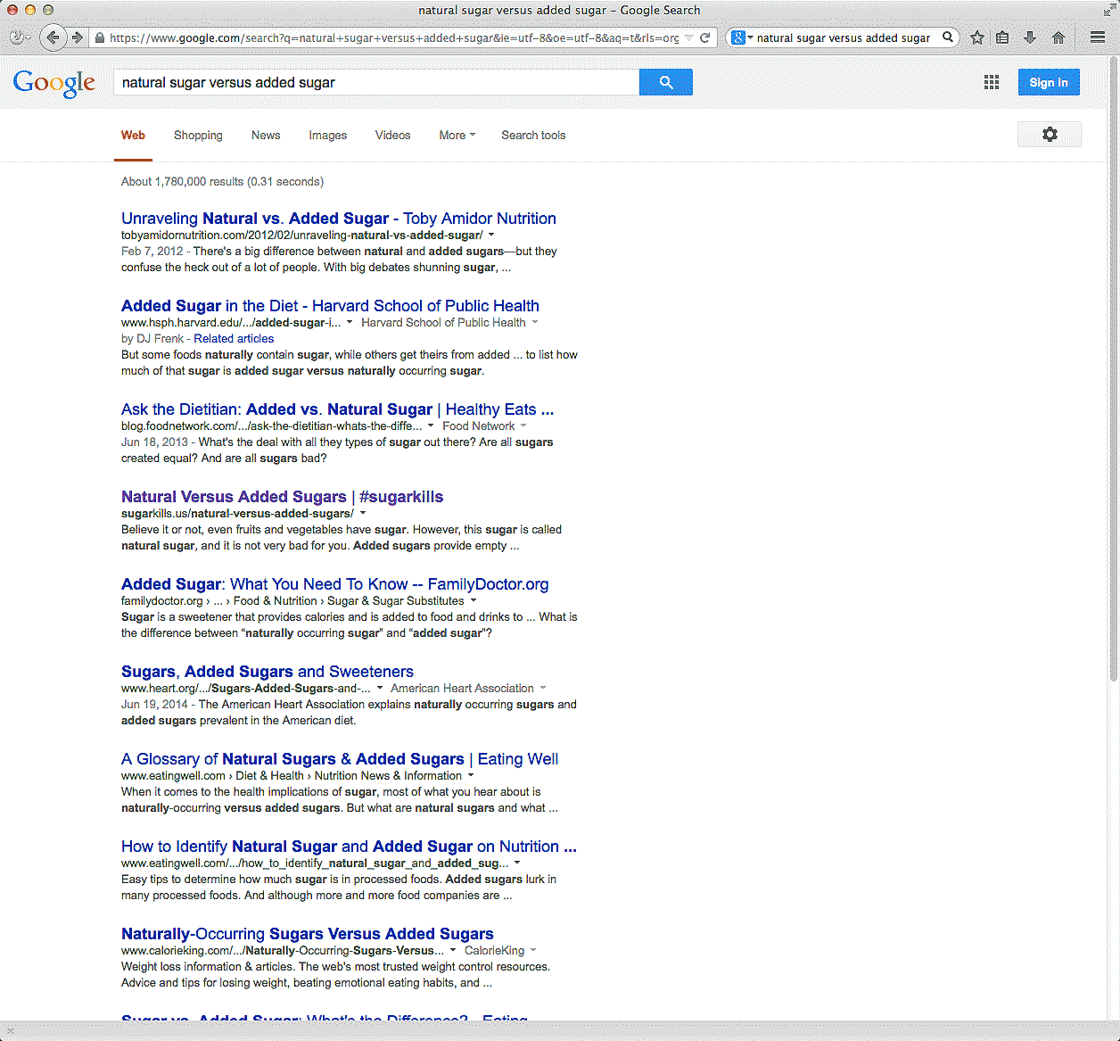
Notes:
If you Googled "natural sugar versus added sugar."
See the fourth post down?
→
just behind the post from Harvard and the post from The Food Network?
That link is to Daniel’s page, an eighth grader working with a team of classmates who are out to change the world.
========
http://www.teachingquality.org/content/daniel-learned-he-had-power-yesterday
Daniel Learned that He Had Power Yesterday.
Posted by Bill Ferriter on Tuesday, 08/12/2014
Try this: Go to Google. Type in "natural sugar versus added sugar."
Really. Do it.
Here's what you will find (link is external).
See the fifth post down? The one with #sugarkills in the title? The one just behind the post from Harvard and the post from The Food Network?
It was written by Daniel -- an eighth grader at my school and a leader of a pretty motivated group of middle schoolers (link is external) who are out to change the world. They have been working to raise awareness about the sugar in the foods that we eat on a regular basis for the last two years. There are 113 posts on their blog (link is external) -- all ungraded work generated during lunch time. In less than two years, they've gotten over 20,000 page views from 117 different countries and all 50 states.
Not bad for kids, right?
Daniel was in my room yesterday during a school-wide enrichment period. While poking around our site stats, he noticed that "natural versus added sugar" was a search term that often brings people to our blog. He wanted to know how high his post would be listed in Google's search results.
When he saw that it was fifth -- FIFTH out of 21 MILLION results -- he was completely blown away. Knowing that HIS content -- his approachable description of the difference between natural and added sugars -- is ranked just two slots lower than a bit from HARVARD opened his eyes, I think, to just how influential he could be.
Ask him, though, and you'll find out that blogging doesn't motivate Daniel. In fact, he MIGHT not even realize that he's a blogger. I'm not sure I've ever used that term with the kids in our club. They just think we've got a great website with a funny web address.
(Seriously. It's funny. Read it as if it were three separate words: http://sugarkills.us (link is external))
Knowing that others are learning from HIM motivates Daniel. Knowing that HIS voice can help others to live a healthier life motivates Daniel. Knowing that HE really does have power and that he really CAN drive change motivates Daniel.
[steppingONsoapbox]
THAT's what I love about cause-driven learning experiences, y'all -- and THAT's why I want to find ways to get MORE kids involved in opportunities to drive REAL change in the world beyond our classroom.
No offense to the entire universe, but I'm not trying to prepare kids for colleges and careers. I'm preparing kids for colleges, careers and COMMUNITIES. I want my students to take an action orientation towards the world that they live in. I want them to see problems and know that THEY can be the solvers even if they aren't old enough to drive.
Gimmie a keyboard and an internet connection and I'll show kids how they can change the world. You can too.
======
About Us
We are a group of middle schoolers who spent the better part of the 2012-2013 school year studying the New York City Soda Ban.
In the course of our studies, we decided to learn more about just how much sugar is in our foods — and just how much sugar we should be eating on a daily basis.
=====

Slide 24
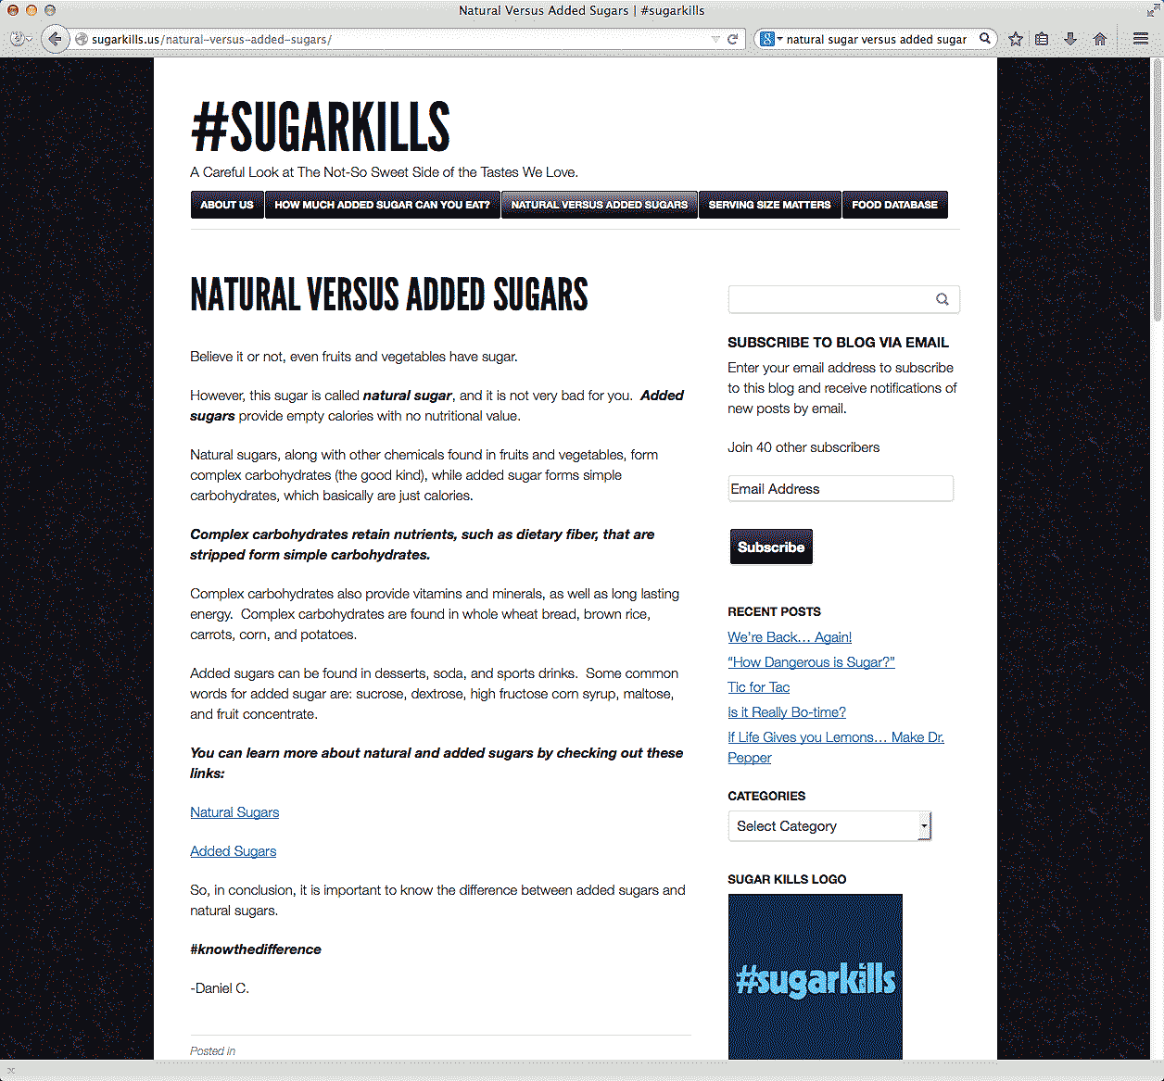
Notes:
They have been working for the last two years to raise the awareness about the sugar in the foods that we eat.
This is all all ungraded work generated during lunch time.
In less than two years, they've gotten over 20,000 page views from 117 different countries.
========
http://www.teachingquality.org/content/daniel-learned-he-had-power-yesterday
Daniel Learned that He Had Power Yesterday.
Posted by Bill Ferriter on Tuesday, 08/12/2014
Try this: Go to Google. Type in "natural sugar versus added sugar."
Really. Do it.
Here's what you will find (link is external).
See the fifth post down? The one with #sugarkills in the title? The one just behind the post from Harvard and the post from The Food Network?
It was written by Daniel -- an eighth grader at my school and a leader of a pretty motivated group of middle schoolers (link is external) who are out to change the world. They have been working to raise awareness about the sugar in the foods that we eat on a regular basis for the last two years. There are 113 posts on their blog (link is external) -- all ungraded work generated during lunch time. In less than two years, they've gotten over 20,000 page views from 117 different countries and all 50 states.
Not bad for kids, right?
Daniel was in my room yesterday during a school-wide enrichment period. While poking around our site stats, he noticed that "natural versus added sugar" was a search term that often brings people to our blog. He wanted to know how high his post would be listed in Google's search results.
When he saw that it was fifth -- FIFTH out of 21 MILLION results -- he was completely blown away. Knowing that HIS content -- his approachable description of the difference between natural and added sugars -- is ranked just two slots lower than a bit from HARVARD opened his eyes, I think, to just how influential he could be.
Ask him, though, and you'll find out that blogging doesn't motivate Daniel. In fact, he MIGHT not even realize that he's a blogger. I'm not sure I've ever used that term with the kids in our club. They just think we've got a great website with a funny web address.
(Seriously. It's funny. Read it as if it were three separate words: http://sugarkills.us (link is external))
Knowing that others are learning from HIM motivates Daniel. Knowing that HIS voice can help others to live a healthier life motivates Daniel. Knowing that HE really does have power and that he really CAN drive change motivates Daniel.
[steppingONsoapbox]
THAT's what I love about cause-driven learning experiences, y'all -- and THAT's why I want to find ways to get MORE kids involved in opportunities to drive REAL change in the world beyond our classroom.
No offense to the entire universe, but I'm not trying to prepare kids for colleges and careers. I'm preparing kids for colleges, careers and COMMUNITIES. I want my students to take an action orientation towards the world that they live in. I want them to see problems and know that THEY can be the solvers even if they aren't old enough to drive.
Gimmie a keyboard and an internet connection and I'll show kids how they can change the world. You can too.
======
About Us
We are a group of middle schoolers who spent the better part of the 2012-2013 school year studying the New York City Soda Ban.
In the course of our studies, we decided to learn more about just how much sugar is in our foods — and just how much sugar we should be eating on a daily basis.
=====

Slide 25
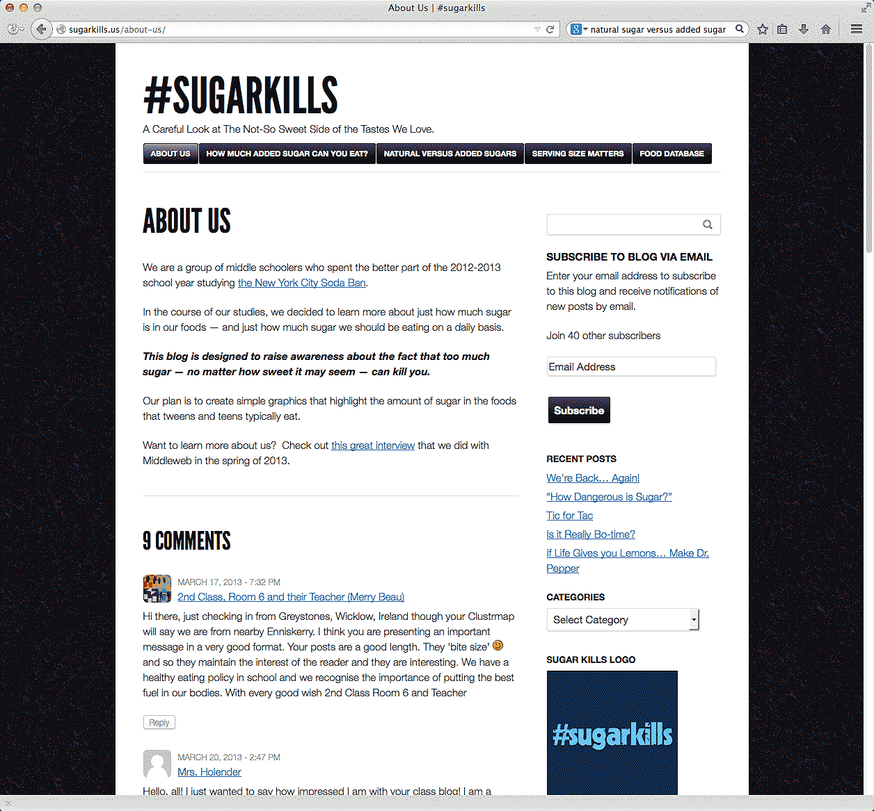
Notes:
Not bad for kids, right?
They are doing this because they want to.
They are learning about something that is important to them, and they are sharing it with the world.
They are not driven by grades, money or any other reward. They are doing this work because they believe it is the right thing to do.
It really means something to them.
========
http://www.teachingquality.org/content/daniel-learned-he-had-power-yesterday
Daniel Learned that He Had Power Yesterday.
Posted by Bill Ferriter on Tuesday, 08/12/2014
Try this: Go to Google. Type in "natural sugar versus added sugar."
Really. Do it.
Here's what you will find (link is external).
See the fifth post down? The one with #sugarkills in the title? The one just behind the post from Harvard and the post from The Food Network?
It was written by Daniel -- an eighth grader at my school and a leader of a pretty motivated group of middle schoolers (link is external) who are out to change the world. They have been working to raise awareness about the sugar in the foods that we eat on a regular basis for the last two years. There are 113 posts on their blog (link is external) -- all ungraded work generated during lunch time. In less than two years, they've gotten over 20,000 page views from 117 different countries and all 50 states.
Not bad for kids, right?
Daniel was in my room yesterday during a school-wide enrichment period. While poking around our site stats, he noticed that "natural versus added sugar" was a search term that often brings people to our blog. He wanted to know how high his post would be listed in Google's search results.
When he saw that it was fifth -- FIFTH out of 21 MILLION results -- he was completely blown away. Knowing that HIS content -- his approachable description of the difference between natural and added sugars -- is ranked just two slots lower than a bit from HARVARD opened his eyes, I think, to just how influential he could be.
Ask him, though, and you'll find out that blogging doesn't motivate Daniel. In fact, he MIGHT not even realize that he's a blogger. I'm not sure I've ever used that term with the kids in our club. They just think we've got a great website with a funny web address.
(Seriously. It's funny. Read it as if it were three separate words: http://sugarkills.us (link is external))
Knowing that others are learning from HIM motivates Daniel. Knowing that HIS voice can help others to live a healthier life motivates Daniel. Knowing that HE really does have power and that he really CAN drive change motivates Daniel.
[steppingONsoapbox]
THAT's what I love about cause-driven learning experiences, y'all -- and THAT's why I want to find ways to get MORE kids involved in opportunities to drive REAL change in the world beyond our classroom.
No offense to the entire universe, but I'm not trying to prepare kids for colleges and careers. I'm preparing kids for colleges, careers and COMMUNITIES. I want my students to take an action orientation towards the world that they live in. I want them to see problems and know that THEY can be the solvers even if they aren't old enough to drive.
Gimmie a keyboard and an internet connection and I'll show kids how they can change the world. You can too.
======
About Us
We are a group of middle schoolers who spent the better part of the 2012-2013 school year studying the New York City Soda Ban.
In the course of our studies, we decided to learn more about just how much sugar is in our foods — and just how much sugar we should be eating on a daily basis.
=====

Slide 26
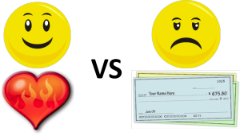
Passion vs Paycheck
Notes:
Which is more important?
Looking forward to going to work on Monday morning,
or looking forward to a paycheck on Friday afternoon?
======
http://theherowithinu.com/2013/01/23/passion-vs-paycheck/

Slide 27

Notes:
Why do people think they have to choose between the two?
OK, I did decide to become a teacher rather than an engineer! And then I married another teacher rather than an engineer.
============
http://www.beyond.com/data/articles/images/changing-careers/Passion%20for%20love%20or%20money.jpg

Slide 28
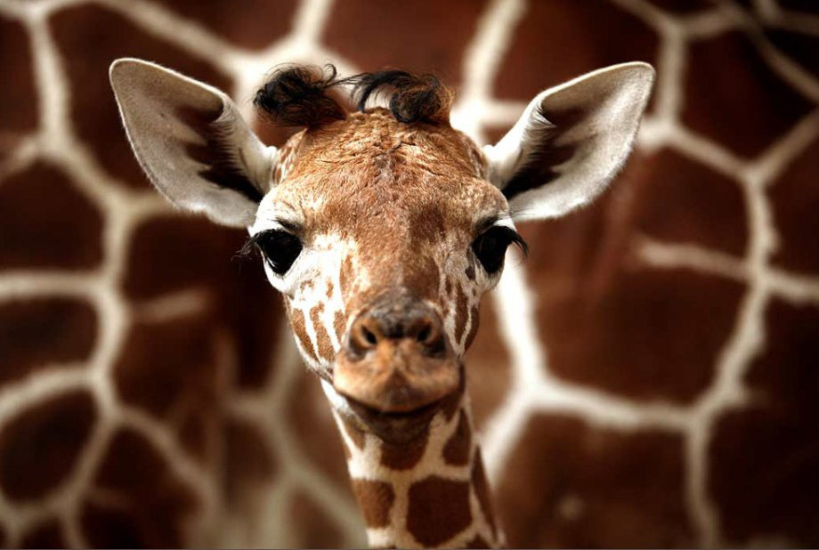
Do You Like Animals?
Notes:
One of my passions is giraffes.
Lots of kids like animals,
and when asked what they want to do when they grow up, they say they want to work with animals.
When adults hear this they automatically respond “You should be a ----- veterinarian.”
But kids don’t really know what a veterinarian really does for a job,
Kids just know that if it involves animals they will be happy.
The problem is that when they finally get old enough to job-shadow or intern with a veterinarian, they are often shocked to find out that they had no idea of the work of the veterinarian -- and want nothing to do with it.
Their dreams are now shattered.
For many years they have told everyone that they were going to be a veterinarian, -- and now that they have seen the work, -- they are left confused and hopeless.
=====
https://shechive.files.wordpress.com/2011/01/a-cute-animals-10.jpg?quality=94&strip=all&w=920
http://theberry.com/2011/01/04/daily-awww-whats-better-than-cute-animal-pics-hi-res-ones-30-hq-photos/#.

Slide 29
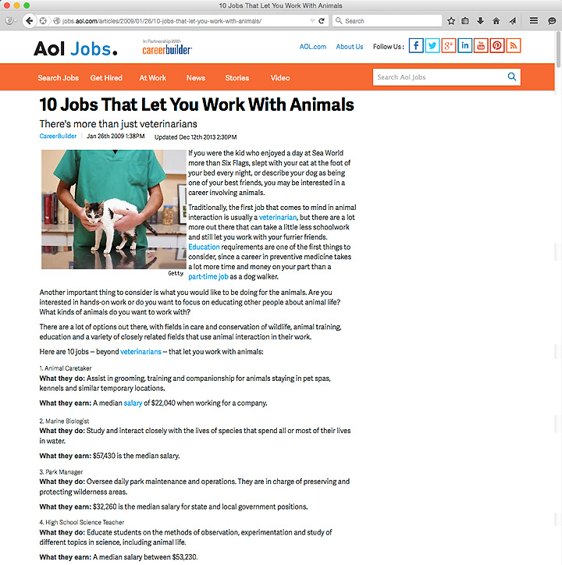
Notes:
There are lots of jobs that work with animals that do not require “fixing” them.
Here is a list of ten of them.
The American Kennel Club lists two dozen jobs that are related to working with dogs.
We need to stop telling kids that veterinarian is the answer.
Kids need to discover their own direction after doing the research ---
after having the experiences.
=====
http://jobs.aol.com/articles/2009/01/26/10-jobs-that-let-you-work-with-animals/
http://www.akc.org/events/junior-showmanship/careers/

Slide 30
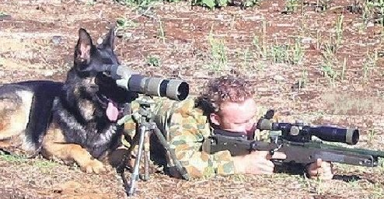
NOT Jobs For Animals
Notes:
I am talking about jobs with animals not jobs for animals.
====
http://cubiclebot.com/pictures/dogs-are-unqualified-for-everything/

Slide 31
Try it Out
Take elective courses
  Fine and Performing Arts
  Career and Technical
School Clubs
Notes:
Try it Out!
Classes in The Arts are a great place to explore your interests. Especially the performing arts like Theatre, Dance, Instrumental Music, and Chorus. You might discover a hidden talent.
And Career and Technical Education courses --.
Some schools have an ninth-grade introductory course where you can get a sense of all of the CTE courses offered at the school.
School Clubs are another way to get hands on experiences. My participation in the Stamp Collecting club helped me to learn geography and learn about other cultures.
And the Technical Crew in high school was my avenue to apply physics to the real world.

Slide 32
Try it Out
Work-based learning
Scouting
  Merit Badges
  Exploring
  Learning for Life
Notes:
Work-based learning means job shadowing where you get away from the school for a day and watch someone work --- to see if that job is for you.
Internships are longer experiences where you get to work in a real job for a few months in order to try out various occupations. You don’t know what you will like until you try.
I ran the radio station at my high school, which got me into DeeJaying, which got me into running sound for bands, and opening my own recording studio.
The Merit Badge Programs in Girl Scouts and Boy Scouts are designed to help kids explore various career interests.
The Exploring program is career-oriented experiences for teenagers. I was in a MultiMedia explorer post.
It helped me discover that I had a passion for helping people communicate information, which we did through sound reinforcement, stage lighting, video projection, and print media.
I still do the sound, stage lights, and video projection for the large Boy Scout camporees and conclaves in the area.
. If I had not had these experiences in high school, you probably would have had a different DeeJay at the dance last night.

Slide 33
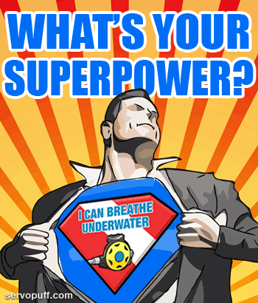
Notes:
I believe that everyone has a special super power.
The first thing is to discover what your special power is.
Then you might have to hone your craft through practice.
Learn the limits of your super power.
Learn how your super power can work in concert with other’s super powers for team work. – Synergy!
Then decide if you plan to use your super power for good or evil. I hope for good.
====
http://misterjean.net/?p=178
http://misterjean.net/wp-content/uploads/2011/04/comment_superpower1.gif

Slide 34

Notes:
Superman uses his incredible strength, speed, flight, and various superpowers to fight evil and protect the innocent. His passion -- is to fight evil.
What is the difference between your super power or innate gift and your passion.
Hopefully you can find a way to use your natural gifts to fulfill your passion. For some people, the two never come together.
We usually do not know we have super powers until someone points them out. What is your super power?
When did you discover that you had a super power that others around you did not have? Who pointed it out to you? Was it a teacher? Someone else in the same profession? Often, it takes one to know one!
When did you discover that your super power was helping other people?
We have to help the kids discover their super power, help them to nourish it, help them to use it for good, and get them on track to a career where their super power is highly prized.
=====
http://www.metropolisplus.com/superman/

Slide 35
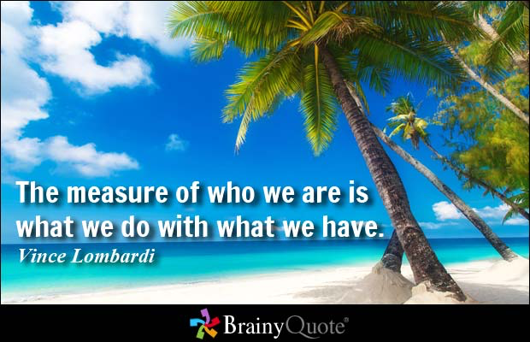
Notes:
First we have to know what we have.
Then decide what to do with what we have.
=======
“The measure of who we are is what we do with what we have."
-- Vince Lombardi, American football coach
=========
http://www.brainyquote.com/quotes/quotes/v/vincelomba382625.html

Slide 36
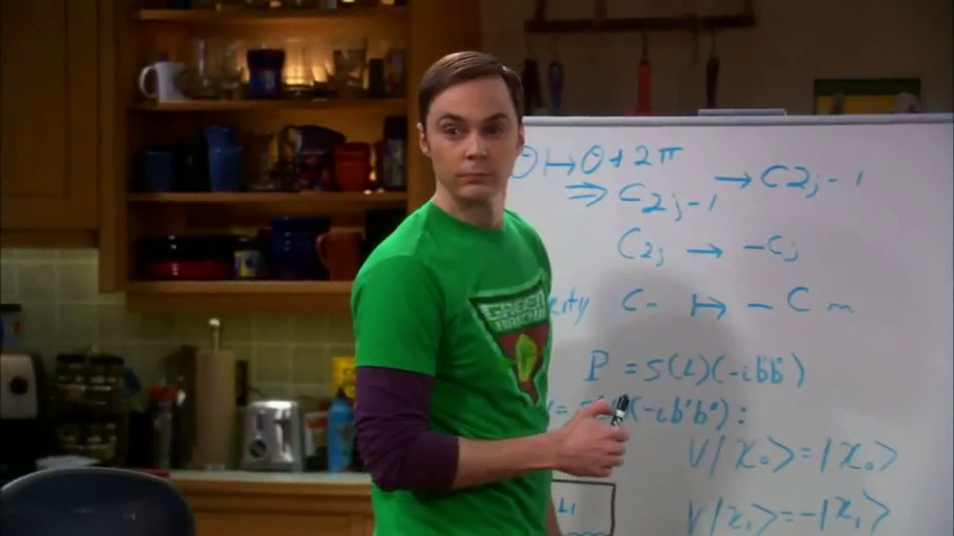
Notes:
For someone like Doctor Sheldon Cooper, it is easy to discover his passion.
He makes no attempt to hide what excites him.
He allows you to be his audience as he opens himself up on the great stage of life.
http://upload.wikimedia.org/wikipedia/it/6/65/Big_Bang_Theory,_Sheldon_Cooper,_5x20.png

Slide 37
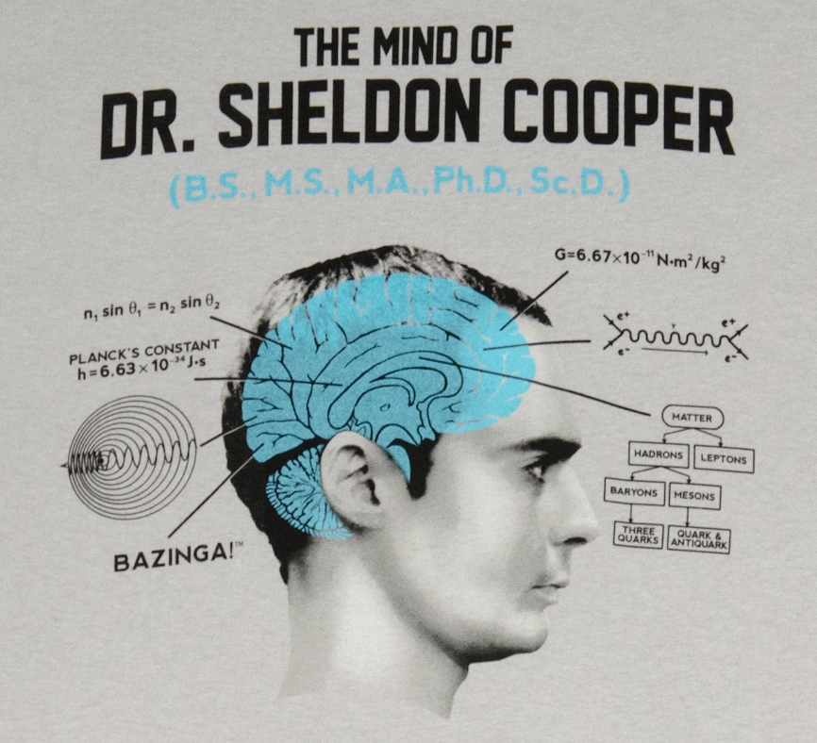
Notes:
Sometimes super powers are very apparent –
and sometimes obnoxious.
Some people never discover their super power,
and it sits on a shelf like an unopened gift.
=======
http://www.gravitywear.com/sites/default/files/styles/gw_product_full/public/Dr_Sheldon_Cooper_Mind_Logo.jpg

Slide 38

Notes:
I do like to eat, and I am glad some people have the passion and the super powers for cooking.
Though I do have Cooking merit badge,
I do not have a passion nor super powers for cooking.
Luckily I married someone who does.
====
http://www.atlantic.edu/aca/index.htm

Slide 39
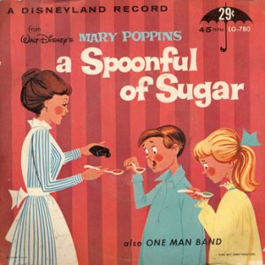
Notes:
One of Mary Poppins’s super powers is to get people to see the fun in everything.
In the introduction to the song “A Spoonful of Sugar” Mary Poppins reminds us how we often have to do unpleasant things.
“With every job that must be done, there is an element of fun. You find the fun and snap, the job’s a game. And every task you undertake becomes a piece of cake …”
Well, I do like cake!
When unpleasant tasks come my way at work, I just remember what Mary Poppins said, and it’s all good.
==========
http://s.ecrater.com/stores/53443/4c171b553dd23_53443n.jpg

Slide 40
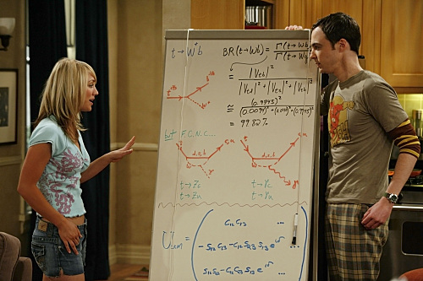
Notes:
Penny and Sheldon have different passions and different super powers. -- Did you notice?
=============
http://img3.wikia.nocookie.net/__cb20110728044900/bigbangtheory/images/c/c6/Big-bang-theory-penny-sheldon-photo1.jpg

Slide 41
Interests vs. Passion
Notes:
Starting at Middle School most folks can grasp their career interests. Like working indoors or outside.
Like structured work or free thinking.
Like working around people or working by themselves.
Passion is something else.
It turns out that my interests -- are not really right for my job.
This means that I have to stretch into uncomfortable areas like being extraverted, -- when I prefer to be introverted.
(point) I also don’t get to file a lot of wood in my job, which to me is fun.
An interest is “working with my hands,”
but a passion is “building things for people who who can’t afford it and really need it.”
Your passion can easily override your interests.
To follow your passion, you will do almost anything.

Slide 42
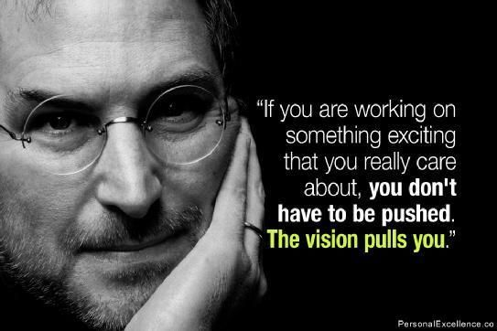
Think Different
Making Better Things
Steve Jobs
Notes:
Steve Jobs was passionate about Making Better Things.
He cared about making something from which other people could benefit.
He challenged us all to Think Different.
====
https://www.pinterest.com/pin/166422148705420451/
http://finance.yahoo.com/news/steve-jobs-destroyed-passion-myth-163000433.html;_ylt=A0LEV7_TYvdUvyQAJscnnIlQ;_ylu=X3oDMTEzamFkOTJqBHNlYwNzcgRwb3MDMgRjb2xvA2JmMQR2dGlkA1lIUzAwNF8x

Slide 43

Teamwork
Notes:
Dean Smith was passionate about teamwork.
Creating team players.
He was also passionate about the academic success of his players.
======
http://bleacherreport.com/

Slide 44
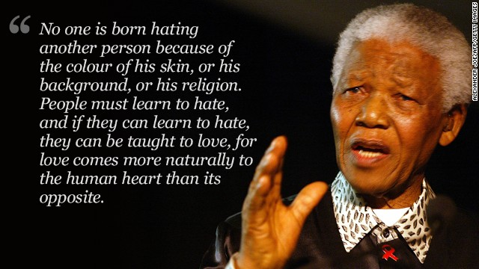
Racism, Human Rights
Notes:
Nelson Mandela was Passionate about racism and human rights.
====
http://www.cnn.com/2013/12/06/world/africa/nelson-mandela-other-side/

Slide 45
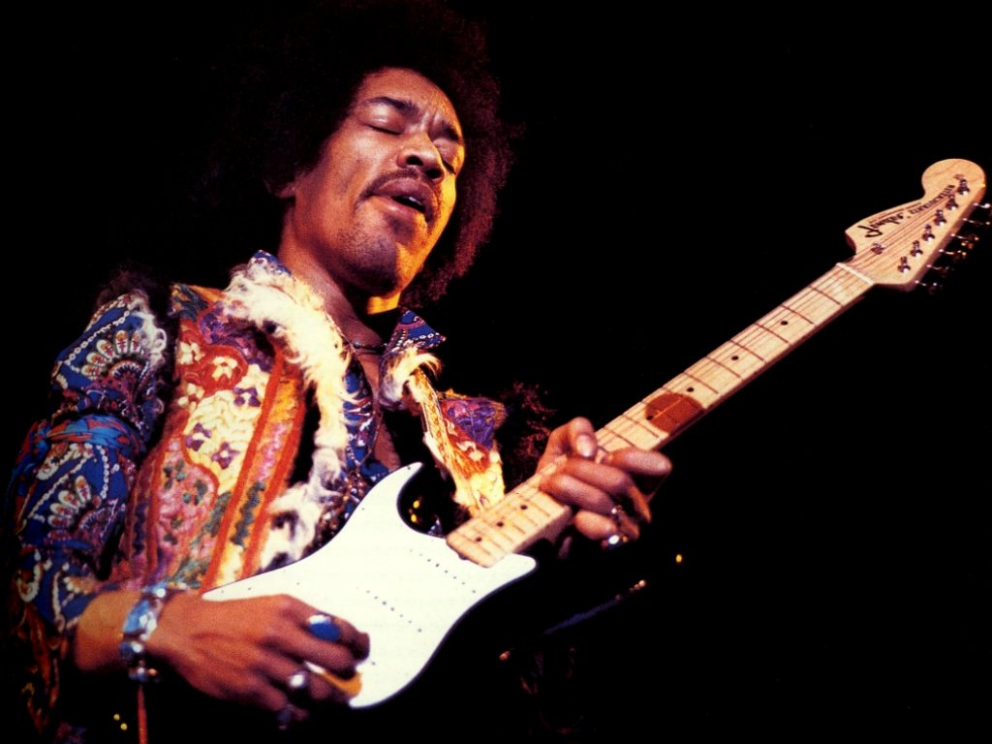
Making New Music
Notes:
Jimi Hendrix was passionate about creating musical sounds that had never been heard before.
====
http://hinter-den-schlagzeilen.de/2012/11/27/jimi-hendrix-zum-70-geburtstag/

Slide 46
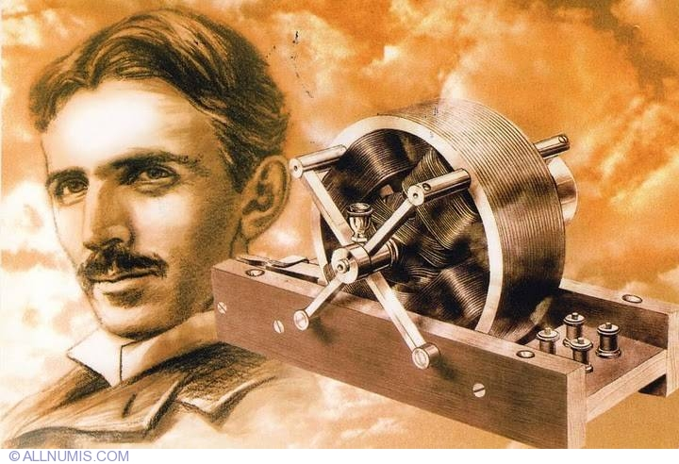
Transmission of Electricity
Notes:
Nikola Tesla was passionate about the transmission of electrical energy.
It is because of Tesla that we have electricity in our homes.
Tesla pursued technology, not fame.
=======
http://www.allnumis.com/postcard/serbia/nikola-tesla-2087

Slide 47
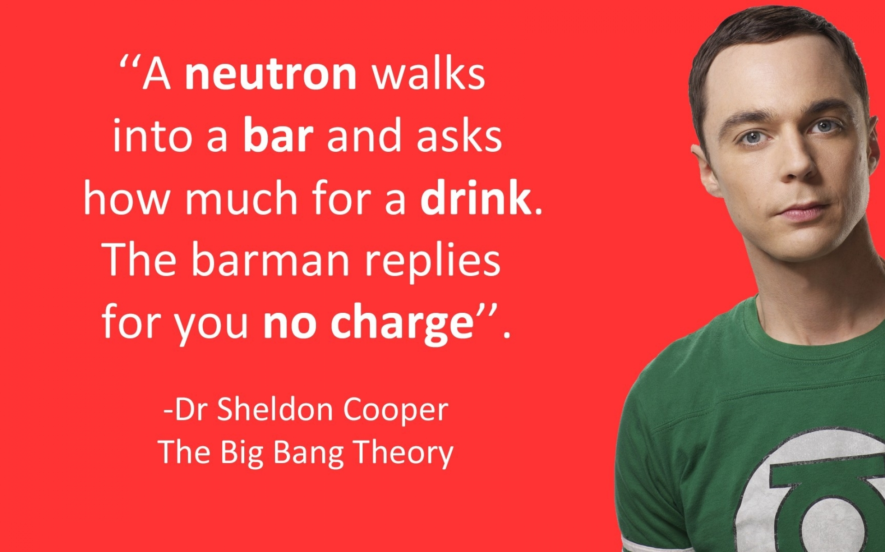
Theoretical Physics
Notes:
Dr. Sheldon Cooper is Passionate about Theoretical Physics.
And if you paid attention in Physics class,
you will have to admit
that this is one of the funniest bar jokes ever. -
Bazinga!
====
http://www.wallpaperhi.com/Entertainment/TV_Series/science_nerd_funny_physics_comedy_the_big_bang_theory_tv_serie_jim_parsons_sheldon_cooper_tv_shows_84078/download_1920x1200

Slide 48
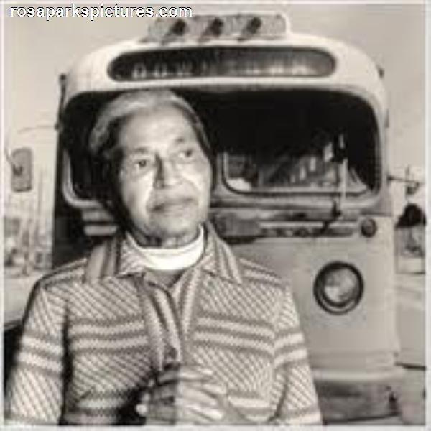
Civil Rights
Notes:
Rosa Parks refused to give up her seat on the bus.
She was passionate about civil rights.
Equality for all.
What are the youth with whom you work passionate about?
How can you connect their passion to what you are teaching them?
=====
http://rosaparkspictures.com/images/Rosa-Parks-Bus.jpg

Slide 49
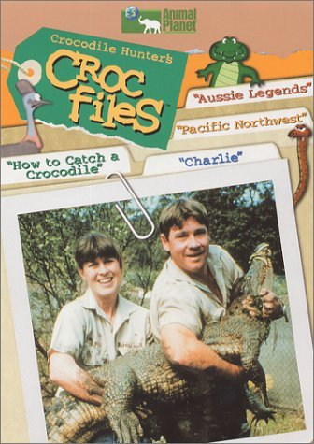
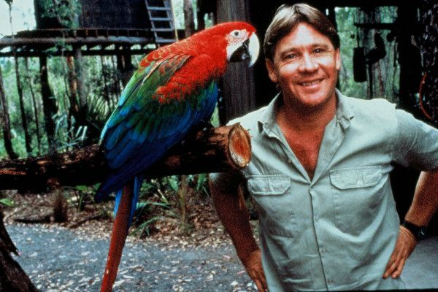
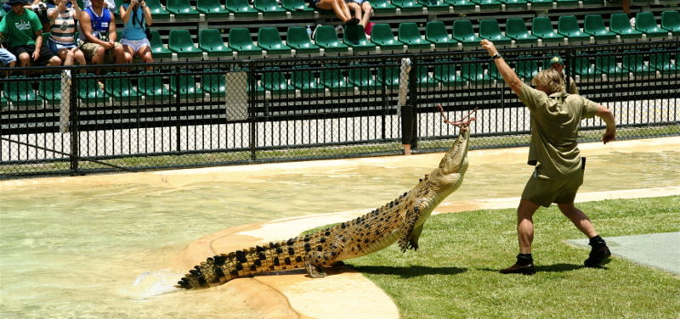
Wildlife Conservation
a passionate conservationist
Notes:
49
Steve Irwin, better known as The Crocodile Hunter was passionate about Wildlife Conservation.
Nobody had to tell him it was time to learn about a new species of animal.
He was probably the first person at work on Monday morning.

Slide 50
Questions before I conclude?
Emil Barnabas
Emil@barnabas.com
Notes:
Before I conclude my presentation, I will pause here to see if anyone has any questions.
Usually by this time most of the audience is overwhelmed and just need a break to digest what I’ve said.
Remember that you can download the PowerPoint and use it however you can.
Any questions before I conclude this presentation?

Slide 51
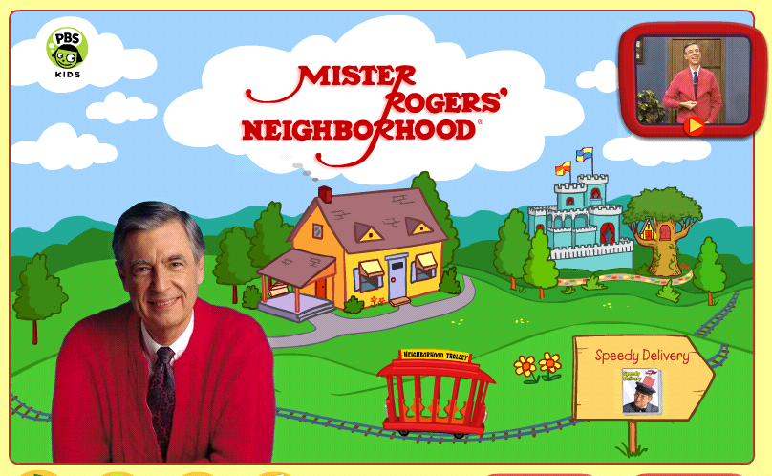
Education
Notes:
51
51
And then there is Mister Rogers – passionate about educating children.
It was so nice growing up knowing that Mr. Rogers was my neighbor, -- and that he liked me just the way I was.
Wouldn’t it be great if everyone could find a career about which they are passionate?
Not just a job that pays for their weekend activities, but a job that gives them a sense of purpose?
What if that sense of purpose leads to a thirst for knowledge?
A desire for life-long education.
A desire to share that passion with others.
=========
Graphic from http://pbskids.org/rogers/
Video from http://www.youtube.com/watch?v=JMFDphMXTlQ&feature=related

Slide 52
Passion and Purpose
Thriving in your work, not just surviving.
Leaving the world a little better off because you cared to make a difference in your work.
Helping kids discover their passion and then helping them turn that passion into an educational pathway that will lead to a rewarding career.
Notes:
52
→
What makes you want to get up in the morning?
→
Are you passionate about your own career?
→
How can we help kids discover their passion,
and put them on an education pathway,
to turning their passion into a career?
--
======
Chris Droessler

Slide 53
Help kids discover their passion, then help them get on a pathway where they can turn that passion into a career.
Notes:
Though the term “vocational” has earned a bad reputation in the last few decades, the original meaning of the term is clear that your “vocation” is your life’s calling.
My vocation as an educator is educating young minds and preparing them for the real world.
What is the vocation of the kids with whom you work? What is life calling them to do?
What is their purpose in life?
We need to help kids discover their passion.
What makes them get up in the morning and want to learn something new?
And we need to help them to turn that passion into a rewarding career.
-- --
=======
Emil Barnabas
53

Slide 54
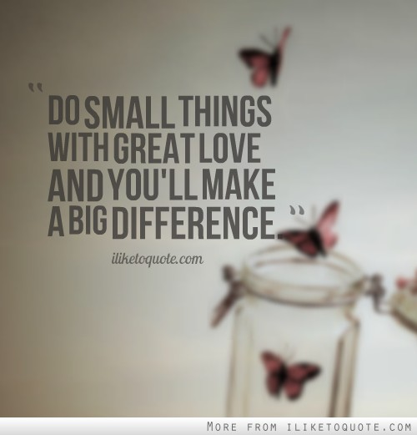
Notes:
In the future –
when our youth are employed and someone asks them what they do for a living, --
wouldn’t it be great if they could say –
“I get to make a difference in the world.”
“I get -- to make -- a difference!”
====
http://www.iliketoquote.com/do-small-things-with-great-love-and-youll-make-a-big-difference/

Slide 55
Thanks for listening!
Chris Droessler
CTE Coordinator
NC Community Colleges
DroesslerC@NCCommunityColleges.edu
www.ctpnc.org/presentations
Notes:
Thanks for inviting me to come speak today.

Slide 56
Please scan your Smart Card on the way out
Chris Droessler
CTE Coordinator
NC Community Colleges
DroesslerC@NCCommunityColleges.edu
www.ctpnc.org/presentations
Notes:
Thanks for inviting me to come speak today.

Slide 57
Help Kids Discover Their Passion and Turn it into a
Career Pathway
Chris Droessler
CTE Coordinator
NC Community Colleges
DroesslerC@NCCommunityColleges.edu
www.ctpnc.org/presentations

