Slide 1
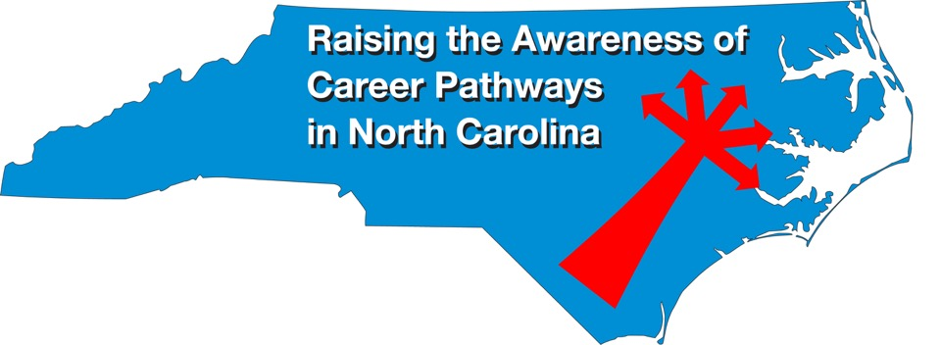
August 17, 2022
Careers in Data Analytics
Download the PowerPoint
and access the recording:
www.ncperkins.org/presentations
Notes:
Good morning. Welcome to our monthly career pathways webinar.
We are here to help promote the great jobs, often unknown, in the great state of North Carolina.
Through these meetings, we are going to let you know about some great career opportunities in North Carolina.
And bring in special guests talk about these opportunities.
Please download this PowerPoint file and use it anyway you can to help get folks on a career pathway.
In the notes section of the PowerPoint, you will find any reference from where the information was found, as well as the contact information for the speaker.
Get the PowerPoint on our NCPerkins.org website on our Presentations and Webinars page.
The direct address is on the screen, just scroll down to today’s date.
-----
Many of the videos shown during this webinar can be found here:
https://www.ncperkins.org/video/

Slide 2
Career & Technical Education Team
Bob Witchger
Tony Reggi
Patti Coultas
Mary Olvera
vacant
Darice McDougald
Lane Freeman

Slide 3
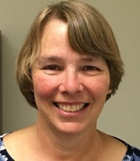

Patti Coultas
CTE Coordinator
Notes:
Patti Coultas
919-807-7130
coultasp@nccommunitycolleges.edu

Slide 4
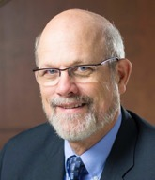
Dr. Bob Witchger
CTE Director, Team Perkins
NCCCS
Notes:
Dr. Robert (Bob) Witchger
NCCCS, CTE Director
919-807-7126
witchgerb@nccommunitycolleges.edu

Slide 5
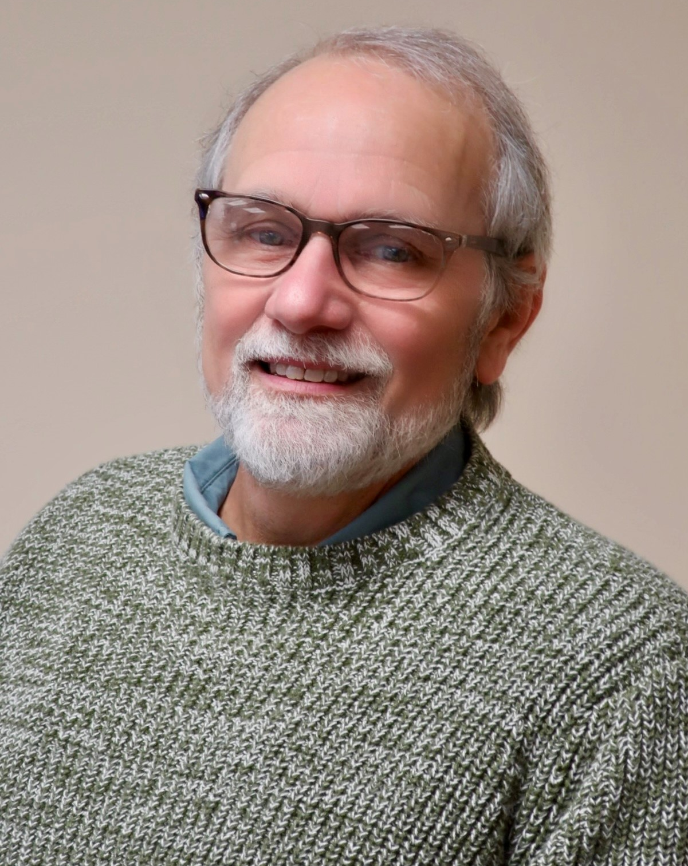
Dr. Tony Reggi
CTE Associate Director,
Team Perkins, NCCCS
Notes:
Tony Reggi
919-807-7131
reggia@nccommunitycolleges.edu

Slide 6
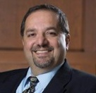
Dr. Hilmi Lahoud
Senior Program Administrator – Business and Information Technology Programs
Notes:
Hilmi A. Lahoud, Ph.D.
Senior Program Administrator, Business and Information Technology Programs
Academic and Student Services
Phone: 919-807-7116
lahoudh@nccommunitycolleges.edu

Slide 7
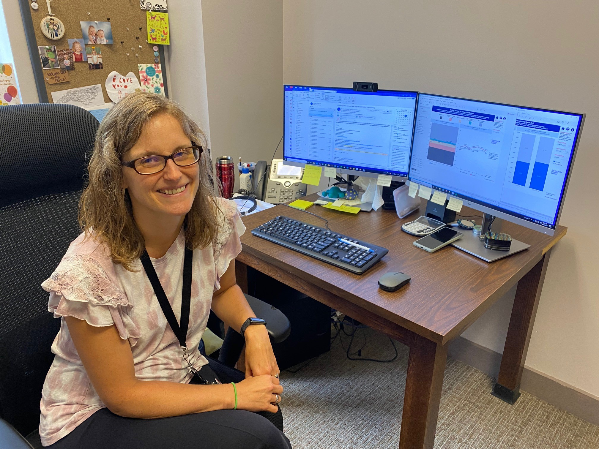
Elizabeth Stoddard
Director of Analytics and Reporting
Notes:
Elizabeth Stoddard
Director of Analytics and Reporting
Research & Performance Management
919-807-7223 l stoddarde@nccommunitycolleges.edu

Slide 8
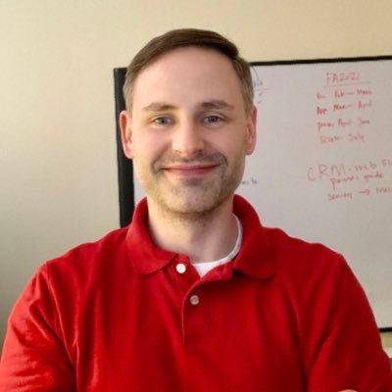
Aaron Mabe
Career & College Promise Coordinator
Notes:
Aaron Mabe
919-807-7098
mabea@nccommunitycolleges.edu

Slide 9
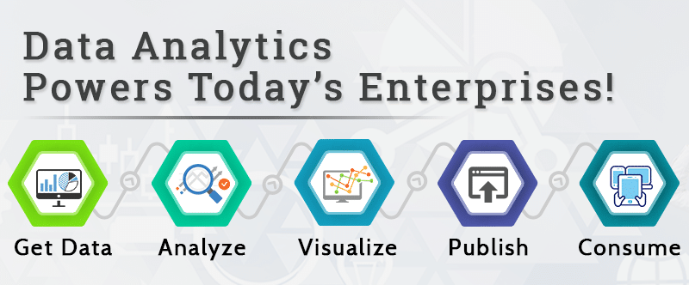
Data Analyst Tools
Data analyst tools is a term used to describe software and applications that data analysts use in order to develop and perform analytical processes that help companies to make better, informed business decisions while decreasing costs and increasing profits.

Slide 10
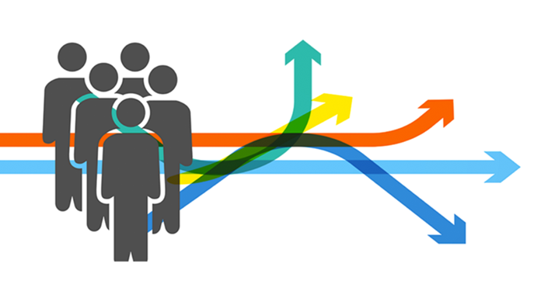
Career pathways in data analytics
Statistician
Data
Engineer
Data Scientist
Business Analyst
Statistical Assistants

Slide 11
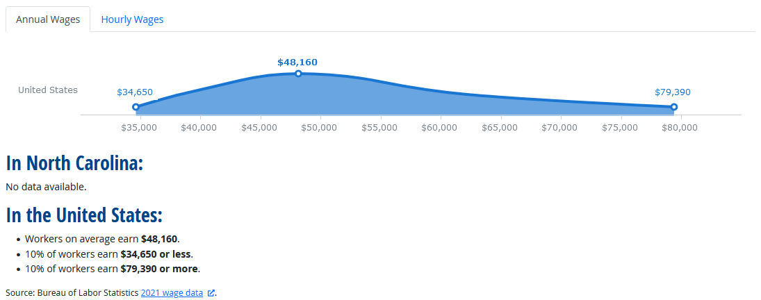
Statistical Assistant
Compile and compute data according to statistical formulas for use in statistical studies. May perform actuarial computations and compile charts and graphs for use by actuaries. Includes actuarial clerks.
Notes:
Source: https://www.onetonline.org/link/summary/43-9111.00

Slide 12
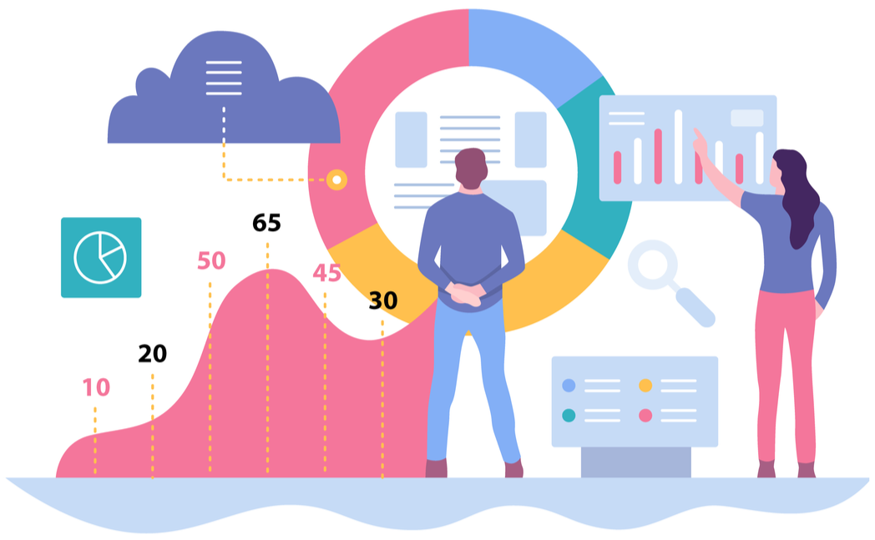
Data Scientist Job Description
Develop and implement a set of techniques or analytics applications to transform raw data into meaningful information using data-oriented programming languages and visualization software. Apply data mining, data modeling, natural language processing, and machine learning to
extract and analyze information from
large structured and unstructured
datasets. Visualize, interpret, and
report data findings. May create
dynamic data reports.

Slide 13
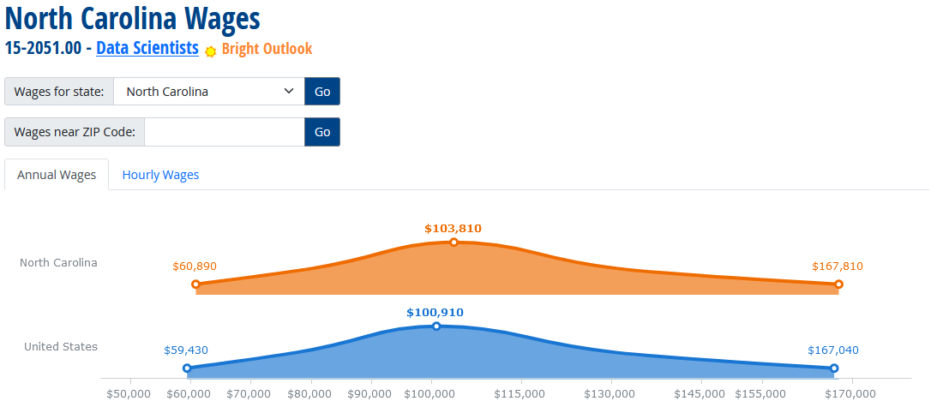
Data Scientist
Notes:
Source: https://www.onetonline.org/link/summary/15-2051.00

Slide 14
Business Intelligence Analyst
Produce financial and market intelligence by querying data repositories and generating periodic reports. Devise methods for identifying data patterns and trends in available information sources.
Wage data same as
Data Scientists
Notes:
Source: https://www.onetonline.org/link/summary/15-2051.01

Slide 15
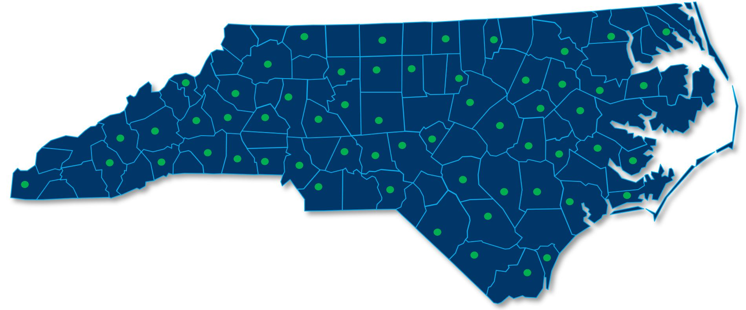
NC Community College AAS Programs
Business Analytics (A25350)
  Cape Fear Community College
  Wake Technical Community College
Healthcare Business Informatics (A25510)
  Brunswick Community College
  Cape Fear Community College
  College of the Albemarle
  Forsyth Technical Community College
  Nash Community College
Information Technology (A25590), concentrating in Database Administration or Data Reporting and Analytics
  All 58 Community Colleges offer IT, check with them about their focus
Notes:
NCCCS Catalog: https://www.nccommunitycolleges.edu/sites/default/files/basic-pages/academic-programs/attachments/education_catalog_15july2022.pdf

Slide 16

Kristopher Roark
Data Engineer
Research & Performance Management
Notes:
Kristopher Roark
919-807-7136
roarkk@nccommunitycolleges.edu

Slide 17


Ben Goliwas
Asheville-Buncombe
Technical Community College
Faculty, Computer Technologies
Notes:
Ben Goliwas
Faculty - Computer Technologies
A-B Tech Community College
340 Victoria Road, Asheville, NC 28801
828.398.7666
bengoliwas@abtech.edu

Slide 18
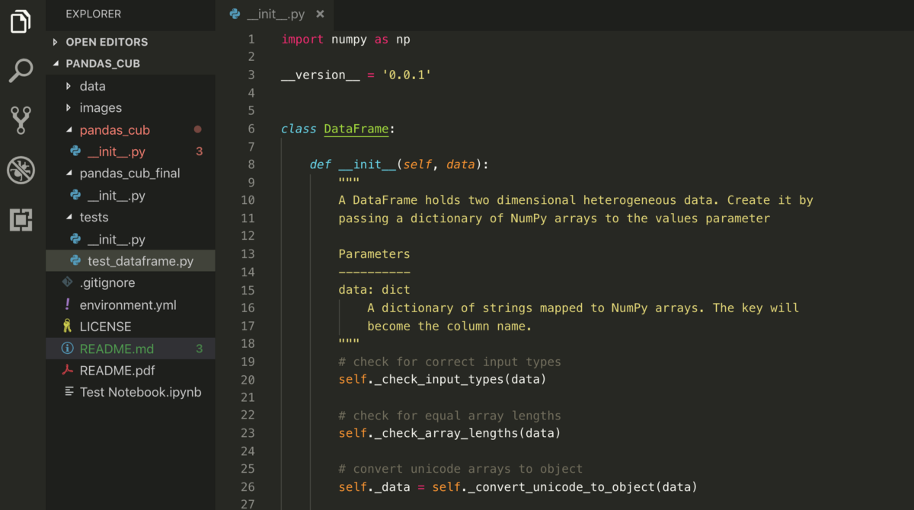

Slide 19
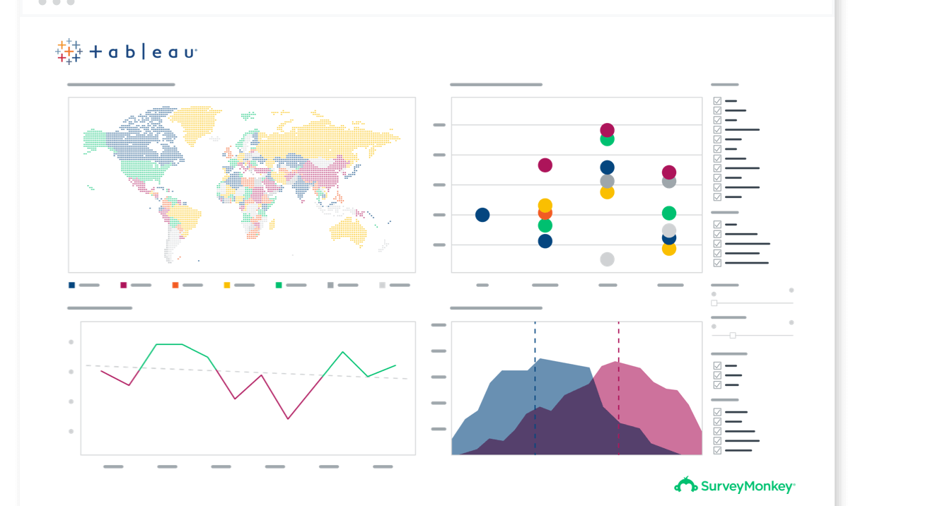
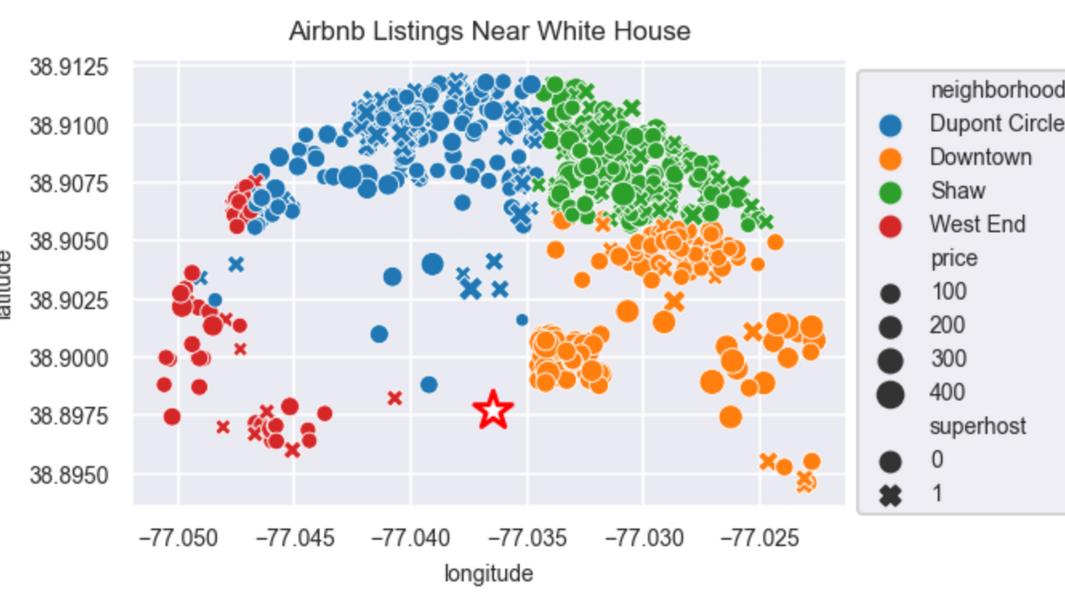
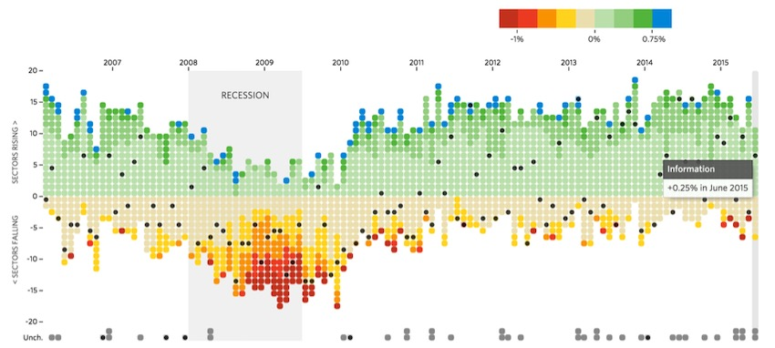
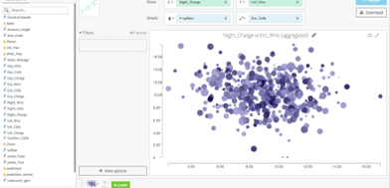

Slide 20
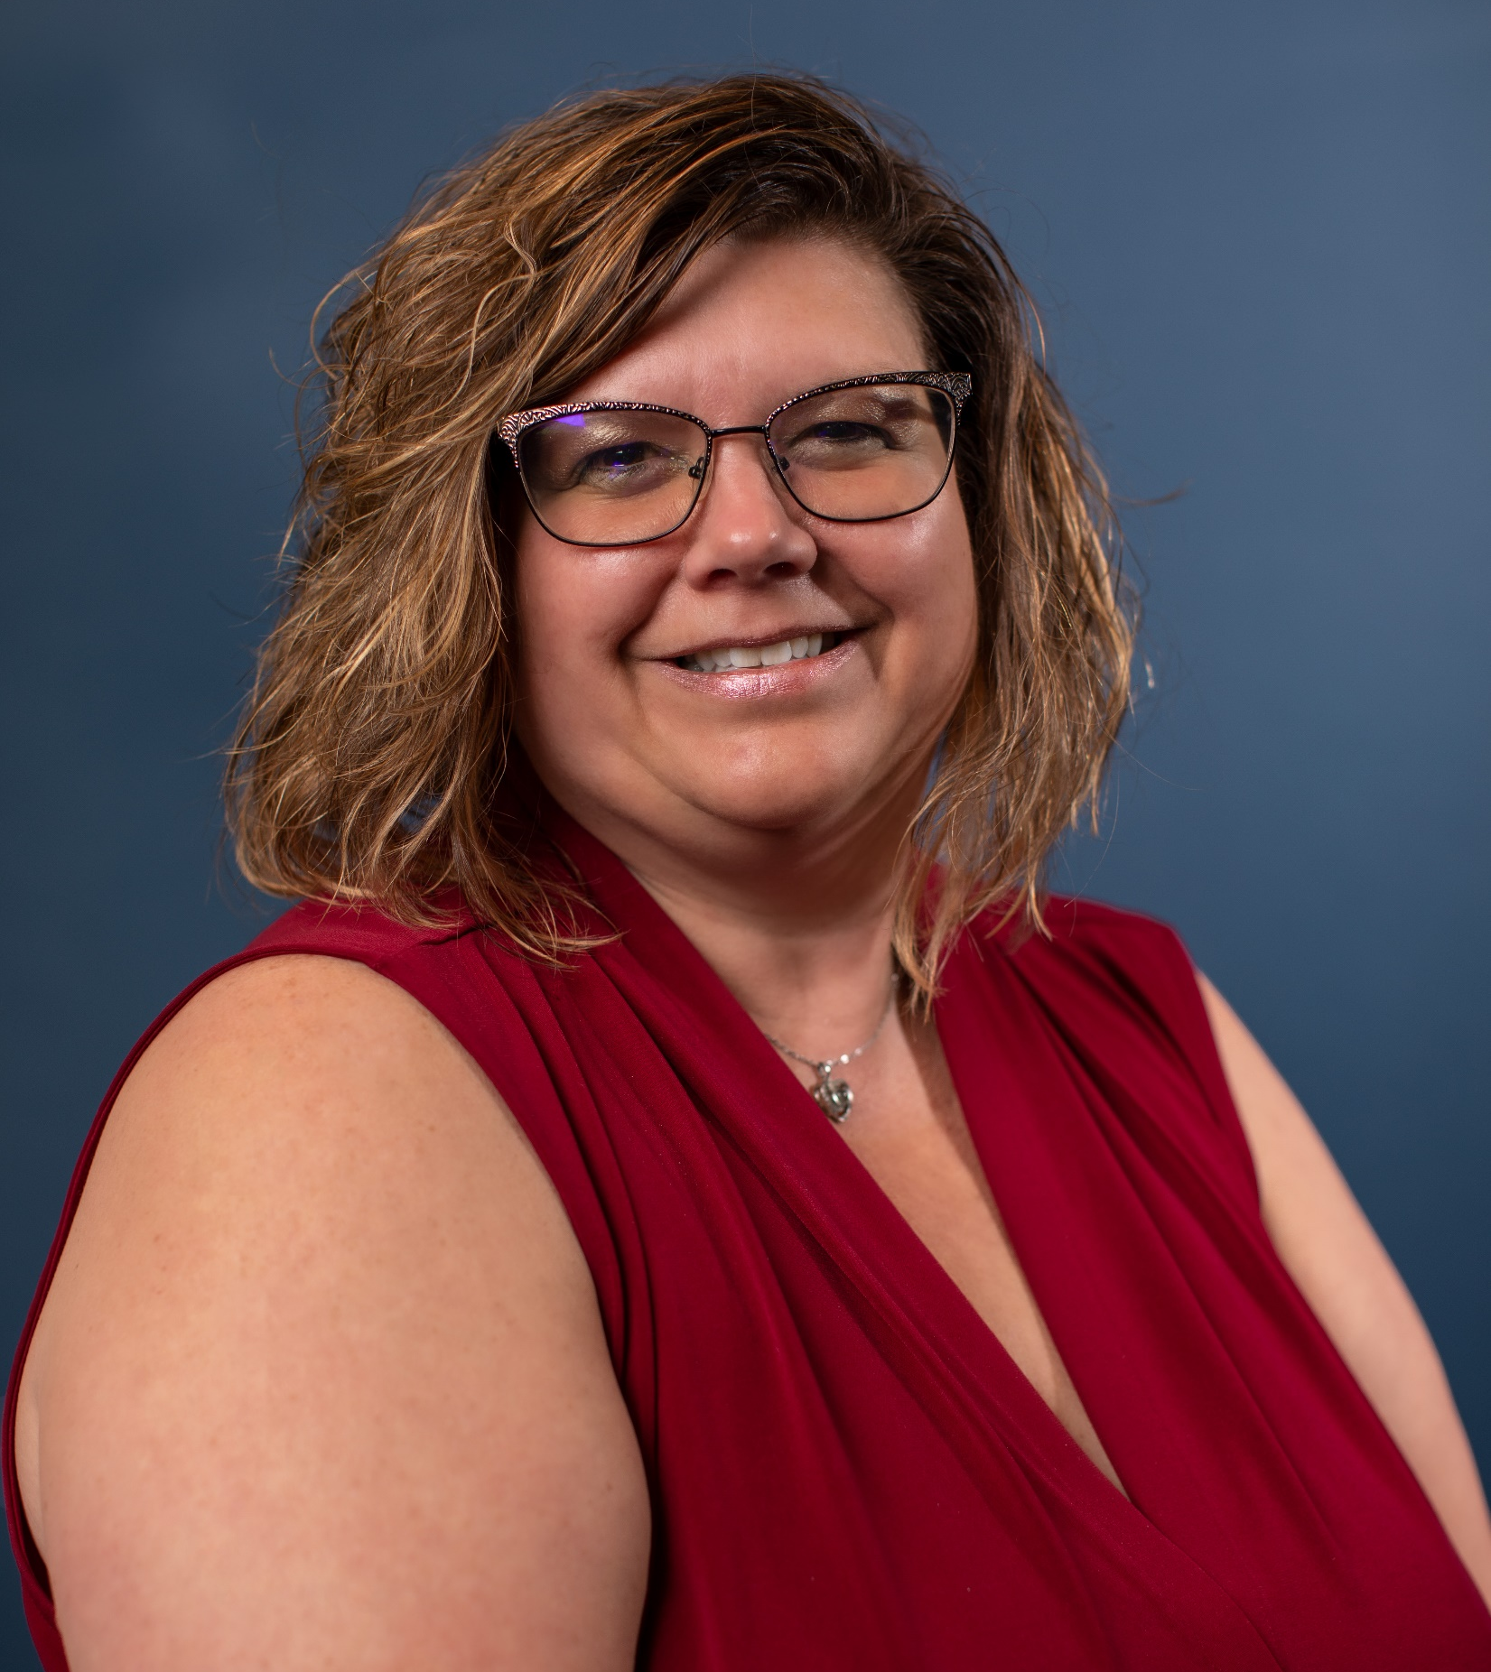

Norene Kemp
Wake Technical
Community College
Department Head,
Programming and Information Sciences
Notes:
Norene Kemp
nckemp@waketech.edu
919-866-5482

Slide 21
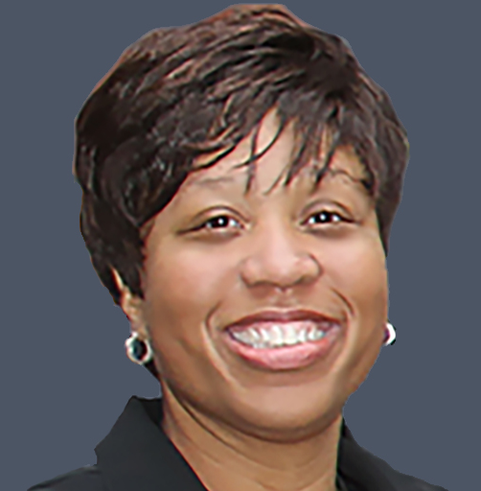

Lisa Outlaw
The University of
North Carolina System
Internal Audit Director
Compliance and Audit Services

Slide 22
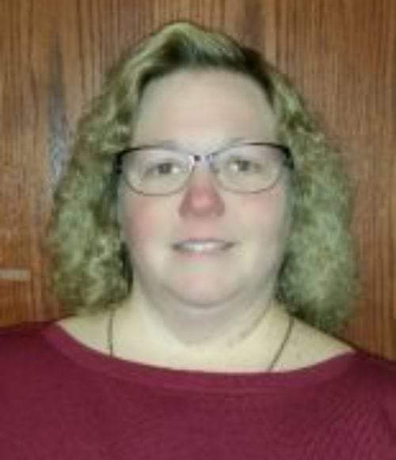

Joey Bryant
Forsyth Technical
Community College
Department Chair,
Thomas H. Davis iTEC Center
Notes:
Professor Joey Bryant, MBA, CHPS
Department Chair, Thomas H. Davis iTEC Center
Program Coordinator – IT-Programming & Software Development
Technology Building, Main Campus
2100 Silas Creek Parkway | Winston-Salem, NC 27103
t 336.757.3348
forsythtech.edu

Slide 23
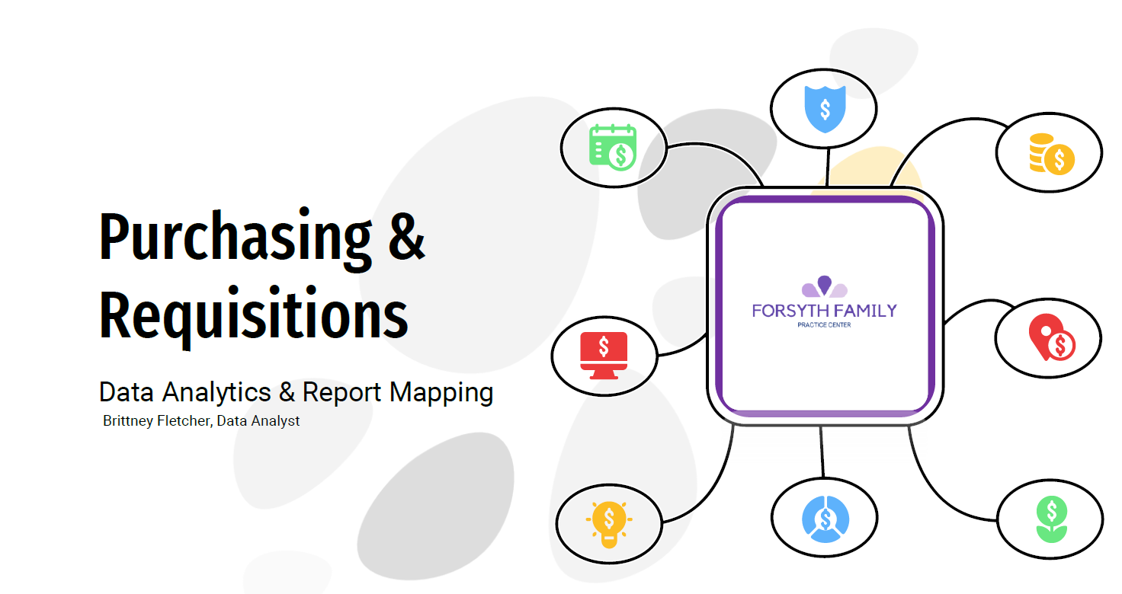
What is Data Analytics?

Slide 24
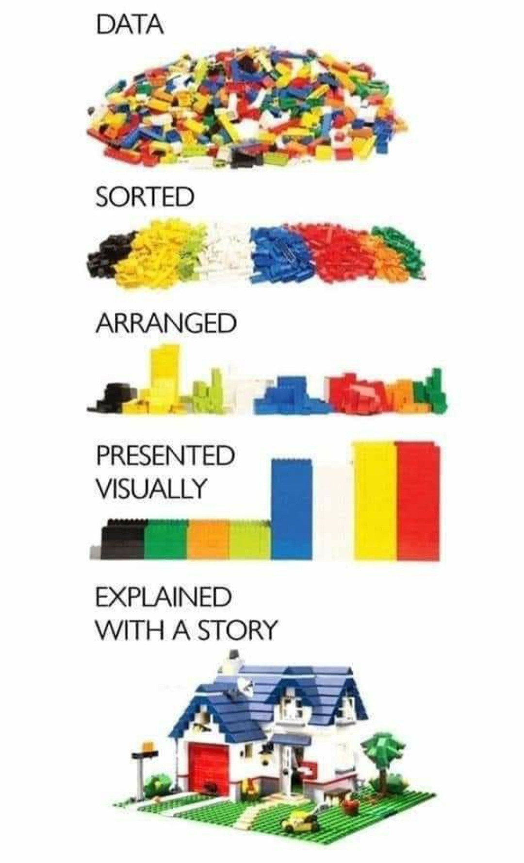

Slide 25
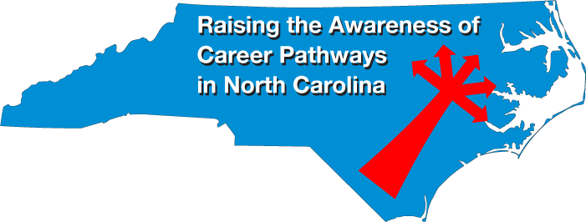
Raising the Awareness of Career Pathways in North Carolina
Our next webinar is September 21, 2022
Career topic to be determined
Download the PowerPoint
and access the recording:
www.ncperkins.org/presentations
Notes:
Our next meeting like this one will be on September 21st
You can go to the NCPerkins Presentations website to register for that meeting.
We'll also send you a reminder, since you are now on our mailing list.
So go ahead and sign up for all the meetings, and you'll be reminded the day before.
If you liked something you saw here, send folks to the recording. Find it at that same web page.

