Slide 1
2021-2022
End of Year Review
Mitchell Community College

Slide 2
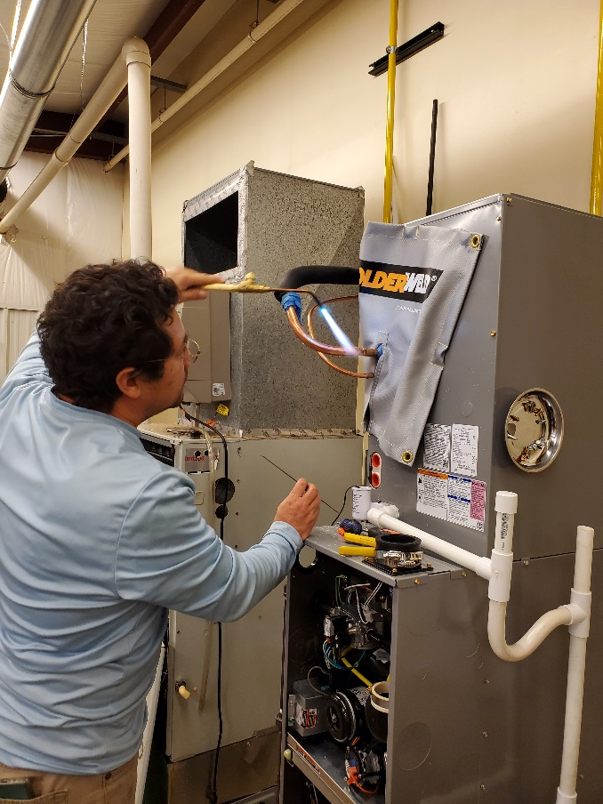
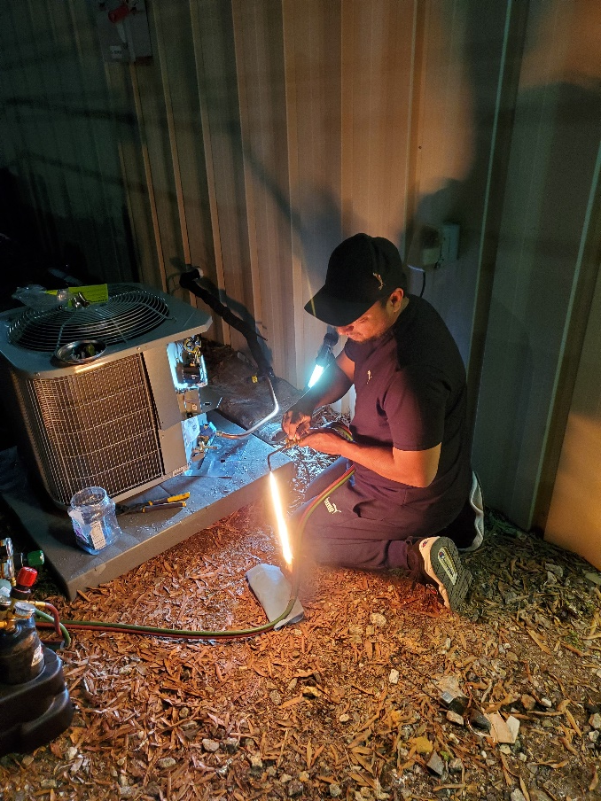
Brazing in new furnace AC coil
Brazing in new Unit

Slide 3
How has Perkins helped your program this year?
We have reinstated the HVAC-R program in Iredell county to train tomorrow's workforce leaders.
We provided the equipment needed to educate students who ultimately obtained their EPA 608 certification.
It helped create a modern program that can meet today's industry standards.
We started our new lab design with new equipment and modern diagnostic tooling to incorporate a smart-lab environment.

Slide 4
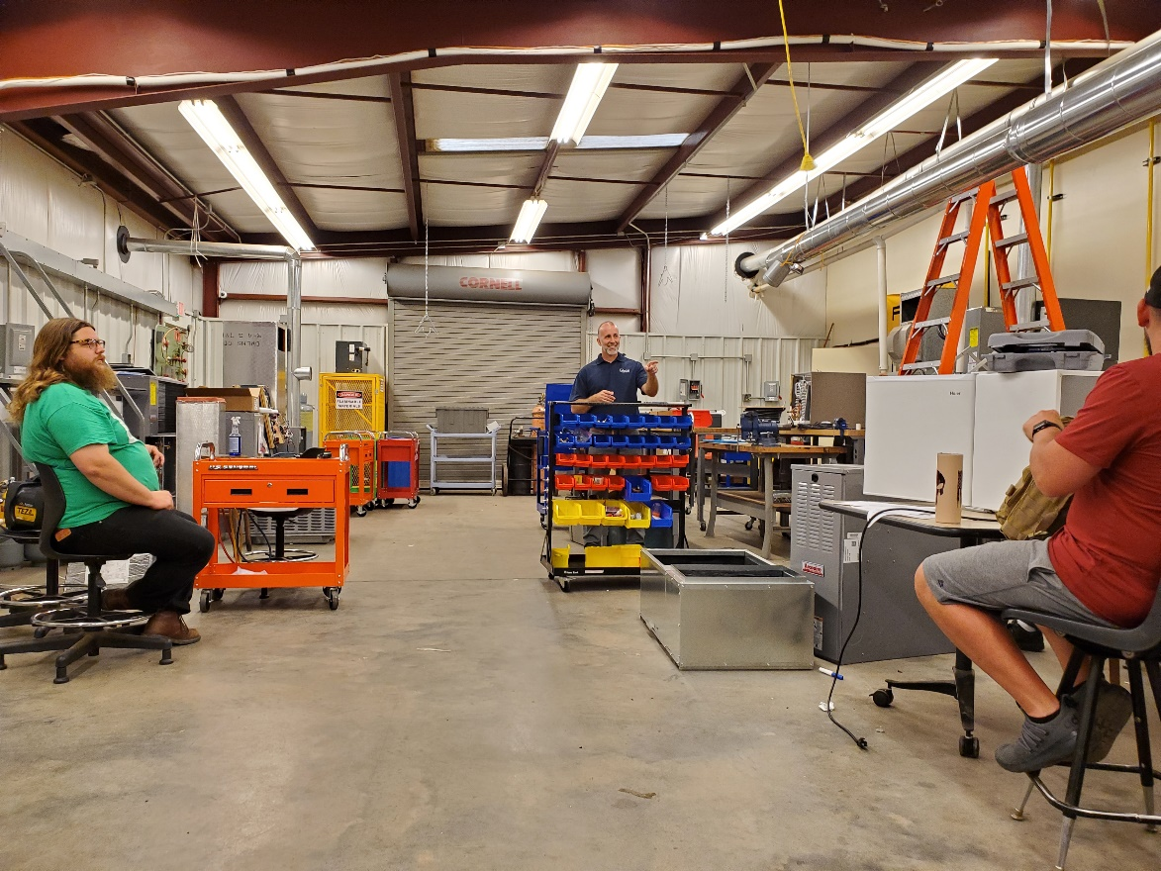
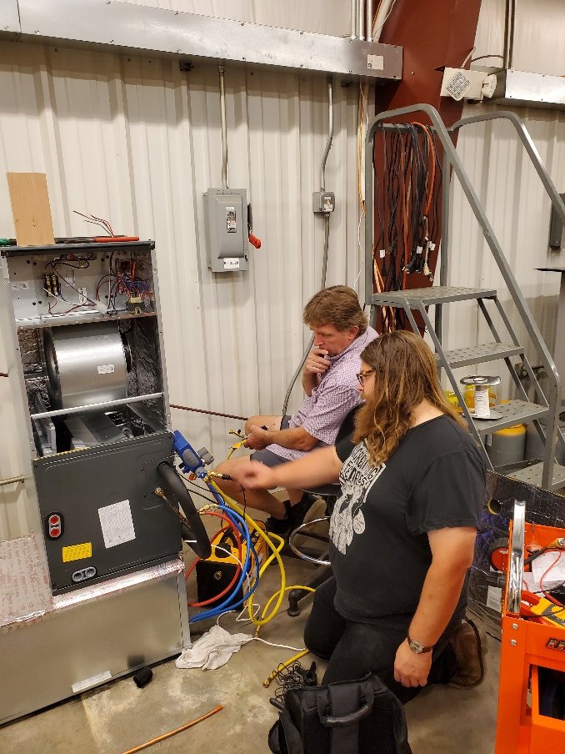
Industry Partner behind new parts rack and tool boxes
Installing new heat pump air handler

Slide 5
How have the students benefited from Perkins?
Facilitated and provided equipment to have hands-on training to obtain EPA 608 certification
25% of students have become employed because of the new and modern equipment they use as part of their education.

Slide 6
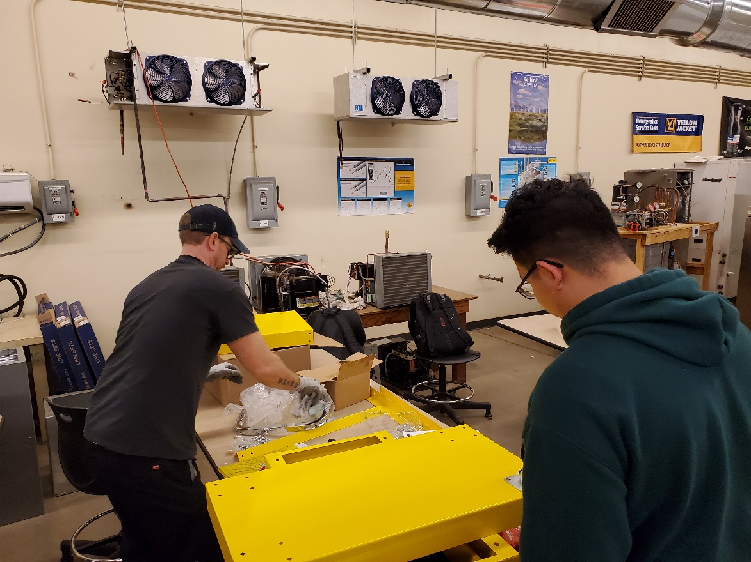
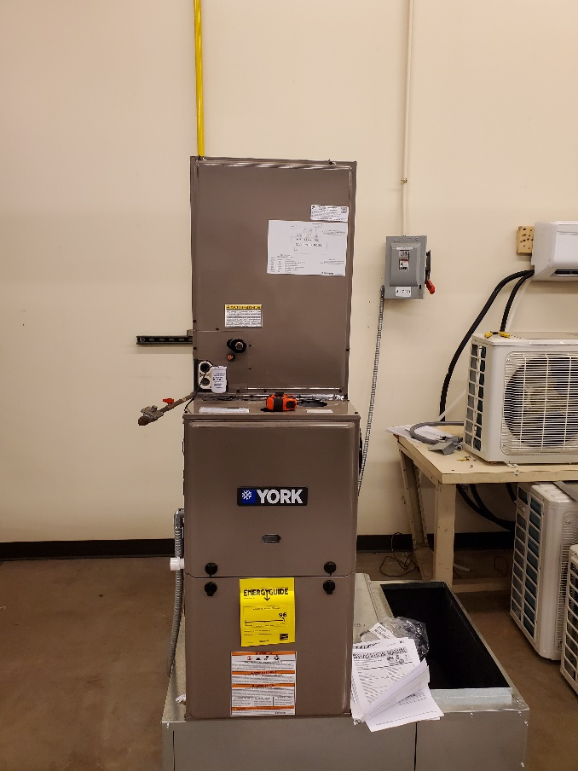
New furnace installation begins
New Tool Carts being assembled

Slide 7
Additional information regarding the Perkins funds received.
Significantly improved students' diagnostic skills with the updated equipment.
The new equipment increased knowledge of the latest trends and equipment in the industry.
The investment has created opportunities for the potential expansion of the program with the county high schools.

Slide 8
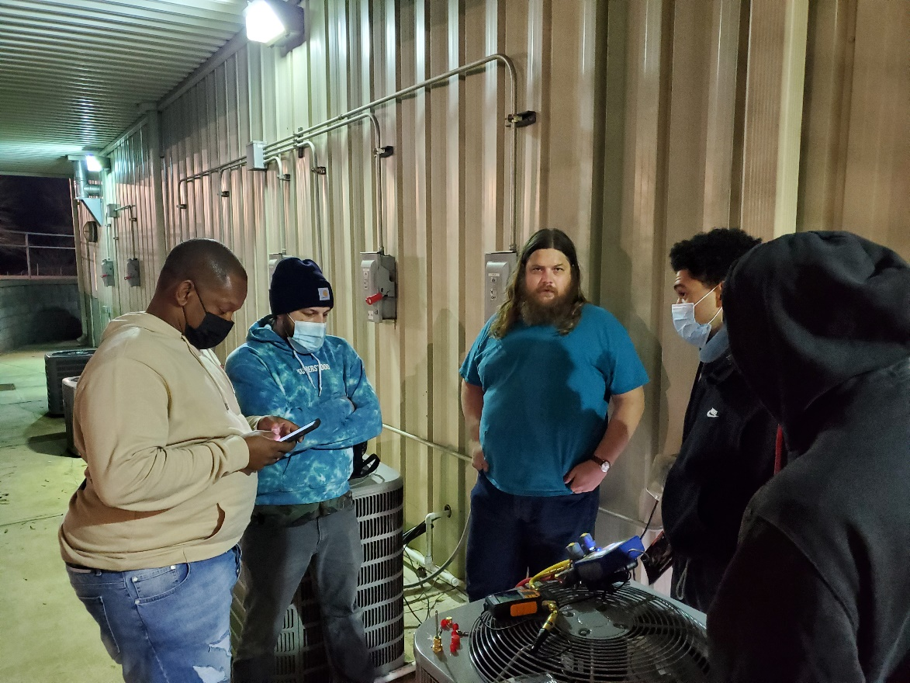
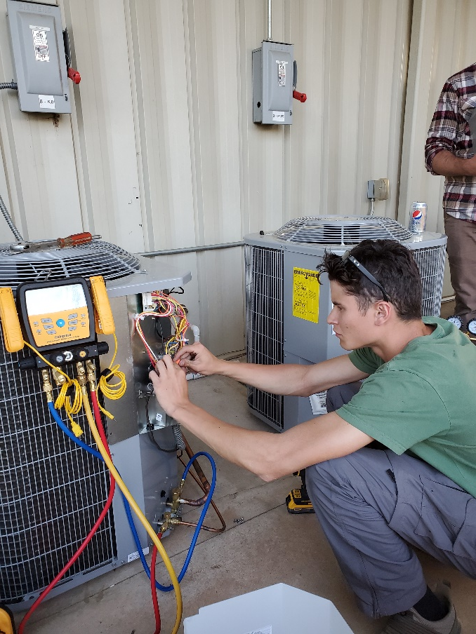
Student works with new Manifold set
Using new Bluetooth gauge manifold

Slide 9
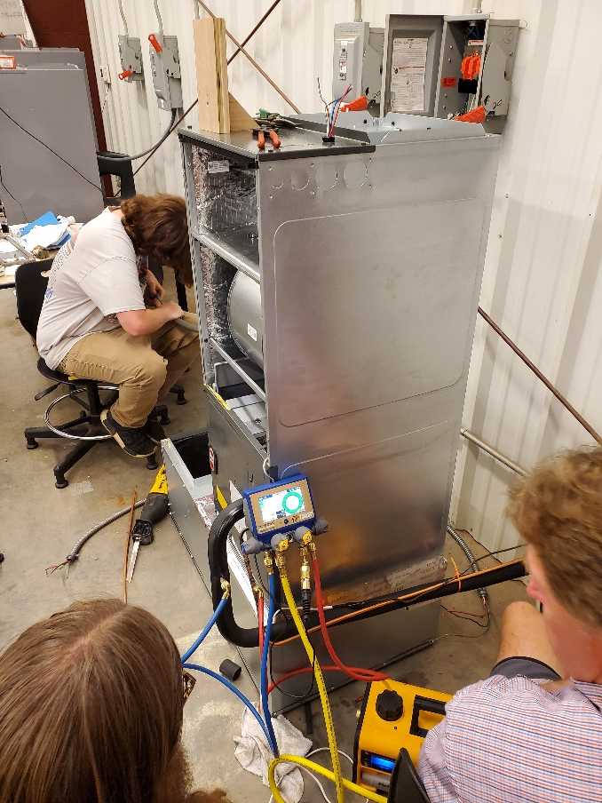
Working with new Yellow Jacket Bluetooth wireless manifold set

Slide 10
Comments, Questions, Suggestions?

