Slide 1
College and Career Readiness

Slide 2
College and Career Readiness
Programs
Adult Basic Education
Gateway to College/Adult High School
High School Equivalency
*English as a Second Language (Center for Global Learner)

Slide 3


Notes:
Made in Durham
Public-private partnership
Shared vision: Postsecondary credential
Rewarding career by 25
Build an education to career system

Slide 4
Creating an education-to-career system requires:
  Strategic Leadership: Providing the framework for effective collaboration to accomplish shared vision and goals.
  Data to Drive Our Work: Tracking youth and their success to enable strategic action, chart progress and measure success.
  Flexible Career Pathways: Providing knowledge and experiences that prepare youth and young adults for meaningful careers in the community.
  Engaged Employers: Connecting employers and educators to create and offer meaningful experiences that link learning and work.
  Young People as Leaders: Ensuring that youth and young adults fully participate in building our education-to-career system.
  Particular Supports for Disconnected Youth: Developing a clear sequence of steps by which young people who are behind or disconnected from school or work can complete high school and postsecondary education and secure living-wage work.

Slide 5
Durham Futures
Goals
  Developing a clear sequence of steps by which young people who
  are behind or disconnected from school or work can complete high
  school and postsecondary education and secure living-wage work.
  Durham Futures Year 1 Goals:
  Piloting a system of supports for 250 opportunity youth attending 3 alternative education programs
  Leveraging funding
  Developing a pilot strategy to reconnect dropped out youth to the best fit education program

Slide 6


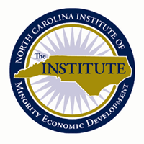


Durham Futures Team Members
Notes:
Greg, can you go ahead and lead into the next slide and start with youth from 3 schools getting connected with RS’s?

Slide 7
Durham Futures Team Members
  Gateway to College – Durham Tech College and Career Readiness program
  for students wishing to earn the high school diploma in partnership with
  the Bill and Melinda Gates Foundation.
  http://www.durhamtech.edu/gateway/
  Magic Johnson Bridgescape Academy – Durham Public Schools program
  providing students who have dropped out or are at-risk of dropping out of
  school with an alternative path to earn a high school diploma.
  http://dplc.dpsnc.net/pages/PLC/Magic_Johnson_Bridgescape_Acad
  Achievement Academy - nonprofit created to assist Durham youth to pass
  the HSE and then graduate with a post-secondary degree or recognized
  certification, enabling them to move out of poverty.
  http://achievedurham.org/program/our-program
  The Institute – Durham based business incubator that works to strengthen
  the asset base of diverse populations though policy, education and
  opportunities. http://www.theinstitutenc.org/

Slide 8
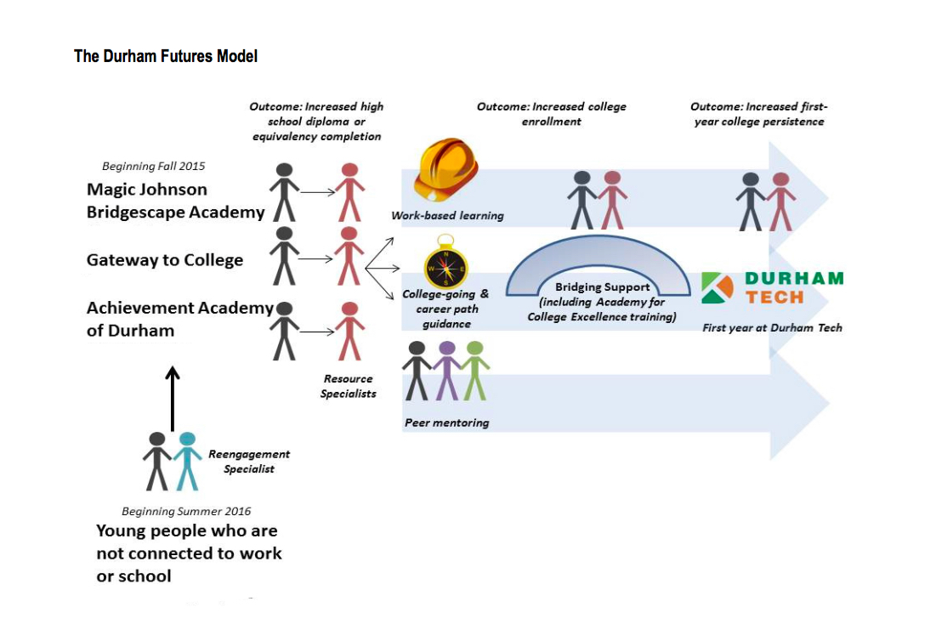

Slide 9
Student Supports
Resource Specialists
Advise students on program requirements and academic goals.
Introduce students to resources available throughout the college.
develop strategies for keeping at-risk students in class.
Provide support for students experiencing family, personal, or economic crises.
Help students access needed counseling services, support networks, community health, or housing services.

Slide 11
Work-based Learning
Grant Initiatives
Employer engagement associate funded by United Way of the Greater Triangle
Partnership with Office of Economic and Workforce Development (Durham YouthWork Internship Program)
Duke Energy Foundation Grant
Durham Tech, Human Resources Development

Slide 12
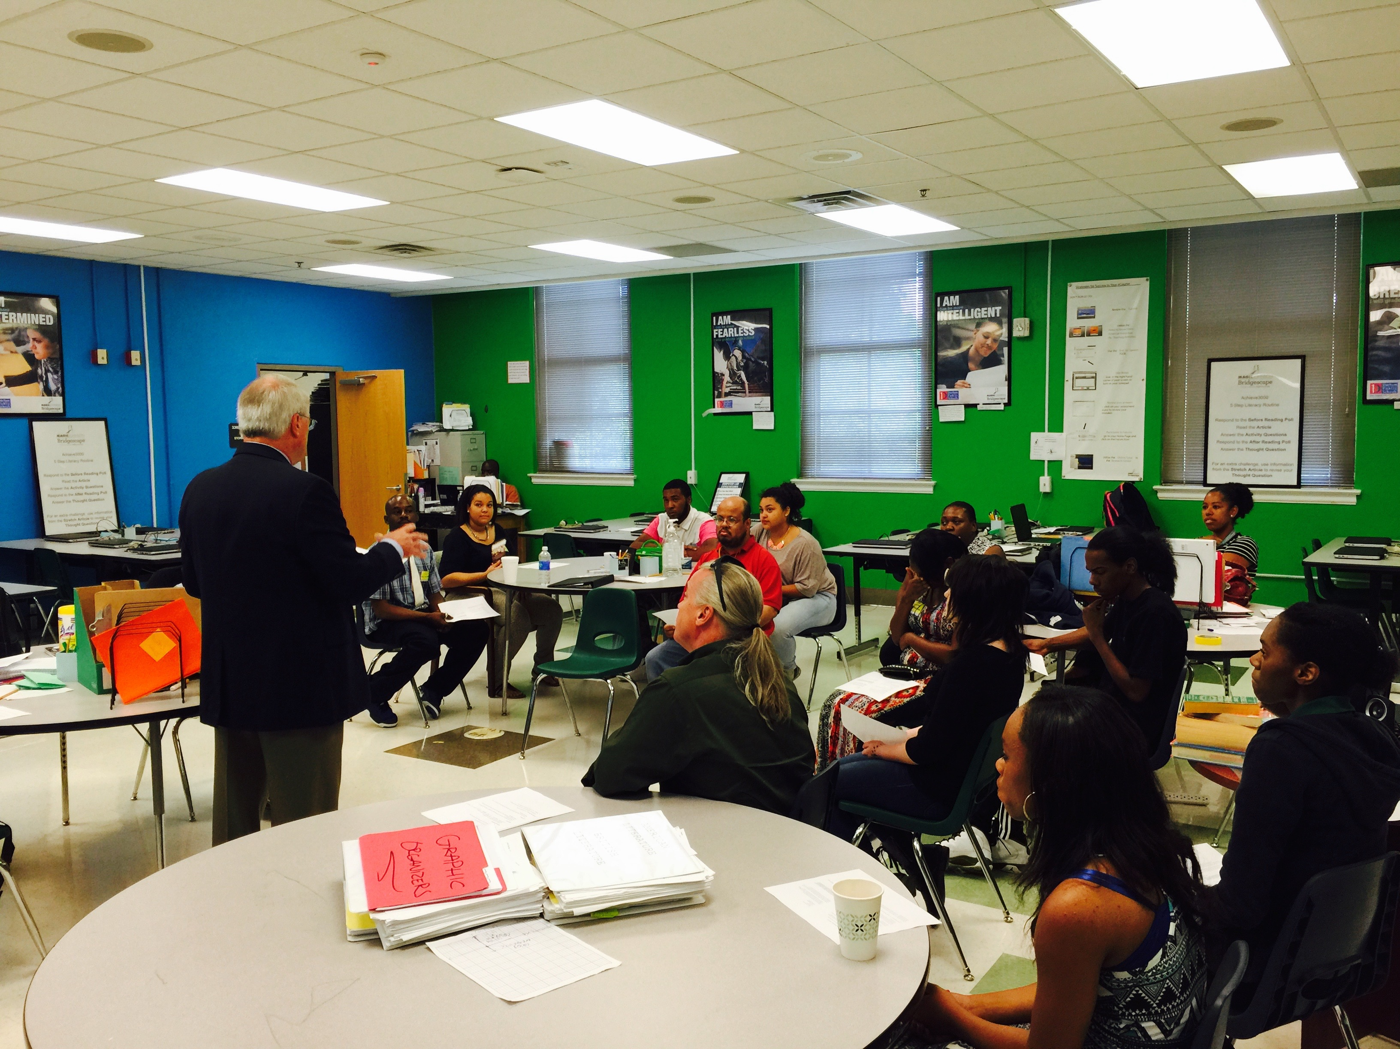

Slide 13
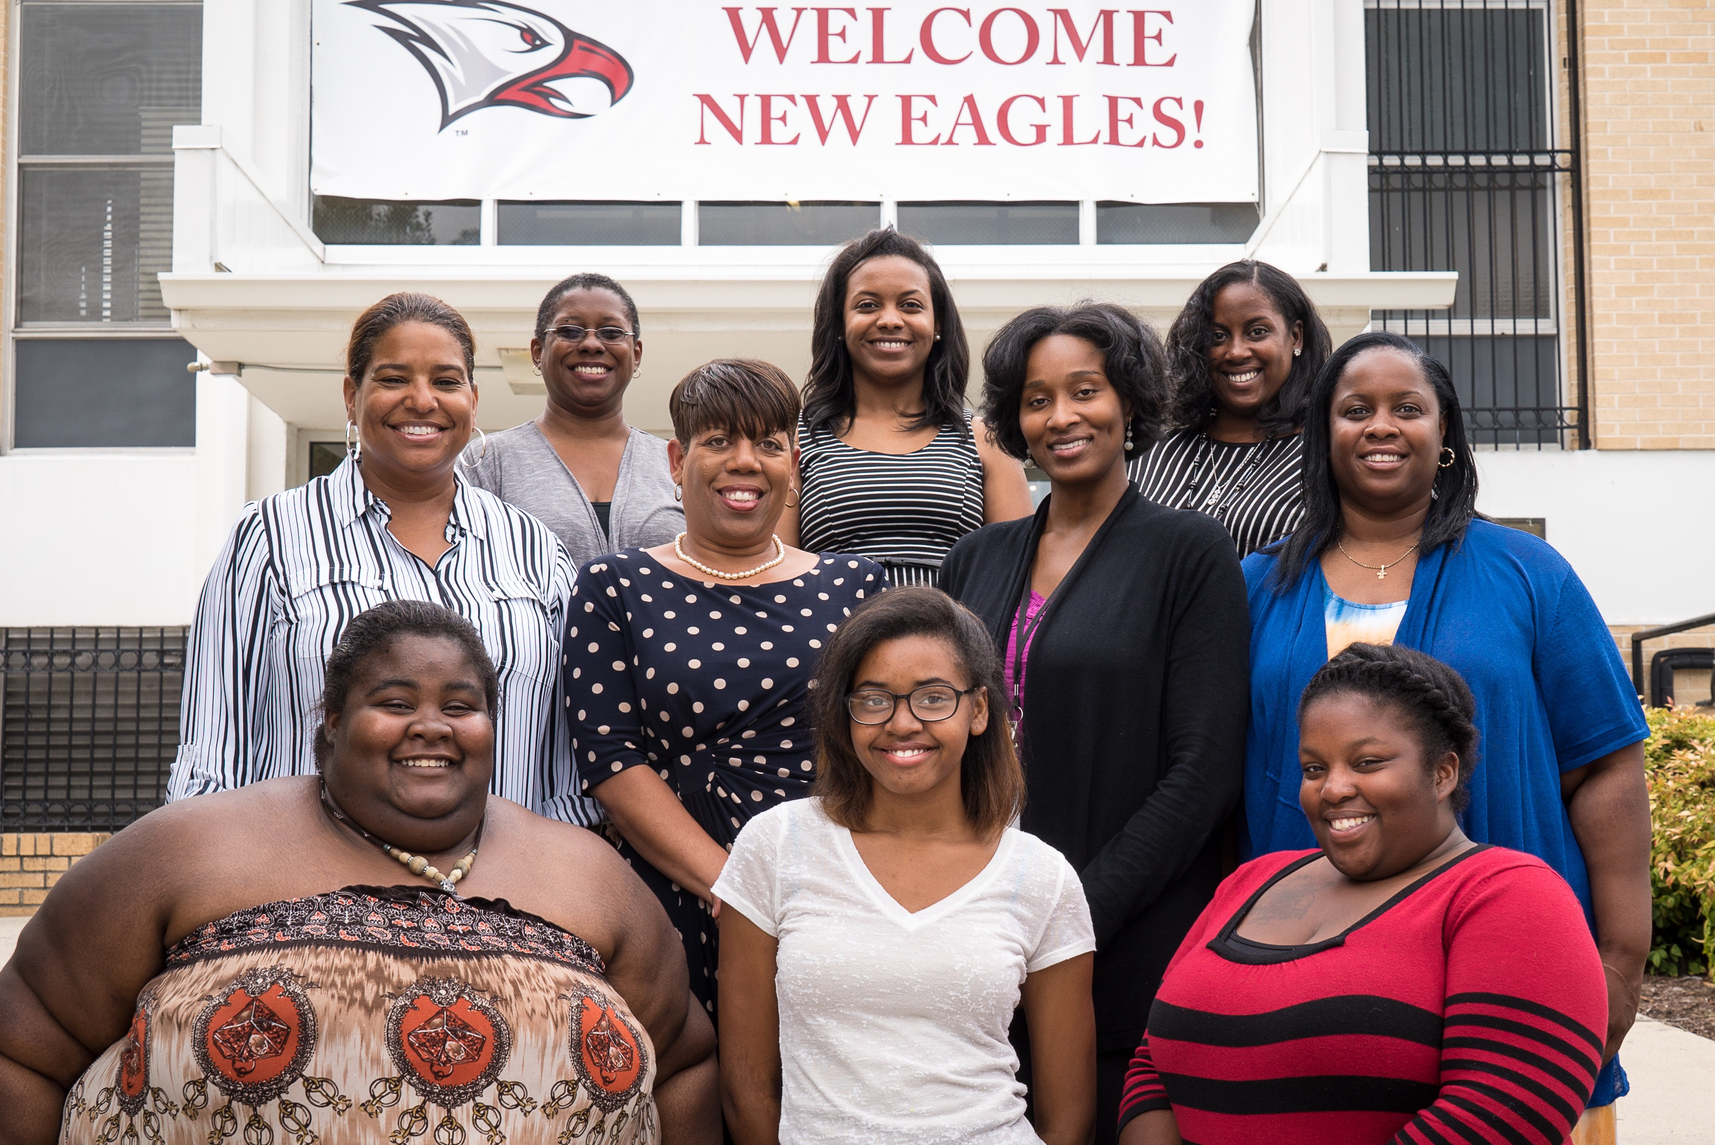

Slide 14
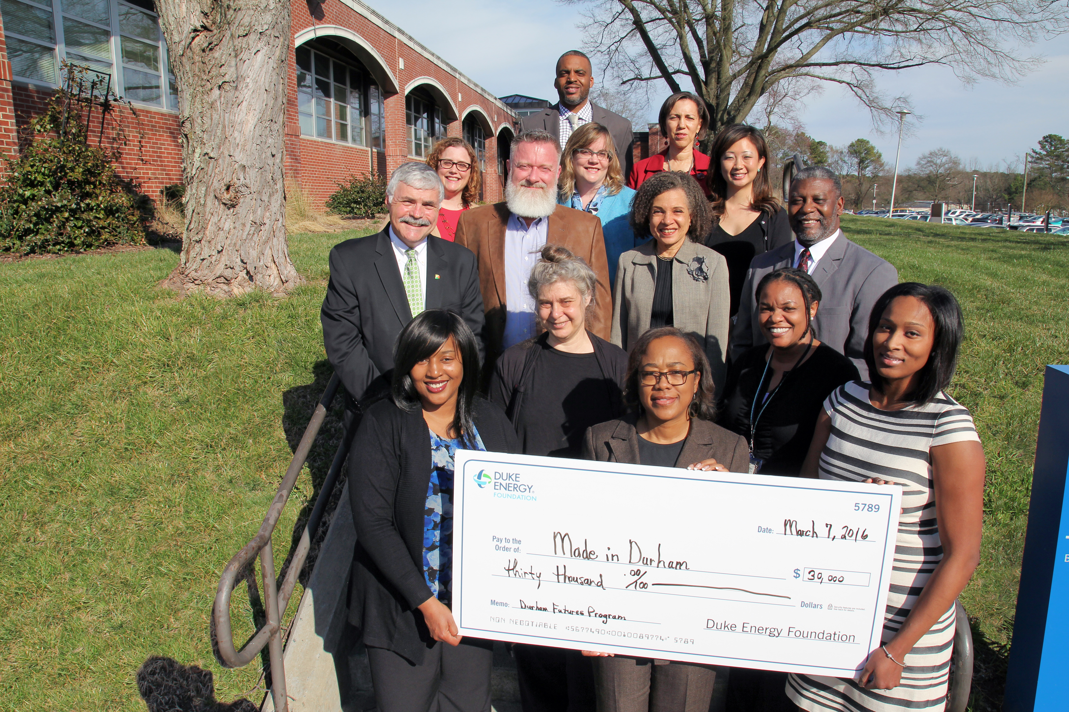

Slide 16
Durham Futures
Challenges
Division/Department alignment
Coordination of schedules
Financial support
Fluidity and flexibility

Slide 17
Durham Futures
Best Practices
Program Alignment
Braided Funding/Leveraging Financial support
Continuous Communication
Establishing a shared system of measurement

Slide 18
Questions or Comments?
Gregory Bellamy
Dean, College and Career Readiness
Durham Technical Community College
bellamyg@durhamtech.edu
Lydia Newman
Youth Transitions Strategist
Made in Durham
Newman@madeindurham.org

