Slide 1
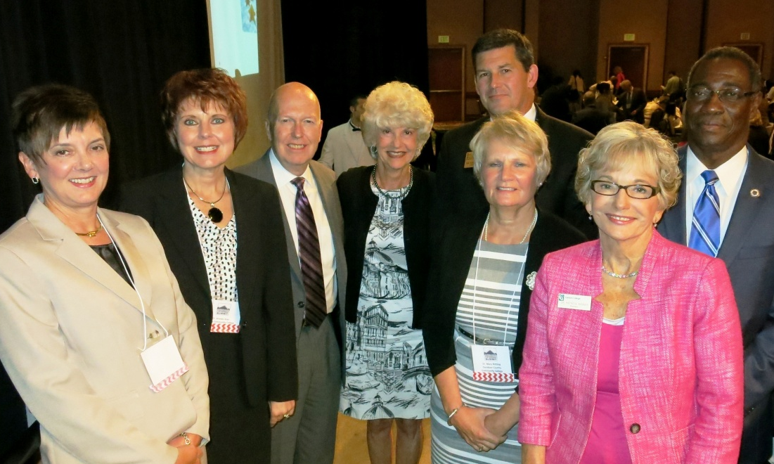
The Performance Partnership:
Joining Hands across NC to Boost Student Success
Notes:
Linda kickoff. $24M in PF per year. Legislature: What are we doing to help low-performing colleges? No college is high performing on all 8 PMs – nearly all are a mix of higher-performing and lower-performing on different Measures. What if we find a way to connect high- and low- performers on each individual Measure? The PP was born. Zero-budget, all-volunteer initiative that connects higher-performing and lower-performing colleges on each individual PM. Include Mr. Fouts suggestion to talk with all Presidents for input on how to move forward.

Slide 2

The Plan…
Facilitate institutional improvements/boost student success
Based on individual Performance Measures each year
College-driven
Collaborative
Ongoing
Voluntary
Open to all colleges
Sharing of Best Practices
Sharing in Each Others’ Success!
Notes:
Now in its third year, the Performance Partnership is a college-driven, collaborative, statewide initiative aimed at helping colleges improve their performance outcomes as demonstrated by the Performance Measures and other accountability indicators. We are passionate about boosting student success!
[Facilitate institutional improvements and boost student success through the sharing of best practices
Help colleges identify institutional strengths and opportunities
Assist in the development of strategies and tools
Coordinate collaborative relationships
Utilize and help colleges better understand performance measure data
Ensure program is college-driven, ongoing, voluntary, and open to all colleges
To share in Each Other’s Success!]

Slide 3


Components
Performance Partnership Summit
Measure-Specific Conference Call-Ins
Peer Mentoring
Boosting Student Success!
Sharing Resources
Advocacy
Notes:
Linda

Slide 4

The Secret Sauce …
Dr. Bob Shackleford:
“It’s All About
Relationships.”
Notes:
Change is Hard. It’s a little easier with the support of a friend. The relationships that have formed across colleges are phenomenal.

Slide 5
Committee
Wesley Beddard, AVP for Student Learning and Success, NCCCS
Thom Brooks, Exec. VP, Instruction, Stdt. Svcs, & Workforce Innovations, Southwestern CC
Evonne Carter, Vice President for Learning, College of the Albemarle
Doris Carver, (Co-Chair), VP of Continuing Education, Piedmont CC
Deryl Davis-Fulmer, Vice President of Academic Affairs, Halifax CC
Nancy Gaj, CCR Director of Program & Professional Development, NCCCS
Deborah Grimes, Senior VP of Instruction and Student Services, Lenoir CC
Kristie Sullivan, Dean of Planning and Research, Sandhills CC
Patricia Phillips, Associate Dean, Foundational Studies, Davidson County CC
Bill Schneider, AVP for Research and Performance Management, NCCCS
Linda Scuiletti (Chair), AVP of Student Learning & Strategic Planning, Central Carolina CC
Kimberly Sepich, AVP for Student Services, NCCCS
Kenny Weatherington, Quality Assurance Specialist-Public Safety Training, NCCCS
Bob Witchger, Director of Career & Technical Education, NCCCS
Notes:
Deryl: Representing 8 colleges with representation from Academic Affairs, Student Services, IE, and 6 System Office areas

Slide 6
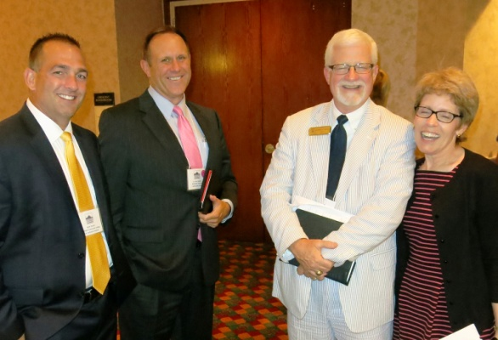
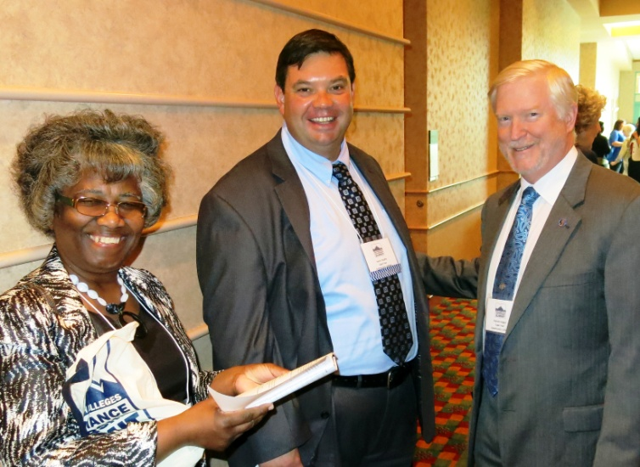
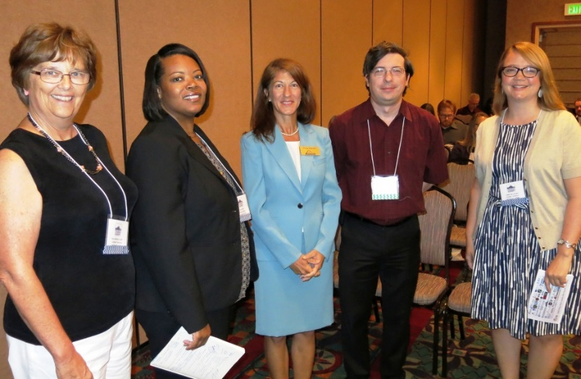
1. Peer Mentoring
Collaborations to facilitate institutional improvements and increased success rates for our students across the state
Mentees choose a willing Mentor
Mentors Share best practices/strategies
Campus visits or other interactions
Collaboratively develop an action plan for improvement

Slide 7
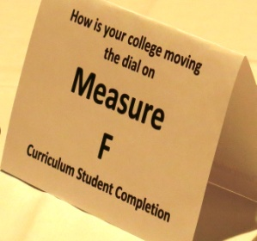
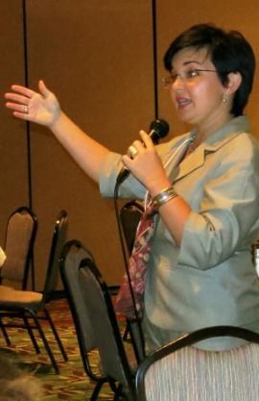
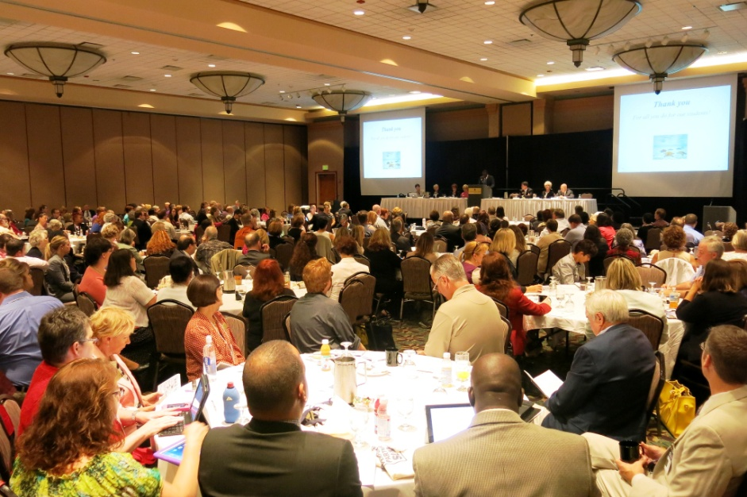

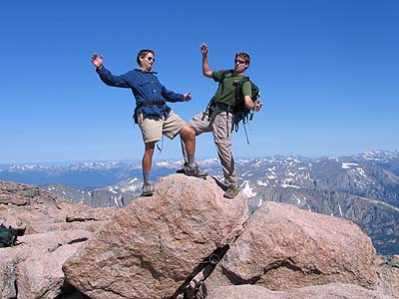
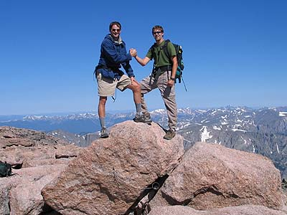
2. Summit
One-day showcase of best practices and forums associated with performance improvement related to performance measures and other topics associated with student success
Held during the summer in 2014 and 2015
Future: Off-years from System Conference – Next is July 2017
Inclusive of all colleges – nearly 600 attendees
Now including Performance Metrics for CTE/Perkins and Basic Skills

Slide 8
3. Sharing Resources
Website … A Repository for:
    Presentations from Summit
    Measure-Specific Panel Discussion Notes
    Presentations from Conference Call-In Sessions
  http://www.piedmontcc.edu/Performance-Partnership-Summit
Notes:
Deborah

Slide 9

Advocacy has Multiple Dimensions …
4. Advocacy
At the State Level
At the System Level
At the institutional Level
Among professional organizations within community college divisions.

Slide 10
5. Conference Call-Ins
Themed to cover State and Federal Performance Metrics
Feature Best Practices presented by high-performing colleges
Discuss what's working and what isn't among callers
Discuss up-to-the-moment new ideas being implemented to spur performance improvement
Open discussion by college participants during call-ins
Majority of colleges participate
Notes:
Deborah

Slide 11
Measures being discussed today:
Perkins 5P1 & 2: Boosting CTE Non-Traditional Gender Enrollment
Your Hosts:
Dr. Bob Witchger, Director of CTE, NCCCS
Dr. Linda Scuiletti, AVP of Assessment, Planning & Research, Central Carolina CC

Slide 12
Today’s Presenters:
Pamela Silvers (A-B Tech): AB-Tech's Non-Traditional Enrollment Grant and Strategies to Improve Performance
Pam Gibson (Fayetteville Tech): Success Strategies for Improving Performance on Perkins 5P1 and 5P2
Diane Albahrawy (Wake Tech): Strategies for Improvement on Perkins Core Indicators
Julia Hamilton (NCCCS): The Perkins Data, In-Depth
Chris Droessler (NCCCS): Insights from Colleges across the State
Tony Reggi (NCCCS): Perkins Core Indicators and Steps Colleges Have Taken to Improve Performance

Slide 13
AB-Tech's Non-Traditional Enrollment Grant and Strategies to Improve Performance
Pamela Silvers
Instructor – Computer Technologies
Principal Investigator – NSF-ATE Grant,
Asheville-Buncombe Tech Community College
pamelajsilvers@abtech.edu

Slide 14
Strategies for Connecting With and Recruiting Females
Pamela Silvers

Slide 15
Underlying Facts
  Women do not see themselves in many STEM professions
Marketing points – salary, job potential and the technology - tend to appeal to males

Slide 16
Skills that Appeal
Helping others
Working in teams
Solving problems

Slide 17
Marketing Materials
Theme – Picture Yourself
  Display board
  Posters
        Notable women
        Technology posters
  Bulletin boards
  Bookmarks
Boosting CTE Non-Traditional Gender Enrollment - April 2016

Slide 18
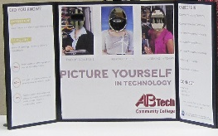

Boosting CTE Non-Traditional Gender Enrollment - April 2016

Slide 19


P
O
S
T
E
R
S
Boosting CTE Non-Traditional Gender Enrollment - April 2016

Slide 20
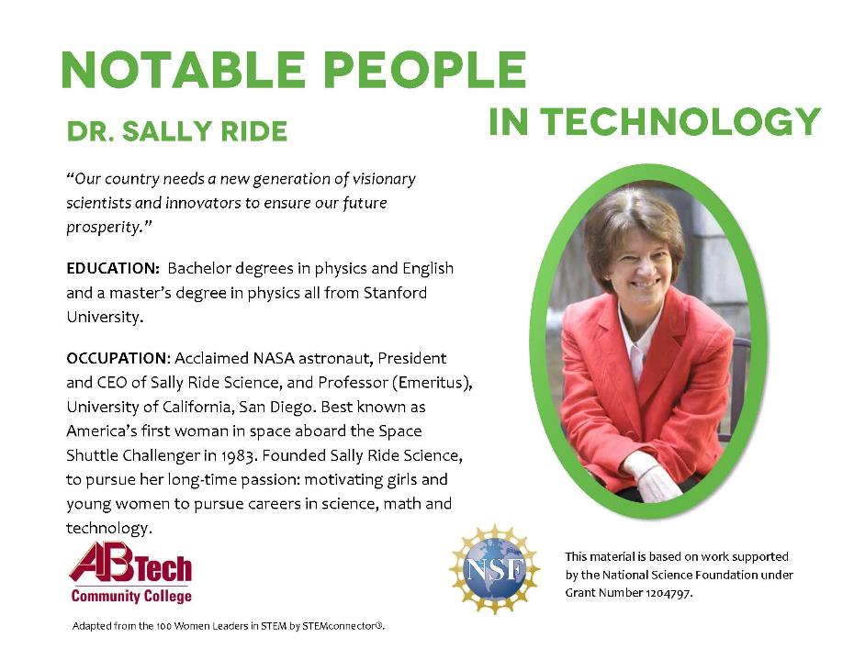
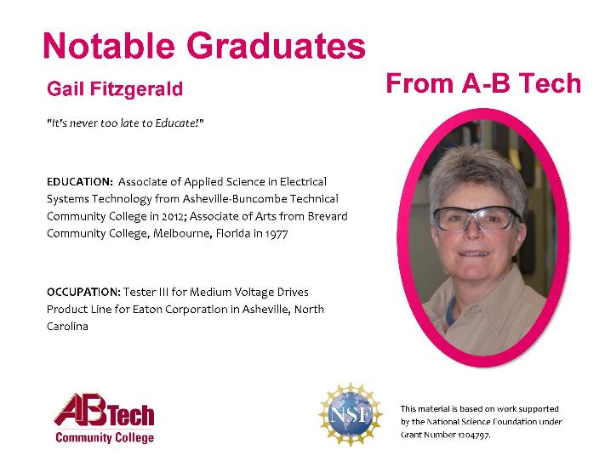

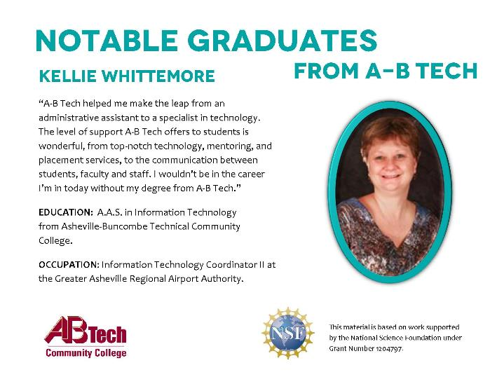
Boosting CTE Non-Traditional Gender Enrollment - April 2016

Slide 21



B
O
O
K
M
A
R
K
S
Boosting CTE Non-Traditional Gender Enrollment - April 2016

Slide 22
Recruiting
Boosting CTE Non-Traditional Gender Enrollment - April 2016

Slide 23
Determine what YOUR Goal is
Career awareness
Recruiting
Boosting CTE Non-Traditional Gender Enrollment - April 2016

Slide 24
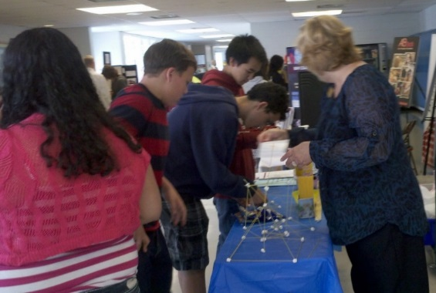
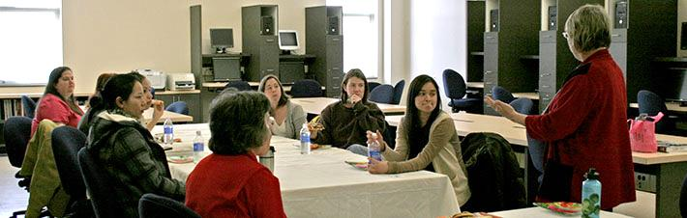
Career Awareness
Middle school career days
ESTEAM event (great PR)
Women in
History Month
Boosting CTE Non-Traditional Gender Enrollment - April 2016

Slide 25
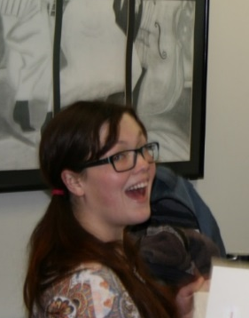
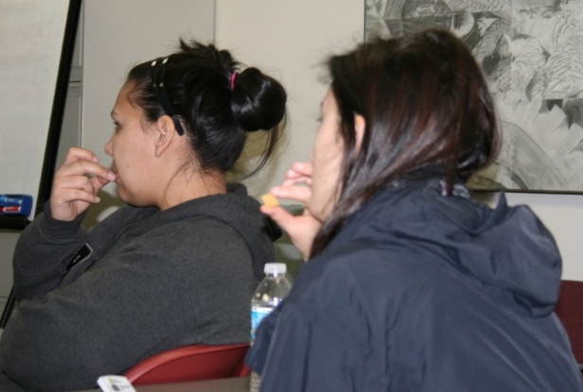
Recruiting: Go Where the Students ARE
ASPIRE program
GED students
Innovative Expo
JobLink
Student Services
Boosting CTE Non-Traditional Gender Enrollment - April 2016

Slide 26
Resources
Boosting CTE Non-Traditional Gender Enrollment - April 2016

Slide 27
National Coalition of Women in Technology (ncwit.org)
Institute for Women in Trades, Technology and Science
(iwitts .org)
Boosting CTE Non-Traditional Gender Enrollment - April 2016

Slide 28
Thank you
For more information contact:
Pamela Silvers
pamelajsilvers@abtech.edu
Boosting CTE Non-Traditional Gender Enrollment - April 2016

Slide 29
Success Strategies for Improving Performance on Perkins 5P1 and 5P2
Pam Gibson (Fayetteville Tech):

Slide 30
Strategies for Improvement on Perkins Core Indicators
Diane Albahrawy, J.D.
Associate Professor, Business Technologies Division
Wake Tech Community College
Co-Advisor, Phi Beta Lambda

Slide 31


Slide 32
Innovative Ways to Use Perkins Funding
Presented by:
Diane Albahrawy, J.D., Associate Professor – Business Administration
Perkins Coordinator
Stephanie Grossman, MBA, Instructor- Business Administration
Wake Technical Community College

Slide 33
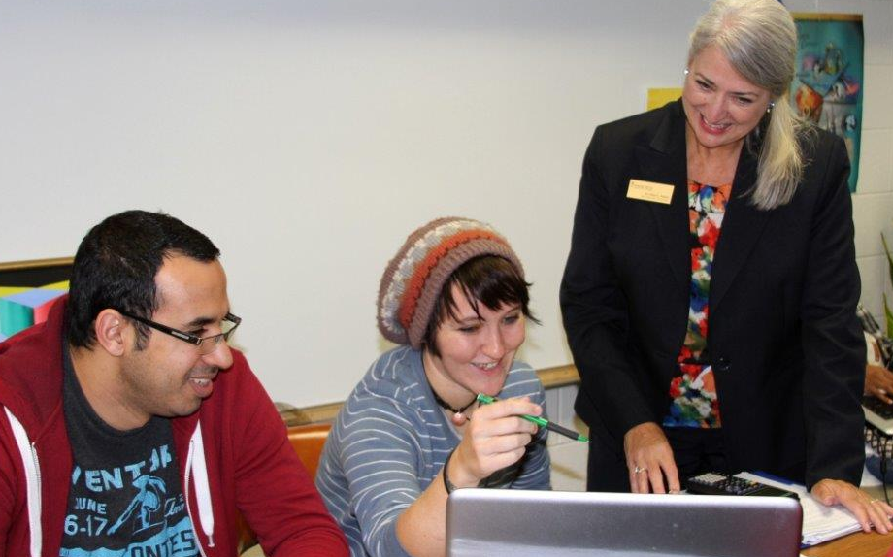
Career Programs at WTCC
Applied Engineering Technologies
Business and Public Services Technologies
Computer Technologies
Health Science

Slide 34
Perkins Performance Measures
  Team of 4 Division Deans and Perkins Coordinator
  All spending tied to one or more of the Performance Measures (1P1, 2P1, 3P1, 4P1, 5P1 and 5P2)
  Meet bi-weekly all year
  Research and discuss best practices aligned with each measure
  3. What are others doing well? How can we tailor it to our needs?
  4. Discuss ideas with department heads and faculty
  5. Choose spending options that align with measures

Slide 35
Resources
Community College Research Center (opens in new window)
ACTE Career Tech Update SMART Brief (opens in new window)
ACTE Legislative Alerts (opens in new window)
Non-Traditional Occupations Outreach Guide (opens in new window)
Perkins Collaborative Resource Center-OCTAE (opens in new window)

Slide 36
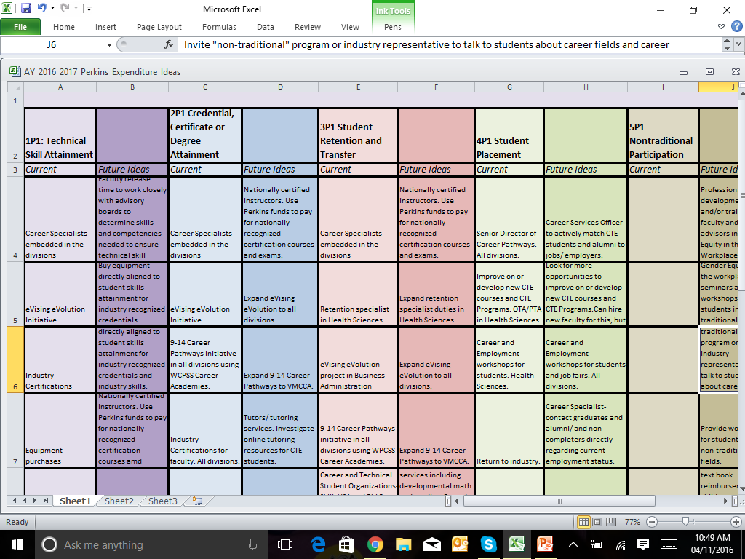

Slide 37
Measures 2P1, 3P1 and 4P1
Retention, Completion and Job Placement
Senior Director of Career Pathways
Articulation Agreements
Career and College Promise
Career Pathways (9-14 and 9-16)
Structured Pathways

Slide 38
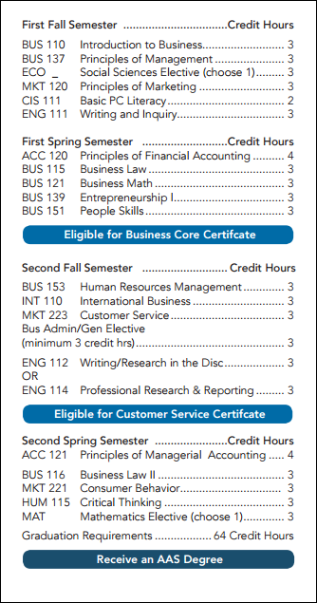
Structured Pathways – Example
Stackable Credentials
Earn Certificate 1
Possible Exit Point
Earn Certificate 2
Possible Exit Point
Earn Associates Degree

Slide 39
Measures 2P1, 3P1 and 4P1
Career Program Specialists/Embedded Advisors
Focus on specific programs of study
Provide support for faculty advisors
eVising eVolution Course Development

Slide 40
eVising eVolution
What is eVising?
A new one-stop-shop for all advising needs
Hosted on Blackboard along with students’ registered courses
eVolution – start with small team, anticipate rapid expansion over the next few years

Slide 41

eVising eVolution – Plan, Track, Achieve
The eVising motto, "Plan, Track, Achieve," means you will be guided through every step of being a Business Administration student, from the beginning to the end of your academic journey...and beyond.

Slide 42
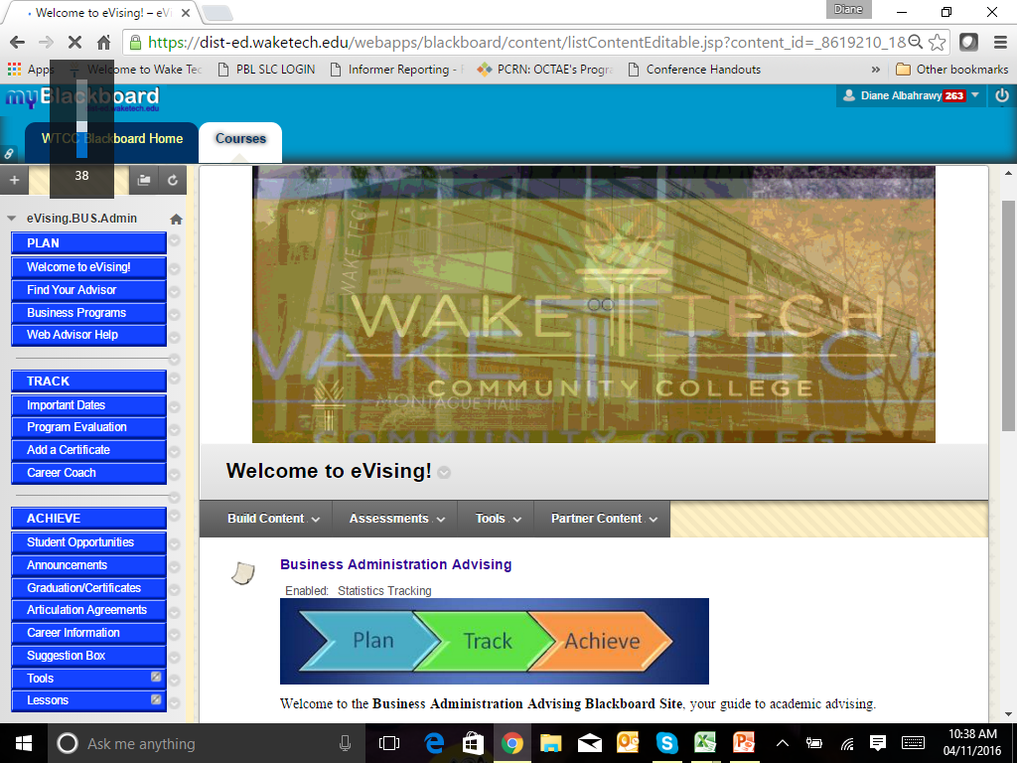

Slide 43
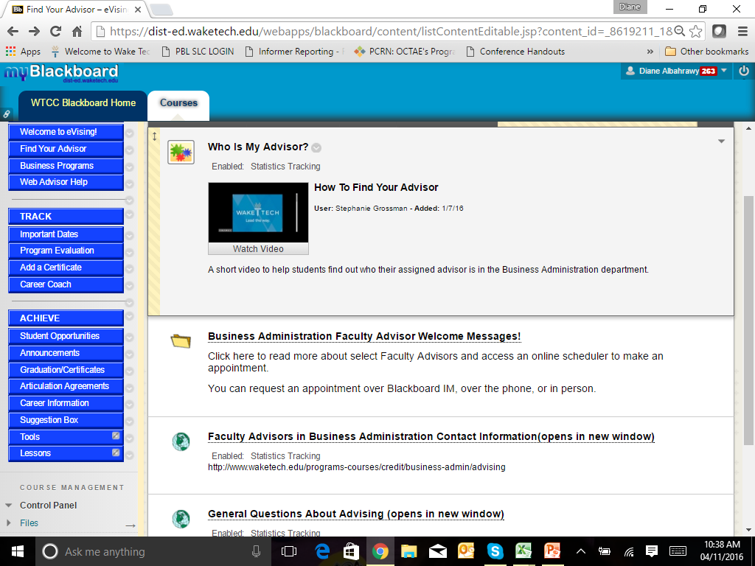

Slide 44
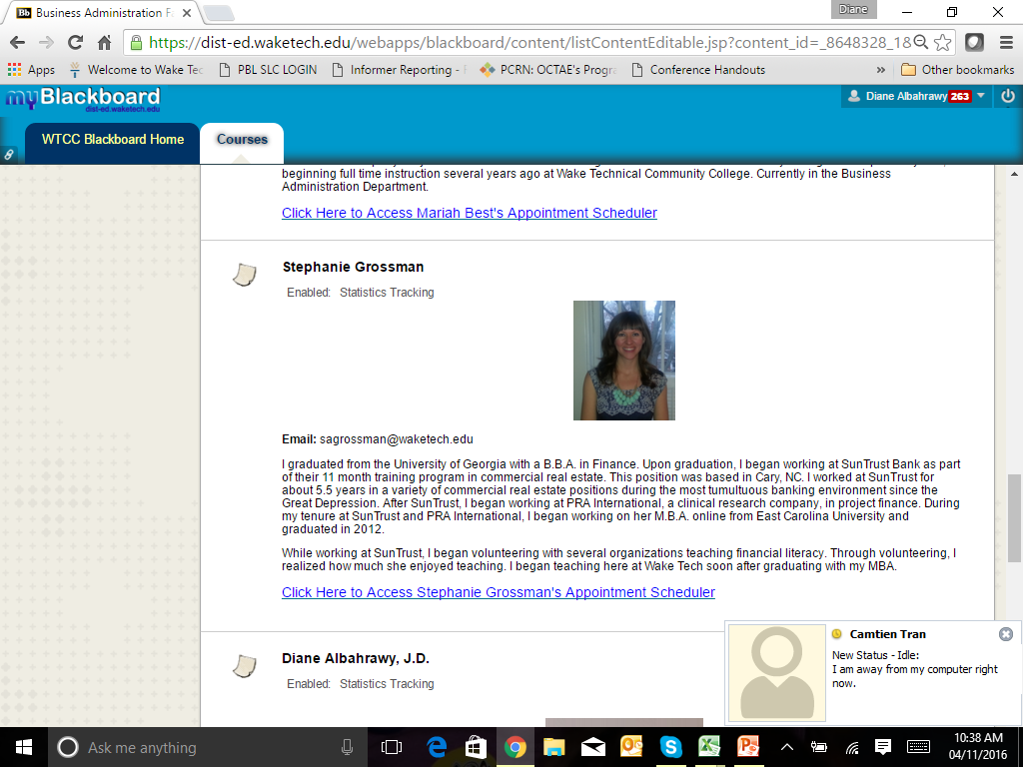

Slide 45
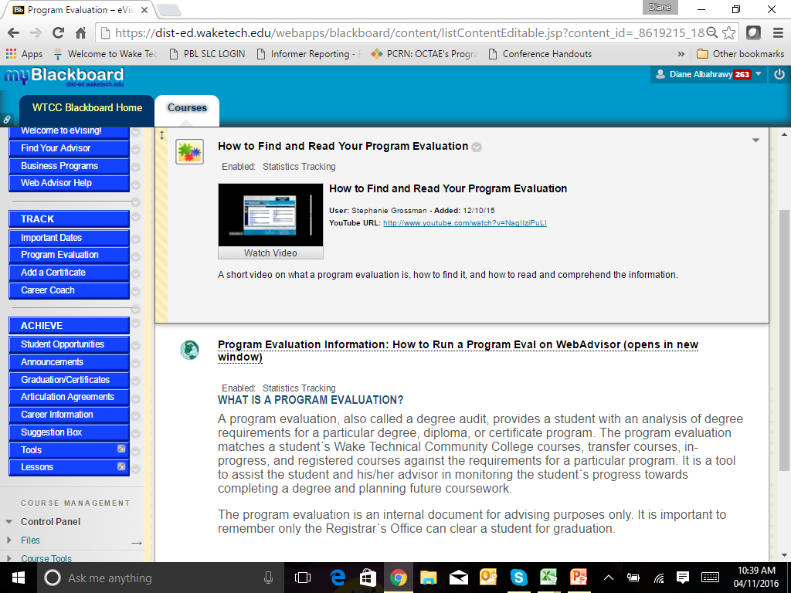

Slide 46
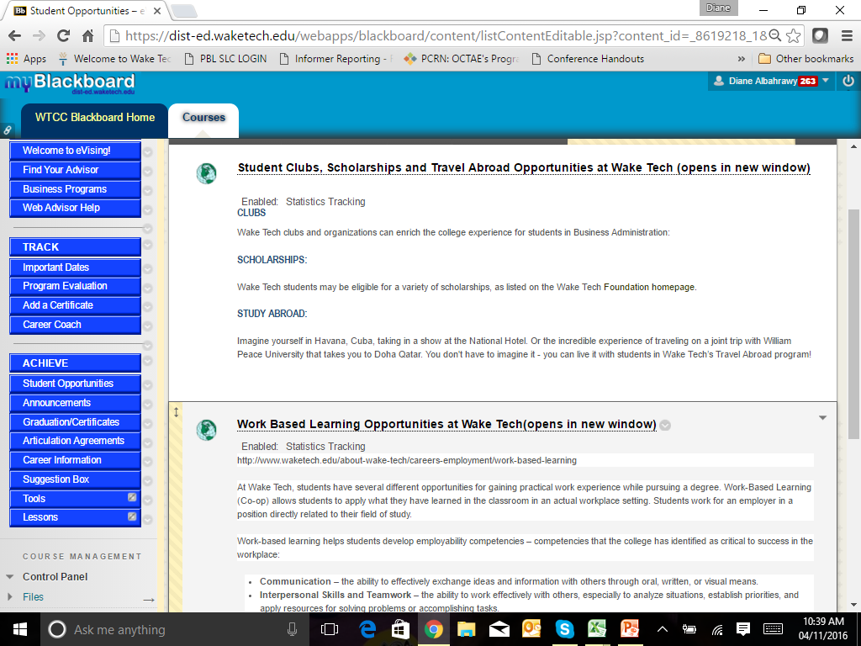

Slide 47

On The Horizon….
Embedded Instructional Designers
Contextualized Math Course Development for the Trades
Expanded Career Pathways
eVising eVolution Course Development for all Departments
Applied Benchmarking Grants

Slide 48
Takeaways
Use research to design a plan
Include your deans, department heads, and faculty members in the planning process
Rewards for innovation = motivated and happier employees = better supported students
Never stop looking for opportunities to help your students succeed.

Slide 49
The Perkins Data, In-Depth
Julia Hamilton
Coordinator for Career and Technical Education
North Carolina Community College System

Slide 50
2015 Perkins Core Indicators of Performance Report
April 13, 2016

Slide 51
Perkins Performance Indicators
1P1 - Students who attain a 2.5 GPA or higher
2P1 - Students who complete a credential, certificate, diploma or degree
3P1 - Students who continue in CTE (retention or transfer)
4P1 - Students who are placed in a job (employment)
5P1 - Students who enroll in nontraditional program of study
5P2 - Students who complete a nontraditional program of study

Slide 52
1P1 Technical Skill Attainment
Source
  Curriculum Registration, Progress, Financial Aid Report (CRPFAR) data file
Details
  Numerator – Students who have a GPA of 2.5 or higher on courses at the 100 level or higher
  Denominator – A concentrator is defined as any student enrolled in any semester during the reporting year in a non-transfer program area and by the end of the current reporting year has completed 12 non-developmental credit hours, 6 of which are CTE.
    The curriculum program area is the primary active program code for the student listed in the CRPFAR file

Slide 53
1P1 – Technical Attainment

Slide 54
2P1 Credential, Certificate or Degree
Source
  CRPFAR
Details
  Numerator – Students who graduated with a certificate, diploma, or a degree
    Industry-recognized credentials are not possible at the individual level for data matching to our students, so completion is based solely on credentials awarded by the individual colleges.
  Denominator – CTE Concentrators from the previous year who did not re-enroll in the current reporting year

Slide 55
2P1 – Credential, Certificate, or Degree

Slide 56
3P1 Student Retention or Transfer
Source
  CRPFAR
  National Student Clearninghouse
Details
  Numerator – Students who did not graduate the previous year are sent to the National Student Clearninghouse to see if they transferred during the current year. The enrollment at the transfer institution must begin between August 1 and May 31.
  Denominator – CTE Concentrators who are enrolled in the fall of the previous year and who did not earn any credential during the previous year. Credentials are those awarded by the individual colleges and listed in the CRPFAR

Slide 57
3P1 – Student Retention or Transfer

Slide 58
4P1 – Student Placement
Source
  CRPFAR
  Employment Wage Records (Common Follow-up System)
Details
  Numerator – CTE Concentrators who were found to have a record of employment in the second quarter following the program year in which the student exists
  Denominator – CTE Concentrators from the previous year who did not return during the current year. These individuals are checked for employment records using the Employment Wage Records from the Department of Commerce
  Inmates are NOT included in 4P1

Slide 59
4P1 – Placement into the Labor Force

Slide 60


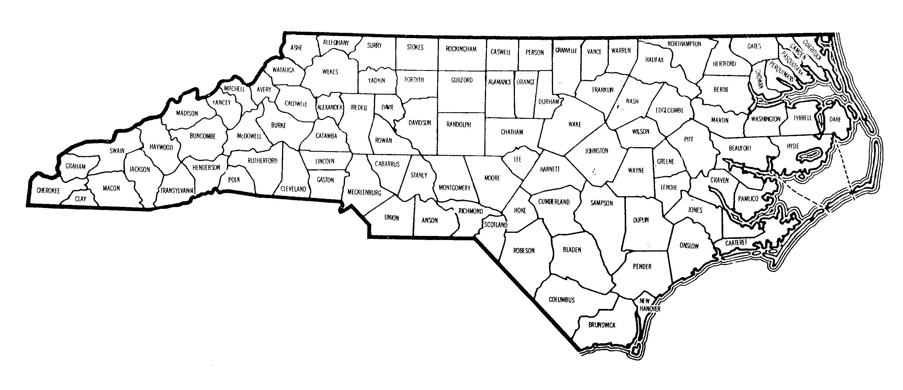

4P1 – Border Counties & Military Installations
Colleges that missed 4P1 by more than 10%
Military Installations

Slide 61
5P1 – Non-Traditional Participation
Source
  CRPFAR
  National Alliance for Partnerships in Equity (NAPE) Nontraditional Crosswalk
Details
  Numerator – Students who gender does not match the majority gender in the program area as noted by NAPE
  Denominator – CTE Participants are identified using the following methodology:
    Not enrolled in a primary active program code of A10, C10, D10, T90, or P10.
    Students must attempt 6 hours of CTE
    College letter grades of NA and NS are not included, but W grades are included
  Inmates are NOT included in 5P1

Slide 62
Non-Traditional Programs NOT included in the 2007 NAPE Crosswalk
A15230 – Golf Course Mgt Tech
A15420 – Viticulture & Enology Tech
A15410 – Sustainable Agriculture
A20150 – Environmental Bio Tech
A20190 – Nanotechnology
A25110 – Hospitality Mgt
A40120 – Automation Engineering Tech
A45110 – Associate Degree Nursing
C45180 – Central Sterile Processing
A45190 – Clinical Trials Research Associate
A45630 – Health & Fitness Science
A45430 – Healthcare Interpreting
A4538F – Human Services Tech/Animal Assisted Interactions
C45390 – Licensed Practical Nurse Refresher
A45800 – Magnetic Resonance Imaging
C45380 – Mammography
C45480 – Nursing Assistant
D45930 – Nursing Assistant
C45650 – Polysomnography
A45670 – Polysomnography
D45660 – Practical Nursing
A45730 – Speech-Language Pathology Assistant
A50510 – Electric Utility Substation & Relay Tech
A55370 – Community Spanish Interpreter
A55210 – Cyber Crime Tech
A55460 – Emergency Mgt
A55300 – Interpreter Education
A55220 – Outdoor Leadership
A60150 – Aviation Electronics (Avionics) Tech
D60310 – Recreational Vehicle Maint & Repair Tech

Slide 63
5P1 – Nontraditional Program Participation

Slide 64
5P2 Non-Traditional Completion
Source
  CRPFAR
  NAPE Crosswalk
Details
  Numerator – Students whose gender does not match the majority gender in the program area as noted by NAPE
  Denominator – CTE Concentrators for the current reporting year completing a non-traditional program. Completion is identified as those having a graduate record in the CRPFAR during the current program year.
    Note: Programs that finish during that summer semester are counted during the following academic year.
  Inmates are NOT included in 5P2

Slide 65
5P2 – Nontraditional Program Completion

Slide 66
2015 Perkins Core Indicators of Performance Report
The complete report can be downloaded from www.ncperkins.org under Performance Data

Slide 67
Perkins Core Indicators and Steps Colleges Have Taken to Improve Performance
Chris Droessler
Career and Tech Education Coordinator
North Carolina Community College System
Tony Reggi
Coordinator, Career and Tech Education
North Carolina Community College System

Slide 68
Strategies for 5P1 and 5P2
nontraditional enrollment and completions

Slide 69
Enrollment and Marketing
Promote the development of a series of career cluster publications to target high school students that highlight business and industry leaders, particularly in nontraditional role models
Develop training designed to help school administrators, guidance counselors, and middle school career orientation teachers to understand the manufacturing career cluster and highlight advanced manufacturing positions held by women.

Slide 70
Enrollment and Marketing
Develop a “tool kit” of resources, including information on high-skill, high-wage occupations, nontraditional careers, and classroom resources. Use this information to support teachers in service training, recruitment efforts, curriculum development, and other services deemed effective in promoting participation in nontraditional training and employment.
Collaborate with community based organizations. Many community-based organizations (e.g., Girls Inc., American Association of University Women, YWCA, Girl Scouts, Take Our Daughters to Work) have nontraditional career exposure programs for young girls.

Slide 71
Enrollment and Marketing
Conduct professional development with teachers at all levels. Increase teacher awareness of gender bias and stereotyping in curriculum materials and classroom instruction that create negative effects on student course selection.
Implement and model gender fair institutional strategies; including nontraditional representatives on advisory committees, hiring of nontraditional instructors, conducting workshops on nontraditional careers with students and staff, providing grant incentives in RFPs, purchasing materials portraying nontraditional students, collecting data that link occupations and gender.

Slide 72
Retention
Offer support services. Students enrolled in nontraditional career and technical education programs who receive support services (i.e., tutoring, mentoring, support groups, child care, and transportation) are more likely to succeed.
Develop peer support groups for nontraditional students, When underrepresented-gender students participate together in the same program, they are more likely to succeed.
When nontraditional participants enroll individually, they are less likely to integrate effectively into the social structure, more likely to suffer decreased performance, and more likely to drop out. Change is carried in cohorts, not in single individuals.

Slide 73
Retention
Provide access to nontraditional role models and mentors in a student’s nontraditional career field to increase retention and success.
Review and adjust instructional strategies. Gender-biased instructional and support strategies is one of the major factors for students dropping out of nontraditional career and technical education programs.

Slide 74
Retention
Female students are more successful in classrooms where cooperative learning is addressed and teachers recognize a variety of learning styles and capitalize on students’ strengths.
Alternative assessments including integrated performance tasks, journals, portfolios, and pictorial explanations are valid ways of demonstrating understanding, and allow women to showcase their talent more effectively than they can on traditional tests

Slide 75
Follow-up questions for our presenters?

Slide 76
What have you done on your campus to improve student success as it relates to this measure?
What has been the impact?
What’s working?
What isn’t working?

Slide 77
What strategies are you considering as you move forward?

Slide 78
What challenges have you faced at your college in attempts to implement new strategies?

Slide 79
Comments and feedback on today’s call?
What would you like to discuss during the next conference call for this measure?

Slide 80
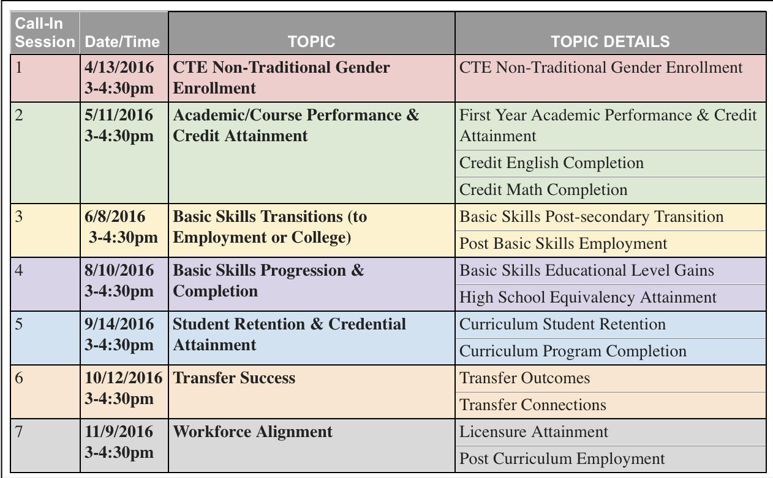
2016 Performance Partnership
Call-In Schedule:

Slide 81
See All Performance Measures Results:
http://www.nccommunitycolleges.edu/analytics-and-reporting/state-and-federal-performance-measures

Slide 82
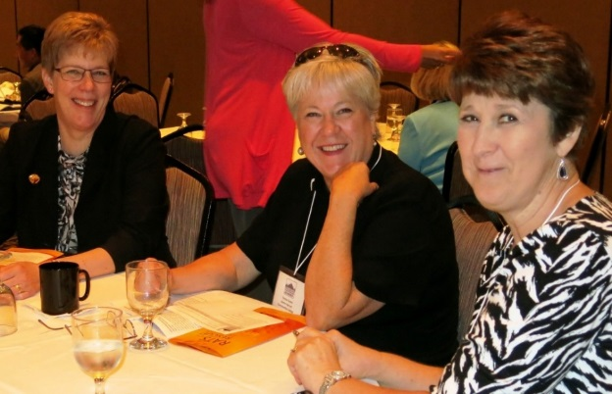
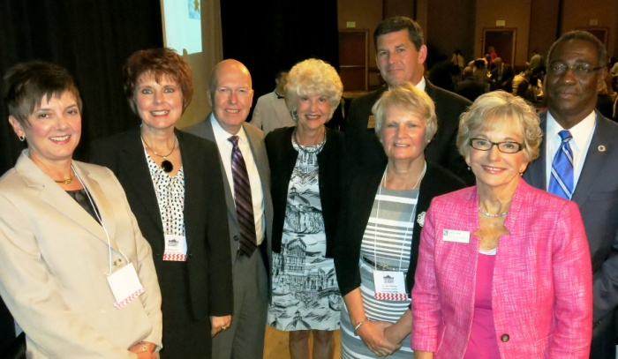
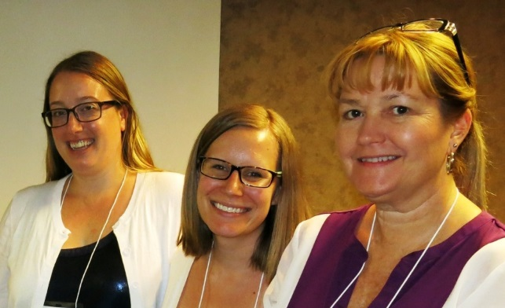
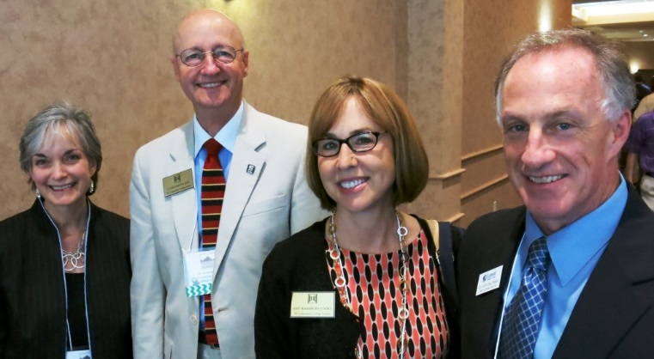
Thanks for joining us!
For more information, contact:
Dr. Bob Witchger, Director of CTE: witchgerb@nccommunitycolleges.edu
Dr. Linda Scuiletti, Chair, Performance Partnership,
AVP, Assessment, Planning & Research, Central Carolina CC: lscuiletti@cccc.edu
Dr. Doris Carver, Co-Chair, Performance Partnership,
VP, Continuing Ed, Piedmont CC: doris.carver@piedmontcc.edu

