Slide 1
Postsecondary CTE
Annual Perkins Planning Meeting
April 20 & 21, 2016
Greensboro, NC

Slide 2
Annual Planning Meeting
Overview
Skills USA Observation and Awards
Integrating Perkins funding at my Community College to enhance CTE Programs and Student Success
Enhancing CTE Programs of Study

Slide 3
Planning Part I
North Carolina Postsecondary Perkins
CTE Programs of Study - Integrating Career Pathways and Career & College Promise
Accountability - Measuring Success
Expectations monitored
Sharing promising practices

Slide 4
CTE State Staff
Dr. Bob Witchger Director, Career & Technical Education WitchgerB@nccommunitycolleges.edu 919-807-7126
Dr. Tony R. Reggi Coordinator, Career & Technical Education ReggiA@nccommunitycolleges.edu 919-807-7131
Julia Hamilton Coordinator, Career & Technical Education HamiltonJ@nccommunitycolleges.edu 919-807-7130
Chris Droessler Coordinator, Career & Technical Education DroesslerC@nccommunitycolleges.edu 919-807-7068
Ashley Bowling CTE Administrative Assistant BowlingA@nccommunitycolleges.edu 919-807-7129

Slide 5
Postsecondary Perkins
Basic Grant - Enhancing Program of Study
Leadership Grant - Pushing the Envelope
FAUPL - Performance and Accountability
Methods of Administration - Equity

Slide 6
Basic Grant
Enhance CTE - Leveling the field for those who elect to enroll
Employers - Listening, acting, engaging
Develop more fully the academic, technical and professional skills of faculty
Advocate for partnership vs competition with stakeholders

Slide 7
Basic Grant
Strengthen & build rigorous programs of study (POS)
Link secondary and postsecondary POS
Teach all aspects of industry
Improve the use of technology in teaching
Provide professional development
Evaluate CTE programs of study
Expand and modernize CTE programs
Fund programs of sufficient size, scope, and quality
Develop self-sufficiency strategies for those who elect to enroll in CTE

Slide 8
Basic Grant
Group Discussion
What is one activity that your college completed this year that supports these required activities?
What is one activity this year that you used Perkins funds to support?

Slide 9
Perkins Planning Part II
Writing the Local Plan
Contact information
Allotment options
Required use of funds
Assurances
Local Plan
Budget

Slide 10
Leadership
Assessment of CTE
Expand the use of technology
Professional developments programs
Support and improve CTE programs
Support partnerships
Serve state institutions
Support programs for special populations
Provide technical assistance to our colleges

Slide 11
Leadership
2015-16
Office Alignment
Competency Based Education
Automotive
Career Book
Manufacturing
SkillsUSA
Microsoft
Advanced Manufacturing
WIOA
Apprenticeship
Articulation
CORD / NC-NET
Health Diversity
2016-17
Automotive
SkillsUSA
Pathways
Career Coaches
RN to BSN
CBE Charlotte
Accounting

Slide 12
Perkins Performance Indicators
1P1 - Students who attain a 2.5 GPA or higher
2P1 - Students who complete a credential, certificate, diploma or degree
3P1 - Students who continue in CTE (retention or transfer)
4P1 - Students who are placed in a job (employment)
5P1 - Students who enroll in nontraditional program of study
5P2 - Students who complete a nontraditional program of study

Slide 13
1P1 Technical Skill Attainment
Source
Curriculum Registration, Progress, Financial Aid Report (CRPFAR) data file
Details
Numerator – Students who have a GPA of 2.5 or higher on courses at the 100 level or higher
Denominator – A concentrator is defined as any student enrolled in any semester during the reporting year in a non-transfer program area and by the end of the current reporting year has completed 12 non-developmental credit hours, 6 of which are CTE.
The curriculum program area is the primary active program code for the student listed in the CRPFAR file

Slide 14
1P1 – Technical Attainment

Slide 15
2P1 - Credential, Certificate or Degree
Source
CRPFAR
Details
Numerator – Students who graduated with a certificate, diploma, or a degree
Industry-recognized credentials are not possible at the individual level for data matching to our students, so completion is based solely on credentials awarded by the individual colleges.
Denominator – CTE Concentrators from the previous year who did not re-enroll in the current reporting year

Slide 16
2P1 - Credential, Certificate or Degree

Slide 17
3P1 - Student Retention or Transfer
Source
CRPFAR
National Student Clearinghouse
Details
Numerator – Students who did not graduate the previous year are sent to the National Student Clearinghouse to see if they transferred during the current year. The enrollment at the transfer institution must begin between August 1 and May 31.
Denominator – CTE Concentrators who are enrolled in the fall of the previous year and who did not earn any credential during the previous year. Credentials are those awarded by the individual colleges and listed in the CRPFAR

Slide 18
3P1 - Student Retention or Transfer

Slide 19
4P1 – Student Placement
Source
CRPFAR
Employment Wage Records (Common Follow-up System)
Details
Numerator – CTE Concentrators who were found to have a record of employment in the second quarter following the program year in which the student exists
Denominator – CTE Concentrators from the previous year who did not return during the current year. These individuals are checked for employment records using the Employment Wage Records from the Department of Commerce
Inmates are NOT included in 4P1

Slide 20
4P1 – Placement into the Labor Force

Slide 21
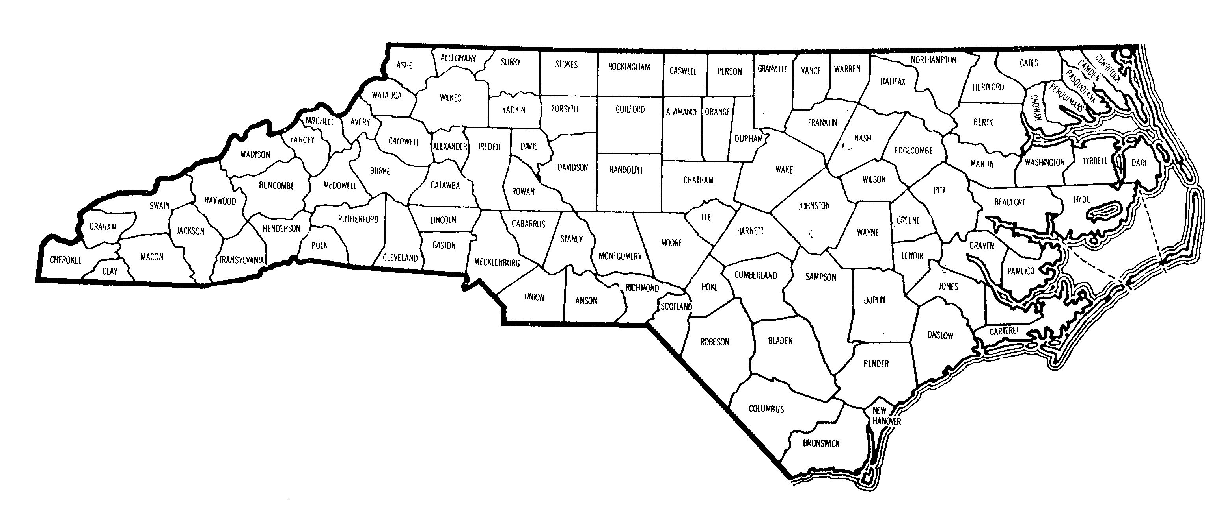
4P1 – Border Counties & Military Installations
Colleges that missed 4P1 by more than 10%
Military Installations

Slide 22
5P1 – Non-Traditional Participation
Source
CRPFAR
National Alliance for Partnerships in Equity (NAPE) Nontraditional Crosswalk
Details
Numerator – Students who gender does not match the majority gender in the program area as noted by NAPE
Denominator – CTE Participants are identified using the following methodology:
Not enrolled in a primary active program code of A10, C10, D10, T90, or P10.
Students must attempt 6 hours of CTE
College letter grades of NA and NS are not included, but W grades are included
Inmates are NOT included in 5P1

Slide 23
Non-Traditional Programs NOT included in the 2007 NAPE Crosswalk
A15230 – Golf Course Mgt Tech
A15420 – Viticulture & Enology Tech
A15410 – Sustainable Agriculture
A20150 – Environmental Bio Tech
A20190 – Nanotechnology
A25110 – Hospitality Mgt
A40120 – Automation Engineering Tech
A45110 – Associate Degree Nursing
C45180 – Central Sterile Processing
A45190 – Clinical Trials Research Associate
A45630 – Health & Fitness Science
A45430 – Healthcare Interpreting
A4538F – Human Services Tech/Animal Assisted Interactions
C45390 – Licensed Practical Nurse Refresher
A45800 – Magnetic Resonance Imaging
C45380 – Mammography
C45480 – Nursing Assistant
D45930 – Nursing Assistant
C45650 – Polysomnography
A45670 – Polysomnography
D45660 – Practical Nursing
A45730 – Speech-Language Pathology Assistant
A50510 – Electric Utility Substation & Relay Tech
A55370 – Community Spanish Interpreter
A55210 – Cyber Crime Tech
A55460 – Emergency Mgt
A55300 – Interpreter Education
A55220 – Outdoor Leadership
A60150 – Aviation Electronics (Avionics) Tech
D60310 – Recreational Vehicle Maint & Repair Tech

Slide 24
5P1 – Nontraditional Program Participation

Slide 25
5P2 Non-Traditional Completion
Source
CRPFAR
NAPE Crosswalk
Details
Numerator – Students whose gender does not match the majority gender in the program area as noted by NAPE
Denominator – CTE Concentrators for the current reporting year completing a non-traditional program. Completion is identified as those having a graduate record in the CRPFAR during the current program year.
Note: Programs that finish during that summer semester are counted during the following academic year.
Inmates are NOT included in 5P2

Slide 26
5P2 – Nontraditional Program Completion

Slide 27
Monitoring - Basic Grant
Handout - For review and discussion
Career and Technical Education activities
Secondary students earning postsecondary credit
Improve academic and technical skills of students
Understanding all aspects of industry
Taught to challenging standards
Professional development for staff in CTE POS
Inform stakeholders of CTE ACT
Continuous improvement

Slide 28
Monitoring - Basic Grant
Enable special populations to meet performance measures
Prepare special populations for high-skill, high-wage, high-demand occupations
Do not discriminate against special populations
Promote student preparation for non-traditional fields
Career guidance with links to future education and training
Recruit and retain CTE faculty; Improve transition to teaching
Review programs to help individuals overcome barriers
Purchases follow EDGAR and Super Circular for Federal Programs
Group discussion - Five documents you might use to prove this is happening

Slide 29
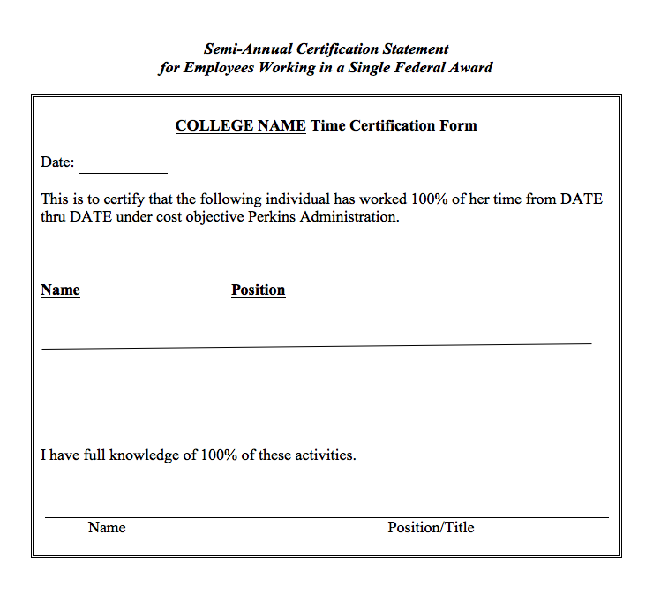

Slide 30
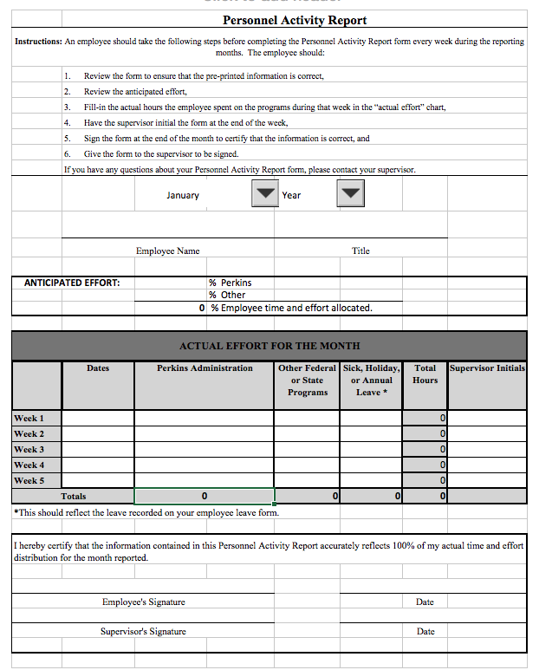

Slide 31
Methods of Administration of Federal CTE Programs
Student accessibility
Student access
Equity in teaching faculty, enrolled students, and support staff

Slide 32
Methods of Administration of Federal CTE Programs Checklist
Administrative - Notice of non-discrimination
Site location and student eligibility
Equity recruitment
Admissions
Student financial assistance
Counseling and prevocational programs
Services for students with disabilities
Accessibility 504-ADA
Comparable facilities
Work study, cooperative education, job placement, apprenticeship
Employment

Slide 33
Writing the Local Plan
Contact information
Allotment - Accept or reject
Required use of funds - Focusing the grant
Assurances
Local plan - Pathways, accountability, enhancement
Budget allocation - Pathways, equipment, staffing
Required activities - What difference does the funding make?
Supplanting - Equipment, supplies

Slide 34
Postsecondary CTE
Annual Perkins Planning Meeting
April 20 & 21, 2016
Greensboro, NC

