Slide 1
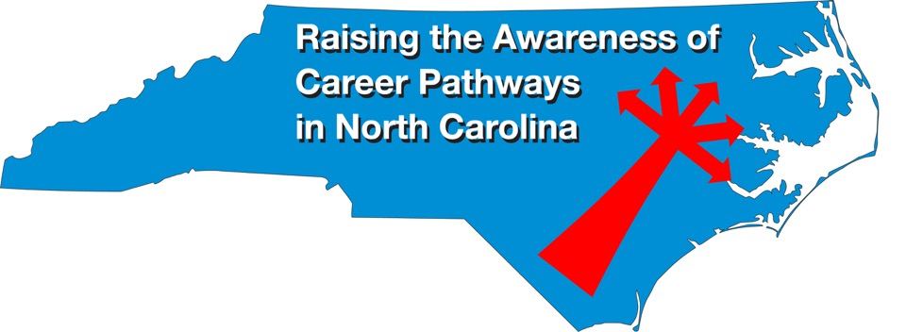
February 16, 2022 Careers in Veterinary Medical Technology
Download the PowerPoint and access the recording: www.ncperkins.org/presentations
Notes:
Good morning. Welcome to our monthly career pathways webinar.
We are here to help promote the great jobs, often unknown, in the great state of North Carolina.
Through these meetings, we are going to let you know about some great career opportunities in North Carolina.
And bring in special guests talk about these opportunities.
Please download this PowerPoint file and use it anyway you can to help get folks on a career pathway.
In the notes section of the PowerPoint, you will find any reference from where the information was found, as well as the contact information for our.
Get the PowerPoint on our NCPerkins.org website on our Presentations and Webinars page.
The direct address is on the screen, just scroll down to today’s date.
-----
Many of the videos shown during this webinar can be found here:
https://www.ncperkins.org/video/

Slide 2
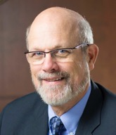
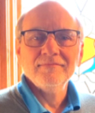
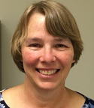
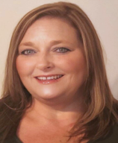
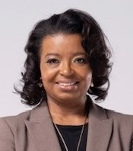
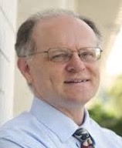
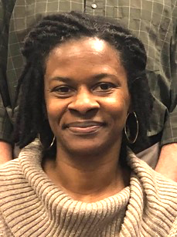
Team Perkins
Bob Witchger
Tony Reggi
Patti Coultas
Mary Olvera
Michelle Lair
Chris Droessler
Darice McDougald
Notes:
Dr. Bob Witchger
919-807-7126
WitchgerB@nccommunitycolleges.edu
Dr. Tony R. Reggi
919-807-7131
ReggiA@nccommunitycolleges.edu
Patti Coultas
919-807-7130
CoultasP@nccommunitycolleges.edu
Dr. Mary Olvera
919-807-7120
OlveraM@nccommunitycolleges.edu
Michelle Lair
919-807-72227
LairM@nccommunitycolleges.edu
Chris Droessler
919-807-7068
DroesslerC@nccommunitycolleges.edu
Darice McDougald
919-807-7219
McDougaldD@nccommunitycolleges.edu

Slide 3
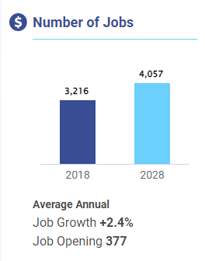
Veterinary Technologists and Technicians
Veterinary Medical Technology (A45780) = 313
Notes:
Source
https://nccareers.org/occupation-profile/292056/1284
https://www.nccommunitycolleges.edu/analytics/dashboards

Slide 4
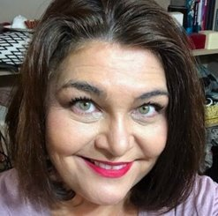
Dr. Lori Byrd
Associate Director, Academic Programs – Health Sciences
Notes:
Dr. Lori Byrd
Associate Director, Academic Programs - Health Sciences
byrdl@nccommunitycolleges.edu
919-807-7118

Slide 5
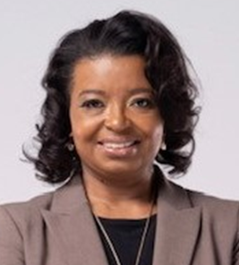
Michelle Lair
Director, Academic Programs
Interim CCP CTE Coordinator
Notes:
Michelle Lair, Director Academic Programs
919-807-7227
lairm@nccommunitycolleges.edu

Slide 6
Program Description
This curriculum is designed to prepare individuals to assist veterinarians in preparing animals, equipment, and medications for examination and surgery; collecting specimens; performing laboratory, radiographic, anesthetic, dental procedures; assisting in surgery; and providing proper husbandry of animals and their environment.
Course work includes instruction in veterinary anatomy, nutrition, parasitology, pathology, physiology, radiology, terminology, zoology, office practices, laboratory techniques, dentistry, and small and large animal clinical practices.
Graduates of accredited programs may be eligible to take state and national examinations administered by the North Carolina Veterinary Medical Board. Graduates may be employed in veterinary clinics; diagnostic, research, or pharmaceutical laboratories; zoos; academic institutions; or other areas associated with animal care.
Notes:
Associate Degree Program at NC Community Colleges
https://www.nccommunitycolleges.edu/academic-programs/nc-community-college-system-catalog

Slide 7
Veterinary Medical Technology (A45780)
Asheville-Buncombe Technical Community College
Cape Fear Community College
Central Carolina Community College
Gaston College
Nash Community College

Slide 8
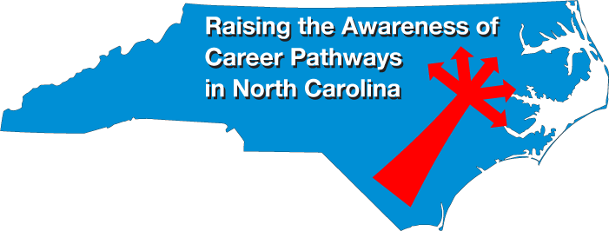
Notes:
www.ncperkins.org/presentations

Slide 9
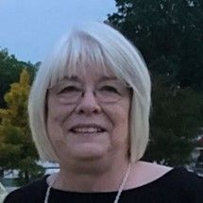
Nash Community College
Gail Harrell
Registered Veterinary Technician
Director/Instructor of Veterinary Medical Technology
Notes:
Gail Harrell
Nash Community College
tgharrell204@nashcc.edu
252-451-8211

Slide 10
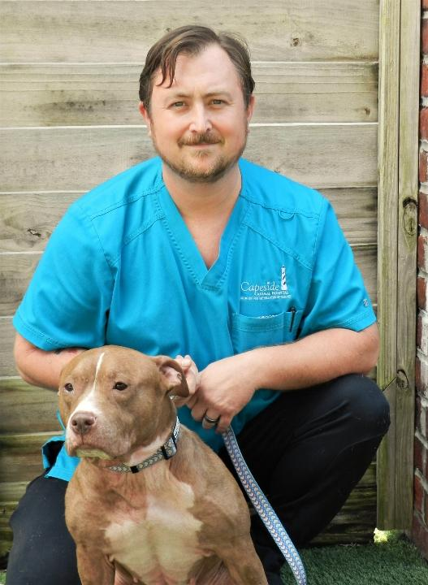
Cape Fear Community College 2019 VMT Graduate
Nathan Moyer
Registered Veterinary Technician
Capeside Animal Hospital
Notes:
Nathan Moyer
https://capesideanimalhospital.com/

Slide 11
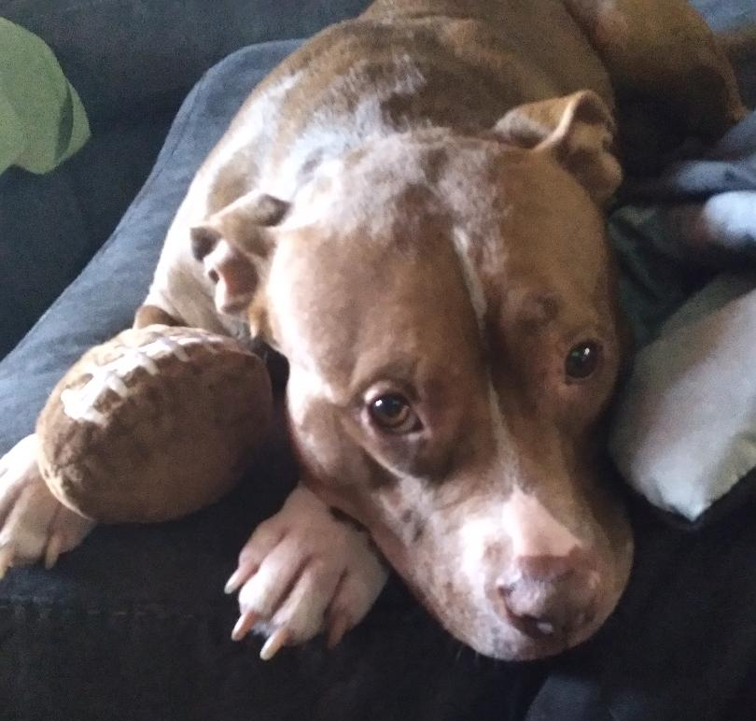
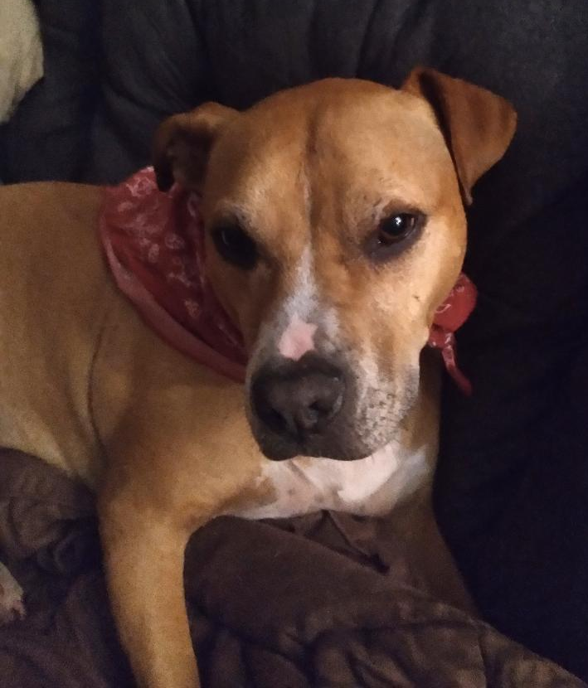
Nathan Moyer’s dogs
Betty
Betty
Johnny
Emmie & Ollie

Slide 12
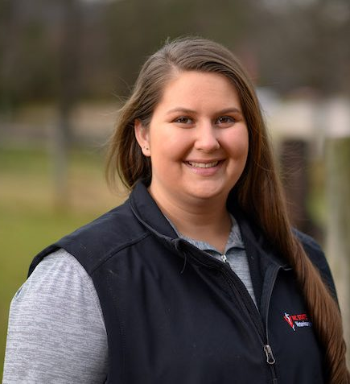
Cape Fear Community College 2019 VMT Graduate
Alyson Camire
NCSU College of Veterinary Medicine
Equine and Farm Animal Veterinary Center
Veterinary Technician
Notes:
Alyson Camire
ancamire@ncsu.edu

Slide 13
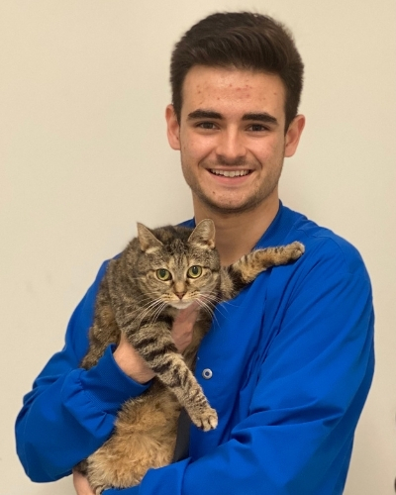
Nash Community College VMT Graduate
Devin Powell
Registered Veterinary Technician
Brentwood Veterinary Center
Notes:
Brentwood Vet Center
https://brentwoodvetcenter.com/

Slide 14
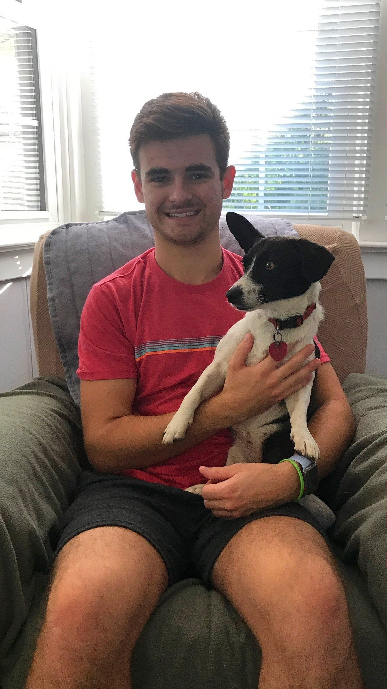
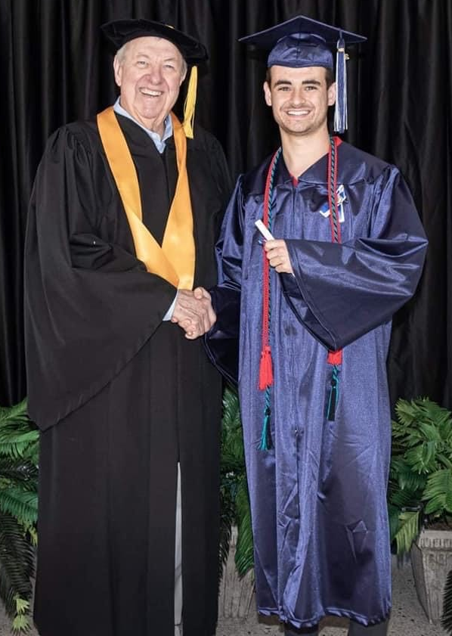
Devin Powell

Slide 15
Raising the Awareness of Career Pathways in North Carolina
Next meeting is March 23, 2022 – NOTE DATE CHANGE!
Careers in Air Conditioning, Heating, and Refrigeration Technicians
Download the PowerPoint and access the recording: www.ncperkins.org/presentations
Notes:
Our next meeting like this one will be on March 23rd. Note that this meeting is a week later in the month than normal.
You can go to the NCPerkins Presentations website to register for that meeting.
We'll also send you a reminder, since you are now on our mailing list.
So go ahead and sign up for all the meetings, and you'll be reminded the day before.
If you liked something you saw here, send folks to the recording. Find it at that same web page.

