Slide 1

Perkins Mid-Year Reviews
January 2022

Slide 2
Perkins Mid-Year Reviews
January 12, 2022
Brunswick CC
College of The Albemarle
Halifax CC
James Sprunt CC
Martin CC & Roanoke-Chowan CC
Mayland CC
McDowell TCC
Montgomery CC
Piedmont CC
Tri-County CC

Slide 3
Brunswick Community College
Introductions
Performance indicators – performance vs negotiated
College presentation
  Have CLNA findings improved CTE?
  Share a Promising Practice
  How is college coping under COVID-19?
  Budget and spending plan
Comments and questions
Notes:
Brunswick CC

Slide 4
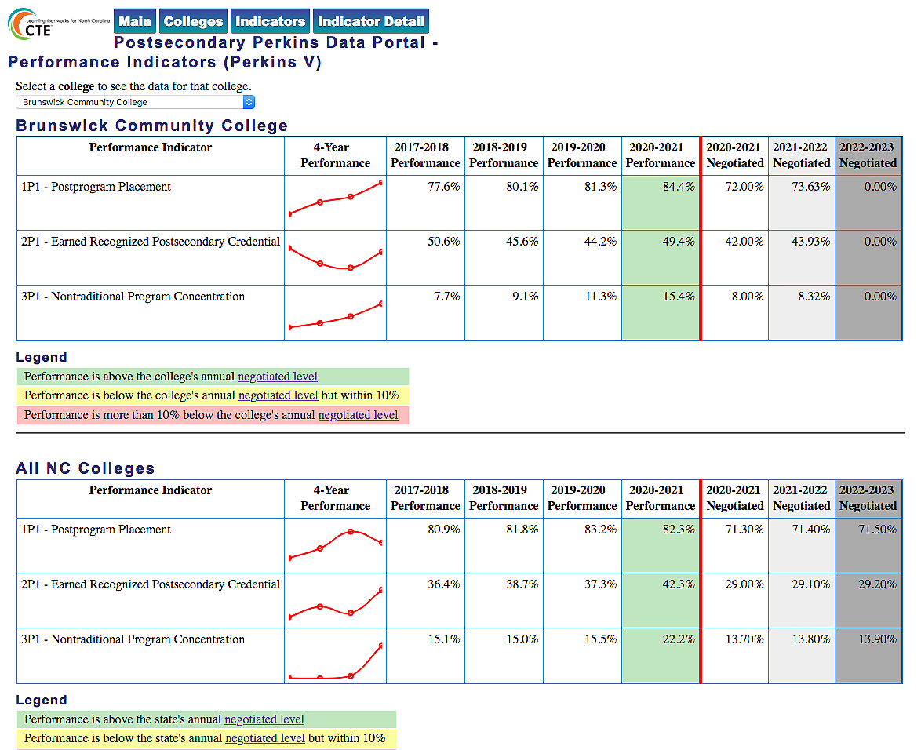
Notes:
Brunswick CC
https://www.ncperkins.org/data/indicatorV.php

Slide 5
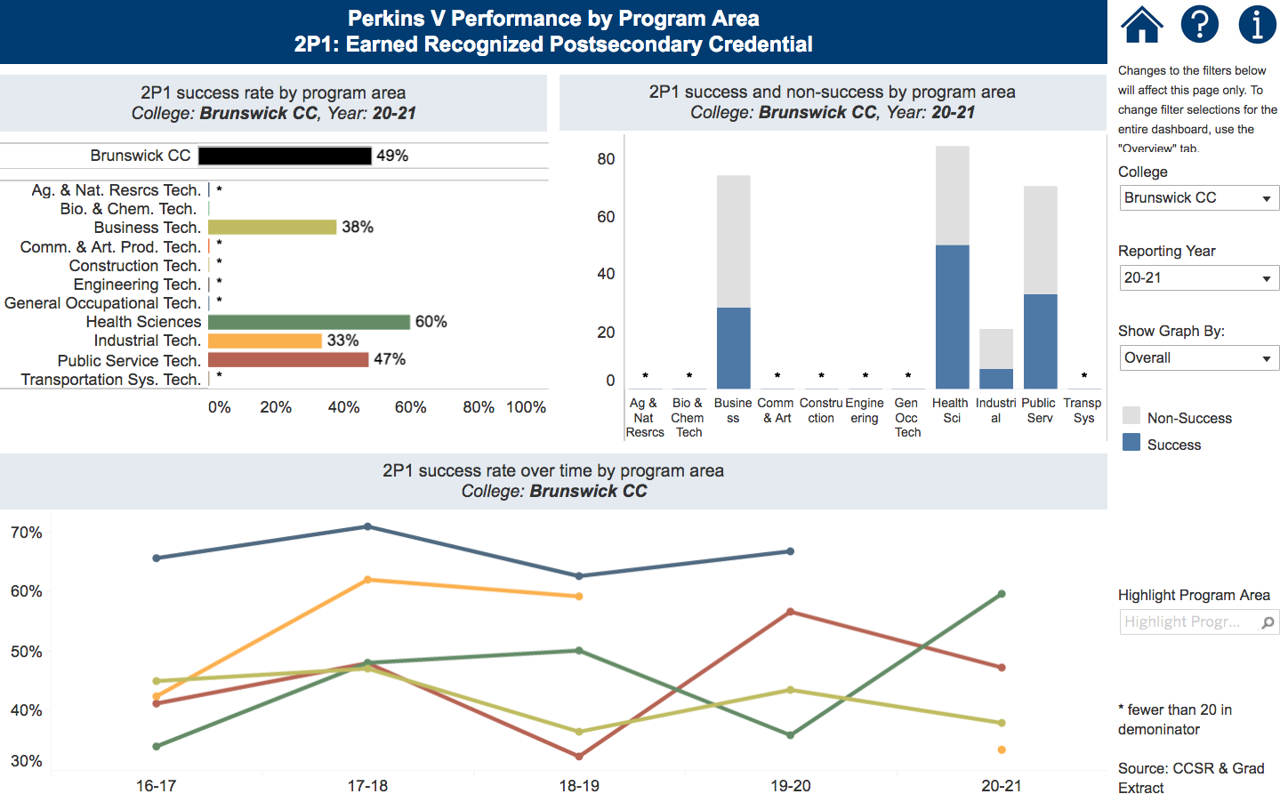
Notes:
Brunswick CC
https://www.nccommunitycolleges.edu/analytics/dashboards/cte-perkins-v-performance-indicator-2p1-earned-recognized-postsecondary

Slide 6
College of the Albemarle
Introductions
Performance indicators – performance vs negotiated
College presentation
  Have CLNA findings improved CTE?
  Share a Promising Practice
  How is college coping under COVID-19?
  Budget and spending plan
Comments and questions
Notes:
College of the Albemarle

Slide 7

Notes:
College of the Albemarle
https://www.ncperkins.org/data/indicatorV.php

Slide 8
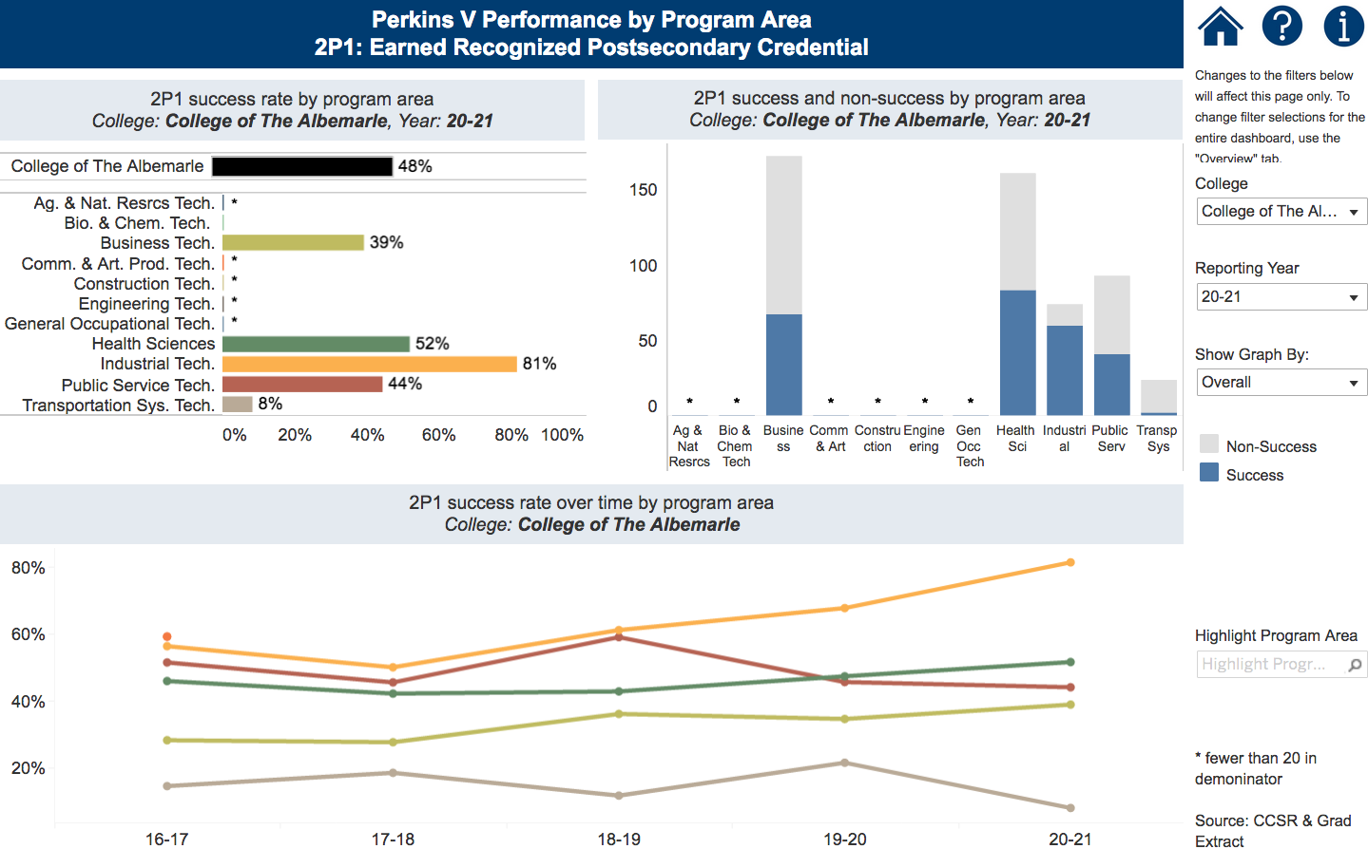
Notes:
College of the Albemarle
https://www.nccommunitycolleges.edu/analytics/dashboards/cte-perkins-v-performance-indicator-2p1-earned-recognized-postsecondary

Slide 9
Halifax Community College
Introductions
Performance indicators – performance vs negotiated
College presentation
  Have CLNA findings improved CTE?
  Share a Promising Practice
  How is college coping under COVID-19?
  Budget and spending plan
Comments and questions
Notes:
Halifax CC

Slide 10
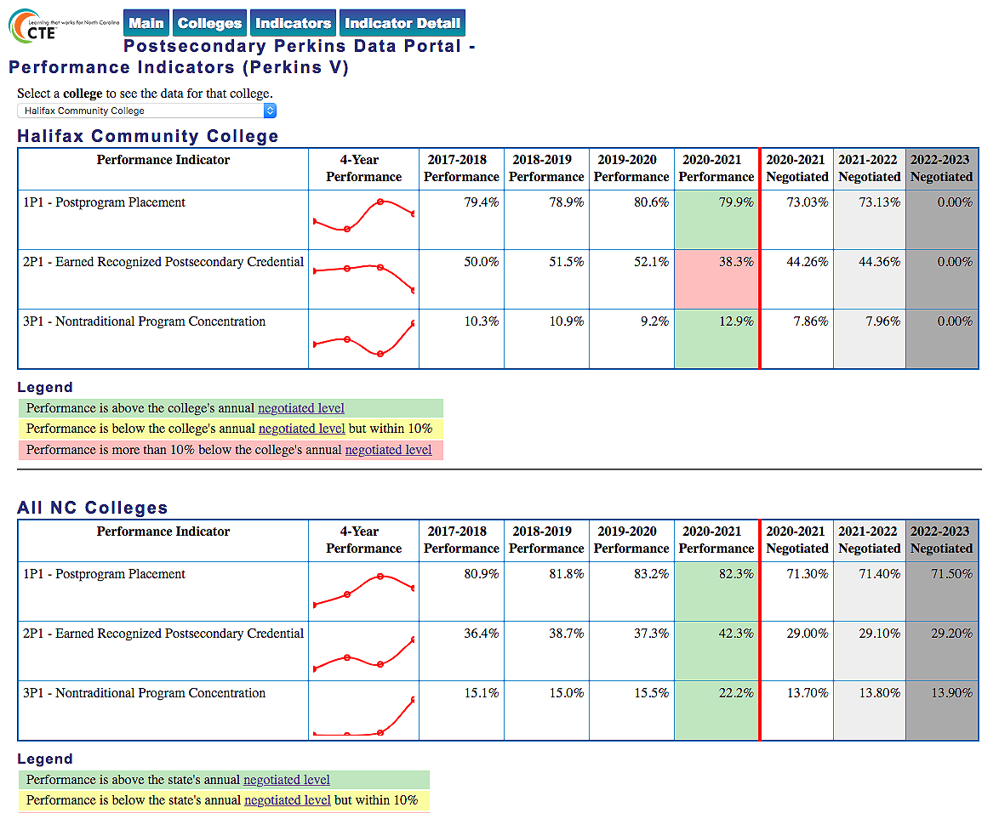
Notes:
Halifax CC
https://www.ncperkins.org/data/indicatorV.php

Slide 11
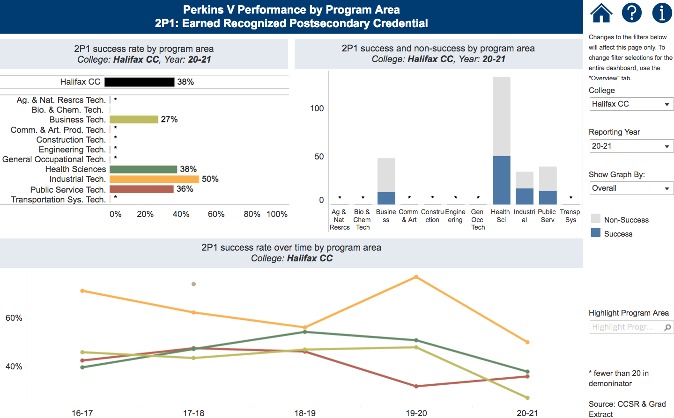
Notes:
Halifax CC
https://www.nccommunitycolleges.edu/analytics/dashboards/cte-perkins-v-performance-indicator-2p1-earned-recognized-postsecondary

Slide 12
James Sprunt Community College
Introductions
Performance indicators – performance vs negotiated
College presentation
  Have CLNA findings improved CTE?
  Share a Promising Practice
  How is college coping under COVID-19?
  Budget and spending plan
Comments and questions
Notes:
James Sprunt CC

Slide 13
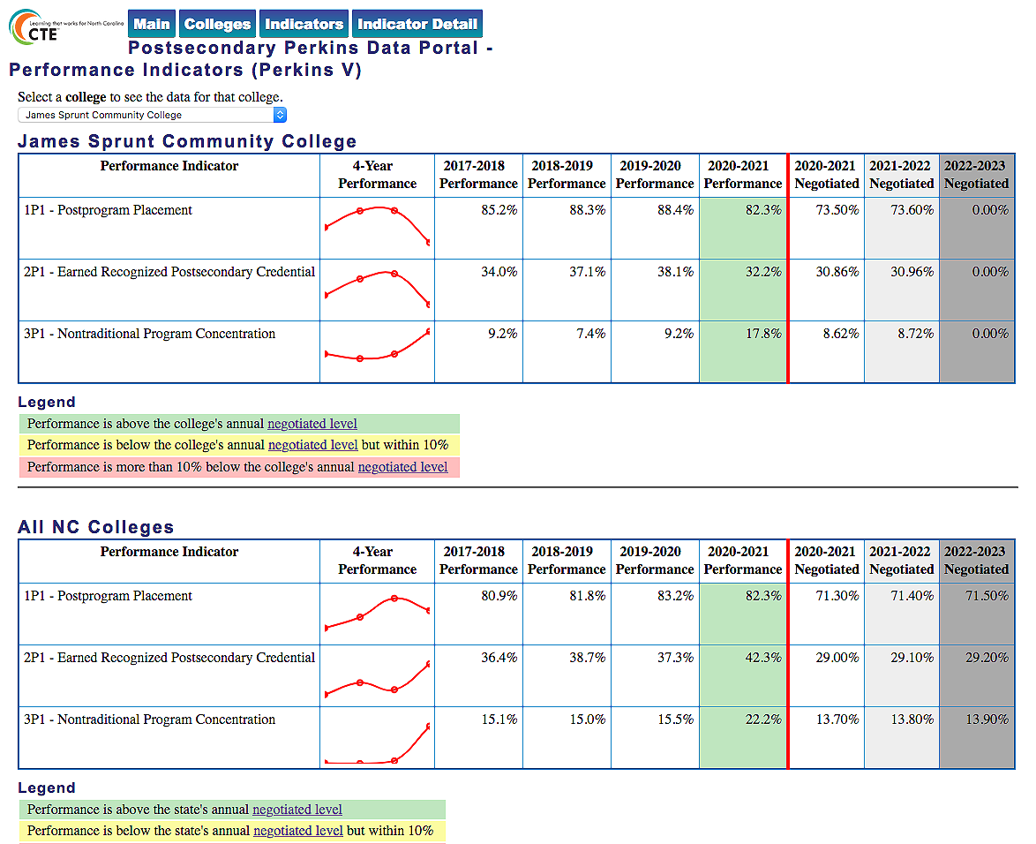
Notes:
James Sprunt CC
https://www.ncperkins.org/data/indicatorV.php

Slide 14
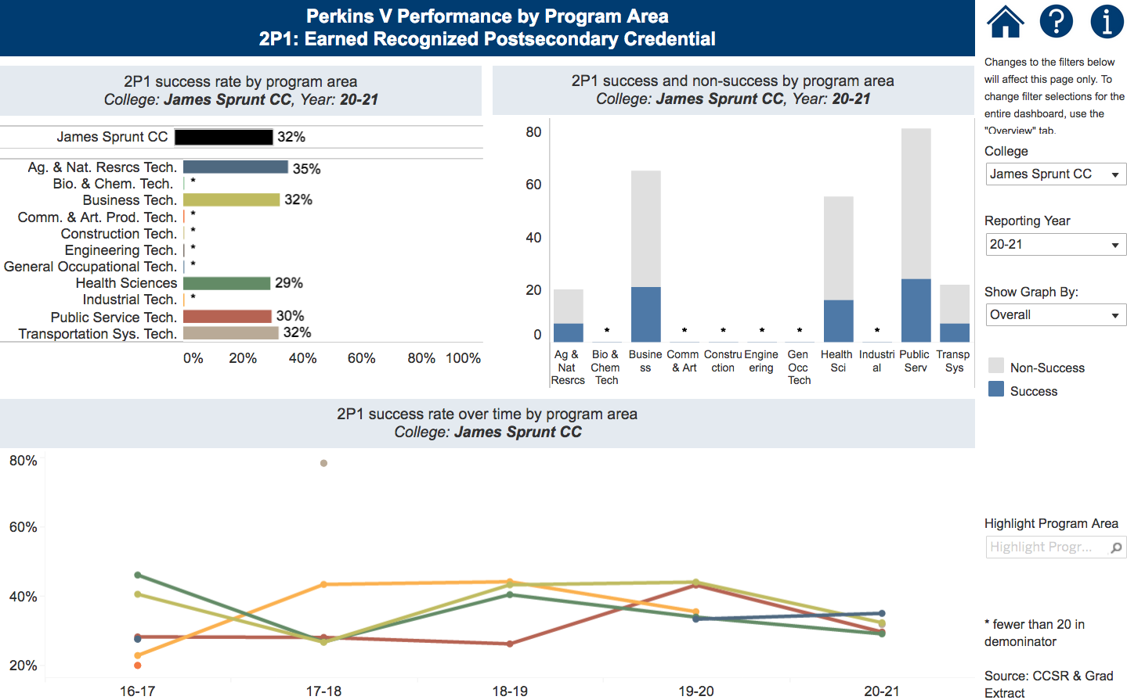
Notes:
James Sprunt CC
https://www.nccommunitycolleges.edu/analytics/dashboards/cte-perkins-v-performance-indicator-2p1-earned-recognized-postsecondary

Slide 15
Martin Community College
Introductions
Performance indicators – performance vs negotiated
College presentation
  Have CLNA findings improved CTE?
  Share a Promising Practice
  How is college coping under COVID-19?
  Budget and spending plan
Comments and questions
Notes:
Martin CC

Slide 16

Notes:
Martin CC
https://www.ncperkins.org/data/indicatorV.php

Slide 17
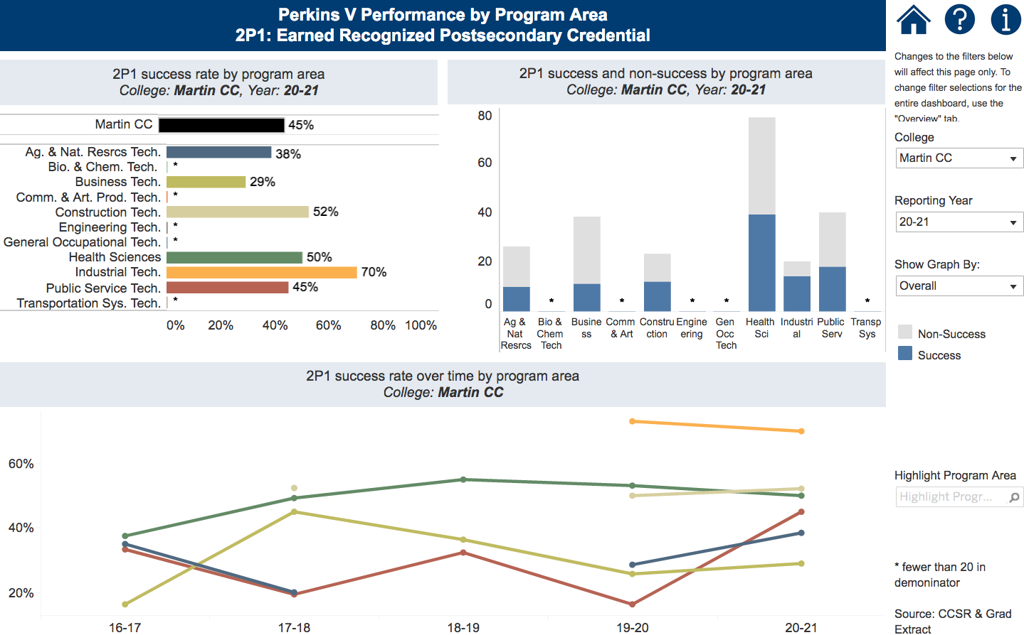
Notes:
Martin CC
https://www.nccommunitycolleges.edu/analytics/dashboards/cte-perkins-v-performance-indicator-2p1-earned-recognized-postsecondary

Slide 18
Roanoke-Chowan Community College
Introductions
Performance indicators – performance vs negotiated
College presentation
  Have CLNA findings improved CTE?
  Share a Promising Practice
  How is college coping under COVID-19?
  Budget and spending plan
Comments and questions
Notes:
Roanoke-Chowan CC

Slide 19

Notes:
Roanoke-Chowan CC
https://www.ncperkins.org/data/indicatorV.php

Slide 20
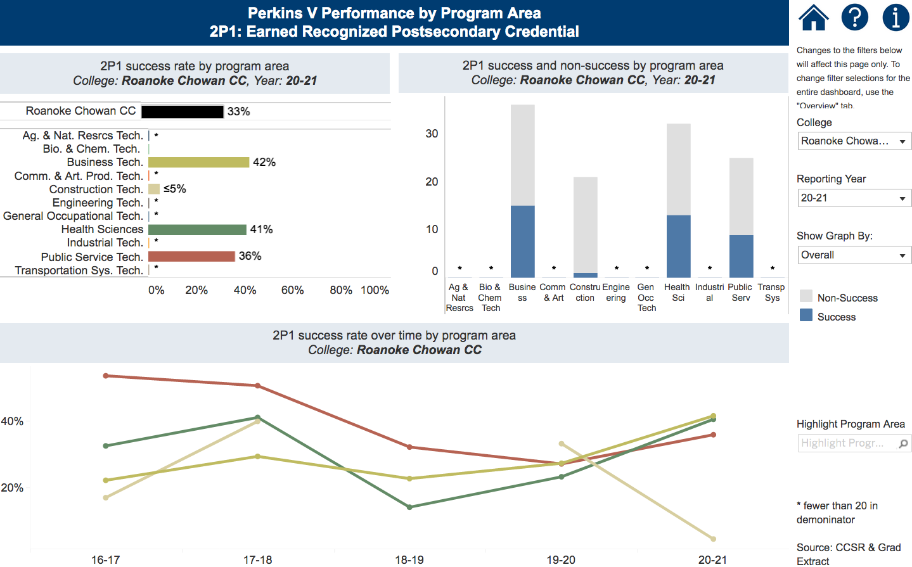
Notes:
Roanoke-Chowan CC
https://www.nccommunitycolleges.edu/analytics/dashboards/cte-perkins-v-performance-indicator-2p1-earned-recognized-postsecondary

Slide 21
Mayland Community College
Introductions
Performance indicators – performance vs negotiated
College presentation
  Have CLNA findings improved CTE?
  Share a Promising Practice
  How is college coping under COVID-19?
  Budget and spending plan
Comments and questions
Notes:
Mayland CC

Slide 22

Notes:
Mayland CC
https://www.ncperkins.org/data/indicatorV.php

Slide 23
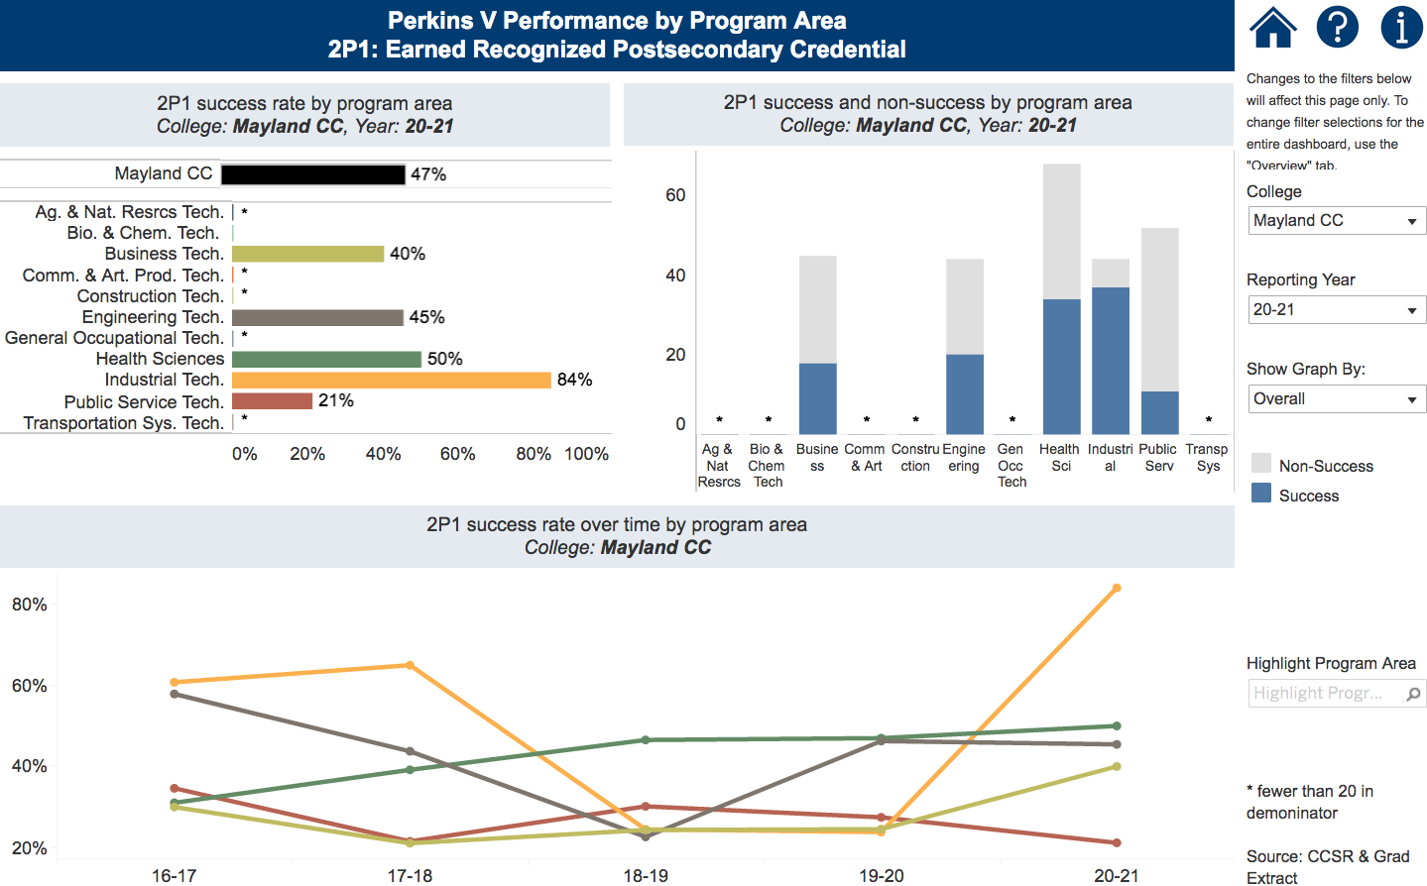
Notes:
Mayland CC
https://www.nccommunitycolleges.edu/analytics/dashboards/cte-perkins-v-performance-indicator-2p1-earned-recognized-postsecondary

Slide 24
McDowell Technical Community College
Introductions
Performance indicators – performance vs negotiated
College presentation
  Have CLNA findings improved CTE?
  Share a Promising Practice
  How is college coping under COVID-19?
  Budget and spending plan
Comments and questions
Notes:
McDowell TCC

Slide 25

Notes:
McDowell TCC
https://www.ncperkins.org/data/indicatorV.php

Slide 26
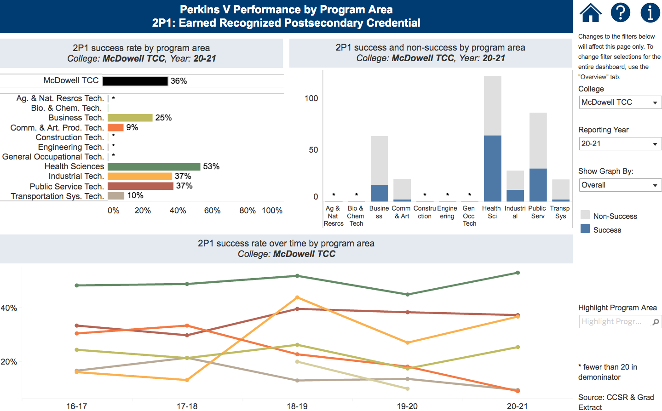
Notes:
McDowell TCC
https://www.nccommunitycolleges.edu/analytics/dashboards/cte-perkins-v-performance-indicator-2p1-earned-recognized-postsecondary

Slide 27
Montgomery Community College
Introductions
Performance indicators – performance vs negotiated
College presentation
  Have CLNA findings improved CTE?
  Share a Promising Practice
  How is college coping under COVID-19?
  Budget and spending plan
Comments and questions
Notes:
Montgomery CC

Slide 28

Notes:
Montgomery CC
https://www.ncperkins.org/data/indicatorV.php

Slide 29
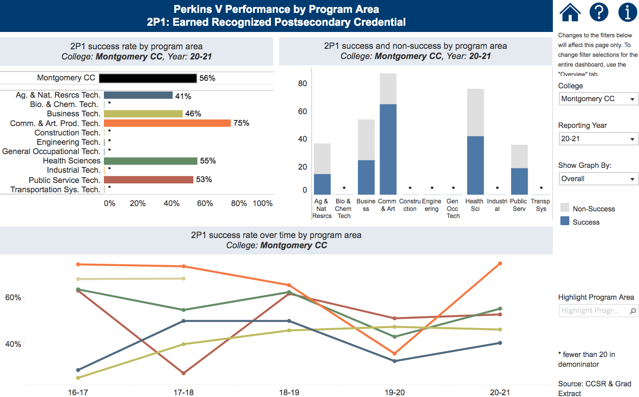
Notes:
Montgomery CC
https://www.nccommunitycolleges.edu/analytics/dashboards/cte-perkins-v-performance-indicator-2p1-earned-recognized-postsecondary

Slide 30
Piedmont Community College
Introductions
Performance indicators – performance vs negotiated
College presentation
  Have CLNA findings improved CTE?
  Share a Promising Practice
  How is college coping under COVID-19?
  Budget and spending plan
Comments and questions
Notes:
Piedmont CC

Slide 31

Notes:
Piedmont CC
https://www.ncperkins.org/data/indicatorV.php

Slide 32
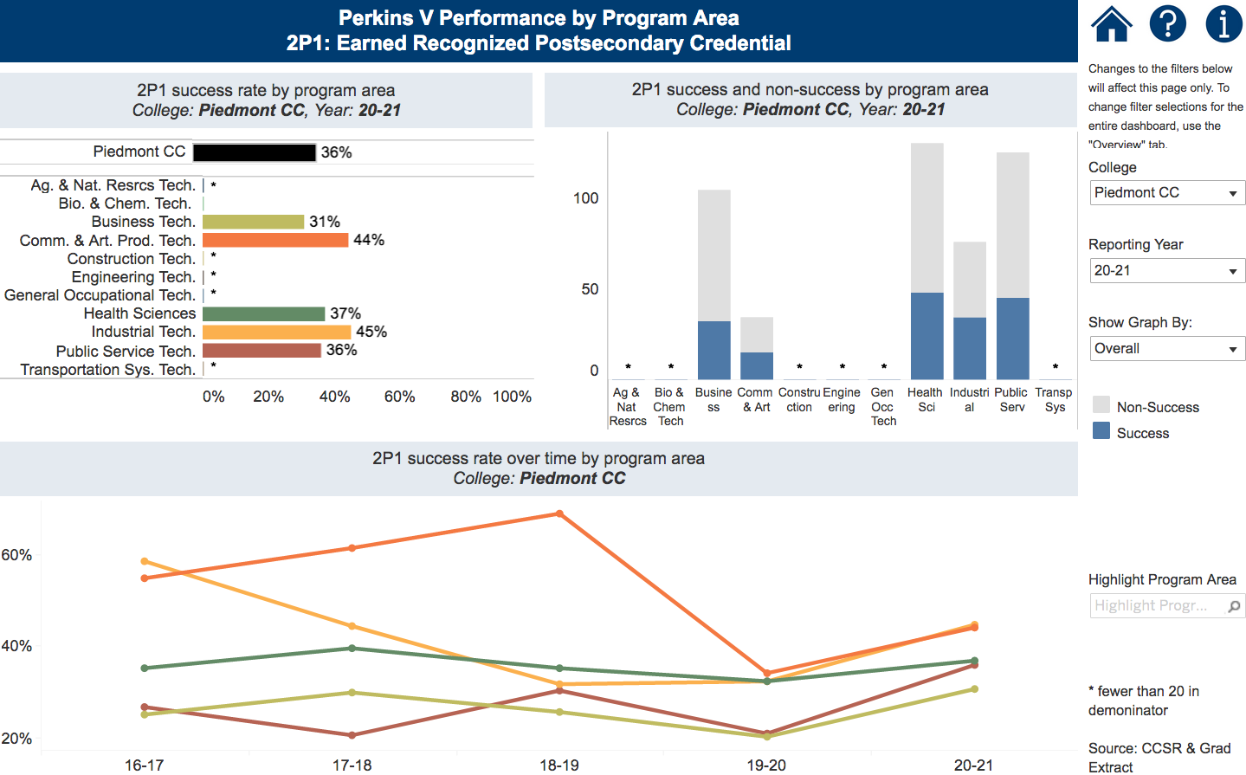
Notes:
Piedmont CC
https://www.nccommunitycolleges.edu/analytics/dashboards/cte-perkins-v-performance-indicator-2p1-earned-recognized-postsecondary

Slide 33
Tri-County Community College
Introductions
Performance indicators – performance vs negotiated
College presentation
  Have CLNA findings improved CTE?
  Share a Promising Practice
  How is college coping under COVID-19?
  Budget and spending plan
Comments and questions
Notes:
Tri-County CC

Slide 34

Notes:
Tri-County CC
https://www.ncperkins.org/data/indicatorV.php

Slide 35
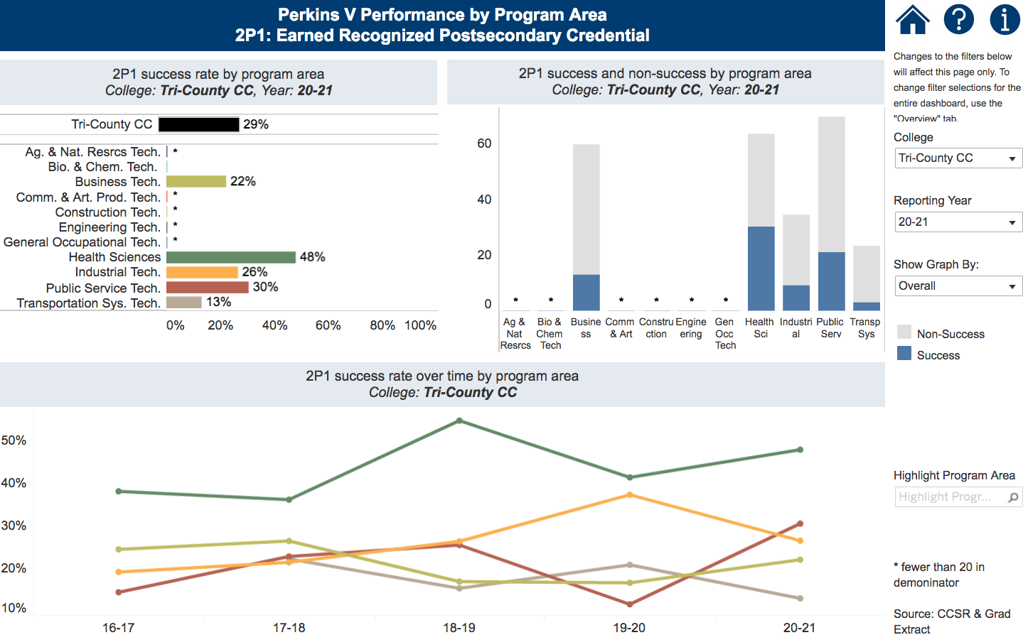
Notes:
Tri-County CC
https://www.nccommunitycolleges.edu/analytics/dashboards/cte-perkins-v-performance-indicator-2p1-earned-recognized-postsecondary

Slide 36
Perkins Mid-Year Reviews
January 13, 2022
Beaufort County CC
Bladen CC
Blue Ridge CC
Carteret CC & Pamlico CC
Mitchell CC
Rockingham CC
Sampson CC
South Piedmont CC
Wilson CC

Slide 37
Beaufort County Community College
Introductions
Performance indicators – performance vs negotiated
College presentation
  Have CLNA findings improved CTE?
  Share a Promising Practice
  How is college coping under COVID-19?
  Budget and spending plan
Comments and questions
Notes:
Beaufort County CC

Slide 38
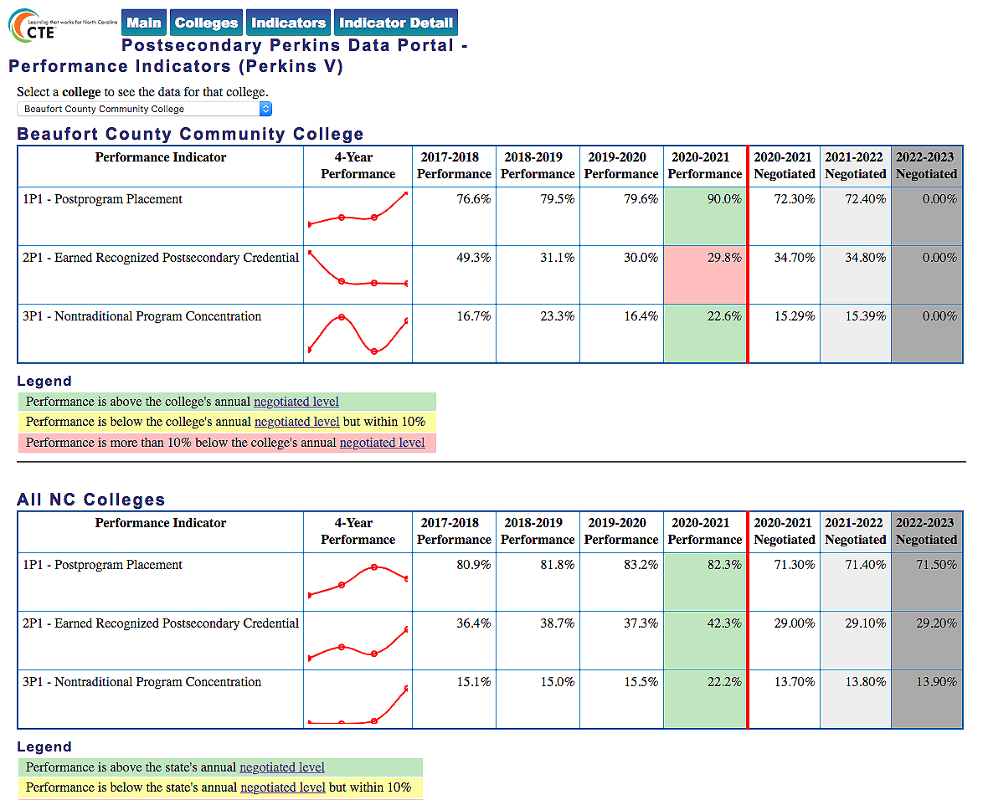
Notes:
Beaufort County CC
https://www.ncperkins.org/data/indicatorV.php

Slide 39
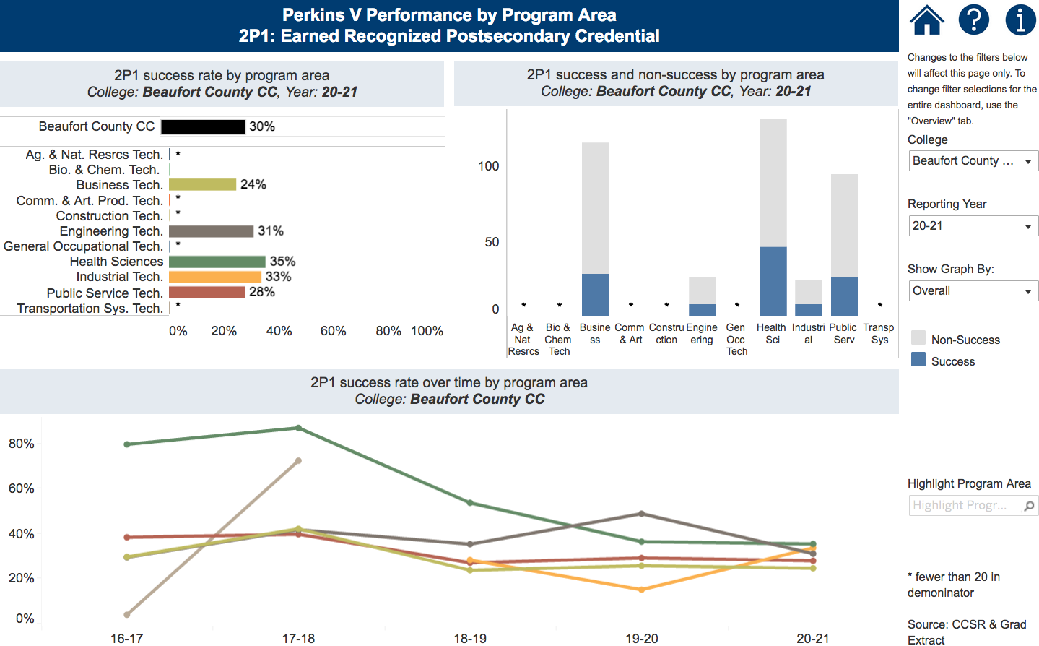
Notes:
Beaufort County CC
https://www.nccommunitycolleges.edu/analytics/dashboards/cte-perkins-v-performance-indicator-2p1-earned-recognized-postsecondary

Slide 40
Bladen Community College
Introductions
Performance indicators – performance vs negotiated
College presentation
  Have CLNA findings improved CTE?
  Share a Promising Practice
  How is college coping under COVID-19?
  Budget and spending plan
Comments and questions
Notes:
Bladen CC

Slide 41
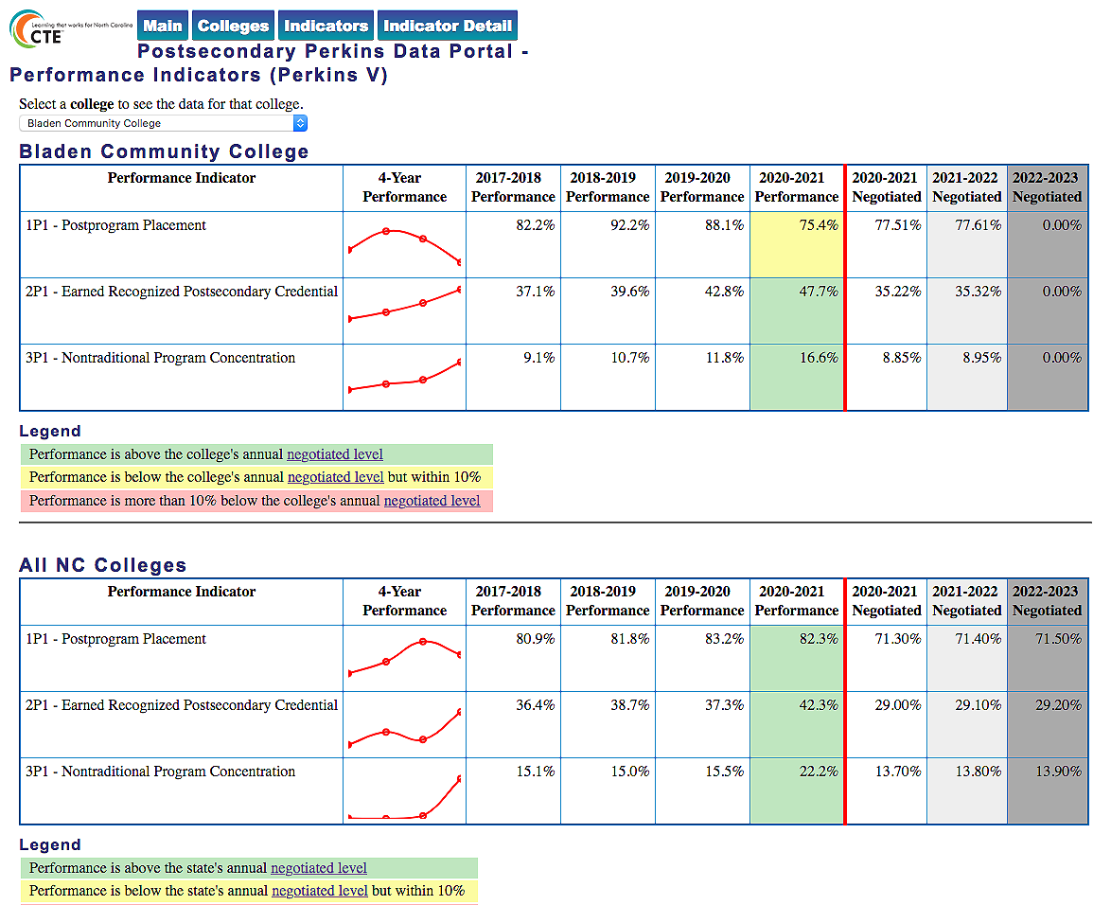
Notes:
Bladen CC
https://www.ncperkins.org/data/indicatorV.php

Slide 42
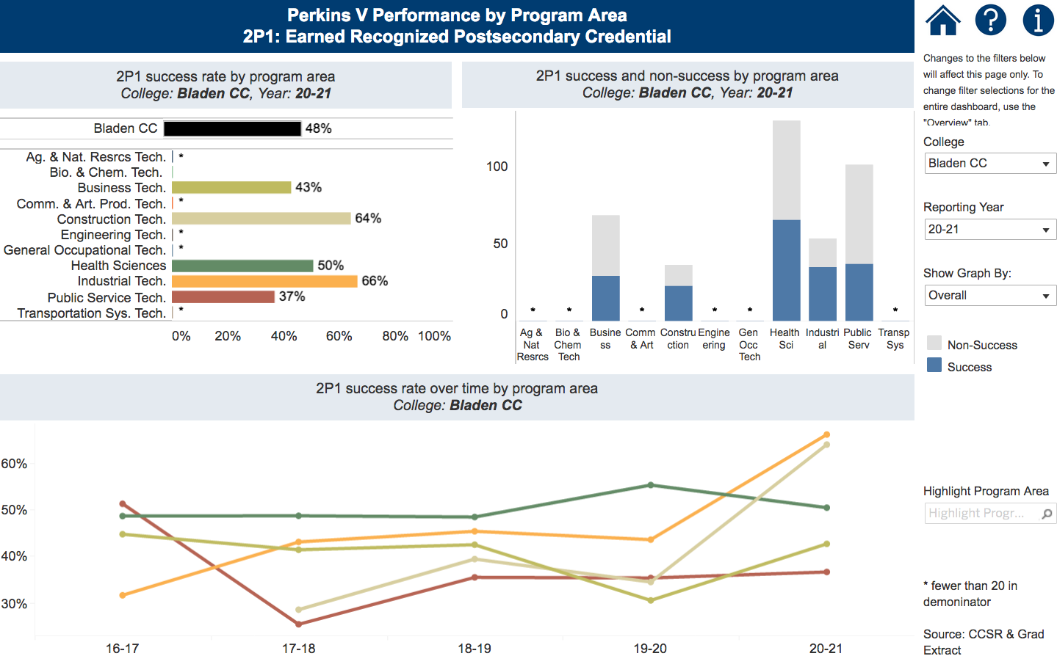
Notes:
Bladen CC
https://www.nccommunitycolleges.edu/analytics/dashboards/cte-perkins-v-performance-indicator-2p1-earned-recognized-postsecondary

Slide 43
Blue Ridge Community College
Introductions
Performance indicators – performance vs negotiated
College presentation
  Have CLNA findings improved CTE?
  Share a Promising Practice
  How is college coping under COVID-19?
  Budget and spending plan
Comments and questions
Notes:
Blue Ridge CC

Slide 44

Notes:
Blue Ridge CC
https://www.ncperkins.org/data/indicatorV.php

Slide 45
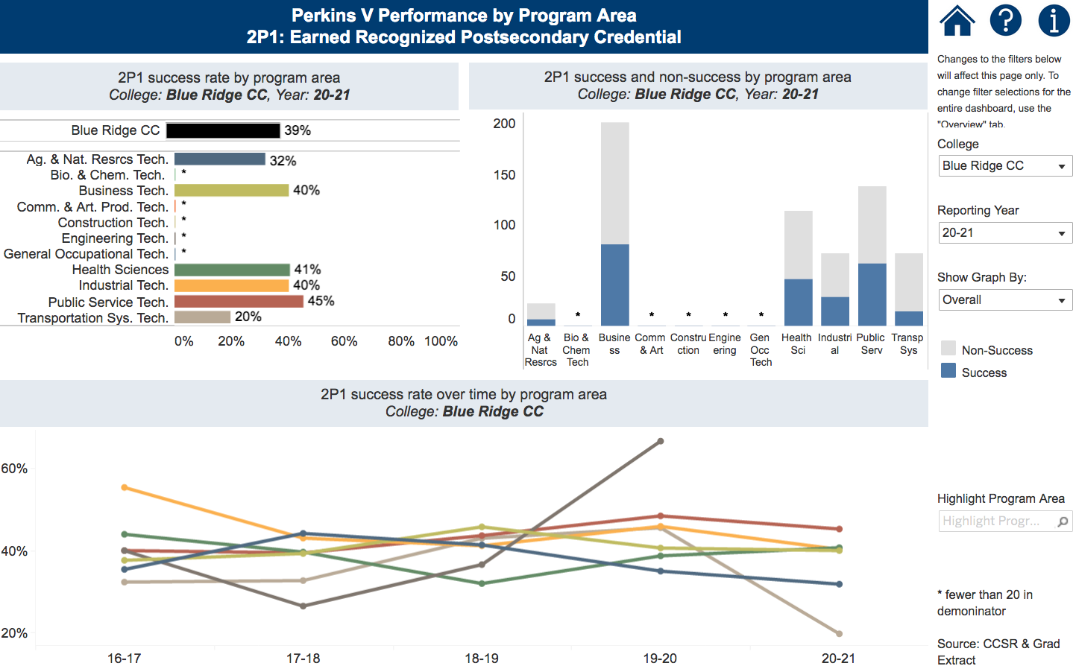
Notes:
Blue Ridge CC
https://www.nccommunitycolleges.edu/analytics/dashboards/cte-perkins-v-performance-indicator-2p1-earned-recognized-postsecondary

Slide 46
Carteret Community College
Introductions
Performance indicators – performance vs negotiated
College presentation
  Have CLNA findings improved CTE?
  Share a Promising Practice
  How is college coping under COVID-19?
  Budget and spending plan
Comments and questions
Notes:
Carteret CC

Slide 47

Notes:
Carteret CC
https://www.ncperkins.org/data/indicatorV.php

Slide 48
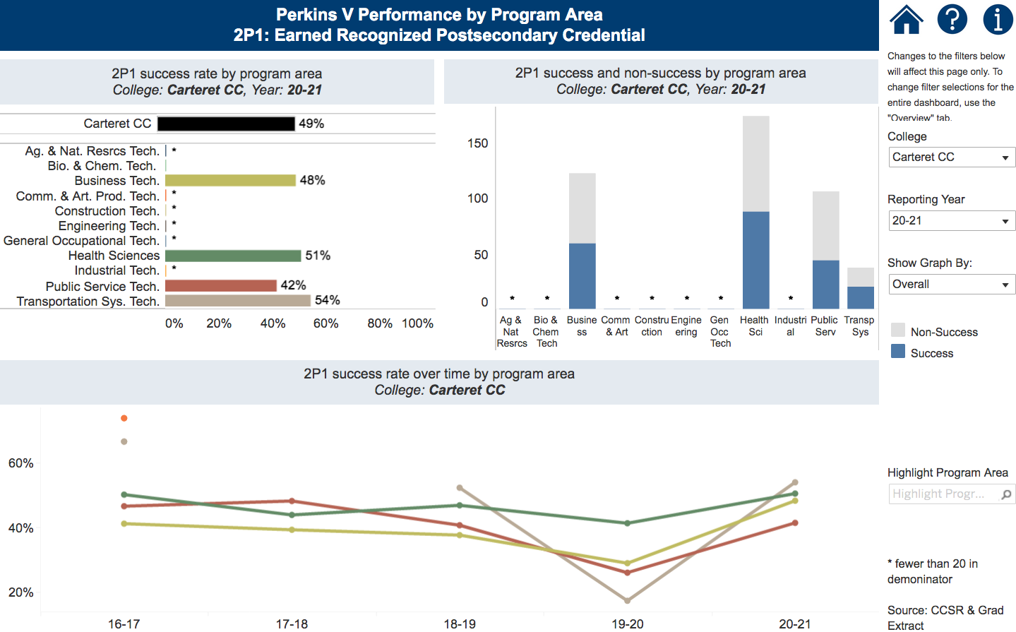
Notes:
Carteret CC
https://www.nccommunitycolleges.edu/analytics/dashboards/cte-perkins-v-performance-indicator-2p1-earned-recognized-postsecondary

Slide 49
Pamlico Community College
Introductions
Performance indicators – performance vs negotiated
College presentation
  Have CLNA findings improved CTE?
  Share a Promising Practice
  How is college coping under COVID-19?
  Budget and spending plan
Comments and questions
Notes:
Pamlico CC

Slide 50
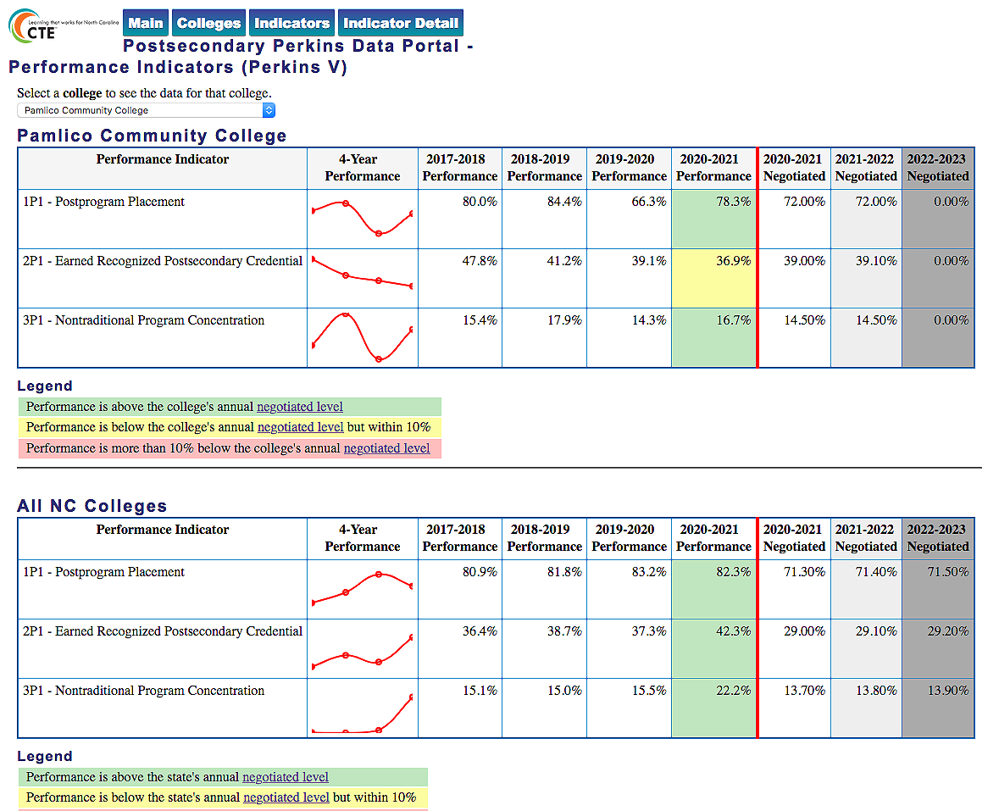
Notes:
Pamlico CC
https://www.ncperkins.org/data/indicatorV.php

Slide 51
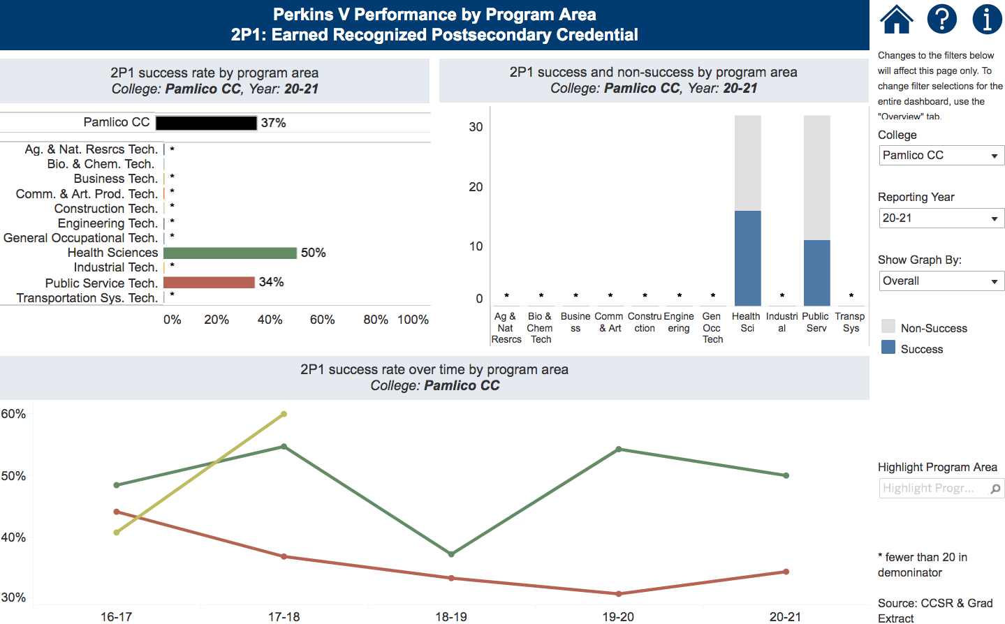
Notes:
Pamlico CC
https://www.nccommunitycolleges.edu/analytics/dashboards/cte-perkins-v-performance-indicator-2p1-earned-recognized-postsecondary

Slide 52
Mitchell Community College
Introductions
Performance indicators – performance vs negotiated
College presentation
  Have CLNA findings improved CTE?
  Share a Promising Practice
  How is college coping under COVID-19?
  Budget and spending plan
Comments and questions
Notes:
Mitchell CC

Slide 53

Notes:
Mitchell CC
https://www.ncperkins.org/data/indicatorV.php

Slide 54
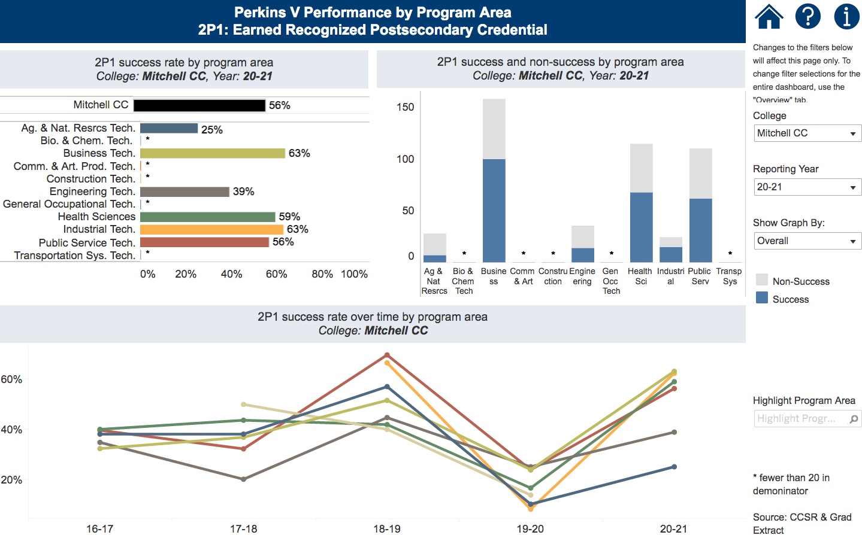
Notes:
Mitchell CC
https://www.nccommunitycolleges.edu/analytics/dashboards/cte-perkins-v-performance-indicator-2p1-earned-recognized-postsecondary

Slide 55
Rockingham Community College
Introductions
Performance indicators – performance vs negotiated
College presentation
  Have CLNA findings improved CTE?
  Share a Promising Practice
  How is college coping under COVID-19?
  Budget and spending plan
Comments and questions
Notes:
Rockingham CC

Slide 56

Notes:
Rockingham CC
https://www.ncperkins.org/data/indicatorV.php

Slide 57

Notes:
Rockingham CC
https://www.nccommunitycolleges.edu/analytics/dashboards/cte-perkins-v-performance-indicator-2p1-earned-recognized-postsecondary

Slide 58
Sampson Community College
Introductions
Performance indicators – performance vs negotiated
College presentation
  Have CLNA findings improved CTE?
  Share a Promising Practice
  How is college coping under COVID-19?
  Budget and spending plan
Comments and questions
Notes:
Sampson CC

Slide 59

Notes:
Sampson CC
https://www.ncperkins.org/data/indicatorV.php

Slide 60
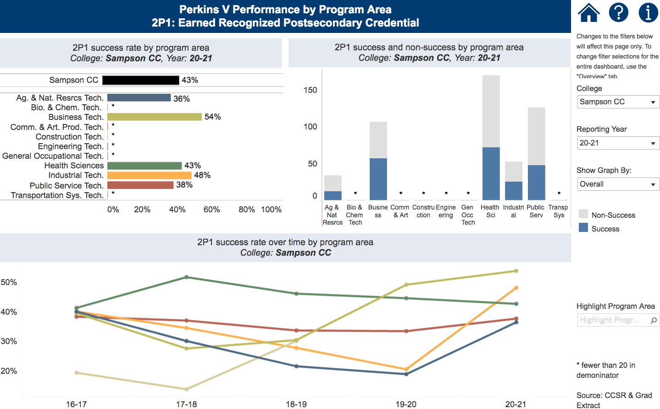
Notes:
Sampson CC
https://www.nccommunitycolleges.edu/analytics/dashboards/cte-perkins-v-performance-indicator-2p1-earned-recognized-postsecondary

Slide 61
South Piedmont Community College
Introductions
Performance indicators – performance vs negotiated
College presentation
  Have CLNA findings improved CTE?
  Share a Promising Practice
  How is college coping under COVID-19?
  Budget and spending plan
Comments and questions
Notes:
South Piedmont CC

Slide 62

Notes:
South Piedmont CC
https://www.ncperkins.org/data/indicatorV.php

Slide 63
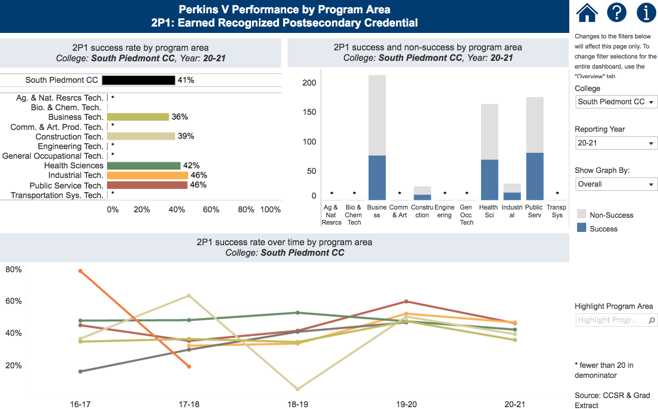
Notes:
South Piedmont CC
https://www.nccommunitycolleges.edu/analytics/dashboards/cte-perkins-v-performance-indicator-2p1-earned-recognized-postsecondary

Slide 64
Wilson Community College
Introductions
Performance indicators – performance vs negotiated
College presentation
  Have CLNA findings improved CTE?
  Share a Promising Practice
  How is college coping under COVID-19?
  Budget and spending plan
Comments and questions
Notes:
Wilson CC

Slide 65

Notes:
Wilson CC
https://www.ncperkins.org/data/indicatorV.php

Slide 66
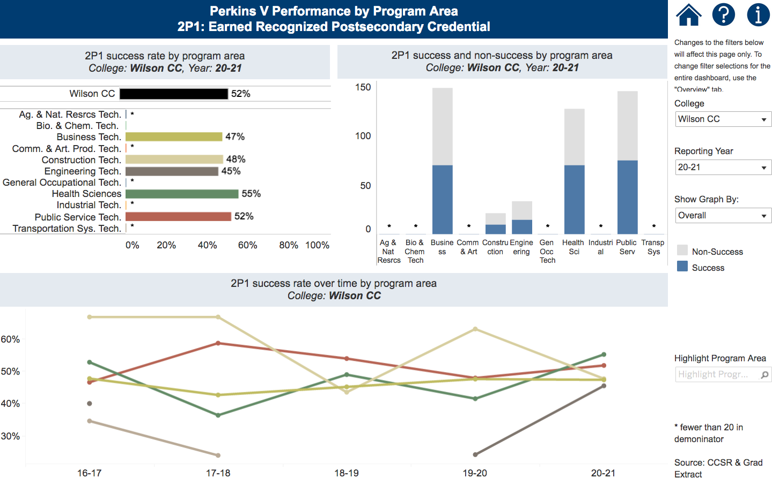
Notes:
Wilson CC
https://www.nccommunitycolleges.edu/analytics/dashboards/cte-perkins-v-performance-indicator-2p1-earned-recognized-postsecondary

Slide 67
Perkins Mid-Year Reviews
January 14, 2022
Caldwell CC and TI
Coastal Carolina CC
Craven CC
Haywood CC
Isothermal CC
Randolph CC
Southeastern CC
Southwestern CC
Western Piedmont CC
Wilkes CC

Slide 68
Caldwell Community College and Technical Institute
Introductions
Performance indicators – performance vs negotiated
College presentation
  Have CLNA findings improved CTE?
  Share a Promising Practice
  How is college coping under COVID-19?
  Budget and spending plan
Comments and questions
Notes:
Caldwell CC and TI

Slide 69
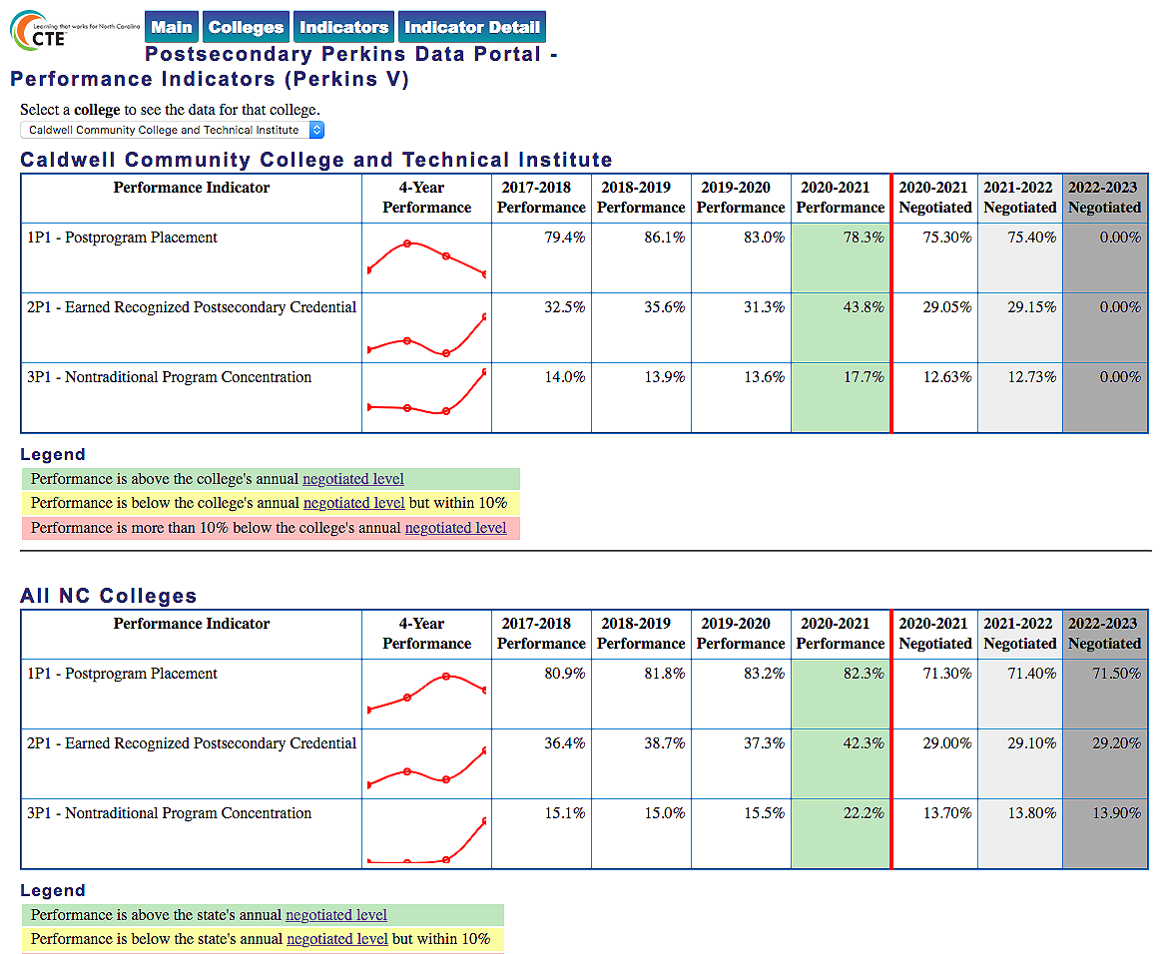
Notes:
Caldwell CC and TI
https://www.ncperkins.org/data/indicatorV.php

Slide 70

Notes:
Caldwell CC and TI
https://www.nccommunitycolleges.edu/analytics/dashboards/cte-perkins-v-performance-indicator-2p1-earned-recognized-postsecondary

Slide 71
Coastal Carolina Community College
Introductions
Performance indicators – performance vs negotiated
College presentation
  Have CLNA findings improved CTE?
  Share a Promising Practice
  How is college coping under COVID-19?
  Budget and spending plan
Comments and questions
Notes:
Coastal Carolina CC

Slide 72

Notes:
Coastal Carolina CC
https://www.ncperkins.org/data/indicatorV.php

Slide 73
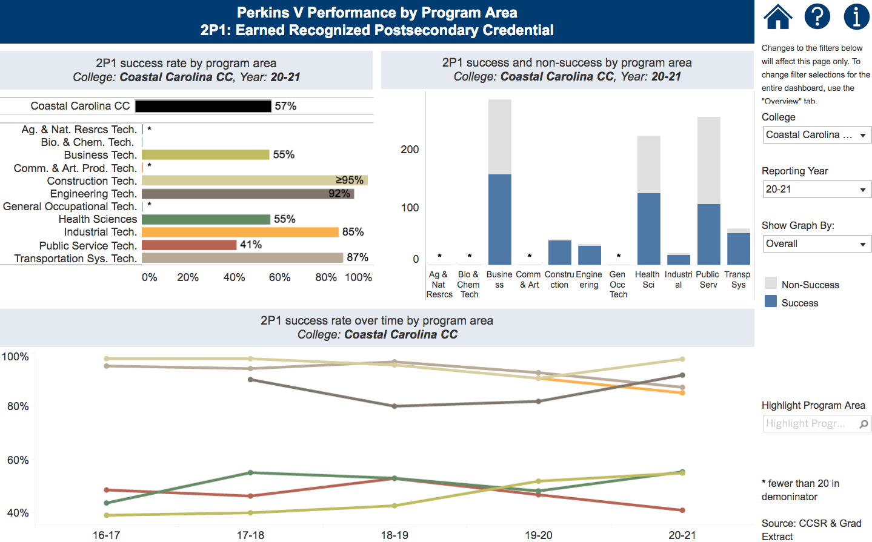
Notes:
Coastal Carolina CC
https://www.nccommunitycolleges.edu/analytics/dashboards/cte-perkins-v-performance-indicator-2p1-earned-recognized-postsecondary

Slide 74
Craven Community College
Introductions
Performance indicators – performance vs negotiated
College presentation
  Have CLNA findings improved CTE?
  Share a Promising Practice
  How is college coping under COVID-19?
  Budget and spending plan
Comments and questions
Notes:
Craven CC

Slide 75

Notes:
Craven CC
https://www.ncperkins.org/data/indicatorV.php

Slide 76
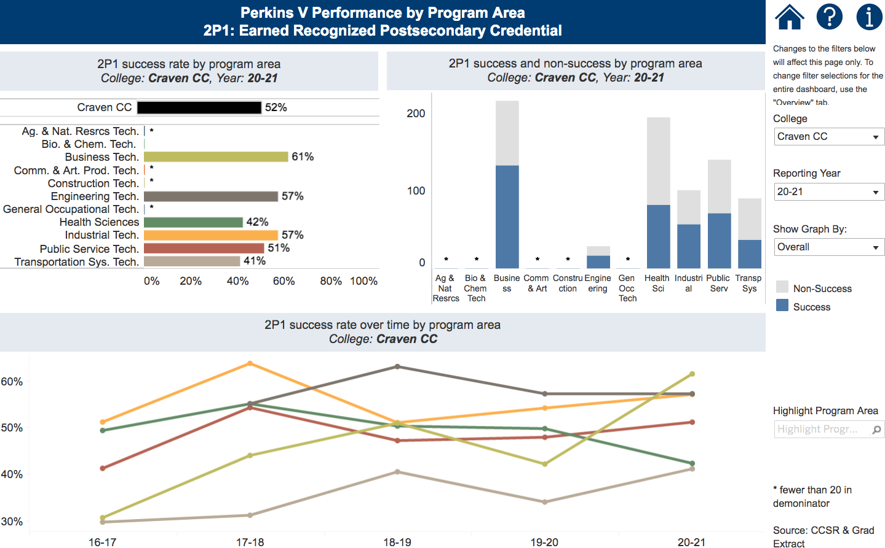
Notes:
Craven CC
https://www.nccommunitycolleges.edu/analytics/dashboards/cte-perkins-v-performance-indicator-2p1-earned-recognized-postsecondary

Slide 77
Haywood Community College
Introductions
Performance indicators – performance vs negotiated
College presentation
  Have CLNA findings improved CTE?
  Share a Promising Practice
  How is college coping under COVID-19?
  Budget and spending plan
Comments and questions
Notes:
Haywood CC

Slide 78

Notes:
Haywood CC
https://www.ncperkins.org/data/indicatorV.php

Slide 79
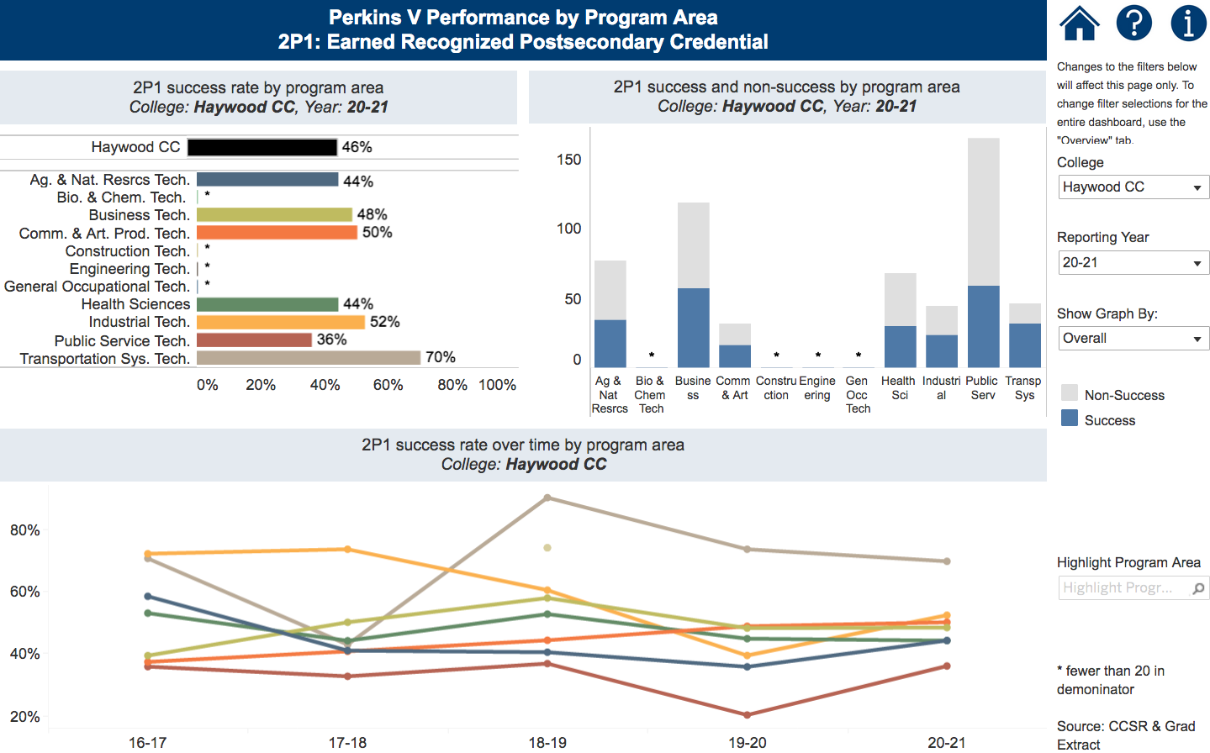
Notes:
Haywood CC
https://www.nccommunitycolleges.edu/analytics/dashboards/cte-perkins-v-performance-indicator-2p1-earned-recognized-postsecondary

Slide 80
Isothermal Community College
Introductions
Performance indicators – performance vs negotiated
College presentation
  Have CLNA findings improved CTE?
  Share a Promising Practice
  How is college coping under COVID-19?
  Budget and spending plan
Comments and questions
Notes:
Isothermal CC

Slide 81

Notes:
Isothermal CC
https://www.ncperkins.org/data/indicatorV.php

Slide 82
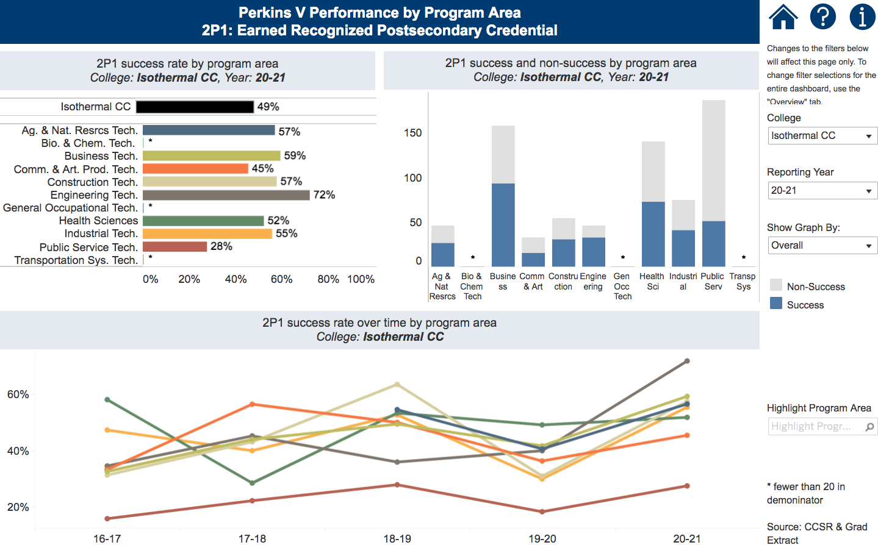
Notes:
Isothermal CC
https://www.nccommunitycolleges.edu/analytics/dashboards/cte-perkins-v-performance-indicator-2p1-earned-recognized-postsecondary

Slide 83
Randolph Community College
Introductions
Performance indicators – performance vs negotiated
College presentation
  Have CLNA findings improved CTE?
  Share a Promising Practice
  How is college coping under COVID-19?
  Budget and spending plan
Comments and questions
Notes:
Randolph CC

Slide 84

Notes:
Randolph CC
https://www.ncperkins.org/data/indicatorV.php

Slide 85
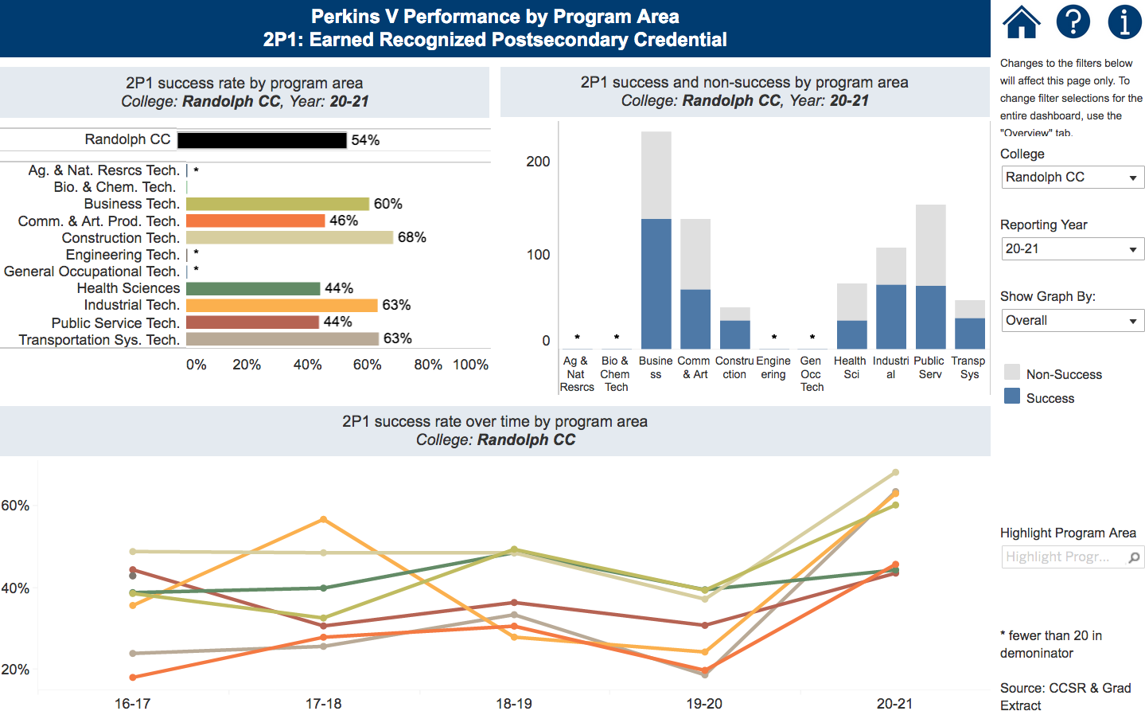
Notes:
Randolph CC
https://www.nccommunitycolleges.edu/analytics/dashboards/cte-perkins-v-performance-indicator-2p1-earned-recognized-postsecondary

Slide 86
Southeastern Community College
Introductions
Performance indicators – performance vs negotiated
College presentation
  Have CLNA findings improved CTE?
  Share a Promising Practice
  How is college coping under COVID-19?
  Budget and spending plan
Comments and questions
Notes:
Southeastern CC

Slide 87

Notes:
Southeastern CC
https://www.ncperkins.org/data/indicatorV.php

Slide 88
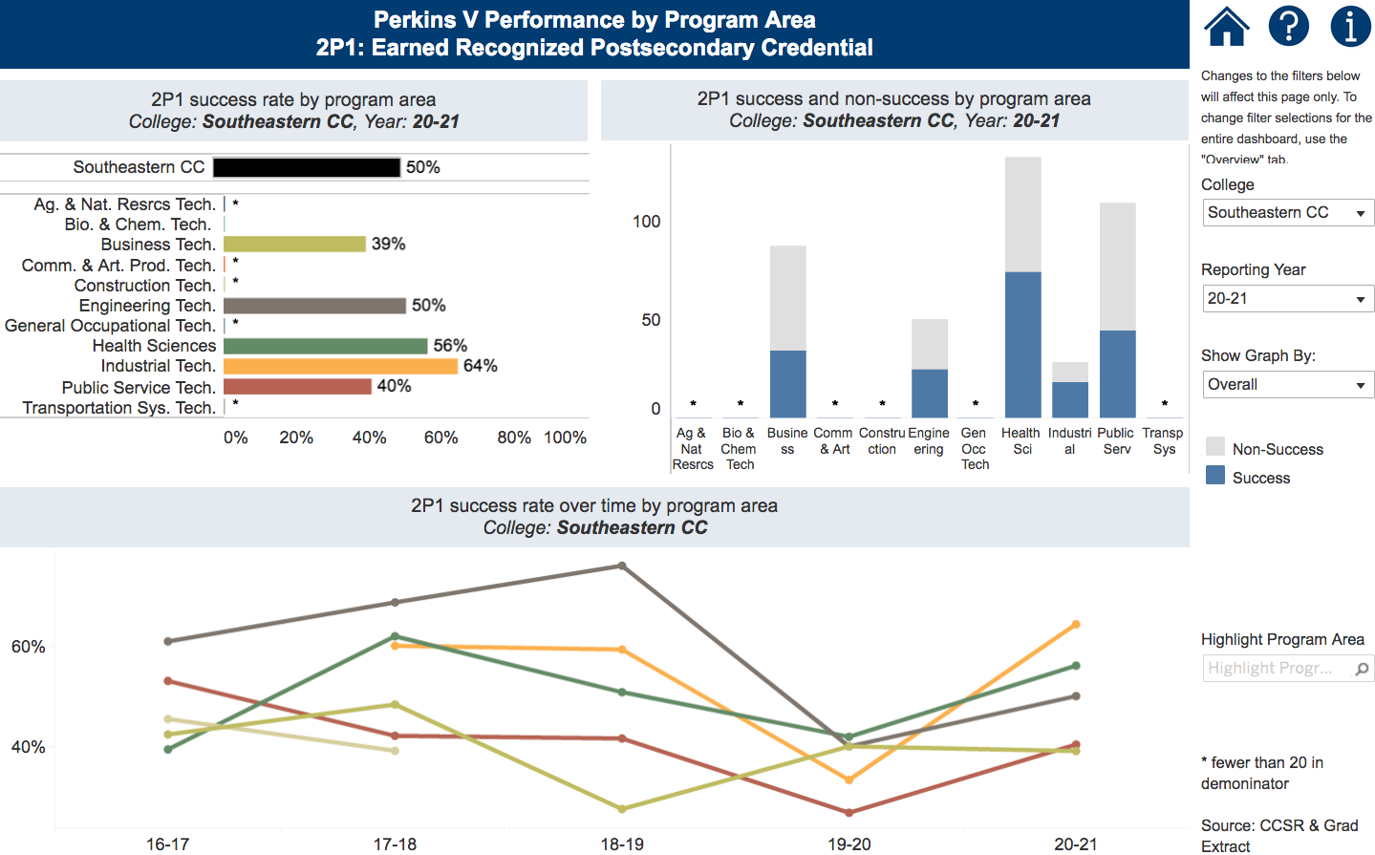
Notes:
Southeastern CC
https://www.nccommunitycolleges.edu/analytics/dashboards/cte-perkins-v-performance-indicator-2p1-earned-recognized-postsecondary

Slide 89
Southwestern Community College
Introductions
Performance indicators – performance vs negotiated
College presentation
  Have CLNA findings improved CTE?
  Share a Promising Practice
  How is college coping under COVID-19?
  Budget and spending plan
Comments and questions
Notes:
Southwestern CC

Slide 90

Notes:
Southwestern CC
https://www.ncperkins.org/data/indicatorV.php

Slide 91
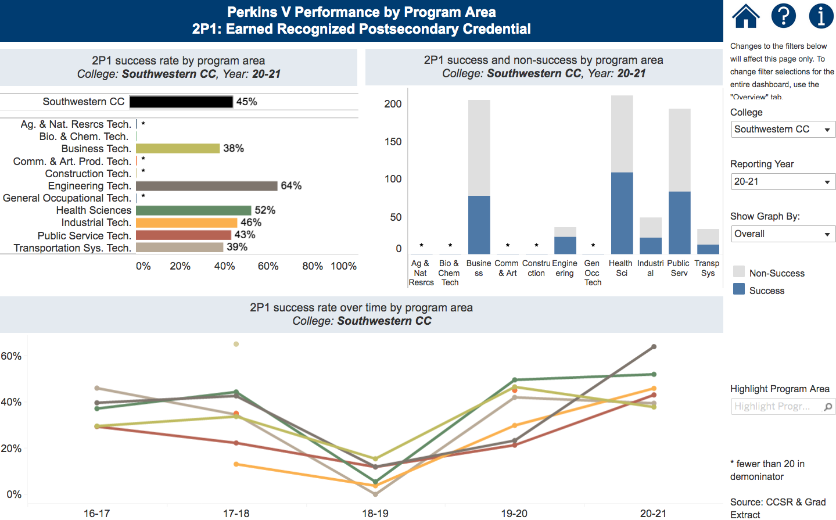
Notes:
Southwestern CC
https://www.nccommunitycolleges.edu/analytics/dashboards/cte-perkins-v-performance-indicator-2p1-earned-recognized-postsecondary

Slide 92
Western Piedmont Community College
Introductions
Performance indicators – performance vs negotiated
College presentation
  Have CLNA findings improved CTE?
  Share a Promising Practice
  How is college coping under COVID-19?
  Budget and spending plan
Comments and questions
Notes:
Western Piedmont CC

Slide 93

Notes:
Western Piedmont CC
https://www.ncperkins.org/data/indicatorV.php

Slide 94
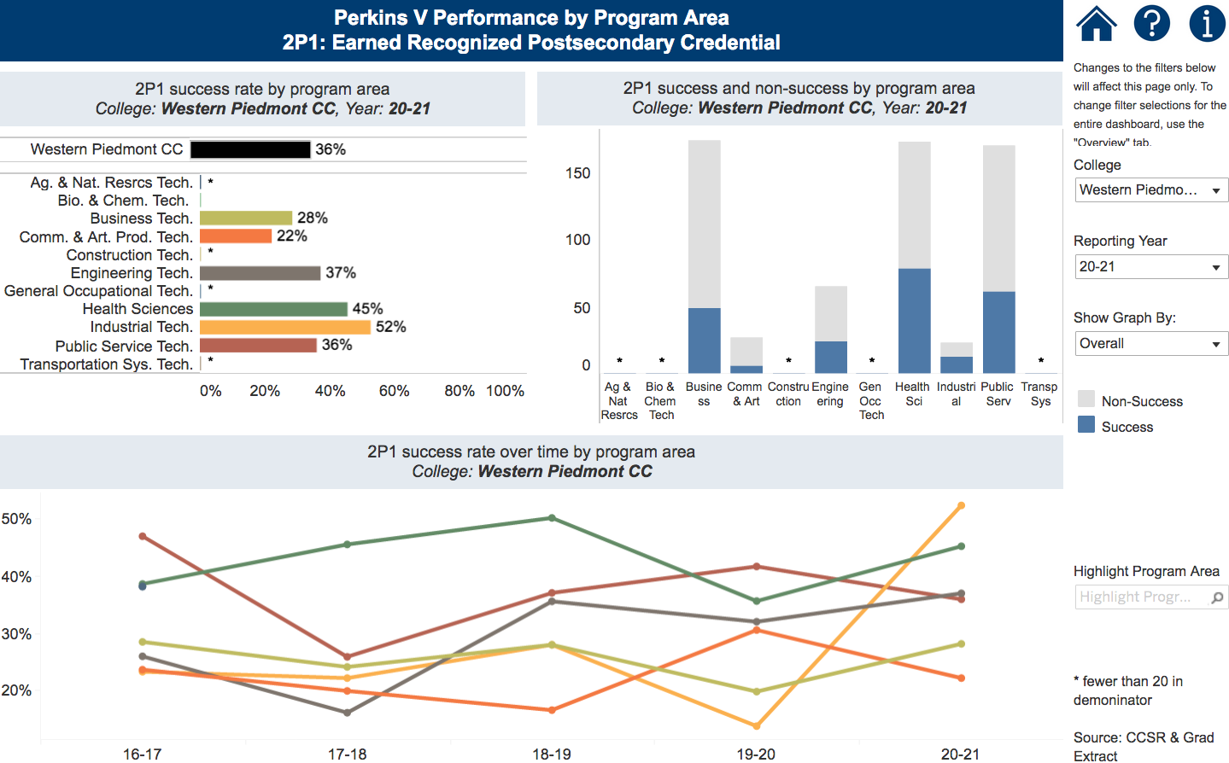
Notes:
Western Piedmont CC
https://www.nccommunitycolleges.edu/analytics/dashboards/cte-perkins-v-performance-indicator-2p1-earned-recognized-postsecondary

Slide 95
Wilkes Community College
Introductions
Performance indicators – performance vs negotiated
College presentation
  Have CLNA findings improved CTE?
  Share a Promising Practice
  How is college coping under COVID-19?
  Budget and spending plan
Comments and questions
Notes:
Wilkes CC

Slide 96

Notes:
Wilkes CC
https://www.ncperkins.org/data/indicatorV.php

Slide 97
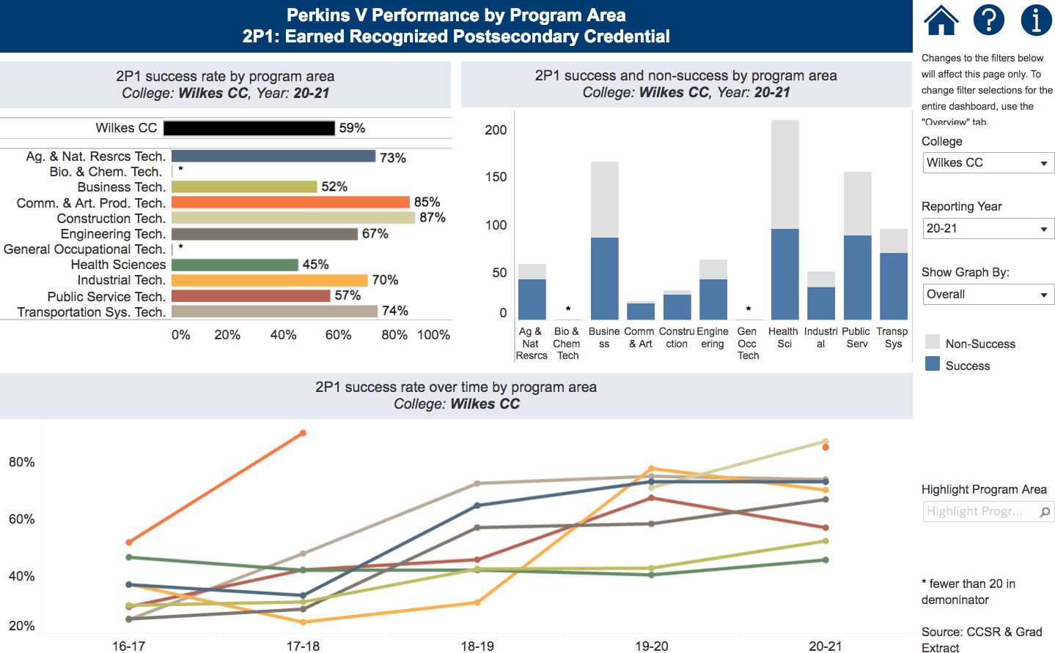
Notes:
Wilkes CC
https://www.nccommunitycolleges.edu/analytics/dashboards/cte-perkins-v-performance-indicator-2p1-earned-recognized-postsecondary

Slide 98
Perkins Mid-Year Reviews
January 18, 2022
Cleveland CC
Johnston CC
Lenoir CC
Nash CC
Robeson CC
Sandhills CC
Surry CC
Vance-Granville CC
Wayne CC

Slide 99
Cleveland Community College
Introductions
Performance indicators – performance vs negotiated
College presentation
  Have CLNA findings improved CTE?
  Share a Promising Practice
  How is college coping under COVID-19?
  Budget and spending plan
Comments and questions
Notes:
Cleveland CC

Slide 100

Notes:
Cleveland CC
https://www.ncperkins.org/data/indicatorV.php

Slide 101

Notes:
Cleveland CC
https://www.nccommunitycolleges.edu/analytics/dashboards/cte-perkins-v-performance-indicator-2p1-earned-recognized-postsecondary

Slide 102
Johnston Community College
Introductions
Performance indicators – performance vs negotiated
College presentation
  Have CLNA findings improved CTE?
  Share a Promising Practice
  How is college coping under COVID-19?
  Budget and spending plan
Comments and questions
Notes:
Johnston CC

Slide 103

Notes:
Johnston CC
https://www.ncperkins.org/data/indicatorV.php

Slide 104

Notes:
Johnston CC
https://www.nccommunitycolleges.edu/analytics/dashboards/cte-perkins-v-performance-indicator-2p1-earned-recognized-postsecondary

Slide 105
Lenoir Community College
Introductions
Performance indicators – performance vs negotiated
College presentation
  Have CLNA findings improved CTE?
  Share a Promising Practice
  How is college coping under COVID-19?
  Budget and spending plan
Comments and questions
Notes:
Lenoir CC

Slide 106

Notes:
Lenoir CC
https://www.ncperkins.org/data/indicatorV.php

Slide 107
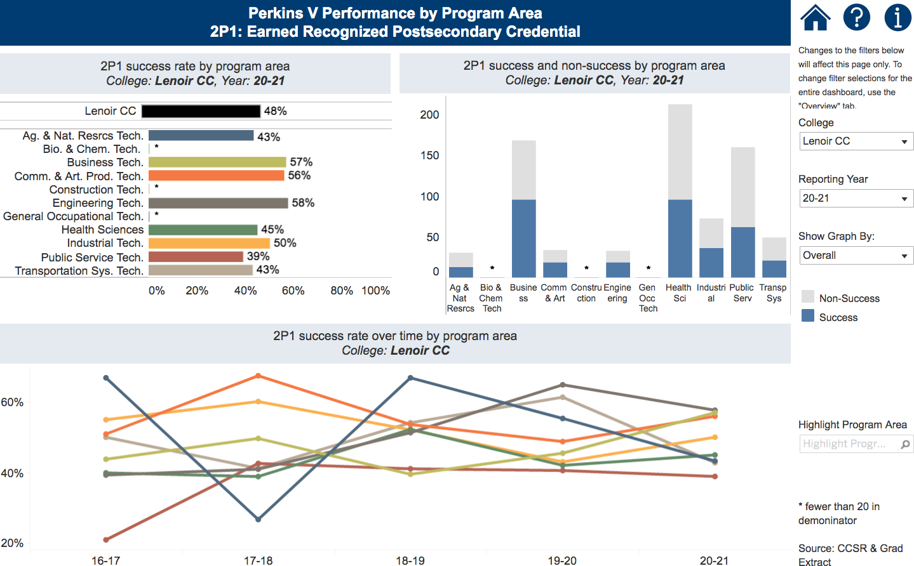
Notes:
Lenoir CC
https://www.nccommunitycolleges.edu/analytics/dashboards/cte-perkins-v-performance-indicator-2p1-earned-recognized-postsecondary

Slide 108
Nash Community College
Introductions
Performance indicators – performance vs negotiated
College presentation
  Have CLNA findings improved CTE?
  Share a Promising Practice
  How is college coping under COVID-19?
  Budget and spending plan
Comments and questions
Notes:
Nash CC

Slide 109
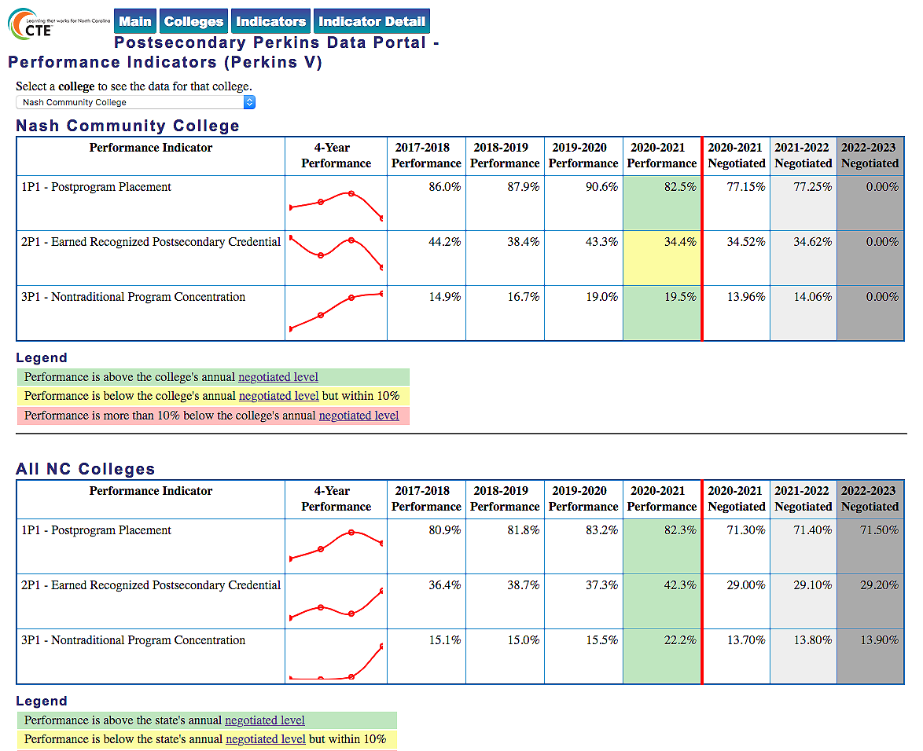
Notes:
Nash CC
https://www.ncperkins.org/data/indicatorV.php

Slide 110
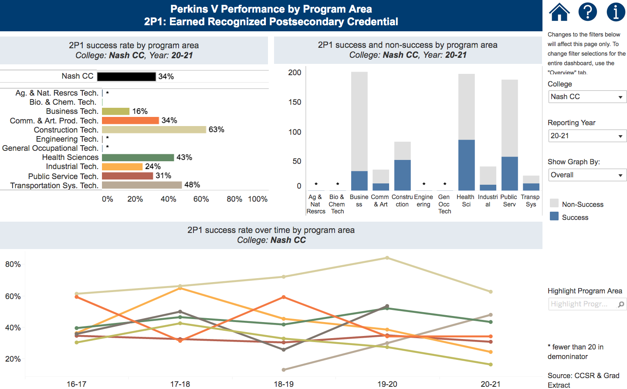
Notes:
Nash CC
https://www.nccommunitycolleges.edu/analytics/dashboards/cte-perkins-v-performance-indicator-2p1-earned-recognized-postsecondary

Slide 111
Robeson Community College
Introductions
Performance indicators – performance vs negotiated
College presentation
  Have CLNA findings improved CTE?
  Share a Promising Practice
  How is college coping under COVID-19?
  Budget and spending plan
Comments and questions
Notes:
Robeson CC

Slide 112

Notes:
Robeson CC
https://www.ncperkins.org/data/indicatorV.php

Slide 113
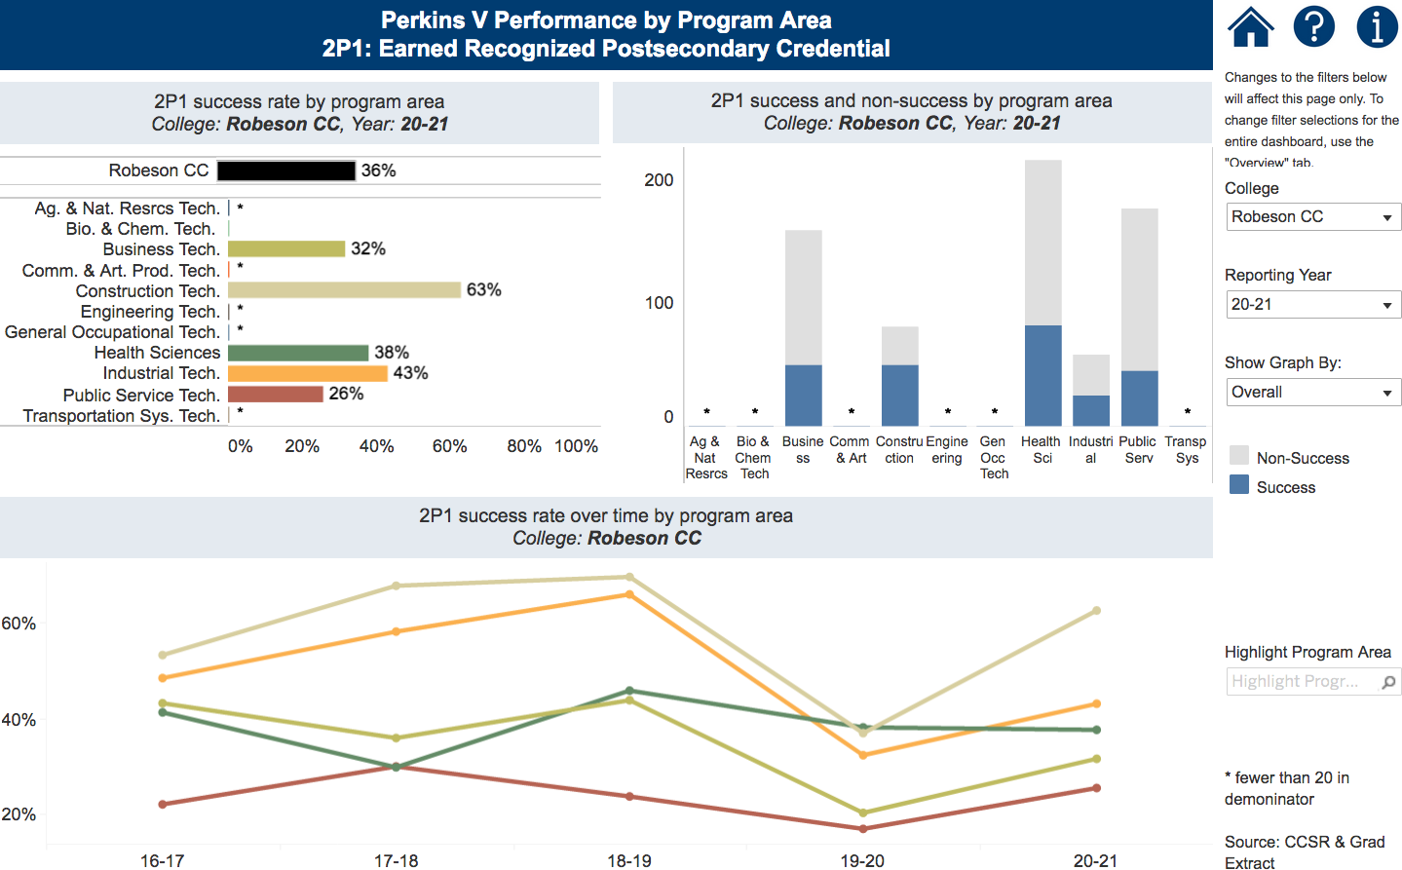
Notes:
Robeson CC
https://www.nccommunitycolleges.edu/analytics/dashboards/cte-perkins-v-performance-indicator-2p1-earned-recognized-postsecondary

Slide 114
Sandhills Community College
Introductions
Performance indicators – performance vs negotiated
College presentation
  Have CLNA findings improved CTE?
  Share a Promising Practice
  How is college coping under COVID-19?
  Budget and spending plan
Comments and questions
Notes:
Sandhills CC

Slide 115

Notes:
Sandhills CC
https://www.ncperkins.org/data/indicatorV.php

Slide 116
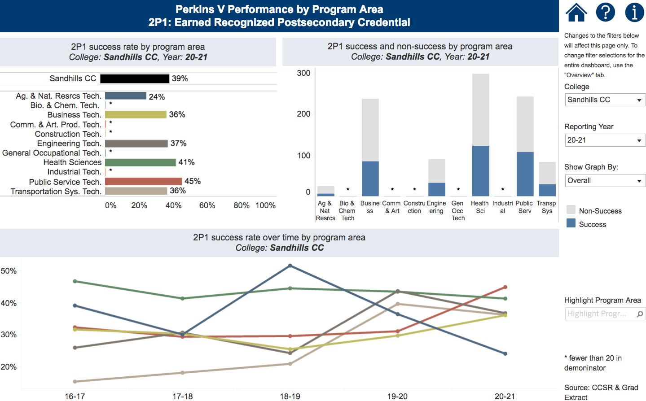
Notes:
Sandhills CC
https://www.nccommunitycolleges.edu/analytics/dashboards/cte-perkins-v-performance-indicator-2p1-earned-recognized-postsecondary

Slide 117
Surry Community College
Introductions
Performance indicators – performance vs negotiated
College presentation
  Have CLNA findings improved CTE?
  Share a Promising Practice
  How is college coping under COVID-19?
  Budget and spending plan
Comments and questions
Notes:
Surry CC

Slide 118

Notes:
Surry CC
https://www.ncperkins.org/data/indicatorV.php

Slide 119

Notes:
Surry CC
https://www.nccommunitycolleges.edu/analytics/dashboards/cte-perkins-v-performance-indicator-2p1-earned-recognized-postsecondary

Slide 120
Vance-Granville Community College
Introductions
Performance indicators – performance vs negotiated
College presentation
  Have CLNA findings improved CTE?
  Share a Promising Practice
  How is college coping under COVID-19?
  Budget and spending plan
Comments and questions
Notes:
Vance-Granville CC

Slide 121

Notes:
Vance-Granville CC
https://www.ncperkins.org/data/indicatorV.php

Slide 122

Notes:
Vance-Granville CC
https://www.nccommunitycolleges.edu/analytics/dashboards/cte-perkins-v-performance-indicator-2p1-earned-recognized-postsecondary

Slide 123
Wayne Community College
Introductions
Performance indicators – performance vs negotiated
College presentation
  Have CLNA findings improved CTE?
  Share a Promising Practice
  How is college coping under COVID-19?
  Budget and spending plan
Comments and questions
Notes:
Wayne CC

Slide 124

Notes:
Wayne CC
https://www.ncperkins.org/data/indicatorV.php

Slide 125
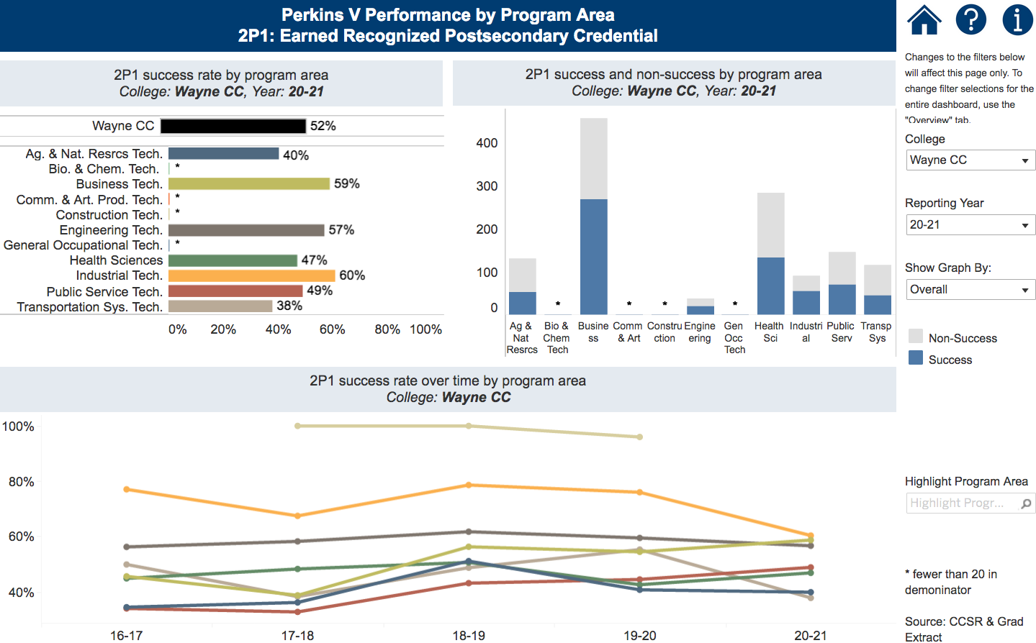
Notes:
Wayne CC
https://www.nccommunitycolleges.edu/analytics/dashboards/cte-perkins-v-performance-indicator-2p1-earned-recognized-postsecondary

Slide 126
Perkins Mid-Year Reviews
January 20, 2022
Alamance CC
Asheville-Buncombe TCC
Catawba Valley CC
Davidson-Davie CC​
Durham TCC
Edgecombe CC
Gaston College
Richmond CC
Stanly CC

Slide 127
Alamance Community College
Introductions
Performance indicators – performance vs negotiated
College presentation
  Have CLNA findings improved CTE?
  Share a Promising Practice
  How is college coping under COVID-19?
  Budget and spending plan
Comments and questions
Notes:
Alamance CC

Slide 128

Notes:
Alamance CC
https://www.ncperkins.org/data/indicatorV.php

Slide 129
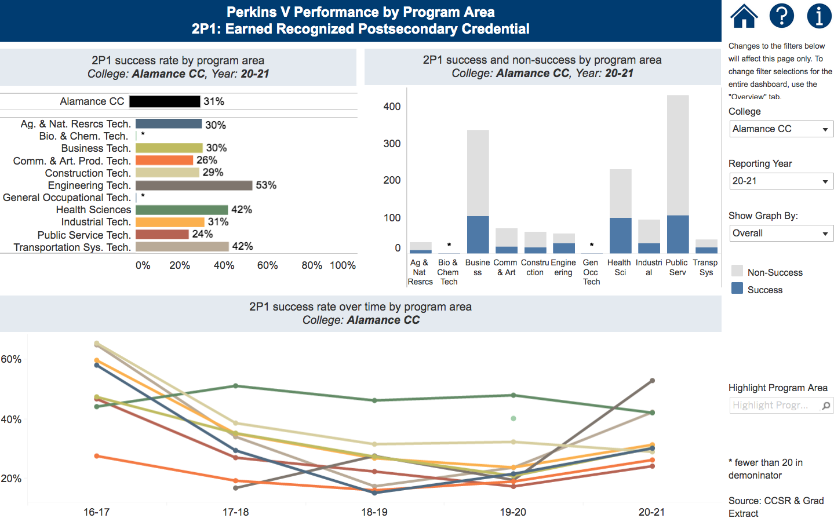
Notes:
Alamance CC
https://www.nccommunitycolleges.edu/analytics/dashboards/cte-perkins-v-performance-indicator-2p1-earned-recognized-postsecondary

Slide 130
Asheville-Buncombe Technical Community College
Introductions
Performance indicators – performance vs negotiated
College presentation
  Have CLNA findings improved CTE?
  Share a Promising Practice
  How is college coping under COVID-19?
  Budget and spending plan
Comments and questions
Notes:
Asheville-Buncombe TCC

Slide 131
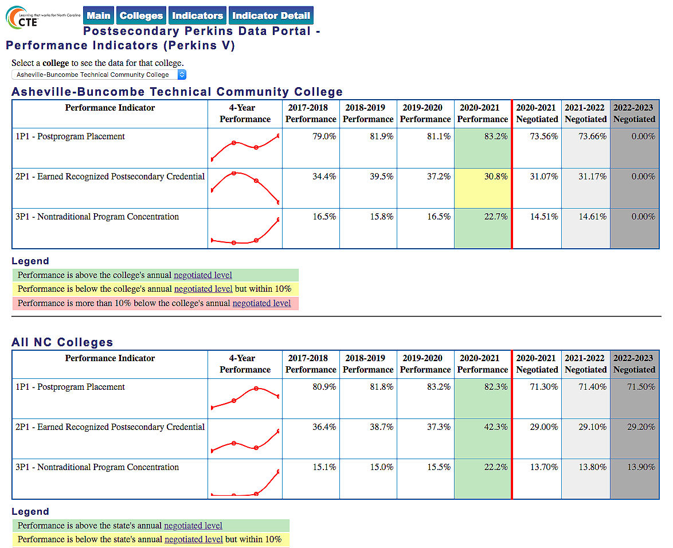
Notes:
Asheville-Buncombe TCC
https://www.ncperkins.org/data/indicatorV.php

Slide 132
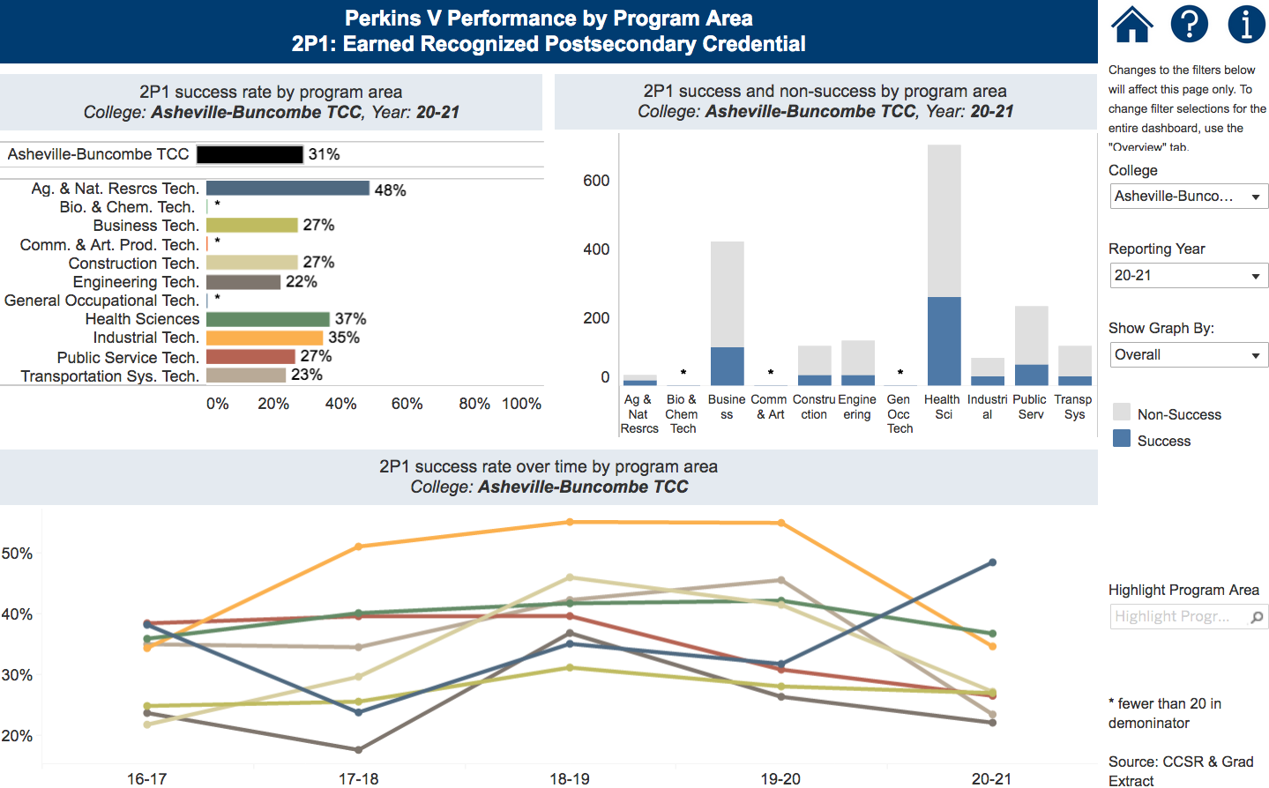
Notes:
Asheville-Buncombe TCC
https://www.nccommunitycolleges.edu/analytics/dashboards/cte-perkins-v-performance-indicator-2p1-earned-recognized-postsecondary

Slide 133
Catawba Valley Community College
Introductions
Performance indicators – performance vs negotiated
College presentation
  Have CLNA findings improved CTE?
  Share a Promising Practice
  How is college coping under COVID-19?
  Budget and spending plan
Comments and questions
Notes:
Catawba Valley CC

Slide 134

Notes:
Catawba Valley CC
https://www.ncperkins.org/data/indicatorV.php

Slide 135
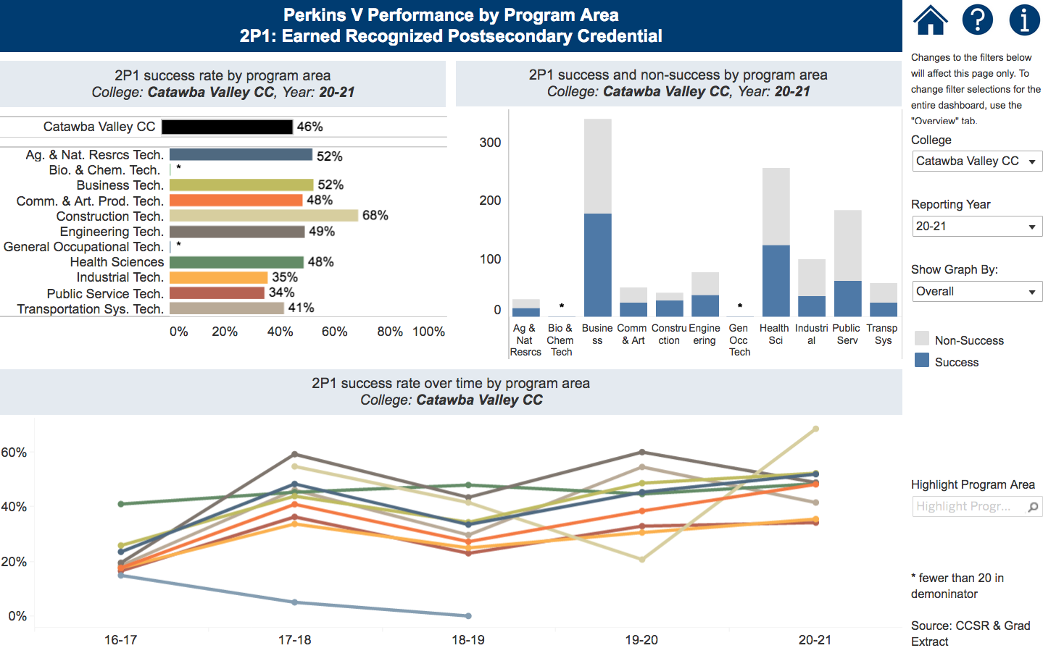
Notes:
Catawba Valley CC
https://www.nccommunitycolleges.edu/analytics/dashboards/cte-perkins-v-performance-indicator-2p1-earned-recognized-postsecondary

Slide 136
Davidson-Davie Community College
Introductions
Performance indicators – performance vs negotiated
College presentation
  Have CLNA findings improved CTE?
  Share a Promising Practice
  How is college coping under COVID-19?
  Budget and spending plan
Comments and questions
Notes:
Davidson County CC

Slide 137
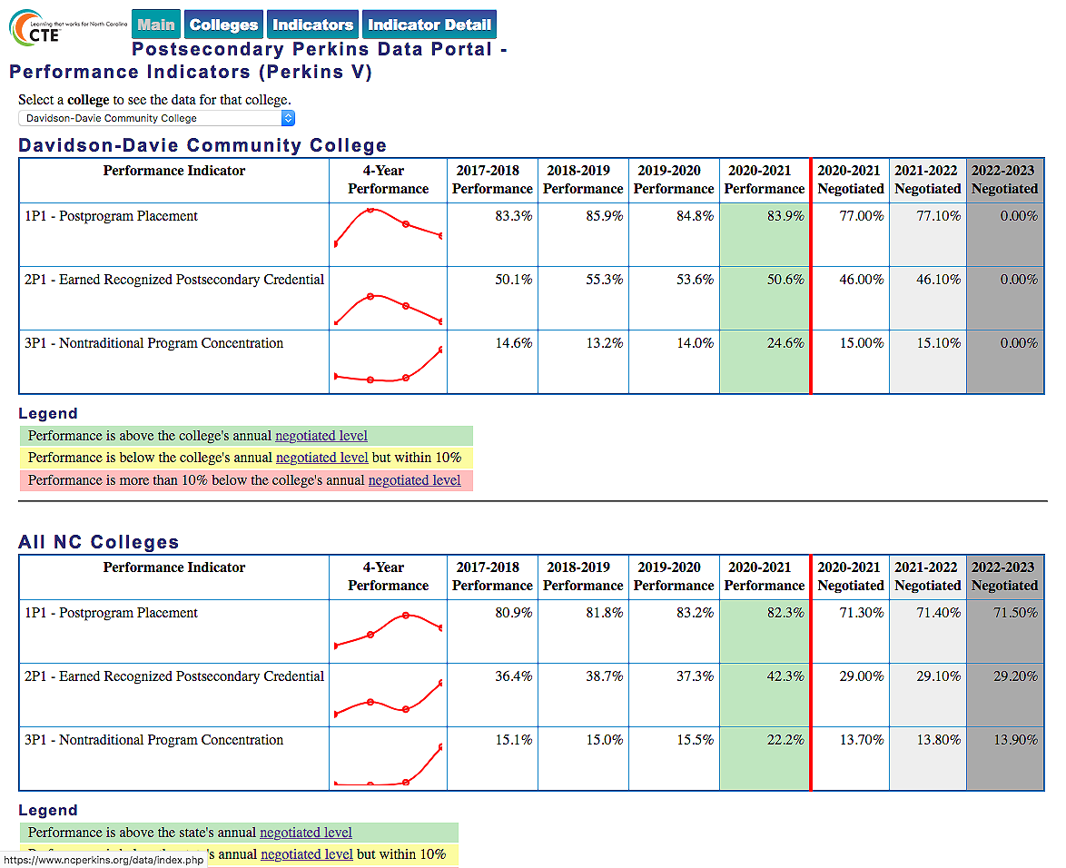
Notes:
Davidson County CC
https://www.ncperkins.org/data/indicatorV.php

Slide 138
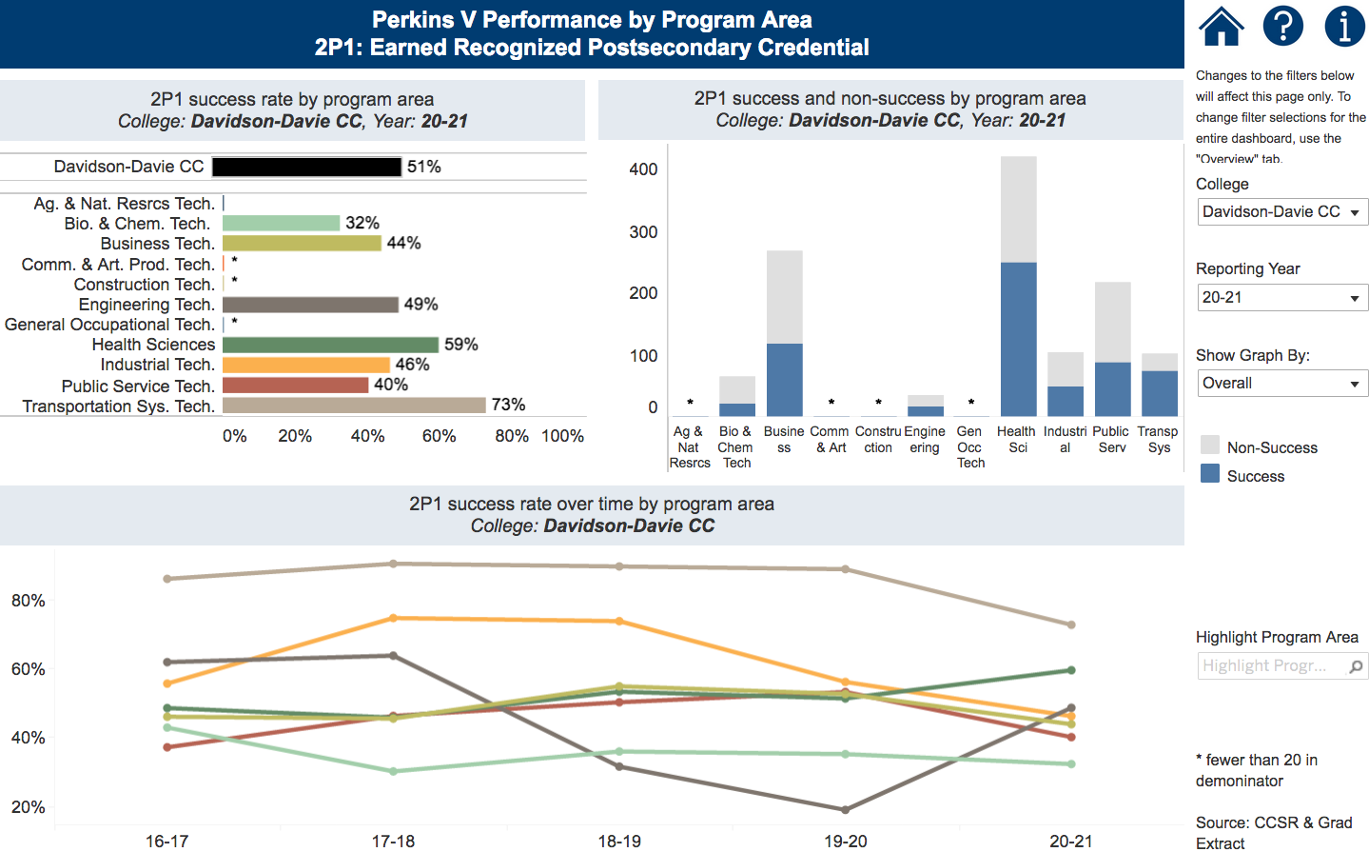
Notes:
Davidson County CC
https://www.nccommunitycolleges.edu/analytics/dashboards/cte-perkins-v-performance-indicator-2p1-earned-recognized-postsecondary

Slide 139
Durham Technical Community College
Introductions
Performance indicators – performance vs negotiated
College presentation
  Have CLNA findings improved CTE?
  Share a Promising Practice
  How is college coping under COVID-19?
  Budget and spending plan
Comments and questions
Notes:
Durham TCC

Slide 140

Notes:
Durham TCC
https://www.ncperkins.org/data/indicatorV.php

Slide 141
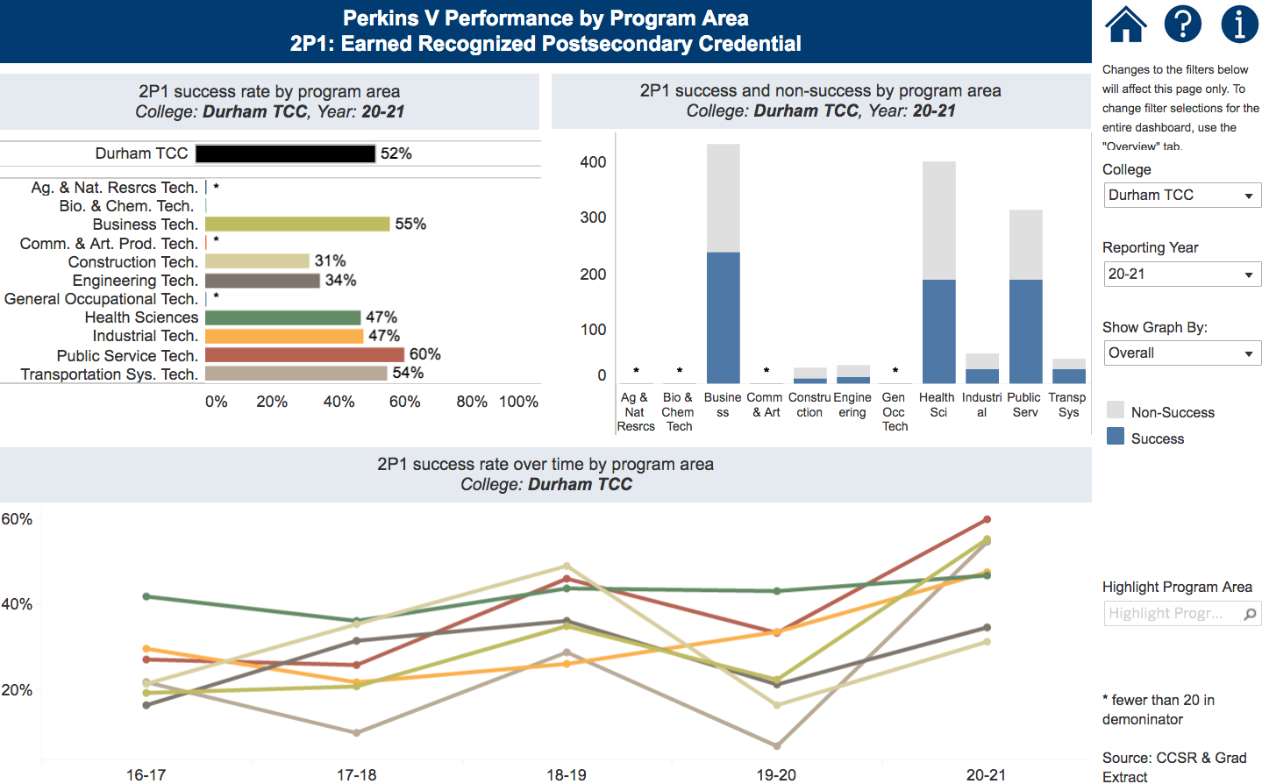
Notes:
Durham TCC
https://www.nccommunitycolleges.edu/analytics/dashboards/cte-perkins-v-performance-indicator-2p1-earned-recognized-postsecondary

Slide 142
Edgecombe Community College
Introductions
Performance indicators – performance vs negotiated
College presentation
  Have CLNA findings improved CTE?
  Share a Promising Practice
  How is college coping under COVID-19?
  Budget and spending plan
Comments and questions
Notes:
Edgecombe CC

Slide 143

Notes:
Edgecombe CC
https://www.ncperkins.org/data/indicatorV.php

Slide 144
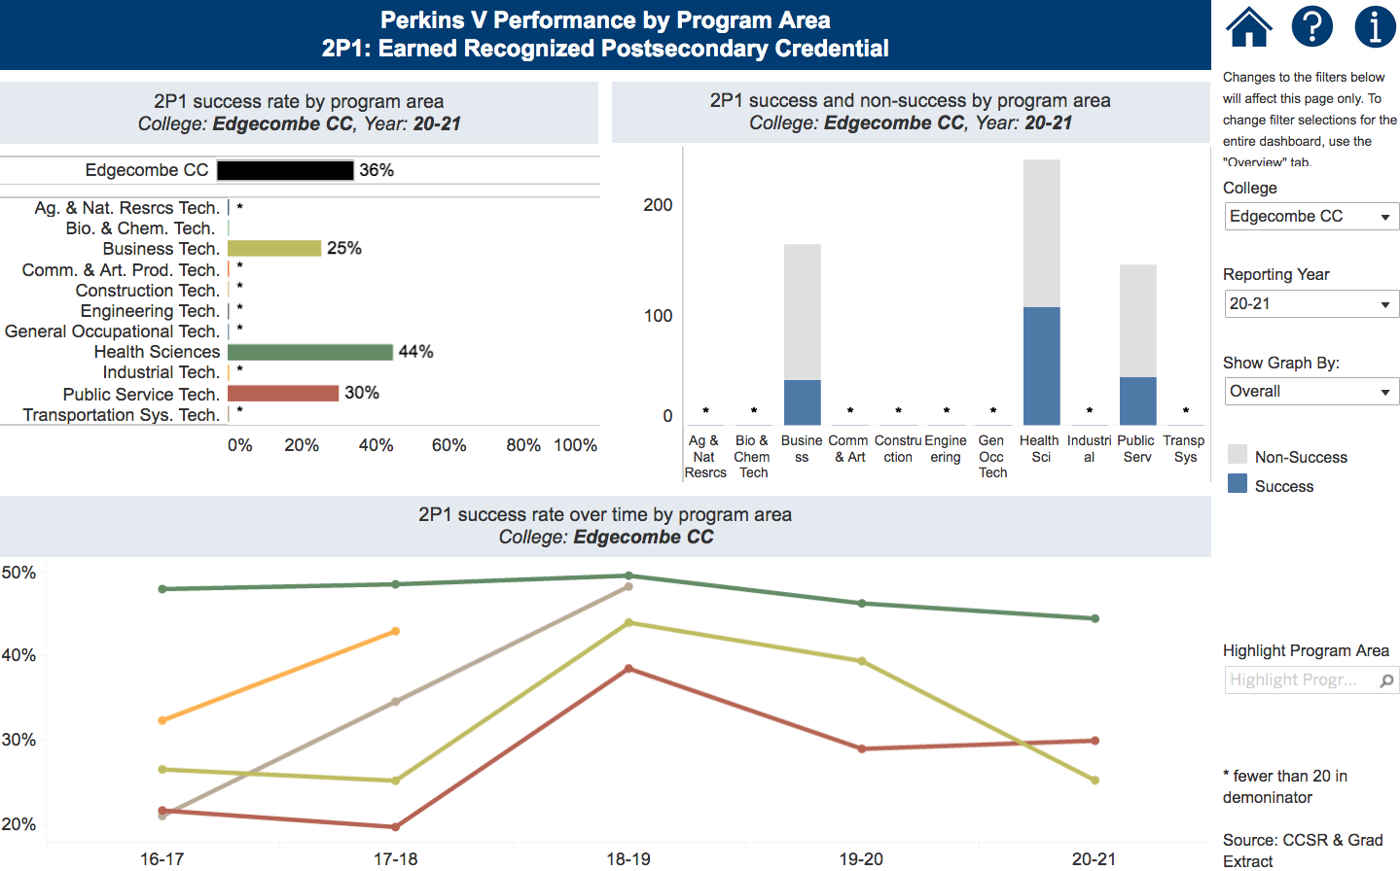
Notes:
Edgecombe CC
https://www.nccommunitycolleges.edu/analytics/dashboards/cte-perkins-v-performance-indicator-2p1-earned-recognized-postsecondary

Slide 145
Gaston College
Introductions
Performance indicators – performance vs negotiated
College presentation
  Have CLNA findings improved CTE?
  Share a Promising Practice
  How is college coping under COVID-19?
  Budget and spending plan
Comments and questions
Notes:
Gaston College

Slide 146

Notes:
Gaston College
https://www.ncperkins.org/data/indicatorV.php

Slide 147

Notes:
Gaston College
https://www.nccommunitycolleges.edu/analytics/dashboards/cte-perkins-v-performance-indicator-2p1-earned-recognized-postsecondary

Slide 148
Richmond Community College
Introductions
Performance indicators – performance vs negotiated
College presentation
  Have CLNA findings improved CTE?
  Share a Promising Practice
  How is college coping under COVID-19?
  Budget and spending plan
Comments and questions
Notes:
Richmond CC

Slide 149

Notes:
Richmond CC
https://www.ncperkins.org/data/indicatorV.php

Slide 150

Notes:
Richmond CC
https://www.nccommunitycolleges.edu/analytics/dashboards/cte-perkins-v-performance-indicator-2p1-earned-recognized-postsecondary

Slide 151
Stanly Community College
Introductions
Performance indicators – performance vs negotiated
College presentation
  Have CLNA findings improved CTE?
  Share a Promising Practice
  How is college coping under COVID-19?
  Budget and spending plan
Comments and questions
Notes:
Stanly CC

Slide 152

Notes:
Stanly CC
https://www.ncperkins.org/data/indicatorV.php

Slide 153

Notes:
Stanly CC
https://www.nccommunitycolleges.edu/analytics/dashboards/cte-perkins-v-performance-indicator-2p1-earned-recognized-postsecondary

Slide 154
Perkins Mid-Year Reviews
January 21, 2022
Cape Fear CC
Central Carolina CC
Central Piedmont CC
Fayetteville TCC
Forsyth TCC
Guilford TCC
Pitt CC
Rowan-Cabarrus CC
Wake TCC

Slide 155
Cape Fear Community College
Introductions
Performance indicators – performance vs negotiated
College presentation
  Have CLNA findings improved CTE?
  Share a Promising Practice
  How is college coping under COVID-19?
  Budget and spending plan
Comments and questions
Notes:
Cape Fear CC

Slide 156

Notes:
Cape Fear CC
https://www.ncperkins.org/data/indicatorV.php

Slide 157

Notes:
Cape Fear CC
https://www.nccommunitycolleges.edu/analytics/dashboards/cte-perkins-v-performance-indicator-2p1-earned-recognized-postsecondary

Slide 158
Central Carolina Community College
Introductions
Performance indicators – performance vs negotiated
College presentation
  Have CLNA findings improved CTE?
  Share a Promising Practice
  How is college coping under COVID-19?
  Budget and spending plan
Comments and questions
Notes:
Central Carolina CC

Slide 159

Notes:
Central Carolina CC
https://www.ncperkins.org/data/indicatorV.php

Slide 160

Notes:
Central Carolina CC
https://www.nccommunitycolleges.edu/analytics/dashboards/cte-perkins-v-performance-indicator-2p1-earned-recognized-postsecondary

Slide 161
Central Piedmont Community College
Introductions
Performance indicators – performance vs negotiated
College presentation
  Have CLNA findings improved CTE?
  Share a Promising Practice
  How is college coping under COVID-19?
  Budget and spending plan
Comments and questions
Notes:
Central Piedmont CC

Slide 162

Notes:
Central Piedmont CC
https://www.ncperkins.org/data/indicatorV.php

Slide 163

Notes:
Central Piedmont CC
https://www.nccommunitycolleges.edu/analytics/dashboards/cte-perkins-v-performance-indicator-2p1-earned-recognized-postsecondary

Slide 164
Fayetteville Technical Community College
Introductions
Performance indicators – performance vs negotiated
College presentation
  Have CLNA findings improved CTE?
  Share a Promising Practice
  How is college coping under COVID-19?
  Budget and spending plan
Comments and questions
Notes:
Fayetteville TCC

Slide 165

Notes:
Fayetteville TCC
https://www.ncperkins.org/data/indicatorV.php

Slide 166

Notes:
Fayetteville TCC
https://www.nccommunitycolleges.edu/analytics/dashboards/cte-perkins-v-performance-indicator-2p1-earned-recognized-postsecondary

Slide 167
Forsyth Technical Community College
Introductions
Performance indicators – performance vs negotiated
College presentation
  Have CLNA findings improved CTE?
  Share a Promising Practice
  How is college coping under COVID-19?
  Budget and spending plan
Comments and questions
Notes:
Forsyth TCC

Slide 168

Notes:
Forsyth TCC
https://www.ncperkins.org/data/indicatorV.php

Slide 169

Notes:
Forsyth TCC
https://www.nccommunitycolleges.edu/analytics/dashboards/cte-perkins-v-performance-indicator-2p1-earned-recognized-postsecondary

Slide 170
Guilford Technical Community College
Introductions
Performance indicators – performance vs negotiated
College presentation
  Have CLNA findings improved CTE?
  Share a Promising Practice
  How is college coping under COVID-19?
  Budget and spending plan
Comments and questions
Notes:
Guilford TCC

Slide 171

Notes:
Guilford TCC
https://www.ncperkins.org/data/indicatorV.php

Slide 172

Notes:
Guilford TCC
https://www.nccommunitycolleges.edu/analytics/dashboards/cte-perkins-v-performance-indicator-2p1-earned-recognized-postsecondary

Slide 173
Pitt Community College
Introductions
Performance indicators – performance vs negotiated
College presentation
  Have CLNA findings improved CTE?
  Share a Promising Practice
  How is college coping under COVID-19?
  Budget and spending plan
Comments and questions
Notes:
Pitt CC

Slide 174

Notes:
Pitt CC
https://www.ncperkins.org/data/indicatorV.php

Slide 175

Notes:
Pitt CC
https://www.nccommunitycolleges.edu/analytics/dashboards/cte-perkins-v-performance-indicator-2p1-earned-recognized-postsecondary

Slide 176
Rowan-Cabarrus Community College CC
Introductions
Performance indicators – performance vs negotiated
College presentation
  Have CLNA findings improved CTE?
  Share a Promising Practice
  How is college coping under COVID-19?
  Budget and spending plan
Comments and questions
Notes:
Rowan-Cabarrus CC

Slide 177

Notes:
Rowan-Cabarrus CC
https://www.ncperkins.org/data/indicatorV.php

Slide 178

Notes:
Rowan-Cabarrus CC
https://www.nccommunitycolleges.edu/analytics/dashboards/cte-perkins-v-performance-indicator-2p1-earned-recognized-postsecondary

Slide 179
Wake Technical Community College
Introductions
Performance indicators – performance vs negotiated
College presentation
  Have CLNA findings improved CTE?
  Share a Promising Practice
  How is college coping under COVID-19?
  Budget and spending plan
Comments and questions
Notes:
Wake TCC

Slide 180

Notes:
Wake TCC
https://www.ncperkins.org/data/indicatorV.php

Slide 181

Notes:
Wake TCC
https://www.nccommunitycolleges.edu/analytics/dashboards/cte-perkins-v-performance-indicator-2p1-earned-recognized-postsecondary

Slide 182
Perkins/CTE State Staff
Dr. Bob Witchger Director, Career & Technical Education
WitchgerB@nccommunitycolleges.edu 919-807-7126
Dr. Tony R. Reggi Coordinator, Career & Technical Education
ReggiA@nccommunitycolleges.edu 919-807-7131
Patti Coultas Coordinator, Career & Technical Education
CoultasP@nccommunitycolleges.edu 919-807-7130
Dr. Mary Olvera Coordinator, Career & Technical Education
OlveraM@nccommunitycolleges.edu 919-807-7120
Michelle Lair Coordinator, CCP and Career & Technical Education
LairM@nccommunitycolleges.edu 919-807-7227
Chris Droessler Coordinator, Career & Technical Education
DroesslerC@nccommunitycolleges.edu 919-807-7068
Darice McDougald CTE Administrative Assistant
McDougaldD@nccommunitycolleges.edu 919-807-7219
Notes:
http://www.ncperkins.org/course/view.php?id=6

Slide 183







Team Perkins
Bob Witchger
Patti Coultas
Tony Reggi
Darice McDougald
Michelle Lair
Mary Olvera
Chris Droessler
Notes:
Dr. Bob Witchger
919-807-7126
WitchgerB@nccommunitycolleges.edu
Dr. Tony R. Reggi
919-807-7131
ReggiA@nccommunitycolleges.edu
Patti Coultas
919-807-7130
CoultasP@nccommunitycolleges.edu
Dr. Mary Olvera
919-807-7120
OlveraM@nccommunitycolleges.edu
Michelle Lair
919-807-72227
LairM@nccommunitycolleges.edu
Chris Droessler
919-807-7068
DroesslerC@nccommunitycolleges.edu
Darice McDougald
919-807-7219
McDougaldD@nccommunitycolleges.edu

