Slide 1
Perkins Update
October 12, 2021

Slide 2
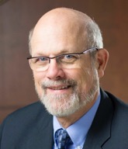
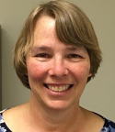
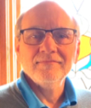
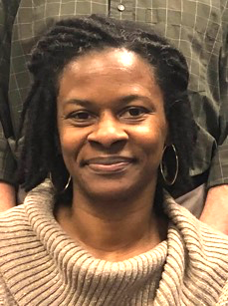
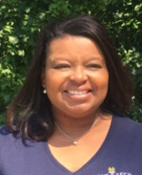
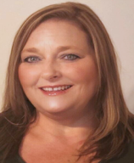
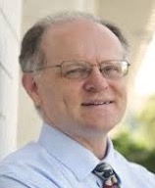
Team Perkins
Bob Witchger
Patti Coultas
Tony Reggi
Darice McDougald
Michelle Lair
Mary Olvera
Chris Droessler
Notes:
Dr. Bob Witchger
919-807-7126
WitchgerB@nccommunitycolleges.edu
Dr. Tony R. Reggi
919-807-7131
ReggiA@nccommunitycolleges.edu
Patti Coultas
919-807-7130
CoultasP@nccommunitycolleges.edu
Dr. Mary Olvera
919-807-7120
OlveraM@nccommunitycolleges.edu
Michelle Lair
919-807-72227
LairM@nccommunitycolleges.edu
Chris Droessler
919-807-7068
DroesslerC@nccommunitycolleges.edu
Darice McDougald
919-807-7219
McDougaldD@nccommunitycolleges.edu

Slide 3
Purpose of Perkins
Develop more fully the academic knowledge and technical and employability skills of secondary education students and postsecondary education students who elect to enroll in CTE curriculum programs and programs of study
Notes:
The Strengthening Career and Technical Education for the 21st Century Act reauthorized and updated the Carl D. Perkins Career and Technical Education Act of 2006 to become the current Carl D. Perkins Career and Technical Education Act of 2006 as amended by the Strengthening Career and Technical Education for the 21st Century Act (Perkins V)
This updated act stresses:
- Academic, Technical, and Employability Skills
- Funding Secondary and Postsecondary CTE
- Focusing on Students who elect to enroll in CTE Programs of Study

Slide 4
Promising Practice Video 2021
Stanly Community College
Developing and strengthening of effective online teaching practices
https://www.ncperkins.org/video/video.php?v=Stanly-2021&y=2021
See all the videos:
https://www.ncperkins.org/video/
Notes:
August 2021
Wilson
Wilkes
September 2021
Wayne
Vance-Granville
October 2021
Stanly
Southeastern
November 2021
South Piedmont
Rowan-Cabarrus
Rockingham
Robeson
Pitt-Martin
Pamlico
Nash
Mayland
Lenoir
Johnston
James_Sprunt
Halifax
Gaston
Forsyth
Fayetteville
Edgecombe
Durham
Davidson
Craven
Coastal_Carolina
Central_Piedmont
Carteret
Cape_Fear
Caldwell
Brunswick
Blue_Ridge
Beaufort
AB_Tech

Slide 5
Disability Project – Update
Invitation to Participate (Pilot Project)
Disability Inclusion: Preparing for the Workforce of Tomorrow
Purpose
Provide college faculty, staff, employers, and other stakeholders with professional development to improve their knowledge and skills in working with students with disabilities in CTE programs and in the workplace.
This project is consistent with Perkins V mission for enhancing CTE programs and serving special populations and providing equitable opportunities.
Requirements
20 teams (example: CTE faculty, Disability Services staff, Work-based-learning coordinator, and employers
Complete training modules (approximately 5 hours)
Complete pre/post tests
After completion, meet with team members to reflect on experience
Participate in focus group

Slide 6
Disability Project – Update
Ablr Modules (https://ablr360.com/)
This course consists of 5 modules
Module 1: Understanding Disabilities
Module 2: Disability Etiquette
Module 3: The Business Case for Disability Inclusion
Module 4: Actions for Making your Workplace Inclusive
Module 5: Adaptations and Assistive Technologies
By the end of this course, participants will:
Gain a greater awareness of the history, conceptual models, and categories of disability
Learn best practices for respectful and inclusive interpersonal behavior
Understand the business benefits of disability inclusion, inclusive marketing, and digital accessibility
Identify key steps our organization should take to incite and maintain a culture of inclusion
Explore the most common assistive technology

Slide 7
Disability Project – Update
Letter of Intent to Participate: Due October 27 by 5:00 p.m.
Letter of interest must include:
A description of interest in participating in the Disability Inclusion: Preparing for the Workforce of Tomorrow course
The names, titles, and email addresses of each team member.
A statement on how your college recruits and works with students with disabilities.
A statement on what you hope to gain from participating in this course.
Please send your letter of interest to Dr. Mary Olvera olveram@nccommunitycolleges.edu and Dr. Trudie Hughes hughest@nccommunitycolleges.edu

Slide 8
Tips on the CLNA
Updating existing CLNA
There must be modified content
If you continue an activity that addresses an existing gap, give evidence of how the activity is closing the gap or justification as to why more time and money are needed
You may address gaps in existing CLNAs that were not targeted in the last fiscal year(s)
Show evidence of how stakeholders were consulted for new gaps or ideas to address existing ones
Creating New CLNAs
Consult stakeholders listed in the guide
Identify and address gaps

Slide 9
Stakeholders (CLNA guide page 6)
CTE program representatives at the secondary and postsecondary levels including teachers, faculty, administrators, career guidance and advisement professionals, and other staff
State or local workforce development board representatives, chambers of commerce, economic development representatives
Representatives from a range of local businesses and industries, as well as non-profit agencies
Parents and students
Representatives of special populations
Representatives from agencies serving at-risk, homeless, and out-of-school youth
Representatives from Indian Tribes or Tribal organizations, where applicable

Slide 10
Technical Assistance Visits
Virtual vs in-person
Either works for us. We can travel and observe the college's protocols when we do.
Content to discuss
We are here (or there) to serve you
We also see state-wide issues and solutions we like to share
Promising practices are always on the table for discussion
Who should be at the table
Perkins Contact
CAO & CFO
CTE Deans and faculty
Workforce partners
Secondary partners
Other partners as the college deems fit

Slide 11
Perkins 101
Virtual vs hybrid?
We are leaning toward hybrid, with regional face-to-face broadcast via Go To Webinar.
Who should attend?
Perkins contacts who have been supervising Perkins for 2 years or less
Anyone who wants a refresher
When?
Date to be determined.

Slide 12
Modification to add carry-forward funds
Determine dollar amount to be added
** It will NOT be the amount approved by the state board due to WIOA contribution.
Update local plan, include link to CLNA
** May need to reduce VOC Code 10 budgeted amount
** Remember to submit job descriptions if hiring additional employees
Complete budget modification form (separate file from local plan budget tab)
Submit both the plan and modification to the Moodle.

Slide 13
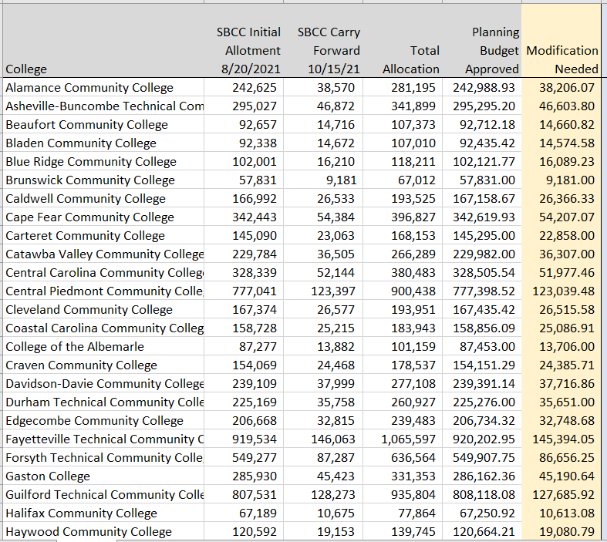
Perkins Carry Forward Calculation
Check with your Perkins Coordinator

Slide 14
Budget Modifications

Slide 15
2021-22 Local Plan Template
CLNA Link

Slide 16
Paying someone via Payroll?
EVERYONE who is paid via Payroll using Perkins funds must have a job description or extra-duty-pay/contact description uploaded. Please ensure all employee titles are the same on the description and the plan’s salary tab

Slide 17
Three categories of Employees
Semi‐annual certifications are required for personnel whose compensation is funded solely from the Perkins grant. These certifications document that the employee has been working solely in activities supported by the Perkins grant.
Semi‐annual certifications are required for personnel whose time is spent solely on Perkins Act allowable activities but is paid in part from Perkins and in part from other sources.
Monthly certifications are required for personnel whose time is split between Perkins allowable activities and non-allowable activities and is charged in part to Perkins and in part to other sources (split‐funded staff).

Slide 18
CTE Programs of Study /Pathways
REMINDER:
December 18, 2021
9-14 CTE Pathways due in Moodle

Slide 19
Elements of a 9-14 CTE Career Pathway
Aligned to labor market needs, which includes engaged employers
Secondary and postsecondary program of study linkage
Career advising - to develop an individual plan
Education and work-based learning offered concurrently with WIOA
Pathway designed to meet individual needs
Individual earns a postsecondary credential
Individuals enter and advance in a career
Perkins Sec 3(8) which references WIOA (29 U.S.C. 3102) Sec 3(7)

Slide 20
Mid-Year Review - Reminder
Power Point –
Update on Activities
Spending
Time Certifications
Semi-Annual Time Certification
Jan 12, 13, 14, 18, 20, 21, 2022
8am to 1pm

Slide 21
Mid-Year Reviews January 12, 2022
Brunswick CC
College of The Albemarle
Halifax CC
James Sprunt CC
Martin & Roanoke-Chowan
Mayland CC
McDowell TCC
Montgomery CC
Piedmont CC
Tri-County CC

Slide 22
Mid-Year Reviews January 13, 2022
Beaufort County CC
Bladen CC
Blue Ridge CC
Carteret CC & Pamlico CC
Mitchell CC
Rockingham CC
Sampson CC
South Piedmont CC
Southeastern CC
Wilson CC

Slide 23
Mid-Year Reviews January 14, 2022
Caldwell CC and TI
Coastal Carolina CC
Craven CC
Haywood CC
Isothermal CC
Randolph CC
Southwestern CC
Western Piedmont CC
Wilkes CC

Slide 24
Mid-Year Reviews January 18, 2022
Cleveland CC
Johnston CC
Lenoir CC
Nash CC
Robeson CC
Sandhills CC
Surry CC
Vance-Granville CC
Wayne CC

Slide 25
Mid-Year Reviews January 20, 2022
Alamance CC
Asheville-Buncombe TCC
Catawba Valley CC
Davidson-Davie CC
Durham TCC
Edgecombe CC
Gaston College
Richmond CC
Stanly CC

Slide 26
Mid-Year Reviews January 21, 2022
Cape Fear CC
Central Carolina CC
Central Piedmont CC
Fayetteville TCC
Forsyth TCC
Guilford TCC
Pitt CC
Rowan-Cabarrus CC
Wake TCC

Slide 27
Promising Practice Video 2021
Southeastern Community College
Implemented Quality Matters Framework to improve education
https://www.ncperkins.org/video/video.php?v=Southeastern-2021&y=2021
See all the videos:
https://www.ncperkins.org/video/
Notes:
August 2021
Wilson
Wilkes
September 2021
Wayne
Vance-Granville
October 2021
Stanly
Southeastern
South Piedmont
Rowan-Cabarrus
Rockingham
Robeson
Pitt-Martin
Pamlico
Nash
Mayland
Lenoir
Johnston
James_Sprunt
Halifax
Gaston
Forsyth
Fayetteville
Edgecombe
Durham
Davidson
Craven
Coastal_Carolina
Central_Piedmont
Carteret
Cape_Fear
Caldwell
Brunswick
Blue_Ridge
Beaufort
AB_Tech

Slide 28
Leadership Projects
Continuing Projects
Proposed
CORD
SkillsUSA-NC
Cyber Security
Apple Swift
Success Coach training with Student Services
BLET Curriculum Development
EDU Curriculum review and update
Distance Learning meetings
Career Clusters Guide
Addressing gaps in Equity and other statewide CLNA identified gaps
Marketing CTE
Other Ideas?

Slide 29
MOA
MOA = Ensuring accessible education programs for all
Monitoring this fall at Rockingham Community College
Follow-up with 15 colleges who were recently monitored

Slide 30
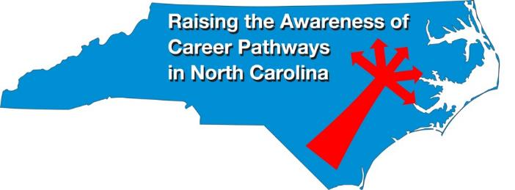
Raising the Awareness of Career Pathways Webinars
October 20, 2021 @ 9am
Come explore careers in Culinary Arts and Baking & Pastry Arts
https://register.gotowebinar.com/register/1973762323224693520
See all upcoming and past webinars at https://www.ncperkins.org/presentations/

Slide 31
Perkins Updates
2nd Tuesday of the month
9 am
Via GoToWebinar
Find the registration links at NCperkins.org/presentations
Notes:
Register now and let the system remind you.

Slide 32
CTE Training
Training online - www.ncperkins.org
Perkins Update Webinars - Second Tuesday
Career Pathways Webinars - Third Wednesday
Additional webinars on popular topics:
CLNA
Programs of Study
Career Pathways
At your College by request
https://www.ncperkins.org/presentations/
Notes:
https://www.ncperkins.org/presentations/

Slide 33
Technical assistance is available
We are here to help!
Team Perkins is available by phone, email, TEAMS, etc.
Your CTE Coordinator will be traveling to your college throughout the year.

Slide 34
Perkins/CTE State Staff
Dr. Bob Witchger Director, Career & Technical Education WitchgerB@nccommunitycolleges.edu 919-807-7126
Dr. Tony R. Reggi Coordinator, Career & Technical Education ReggiA@nccommunitycolleges.edu 919-807-7131
Patti Coultas Coordinator, Career & Technical Education CoultasP@nccommunitycolleges.edu 919-807-7130
Dr. Mary Olvera Coordinator, Career & Technical Education OlveraM@nccommunitycolleges.edu 919-807-7120
Michelle Lair Coordinator, CCP and Career & Technical Education LairM@nccommunitycolleges.edu 919-807-7227
Chris Droessler Coordinator, Career & Technical Education DroesslerC@nccommunitycolleges.edu 919-807-7068
Darice McDougald CTE Administrative Assistant McDougaldD@nccommunitycolleges.edu 919-807-7219
Notes:
http://www.ncperkins.org/course/view.php?id=6

