Slide 1
Perkins Update
August 10, 2021

Slide 2
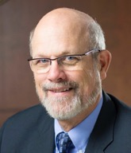
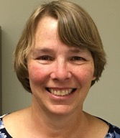
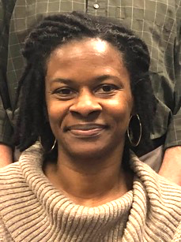
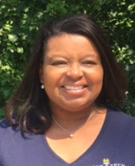
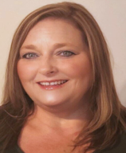
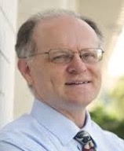
Team Perkins
Bob Witchger
Patti Coultas
Tony Reggi
Darice McDougald
Michelle Lair
Mary Olvera
Chris Droessler
Notes:
Dr. Bob Witchger
919-807-7126
WitchgerB@nccommunitycolleges.edu
Dr. Tony R. Reggi
919-807-7131
ReggiA@nccommunitycolleges.edu
Patti Coultas
919-807-7130
CoultasP@nccommunitycolleges.edu
Dr. Mary Olvera
919-807-7120
OlveraM@nccommunitycolleges.edu
Michelle Lair
919-807-72227
LairM@nccommunitycolleges.edu
Chris Droessler
919-807-7068
DroesslerC@nccommunitycolleges.edu
Darice McDougald
919-807-7219
McDougaldD@nccommunitycolleges.edu

Slide 3
Purpose of Perkins
Develop more fully the academic knowledge and technical and employability skills of secondary education students and postsecondary education students who elect to enroll in CTE programs and programs of study
Notes:
The Strengthening Career and Technical Education for the 21st Century Act reauthorized and updated the Carl D. Perkins Career and Technical Education Act of 2006 to become the current Carl D. Perkins Career and Technical Education Act of 2006 as amended by the Strengthening Career and Technical Education for the 21st Century Act (Perkins V)
This updated act stresses:
- Academic, Technical, and Employability Skills
- Funding Secondary and Postsecondary CTE
- Focusing on Students who elect to enroll in CTE Programs of Study

Slide 4
Promising Practice Video 2021
Wilson Community College
Inclusive teaching using the Inclusive Teaching Practices Toolkit
https://www.ncperkins.org/video/video.php?v=Wilson-2021&y=2021
See all the videos:
https://www.ncperkins.org/video/
Notes:
August 2021
Wilson
Wilkes
September 2021
Wayne
Vance-Granville
October 2021
Stanly
Southeastern
November 2021
South Piedmont
Rowan-Cabarrus
Rockingham
Robeson
Pitt-Martin
Pamlico
Nash
Mayland
Lenoir
Johnston
James_Sprunt
Halifax
Gaston
Forsyth
Fayetteville
Edgecombe
Durham
Davidson
Craven
Coastal_Carolina
Central_Piedmont
Carteret
Cape_Fear
Caldwell
Brunswick
Blue_Ridge
Beaufort
AB_Tech

Slide 5
Perkins Update Agenda
Use of Perkins funds for funding positions at colleges
Automotive faculty Professional Development
Serving Special Populations
CTE Programs of Study
HEERF - Higher Education Emergency Relief Fund
New Staff - Director of Online Learning
Mid-Year Reviews

Slide 6
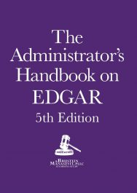
EDGAR Updates
2 CFR PART 200.403 (f)
2 CFR PART 200.406 (b)
Notes:
Buy the EDGAR Book
https://www.bruman.com/publications/

Slide 7
Use of Perkins funds for funding positions at colleges
Perkins Basic Grant Funding for Local Colleges to enhance CTE Programs of Study
Split Time and Effort funding for positions will end June 30, 2022
Questions? - Consult with Regional Perkins Consultant

Slide 8
Automotive Faculty Professional Development - in Planning Stages
Please inform your Automotive faculty
We will be meeting in person or virtually in the fall
Topics to include:
Faculty report out on teaching and strategies used/developed during the pandemic
Enhancing Secondary and Postsecondary Pathways
ASE Accreditation
State-wide association for Automotive Faculty
Perkins Basic Grant funds can be used for this travel

Slide 9
Frank Scuiletti
Program Coordinator: Construction, Engineering, Industrial, Transportation, Criminal Justice,
Fire Protection, & Work-Based Learning
Notes:
Frank Scuiletti
scuilettif@nccommunitycolleges.edu

Slide 10
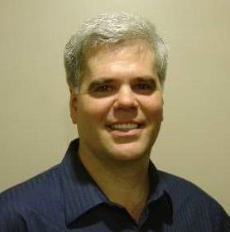
Jim Pressly
Trade, Technology, Engineering, and Industrial Education Consultant: Automotive Service, Collision Repair, Welding, and Metal Manufacturing.
Notes:
919-807-3887
james.pressly@dpi.nc.gov

Slide 11
Serving Special Populations
System Office Goal of: Diversity, Equity and Inclusion in our work
Postsecondary Special Population individuals are defined as an individual who is enrolled in a CTE curriculum program at a community college
Special Populations:
What’s happening at your college or community?
Is there an interest in developing a special strategy at your college?
Do you currently have programs or strategies in this area?
Toward the development of CTE Strategy POS for Special Pops.
Survey of college activities serving Special Populations will be developed.

Slide 12
CTE Programs of Study /Pathways
REMINDER:
December 18, 2021
9-14 CTE Pathways Due in Moodle

Slide 13
Elements of a 9-14 CTE Career Pathway
Aligned to labor market needs, which includes engaged employers
Secondary and postsecondary program of study linkage
Career advising - to develop an individual plan
Education and work-based learning offered concurrently with WIOA
Pathway designed to meet individual needs
Individual earns a postsecondary credential
Individuals enter and advance in a career
Perkins Sec 3(8) which references WIOA (29 U.S.C. 3102) Sec 3(7)

Slide 14
Notes:
https://www.ccs.k12.nc.us/cms/lib/NC50000603/Centricity/Domain/1617/Cumberland%20County%20Career%20Pathways%20Guide_2021_Final.pdf

Slide 15
Notes:
https://www.ccs.k12.nc.us/cms/lib/NC50000603/Centricity/Domain/1617/Cumberland%20County%20Career%20Pathways%20Guide_2021_Final.pdf

Slide 16
Notes:
https://www.ccs.k12.nc.us/cms/lib/NC50000603/Centricity/Domain/1617/Cumberland%20County%20Career%20Pathways%20Guide_2021_Final.pdf

Slide 17
Notes:
https://www.ccs.k12.nc.us/cms/lib/NC50000603/Centricity/Domain/1617/Cumberland%20County%20Career%20Pathways%20Guide_2021_Final.pdf

Slide 18
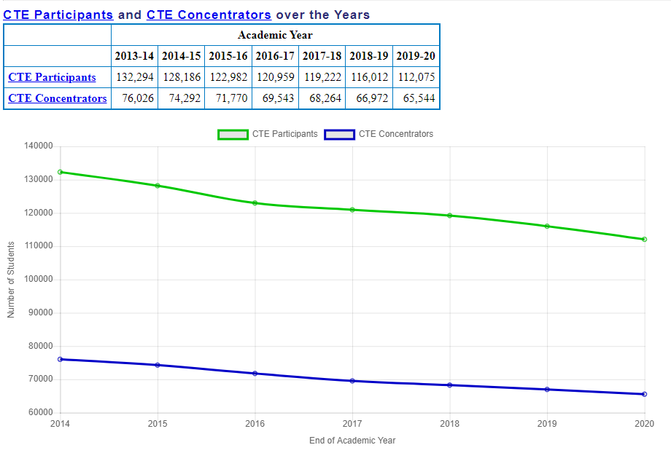
Notes:
https://www.ncperkins.org/data/index.php
A CTE Participant (2020-2025) - is an individual who completes not less than one credit-level course in a CTE program or program of study.
A CTE Concentrator (2020-2025) - is a CTE Participant who has earned at least 12 CTE credits within a CTE program or program of study.

Slide 19
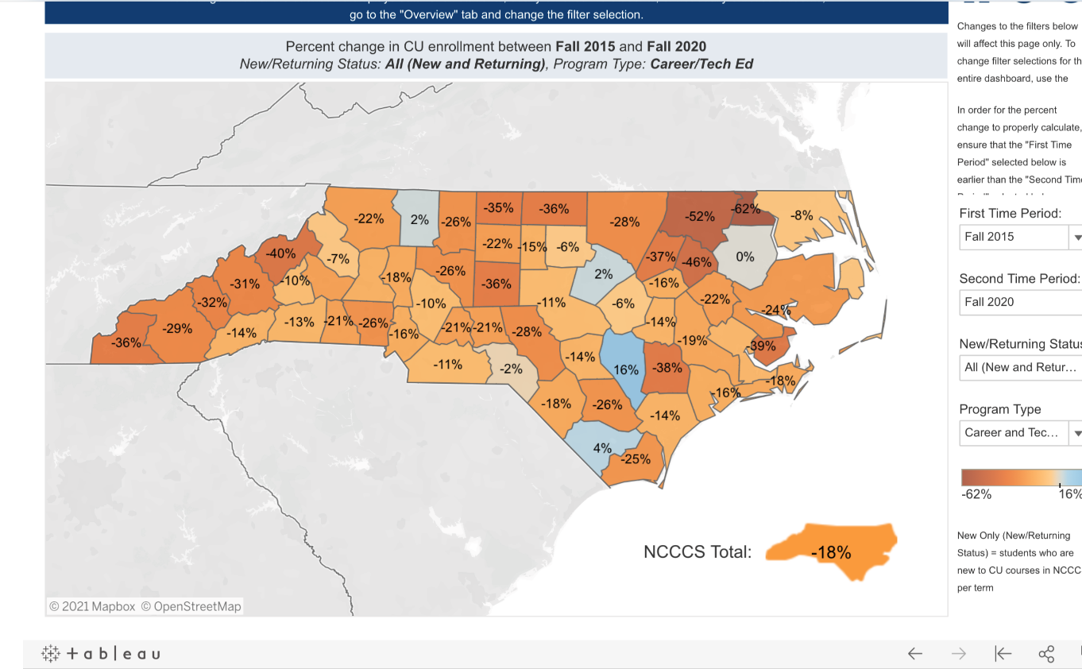
Notes:
https://www.nccommunitycolleges.edu/analytics/dashboards

Slide 20
Pathway to Employment (PTE)
Consider using this program to recruit NC Works Students for Apprenticeship

Slide 21
Higher Education Emergency Relief Fund (HEERF)
US Department of Education program
COVID-19 Emergency Grants for Postsecondary Education
HEERF - Higher Education Emergency Relief Fund
https://www2.ed.gov/programs/heerf/index.html
How are colleges spending these funds?
Notes:
https://www2.ed.gov/programs/heerf/index.html

Slide 22
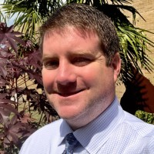
New Staff
Dr. Lane Freeman
Director of Online Learning at North Carolina Community College System

Slide 23
Mid Year Review - Reminder
Power Point –
Update on Activities
Spending
Time Certifications
Semi-Annual Time Certification

Slide 24
EDU Course Development
Objective: To develop content for 5 courses in proposed Residency Certificate included in the application for the NCCCS to become an Educator Preparation Program (EPP). The Residency Certificate will be a stand-alone workforce credential that will allow participants to apply for teaching licensure in NC.
Deliverables:
Syllabus (8-week & 16-week versions)
Lecture Notes/Content
Course Assignments (Major assignments, weekly assignment, discussions)
Assessments
Suggested text list (Open resource and/or textbooks)
Existing Courses
EDU 187 Teaching and Learning for All
EDU 257 Instructional Strategies/Math
EDU 279 Literacy Development and Instruction
New Courses
EDU 272 Technology, Data, and Assessment
EDU 283 Residency to Teacher Licensure
Faculty Resources
2 faculty per course from different colleges

Slide 25
Promising Practice Video 2021
Wilkes Community College
New equipment for hydraulic hose safety, construction, and proper assembly
https://www.ncperkins.org/video/video.php?v=Wilkes-2021&y=2021
See all the videos:
https://www.ncperkins.org/video/
Notes:
August 2021
Wilson
Wilkes
September 2021
Wayne
Vance-Granville
October 2021
Stanly
Southeastern
South Piedmont
Rowan-Cabarrus
Rockingham
Robeson
Pitt-Martin
Pamlico
Nash
Mayland
Lenoir
Johnston
James_Sprunt
Halifax
Gaston
Forsyth
Fayetteville
Edgecombe
Durham
Davidson
Craven
Coastal_Carolina
Central_Piedmont
Carteret
Cape_Fear
Caldwell
Brunswick
Blue_Ridge
Beaufort
AB_Tech

Slide 27
NCETA Conference
NC Employment and Training Association (NCETA)
Breaking New Ground Conference
September 8-10, 2021
Wilmington NC @ Hotel Ballast
https://www.ncperkins.org/nceta/
Notes:
https://www.ncperkins.org/nceta/

Slide 28
Leadership Projects
Continuing Projects
Proposed
CORD
SkillsUSA-NC
Cyber Security
Apple Swift
Success Coach training with Student Services
BLET Curriculum Development
EDU Curriculum review and update
Distance Learning meetings
Career Clusters Guide
Addressing gaps in Equity and other statewide CLNA identified gaps
Marketing CTE
Other Ideas?

Slide 29
MOA
MOA = Ensuring accessible education programs for all
Monitoring this fall at Rockingham Community College
Follow-up with 15 colleges who were recently monitored

Slide 30
Talent Response Meetings
August 12 at 10:00 a.m. Gaston (Gaston College)
August 13 at 1:30 p.m. Lumber River (Robeson, Bladen, Richmond, Sandhills)
August 16 at 10:00 a.m. North Eastern (Roanoke-Chowan, COA, Beaufort)
August 23 at 10 a.m. Region C (Isothermal, Cleveland, McDowell)
August 25 at 10:00 a.m. Regional Partnership (Durham, Randolph, Montgomery, Sandhills, Alamance)
Sept 13 at 10 am Triangle South (Central Carolina, Sampson)
Sept 14 at 1:30 Eastern (Craven, James Sprunt, Pamlico, Coastal, Lenoir, Wayne, Carteret)
Sept 20 at 10 am Mountain Area (AB Tech, Blue Ridge)
Sept 21 at 1:30 Piedmont Triad (Forsyth, Surry, Davidson-Davie, Rockingham, Piedmont)
Sept 22 at 10 am River East (Beaufort, Pitt, Martin)
Sept 23 at 9:30 am Centralina (SPCC, RCCC, Stanly, Mitchell, Gaston)
Sept 24 at 10 am - Capital Area (Wake, Johnston)
Notes:
Contact Alex Doles <dolesa@nccommunitycolleges.edu> for a Zoom link for each meeting.
12 - 10 am - 11:30 - Gaston (Gaston College)
13 - 1:30 -3pm - Lumber River (Robeson, Bladen, Richmond, Sandhills)
16 - 10 am - 11:30 – North Eastern (Roanoke-Chowan, COA, Beaufort)
23 - 10 am - 11:30 - Region C (Isothermal, Cleveland, McDowell)
25 - 10 am - 11:30 - Regional Partnership (Durham, Randolph, Montgomery, Sandhills, Alamance)
Sept
13 - 10 am - 11:30 – Triangle South (Central Carolina, Sampson)
14 - 1:30 - 3pm – Eastern (Craven, James Sprunt, Pamlico, Coastal, Lenoir, Wayne, Carteret)
20 - 10 am - 11:30 - Mountain Area (AB Tech, Blue Ridge)
21 - 1:30 - 3pm - Piedmont Triad (Forsyth, Surry, Davidson-Davie, Rockingham, Piedmont)
22 - 10 am - 11:30 - River East (Beaufort, Pitt, Martin)
23 - 9:30 - 11am - Centralina (SPCC, RCCC, Stanly, Mitchell, Gaston)
24 - 10 am - 11:30 - Capital Area (Wake, Johnston)

Slide 31
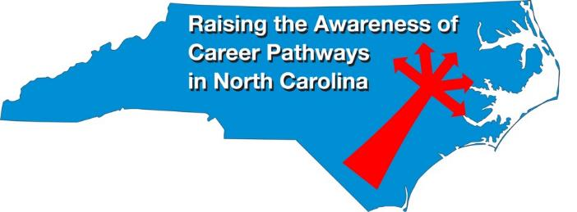
Raising the Awareness of Career Pathways Webinars
August 18, 2021 @ 9am
Come explore careers in Diesel Mechanics
https://register.gotowebinar.com/register/7346222427142833168
See all upcoming and past webinars at https://www.ncperkins.org/presentations/

Slide 32
Perkins Updates
2nd Tuesday of the month
9 am
Via GoToWebinar
Find the registration links at NCperkins.org/presentations
Notes:
Register now and let the system remind you.

Slide 33
CTE Training
Training online - www.ncperkins.org
Perkins Update Webinars - Second Tuesday
Career Pathways Webinars - Third Wednesday
Additional webinars on popular topics:
CLNA
Programs of Study
Career Pathways
At your College by request
https://www.ncperkins.org/presentations/
Notes:
https://www.ncperkins.org/presentations/

Slide 34
Technical assistance is available
We are here to help!
Team Perkins is available by phone, email, TEAMS, etc.
Your CTE Coordinator will be traveling to your college throughout the year.

Slide 35
Perkins/CTE State Staff
Dr. Bob Witchger Director, Career & Technical Education WitchgerB@nccommunitycolleges.edu 919-807-7126
Dr. Tony R. Reggi Coordinator, Career & Technical Education ReggiA@nccommunitycolleges.edu 919-807-7131
Patti Coultas Coordinator, Career & Technical Education CoultasP@nccommunitycolleges.edu 919-807-7130
Dr. Mary Olvera Coordinator, Career & Technical Education OlveraM@nccommunitycolleges.edu 919-807-7120
Michelle Lair Coordinator, CCP and Career & Technical Education LairM@nccommunitycolleges.edu 919-807-7227
Chris Droessler Coordinator, Career & Technical Education DroesslerC@nccommunitycolleges.edu 919-807-7068
Darice McDougald CTE Administrative Assistant McDougaldD@nccommunitycolleges.edu 919-807-7219
Notes:
http://www.ncperkins.org/course/view.php?id=6

