Slide 1

Perkins Annual Meeting for
2021-2022 Academic Year
April 13, 2021

Slide 2
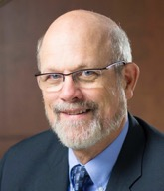
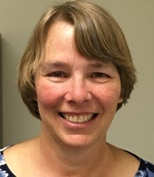

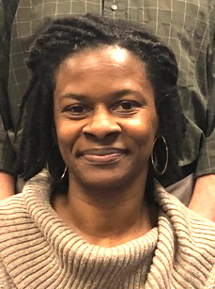
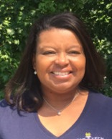
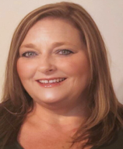
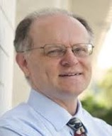
Team Perkins
Bob Witchger
Patti Coultas
Tony Reggi
Darice McDougald
Michelle Lair
Mary Olvera
Chris Droessler
Notes:
Dr. Bob Witchger
919-807-7126
WitchgerB@nccommunitycolleges.edu
Dr. Tony R. Reggi
919-807-7131
ReggiA@nccommunitycolleges.edu
Patti Coultas
919-807-7130
CoultasP@nccommunitycolleges.edu
Dr. Mary Olvera
919-807-7120
OlveraM@nccommunitycolleges.edu
Michelle Lair
919-807-72227
LairM@nccommunitycolleges.edu
Chris Droessler
919-807-7068
DroesslerC@nccommunitycolleges.edu
Darice McDougald
919-807-7219
McDougaldD@nccommunitycolleges.edu

Slide 3
COVID-19 Follow Up
How are you all doing?
What’s happening at your College?
What can we do to assist you?

Slide 4
Purpose of Perkins
Develop more fully the academic knowledge and technical and employability skills of secondary education students and postsecondary education students who elect to enroll in CTE programs and programs of study
Notes:
The Strengthening Career and Technical Education for the 21st Century Act reauthorized and updated the Carl D. Perkins Career and Technical Education Act of 2006 to become the current Carl D. Perkins Career and Technical Education Act of 2006 as amended by the Strengthening Career and Technical Education for the 21st Century Act (Perkins V)
This updated act stresses:
- Academic, Technical, and Employability Skills
- Funding Secondary and Postsecondary CTE
- Focusing on Students who elect to enroll in CTE Programs of Study

Slide 5
Welcome
Dr. Kimberly Gold
Senior Vice President/Chief Academic Officer

Slide 6
Welcome
Lisa Mabe Eads, Ph.D.
Associate Vice President of Programs

Slide 7
Overview
Dr. Bob Witchger
Director of Career and Technical Education

Slide 8
Monthly Updates
NC-Net
SkillsUSA
Pathways Seminar
EDU Course Development
Budget Modification Deadlines
Leadership Projects
Apprenticeship Conference
Performance Management Conference
Negotiated Levels of Performance
End of year Reviews – sign up

Slide 9
NC-NET.info
Ann-Claire Anderson
Center for Occupational Research and Development (CORD)
https://www.nc-net.info/
Notes:
Ann-Claire Anderson might have PowerPoint to show or show website on her computer

Slide 10
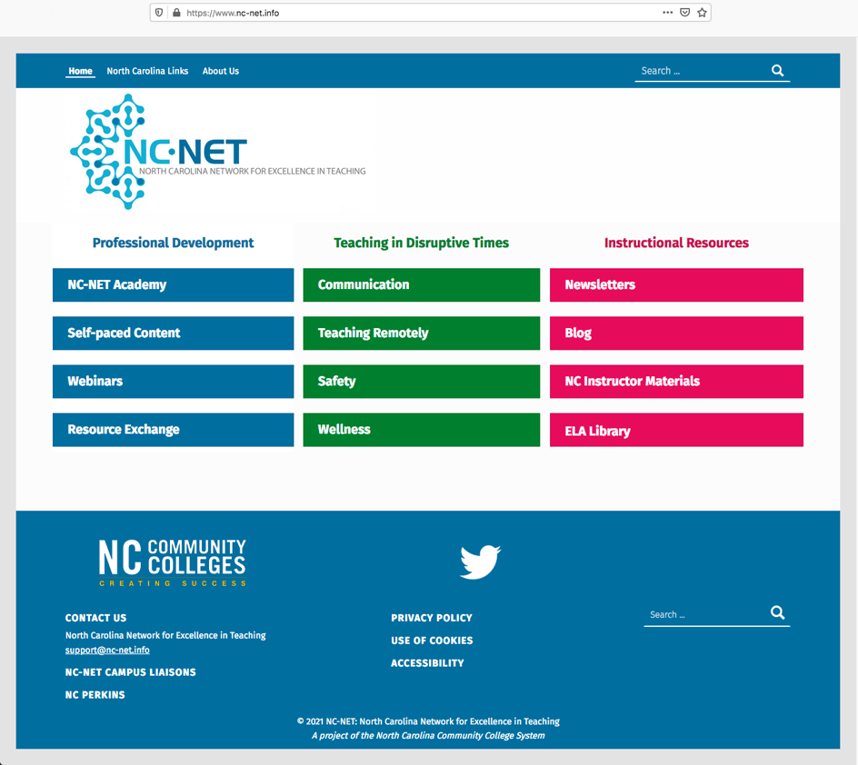
NC-Net.info
Notes:
https://www.nc-net.info/

Slide 11

SkillsUSA – North Carolina
Tony-10
Paul Heidepriem, Executive Director
Rod Lykins, Director of Membership & Curriculum
https://www.skillsusanc.org/
Notes:
https://www.skillsusanc.org/

Slide 12
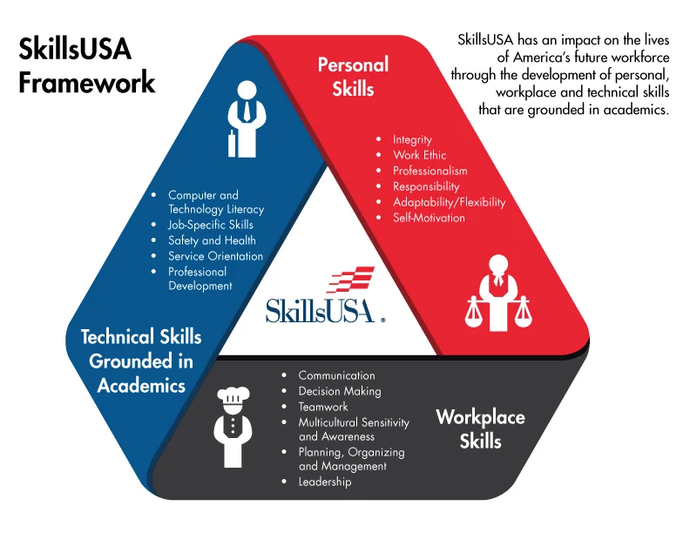
SkillsUSA North Carolina
Notes:
https://www.skillsusanc.org/

Slide 13

Michelle
Michelle 10

Slide 14

EDU Course Development
Mary
Mary - 10
Objective: To develop content for 5 courses in proposed Residency Certificate included in the application for the NCCCS to become an Educator Preparation Program (EPP). The Residency Certificate will be a stand-alone workforce credential that will allow participants to apply for teaching licensure in NC.
Deliverables:
Syllabus (8-week & 16-week versions)
Lecture Notes/Content
Course Assignments (Major assignments, weekly assignment, discussions)
Assessments
Suggested text list (Open resource and/or textbooks)
Existing Courses
EDU 187 Teaching and Learning for All
EDU 257 Instructional Strategies/Math
EDU 279 Literacy Development and Instruction
New Courses
EDU 272 Technology, Data, and Assessment
EDU 283 Residency to Teacher Licensure
Faculty Resources
2 faculty per course from different colleges

Slide 15

Budget Modifications
All modifications must be
submitted by May 15th

Slide 16
Leadership Projects
Continuing Projects
Proposed
CORD
SkillsUSA-NC
Pathways to Employment
Amy Climer Course for CTE Faculty
Success Coach training with Student Services
Curriculum Development
Addressing gaps in Equity and other statewide CLNA identified gaps
Marketing CTE
Other Ideas?
Notes:
https://www.skillsusanc.org/

Slide 17
2021 ApprenticeshipNC Conference
Chris 2
April 27 and 28 virtual conference
8:30 to 12:30 each day
Free
https://www.apprenticeshipnc.com/events/2021-apprenticeshipnc-annual-conference
Notes:
https://www.apprenticeshipnc.com/events/2021-apprenticeshipnc-annual-conference

Slide 18
Michelle 5

Slide 19
Negotiated Levels of Performance
Time to negotiate level or goal for 2021-2022 academic year
https://www.ncperkins.org/data/negotiation_form.php
  1P1 - Postprogram Placement
  2P1 - Earned Recognized Postsecondary Credential
  3P1 - Nontraditional Program Concentration

Slide 20
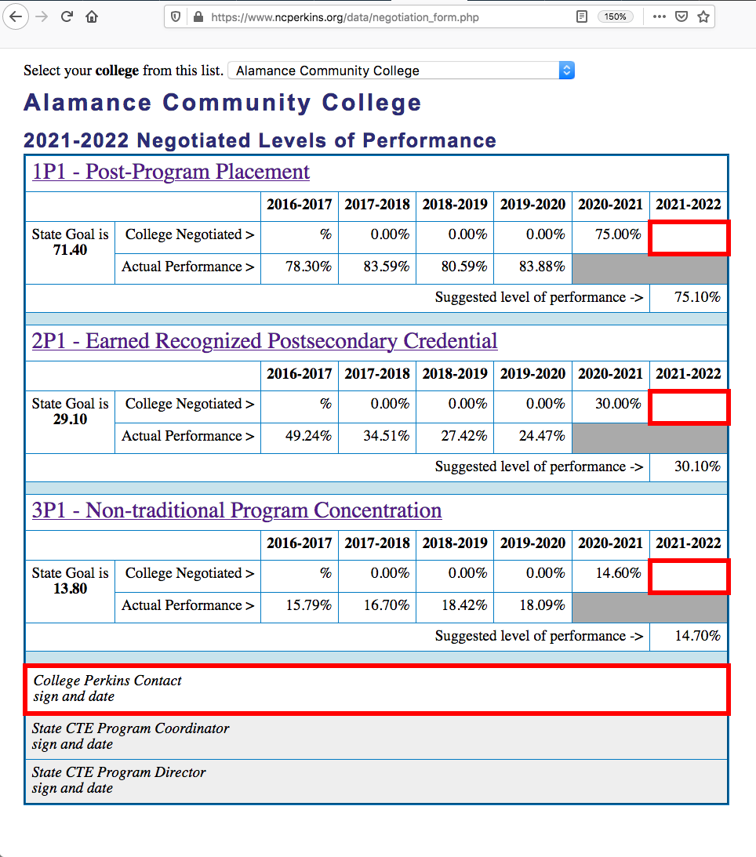
https://www.ncperkins.org/data/negotiation_form.php
Select your college from dropdown
Print the page
Fill in three red rectangles
Sign in bottom red rectangle
Scan to PDF
Upload to the Moodle
Notes:
https://www.ncperkins.org/data/negotiation_form.php

Slide 21
1P1 Postprogram Placement
New State Wage Interchange System (SWIS) allows states to access employment wage data from other states.
If your graduates are employed outside of NC, they can now be counted in 1P1.
This applies mostly to our border colleges.
We still cannot access employment data for federal employees or
self-employed, independent contractors, freelancers, and gig workers.
Notes:
https://www.dol.gov/agencies/eta/performance/swis

Slide 22
End-of-Year Reviews – May 24-June 11
Sign up for college presentation:
https://www.ncperkins.org/review/
special consideration = Pathways
Sign up for each person to view sessions:
https://www.ncperkins.org/presentations/
Promising practice video:
5-minutes or less. Highlight one thing you did with Perkins funds and how it made a difference in student learning.

Slide 23

Notes:
https://www.ncperkins.org/

Slide 24
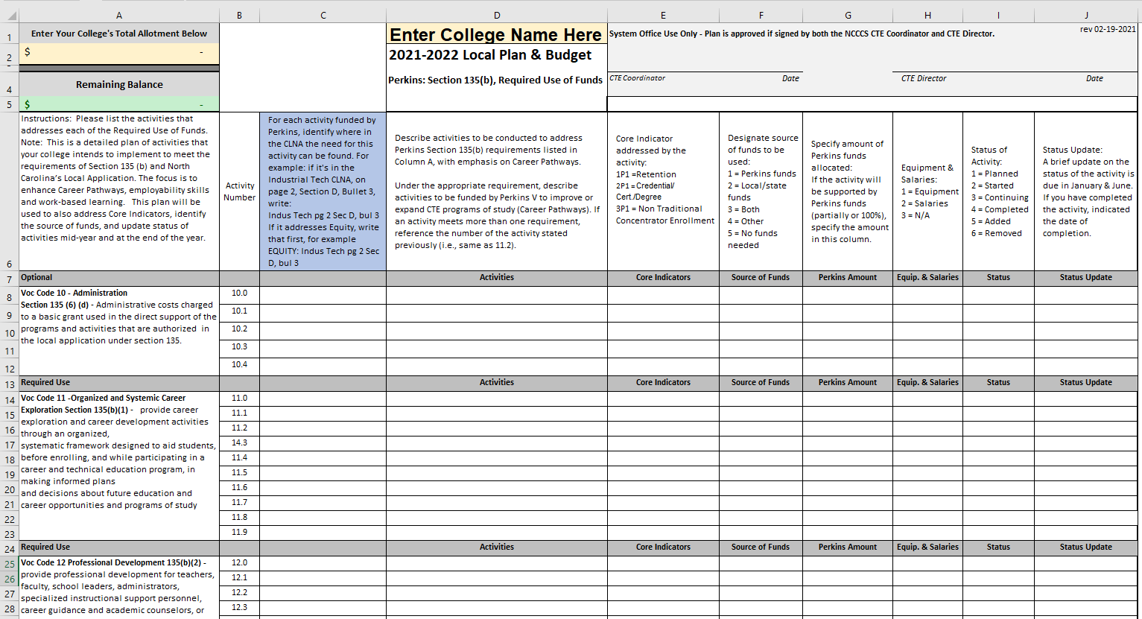
2021-22 NEW Plan Template

Slide 25
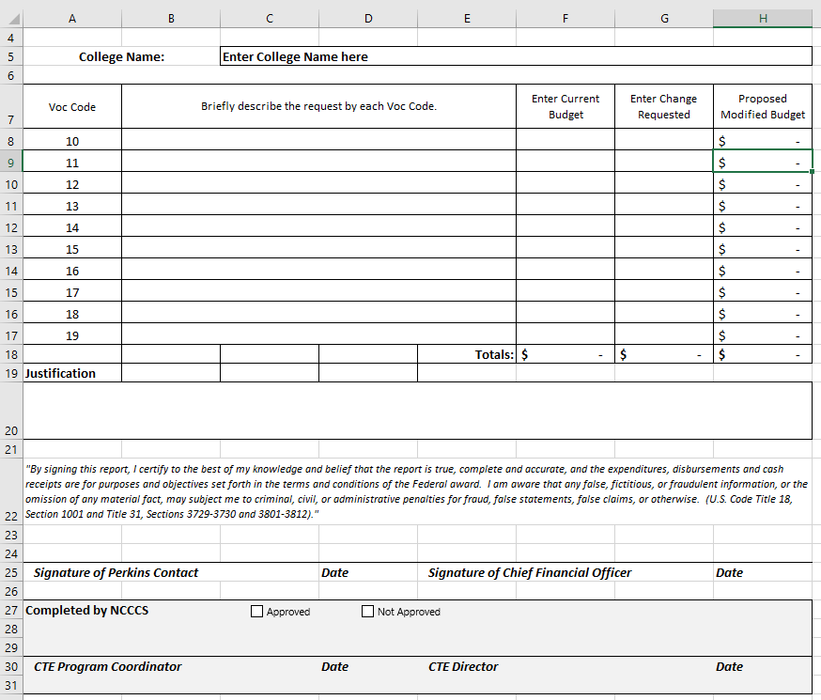
Budget Modifications

Slide 26
Allocations
Budget for 2021-2022
Estimated Budget

Slide 27
Perkins/CTE State Staff
Dr. Bob Witchger Director, Career & Technical Education
WitchgerB@nccommunitycolleges.edu 919-807-7126
Dr. Tony R. Reggi Coordinator, Career & Technical Education
ReggiA@nccommunitycolleges.edu 919-807-7131
Patti Coultas Coordinator, Career & Technical Education
CoultasP@nccommunitycolleges.edu 919-807-7130
Dr. Mary Olvera Coordinator, Career & Technical Education
OlveraM@nccommunitycolleges.edu 919-807-7120
Michelle Lair Coordinator, CCP and Career & Technical Education
LairM@nccommunitycolleges.edu 919-807-7227
Chris Droessler Coordinator, Career & Technical Education
DroesslerC@nccommunitycolleges.edu 919-807-7068
Darice McDougald CTE Administrative Assistant
McDougaldD@nccommunitycolleges.edu 919-807-7219
Notes:
http://www.ncperkins.org/course/view.php?id=6

