Slide 1
March 17, 2021 Careers in Simulation and Game Development
Download the PowerPoint and access the recording: www.ncperkins.org/presentations
Notes:
Chris
We are here to help promote the great jobs, often unknown, in the great state of North Carolina.
Through these monthly meetings, we are going to let you know about some great career opportunities in North Carolina.
And bring in special guests to let you know about the great career opportunities in North Carolina.
Please download this PowerPoint file and use it anyway you can to help get folks on a career pathway.
The reference showing from where the information was found, as well as the contact information for our guests is in the Notes section under each slide.
Get the PowerPoint on our NCPerkins.org website on our Presentations and Webinars page.
Here is the direct address on the screen.
-----
Many of the videos shown during this webinar can be found here:
https://www.ncperkins.org/video/

Slide 2
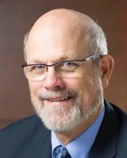
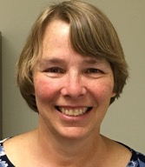
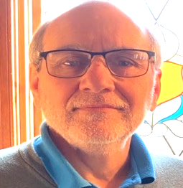
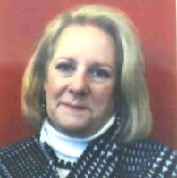
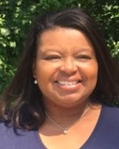
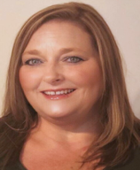
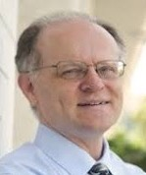
Raising the Awareness of Career Pathways in North Carolina
Bob Witchger
Patti Coultas
Tony Reggi
Cheryl Cox
NC Dept of Public Instruction
Michelle Lair
Mary Olvera
Chris Droessler
Notes:
Chris
I always say our webinars are like radio but with pictures.
And here are a few pictures of your hosts for these monthly explorations into career pathways.
(Why does the photographer have the best photo?)
Our contact information is in the notes section under this slide.
Dr. Bob Witchger
919-807-7126
WitchgerB@nccommunitycolleges.edu
Dr. Tony R. Reggi
919-807-7131
ReggiA@nccommunitycolleges.edu
Patti Coultas
919-807-7130
CoultasP@nccommunitycolleges.edu
Dr. Mary Olvera
919-807-7120
OlveraM@nccommunitycolleges.edu
Michelle Lair
919-807-72227
LairM@nccommunitycolleges.edu
Chris Droessler
919-807-7068
DroesslerC@nccommunitycolleges.edu
Cheryl Cox
NC Department of Public Instruction
919-807-3814
Cheryl.Cox@dpi.nc.gov

Slide 3
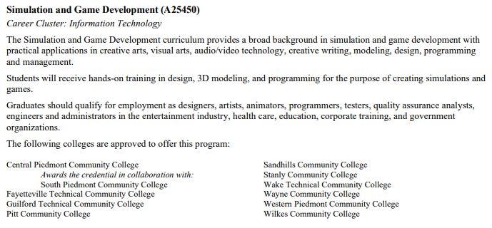
Community College Programs
Notes:
www.ncperkins.org/presentations

Slide 4
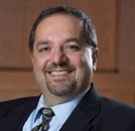
Dr. Hilmi Lahoud
Senior Program Administrator – Business and Information Technology Programs
NC Community College System Office
Notes:
Hilmi A. Lahoud, Ph.D. Senior Program Administrator, Business and Information Technology Programs
Academic and Student Services North Carolina Community College System 5016 Mail Service Center Raleigh, NC 27699-5016 Phone: 919-807-7116 Fax: 919-807-7173
lahoudh@nccommunitycolleges.edu
https://www.nccommunitycolleges.edu/sites/default/files/academic-programs/curriculum-standards/attachments/a25590_information_technology_fa2017v5.pdf

Slide 5
Notes:
www.ncperkins.org/presentations

Slide 6
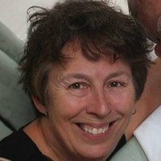
Cindy Foster
Department Head & Senior Professor, Simulation & Game Development
Wake Technical Community College
Notes:
Cindy Foster
Department Head & Senior Professor, Simulation & Game Development
Wake Technical Community College
crfoster@waketech.edu
919-866-5390

Slide 7
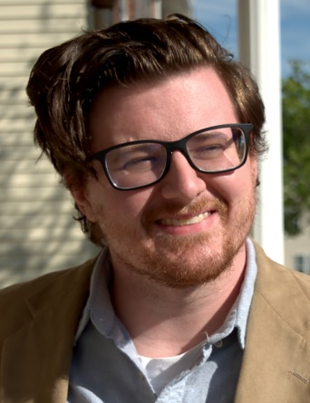
Thomas Hopfer
Simulation and Game Development Instructor
Wake Technical Community College
Notes:
Thomas Hopfer, Wake Tech, formerly at Wayne CC, and formerly employed at EPIC Games
tghopfer@waketech.edu

Slide 8
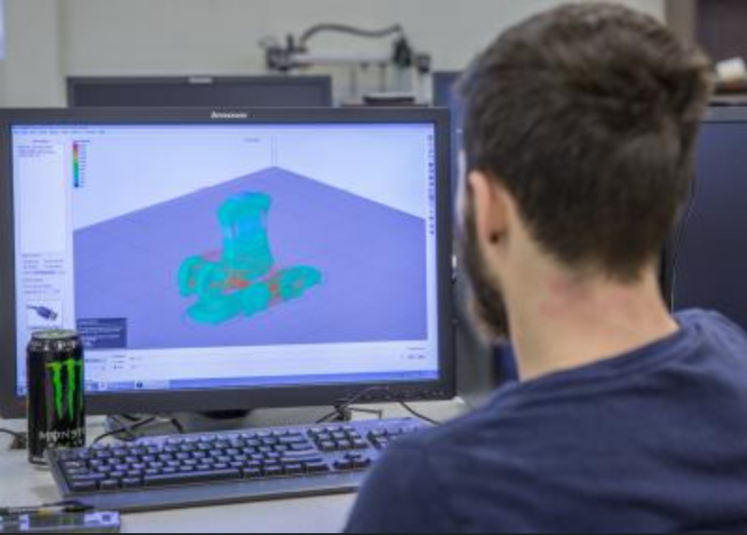
Notes:
Cindy Foster
Department Head & Senior Professor, Simulation & Game Development
Wake Technical Community College
crfoster@waketech.edu
919-866-5390

Slide 9
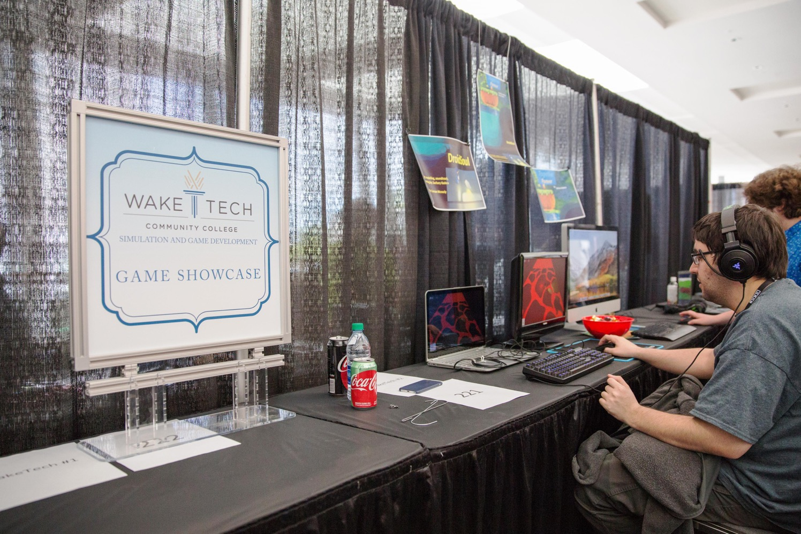
Notes:
Cindy Foster
Department Head & Senior Professor, Simulation & Game Development
Wake Technical Community College
crfoster@waketech.edu
919-866-5390

Slide 10
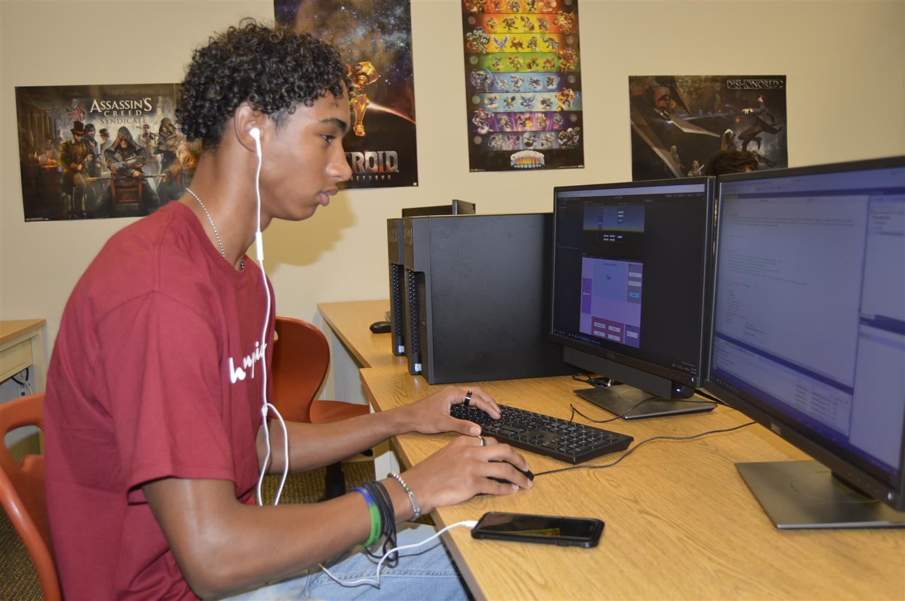
Notes:
Cindy Foster
Department Head & Senior Professor, Simulation & Game Development
Wake Technical Community College
crfoster@waketech.edu
919-866-5390

Slide 11
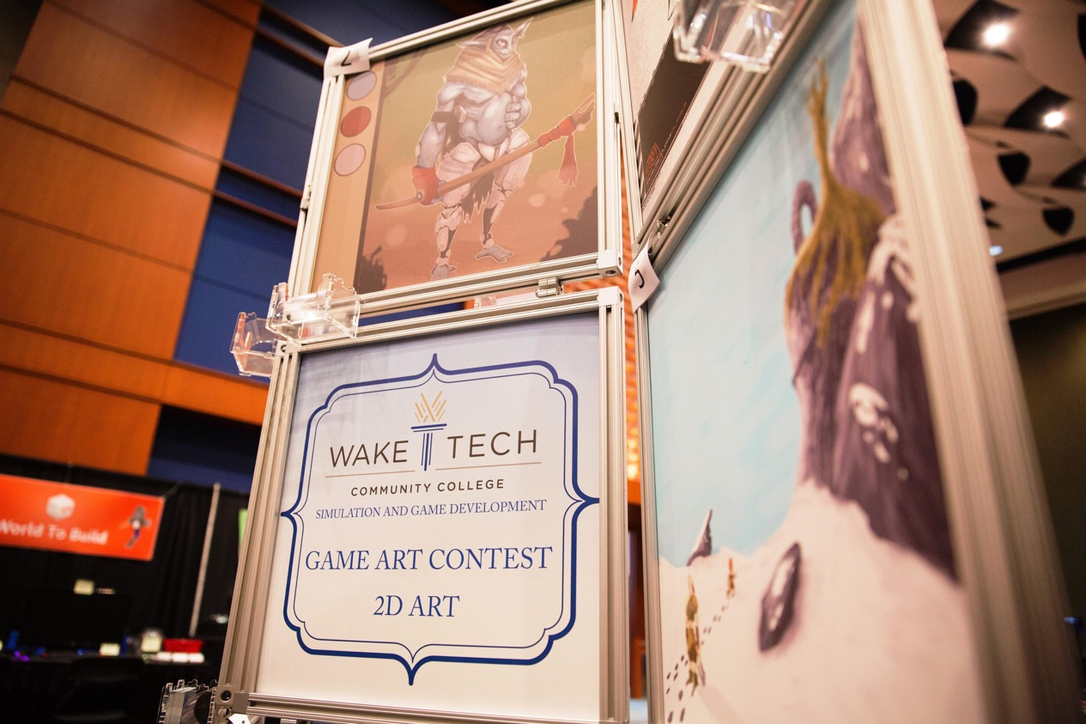
Notes:
Cindy Foster
Department Head & Senior Professor, Simulation & Game Development
Wake Technical Community College
crfoster@waketech.edu
919-866-5390

Slide 12
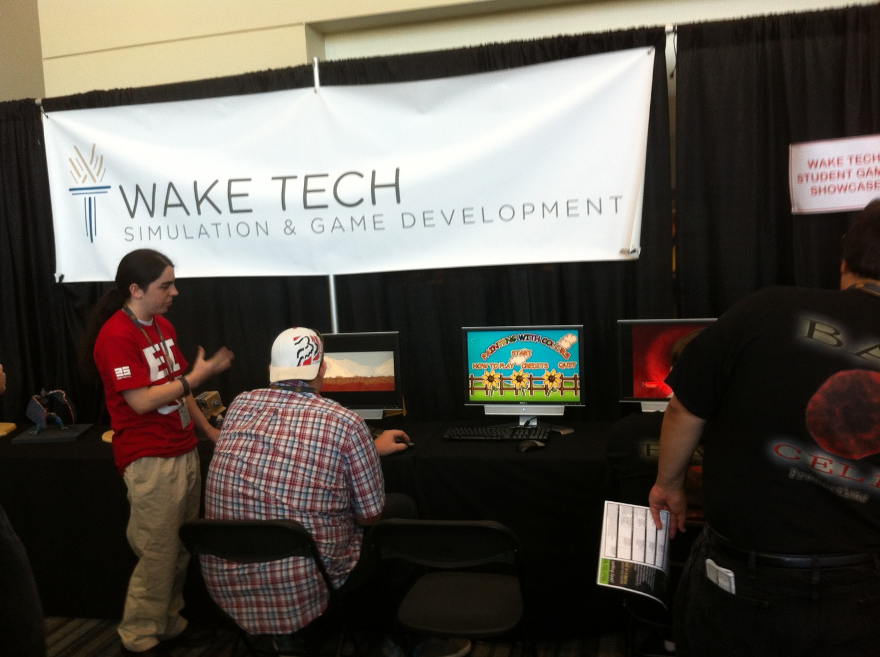
Notes:
Cindy Foster
Department Head & Senior Professor, Simulation & Game Development
Wake Technical Community College
crfoster@waketech.edu
919-866-5390

Slide 13
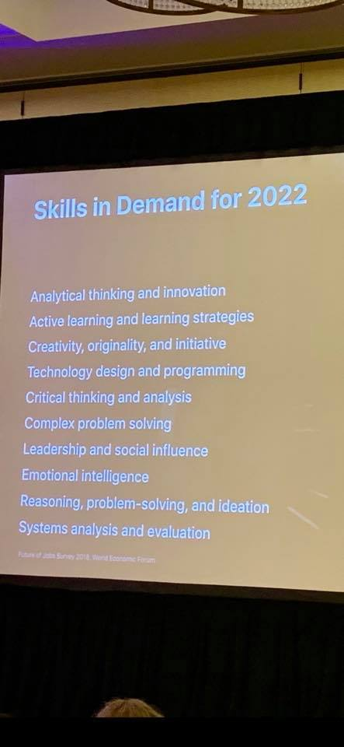
Notes:
Cindy Foster
Department Head & Senior Professor, Simulation & Game Development
Wake Technical Community College
crfoster@waketech.edu
919-866-5390

Slide 14
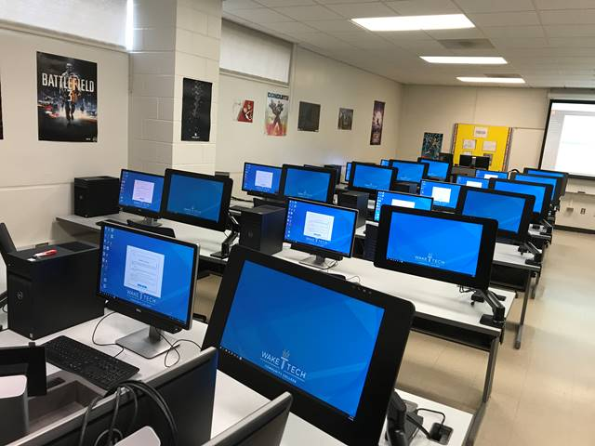
Notes:
Cindy Foster
Department Head & Senior Professor, Simulation & Game Development
Wake Technical Community College
crfoster@waketech.edu
919-866-5390

Slide 15
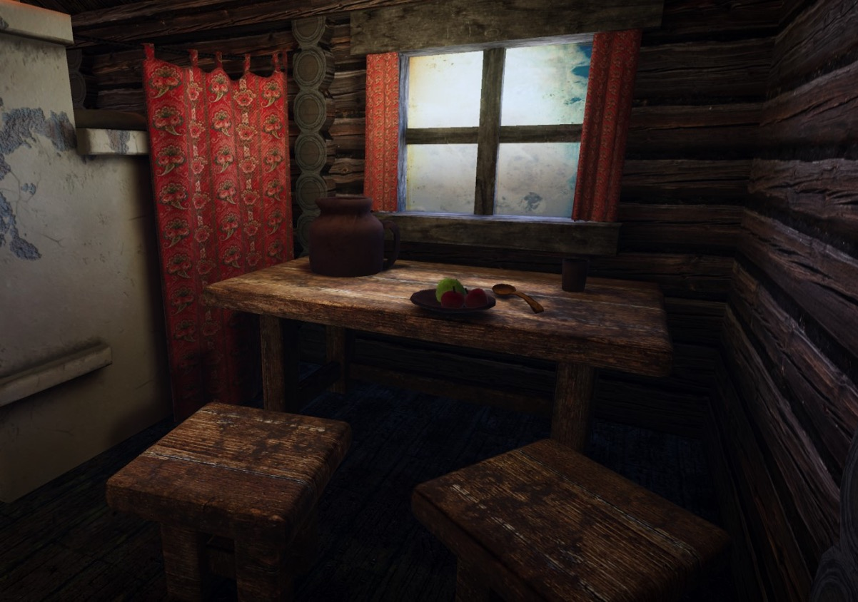
Notes:
Cindy Foster
Department Head & Senior Professor, Simulation & Game Development
Wake Technical Community College
crfoster@waketech.edu
919-866-5390

Slide 16
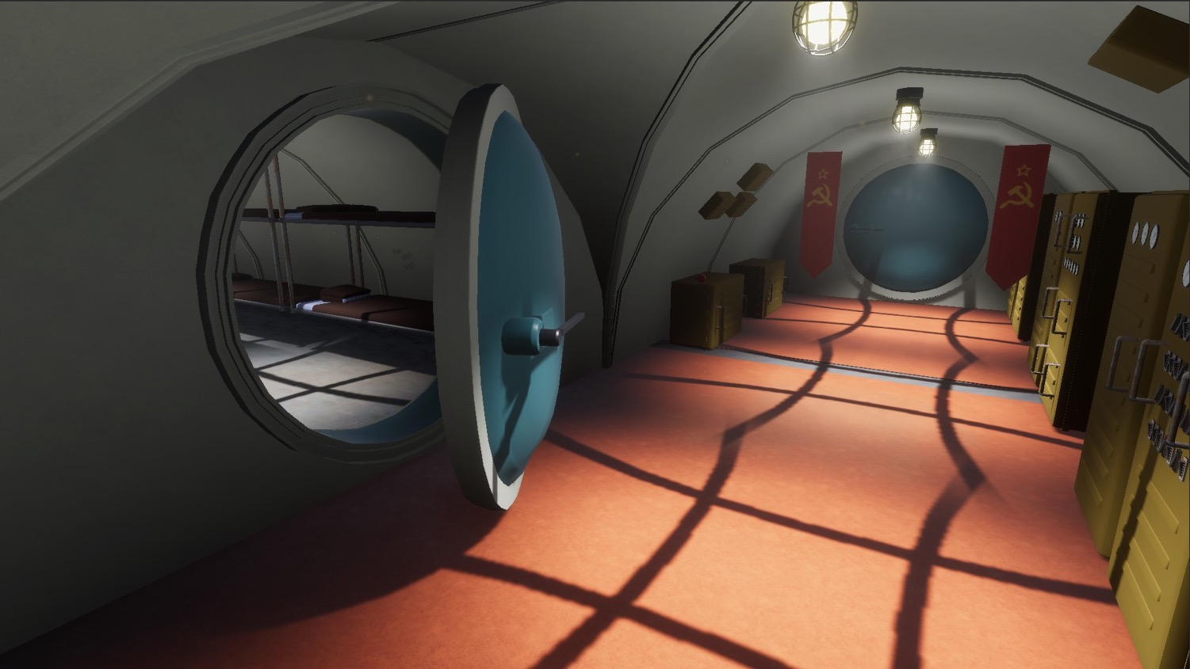
Notes:
Cindy Foster
Department Head & Senior Professor, Simulation & Game Development
Wake Technical Community College
crfoster@waketech.edu
919-866-5390

Slide 17
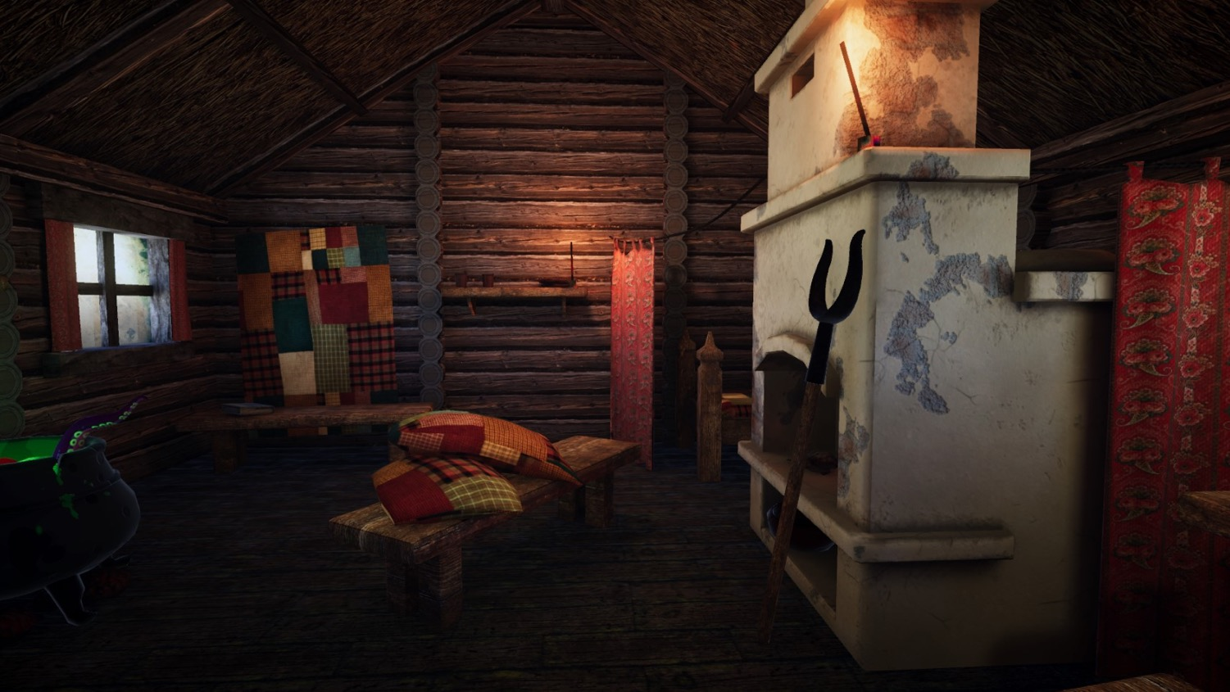
Notes:
Cindy Foster
Department Head & Senior Professor, Simulation & Game Development
Wake Technical Community College
crfoster@waketech.edu
919-866-5390

Slide 18
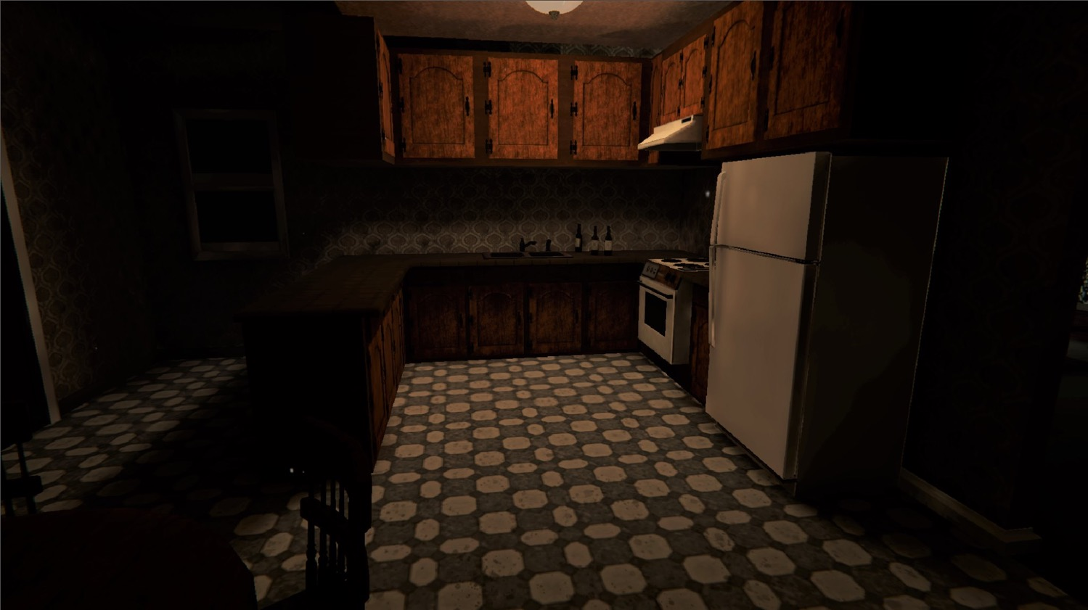
Notes:
Cindy Foster
Department Head & Senior Professor, Simulation & Game Development
Wake Technical Community College
crfoster@waketech.edu
919-866-5390

Slide 19
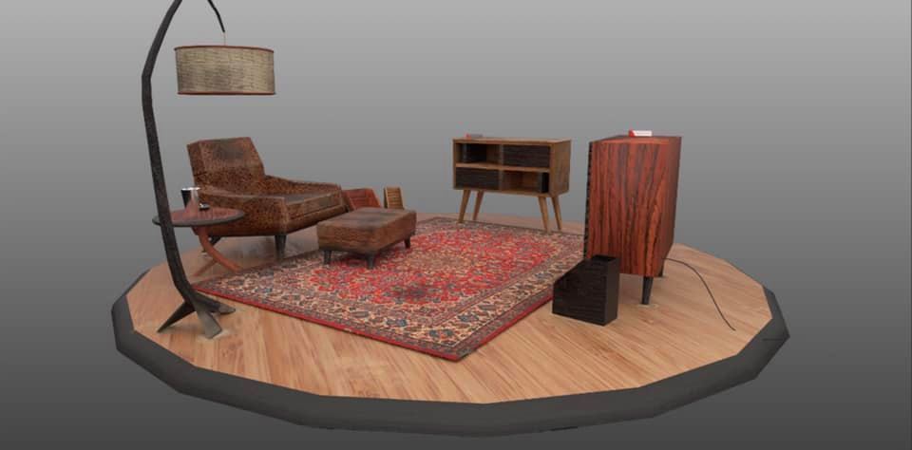
Notes:
Cindy Foster
Department Head & Senior Professor, Simulation & Game Development
Wake Technical Community College
crfoster@waketech.edu
919-866-5390

Slide 20
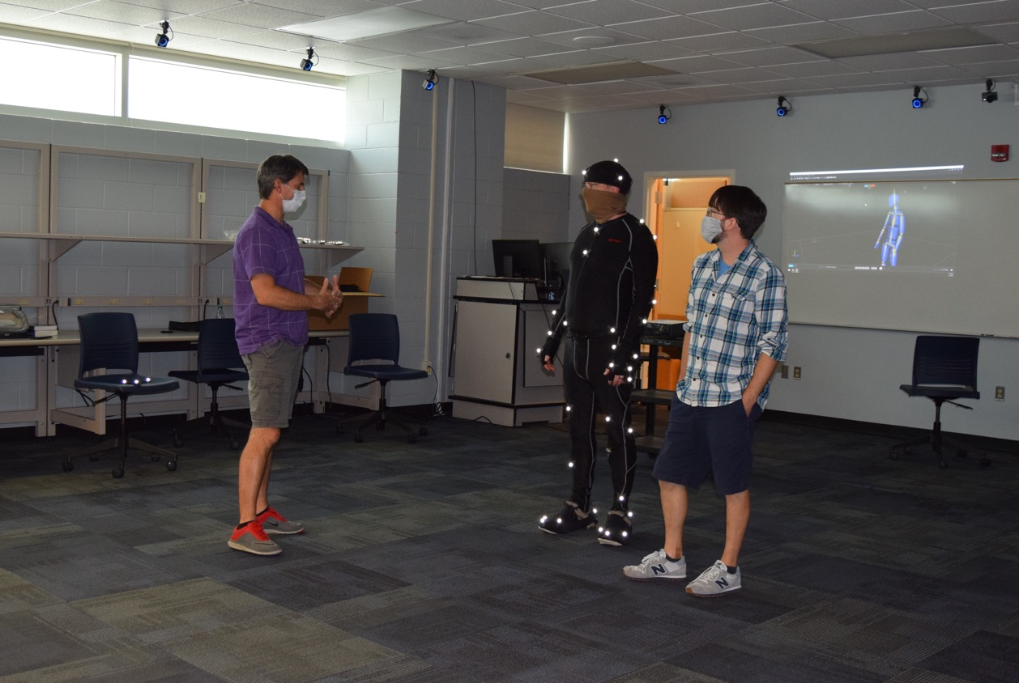
Notes:
Cindy Foster
Department Head & Senior Professor, Simulation & Game Development
Wake Technical Community College
crfoster@waketech.edu
919-866-5390

Slide 21
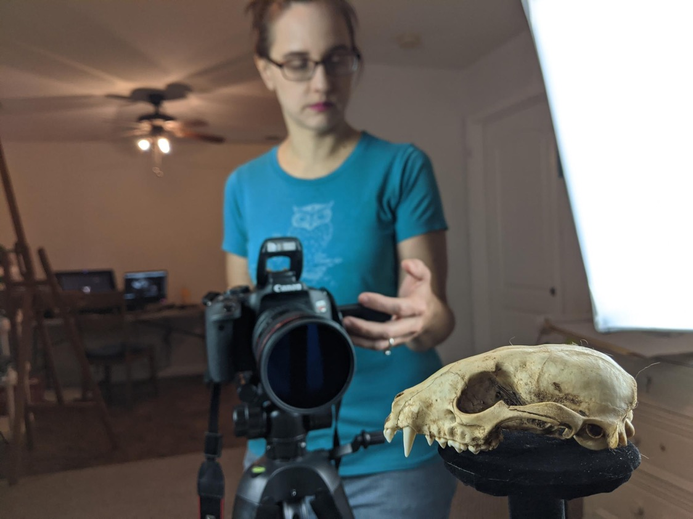
Notes:
Cindy Foster
Department Head & Senior Professor, Simulation & Game Development
Wake Technical Community College
crfoster@waketech.edu
919-866-5390

Slide 22
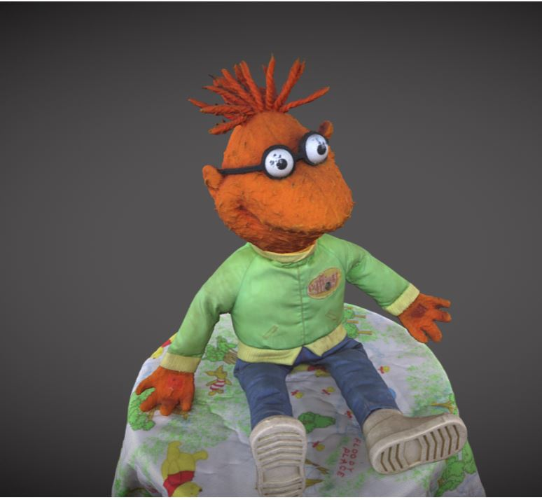
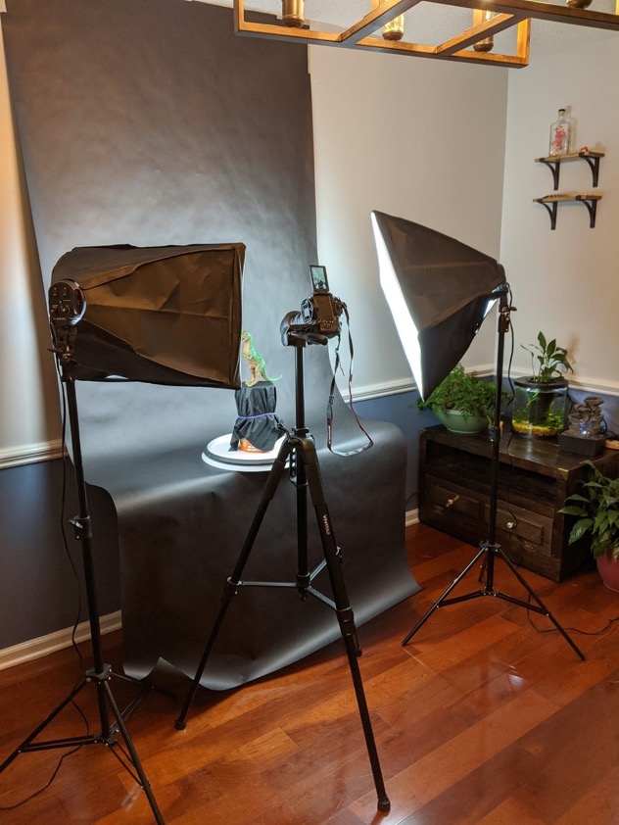
Notes:
Cindy Foster
Department Head & Senior Professor, Simulation & Game Development
Wake Technical Community College
crfoster@waketech.edu
919-866-5390

Slide 23
Notes:
www.ncperkins.org/presentations

Slide 24
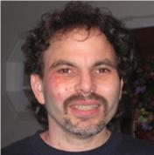
Stephen Umland
Department Chair, Simulation and Game Development and Digital Media Technology
Fayetteville Technical Community College
Notes:
Stephen Umland
Originally from New York City, Stephen’s formal education centered on science and engineering and culminated in the completion of degrees in Atmospheric Science and Mechanical Engineering. He has worked for various government agencies and has been involved in research in energy, military weaponry, and air pollution. He relocated to North Carolina since the 1990 and I have worked for NCCCS since 1996 as a continuing education and curriculum instructor. He has been involved in Fayetteville Technical Community College’s SGD department since 2010, assuming the role of department chair in 2012 and has grown and shaped the program since then. He has been involved in military board gaming since age 12 as hobby and sideline.
Education: Degrees in Atmospheric Science and Mechanical Engineering.
Experience: 24 years in the North Carolina Community College System as a technology instructor.
Gaming Experience: Designed, developed, and play-tested military and historical board games.
Stephen W. Umland Department Chair
Simulation and Game Development and Digital Media Technology
Fayetteville Technical Community College Office: Advanced Technology Center Room 244D Phone: (910) 678-9792 Email: umlands@faytechcc.edu

Slide 25
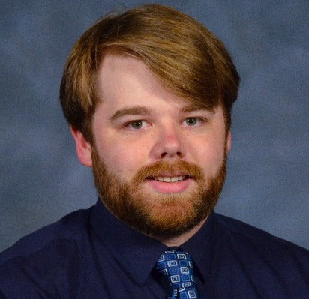
David Joyner
Simulation and Game Development Instructor
Fayetteville Technical Community College
Notes:
David Joyner
David Joyner is a Simulation and Game Development Instructor who teaches animation, 3D modeling, character design at Fayetteville Technical Community College. David believes that hands-on instruction and cooperative project development are crucial to preparing students for a role within the simulation and game industries. In addition to teaching SGD courses, he has developed content for and taught courses within Digital Media Technology, 3D Printing, and PC Support & Services, along with holding extracurricular workshops and labs for students to improve their skills and promote personal growth. In 2021, he also received the NISOD Excellence Award. David holds a BA in Animation and Game Design from the Living Arts College and is currently working to complete his MFA in Animation at the Savannah College of Art & Design.
joynerd@faytechcc.edu
(910) 678-0099

Slide 26
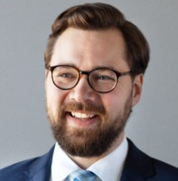
Tim French
Digital Media Instructor
Fayetteville Technical Community College
Notes:
Tim French
Mr. French is an educator and marketing strategist with a results-driven focus, an interest in building teams, refining processes, and curiosity for the new and untested. He has worked with advertising and media agencies in New York, Washington, DC, and throughout the south on projects for the CDC, FDA, BMW, Freightliner, BH Media, International Justice Mission, the National Science Teaching Association, and many others. What started as an interest in graphic design as a form of communication broadened to a fascination with communication technologies and the way people explore and share. Finding ways to reach people at the right time and place with the right content, product, or service never tires him.
Education: Degrees in Atmospheric Science and Mechanical Engineering.
Experience: 24 years in the North Carolina Community College System as a technology instructor.
Gaming Experience: Designed, developed, and play-tested military and historical board games.
frencht@faytechcc.edu
(910) 486-7367

Slide 27
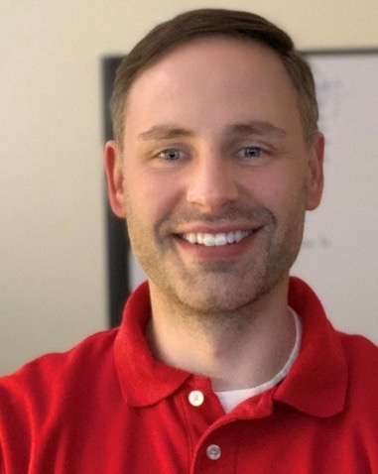
Aaron Mabe
Career and College Promise Coordinator
Fayetteville Technical Community College
Notes:
Aaron Mabe
mabes@faytechcc.edu
Career and College Promise Coordinator
Fayetteville Technical Community College
Link to college CCP webpage(s):
https://www.faytechcc.edu/academics/high-school-connections/

Slide 28
Simulation and Game Development at FTCC
CCP Simulation and Game Development at FTCC flyer: http://www2.faytechcc.edu/hsc/HSC-Simulation-and-Game-Development.pdf
FTCC Simulation & Game Development Department: https://www.faytechcc.edu/academics/computer-information-technology-programs/simulation-game-development/
Notes:
Aaron Mabe
mabes@faytechcc.edu
Career and College Promise Coordinator
Fayetteville Technical Community College
Simulation and Game Development at FTCC: http://www2.faytechcc.edu/hsc/HSC-Simulation-and-Game-Development.pdf
FTCC Simulation & Game Development Department:
https://www.faytechcc.edu/academics/computer-information-technology-programs/simulation-game-development/

Slide 29
Notes:
Aaron Mabe
mabes@faytechcc.edu
Career and College Promise Coordinator
Fayetteville Technical Community College
Simulation and Game Development at FTCC: http://www2.faytechcc.edu/hsc/HSC-Simulation-and-Game-Development.pdf
FTCC Simulation & Game Development Department:
https://www.faytechcc.edu/academics/computer-information-technology-programs/simulation-game-development/

Slide 30
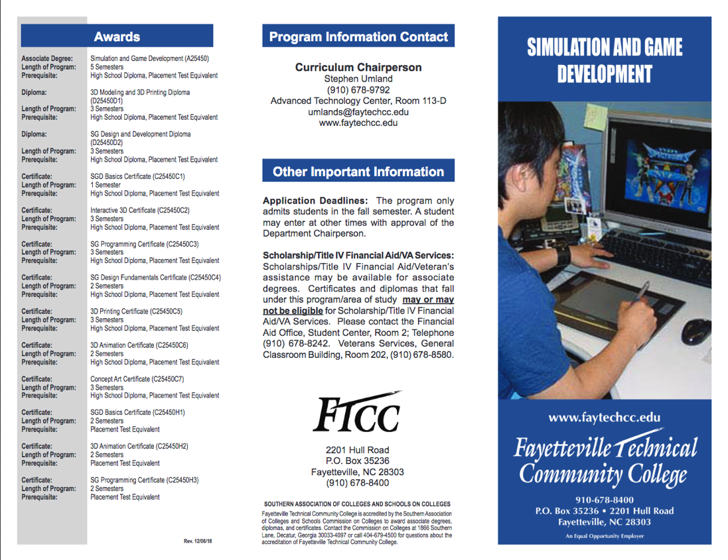
Notes:
Aaron Mabe
mabes@faytechcc.edu
Career and College Promise Coordinator
Fayetteville Technical Community College
Simulation and Game Development at FTCC: http://www2.faytechcc.edu/hsc/HSC-Simulation-and-Game-Development.pdf
FTCC Simulation & Game Development Department:
https://www.faytechcc.edu/academics/computer-information-technology-programs/simulation-game-development/
Brochure:
http://www2.faytechcc.edu/brochures/A25450Brochure.pdf

Slide 31
Notes:
Aaron Mabe
mabes@faytechcc.edu
Career and College Promise Coordinator
Fayetteville Technical Community College
Simulation and Game Development at FTCC: http://www2.faytechcc.edu/hsc/HSC-Simulation-and-Game-Development.pdf
FTCC Simulation & Game Development Department:
https://www.faytechcc.edu/academics/computer-information-technology-programs/simulation-game-development/
Brochure:
http://www2.faytechcc.edu/brochures/A25450Brochure.pdf

Slide 32
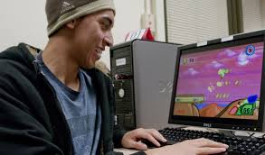
Notes:
Aaron Mabe
mabes@faytechcc.edu
Career and College Promise Coordinator
Fayetteville Technical Community College
Simulation and Game Development at FTCC: http://www2.faytechcc.edu/hsc/HSC-Simulation-and-Game-Development.pdf
FTCC Simulation & Game Development Department:
https://www.faytechcc.edu/academics/computer-information-technology-programs/simulation-game-development/
Brochure:
http://www2.faytechcc.edu/brochures/A25450Brochure.pdf

Slide 33
Notes:
www.ncperkins.org/presentations

Slide 34
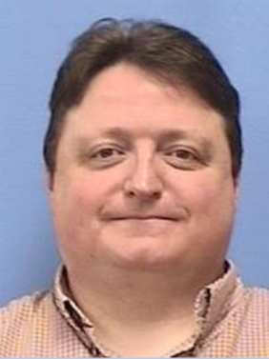
Zach Inks
Simulation and Game Development Lead Instructor
Western Piedmont Community College
Notes:
Zach Inks Lead Instructor (828) 448-6193
zinks@wpcc.edu

Slide 35
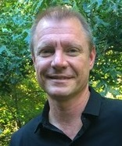
Jonathan Crumpler
Simulation and Game Development Coordinator
Western Piedmont Community College
Notes:
Jonathan Crumpler Coordinator (828) 448-3544
jcrumpler@wpcc.edu
Jonathan Crumpler
Program Coordinator, DEA and SGD
Western Piedmont Community College
Office:828 448 3544
Jonathan Crumpler is the Program Coordinator of Digital Effects and Animation Technology and Simulation and Game Development at Western Piedmont Community College.
He assisted in the process of application and implementation of the Digital Effects and Animation Technology program for WPCC in 2003 and has worked with both industry representatives and educators to develop a viable production media and 3D generalist workforce in the region. In 2009 he assisted WPCC in implementing the Simulation and Game Development program. The Simulation and Game Development program is shaped to meet the growing needs of interactive new media for local and regional demand and to offer career pathways for students who pursuit further education in simulation and game development. Both programs seek collaborative community service learning projects in visualization that engage students in a variety of applied media technology including video production, motion graphic animation, 3D content creation, and immersive interactive visualization. Jonathan Crumpler’s background in education includes a BFA in Studio Art from Appalachian State University and an MFA in Photography and Media Arts from University of Arizona.

Slide 36
Western Piedmont Community College
New Media Programs at WPCC: https://www.wpcc.edu/new-media-degree-programs-at-wpcc/
Simulation and Game Development at WPCC: https://www.wpcc.edu/simulation-game-development/
Notes:
Jonathan Crumpler Coordinator (828) 448-3544
jcrumpler@wpcc.edu
Jonathan Crumpler
Program Coordinator, DEA and SGD
Western Piedmont Community College
Office:828 448 3544

Slide 37
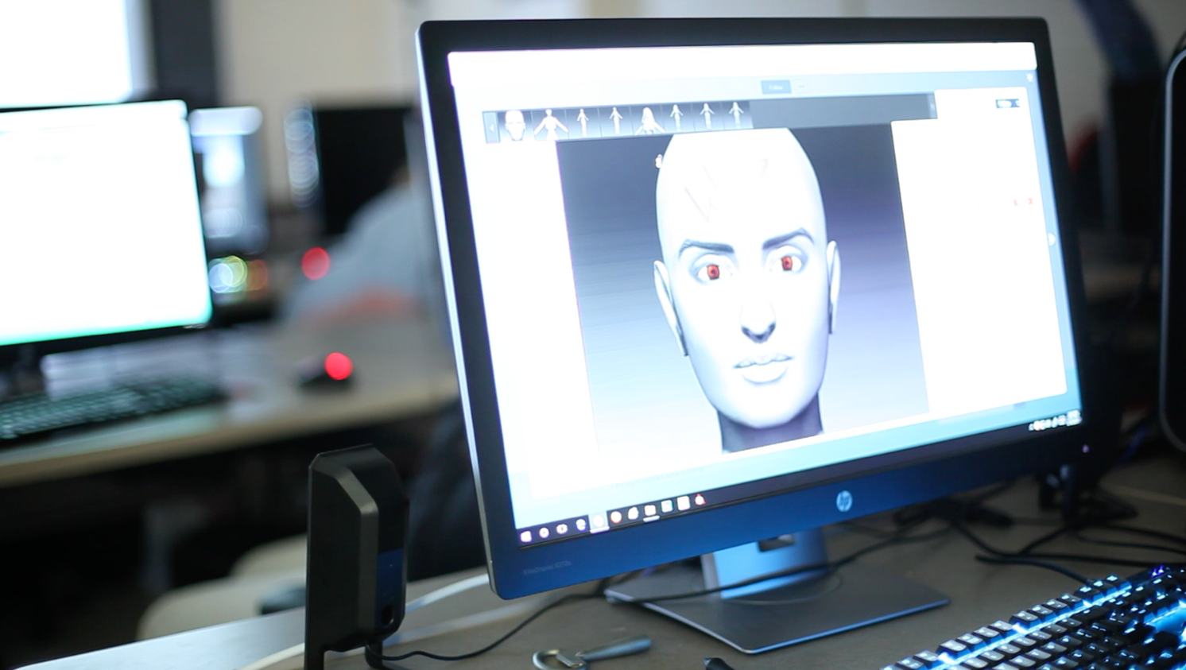
Notes:
Jonathan Crumpler Coordinator (828) 448-3544
jcrumpler@wpcc.edu
Jonathan Crumpler
Program Coordinator, DEA and SGD
Western Piedmont Community College
Office:828 448 3544

Slide 38
Notes:
Jonathan Crumpler Coordinator (828) 448-3544
jcrumpler@wpcc.edu
Jonathan Crumpler
Program Coordinator, DEA and SGD
Western Piedmont Community College
Office:828 448 3544

Slide 39
Notes:
Jonathan Crumpler Coordinator (828) 448-3544
jcrumpler@wpcc.edu
Jonathan Crumpler
Program Coordinator, DEA and SGD
Western Piedmont Community College
Office:828 448 3544

Slide 40
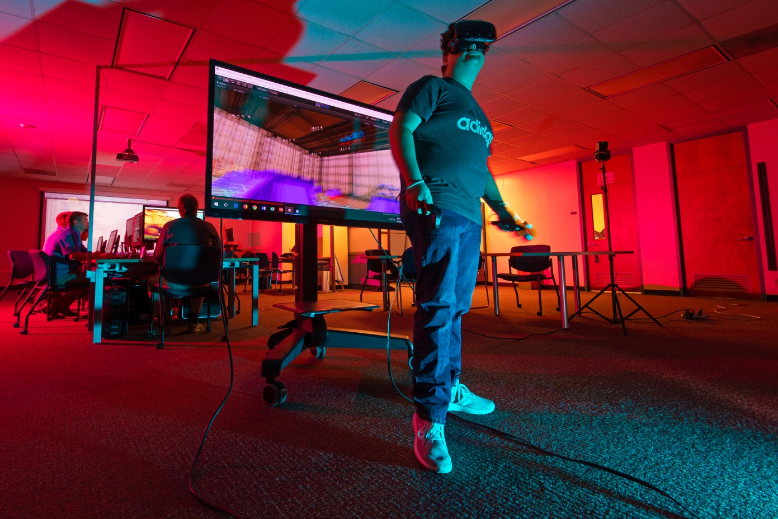
Notes:
Jonathan Crumpler Coordinator (828) 448-3544
jcrumpler@wpcc.edu
Jonathan Crumpler
Program Coordinator, DEA and SGD
Western Piedmont Community College
Office:828 448 3544

Slide 41
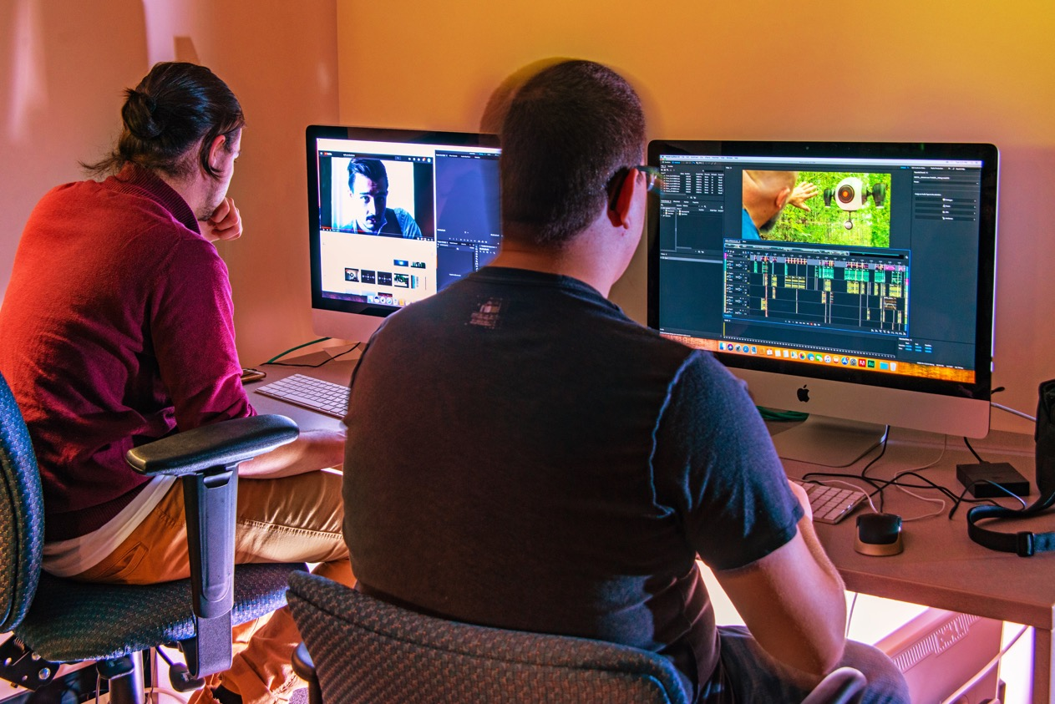
Notes:
Jonathan Crumpler Coordinator (828) 448-3544
jcrumpler@wpcc.edu
Jonathan Crumpler
Program Coordinator, DEA and SGD
Western Piedmont Community College
Office:828 448 3544

Slide 42
2021 ApprenticeshipNC Annual Conference
April 27, 28, 2021
8:30 am to 12:30 pm each day
Free
https://register.gotowebinar.com/register/7684553148246083597
Notes:
Registration page
https://register.gotowebinar.com/register/7684553148246083597

Slide 43
2021 ApprenticeshipNC
Annual Conference
April 27-28, 2021
8:30 am to 12:30 am each day
Notes:
Registration page
https://register.gotowebinar.com/register/7684553148246083597

Slide 44
Raising the Awareness of Career Pathways in North Carolina
Next meeting is April 21, 2021 – Transportation
Download the PowerPoint and access the recording: www.ncperkins.org/presentations
Notes:
Our next meeting like this one will be on ------.
(We will skip December and be back in January.)
You can go to the NCPerkins website to register for that meeting.
We'll also send you a reminder, since you are now on our mailing list.
So go ahead and sign up for all the meetings, and you'll be reminded the day before.
If you liked something you saw here, send folks to the recording. Find it at that same web page.

