Slide 1
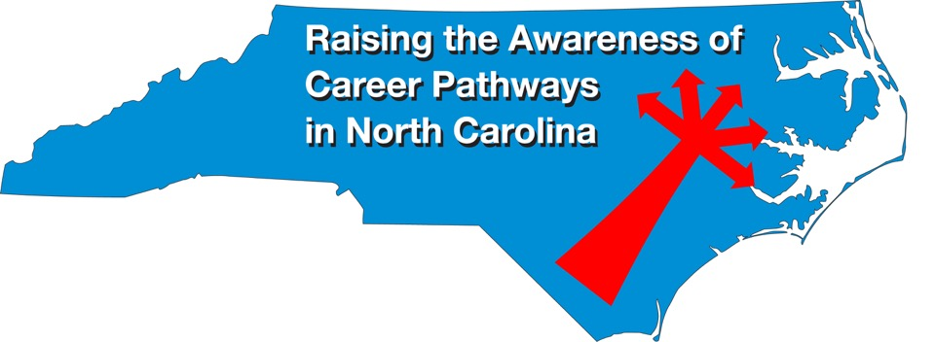
January 20, 2021
Careers in Cybersecurity
Download the PowerPoint
and access the recording:
www.ncperkins.org/presentations
Notes:
Chris
We are here to help promote the great jobs, often unknown, in the great state of North Carolina.
Through these monthly meetings, we are going to let you know about some great career opportunities in North Carolina.
And bring in special guests to let you know about the great career opportunities in North Carolina.
Please download this PowerPoint file and use it anyway you can to help get folks on a career pathway.
The reference showing from where the information was found, as well as the contact information for our guests is in the Notes section under each slide.
Get the PowerPoint on our NCPerkins.org website on our Presentations and Webinars page.
Here is the direct address on the screen.
-----
Many of the videos shown during this webinar can be found here:
https://www.ncperkins.org/video/

Slide 2
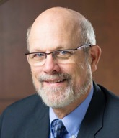
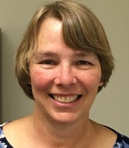

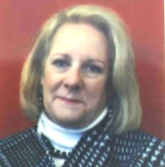
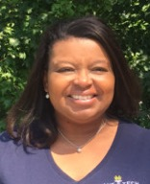
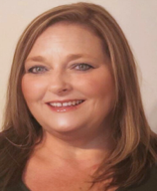
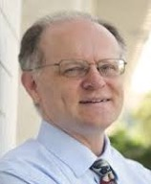
Raising the Awareness of Career Pathways in North Carolina
Bob Witchger
Patti Coultas
Tony Reggi
Cheryl Cox
NC Dept of
Public Instruction
Michelle Lair
Mary Olvera
Chris Droessler
Notes:
Chris
I always say our webinars are like radio but with pictures.
And here are a few pictures of your hosts for these monthly explorations into career pathways.
(Why does the photographer have the best photo?)
Our contact information is in the notes section under this slide.
Dr. Bob Witchger
919-807-7126
WitchgerB@nccommunitycolleges.edu
Dr. Tony R. Reggi
919-807-7131
ReggiA@nccommunitycolleges.edu
Patti Coultas
919-807-7130
CoultasP@nccommunitycolleges.edu
Dr. Mary Olvera
919-807-7120
OlveraM@nccommunitycolleges.edu
Michelle Lair
919-807-72227
LairM@nccommunitycolleges.edu
Chris Droessler
919-807-7068
DroesslerC@nccommunitycolleges.edu
Cheryl Cox
919-807-3814
Cheryl.Cox@dpi.nc.gov

Slide 3
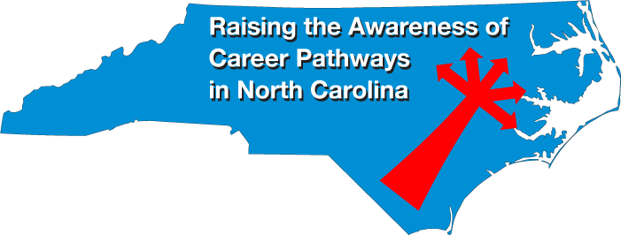
Notes:
www.ncperkins.org/presentations

Slide 4
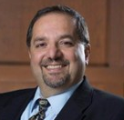

Hilmi Lahoud
Senior Program Administrator – Business and Information Technology Programs
NC Community College System Office
Notes:
Hilmi A. Lahoud, Ph.D.
Senior Program Administrator, Business and Information Technology Programs
Academic and Student Services
North Carolina Community College System
5016 Mail Service Center
Raleigh, NC 27699-5016
Phone: 919-807-7116
Fax: 919-807-7173
lahoudh@nccommunitycolleges.edu
https://www.nccommunitycolleges.edu/sites/default/files/academic-programs/curriculum-standards/attachments/a25590_information_technology_fa2017v5.pdf

Slide 5
Notes:
https://www.nccommunitycolleges.edu/sites/default/files/academic-programs/curriculum-standards/attachments/a25590_information_technology_fa2017v5.pdf

Slide 6
Notes:
www.ncperkins.org/presentations

Slide 7
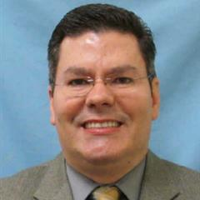

Oscar Gonzalez
Cyber Crime Technology Program Lead
South Piedmont Community College
Notes:
Oscar Gonzalez
Cyber Crime Technology Program Lead
Information Technology Faculty
School of Applied Science and Technology
South Piedmont Community College
ogonzalez@spcc.edu
704-290-5232

Slide 8
Oscar Gonzalez
Oscar Gonzalez is the Cyber Crime Technology Program Lead and an Information Technology Instructor at South Piedmont Community College. He served as a Co-PI for the $1.8 million NSF grant, Advanced Cyberforensics Education Consortium (ACE). He is a current member of the North Carolina FBI InfraGard Charlotte Chapter. He earned a Master of Science in Management Information Systems and a Bachelor of Science in Computer Information Systems. He has 19 years of teaching experience in the following computer fields: Computer Programming, Networking, Microsoft Windows Servers and Operating Systems, Databases, System Analysis and Design, Security, Computer Forensics, Computer Crime Investigation, and Business E-Commerce. He is Internet and Computer Core Certified and a Certified Internet Webmaster. Prior to entering the educational field, Oscar worked in the banking industry for nearly 10 years.
Notes:
Oscar Gonzalez
Cyber Crime Technology Program Lead
Information Technology Faculty
School of Applied Science and Technology
South Piedmont Community College
ogonzalez@spcc.edu
704-290-5232

Slide 9
Oscar Gonzalez
How did you get into cyber security?
  I was selected to lead the cyber security program at SPCC in 2014 when the College applied for the Advanced Cyberforensics Education (ACE) Consortium grant through the National Science Foundation (NSF). At that time, I was introduced to two individuals who were designated to work with other colleges approved for the grant: Mark Pollitt, a retired FBI Special Agent who was the first Agent to lead the Computer Analysis Response Team (CART) program at FBI Headquarters and Dr. Philip Craig, a professor at Daytona State College.
How were employers engaged in the development of the program?
  SPCC collaborated with stakeholders from neighboring community colleges, local law enforcement, courthouse members and FBI agents in the development of the program. Courses were selected to meet needs at that time and program requirements are reviewed annually and revised, if needed, to meet community needs.
How is it marketed to students?
  Cyber Security is marked to students through marketing initiatives with various local law enforcements in the county, summer camps, Cyber Crime board members, Infragard, workforce development and also through presentations within the communities and local high schools.
What is the employment outlook in your area? What kind of Jobs do the graduates get?
  The cyber security employment outlook in the Charlotte area is increasing. Public and private sectors from small businesses, law enforcement, hospitals and education are hiring our graduates from entry level network security to forensics investigations. Some of our graduates are also continuing their education through a consortium with Middle Georgia State University.
Notes:
Oscar Gonzalez
Cyber Crime Technology Program Lead
Information Technology Faculty
School of Applied Science and Technology
South Piedmont Community College
ogonzalez@spcc.edu
704-290-5232

Slide 10
Notes:
www.ncperkins.org/presentations

Slide 11
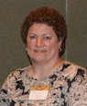

Carolyn DeSimone
Cybersecurity Program Director
Wake Technical Community College
Notes:
Carolyn DeSimone
cgdesimone@waketech.edu
Cybersecurity Program Director
Wake Technical Community College
http://cybersecurity.waketech.edu

Slide 12
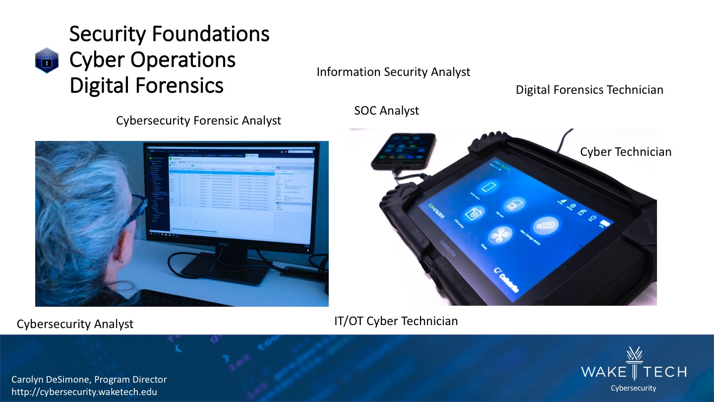
Notes:
Carolyn DeSimone
cgdesimone@waketech.edu
Cybersecurity Program Director
Wake Technical Community College
http://cybersecurity.waketech.edu

Slide 13
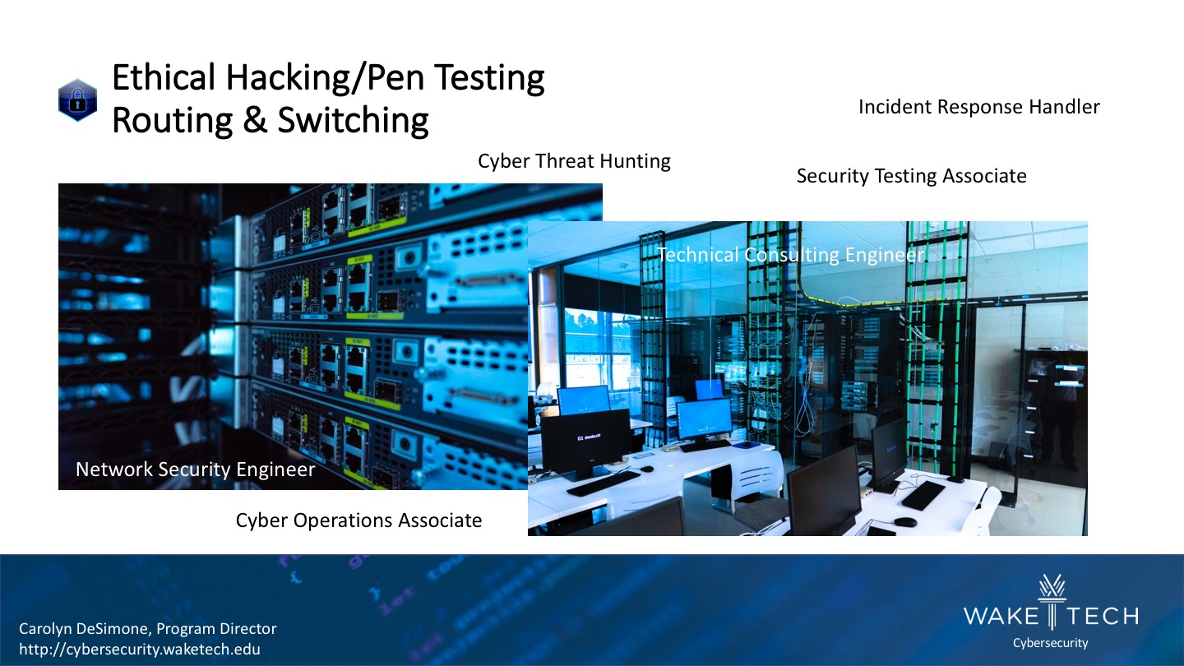
Notes:
Carolyn DeSimone
cgdesimone@waketech.edu
Cybersecurity Program Director
Wake Technical Community College
http://cybersecurity.waketech.edu

Slide 14
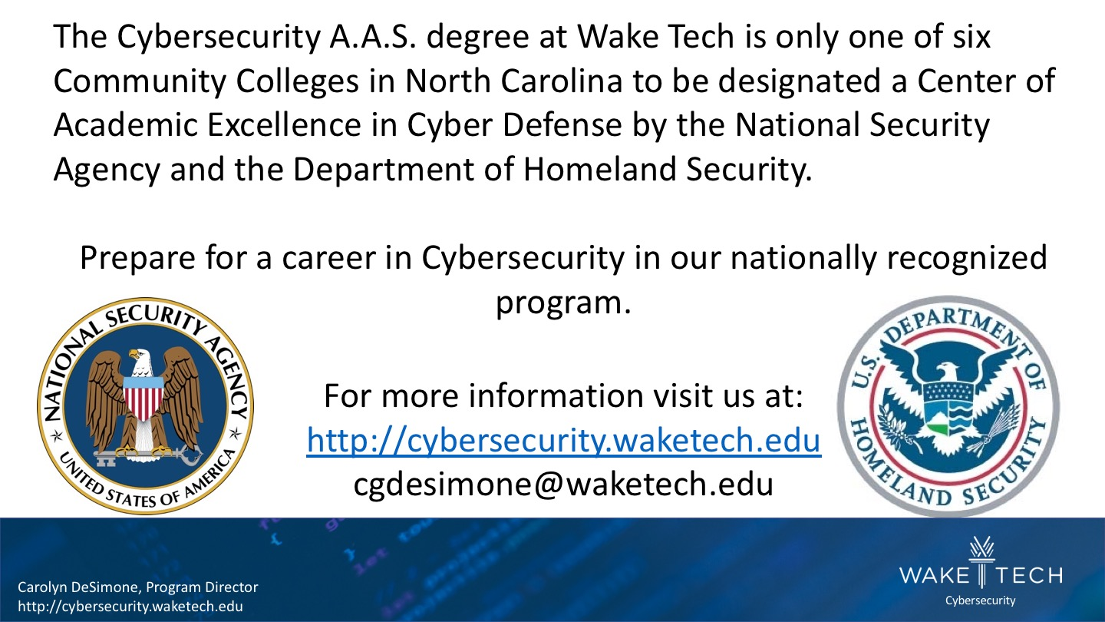
Notes:
Carolyn DeSimone
cgdesimone@waketech.edu
Cybersecurity Program Director
Wake Technical Community College
http://cybersecurity.waketech.edu

Slide 15
Notes:
Carolyn DeSimone
cgdesimone@waketech.edu
Cybersecurity Program Director
Wake Technical Community College
http://cybersecurity.waketech.edu

Slide 16
Notes:
Carolyn DeSimone
cgdesimone@waketech.edu
Cybersecurity Program Director
Wake Technical Community College
http://cybersecurity.waketech.edu

Slide 17
Notes:
www.ncperkins.org/presentations

Slide 18
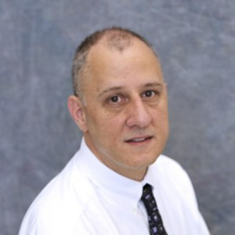

Randy Hollifield
Cyber Crime Technology Instructor
McDowell Technical Community College
Notes:
Randy Hollifield, MSISA
Cyber Crime Technology Instructor
CIW Certified Instructor | Proctor
Certiport Organization Administrator
McDowell Technical Community College
54 College Drive
Marion, North Carolina 28752
Phone: 828.273.1012
Fax: 828.652.1014
rhollifield@go.mcdowelltech.edu

Slide 19
How I Got Into Cyber Security
Fascination with hacking/hackers (Kevin Mitnick, Robert Tappan Morris, etc.)
Prior to getting into the cybercrime/cybersecurity field
  Earned a masters degree in closely related field
  Earned more than twelve industry recognized certifications from vendors such as Cisco, Microsoft, EC-Council, CompTIA, CIW and more.
Enjoy sharing my knowledge with others and helping make the world a safer place
Notes:
Randy Hollifield, MSISA
Cyber Crime Technology Instructor
CIW Certified Instructor | Proctor
Certiport Organization Administrator
McDowell Technical Community College
54 College Drive
Marion, North Carolina 28752
Phone: 828.273.1012
Fax: 828.652.1014
rhollifield@go.mcdowelltech.edu

Slide 20
Steps Taken to Develop the Program
Research was conducted to ensure no other NCCC was offering the same program in close proximity.
    Only Southwestern Community College and Forsyth Tech at the time (approx. 90 miles west/ 100 miles east respectively)
Approval from the central office.
Approval from the curriculum committee.
Secure and retrofit classroom.
Procure hardware/software.
Offer flexibility to online learners by making available simulation software through various vendors.
Notes:
Randy Hollifield, MSISA
Cyber Crime Technology Instructor
CIW Certified Instructor | Proctor
Certiport Organization Administrator
McDowell Technical Community College
54 College Drive
Marion, North Carolina 28752
Phone: 828.273.1012
Fax: 828.652.1014
rhollifield@go.mcdowelltech.edu

Slide 21
How Employers Were Engaged in the Development of the Program
Two ways curriculum is mapped to industry
Larger school's curriculum committees receive continuous input from industry across the state
Certification objectives also map to industry required skill sets
  CompTIA
  Microsoft
  CIW
  TestOut
  Etc.
Notes:
Randy Hollifield, MSISA
Cyber Crime Technology Instructor
CIW Certified Instructor | Proctor
Certiport Organization Administrator
McDowell Technical Community College
54 College Drive
Marion, North Carolina 28752
Phone: 828.273.1012
Fax: 828.652.1014
rhollifield@go.mcdowelltech.edu

Slide 22
How the Program is Marketed to Students
Social media channels
  Facebook
  Twitter
  LinkedIn
Print media
  Local newspaper
  School newspaper
  Pamphlets
Television advertisements
Student created video content
Recruiting
Notes:
Randy Hollifield, MSISA
Cyber Crime Technology Instructor
CIW Certified Instructor | Proctor
Certiport Organization Administrator
McDowell Technical Community College
54 College Drive
Marion, North Carolina 28752
Phone: 828.273.1012
Fax: 828.652.1014
rhollifield@go.mcdowelltech.edu

Slide 23
The Employment Outlook Locally
According to Cyberseek, there are currently 20,357 Cybersecurity jobs available in North Carolina as of 01/18/2021
Currently there are more than 70 full time cybersecurity jobs listed in the Asheville, North Carolina area. Several of these are entry level and some are remote/virtual
Notes:
Randy Hollifield, MSISA
Cyber Crime Technology Instructor
CIW Certified Instructor | Proctor
Certiport Organization Administrator
McDowell Technical Community College
54 College Drive
Marion, North Carolina 28752
Phone: 828.273.1012
Fax: 828.652.1014
rhollifield@go.mcdowelltech.edu
\
Source: Cyberseek.org | Google.com

Slide 24
Types of Jobs for the Graduates
Entry-level
  Information Security Analysts
  Security Specialist
  System Administrator
  Security Administrator
  Network Administrator
  Cybersecurity Specialist/Technician
  Cyber Crime/ Cybersecurity Analyst
  Cyber Crime Investigator
  Incident Analyst/Responder
  Information Technology Auditor
Notes:
Randy Hollifield, MSISA
Cyber Crime Technology Instructor
CIW Certified Instructor | Proctor
Certiport Organization Administrator
McDowell Technical Community College
54 College Drive
Marion, North Carolina 28752
Phone: 828.273.1012
Fax: 828.652.1014
rhollifield@go.mcdowelltech.edu
Sources: Bureau of Labor Statistics | Cybersecurityeducation.org | Cyberseek.org

Slide 25
Notes:
www.ncperkins.org/presentations

Slide 26
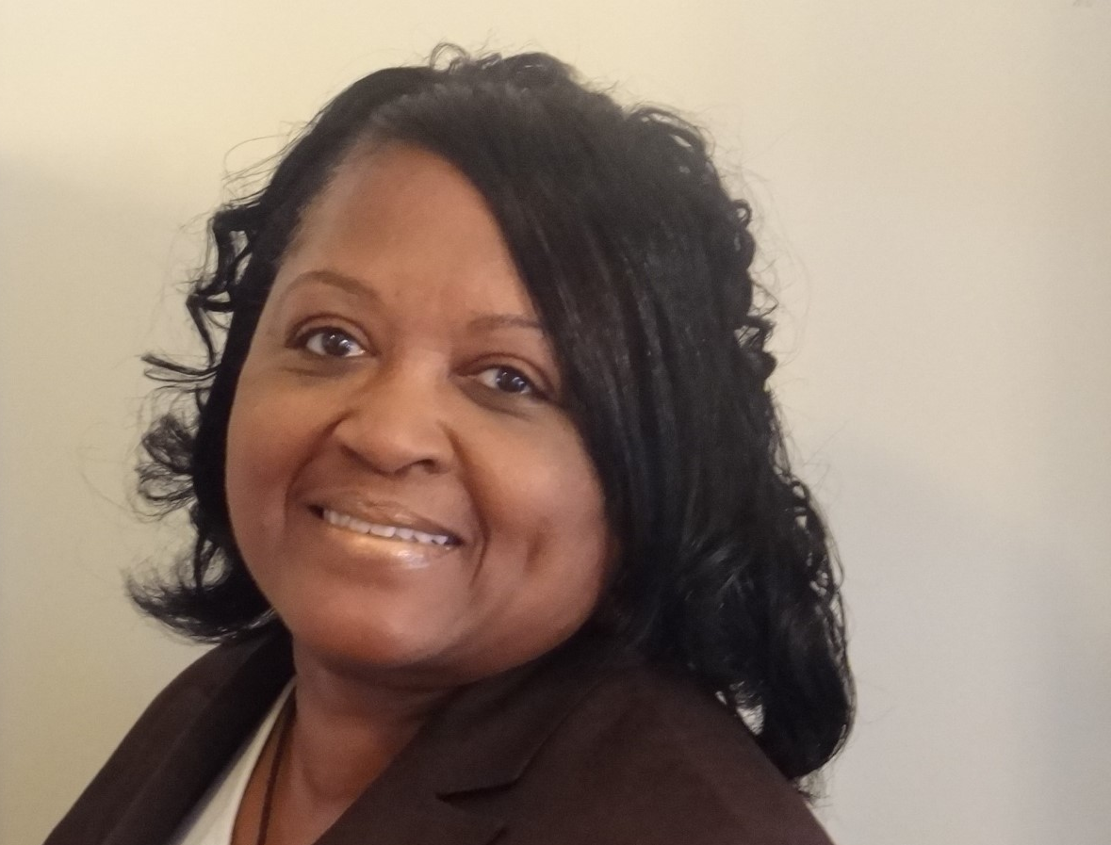

Dr. Deanne Cranford-Wesley
Associate Dean, Davis iTEC Center
Forsyth Technical Community College
Notes:
Dr. Deanne Cranford-Wesley
Associate Dean, Davis iTEC Center
Forsyth Technical Community College
336.734.7305
dwesley@forsythtech.edu

Slide 27
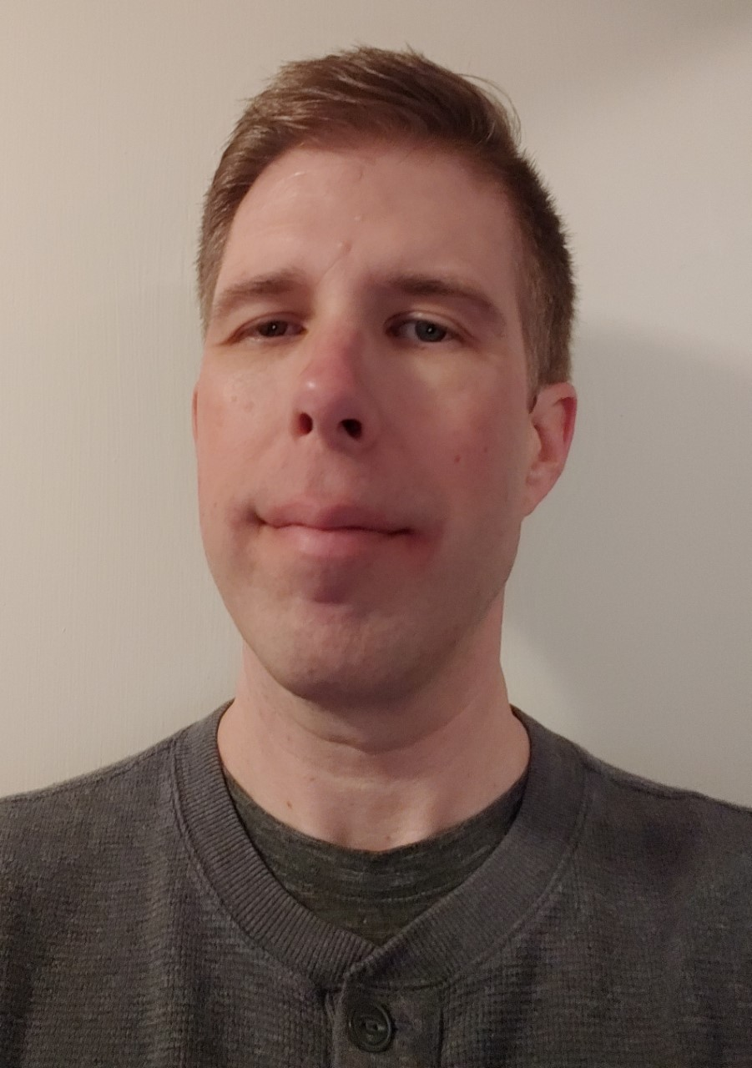
Billy Phillips
NSF Scholarship for Service Student, Davis iTEC Center
Forsyth Technical Community College
Notes:
Billy Phillips
NSF Scholarship for Service Student, Davis iTEC Center
Forsyth Technical Community College
phillipsb1530@forsythtech.edu

Slide 28
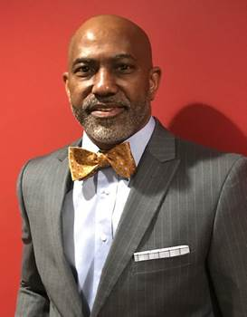
Christopher Martin
NC Works Career Coach Carver High School
Forsyth Technical Community College
Notes:
Christopher Martin
NC Works Career Coach Carver High School
Forsyth Technical Community College
336.734.7642
cmartin@forsythtech.edu

Slide 29
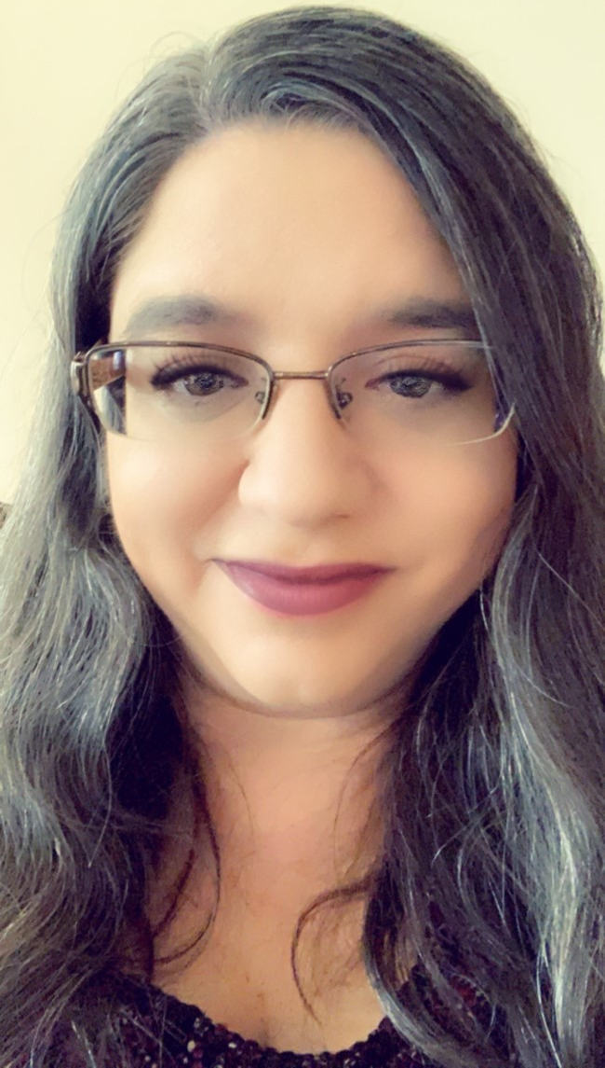
Melissa Carroll
NC Works Career Coach Parkland High School
Forsyth Technical Community College
Notes:
Melissa Carroll
NC Works Career Coach Parkland High School
Forsyth Technical Community College
336.734.7269
mcarroll@forsythtech.edu

Slide 30
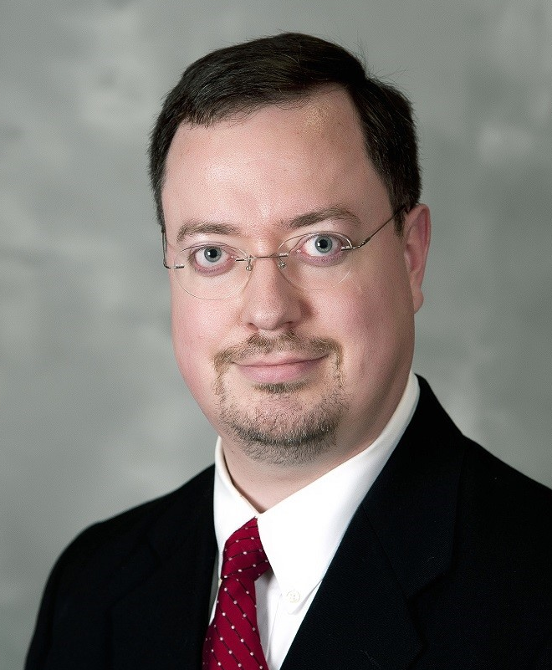

Jason Cox, CISSP, CISM
Chief Information Security Officer
Elevate Textiles
Notes:
Jason Cox
Chief Information Security Officer
Elevate Textiles
jason.cox@elevatetextiles.com
Jason is responsible for the overall Information Security program at Elevate Textiles, the parent company of the historic brands of American & Efird (A&E), Burlington Fabrics, Cone Denim, Gutermann, and Safety Components. With a global footprint that includes 36 facilities and over 15,000 employees, Elevate threads and fabrics can be found in places like your car, the clothes you wear, the gear you carry, the office where you work, and even the seams of a baseball! Prior to Elevate he worked in consulting for a large MSP, as an Information Security Officer in healthcare, and he began his career supporting IT infrastructure, security, and end users for a large independent telecom company. He lives in Central North Carolina with his wife and their three animals.

Slide 31
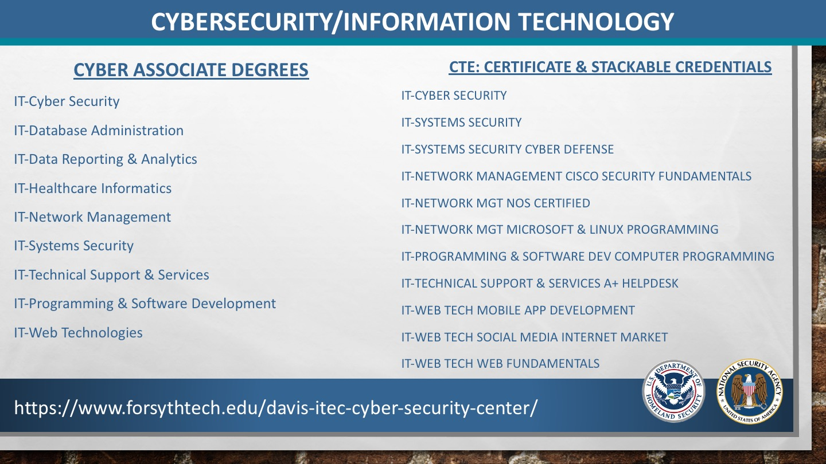
Notes:
Dr. Deanne Cranford-Wesley
Associate Dean, Davis iTEC Center
Forsyth Technical Community College
336.734.7305
dwesley@forsythtech.edu

Slide 32
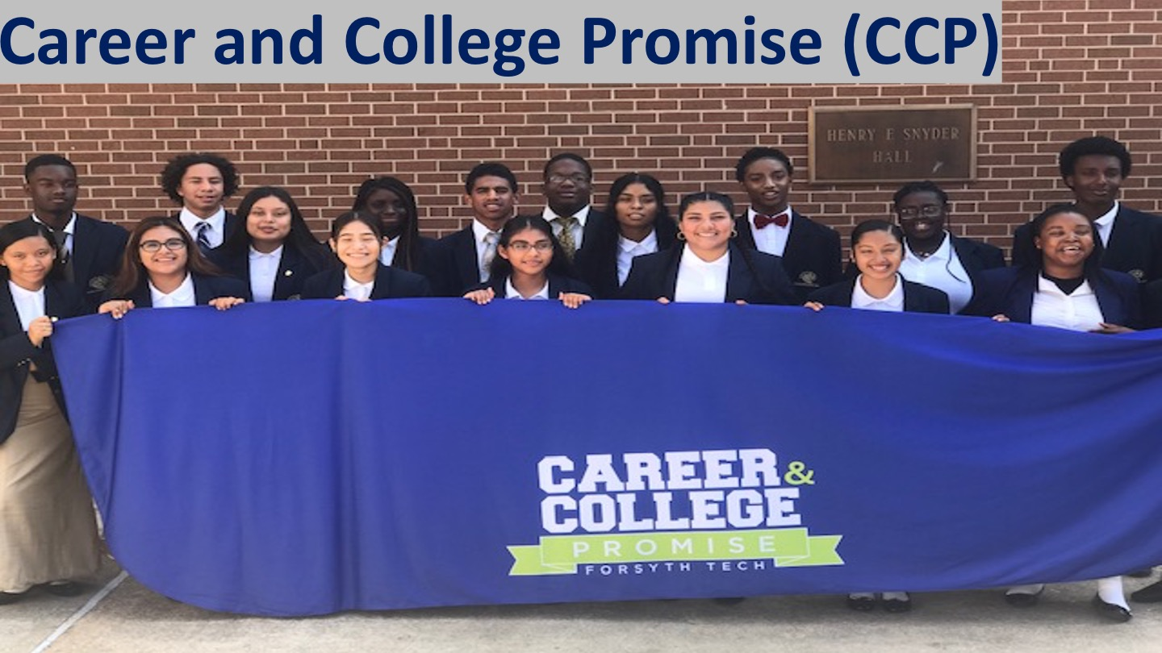
Notes:
Dr. Deanne Cranford-Wesley
Associate Dean, Davis iTEC Center
Forsyth Technical Community College
336.734.7305
dwesley@forsythtech.edu

Slide 33
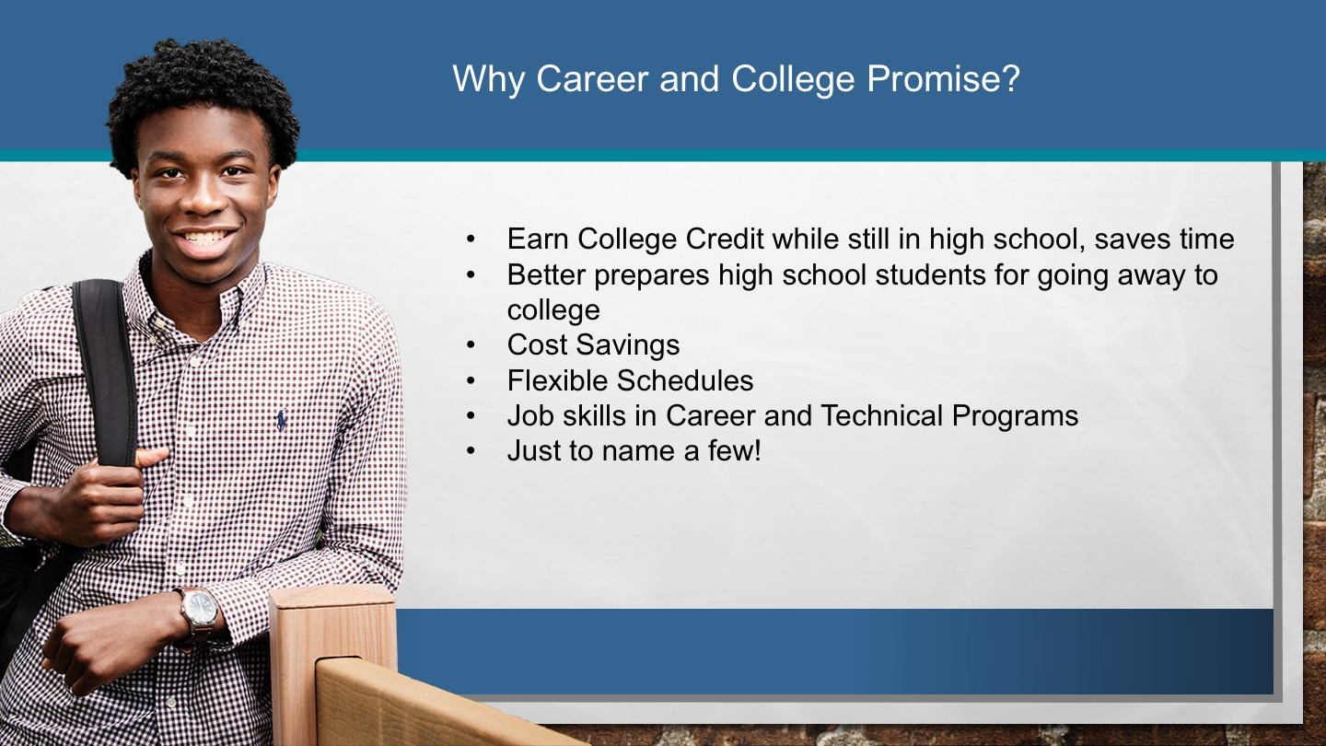
Notes:
Dr. Deanne Cranford-Wesley
Associate Dean, Davis iTEC Center
Forsyth Technical Community College
336.734.7305
dwesley@forsythtech.edu

Slide 34

Notes:
Dr. Deanne Cranford-Wesley
Associate Dean, Davis iTEC Center
Forsyth Technical Community College
336.734.7305
dwesley@forsythtech.edu

Slide 35
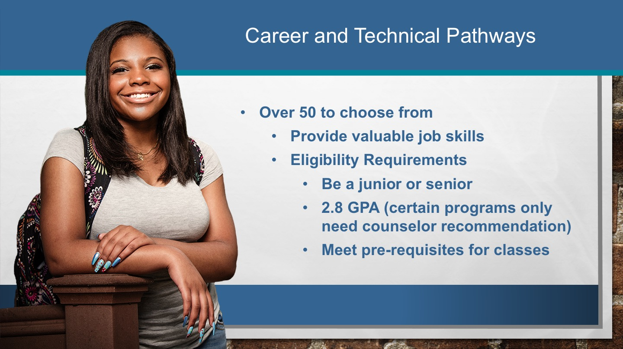
Notes:
Dr. Deanne Cranford-Wesley
Associate Dean, Davis iTEC Center
Forsyth Technical Community College
336.734.7305
dwesley@forsythtech.edu

Slide 36
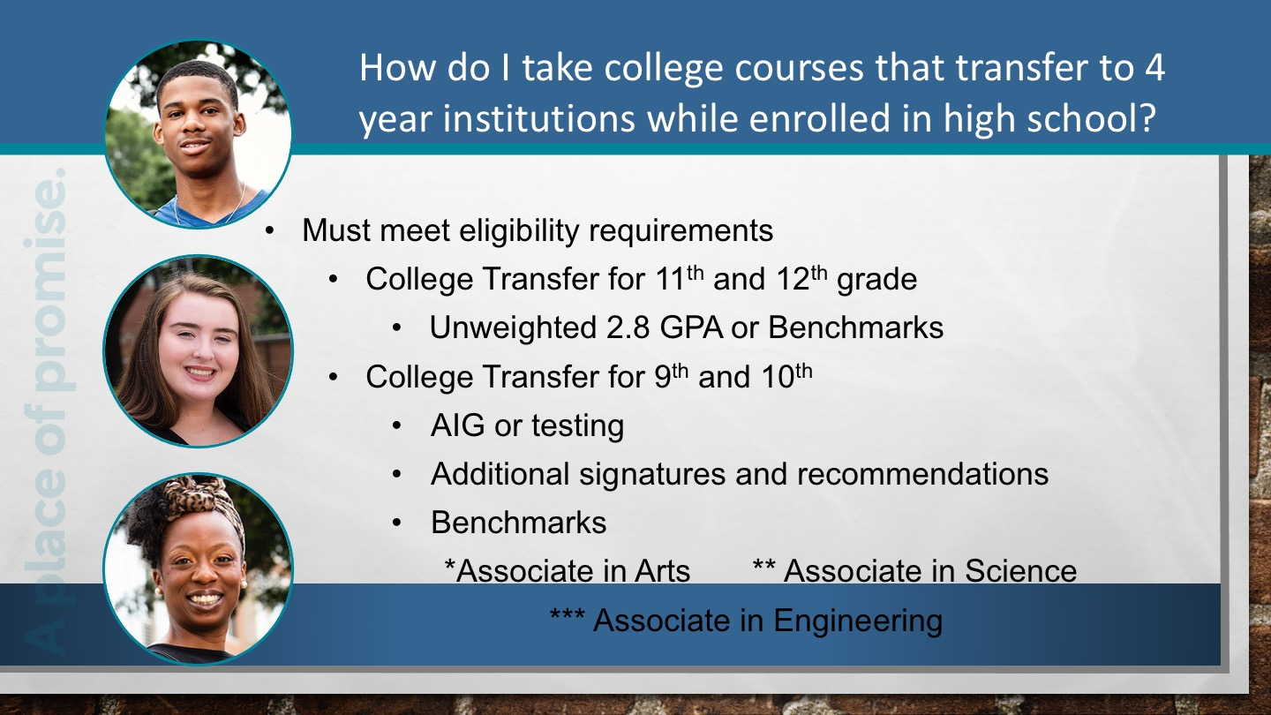
Notes:
Dr. Deanne Cranford-Wesley
Associate Dean, Davis iTEC Center
Forsyth Technical Community College
336.734.7305
dwesley@forsythtech.edu

Slide 37
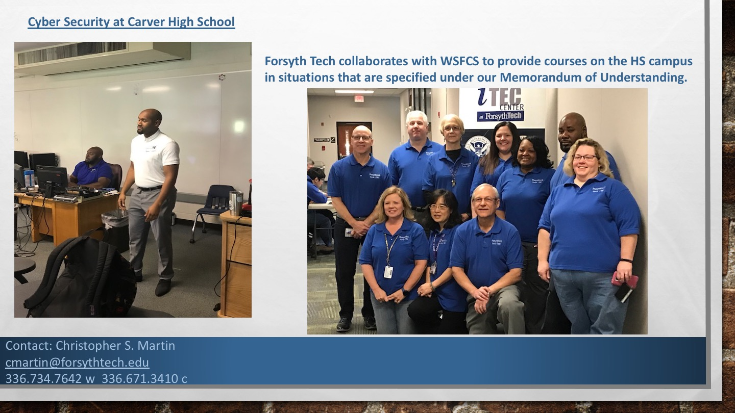
Notes:
Dr. Deanne Cranford-Wesley
Associate Dean, Davis iTEC Center
Forsyth Technical Community College
336.734.7305
dwesley@forsythtech.edu

Slide 38
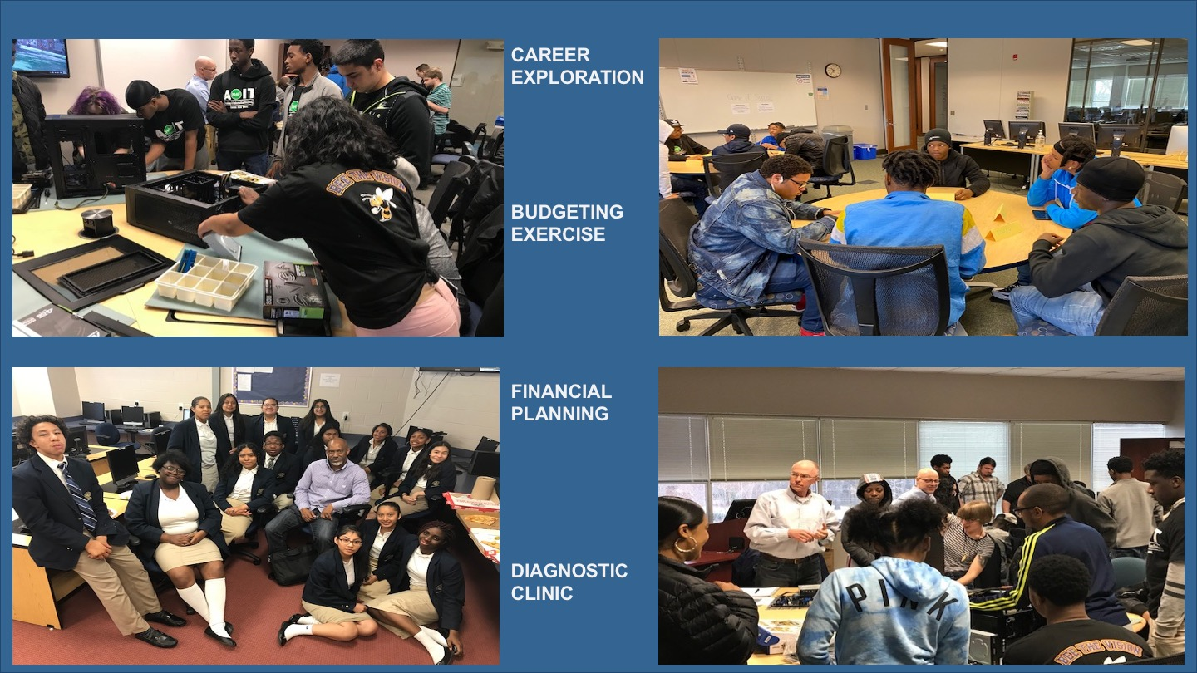
Notes:
Dr. Deanne Cranford-Wesley
Associate Dean, Davis iTEC Center
Forsyth Technical Community College
336.734.7305
dwesley@forsythtech.edu

Slide 39
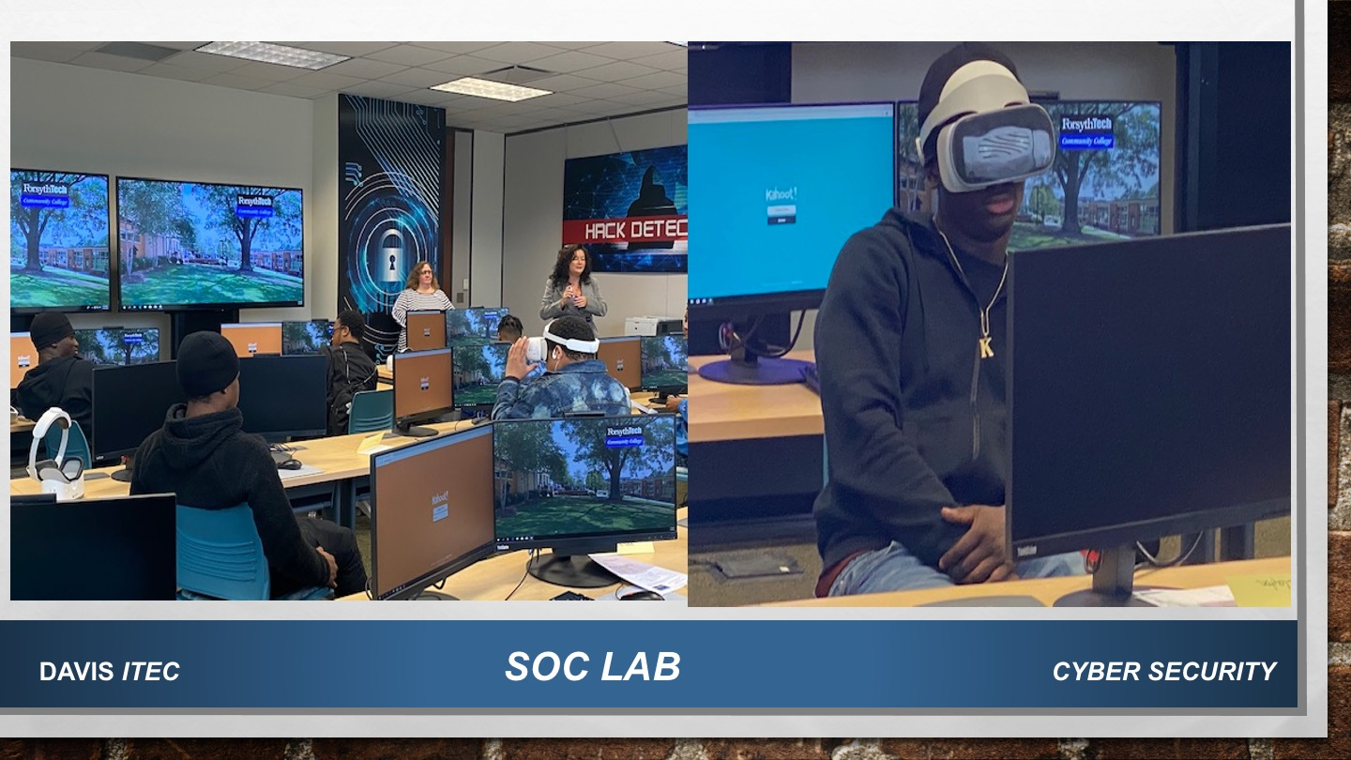
Notes:
Dr. Deanne Cranford-Wesley
Associate Dean, Davis iTEC Center
Forsyth Technical Community College
336.734.7305
dwesley@forsythtech.edu

Slide 40
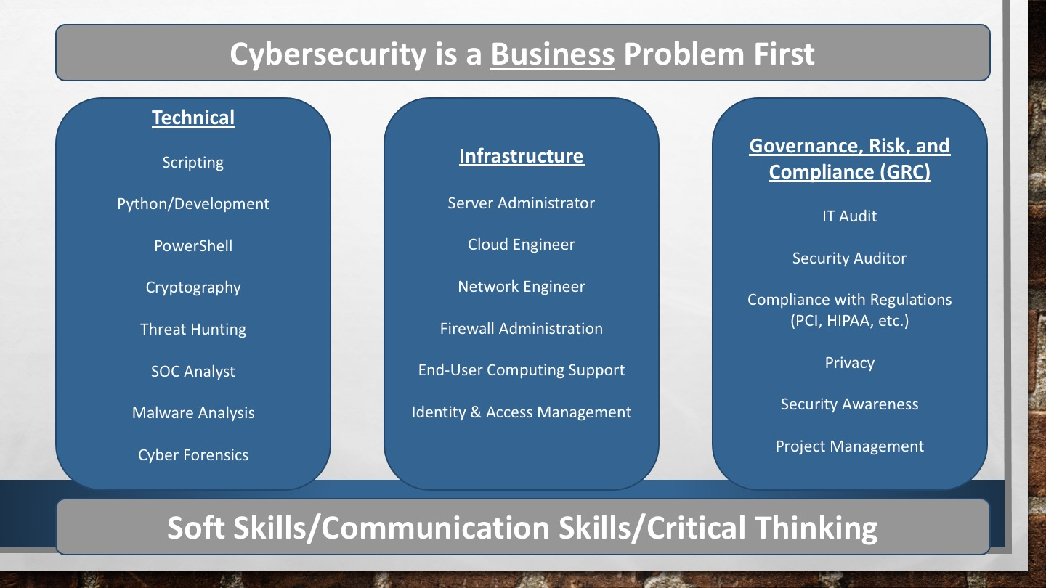
Notes:
Dr. Deanne Cranford-Wesley
Associate Dean, Davis iTEC Center
Forsyth Technical Community College
336.734.7305
dwesley@forsythtech.edu

Slide 41

Notes:
Dr. Deanne Cranford-Wesley
Associate Dean, Davis iTEC Center
Forsyth Technical Community College
336.734.7305
dwesley@forsythtech.edu

Slide 42
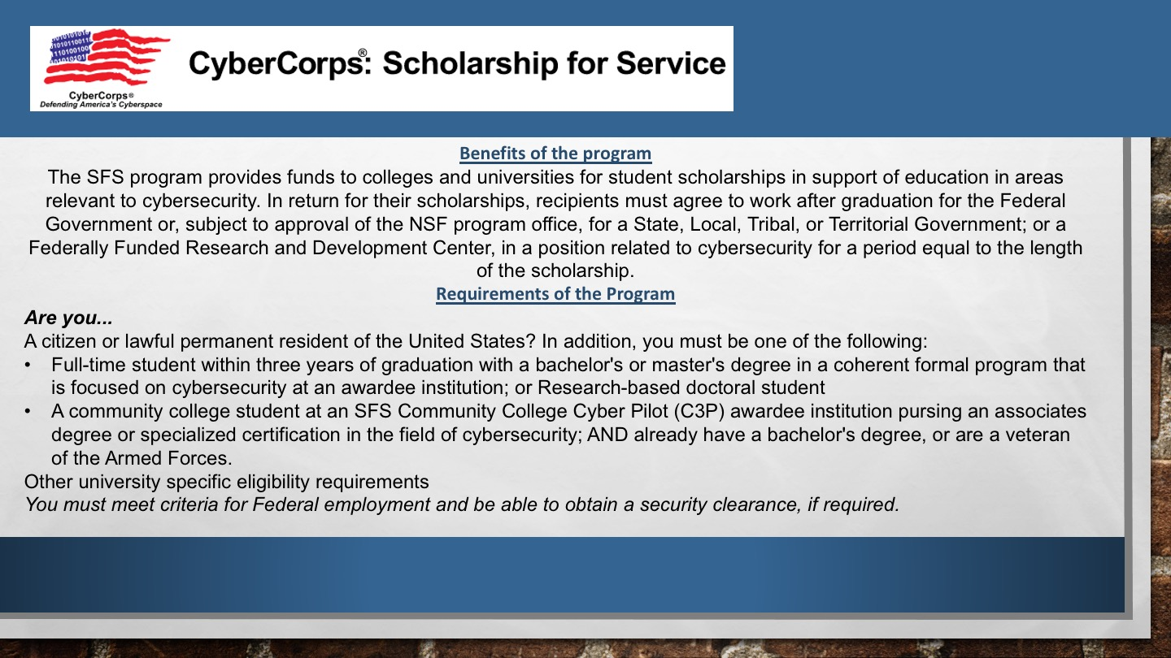
Notes:
Dr. Deanne Cranford-Wesley
Associate Dean, Davis iTEC Center
Forsyth Technical Community College
336.734.7305
dwesley@forsythtech.edu

Slide 43
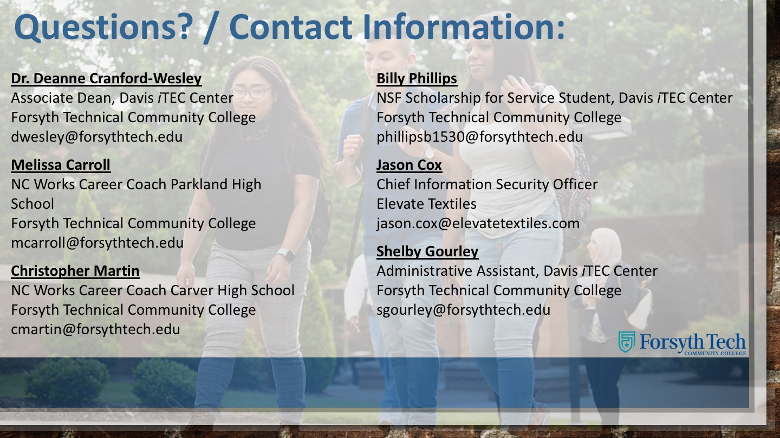
Notes:
Dr. Deanne Cranford-Wesley
Associate Dean, Davis iTEC Center
Forsyth Technical Community College
336.734.7305
dwesley@forsythtech.edu

Slide 44
Raising the Awareness of Career Pathways in North Carolina
Next meeting is February 17, 2021
Download the PowerPoint
and access the recording:
www.ncperkins.org/presentations
Notes:
Our next meeting like this one will be on ------.
(We will skip December and be back in January.)
You can go to the NCPerkins website to register for that meeting.
We'll also send you a reminder, since you are now on our mailing list.
So go ahead and sign up for all the meetings, and you'll be reminded the day before.
If you liked something you saw here, send folks to the recording. Find it at that same web page.

