Slide 1
Perkins Mid-Year Reviews
January, 2021

Slide 2
January 19, 2021
Beaufort County Community College
Bladen Community College
Brunswick Community College
Carteret Community College
Halifax Community College
James Sprunt Community College
Martin Community College
McDowell Technical Community College
Montgomery Community College
Pamlico Community College
Roanoke-Chowan Community College
Tri-County Community College

Slide 3
Beaufort County Community College
Have CLNA findings improved CTE?
Share a Promising Practice.
How is college coping under COVID-19?
Budget and spending plan.
Comments and questions.
Notes:
Beaufort County CC

Slide 4
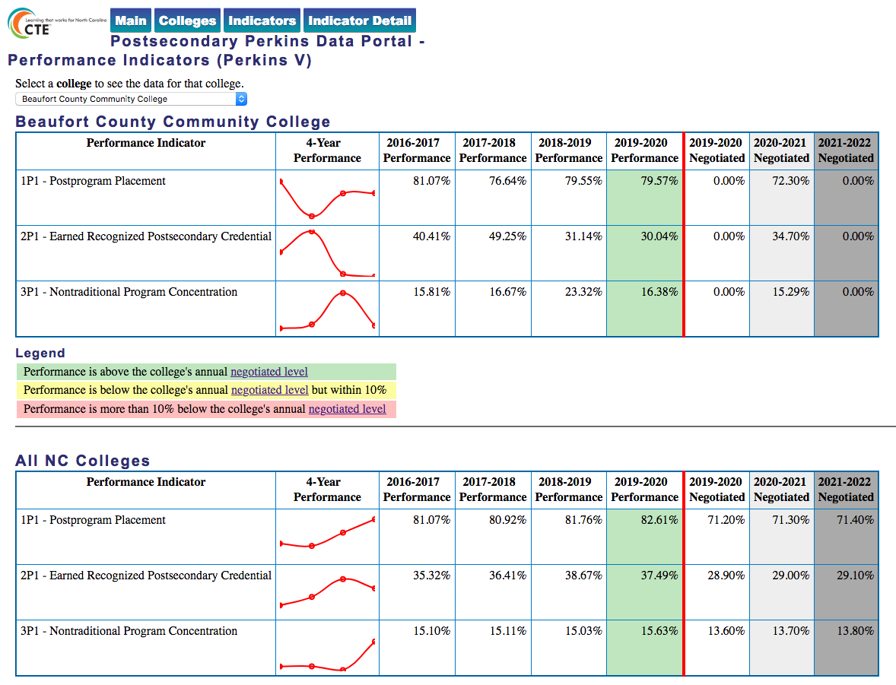
Notes:
Beaufort County CC
https://www.ncperkins.org/data/indicatorV.php

Slide 5
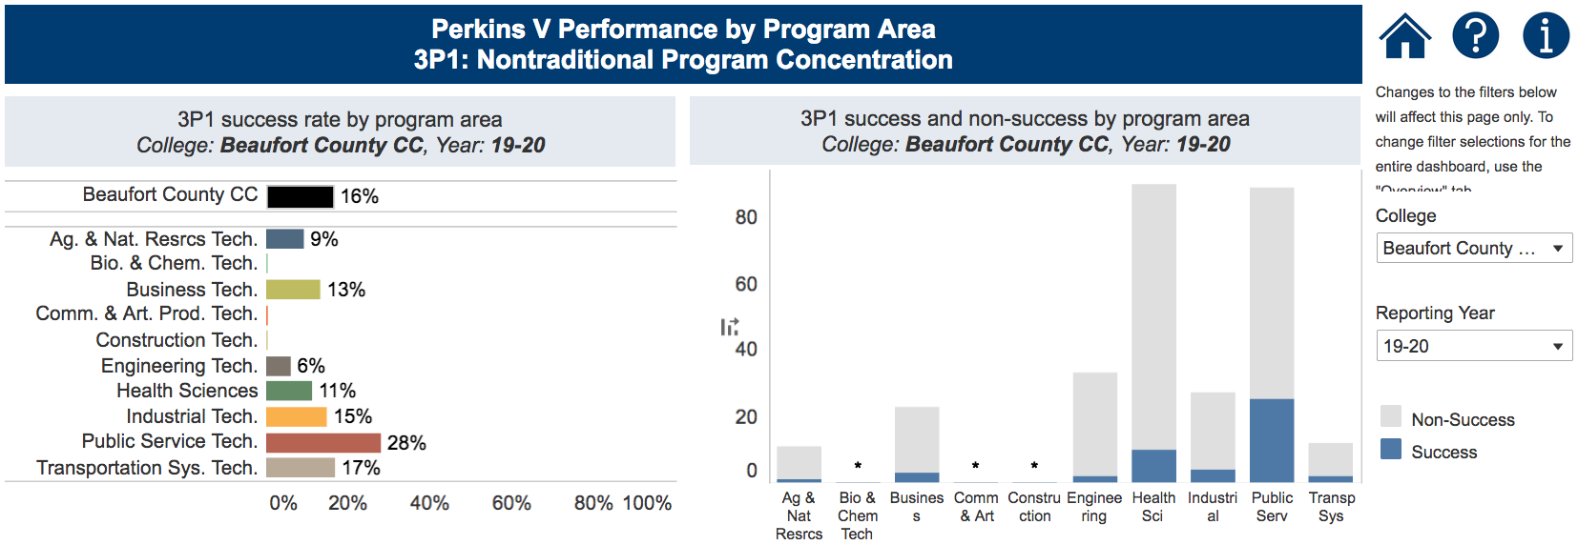
Notes:
Beaufort County CC
https://www.nccommunitycolleges.edu/analytics/dashboards/cte-perkins-v-performance-indicator-3p1-nontraditional-program-concentration-%E2%80%93

Slide 6
Bladen Community College
Have CLNA findings improved CTE?
Share a Promising Practice.
How is college coping under COVID-19?
Budget and spending plan.
Comments and questions.
Notes:
Bladen CC

Slide 7
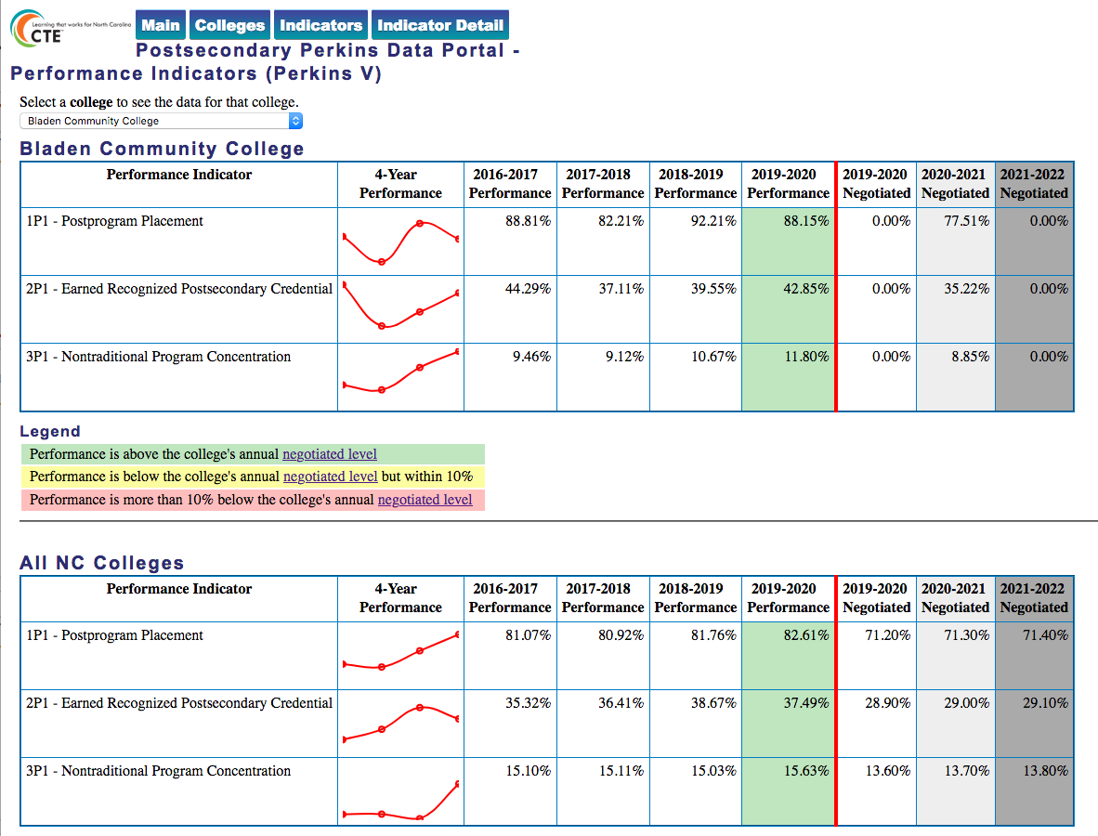
Notes:
Bladen CC
https://www.ncperkins.org/data/indicatorV.php

Slide 8
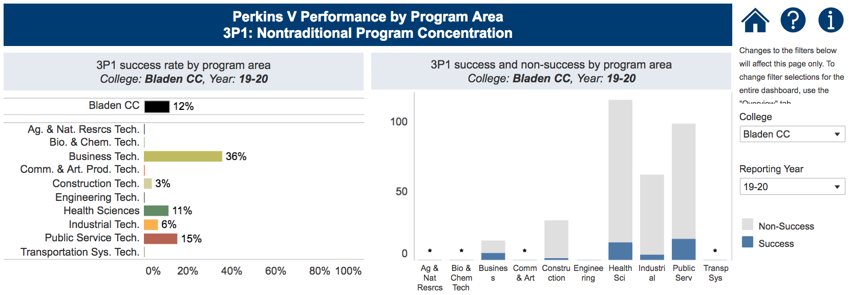
Notes:
Bladen CC
https://www.nccommunitycolleges.edu/analytics/dashboards/cte-perkins-v-performance-indicator-3p1-nontraditional-program-concentration-%E2%80%93

Slide 9
Brunswick Community College
Have CLNA findings improved CTE?
Share a Promising Practice.
How is college coping under COVID-19?
Budget and spending plan.
Comments and questions.
Notes:
Brunswick CC

Slide 10
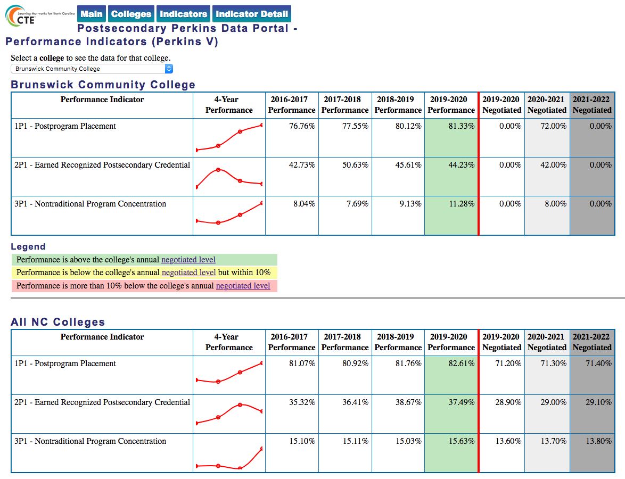
Notes:
Brunswick CC
https://www.ncperkins.org/data/indicatorV.php

Slide 11
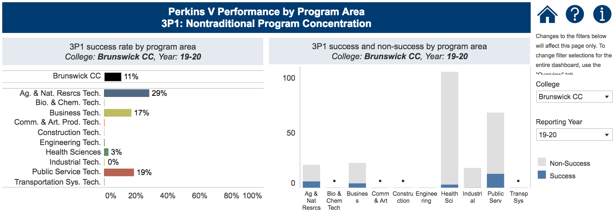
Notes:
Brunswick CC
https://www.nccommunitycolleges.edu/analytics/dashboards/cte-perkins-v-performance-indicator-3p1-nontraditional-program-concentration-%E2%80%93

Slide 12
Carteret Community College
Have CLNA findings improved CTE?
Share a Promising Practice.
How is college coping under COVID-19?
Budget and spending plan.
Comments and questions.
Notes:
Carteret CC

Slide 13
Notes:
Carteret CC
https://www.ncperkins.org/data/indicatorV.php

Slide 14
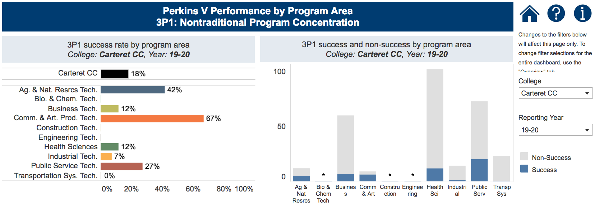
Notes:
Carteret CC
https://www.nccommunitycolleges.edu/analytics/dashboards/cte-perkins-v-performance-indicator-3p1-nontraditional-program-concentration-%E2%80%93

Slide 15
Halifax Community College
Have CLNA findings improved CTE?
Share a Promising Practice.
How is college coping under COVID-19?
Budget and spending plan.
Comments and questions.
Notes:
Halifax CC

Slide 16
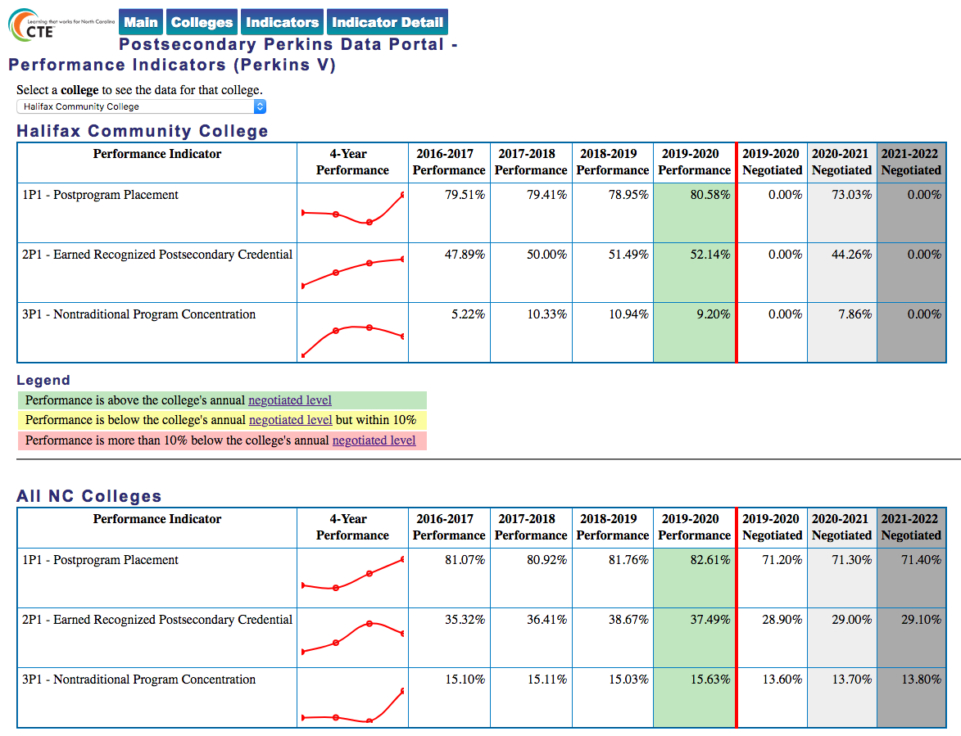
Notes:
Halifax CC
https://www.ncperkins.org/data/indicatorV.php

Slide 17
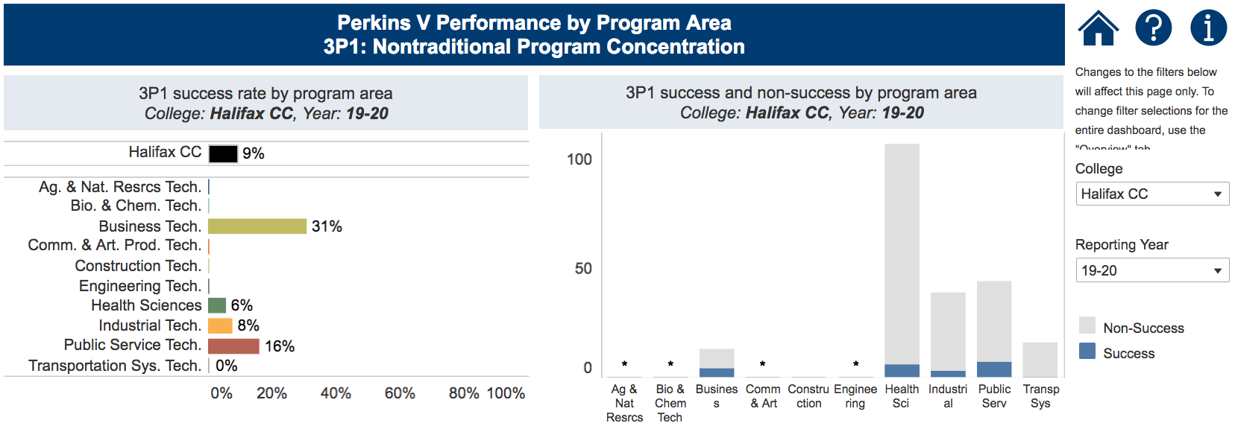
Notes:
Halifax CC
https://www.nccommunitycolleges.edu/analytics/dashboards/cte-perkins-v-performance-indicator-3p1-nontraditional-program-concentration-%E2%80%93

Slide 18
James Sprunt Community College
Have CLNA findings improved CTE?
Share a Promising Practice.
How is college coping under COVID-19?
Budget and spending plan.
Comments and questions.
Notes:
James Sprunt CC

Slide 19
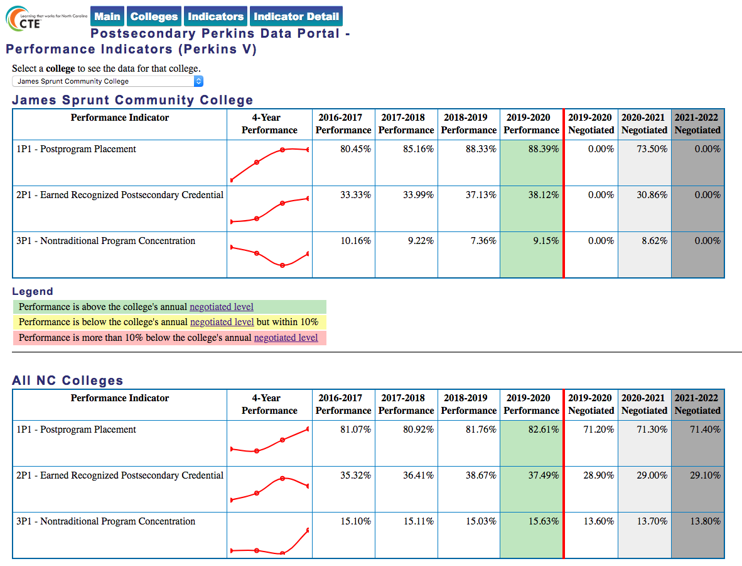
Notes:
James Sprunt CC
https://www.ncperkins.org/data/indicatorV.php

Slide 20
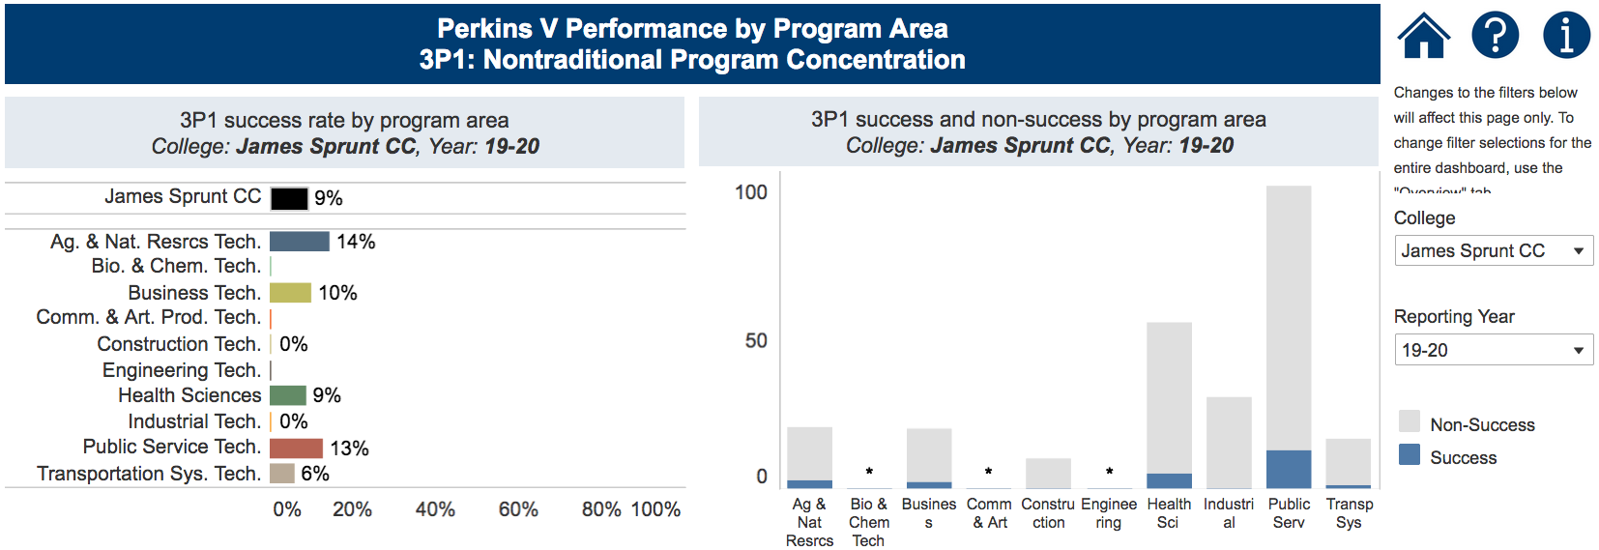
Notes:
James Sprunt CC
https://www.nccommunitycolleges.edu/analytics/dashboards/cte-perkins-v-performance-indicator-3p1-nontraditional-program-concentration-%E2%80%93

Slide 21
Martin Community College
Have CLNA findings improved CTE?
Share a Promising Practice.
How is college coping under COVID-19?
Budget and spending plan.
Comments and questions.
Notes:
Martin CC

Slide 22
Notes:
Martin CC
https://www.ncperkins.org/data/indicatorV.php

Slide 23
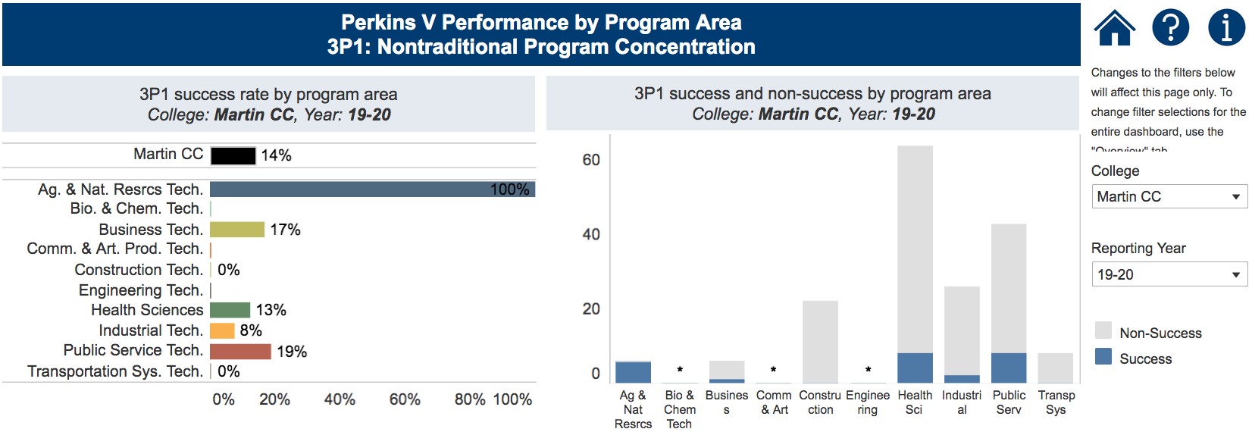
Notes:
Martin CC
https://www.nccommunitycolleges.edu/analytics/dashboards/cte-perkins-v-performance-indicator-3p1-nontraditional-program-concentration-%E2%80%93

Slide 24
McDowell Technical Community College
Have CLNA findings improved CTE?
Share a Promising Practice.
How is college coping under COVID-19?
Budget and spending plan.
Comments and questions.
Notes:
McDowell TCC

Slide 25
Notes:
McDowell TCC
https://www.ncperkins.org/data/indicatorV.php

Slide 26
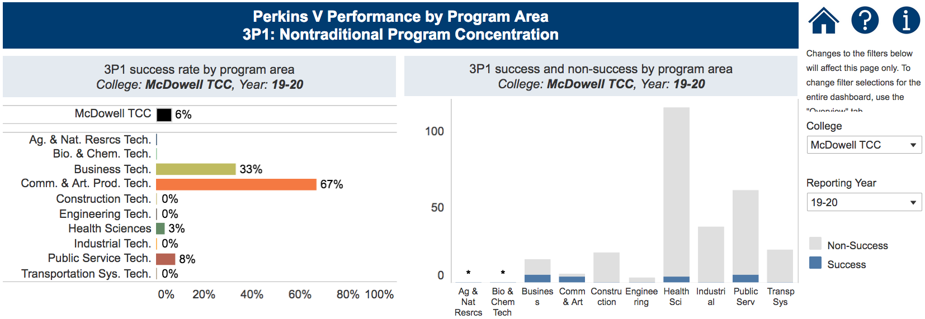
Notes:
McDowell TCC
https://www.nccommunitycolleges.edu/analytics/dashboards/cte-perkins-v-performance-indicator-3p1-nontraditional-program-concentration-%E2%80%93

Slide 27
Montgomery Community College
Have CLNA findings improved CTE?
Share a Promising Practice.
How is college coping under COVID-19?
Budget and spending plan.
Comments and questions.
Notes:
Montgomery CC

Slide 28
Notes:
Montgomery CC
https://www.ncperkins.org/data/indicatorV.php

Slide 29
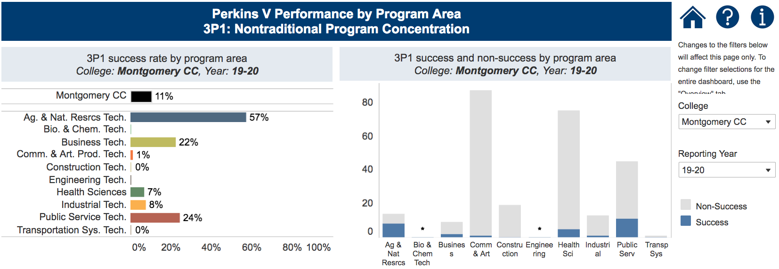
Notes:
Montgomery CC
https://www.nccommunitycolleges.edu/analytics/dashboards/cte-perkins-v-performance-indicator-3p1-nontraditional-program-concentration-%E2%80%93

Slide 30
Pamlico Community College
Have CLNA findings improved CTE?
Share a Promising Practice.
How is college coping under COVID-19?
Budget and spending plan.
Comments and questions.
Notes:
Pamlico CC

Slide 31
Notes:
Pamlico CC
https://www.ncperkins.org/data/indicatorV.php

Slide 32
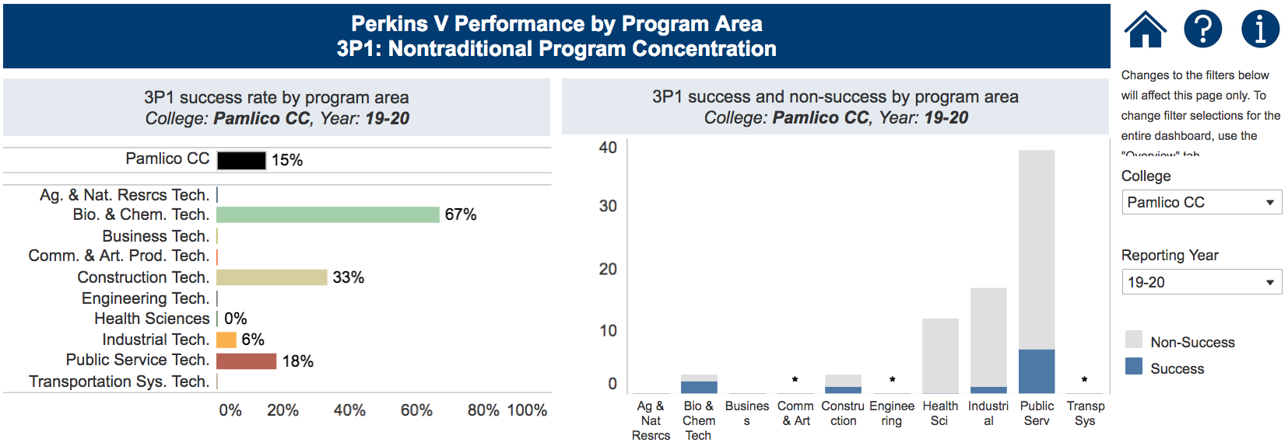
Notes:
Pamlico CC
https://www.nccommunitycolleges.edu/analytics/dashboards/cte-perkins-v-performance-indicator-3p1-nontraditional-program-concentration-%E2%80%93

Slide 33
Roanoke-Chowan Community College
Have CLNA findings improved CTE?
Share a Promising Practice.
How is college coping under COVID-19?
Budget and spending plan.
Comments and questions.
Notes:
Roanoke-Chowan CC

Slide 34
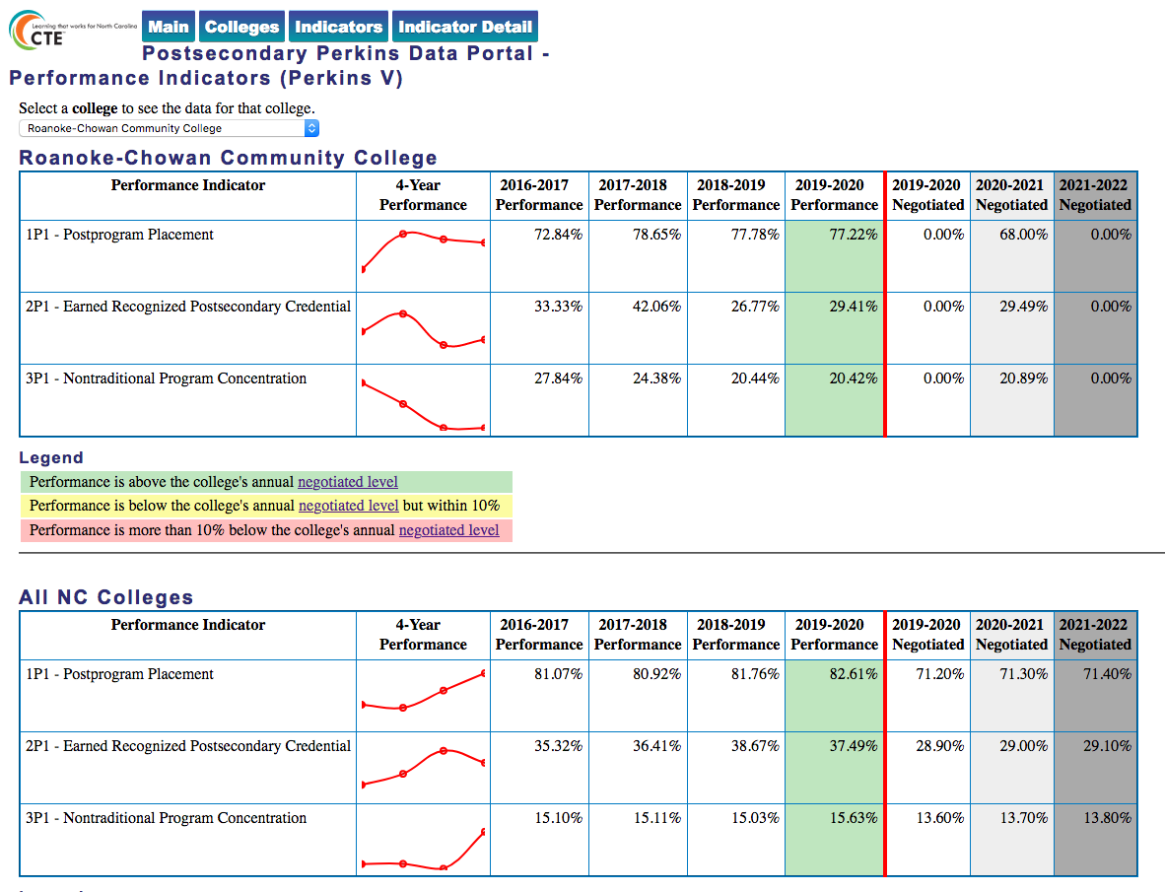
Notes:
Roanoke-Chowan CC
https://www.ncperkins.org/data/indicatorV.php

Slide 35
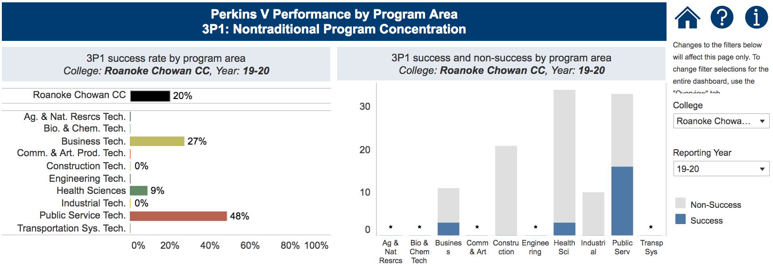
Notes:
Roanoke-Chowan CC
https://www.nccommunitycolleges.edu/analytics/dashboards/cte-perkins-v-performance-indicator-3p1-nontraditional-program-concentration-%E2%80%93

Slide 36
Tri-County Community College
Have CLNA findings improved CTE?
Share a Promising Practice.
How is college coping under COVID-19?
Budget and spending plan.
Comments and questions.
Notes:
Tri-County CC

Slide 37
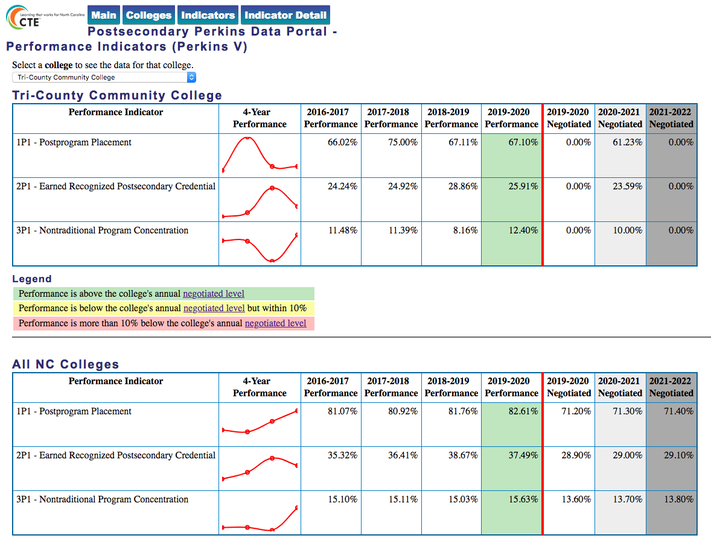
Notes:
Tri-County CC
https://www.ncperkins.org/data/indicatorV.php

Slide 38
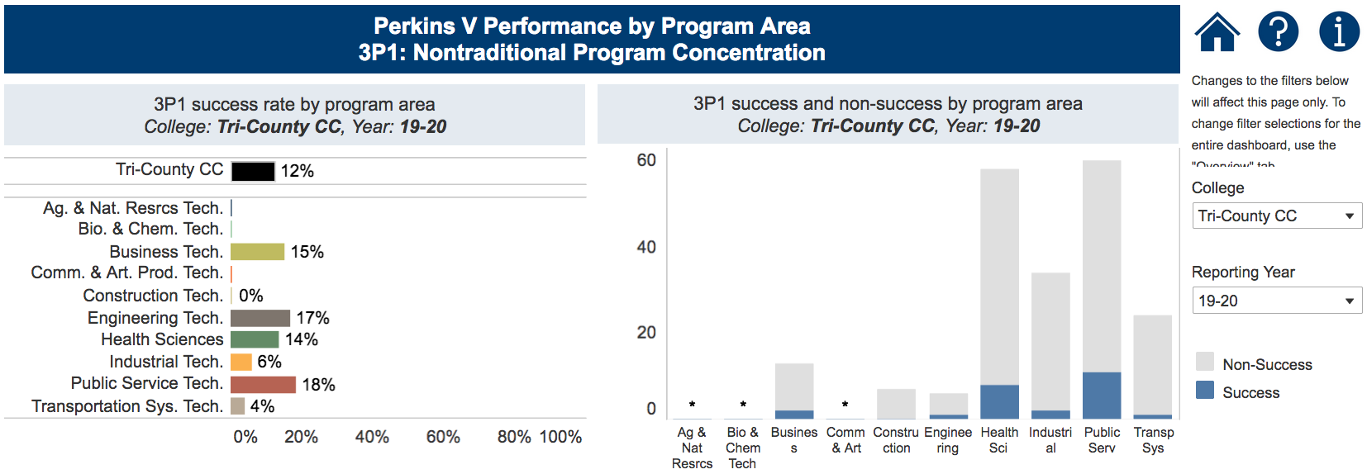
Notes:
Tri-County CC
https://www.nccommunitycolleges.edu/analytics/dashboards/cte-perkins-v-performance-indicator-3p1-nontraditional-program-concentration-%E2%80%93

Slide 39
January 21, 2021
College of the Albemarle
Craven Community College
Haywood Community College
Mayland Community College
Mitchell Community College
Piedmont Community College
Robeson Community College
Rockingham Community College
Sampson Community College
Southeastern Community College
Western Piedmont Community College
Wilson Community College

Slide 40
College of the Albemarle
Have CLNA findings improved CTE?
Share a Promising Practice.
How is college coping under COVID-19?
Budget and spending plan.
Comments and questions.
Notes:
College of the Albemarle

Slide 41
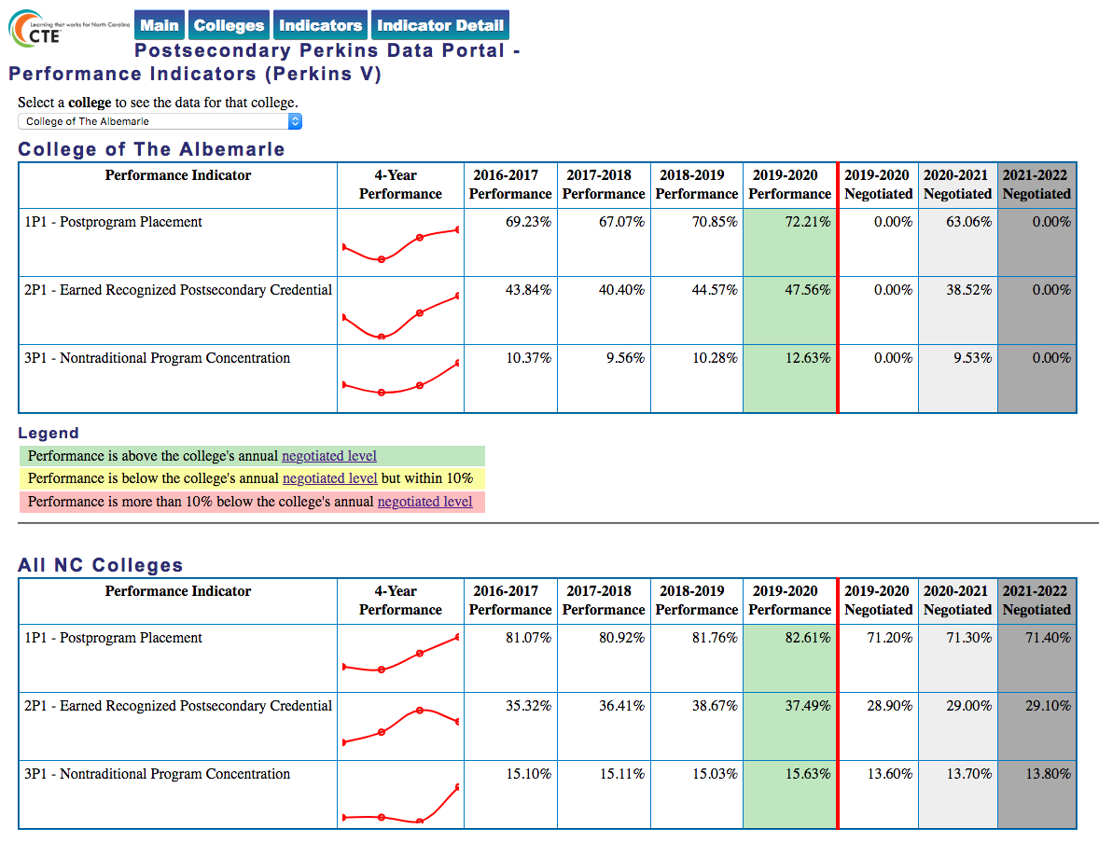
Notes:
College of the Albemarle
https://www.ncperkins.org/data/indicatorV.php

Slide 42
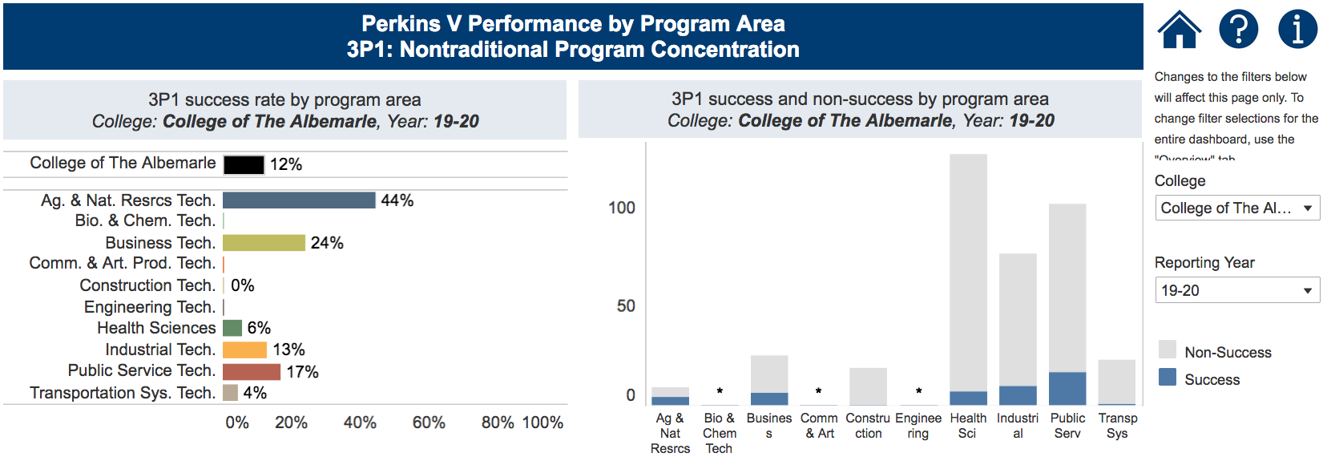
Notes:
College of the Albemarle
https://www.nccommunitycolleges.edu/analytics/dashboards/cte-perkins-v-performance-indicator-3p1-nontraditional-program-concentration-%E2%80%93

Slide 43
Craven Community College
Have CLNA findings improved CTE?
Share a Promising Practice.
How is college coping under COVID-19?
Budget and spending plan.
Comments and questions.
Notes:
Craven CC

Slide 44
Notes:
Craven CC
https://www.ncperkins.org/data/indicatorV.php

Slide 45
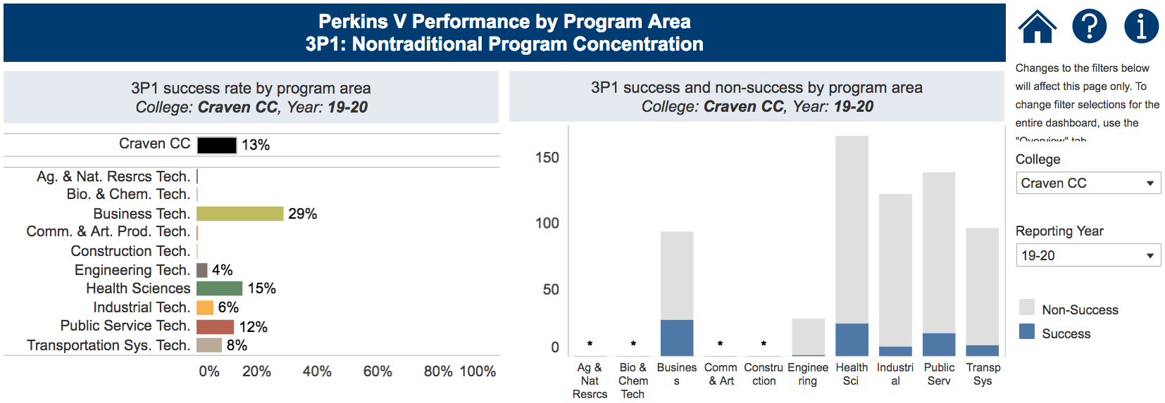
Notes:
Craven CC
https://www.nccommunitycolleges.edu/analytics/dashboards/cte-perkins-v-performance-indicator-3p1-nontraditional-program-concentration-%E2%80%93

Slide 46
Haywood Community College
Have CLNA findings improved CTE?
Share a Promising Practice.
How is college coping under COVID-19?
Budget and spending plan.
Comments and questions.
Notes:
Haywood CC

Slide 47
Notes:
Haywood CC
https://www.ncperkins.org/data/indicatorV.php

Slide 48
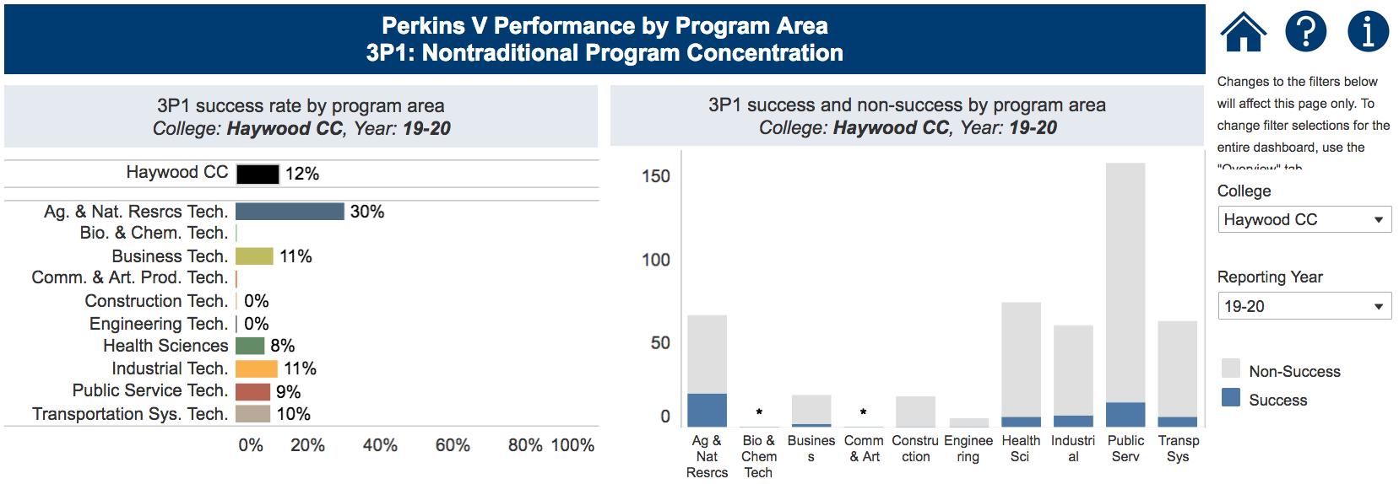
Notes:
Haywood CC
https://www.nccommunitycolleges.edu/analytics/dashboards/cte-perkins-v-performance-indicator-3p1-nontraditional-program-concentration-%E2%80%93

Slide 49
Mayland Community College
Have CLNA findings improved CTE?
Share a Promising Practice.
How is college coping under COVID-19?
Budget and spending plan.
Comments and questions.
Notes:
Mayland CC

Slide 50
Notes:
Mayland CC
https://www.ncperkins.org/data/indicatorV.php

Slide 51
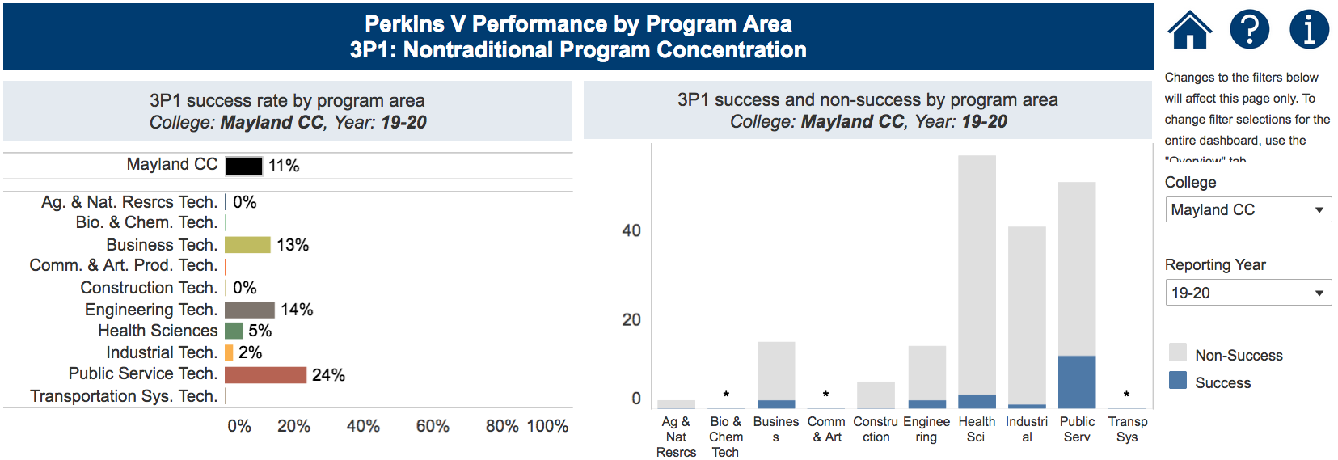
Notes:
Mayland CC
https://www.nccommunitycolleges.edu/analytics/dashboards/cte-perkins-v-performance-indicator-3p1-nontraditional-program-concentration-%E2%80%93

Slide 52
Mitchell Community College
Have CLNA findings improved CTE?
Share a Promising Practice.
How is college coping under COVID-19?
Budget and spending plan.
Comments and questions.
Notes:
Mitchell CC

Slide 53
Notes:
Mitchell CC
https://www.ncperkins.org/data/indicatorV.php

Slide 54
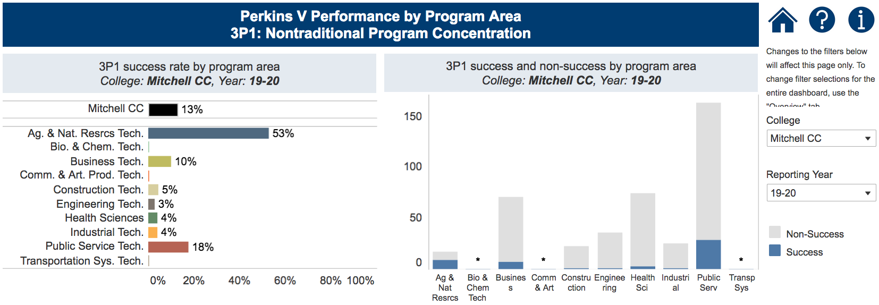
Notes:
Mitchell CC
https://www.nccommunitycolleges.edu/analytics/dashboards/cte-perkins-v-performance-indicator-3p1-nontraditional-program-concentration-%E2%80%93

Slide 55
Piedmont Community College
Have CLNA findings improved CTE?
Share a Promising Practice.
How is college coping under COVID-19?
Budget and spending plan.
Comments and questions.
Notes:
Piedmont CC

Slide 56
Notes:
Piedmont CC
https://www.ncperkins.org/data/indicatorV.php

Slide 57
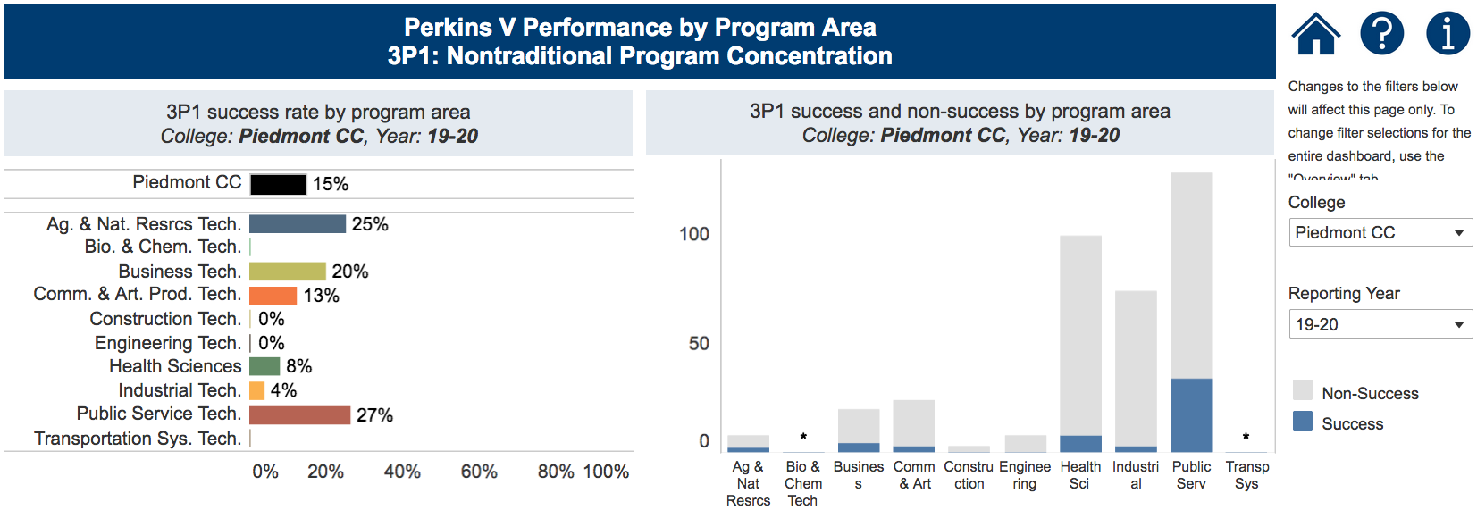
Notes:
Piedmont CC
https://www.nccommunitycolleges.edu/analytics/dashboards/cte-perkins-v-performance-indicator-3p1-nontraditional-program-concentration-%E2%80%93

Slide 58
Robeson Community College
Have CLNA findings improved CTE?
Share a Promising Practice.
How is college coping under COVID-19?
Budget and spending plan.
Comments and questions.
Notes:
Robeson CC

Slide 59
Notes:
Robeson CC
https://www.ncperkins.org/data/indicatorV.php

Slide 60
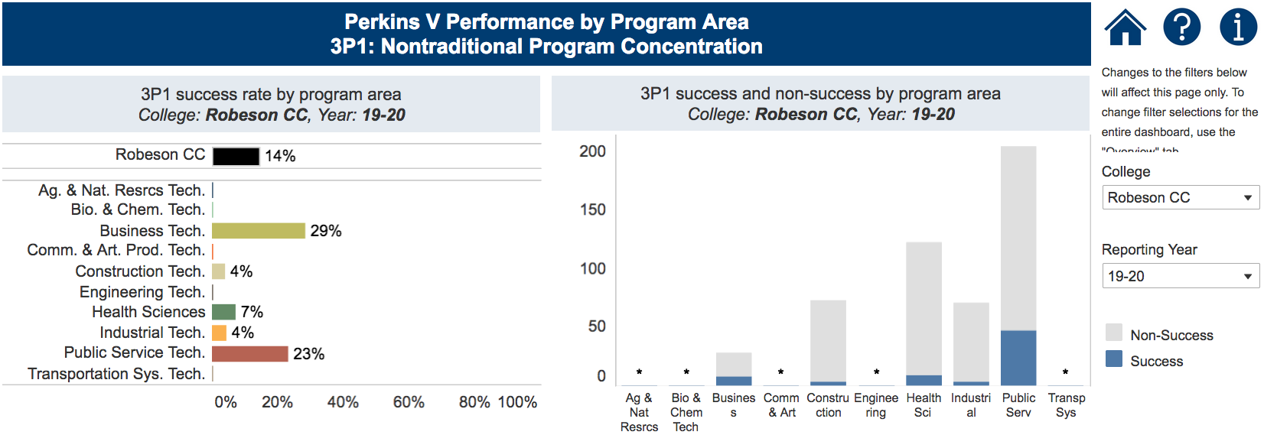
Notes:
Robeson CC
https://www.nccommunitycolleges.edu/analytics/dashboards/cte-perkins-v-performance-indicator-3p1-nontraditional-program-concentration-%E2%80%93

Slide 61
Rockingham Community College
Have CLNA findings improved CTE?
Share a Promising Practice.
How is college coping under COVID-19?
Budget and spending plan.
Comments and questions.
Notes:
Rockingham CC

Slide 62
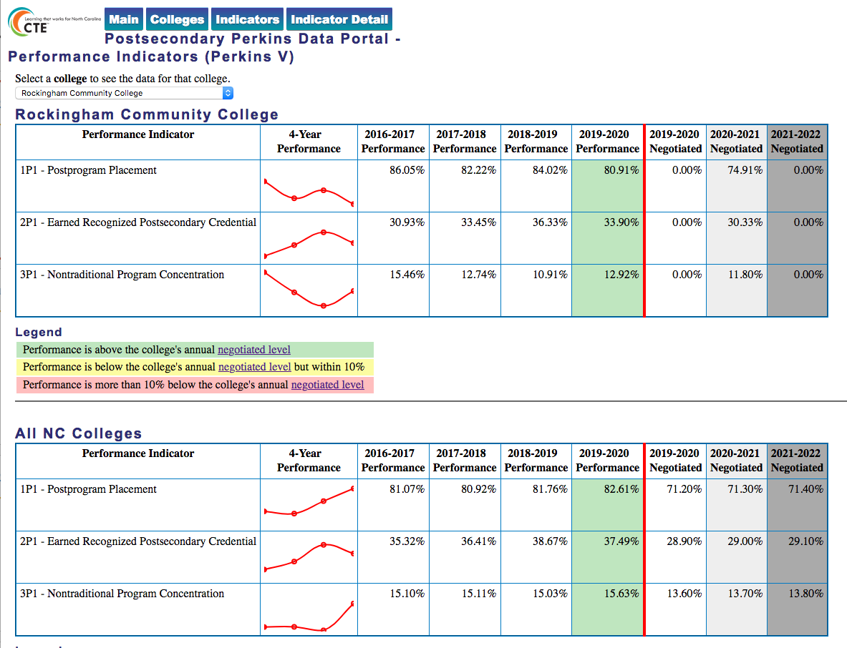
Notes:
Rockingham CC
https://www.ncperkins.org/data/indicatorV.php

Slide 63
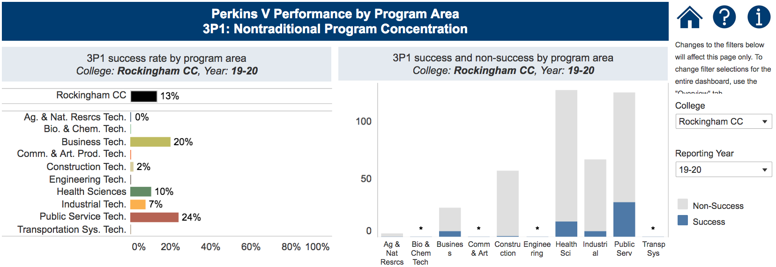
Notes:
Rockingham CC
https://www.nccommunitycolleges.edu/analytics/dashboards/cte-perkins-v-performance-indicator-3p1-nontraditional-program-concentration-%E2%80%93

Slide 64
Sampson Community College
Have CLNA findings improved CTE?
Share a Promising Practice.
How is college coping under COVID-19?
Budget and spending plan.
Comments and questions.
Notes:
Sampson CC

Slide 65
Notes:
Sampson CC
https://www.ncperkins.org/data/indicatorV.php

Slide 66
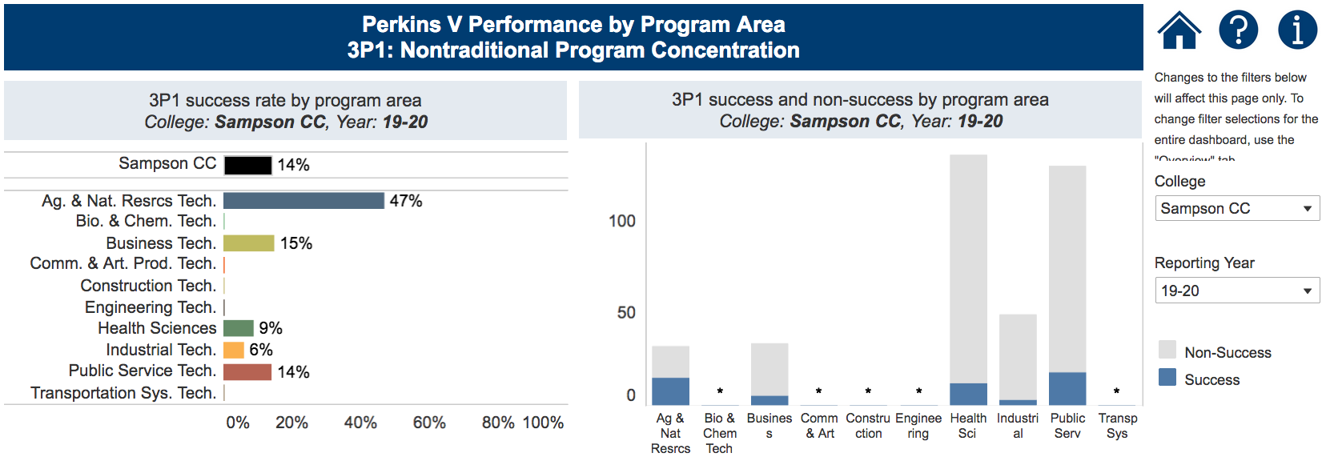
Notes:
Sampson CC
https://www.nccommunitycolleges.edu/analytics/dashboards/cte-perkins-v-performance-indicator-3p1-nontraditional-program-concentration-%E2%80%93

Slide 67
Southeastern Community College
Have CLNA findings improved CTE?
Share a Promising Practice.
How is college coping under COVID-19?
Budget and spending plan.
Comments and questions.
Notes:
Southeastern CC

Slide 68
Notes:
Southeastern CC
https://www.ncperkins.org/data/indicatorV.php

Slide 69
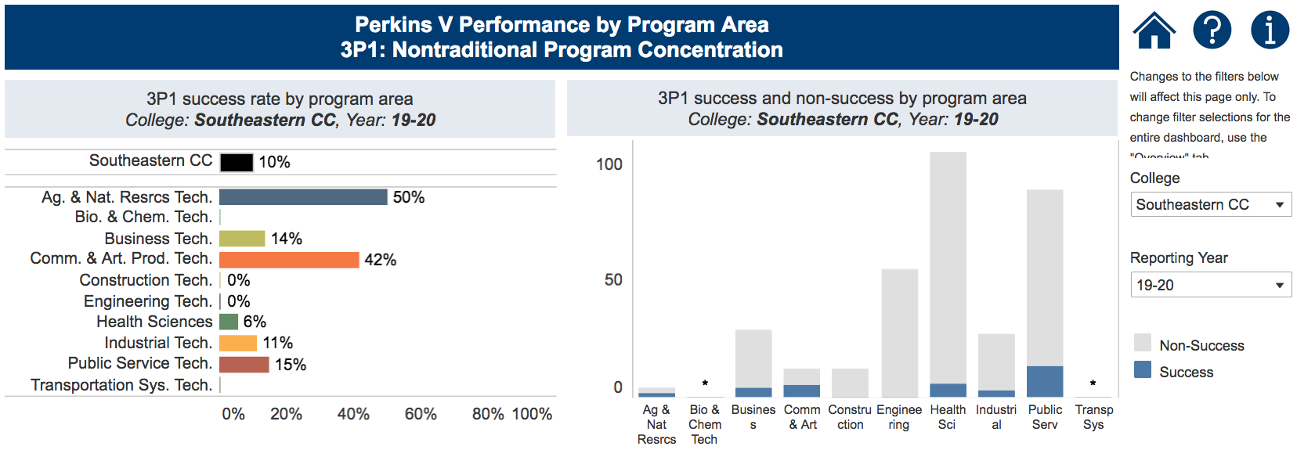
Notes:
Southeastern CC
https://www.nccommunitycolleges.edu/analytics/dashboards/cte-perkins-v-performance-indicator-3p1-nontraditional-program-concentration-%E2%80%93

Slide 70
Western Piedmont Community College
Have CLNA findings improved CTE?
Share a Promising Practice.
How is college coping under COVID-19?
Budget and spending plan.
Comments and questions.
Notes:
Western Piedmont CC

Slide 71
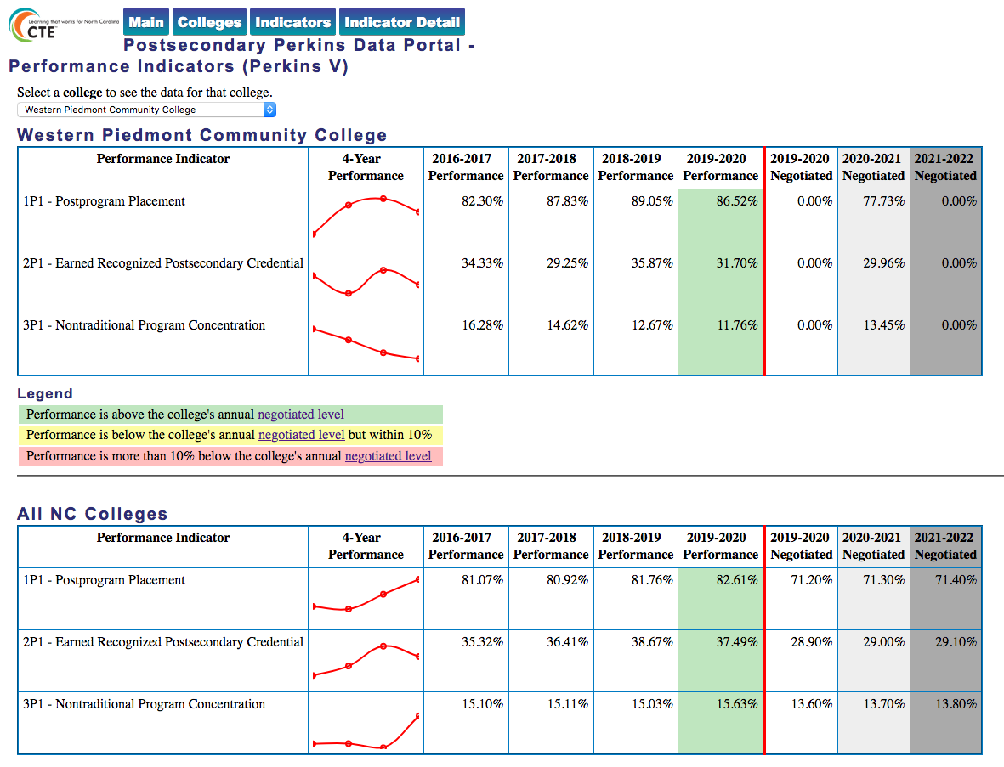
Notes:
Western Piedmont CC
https://www.ncperkins.org/data/indicatorV.php

Slide 72
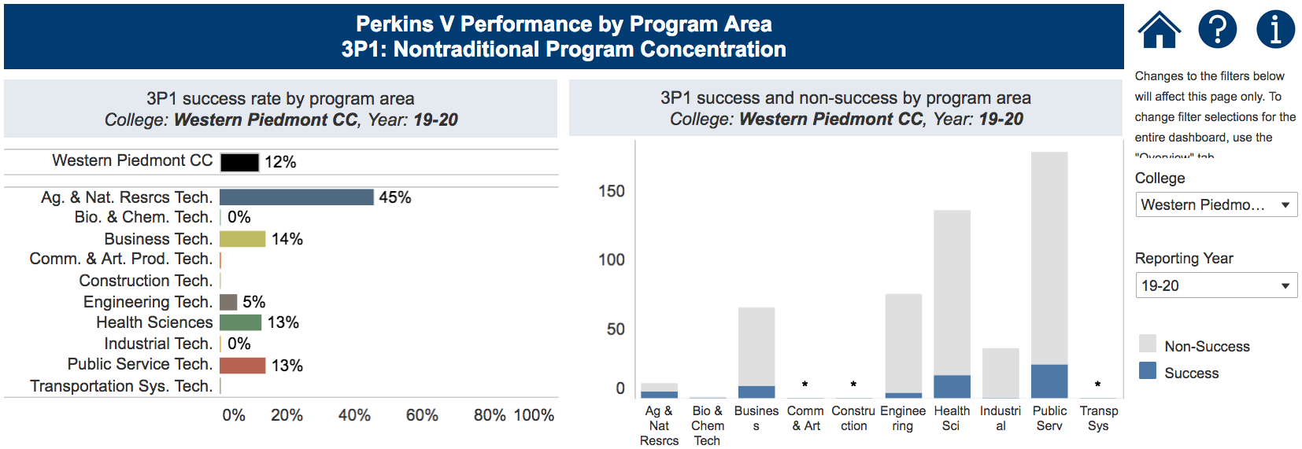
Notes:
Western Piedmont CC
https://www.nccommunitycolleges.edu/analytics/dashboards/cte-perkins-v-performance-indicator-3p1-nontraditional-program-concentration-%E2%80%93

Slide 73
Wilson Community College
Have CLNA findings improved CTE?
Share a Promising Practice.
How is college coping under COVID-19?
Budget and spending plan.
Comments and questions.
Notes:
Wilson CC

Slide 74
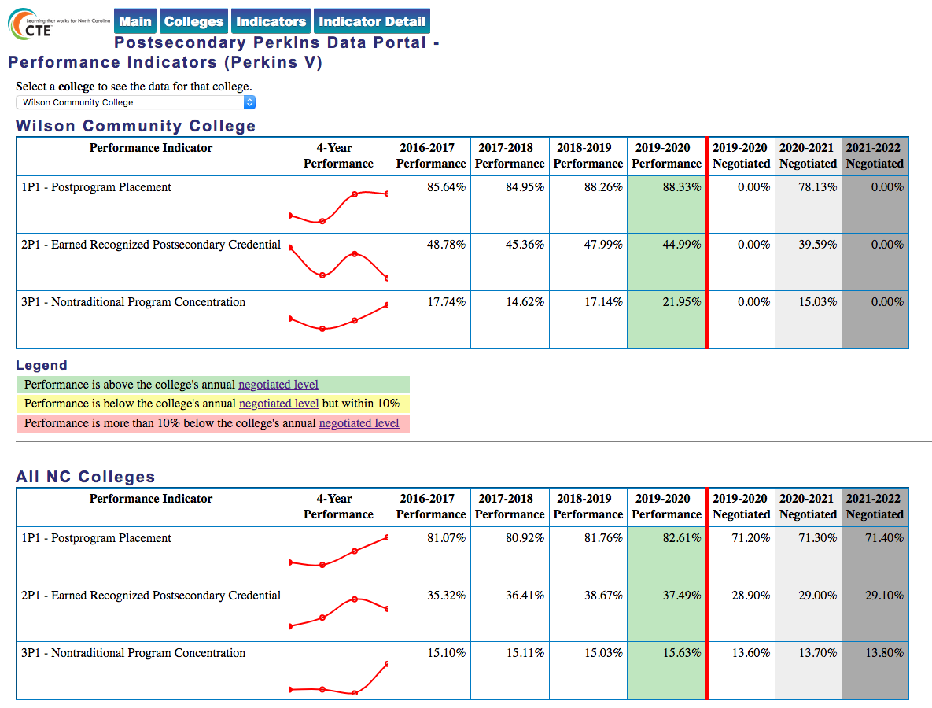
Notes:
Wilson CC
https://www.ncperkins.org/data/indicatorV.php

Slide 75
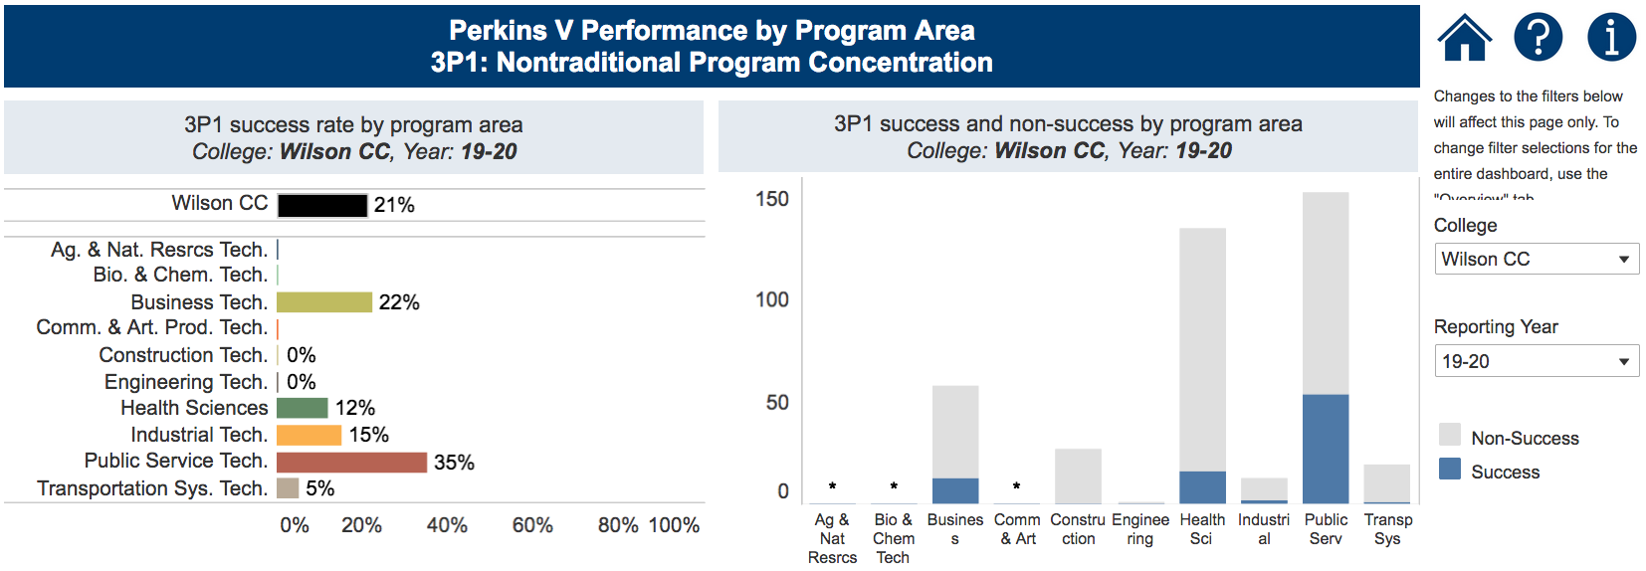
Notes:
Wilson CC
https://www.nccommunitycolleges.edu/analytics/dashboards/cte-perkins-v-performance-indicator-3p1-nontraditional-program-concentration-%E2%80%93

Slide 76
January 26, 2021
Blue Ridge Community College
Caldwell Community College and Technical Institute
Cleveland Community College
Coastal Carolina Community College
Edgecombe Community College
Isothermal Community College
Lenoir Community College
Richmond Community College
South Piedmont Community College
Southwestern Community College
Surry Community College
Vance-Granville Community College
Wilkes Community College

Slide 77
Blue Ridge Community College
Have CLNA findings improved CTE?
Share a Promising Practice.
How is college coping under COVID-19?
Budget and spending plan.
Comments and questions.
Notes:
Blue Ridge CC

Slide 78
Notes:
Blue Ridge CC
https://www.ncperkins.org/data/indicatorV.php

Slide 79
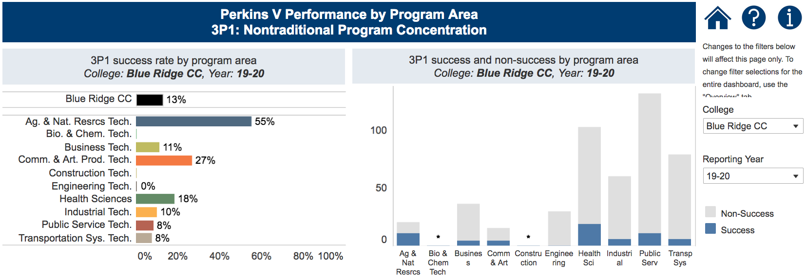
Notes:
Blue Ridge CC
https://www.nccommunitycolleges.edu/analytics/dashboards/cte-perkins-v-performance-indicator-3p1-nontraditional-program-concentration-%E2%80%93

Slide 80
Caldwell Community College and Technical Institute
Have CLNA findings improved CTE?
Share a Promising Practice.
How is college coping under COVID-19?
Budget and spending plan.
Comments and questions.
Notes:
Caldwell CC and TI

Slide 81
Notes:
Caldwell CC and TI
https://www.ncperkins.org/data/indicatorV.php

Slide 82
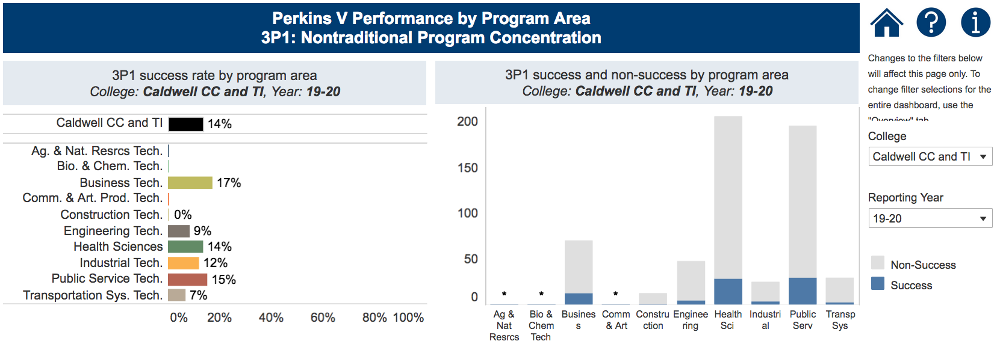
Notes:
Caldwell CC and TI
https://www.nccommunitycolleges.edu/analytics/dashboards/cte-perkins-v-performance-indicator-3p1-nontraditional-program-concentration-%E2%80%93

Slide 83
Cleveland Community College
Have CLNA findings improved CTE?
Share a Promising Practice.
How is college coping under COVID-19?
Budget and spending plan.
Comments and questions.
Notes:
Cleveland CC

Slide 84
Notes:
Cleveland CC
https://www.ncperkins.org/data/indicatorV.php

Slide 85
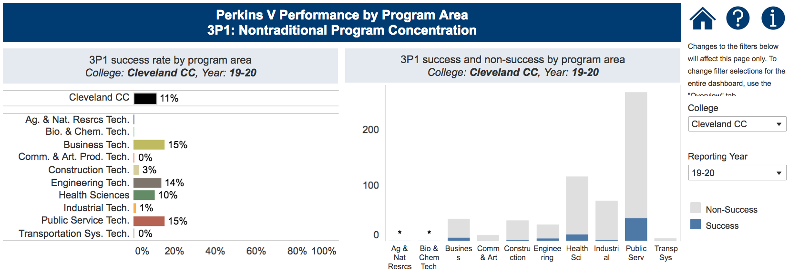
Notes:
Cleveland CC
https://www.nccommunitycolleges.edu/analytics/dashboards/cte-perkins-v-performance-indicator-3p1-nontraditional-program-concentration-%E2%80%93

Slide 86
Coastal Carolina Community College
Have CLNA findings improved CTE?
Share a Promising Practice.
How is college coping under COVID-19?
Budget and spending plan.
Comments and questions.
Notes:
Coastal Carolina CC

Slide 87
Notes:
Coastal Carolina CC
https://www.ncperkins.org/data/indicatorV.php

Slide 88
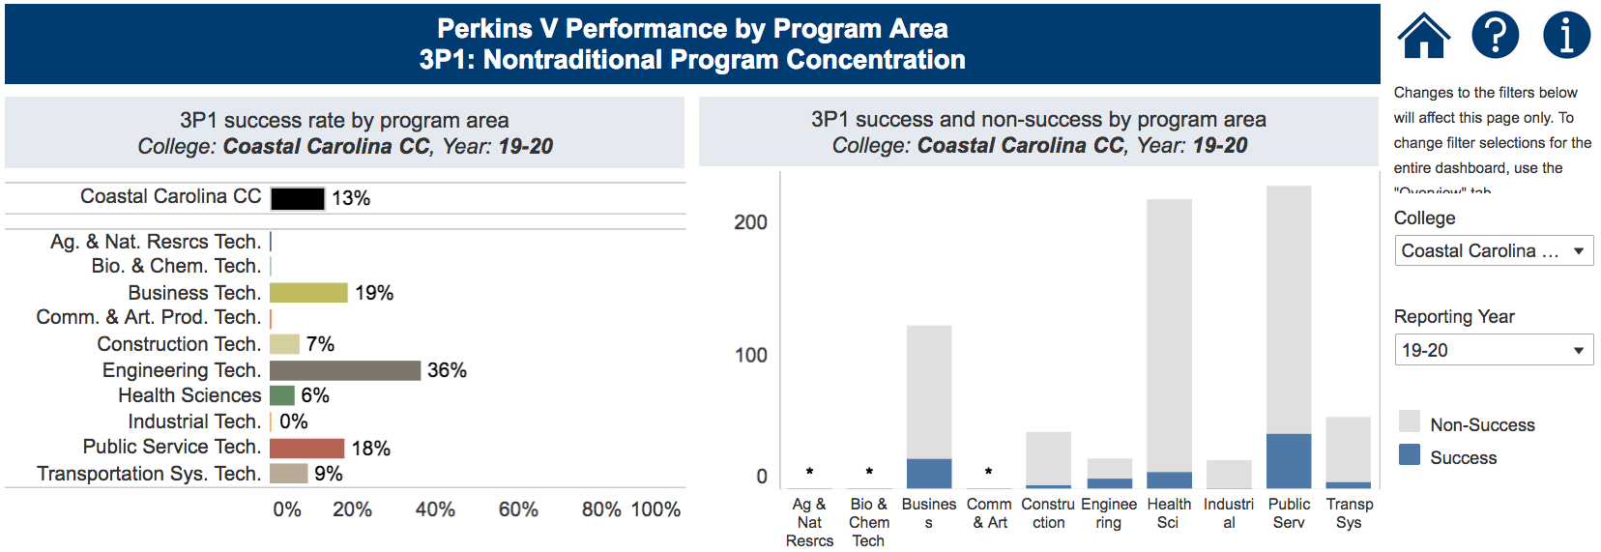
Notes:
Coastal Carolina CC
https://www.nccommunitycolleges.edu/analytics/dashboards/cte-perkins-v-performance-indicator-3p1-nontraditional-program-concentration-%E2%80%93

Slide 89
Edgecombe Community College
Have CLNA findings improved CTE?
Share a Promising Practice.
How is college coping under COVID-19?
Budget and spending plan.
Comments and questions.
Notes:
Edgecombe CC

Slide 90
Notes:
Edgecombe CC
https://www.ncperkins.org/data/indicatorV.php

Slide 91
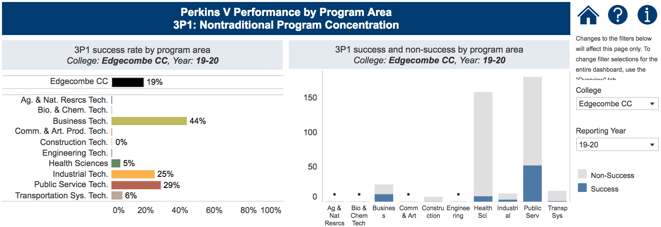
Notes:
Edgecombe CC
https://www.nccommunitycolleges.edu/analytics/dashboards/cte-perkins-v-performance-indicator-3p1-nontraditional-program-concentration-%E2%80%93

Slide 92
Isothermal Community College
Have CLNA findings improved CTE?
Share a Promising Practice.
How is college coping under COVID-19?
Budget and spending plan.
Comments and questions.
Notes:
Isothermal CC

Slide 93
Notes:
Isothermal CC
https://www.ncperkins.org/data/indicatorV.php

Slide 94
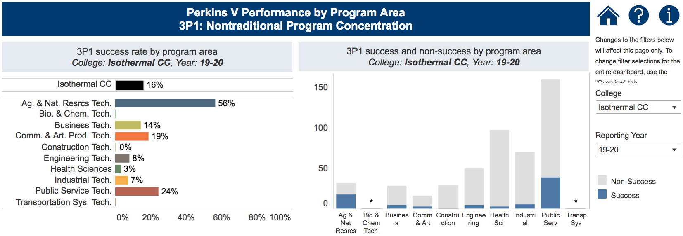
Notes:
Isothermal CC
https://www.nccommunitycolleges.edu/analytics/dashboards/cte-perkins-v-performance-indicator-3p1-nontraditional-program-concentration-%E2%80%93

Slide 95
Lenoir Community College
Have CLNA findings improved CTE?
Share a Promising Practice.
How is college coping under COVID-19?
Budget and spending plan.
Comments and questions.
Notes:
Lenoir CC

Slide 96
Notes:
Lenoir CC
https://www.ncperkins.org/data/indicatorV.php

Slide 97
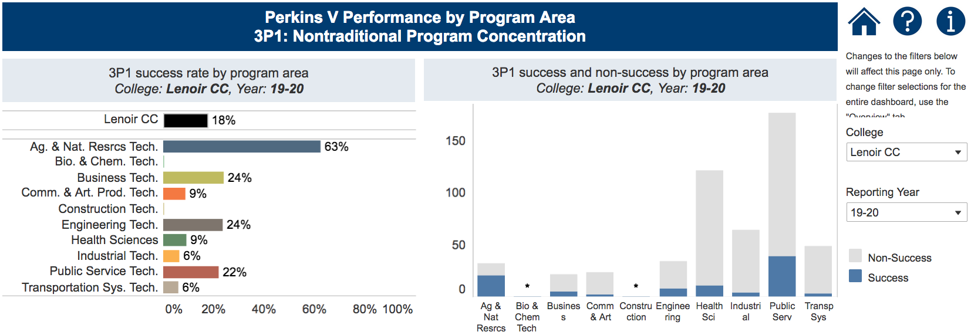
Notes:
Lenoir CC
https://www.nccommunitycolleges.edu/analytics/dashboards/cte-perkins-v-performance-indicator-3p1-nontraditional-program-concentration-%E2%80%93

Slide 98
Richmond Community College
Have CLNA findings improved CTE?
Share a Promising Practice.
How is college coping under COVID-19?
Budget and spending plan.
Comments and questions.
Notes:
Richmond CC

Slide 99
Notes:
Richmond CC
https://www.ncperkins.org/data/indicatorV.php

Slide 100
Notes:
Richmond CC
https://www.nccommunitycolleges.edu/analytics/dashboards/cte-perkins-v-performance-indicator-3p1-nontraditional-program-concentration-%E2%80%93

Slide 101
South Piedmont Community College
Have CLNA findings improved CTE?
Share a Promising Practice.
How is college coping under COVID-19?
Budget and spending plan.
Comments and questions.
Notes:
South Piedmont CC

Slide 102
Notes:
South Piedmont CC
https://www.ncperkins.org/data/indicatorV.php

Slide 103
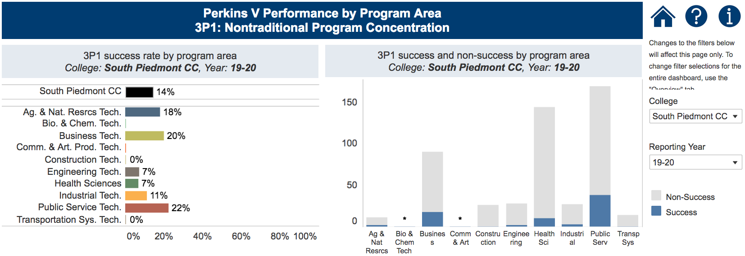
Notes:
South Piedmont CC
https://www.nccommunitycolleges.edu/analytics/dashboards/cte-perkins-v-performance-indicator-3p1-nontraditional-program-concentration-%E2%80%93

Slide 104
Southwestern Community College
Have CLNA findings improved CTE?
Share a Promising Practice.
How is college coping under COVID-19?
Budget and spending plan.
Comments and questions.
Notes:
Southwestern CC

Slide 105
Notes:
Southwestern CC
https://www.ncperkins.org/data/indicatorV.php

Slide 106
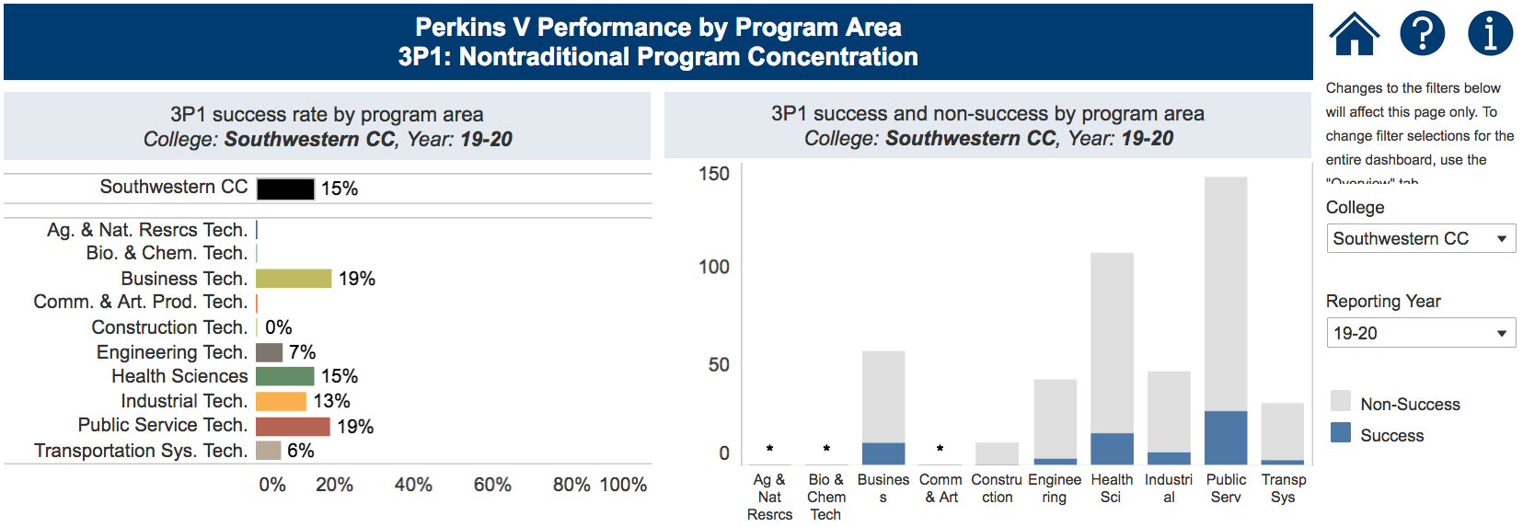
Notes:
Southwestern CC
https://www.nccommunitycolleges.edu/analytics/dashboards/cte-perkins-v-performance-indicator-3p1-nontraditional-program-concentration-%E2%80%93

Slide 107
Surry Community College
Have CLNA findings improved CTE?
Share a Promising Practice.
How is college coping under COVID-19?
Budget and spending plan.
Comments and questions.
Notes:
Surry CC

Slide 108
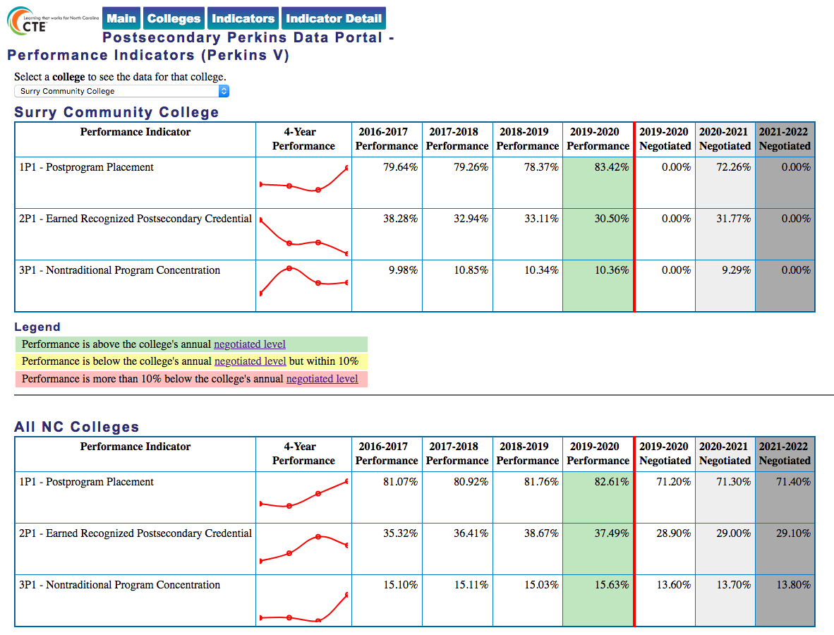
Notes:
Surry CC
https://www.ncperkins.org/data/indicatorV.php

Slide 109
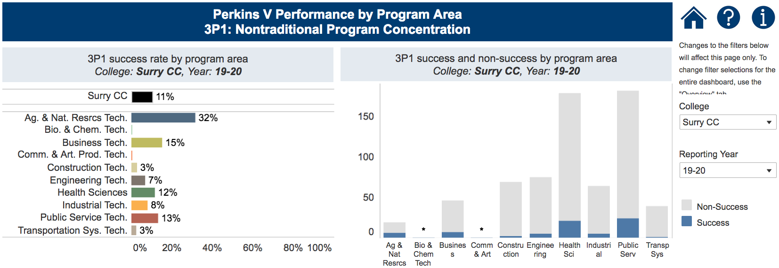
Notes:
Surry CC
https://www.nccommunitycolleges.edu/analytics/dashboards/cte-perkins-v-performance-indicator-3p1-nontraditional-program-concentration-%E2%80%93

Slide 110
Vance-Granville Community College
Have CLNA findings improved CTE?
Share a Promising Practice.
How is college coping under COVID-19?
Budget and spending plan.
Comments and questions.
Notes:
Vance-Granville CC

Slide 111
Notes:
Vance-Granville CC
https://www.ncperkins.org/data/indicatorV.php

Slide 112
Notes:
Vance-Granville CC
https://www.nccommunitycolleges.edu/analytics/dashboards/cte-perkins-v-performance-indicator-3p1-nontraditional-program-concentration-%E2%80%93

Slide 113
Wilkes Community College
Have CLNA findings improved CTE?
Share a Promising Practice.
How is college coping under COVID-19?
Budget and spending plan.
Comments and questions.
Notes:
Wilkes CC

Slide 114
Notes:
Wilkes CC
https://www.ncperkins.org/data/indicatorV.php

Slide 115
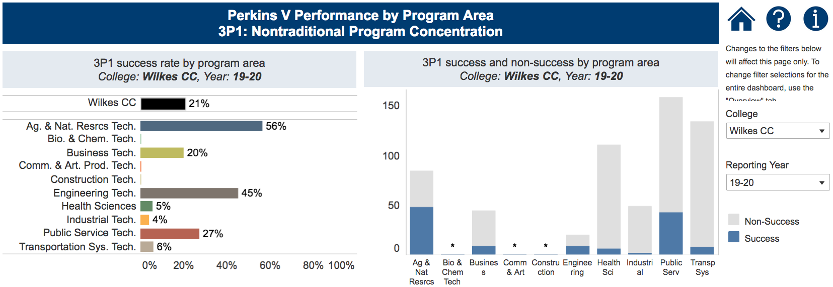
Notes:
Wilkes CC
https://www.nccommunitycolleges.edu/analytics/dashboards/cte-perkins-v-performance-indicator-3p1-nontraditional-program-concentration-%E2%80%93

Slide 116
January 28, 2021
Alamance Community College
Catawba Valley Community College
Davidson-Davie Community College
Durham Technical Community College
Gaston College
Johnston Community College
Nash Community College
Randolph Community College
Rowan-Cabarrus Community College
Sandhills Community College
Stanly Community College
Wayne Community College

Slide 117
Alamance Community College
Have CLNA findings improved CTE?
Share a Promising Practice.
How is college coping under COVID-19?
Budget and spending plan.
Comments and questions.
Notes:
Alamance CC

Slide 118
Notes:
Alamance CC
https://www.ncperkins.org/data/indicatorV.php

Slide 119
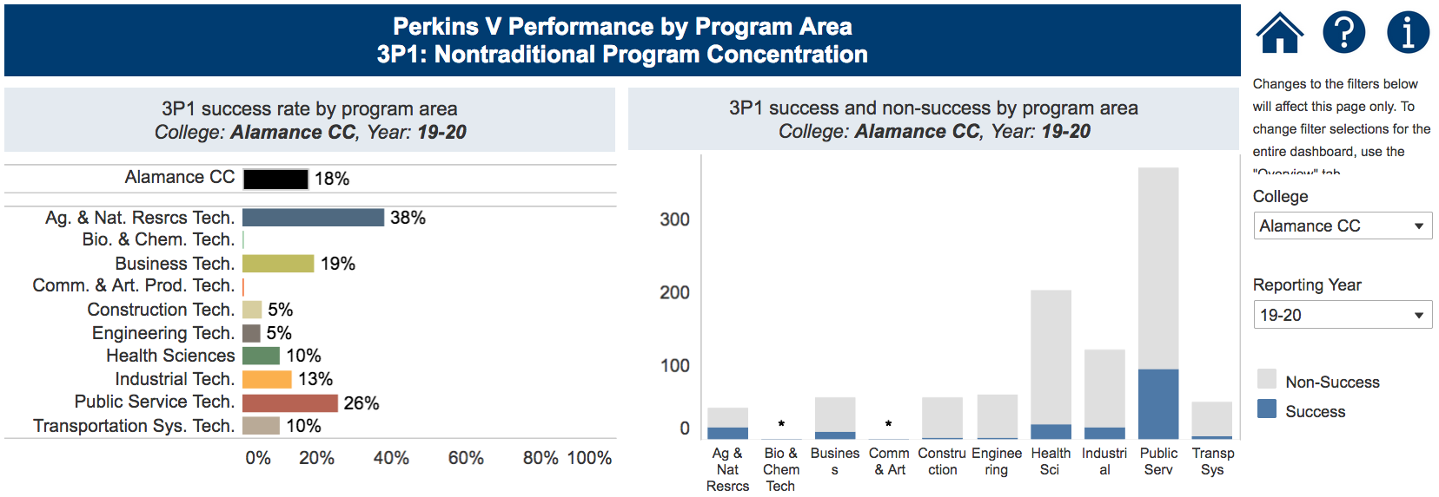
Notes:
Alamance CC
https://www.nccommunitycolleges.edu/analytics/dashboards/cte-perkins-v-performance-indicator-3p1-nontraditional-program-concentration-%E2%80%93

Slide 120
Catawba Valley Community College
Have CLNA findings improved CTE?
Share a Promising Practice.
How is college coping under COVID-19?
Budget and spending plan.
Comments and questions.
Notes:
Catawba Valley CC

Slide 121
Notes:
Catawba Valley CC
https://www.ncperkins.org/data/indicatorV.php

Slide 122
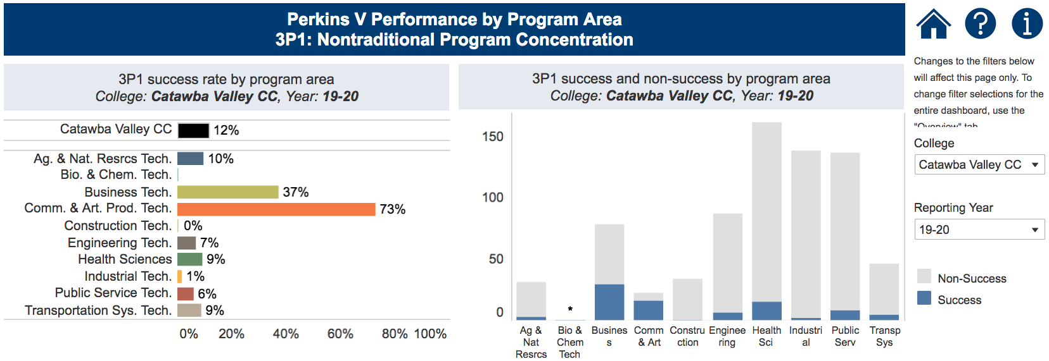
Notes:
Catawba Valley CC
https://www.nccommunitycolleges.edu/analytics/dashboards/cte-perkins-v-performance-indicator-3p1-nontraditional-program-concentration-%E2%80%93

Slide 123
Davidson-Davie Community College
Have CLNA findings improved CTE?
Share a Promising Practice.
How is college coping under COVID-19?
Budget and spending plan.
Comments and questions.
Notes:
Davidson County CC

Slide 124
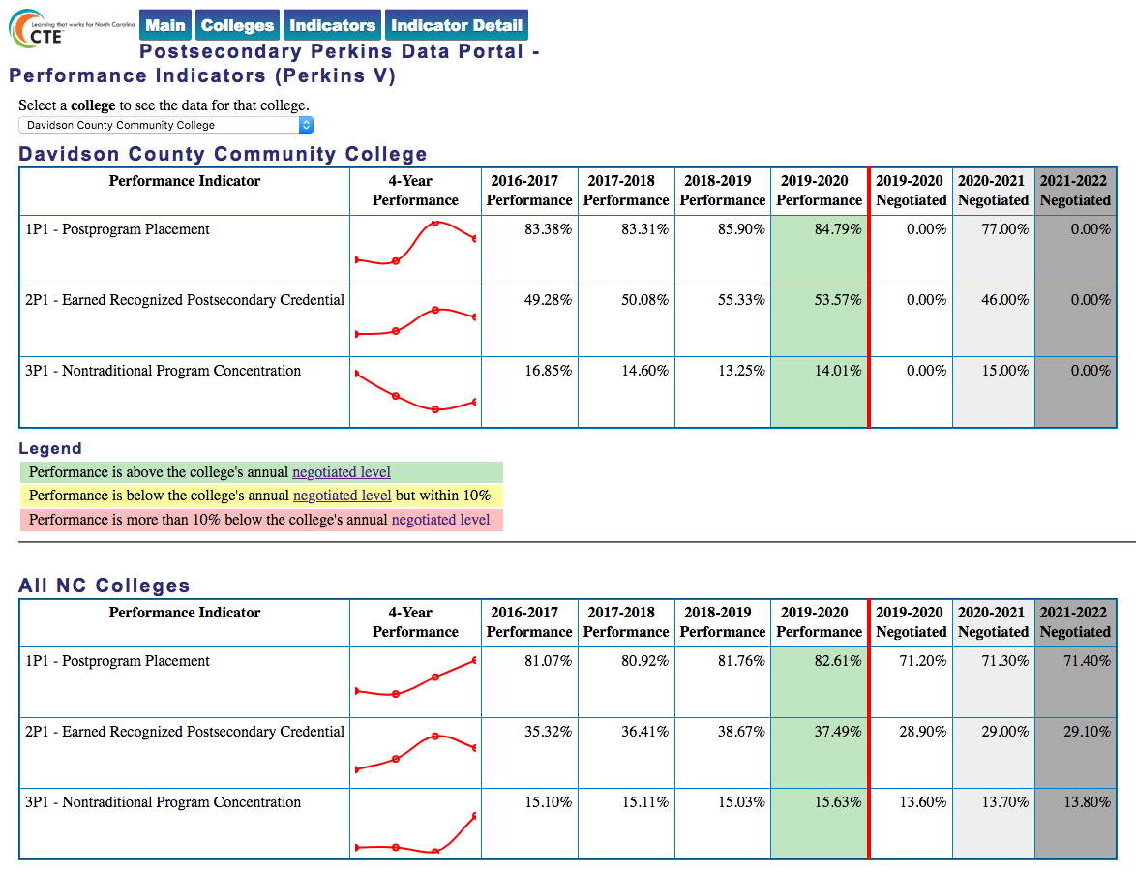
Notes:
Davidson County CC
https://www.ncperkins.org/data/indicatorV.php

Slide 125
Notes:
Davidson County CC
https://www.nccommunitycolleges.edu/analytics/dashboards/cte-perkins-v-performance-indicator-3p1-nontraditional-program-concentration-%E2%80%93

Slide 126
Durham Technical Community College
Have CLNA findings improved CTE?
Share a Promising Practice.
How is college coping under COVID-19?
Budget and spending plan.
Comments and questions.
Notes:
Durham TCC

Slide 127
Notes:
Durham TCC
https://www.ncperkins.org/data/indicatorV.php

Slide 128
Notes:
Durham TCC
https://www.nccommunitycolleges.edu/analytics/dashboards/cte-perkins-v-performance-indicator-3p1-nontraditional-program-concentration-%E2%80%93

Slide 129
Gaston College
Have CLNA findings improved CTE?
Share a Promising Practice.
How is college coping under COVID-19?
Budget and spending plan.
Comments and questions.
Notes:
Gaston College

Slide 130
Notes:
Gaston College
https://www.ncperkins.org/data/indicatorV.php

Slide 131
Notes:
Gaston College
https://www.nccommunitycolleges.edu/analytics/dashboards/cte-perkins-v-performance-indicator-3p1-nontraditional-program-concentration-%E2%80%93

Slide 132
Johnston Community College
Have CLNA findings improved CTE?
Share a Promising Practice.
How is college coping under COVID-19?
Budget and spending plan.
Comments and questions.
Notes:
Johnston CC

Slide 133
Notes:
Johnston CC
https://www.ncperkins.org/data/indicatorV.php

Slide 134
Notes:
Johnston CC
https://www.nccommunitycolleges.edu/analytics/dashboards/cte-perkins-v-performance-indicator-3p1-nontraditional-program-concentration-%E2%80%93

Slide 135
Nash Community College
Have CLNA findings improved CTE?
Share a Promising Practice.
How is college coping under COVID-19?
Budget and spending plan.
Comments and questions.
Notes:
Nash CC

Slide 136
Notes:
Nash CC
https://www.ncperkins.org/data/indicatorV.php

Slide 137
Notes:
Nash CC
https://www.nccommunitycolleges.edu/analytics/dashboards/cte-perkins-v-performance-indicator-3p1-nontraditional-program-concentration-%E2%80%93

Slide 138
Randolph Community College
Have CLNA findings improved CTE?
Share a Promising Practice.
How is college coping under COVID-19?
Budget and spending plan.
Comments and questions.
Notes:
Randolph CC

Slide 139
Notes:
Randolph CC
https://www.ncperkins.org/data/indicatorV.php

Slide 140
Notes:
Randolph CC
https://www.nccommunitycolleges.edu/analytics/dashboards/cte-perkins-v-performance-indicator-3p1-nontraditional-program-concentration-%E2%80%93

Slide 141
Rowan-Cabarrus Community College CC
Have CLNA findings improved CTE?
Share a Promising Practice.
How is college coping under COVID-19?
Budget and spending plan.
Comments and questions.
Notes:
Rowan-Cabarrus CC

Slide 142
Notes:
Rowan-Cabarrus CC
https://www.ncperkins.org/data/indicatorV.php

Slide 143
Notes:
Rowan-Cabarrus CC
https://www.nccommunitycolleges.edu/analytics/dashboards/cte-perkins-v-performance-indicator-3p1-nontraditional-program-concentration-%E2%80%93

Slide 144
Sandhills Community College
Have CLNA findings improved CTE?
Share a Promising Practice.
How is college coping under COVID-19?
Budget and spending plan.
Comments and questions.
Notes:
Sandhills CC

Slide 145
Notes:
Sandhills CC
https://www.ncperkins.org/data/indicatorV.php

Slide 146
Notes:
Sandhills CC
https://www.nccommunitycolleges.edu/analytics/dashboards/cte-perkins-v-performance-indicator-3p1-nontraditional-program-concentration-%E2%80%93

Slide 147
Stanly Community College
Have CLNA findings improved CTE?
Share a Promising Practice.
How is college coping under COVID-19?
Budget and spending plan.
Comments and questions.
Notes:
Stanly CC

Slide 148
Notes:
Stanly CC
https://www.ncperkins.org/data/indicatorV.php

Slide 149
Notes:
Stanly CC
https://www.nccommunitycolleges.edu/analytics/dashboards/cte-perkins-v-performance-indicator-3p1-nontraditional-program-concentration-%E2%80%93

Slide 150
Wayne Community College
Have CLNA findings improved CTE?
Share a Promising Practice.
How is college coping under COVID-19?
Budget and spending plan.
Comments and questions.
Notes:
Wayne CC

Slide 151
Notes:
Wayne CC
https://www.ncperkins.org/data/indicatorV.php

Slide 152
Notes:
Wayne CC
https://www.nccommunitycolleges.edu/analytics/dashboards/cte-perkins-v-performance-indicator-3p1-nontraditional-program-concentration-%E2%80%93

Slide 153
February 2, 2021
Asheville-Buncombe Technical Community College
Cape Fear Community College
Central Carolina Community College
Central Piedmont Community College
Fayetteville Technical Community College
Forsyth Technical Community College
Guilford Technical Community College
Pitt Community College
Wake Technical Community College

Slide 154
Asheville-Buncombe Technical Community College
Have CLNA findings improved CTE?
Share a Promising Practice.
How is college coping under COVID-19?
Budget and spending plan.
Comments and questions.
Notes:
Asheville-Buncombe TCC

Slide 155
Notes:
Asheville-Buncombe TCC
https://www.ncperkins.org/data/indicatorV.php

Slide 156
Notes:
Asheville-Buncombe TCC
https://www.nccommunitycolleges.edu/analytics/dashboards/cte-perkins-v-performance-indicator-3p1-nontraditional-program-concentration-%E2%80%93

Slide 157
Cape Fear Community College
Have CLNA findings improved CTE?
Share a Promising Practice.
How is college coping under COVID-19?
Budget and spending plan.
Comments and questions.
Notes:
Cape Fear CC

Slide 158
Notes:
Cape Fear CC
https://www.ncperkins.org/data/indicatorV.php

Slide 159
Notes:
Cape Fear CC
https://www.nccommunitycolleges.edu/analytics/dashboards/cte-perkins-v-performance-indicator-3p1-nontraditional-program-concentration-%E2%80%93

Slide 160
Central Carolina Community College
Have CLNA findings improved CTE?
Share a Promising Practice.
How is college coping under COVID-19?
Budget and spending plan.
Comments and questions.
Notes:
Central Carolina CC

Slide 161
Notes:
Central Carolina CC
https://www.ncperkins.org/data/indicatorV.php

Slide 162
Notes:
Central Carolina CC
https://www.nccommunitycolleges.edu/analytics/dashboards/cte-perkins-v-performance-indicator-3p1-nontraditional-program-concentration-%E2%80%93

Slide 163
Central Piedmont Community College
Have CLNA findings improved CTE?
Share a Promising Practice.
How is college coping under COVID-19?
Budget and spending plan.
Comments and questions.
Notes:
Central Piedmont CC

Slide 164
Notes:
Central Piedmont CC
https://www.ncperkins.org/data/indicatorV.php

Slide 165
Notes:
Central Piedmont CC
https://www.nccommunitycolleges.edu/analytics/dashboards/cte-perkins-v-performance-indicator-3p1-nontraditional-program-concentration-%E2%80%93

Slide 166
Fayetteville Technical Community College
Have CLNA findings improved CTE?
Share a Promising Practice.
How is college coping under COVID-19?
Budget and spending plan.
Comments and questions.
Notes:
Fayetteville TCC

Slide 167
Notes:
Fayetteville TCC
https://www.ncperkins.org/data/indicatorV.php

Slide 168
Notes:
Fayetteville TCC
https://www.nccommunitycolleges.edu/analytics/dashboards/cte-perkins-v-performance-indicator-3p1-nontraditional-program-concentration-%E2%80%93

Slide 169
Forsyth Technical Community College
Have CLNA findings improved CTE?
Share a Promising Practice.
How is college coping under COVID-19?
Budget and spending plan.
Comments and questions.
Notes:
Forsyth TCC

Slide 170
Notes:
Forsyth TCC
https://www.ncperkins.org/data/indicatorV.php

Slide 171
Notes:
Forsyth TCC
https://www.nccommunitycolleges.edu/analytics/dashboards/cte-perkins-v-performance-indicator-3p1-nontraditional-program-concentration-%E2%80%93

Slide 172
Guilford Technical Community College
Have CLNA findings improved CTE?
Share a Promising Practice.
How is college coping under COVID-19?
Budget and spending plan.
Comments and questions.
Notes:
Guilford TCC

Slide 173
Notes:
Guilford TCC
https://www.ncperkins.org/data/indicatorV.php

Slide 174
Notes:
Guilford TCC
https://www.nccommunitycolleges.edu/analytics/dashboards/cte-perkins-v-performance-indicator-3p1-nontraditional-program-concentration-%E2%80%93

Slide 175
Pitt Community College
Have CLNA findings improved CTE?
Share a Promising Practice.
How is college coping under COVID-19?
Budget and spending plan.
Comments and questions.
Notes:
Pitt CC

Slide 176
Notes:
Pitt CC
https://www.ncperkins.org/data/indicatorV.php

Slide 177
Notes:
Pitt CC
https://www.nccommunitycolleges.edu/analytics/dashboards/cte-perkins-v-performance-indicator-3p1-nontraditional-program-concentration-%E2%80%93

Slide 178
Wake Technical Community College
Have CLNA findings improved CTE?
Share a Promising Practice.
How is college coping under COVID-19?
Budget and spending plan.
Comments and questions.
Notes:
Wake TCC

Slide 179
Notes:
Wake TCC
https://www.ncperkins.org/data/indicatorV.php

Slide 180
Notes:
Wake TCC
https://www.nccommunitycolleges.edu/analytics/dashboards/cte-perkins-v-performance-indicator-3p1-nontraditional-program-concentration-%E2%80%93

Slide 181
Perkins/CTE State Staff
Dr. Bob Witchger Director, Career & Technical Education WitchgerB@nccommunitycolleges.edu 919-807-7126
Dr. Tony R. Reggi Coordinator, Career & Technical Education ReggiA@nccommunitycolleges.edu 919-807-7131
Patti Coultas Coordinator, Career & Technical Education CoultasP@nccommunitycolleges.edu 919-807-7130
Dr. Mary Olvera Coordinator, Career & Technical Education OlveraM@nccommunitycolleges.edu 919-807-7120
Michelle Lair Coordinator, Career & Technical Education LairM@nccommunitycolleges.edu 919-807-7227
Chris Droessler Coordinator, Career & Technical Education DroesslerC@nccommunitycolleges.edu 919-807-7068
Darice McDougald CTE Administrative Assistant McDougaldD@nccommunitycolleges.edu 919-807-7219
Notes:
http://www.ncperkins.org/course/view.php?id=6

