Slide 1
Perkins Update Webinar
January 12, 2021

Slide 2
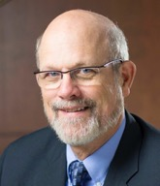
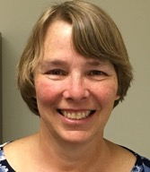
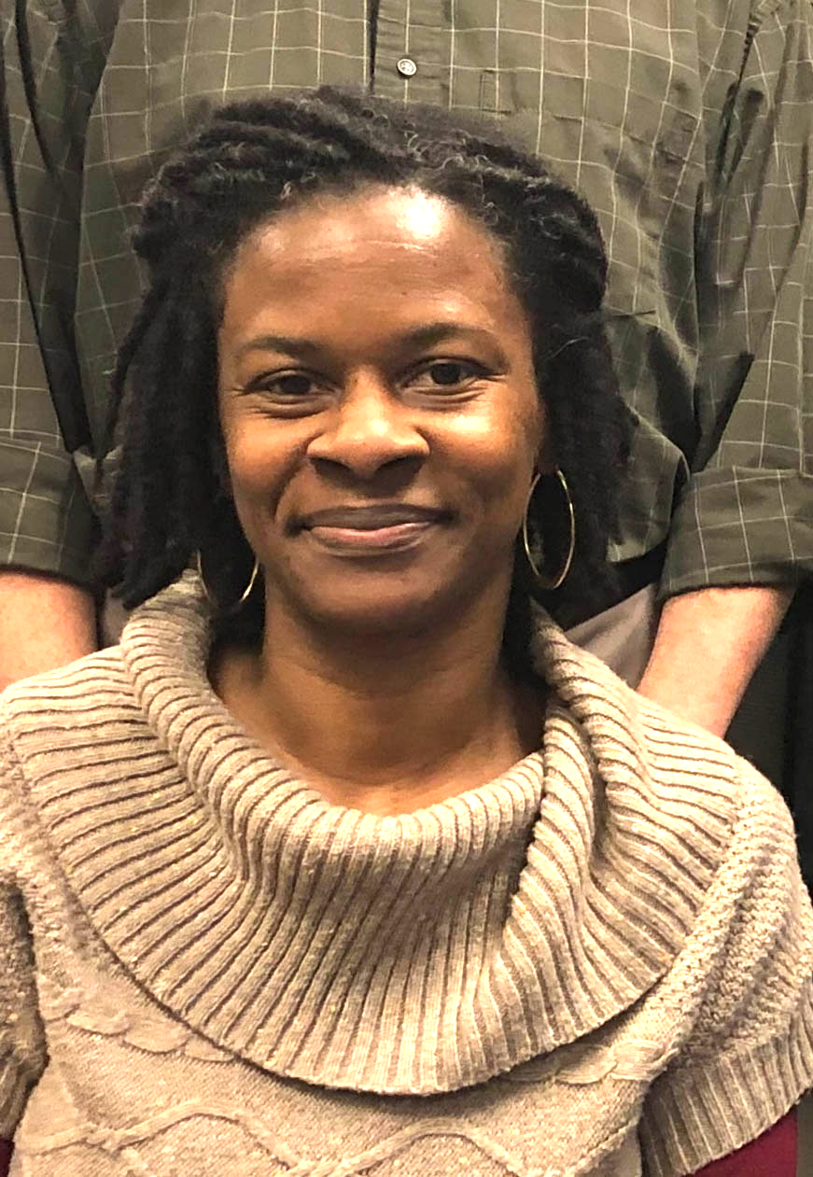
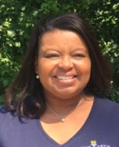
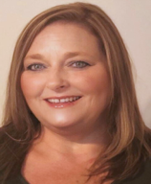
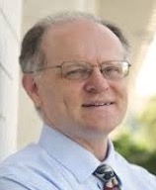
Team Perkins
Bob Witchger
Patti Coultas
Tony Reggi
Darice McDougald
Michelle Lair
Mary Olvera
Chris Droessler
Notes:
Dr. Bob Witchger
919-807-7126
WitchgerB@nccommunitycolleges.edu
Dr. Tony R. Reggi
919-807-7131
ReggiA@nccommunitycolleges.edu
Patti Coultas
919-807-7130
CoultasP@nccommunitycolleges.edu
Dr. Mary Olvera
919-807-7120
OlveraM@nccommunitycolleges.edu
Michelle Lair
919-807-72227
LairM@nccommunitycolleges.edu
Chris Droessler
919-807-7068
DroesslerC@nccommunitycolleges.edu
Darice McDougald
919-807-7219
McDougaldD@nccommunitycolleges.edu

Slide 3
COVID-19 Follow Up
How are you all doing?
What’s happening at your College?
What can we do to assist you?

Slide 4
Purpose of Perkins
Develop more fully the academic knowledge and technical and employability skills of secondary education students and postsecondary education students who elect to enroll in CTE programs and programs of study
Notes:
The Strengthening Career and Technical Education for the 21st Century Act reauthorized and updated the Carl D. Perkins Career and Technical Education Act of 2006 to become the current Carl D. Perkins Career and Technical Education Act of 2006 as amended by the Strengthening Career and Technical Education for the 21st Century Act (Perkins V)
This updated act stresses:
- Academic, Technical, and Employability Skills
- Funding Secondary and Postsecondary CTE
- Focusing on Students who elect to enroll in CTE Programs of Study

Slide 5
What’s Happening in Raleigh
MOA – Civil Rights Reviews
Plan and Budget Review - Consistency with CLNA
Pell Verification – Students Primary Code, Participant Definition
Accountability Measures – Dashboard, Future Negotiated Levels
Pathways Survey - Early Glimpse

Slide 6
Promising Practice Videos 2020
Rowan-Cabarrus Community College
Sent faculty to National Nursing Conference
Purchased Nursing simulator
https://www.ncperkins.org/video
Notes:
Sept 2020
AB-Tech
Coastal Carolina
October 2020
Mitchell
Tri-County
November 2020
Haywood
Pamlico
January 2021
Rowan-Cabarrus
Isothermal
Johnston
Randolph
Pitt
Blue Ridge
Cape Fear
Mayland
Carteret
Sandhills
Central Piedmont
Wilson
Cleveland
Craven
Wilkes
Durham
Forsyth
Southwestern
Halifax
McDowell
Nash
Richmond
Wayne
Robeson
Caldwell
Rockingham
South Piedmont
Edgecombe
Western Piedmont
Southeastern
Catawba Valley
Stanly
Surry
Wake Tech
Fayetteville
Gaston
Vance-Granville
Sampson
Guilford
Central Carolina
Lenoir
Martin
Brunswick
Davidson
Roanoke-Chowan
James Sprunt
Bladen
College of Albemarle

Slide 7
Monitoring – February through May
Equipment - Looking at Program Area, Equipment and Supplies Purchased
Staff Time and Effort - Staff Supported – Program Area, Faculty, Counseling, Support
College Site Monitoring – General Requirements, CLNA, Faculty Interview

Slide 8
Mid-year Perkins Reviews
January 19, 21, 26, 28, February 2, 2021
How is the college coping under COVID?
Has the comprehensive local needs assessment (CLNA) improved CTE?
Share a CTE promising practice
Budget update, spending plan
Comments, questions from state staff
Submit your PowerPoint to the Moodle
All are invited to all sessions. https://www.ncperkins.org/presentations/
Notes:
Each college will have 10-15 minutes to report on the progress of their Perkins basic grant followed by questions. The presentation could include the following:
How have the findings of the CLNA been addressed in improving CTE at your college?
Please include funded and nonfunded activities
Student Performance
Programs of Study/Pathways
Programs aligned to labor market needs
Addressing needs of special populations
College Professional Development plan for CTE Faculty
Share a CTE promising practice
This is not necessarily a best practice, but something you are doing or have started that you want to share. You might use this as a time to enlist input from your colleagues.
You may provide reflections from the staff, faculty, students, and or business.
How is the college coping under COVID?
Are there any successful practices your faculty are doing to help make their instruction more applied?
How has Perkins funding enhanced the college’s response?
Budget update
How have the funds been spent so far? Include examples of Items/services purchased.
What is your college’s plan for Perkins spending through June 30, 2021?
Comments, Questions, Suggestions
Questions from the Perkins Staff and others in attendance

Slide 9
Reminders
Updated Budgets with New Carry-Over funds - Due January 8th
Send in your - XDBR and updates to Plan - January 15
Carefully align your plan and budget with the CLNA
Upload your 9-14 Pathways
Gather semi-annual Time & Effort forms

Slide 10
Ideas for 2021-22 Leadership Projects
State-wide significance
Enhancing Career and Technical Education Programs of Study
Potential Spring 2021 projects

Slide 11
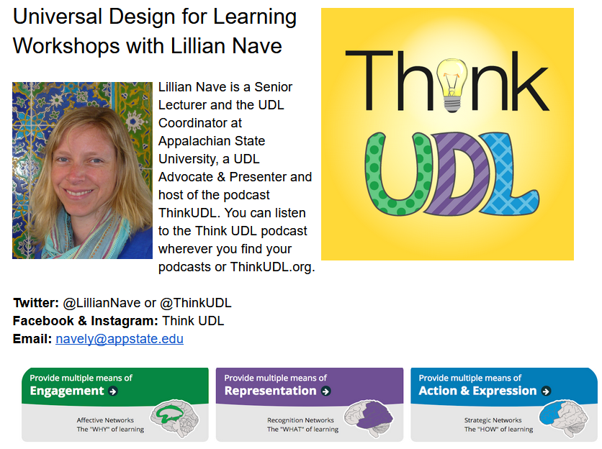
Free Universal Design for Learning On-line Workshop Series
Recordings of workshops
ncperkins.org/pd
UDL Podcasts
ThinkUDL.org
Notes:
www.ncperkins.org/udl/

Slide 12
UDL Training - Professional Development from your point of view
Second Round UDL
On-line
Did you have colleges faculty attend?
How would you rate the training?
Would it be beneficial for a Spring on-line?
Are you familiar with the ACUE Training?
Does this training supplement UDL?
Is it training we should add?

Slide 13
NC-NET.info
Notes:
https://www.nc-net.info/

Slide 14
Skills USA – Virtual Competitions for 2021

Slide 15
Linkages with WIOA (Workforce Innovation and Opportunity Act)
Linkages with Local Area Directors
Sharing our Comprehensive Local Needs Assessments
Registration with NC Works – Career Support Services (Support student tuition, books, supplies, students equipment)

Slide 16
Begin to Think about – Links with Perkins and Programs, CLNA and New Curriculum
Equipment
Staff to Develop Program
Supplies
Marketing
Career Planning
Special Populations Support
Career Pathways links with High Schools and Colleges

Slide 17
9-14 CTE Pathway Survey
71% of our 58 colleges responded
98% of responding colleges used a collaborative process in developing pathways
73% of responding colleges have pathways that include HS to CC articulated credit
95% of colleges want to develop and/or enhance pathways
85% of our colleges have uploaded or moved forward pathways in the Moodle for Perkins Basic Grant activities for 2020-2021
Notes:
9-14 CTE Pathway Survey

Slide 18
9-14 CTE Pathway Survey
Notes:
9-14 CTE Pathway Survey

Slide 19
9-14 CTE Pathway Survey
Notes:
9-14 CTE Pathway Survey

Slide 20
9-14 CTE Pathway Survey
Notes:
9-14 CTE Pathway Survey

Slide 21
Promising Practice Videos 2020
Isothermal Community College
Remote kit for Broadcasting
Disability simulation equipment
Curriculum videos
https://www.ncperkins.org/video
Notes:
Sept 2020
AB-Tech
Coastal Carolina
October 2020
Mitchell
Tri-County
November 2020
Haywood
Pamlico
January 2021
Rowan-Cabarrus
Isothermal
Johnston
Randolph
Pitt
Blue Ridge
Cape Fear
Mayland
Carteret
Sandhills
Central Piedmont
Wilson
Cleveland
Craven
Wilkes
Durham
Forsyth
Southwestern
Halifax
McDowell
Nash
Richmond
Wayne
Robeson
Caldwell
Rockingham
South Piedmont
Edgecombe
Western Piedmont
Southeastern
Catawba Valley
Stanly
Surry
Wake Tech
Fayetteville
Gaston
Vance-Granville
Sampson
Guilford
Central Carolina
Lenoir
Martin
Brunswick
Davidson
Roanoke-Chowan
James Sprunt
Bladen
College of Albemarle

Slide 22
Raising the Awareness of Career Pathways Webinars
January 20, 2021 @ 9am
Come explore careers in Cybersecurity
https://register.gotowebinar.com/register/4274380445130250509
See all upcoming and past webinars at https://www.ncperkins.org/presentations/

Slide 23
CTE Training
Training online - www.ncperkins.org
Perkins Update Webinars - Second Tuesday
Career Pathways Webinars - Third Wednesday
At your College by request
https://www.ncperkins.org/presentations/
Notes:
https://www.ncperkins.org/presentations/

Slide 24
Perkins Updates
2nd Tuesday of the month
9 am
Via GoToWebinar
Find the registration links at NCperkins.org/presentations
Notes:
Register now and let the system remind you.

Slide 25
Perkins/CTE State Staff
Dr. Bob Witchger Director, Career & Technical Education WitchgerB@nccommunitycolleges.edu 919-807-7126
Dr. Tony R. Reggi Coordinator, Career & Technical Education ReggiA@nccommunitycolleges.edu 919-807-7131
Patti Coultas Coordinator, Career & Technical Education CoultasP@nccommunitycolleges.edu 919-807-7130
Dr. Mary Olvera Coordinator, Career & Technical Education OlveraM@nccommunitycolleges.edu 919-807-7120
Michelle Lair Coordinator, CCP and Career & Technical Education LairM@nccommunitycolleges.edu 919-807-7227
Chris Droessler Coordinator, Career & Technical Education DroesslerC@nccommunitycolleges.edu 919-807-7068
Darice McDougald CTE Administrative Assistant McDougaldD@nccommunitycolleges.edu 919-807-7219
Notes:
http://www.ncperkins.org/course/view.php?id=6

