Slide 1
Returning Citizens – Reentry Programs
Download the PowerPoint and access the recording: www.ncperkins.org/presentations
Notes:
Chris
We are here to help promote employment and training in the great state of North Carolina.,,
Through these monthly workshops, we are going to ….
And bring in special guests to let you know about …
Please download this PowerPoint file and use it anyway you can to help get folks on a career pathway.
The reference showing from where the information was found, as well as the contact information for our guests is in the Notes section under each slide.
Get the PowerPoint on our NCPerkins.org website on our Presentations and Webinars page.
Here is the direct address on the screen.

Slide 2
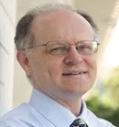
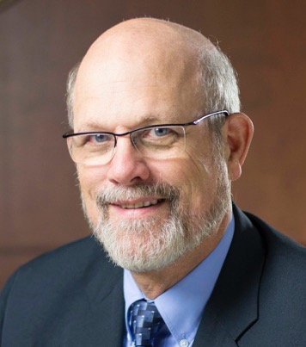
Chris Droessler Career and Technical Education
Dr. Bob Witchger Career and Technical Education Director
Notes:
Your hosts for today’s workshop:
Robert J. Witchger Ed.D.
Director Career and Technical Education
North Carolina Community College System
200 W. Jones Street
(919) 807-7126
witchgerb@nccommunitycolleges.edu
Chris Droessler
Career and Technical Education Coordinator
North Carolina Community College System
DroesslerC@nccommunitycolleges.edu

Slide 3
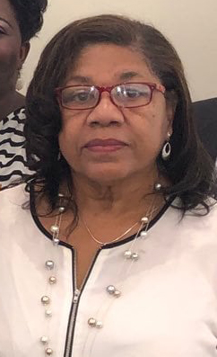
NC Employment and Training Association (NCETA)
Malinda Marsh
NCETA President (www.nceta.org)
NCWorks Career Center, Chatham County
NCperkins.org/presentations
Notes:
This is an NCETA workshop.
This workshop is sponsored by NCETA
Malinda Marsh, president of NCETA, will explain.
======
Malinda Marsh
NCETA President
malinda.amarsh@gmail.com

Slide 4
NCETA Conference 2021
September 8-10, 2021
Hotel Ballast in Wilmington
www.nceta.org
Notes:
We moved our Spring conference to the Fall .
We will be back in Wilmington on September 8, 2021.
=====
nceta.org

Slide 5
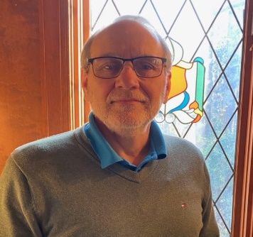
Tony Reggi
Career and Technical Education Coordinator
NC Community College System
Notes:
Dr. Tony R. Reggi
Coordinator, Career & Technical Education
NC Community College System
ReggiA@nccommunitycolleges.edu
919-807-7131

Slide 6
Ashley Palmer
Board Chair
Experience 180 Inc.
Notes:
Ashley Palmer

Slide 7
Dr. Crystal McIver
Executive Director
Experience 180 Inc. - Total Package
Notes:
Crystal McIver
Crystal2of5@yahoo.com
919 935 6890
Experience 180 Inc. - Total Package
Total Package Re-entry program in Lee County

Slide 8
Notes:
Crystal McIver
Crystal2of5@yahoo.com
919 935 6890
Experience 180 Inc. - Total Package
Total Package Re-entry program in Lee County

Slide 9
Notes:
Crystal McIver
Crystal2of5@yahoo.com
919 935 6890
Experience 180 Inc. - Total Package
Total Package Re-entry program in Lee County

Slide 10
Notes:
Crystal McIver
Crystal2of5@yahoo.com
919 935 6890
Experience 180 Inc. - Total Package
Total Package Re-entry program in Lee County

Slide 11
Notes:
Crystal McIver
Crystal2of5@yahoo.com
919 935 6890
Experience 180 Inc. - Total Package
Total Package Re-entry program in Lee County

Slide 12
Notes:
Crystal McIver
Crystal2of5@yahoo.com
919 935 6890
Experience 180 Inc. - Total Package
Total Package Re-entry program in Lee County

Slide 13
Notes:
Crystal McIver
Crystal2of5@yahoo.com
919 935 6890
Experience 180 Inc. - Total Package
Total Package Re-entry program in Lee County

Slide 14
Notes:
Crystal McIver
Crystal2of5@yahoo.com
919 935 6890
Experience 180 Inc. - Total Package
Total Package Re-entry program in Lee County

Slide 15
Notes:
Crystal McIver
Crystal2of5@yahoo.com
919 935 6890
Experience 180 Inc. - Total Package
Total Package Re-entry program in Lee County

Slide 16
Notes:
Crystal McIver
Crystal2of5@yahoo.com
919 935 6890
Experience 180 Inc. - Total Package
Total Package Re-entry program in Lee County

Slide 17
Notes:
Crystal McIver
Crystal2of5@yahoo.com
919 935 6890
Experience 180 Inc. - Total Package
Total Package Re-entry program in Lee County

Slide 18
Notes:
Crystal McIver
Crystal2of5@yahoo.com
919 935 6890
Experience 180 Inc. - Total Package
Total Package Re-entry program in Lee County

Slide 19
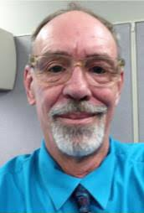
Michael Westray
Regional Reentry Specialist
NC Department of Commerce Reentry Initiative
Notes:
Michael Westray
Fayetteville
919-306-1029
michael.westray@nccommerce.com

Slide 20
Reentry Initiative Staff Directory
Wendi Bowen Eure | Reentry Initiative & Federal Bonding Program Coordinator Raleigh | 919-814-0457 | wendi.bowen@nccommerce.com
Regional Reentry Specialists (Out-stationed Staff)
Vanessa James | Asheville | 919-368-5391 | vanessa.james@nccommerce.com
Brian Long | Lexington | 919-268-1996 | brian.long@nccommerce.com
Janie Rollins | Salisbury | 919-909-1616 | janie.rollins@nccommerce.com
Tenisha Kelly | Raleigh | 919-841-0458 | tenisha.Kelly@nccommerce.com
Victor Hinnant | Greenville | 919-607-0645 | victor.hinnant@nccommerce.com
Michael Westray | Fayetteville | 919-306-1029 | michael.westray@nccommerce.com
Notes:
Michael Westray
Fayetteville
919-306-1029
michael.westray@nccommerce.com

Slide 21
Jessie Garner
Reentry Coordinator Fayetteville Cumberland Reentry Council
Notes:
Reentry Coordinator Fayetteville Cumberland Reentry Council
jgarner@co.cumberland.nc.us
910 486 1010 ext 2125

Slide 22
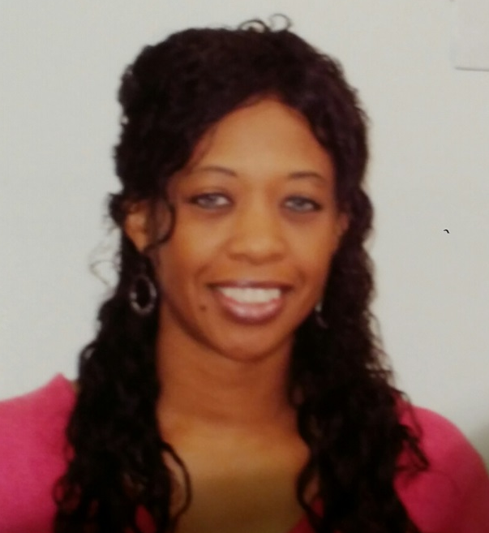
Vanessa L. James M.Div.
Regional Reentry Specialist
North Carolina Department of Commerce
Notes:
Vanessa L. James, M. Div.
Regional Reentry Specialist
North Carolina Department of Commerce
828 251-6200 office
919 368-5391 mobile
vanessa.james@nccommerce.com
48 Grove Street
Asheville, NC 28801

Slide 23
Notes:
Vanessa L. James, M. Div.
Regional Reentry Specialist
North Carolina Department of Commerce
828 251-6200 office
919 368-5391 mobile
vanessa.james@nccommerce.com
48 Grove Street
Asheville, NC 28801

Slide 24
Notes:
Vanessa L. James, M. Div.
Regional Reentry Specialist
North Carolina Department of Commerce
828 251-6200 office
919 368-5391 mobile
vanessa.james@nccommerce.com
48 Grove Street
Asheville, NC 28801

Slide 25
Notes:
Vanessa L. James, M. Div.
Regional Reentry Specialist
North Carolina Department of Commerce
828 251-6200 office
919 368-5391 mobile
vanessa.james@nccommerce.com
48 Grove Street
Asheville, NC 28801

Slide 26
Notes:
Vanessa L. James, M. Div.
Regional Reentry Specialist
North Carolina Department of Commerce
828 251-6200 office
919 368-5391 mobile
vanessa.james@nccommerce.com
48 Grove Street
Asheville, NC 28801

Slide 27
Notes:
Vanessa L. James, M. Div.
Regional Reentry Specialist
North Carolina Department of Commerce
828 251-6200 office
919 368-5391 mobile
vanessa.james@nccommerce.com
48 Grove Street
Asheville, NC 28801

Slide 28
Notes:
Vanessa L. James, M. Div.
Regional Reentry Specialist
North Carolina Department of Commerce
828 251-6200 office
919 368-5391 mobile
vanessa.james@nccommerce.com
48 Grove Street
Asheville, NC 28801

Slide 29
Notes:
Vanessa L. James, M. Div.
Regional Reentry Specialist
North Carolina Department of Commerce
828 251-6200 office
919 368-5391 mobile
vanessa.james@nccommerce.com
48 Grove Street
Asheville, NC 28801

Slide 30
Notes:
Vanessa L. James, M. Div.
Regional Reentry Specialist
North Carolina Department of Commerce
828 251-6200 office
919 368-5391 mobile
vanessa.james@nccommerce.com
48 Grove Street
Asheville, NC 28801

Slide 31
Notes:
Vanessa L. James, M. Div.
Regional Reentry Specialist
North Carolina Department of Commerce
828 251-6200 office
919 368-5391 mobile
vanessa.james@nccommerce.com
48 Grove Street
Asheville, NC 28801

Slide 32
Notes:
Vanessa L. James, M. Div.
Regional Reentry Specialist
North Carolina Department of Commerce
828 251-6200 office
919 368-5391 mobile
vanessa.james@nccommerce.com
48 Grove Street
Asheville, NC 28801

Slide 33
Notes:
Vanessa L. James, M. Div.
Regional Reentry Specialist
North Carolina Department of Commerce
828 251-6200 office
919 368-5391 mobile
vanessa.james@nccommerce.com
48 Grove Street
Asheville, NC 28801

Slide 34
Notes:
Vanessa L. James, M. Div.
Regional Reentry Specialist
North Carolina Department of Commerce
828 251-6200 office
919 368-5391 mobile
vanessa.james@nccommerce.com
48 Grove Street
Asheville, NC 28801

Slide 36
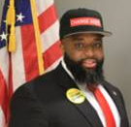
Phillip Cooper
Up Skill WNC Coordinator
A-B Technical Community College
Notes:
Phillip Cooper
Up Skill WNC Coordinator
A-B Technical Community College
PhiIipACooper@abtech.edu
A-B Tech CC
828-772-0362

Slide 37
Download the PowerPoint and access the recording: www.ncperkins.org/presentations
Notes:
Please download this PowerPoint file and use it anyway you can to help get folks on a career pathway.
The reference showing from where the information was found, as well as the contact information for our guests is in the Notes section under each slide.
Get the PowerPoint on our NCPerkins.org website on our Presentations and Webinars page.
Here is the direct address on the screen.

Slide 38
The Next NCETA Workshop
January ??, 2021
TBD
TBD
www.ncperkins.org/presentations
Notes:
The next workshop

