Slide 1
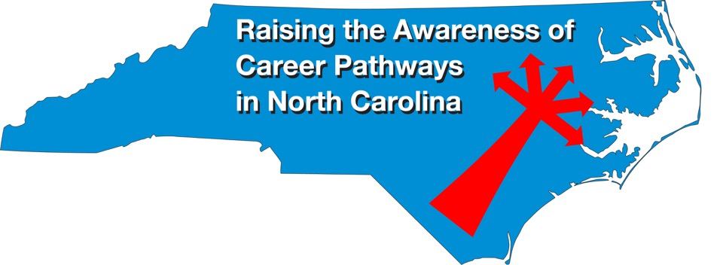
September 16, 2020 Careers in Advanced Manufacturing
Download the PowerPoint and access the recording: www.ncperkins.org/presentations
Notes:
Chris
We are here to help promote the great jobs, often unknown, in the great state of North Carolina.
Through these monthly meetings, we are going to let you know about some great career opportunities in North Carolina.
And bring in special guests to let you know about the great career opportunities in North Carolina.
Please download this PowerPoint file and use it anyway you can to help get folks on a career pathway.
The reference showing from where the information was found, as well as the contact information for our guests is in the Notes section under each slide.
Get the PowerPoint on our NCPerkins.org website on our Presentations and Webinars page.
Here is the direct address on the screen.
-----
Many of the videos shown during this webinar can be found here:
https://www.ncperkins.org/video/

Slide 2
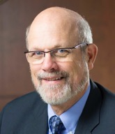
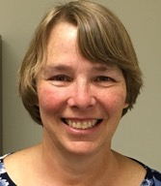
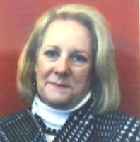
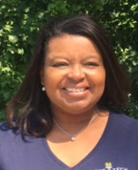
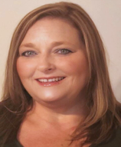
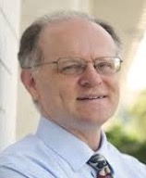
Raising the Awareness of Career Pathways in North Carolina
Bob Witchger
Patti Coultas
Tony Reggi
Cheryl Cox
NC Dept of Public Instruction
Michelle Lair
Mary Olvera
Chris Droessler
Notes:
Chris
I always say our webinars are like radio but with pictures.
And here are a few pictures of your hosts for these monthly explorations into career pathways.
(Why does the photographer have the best photo?)
Our contact information is in the notes section under this slide.
Dr. Bob Witchger
919-807-7126
WitchgerB@nccommunitycolleges.edu
Dr. Tony R. Reggi
919-807-7131
ReggiA@nccommunitycolleges.edu
Patti Coultas
919-807-7130
CoultasP@nccommunitycolleges.edu
Dr. Mary Olvera
919-807-7120
OlveraM@nccommunitycolleges.edu
Michelle Lair
919-807-72227
LairM@nccommunitycolleges.edu
Chris Droessler
919-807-7068
DroesslerC@nccommunitycolleges.edu
Cheryl Cox
919-807-3814
Cheryl.Cox@dpi.nc.gov

Slide 3
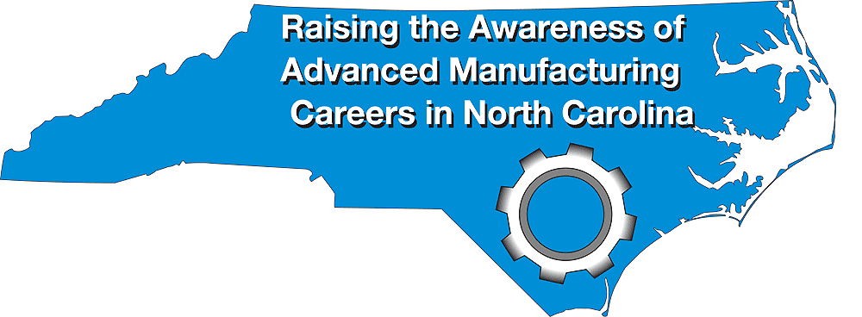
September 28 – October 2, 2020
www.ncperkins.org/manufacturing
Notes:
In case you haven’t heard, The ninth-annual North Carolina Advanced Manufacturing Careers Awareness Week will be September 28 through October 5.
National Manufacturing day (that’s their logo on the left) will be that Friday, October 2. Always the first Friday in October.
And that’s our website at the bottom of the screen.
We are the local franchise for National Manufacturing Day in North Carolina.
=====
1 - April 7, 2013
2 - April 6, 2014
3 - April 12, 2015
4 - April 3, 2016
5 - October 2, 2016
6 - October 1, 2017
7 - September 30, 2018
8 - September 29, 2019
9 - October 2, 2020

Slide 4
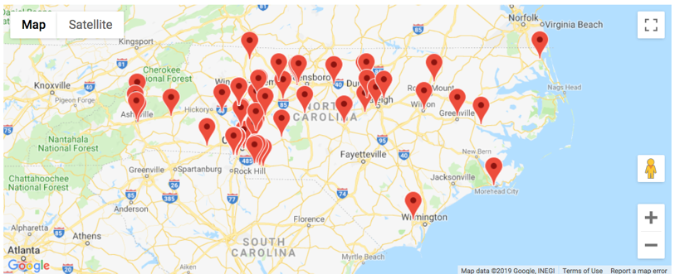
NC Manufacturing Week 2019
There were 118 Manufacturing Week events in NC for 2019
Notes:
Manufacturing Day, or as we like to say "Raising the Awareness of Advanced Manufacturing Careers in North Carolina."
Manufacturing Day is always the first Friday in October. In North Carolina we like to stretch it out to a week, and beyond.
The national calendar listed 118 events in North Carolina last year. Most were at businesses opening their doors for tours, a look behind the scenes at a manufacturing plant.
Many of our colleges host open houses to showcase their classrooms and laboratories, and to host many manufacturing businesses in one location.
With COVID, the events have gone virtual.
To find an event near you, click that link or just go to https://creatorswanted.org/find-events/
Some of these events listed are closed to the public. They might be just for high school students.
Some of the events require a registration, and some require closed-toe shoes. So check the website carefully to ensure that you have a pleasant and rewarding experience.
https://creatorswanted.org/find-events/

Slide 5
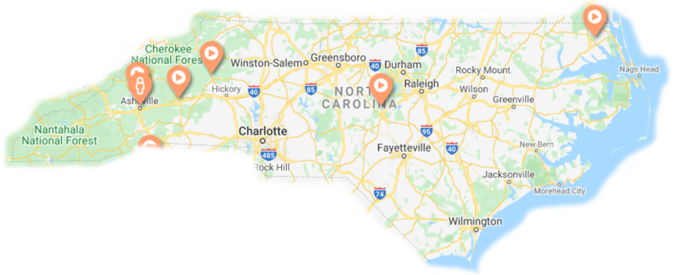
NC Manufacturing Week 2020
6 virtual events in NC
177 virtual events in USA
https://creatorswanted.org
Notes:
https://creatorswanted.org/find-events/

Slide 6
NC Manufacturing Week 2020
College of The Albemarle. Live tours on 10/2. Register by Sept 28. Virtual tours on 10/21
Mertek. Virtual event at 9am on 10/2
AikenControls. Virtual tour at 11am on 10/2
(2) ABB - 5 Day virtual STEAM Experience. 9/28 – 10/2
Mathis Electronics, Asheville – Live tour 9am-3pm on 10/2
Notes:
Here are the six events in North Carolina
Check the website for more information. Some require registration. Live events might require special dress.
https://creatorswanted.org/find-events/

Slide 7
https://www.ncperkins.org/manufacturing/
Notes:
Register your event
https://www.ncperkins.org/manufacturing/

Slide 8
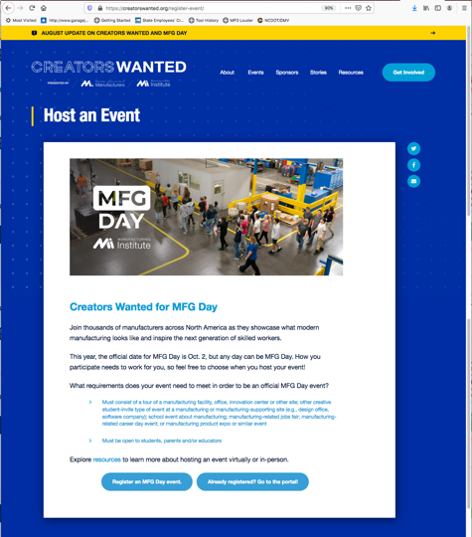
https://creatorswanted.org/register-event/
Notes:
Register your event
https://creatorswanted.org/register-event/

Slide 9
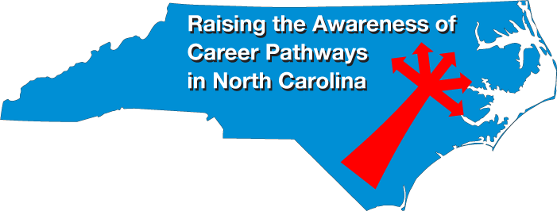
Notes:
www.ncperkins.org/presentations

Slide 10
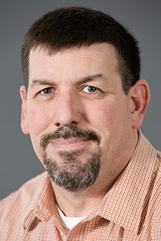
Tony Bean
Program Chair – Engineering Technologies
Rowan-Cabarrus Community College
Notes:
Tony Bean
Program Chair – Engineering Technologies
Rowan-Cabarrus Community College
704-216-3917
tony.bean@rccc.edu

Slide 11
Engineering Technology Programs
Electronics Engineering Technology
Industrial Engineering Technology
Mechanical Drafting Technology
Mechanical Engineering Technology
Mechatronics Engineering Technology
Notes:
Tony Bean
Program Chair – Engineering Technologies
Rowan-Cabarrus Community College
704-216-3917
tony.bean@rccc.edu

Slide 12
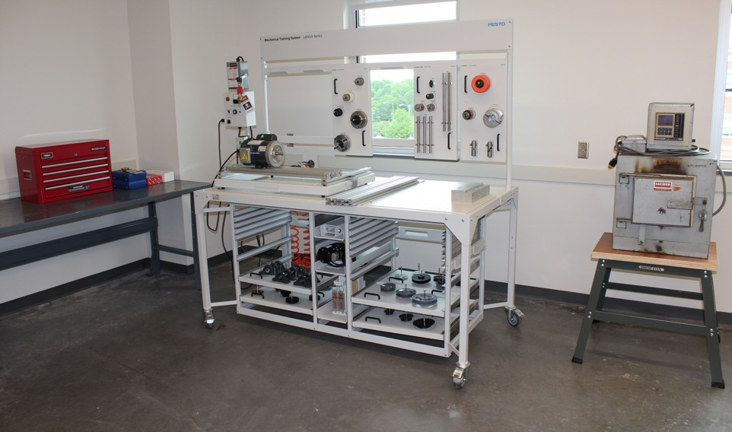
Engineering Technology Programs
Certificates
Diplomas
Degrees
Continuing Education
Apprenticeship Program
Notes:
Tony Bean
Program Chair – Engineering Technologies
Rowan-Cabarrus Community College
704-216-3917
tony.bean@rccc.edu

Slide 13
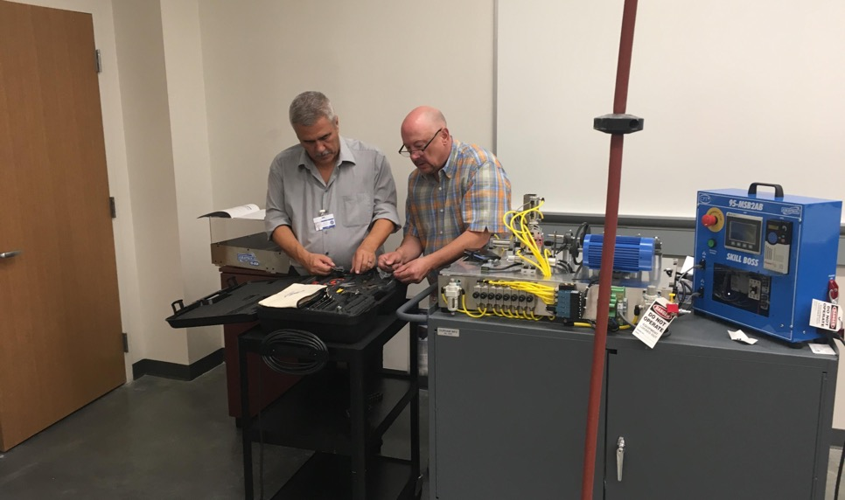
Engineering Technology Program Internship Companies
Ashley Furniture
Daimler Trucks
Duke Energy
Integro Technologies
Joe Gibbs Racing
NASCAR
Turnkey Technologies
Notes:
Tony Bean
Program Chair – Engineering Technologies
Rowan-Cabarrus Community College
704-216-3917
tony.bean@rccc.edu

Slide 14
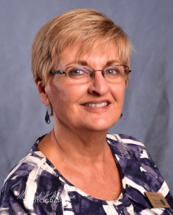
Donna Ludwig
Account Manager, Business Services
Notes:
Tony
Donna Ludwig
Account Manager, Business Services
Rowan-Cabarrus Community College
704-216-3668 (Office)
980-622-0135 (Cell/Text)
donna.ludwig@rccc.edu

Slide 15
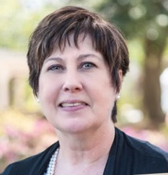
Deb Lazenby
Business Services & Customized Training Coordinator
Mitchell Community College
Notes:
Deb Lazenby
Mitchell CC
DLazenby@mitchellcc.edu
Deb Lazenby
Business Services & Customized Training Coordinator
Mitchell Community College
Statesville, NC

Slide 16
Notes:
NC Manufacturing Institute

Slide 17
Notes:
NC Manufacturing Institute

Slide 18
Notes:
NC Manufacturing Institute

Slide 19
Notes:
NC Manufacturing Institute

Slide 20
Notes:
NC Manufacturing Institute

Slide 21
Notes:
NC Manufacturing Institute

Slide 22
Notes:
NC Manufacturing Institute

Slide 23
Notes:
NC Manufacturing Institute

Slide 24
Notes:
NC Manufacturing Institute
www.NCManufacturingInstitute.com
www.MSSCusa.org (Manufacturing Skill Standards Council)
QUESTIONS? Deb Lazenby, dlazenby@mitchellcc.edu donna.Ludwig@rccc.edu

Slide 25
Notes:
NC Manufacturing Institute

Slide 26
Notes:
www.ncperkins.org/presentations

Slide 27
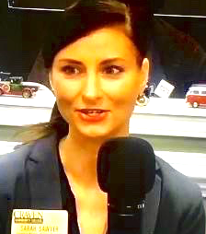
Sarah Sawyer
Executive Director of Career Programs
Craven Community College
Notes:
Sarah Sawyer
Executive Director of Career Programs
Craven Community College
sawyers@cravencc.edu

Slide 28
Ricky Meadows
Dean of Career Programs
Craven Community College
Notes:
Ricky Meadows
Dean of Career Programs
Craven Community College
(252) 638-4550
meadowsr@cravencc.edu

Slide 29
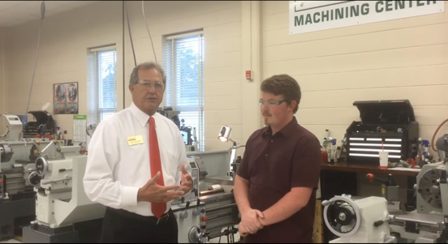
Craven Community College
Isaac’s Journey video
https://youtu.be/SQhyJ5GZ1QM
Notes:
https://youtu.be/SQhyJ5GZ1QM

Slide 30
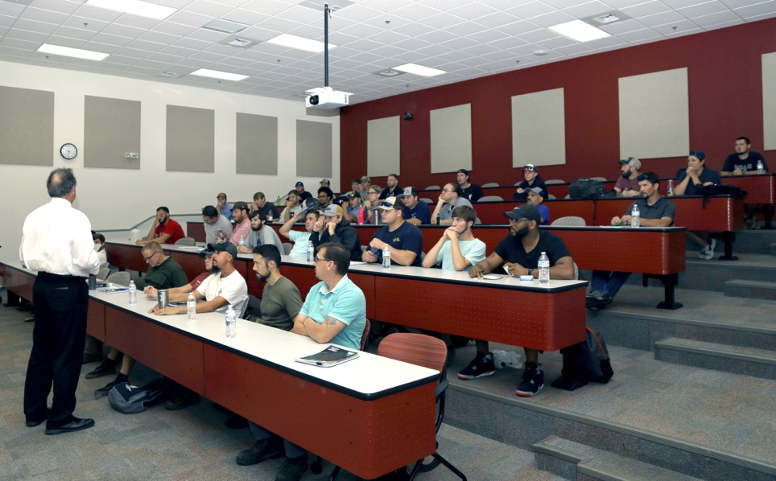
Notes:
Ricky Meadows
Dean of Career Programs
Craven Community College
(252) 638-4550
meadowsr@cravencc.edu

Slide 31
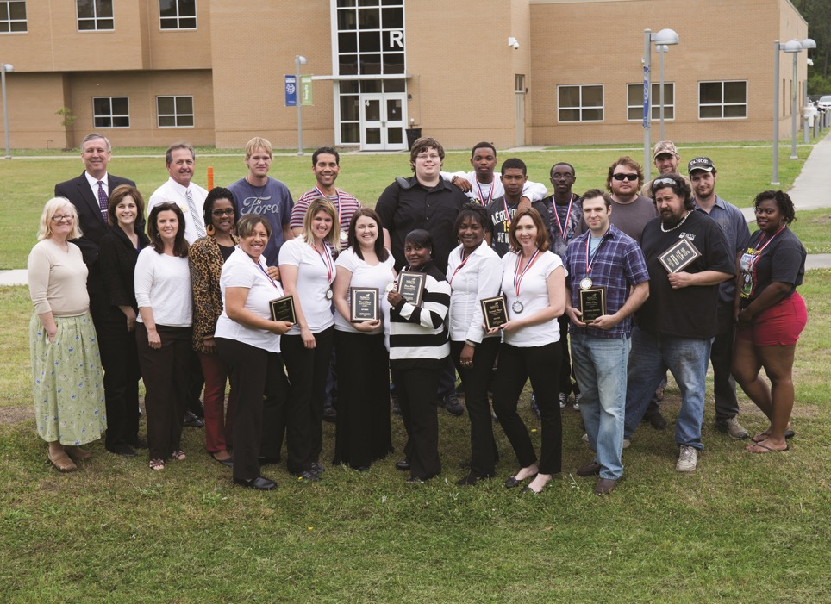
Notes:
Ricky Meadows
Dean of Career Programs
Craven Community College
(252) 638-4550
meadowsr@cravencc.edu

Slide 32
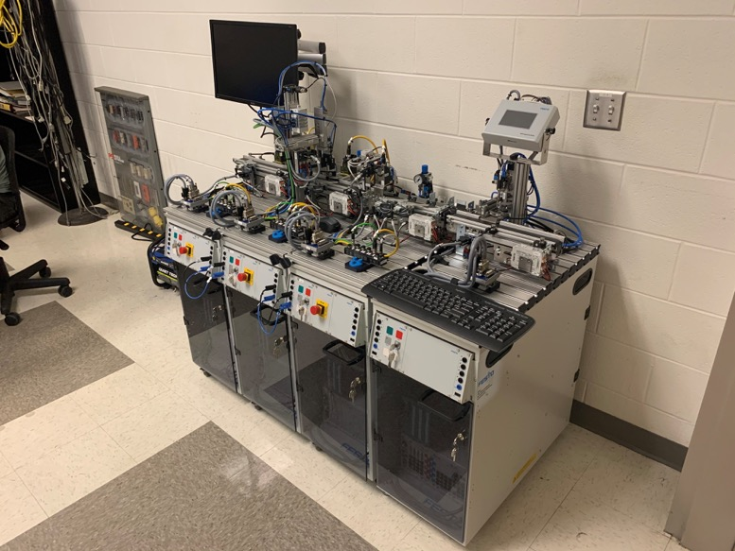
Notes:
Craven CC

Slide 33
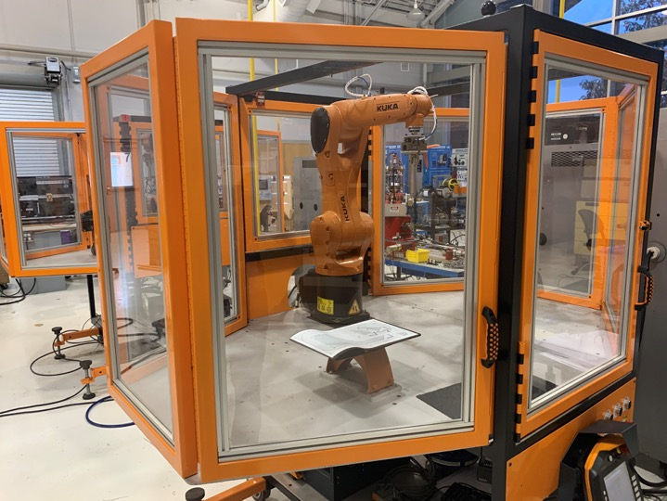
Notes:
Craven CC

Slide 34
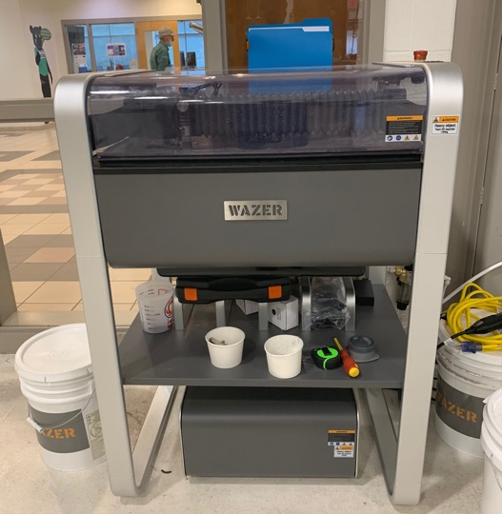
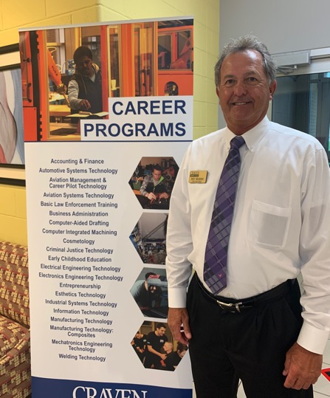
Notes:
Craven CC

Slide 35
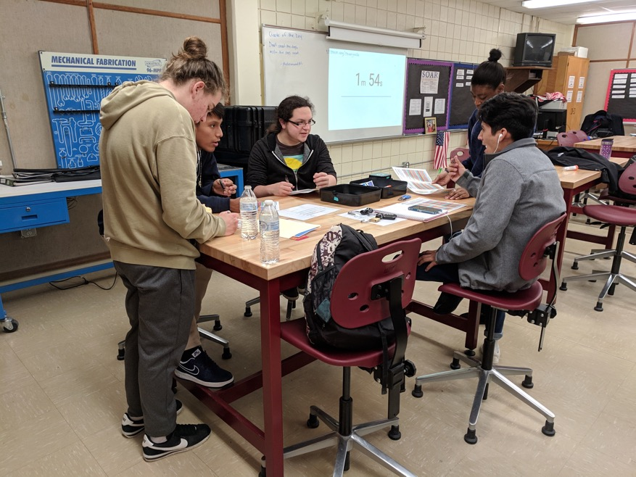
Notes:
Craven CC

Slide 36
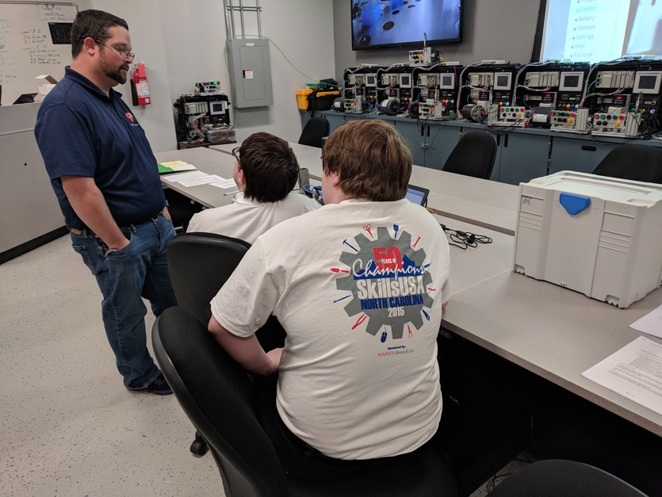
Notes:
Craven CC

Slide 37
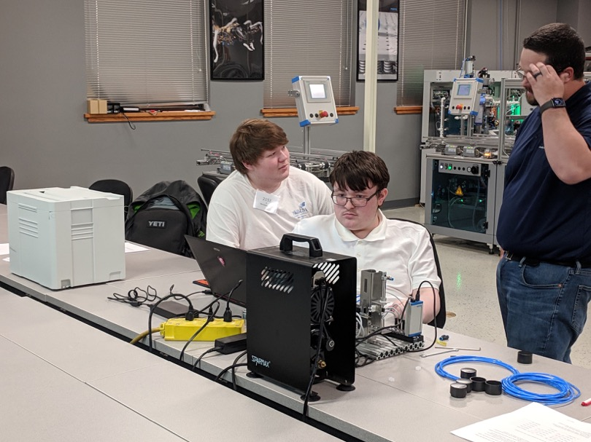
Notes:
Craven CC

Slide 38
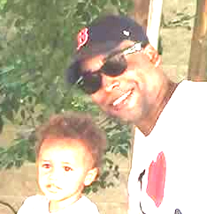
Ron Brewer
Advanced Manufacturing Teacher West Craven High School
Notes:
Ron Brewer
Advanced Manufacturing Teacher West Craven High School
Phone: 252-244-3200
Email: ronald.brewer@cravenk12.org

Slide 39
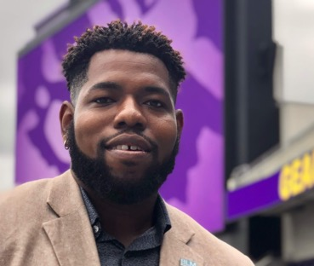
Austin Dixon
Academic Advisor, Career & College Promise Craven Community College
Notes:
dixona@cravencc.edu
Austin R. Dixon
Academic Advisor, Career & College Promise
800 College Court
New Bern, NC 28562
(252) 638-7242 phone
(252) 637-6112 fax

Slide 40
Notes:
www.ncperkins.org/presentations

Slide 41
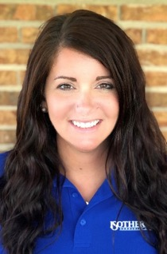
Bobbi Hodge
Coordinator/Faculty for iTECH Academy
Applied Sciences & Engineering Technology
Isothermal Community College
Notes:
Bobbi Hodge
Coordinator/Faculty for iTECH Academy
Applied Sciences & Engineering Technology
Isothermal Community College
bhodge@isothermal.edu
828-395-4325

Slide 42
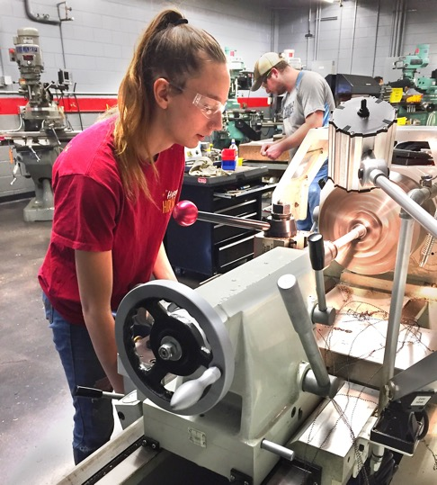
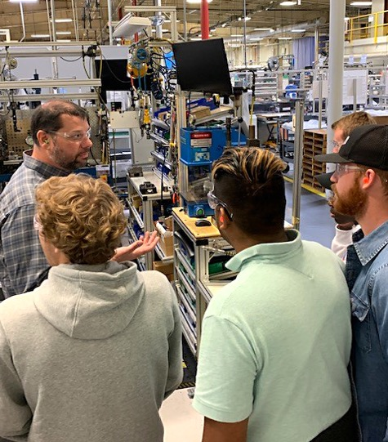
Notes:
Bobbi Hodge
Coordinator/Faculty for iTECH Academy
Applied Sciences & Engineering Technology
Isothermal Community College
bhodge@isothermal.edu
828-395-4325

Slide 43
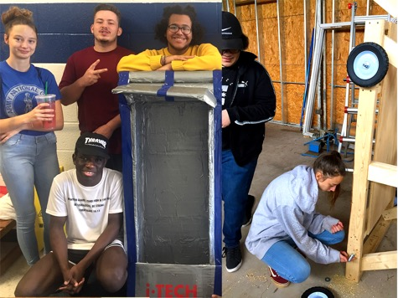
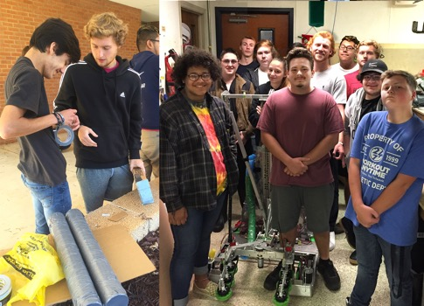
Notes:
Bobbi Hodge
Coordinator/Faculty for iTECH Academy
Applied Sciences & Engineering Technology
Isothermal Community College
bhodge@isothermal.edu
828-395-4325

Slide 44
iTECH Academy
CCP Dual Enrollment Diploma program
Stackable Credentials:
Mechanical Engineering Advanced Technology Certificate
Mechanical Engineering Technology Diploma
Upon High School Graduation: Mechanical Engineering Technology Associates Degree
Upon College Graduation:
Workforce
2+2 college transfer (WCU Distance ET Program and others)
Students explore careers through:
Industry tours
Guest speakers
Hands on projects
College experience on college campus
Books and Transportation provided
Notes:
Bobbi Hodge
Coordinator/Faculty for iTECH Academy
Applied Sciences & Engineering Technology
Isothermal Community College
bhodge@isothermal.edu
828-395-4325

Slide 45
Notes:
www.ncperkins.org/presentations

Slide 46
Aviation Manufacturing Quick Careers program at Guilford Tech CC
Their advanced composite course is the only composite course on the east coast recognized by American Composite Manufacturers Association as a prerequisite to take the Composite Certified Technician exam.
Past graduates work at Hondajet, Boeing, Airbus, Spirit and others
www.gtcc.edu/structuresassembly
www.gtcc.edu/compositetechnology
Notes:
Tony Turner
Coordinator Aviation Manufacturing Quick Career Programs
Guilford Technical Community College
Aviation 2 Campus, Office # 109
819 Radar Road, Greensboro, NC 27409
E-mail: laturner@gtcc.edu
Direct: (336) 334-4822 ext. 59024
Post Office Box 309, Jamestown, NC 27282
www.gtcc.edu

Slide 47
Raising the Awareness of Career Pathways in North Carolina
Next meeting is October 14, 2020
Download the PowerPoint and access the recording: www.ncperkins.org/presentations
Notes:
Our next meeting like this one will be on ------.
(We will skip December and be back in January.)
You can go to the NCPerkins website to register for that meeting.
We'll also send you a reminder, since you are now on our mailing list.
So go ahead and sign up for all the meetings, and you'll be reminded the day before.
If you liked something you saw here, send folks to the recording. Find it at that same web page.

