Slide 1
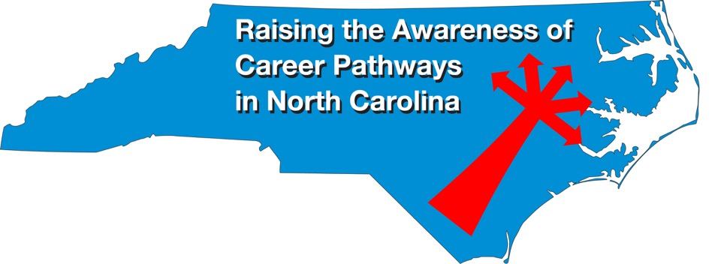
April 23, 2020
Download the PowerPoint and access the recording: www.ncperkins.org/presentations
Notes:
Chris
We are here to help promote the great jobs, often unknown, in the great state of North Carolina.
Through these monthly meetings, we are going to let you know about some great career opportunities in North Carolina.
And bring in special guests to let you know about the great career opportunities in North Carolina.
Please download this PowerPoint file and use it anyway you can to help get folks on a career pathway.
The reference showing from where the information was found, as well as the contact information for our guests is in the Notes section under each slide.
Get the PowerPoint on our NCPerkins.org website on our Presentations and Webinars page.
Here is the direct address on the screen.

Slide 2
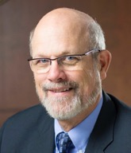
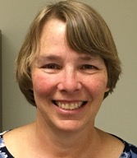
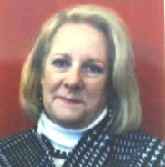
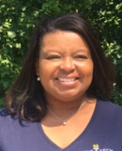
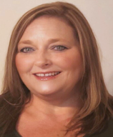
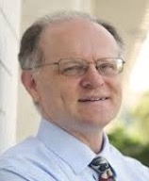
Raising the Awareness of Career Pathways in North Carolina
Bob Witchger
Patti Coultas
Tony Reggi
Cheryl Cox
NC Dept of Public Instruction
Michelle Lair
Mary Olvera
Chris Droessler
Notes:
Chris
I always say our webinars are like radio but with pictures.
And here are a few pictures of your hosts for these monthly explorations into career pathways.
(Why does the photographer have the best photo?)
Our contact information is in the notes section under this slide.
Dr. Bob Witchger
919-807-7126
WitchgerB@nccommunitycolleges.edu
Dr. Tony R. Reggi
919-807-7131
ReggiA@nccommunitycolleges.edu
Patti Coultas
919-807-7130
CoultasP@nccommunitycolleges.edu
Dr. Mary Olvera
919-807-7120
OlveraM@nccommunitycolleges.edu
Michelle Lair
919-807-72227
LairM@nccommunitycolleges.edu
Chris Droessler
919-807-7068
DroesslerC@nccommunitycolleges.edu
Cheryl Cox
919-807-3814
Cheryl.Cox@dpi.nc.gov

Slide 3
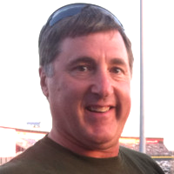
Frank Scuiletti
Program Coordinator: Construction, Engineering, Industrial, Transportation, Criminal Justice, Fire Protection, & Work-Based Learning
Notes:
Frank Scuiletti
scuilettif@nccommunitycolleges.edu

Slide 4
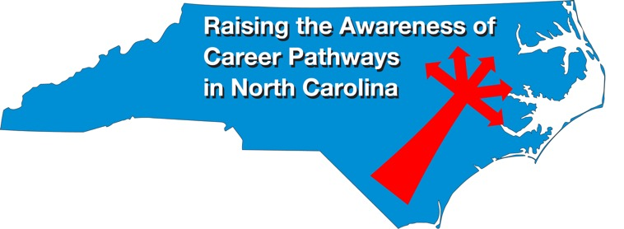
Notes:
www.ncperkins.org/presentations

Slide 5
Online AUVSI NC Workshop -- Today at 1pm
The AUVSI NC is dedicated to promoting and supporting education in the unmanned systems and robotics industry by bridging the gap between state and local agencies, public safety agencies, military industries and academia. Expected presenters from FAA, Zipline, DJI, and NASA Registration: https://marketscale.brand.live/c/auvsi-nc-workshop
Notes:
AUVSI North Carolina is Excited to announce our strategic partnership with MARKETSCALE to promote UAS Education. The AUVSI NC is dedicated to promoting and supporting education in the unmanned systems and robotics industry by bridging the gap between state and local agencies, public safety agencies, military industries and academia. Expected presenters from FAA, Zipline, DJI, and NASA Registration: https://marketscale.brand.live/c/auvsi-nc-workshop
The Association for Unmanned Vehicle Systems International (AUVSI) — the world's largest non-profit organization dedicated to the advancement of unmanned systems and robotics — represents corporations and professionals from more than 60 countries involved in industry, government and academia. AUVSI members work in the defense, civil and commercial markets. For more information, visit AUVSI.org.
The North Carolina Chapter started on August 13, 2019
NC Chapter of AUVSI
https://www.auvsi.org/north-carolina-chapter

Slide 6
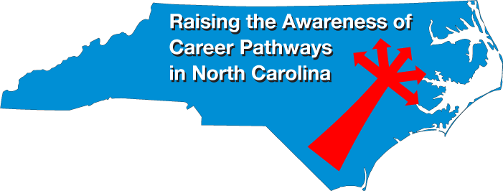
Notes:
www.ncperkins.org/presentations

Slide 7
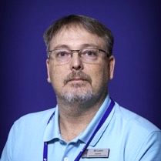
Bill Lewis
Drones – Unmanned Aerial Systems
Pitt Community College
Notes:
Patti
Bill Lewis
Drones – Unmanned Aerial Systems
493-7895
wlewis@email.pittcc.edu

Slide 8
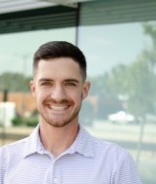
Paul Rossi
Chief Operations Officer and Chief Pilot Nine Ten Drones
Notes:
Patti
Nine Ten Drones
Paul also teaches UAS for Fayetteville Tech and works with the Fayetteville area high schools in student engagement opportunities within the UAS field.
Paul Rossi <paulrossi@910drones.com>
Phone: + 1 910 978 0315
Email: info@910drones.com

Slide 9
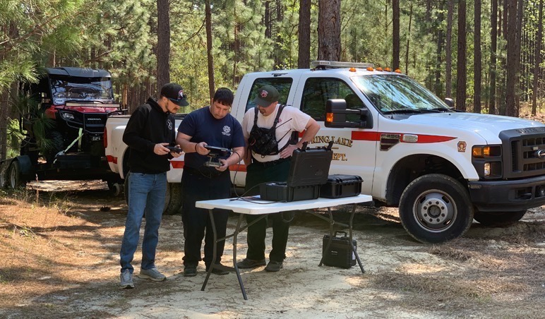
Notes:
Nine Ten Drones
Paul also teaches UAS for Fayetteville Tech and works with the Fayetteville area high schools in student engagement opportunities within the UAS field.
Paul Rossi <paulrossi@910drones.com>
Phone: + 1 910 978 0315
Email: info@910drones.com

Slide 10
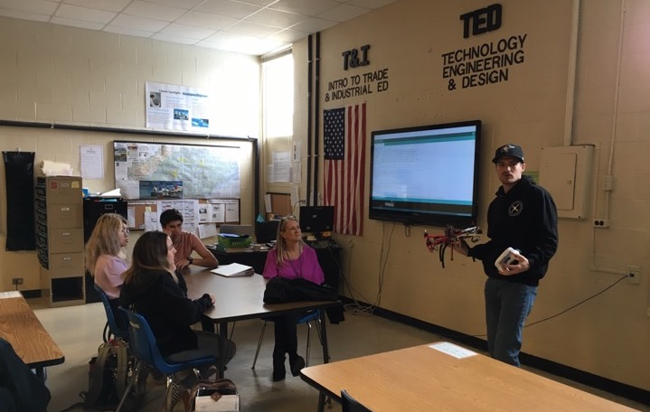
Notes:
Nine Ten Drones
Paul also teaches UAS for Fayetteville Tech and works with the Fayetteville area high schools in student engagement opportunities within the UAS field.
Paul Rossi <paulrossi@910drones.com>
Phone: + 1 910 978 0315
Email: info@910drones.com

Slide 11
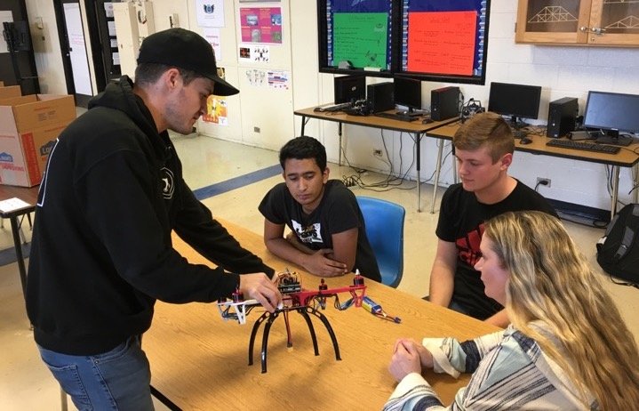
Notes:
Nine Ten Drones
Paul also teaches UAS for Fayetteville Tech and works with the Fayetteville area high schools in student engagement opportunities within the UAS field.
Paul Rossi <paulrossi@910drones.com>
Phone: + 1 910 978 0315
Email: info@910drones.com

Slide 12
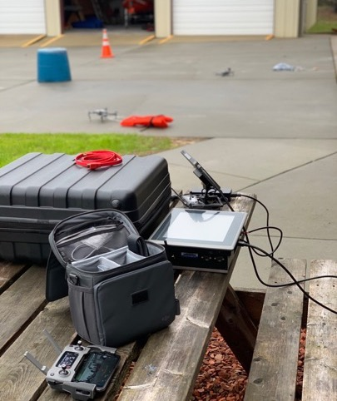
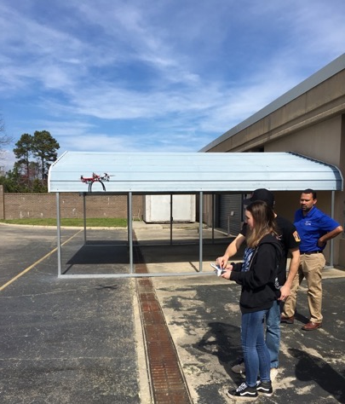
Notes:
Nine Ten Drones
Paul also teaches UAS for Fayetteville Tech and works with the Fayetteville area high schools in student engagement opportunities within the UAS field.
Paul Rossi <paulrossi@910drones.com>
Phone: + 1 910 978 0315
Email: info@910drones.com

Slide 13
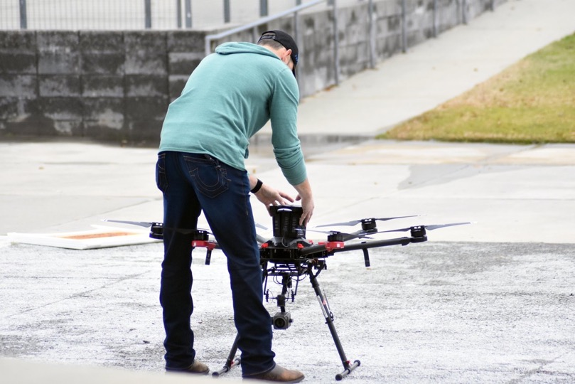
Notes:
Nine Ten Drones
Paul also teaches UAS for Fayetteville Tech and works with the Fayetteville area high schools in student engagement opportunities within the UAS field.
Paul Rossi <paulrossi@910drones.com>
Phone: + 1 910 978 0315
Email: info@910drones.com

Slide 14
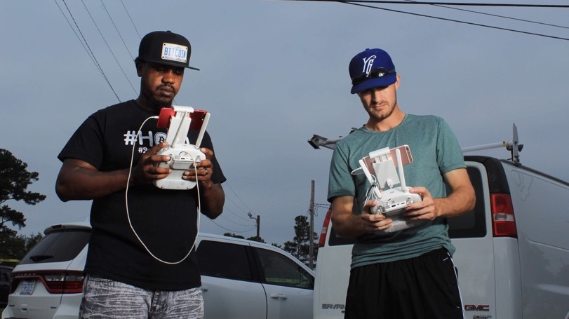
Notes:
Nine Ten Drones
Paul also teaches UAS for Fayetteville Tech and works with the Fayetteville area high schools in student engagement opportunities within the UAS field.
Paul Rossi <paulrossi@910drones.com>
Phone: + 1 910 978 0315
Email: info@910drones.com

Slide 15
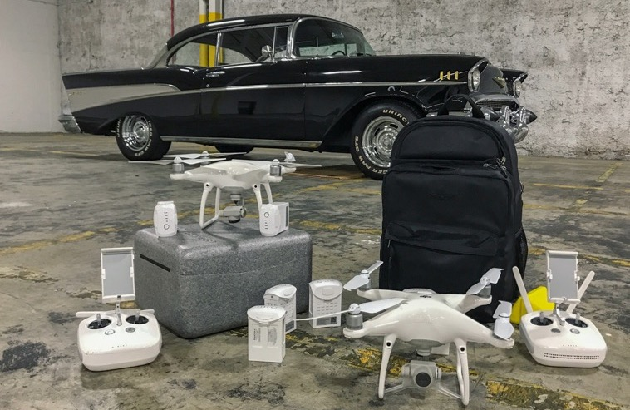
Notes:
Nine Ten Drones
Paul also teaches UAS for Fayetteville Tech and works with the Fayetteville area high schools in student engagement opportunities within the UAS field.
Paul Rossi <paulrossi@910drones.com>
Phone: + 1 910 978 0315
Email: info@910drones.com

Slide 16
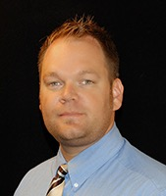
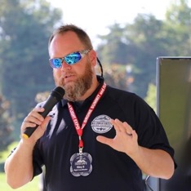
Riley Beaman
Director of the NC Public Safety Drone Academy Montgomery Community College
Notes:
Riley Beaman
(910) 898-9683 beamanr@montgomery.edu

Slide 17
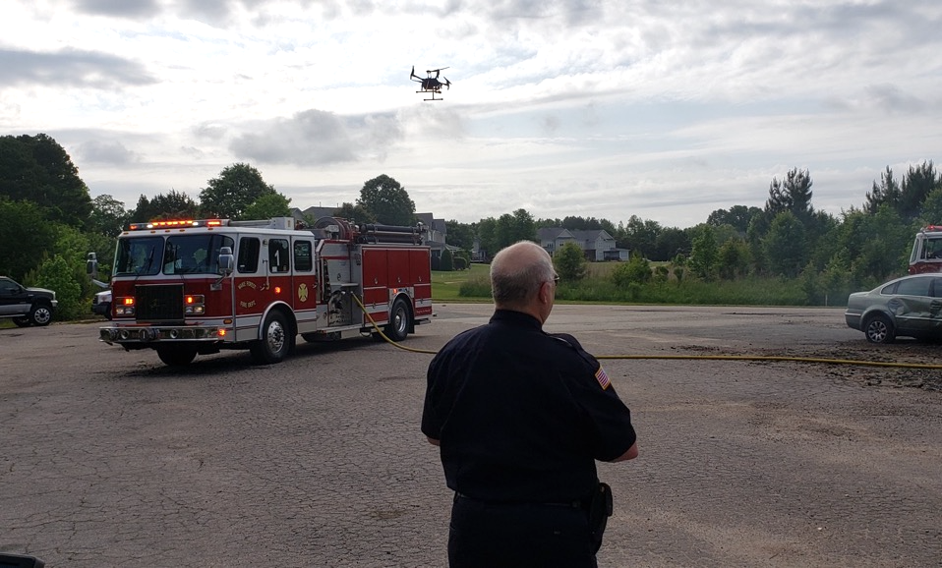
Notes:
Riley Beaman
(910) 898-9683 beamanr@montgomery.edu

Slide 18
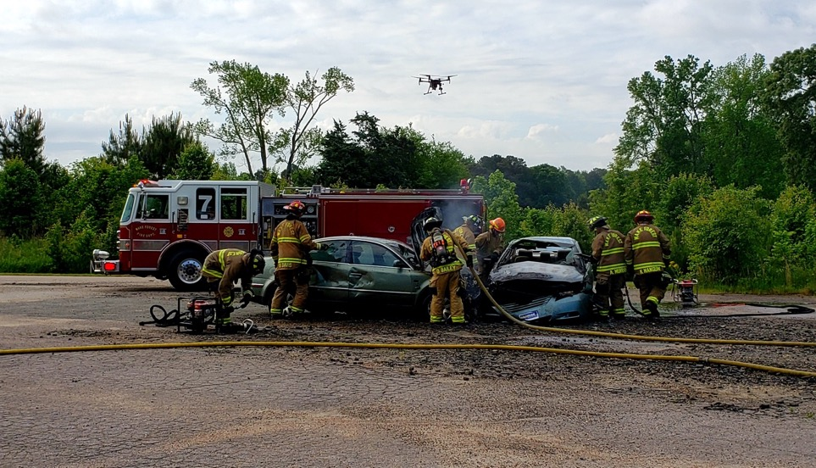
Notes:
Riley Beaman
(910) 898-9683 beamanr@montgomery.edu

Slide 19
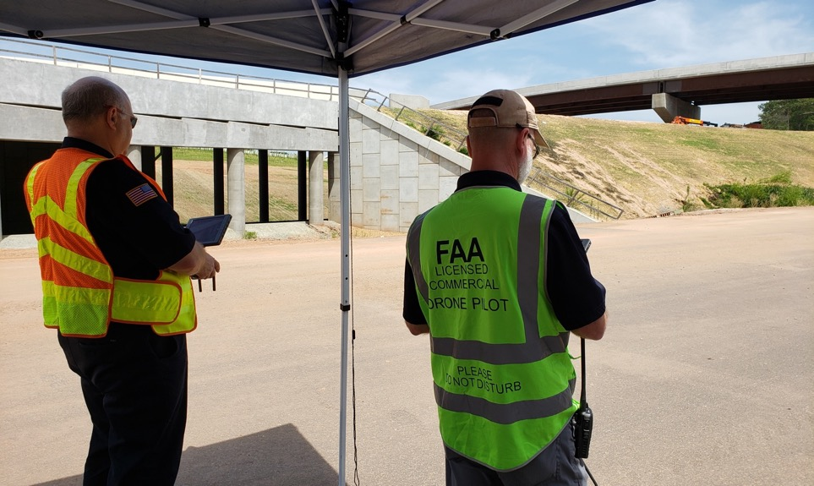
Notes:
Riley Beaman
(910) 898-9683 beamanr@montgomery.edu

Slide 20
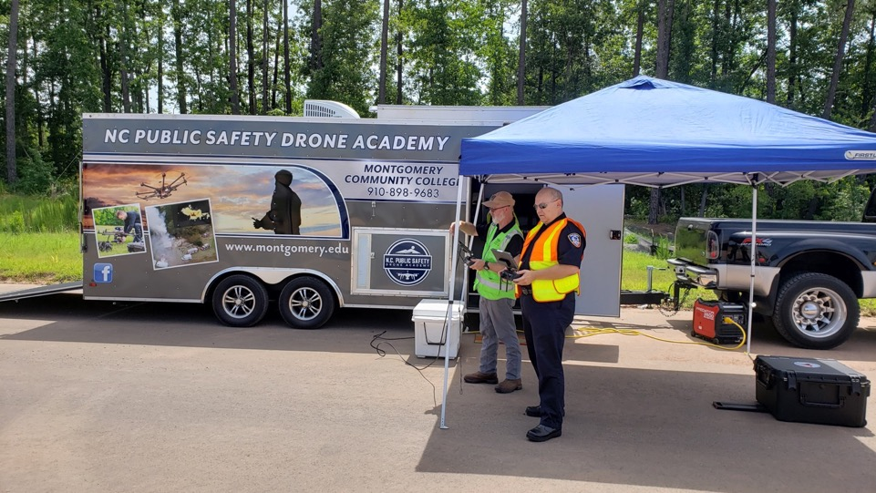
Notes:
Riley Beaman
(910) 898-9683 beamanr@montgomery.edu

Slide 21
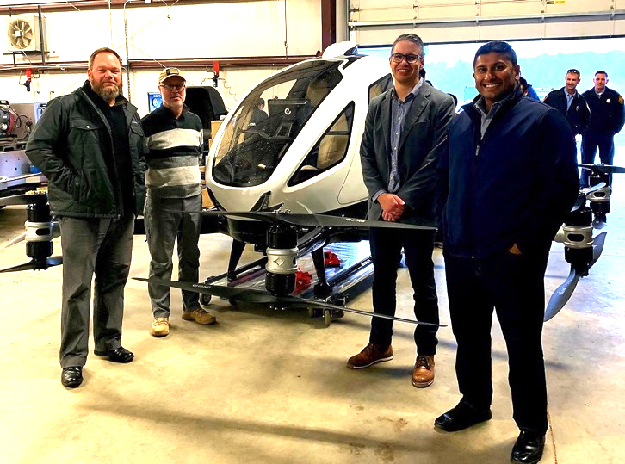
Notes:
Riley Beaman
(910) 898-9683 beamanr@montgomery.edu

Slide 22
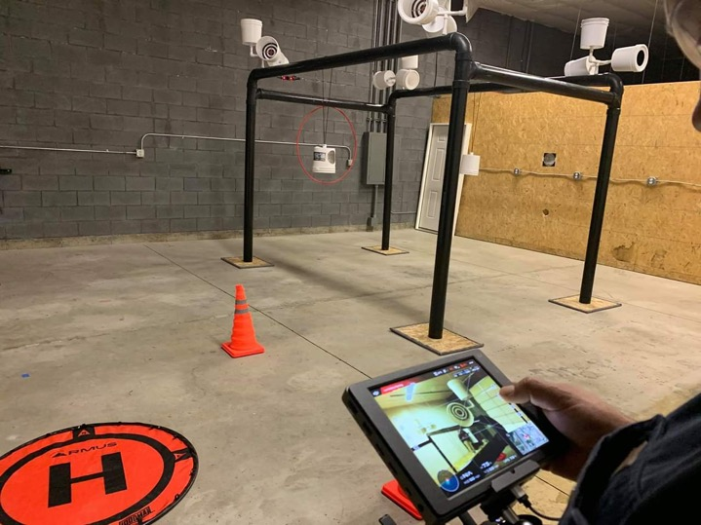
Notes:
Riley Beaman
(910) 898-9683 beamanr@montgomery.edu

Slide 23
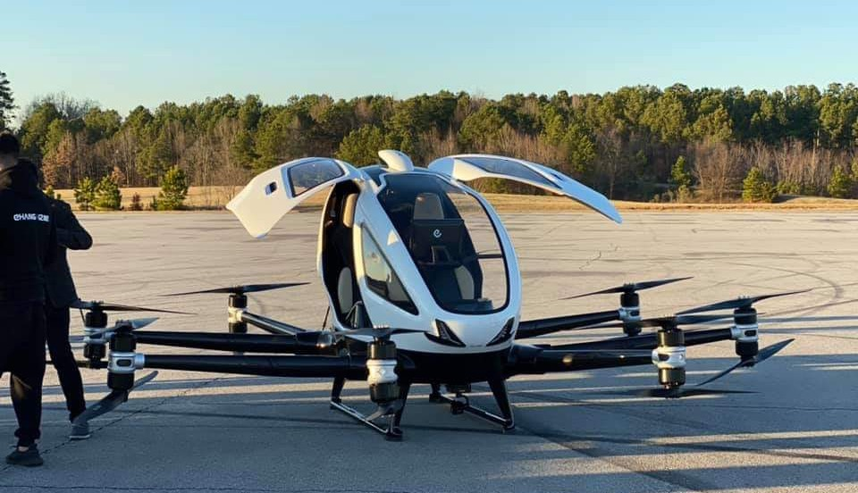
Notes:
Riley Beaman
(910) 898-9683 beamanr@montgomery.edu

Slide 24
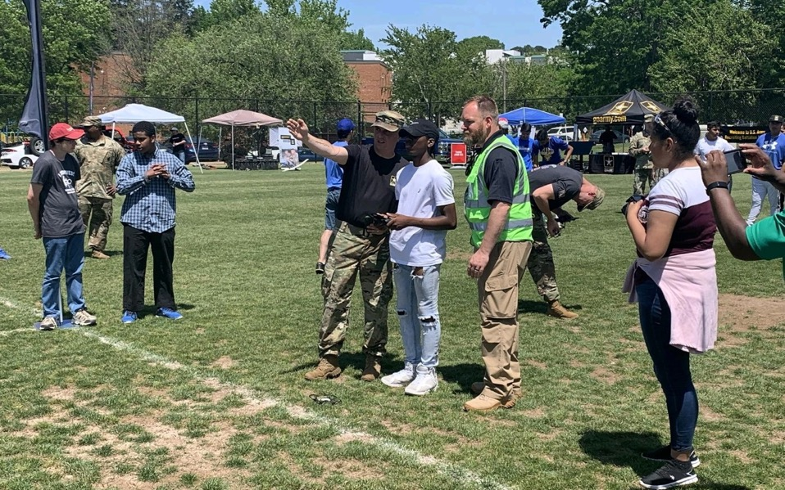
Notes:
Riley Beaman
(910) 898-9683 beamanr@montgomery.edu

Slide 25
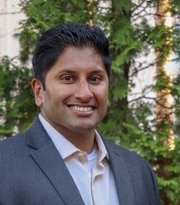
Darshan Divakaran
President Airavat
Notes:
Patti
Darshan Divakaran <darshan@airavatsolutions.com>
https://www.airavatsolutions.com/
AUVSI North Carolina Chapter
https://www.auvsi.org/north-carolina-chapter

Slide 26
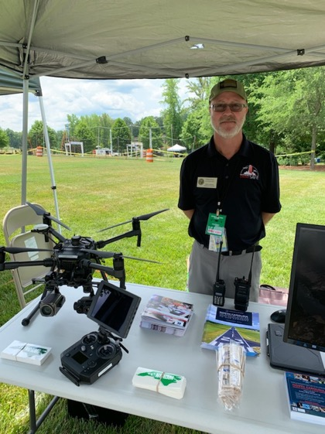
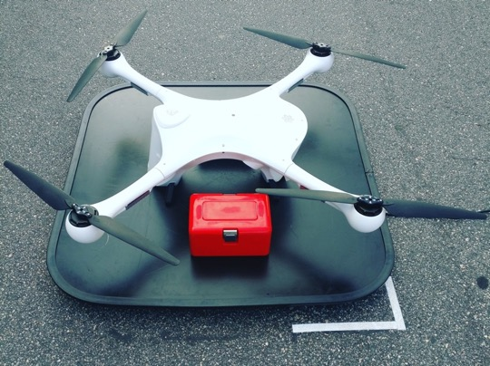
Notes:
Darshan Divakaran <darshan@airavatsolutions.com>
https://www.airavatsolutions.com/
AUVSI North Carolina Chapter
https://www.auvsi.org/north-carolina-chapter

Slide 27
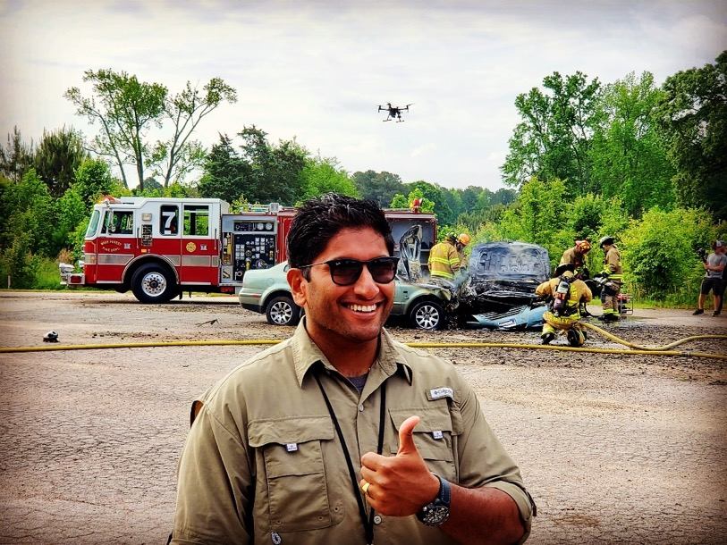
Notes:
Darshan Divakaran <darshan@airavatsolutions.com>
https://www.airavatsolutions.com/
AUVSI North Carolina Chapter
https://www.auvsi.org/north-carolina-chapter

Slide 28
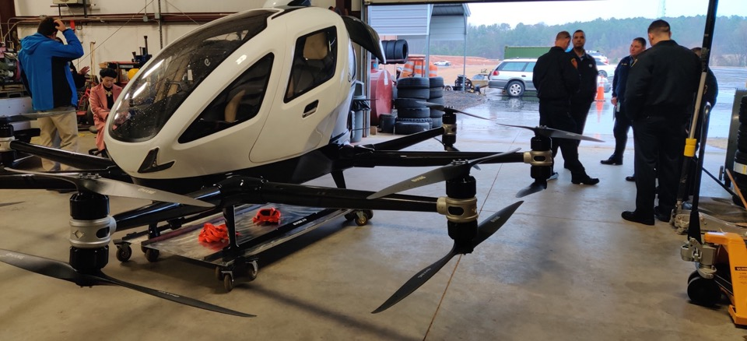
Notes:
Darshan Divakaran <darshan@airavatsolutions.com>
https://www.airavatsolutions.com/
AUVSI North Carolina Chapter
https://www.auvsi.org/north-carolina-chapter

Slide 29
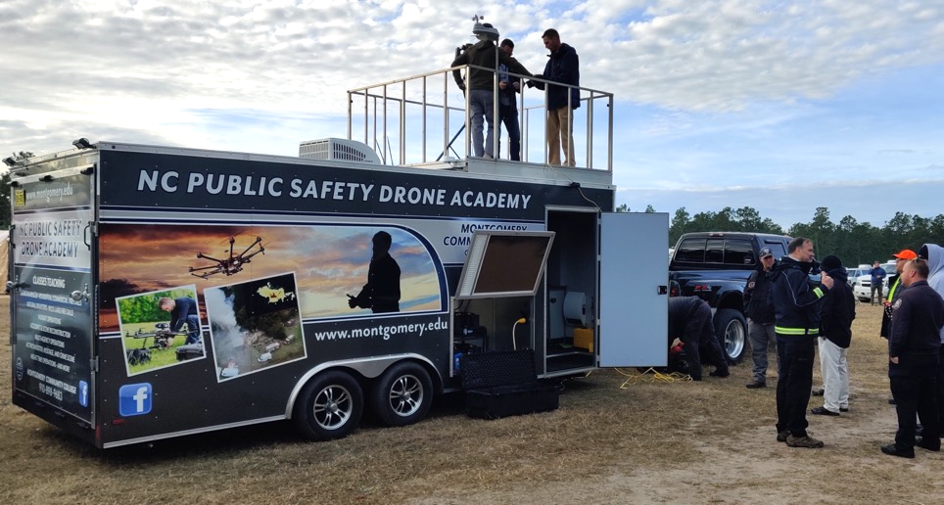
Notes:
Darshan Divakaran <darshan@airavatsolutions.com>
https://www.airavatsolutions.com/
AUVSI North Carolina Chapter
https://www.auvsi.org/north-carolina-chapter

Slide 30
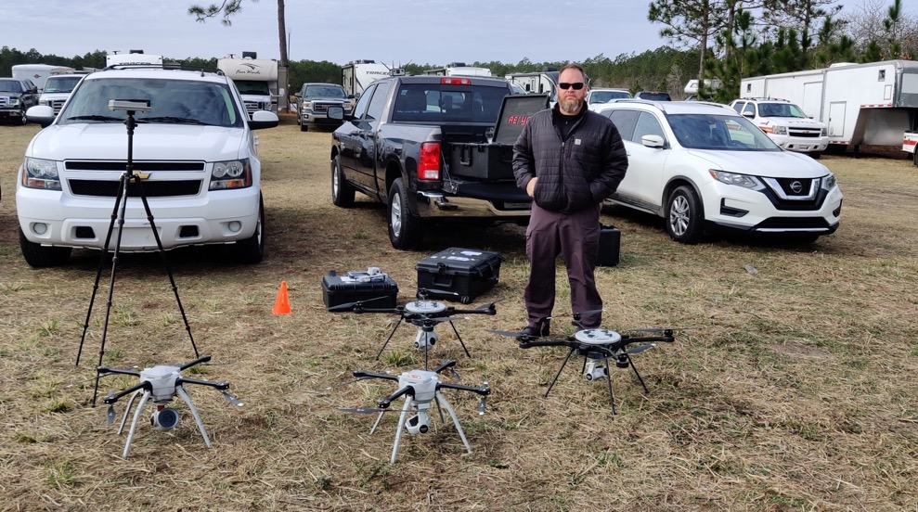
Notes:
Darshan Divakaran <darshan@airavatsolutions.com>
https://www.airavatsolutions.com/
AUVSI North Carolina Chapter
https://www.auvsi.org/north-carolina-chapter

Slide 31
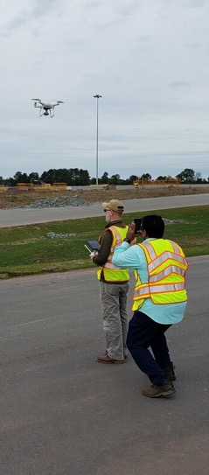
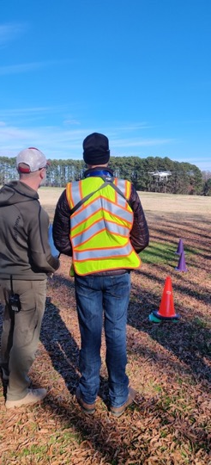
Notes:
Darshan Divakaran <darshan@airavatsolutions.com>
https://www.airavatsolutions.com/
AUVSI North Carolina Chapter
https://www.auvsi.org/north-carolina-chapter

Slide 32
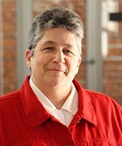
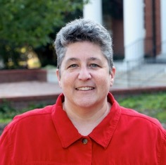
Justine Hollingshead
Chief of Staff and Assistant Vice-Chancellor
NC State University
Notes:
Patti
Justine R Hollingshead
Acad Stu Aff-VC and Dean Off Chief of Staff & Assistant Vice Chancellor
Phone: 919-515-2446 Email: jrhollin@ncsu.edu Web Site: http://dasa.ncsu.edu

Slide 33
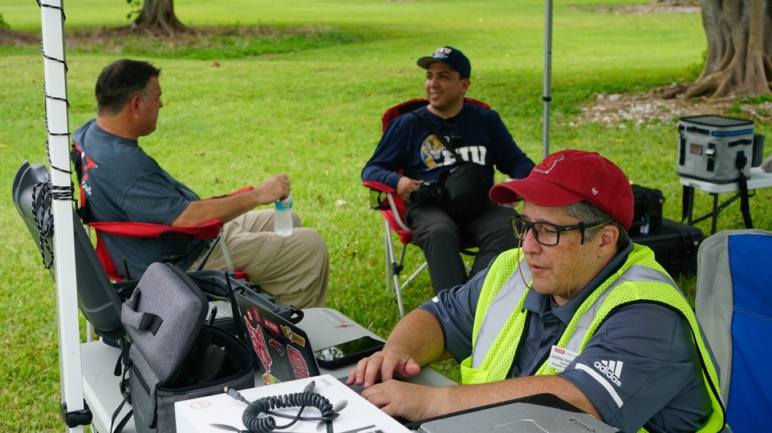
Notes:
Justine R Hollingshead
Acad Stu Aff-VC and Dean Off Chief of Staff & Assistant Vice Chancellor
Phone: 919-515-2446 Email: jrhollin@ncsu.edu Web Site: http://dasa.ncsu.edu

Slide 34
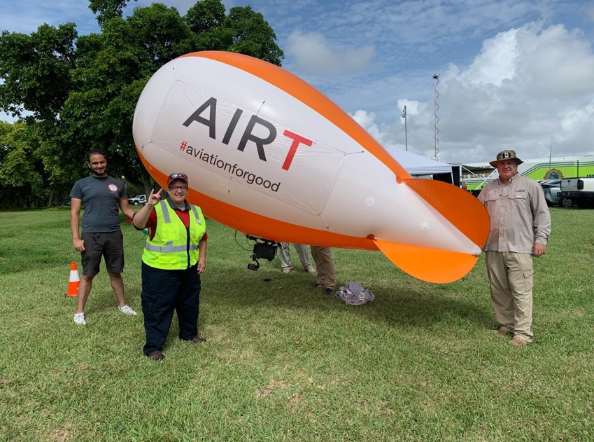
Notes:
Justine R Hollingshead
Acad Stu Aff-VC and Dean Off Chief of Staff & Assistant Vice Chancellor
Phone: 919-515-2446 Email: jrhollin@ncsu.edu Web Site: http://dasa.ncsu.edu

Slide 35
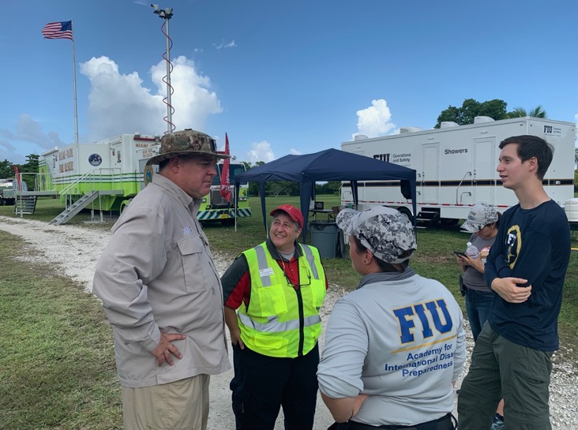
Notes:
Justine R Hollingshead
Acad Stu Aff-VC and Dean Off Chief of Staff & Assistant Vice Chancellor
Phone: 919-515-2446 Email: jrhollin@ncsu.edu Web Site: http://dasa.ncsu.edu

Slide 36
Notes:
www.ncperkins.org/presentations

Slide 37
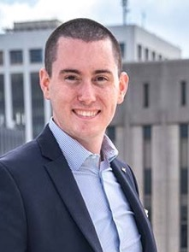
Ben Armstrong
9miles Media
Notes:
Chris
Ben Armstrong
https://9milesmedia.com/
inquiries@9milesmedia.com
919-809-9514
9miles Media is an FAA and NCDOT licensed Commercial UAV Operator with over five years experience building and flying a wide range of large format drones. We capture stunning 4K Ultra-HD video content and high resolution still imagery.

Slide 38
Notes:
Chris
Ben Armstrong
https://9milesmedia.com/
inquiries@9milesmedia.com
919-809-9514
9miles Media is an FAA and NCDOT licensed Commercial UAV Operator with over five years experience building and flying a wide range of large format drones. We capture stunning 4K Ultra-HD video content and high resolution still imagery.

Slide 39
Notes:
Chris
Ben Armstrong
https://9milesmedia.com/
inquiries@9milesmedia.com
919-809-9514
9miles Media is an FAA and NCDOT licensed Commercial UAV Operator with over five years experience building and flying a wide range of large format drones. We capture stunning 4K Ultra-HD video content and high resolution still imagery.

Slide 40
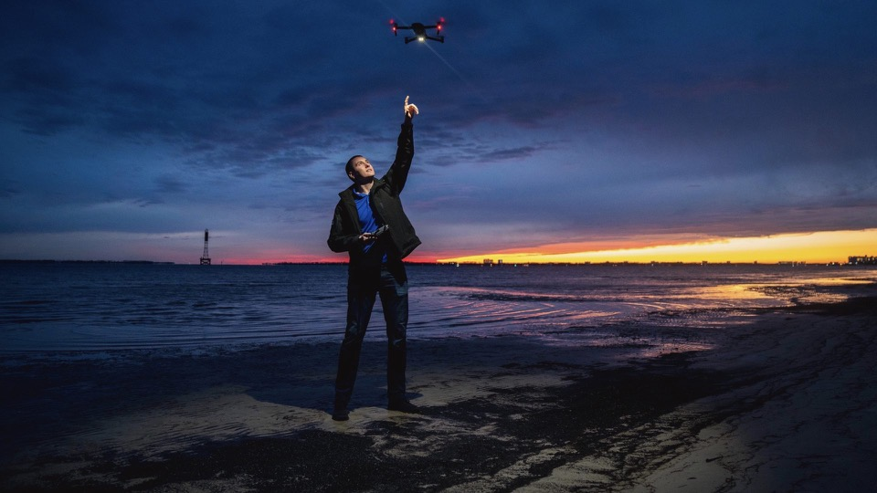
Notes:
Chris
Ben Armstrong
https://9milesmedia.com/
inquiries@9milesmedia.com
919-809-9514
9miles Media is an FAA and NCDOT licensed Commercial UAV Operator with over five years experience building and flying a wide range of large format drones. We capture stunning 4K Ultra-HD video content and high resolution still imagery.

Slide 41
Notes:
www.ncperkins.org/presentations

Slide 42
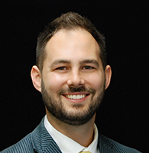
Andrew Gardner
Dean of Continuing Education, Drone Academy
Montgomery Community College
Notes:
Drone Academy
Montgomery CC
Andrew Gardner / Dean of Continuing Education gardnera@montgomery.edu
Montgomery Community College 910-898-9670 1011 Page St.Troy, NC 27371 www.montgomery.edu

Slide 43
Notes:
www.ncperkins.org/presentations

Slide 44
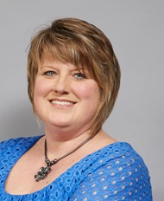
Margaret Annunziata
Vice President, Academic Programs and Services
Davidson County Community College
Notes:
Tony
Margaret Annunziata - CAO DCCC.
Added UAS to Electrical programs.
Margaret H. Annunziata
Vice President, Academic Affairs
Davidson County Community College
(336) 249-8186, ext. 6706
mannunziata5018@davidsonccc.edu
margaret_annunziata@davidsonccc.edu

Slide 45
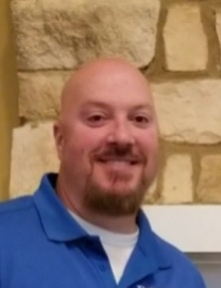
Rodney Reece
Associate Dean, School of Business, Engineering, & Technical
Davidson County Community College
Notes:
Tony
Rodney_Reece
Rodney_Reece@davidsonccc.edu

Slide 46
Notes:
www.ncperkins.org/presentations

Slide 47
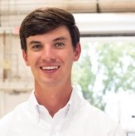
Jacob Velky
Unmanned Aerial Systems Group Manager
Duke Energy
Notes:
Patti
Jacob Velky, Interim Aircraft Maintenance Manager
Jacob.velky@duke-energy.com
Garrett Scott, UAS Coordinator
Bryan Williams, Senior Reactor Operator
Sawyer Raffield, Unmanned Aerial Systems Pilot
Duke Energy started using drones in 2015 to inspect wind and solar sites
https://illumination.duke-energy.com/articles/5-ways-duke-energy-is-using-drone-technology

Slide 48
This solar plant was inspected by drone with an infrared camera. The bright yellow section shown here lets technicians know that there is likely an issue that needs to be inspected based on the heat of the panel.
Notes:
Patti
Jacob Velky, Interim Aircraft Maintenance Manager
Jacob.velky@duke-energy.com
Garrett Scott, UAS Coordinator
Bryan Williams, Senior Reactor Operator
Sawyer Raffield, Unmanned Aerial Systems Pilot
Duke Energy started using drones in 2015 to inspect wind and solar sites
https://illumination.duke-energy.com/articles/5-ways-duke-energy-is-using-drone-technology

Slide 49
During Hurricane Irma, drones helped show damage in Florida.
Notes:
Patti
Jacob Velky, Interim Aircraft Maintenance Manager
Jacob.velky@duke-energy.com
Garrett Scott, UAS Coordinator
Bryan Williams, Senior Reactor Operator
Sawyer Raffield, Unmanned Aerial Systems Pilot
Duke Energy started using drones in 2015 to inspect wind and solar sites
https://illumination.duke-energy.com/articles/5-ways-duke-energy-is-using-drone-technology

Slide 50
Drone inspections helped reduce the number of times employees had to climb these 335-foot tall transmission towers in Wilmington, N.C.
Notes:
Patti
Jacob Velky, Interim Aircraft Maintenance Manager
Jacob.velky@duke-energy.com
Garrett Scott, UAS Coordinator
Bryan Williams, Senior Reactor Operator
Sawyer Raffield, Unmanned Aerial Systems Pilot
Duke Energy started using drones in 2015 to inspect wind and solar sites
https://illumination.duke-energy.com/articles/5-ways-duke-energy-is-using-drone-technology

Slide 51
Notes:
www.ncperkins.org/presentations

Slide 52
Gregory A. Minton, Ed.D.
Dean of Public Safety
Wilkes Community College
Notes:
Tony
Gregory A. Minton, Ed.D
Dean of Public Safety
Wilkes Community College
will talk about drone use in his program;
Greg Minton, EdD Title: Dean of Public Safety Department: Workforce Development and Community Education Phone: 336-838-6217 Fax: 336-903-3180 Email: gaminton413@wilkescc.edu

Slide 53
Keith Casey
Lead Instructor - Computer Engineering and Robotics Wilkes Community College
Notes:
Tony
Keith Casey
ikcasey998@wilkescc.edu
Phone: 336-838-6486 Email: ikcasey998@wilkescc.edu
Keith repairs the drones that the college uses in their programs.

Slide 54
Donna Riddle
Lead Horticulture Instructor Wilkes CC
Notes:
Mary
Donna Riddle
Lead Horticulture Instructor
Wilkes Community College
deriddle368@wilkescc.edu
1328 S. Collegiate Dr.
Wilkesboro, NC 28697

Slide 55
Kayla Mounce
Resource Conservationist/Grants Admin.
Wilkes County Soil and Water
Notes:
Mary
Kayla Mounce with Wilkes Soil and Water.
Phone: 336-838-3622 ext. 3
E-mail: wilkesswcd@gmail.com
In Person: 416 Executive Dr. Ste. A, Wilkesboro, NC 28697
Mail: PO Box 194, Wilkesboro, NC 28697

Slide 56
Notes:
Mary
Kayla Mounce with Wilkes Soil and Water.
Phone: 336-838-3622 ext. 3
E-mail: wilkesswcd@gmail.com
In Person: 416 Executive Dr. Ste. A, Wilkesboro, NC 28697
Mail: PO Box 194, Wilkesboro, NC 28697

Slide 57
Notes:
Mary
Kayla Mounce with Wilkes Soil and Water.
Phone: 336-838-3622 ext. 3
E-mail: wilkesswcd@gmail.com
In Person: 416 Executive Dr. Ste. A, Wilkesboro, NC 28697
Mail: PO Box 194, Wilkesboro, NC 28697

Slide 58
Notes:
www.ncperkins.org/presentations

Slide 59
Travis Smith
Department Chair - Architectural Technology
Central Piedmont Community College
Notes:
Tony
Travis Smith
Department Chair Architectural Technology
1
mailto:Travis.Smith@cpcc.edu
(704) 330-6783
Architects use drones in the field for site work and other large scale efforts.

Slide 60
Notes:
www.ncperkins.org/presentations

Slide 61
Trey Cherry
Chair, Information Technology Studies
Edgecombe Community College
Notes:
Patti
Trey Cherry Chair, Information Technology Studies Edgecombe Community College 2009 West Wilson Street Fleming Building (H), Room 204 Tarboro, NC 27886 252.618-6622 - voice 252.823.6817 - fax cherryt@edgecombe.edu As for talking points...
Our program is an 18 hour curriculum certificate, and is financial aid eligible.
In addition to teaching about drones, we focus on training students to use a set of tools that can lead to employment. One of the principle ideas behind the program is that drones aren't just fun toys, and aerial camera platforms, but also a tool that can be used for data collection.
Students take a course that prepares them to test for the FAA Part 107 certification and NCDOT commercial operators permit, similar to what many colleges are already offering through their continuing education programs.
From there, students go on to learn flight planning and execution through classroom activities and actual flight missions. We try to model flight missions after real-world job opportunities such as roof inspections, real-estate photography, agricultural mapping, etc.
Students learn about the legal aspects of flight operations as well as the business prospects, and how they can turn a certification and flight skills into a job.
Beyond learning about drones and flight, student also study GIS and GPS technologies so they will understand the basics of global positioning and mapping. They use ArcGIS products to manipulate data and create basic maps, as well as studying aerial photo interpretation.
Trey Cherry <cherryt@edgecombe.edu> GIS/UAS change. Trey Cherry Chair, Information Technology Studies Edgecombe Community College 2009 West Wilson Street Fleming Building (H), Room 204 Tarboro, NC 27886 252.823.5166 ext. 207 252.823.6817 - fax [mailto]cherryt@edgecombe.edu
Works for Michael Starling

Slide 62
Notes:
www.ncperkins.org/presentations

Slide 63
Basil Yap
UAS Program Manager
NC Department of Transportation
Division of Aviation
Notes:
Patti
Basil Yap
UAS Program Manager
NC Department of Transportation
Division of Aviation
919-814-0550 office
bkyap@ncdot.gov
1050 Meridian Drive
Morrisville, NC, 27560

Slide 64
Notes:
Patti
Basil Yap
UAS Program Manager
NC Department of Transportation
Division of Aviation
919-814-0550 office
bkyap@ncdot.gov
1050 Meridian Drive
Morrisville, NC, 27560

Slide 65
Notes:
Patti
Basil Yap
UAS Program Manager
NC Department of Transportation
Division of Aviation
919-814-0550 office
bkyap@ncdot.gov
1050 Meridian Drive
Morrisville, NC, 27560

Slide 66
Notes:
Patti
Basil Yap
UAS Program Manager
NC Department of Transportation
Division of Aviation
919-814-0550 office
bkyap@ncdot.gov
1050 Meridian Drive
Morrisville, NC, 27560

Slide 67
Notes:
Patti
Basil Yap
UAS Program Manager
NC Department of Transportation
Division of Aviation
919-814-0550 office
bkyap@ncdot.gov
1050 Meridian Drive
Morrisville, NC, 27560

Slide 68
Notes:
Patti
Basil Yap
UAS Program Manager
NC Department of Transportation
Division of Aviation
919-814-0550 office
bkyap@ncdot.gov
1050 Meridian Drive
Morrisville, NC, 27560

Slide 69
Notes:
Patti
Basil Yap
UAS Program Manager
NC Department of Transportation
Division of Aviation
919-814-0550 office
bkyap@ncdot.gov
1050 Meridian Drive
Morrisville, NC, 27560

Slide 70
Notes:
Patti
Basil Yap
UAS Program Manager
NC Department of Transportation
Division of Aviation
919-814-0550 office
bkyap@ncdot.gov
1050 Meridian Drive
Morrisville, NC, 27560

Slide 71
Notes:
Patti
Basil Yap
UAS Program Manager
NC Department of Transportation
Division of Aviation
919-814-0550 office
bkyap@ncdot.gov
1050 Meridian Drive
Morrisville, NC, 27560

Slide 72
Notes:
www.ncperkins.org/presentations

Slide 73
NC Community College Courses
UAS-110 Intro to UAS Operations
UAS-111 Unmanned Aircraft Systems
UAS-112 UAS Communications/Telemetry
UAS-115 Small UAS Certification
UAS-150 UAS Flight Simulation
UAS-152 Remote UAS Sensing & Control
UAS-230 UAS Aerial Photo Surveys
Notes:
Lenoir CC

Slide 74
NC Community College Course UAS-3111 Small Unmanned Aircraft System
This course prepares learners for small Unmanned Aircraft Systems (sUAS)/Drone flight certification. Topics include flight theory, flight operations, and flight training utilizing the Federal Aviation Administration (FAA) Remote Pilot - Small Unmanned Aircraft Systems Study Guide, North Carolina Unmanned Aircraft Systems Operator Permit Knowledge Test Study Guide, and North Carolina Department of Transportation (NCDOT) Division of Aviation UAS flight standards & best practices. Learners will gain an introduction to commercial, government, and recreational drone applications. Coursework will highlight topics such as regulations, weather, airspace, human factors and sUAS performance. Upon completion, students will be prepared to sit for the FAA Part 107 Remote Pilot Knowledge Test and NCDOT UAS Operator Permit.

Slide 76
Raising the Awareness of Career Pathways in North Carolina
Next meeting is May 21, 2020
www.ncperkins.org/presentations
Notes:
Our next meeting like this one will be on ------.
(We will skip December and be back in January.)
(We will skip June, July and August and be back in September.)
You can go to the NCPerkins website to register for that meeting.
We'll also send you a reminder, since you are now on our mailing list.
So go ahead and sign up for all the meetings, and you'll be reminded the day before.
If you liked something you saw here, send folks to the recording. Find it at that same web page.

