Slide 1
Promising Practices
Perkins Mid-Year Review
21 January 2020
Dr. Tabitha R. Miller, PhD, Dean of Academic Affairs/Chief Academic Officer

Slide 2
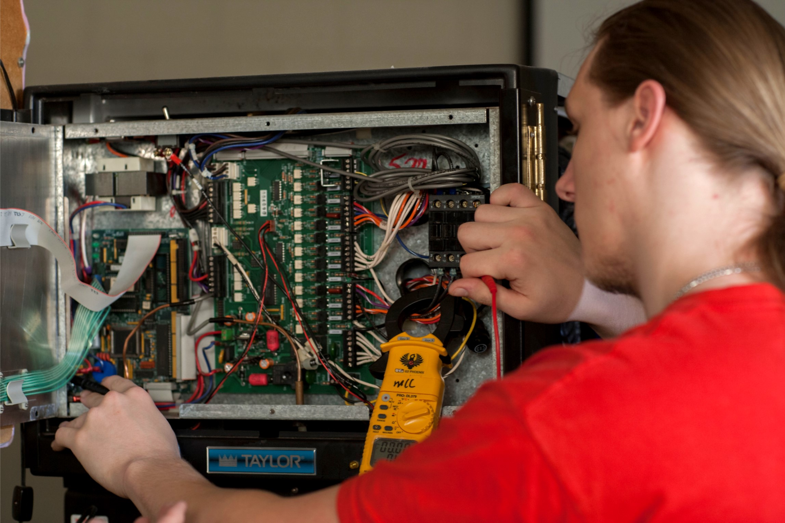
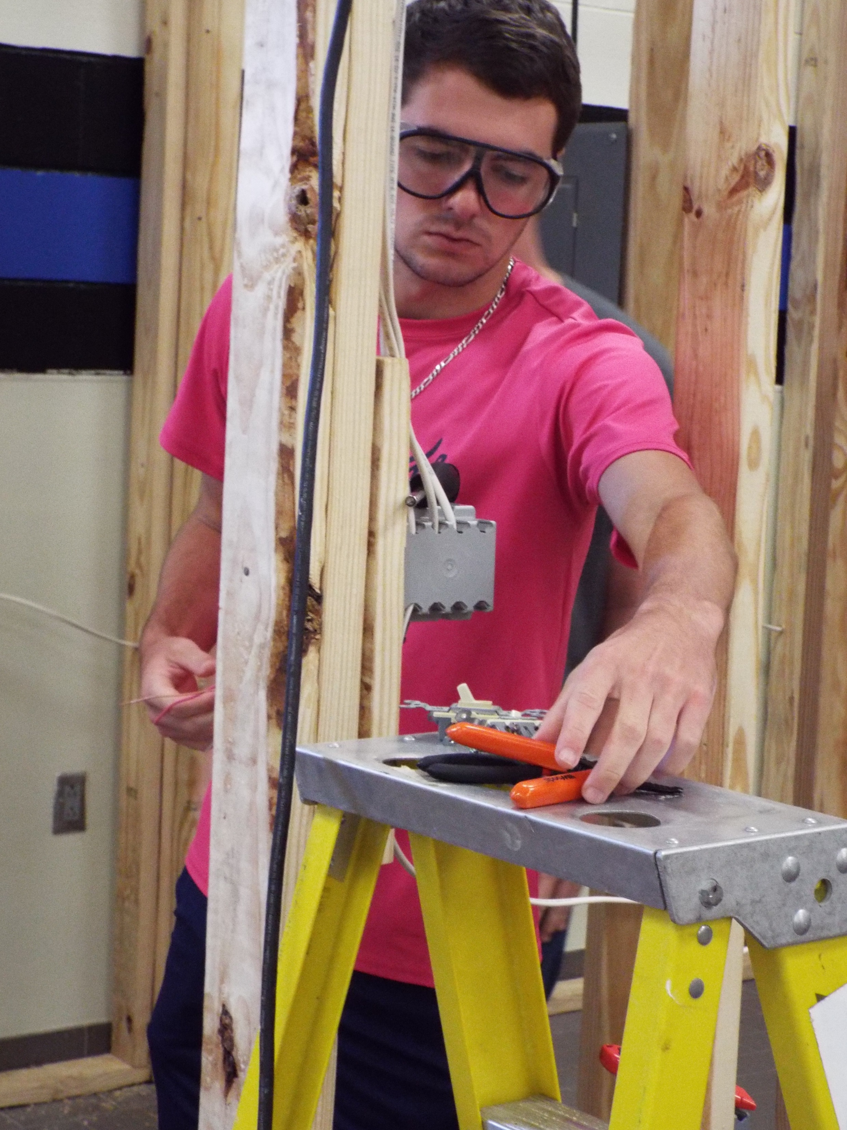
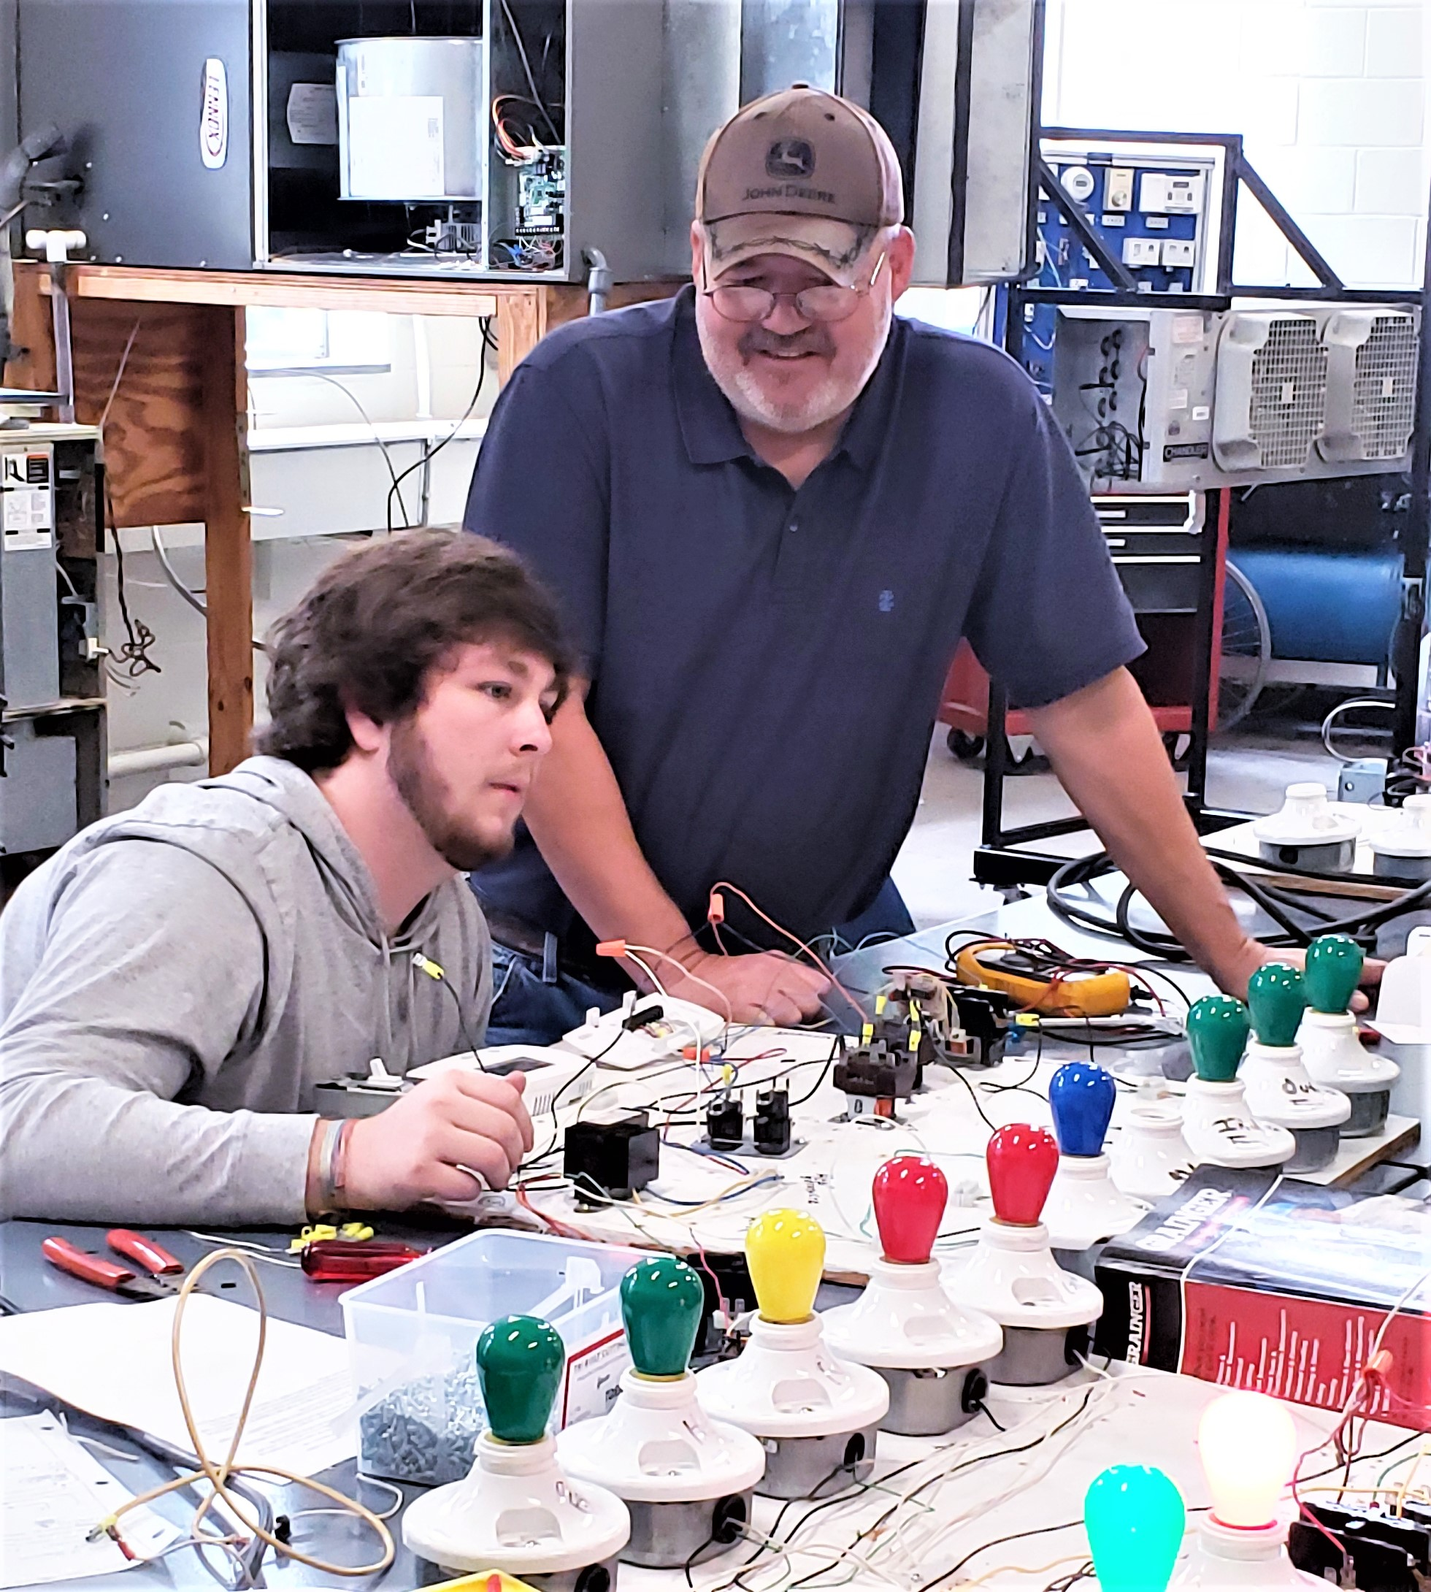
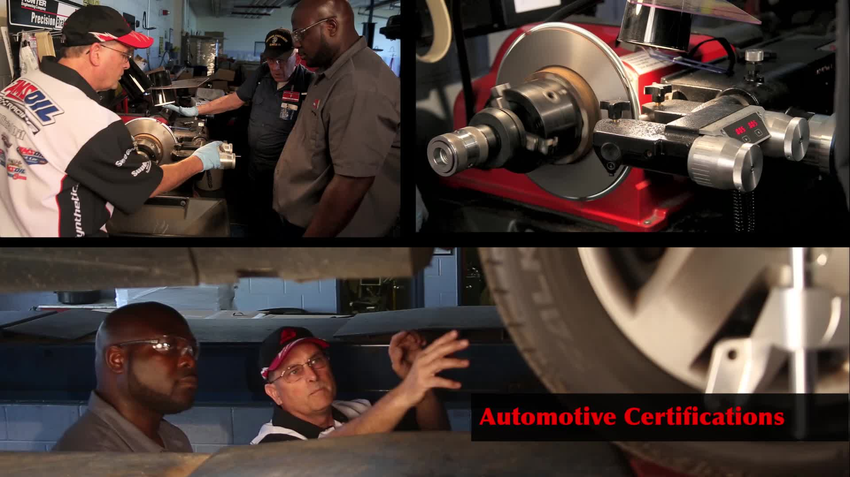
Advanced Manufacturing and Automotive Programs
Air Conditioning, Heating, and Refrigeration Technology
Automotive Systems Technology
Electrical Systems Technology
Industrial Systems Technology
Welding Technology

Slide 3
Perkins Initiative (FA2018)
Create a CTE Division Chair position for Advanced Manufacturing and Transportation Programs.
Fund stipend for position from Perkins (15% Perkins/85% State)
Focus responsibilities on improving the programs and increasing enrollment, especially for special populations.
Focus on non-traditional participation and completion to improve outcomes for 5P1 and 5P2.
Strengthen connection with local business and industry.

Slide 4
5P1 and 5P2 Performance Indicators
No quantifiable significant improvements in participation and completion yet.
Increased enrollment this year includes some non-traditional.
For the first time…. One female welding student.

Slide 5
Program Enrollment Data
Programs | FA2019 | FA2018 | FA2017 | FA2016
Air Conditioning, Heating and Refrigeration Technology | 20 | 15 | 8 | 4
Automotive Systems Technology | 18 | 10 | 11 | 13
Electrical Systems Technology | 17 | 8 | 6 | 11
Industrial Systems Technology | 30 | 36 | 25 | 30
Welding Technology | 2 | -- | -- | --
Overall AMA Program Enrollment | 87 | 69 | 50 | 58

Slide 6
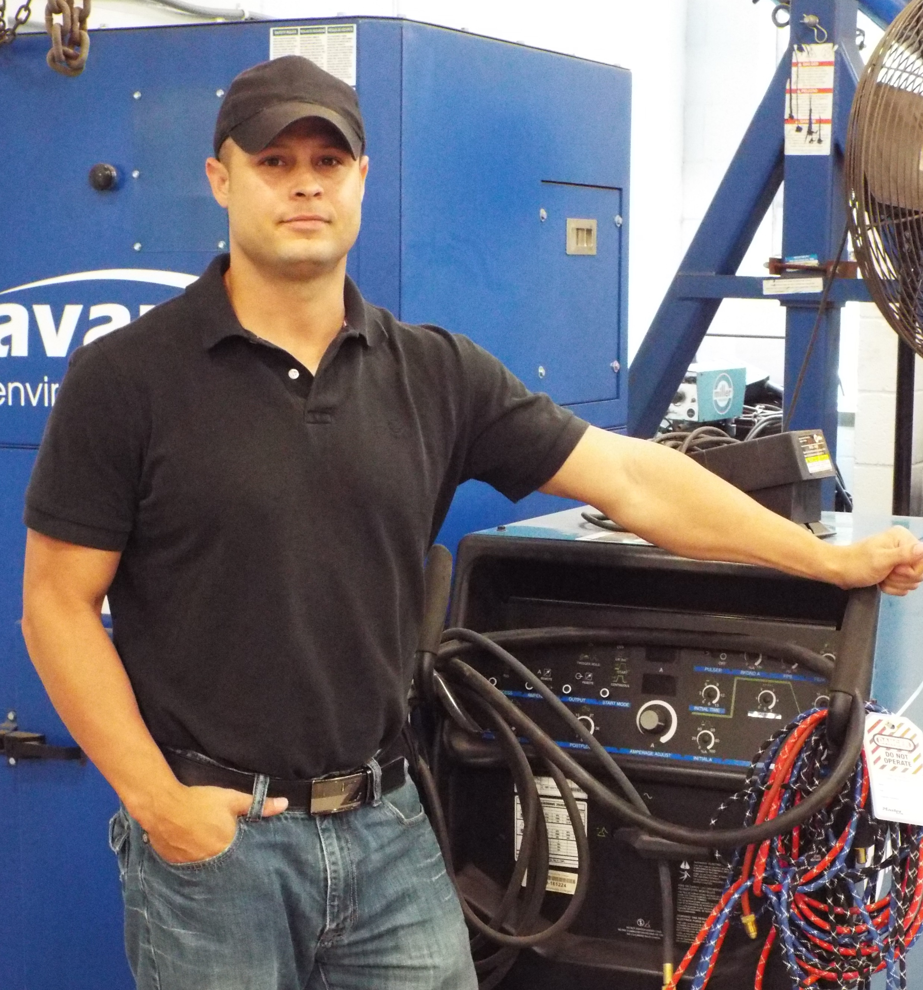
Active Improvement of Programs and Courses
Restructures course offerings
Creates collaborative degree pathways
Manages administrative documentation
Manages faculty/student issues
Facilitates division specific faculty professional development
Recruits students for the program
Develops relationships with business and industry
Remains innovative and passionate about the programs

