Slide 1
Perkins Midyear review
Dr. Jeffery Fields
Vice President of Academic Affairs
January 2020
Notes:
NOTE:
To change the image on this slide, select the picture and delete it. Then click the Pictures icon in the placeholder to insert your own image.

Slide 2
Current Fund Activities
EDGAR Workshop
September 25, 2019
Purchased books
VP of Administrative Services
Senior Accountant
VP of Academic Affairs
Nursing Education Conference, Washington DC
Prepaid registration
March 26, 2020
Nursing Director and 5 Faculty
6%

Slide 3
Upcoming Fund Activities
Equipment
Video equipment for Nursing simulation lab
11 microscopes for Medical Lab Technology program
2 incubators for Medical Lab Technology program
1 vehicle alignment machine for Automotive Technology program
Secondary Schools Tour HCC CTE Programs
Supplies for hands-on activities
Brochures
CTE programs
Include pictures of targeted special population
Highlight a successful student (special population)
Currently updating last year’s brochures already developed
Professional Development
Remaining: 94%

Slide 4
Comprehensive Local Needs Assessment (CLNA)
Pathways reviewed
Business Technologies
Construction Technologies
Health Sciences
Industrial Technologies
Public Service
Transport System Technologies
3 Secondary School Systems
Halifax County Schools
Roanoke Rapids Graded School District
Weldon City Schools
NCWorks and WIOA Representative
Program Industry Advisory Meeting
Common Gaps
Industry standard equipment
Faculty staying current on industry changes and education methods
Faculty turnover
Special populations
Transition from secondary school to HCC
Connecting industry with students/graduates

Slide 5
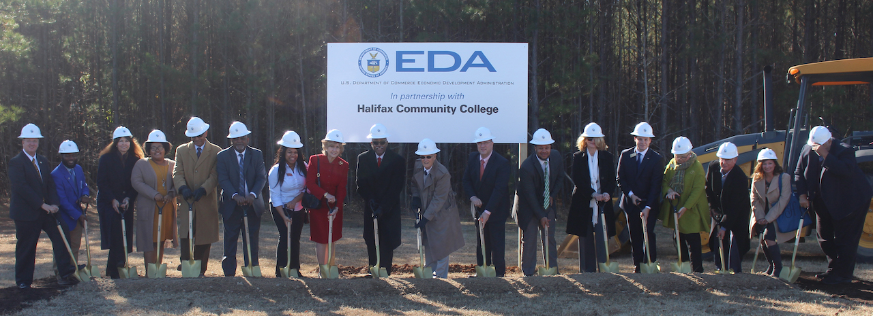
Advanced Manufacturing and Corporate Training Center
Groundbreaking
December 12, 2019
Completion
January 2021
Programs
Automotive Technology
Industrial Systems Technology
Welding Technology

Slide 6
Questions/Suggestions?

