Slide 1
Perkins Drive in Meeting
Review of Best Practices 2020

Slide 2
How the College Conducted the CLNA
Held an internal discussion with Deans to discuss process
Created a template document from materials provided to guide completion by individual programs
Met with program directors to review requirements
Worked with our institutional research department to review data
Referred to our program review and accreditation procedures and documentation
Used individual program reports to build the program area submissions

Slide 3
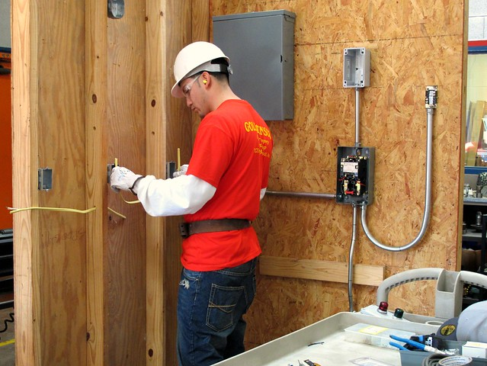
How the College Conducted the CLNA
We are focusing on:
Health Sciences (Health and Wellness)
Information Technology
Building and Skilled Trades

Slide 4
How the College Conducted the CLNA
Participated in regional efforts with Durham Public Schools, Chapel Hill/Carrboro, and Orange County School System Business Advisory Committees
Met with CTE representatives from all three school systems to discuss local plans, synergies, and areas of improvement

Slide 5
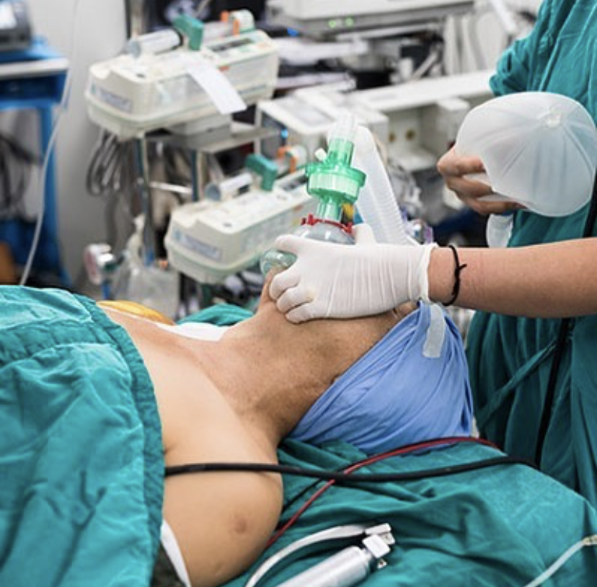
Required Use: Strengthen the Academic, Career and Technical Skills of Students
Anesthesia Tech equipment/manikins are allowing students to:
Learn how to safely position patients
Learn how to properly place monitors
Learn basic airway management techniques
Learn to assist the anesthesia care provider during induction of anesthesia
Notes:
Hired male tutor

Slide 6
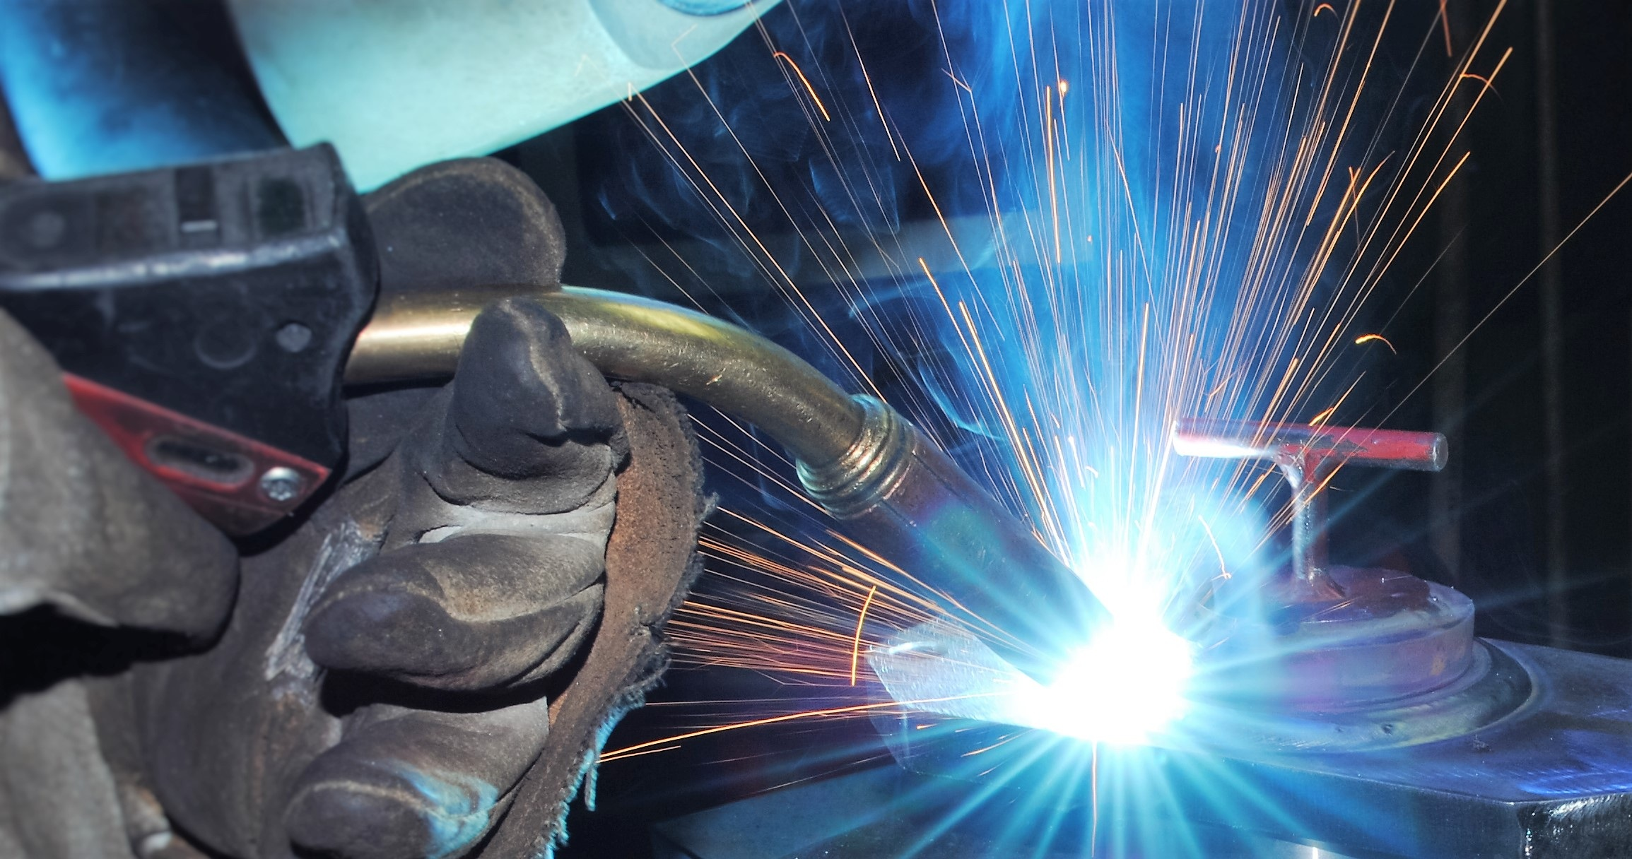
Required Use: Develop, Improve, or Expand the Use of Technology
MIG welder and air compressor will:
Allow students to have greater opportunity to practice
Increase in machine efficiency for students
Better sustainable air pressure for the various equipment

Slide 7
Required Use: Develop, Improve, or Expand the Use of Technology
EMS Simulator
Received before break; training last week
Using virtual reality technology, students will be able to :
“Step inside” the various parts of the human body
See the various changes of the human body from the inside based on shock and other acute events
Watch a VR patient and use a cardiac monitor or another diagnostic tools as they go through assessments
Observe VR child birth allowing students to see an event that they may never get the opportunity to experience on shift

Slide 8
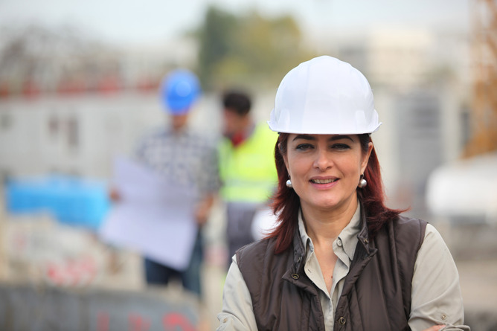
Required Use: Activities for Special Populations
Career and Technical Programs Case Workers
Focusing on 5P1 and 5P2
Future plans to expand to more special pops
Notes:
Required Use: Strengthen the Academic, Career and Technical Skills of Students

Slide 9
Required Use: Activities for Special Populations
Coordinate with marketing to develop print materials, videos and other promotional items relating to non-traditional students;
Coordinate with other areas of the college regarding recruiting, student success, and, career transition;
Coordinate with college organizations to promote non-traditional student completion;
Assist, monitor and provide resources to encourage students to overcome barriers to enter and complete non-traditional programs in career and technical education
Explore, develop, and implement a career transition plan to provide students with information about professional skills to transition from graduation to jobs in non-traditional career;
Collect data regarding student enrollment in, progression through and completion of non-traditional careers;
Develop “best practices” resources and presentations to present to internal and external stakeholders regarding non-traditional recruitment, enrollment, and retention;
Notes:
Perkins encourages collaboration with industry partners

Slide 10
Next Steps

