Slide 1
Cleveland community college mid-year meeting presentation
Bruce Mack
Forsyth Technical CC
January 29, 2020
Notes:
Apprenticeship Cleveland County

Slide 2
Impact of Perkins Funds
Hiring of WBL Coordinator
Increased our number of WBL students
2018SU, 2018FA, 2019SP (38 students)
2019SU, 2019FA, 2020SP (49 students)
Increased our number of programs offering WBL
Increased our Pre-apprenticeship and Apprenticeship Programs
Faculty Professional Development
Program Equipment
Welding Units
Electronics Equipment

Slide 3
Comprehensive Local Needs Assessment (CLNA)
Biotechnology
9-14 pathway in Animal Science and Plant Science to align with agriculture industry of rural Cleveland County. This program includes WBL.
Information Systems Technology
9-14 pathway to recruit and retain high school students in an associate degree. This program includes WBL.
Computer Integrated Machining
9-14 pathway to meet industry demand for machinist in Cleveland County.
Electrical Systems Technology
9-14 pathway will allow high school students an opportunity to become a license electrician upon completion of an associate degree. This program includes WBL.
Electronics Engineering Technology
9-14 pathway to align with the high school Electronics’ program of study.

Slide 4
Comprehensive Local Needs Assessment (CLNA)
Medical Assisting
9-14 pathway to target high school Health Sciences. All four high schools in the county has this program.
Mechanical Drafting Technology
9-14 pathway to align with our local high school’s drafting curriculum. Students are able to complete an associate degree within one year after graduating high school. This program includes WBL.
Welding Technologies
9-14 pathway to align with the high school’s welding program. All high schools in Cleveland County have welding programs. This program includes in WBL.

Slide 5
Tim Wisher, Welding Instructor, Cleveland Community College
Tim Wisher has taught welding at Cleveland Community College since 1994. He holds several welding certifications, but wanted to be able to offer his students “downhill” pipeline welding in his WLD 215 SMAW (Stick) Pipe classes. Tim has seen pipeline construction in an area of Cleveland County and heard the younger students having an interest in the pay and travel associated with pipeline welding.

Slide 6
Use of Perkins Funding to Develop “Downhill Welding” Option for Students
Tim arranged his training at Alabama Pipe Welders Academy in Mobile, Alabama to allow him to get instruction and practice the skills in early January 2020. “Downhill” stick welding is different from “Uphill” in that the welder starts at the 12:00 position and welds in either a fixed horizontal or a fixed 45 degree angle.

Slide 7
Welding Requires Precision
The welding code that covers “Downhill” Pipe Welding is American Petroleum Institute (API) 1104. This is required for cross-country natural gas and petroleum pipelines. The certification test requires a “branch test” in which the welder has to cut and grind a “T” to weld a branch onto the line. No arc strikes are allowed outside of the weld zone. Destructive testing is required to ensure that the welds conform to the code. Tim plans to become certified in API 1104.

Slide 8
Plans for Instruction in “Downhill” Welding
Tim will use the instruction and skill that he gained to offer students in his WLD 215 classes the options of concentrating on “uphill” welding for structures or “downhill” for pipeline welding. Tim’s program is growing and he appreciates the opportunity that the Perkins Professional Development provided him to learn from the experts.

Slide 9
9-14 Pathway Welding

Slide 10
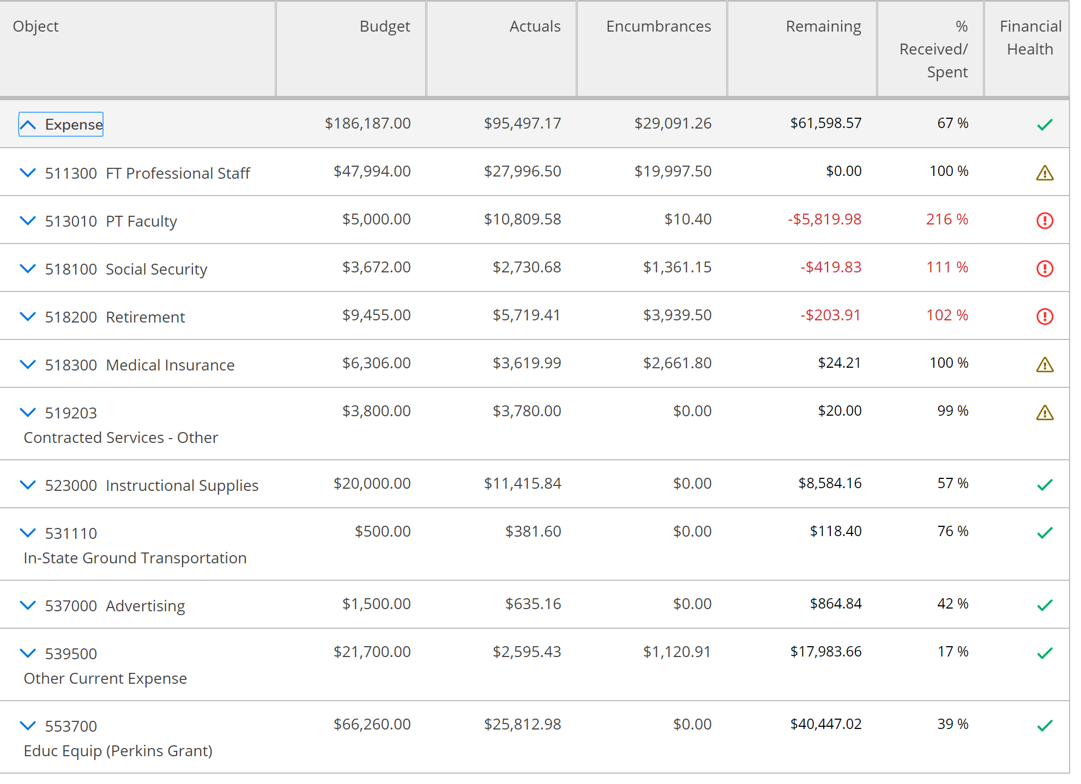
FY2019 Budget Update

