Slide 1
Perkins 2019-2020 Mid-Year Review
Beaufort County Community College

Slide 2
How Perkins Funds Made / Will Make a Difference
Supplies and materials allowed for additional course offerings in Industrial Technology area.
The program chair for Mechanical Engineering Technology was able to participate in professional development in state of the art CAD.
The Nursing Simulation Lab is being enhanced / modernized to keep pace with industry needs.
Student Services and the Accessibility Services Coordinator will collaborate with Program Leads to develop and review Technical Standards for each CTE area.
Perkins staff and Academic Deans participated in professional development related to best practices in credentialing.

Slide 3
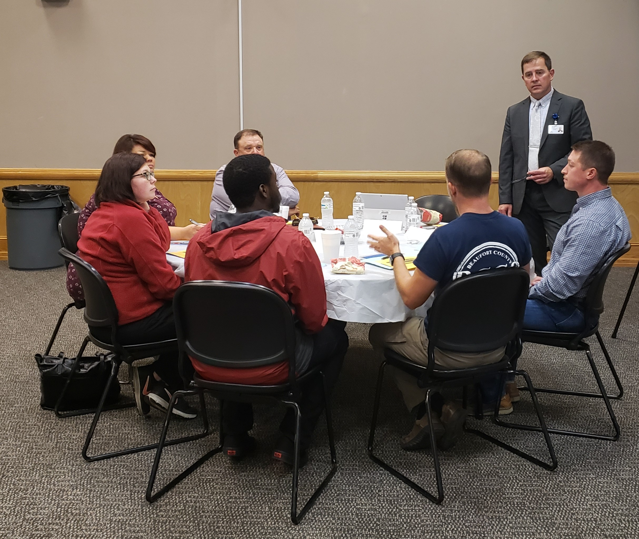
Comprehensive Local Needs Assessment
CLNA core committee formed and sought out additional members for the CLNA team.
CLNA core committee met and identified areas that needed to be addressed by the entire CLNA team.
CLNA committee met and discussed local needs.

Slide 4
CLNA
The following pathways were reviewed:
Agricultural and Natural Resource Technology
Business Technologies
Engineering Technologies
Health Sciences
Industrial Technologies
Public Services
Transport Systems Technologies

Slide 5
CLNA
The following gaps or needs were identified.
Work-Based Learning offerings need to be strengthened.
A process to identify, track, and follow-up with special population students needs to be developed.
Additional professional development training for CTE instructors in field of study.
Additional supplies and materials to ensure student proficiency and hands on opportunities.

Slide 6
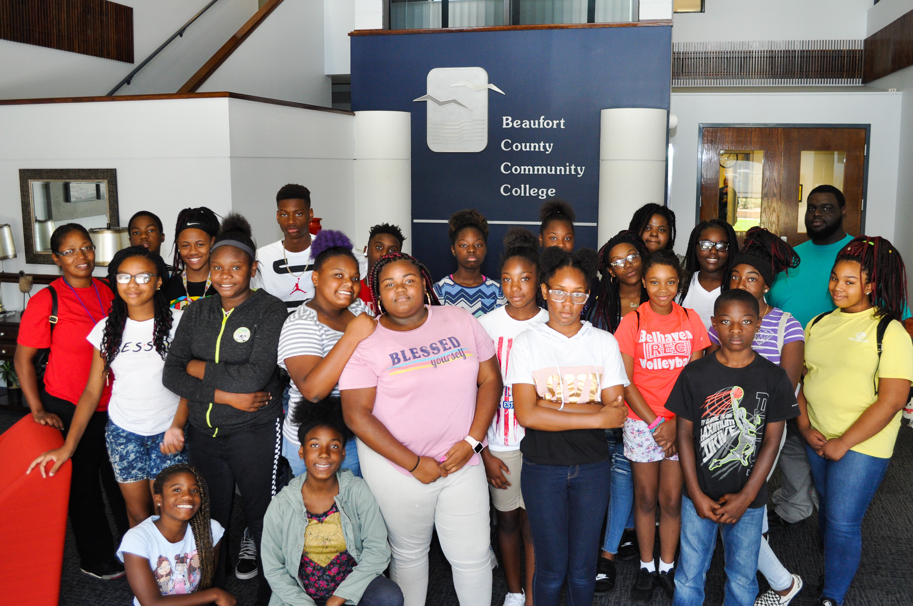
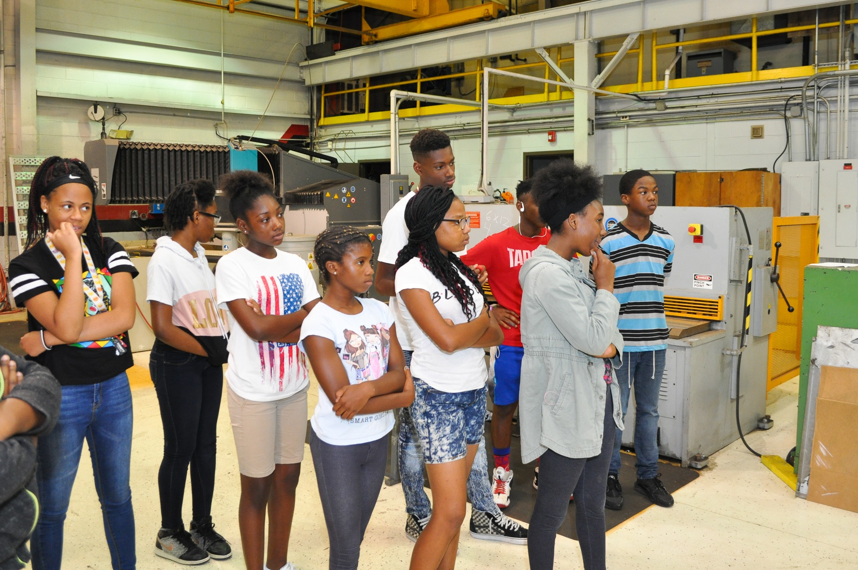
Promising Practices
Hosted 20 youth (7th-9th graders) from Washington and Belhaven Boys and Girls Clubs in Summer 2019.

Slide 7
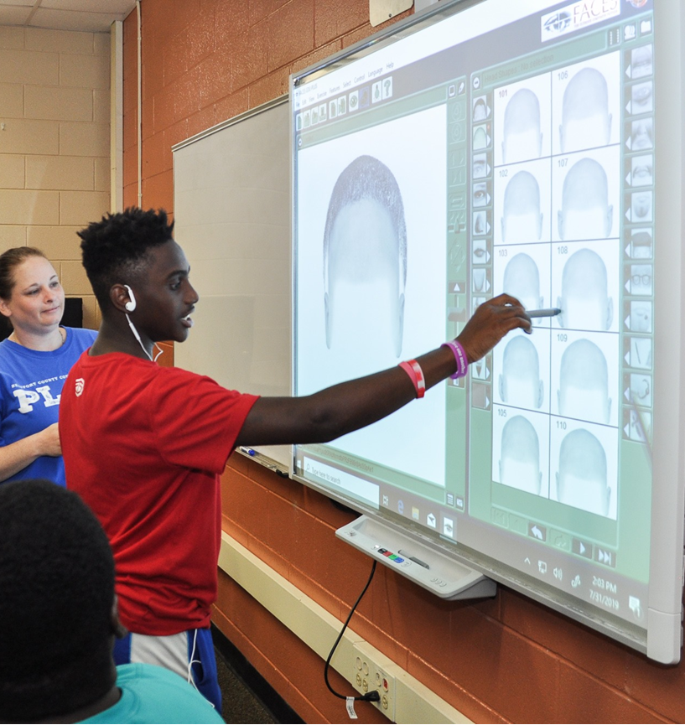
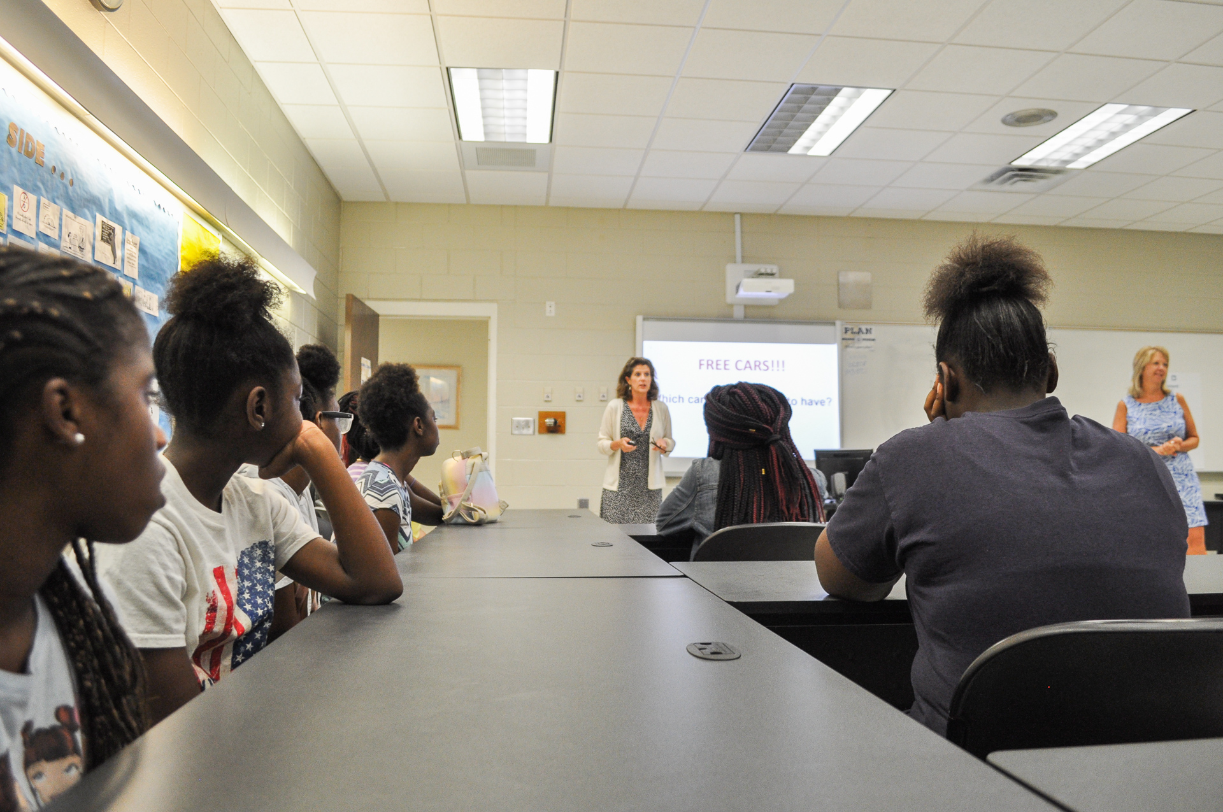
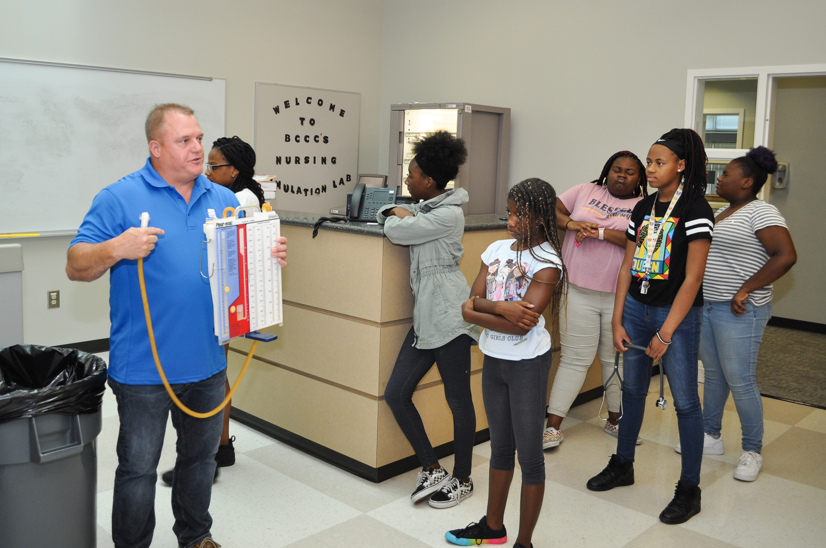
Promising Practices
Youth participated in workshops on Entrepreneurship, Career Inventory, and Career Awareness, Allied Health, Industrial Technology, Criminal Justice, etc.

Slide 8
Promising Practices: Teacher Externship with Beaufort County Schools
Up to 30 high school teachers will be embedded for a week in CTE programs during Summer 2020:
HVAC
CDL
Mechanical Engineering Tech.
Electrical Engineering Tech.
Welding Tech.
Automotive Systems Tech.
The program will include visits to local industry each afternoon.

Slide 9
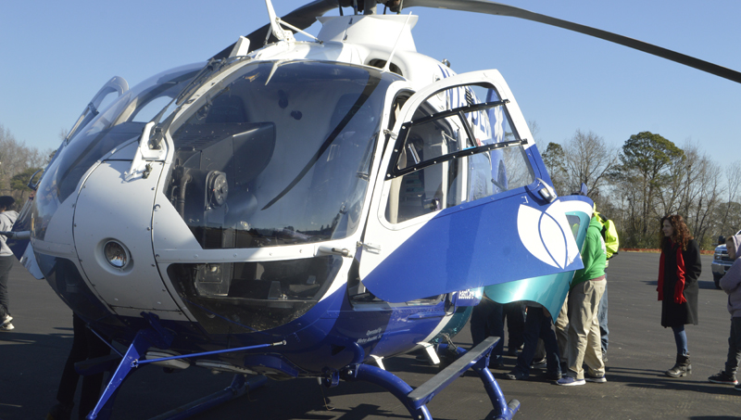
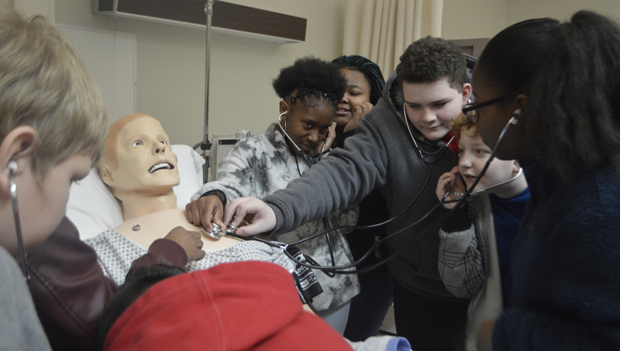
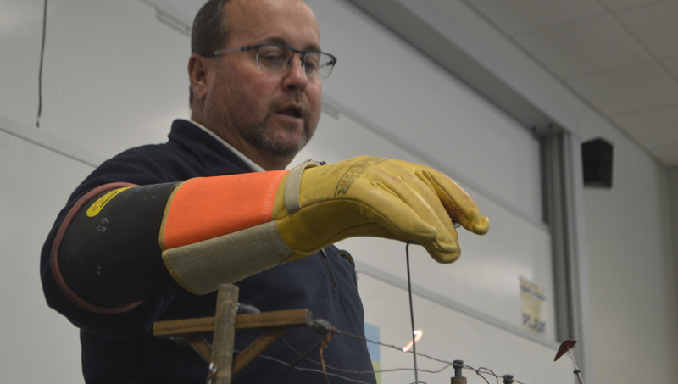
Promising Practices
In collaboration with Inner Banks Stem Center, BCCC hosted 250 seventh graders at the 6th Annual Youth STEM Career Day.
Business and Industry that participated in the event included NASA, DSM pharmaceutical, BCCC School of Nursing, Nutrien, Tideland Electric, US Coast Guard, Bunyan Fire Department, and Vidant East Care.

Slide 10
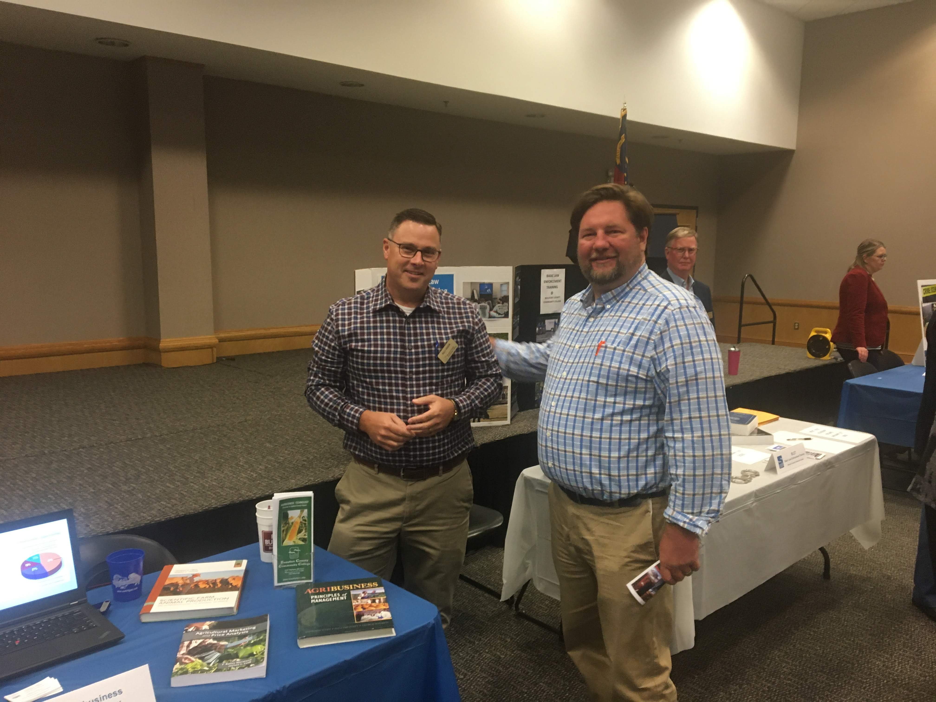
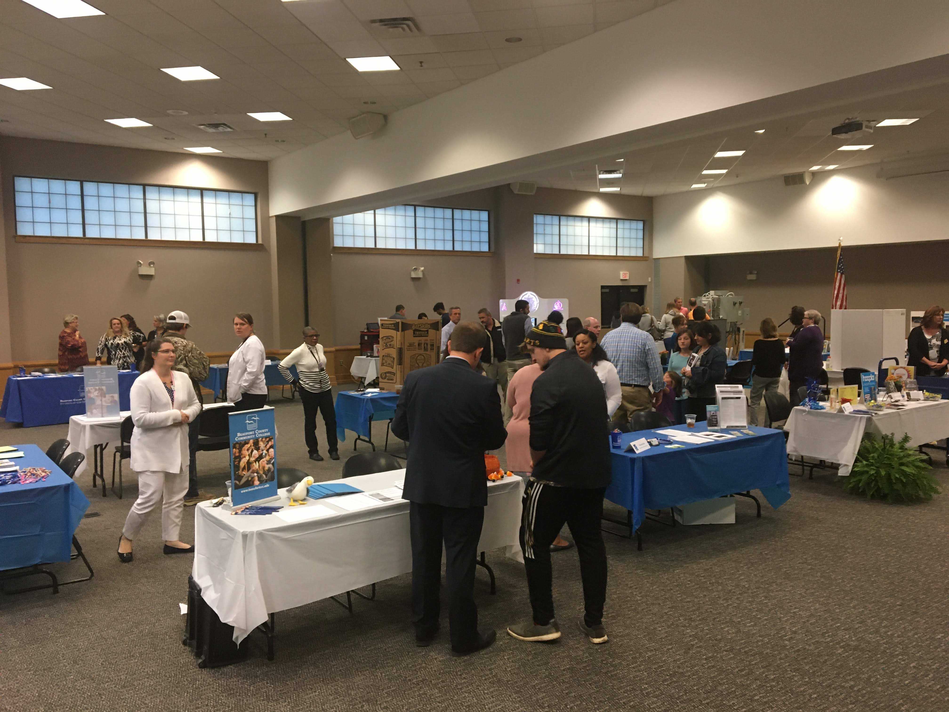
Annual Open House
All degree and non-degree programs participated in Open House 2019.
Direct marketed to high school juniors and seniors in addition to traditional marketing (web, ads, social media, etc.).
Expanding in 2020 to target high school and middle school groups.

Slide 11
Global Solutions Sustainability Challenge
Global Solutions Sustainability Challenge is a virtual exchange initiative that supports career readiness in the U.S., Iraq, and Jordan. Community college students from the BCCC and university students from Iraq and Jordan are teaming up to solve global challenges facing the business sector across industries.

Slide 12
Budget Update
Approximately 25% of Perkins budget has been expended or encumbered as of 1/16/2020.
Several large purchases (Nursing Simulation lab, equipment upgrades, etc.) are being finalized.
Additional faculty PD in Nursing and Welding are scheduled for February and March.

Slide 13
Comments, Questions, Suggestions?

