Slide 1

A-B Tech Perkins Mid-Year Update
January 28, 2020
A-B TECH

Slide 2
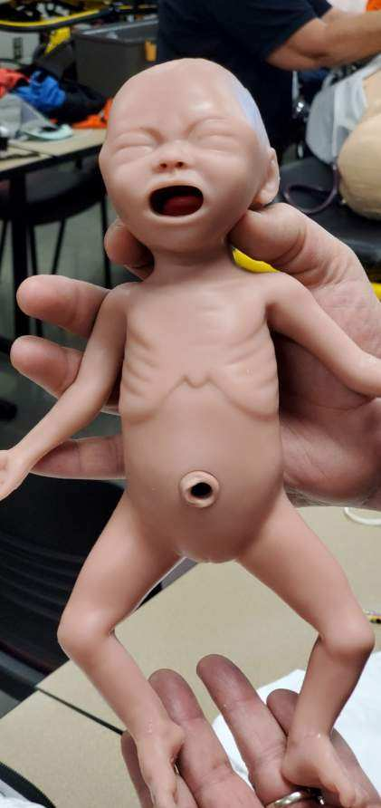
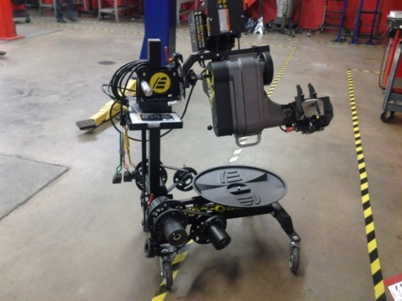
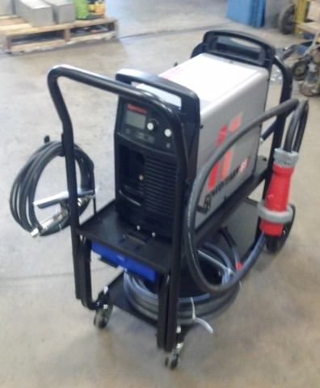
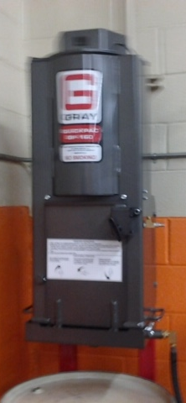
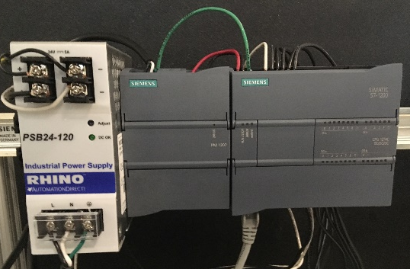
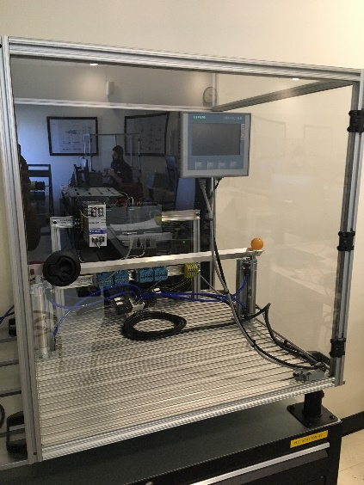
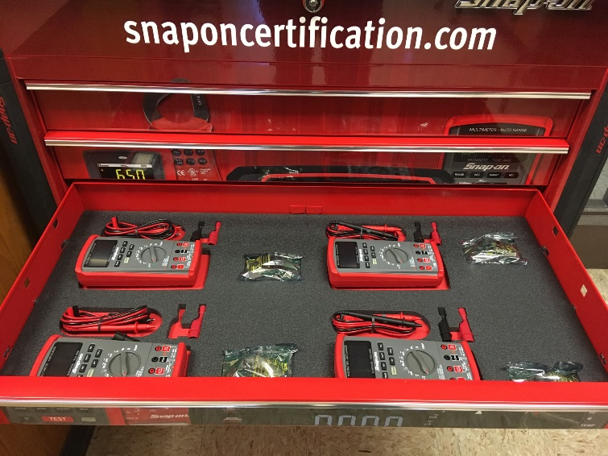
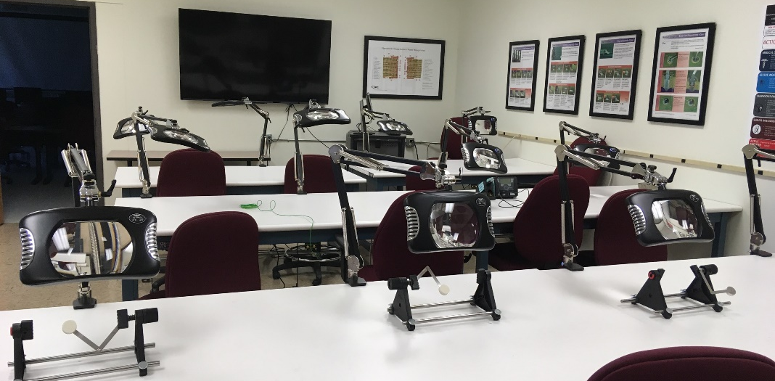
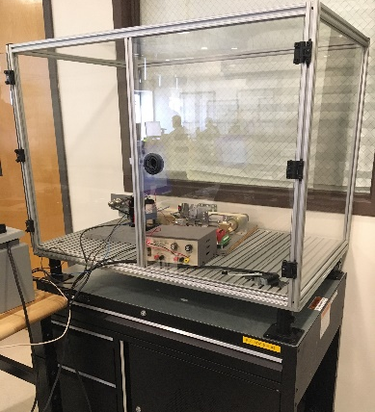
How Perkins Has Made A Difference
State-of-the Art Equipment
  Automotive, CIT, Electronics, EMS, Machining, Surveying, Welding
Work-Based Learning
  WBL Coordinator
  Will Open New Center for Work-Based Learning

Slide 3
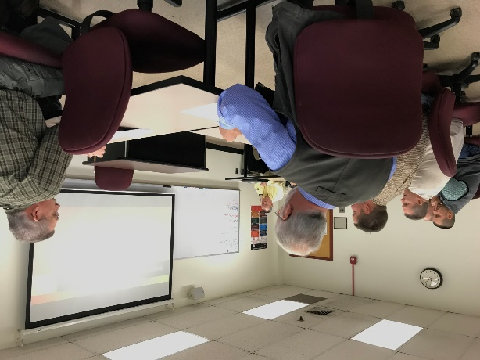
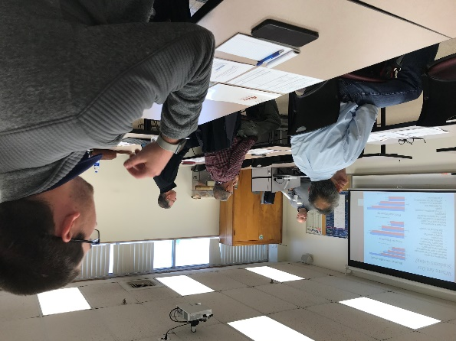
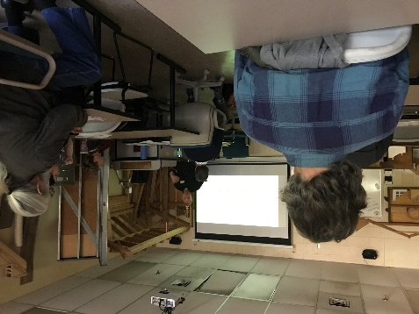
A-B Tech CLNA
Conducted in Clusters with Existing Advisory Committees/Students
Clusters included: Computer Technology, Culinary/Baking/Hotel Management, Emergency Services, Transportation Systems, Industrial Technologies, Construction Technologies
Invited Workforce Board and Schools – Workforce participated; Principals would not release teachers
Areas of challenges included: Soft skills, Low unemployment impacting enrollments, nonacademic challenges to enrollment, Challenges involving employers in school programs, need for cutting edge technology, challenges in recruiting faculty with such low salaries, how do we “sell” CCP?, need to align K-12 and CC calendars

Slide 4
Promising Practice – Leadership Academy October 8, 2019 – Lioncrest Biltmore Estate
8:00 Departure from schools
8:30 -9:00 School Arrival Networking
9:00 - 9:15 Introductions and Schedule Review
9:15 - 9:30 Groups Breakout
9:30 - 11:00 Leadership and STEAM Activities
11:00 - 11:15 Break/Back in Lion Crest seated
11:15 – 11:30 AB Tech Pam Silvers Presentation
11:30 - 1:00 Lunch/Speaker (Dr. Tony Baldwin)
1:00 - 3:00 Explore Biltmore/Head back to schools

Slide 5
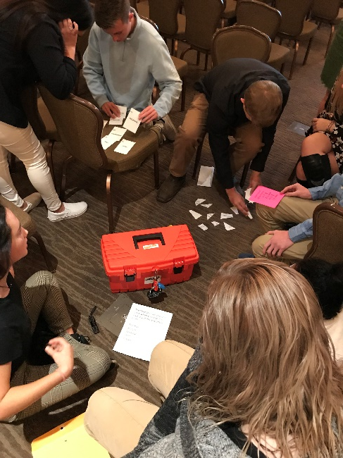
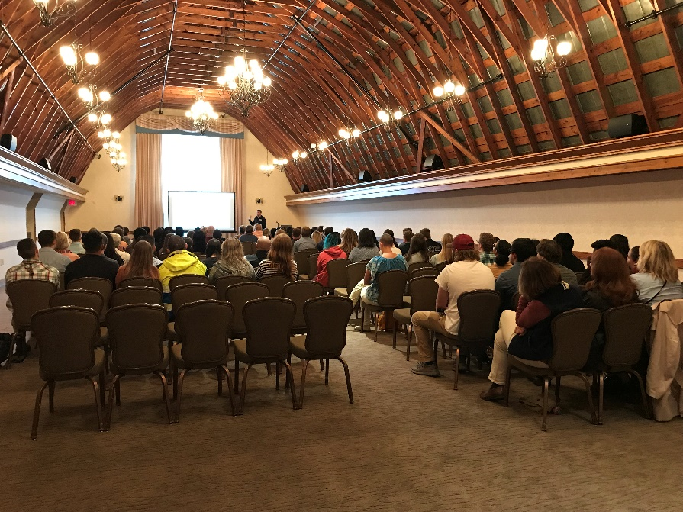
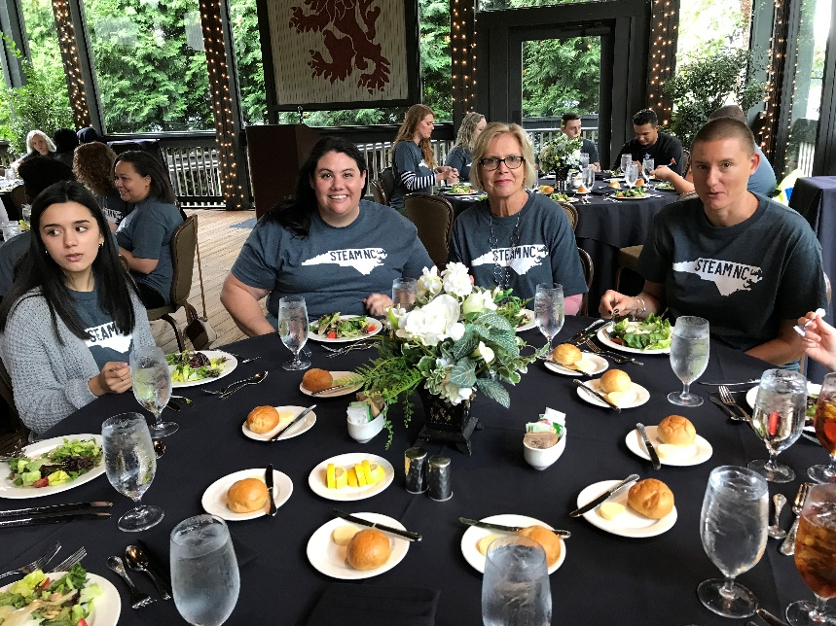
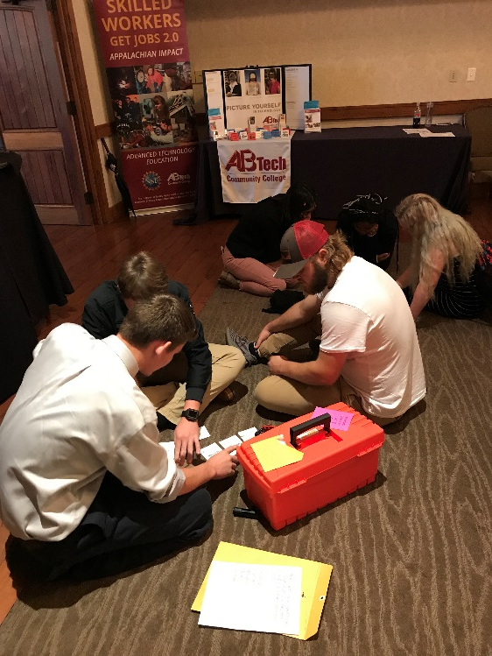
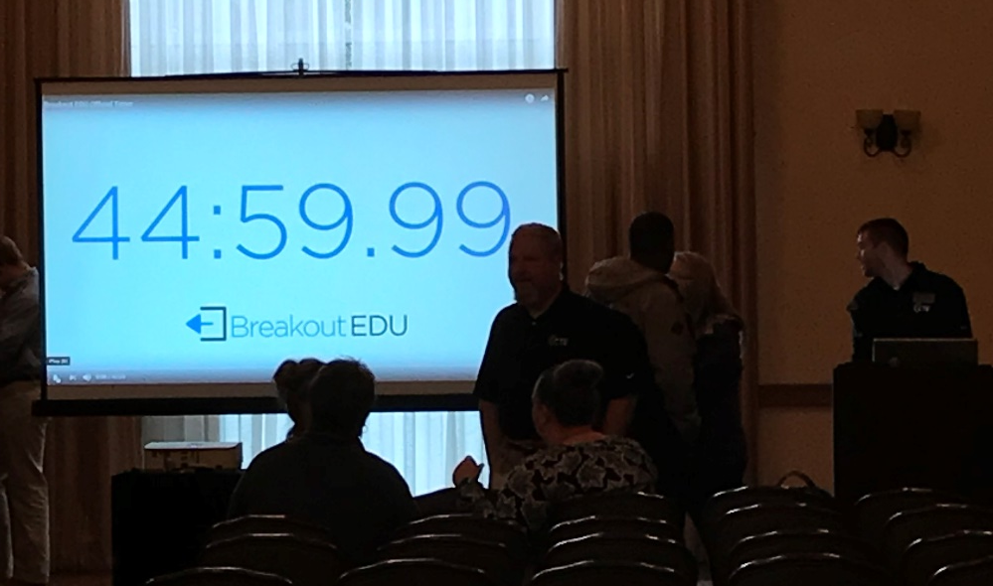
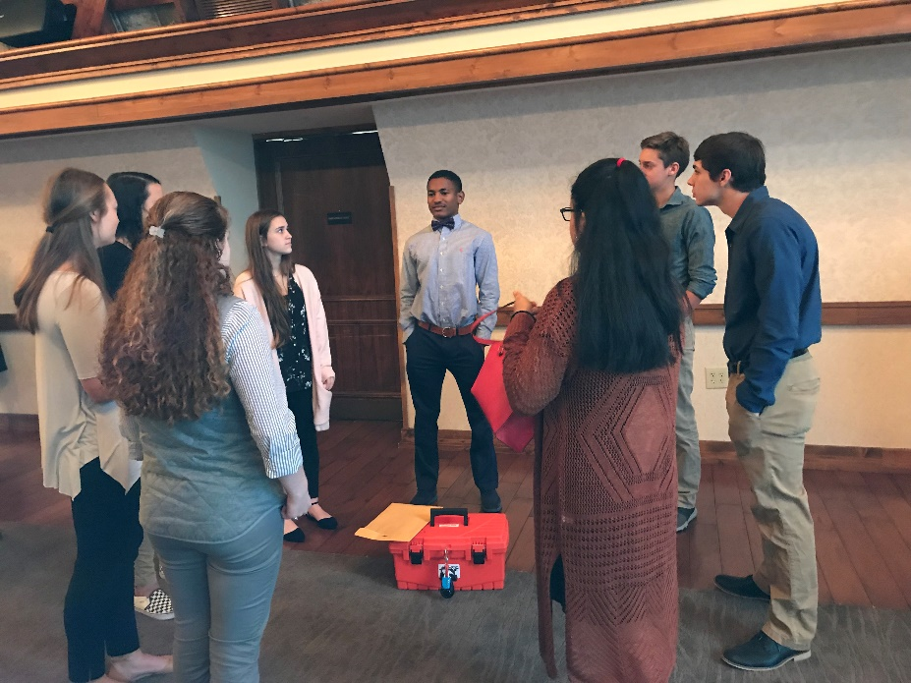
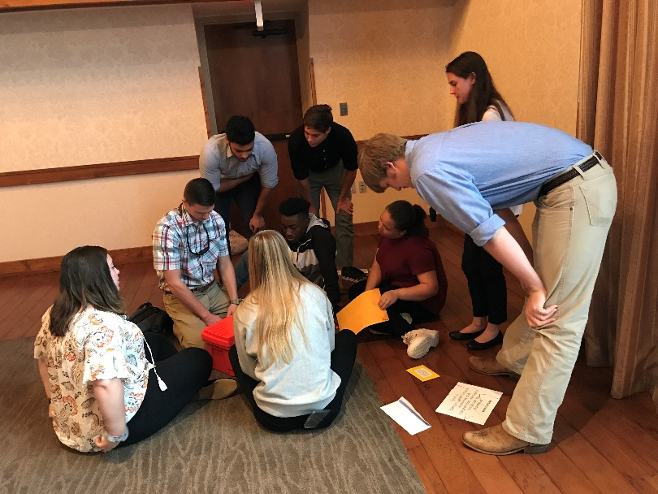
Promising Practice – Leadership Academy October 8, 2019 – Lioncrest Biltmore Estate

Slide 6
Budget Update
As of December approximately 75% of budget has been expended or encumbered.
Of the 25% remaining, approximately half (about 15% of the total) is equipment going through the bid process. This should be completed in time for 2019-2020 purchase.
The remaining 10% is unencumbered salary that will be used and funds for travel and summer camps. Some of this may need to be used to cover equipment overages.

Slide 7
Questions
How does NC WIOA Plan impact Perkins?
What training will be available for Perkins application? We have heard that DPI is holding regional workshops for the schools.
How can Perkins connect with the My Future NC 2030?
Can I have a raise?
What is the meaning of life?

Slide 8

This Perkins Presentation Brought to You By..
Asheville-Buncombe
Technical Community College
Disclaimer: A-B Tech wishes to notify participants that the content of this presentation in no way reflects the views and opinions of the Board of Trustees, administration, faculty, staff and students of A-B Tech. In addition, NCCCS and session participants may not hold A-B Tech liable for any stupid thing Gene says during the presentation.

