Slide 1
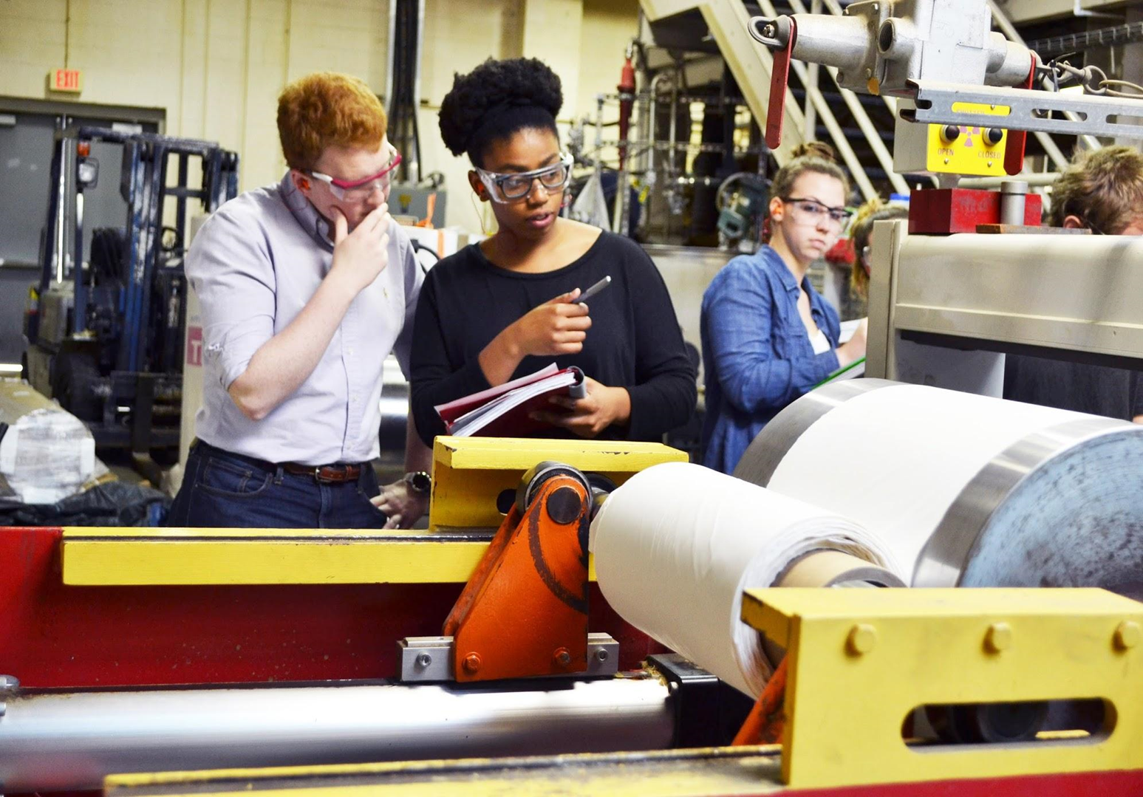
Paper Science and Engineering

Slide 2
Paper Science and Engineering
65 year old, fully accredited ABET engineering program
Ranked #1 in North America
Established by industry to meet our unique needs
Program enrollment is around 200 students
40 person Advisory Board that provides support, input and guidance to our program
Co-administered by the Colleges of Engineering and Natural Resources
Notes:
Accreditation Board for Engineering and Technology
Universities.com and Center for World University Rankings
Students can take advantages of everything both colleges have to offer our university

Slide 3
Paper Science and Engineering
Small program with individual attention + industry interaction
Hands on learning (labs, work experiences)
Double Major in Chemical Engineering
On site career services
One work experience required
90-100% full time job placement
$73,800 average starting salary
Scholarships available
Notes:
Graduate 30-40 students per year
Many of our faculty have worked in industry
Close, personal relationships are developed between students, faculty, staff and industry
Everyone is investing in the academic education of our students as well as their growth in “soft skills” such as leadership, communication, working effectively with others, working on diverse team, etc.
Laboratory based instruction is a pillar of our program to ensure students can translate the theoretical engineering principles they learn in class, into real world applications
Double major with chemical engineering is the only one of its kind in the US, taking only 1 extra semester
Students receive professional development by our staff and industry volunteers. About 25 paper companies attend our paper industry career fair in September and then interview in our buildings from August to November for summer, coop and full time job opportunities. Students can also take advantage of the 2 engineering career fairs each year hosted by the College of Engineering and the 1 career fair hosted by the College of Natural Resources
Internships, coops and super coops are all paid at $18-25/hour
One industry work experience is required
Our placement is historically 100% within 6 months of graduation but our goal is 100% at graduation and we are usually at 90-100%
Highest starting salary on campus
Scholarship available for all types of students, from inside and outside of the university

Slide 4
Paper Science and Engineering
Looking for students who are:
Strong in math and sciences
Desire engineering or STEM based careers
Enjoy hands on learning
Coming from High Schools or other institutions (four year or community colleges)
Notes:
Taking challenging and rigorous coursework in math and sciences with mostly A’s and B’s (and ideally more A’s than B’s)
Fall 2019 incoming freshman students to NC State had these metrics:
1337 SAT (1270 to 1410 mid 50%)
29 ACT (27-32 mid 50%)
4.15 – 4.47 WGPA and 3.69-3.96 unweight GPA
College of Engineering applicants do tend to be on the higher end of this scale.
For transfer students we are happy to work with students early on, helping to assist community college advisors with course selection and requirements to transfer admission into our program (3.0 GPA plus completion of specific coursework such as Calculus 1 and 2, Physics 1 with Lab, Chemistry 1 with lab and English 101)

Slide 5
Paper Science and Engineering
University Open House – Saturday, October 19
Engineering Open House – Saturday, March 21, 2020
Summer Camp Opportunities for high school students
Personalized Visits offered
Jennifer Piercy
919-515-7709
jmpiercy@ncsu.edu
Notes:
Feel free to contact Jennifer Piercy with any questions.
University Open House information: https://admissions.ncsu.edu/m/open-house/
Natural Resources Open House Information: https://cnr.ncsu.edu/admissions/open-house/
Engineering Open House Information: https://www.engr.ncsu.edu/openhouse/
Summer Camp Information: https://www.engr.ncsu.edu/theengineeringplace/summerprograms/

