Slide 1
Data Comes Alive
(Readily Available Performance Data Makes a Difference)
Dr. Bob Witchger,
Director, Career and Technical Education
Happy Gingras, Pitt Community College
www.NCperkins.org/presentations
Notes:
Presentation to NACTEI 2019 Conference
Data Comes Alive
(Readily Available Performance Data Makes a Difference)
Tuesday, May 14, 2019
Room - Pershing W
Download the presentation at www.ncperkins.org/presentations
Robert J. Witchger, Ed.D.
Director, Career and Technical Education
NC Community College System
witchgerb@nccommunitycolleges.edu
919-807-7126

Slide 2
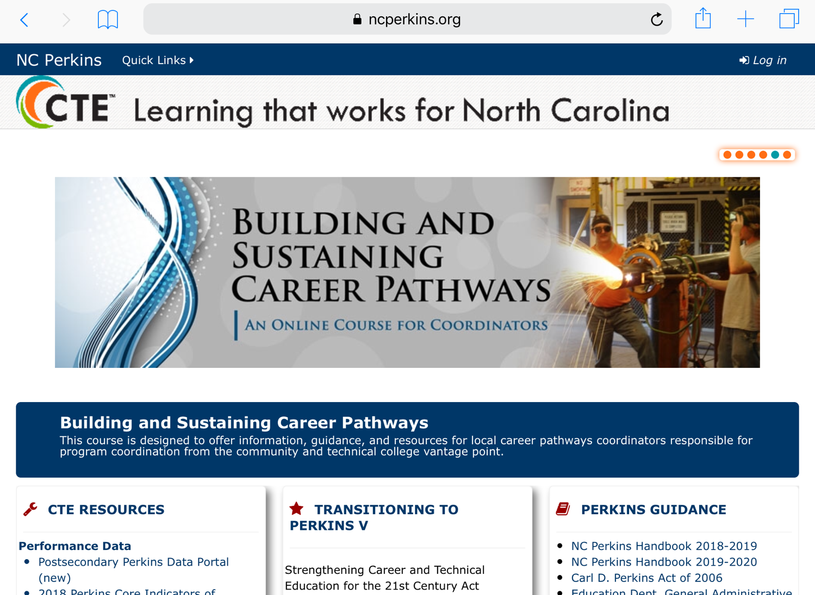
Notes:
North Carolina Postsecondary CTE Website
http://www.ncperkins.org

Slide 3
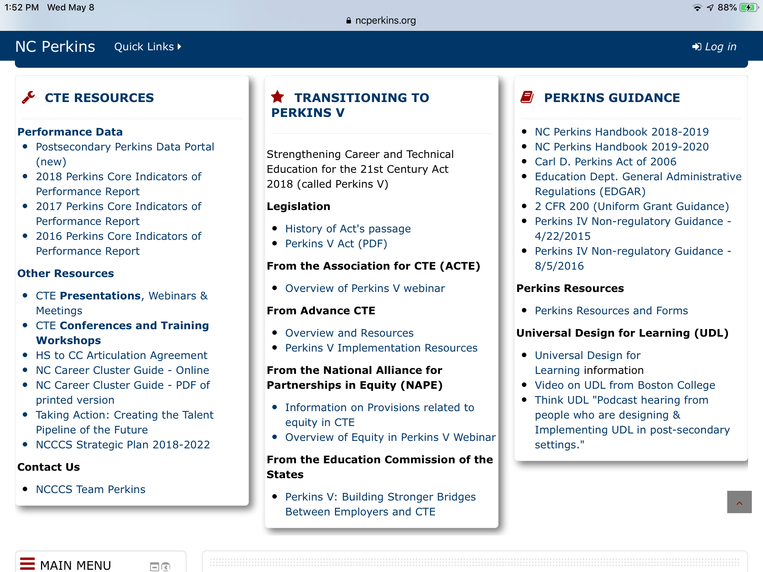

Slide 4
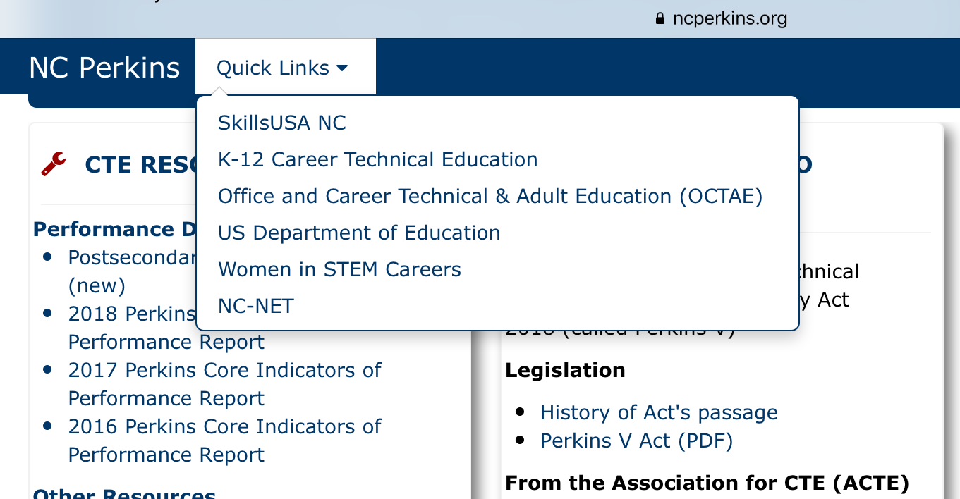

Slide 5


Slide 6
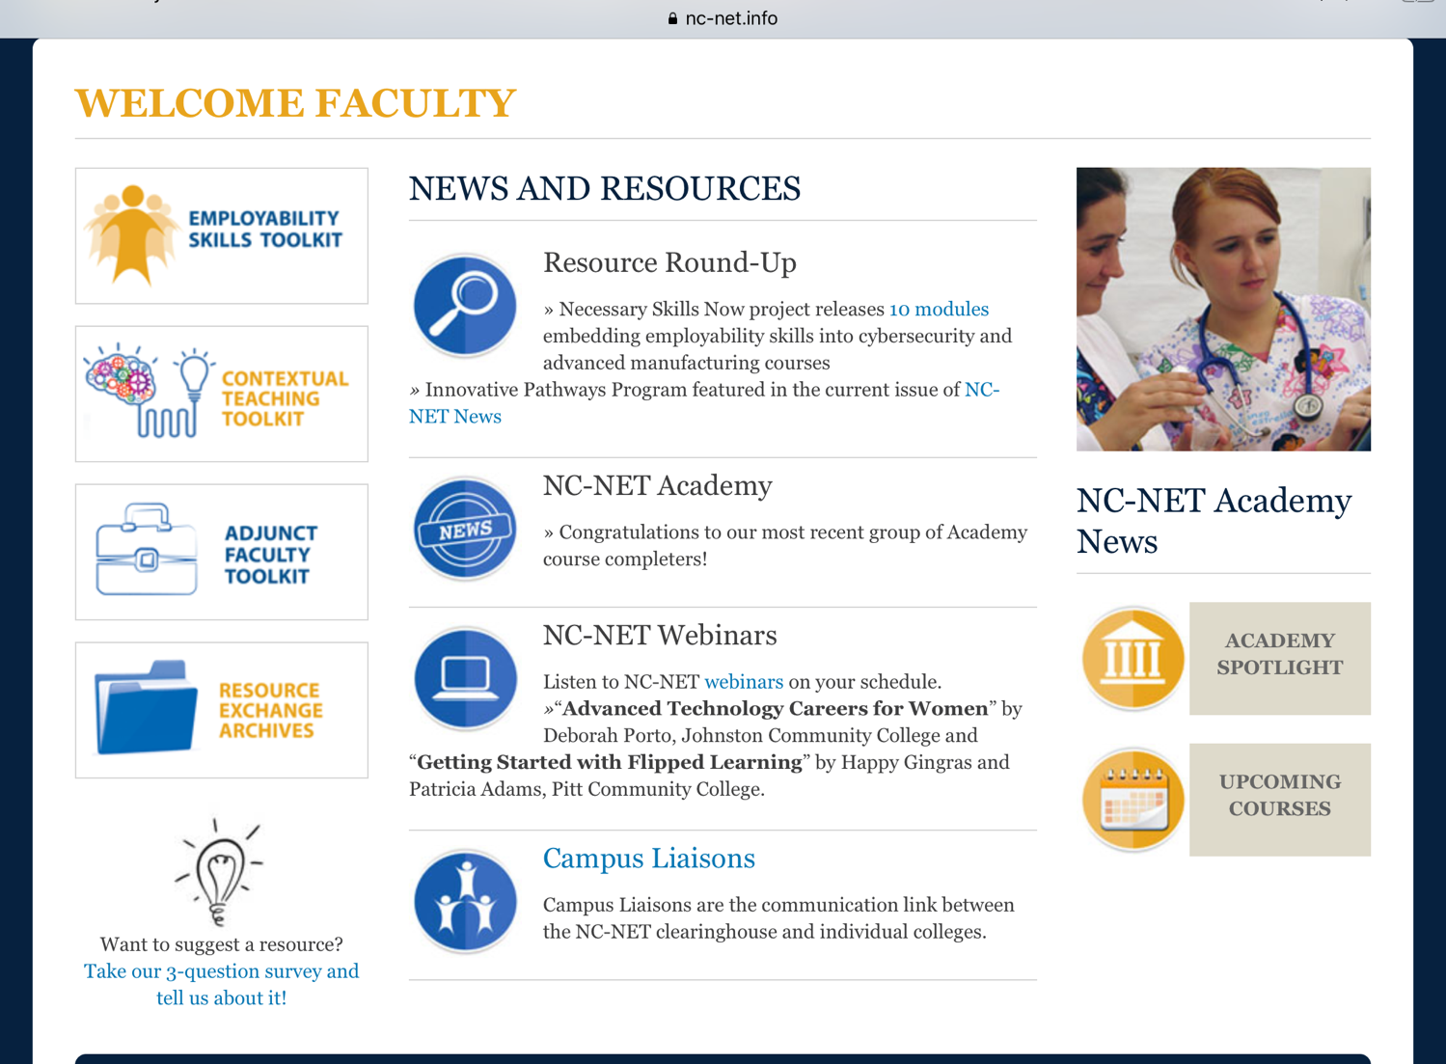

Slide 7
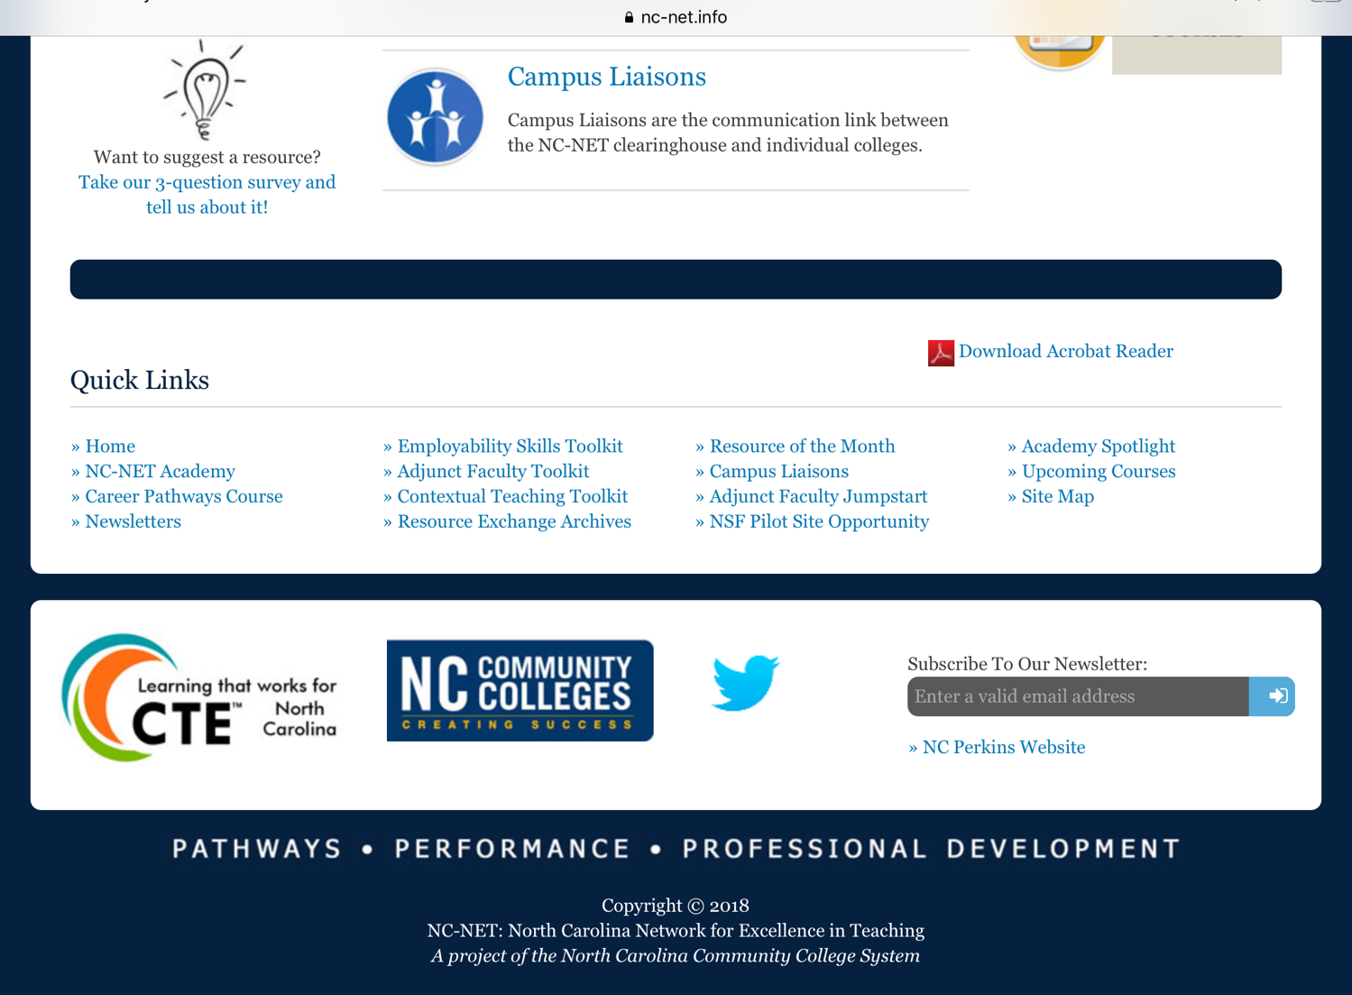

Slide 8

Notes:
2018

Slide 9
Notes:
2018

Slide 10
Notes:
2018

Slide 11
Notes:
2018

Slide 12
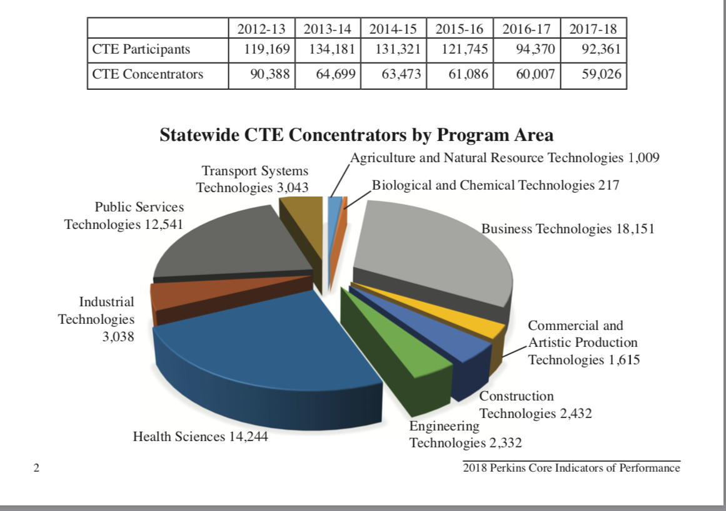
Notes:
2018

Slide 13
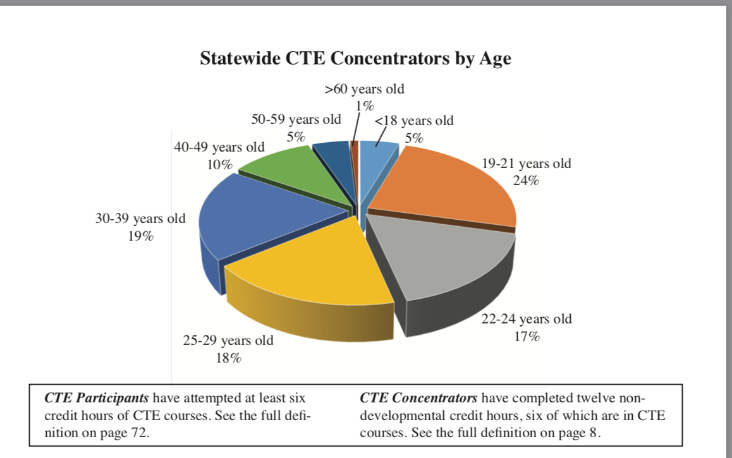
Notes:
2018

Slide 14
Notes:
2018

Slide 22
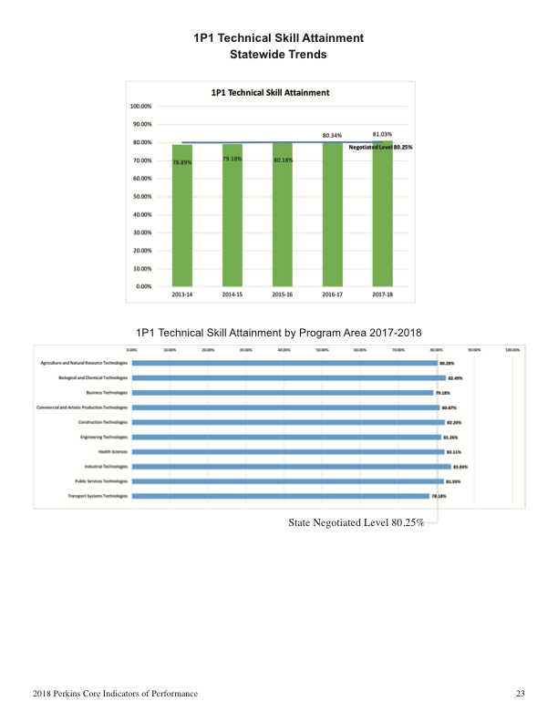

Slide 25
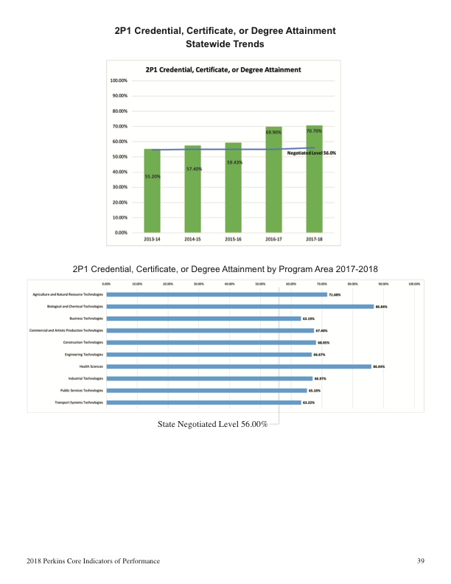

Slide 28
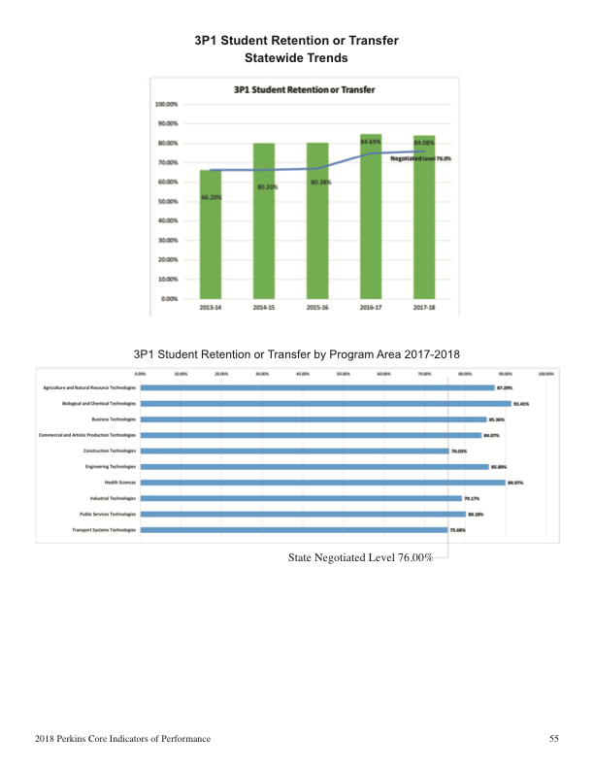

Slide 31
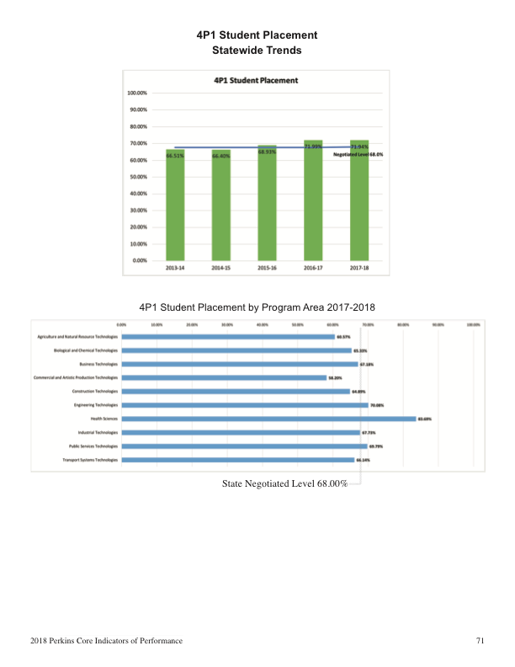

Slide 34
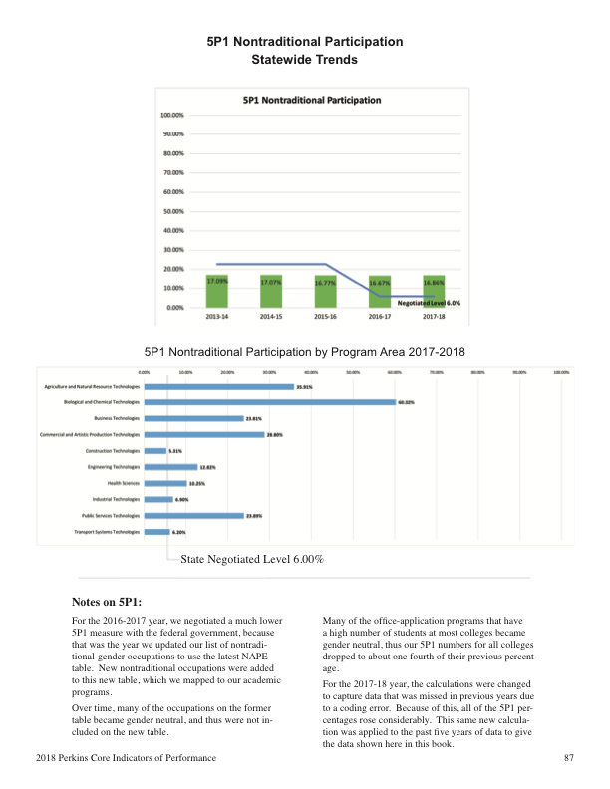

Slide 37
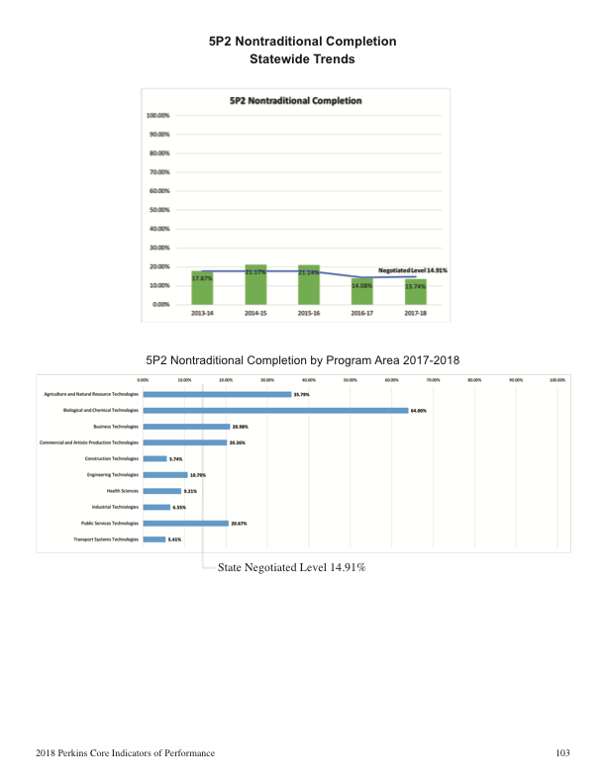

Slide 38
2019 - On-Line System
Perkins Data Portal
www.NCperkins.org/data
HTML, PHP, MySQL, JavaScript

Slide 39
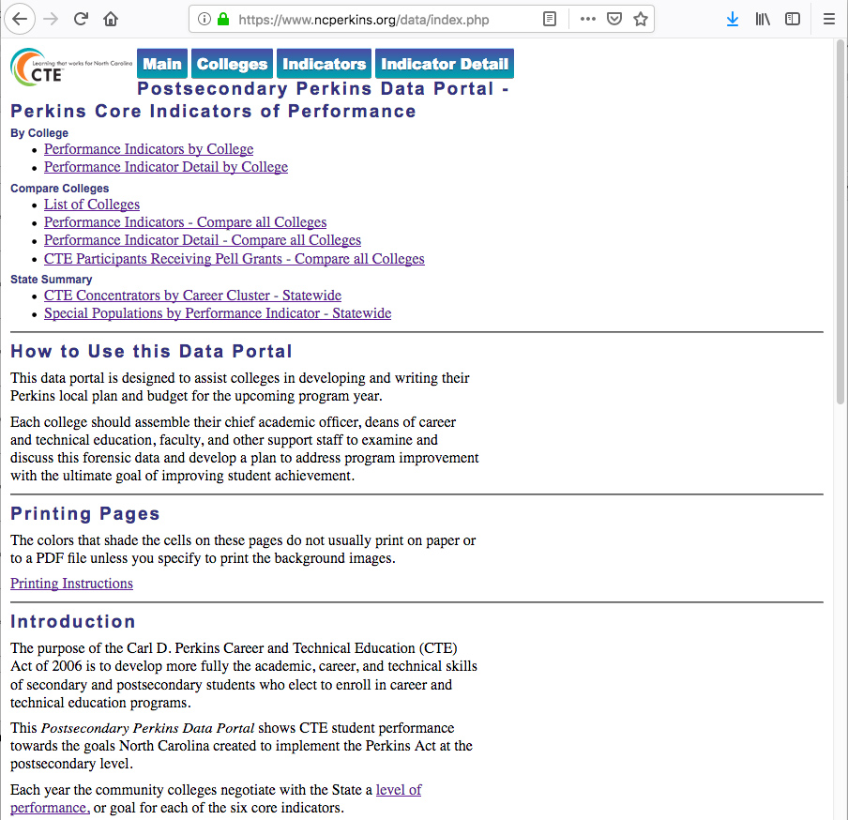
Three sections:
Individual college
Compare all 58 colleges
Summary of state data

Slide 40
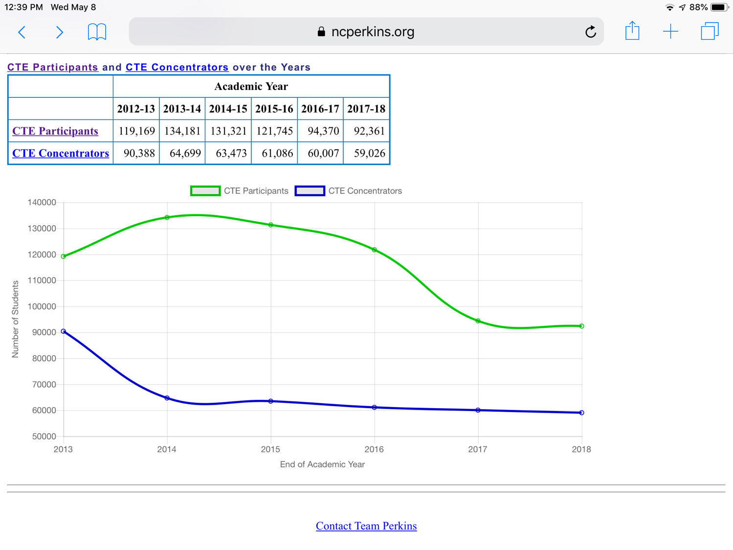

Slide 41
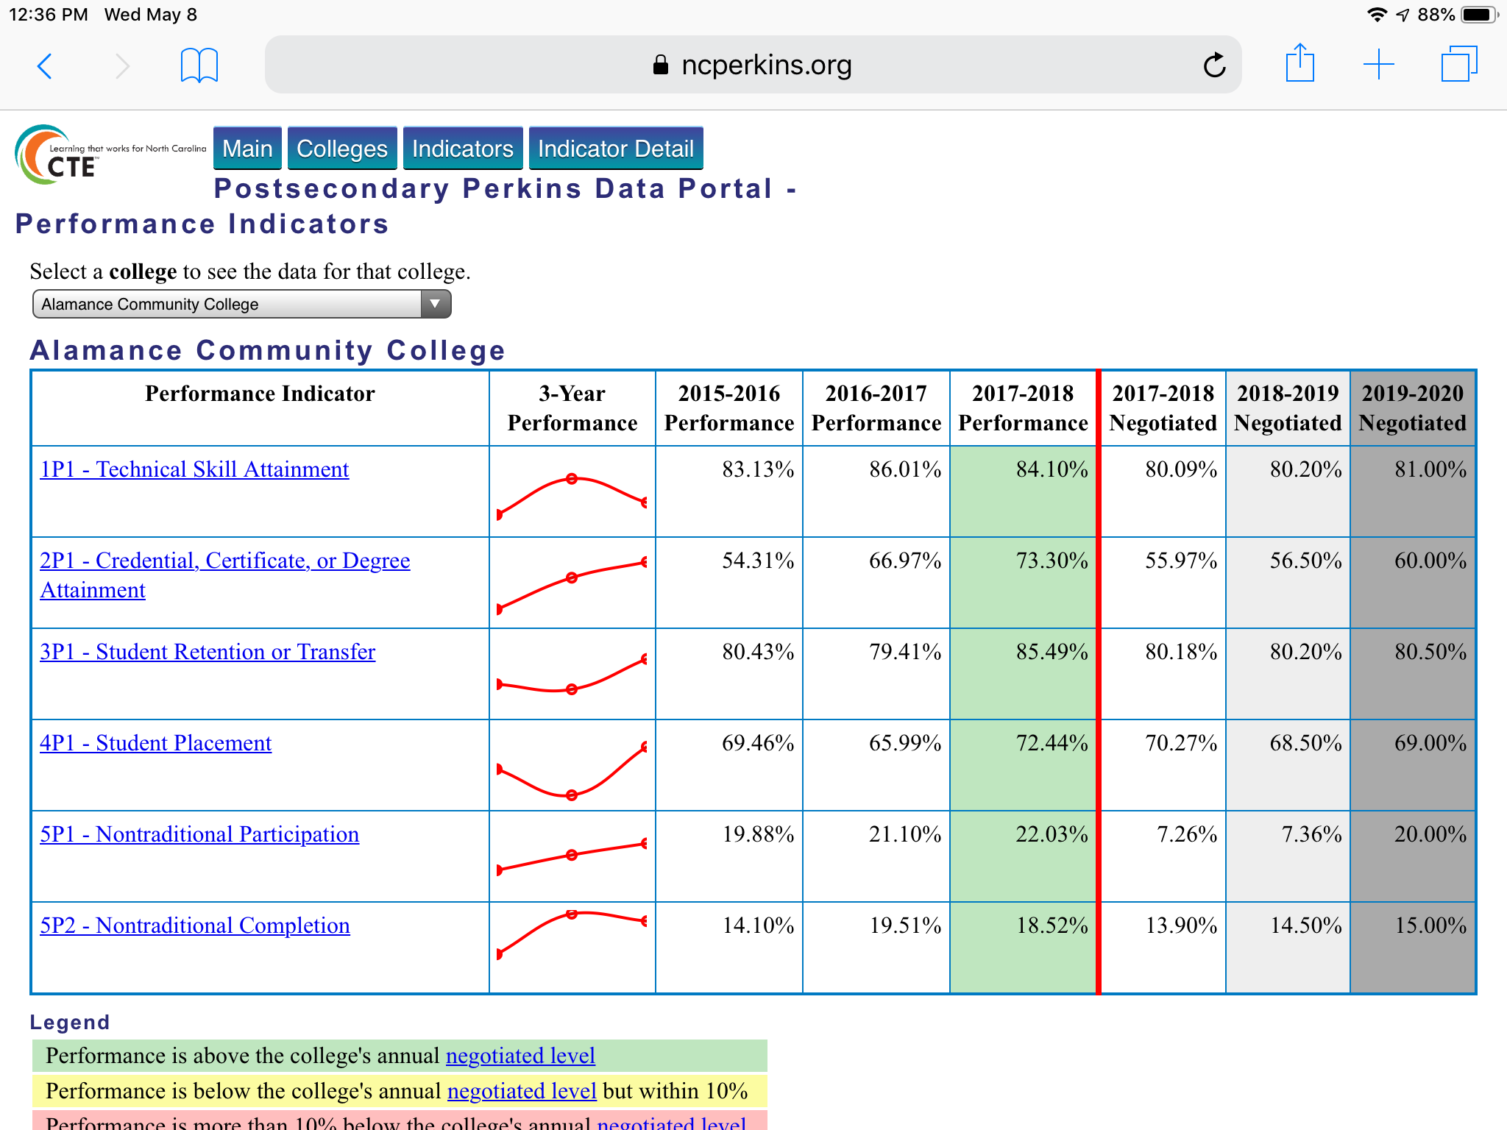

Slide 42
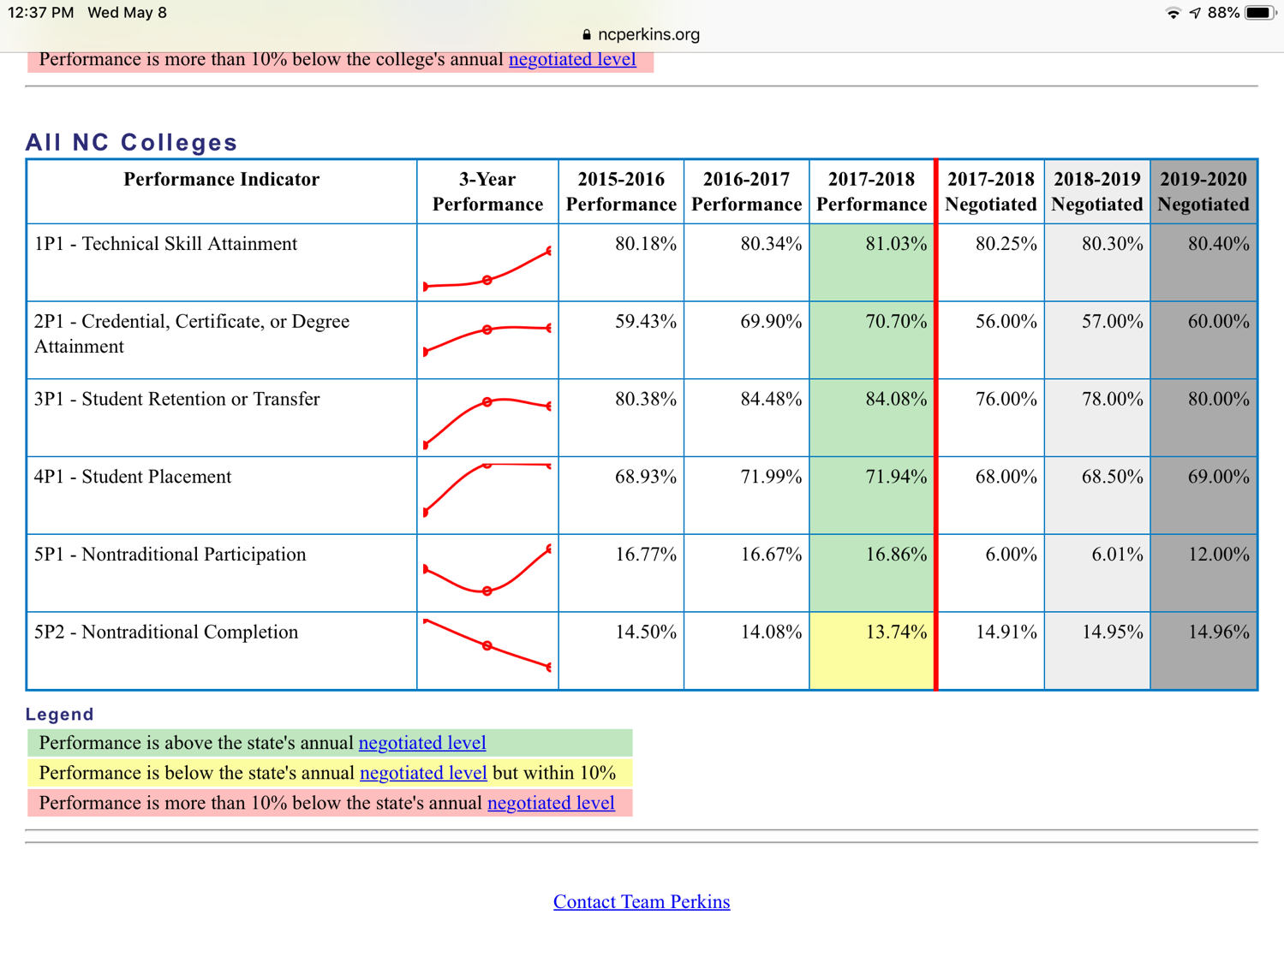
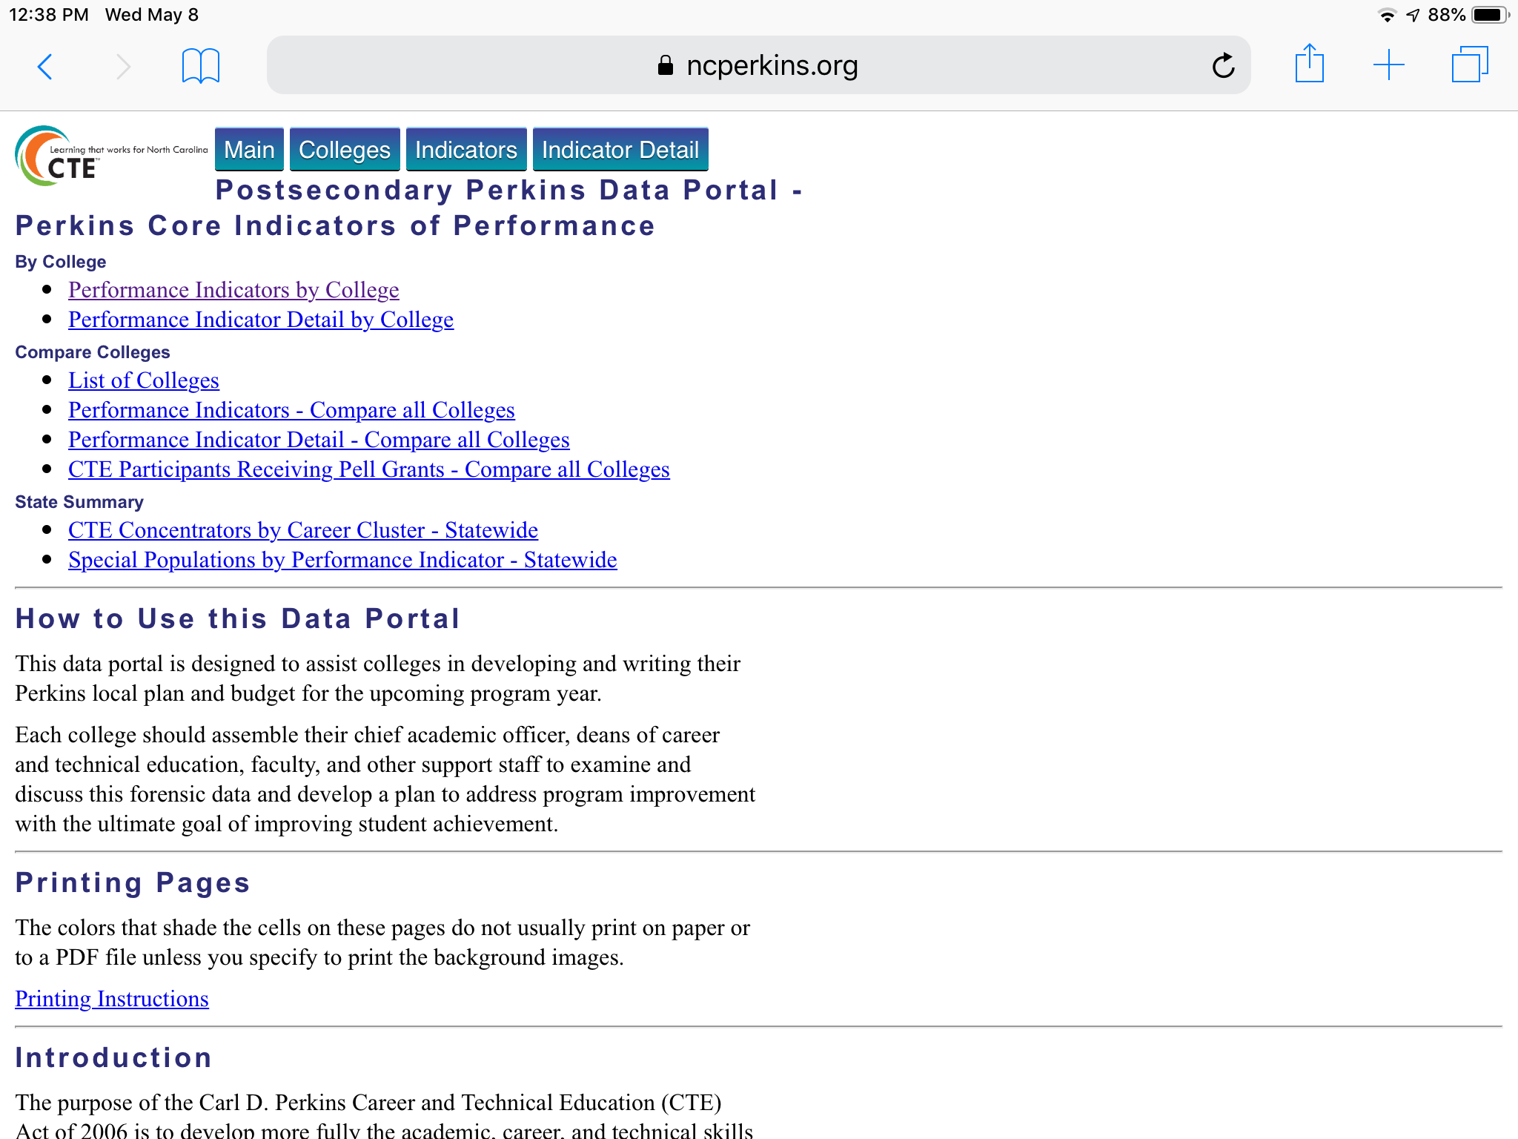
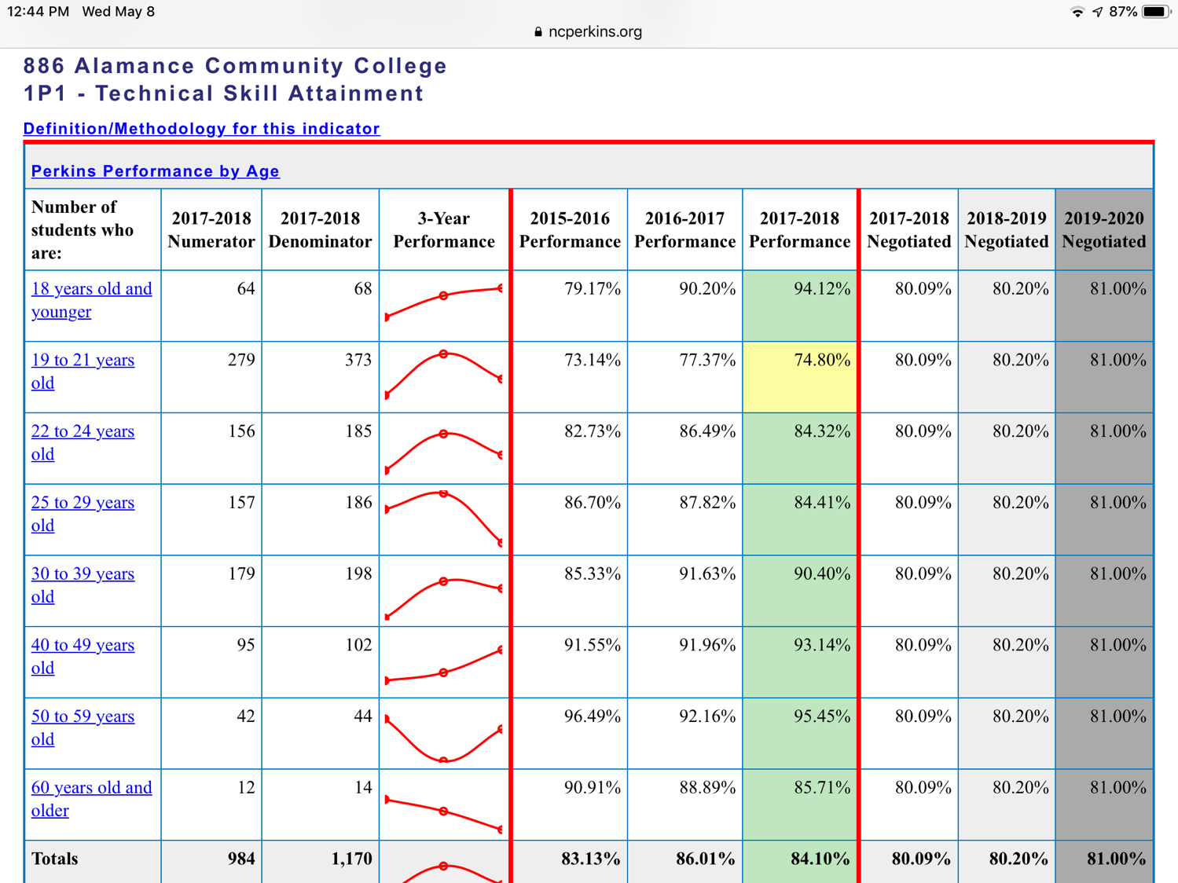

Slide 43
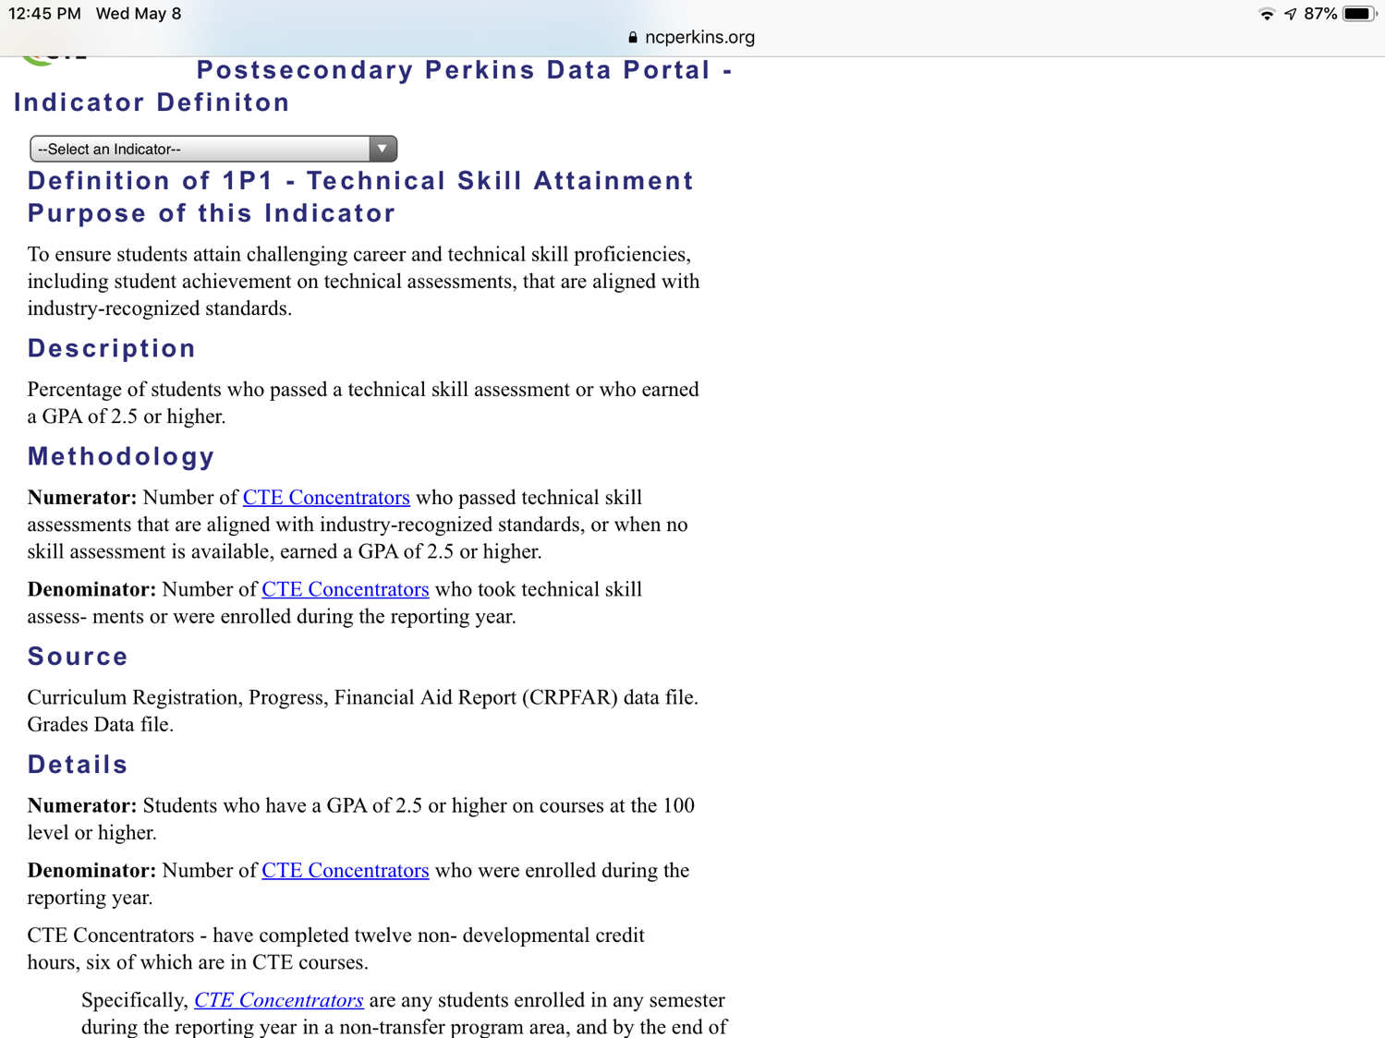

Slide 44
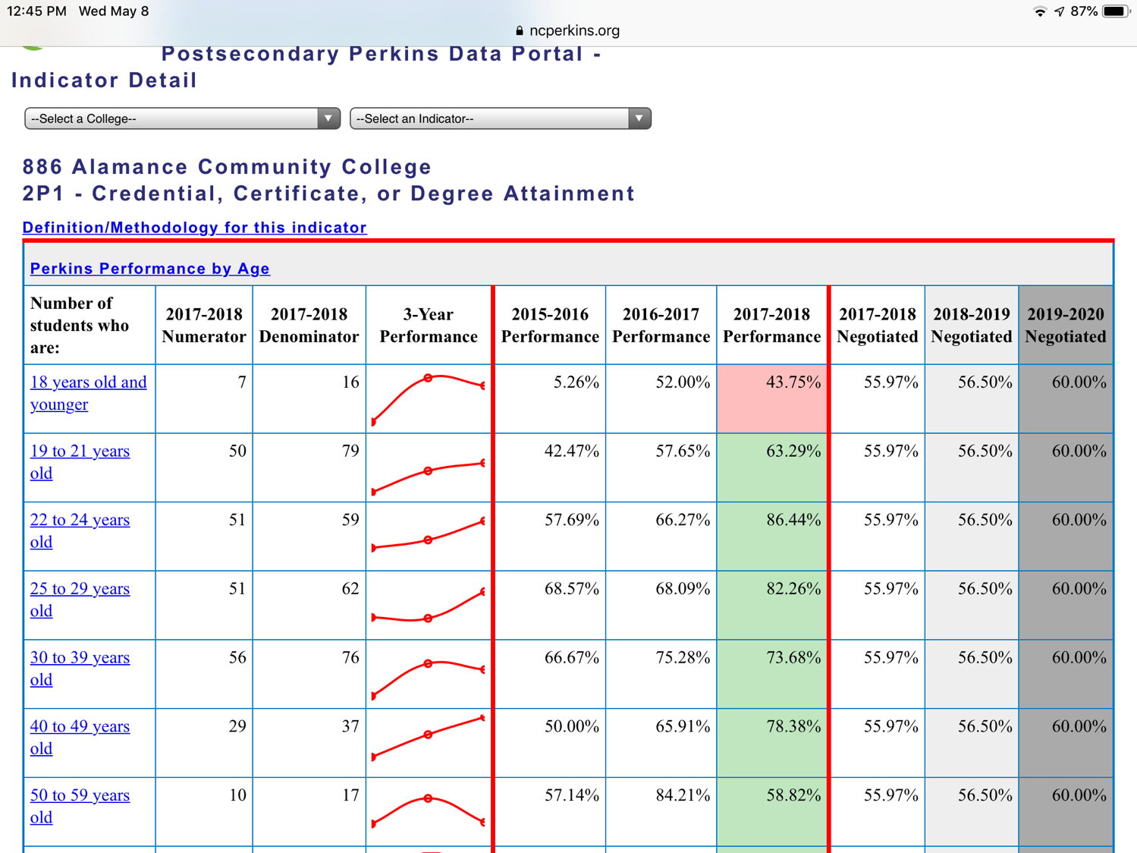

Slide 45
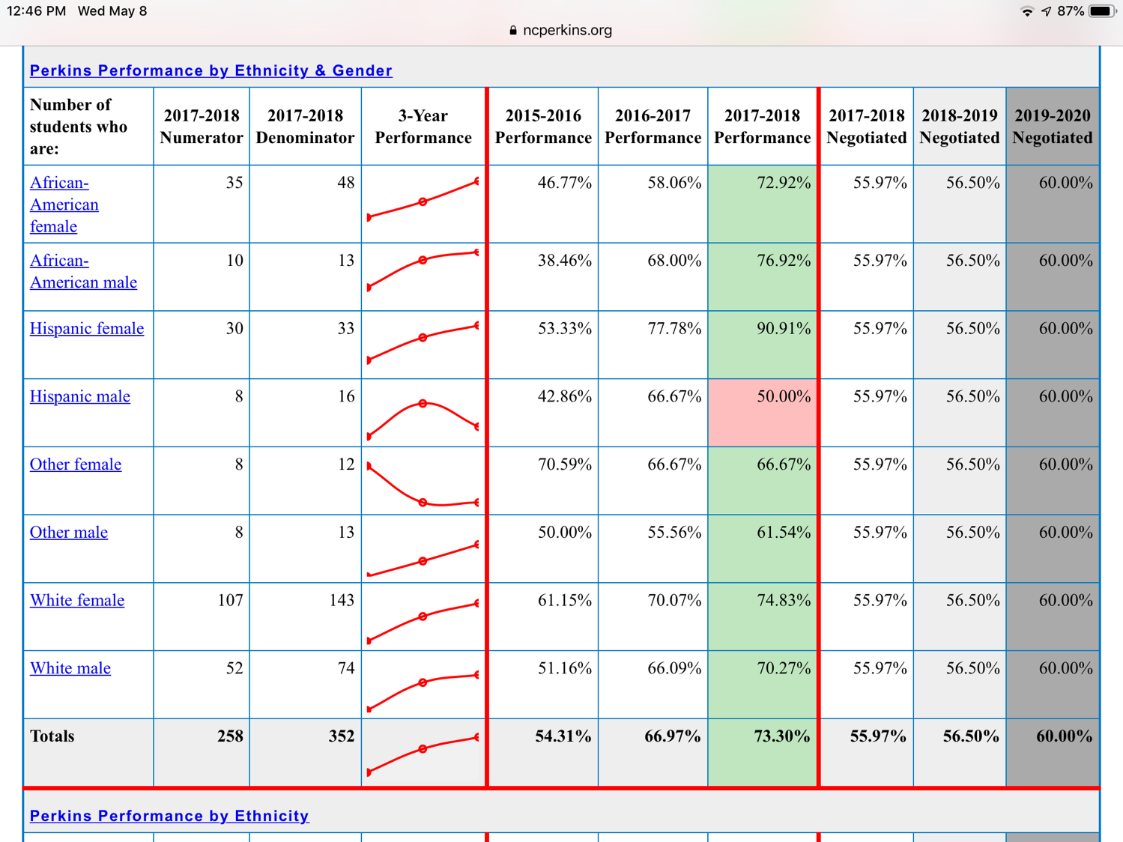

Slide 46
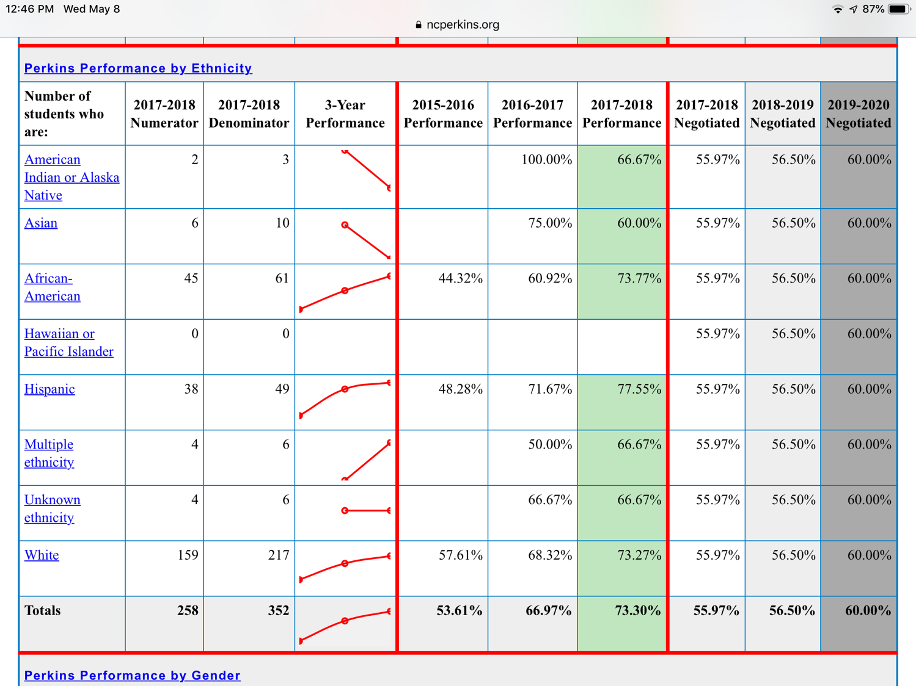

Slide 47
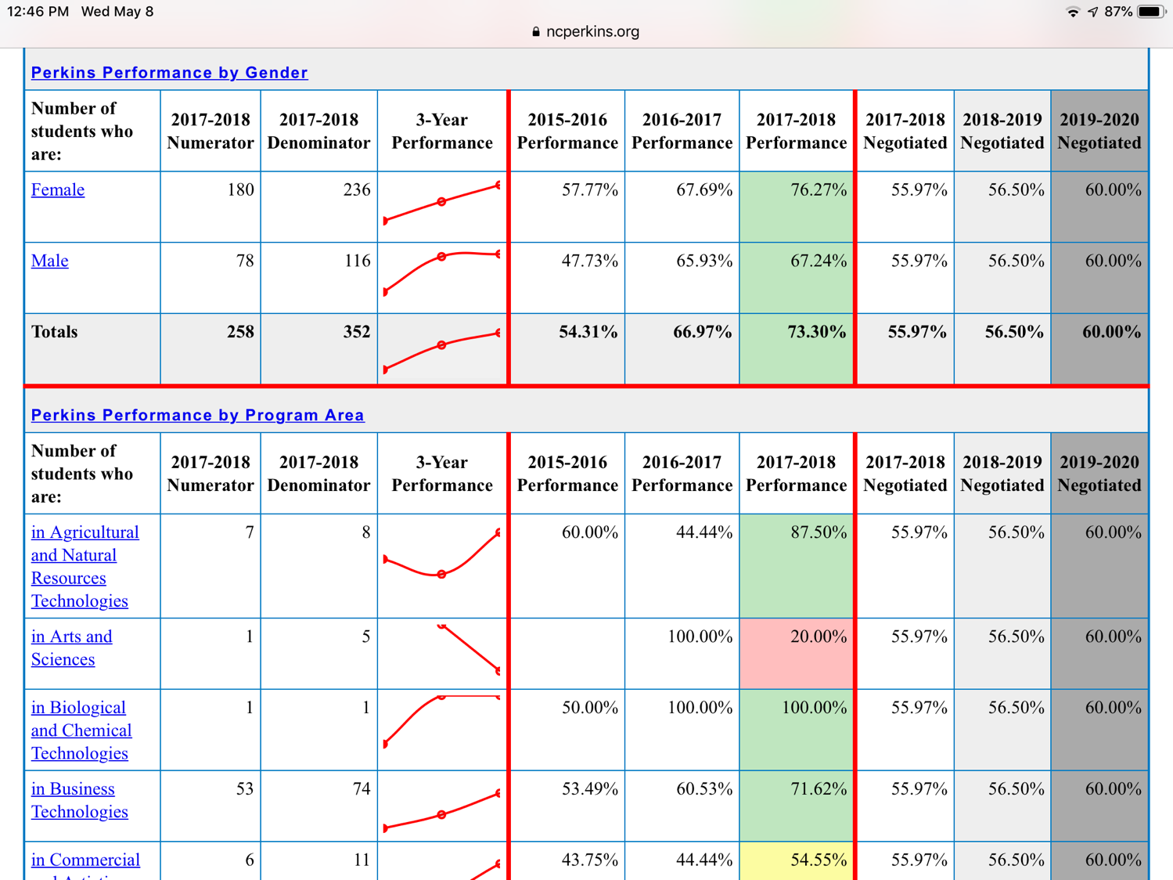

Slide 48
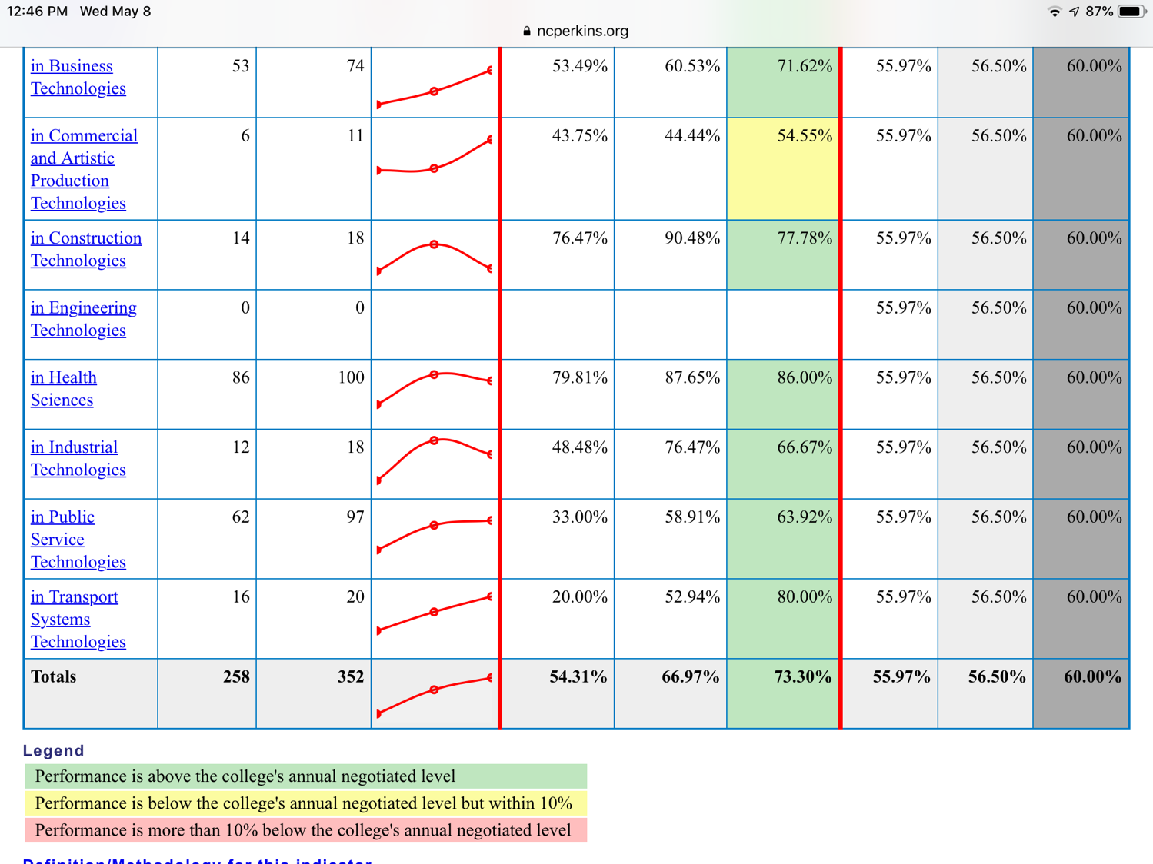

Slide 49
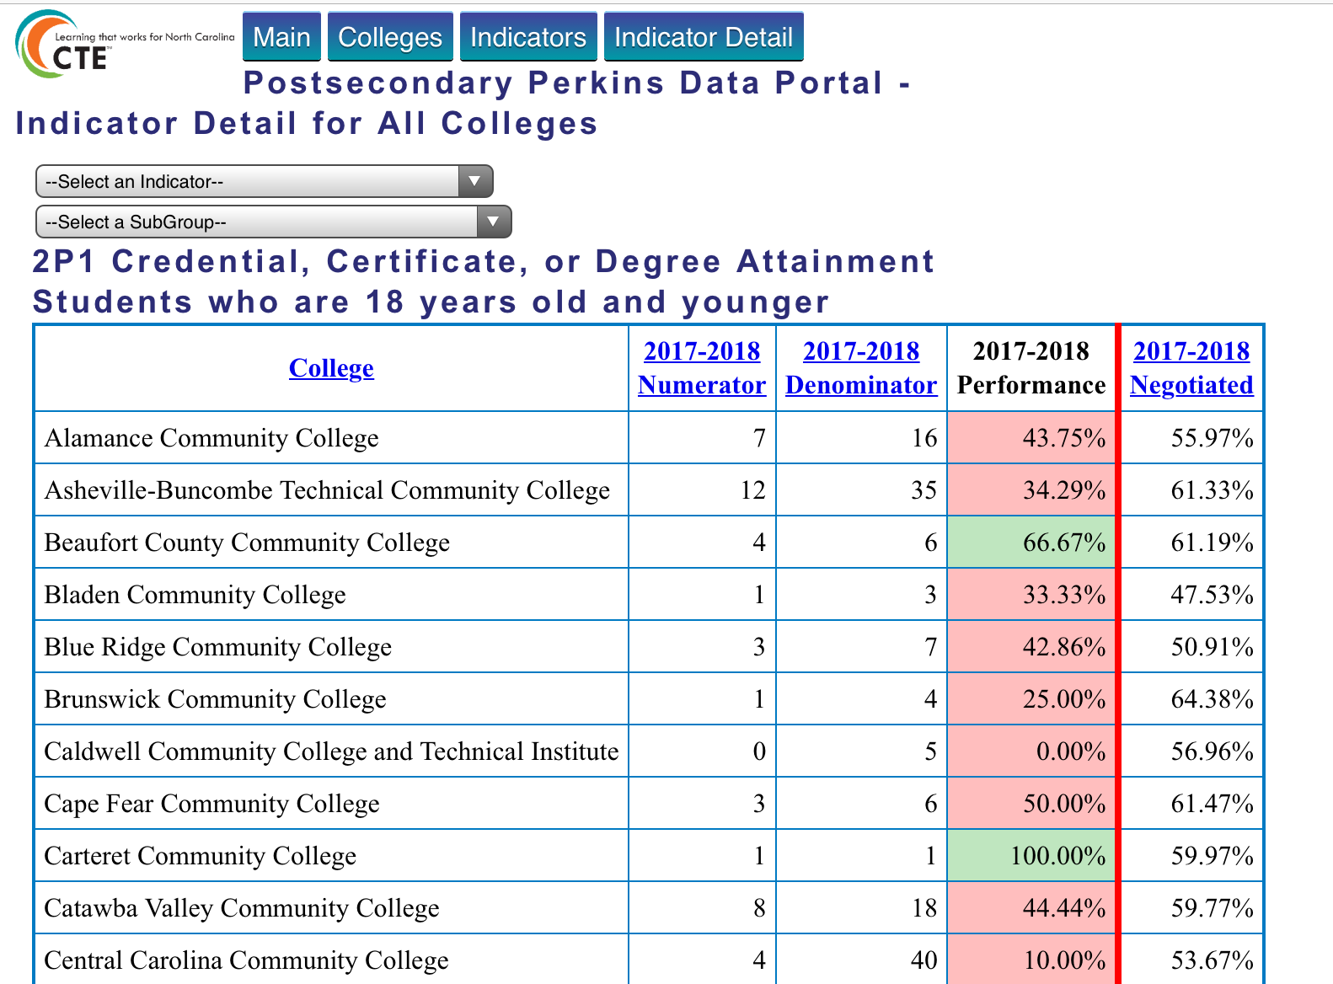

Slide 50
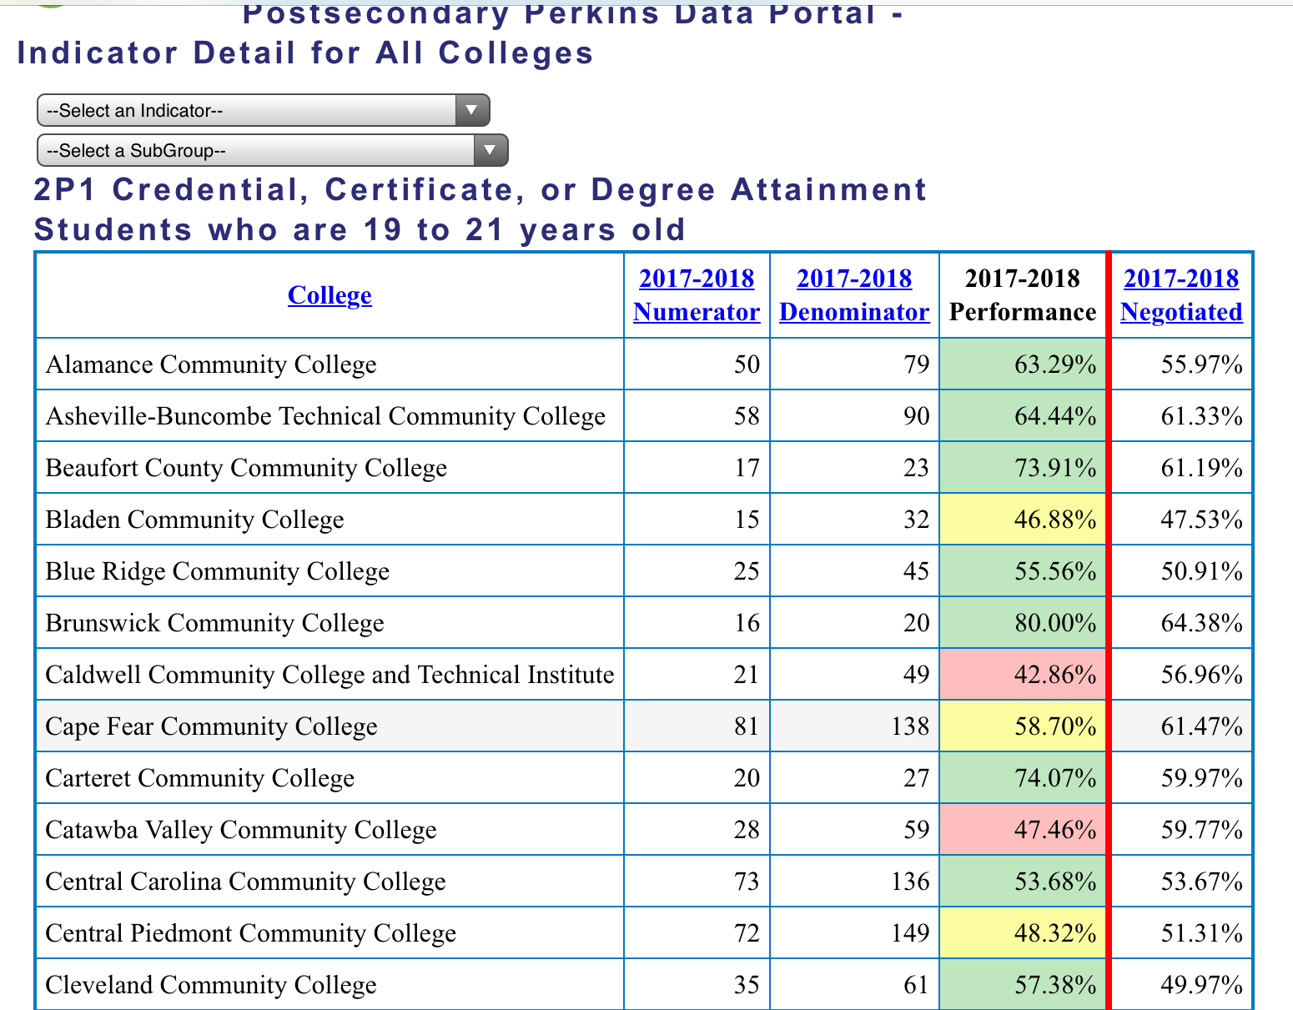

Slide 51
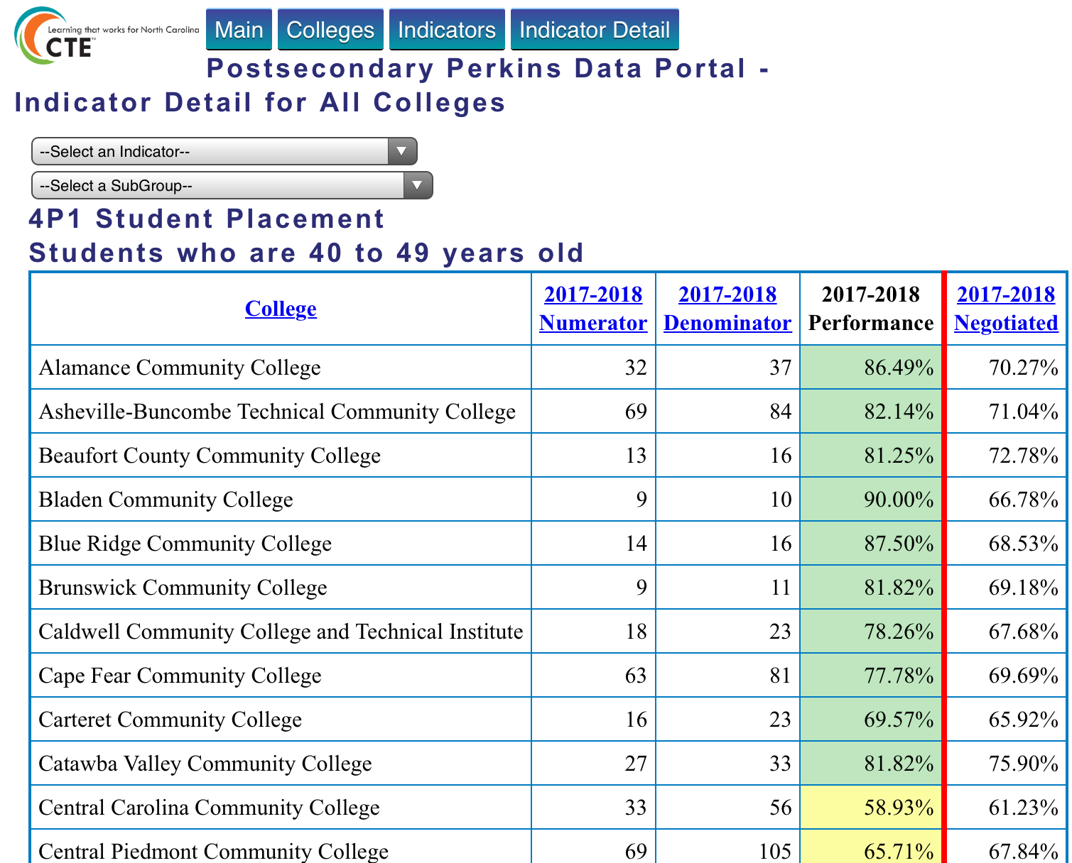

Slide 52
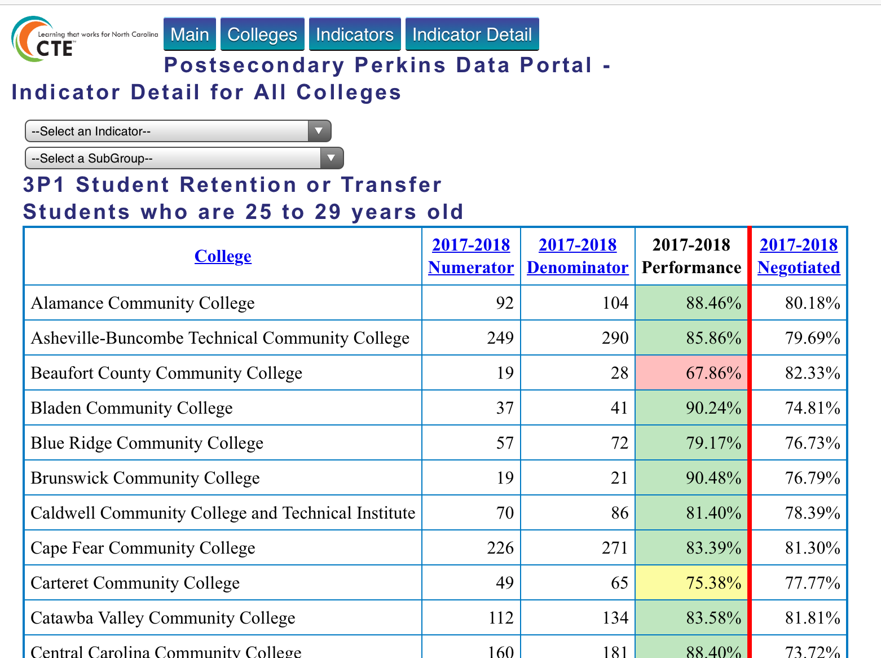

Slide 53
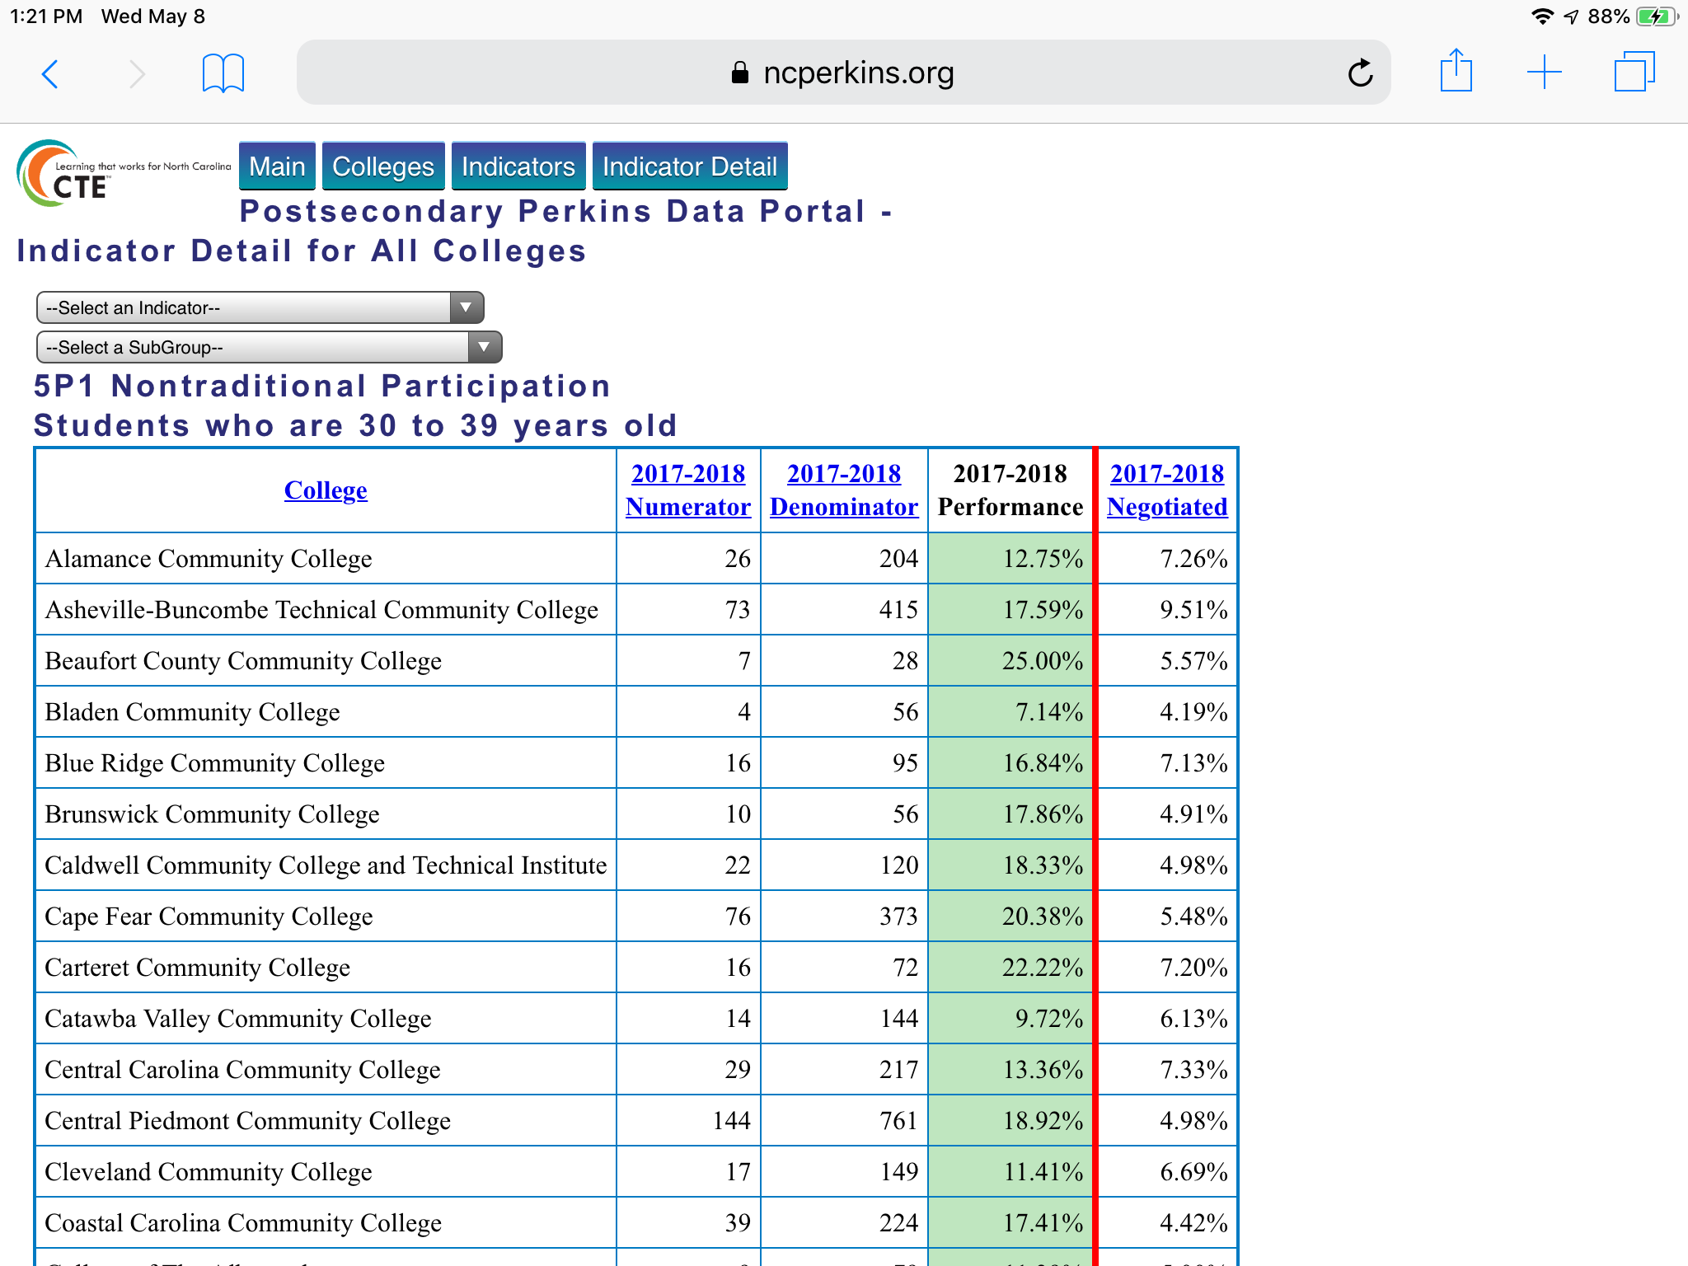

Slide 54
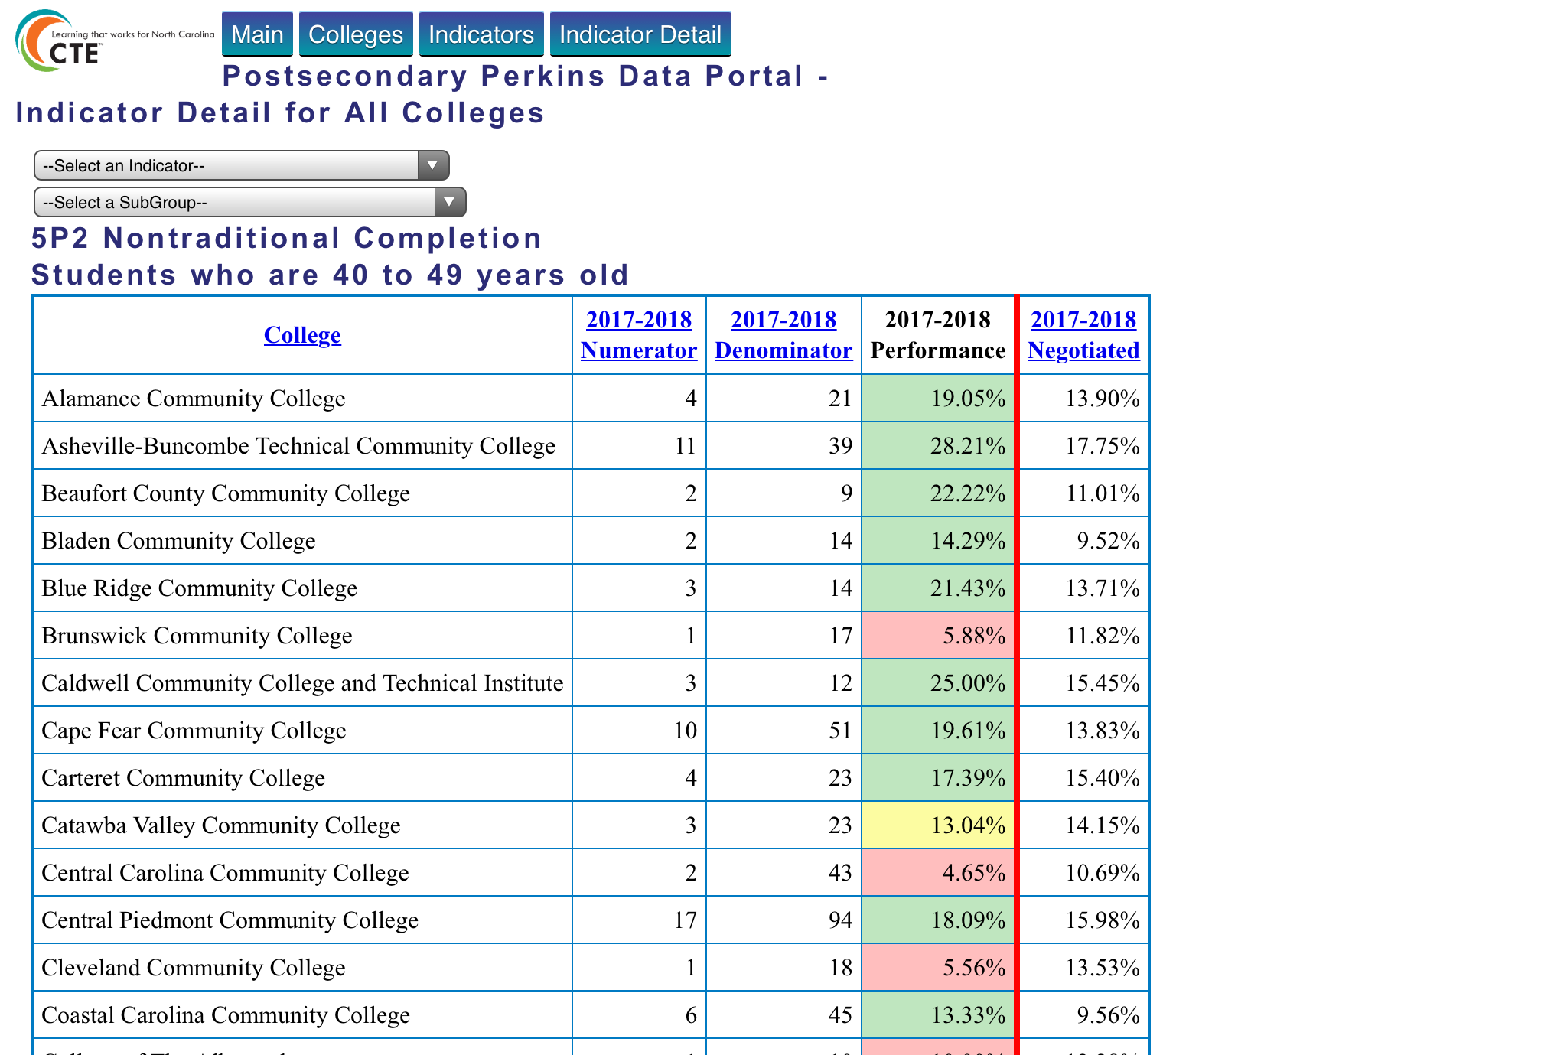

Slide 55
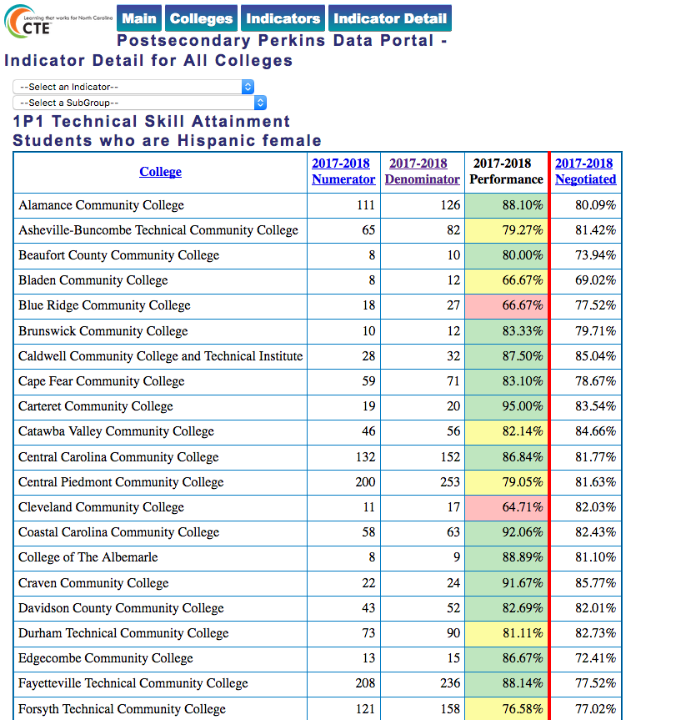

Slide 56
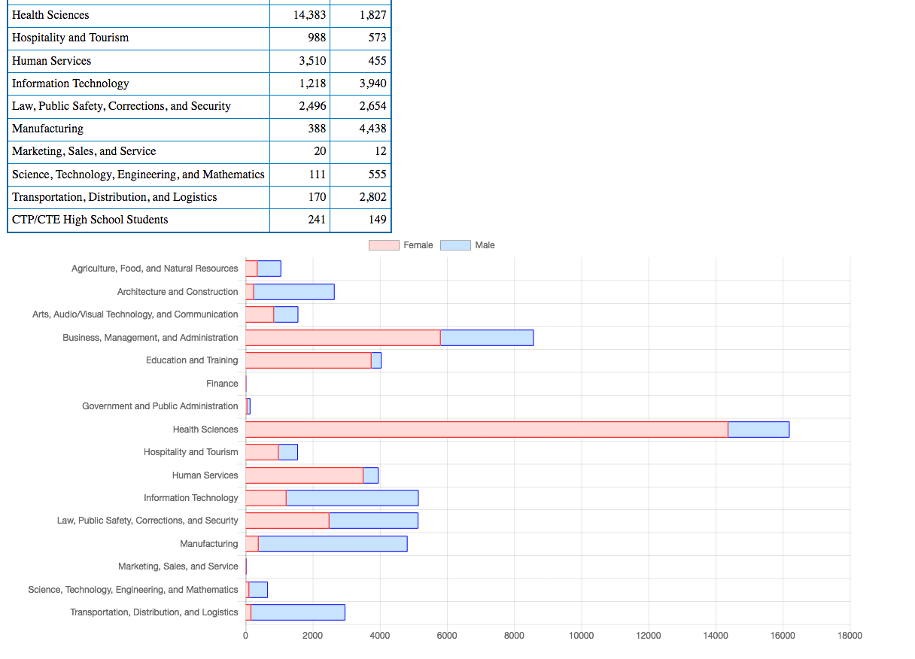
Notes:
CTE Concentrators - Gender in each of the CTE program areas - state summary data

Slide 57
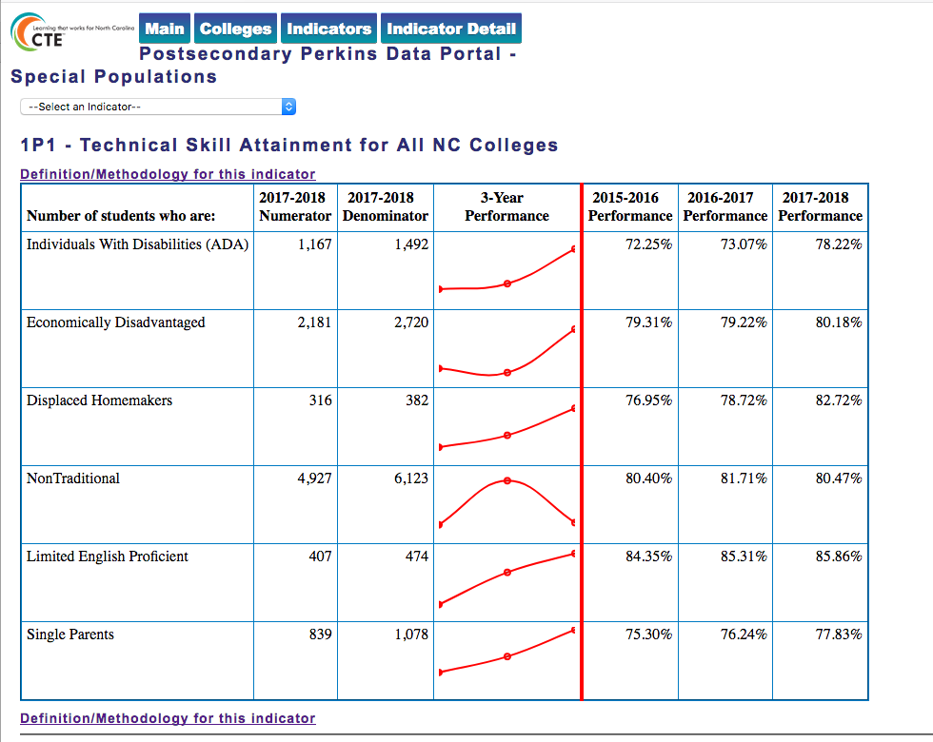
Notes:
Special Populations - statewide summary

Slide 58
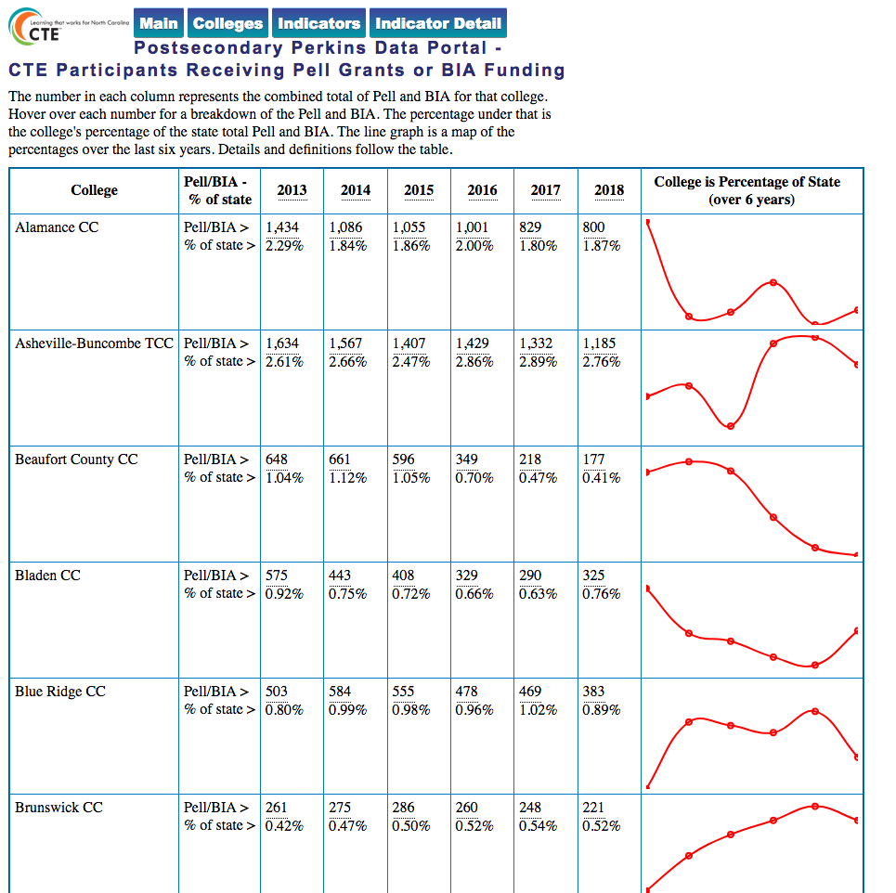
Notes:
CTE Participants receiving Pell grant shown over six years.

Slide 59
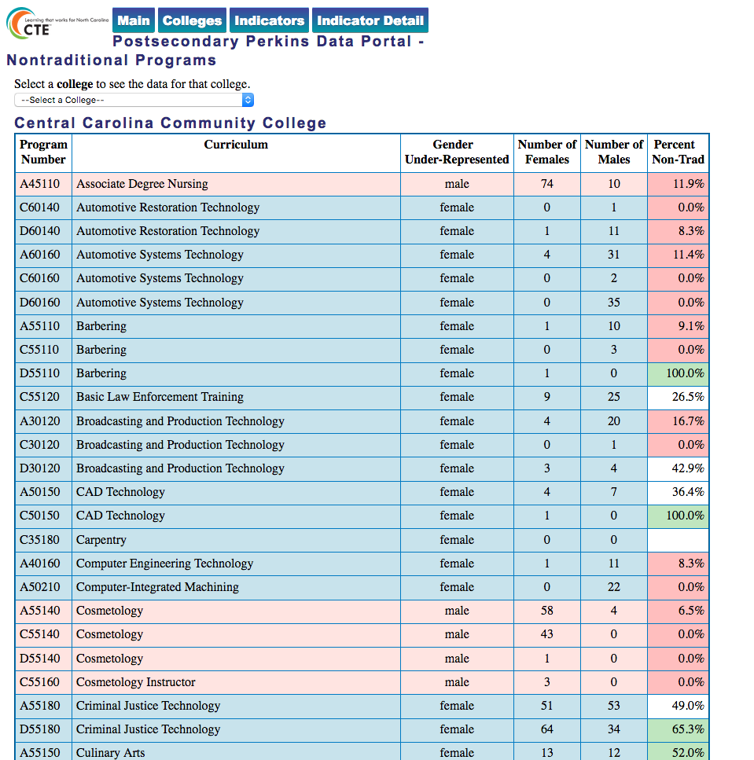
Notes:
Gender nontraditional programs at a particular college

Slide 60
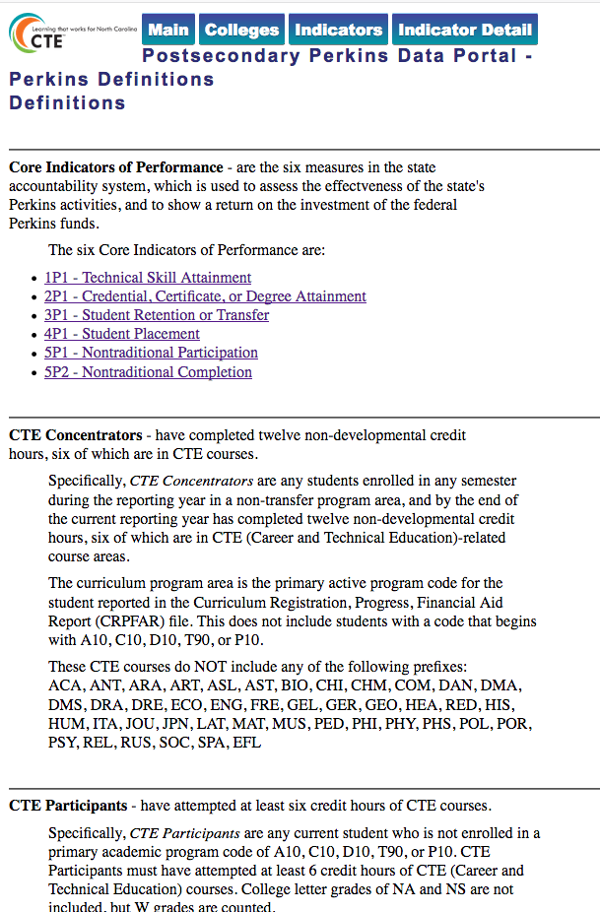
Notes:
Links on all of the pages lead to this page of definitions.

Slide 61
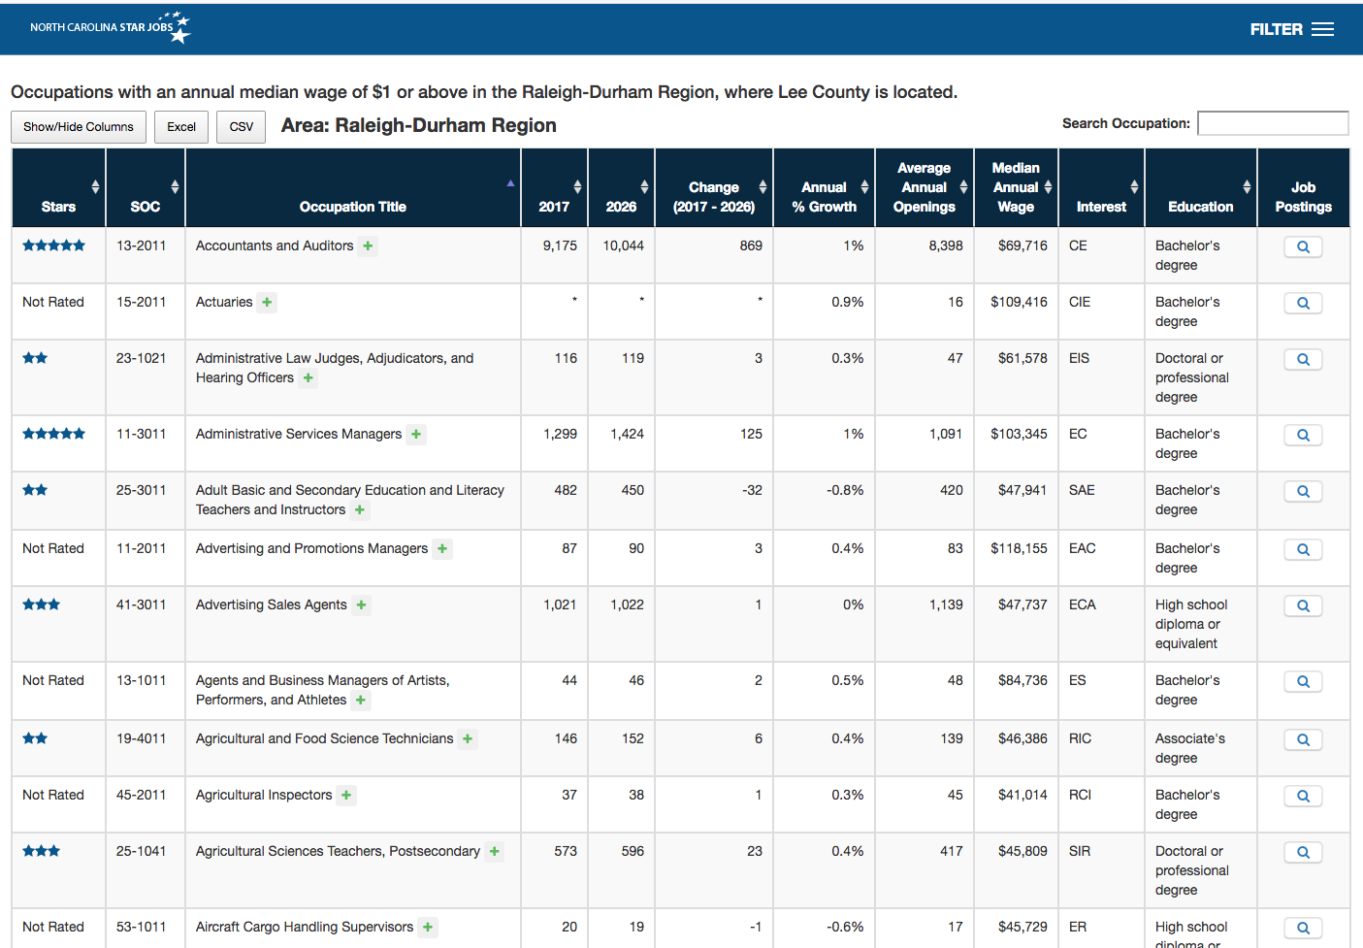
Notes:
We provide a link for each college to see the high-demand jobs in their part of the state.
The state is divided into 16 economic regions

Slide 62
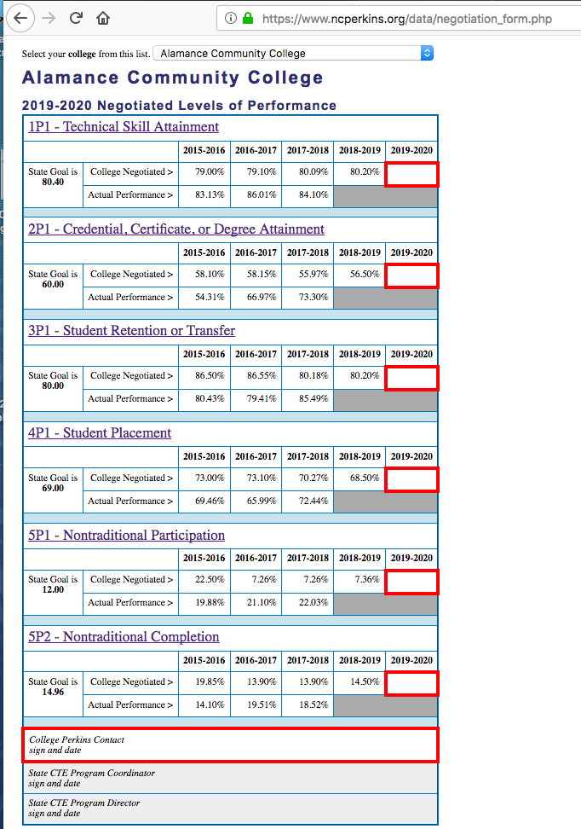
Notes:
We used to do a mail merge to create the document we sent to each college annually to enter their negotiated levels for the following year.
Now it is part of the data portal, using the same data.
Colleges go to this page, choose their college from the drop-down list, and print it out.
They fill in the seven red boxes. Scan it and upload it to our Perkins Moodle.

Slide 63
Data Comes Alive
(Readily Available Performance Data Makes a Difference)
Dr. Bob Witchger,
Director, Career and Technical Education
Happy Gingras, Pitt Community College
www.NCperkins.org/presentations
Notes:
Presentation to NACTEI 2019 Conference
Data Comes Alive
(Readily Available Performance Data Makes a Difference)
Tuesday, May 14, 2019
Room - Pershing W
Download the presentation at www.ncperkins.org/presentations
Robert J. Witchger, Ed.D.
Director, Career and Technical Education
NC Community College System
witchgerb@nccommunitycolleges.edu
919-807-7126

