Slide 1
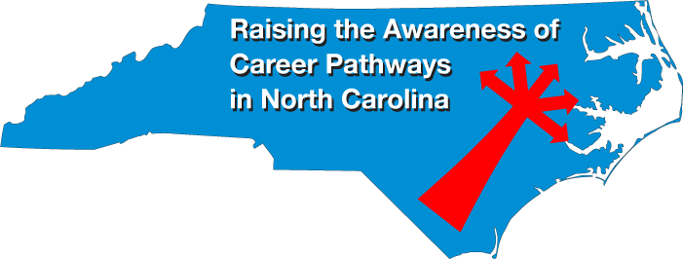
January 24, 2019
Bob Witchger
Chris Droessler
NC Community Colleges
Cheryl Cox
NC Department of Public Instruction
www.ncperkins.org/presentations
Notes:
====
January 24, 2019

Slide 2
Raising the Awareness of Career Pathways in North Carolina
The purpose of these monthly webinars
www.ncperkins.org/presentations
Notes:
Welcome to something new.
Thanks to all of you who have helped plan open house events the last seven years for Advanced Manufacturing and Construction Careers.
We believe we have done very well getting the word out about the great careers across the state.
We are combining efforts starting now -- to help promote the great jobs, often unknown, in the great state of North Carolina.
We are going to let you know about some great career opportunities in North Carolina.
Please download this PowerPoint file and use it anyway you can to help get folks on a career pathway.
The reference showing from where the information was found is in the Notes section under each slide.
Get the PowerPoint on our NCPerkins.org website on our Presentations and Webinars page.
Here is the direct address.

Slide 3
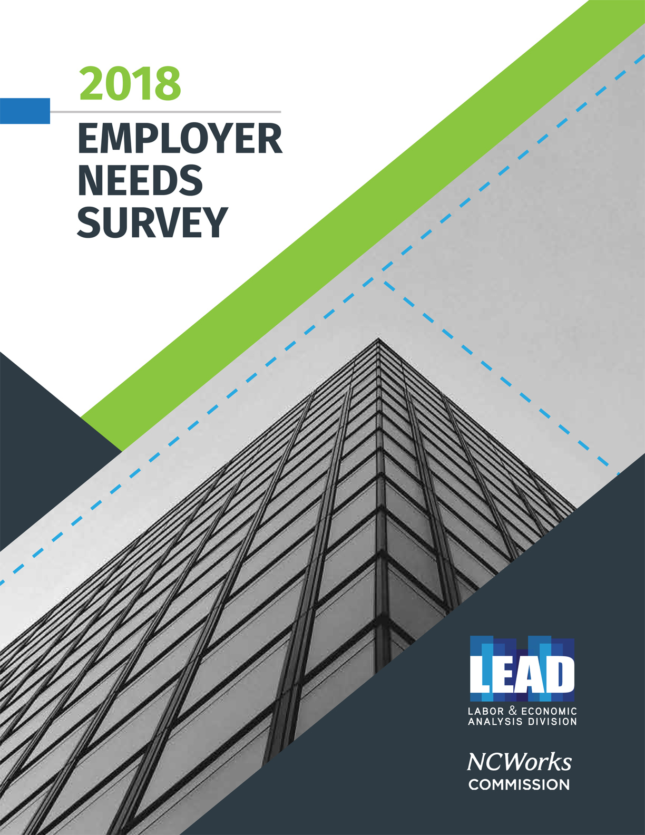
Notes:
The Labor & Economic Analysis Division of the state Department of Commerce conducts this needs assessment with employers every two years.
This 2018 survey was just published.
It's a look at the needs of 2,000 employers across the state, specifically their difficulties in hiring new employees.
They looked only at employers with 10 or more employees.
Public and private companies
=======
https://www.nccommerce.com/nc-workforce-development/workforce/commission--workforce/2018employerneedssurvey.pdf

Slide 4
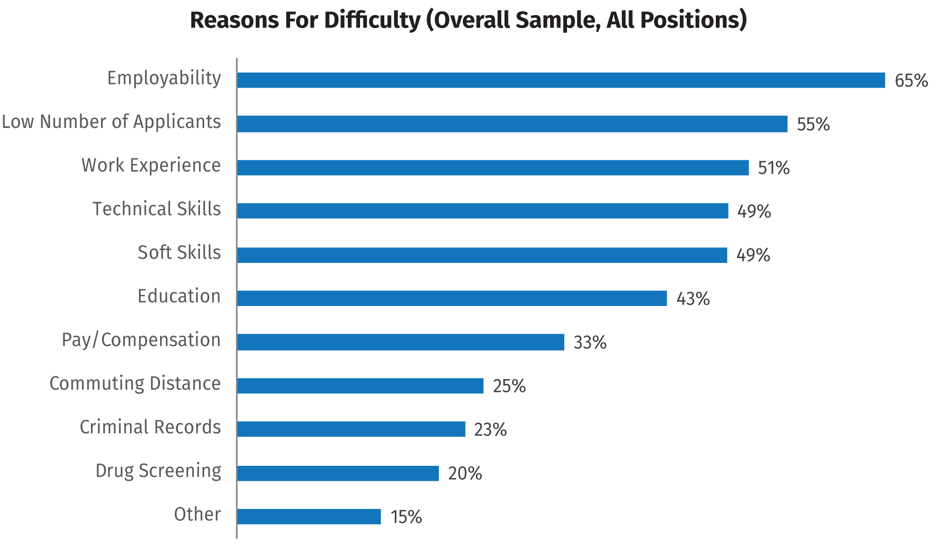
Notes:
Employers who had reported difficulties filling positions were asked about the reasons why -- and were able to select multiple responses from a range of possible explanations.
It is important to note that there is potential overlap among these reasons, and it is possible for the same employer to have different reasons for multiple positions.
Among employers experiencing hiring difficulties in the Overall sample in 2018, the top reasons were:
- applicants’ lack of employability. This includes including work ethic, professionalism, reliability, and motivation).
Many will call these soft skills, but you see the soft skills further down the chart.
For Employability, think -- can they show up on time, ready to work?
- a low number of applicants . Some of this might be because the employers do not know how to advertise their openings -- to reach out to those looking for work..
- applicants’ lack of relevant work experience. In the education business, we are usually looking at helping our students get that first job. This shows where work-based learning can play a big part helping the student get real-world work experience that they can't get anywhere else. Work experience, even through work-based learning, will give our students a leg up on the competition.
- lack of technical or occupation-related skills. That's what we do at the community colleges. I would hope that this was not the description of our graduates.
- soft skills, such as communication, teamwork, critical thinking, creativity
Sometimes the Employability measure at the top of the chart are lumped in with soft skills, but here we separate them. Where can we teach these soft skills that employers say are lacking?
- lack of the necessary education level, certification, or training.
We are doing something about that, but many think they can bypass the training and go straight to work.
The employers want their new employees to already have a certain level of training.
If you, as a potential employee, are not sure what the employers want, ask them. They know what they want.
=======
https://www.nccommerce.com/nc-workforce-development/workforce/commission--workforce/2018employerneedssurvey.pdf
What reasons do employers give for hiring difficulties?
Employers who had reported difficulties filling positions were asked about the reasons why and were able to select multiple responses from a range of possible explanations.
It is important to note that there is potential overlap among these reasons, and it is possible for the same employer to have different reasons for multiple positions.
Among employers experiencing hiring difficulties in the Overall sample in 2018, the top reasons were applicants’ lack of employability (including work ethic, professionalism, reliability, motivation) (65.1%), a low number of applicants (55.3%), and applicants’ lack of relevant work experience (51.4%). A perceived lack of technical or occupation-related skills (49.3%) and soft skills (such as communication, teamwork, critical thinking, creativity) (49.2%) were close behind, with nearly half of employers with hiring difficulties choosing these reasons. Applicants’ lack of the necessary education level, certification, or training (43.2%) was chosen by a substantial number of employers, followed by smaller percentages selecting applicants’ unwillingness to accept the offered pay or compensation (32.9%), commuting distance or other geographic issues (24.8%), applicants’ criminal records (22.9%), failure to pass drug screening (20.3%), or other reasons (14.5%).

Slide 5
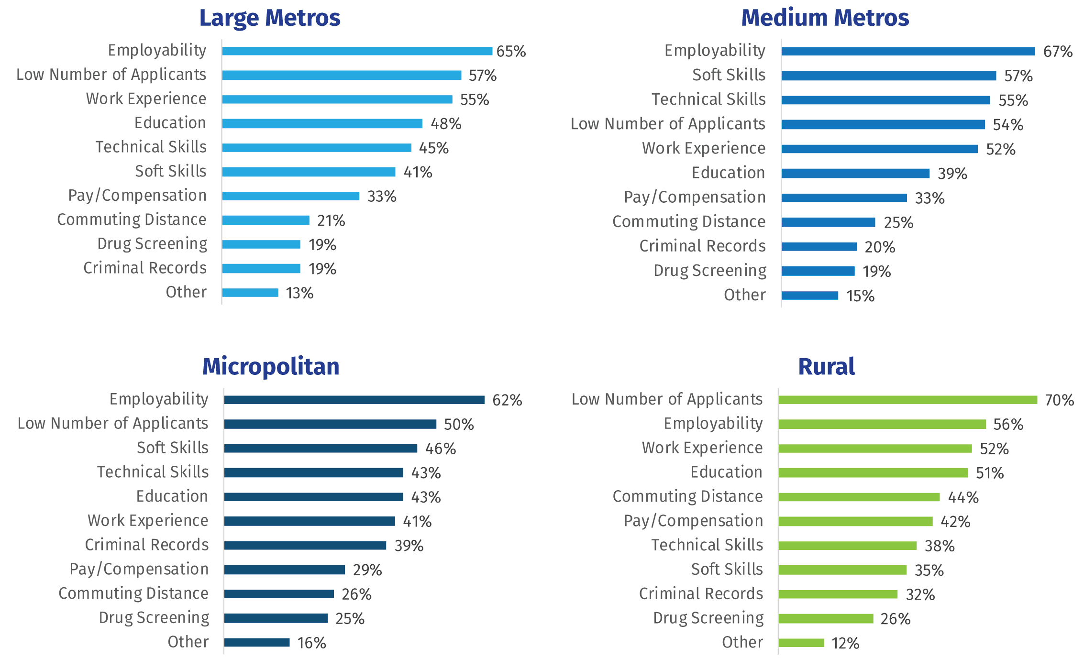
Notes:
We have a vast state with different kinds of rural and urban areas.
Here, they looked at the same reasons for difficulty in hiring and found some big differences in the urban and rural areas.
Large is Charlotte and the Triangle (Raleigh, Durham, Chapel Hill)
Medium is Greensboro, Winston-Salem, Fayetteville, Asheville, Burlington, Wilmington, and other similar-sized cities.
Micropolitan are small cities and towns.
In the rural areas you see they mainly did not have people applying for the jobs.
Was it because folks did not know about the job or because people want to live and work in cities?
=======
https://www.nccommerce.com/nc-workforce-development/workforce/commission--workforce/2018employerneedssurvey.pdf
Top Reasons for Difficulties by Region
Employers in the Large metros (Charlotte and the Triangle) chose the same top three reasons as the Overall sample, followed by education (47.8%) and technical skills (45.2%). Work experience (54.8%) and education (47.8%) were more frequently selected in this region, and soft skills were less frequently chosen (41.4%).
Employers in the Medium metros chose employability (67.3%), soft skills (57.1%), and technical skills as the top three reasons for difficulty, which were all significantly higher than the Overall sample.
A low number of applicants (54.1%) and work experience (52.1%) were also frequently chosen by regional employers.
Employers in the Micropolitan labor markets chose employability (61.9%), a low number of applicants (50.4%), and soft skills (45.9%) as the top three reasons for difficulty, followed by education (42.6%) and technical skills (42.6%). Although not top reasons, having a criminal record (38.5%) and failing a drug test (24.6%) were significantly higher than the Overall sample.
Employers in the Rural labor markets cited a low number of applicants (70.0%) as the top reason for difficulty, a significantly higher percentage than the Overall sample. Employability (56.2%),
a lack of work experience (52.4%), and education (51.4%) were also top reasons for difficulty. Commuting distance (43.8%) was significantly higher than the Overall sample, as were pay/ compensation (41.9%), criminal records (32.4%), and drug screening (25.7%).

Slide 6
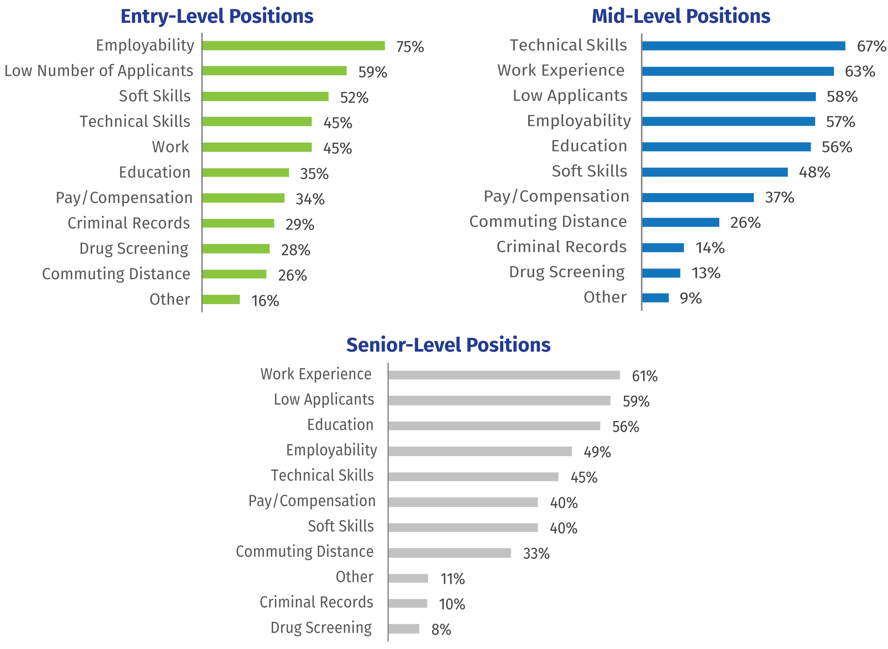
Notes:
And then if we look at the Top Reasons for Hiring Difficulties by Level of Work Experience
As educators, we are usually focused on the entry-level positions, but some of the students at our community college are getting training to move to a higher level of employment.
For our entry-level positions, the Employability skills are on top (that's showing up on time ready to work) with Soft Skills not far behind.
Where do we teach that?
=======
https://www.nccommerce.com/nc-workforce-development/workforce/commission--workforce/2018employerneedssurvey.pdf
Top Reasons for Hiring Difficulties by Level of Work Experience
Employers in the Overall sample were asked about reasons for difficulty for positions by level of work experience, which differed in a few ways. Employers seeking to fill entry-level positions (requiring one year of experience or less) chose employability (74.6%) and a low number of applicants (59.1%) as the top reasons for hiring difficulties, followed by soft skills (51.7%). Having a criminal record (29.5%) and failing to pass a drug test (27.7%) were not top reasons but were mentioned about twice as frequently for entry-level positions than for mid- and senior-level positions.
Employers seeking mid-level positions (requiring two to four years) chose a lack of technical skills (67.5%), work experience (63.5%) and a low number of applicants (57.5%) most frequently, followed closely by employability (57.3%) and education (55.9%). Employers seeking more senior-level positions (requiring five years or more) chose work experience (61.2%), low number of applicants (58.9%), and education (56.1%) most frequently, followed by employability (48.5%) and technical skills (45.0%).

Slide 7
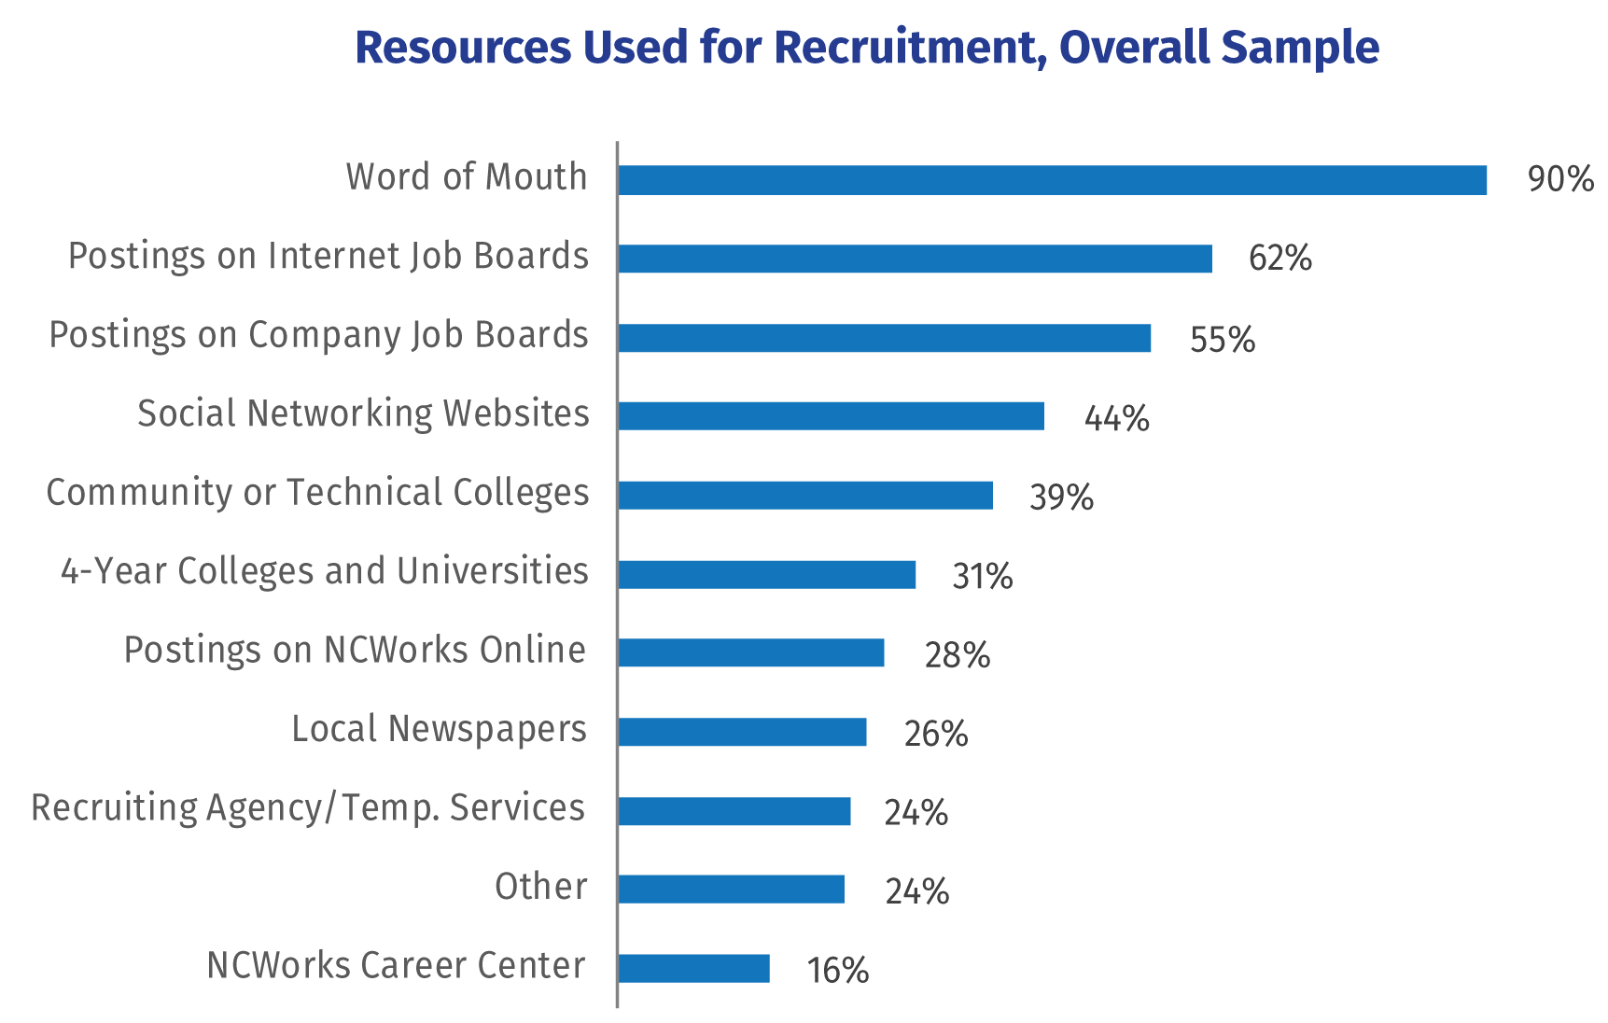
Notes:
This part always surprises me.
The number one method that businesses use to recruit is by word of mouth. It's employers telling their employees to recommend a friend.
We've all heard it before, but this makes it clear, it's all about who you know.
If you want a job, it is far better to tell your friends than it is to post your resume on line.
We do see that 62 percent of the employers do post their job openings on the Internet job boards
as well as 55 percent to their own company job board.
It's surprising to see the NCWorks Career Centers at the bottom of the list.
You see the Recruiting Agencies and Temp Services near the bottom at 24 percent, but for the manufacturing sector, almost 53 percent used Recruiting Agencies and Temp Services
=======
https://www.nccommerce.com/nc-workforce-development/workforce/commission--workforce/2018employerneedssurvey.pdf
Resources for Recruiting
In order to better understand hiring practices, all employers (not just those that had attempted to hire in the past 12 months) were asked to identify any of the resources they use when recruiting. As in previous surveys, “word of mouth” was used by nearly all hiring employers (90.0%), followed by online postings on job boards (61.7%), company websites (55.3%), and social networking sites (44.2%), and community colleges (38.9%). Employers reported use of online postings and social networking websites at significantly higher rates than in 2016, perhaps reflecting tighter labor market conditions or simply greater adoption of this technology over time. In general, those with difficulty hiring were more likely to utilize each type of resource for recruiting than those without difficulty.
Compared to the Overall sample, employers in Charlotte and the Triangle were slightly less likely to use “word of mouth,” while employers in the other regions were more likely to use it. The use of NCWorks Online was higher in Rural areas (38.3%), Micropolitan areas (30.0%), and Medium labor markets (32.8%), but lower in Charlotte and the Triangle (19.7%). Employers in Medium labor markets (30.0%), Micropolitan areas (35.8%), and Rural areas (41.9%) were more likely to use local newspapers, while employers in Charlotte and the Triangle (15.4%) were less likely to use them. Recruiting agency/temporary employment services were used more frequently in Charlotte and the Triangle (27.4%) and less so in Micropolitan (17.9%) and Rural (12.0%) areas. A lower percentage of employers in Charlotte and the Triangle (10.2%) reported using NCWorks Career Centers, while employers reported higher percentages in Medium metros (17.0%), Micropolitan (23.9%) and Rural (23.3%) regions.
Manufacturers were much more likely to use recruiting agencies/temporary employment services (52.6%), community colleges (46.7%), NCWorks Online (42.6%), and NC Works Career Centers (24.6%) but less likely to use company job boards (41.5%), general internet job boards (56.5%), and social networking websites (37.2%). STEM employers were more likely to post on online job boards (77.5%) and their own company job boards (62.6%) as well as social networking websites (52.8%). They were also more likely to use 4-year colleges (46.1%) and community colleges (46.0%) as well as recruiting agencies or temporary employment services (31.2%).

Slide 8
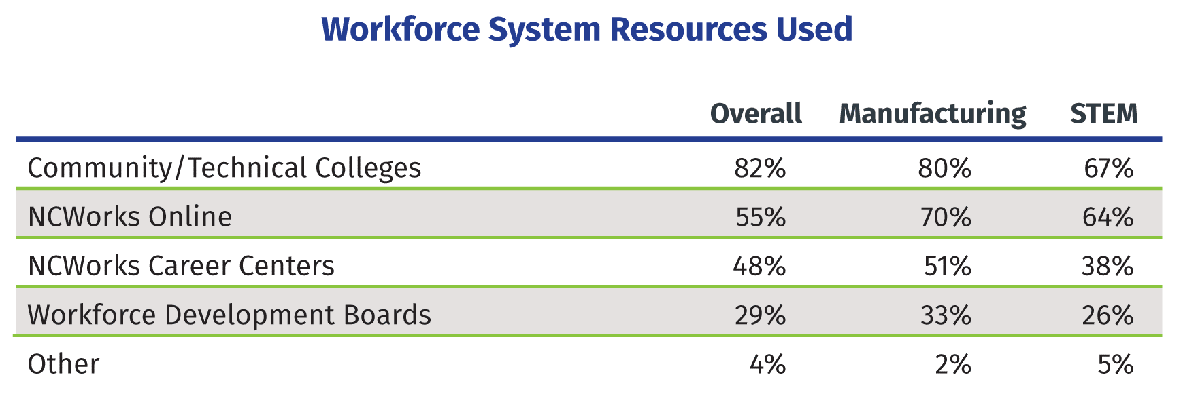
Notes:
You can see here that Manufacturing and STEM employers relied less on the community colleges for their recruiting than the overall field of employers.
Yet both of these industries used NCWorks Online more then the average employer.
Manufacturing had a high than average use of NCWorks Career Centers as well as Workforce Development Boards.
Large metro areas favored the use of community colleges for recruiting,
whereas, the rural employers were more likely to use NCWorks Career Centers and NCWorks Online.
=======
https://www.nccommerce.com/nc-workforce-development/workforce/commission--workforce/2018employerneedssurvey.pdf
Using Workforce Development System Resources
Those employers who reported using workforce system resources were asked a follow-up question about which specific resources they had used. Manufacturers were significantly more likely to use NCWorks Online (69.5%) than employers in the Overall sample. STEM employers were less likely to use community colleges (67.3%) and NCWorks Career Centers (38.2%) but more likely to use NCWorks Online (63.6%).
Looking across regions, the Large metros were less likely to use NCWorks Career Centers (33.7%), NCWorks Online (41.1%), and workforce development boards (21.7%) and more likely to use community colleges (85.9%). The Medium metros were more likely to use NCWorks Career Centers (57.5%), NCWorks Online (62.7%), and workforce development boards (34.4%). The Micropolitan areas had no significant differences. The Rural employers were more likely to use NCWorks Career Centers (61.7%) and NCWorks Online (75.8%).

Slide 9
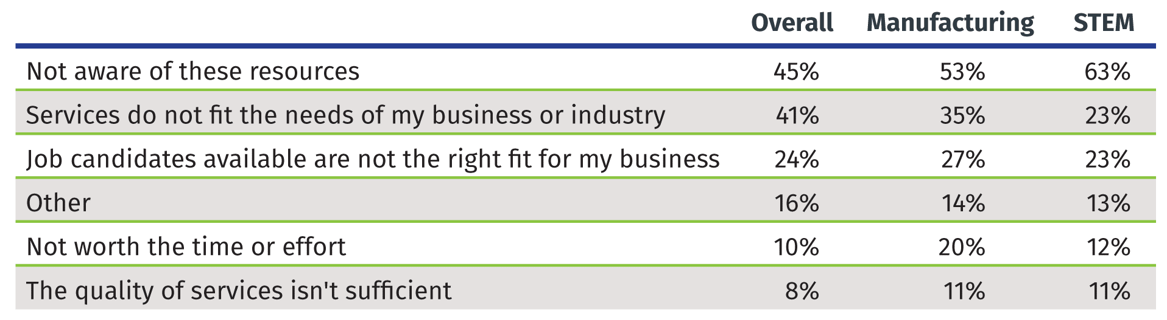
Why did employers not use:
Community/Technical Colleges
NCWorks Online
NCWorks Career Centers
Workforce Development Boards
Notes:
Why did employers not use:
Community/Technical Colleges
NCWorks Online
NCWorks Career Centers, and
Workforce Development Boards
… to help them recruit new employees?
Most of the employers were not aware of these resources that they could have used to help them recruit new employees.
In the rural areas, the lack of awareness was over 60 percent of employers.
What can we do as a state to market these great resources that our employers know nothing about?
=======
https://www.nccommerce.com/nc-workforce-development/workforce/commission--workforce/2018employerneedssurvey.pdf
Employers who did not use workforce system resources were asked about why they didn’t use them. A lack of awareness of existing resources was the most common answer, with about 45 percent of employers choosing this reason. Others felt the services did not fit the needs of their business or industry (41.0%) or that the job candidates available through these resources were not the right fit for their business (23.5%). There were significantly more employers citing a lack of awareness in Rural areas (60.1%), but also far fewer employers who felt the services did not fit the needs of their business (25.8%). Micropolitan employers cited job candidates were not a fit (30.4%) and that it was not worth the time or effort (27.7%) at higher rates. Manufacturers were more likely to choose a lack of awareness (52.7%) and were twice as likely to say it was not worth the time or effort (19.9%) than the Overall sample (10.0%)—however, it must be remembered that Manufacturers (41.1%) were significantly more likely to say they use workforce system resources than Overall employers (27.7%). STEM employers were more likely to say they were not aware of these resources (63.4%).

Slide 10
The declining prevalence of youth employment may also contribute to a lack of exposure to work environments, and programs which teach on-the-job learning such as apprenticeships may be a tool to address these needs.
Notes:
I found this in the Conclusion section at the back of the book.
Our high school aged youth are not working like we did generations ago.
We are doing a promotion to get our students in the workplace through various forms of work-based learning.
Hopefully, that will make more of our North Carolinians more job ready.
=======
https://www.nccommerce.com/nc-workforce-development/workforce/commission--workforce/2018employerneedssurvey.pdf

Slide 11
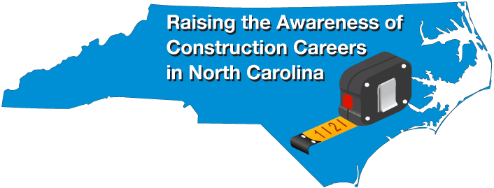
April 8-12, 2019
Bob Witchger
Chris Droessler
NC Community Colleges
Cheryl Cox
NC Department of Public Instruction
NCperkins.org/construction
Notes:
Our Construction Careers Week is coming up in April. It's a state-wide effort to get the word out about the great careers in the construction industry.

Slide 12
Vision
To raise the awareness of Construction Careers across North Carolina
To provide an opportunity for students and parents to visit community colleges to learn of the many opportunities for training in the trades
To provide an opportunity to Students and Parents to talk to employers in their community about president and future employment opportunities in their construction businesses
Notes:
So here is why we do this.
Coming out of the recession, the construction industry is ready to build but they need more workers.
These open houses are a way to let the future construction workers see what's down the road. To try on the industry and see if it fits.

Slide 13
What?
Curriculum, continuing education, and basic skills coming together to coordinate a career fair or other activities
Invite local construction businesses to the college for a career fair activity
Use your imagination and ideas to help raise the awareness of building trades careers.
Notes:
We envision open houses.
Our colleges are doing their part in creating these open houses.
Each month we will let you know about the events that might be in your part of the state.

Slide 14
Activities
Construction site tours
Open house
Hands-on
Job fair
Presentations to students
Day-time events and evening events
Invite the media
Let the community know what goes on behind that big exterior wall
Notes:
There are all kinds of events you can hold during this week to promote what you are doing and hopefully get your future employees interested.
Open Houses could occur at a community college or at a construction site, or at the headquarters for a construction company.
Even high schools hosted events last year.

Slide 15
Who?
Middle school students, teachers, counselors, and parents
High school students, teachers, counselors, and parents
Current and future community college students
College graduates
NCWorks Career Center participants
General community
Notes:
These kind of open houses can benefit people at all kinds of places in life.

Slide 16
Construction Week Website
www.ncperkins.org/construction
Event Calendar
Promotional Materials
Planning Meetings/webinars
Partners
Participating Colleges
Notes:
The go-to website for all events in North Carolina is
NC Perkins dot org slash construction
There you will find the calendar of events, promotional materials, information about our planning meetings, like this one, and our partners and our participating colleges.
Lots of good stuff on that web site.
Stick a bookmark on that page, so you can keep checking it as we get closer to the big week.
======
www.ncperkins.org/construction

Slide 17
Calendar of Events
Career Open Houses
Notes:
Lets' take a look at the events that we know about across the state.
If you know of a large event, please let us know so we can promote it.
We are not talking about job fairs where the focus is on getting hired.
What we are talking about are the events where careers can be explored and tried out.
This is for folks to explore careers and talk to professionals about those careers.
It's about career exploration
It's about recruiting folks into an industry, not just a specific company.

Slide 18
Raising the Awareness of Career Pathways in North Carolina
Next meeting is February 21, 2019
www.ncperkins.org/presentations
Notes:
Our next meeting like this one will be on February 21.
You can go to the NCPerkins website to register for that meeting.
We'll also send you a reminder, since you are now on our mailing list.

Slide 19

NCWorks Certified Career Pathways week
January 28, 2019
events in each of the state’s eight prosperity zones
highlight the Impact Report’s findings
promote the inclusion of nontraditional career seekers into career pathways.
Notes:
As these events are planned, we’ll let you know about them.
Pathways Week:
https://nccertifiedcareerpathways.com/career-pathways-week-2019/
Event Flyer:
https://nccertifiedcareerpathways.com/wp-content/uploads/2018/12/2019_Career-Pathways-Week_Flyer-2.pdf
The report can be found here: https://nccertifiedcareerpathways.com/ncworks-certified-career-pathways-one-year-impact-report/

Slide 20
NCWorks Certified Career Pathways week - Workshops
Jan 29 - Asheville
Jan 29 - Lenoir
Jan 30 - Charlotte
Jan 29 - Graham
Jan 31 - Fayetteville
Jan 29 - Raleigh
Jan 29 - Williamston
Jan 30 - New Bern
Notes:
As these events are planned, we’ll let you know about them.
Pathways Week:
https://nccertifiedcareerpathways.com/career-pathways-week-2019/
Event Flyer:
https://nccertifiedcareerpathways.com/wp-content/uploads/2018/12/2019_Career-Pathways-Week_Flyer-2.pdf
The report can be found here: https://nccertifiedcareerpathways.com/ncworks-certified-career-pathways-one-year-impact-report/

Slide 21
CTE Month
February is National CTE (Career and Technical Education) Month
Notes:
CTE month is in February. Many high schools make a big deal about this.
If we learn of any big events, we’ll let you know.
National Info:
https://www.acteonline.org/why-cte/cte-awareness/cte-month/
https://www.dodea.edu/dodeaCelebrates/CTE.cfm

Slide 22

Science Saturday
NC Museum of Natural Sciences - Raleigh
Meet a scientist, learn about careers
February 2, 2019 - 2:30 -3:30 pm
Dr. Jesko von Windheim, Associate Dean and Professor of the Practice, Innovation & Entrepreneurship, at Duke University’s Nicholas School of the Environment.
Notes:
The North Carolina Museum of Natural Sciences hosts events to learn about careers in science.
They host a Science Saturday each month
https://naturalsciences.org/calendar/events/

Slide 23
Construction Week
NC Construction Careers Awareness Week
April 8-12, 2019
ncperkins.org/construction
Notes:
We mentioned this earlier.
We hope to have open houses at our college construction programs across the state.
The high schools in Wake County will have their annual shed building competition, which should be during this week.
Bob
ncperkins.org/construction

Slide 24

SkillsUSA
Greensboro
April 9-11, 2019
Postsecondary Awards Ceremony on April 10
Notes:
Skills USA is a more than just a student club.
We go to the state-wide competition every spring in Greensboro.
The postsecondary participants and competitions have been growing for years.
Lots of businesses come to this competition to recruit right off the competition floor.
http://www.skillsusanc.org/state-conference

Slide 25
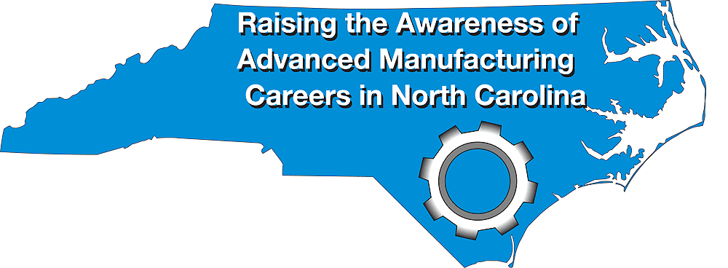
Manufacturing Week
NC Advanced Manufacturing Careers
Awareness Week
September 30 – October 4, 2019
ncperkins.org/manufacturing
Notes:
First week in October, we expect about 70 open houses across the state.
NCperkins.org/manufacturing

Slide 26
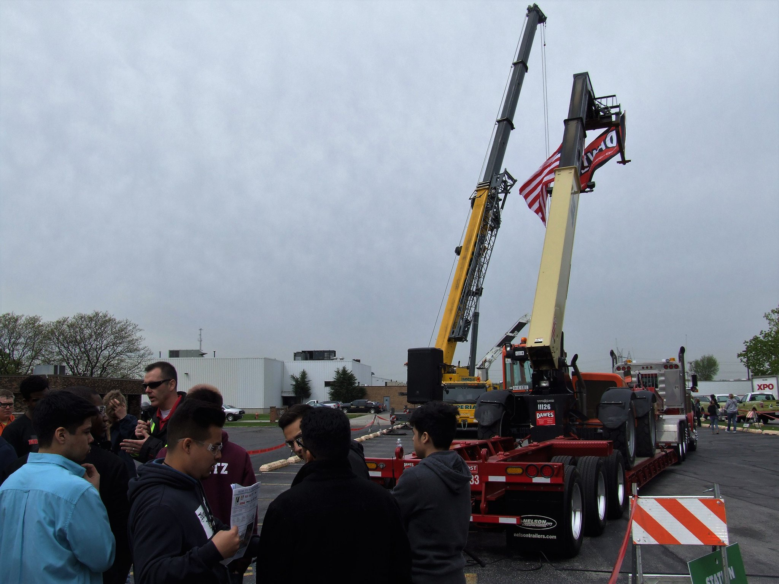

Lift & Move USA
Promoting careers in the crane, rigging and specialized transport industry
No NC events on the calendar for 2019
http://www.liftandmoveusa.com/
Notes:
I hope the Lift and Move folks do another event in North Carolina next year. The one I went to was great.
=========
http://www.liftandmoveusa.com/
https://twitter.com/liftmoveusa

Slide 27
Transportation Career Fair
Women and Girls in Transportation Initiative.
April 2019 ??
Notes:
https://www.wtsinternational.org

Slide 28
STEM Career Showcase for Students with Disabilities
Sponsored by the NC Museum of Natural Sciences in Raleigh
2018 showcase was in October
Notes:
The North Carolina Museum of Natural Sciences hosts events to learn about careers in science.
This is one they do every October.
https://naturalsciences.org/calendar/event/stem-career-showcase-2/

Slide 29
Transportation Career Fairs
Sponsored by the Collision Repair Education Foundation (I-CAR)
(2018 fair was in Concord NC)
So far, none scheduled in NC for 2019
Notes:
The Collision Repair industry hosts open house events across the country.
They held an event in Concord, North Carolina a few months ago.
They have not posted their 2019 calendar.
https://www.collisioneducationfoundation.org/transportation-career-fairs/

Slide 30
Charlotte Career Discovery Day
2,000 students
100 businesses and colleges
collaboration between
  City of Charlotte
  Charlotte-Mecklenburg Schools (CMS)
  November 2019
Notes:
Charlotte has a big event where they bring together 2,000 students and 100 businesses and colleges to help these students decide on a career pathway.
That will be in November.
https://charlottenc.gov/Mayor/Youth/MYEP/Pages/CCDD.aspx

Slide 31
Raising the Awareness of Career Pathways in North Carolina
Next meeting is February 21, 2019
www.ncperkins.org/presentations
Notes:
Our next meeting like this one will be on February 21.
You can go to the NCPerkins website to register for that meeting.
We'll also send you a reminder, since you are now on our mailing list.

