Slide 1
Perkins Update Webinar
November 14, 2018

Slide 2
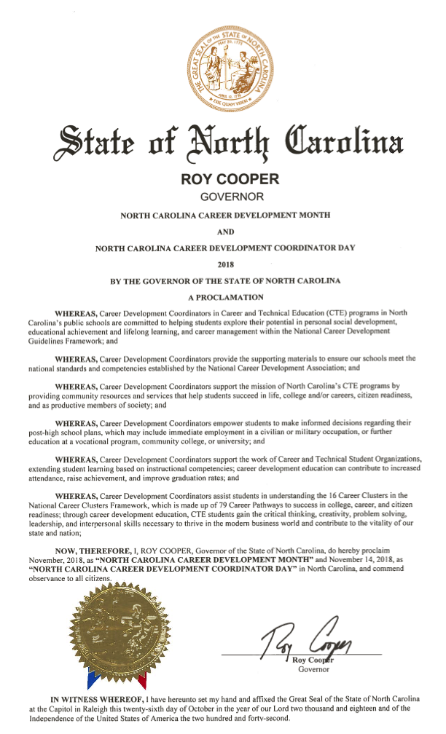
NC Career Month
November 2018 - North Carolina Career Development Month
November 14, 2018 - North Carolina Career Development Coordinator Day

Slide 3
NCPerkins.org Moodle
Contact list - send Patti/Tony the changes

Slide 4
Budget
Spending Levels July – December
Encouraged to meet with your Chief Financial Officer
Update your programmatic and fiscal Perkins Plan

Slide 5
Perkins V
State Plan
Needs Assessment
Uses of Funds
Links to WIOA
Work-Based Learning
Outcome Measures
July Summer Conference
Application for Transition Year

Slide 6
Special Populations
Perkins IV (current) | Perkins V (near future)
individuals with disabilities; | individuals with disabilities;
individuals from economically disadvantaged families, including foster children; | - individuals from economically disadvantaged families, including low-income youth and adults; - youth who are in, or have aged out of, the foster care system;
individuals preparing for non-traditional fields; | individuals preparing for non-traditional fields;
single parents, including single pregnant women; | single parents, including single pregnant women;
displaced homemakers; and | out-of-work individuals;
individuals with limited English proficiency. | English learners;
 | homeless individuals described in section 725 of he McKinney-Vento Homeless Assistant Act (42 U.S.C. 11434a);
 | youth with a parent who - (i) is a member of the armed forces (as such term is defined in section 101(a)(4) of title 10, United States Code); and (ii) is on active duty (as such term is defined in section 101(d)(1) of such title).

Slide 7
Basic Grant Monitoring
Desk Review
Budget and Equipment – On Line
Desk Review
Paperwork to Submit
Site Monitoring
Interviews with Faculty, Staff, CAO, CFT
Career Pathways
Faculty Professional Development
Work-Based Learning

Slide 8
Technical Assistance
Interested in college visitations
Meeting with Chief Academic Officer
Meeting with Fiscal Department
Meeting with Faculty teaching in Pathways
Meeting with Secondary Partners around CTE Pathways of Study
On Line – In Person – Open Discussion

Slide 9
Credentialing
What’s Happening
Interest in working with NOCTI?
Send in your Name to take part in an introductory Webinar on Credentialing

Slide 10
Work-Based Learning Mobile App
Development of an Intermediary-type App
Communication between Faculty, Worksite Supervisor, Student, and WBL Coordinator
Tracking Hours on the job and competencies gained
Tracking Hours spent on Learning Objectives
Application for Work-Based Learning
Discussion of Purpose, Elements, and Practicality

Slide 11
Got 'em?
Notes:
https://nccareers.org/

Slide 12
NC Career Cluster Guide Workshops
Offered by the NC Employment and Training Association (NCETA)
This workshop is intended for front-line workforce professionals who work with people who need to discover a career that is best for them.
Topics
Helping your Clients Choose a Career
The Role of Career Assessments
Using Labor Market Information
Holland Code in Counseling
Career Cluster Guide 2018
Career Clusters and Career Pathways
Integrating Programs of Study and Pathways
Promising Practices from the Field
Registration
Free for NCETA members
$25 for non-members
Join NCETA for $20 and attend for free
https://nceta.org/conferences
Offered regionally to meet your needs.
Each session is 9am-3pm and includes refreshments and a boxed lunch.
Nov. 13, 2018: Pitt Community College in Greenville, NC
Nov. 15, 2018: Catawba Valley Community College in Hickory, NC

Slide 13
Perkins Reviews
Mid-Year Reviews
2 drive-in meetings - pick one
January 15, 2019 @ Pitt CC
January 17, 2019 @ Catawba Valley CC
Each college - prepare a 10-minute presentation on best practice. Followed by questions.
End-of-Year Reviews
May 6-17, 2019
End-of-Year Report and Best Practice Video

Slide 14
Best Practice Videos 2018
Lenoir Community College
DACUMs for Automotive Technologies, Computer Engineering, Computer Integrated Machining, and Industrial Systems.
"Be Like Me" campaign.
Partnered with the Eastern Carolina Workforce Development Board.
Best practice videos are on NCperkins.org under Perkins Resources.
http://www.ncperkins.org/course/view.php?id=8
Notes:
This one is set to 480p and gives an error message when uploading
Already shown:
Alamance Community College - Teachers shadowing teachers
Fayetteville Technical Community College - Nursing, Faculty position, Simulation equipment
Mayland Community College - Mac Lab, 26 iMac computers
Vance-Granville – Advising, Professional Development.
Beaufort County CC
Carteret CC
Lenoir CC
Coastal Carolina CC

Slide 15
Best Practice Videos 2018
Coastal Carolina Community College
Nursing program
Professional development on using simulation mannequins.
Best practice videos are on NCperkins.org under Perkins Resources.
http://www.ncperkins.org/course/view.php?id=8
Notes:
I set this one to 720p to check quality
Already shown:
Alamance Community College - Teachers shadowing teachers
Fayetteville Technical Community College - Nursing, Faculty position, Simulation equipment
Mayland Community College - Mac Lab, 26 iMac computers
Vance-Granville – Advising, Professional Development.
Beaufort County CC
Carteret CC
Lenoir CC
Coastal Carolina CC

Slide 16
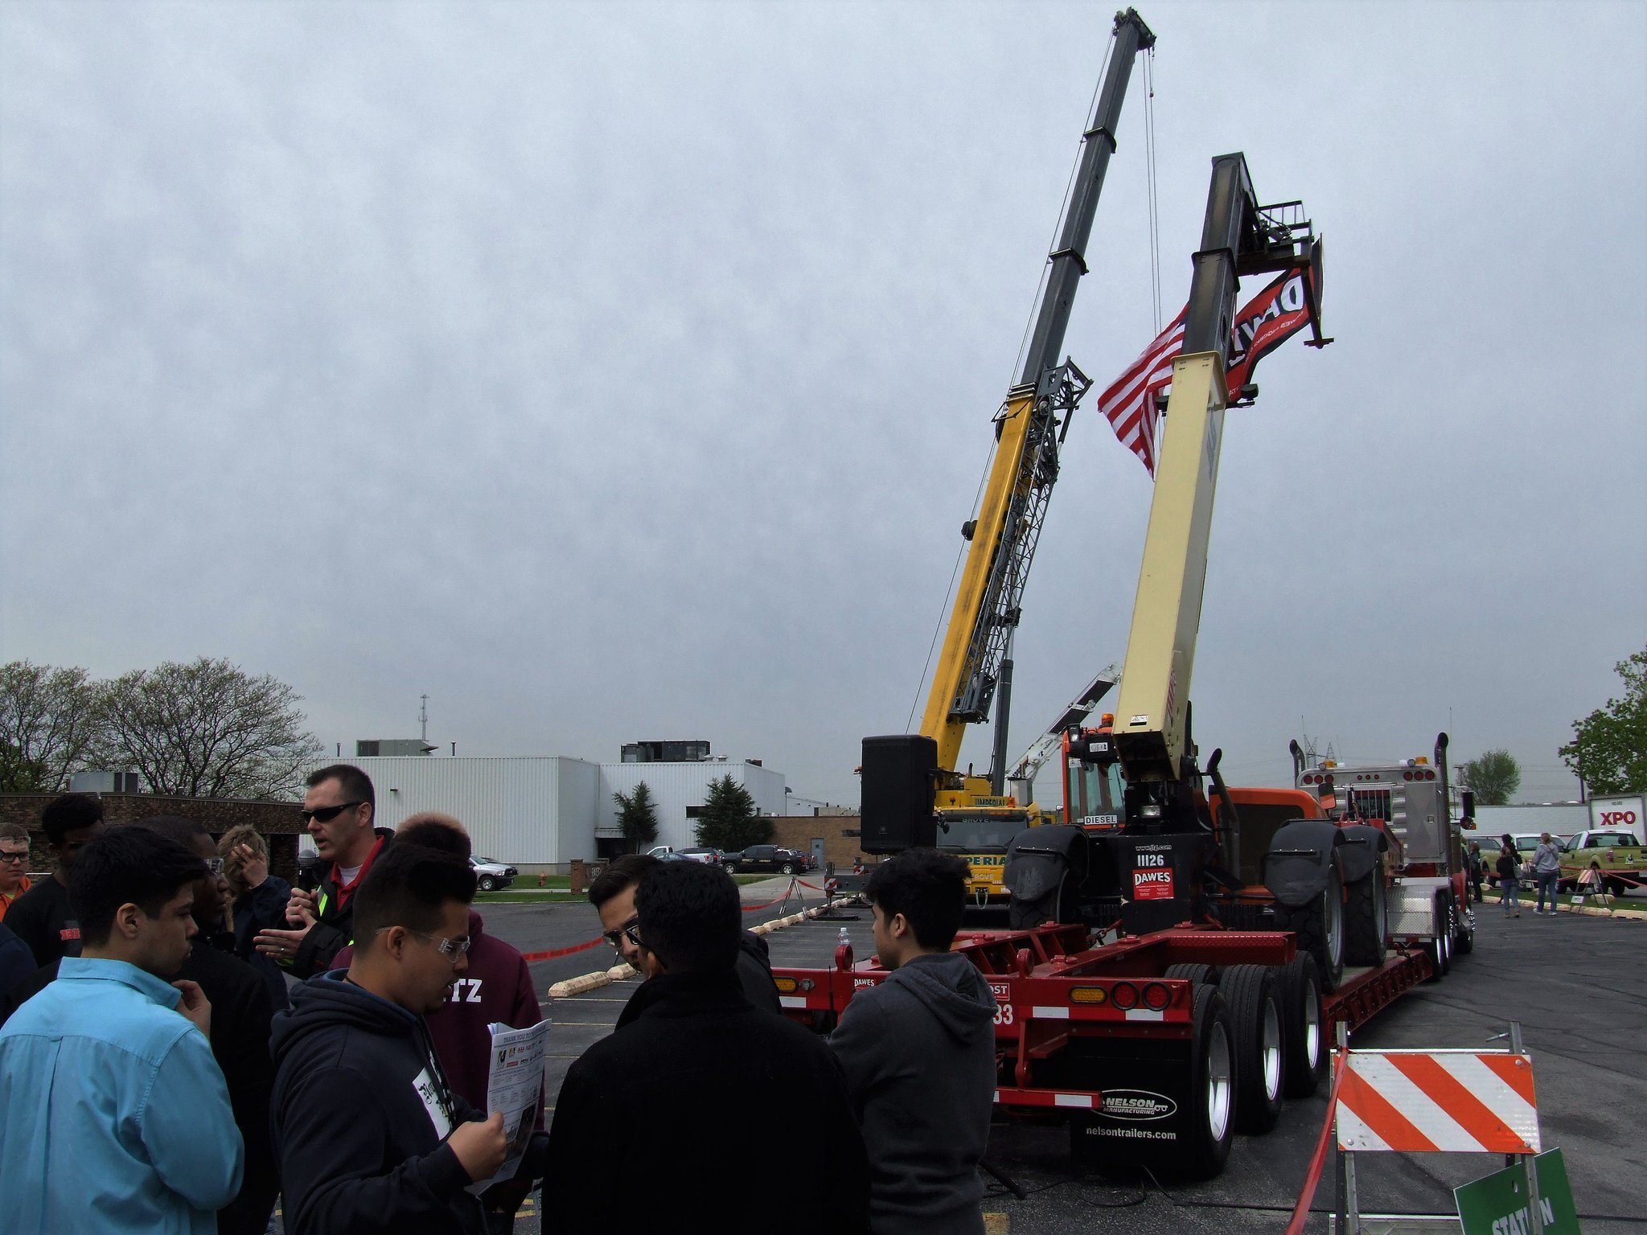
Lift & Move USA Promoting careers in the crane, rigging and specialized transport industry
November 29, 2018
Rockingham, NC
Host: Superior Cranes, Inc.
http://www.liftandmoveusa.com/
Notes:
=========
http://www.liftandmoveusa.com/
https://twitter.com/liftmoveusa
http://www.superiorcranes.com/
Kyle Belkoski | Director of Sales | Superior Cranes, Inc. 1079 Boulder Rd, Greensboro, NC 27410 Tel: 910.997.7700 | Fax: 336.464.2724 | Mob: 336.209.7548 Email: kyle@superiorcranes.com | Web: www.superiorcranes.com

Slide 17
ACTE CareerTech VISION 2018
Association for Career & Technical Education
November 28 to December 1, 2018
San Antonio, Texas
http://www.careertechvision.com/
Notes:
http://www.careertechvision.com/

Slide 18
Construction Week
NC Construction Careers Awareness Week
April 8-12, 2019
Planning meeting via webinar - December 13 at 9am
ncperkins.org/construction
Notes:
College Open Houses.
Invite the local high schools and middle schools
Talk to LEA CTE Director
Career Development Coordinator at the High School
Invite the public

Slide 19
SkillsUSA
Greensboro
April 9-11, 2019
Annual Perkins meeting on Wednesday, April 10
Postsecondary Awards Ceremony on April 10
Notes:
http://www.skillsusanc.org/state-conference

Slide 20
Performance Partnership Summit

Slide 21
Manufacturing Week
NC Advanced Manufacturing Careers Awareness Week
September 30 – October 4, 2019
ncperkins.org/manufacturing
Notes:
Does anyone want to talk about any open houses they planned or attended?

Slide 22
Perkins Updates
2nd Tuesday of the month
9 am
Via GoToWebinar
Find the registration links at NCperkins.org/presentations
Next Update: Tuesday, December 11, 2018
Notes:
Registration links through December have been posted. Register now and let the system remind you.

Slide 23
Perkins/CTE State Staff
Dr. Bob Witchger Director, Career & Technical Education WitchgerB@nccommunitycolleges.edu 919-807-7126
Dr. Tony R. Reggi Coordinator, Career & Technical Education ReggiA@nccommunitycolleges.edu 919-807-7131
Patti Coultas Coordinator, Career & Technical Education CoultasP@nccommunitycolleges.edu 919-807-7130
Chris Droessler Coordinator, Career & Technical Education DroesslerC@nccommunitycolleges.edu 919-807-7068
Darice McDougald CTE Administrative Assistant McDougaldD@nccommunitycolleges.edu 919-807-7129
Notes:
http://www.ncperkins.org/course/view.php?id=6

