Slide 1

Perkins Update Webinar
October 16, 2018

Slide 2
NCPerkins.org Moodle
Contact list - send Patti/Tony the changes
Budgets modifications due 9/30/18
Reserve Fund budgets due 9/15/18

Slide 3
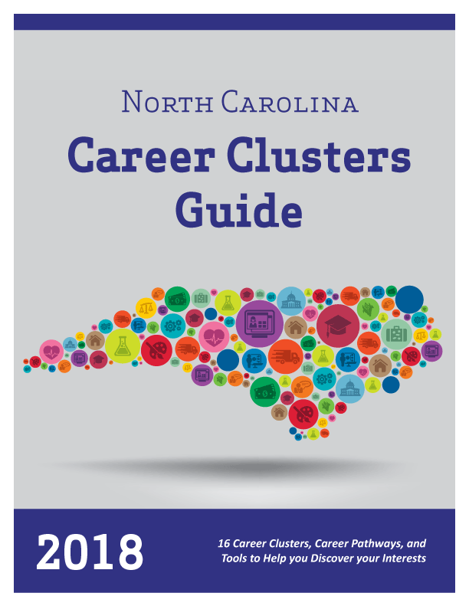
Got 'em?
Notes:
https://nccareers.org/

Slide 4
NC Career Cluster Guide Workshops
Offered by the NC Employment and Training Association (NCETA)
This workshop is intended for front-line workforce professionals who work with people who need to discover a career that is best for them.
Topics
Helping your Clients Choose a Career
The Role of Career Assessments
Using Labor Market Information
Holland Code in Counseling
Career Cluster Guide 2018
Career Clusters and Career Pathways
Integrating Programs of Study and Pathways
Promising Practices from the Field
Registration
Free for NCETA members
$25 for non-members
Join NCETA for $20 and attend for free
https://nceta.org/conferences
Offered regionally to meet your needs.
Each session is 9am-3pm and includes refreshments and a boxed lunch.
Nov. 13, 2018: Pitt Community College in Greenville, NC
Nov. 15, 2018: Catawba Valley Community College in Hickory, NC

Slide 5
Perkins Reviews
Mid-Year Reviews
2 drive-in meetings - pick one
January 15, 2019 @ Pitt CC
January 17, 2019 @ Catawba Valley CC
End-of-Year Reviews
May 6-17, 2019
End-of-Year Report and Best Practice Video

Slide 6
Best Practice Videos 2018
Beaufort County Community College
Electrical Engineering
Welding
Mechanical Engineering
Best practice videos are on NCperkins.org under Perkins Resources.
http://www.ncperkins.org/course/view.php?id=8
Notes:
Already shown:
Alamance Community College - Teachers shadowing teachers
Fayetteville Technical Community College - Nursing, Faculty position, Simulation equipment
Mayland Community College - Mac Lab, 26 iMac computers
Vance-Granville – Advising, Professional Development.

Slide 7
Best Practice Videos 2018
Carteret Community College
Career and Technology Expo
Morehead Middle Career Day
Health Sciences Academy
Construction Trades Day
Beaufort National Boatbuilding Challenge
Best practice videos are on NCperkins.org under Perkins Resources.
http://www.ncperkins.org/course/view.php?id=8
Notes:
Already shown:
Alamance Community College - Teachers shadowing teachers
Fayetteville Technical Community College - Nursing, Faculty position, Simulation equipment
Mayland Community College - Mac Lab, 26 iMac computers
Vance-Granville – Advising, Professional Development.

Slide 8
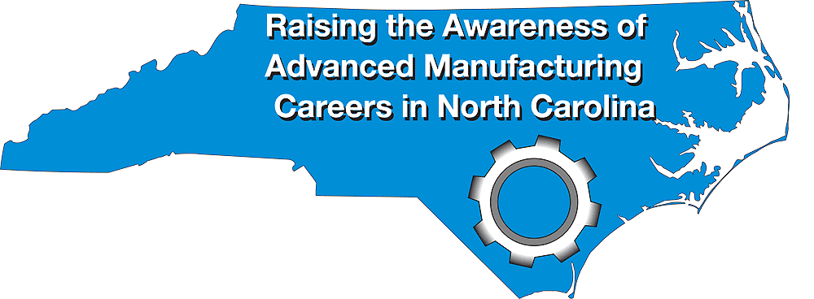
Manufacturing Week
NC Advanced Manufacturing Careers Awareness Week
October 1-5, 2018
September 30 – October 4, 2019
ncperkins.org/manufacturing
Notes:
Does anyone want to talk about any open houses they planned or attended?

Slide 9

Construction Week
NC Construction Careers Awareness Week
April 8-12, 2019
Planning meeting via webinar - November ?? at 9am
ncperkins.org/construction
Notes:
College Open Houses.
Invite the local high schools and middle schools
Talk to LEA CTE Director
Career Development Coordinator at the High School
Invite the public

Slide 10

System Office Conference
October 7-9, 2018 in Raleigh
https://projects.ncsu.edu/mckimmon/cpe/opd/NCCCS
Notes:
Anyone see any great sessions?
Ideas for next time?

Slide 11
Perkins V Workshop
Michael Brustein and Steven Spillan conducted an all-day workshop on the Strengthening Career and Technical Education for the 21st Century Act and EDGAR.
Tuesday, October 9, 2018 from 9:00 AM to 4:00 PM
Greensboro
https://www.bruman.com/north-carolina-perkins-and-edgar-workshop/

Slide 12
Notes:
https://cte.careertech.org/sites/default/files/AdvanceCTE_ACTE_P.L.115-224Summary_Updated082218.pdf

Slide 13
Partnership Conference
NC Job Ready: All In!
October 10-12, 2018
https://www.nccommerce.com/wf/workforce-professionals/ncworks-training-center/partnership-conference
Notes:
https://www.nccommerce.com/wf/workforce-professionals/ncworks-training-center/partnership-conference

Slide 14
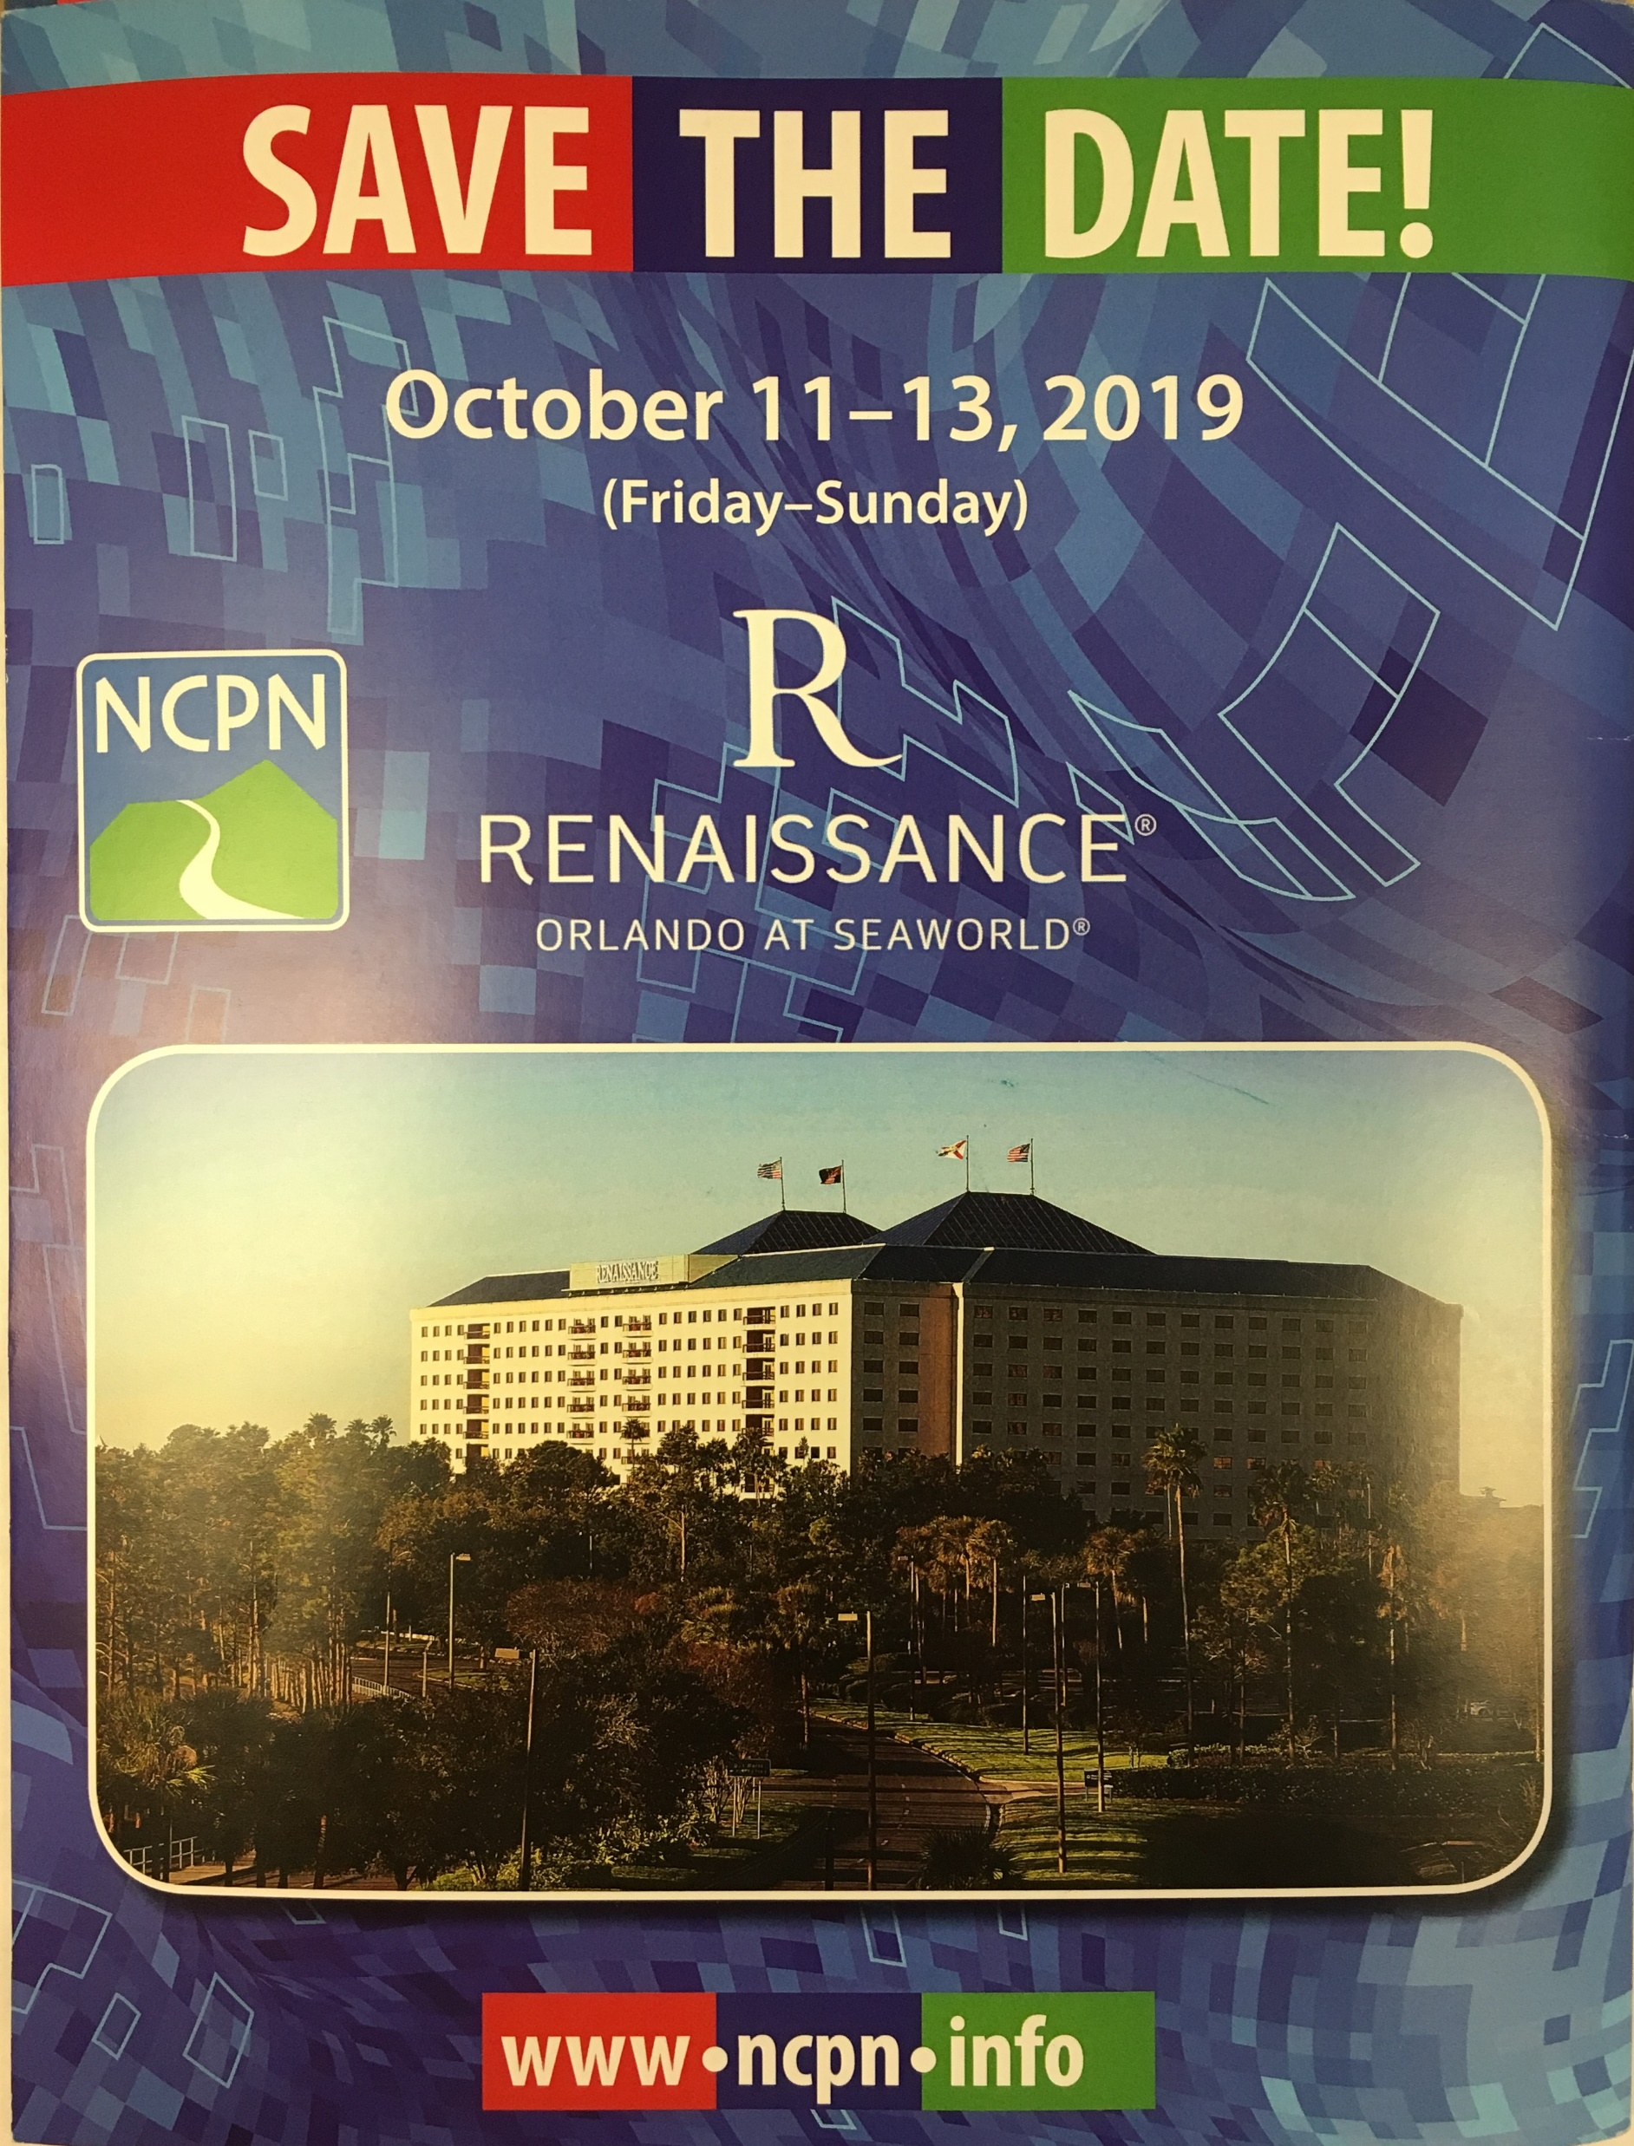
NCPN Conference Reflection
National Career Pathways Network Conference
Attended many interesting sessions
  Career Pathways components and pathways partnerships
  Labor Market Analysis for needs assessments for Perkins V
  Actively engaging employers in program development/improvement (Forsyth Tech)
  Revitalizing STEM Education
  Helping Students find their place (A-B Tech)

Slide 15


Slide 16

ACTE CareerTech VISION 2018
Association for Career & Technical Education
November 28 to December 1, 2018
San Antonio, Texas
http://www.careertechvision.com/
Notes:
http://www.careertechvision.com/

Slide 17

SkillsUSA
Greensboro
April 9-11, 2019
Annual Perkins meeting on Wednesday, April 10
Postsecondary Awards Ceremony on April 10
Notes:
http://www.skillsusanc.org/state-conference

Slide 18
CTE Program Certifications
Taking us to the Next Level…

Slide 19
Perkins Updates
2nd Tuesday of the month
9 am
Via GoToWebinar
Find the registration links at NCperkins.org/presentations
Moved November Update to Wednesday,
November 14, 2018
Notes:
Registration links through December have been posted. Register now and let the system remind you.

Slide 20
Perkins/CTE State Staff
Dr. Bob Witchger Director, Career & Technical Education
WitchgerB@nccommunitycolleges.edu 919-807-7126
Dr. Tony R. Reggi Coordinator, Career & Technical Education
ReggiA@nccommunitycolleges.edu 919-807-7131
Patti Coultas Coordinator, Career & Technical Education
CoultasP@nccommunitycolleges.edu 919-807-7130
Chris Droessler Coordinator, Career & Technical Education
DroesslerC@nccommunitycolleges.edu 919-807-7068
Darice McDougald CTE Administrative Assistant
McDougaldD@nccommunitycolleges.edu 919-807-7129
Notes:
http://www.ncperkins.org/course/view.php?id=6

