Slide 1
Dr. Elizabeth Standafer
Youth Apprenticeship Coordinator

Slide 2
Today’s Topics:
Why was the North Carolina Youth Guide created?
What are the important parts of the guide?
What are some of the best practices from your local area that you can share?
https://www.apprenticeshipnc.com/sites/default/files/file-uploads/nccc-printablehandbook-final-r1-print_quality.pdf

Slide 3
Why was the Youth Guide Created?
To demonstrate the flexibility and customizability of youth programs
To dispel myths and perceived barriers of working with youth
To emphasize the leadership role of industry and to highlight effective partnerships
To make apprenticeship development easier by using common language and sample materials

Slide 5
Setting the Stage on Pgs. 3-11
Introduction to the language of apprenticeship that is simple and informative.

Slide 6
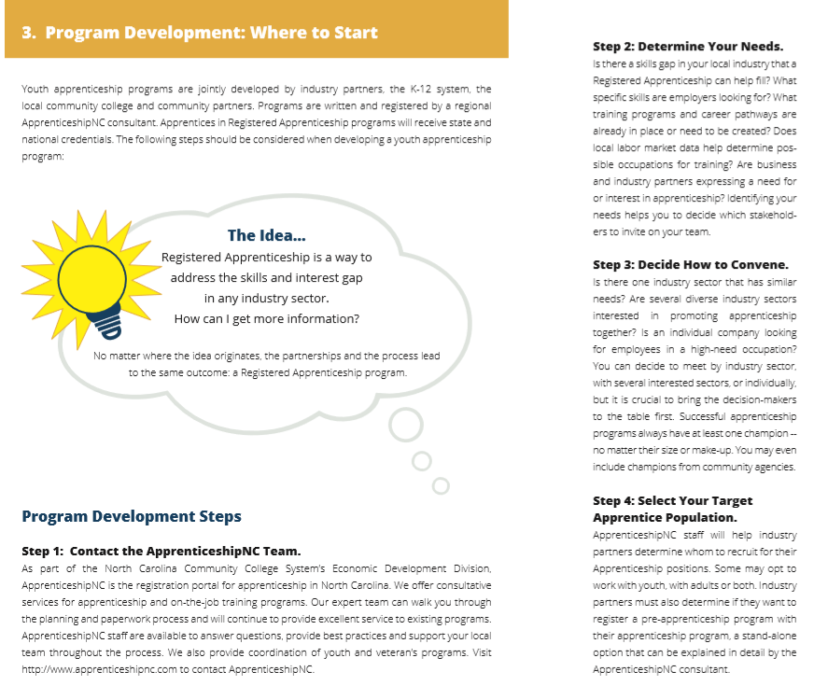
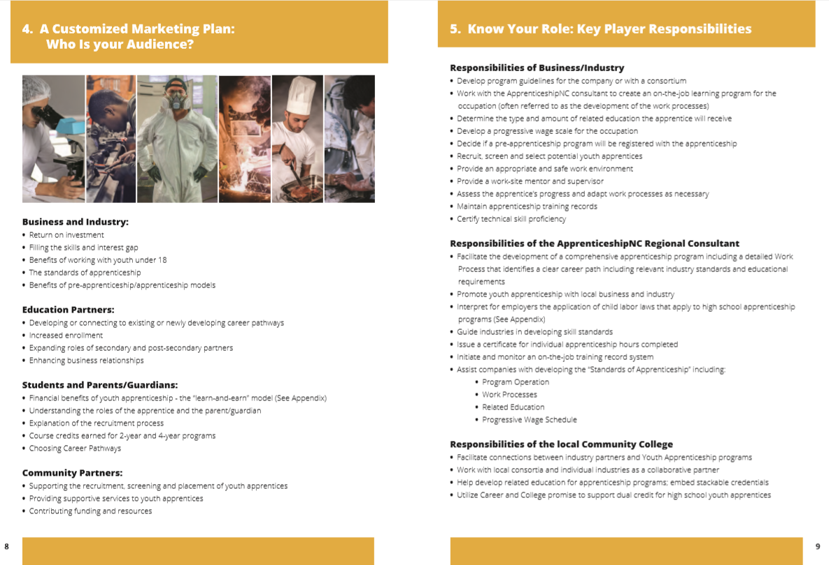
Setting the Stage
2. Guidance for how the reader can begin program development in their local area, talking points for different audiences and the roles of each stakeholder group.

Slide 7
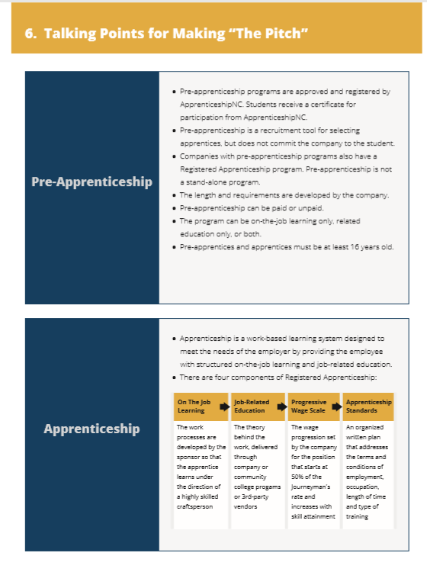
Setting the Stage
3. Provides reproducible materials for making a personalized presentation.
Content cycles throughout the book

Slide 8
Five Minute Group Talk
How did you “set the stage” for youth apprenticeship in your local area?

Slide 9
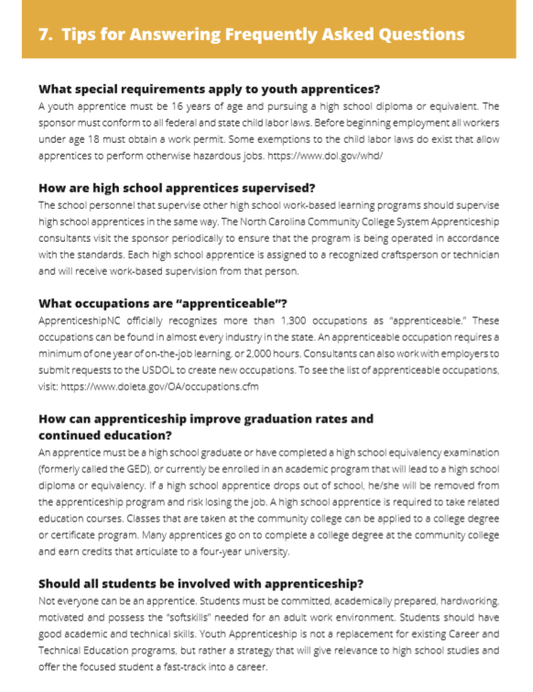
Engaging with Partners Pgs. 13-18
1. Shares guidance for answering the specific programmatic questions.

Slide 10
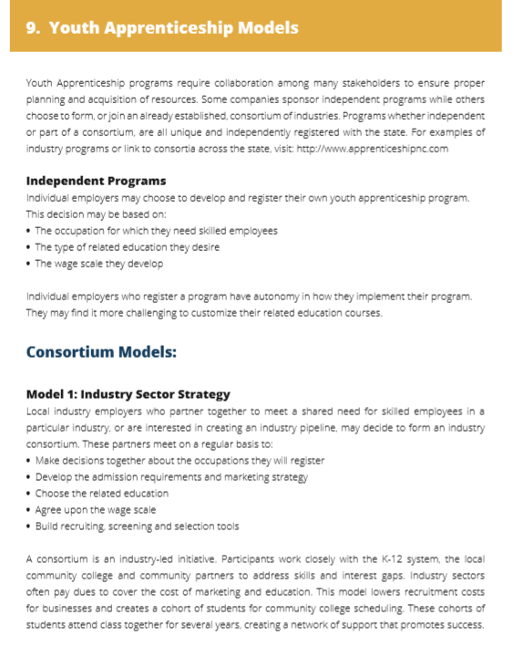
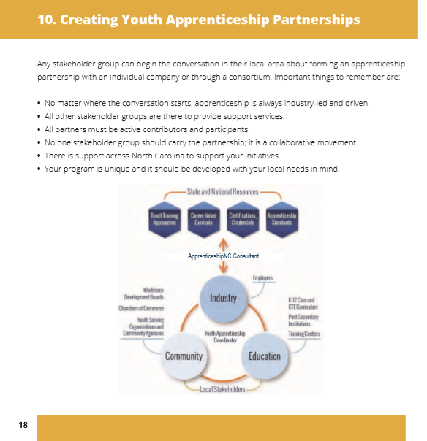
Engaging with Partners
2. Introduces models for how to convene and who to include in local partnerships.

Slide 11
Five Minute Group Talk
What is the key to developing a strong partnership that moves the local area from meeting and talking about apprenticeship to actual implementation?

Slide 12
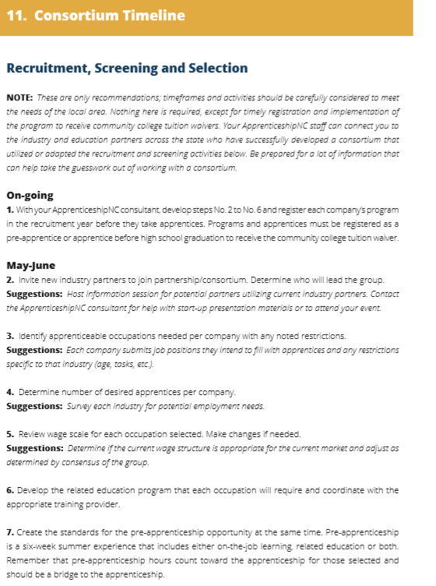
Building the Apprenticeship Program Pgs. 19-23
1. Shares detailed information about when to convene and what to accomplish at each meeting.

Slide 13
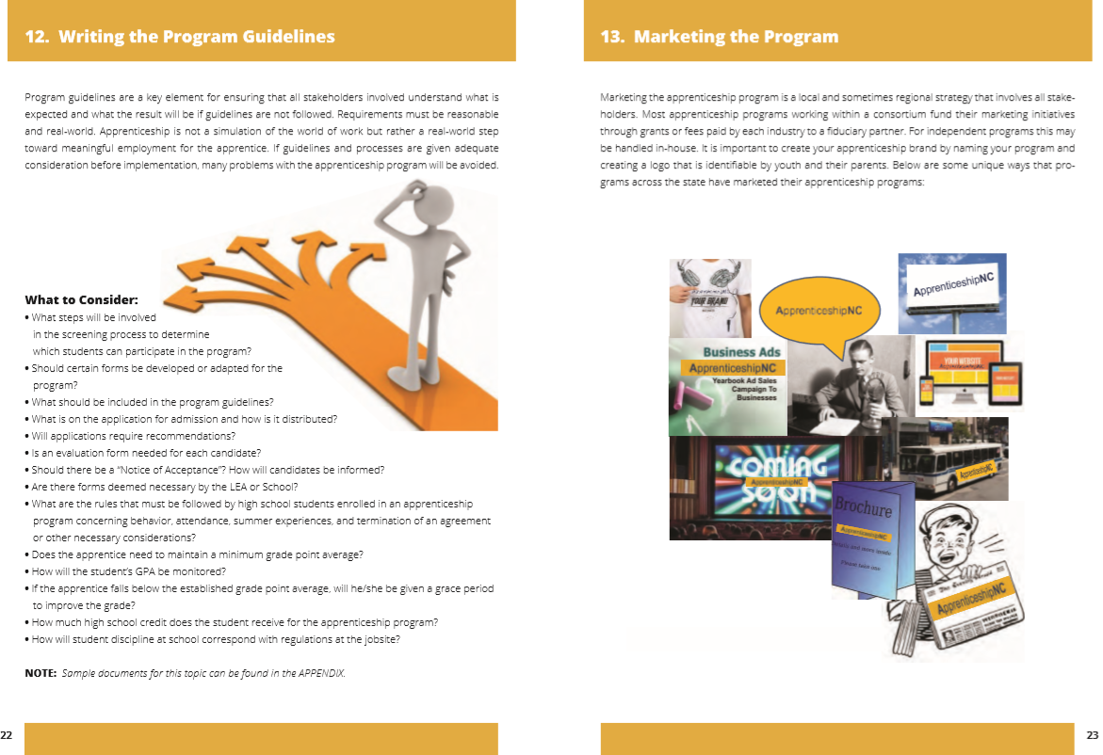
Building the Apprenticeship Program
2. Explains how to lead the group in thinking about the components of the apprenticeship program and how to market them to students.

Slide 14
Five Minute Group Talk
What are important things to consider when building a local apprenticeship program that connects to youth?

Slide 15
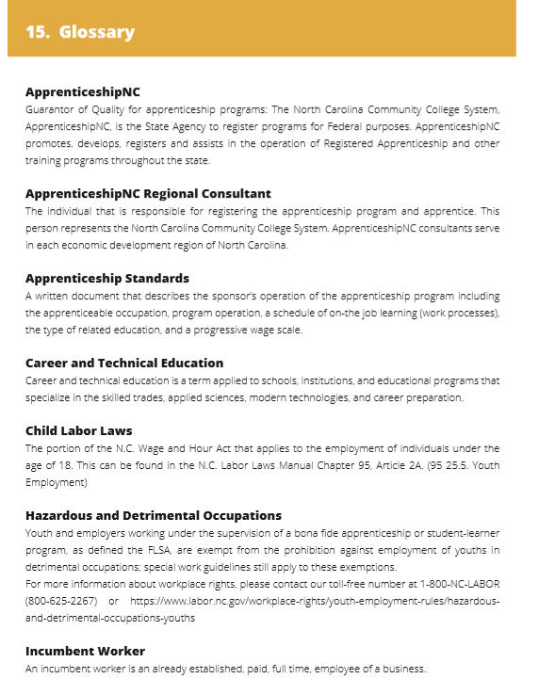
Connecting to Resources Pgs. 24-31
1. Provides quick links from the electronic version to other resources and gives definitions of terms that a group may need during their planning

Slide 16
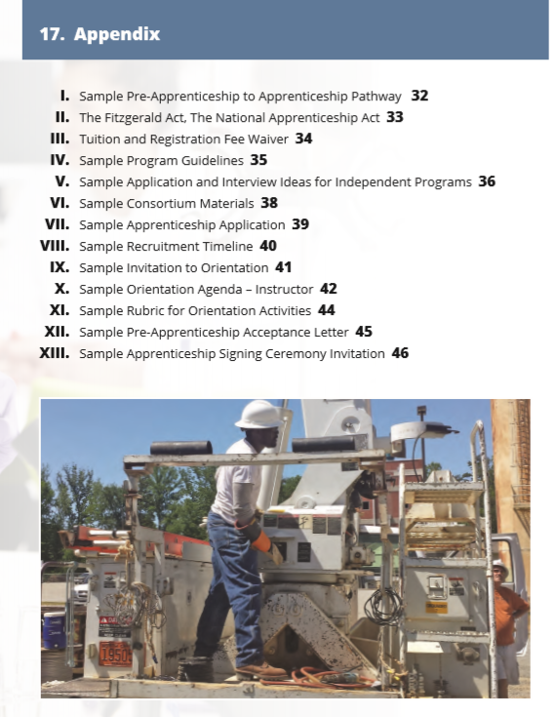
Connecting to Resources
2. Offers generic and adaptable forms and processes for groups to utilize.

Slide 17
Five Minute Group Talk
What is the most valuable resource for a group who is developing their youth apprenticeship program?

Slide 18
Wrap-up and questions
The committee realized the guide would contain a large amount of text.
We wanted the guide to tell the story of apprenticeship in common language in a variety of ways.
Hopefully, with the use of guide words and topic sentences, most questions about youth apprenticeship can be answered!
What questions do you have?

Slide 19
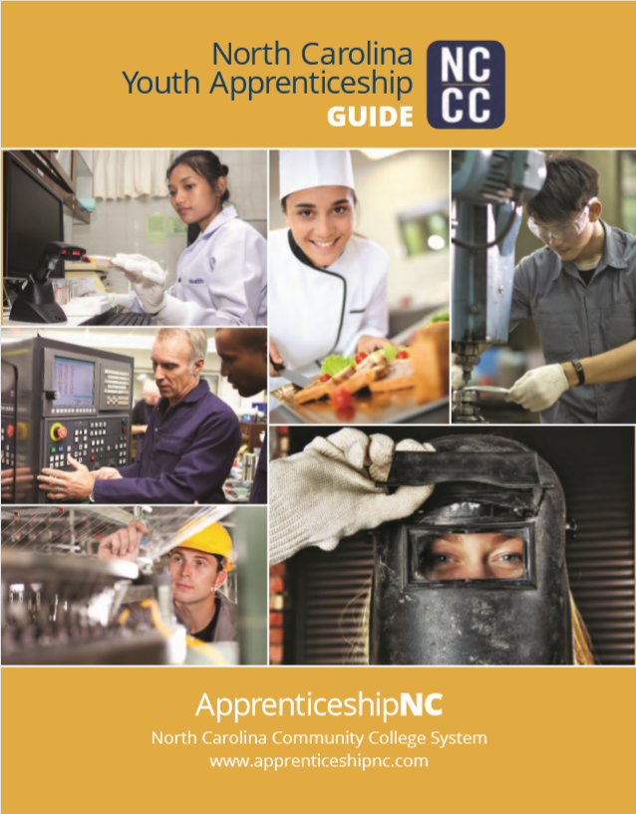
Youth Apprenticeship Guide
https://www.apprenticeshipnc.com/sites/default/files/file-uploads/nccc-printablehandbook-final-r1-print_quality.pdf

Slide 20
http://www.apprenticeshipnc.com

