Slide 1

Perkins Update Webinar
August 14, 2018

Slide 2
New Face
Darice McDougald
New CTE Administrative Assistant
mcdougaldd@nccommunitycolleges.edu
919-807-7129

Slide 3
Budget – Update Webinar August 14, 2018
Budget Modifications will need to be completed with the anticipated passing of budget packet by the State Board of Community Colleges on Friday August 17, 2018. (You will see a slight increase)
When modifying you budget please plan on 6 overnight meetings for faculty and or staff at your college
  2- Meetings for Faculty Enhancement Training (Dr. Lisa Eads)
  1 – Military Articulation Meeting ( Dr. Susan Barbitta)
  1 – Perkins Reauthorization Meeting (Early December)
    The Act, EDGAR – Finance, Collaboration with Workforce
  1- Perkins Mid Year Review and Promising Practice Training
  1- Perkins Year End Evaluation Meeting

Slide 4
Initial vs Final Budget
Extra funds added to Basic Grant
Need to do a budget modification?

Slide 5
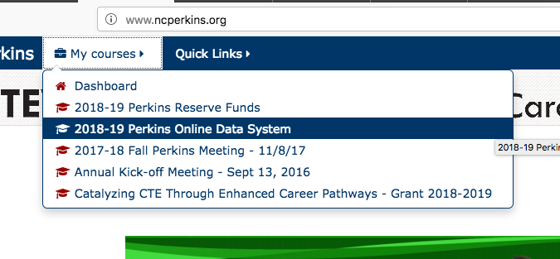
Which Moodle?

Slide 6
DACUM (Developing a Curriculum)
Maggie Brown, Lenoir CC
Debbie Fondow, Guilford Tech CC

Slide 7
Perkins V
2019-2020 transition year
2020-2021 full implementation
more details to come

Slide 8
CCP Catalog at your College
Be sure to include a pathway for students taking CCP courses to continue at your college after they graduate from high school.

Slide 10

Got 'em?

Slide 11
Manufacturing Week
NC Advanced Manufacturing Careers Awareness Week
October 1-5, 2018
Planning meeting via webinar - August 23 at 9am
Planning meeting via webinar - September 20 at 9am
ncperkins.org/manufacturing
Notes:
College Open Houses.
Invite the local high schools and middle schools
Talk to LEA CTE Director
Career Development Coordinator at the High School
Invite the public

Slide 12

System Office Conference
October 7-9, 2018 in Raleigh
Early Bird Registration - September 29
https://projects.ncsu.edu/mckimmon/cpe/opd/NCCCS

Slide 13
Perkins Updates
2nd Tuesday of the month
9 am
Via GoToWebinar
Find the registration links at NCperkins.org/presentations
Next update is September 11, 2018
Notes:
Registration links through December have been posted. Register now and let the system remind you.

Slide 14
Budget – Update Webinar August 14, 2018
Budget Modifications will need to be completed with the anticipated passing of budget packet by the State Board of Community Colleges on Friday August 17, 2018. (You will see a slight increase)
When modifying you budget please plan on 6 overnight meetings for faculty and or staff at your college
  2- Meetings for Faculty Enhancement Training (Dr. Lisa Eads)
  1 – Military Articulation Meeting ( Dr. Susan Barbitta)
  1 – Perkins Reauthorization Meeting (Early December)
    The Act, EDGAR – Finance, Collaboration with Workforce
  1- Perkins Mid Year Review and Promising Practice Training
  1- Perkins Year End Evaluation Meeting

Slide 15
Perkins/CTE State Staff
Dr. Bob Witchger Director, Career & Technical Education
WitchgerB@nccommunitycolleges.edu 919-807-7126
Dr. Tony R. Reggi Coordinator, Career & Technical Education
ReggiA@nccommunitycolleges.edu 919-807-7131
Patti Coultas Coordinator, Career & Technical Education
CoultasP@nccommunitycolleges.edu 919-807-7130
Chris Droessler Coordinator, Career & Technical Education
DroesslerC@nccommunitycolleges.edu 919-807-7068
Darice McDougald CTE Administrative Assistant
McDougaldD@nccommunitycolleges.edu 919-807-7129

