Slide 1

Perkins Update Webinar
March 13, 2018

Slide 2
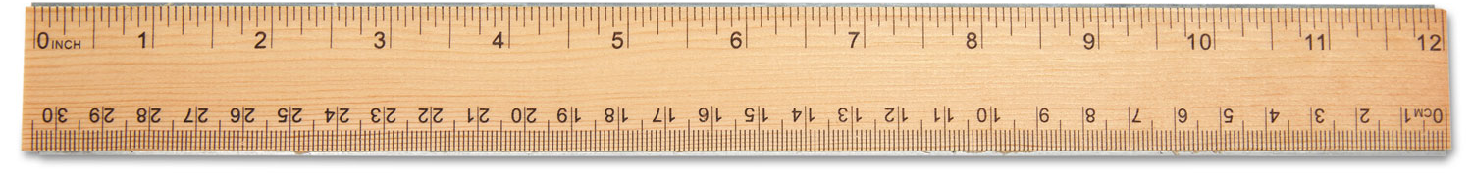
Performance Measures
Discussion and Ideas on Strategies for Improvement Plans
Perkins 2017-18 Improvement Plans due March 23
March 26 webinar about 5P1/5P2
1P1 - 2P1 - 3P1 - 4P1 - 5P1 - 5P2

Slide 3

Negotiated Levels of Performance
Updates

Slide 4
Monitoring
Desk Monitoring – letters have been sent out
Emphasis on staff allocation in budget
Due March 12, 2018

Slide 5
Perkins Handbook
Updating
Plan of Action for the year
Calendar dates
Required and Permissive use of funds
Strategies for completing Perkins forms

Slide 6

Skills USA – State Competition
April 18-20, 2018
Greensboro

Slide 7
Annual Planning Meeting
April 18, 2018 - Perkins 101
  For New Perkins Contacts
April 19, 2018 - Perkins Annual Planning Meeting
  10-noon - tour SkillsUSA competitions and lunch
  1-5 pm meeting at Koury
  6:30 pm postsecondary awards ceremony
Eventbrite sign up
Agenda

Slide 8
End of Year Reviews
May 3-19, 2018
Online via GoToWebinar
Have plan completed
On-page summary of activities for the year (bullets)
Short best practice video

Slide 9

NCETA Conference
April 4-6th, 2018
Wilmington
www.nceta.org

Slide 10

Construction Careers Awareness Week
April 9-13, 2018
Planning Webinar – March 27, 2018 @ 9am
NCperkins.org/construction

Slide 11

System Office Conference
October 7-9, 2018 - Raleigh
Call for Presenters
https://projects.ncsu.edu/mckimmon/cpe/opd/NCCCS

Slide 12
Perkins Update
Perkins Update Meeting on April 10
Next on May 8, 2018 @ 9 am
Go to NCperkins.org/presentations to register, download the PowerPoint, and watch recordings.

Slide 13

New Perkins Coordinator
In final steps of hiring
Reports to work on April 9, 2018

Slide 14
Perkins/CTE State Staff
Dr. Bob Witchger Director, Career & Technical Education
WitchgerB@nccommunitycolleges.edu 919-807-7126
Dr. Tony R. Reggi Coordinator, Career & Technical Education
ReggiA@nccommunitycolleges.edu 919-807-7131
vacant Coordinator, Career & Technical Education
xxxxx@nccommunitycolleges.edu 919-807-7130
Chris Droessler Coordinator, Career & Technical Education
DroesslerC@nccommunitycolleges.edu 919-807-7068
Jennifer Holloway CTE Administrative Assistant
HollowayJ@nccommunitycolleges.edu 919-807-7129

