Slide 1
A Changing World: Helping people prepare for career and life success
Chris Droessler, CTE Coordinator
NCperkins.org/presentations
Notes:
The job market has changed considerably from when we graduated from high school.
Good morning. I am Chris Droessler, -- from your North Carolina Community College System.
If you have a smart phone, and you are smart enough to use it, you can capture that QR code, and your phone or tablet takes you to the webpage where you can download a copy of this PowerPoint file.
Or you can just go to NCperkins dot org and click on the “presentations” link.
How many of you have already downloaded my presentation??
Warning: I talk fast and have lots of information to cover. My goal is to get the information to you so that you can go back and digest it later.
I have documented my information sources in the notes section of the PowerPoint, to allow you to further research anything that you see here.
In fact, the notes from which I am reading are there as well.
(In some cases I am reading directly from an original source, because they said it so well.)
Download the PowerPoint and use it any way you wish –
use single slides or the whole presentation. -- --
If it will help people get on the right career path – that's great.. --
This presentation takes a hard look at where we are -- and where we should be -- in preparing the citizens of North Carolina for the future job market.
=====
www.NCperkins.org/presentations
====
NCWorks Career Coach Meeting
September 19, 2017
Graham, NC

Slide 2
You can’t see the whole sky through a bamboo tube
Notes:
An Ancient Japanese proverb says “You can’t see the whole sky through a bamboo tube.”
We are trained from an early age to look at things through a tube.
Our education system is set up to train students to look at math, English, and other subjects in isolation from each other.
The focus is on doing just enough in those independent classes to make the grade you wish and move on.
If you are caught looking at the world outside your bamboo tube, -- you might be accused of -- cheating.
Just as you can not see the whole sky by looking through a bamboo tube, you can’t learn everything from me.
So I’ll show you what I have been looking at through my own bamboo tube.
And I’ll show you some of the things that I get to see when I put the bamboo tube aside -- and just look at the whole sky.
====
Quote
http://www.rodneyohebsion.com/japan.htm
http://www.worldofproverbs.com/2012/04/you-cant-see-whole-sky-through-bamboo.html
Panda photo
https://www.flickr.com/photos/kjdrill/148617834/sizes/z/

Slide 3
Begin with the End in Mind
What do you want to be when you grow up?
Notes:
Stephen Covey’s second habit of highly effective people says “Begin with the end in mind.”
Too often that habit is summed up with the phrase “What do you want to be when you grow up?”
This habit relies on using your imagination, -- which is something that is not often valued in our society, especially in education and training. We have become accustomed to allowing others tell us how to act -- and where to go.
You should be in charge of your own life.
And we have to help others do the same, or we end up like riding in bumper cars without a steering wheel.
Always reacting to outside stimulations -- rather than creating our own path.
=====
Steven Covey
https://www.stephencovey.com/7habits/7habits-habit2.php
Tortoise race
https://theleadershipwiki.wikispaces.com/Begin+with+the+End+in+Mind

Slide 4
What do we want our future to look like?
Notes:
The end for this presentation is the future.
(About an hour into the future to be precise.)
What will the future look like?
(Not an hour from now, but like ten or twenty years in the future.)
The more important question is:
“What do we want our future to look like?”
=====
https://i.ytimg.com/vi/MFEw37uMQyM/maxresdefault.jpg

Slide 5
Notes:
We all got a glimpse of the future by watching the Jetsons.
But that was back in the early Nineteen Sixties.
That was over 50 years ago.
Several years before we actually stepped foot on the moon, the Jetsons were showing us life in the future.
Is this the world we are preparing our youth to take over and run?
Have we asked them, the youth, what they want?
======
http://lovelace-media.imgix.net/uploads/315/297c6fd0-e98c-0131-6d32-0aa0f90d87b4.jpg?

Slide 6
NC Education Plan
All students must graduate from high school and be career, college, and citizenship READY.
Notes:
6
Here is the simplified version of our state school board mission.
Since you will be working with high school students, you need to know the plan for K-12 education in North Carolina.
- You should also get to know the mission statement of the school district in which you will work.
Figure out how the work you do supports the mission of your school, school district, and the state plan you see here.
So… the NC Education Plan says "Every graduate must be career, college, and citizenship ready."
Notice the “and.” That means we recognize that everyone needs to be ready for all three.
Career ready means they have the technical skills and soft skills for which the employer is looking, and they are ready to get and keep the job.
“College ready” does not mean that everyone needs a four-year college degree. It means some kind of training after high school as well as life-long learning.
The learning does not stop after high school graduation.
With the ever-changing world in which we live, everyone must continuously learn to keep up with the latest in their chosen profession.
Today we focus on the Career-ready part. The schools usually focus on the college-ready part.
===
http://legislative.ncpublicschools.gov/resources-for-legislation/2012/20120608-sup-howmeasure.pdf

Slide 7
Surprises Future Demand Articulation Changing World
www.ncPerkins.org/presentations
Notes:
Here is what we will be covering today.
Surprises in the job market,
Future Demand in occupations and the business world,
Articulation between high school and college programs
And Our Changing World – especially as it relates to jobs of the future.
→
We will start with a few facts that might surprise you.

Slide 8
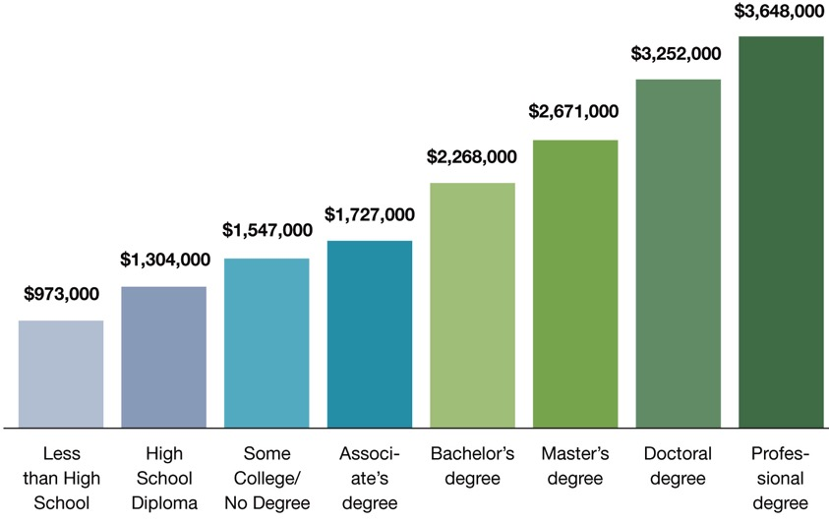
Degree Level Matters People with more education make more money than those with less education
Notes:
This chart shows that, on average, people earn more over their lifetime if they have a higher level of education.
There’s no surprise here.
But the reason I include this chart is to remind you that this chart shows people who are currently employed.
What does chart this say to our students who will be employed a few years from now?
Will the chart look different for them?
What if lifetime education costs and student loan interest is figured in? Does that narrow the gap?
What about the cost of business attire, business social expenses, club memberships, and other expenses that might be different at different levels of employment?
What does this chart tell our students about their future?
====
http://cew.georgetown.edu/collegepayoff/
http://www9.georgetown.edu/grad/gppi/hpi/cew/pdfs/collegepayoff-summary.pdf
Page 4, 5
8

Slide 9
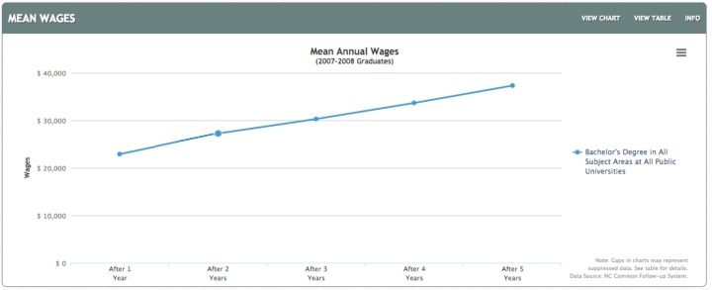
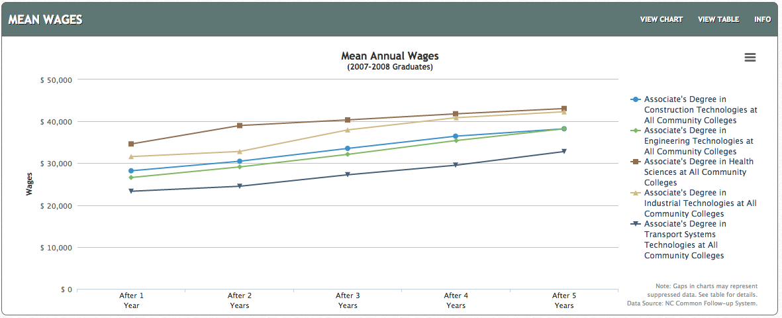
$37,318
$22,896
NC Bachelor Degree
$32,800- $43,062
$23,316- $34,619
NC Associate Degrees
Notes:
First – Apologies for the age of the data. This is the latest that has been released. And I want to show a progression of five years of data.
On the top you see the first five years of mean salaries for all graduates of all North Carolina Bachelor Degree programs. This is the Mean wage, which many refer to as the average.
The bottom chart shows graduates from Associate Degree programs from our North Carolina Community Colleges.
After five years of working, a bachelor degree graduate in North Carolina earned an average of 37 thousand, 3 hundred and 18 dollars.
Whereas an associate degree graduate earned between 32 and 42 thousand dollars depending on the program area.
-Health Science and Industrial Technologies are the two programs with the highest wages. Higher than the 4-year degrees.
And not only do the graduates of the 2-year program make more money than the graduates of the 4-year programs, think about the student loans to pay back.
A 4-year program at a state university costs about ten times as much as a 2-year program at a community college.
Considering the cost of the education, and the student loans to pay back, who will be able to buy that fancy car sooner?
The web addresses where you can find all of my data sources is in the Notes section under each slide.
At this website you can break it down by exact degree and specific college.
You could do this for the technical programs offered at your specific high school and community college and share them with the students, parents, and school counselors.
Forget what you have been told in the past about education and salaries. – This is the new reality.
====
http://nctower.com/output/unc/7810/
2007-2008 Bachelor Degree graduates from All NC Universities
http://nctower.com/output/ncccs/4840-4946-4797-4887-5059/
2007-2008 graduates from selected Associate Degree programs in NC

Slide 10
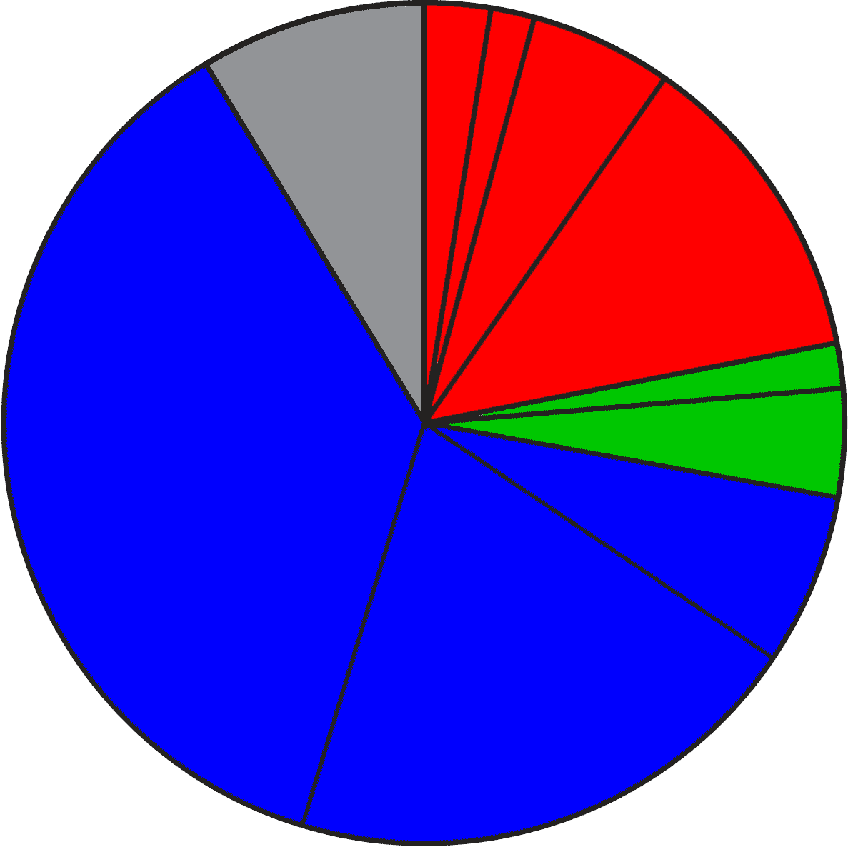
2024 Projected NC Employment: Education Required
Doctorate & Professional degree
work exp.
Master’s degree
8.0%
Bachelor + work exp.
4.8%
Bachelor’s degree
11.6%
4.8%
Associate degree
3.9%
37.0%
1,2 year college
short OJT
6.2%
long OJT
19.0%
moderate OJT
Notes:
Here is the breakdown of the minimum education required for all jobs projected in North Carolina in the year 2024.
The red jobs require four or more years of college.
Green jobs require one or two years of college.
You will notice that the largest portion, in blue, are the jobs that do not require any formal education past high school in order to get the job. They require various amounts of On-The-Job Training.
====
NC Employment Security Commission data via www.CareerOutlook.US
http://careeroutlook.us/
These are for all jobs that get a paycheck, not for contracted positions, or small business owners who do not write themselves a paycheck.
NC Projections for 2024
2.61% Doctoral or professional degree
2.13% Master's Degree
4.77% Bachelor's Degree plus work experience
11.60% Bachelor's Degree
4.75% Associate Degree
3.92% One/two years of college
6.20% Long-term on-the-job (OJT) training
19.04% Moderate-term on-the-job (OJT) training
36.96% Short-term on-the-job (OJT) training
8.01% Work experience in a related occupation

Slide 11
2015 NC High School: Graduate Intentions
Other
Employment
9.7%
Military
Trade and
Business
Schools
4.6%
Public Senior
Institutions
34.4%
Private
Junior
Colleges
37.2%
Community and
Technical Colleges
10.4%
Private Senior
Institutions
Notes:
Since you will be working with high school students, you need to know what they are thinking.
Here you see the breakdown of the postsecondary intentions of our North Carolina high school graduates.
The red shows that almost half of our high school graduates say they are going to a four-year college program.
The green is one or two years at a community college, junior college, or trade school.
The blue is joining the military or going directly into employment.
The Other category is the one-and-a-half percent of our recent high school graduates who plan to sit on Mom’s couch the rest of their lives texting their friends.
=====
http://www.ncpublicschools.org/fbs/resources/data/
NC Public Schools Statistical Profile 2014-2015
Pupil Information
Table 12.1 High School Graduates by Intentions
Of the 96,846 graduates in the class of 2015, here is where they say they are going after high school.
34.4% Public Senior Institutions
10.4% Private Senior Institutions
37.2% Community/Technical College
0.5% Private Junior College
1.2% Trade/Business School
4.6% Military
9.7% Employment
1.9% Other

Slide 12
Postsecondary Intentions vs. Reality
Graduate Intentions
Education Required
8.0%
OJT
4 year
14.3%
21.1%
4 year
8.7%
44.8%
1-2 year
1-2 year
OJT
38.9%
62.2%
Notes:
Here we can compare these two charts.
On the left is where the high school students say they are going, and on the right is what kind of education the jobs require.
→almost 45 percent of our high school students say they are going to a four-year college program, which will prepare them for 21 percent of the job openings. Do you see that in the red part of the two charts?
If you do the math, it looks like half of them will be left holding a sheepskin with no job to show for it. We’ll discus that in a few minutes.
→Likewise, in green you see that 39 percent of our high school graduates say they are going to a one- or two-year program at a community college or private training facility.
This prepares them for almost 9 percent of the jobs.
Whether you use old math or new math, you still see that there is some disparity between the number of people going into a postsecondary education program and the number of jobs that will demand that kind of education.
→Though the blue on the right shows that 62 percent of the jobs do not require postsecondary education (that means that you can get any of those blue jobs right out of high school), there are community college and technical school programs for most of these blue jobs, which means that the education is not required, but in these days of high unemployment, the postsecondary education is preferred, and you will be more likely to get hired, and might start at a higher salary.
=============
21.11% four or more years of college
8.67% 1-2 years of college
62.21% OJT - On the job training
8.01% Work experience in a related occupation

Slide 13
Short OJT NC starting salaries - high-projected demand 2024
$27,900 Loan Interviewers and Clerks
$26,640 Costume Attendants
$22,000 Medical Equipment Preparers
$21,110 Healthcare Support Workers, all other
$20,850 Helpers--Brickmasons, Blockmasons, Stonemasons, and Tile and Marble Setters
$20,400 Occupational Therapist Aides
$20,170 Helpers--Carpenters
$19,850 Physical Therapist Aides
$18,470 Helpers--Painters, Paperhangers, Plasterers, and Stucco Masons
$17,530 Helpers--Roofers
$17,410 Nursing Assistants
$17,290 Veterinary Assistants and Laboratory Animal Caretakers
$16,990 Taxi Drivers and Chauffeurs
$16,410 Personal Care Aides
$16,410 Home Health Aides
Notes:
Let’s look at some salaries.
Here you see the jobs that require short O J T or on-the-job training.
And I am showing you only jobs that are projected to be in high demand over this 10-year projection period.
Short OJT means you can get one of these jobs right out of high school, and within a month you know all you need to know to do the job.
You do not see life-sustaining wages here, but these jobs could be a start on a pathway to a higher-paying occupation.
=====
CareerOutlook.us
These are all ”high demand” occupations, projected to have high growth over the 2014-2024 projection period.
Estimated average salary for all entry-level (first-year) workers in this occupation in North Carolina in 2016. Technically it is the annual 10th percentile wage.

Slide 14
Moderate OJT NC starting salaries - high-projected demand 2024
$29,300 Dental Assistants
$26,480 Computer-Controlled Machine Tool Operators, Metal and Plastic
$25,300 Mechanical Door Repairers
$25,270 Cement Masons and Concrete Finishers
$24,890 Roofers
$23,530 Medical Assistants
$23,110 Insulation Workers, Floor, Ceiling, and Wall
$20,770 Ambulance Drivers and Attendants, Except Emergency Medical Technicians
$18,670 Construction Laborers
$18,430 Floor Layers, Except Carpet, Wood, and Hard Tiles
Notes:
Moderate on-the-job training means you need more than a month of training, but within a year, you are ready to work by yourself.
There are community college programs for many of these jobs, but they are not required by the workforce for entry-level employment, but would make you more hirable.
We are looking only at high-demand occupations.
=====
CareerOutlook.us
These are all ”high demand” occupations, projected to have high growth over the 2014-2024 projection period.
Estimated average salary for all entry-level (first-year) workers in this occupation in North Carolina in 2016. Technically it is the annual 10th percentile wage.

Slide 15
Long OJT NC starting salaries - high-projected demand 2024
$34,650 Electrical Power-Line Installers and Repairers
$29,390 Computer Numerically Controlled Machine Tool Programmers, Metal and Plastic
$25,960 Opticians, Dispensing
$25,370 Brickmasons and Blockmasons
$21,940 Medical Appliance Technicians
$16,630 Cooks, Restaurant
Notes:
Long on-the-job training means you can get these jobs right out of high school, but it will take on-the-job training for over a year to get you completely trained.
Most of these jobs have training programs at our community colleges. Which means you could get the training first, and then probably start at a higher salary.
An Apprenticeship program could be the pathway to these occupations.
=====
CareerOutlook.us
These are all ”high demand” occupations, projected to have high growth over the 2014-2024 projection period.
Estimated average salary for all entry-level (first-year) workers in this occupation in North Carolina in 2016. Technically it is the annual 10th percentile wage.

Slide 16
1-2 Year Diploma/Certificate NC starting salaries - high-projected demand 2024
$32,610 Surgical Technologists
$25,070 Health Technologists and Technicians, all other
$23,400 Medical Secretaries
$20,870 Massage Therapists
$16,100 Gaming Dealers
Notes:
These jobs require one or two years at a community college or other training school.
You might end up with a diploma or a certificate, but not an Associate degree.
The starting salaries are not much better than the jobs that do not require any college work.
Some of these require a state license in order to work in these occupations.
=====
CareerOutlook.us
These are all ”high demand” occupations, projected to have high growth over the 2014-2024 projection period.
Estimated average salary for all entry-level (first-year) workers in this occupation in North Carolina in 2016. Technically it is the annual 10th percentile wage.

Slide 17
Associate Degree NC starting salaries - high-projected demand 2024
$56,130 Radiation Therapists
$52,050 Dental Hygienists
$49,640 Diagnostic Medical Sonographers
$44,960 Cardiovascular Technologists and Technicians
$43,910 Registered Nurses
$42,870 Occupational Therapist Assistants
$42,680 Physical Therapist Assistants
$42,540 Respiratory Therapists
$27,900 Medical and Clinical Laboratory Technicians
$21,520 Veterinary Technologists and Technicians
Notes:
Here is where you see the jump in salaries.
These are the jobs that are predicted to be in high-demand that require an Associate Degree.
Note that most of these occupations are the “helping” or “assisting”-type jobs in the Healthcare industry.
All of the “assisting”-type jobs in the Healthcare industry are in high demand, -- were in high demand throughout the recent recession, -- and should stay in high demand for many years to come -- to help support the aging baby boomers.
=====
CareerOutlook.us
These are all ”high demand” occupations, projected to have high growth over the 2014-2024 projection period.
Estimated average salary for all entry-level (first-year) workers in this occupation in North Carolina in 2016. Technically it is the annual 10th percentile wage.

Slide 18
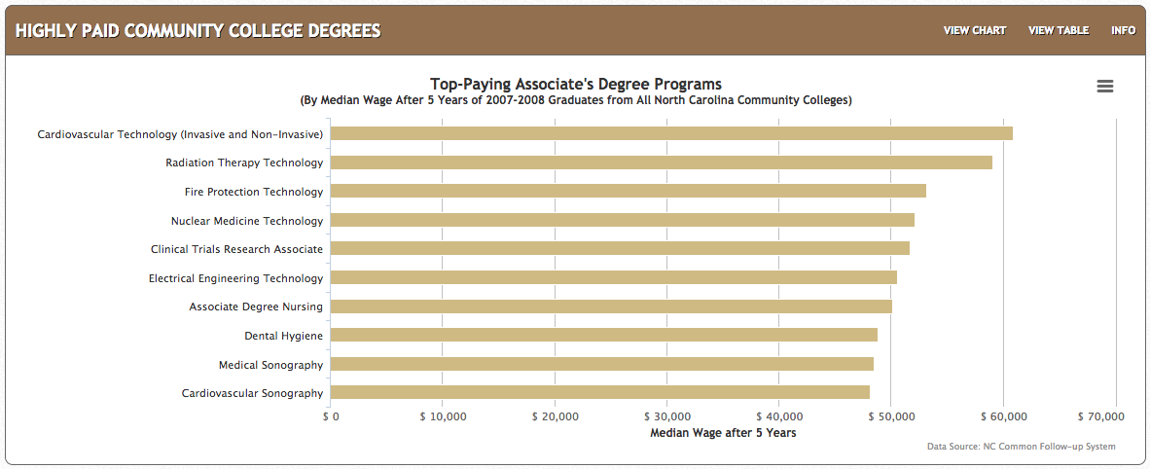
NC Top-Paying Associate Degrees: after five years of employment
$60,869
$59,102
$48,160
Notes:
Here are the actual salaries for Associate Degree graduates from our North Carolina Community Colleges.
These are the highest paying jobs, five years after graduation.
- Cardiovascular Technicians make almost 61 thousand dollars, and the
- Radiation Therapy Technicians make 59 thousand dollars.
Keep an eye on the last two on this list.
I predict an increasing demand for Sonographers – as many industries are finding more uses for this technology, -- and it’s not just in healthcare.
====
http://nctower.com/
2007-2008 graduates from All NC Community Colleges

Slide 19
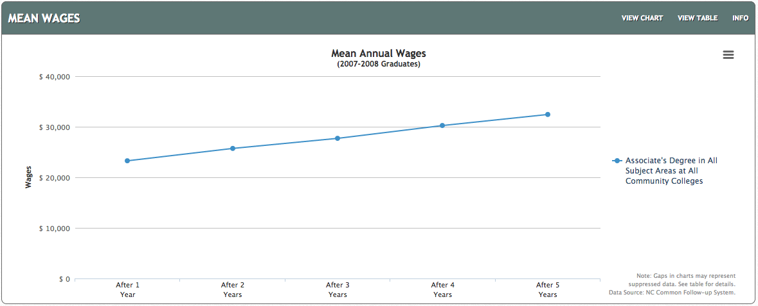
All NC Associate Degrees – Five-Year Wages
$32,431
$23,277
Notes:
The Average wage - the first year out of college with a North Carolina Associate Degree is about 23 thousand dollars.
After 5 years, the average wage is about 32 thousand dollars.
That’s really good.
====
http://nctower.com/output/ncccs/4506/2008/
2007-2008 graduates from all Associate Degree programs in NC

Slide 20
NC Selected Associate Degrees – Five-Year Wages
$43,062
$34,619
$32,800
$23,316
Notes:
And here are the salaries for some specific technical program areas.
Five years out of college, the average salary for all Associate Degree graduates in Health Sciences and Industrial Technologies is about 43 thousand dollars.
Transport Systems Technologies is the low line on this chart making almost 33 thousand dollars after five years of work.
====
http://nctower.com/output/ncccs/4840-4946-4797-4887-5059/
2007-2008 graduates from selected Associate Degree programs in NC
The five year mark is the year 2013.

Slide 21
Bachelor Degree NC starting salaries - high-projected demand 2024
$76,020 Physician Assistants
$59,460 Software Developers, Applications
$56,610 Computer Systems Analysts
$55,560 Occupational Therapists
$49,710 Financial Analysts
$48,500 Financial Examiners
$47,180 Technical Writers
$46,710 Biomedical Engineers
$45,120 Personal Financial Advisors
$44,100 Credit Analysts
$41,550 Medical and Clinical Laboratory Technologists
$39,670 Cartographers and Photogrammetrists
$36,150 Healthcare Social Workers
$33,860 Orthotists and Prosthetists
$33,200 Therapists, all other
$31,530 Loan Officers
$29,800 Athletic Trainers
$29,190 Credit Counselors
Notes:
And now the Bachelor's degree – a four-year degree program at a college or university is required to get these jobs.
And this is showing only the jobs projected to be in high demand
The starting salaries are a little higher than most Associate degrees, but not all.
=====
CareerOutlook.us
These are all ”high demand” occupations, projected to have high growth over the 2014-2024 projection period.
Estimated average salary for all entry-level (first-year) workers in this occupation in North Carolina in 2016. Technically it is the annual 10th percentile wage.

Slide 22
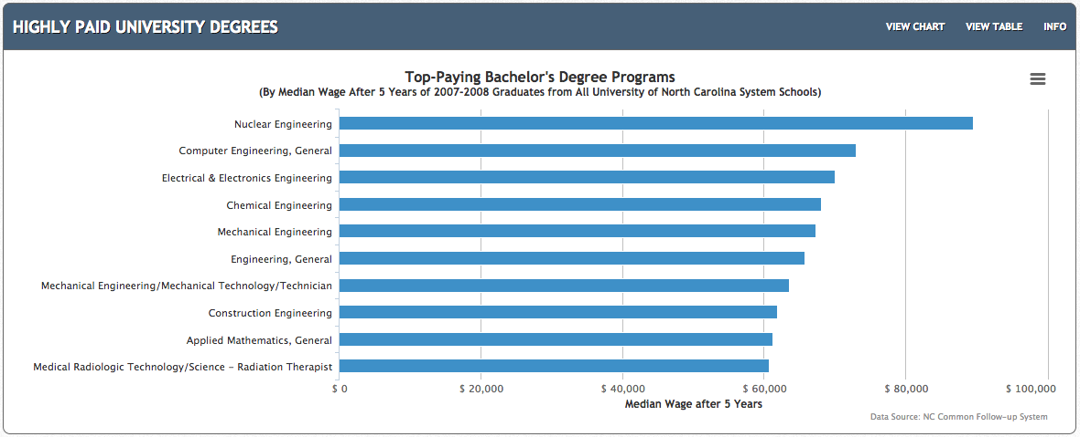
NC Top-Paying Bachelor Degrees
$89,537
$60,704
Notes:
Here are the actual salaries for Bachelor Degree graduates from our North Carolina public universities.
These are the average salaries after working for five years. These are actual North Carolina salaries, not just a projection.
In 2013, Nuclear Engineering was the highest paying at 89 and a half thousand dollars.
You see lots of Engineers on this list because the pay is good, but how about the chances of getting a job?
We will look at that in a minute.
====
http://nctower.com/
2007-2008 graduates from All NC Universities

Slide 23
All NC Bachelor Degrees - Five-Year Wages
$37,318
$22,896
Notes:
For the folks who graduated with a Bachelor’s Degree from a North Carolina Public University,
the average salary after five years of work is just above 37 thousand dollars.
But ---
====
http://nctower.com/output/unc/7810/
2007-2008 Bachelor Degree graduates from All NC Universities

Slide 24
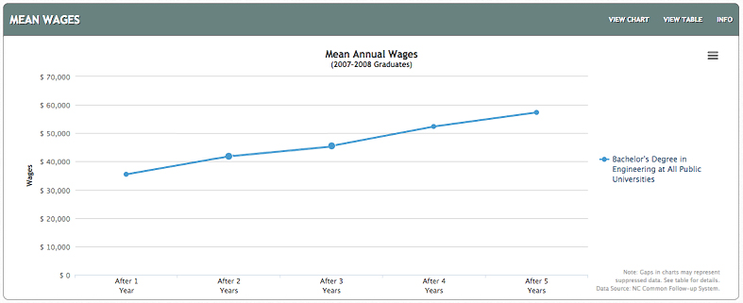
NC Engineering Bachelor Degree Five-Year Wages
$57,338
$35,483
Notes:
But -- if you look at just the graduates with a Bachelor’s Degree in Engineering,
They started working at just 35 thousand dollars, and after five years jumped to 57 thousand dollars.
Later on we will see how only half of these graduates are getting a regular paycheck.
====
http://nctower.com/output/unc/7901/
2007-2008 Bachelor Degree, Engineering graduates from All NC Universities

Slide 25
Masters Degree NC starting salaries - high-projected demand 2024
$59,250 Physical Therapists
$58,040 Statisticians
$54,180 Audiologists
$45,530 Speech-Language Pathologists
$42,170 Operations Research Analysts
$37,780 Survey Researchers
$35,610 Market Research Analysts and Marketing Specialists
$34,010 Health Specialties Teachers, Postsecondary
$33,420 Mental Health Counselors
$33,060 Mental Health and Substance Abuse Social Workers
$32,240 Substance Abuse and Behavioral Disorder Counselors
Notes:
These occupations require a Master’s Degree. That’s two more years beyond a Bachelor’s Degree,
But the salaries you see here are mostly lower than the occupations that require only a bachelor’s degree, and similar to the starting salaries for occupations that require only an Associate degree.
It does not always make sense.
Sometimes higher education does not mean higher salary. This is why your students need to explore these data to see what occupation meets all of their requirements.
=====
CareerOutlook.us
These are all ”high demand” occupations, projected to have high growth over the 2014-2024 projection period.
Estimated average salary for all entry-level (first-year) workers in this occupation in North Carolina in 2016. Technically it is the annual 10th percentile wage.

Slide 26
Doctorate/Professional Degree NC starting salaries - high-projected demand 2024
>$208,000 Oral and Maxillofacial Surgeons
>$208,000 Anesthesiologists
$191,820 Surgeons
$149,890 Orthodontists
$113,660 Psychiatrists
$113,150 Dentists, General
$73,390 Optometrists
$46,000 Law Teachers, Postsecondary
$45,000 Nursing Instructors and Teachers, Postsecondary
$42,060 Clinical, Counseling, and School Psychologists
$39,710 Criminal Justice and Law Enforcement Teachers, Postsecondary
Notes:
These occupations require a Doctorate or Professional Degree.
The federal government does not report salaries above 208 thousand dollars, so that is why you see the greater-than symbol.
Some of these high-demand occupations pay less than the occupations requiring an Associate Degree,
but they have the potential to raise much higher over the course of a career.
=====
CareerOutlook.us
These are all ”high demand” occupations, projected to have high growth over the 2014-2024 projection period.
Estimated average salary for all entry-level (first-year) workers in this occupation in North Carolina in 2016. Technically it is the annual 10th percentile wage.

Slide 27
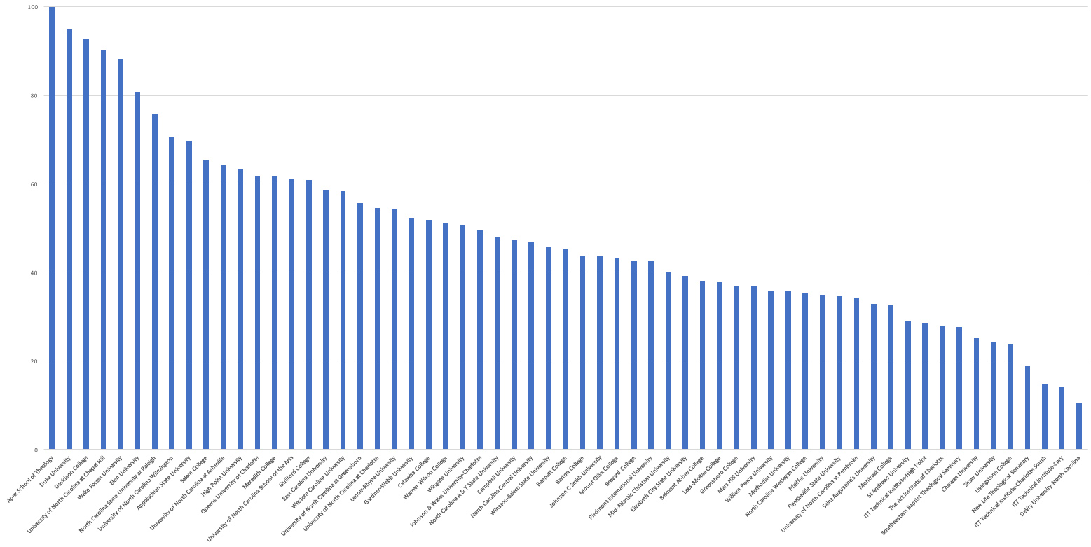
North Carolina
Bachelor Degree 6-year Graduation Rate 61.1% average
Notes:
27
Here’s a chart that shows the graduation rate for all of the four-year colleges in North Carolina.
This is the percentage of students who complete their four-year program in six years.
This shows that almost half of the students that we send to a four-year college program in North Carolina will drop out or take longer than 6 years to complete.
It took me 11 years to complete my four-year degree.
Duke’s graduation rate, second bar from the left, is very high, but they are also very picky about who they let in.
One drawback to this data is that it is showing how many start a four-year program and complete it within six years at the same institution.
Some of the smaller, private colleges have low graduation rates because students might start there, and then transfer to a larger state university.
This counts as a negative where the student started, and does not count at all where the student completed their degree.
Anytime you look at data, you have to take time to truly understand them, -- so you don’t jump to the wrong conclusion.
The main point I want to make here is that when we send someone to a four-year college, we need to make sure that they are truly ready for the work -- and are in the right education program for their chosen career pathway.
====
www.collegeresults.org
2014 data
Total number of students 229,307
Number of graduates 140,211
140,211 / 229,307 = 61 percent graduation rate in 6 years

Slide 28
It makes you think?
What happens to our 4-year program dropouts?
25% of all students in Community College have a 4-year degree.
Notes:
28
So, what happens to our college dropouts?
Remember that 40 percent do not complete their 4-year degree in 6 years.
Do they come back to high school – and say “That didn’t work out. What should I try next?”
Probably not, so we have to prepare them for the possibility that the four-year program does not work out.
Make sure they know about the NCWorks Career Centers.
→Many university graduates are going to community colleges to get the specific training they need for a job.
I’m not saying that four-year degrees are not important… But for career purposes, (especially entry-level) it may not always be the best choice.
Wake Tech, Our state’s largest Community College claims to be the largest graduate school in North Carolina based on the number of students they have -- who already have a four-year degree.
I started putting this data together about 15 years ago to show that community colleges should not be treated as second class colleges. That seemed to be the perception of the high school counselors who were thinking "Lets get all the kinds into a good university, -- and those that can't can go to community college or the military."
I knew then that we had to change the perception. If we get kids on a career pathway, then that pathway might lead to community college on purpose, rather then serving as a second choice if you can't get into a university.

Slide 29
Surprises Future Demand Articulation Changing World
www.ncPerkins.org/presentations
Notes:
Now --- let’s look towards the future.
Unfortunately I don’t have a budget code for a crystal ball, so I have to divine the future using Google.

Slide 30
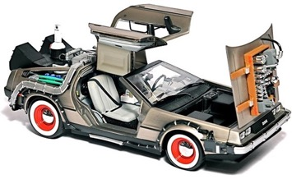
Notes:
30
In Back to the Future part two, Marty McFly traveled into the future to the year 2015, -- which is now in the past.
How well did they predict the future?
For one thing -- The Hover Boards of today are nothing like the Hover Boards in the movie.
Today’s Hover Boards don’t really hover, they have wheels.
And Marty McFly never worried that his Hover Board would spontaneously catch fire.
========
http://static6.businessinsider.com/image/54a8b647ecad040d3b68d5bc-1200/we-also-dont-have-automatic-dog-walkers-to-take-sparky-for-a-stroll-around-the-block.jpg
http://25.media.tumblr.com/tumblr_m13y12wUqk1qf7kwgo1_500.jpg
http://boxofficescoop.first.netdna-cdn.com/wp-content/uploads/2014/03/back-to-the-future-hoverboard.jpg
admintell.napco.com/ee/images/uploads/gadgetell/delorean-external-harddrive-02-640.jpg
https://sp.yimg.com/ib/th?id=HN.607990799156251306&pid=15.1&P=0
http://mentalfloss.com/sites/default/files/hill-valley.png
https://www.screenused.com/images/auction_nov13/13946_5.jpg

Slide 31
If we really want to prepare our students for successful careers, we need to know all we can about the rapidly changing job market.
Emil Barnabas
Notes:
31
The job market has changed considerably from when we graduated from high school.
People get most of their career guidance from their parents.
But, -- do our parents keep up with the rapidly changing job market?
What do the parents of our students know about bioinformatics and nanotechnology?
====
Emil Barnabas

Slide 32
Fastest Growing Occupations in NC Requiring Postsecondary Education (Total Change in Positions Projected from 2014 - 2024)
20,320 Registered Nurses
7,970 General and Operations Managers
5,550 Accountants and Auditors
4,990 Computer Systems Analysts
4,700 Software Developers, Applications
4,410 Carpenters
3,950 Business Operations Specialists, All Other
3,900 Market Research Analysts and Marketing Specialists
3,670 Management Analysts
3,320 Computer User Support Specialists
3,260 Elementary School Teachers, Except Special Education
3,150 Computer and Information Systems Managers
2,940 Financial Managers
2,800 Licensed Practical and Licensed Vocational Nurses
2,750 Personal Financial Advisors
2,530 Loan Officers
2,520 Automotive Service Technicians and Mechanics
2,510 Medical Secretaries
2,480 Electricians
2,290 Dental Assistants
2,270 Medical and Clinical Laboratory Technicians
2,260 Clergy
2,240 Physicians and Surgeons, All Other
2,130 Emergency Medical Technicians and Paramedics
2,040 Industrial Machinery Mechanics
Notes:
32
Not counting the occupations that require less than a year of on-the-job-training (OJT),
here are the high-demand occupations in North Carolina that require some kind of postsecondary education.
The number listed is the projected change in the number of positions in North Carolina over the ten-year projection period.
Does that top number stand out a little?
More about that later
=========
These data are from www.CareerOutlook.US
http://www.bls.gov/emp/ep_table_112.htm
Education and training assignments

Slide 33
Fastest Growing Occupations in NC (Total Change in Positions Projected from 2014 - 2024)
29,310 Combined Food Preparation and Serving Workers, Including Fast Food
20,320 Registered Nurses
19,930 Retail Salespersons
16,840 Home Health Aides
15,190 Customer Service Representatives
13,510 Nursing Assistants
9,360 Waiters and Waitresses
9,080 Cooks, Restaurant
8,170 Laborers and Freight, Stock, and Material Movers, Hand
8,000 Cashiers
7,970 General and Operations Managers
6,560 Office Clerks, General
6,480 First-Line Supervisors of Office and Administrative Support Workers
6,430 First-Line Supervisors of Food Preparation and Serving Workers
6,080 Janitors and Cleaners, Except Maids and Housekeeping Cleaners
5,950 Stock Clerks and Order Fillers
5,820 Heavy and Tractor-Trailer Truck Drivers
5,550 Accountants and Auditors
5,520 First-Line Supervisors of Retail Sales Workers
5,230 Secretaries and Administrative Assistants, Except Legal, Medical, and Executive
4990 Computer Systems Analysts
4990 Construction Laborers
4850 Childcare Workers
4810 Landscaping and Groundskeeping Workers
4800 Maids and Housekeeping Cleaners
4780 Receptionists and Information Clerks
4700 Software Developers, Applications
4680 Sales Representatives, Wholesale and Manufacturing, Except Technical and Scientific Products
4540 Maintenance and Repair Workers, General
4470 First-Line Supervisors of Construction Trades and Extraction Workers
4410 Carpenters
3950 Business Operations Specialists, All Other
3950 Personal Care Aides
3900 Market Research Analysts and Marketing Specialists
3670 Management Analysts
3620 Medical Assistants
3400 Team Assemblers
3320 Computer User Support Specialists
3260 Elementary School Teachers, Except Special Education
3150 Computer and Information Systems Managers
3020 Managers, All Other
3020 Sales Representatives, Services, All Other
2940 Financial Managers
2900 Food Preparation Workers
2800 Licensed Practical and Licensed Vocational Nurses
2750 Personal Financial Advisors
2680 Teacher Assistants
2640 Packers and Packagers, Hand
2550 Billing and Posting Clerks
2540 Pharmacy Technicians
2530 Loan Officers
2520 Automotive Service Technicians and Mechanics
2510 Medical Secretaries
2480 Electricians
2290 Dental Assistants
2270 Counter Attendants, Cafeteria, Food Concession, and Coffee Shop
2270 Medical and Clinical Laboratory Technicians
2270 Security Guards
2260 Clergy
2240 Physicians and Surgeons, All Other
2140 Bartenders
2130 Emergency Medical Technicians and Paramedics
2040 Industrial Machinery Mechanics
2030 Amusement and Recreation Attendants
Notes:
33
Here I have added to the list the short and moderate on-the-job-training occupations in green so you can compare their demand with the others.
Thus the green jobs are the ones you can get right out of high school, whereas the blue ones require some college or postsecondary work.
This list shows all occupations in North Carolina that require the most new workers projected through 2024.
That’s the burger flippers at the top of the list. Lots of restaurants, lots of hungry customers, and lots of turnover.
Only one occupation on this list requires a 4-year degree! There are some more if you scroll past the bottom of the screen, which you can do when you download the PowerPoint file.
In 2024, North Carolina will need 20,320 more registered nurses than we had in 2014.
From Where will they all come?
Tell your students: “If you don’t know what you want to be when you grow up, -- consider nursing.”
--------
These data are from www.CareerOutlook.US

Slide 34
Fastest Growing Occupations in NC (Percent Change in Positions Projected from 2014 - 2024)
45.8 Statisticians
43.0 Credit Counselors
42.6 Cartographers and Photogrammetrists
39.7 Operations Research Analysts
39.4 Nurse Practitioners
39.1 Personal Financial Advisors
38.5 Orthotists and Prosthetists
38.2 Helpers--Brickmasons, Blockmasons, Stonemasons, and Tile and Marble Setters
37.9 Occupational Therapy Assistants
35.9 Hearing Aid Specialists
35.1 Physical Therapist Assistants
34.8 Physician Assistants
34.7 Home Health Aides
34.5 Biomedical Engineers
33.8 Diagnostic Medical Sonographers
33.4 Physical Therapist Aides
33.1 Phlebotomists
32.6 Veterinary Technologists and Technicians
32.2 Cardiovascular Technologists and Technicians
31.9 Occupational Therapy Aides
31.8 Web Developers
31 Brickmasons and Blockmasons
30.8 Electrical Power-Line Installers and Repairers
29.4 Taxi Drivers and Chauffeurs
29.1 Physical Therapists
29 Medical and Clinical Laboratory Technicians
28.9 Computer Systems Analysts
28.6 Market Research Analysts and Marketing Specialists
28.6 Mathematicians
28.1 Information Security Analysts
27.8 Health Technologists and Technicians, All Other
27.6 Therapists, All Other
27.4 Mental Health and Substance Abuse Social Workers
27.4 Helpers--Roofers
27.3 Costume Attendants
27.2 Audiologists
27.1 Mental Health Counselors
27.1 Actuaries
150 in 2014 :: 50 increase
48,520 in 2014 :: 16,840 increase
Notes:
34
Here you see the projected percentage change over the same ten-year period.
Sometimes you might have a small number of workers in a particular occupation, but the percentage change might be high, which means that the industry is expanding.
→ For example: There were only 150 Hearing Aid Specialists in North Carolina in 2014, so a 35.9 percent increase is an additional 50 positions.
But -- Compare that with the Home Health Aides with over 48 thousand positions in 2014, so a 34.7 percent increase is an additional 17 thousand positions.
When looking at the job projections, You need to look at both the numbers of positions and the percentage increase.
========
These data are from www.CareerOutlook.US

Slide 35
Fastest Declining Occupations in NC (Total Change in Positions Projected from 2014 - 2024)
-7,970 Farmers, Ranchers, and Other Agricultural Managers
-1,790 Farmworkers and Laborers, Crop, Nursery, and Greenhouse
-1,720 Bookkeeping, Accounting, and Auditing Clerks
-1,270 Postal Service Mail Carriers
-1,180 Farmworkers, Farm, Ranch, and Aquacultural Animals
-1,110 Switchboard Operators, Including Answering Service
-850 Molding, Coremaking, and Casting Machine Setters, Operators, and Tenders, Metal and Plastic
-780 Cutting, Punching, and Press Machine Setters, Operators, and Tenders, Metal and Plastic
-720 Postal Service Mail Sorters, Processors, and Processing Machine Operators
-580 Sewing Machine Operators
-530 Extruding and Drawing Machine Setters, Operators, and Tenders, Metal and Plastic
-520 Textile Knitting and Weaving Machine Setters, Operators, and Tenders
-500 Printing Press Operators
-480 Textile Winding, Twisting, and Drawing Out Machine Setters, Operators, and Tenders
-420 Cooks, Fast Food
-380 Executive Secretaries and Executive Administrative Assistants
-360 Mail Clerks and Mail Machine Operators, Except Postal Service
-350 Extruding, Forming, Pressing, and Compacting Machine Setters, Operators, and Tenders
-300 Grinding, Lapping, Polishing, and Buffing Machine Tool Setters, Operators, and Tenders, Metal and Plastic
-280 Extruding and Forming Machine Setters, Operators, and Tenders, Synthetic and Glass Fibers
-260 Paper Goods Machine Setters, Operators, and Tenders
-250 Lathe and Turning Machine Tool Setters, Operators, and Tenders, Metal and Plastic
-240 Postal Service Clerks
-230 Furnace, Kiln, Oven, Drier, and Kettle Operators and Tenders
-220 Welding, Soldering, and Brazing Machine Setters, Operators, and Tenders
-220 Prepress Technicians and Workers
-220 Photographic Process Workers and Processing Machine Operators
-210 Computer Operators
-200 Office Machine Operators, Except Computer
-180 Print Binding and Finishing Workers
-180 Reporters and Correspondents
-170 Tire Builders
-170 Food and Tobacco Roasting, Baking, and Drying Machine Operators and Tenders
-160 Textile Bleaching and Dyeing Machine Operators and Tenders
-160 Radio and Television Announcers
-140 Power Plant Operators
-140 Travel Agents
-140 Forging Machine Setters, Operators, and Tenders, Metal and Plastic
-140 Electronic Equipment Installers and Repairers, Motor Vehicles
-130 Insurance Underwriters
-130 Meter Readers, Utilities
-120 Graders and Sorters, Agricultural Products
-120 Milling and Planing Machine Setters, Operators, and Tenders, Metal and Plastic
-120 Plating and Coating Machine Setters, Operators, and Tenders, Metal and Plastic
-110 First-Line Supervisors of Farming, Fishing, and Forestry Workers
-110 Word Processors and Typists
-100 Probation Officers and Correctional Treatment Specialists
-100 Tool and Die Makers
-90 Data Entry Keyers
-90 Highway Maintenance Workers
-80 Order Clerks
-80 Surveying and Mapping Technicians
-80 Drilling and Boring Machine Tool Setters, Operators, and Tenders, Metal and Plastic
-70 Procurement Clerks
-70 Fallers
-70 Postmasters and Mail Superintendents
-60 Correctional Officers and Jailers
-60 Coin, Vending, and Amusement Machine Servicers and Repairers
-60 Cutters and Trimmers, Hand
-60 Tool Grinders, Filers, and Sharpeners
-60 Heat Treating Equipment Setters, Operators, and Tenders, Metal and Plastic
-60 Metal Workers and Plastic Workers, All Other
-50 Telecommunications Equipment Installers and Repairers, Except Line Installers
-50 Pressers, Textile, Garment, and Related Materials
-50 Floral Designers
-50 Broadcast Technicians
-50 Rolling Machine Setters, Operators, and Tenders, Metal and Plastic
-50 Locksmiths and Safe Repairers
-50 Desktop Publishers
-50 Manufactured Building and Mobile Home Installers
-40 Police, Fire, and Ambulance Dispatchers
-40 Textile, Apparel, and Furnishings Workers, All Other
-40 Jewelers and Precious Stone and Metal Workers
-30 Cutting and Slicing Machine Setters, Operators, and Tenders
-30 Separating, Filtering, Clarifying, Precipitating, and Still Machine Setters, Operators, and Tenders
-30 Chemical Equipment Operators and Tenders
-30 Editors
-30 Mechanical Drafters
-30 Agricultural Equipment Operators
-20 File Clerks
-20 Tax Examiners and Collectors, and Revenue Agents
-20 Conveyor Operators and Tenders
-20 Chemical Plant and System Operators
-20 Molders, Shapers, and Casters, Except Metal and Plastic
-20 Tailors, Dressmakers, and Custom Sewers
-20 Textile Cutting Machine Setters, Operators, and Tenders
-20 Forest and Conservation Technicians
-20 Nuclear Technicians
-20 Agricultural Inspectors
-20 Crushing, Grinding, and Polishing Machine Setters, Operators, and Tenders
-20 Administrative Law Judges, Adjudicators, and Hearing Officers
-20 Foundry Mold and Coremakers
-20 Pourers and Casters, Metal
-10 Woodworking Machine Setters, Operators, and Tenders, Except Sawing
-10 Electrical and Electronics Repairers, Powerhouse, Substation, and Relay
-10 Biological Scientists, All Other
-10 Labor Relations Specialists
-10 Credit Authorizers, Checkers, and Clerks
-10 Social Workers, All Other
-10 Air Traffic Controllers
-10 Fabric and Apparel Patternmakers
-10 Sewers, Hand
-10 Statistical Assistants
-10 Fish and Game Wardens
-10 Fabric Menders, Except Garment
-10 Log Graders and Scalers
-10 Correspondence Clerks
-10 Home Economics Teachers, Postsecondary
-10 Travel Guides
-10 Respiratory Therapy Technicians
-10 Motion Picture Projectionists
-10 Model Makers, Metal and Plastic
-10 Parking Enforcement Workers
0 Pile-Driver Operators
0 Explosives Workers, Ordnance Handling Experts, and Blasters
0 Mining and Geological Engineers, Including Mining Safety Engineers
0 Choreographers
0 Refractory Materials Repairers, Except Brickmasons
0 Agricultural Engineers
0 Rail-Track Laying and Maintenance Equipment Operators
0 Transit and Railroad Police
0 Musical Instrument Repairers and Tuners
0 Petroleum Pump System Operators, Refinery Operators, and Gaugers
0 Sociologists
0 Museum Technicians and Conservators
0 Dentists, All Other Specialists
0 Gas Plant Operators
0 Nuclear Power Reactor Operators
0 Atmospheric and Space Scientists
0 Legal Secretaries
0 Drafters, All Other
0 Aircraft Cargo Handling Supervisors
0 Historians
0 Pump Operators, Except Wellhead Pumpers
0 Agricultural and Food Science Technicians
0 Legal Support Workers, All Other
0 Embalmers
0 Patternmakers, Metal and Plastic
0 Layout Workers, Metal and Plastic
Notes:
35
This is the bottom of the list of all jobs in North Carolina based on projected demand.
We need this many less of each of these jobs over this 10-year projection period.
For most of these positions, machines are replacing humans.
It used to be that these were the jobs you could get easily if you dropped out of high school.
But the jobs you used to get without a high school education are going away.
A high school education plus additional training is now the new minimum for employment.
Simply put - These are the jobs to stay away from.
=======
These data are from www.CareerOutlook.US

Slide 36
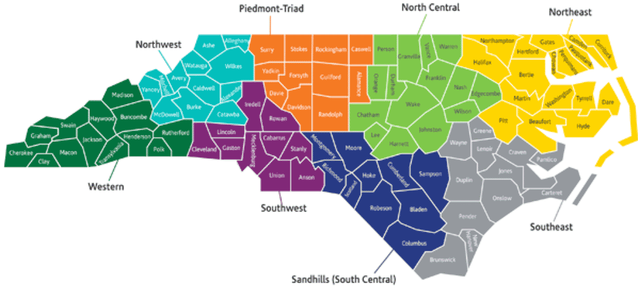
8 NC Prosperity Zones
Notes:
Besides looking at the data for the entire state, the state has been divided into eight prosperity zones,
We can look at salaries and job projections for just that part of the state.
Each part of the state is different.
=====
https://www.nccommerce.com/about-our-department/north-carolina-prosperity-zones

Slide 37
NC - North Central Prosperity Zone (Total Change in Positions Projected from 2012 - 2022)
5,842 Registered Nurses
5,686 Combined Food Preparation and Serving Workers, Including Fast Food
3,874 Home Health Aides
3,628 Nursing Assistants
3,240 Customer Service Representatives
3,236 Secretaries and Administrative Assistants, Except Legal, Medical, and Executive
3,014 Retail Salespersons
2,730 Software Developers, Applications
2,573 General and Operations Managers
2,331 Personal Care Aides
2,238 Childcare Workers
2,175 Health Specialties Teachers, Postsecondary
1,941 Bookkeeping, Accounting, and Auditing Clerks
1,718 Computer User Support Specialists
1,643 Accountants and Auditors
1,640 First-Line Supervisors of Office and Administrative Support Workers
1,601 First-Line Supervisors of Construction Trades and Extraction Workers
1,545 Elementary School Teachers, Except Special Education
1,536 Business Operations Specialists, All Other
1,529 First-Line Supervisors of Food Preparation and Serving Workers
1,519 Sales Representatives, Wholesale and Manufacturing, Except Technical and Scientific Products
1,482 Laborers and Freight, Stock, and Material Movers, Hand
1,470 Waiters and Waitresses
1,464 Preschool Teachers, Except Special Education
1,450 Market Research Analysts and Marketing Specialists
1,409 Computer Systems Analysts
1,408 Office Clerks, General
1,350 Construction Laborers
1,334 Cooks, Restaurant
1,309 Receptionists and Information Clerks
1,303 Cashiers
1,269 Electricians
Notes:
Here are the occupations with the most job openings projected over a ten-year period for the North Central Prosperity Zone. That's the Triangle area and surrounding counties.
If you are trying to build up your local economy, then this is where to build your career pathways.
In this zone they need lots of Registered Nurses and burger flippers.
=====
Occupations projected to be in high demand in 2022
http://www.careeroutlook.us

Slide 38
NC – Western Prosperity Zone (Total Change in Positions Projected from 2012 - 2022)
1,968 Combined Food Preparation and Serving Workers, Including Fast Food
1,712 Home Health Aides
1,412 Registered Nurses
1,210 Retail Salespersons
1,022 Nursing Assistants
958 Secretaries and Administrative Assistants, Except Legal, Medical, and Executive
945 Waiters and Waitresses
828 Cooks, Restaurant
808 Carpenters
685 Customer Service Representatives
637 Maids and Housekeeping Cleaners
514 Construction Laborers
512 Bookkeeping, Accounting, and Auditing Clerks
498 First-Line Supervisors of Food Preparation and Serving Workers
495 General and Operations Managers
490 Personal Care Aides
487 First-Line Supervisors of Office and Administrative Support Workers
480 Childcare Workers
478 First-Line Supervisors of Construction Trades and Extraction Workers
464 Landscaping and Groundskeeping Workers
441 Laborers and Freight, Stock, and Material Movers, Hand
430 Receptionists and Information Clerks
410 Office Clerks, General
408 Heavy and Tractor-Trailer Truck Drivers
406 Janitors and Cleaners, Except Maids and Housekeeping Cleaners
396 Cashiers
393 Medical Assistants
381 Elementary School Teachers, Except Special Education
380 Accountants and Auditors
355 Licensed Practical and Licensed Vocational Nurses
334 Tellers
331 Maintenance and Repair Workers, General
Notes:
And here is the Western Prosperity Zone.
You will notice that we need a lot of Registered Nurses and fast food workers in all parts of the state.
=====
Occupations projected to be in high demand in 2022
http://www.careeroutlook.us

Slide 39
NC – Southwest Prosperity Zone (Total Change in Positions Projected from 2012 - 2022)
5,026 Registered Nurses
4,797 Combined Food Preparation and Serving Workers, Including Fast Food
4,768 Retail Salespersons
4,312 Customer Service Representatives
2,748 Home Health Aides
2,685 Secretaries and Administrative Assistants, Except Legal, Medical, and Executive
2,565 Nursing Assistants
2,536 Heavy and Tractor-Trailer Truck Drivers
2,409 General and Operations Managers
2,195 Laborers and Freight, Stock, and Material Movers, Hand
2,190 First-Line Supervisors of Construction Trades and Extraction Workers
1,901 Accountants and Auditors
1,862 First-Line Supervisors of Office and Administrative Support Workers
1,793 Elementary School Teachers, Except Special Education
1,690 Childcare Workers
1,634 Bookkeeping, Accounting, and Auditing Clerks
1,512 Office Clerks, General
1,479 Computer Systems Analysts
1,437 Market Research Analysts and Marketing Specialists
1,431 Software Developers, Applications
1,430 Construction Laborers
1,397 Waiters and Waitresses
1,334 Securities, Commodities, and Financial Services Sales Agents
1,318 Personal Financial Advisors
1,305 Financial Managers
1,300 Personal Care Aides
1,241 Management Analysts
1,221 Cooks, Restaurant
1,215 Sales Representatives, Wholesale and Manufacturing, Except Technical and Scientific Products
1,189 Janitors and Cleaners, Except Maids and Housekeeping Cleaners
1,185 Carpenters
1,180 First-Line Supervisors of Food Preparation and Serving Workers
Notes:
And here is the Southwest Prosperity Zone.
Here the Registered Nurses are back on top/
=====
Occupations projected to be in high demand in 2022
http://www.careeroutlook.us

Slide 40
NC – Sandhills Prosperity Zone (Total Change in Positions Projected from 2012 - 2022)
3,800 Home Health Aides
2,154 Nursing Assistants
1,425 Registered Nurses
1,032 Combined Food Preparation and Serving Workers, Including Fast Food
914 Retail Salespersons
889 Secretaries and Administrative Assistants, Except Legal, Medical, and Executive
765 Elementary School Teachers, Except Special Education
714 Licensed Practical and Licensed Vocational Nurses
592 Childcare Workers
564 Personal Care Aides
559 Receptionists and Information Clerks
508 Customer Service Representatives
506 Interpreters and Translators
499 First-Line Supervisors of Office and Administrative Support Workers
472 Janitors and Cleaners, Except Maids and Housekeeping Cleaners
447 Maids and Housekeeping Cleaners
440 Bookkeeping, Accounting, and Auditing Clerks
429 General and Operations Managers
425 Preschool Teachers, Except Special Education
415 Teacher Assistants
409 Office Clerks, General
342 Medical Secretaries
315 Laborers and Freight, Stock, and Material Movers, Hand
305 Construction Laborers
298 Medical Assistants
286 Cashiers
278 Social and Human Service Assistants
274 Heavy and Tractor-Trailer Truck Drivers
269 First-Line Supervisors of Food Preparation and Serving Workers
268 Emergency Medical Technicians and Paramedics
262 First-Line Supervisors of Construction Trades and Extraction Workers
235 Child, Family, and School Social Workers
Notes:
And here is the Sandhills Prosperity Zone.
Registered Nurses are third.
Look at the high need for Home Health Aides in this zone.
=====
Occupations projected to be in high demand in 2022
http://www.careeroutlook.us

Slide 41
NC – Southeast Prosperity Zone (Total Change in Positions Projected from 2012 - 2022)
3,095 Combined Food Preparation and Serving Workers, Including Fast Food
2,397 Home Health Aides
1,938 Registered Nurses
1,599 Nursing Assistants
1,458 Retail Salespersons
1,269 Waiters and Waitresses
1,142 Secretaries and Administrative Assistants, Except Legal, Medical, and Executive
979 Childcare Workers
926 Customer Service Representatives
923 Receptionists and Information Clerks
906 Cooks, Restaurant
853 First-Line Supervisors of Food Preparation and Serving Workers
768 Bookkeeping, Accounting, and Auditing Clerks
735 General and Operations Managers
724 Personal Care Aides
660 First-Line Supervisors of Office and Administrative Support Workers
628 Elementary School Teachers, Except Special Education
619 Medical Assistants
600 Office Clerks, General
581 Licensed Practical and Licensed Vocational Nurses
578 Maids and Housekeeping Cleaners
576 Heavy and Tractor-Trailer Truck Drivers
571 Carpenters
558 Heating, Air Conditioning, and Refrigeration Mechanics and Installers
553 Cashiers
530 Janitors and Cleaners, Except Maids and Housekeeping Cleaners
481 Electricians
477 First-Line Supervisors of Construction Trades and Extraction Workers
476 Medical Secretaries
471 Laborers and Freight, Stock, and Material Movers, Hand
453 Teacher Assistants
449 Accountants and Auditors
Notes:
And here is the Southeast Prosperity Zone.
=====
Occupations projected to be in high demand in 2022
http://www.careeroutlook.us

Slide 42
NC – Piedmont-Triad Prosperity Zone (Total Change in Positions Projected from 2012 - 2022)
3,851 Home Health Aides
3,560 Registered Nurses
2,837 Nursing Assistants
2,641 Combined Food Preparation and Serving Workers, Including Fast Food
2,194 Customer Service Representatives
2,106 Personal Care Aides
1,841 Retail Salespersons
1,550 Secretaries and Administrative Assistants, Except Legal, Medical, and Executive
1,156 Laborers and Freight, Stock, and Material Movers, Hand
1,109 Childcare Workers
1,081 Medical and Clinical Laboratory Technicians
1,078 Janitors and Cleaners, Except Maids and Housekeeping Cleaners
1,042 Heavy and Tractor-Trailer Truck Drivers
1,022 Licensed Practical and Licensed Vocational Nurses
1,011 First-Line Supervisors of Office and Administrative Support Workers
999 First-Line Supervisors of Construction Trades and Extraction Workers
991 Maids and Housekeeping Cleaners
956 Carpenters
889 Bookkeeping, Accounting, and Auditing Clerks
871 Receptionists and Information Clerks
861 Construction Laborers
811 Packers and Packagers, Hand
801 General and Operations Managers
793 Medical Secretaries
776 Medical Assistants
749 Sales Representatives, Wholesale and Manufacturing, Except Technical and Scientific Products
645 First-Line Supervisors of Food Preparation and Serving Workers
604 Landscaping and Groundskeeping Workers
583 Cooks, Restaurant
578 Billing and Posting Clerks
575 Preschool Teachers, Except Special Education
566 Market Research Analysts and Marketing Specialists
Notes:
And here is the Piedmont-Triad Prosperity Zone.
=====
Occupations projected to be in high demand in 2022
http://www.careeroutlook.us

Slide 43
NC – Northeast Prosperity Zone (Total Change in Positions Projected from 2012 - 2022)
2,376 Combined Food Preparation and Serving Workers, Including Fast Food
1,878 Nursing Assistants
1,849 Home Health Aides
1,316 Registered Nurses
721 Personal Care Aides
687 Retail Salespersons
673 Waiters and Waitresses
656 Customer Service Representatives
594 Secretaries and Administrative Assistants, Except Legal, Medical, and Executive
528 General and Operations Managers
518 Childcare Workers
502 Maids and Housekeeping Cleaners
497 First-Line Supervisors of Food Preparation and Serving Workers
488 Bookkeeping, Accounting, and Auditing Clerks
426 Janitors and Cleaners, Except Maids and Housekeeping Cleaners
417 Construction Laborers
411 First-Line Supervisors of Construction Trades and Extraction Workers
374 Carpenters
363 First-Line Supervisors of Office and Administrative Support Workers
359 Office Clerks, General
351 Heavy and Tractor-Trailer Truck Drivers
319 Maintenance and Repair Workers, General
293 Cooks, Restaurant
286 Licensed Practical and Licensed Vocational Nurses
275 Fishers and Related Fishing Workers
271 Laborers and Freight, Stock, and Material Movers, Hand
234 Preschool Teachers, Except Special Education
231 Health Specialties Teachers, Postsecondary
219 Clergy
202 Electricians
200 Elementary School Teachers, Except Special Education
200 Cashiers
Notes:
And here is the Northeast Prosperity Zone.
=====
Occupations projected to be in high demand in 2022
http://www.careeroutlook.us

Slide 44
NC – Northwest Prosperity Zone (Total Change in Positions Projected from 2012 - 2022)
1,809 Home Health Aides
861 Personal Care Aides
667 Combined Food Preparation and Serving Workers, Including Fast Food
657 Registered Nurses
615 Carpenters
520 Retail Salespersons
520 Secretaries and Administrative Assistants, Except Legal, Medical, and Executive
518 Customer Service Representatives
470 Nursing Assistants
445 Laborers and Freight, Stock, and Material Movers, Hand
383 Heavy and Tractor-Trailer Truck Drivers
347 Landscaping and Groundskeeping Workers
254 Janitors and Cleaners, Except Maids and Housekeeping Cleaners
246 Construction Laborers
229 Maids and Housekeeping Cleaners
225 First-Line Supervisors of Construction Trades and Extraction Workers
224 Childcare Workers
224 First-Line Supervisors of Office and Administrative Support Workers
217 Bookkeeping, Accounting, and Auditing Clerks
201 Operating Engineers and Other Construction Equipment Operators
200 Cooks, Restaurant
188 Clergy
181 Social and Human Service Assistants
180 Office Clerks, General
176 General and Operations Managers
172 Insurance Sales Agents
162 Heating, Air Conditioning, and Refrigeration Mechanics and Installers
160 Medical Secretaries
157 Preschool Teachers, Except Special Education
151 Pharmacy Technicians
150 Receptionists and Information Clerks
148 Medical Assistants
Notes:
And here is the Northwest Prosperity Zone.
Another zone where Home Health Aides are on the top of the list.
=====
Occupations projected to be in high demand in 2022
http://www.careeroutlook.us

Slide 45
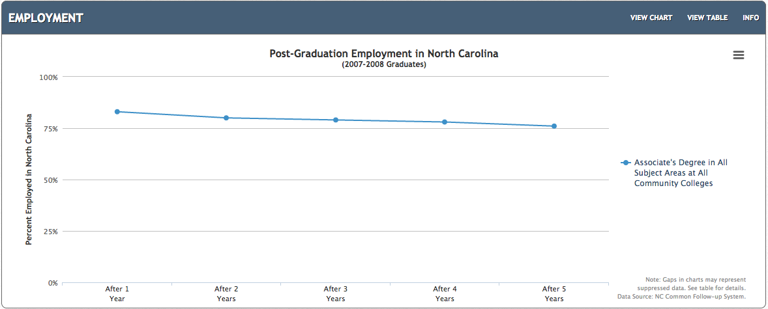
All NC Associate Degrees – Five-Year Employment
83%
76%
Notes:
This shows employment for the first five years after graduation for folks who earned an Associate Degree in North Carolina.
This shows the graduates who are receiving a paycheck. It does not include independent contractors or self-employed.
Over 76 percent of the folks who earned an Associate Degree in North Carolina are still receiving a paycheck 5 years after graduation.
That’s really good.
====
http://nctower.com/output/ncccs/4506/2008/
2007-2008 graduates from all Associate Degree programs in NC

Slide 46
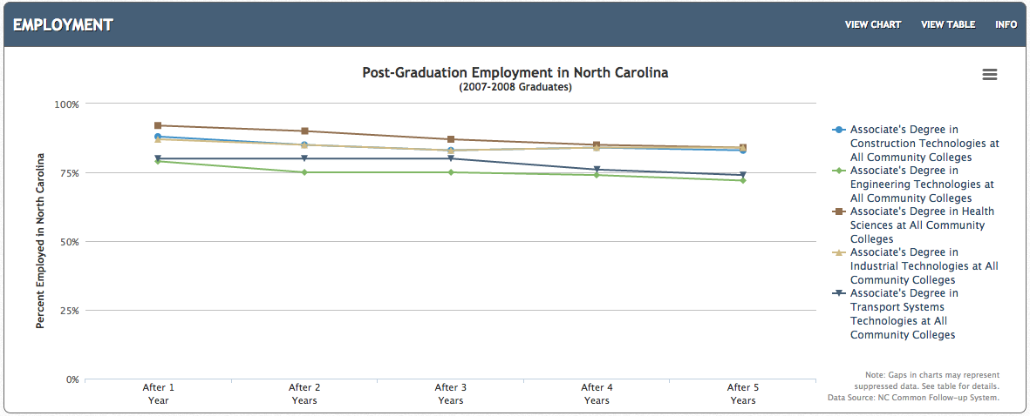
Selected NC Associate Degrees – Five-Year Employment
92%
84%
79%
72%
Notes:
And if we look at some selected Associate Degree programs.
For the most part, -- they are all over 75 percent employed after five years.
Health Sciences, Construction, and Industrial Technologies are the three highest with 84 percent employment after 5 years.
Industrial Technologies is at 72 percent employment.
Still not bad.
====
http://nctower.com/output/ncccs/4840-4946-4797-4887-5059/
2007-2008 graduates from selected Associate Degree programs in NC

Slide 47
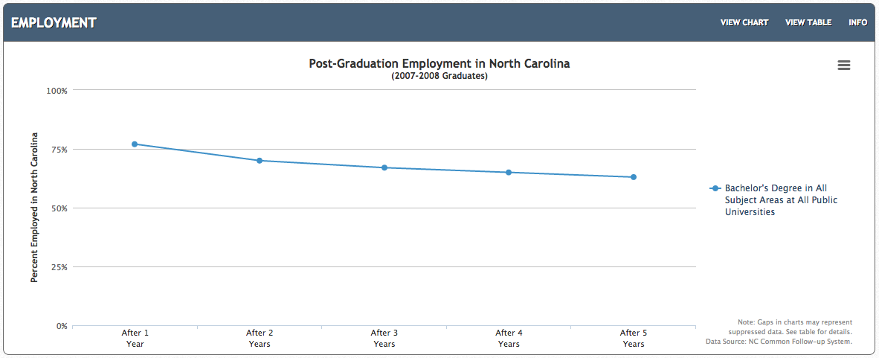
All NC Bachelor Degrees – Five-Year Employment
77%
63%
Notes:
And here is the employment for the first five years out of college for Bachelor Degree graduates from our NC Public Universities.
After 5 years, 63 percent are receiving a paycheck.
====
http://nctower.com/output/unc/7810/
2007-2008 Bachelor Degree graduates from All NC Universities

Slide 48
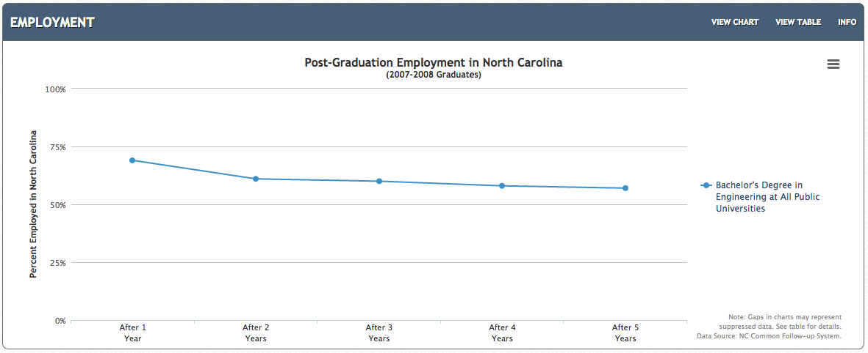
NC Engineering Bachelor Degree – Five-Year Employment
69%
57%
Notes:
If we focus just on Engineering. This is the data for all engineering graduates from all UNC campuses.
After five years of work, the employment is 57 percent. That means that almost half of the engineering graduates are not receiving a paycheck five years after graduation.
Does that mean we are graduating too many engineers, or are high schools funneling folks into engineering programs who probably should be doing something else?
Or are the engineering graduates taking jobs oversees and dropping out of the data pool?
====
http://nctower.com/output/unc/7901/
2007-2008 Bachelor Degree, Engineering graduates from All NC Universities

Slide 49
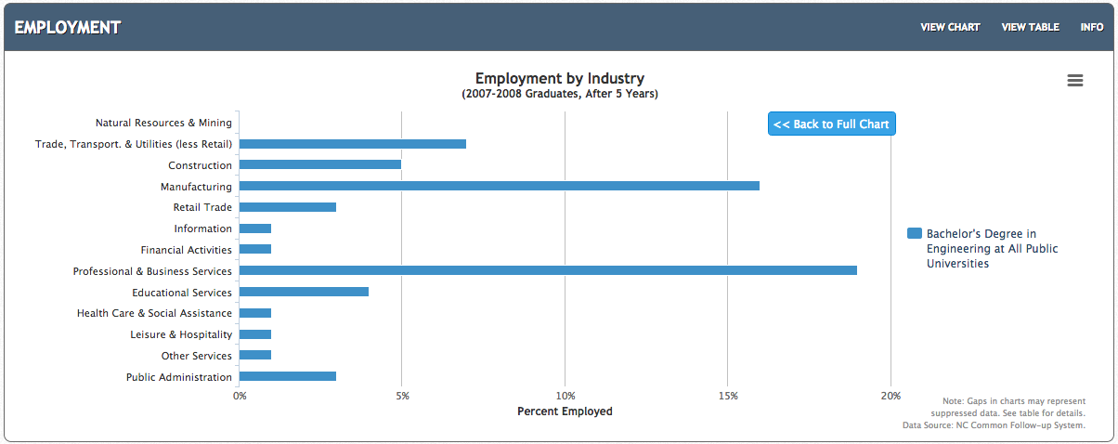
NC Engineering Bachelor Degree – Five-Year Employment
Notes:
If you drill down on that chart you see that five years out of college, here are the industries where those engineering graduates are employed.
The longest bar is the Professional and Business Services, which is where you expect engineers to be employed.
They are also in the Manufacturing industry,. Not necessarily employed as an engineer.
And the next industries are Transportation, Utilities, and Construction, and Education.
And the data show one percent of the engineering graduates working in the Leisure and Hospitality industry.
If they are flipping burgers, then they still show up as employed.
Remember that this chart shows only the 57 percent of the engineering graduates who are getting a paycheck.
====
http://nctower.com/output/unc/7901/

Slide 50
compare
69%
57%
NC Bachelor Degree – Engineering
1,297 graduates
79-92%
72-84%
NC Associate Degrees
5,310 graduates
Notes:
On top is the Bachelor of Engineering graduates that you saw two slides ago, where we see that only 57 percent of he graduates are getting a paycheck.
And on the bottom is the Associate Degree graduates in these five technical areas.
Notice the Bachelor of Engineering graduates start out at 69 percent employment, and after five years are at 57 percent employment.
But at the bottom of the slide -- you see that 79 to 92 percent of the graduates with an associate degree are employed right out of college.
And then after 5 years of employment, the rate is 72 to 84 percent.
This seems to indicate a high demand for folks with a technical associate degree. And less demand for graduates of a four-year engineering program.
====
http://nctower.com/output/unc/7901/
2007-2008 Bachelor Degree, Engineering graduates from All NC Universities
http://nctower.com/output/ncccs/4840-4946-4797-4887-5059/
2007-2008 graduates from selected Associate Degree programs in NC

Slide 51
77%
63%
NC Bachelor Degree
29,044 graduates
79-92%
72-84%
NC Associate Degrees
5,310 graduates
Notes:
Here at the top we see all Bachelor Degree graduates in North Carolina -- where the employment rate right out of college is 77 percent, and after five years, the employment rate is 63 percent.
On the bottom you see the same graph of our associate degree graduates.
Graduates with an Associate degree stay employed at a much higher rate than the graduates with a Bachelors degree.
This seems to indicate a high demand for folks with a technical associate degree. And less demand for graduates of a four-year program.
====
http://nctower.com/output/unc/7810/
2007-2008 Bachelor Degree graduates from All NC Universities
http://nctower.com/output/ncccs/4840-4946-4797-4887-5059/
2007-2008 graduates from selected Associate Degree programs in NC

Slide 52
States with Most New Jobs (Total Change in Positions Projected from 2014 - 2024)
Numeric Change
% Change
9,788,900 United States
2,585,500 California
2,569,930 Texas
1,548,590 Florida
1,297,960 New York
639,950 Colorado
582,470 Washington
577,300 Arizona
540,150 North Carolina
504,540 Maryland
476,730 Georgia
400,000 Tennessee
378,130 Utah
371590 Illinois
368050 Virginia
345920 Pennsylvania
327030 Michigan
326100 Kentucky
313920 Indiana
313340 Nevada
300180 Ohio
275310 New Jersey
259860 Oregon
204760 Massachusetts
196010 Wisconsin
183230 South Carolina
177310 Missouri
159080 Alabama
154140 Iowa
153880 Oklahoma
147170 Louisiana
138080 Idaho
130080 Arkansas
130000 Minnesota
113140 Connecticut
106040 Kansas
97560 Nebraska
76590 Mississippi
76590 Mississippi
65830 New Mexico
55980 Montana
47290 New Hampshire
46040 District of Columbia
38790 Hawaii
37150 Delaware
36080 Rhode Island
32110 South Dakota
20630 North Dakota
19650 Alaska
16550 Vermont
9680 Puerto Rico
5430 West Virginia
5320 Maine
4580 Wyoming
1880 Virgin Islands
27.4 Utah
24.5 Nevada
24.3 Colorado
21.2 Arizona
20.7 Texas
19.9 Idaho
18.3 Florida
18.2 Maryland
16.6 Washington
15.2 Kentucky
15.1 California
13.9 Oregon
13.2 Tennessee
13.1 New York
12.3 North Carolina
11.4 Montana
11.1 Georgia
10.1 Indiana
9.9 Arkansas
9.3 Virginia
8.9 South Carolina
8.7 Oklahoma
8.6 Iowa
8.6 Nebraska
8.1 Delaware
7.7 Alabama
7.7 New Mexico
7.4 Michigan
7.2 Kansas
7.1 Louisiana
7.1 Rhode Island
7 New Hampshire
6.7 South Dakota
6.6 Mississippi
6.6 Mississippi
6.5 United States
6.5 New Jersey
6.1 Missouri
6.1 Connecticut
6 Wisconsin
6 District of Columbia
5.9 Illinois
5.8 Alaska
5.7 Pennsylvania
5.7 Massachusetts
5.6 Hawaii
5.6 Virgin Islands
5.3 Ohio
4.5 Vermont
4.3 Minnesota
4 North Dakota
1.5 Wyoming
0.9 Puerto Rico
0.8 Maine
0.7 West Virginia
Notes:
Here you can compare the states with the most projected job openings.
On the left you see the number of job openings projected over the ten years for each state or territory.
On the right you see the percentage change in jobs over the ten years for each state or territory.
Some states are predicting a large number of job openings, but for our highly populated states, it might not be a large percentage of jobs based on the size of the population.
You see states that I have highlighted in blue. They are near the top of both sides.
That means they are expecting a large number of job openings, which is also a large percentage of their current workforce. Those are the states that are growing the fastest.
You see North Carolina on the left. Projected to have the eighth most number of new jobs. On the right our state is not far down at 12.3 percent.
The state with the least job openings projected is Wyoming.
You see Texas high on the list. I have a feeling that their job projections just changed a few weeks ago.
============
http://projectionscentral.com/Projections/LongTerm
“Total, All Occupations” for each state.
“Numeric Employment Change” is the number of new jobs projected over the ten year period.
www.projectionscentral.com/

Slide 53
Notes:
Let's put the data aside and look at some hot jobs.
If you Google “Hot Jobs,” you will be overwhelmed with lots of lists of what someone considers to be jobs that are in high demand.
=====
http://hhstaffingservices.com/wp-content/uploads/2013/02/hot-jobs-icon.jpg
http://hhstaffingservices.com/job-seekers/hot-jobs-list-will-pay-cash-referral-bonus/

Slide 54
10 Hardest to Fill Jobs in America
Notes:
Here is a list of the top ten hardest-to-fill jobs.
Teachers are on the list at number ten.
Teachers of all kinds are the occupation that requires a bachelor degree -- that is in the highest demand.
As an educator, I find it odd that we should spend so much time trying to get our students into all of the fields except our own.
======
Forbes recently looked at the 10 Hardest to Fill Jobs in America
http://www.forbes.com/sites/jacquelynsmith/2013/05/28/the-10-hardest-jobs-to-fill-in-2013/

Slide 55
10 Hardest to Fill Jobs in America
Notes:
Mechanics are in high demand. We depend on our cars and want them fixed fast and correctly.
Top mechanics can make over $100,000 working at the large dealerships.
And the work on new cars is very clean and in a clean shop. Not like the old days.
======
Forbes recently looked at the 10 Hardest to Fill Jobs in America
http://www.forbes.com/sites/jacquelynsmith/2013/05/28/the-10-hardest-jobs-to-fill-in-2013/

Slide 56
10 Hardest to Fill Jobs in America
Notes:
Technicians are in high demand.
This is the Science and Technology side of the STEM that we keep hearing about.
======
Forbes recently looked at the 10 Hardest to Fill Jobs in America
http://www.forbes.com/sites/jacquelynsmith/2013/05/28/the-10-hardest-jobs-to-fill-in-2013/

Slide 57
10 Hardest to Fill Jobs in America
Notes:
One reason that skilled trades are in high demand is because years ago we started discouraging kids from going into blue-collar jobs.
And we started phasing our our high school shop classes so kids could take more AP courses.
And now that have come out of the recession, -- the building boom is beginning with no one lined up to do the work.
======
Forbes recently looked at the 10 Hardest to Fill Jobs in America
http://www.forbes.com/sites/jacquelynsmith/2013/05/28/the-10-hardest-jobs-to-fill-in-2013/

Slide 58
Notes:
Lots of folks left the construction industry during the recession.
Now the construction industry is working to rebuild their labor pool.
The problem is that there are not enough folks in the pipeline training for jobs in the construction industry.
Lots of high schools have dropped their construction programs, and most community colleges have moved construction to Continuing Education.
How do we get more folks to consider careers in construction?
===
http://constructionlabor.com/construction-demand-is-outpacing-skilled-labor/

Slide 59
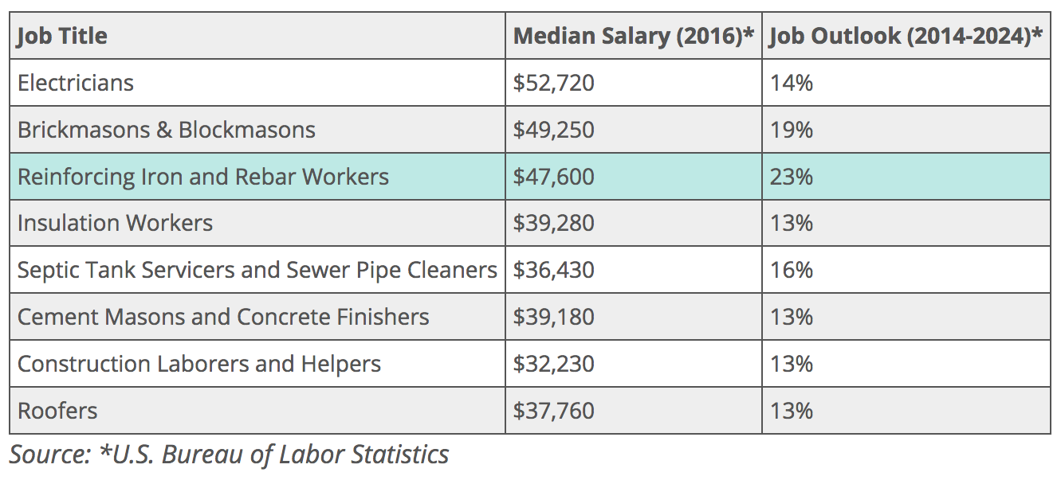
Construction Jobs that are In-Demand
Notes:
Here are some construction jobs that are predicted to be in high demand through 2024.
If you find students who excel in their hands-on classes, or find students who rank highest in the Holland Code Realistic Careers, then these are the jobs to consider.
I've done a little bit of all of these jobs.
====
http://study.com/articles/construction_jobs_that_are_in-demand.html

Slide 60
Notes:
You will be hearing from the Construction industry this afternoon.
They will probably tell you the biggest problem is the lack of soft skills.
They want employees who will show up on time ready to work.
Communication with your work team is the most important trait that seems to be lacking in the new recruits.
Is there anything we can do about that?
====
http://constructionlabor.com/reasons-for-construction-labor-shortage/#more-3586

Slide 61
Top 10 Job Titles that Didn’t Exist Five Years Ago
Notes:
You’ve heard about the cloud … Now someone has to maintain it and keep it going.
I found this list of Top Ten Job Titles that Didn’t Exist Five Years Ago.
My dad spent his whole career working on clouds, but then he was a meteorologist. The clouds have changed.
=====
http://talent.linkedin.com/blog/index.php/2014/01/top-10-job-titles-that-didnt-exist-5-years-ago-infographic
Top 10 Job Titles That Didn’t Exist 5 Years Ago
Methodological details: We counted the frequencies of all English words and phrases used in job titles that were held in 2013 and compared the results to job titles that were held in 2008. We then took the top titles that saw the largest growth in frequency in that 5 year period and ranked them by their relative size in 2013. “Big data” and “cloud services” were the root phrases used to determine frequencies for “big data architect” and “cloud services manager” (which had many permutations, e.g. “big data architect/analyst/engineer” etc.). For simplicity’s sake, the titles you see above were used as examples. Data is current as of November 26, 2013.

Slide 62
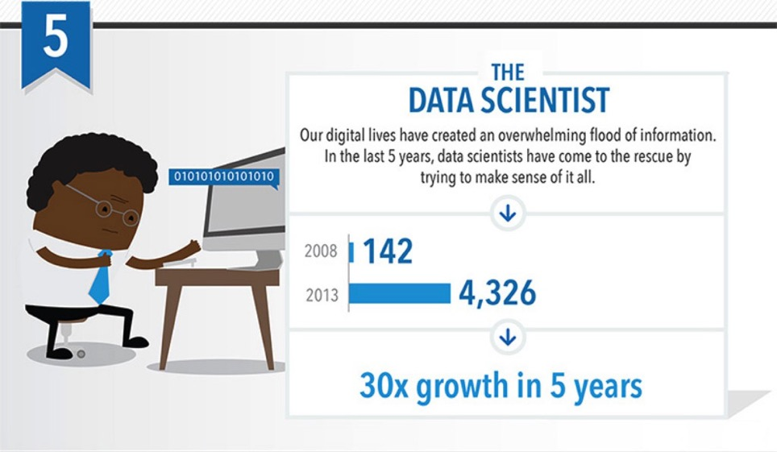
Top 10 Job Titles that Didn’t Exist Five Years Ago
Notes:
Someone needs to take all that data we’ve collected and turn it into information.
That’s the Data Scientist.
=====
http://talent.linkedin.com/blog/index.php/2014/01/top-10-job-titles-that-didnt-exist-5-years-ago-infographic
Top 10 Job Titles That Didn’t Exist 5 Years Ago
Methodological details: We counted the frequencies of all English words and phrases used in job titles that were held in 2013 and compared the results to job titles that were held in 2008. We then took the top titles that saw the largest growth in frequency in that 5 year period and ranked them by their relative size in 2013. “Big data” and “cloud services” were the root phrases used to determine frequencies for “big data architect” and “cloud services manager” (which had many permutations, e.g. “big data architect/analyst/engineer” etc.). For simplicity’s sake, the titles you see above were used as examples. Data is current as of November 26, 2013.

Slide 63
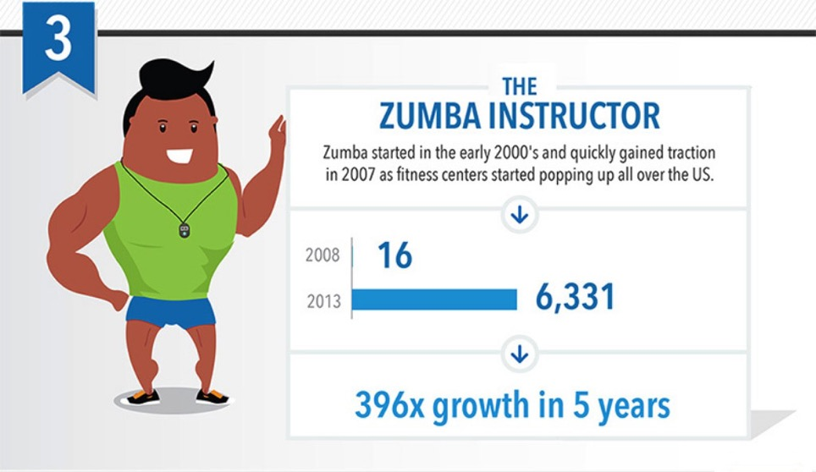
Top 10 Job Titles that Didn’t Exist Five Years Ago
Notes:
Look! It’s a high demand job that does not require a computer!
Raise your hand if you Zumba.
Sometimes we need to get away from our computers for a little while, and that’s why Zumba instructors are in high demand.
=====
http://talent.linkedin.com/blog/index.php/2014/01/top-10-job-titles-that-didnt-exist-5-years-ago-infographic
Top 10 Job Titles That Didn’t Exist 5 Years Ago
Methodological details: We counted the frequencies of all English words and phrases used in job titles that were held in 2013 and compared the results to job titles that were held in 2008. We then took the top titles that saw the largest growth in frequency in that 5 year period and ranked them by their relative size in 2013. “Big data” and “cloud services” were the root phrases used to determine frequencies for “big data architect” and “cloud services manager” (which had many permutations, e.g. “big data architect/analyst/engineer” etc.). For simplicity’s sake, the titles you see above were used as examples. Data is current as of November 26, 2013.

Slide 64
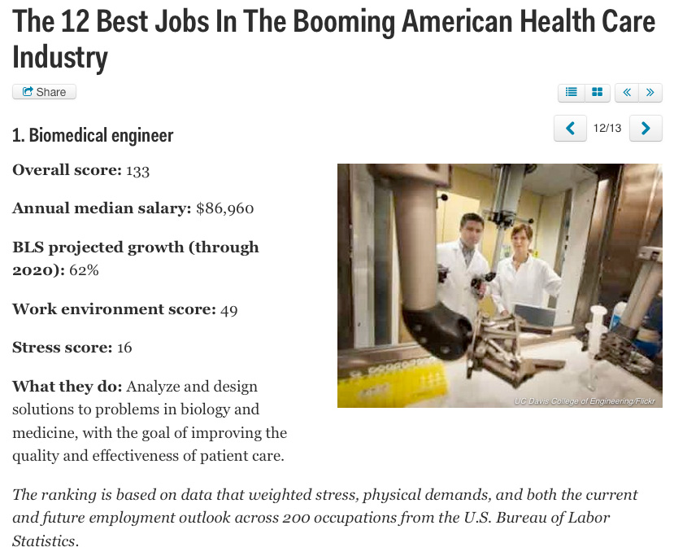
Notes:
New forms of engineering emerge every year.
The Biomedical Engineer combines engineering principals with medicine and biology to create better healthcare for all of us.
=====
http://www.businessinsider.com/best-health-care-jobs-2013-12
The 12 Best Jobs In The Booming American Health Care Industry
To find out which jobs offer the best opportunities in health care, job search site CareerCast analyzed survey data that weighed stress, physical demands, and both the current and future employment outlook of 200 occupations.
Definition: http://en.wikipedia.org/wiki/Biomedical_engineer

Slide 65
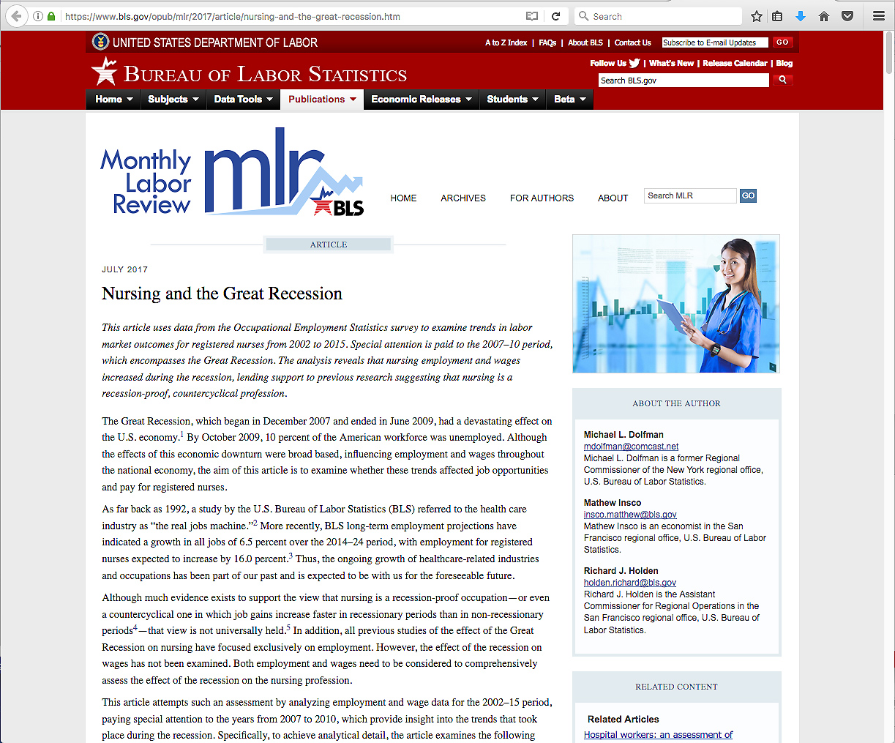
Notes:
Nursing, as well as the rest of the healthcare industry, weathered the recession better than any other segment of industry.
And the demand is great for Nursing and other allied health professionals.
====
https://www.bls.gov/opub/mlr/2017/article/nursing-and-the-great-recession.htm

Slide 66
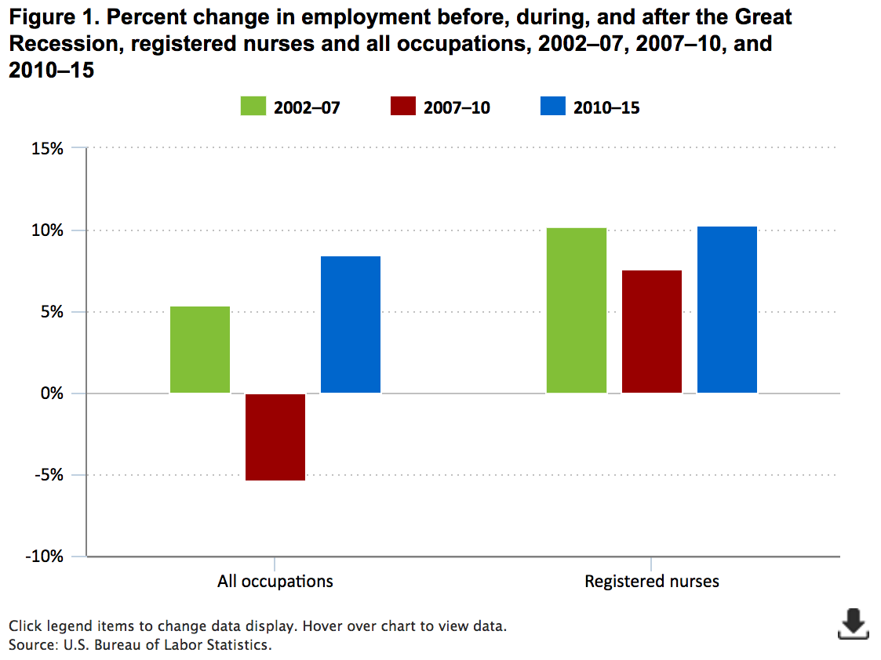
10.2%
10.3%
8.5%
7.6%
5.4%
-5.4%
Notes:
We are looking here at the change in employment over three time periods.
Green is before the recent recession, red is during the recession, and blue is after the recession.
On the left side of the screen you see the data for all occupations. On the right you see the data for registered nurses.
If you focus on the two red rectangles, which represent change in employment during the recession. You see that there was a negative 5.4 percent drop in employment overall, whereas there was a positive increase of 7.6 percent for Registered Nurses.
What this says, is that lots of folks lost their jobs during the recession, however folks employed in healthcare, specifically Registered Nurses, did not get hit hard by the recession. They kept hiring employees.
The recession had little impact on the healthcare industry.
So if you have students who are looking for a stable career, healthcare might be their best choice.
=====
https://www.bls.gov/opub/mlr/2017/article/nursing-and-the-great-recession.htm
Nursing employment in the United States
During the 2002–15 period, employment of registered nurses across the nation increased by 689,280, or 30.8 percent. By contrast, over the same timeframe, the nation’s economy added 10,372,900 jobs—a growth rate of 8.1 percent. Thus, during this 13-year period, 6.6 percent of net national job growth (about 1 out of every 15 new jobs) was due to the increase in registered nursing employment.
In the national economy, however, job growth was anything but steady. National employment increased by 6,830,490 (5.4 percent) between 2002 and 2007, decreased by 7,257,090 (−5.4 percent) between 2007 and 2010, and increased by 10,799,500 (8.5 percent) between 2010 and 2015. (See figure 1.)
In contrast to the uneven national job picture, employment growth among registered nurses was steady, averaging more than 50,000 new jobs each year between 2002 and 2015. This increase, coupled with the marked fluctuation in national employment, affected the national job picture. In 2002, jobs for registered nurses represented 1.8 percent of the national job base. By 2015, this percentage had reached more than 2 percent, meaning that about 2 out of every 100 jobs in the country were in registered nursing.
As noted earlier, focusing only on the recessionary years between 2007 and 2010, which encompasses the Great Recession, suggests that the national economy lost 7,257,090 million jobs—an employment decline of 5.4 percent. By contrast, employment of registered nurses moved in the opposite direction, increasing by 186,680, or 7.6 percent, over the same period.

Slide 67
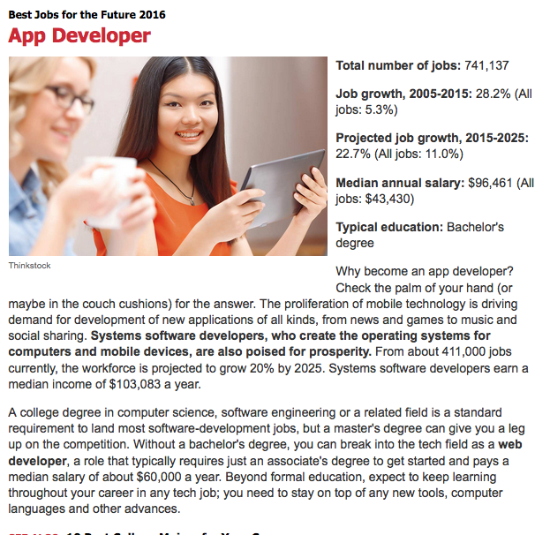
Notes:
We can’t get enough of those smart phone apps, -- and someone has to create them.
App developers are in high demand.
=======
http://www.kiplinger.com/slideshow/business/T012-S001-best-jobs-for-the-future-2016/index.html

Slide 68
Notes:
It seems that we hear about some kind of data breach every day.
Keeping up with the criminals is a job that is in high demand.
I am so tired of having to change my credit card number every few months because it has been compromised.
=======
http://www.kiplinger.com/slideshow/business/T012-S001-best-jobs-for-the-future-2016/index.html

Slide 69
Notes:
As the population gets older and lives longer, there is more potential for personal breakage.
And someone has to help us get back on our feet.
Physical Therapists as well as their assistants are in high demand.
=======
http://www.kiplinger.com/slideshow/business/T012-S001-best-jobs-for-the-future-2016/index.html

Slide 70
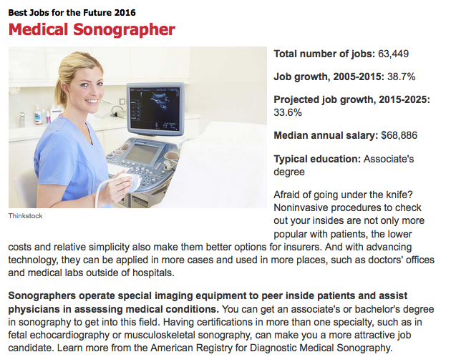
Notes:
The sonographer uses ultrasound, a process of sending sound waves through your body to allow the doctors to know what’s going on inside.
It’s not just for looking at unborn babies, there are many uses of sonography.
My doctor used it on me to look inside my head.
There were no babies in there!
I predict a huge demand for sonographers in many industries other than Healthcare. Construction, engineering,
=======
http://www.kiplinger.com/slideshow/business/T012-S001-best-jobs-for-the-future-2016/index.html

Slide 71
Notes:
For only two years of college, you can start at a very high salary.
That is, if you don’t mind putting your hands in other people’s mouths.
But you do have Fridays off.
And the dental hygienists will be in high demand for many years to come.
=======
http://www.kiplinger.com/slideshow/business/T012-S001-best-jobs-for-the-future-2016/index.html

Slide 72
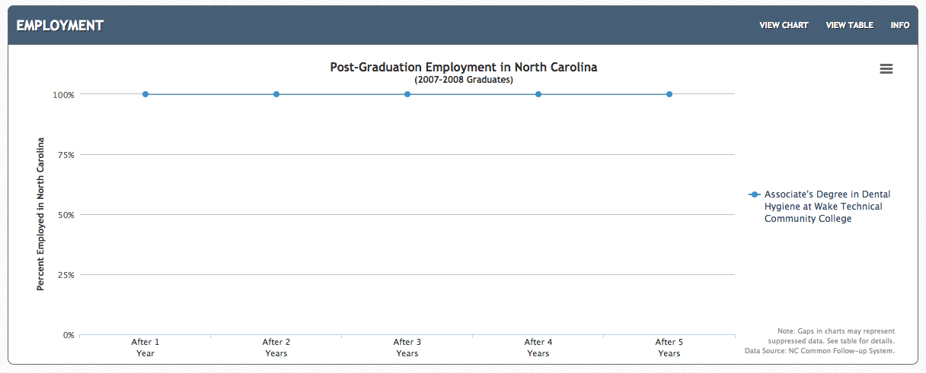
Associate Degree - Dental Hygiene Wake Tech CC
Notes:
Here is an example.
Wake Tech Community College
Associate Degree in Dental Hygiene
100 percent of the graduates are employed five years after graduation.
======
http://nctower.com/output/ncccs/6725/2008/

Slide 73
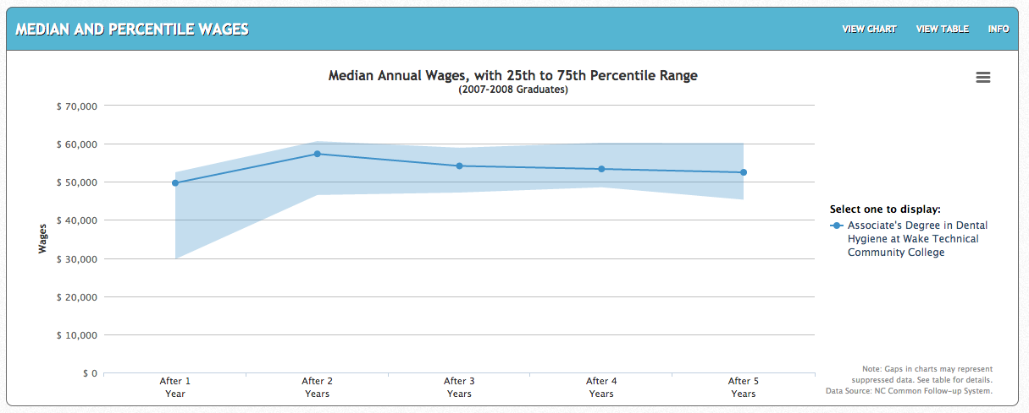
Associate Degree - Dental Hygiene Wake Tech CC
Notes:
Wake Tech Community College
Associate Degree in Dental Hygiene
Right out of college the median salary is right at 50 thousand.
The shaded area shows that many are making as much as 60 thousand dollars
Dental hygienists have been in high demand for many years.
And the pay is above average for an Associate Degree.
In the past most dental hygienists were hourly, working at multiple dentist offices to make up a full work week.
The trend now is to hire a full-time hygienist who now gets benefits.
And if you don't mind moving to Alaska, there the Dental Hygienists start at 82 thousand dollars, and the experienced Dental Hygienists make over 125 thousand dollars, and there is a high demand.
Not bad for a two-year degree from a community college.
======
Wake Tech data
http://nctower.com/output/ncccs/6725/2008/
Alaska data
http://www.careeroutlook.us/career.php?id=292021&st=AK

Slide 74
Surprises Future Demand Articulation Changing World
www.ncPerkins.org/presentations
Notes:
Lets look at Articulation

Slide 75
Articulation = Joining Parts Together
Articulation is a seamless process that joins secondary and postsecondary education and minimizes duplication of effort
Articulation connects high school coursework with community college coursework.
Notes:
Our vocabulary word for today is Articulation.
Articulation is parts that are joined together with a joint, like the way our bones are held together.
In this case we are joining high school and community college technical programs, -- and one joint that holds them together is the state-wide Articulation Agreement.
An articulate speaker is one who expertly joins syllables and words together to create effective expressions.
It’s all about joining things.
======
http://www.ncperkins.org/course/view.php?id=4

Slide 76
HS to CC Articulation Agreement
Statewide Agreement
NCDPI & NCCCS
Joins secondary and postsecondary CTE
~50 high school courses
Proficient students receive college credit
Eliminates duplication of coursework
Notes:
The North Carolina High School to Community College Articulation Agreement is an agreement between the North Carolina Department of Public Instruction and the North Carolina Community College System.
The North Carolina High School to Community College Articulation Agreement provides a seamless process that joins secondary and postsecondary Career and Technical Education (CTE) programs of study.
This statewide articulation agreement comprises approximately 50 high school CTE courses that match the knowledge and skills taught in similar community college courses.
The articulation agreement ensures that if a student is proficient in his/her high school course, the student can receive college credit for that course at any North Carolina community college.
This streamlines the student's educational pathway by eliminating the need to take multiple courses with the same learning outcomes.
=====
http://www.ncperkins.org/course/view.php?id=4

Slide 77
Which Agreement?
North Carolina Comprehensive Articulation Agreement (CAA)
NC High School to Community College Articulation Agreement
Notes:
There are two different articulation agreements.
The North Carolina Comprehensive Articulation Agreement, also known as the CAA, is a statewide agreement governing the transfer of credits between North Carolina community colleges and North Carolina public universities.
That is not what we are discussing today.
→
Today we are discussing the North Carolina High School to Community College Articulation Agreement. An agreement that identifies certain high school courses that match the learning objectives of certain college courses and awards college credit to students who show proficiency in the course.
=====
http://www.ncperkins.org/course/view.php?id=4

Slide 78
Process to Document and Award Credit
To receive articulated credit, students must enroll at the community college within two years of their high school graduation date and meet the following criteria:
Final grade of B or higher in the course and
A score of 93 or higher on the standardized CTE postassessment
High school students who enroll in a Career and College Promise pathway may earn articulated college credit as described in this agreement while enrolled in high school if the CTE articulated college credit is part of their Career and College Promise pathway.
Notes:
To receive college credit for a course in the Articulation Agreement:
- High school students must earn a B or better in the course
- and score a 93 or higher on the standardized CTE Postassessment test.
We have found that those two measures equates to the student mastering at least 80 percent of the course content.
======
http://www.ncperkins.org/course/view.php?id=4

Slide 79
NCperkins.org
Notes:
To access the state Articulation Agreement, first go to
➔ NCperkins.org.
Then select the Articulation Agreement link under “Other Resources.”
Just above that link you see a link for “CTE Presentations and Webinars.”
We have posted a copy of this PowerPoint there.
=====
http://www.ncperkins.org/course/view.php?id=4

Slide 80
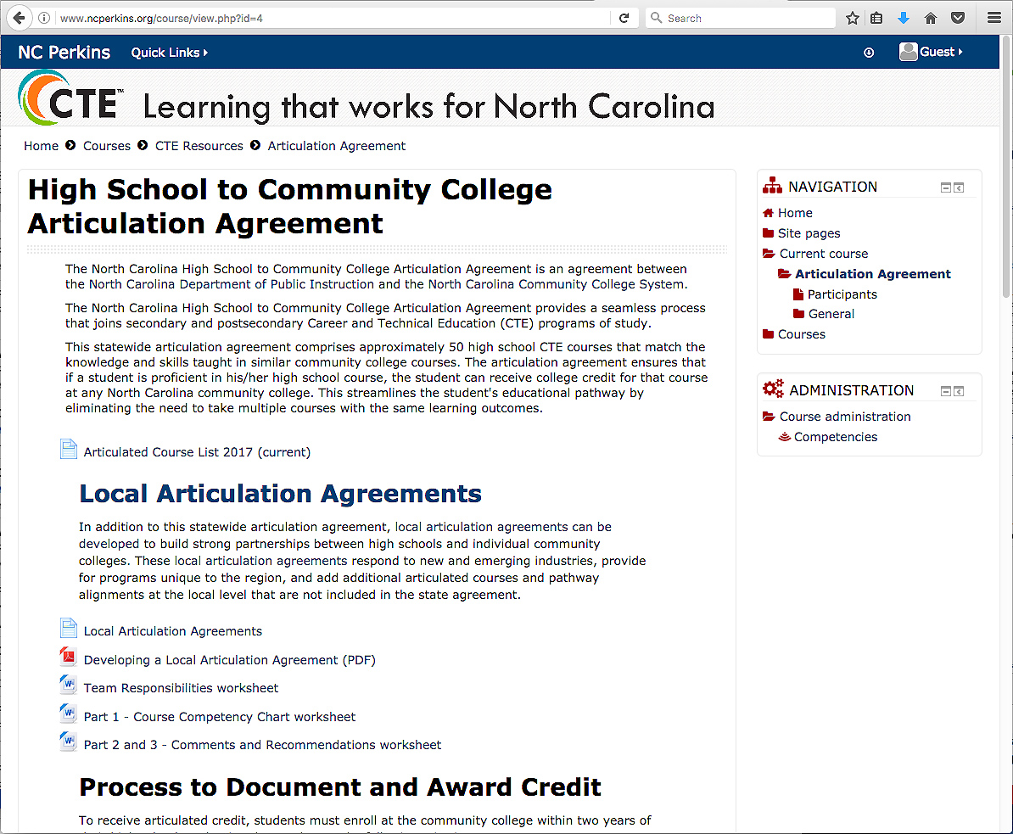
Notes:
So if you selected that link, it takes you to this page where you find the state Articulation Agreement
→
To get to the list of course matches on the current agreement, select this link.
=====
http://www.ncperkins.org/course/view.php?id=4

Slide 81
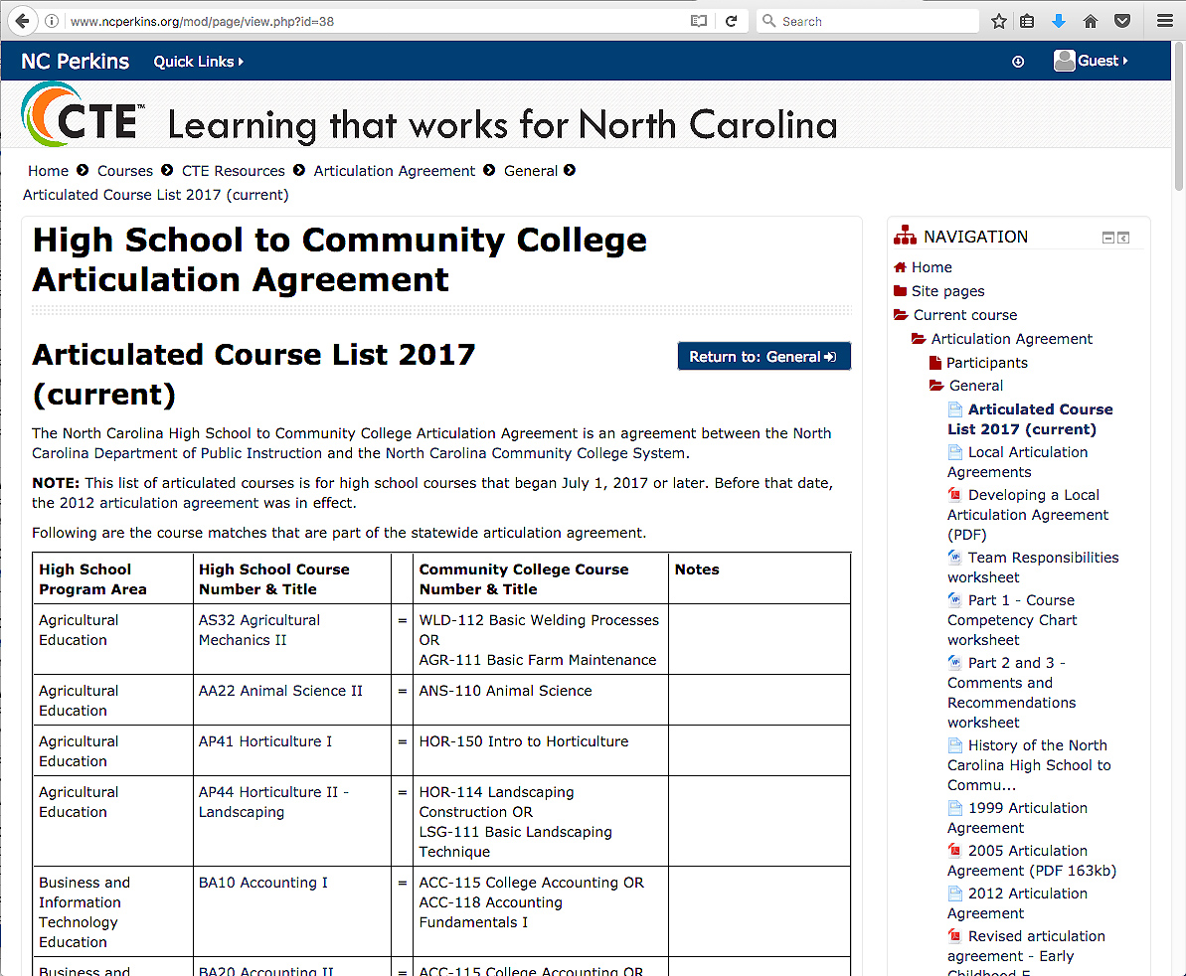
Notes:
Here is the current list of articulated credits. We just updated it this year.
Teachers who teach these courses need to know that they are teaching college-level courses where their students may be earning college credit.
Students need to know that these courses could earn them college credit.
School counselors need to know that these are the other AP courses where students can earn college credit just by showing proficiency in these specific high school courses.
Besides marketing these courses, we are working on a way to streamline the process to let the student know they have received the credit, and then to get the college to recognize and award the credit. The lack of a consistent student numbering system that connects K-12 and college does not help.
======
http://www.ncperkins.org/course/view.php?id=4

Slide 82
Local Articulation Agreements
Local agreements can be developed
Needs of local industry
Local courses
Courses less than 1,000 enrollment
“Developing a Local Articulation Agreement Guide”
Self-paced course on NC-NET
Notes:
We encourage the colleges to develop a local articulation agreement with the LEAs in their service area.
These local agreements can respond to the needs of the local business and industry.
Our state agreement does not include courses where there is less than 1,000 high school students enrolled, so if the course is unique to your area, you will need to add it to a local articulation agreement.
On the website you can find a guide to developing a local articulation agreement.
=====
http://www.ncperkins.org/course/view.php?id=4

Slide 83
Surprises Future Demand Articulation Changing World
www.ncPerkins.org/presentations
Notes:
Next we will look at the rapidly changing world in which we are preparing folks to live and work.

Slide 84
Upsetting the Projection Data
Recession
Natural Disasters
Immigration
Automation / Technology
Job relocation
Elections / Politics
Notes:
All of that projection data I showed you earlier can be easily upset by a variety of conditions.
The recent recession changed what occupations were in high demand.
Natural disasters, such as hurricanes, can drastically change which jobs are in high demand and which ones are not.
And we don’t have to talk about how elections and politics can change the job market.

Slide 85
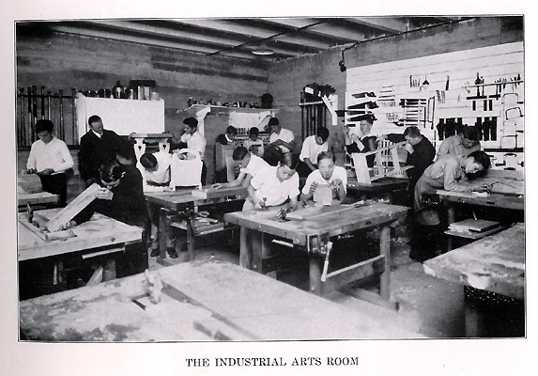
Notes:
I’m certified to teach Industrial Arts Education.
How many of you took Industrial Arts, or Shop class while in high school????
Unfortunately, some of our high schools are still teaching classes like this.
Some because of a lack of funds to modernize, and
Some because the same teacher is still there after 40 years.
=====
http://www.rootsweb.ancestry.com/~innwigs/ImageArchive/LibertyTownship/LibertyTwpPorterCoIndiana-LibertyCenterHighSchool-IndustrialArtsRoom-1931-SS.jpg

Slide 86
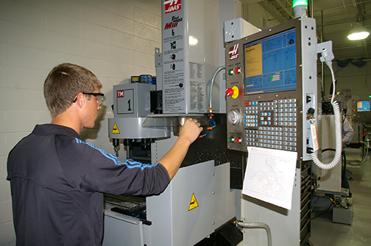
Notes:
But our modern shop classes should look like this. And many of them do.
We’ve had to modernize to keep up with business and industry.
Fortunately in North Carolina, we can send our high school students to a community college to learn in shops like this.
====
http://www.caboces.org/sites/default/files/images/John%20Gethicker/AMPBabb8744LR.jpg

Slide 87
Notes:
Why would anyone want a young lady to take a manufacturing class knowing that she could end up with a job like this?
Compare the cleanliness of the work environment in this OLD picture with …
====
https://dwd.wisconsin.gov/dwd/dwdhistory/images/women_in_factory_big.jpg

Slide 88
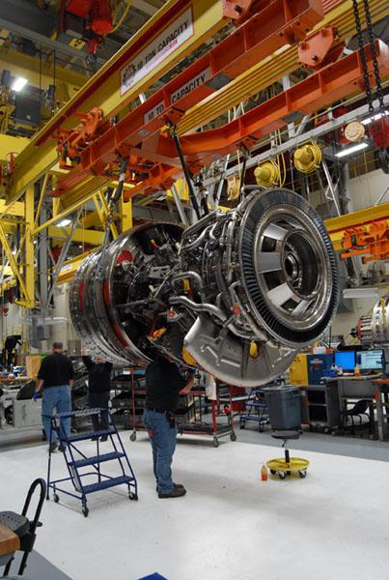
Notes:
…this one, where they are building jet engines in Durham, North Carolina.
You could eat off of that floor!
====
http://www.bizjournals.com/triangle/news/2012/08/03/slideshow-a-look-at-ge-aviations.html?ana=e_du_pap&s=article_du&ed=2012-08-03
A GE90 engine nears completion at the GE Aviation factory off South Miami Boulevard in Durham. The GE90 is used for large commercial aircraft such as the Boeing 777. More than 1,000 777s have been built over the years, incorporating a total of more than 2,000 engines from Boeing, Rolls-Royce and United Technologies' Pratt & Whitney division.

Slide 89
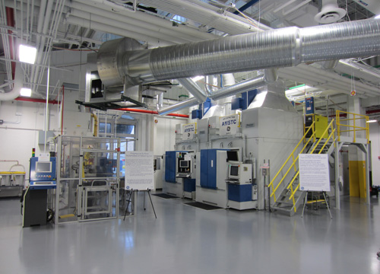
Notes:
The reality is that most educators, students, and their parents have no idea of what is happening in today’s factories.
Name one TV show that shows employees working in a modern factory.
How can students, teachers, and everyone else learn about modern industry?
Field trips, job shadowing, internships, open houses?
=====
http://files.gereports.com/wp-content/uploads/2012/04/AMSTC3.jpg

Slide 90
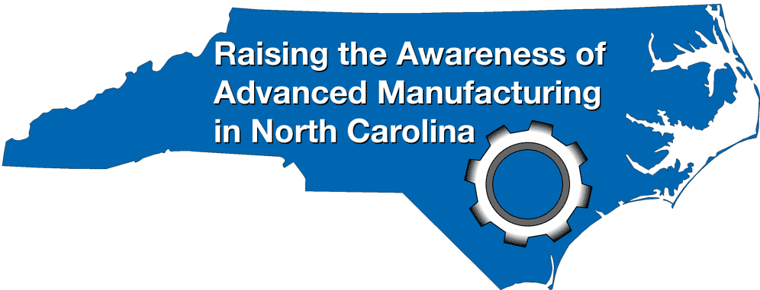
NC Advanced Manufacturing Careers Awareness Week
October 2-6, 2017
NCperkins.org/manufacturing
Notes:
This is our sixth annual North Carolina Advanced Manufacturing Careers Awareness Week
Last year We had 60 open houses all across the state, mostly at manufacturing companies and community colleges, helping people learn about the modern careers in Advanced Manufacturing.
Make sure your students, and their parents, know about these open houses next month.
Details are on the nc perkins dot org website.
======
http://www.ncperkins.org/moodle/course/view.php?id=14
April 8-12, 2013
April 7-11, 2014
April 13-17, 2015
April 4-8, 2016
October 3-7, 2016
October 2-6, 2017

Slide 91
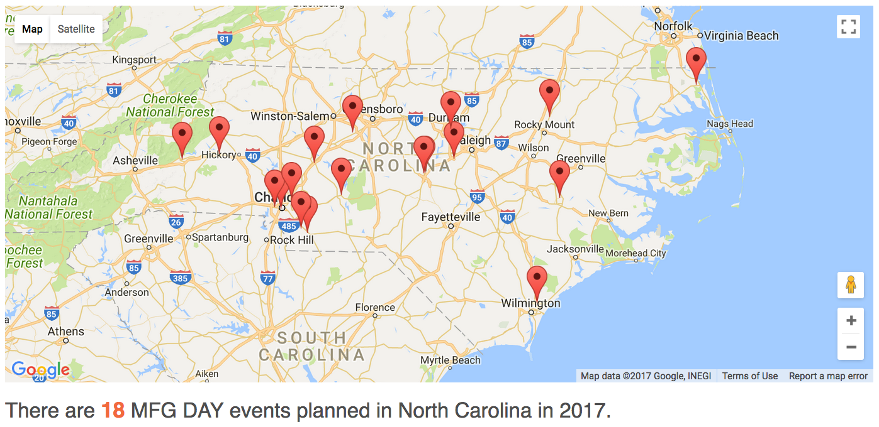
2017 Calendar
Notes:
Right Now, there are already xx events planned for North Carolina and entered on the national calendar.
Most of those events are at manufacturers. Many are at community colleges. Some are at community centers.
It’s not just businesses and colleges, The Charlotte Chamber is sponsoring a symposium and an expo.
If you are in a border county, be sure to check out the events in the neighboring states. The map on the website will let you see the events in all of the states.
Most of these events are open to the public. Some require advanced notice, and some may be by-invitation-only.
Some might allow school groups during the day and open to the public in the evening. Be sure to check out the requirements.
Also, some may have age restrictions or restrictions on what to wear, like shoes that might be required to walk around the factory.
Each of the events has a contact person, so call to make sure that you will be able to get the most out of the visit.
======
http://www.mfgday.com/events?country=US&state=NC#filter

Slide 92
We are currently preparing people for jobs that don’t yet exist …
Notes:
You may have seen this quote that is spread across the next three slides.
It profoundly reminds us that we are preparing people for jobs that don’t yet exist…
=======
Shift Happens
Karl Fisch and Scott McLeod
http://shifthappens.wikispaces.com/

Slide 93
… using technologies that haven’t yet been invented …
Notes:
… and they will be Using technologies that have not yet been invented …
=======
Shift Happens
Karl Fisch and Scott McLeod
http://shifthappens.wikispaces.com/

Slide 94
… in order to solve problems we don’t even know are problems yet.
Notes:
… to solve problems that we do not yet know are problems.
Are we equipping the next generation with the knowledge and tools they will need to do this?
=======
Shift Happens
Karl Fisch and Scott McLeod
http://shifthappens.wikispaces.com/

Slide 95
Who predicted these?
Cell phones for everyone
iPads, Kindles, tablets
Smart phones
iPod - portable music, videos
Hand-held GPS
Text messaging
Blogs, Twitter
MySpace, FaceBook
Wikipedia
YouTube
Pinterest
Google Plus
Tumblr
Instagram
SUVs
Self-driving cars
Electric cars
Wearable tech - Fitbits
Cloud computing
“Reality” TV
3D printing
Presentations like this one !!
Notes:
Think back 20 years ago.
Would you have predicted any of these?
What’s next?
How soon will these become obsolete?
Yes, these will all become obsolete someday soon!

Slide 96
Old technologies making a comeback
Vegetable powered-Diesel engines
Electric cars
Wind power
Rain barrels
Recycling building materials
Biofuel (Moonshine)
Notes:
Some of the latest trends are actually old technologies making a comeback.
Over 100 years ago. When Rudolph Diesel first demonstrated his diesel engine, he powered it with peanut oil.
Then along came this cheap stuff called petroleum that even Jed Clampett didn't want at first, and Rudolph Diesel quickly switched over to the newly created Diesel fuel, because it was so cheap to make.
Now people are paying McDonalds to let them take away their waste cooking oil, so they can use it to fuel their Diesel-powered vehicle.
And Electric cars? Invented almost 200 years ago. Electric cars were very popular until the early 1900s when gasoline-powered engines took over, because -- at the time -- gasoline was very cheap.
And the Biofuels Center of North Carolina is helping people build government-approved stills to create legal moonshine that we can burn in our cars.
Yes, some old technologies are coming back around again.

Slide 97
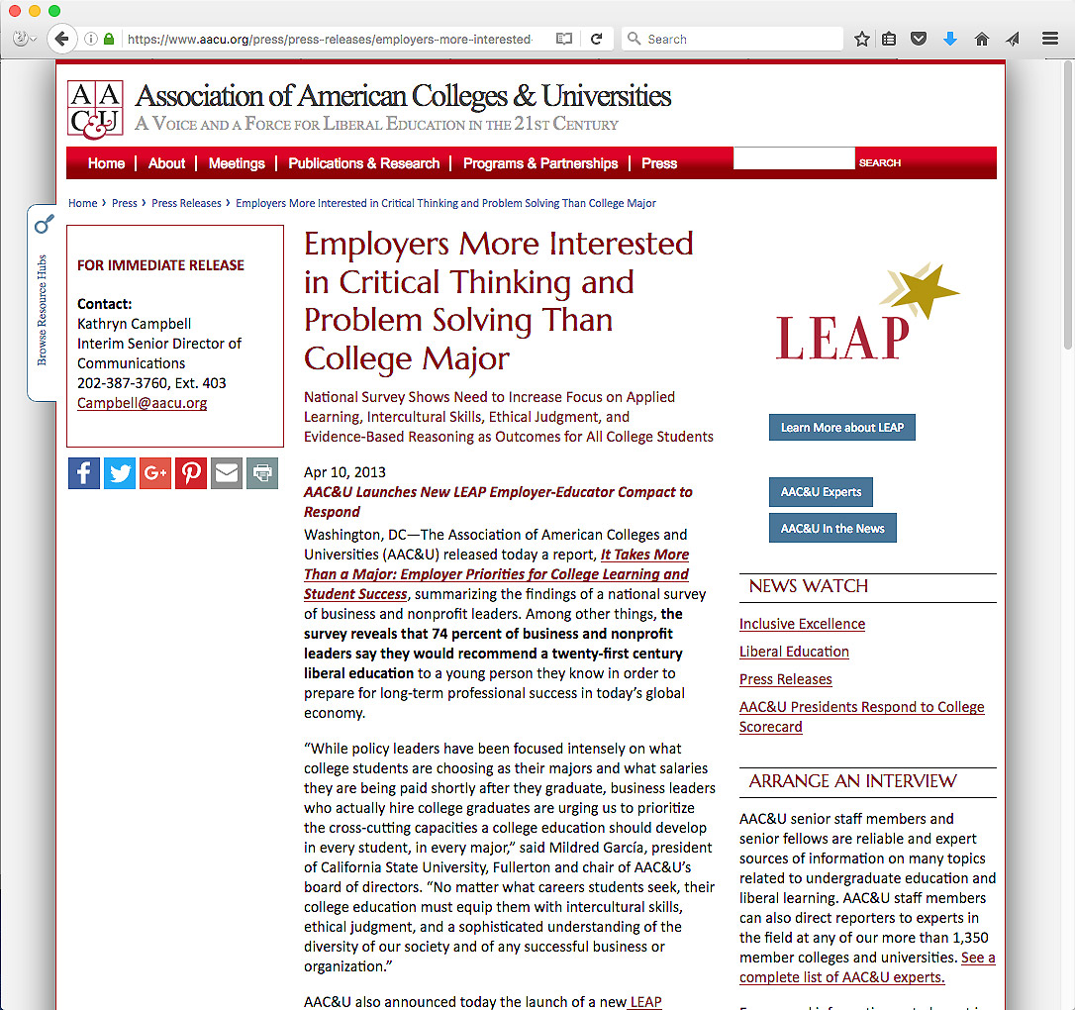
Notes:
The employers know what they want in their new recruits.
And it is not always what the education establishment is giving them.
The high schools seem to be more concerned with GPAs and getting students into the best colleges.
The focus should be on getting on the education pathway that would actually be beneficial to securing employment.
Do we even know who the employers are -- where our students will be working in the near future.
Do we know what the employers are looking for in their new recruits?
=======
https://www.aacu.org/press/press-releases/employers-more-interested-critical-thinking-and-problem-solving-college-major

Slide 98
2016 NC Employer Needs Survey
Notes:
The North Carolina Department of Commerce surveys businesses all across the state every two years.
For 2016, they collected 19 hundred surveys.
This included companies of all sizes from all 100 counties.
=====
2016 NC Employer Needs Survey
http://www.nccommerce.com/Portals/47/Publications/Industry%20Reports/2016-Employer-Needs-Survey.pdf
2016 NC Employer Needs Survey - PowerPoint
http://www.ncga.state.nc.us/documentsites/committees/BCCI-6578/2015-16%20Session/Meeting%20Documents/March%201,%202016/Employer%20Needs%20Survey%202016%20-%20Leg%20Workforce%20Development%20Committee.pdf

Slide 99
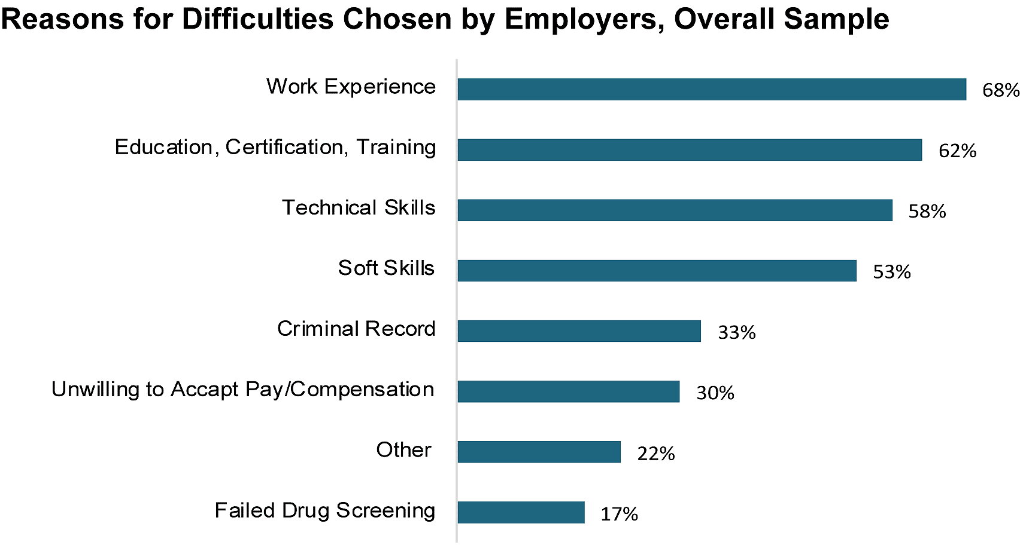
Hiring Difficulties
Notes:
This survey found that Four out of Ten employers who tried to hire in the past year had difficulty filling at least one position.
First on the list - The employers said their new recruits lacked work experience.
Well if that is true, you can show them how a good work-based learning program, like an internship, can help their future employees get the work experience they need.
And second -- is education and training. That’s why we are here to help educate their new recruits.
What else can we do to help prepare their new recruits?
Ask your local employers if this chart is true for their company.
Are there other items they think should be added to his list?
Ask them. They know what they want.
=====
2016 NC Employer Needs Survey
http://www.nccommerce.com/Portals/47/Publications/Industry%20Reports/2016-Employer-Needs-Survey.pdf
2016 NC Employer Needs Survey - PowerPoint
http://www.ncga.state.nc.us/documentsites/committees/BCCI-6578/2015-16%20Session/Meeting%20Documents/March%201,%202016/Employer%20Needs%20Survey%202016%20-%20Leg%20Workforce%20Development%20Committee.pdf

Slide 100
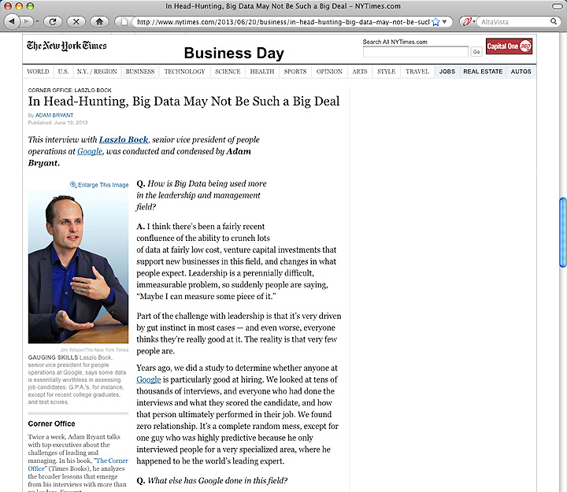
Notes:
We educators often place a great emphasis on grades, class rank, and being valedictorian.
These create parental bragging rights for the parents, but what do they mean outside of high school and college?
Google has crunched the numbers and found that GPA is a worthless criteria for hiring.
They compared the GPA of their new recruits with how well they were performing years later -- and found no correlation.
So they stopped asking their potential employees for their GPA.
You can imagine how well this news goes over in our high schools and colleges where grades appear to be everything.
=======
http://www.nytimes.com/2013/06/20/business/in-head-hunting-big-data-may-not-be-such-a-big-deal.html?pagewanted=all&_r=1&
In Head-Hunting, Big Data May Not Be Such a Big Deal
June 19, 2013
One of the things we’ve seen from all our data crunching is that G.P.A.’s are worthless as a criteria for hiring, and test scores are worthless — no correlation at all except for brand-new college grads, where there’s a slight correlation. Google famously used to ask everyone for a transcript and G.P.A.’s and test scores, but we don’t anymore, unless you’re just a few years out of school. We found that they don’t predict anything.
What’s interesting is the proportion of people without any college education at Google has increased over time as well. So we have teams where you have 14 percent of the team made up of people who’ve never gone to college.
After two or three years, your ability to perform at Google is completely unrelated to how you performed when you were in school, because the skills you required in college are very different. You’re also fundamentally a different person. You learn and grow, you think about things differently.
Another reason is that I think academic environments are artificial environments. People who succeed there are sort of finely trained, they’re conditioned to succeed in that environment. One of my own frustrations when I was in college and grad school is that you knew the professor was looking for a specific answer. You could figure that out, but it’s much more interesting to solve problems where there isn’t an obvious answer. You want people who like figuring out stuff where there is no obvious answer.
===
Google no longer hires based on GPA or test scores
"One of the things we’ve seen from all our data crunching is that G.P.A.’s are worthless as a criteria for hiring, and test scores are worthless"
Google also said that "academic environments are artificial environments." Students are "conditioned to succeed in that environment ... looking for a specific answer." Google wants "people who like figuring out stuff where there is no obvious answer."
These problem-solving skills that Google and others are looking for can be taught in our CTE classes, but the learning can be hard to measure, which makes it tough to convice the administration that these skills need to be taught.
http://www.nytimes.com/2013/06/20/business/in-head-hunting-big-data-may-not-be-such-a-big-deal.html?pagewanted=all&_r=1&

Slide 101
Notes:
Besides saying that GPAs are a worthless hiring criteria, Google says that test scores, and even college degree don’t matter much when hiring.
Google says the No. 1 thing they look for is general cognitive ability, and it’s not I.Q.
It’s learning ability. It’s the ability to process on the fly.
Businesses want people who can grab a bunch of data, quickly turn it into useful information, and use that information to solve a problem.
======
http://www.wnd.com/2014/02/google-calls-these-talents-worthless/

Slide 102
Notes:
Google says the second thing they are looking for is leadership. --in particular, emergent leadership as opposed to traditional leadership.
What they are looking for is: when faced with a problem, and you’re a member of a team, do you, at the appropriate time, step in and lead.
And just as critically, do you step back at the right time and stop leading, and let someone else lead?
How do people learn to take the leadership reigns when necessary and to relinquish when it’s time for someone else to lead?
Google said “It’s feeling the sense of responsibility, the sense of ownership, to step in,” to try to solve any problem – and the humility to step back and embrace the better ideas of others.
The end goal is group problem-solving. How do people learn that? Can we do more leadership training in our schools?
======
http://www.wnd.com/2014/02/google-calls-these-talents-worthless/
Photo
https://qph.ec.quoracdn.net/main-qimg-f789f6f600c4407198ce947708761ffe-c?convert_to_webp=true

Slide 103
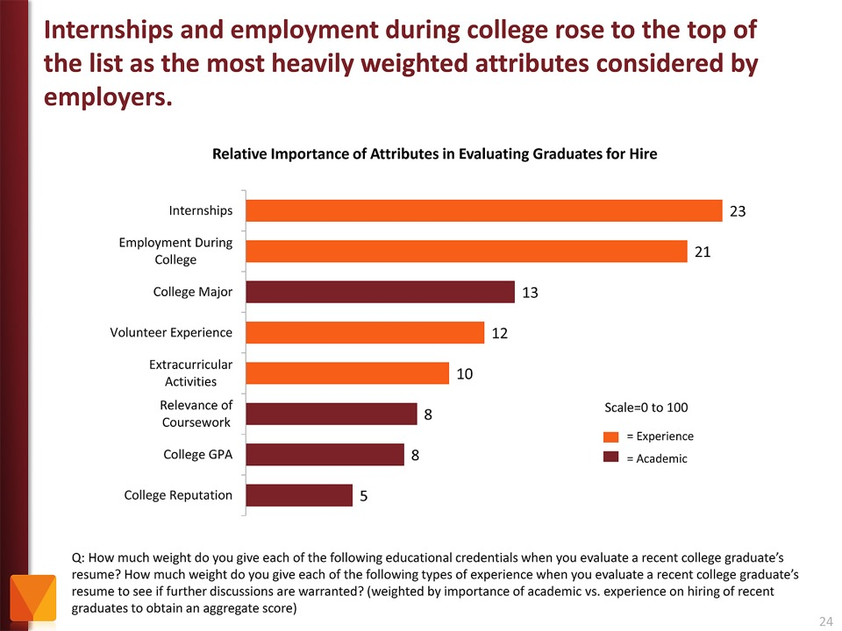
Notes:
Employers value Internships and other employment while in school as more important than college major and GPA.
Even volunteer work and extra-curricular activities are more important to the business community than grades.
Yet, -- most students are too focused on getting good grades -- and are missing out on the experiences that really matter.
If you “begin with the end in mind” like I said earlier, then students should ask the businesses what they will want in their new recruits, rather than focusing on something like grades that the business community could care less about.
======
http://chronicle.com/article/The-Employment-Mismatch/137625/#id=overview
The Employment Mismatch: A College Degree Sorts Job Applicants, but Employers Wish It Meant More
Employers value a four-year college degree, many of them more than ever.
Yet half of those surveyed recently by The Chronicle and American Public Media's Marketplace said they had trouble finding recent graduates qualified to fill positions at their company or organization. Nearly a third gave colleges just fair to poor marks for producing successful employees. And they dinged bachelor's-degree holders for lacking basic workplace proficiencies, like adaptability, communication skills, and the ability to solve complex problems.
The report
The Role of Higher Education in Career Development: Employer Perceptions
http://chronicle.com/items/biz/pdf/Employers%20Survey.pdf

Slide 104
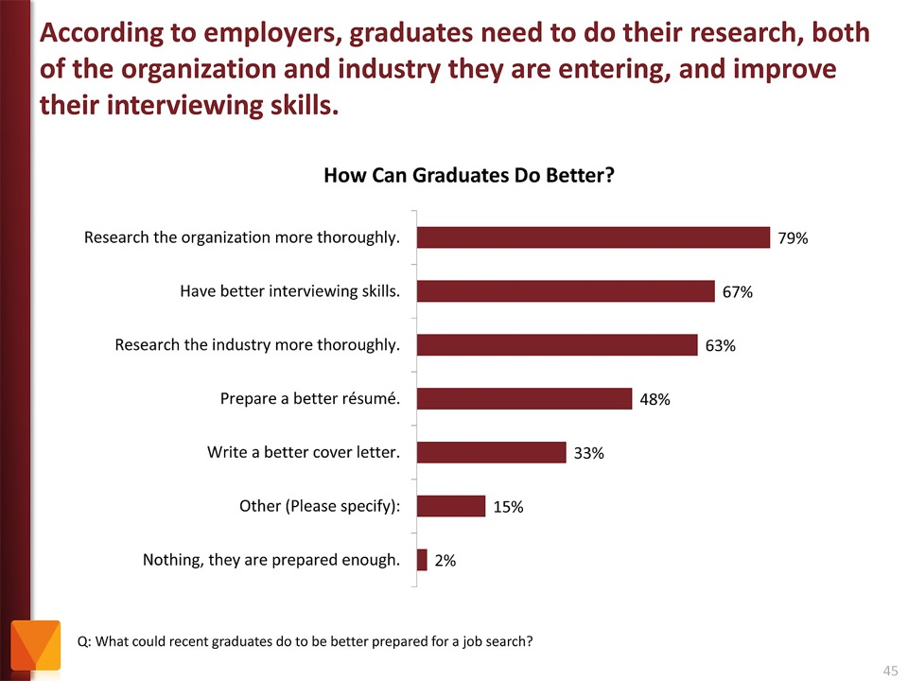
Notes:
Tell your students to research the companies where they are applying for work. And learn about the interview process.
It just amazes me that folks would try to get a job at a company they know nothing about.
The focus of the job interview should be on what you can do for the company.
======
http://chronicle.com/article/The-Employment-Mismatch/137625/#id=overview
The Employment Mismatch: A College Degree Sorts Job Applicants, but Employers Wish It Meant More
Employers value a four-year college degree, many of them more than ever.
Yet half of those surveyed recently by The Chronicle and American Public Media's Marketplace said they had trouble finding recent graduates qualified to fill positions at their company or organization. Nearly a third gave colleges just fair to poor marks for producing successful employees. And they dinged bachelor's-degree holders for lacking basic workplace proficiencies, like adaptability, communication skills, and the ability to solve complex problems.
The report
The Role of Higher Education in Career Development: Employer Perceptions
http://chronicle.com/items/biz/pdf/Employers%20Survey.pdf

Slide 105
Myth # 1
All of the manufacturing is moving to China.
Notes:
105
If you read the front page of the newspaper (or listen to the politicians), you might still believe this.
But if you read the Business section like I do …
=====
http://www.honestfilms.net/wp-content/uploads/burtynsky_manufacturing.jpg

Slide 106
Notes:
… you will find that times have changed -- and the manufacturing is coming back home.
=====
http://www.forbes.com/sites/singularity/2012/07/23/the-end-of-chinese-manufacturing-and-rebirth-of-u-s-industry/
The End of Chinese Manufacturing and Rebirth of U.S. Industry

Slide 107
Notes:
People don’t believe me when I tell them that Chinese companies have moved some of their manufacturing to North Carolina.
=====
http://money.cnn.com/2012/04/24/smallbusiness/china-us-manufacturing/index.htm
China offshores manufacturing to the U.S.

Slide 108
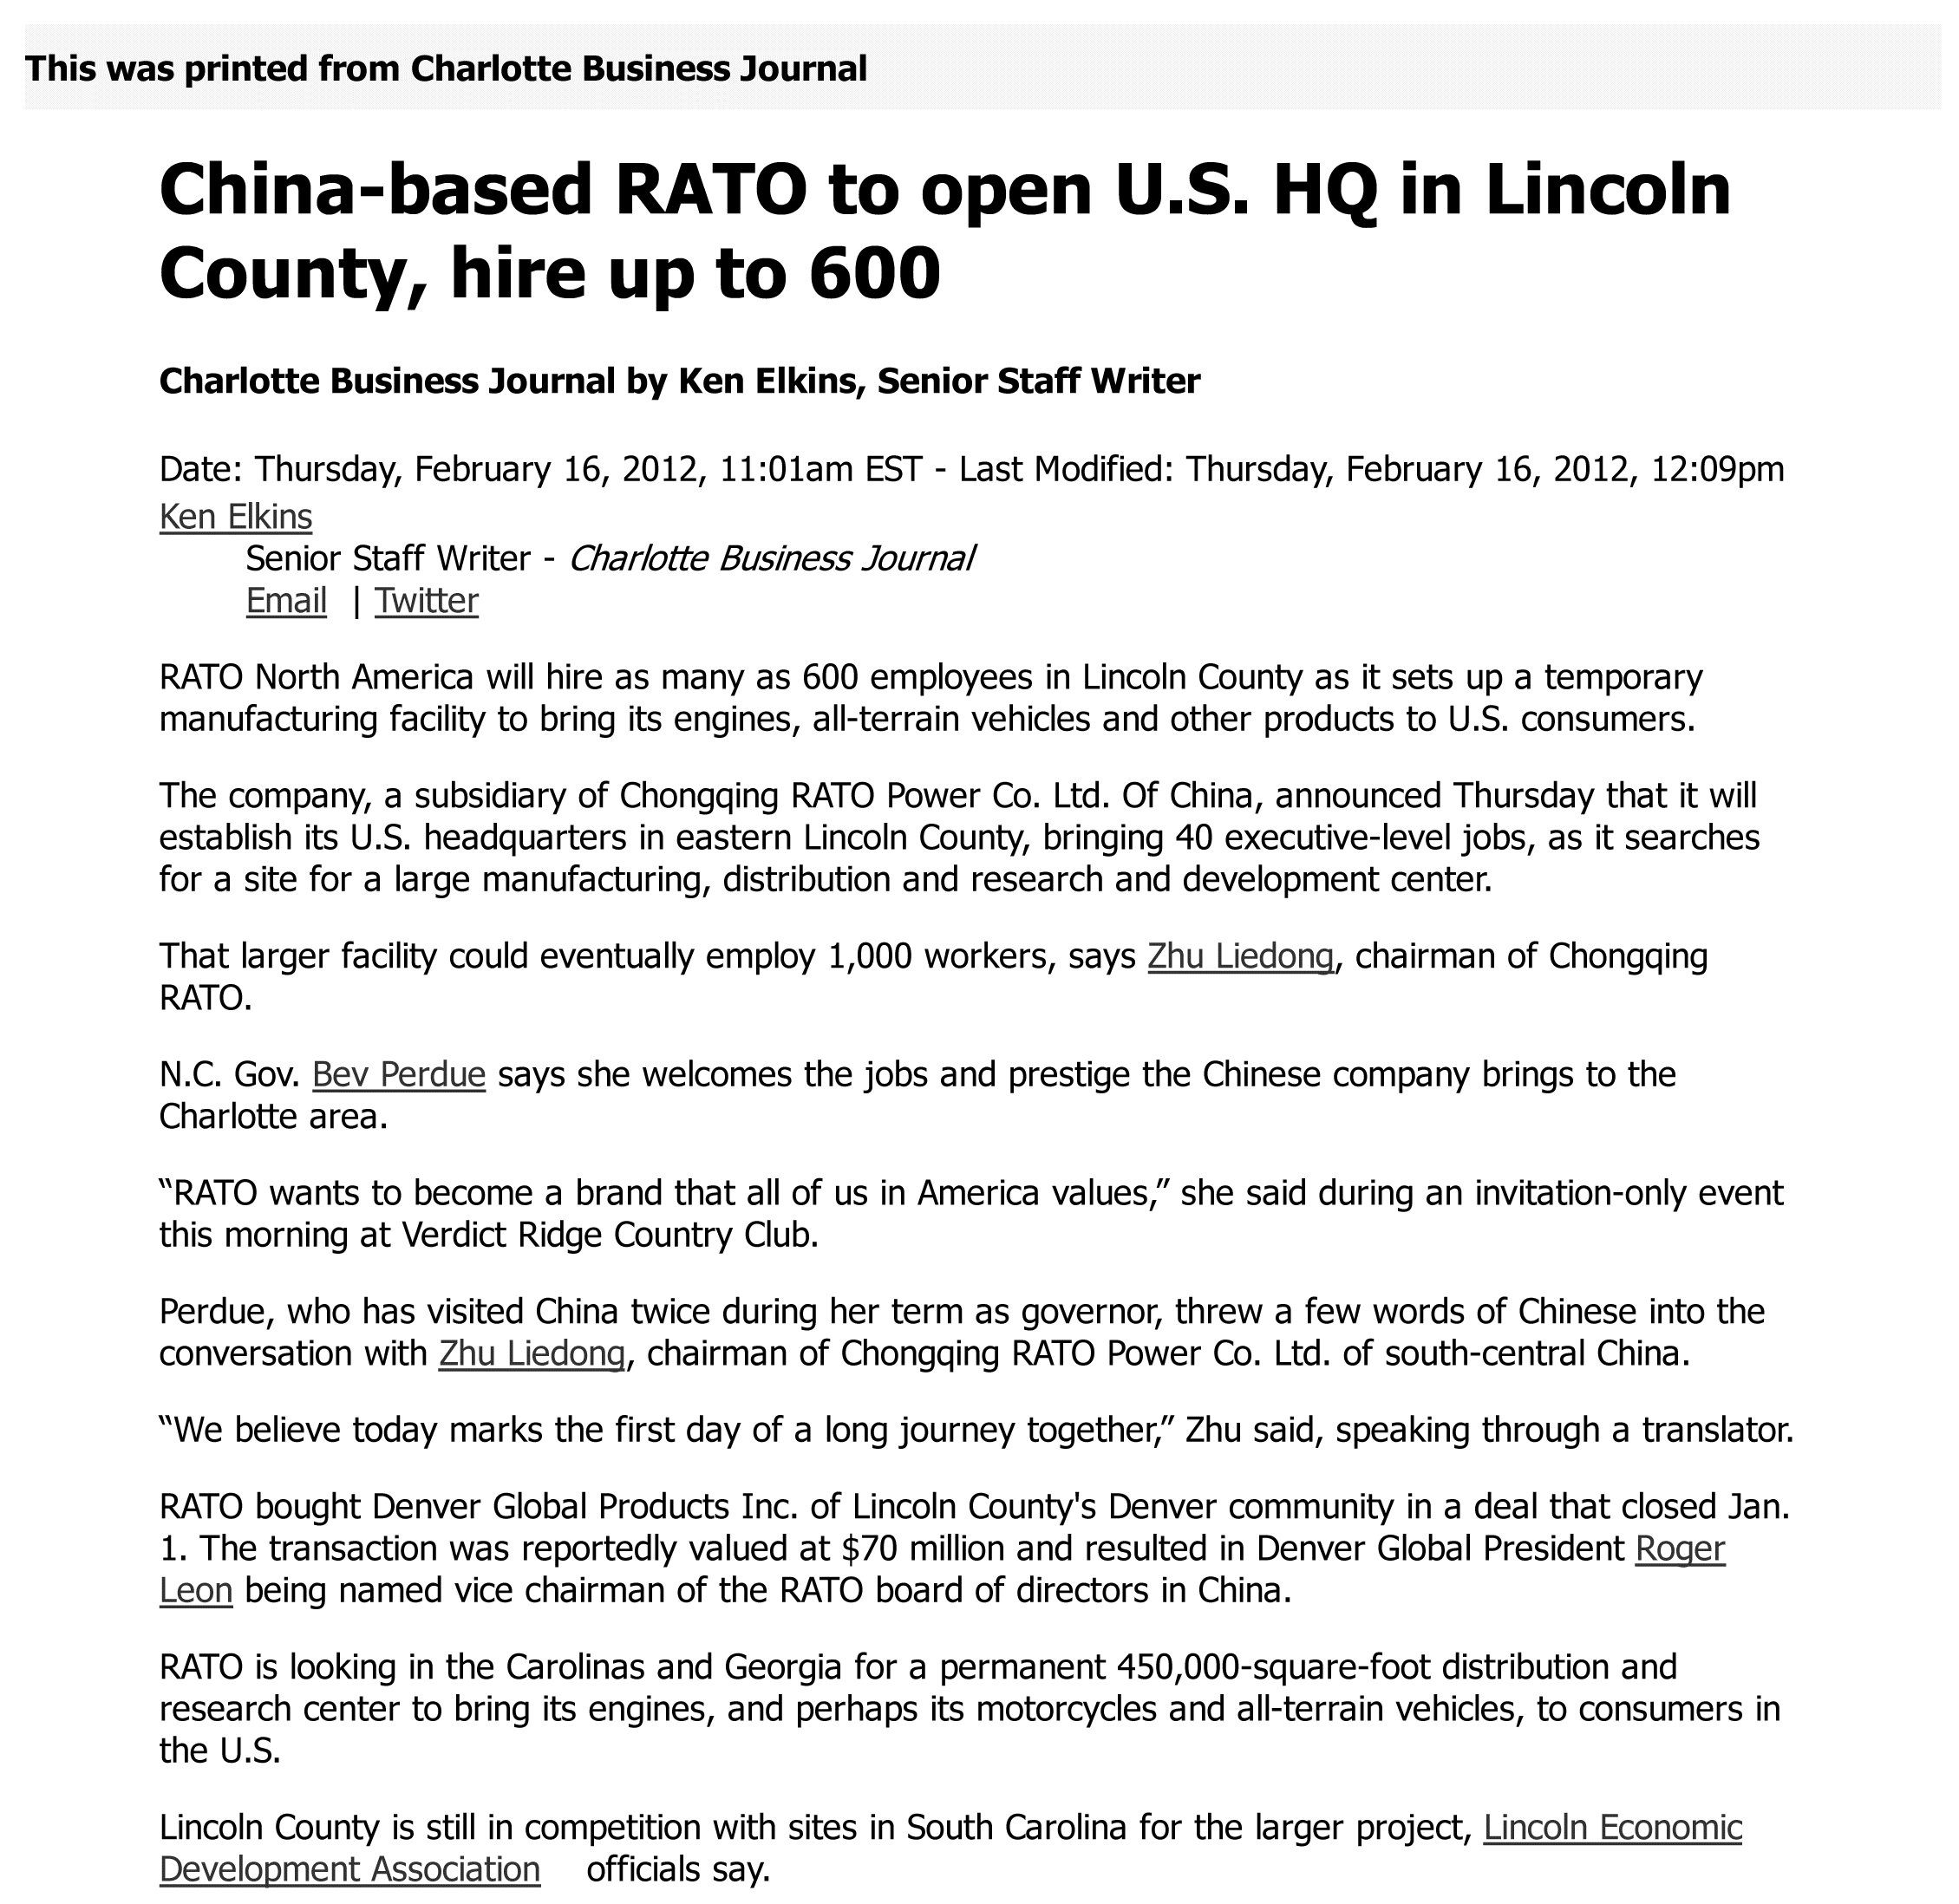
Notes:
108
Here we have a Chinese all-terrain vehicle company that built a manufacturing plant in North Carolina
====
China-based RATO to open U.S. HQ in Lincoln County, hire up to 600 (maybe 1000 jobs)
Feb 16, 2012
http://www.bizjournals.com/charlotte/blog/outside_the_loop/2012/02/chinese-company-to-open-in-lincoln.html

Slide 109
Notes:
Another Chinese company is bringing their solar panel factory to Charlotte
====
International company will bring up to 36 jobs; site will serve as main manufacturing
plant.
http://www.charlotteobserver.com/2011/06/24/2402136/solar-panel-jobs-coming-to-charlotte.html#storylink=misearch
109

Slide 110
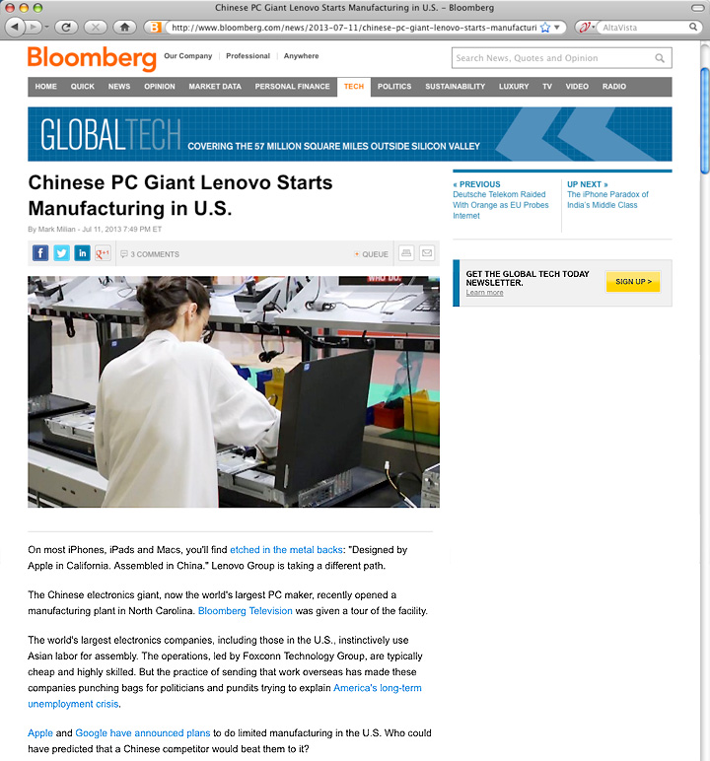
Notes:
And Lenovo, who makes the IBM ThinkPads, is setting up manufacturing in the United States.
=====
http://www.bloomberg.com/news/2013-07-11/chinese-pc-giant-lenovo-starts-manufacturing-in-u-s-.html
Chinese PC Giant Lenovo Starts Manufacturing in U.S.
The Chinese electronics giant, now the world's largest PC maker, recently opened a manufacturing plant in North Carolina. Bloomberg Television was given a tour of the facility.
The world's largest electronics companies, including those in the U.S., instinctively use Asian labor for assembly. The operations, led by Foxconn Technology Group, are typically cheap and highly skilled. But the practice of sending that work overseas has made these companies punching bags for politicians and pundits trying to explain America's long-term unemployment crisis.

Slide 111
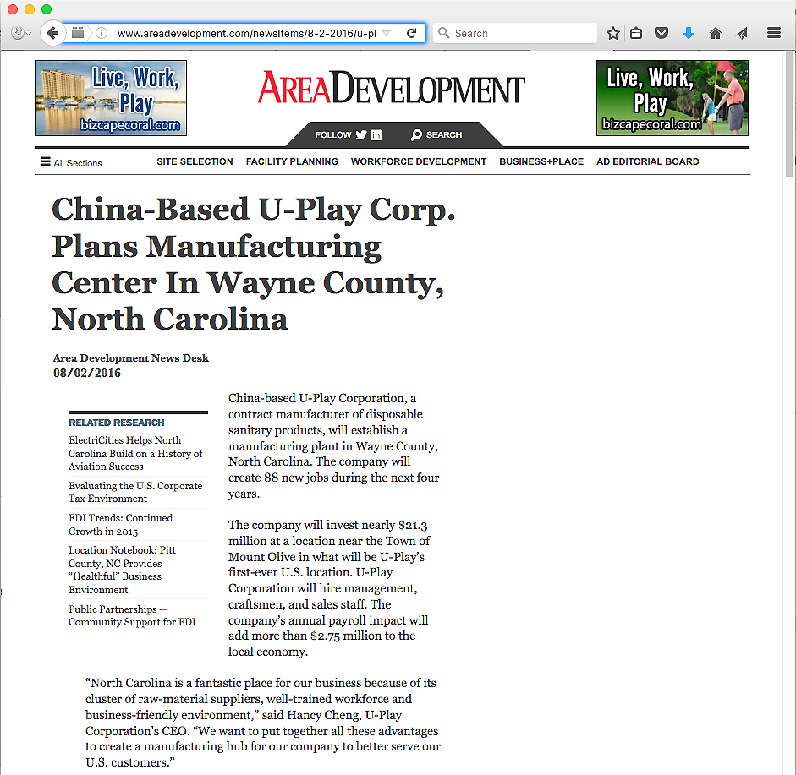
Notes:
Here is a Chinese manufacturer who recently picked North Carolina over South Carolina for a new manufacturing facility, and 88 jobs.
====
http://www.areadevelopment.com/newsItems/8-2-2016/u-play-corporation-wayne-county-north-carolina.shtml
http://www.bizjournals.com/triangle/blog/techflash/2016/08/chinese-firm-picks-north-carolina-over-south.html

Slide 112
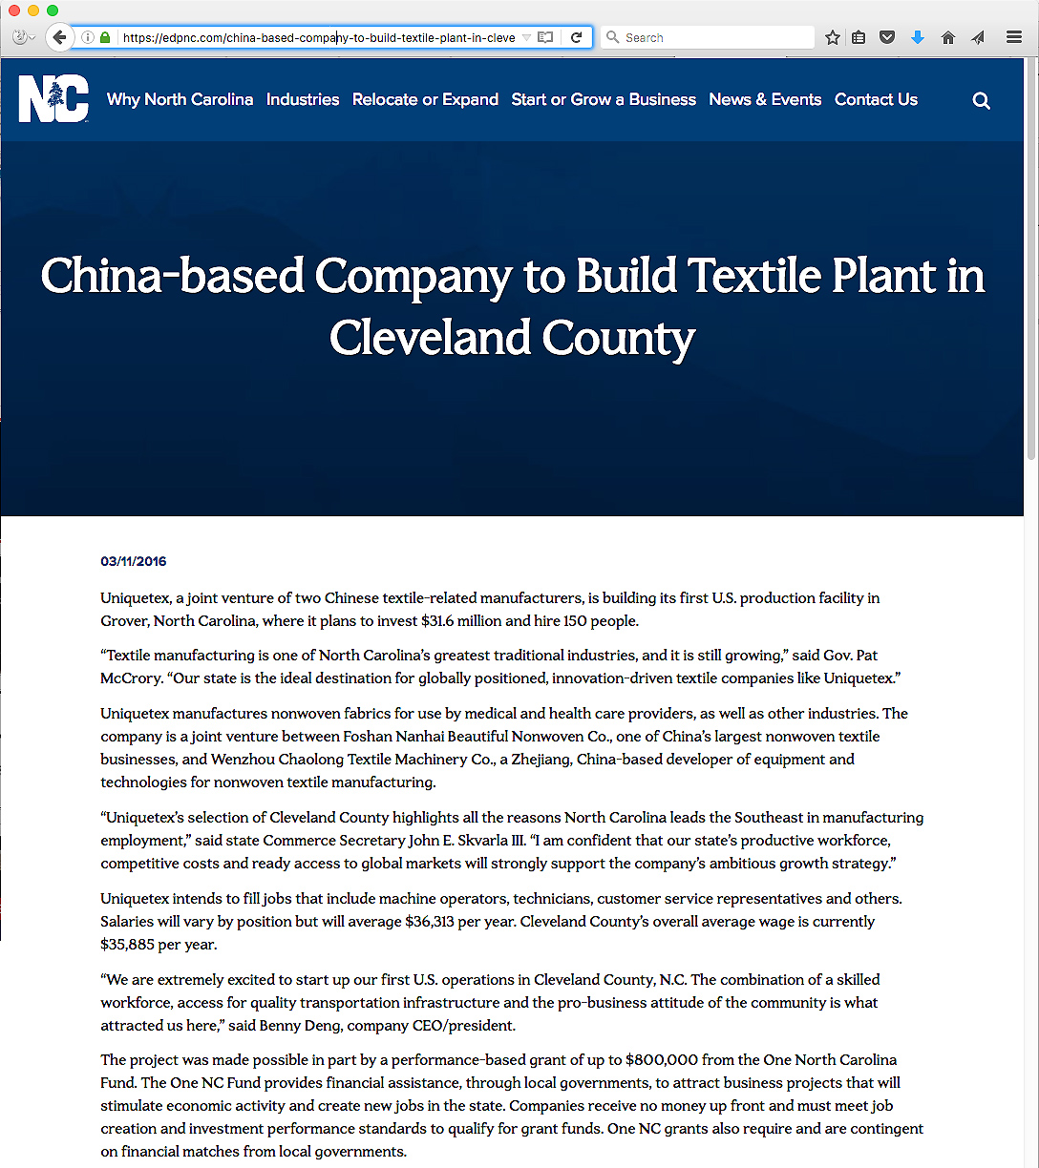
Notes:
Chinese textile company setting up shop in North Carolina.
====
https://edpnc.com/china-based-company-to-build-textile-plant-in-cleveland-county/

Slide 113
Notes:
113
And Chinese Wind Power Technologies is coming to Raleigh.
What should we be doing to prepare our current students for these jobs, and the jobs that will follow?
How are we preparing our youth to work for a company with cultural norms that our different from ours?
===
China Ming Yang Wind Power Group Limited, a wind turbine manufacturer in China, opened a North American research and development center on N.C. State’s Centennial Campus on Tuesday.
The center will focus on offshore wind turbine research and development. Shu Ching Quek, president of Ming Yang Wind Power USA Inc. (NYSE: MY), will lead the center.
Initially, the company will employ about five people at Centennial Campus, according to Gene Pinder, the campus’ marketing director. It has leased space formerly occupied by WebAssign in the Venture Center IV building at Centennial Campus.
http://www.bizjournals.com/triangle/news/2012/03/13/ncsus-centennial-campus-lands-new.html

Slide 114
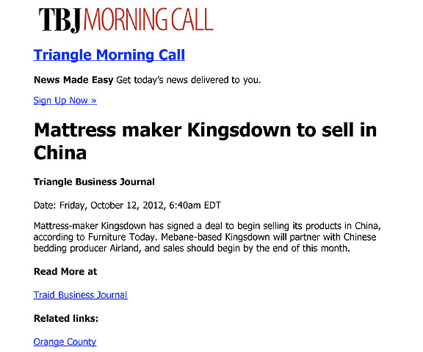
Notes:
And here it works the other way around.
Here is an American manufacturing company in North Carolina that is shipping it’s high-quality mattresses to China.
Yes, products made in America being sold in China.
===
http://www.bizjournals.com/triangle/morning_call/2012/10/mattress-maker-kingsdown-to-sell-in.html?ana=e_trig_rdup&s=newsletter&ed=2012-10-12
114

Slide 115
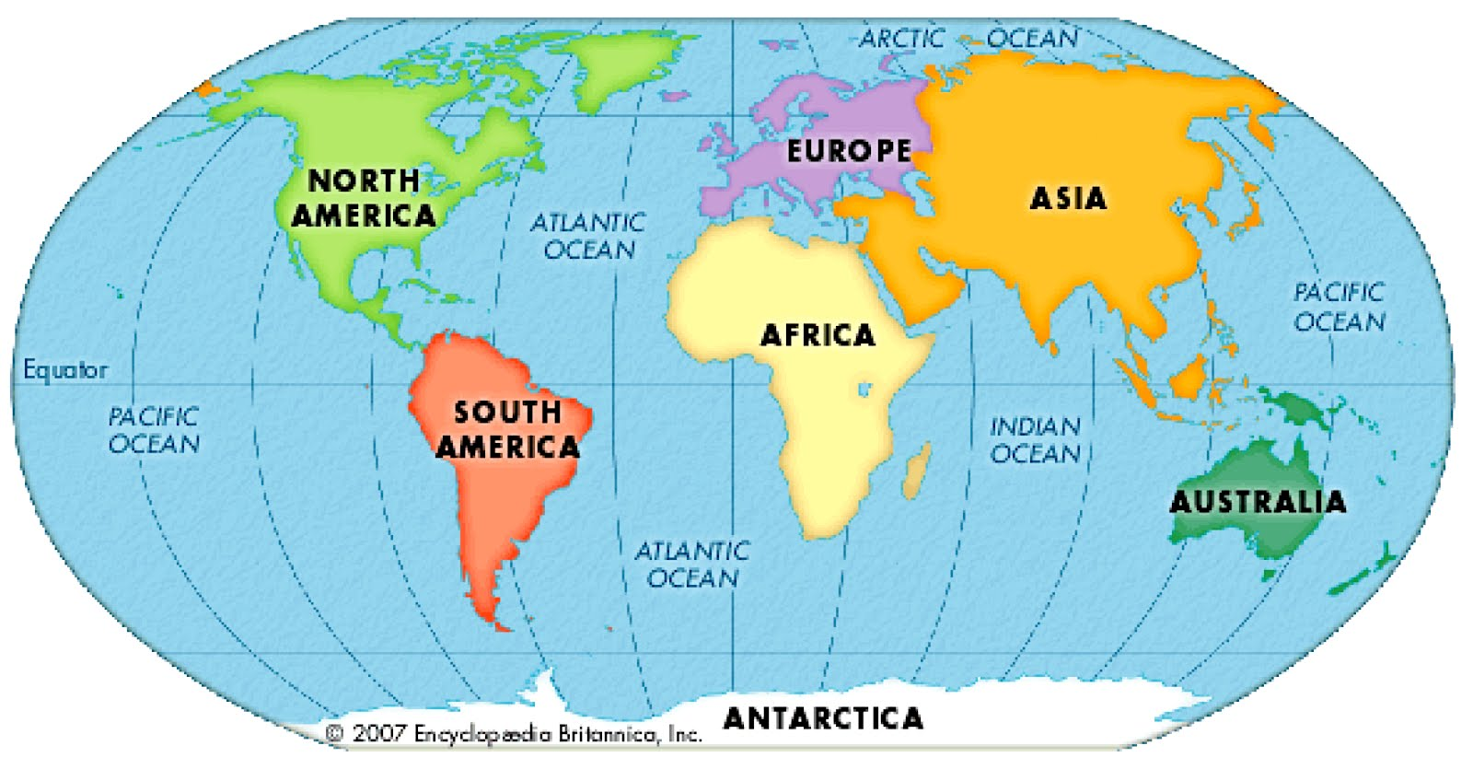
NC Exports to Countries in 2016
$6,407,000 Canada
$3,012,000 Mexico
$2,186,000 China
$1,611,000 Saudi Arabia
$1,547,000 Japan
$1,455,000 United Kingdom
$1,184,000 France
$999,000 Germany
$841,000 Honduras
$758,000 Netherlands
Notes:
Not all things are made in China.
North Carolina has a healthy export business, and as you see, we sold over 2 million dollars worth of products last year to China.
====
https://www.census.gov/foreign-trade/statistics/state/data/nc.html
2016 data
Map
http://4.bp.blogspot.com/-_aOqG-WDaic/T91LXcUziPI/AAAAAAAAAQs/TZ9SqXv0XY8/s1600/KidsFlatGlobe2.jpg

Slide 116
NC Exports - Products 2016
$1,418,490,000 Civilian Aircraft, Engines, and Parts
$1,409,000,000 Antisera, Blood Fractions & Immunological Pro
$1,214,530,000 Medicaments Nesoi, Measured Doses, Retail Pk
$993,730,000 Parts of Airplanes or Helicopters, Nesoi
$689,070,000 Tobacco, Partly or Wholly Stemmed/Stripped
$659,410,000 Chemical Woodpulp, Soda rtc. N Dis S Bl & Bl
$400,480,000 Road Tractors for Semi-trailers
$329,930,000 Cot Yarn, 85% Cot, No Retail, Ov 14nm Not Ov
$328,030,000 Photosnsitve Semicndctr Dvice Inc Phtvltc Cel
$276,920,000 Parts of Mach for Assmbl Elec Lamp etc Mfg Gl
$268,480,000 Auto Regulating Ins & Appr Ex Throstat,mnstat
Notes:
And in case you are wondering what the other countries are buying from us.
You see here that North Carolina exports lots of airplanes and aviation parts -- and pharmaceuticals.
And there is still a high demand around the world for some of our older products like tobacco and cotton yarn.
Who knew this?
We need lots of skilled workers to keep making this stuff that the Chinese, and others are buying from us.
======
https://www.census.gov/foreign-trade/statistics/state/data/nc.html
2016 data

Slide 117
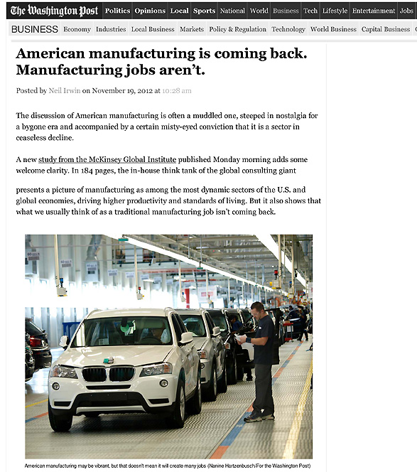
Notes:
As American manufacturing is making its comeback, we find that the old Manufacturing jobs that required a strong back and no education are not coming back.
That's the big difference between old-school manufacturing and modern advanced manufacturing.
The manufacturers need people who know math, physics, and can solve problems.
=====
http://www.washingtonpost.com/blogs/wonkblog/wp/2012/11/19/american-manufacturing-is-coming-back-manufacturing-jobs-arent/
117

Slide 118
NC Advanced Manufacturing Careers Awareness Week
October 2-6, 2017
ncperkins.org/manufacturing
Notes:
I mentioned this earlier.
We expect over 60 open houses all across the state helping people learn about the modern careers in Advanced Manufacturing.
Spread the word.
======
http://www.ncperkins.org/moodle/course/view.php?id=14

Slide 119
Notes:
Last year, folks around the world got to see some of our Made in North Carolina products, like these uniforms worn by the American athletes at the Olympics.
The textile industry is alive and well in North Carolina.
There are no longer sweat shops in North Carolina with young ladies hunched over a manual sewing machine.
No -- these textile operations are high-tech and require smart folks to operate the equipment.
Advanced Manufacturing, including textile production, is big in North Carolina.
====
Opening Ceremony
http://www.bizjournals.com/triangle/news/2016/08/09/those-team-usa-uniforms-in-rio-made-in-north.html?ana=e_du_prem&s=article_du&ed=2016-08-09&u=DFsejj4U8KnV9lBFgI8D1Q03b85e1a&t=1470853007&j=75380092
Rowing Team
http://www.wcnc.com/sports/olympics/local-business-made-olympic-uniforms/280016944
White fabric
http://www.wyff4.com/sports/2016-olympics/upstate-company-helps-make-uniforms-for-us-olympians/41032828
Pants
http://www.twcnews.com/nc/triangle-sandhills/news/2016/08/6/usa-olympic-opening-ceremony-uniforms-made-in-nc.html
Blazers
http://www.twcnews.com/nc/triangle-sandhills/news/2016/08/6/usa-olympic-opening-ceremony-uniforms-made-in-nc.html
The white thread in the pants you see here was made in North Carolina and shipped to South Carolina where the white fabric was made.
Then the white fabric came back to North Carolina where the pants were assembled in Rutherfordton and Greensboro, North Carolina.
The blazers were assembled in Burlington, Raeford, and Cordova, North Carolina

Slide 120
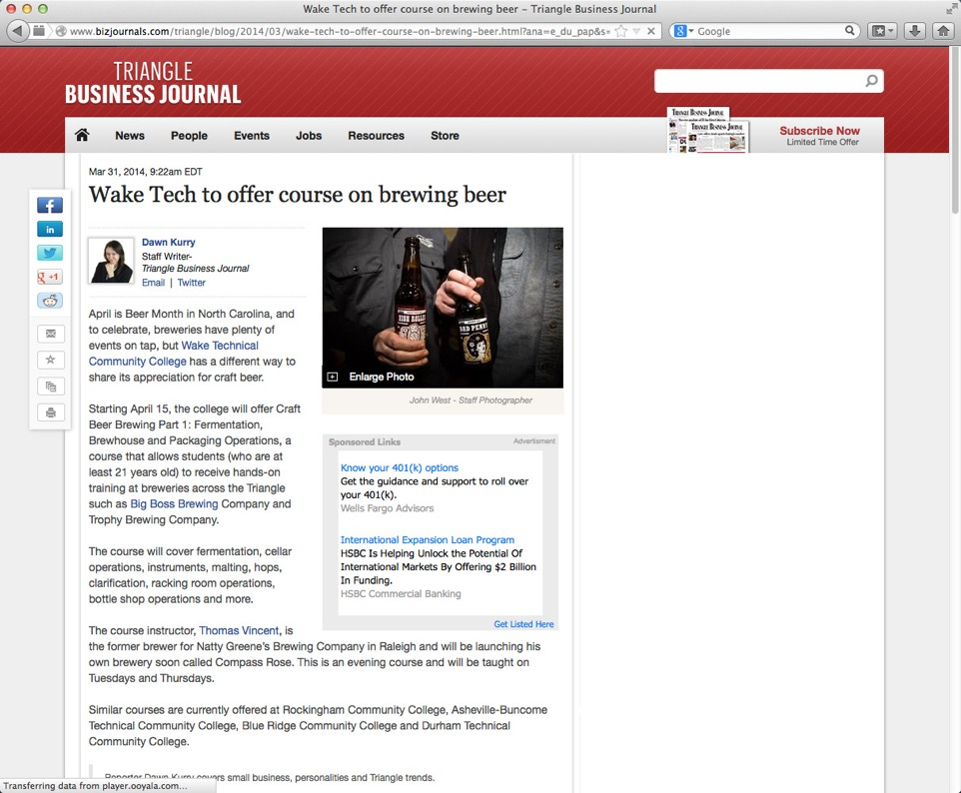
Notes:
We giggle when we think that college students are taking classes to learn how to make beer.
What’s next, classes on how to drink beer?
======
http://www.bizjournals.com/triangle/blog/2014/03/wake-tech-to-offer-course-on-brewing-beer.html?ana=e_du_pap&s=article_du&ed=2014-03-31
Mar 31, 2014, 9:22am EDT
Wake Tech to offer course on brewing beer
Starting April 15, the college will offer Craft Beer Brewing Part 1: Fermentation, Brewhouse and Packaging Operations, a course that allows students (who are at least 21 years old) to receive hands-on training at breweries across the Triangle such as Big Boss Brewing Company and Trophy Brewing Company.

Slide 121
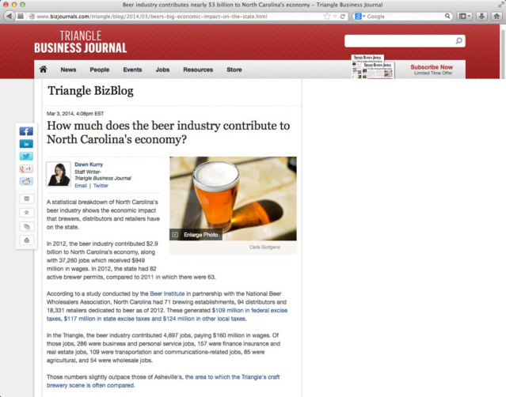
In 2016, the Beer industry in NC
58,949 jobs
$2,496,990,300 wages
$1,213,793,700 business/personal taxes
$437,153,600 consumption taxes
Notes:
Seriously though, beer making is becoming big business in North Carolina, especially in the Triangle region and in Asheville.
In 2016 the beer industry contributed almost 59 thousand jobs.
In federal, state and local taxes, North Carolina beer manufacturing contributed over one and a half billion dollars.
Yet another report, by Datafini, ranked North Carolina No. 10 in the U.S. by the sheer number of craft breweries, at 205. California topped the list, at 687 breweries.
This is manufacturing, and it is not like the beer making factories of old.
=============
Current Data
http://beerservesamerica.org/
Article
http://www.bizjournals.com/triangle/blog/2014/03/beers-big-economic-impact-on-the-state.html
Mar 3, 2014, 4:08pm EST
How much does the beer industry contribute to North Carolina's economy?
In 2012, the beer industry contributed $2.9 billion to North Carolina’s economy, along with 37,260 jobs which received $949 million in wages. In 2012, the state had 82 active brewer permits, compared to 2011 in which there were 63.
According to a study conducted by the Beer Institute in partnership with the National Beer Wholesalers Association, North Carolina had 71 brewing establishments, 94 distributors and 18,331 retailers dedicated to beer as of 2012. These generated $109 million in federal excise taxes, $117 million in state excise taxes and $124 million in other local taxes.

Slide 122
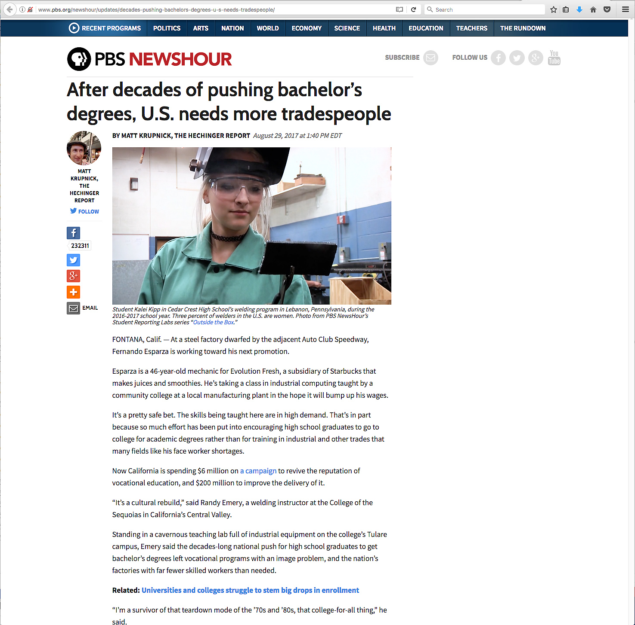
Notes:
Some of us have been preaching this for many years. Unfortunately the middle-class philosophy is that more education is important for success in life.
We have to get them to see that the Right education is the secret to success in life.
=====
http://www.pbs.org/newshour/updates/decades-pushing-bachelors-degrees-u-s-needs-tradespeople/

Slide 123
Notes:
Besides the usual information about what businesses are looking for in their new recruits,
this report also lists the individual needs and solutions from 68 large US companies, many of which have locations here in North Carolina.
See if any of them are in your part of the state, and see if your education programs are aligned with their needs.
Anyone have a CVS Pharmacy in your area? The CVS page in this book describes the apprenticeships program they are using with their new employees.
===
http://businessroundtable.org/sites/default/files/immigration_reports/BRT%20Work%20in%20Progress_0.pdf

Slide 124
Notes:
Who has seen this book?
We published this Career Cluster Guide in 2015. and have just started on an updated version.
Copies were distributed to the community colleges, high schools, and other locations across the state.
We want to ensure that everyone has both timely and accurate career information, thus promoting informed decisions about choosing a career path.
This guide will assist anyone in identifying the available career options by using individual interests, clearly defined career pathways, and timely employment projections.
=====
http://ncperkins.org/careers/
124

Slide 125
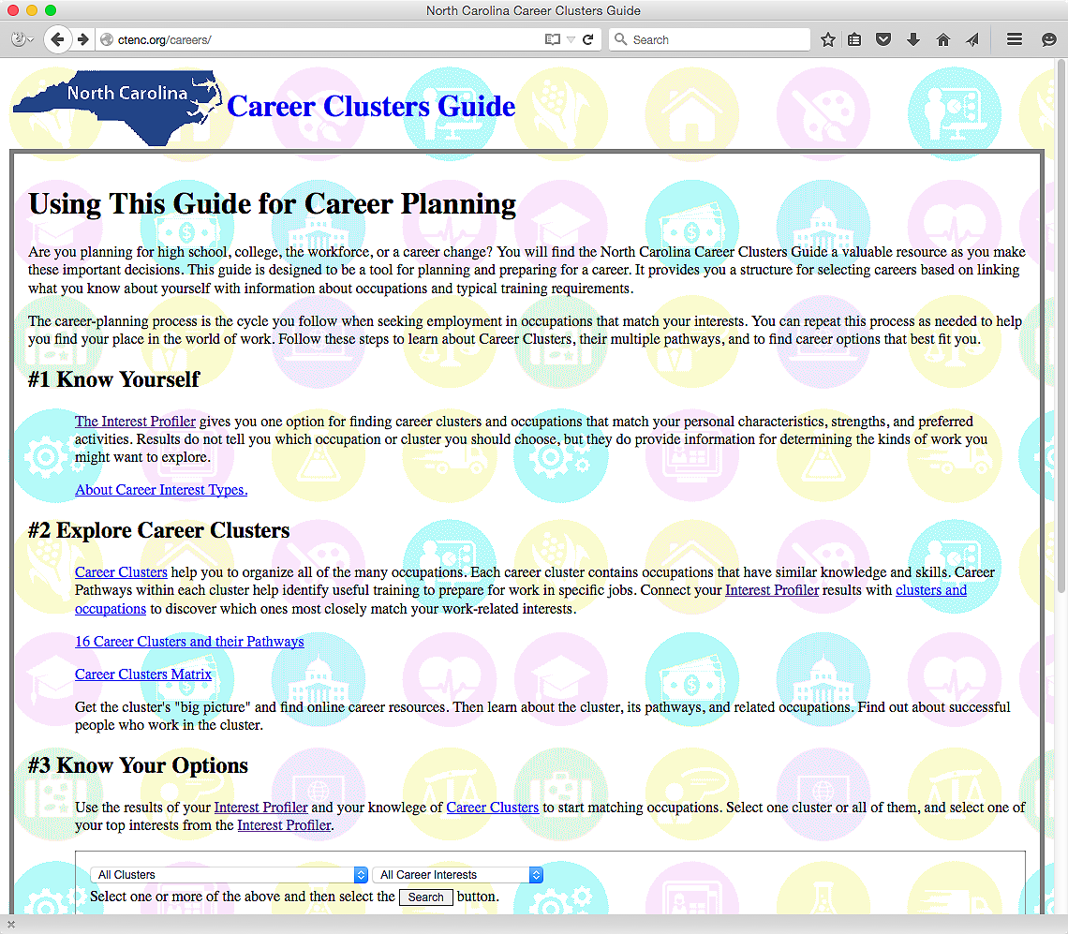
NCperkins.org/careers
Notes:
And now look. We took the book and made it into an interactive website. How cool is that?
Here is the web address. NC Perkins dot org is the same website where you can find this PowerPoint.
You can see the job projections and salaries for each occupation.
Short videos are available for most of the occupations.
There is also a career interest assessment to help the folks get started.
We have to help our students discover who they are first -- before we can help them find the career that is best suited for them.
Besides the interactive web pages, a PDF of the printed book is available at the bottom of the main page.
Check it out.
=====
http://ncperkins.org/careers/

Slide 126
Prosperity Zones
NCperkins.org/careers
Notes:
In the online version you can see the job projections and salaries for each occupation for each of the eight North Carolina Prosperity Zones as well as the composite for the state.
Some folks may not want to move out of the state, but might find a higher demand or a higher salary just across a county border.
((And if you live near the border of the state. …..
====
http://nccareers.org/employmentprojections/images/Prosperity-Zones-Map.png

Slide 127
Notes:
There is a lot of high-tech going on in modern kitchens. The appliances are all talking to each other.
And when you are running low on milk, the refrigerator orders another gallon that could be delivered directly to your house.
When the milk arrives, your refrigerator could even unlock and open the front door of the house -- and let the drone in -- and have the drone put the milk in the refrigerator. It’s all possible now through current technology.
-- We still have to drink the milk ourselves. There’s no app for that!
=====
http://siliconangle.com/blog/2015/01/08/best-new-apps-for-apple-homekit-at-ces2015/

Slide 128
Notes:
This is all great of course -- until someone hacks your fridge –
and now you don’t have access to your own milk.
======
http://www.bizjournals.com/bizjournals/news/2016/11/23/tech-giants-recommend-rules-to-protect-your-fridge.html?ana=e_sjo_tf&s=newsletter&ed=2016-11-23&u=DFsejj4U8KnV9lBFgI8D1Q03b85e1a&t=1481121998&j=76545421

Slide 129
Notes:
But many are hopeful about letting robots and computers take over our lives.
My smart phone frustrates me quite often.
=====
http://www.bizjournals.com/sanjose/news/2016/11/30/techflash-q-a-reasons-to-be-hopeful-about-ourrobot.html?ana=e_sjo_tf&s=newsletter&ed=2016-11-30&u=DFsejj4U8KnV9lBFgI8D1Q03b85e1a&t=1481124453&j=76609931

Slide 130
The 10 Key Skills for the Future of Work
Sense-making
Social intelligence
Novel and adaptive thinking
Cross-cultural competency
Computational thinking
New-media literacy
Transdisciplinarity
Design mind-set
Cognitive load management
Virtual collaboration
Notes:
Here are some broad skills that will help workers adapt to the changing career landscape: This is what the modern employers are looking for.
Sense-making is the ability to determine the deeper meaning or significance of what is being expressed
Social intelligence is the ability to connect to others in a deep and direct way, to sense and stimulate reactions and desired interactions
Novel and adaptive thinking is proficiency at thinking and coming up with solutions and responses beyond that which is rote or rule-based
Cross-cultural competency is the ability to operate in different cultural settings
Download my PowerPoint and read the descriptions for the rest of these.
Where are we teaching these skills that the workforce needs?
==========
Computational thinking is the ability to translate vast amounts of data into abstract concepts and to understand data-based reasoning
New-media literacy is the ability to critically assess and develop content that uses new media forms and to leverage these media for persuasive communication
Transdisciplinarity is literacy in, and ability to understand concepts across multiple disciplines
Design mind-set is the ability to represent and develop tasks and work processes for desired outcomes
Cognitive load management is the ability to discriminate and filter information for importance and to understand how to maximize cognitive functioning using a variety of tools and techniques, and
Virtual collaboration is the ability to work productively, drive engagement, and demonstrate presence as a member of a virtual team
Are we teaching these skills to our students? If not, then who will?
========
GigaOM
Dec. 16, 2011,
http://gigaom.com/collaboration/the-10-key-skills-for-the-future-of-work/?utm_source=General%20Users&utm_campaign=9bd9bdcde9-c%3Atec%20d%3A12-17&utm_medium=email
What are the jobs of the future? The demographics of an aging population suggests health care will be big, say some.
Broad skills that will help workers adapt to the changing career landscape:
Sense-making. The ability to determine the deeper meaning or significance of what is being expressed
Social intelligence. The ability to connect to others in a deep and direct way, to sense and stimulate reactions and desired interactions
Novel and adaptive thinking. Proficiency at thinking and coming up with solutions and responses beyond that which is rote or rule-based
Cross-cultural competency. The ability to operate in different cultural settings
Computational thinking. The ability to translate vast amounts of data into abstract concepts and to understand data-based reasoning
New-media literacy. The ability to critically assess and develop content that uses new media forms and to leverage these media for persuasive communication
Transdisciplinarity. Literacy in and ability to understand concepts across multiple disciplines
Design mind-set. Ability to represent and develop tasks and work processes for desired outcomes
Cognitive load management. The ability to discriminate and filter information for importance and to understand how to maximize cognitive functioning using a variety of tools and techniques
Virtual collaboration. The ability to work productively, drive engagement and demonstrate presence as a member of a virtual team

Slide 131
Questions before I conclude?
Chris Droessler, CTE Coordinator
NCperkins.org/presentations
Notes:
Before I conclude my presentation, I will pause here to see if anyone has any questions.
I have a few more slides to share.
But first I want to know if you have any questions.
Usually by this time most of the audience is overwhelmed and just need a break to digest what I’ve said.
Remember that you can download the PowerPoint and use it however you can.
Do we have any questions? Do we have time for questions?

Slide 132
Notes:
---
Too many people go through life not knowing who they are -- and why they are here on planet Earth.
For some -- the revelation comes late in life.
Somewhere along the way -- all of us found out that we cared about helping others–
and we were supposed to be right here – this very morning–
listening to an old high-school shop teacher talk about the future.
========
http://www.goodreads.com/quotes/505050-the-two-most-important-days-in-your-life-are-the
“The two most important days in your life are the day you are born and the day you find out why.”
― Mark Twain
http://www.huffingtonpost.com/karen-ann-kennedy/the-two-most-important-days-of-your-life_b_5229311.html
Photo
http://myincrediblewebsite.com/mark-twain-on-the-days-of-your-life/

Slide 133
Passion and Purpose
Thriving in your work, not just surviving.
Leaving the world a little better off because you cared to make a difference in your work.
Helping people discover their passion and then helping them turn that passion into an educational pathway that will lead to a rewarding career.
Notes:
Though the term “vocational” has earned a bad reputation in the last few decades, the original meaning of the term is clear that your “vocation” is your life’s calling.
Our vocation as educators is preparing students for careers.
What is the vocation of the students with whom you work?
What is life calling them to do?
What is their purpose in life?
We need to help people discover their passion.
What makes them get up in the morning and want to learn something new?
It’s more than just working for a paycheck.
It’s doing satisfying work, making a difference in the world, feeling needed.
And we need to help them to turn that passion into a rewarding career.
--
In the future -- when our students are employed, -- and someone asks them what they do for a living, --
wouldn’t it be great if they could say –
“I get to make a difference in the world.”
That’s what I do…
“I get to make a difference”
===
Chris Droessler

Slide 134
A Changing World: Helping people prepare for career and life success
Chris Droessler, CTE Coordinator
NCperkins.org/presentations
Notes:
Thank You
=====
www.NCperkins.org/presentations

