Slide 1
Postsecondary Perkins Update
September 12, 2017
www.ncperkins.org

Slide 2
Important Local Grant Reminders
Initial Budgets – Submissions should be uploaded to Moodle by Friday, September 29, 2017
Locally Articulated Courses – Upload a list of any locally articulated courses to Moodle. If you do not have a local articulation agreement, please indicate that in the submission text area.
Improvement Plans – Colleges required to complete an improvement plan have been contacted. Plans should be submitted by September 29, 2017
Drive-In Meetings – We will have one statewide meeting on November 8th at the System Office and regional meetings in the spring (date TBD)

Slide 3
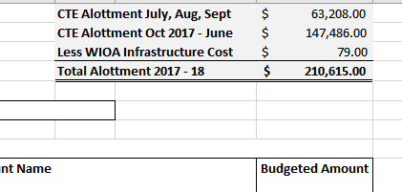
Completing the Initial Budget Form
Use the CTE Allotment information found in the State Aid Allocations and Budget Policies.

Slide 4
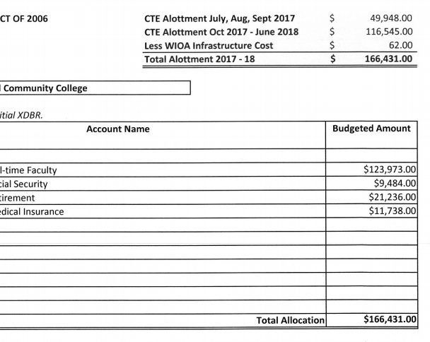
Completing the Initial Budget Form (cont.)
Copy your information from your XDBR
The two numbers should match

Slide 5
Career Pathway Grant Reminders
Colleges selected for the grant should have received their award letters.
A Moodle site has been setup and should be available to colleges receiving the Catalyzing Career Pathways grant.
All documents related to this grant can be found in the Moodle site.
EDGAR – Guidelines related to the local grant apply to the Catalyzing Pathways grant

Slide 6
Catalyzing Career Pathways Documents Required
All documents can be found in Moodle.
Acceptance letter
Assurances
Budget with cover letter
All documents should be uploaded by September 29.

Slide 7
Time and Effort
Time and Effort forms have been updated and are available for download at www.ncperkins.org
100% Time & Effort (one cost objective)
Form has not changed
Form should be completed after the Fall and Spring semesters
Split Time & Effort (multiple cost objectives)
The split Time & Effort form no longer requires weekly signatures
Forms still require monthly signatures
A self-paced training course for employees paid by Perkins will be required.
Information will be sent to Perkins contacts in the next couple of weeks.

Slide 8
Equipment Purchases
Management requirements [2 CFR §200.313 (d)]: Procedures for managing equipment (including replacement equipment), whether acquired in whole or in part with federal funds, until disposition takes place will, as a minimum, meet the following requirements:
Property records must be maintained that include:
A physical inventory of the property must be taken and the results reconciled with the property records at least once every two years.
A control system must be developed to ensure adequate safeguards to prevent loss, damage, or theft of the property. Any loss, damage, or theft must be investigated.
Adequate maintenance procedures must be developed to keep the property in good condition.
A description of the property
Serial number or other identification number
The source of funding for the property (including the FAIN)
Who holds title
Acquisition date
Cost of the property
Percentage of Federal participation in the project costs
Current location
Use and condition of the property
Disposition data including the date of disposal and sale price of the property.

Slide 9
Non-Traditional Enrollment
Strategies for Increasing Non-Traditional Gender Enrollment

Slide 10
Education Barriers
Academic Proficiency
When women are academically proficient, they are more likely to persist in choosing nontraditional careers.
Strategies: Gender specific STEM camps, Incentivize AP courses, Develop video games emphasizing non trad situations/ heros
Support Services
Students enrolled in nontraditional career and technical education programs who receive support services are more likely to succeed.
Strategies: Train counselors and tutors on how to work with non traditional students, mentors, non trad clubs & competitions
Access to and Participation in Math, Science and Technology
STEM classes taught in an equitable and “hands-on” manner, increase the likelihood of women participating in nontraditional careers.
Strategies: Adding one unity of calculus increases the enrollment of girls in STEM, use instructional strategies that are conceptual and connected
Curriculum
bias-free curriculum include: relevancy, inclusive images and text, and hands on instructional practice.
Strategies: relevance to prior experience, utilize interventions
Instructional Strategies
learning experiences that they help to design, that are learner centered, and that involve them in a community.
Strategies: practical and hands on learning

Slide 11
Career Information Barriers
Materials and Practices: Assessment, Interest Inventories, and Marketing and Recruitment
Career guidance materials and practices should adhere to equitable standards
Strategies: For men, interest precedes self-confidence, but for women, self-confidence and efficacy in the field precede interest, offer career education programs and make the link between academic work, college success, and careers, Stress the influence of job security of some nontraditional careers, especially for males from lower socioeconomic backgrounds, be catchy e.g. “Are You Man Enough to Be a Nurse?”
Early Intervention
Timing target young people when they are most open to non traditional careers and before any are excluded due to gender type
Strategies: Start at Middle School (10-13), programs like Sisters in Science’s year-long program for elementary school girls
Characteristics of an Occupation:
Careers that give back to the community,
Strategies: promote public-sector employment that reflects public-sector values, and “room to pursue interests and commitments outside work”
Providing comprehensive information about high-wage, high-skill occupations,
Strategies: Work based learning opportunities

Slide 12
Family/Society Barriers
Family Characteristics
Characteristics and engagement of family of origin have a strong influence on career choice.
Strategies: Involve parents in developing a career plan, Design activities to promote family roles,
Self-Efficacy
The strength of a female’s self efficacy is directly related to entry and persistence
Strategies: Increase grit-Teach females to self-affirm, Provide professional development on supportive learning environments, Utilize real-life teaching strategies.
Attribution
Both attribution and fixed traits can affect motivation and confidence
Strategies: Assess and retrain attribution style.
Stereotype Threat
Achievement is positively influenced by the reduction in stereotype threat
Strategies: Reframing the task, Encouraging self-affirmation, Emphasizing high standards with assurances about the capability for meeting them, Providing role models

Slide 13
Family/Society Barriers
Media
Both negative and positive
Strategies: Provide positive nontraditional role models through established media, Provide programs that build positive body image.
Peers
The opinions of peers, especially during adolescence, can influence nontraditional career choice.
Strategies: Involve men in IT intervention efforts for women and women in interventions for male nursing students,
Role Models/ Mentoring
A mentoring relationship is a significant factor in a student’s decision to pursue a nontraditional career.
Strategies: Involve like-minded peers in programs. Facilitate informal support groups, Mentor training valuable.
Showcase role models with good work/life balance, Choose the mentoring format that fits the educational setting.
Collaboration
Between educational entities and community-based organizations or business
Strategies: set expectations clearly and form the outset,” “use project resources as intended right from the beginning,” and “look for collaboration readiness from the onset”

Slide 14
Best Practices for Non-Traditional Enrollment
Pursue grants with funding that can support the above (or other) strategies (AB Tech and Alamance).
Work with community organizations such as Boy and Girl Scouts, Boys and Girls Clubs, Faith-Based Organizations (Several Colleges are involved in these).
Reach out to Veterans, and use the crosswalk for college credit/MOS (CPCC)
Establish pre-apprenticeships that emphasize nontraditional enrollment (CPCC)
Showcase nontraditional in Skills USA when appropriate

Slide 15
Non-Traditional Resources
http://www.teachingdegree.org/2012/10/18/10-reasons-women-struggle-in-stem/
https://www.napequity.org/nape-content/uploads/Root-Causes-Document.pdf
http://icsps.illinoisstate.edu/wp-content/uploads/2013/08/Taking-the-Road-Less-Traveled-Handbook.pdf
http://www.mavcc.org/resourceshandouts.htm/
http://www.collegechangeseverything.org/events/2017-media/Session-4B-NonTradRecruitmentandRetention.pdf

Slide 16
Questions?
Bob Witchger Career and Technical Education Director
Jennifer Holloway Administrative Assistant
Julia Hamilton, Tony Reggi, & Chris Droessler Career and Technical Education Coordinators

Slide 17
Perkins/CTE State Staff
Dr. Bob Witchger Director, Career & Technical Education WitchgerB@nccommunitycolleges.edu 919-807-7126
Dr. Tony R. Reggi Coordinator, Career & Technical Education ReggiA@nccommunitycolleges.edu 919-807-7131
Dr. Julia Hamilton Coordinator, Career & Technical Education HamiltonJ@nccommunitycolleges.edu 919-807-7130
Chris Droessler Coordinator, Career & Technical Education DroesslerC@nccommunitycolleges.edu 919-807-7068
Jennifer Holloway CTE Administrative Assistant HollowayJ@nccommunitycolleges.edu 919-807-7129

