Slide 1
Managing Perkins Funds
2016-17 Perkins Kickoff Meeting

Slide 2
What Regulations Should guide the use of Perkins funds?
Legal Authorities

Slide 3

Statutes
Carl D. Perkins Career and Technical Education Act of 2006
General Education Provisions Act

Slide 4
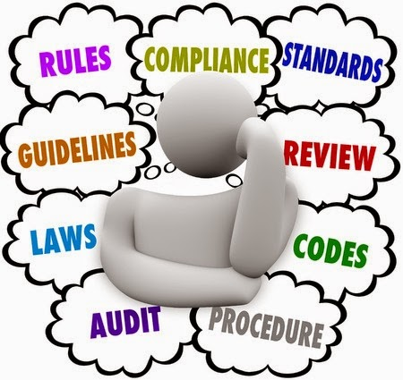
Regulations
Education Department General Administrative Regulations (EDGAR)
  Including Part 200
OMB Circulars

Slide 5
Other Guidance Resources
Guidance on Gender Equity in CTE – June 15, 2016
Program Memo Regarding Program Income – February 5, 2016
Non-Regulatory Guidance Q & A Version 4.0 – April 24, 2015
Non-Regulatory Guidance Q & A Version 3.0 – June 2, 2009
Non-Regulatory Guidance Q & A Version 2.0 – June 7, 2007
Non-Regulatory Guidance Q & A Version 1.0 – January 9, 2007
The Perkins Collaborative Resource Network (PCRN)
  http://cte.ed.gov/
  http://cte.ed.gov/legislation/perkins-policy-guidance

Slide 6
EDGAR 101
An Introduction to EDGAR Regulations

Slide 7
Obligations (76.707)
Type of Obligations | When Obligation Occurs
Acquisition of Property | Date of binding written commitment
Personal Services by Employee | When services are performed
Personal Services by Contractor | Date of binding written commitment
Travel | When travel is taken
Approved Pre-Agreement Cost | On the first day of the grant or subgrant performance period

Slide 8
Time & Effort
NEW – These records must:
  Be supported by a system of internal controls which provides reasonable assurance charges are accurate, allowable and properly allocated
  Be incorporated into official records
  Reasonably reflect total activity for which the employee is compensated (not to exceed 100%)
  Encompass all activities (Perkins and non-Perkins)
  Comply with established accounting policies & practices
  Support distribution among specific activities or cost objectives

Slide 9
Reconciliation (200.430)
NEW – All necessary adjustments must be made such that the final amount charged to the Federal award is accurate, allowable, and properly allocated.

Slide 10
Which time & effort form should I use?
Situation | Time and Effort Form
Single cost objective, | Biannual Certification
Single cost objective, multiple funding sources | Biannual Certification
Multiple cost objective, multiple funding sources | Monthly PAR
So, what does this really mean?

Slide 11
Case 1
ABC College has started a new Welding program and is funding 50% of the position with Perkins funds and the remaining 50% with state funds. This instructor only teaches Welding courses.
  Biannual Certification

Slide 12
Case 2
ABC College has started a new Welding program and is funding 50% of the position with Perkins funds and the remaining 50% with state funds. This instructor teaches Welding courses and two ACA 111 courses.
  Monthly PAR
  Teaching schedule serves as backup documentation

Slide 13
Case 3
A career advisor works with all students enrolled at ABC Community College. The position is funded with 80% Perkins funds and 20% state funds.
  Monthly PAR
  Backup documentation that contains the major of the students served.
  Recommended that the logs be reconciled on a quarterly basis to ensure the percentage of CTE students served

Slide 14
Property Management
Managing Equipment & Other Items Purchased with Perkins Funds

Slide 15
Supplies
All tangible personal property other than equipment
  NEW All computing devices are supplies if less than $5000
NEW – Computing Devices 200.20

Slide 16
Do we still need to track small & attractive items?
Entities must maintain “effective control over, and accountability for, all funds, property and other assets.”
Regardless of cost, grantee must maintain effective control and “safeguard all assets and assure that they are used solely for authorized purposes.”

Slide 17
Equipment (200.313)
NEW – Cannot encumber the property without approval

Slide 18
Use of Equipment (200.313)
Equipment must be used by the college in the program or project for which it was acquired as long as needed, whether or not the project or program continues to be supported by the grant
When no longer needed, the equipment may be used in other activities in using the following priority:
  Projects supported by the grant
  Projects supported by other colleges
Equipment may be shared provided such use will not interfere with work on the original project

Slide 19
Equipment Procedures (200.313)
Property records
  Description
  Serial number or other ID
  Source of funding
  Title
  Use and condition
  Disposition date including sale prices
Physical inventory at least every 2 years
Control system to prevent loss, damage or theft
  All incidents must be investigated
Adequate maintenance procedures
This process will be a part of our monitoring process

Slide 20
What is Supplanting?
Carl D Perkins Career and Technical Education Act of 2006
PL 109-270 Title III, Part A, Section 311

Slide 21
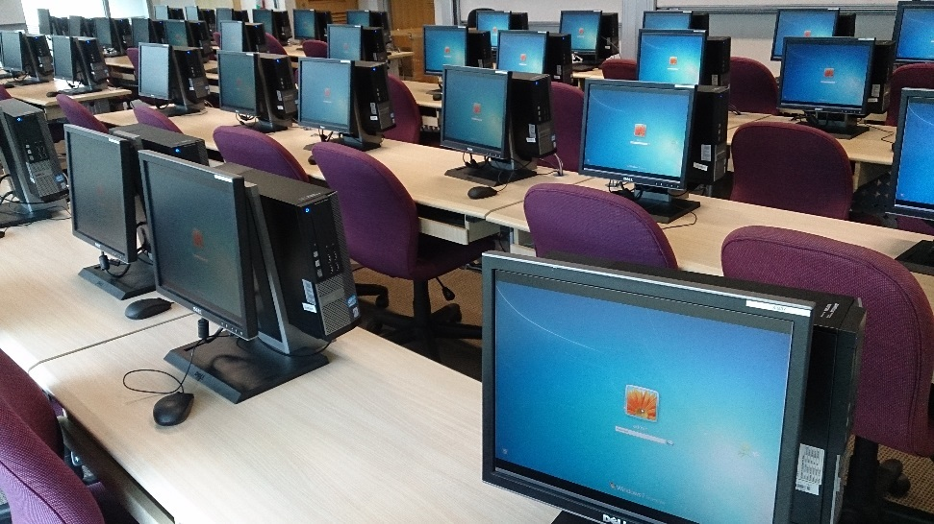
Case 1
ABC College is upgrading computers on their campus on a 5 year cycle.
May ABC College fund computer upgrades for CTE programs using Perkins funds?

Slide 22
Answer to Case 1
No
Five year funding cycle implies ongoing use of Perkins funds to accomplish something that other funds should be used to do
  Remember, Perkins funds should be used for program enhancement or improvement
CTE programs should be treated the same as other state funded programs

Slide 23
Case 2
All non CTE programs at ABC College receive a budget allocation from state funds. CTE programs do not receive an allocation from state funds. ABC College uses Perkins to fund the yearly budget allocation.
May ABC College use Perkins funds as an annual budget allotment?

Slide 24
Answer to Case 2
No
Since ABC College provides all non-CTE programs with a budget allotment using state funds, the use of Perkins funds to do the same for CTE programs is considered supplanting
  Remember, Perkins funds should be used for program enhancement or improvement
CTE programs should be treated the same as other state funded programs

