Slide 1
Perkins Kickoff 2016
Bob Witchger Career and Technical Education Director
Ashley Bowling Administrative Assistant
Julia Hamilton, Tony Reggi, & Chris Droessler Career and Technical Education Coordinators
Get the PowerPoint → www.ncperkins.org/presentations
Notes:
Welcome
We post all of our presentations on the NC Perkins dot org website. Feel free to use anything we present here to educate the rest of your staff and community.
====
Perkins Kickoff 2016
September 13, 2016

Slide 2
The 3 P’s
Performance
Professional Development
Pathways
Notes:
Bob
=====
P graphic
http://www.onlycoloringpages.com/wp-content/uploads/2015/01/P_Coloring_Page_01.jpg

Slide 3
Performance
Preliminary Data
Performance Improvement Plans
Notes:
Bob
====
Performance graphic
http://www.evaluationforms.org/wp-content/uploads/Performance-Evaluation-Process-z.jpg

Slide 4
Professional Development
NC NET Academies/CORD
Practicums
Update NC NET Contacts
Suggestions for Technical Assistance Webinars
Notes:
Bob
=====
Graphic
http://www.cabotschools.org/public/userfiles/Curriculum/logo.jpg

Slide 5
NC-NET Resources
North Carolina Network for Excellence in Teaching
http://www.nc-net.info/
Important Resources
NC-NET Academies
NC-NET Practicums
Adjunct Faculty Toolkit
Career Pathways Course
Employability Skills Toolkit
College Contacts

Slide 6
NC-NET Academies
Six-week, facilitator-led online courses
Courses are free
CTE faculty receive a stipend for completing the course
Small colleges have registration priority
Topics offered in 2016-17
From Good Teaching To Student Learning: An Adjunct Faculty Primer
Technology Bootcamp I: Incorporating The Latest Tools For Effective Instruction
Incorporating Active Learning Strategies In The College Classroom
Technology Bootcamp II: More Tools For Reaching Students
Technology Bootcamp III: Reaching Students With Video

Slide 7
NC-NET Practicum
Collaborative Curriculum Development for Creating Integrated Instruction
An intensive facilitated online practicum on integrated curriculum development
Course Dates: March 10 – April 24, 2017; Final projects due May 1
Practicum Objectives
Interdisciplinary teams will create classroom ready projects that:
Integrate career and technical content and academic concepts—reinforcing both
Use real-world scenarios to engage students and make content relevant
Foster critical thinking, collaboration, and other skills valued by employers
Encourage instructors to use active, authentic assessment techniques
Faculty Nomination and Selection
NC-NET campus liaisons and other college leaders are eligible to nominate faculty members for the practicum using the online nomination form. Nominees will be reviewed and up to 30 faculty members will be selected. As with other Academy courses, tuition is free. Practicum completers will receive a $250 stipend. Nominations will open in late October. Faculty members from mathematics, science, and career-technical (CTE) disciplines will be eligible for nomination.

Slide 8
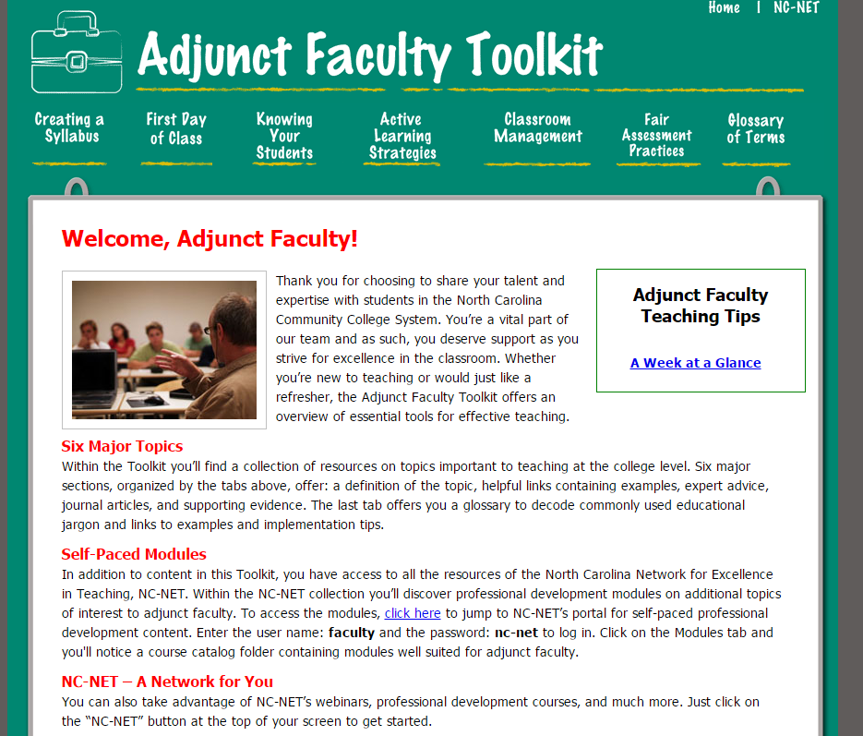
Adjunct Faculty Toolkit
Self-paced, free resource for adjuncts
Great for adjuncts who are new to the NCCCS
Great for adjuncts new to teaching

Slide 9
Career Pathways Course
Great resource for those beginning pathway work!

Slide 10
Employability Skills Toolkit
Lesson plans and resources for:
Interpersonal skills & teamwork
Communication
Integrity & professionalism
Problem solving & decision making
Initiative & dependability
Information processing
Adaptability & lifelong learning
Entrepreneurship

Slide 11
NC-NET College Liaisons
The person designated as the campus liaison will receive communications related to NC-NET professional development
Please take a look at the list of liaisons and verify that the correct person is listed. If you need to appoint a new liaison for your campus, please let me know.
http://www.nc-net.info/liaisons.php

Slide 12
We Would Like Your Feedback!
What type of professional development or technical assistance opportunities would benefit your faculty and students?
Please complete the survey found in the Perkins Online Data System
http://www.ncperkins.org/mod/feedback/view.php?id=372

Slide 13
Pathways
Three 9-14 Pathways
Incorporate articulated courses
Incorporate CCP
Incorporate work-based learning
Consider industry certifications
Student completion of pathways
Notes:
Bob
=====
Graphic
https://media.licdn.com/mpr/mpr/AAEAAQAAAAAAAAIrAAAAJDg5MmE3NTM5LWZhOGEtNDgyOS1hY2Y5LTI4YzEwZjMwODBlNg.jpg

Slide 14
Articulation Update
CAO/CTE Director webinar on September 30
Next Steps
Notes:
Chris
You should have received a copy of an email sent yesterday to your Chief Academic Officers.
We are in the process of updating our state-wide articulation agreement. This is the agreement that says students can earn college credit for successfully completing certain high school courses.
We are having a big webinar on September 30 to explain the next steps.

Slide 15
Edgar
Update
November Meeting
Notes:
Bob
====
http://www.bruman.com/publications/

Slide 16
Local Plan & Budget
How to submit modifications
New $$ amounts
Revised initial budget
XDBR & signature page
VOC codes
Notes:
Bob
=====
Graphic
http://www.ci.ridgefield.wa.us/sites/default/files/imageattachments/finance/page/2186/budget-construction.jpg

Slide 17
MOA Update
Notes:
Bob
=====
Graphic
http://www.westpointevent.org.uk/media/9847/accessibility_-_long.png

Slide 18
Perkins Handbook
Notes:
Bob

Slide 19
Lunch 11:30-12:30
Daily Planet Café – across street @ Science Museum
Legislative Building Café – 1 block East
Pharaoh's Grill - 1 block East at History Museum
Subway & Carolina Bakery – 4 blocks SE in Wells Fargo
Notes:
Bob

Slide 20
Best Practices
AB Tech CC - i3 program (increase STEM participation) and RACE (Articulation) - Gene Loflin
Mayland CC - working with Industry in developing their pathway - Randy Ledford
CPCC - professional development - Heather Parusel
CPCC - developing their consortium - Suzanne Rohrbaugh
Notes:
Bob

Slide 21
Best Practices
AB Tech CC - i3 program (increase STEM participation) and RACE (Articulation)
Gene Loflin
Notes:
AB Tech – Gene Loflin

Slide 22
NSF S-STEM Grant Program
“Ignite Innovation and Inspiration”: I3
$612, 232 total granted to A-B Tech to cover four years
Dr. Jon R. Wiener, P.I.; 4 Co-Pi from A-B Tech: Vernon Daugherty, Susan Schwarz, Tammy Sullivan, Dr. Russ Palmeri
Designed to increase retention and success in the STEM fields
An interactive grant program which offers advising, tutoring, field trips, seminars, internships
Largest fraction of resources go to $2000 scholarships per term for students with unmet financial needs, superior academic performance, and a major in the following degree programs:
Associate of Engineering
Associate of Applied Science in Engineering Technology
Associate of Science in Mathematics, Biology, or Chemistry
Given each term to qualified students for a maximum of four terms, i.e. $8000 maximum.
Notes:
AB Tech – Gene Loflin

Slide 23
Program Data
Program Data
First term (Spring 2016): 9 scholarships: 7 males, 2 females
Two graduated, six remain in program, one changed major out of eligible disciplines
All recipients have maintained at least 3.2 cumulative GPA
Three internships/shadowing experiences took place
Two field trips to four year partner Universities/Colleges
Seminar speakers came to present to the group (public seminar)
Second term (Fall 2016): 9 scholarships: 5 males, 4 females
Thus 15 remain in the program at the present time; their career interests span Aeronautical Engineering, Civil Engineering, Chemistry, Electrical Engineering, Environmental Biology, Computer Engineering Technologies, and Statistics
First term (Spring 2016): 9 scholarships: 7 males, 2 females
Two graduated, six remain in program, one changed major out of eligible disciplines
All recipients have maintained at least 3.2 cumulative GPA
Three internships/shadowing experiences took place
Two field trips to four year partner Universities/Colleges
Seminar speakers came to present to the group (public seminar)
Second term (Fall 2016): 9 scholarships: 5 males, 4 females
Thus 15 remain in the program at the present time; their career interests span Aeronautical Engineering, Civil Engineering, Chemistry, Electrical Engineering, Environmental Biology, Computer Engineering Technologies, and Statistics
Notes:
AB Tech – Gene Loflin

Slide 24
Regional Articulation for Career and Technical Education (RACE)
A-B Tech and Blue Ridge CC
Asheville City, Buncombe County, Henderson County, Madison County, and Transylvania County schools
Leadership Committee with representatives from all members
Two major projects each year
Leadership Academy
RACE Agreement Alignment Meeting
Notes:
AB Tech – Gene Loflin

Slide 25
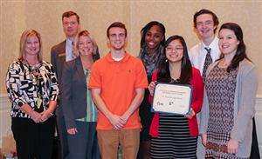
Leadership Academy
Held at Biltmore Estates in fall
Approximately 160 students from all school systems
Focus on Leadership – This year students will look for examples of leadership traits while touring the house and grounds
Notes:
AB Tech – Gene Loflin

Slide 26
RACE Articulation Meeting
RACE Leadership Committee Selects Areas for Review
Held on the campus of A-B Tech or Blue Ridge CC
Faculty and teachers compare learning outcomes and instructional methods and determine equivalencies
Last year included a focus on Project Lead the Way
Notes:
AB Tech – Gene Loflin

Slide 27
Best Practices
Mayland CC - working with Industry in developing their pathway
Randy Ledford
Notes:
Bob

Slide 28
Best Practices
CPCC - professional development Heather Parusel
Notes:
Bob

Slide 29
Best Practices
CPCC - developing their consortium
Suzanne Rohrbaugh
Notes:
Bob

Slide 30
Best Practices
Wake Tech – eVising
Sandhills –
Craven, Pamlico, Brunswick, Southeastern
College of The Albemarle
2016 - 2017 Evaluations
Best Practice Video and Annual Report
Notes:
Bob

Slide 31
Perkins Reauthorization
Preparing Workforce
Programs of Study/Pathways
Helping students make smart choices
Special populations
WIOA performance measures
Notes:
Bob

Slide 32
Collaboration
Certified Pathways
Publish 9-14 Pathways
Alternative Pathways
WIOA Title II
Notes:
Bob
====
Graphic
http://seapointcenter.com/wp-content/uploads/2015/10/Collaboration-Mindset.jpg

Slide 33
Career Awareness Week
Advanced Manufacturing Careers Awareness Week
October 3-7, 2016
Aligns with national MFG DAY on October 7.
www.ncperkins.org/manufacturing
Notes:
Chris
This is our fifth time for a special week to raise the awareness of Advanced Manufacturing in North Carolina.
We have aligned our efforts with the national manufacturing day and expect 50 open houses and other events across the state. Many of those events will be at our community colleges.

Slide 34
Perkins Calendar
Notes:
Bob
=====
graphic
http://www.drk.sd23.bc.ca/About/Calendar/Documents/training.RedCalendar.jpg

Slide 35
Perkins Kickoff 2016
Bob Witchger Career and Technical Education Director
Ashley Bowling Administrative Assistant
Julia Hamilton, Tony Reggi, & Chris Droessler Career and Technical Education Coordinators
Get the PowerPoint → www.ncperkins.org/presentations
Notes:
Do you have any questions for us?

