Slide 1
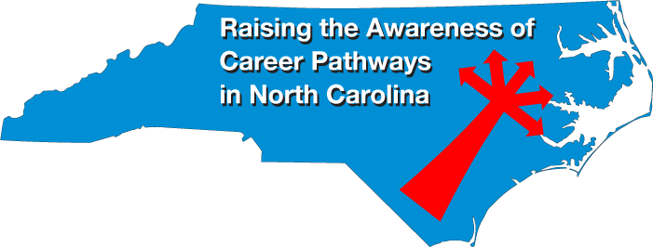
September 19, 2019
Bob Witchger
Chris Droessler
NC Community Colleges
Cheryl Cox
NC Department of Public Instruction
www.ncperkins.org/presentations
Notes:
====

Slide 2
Raising the Awareness of Career Pathways in North Carolina
The purpose of these monthly webinars
www.ncperkins.org/presentations
Notes:
Welcome to something new.
Thanks to all of you who have helped plan open house events the last seven years for Advanced Manufacturing and Construction Careers.
We believe we have done very well getting the word out about the great careers across the state.
We are combining efforts starting now -- to help promote the great jobs, often unknown, in the great state of North Carolina.
We are going to let you know about some great career opportunities in North Carolina.
Please download this PowerPoint file and use it anyway you can to help get folks on a career pathway.
The reference showing from where the information was found is in the Notes section under each slide.
Get the PowerPoint on our NCPerkins.org website on our Presentations and Webinars page.
Here is the direct address.

Slide 3
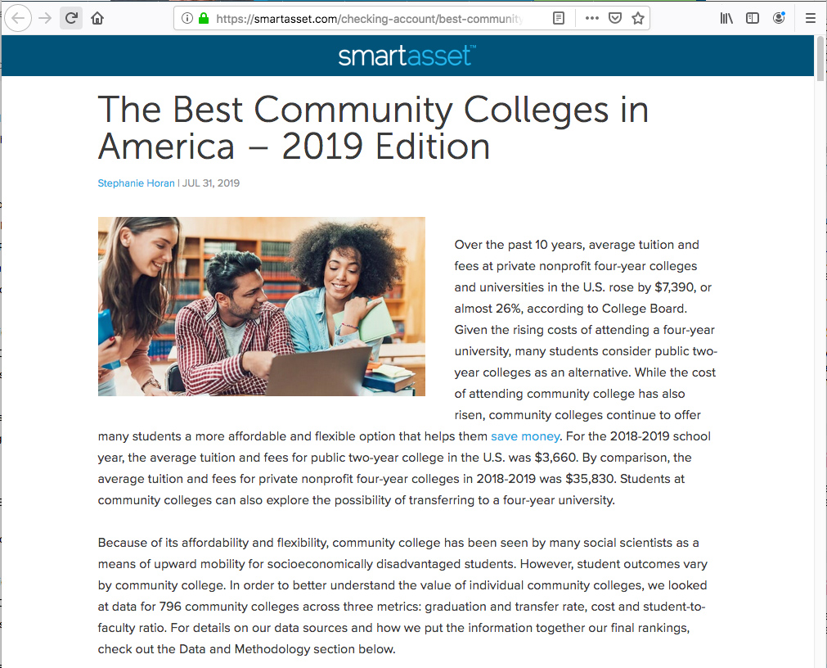
Notes:
Here is a study that looks at the top community colleges in the country.
They looked at three main things:
graduation and transfer rate,
cost of the education,
and student to faculty ratio.
========
https://smartasset.com/checking-account/best-community-colleges-in-america-2019

Slide 4
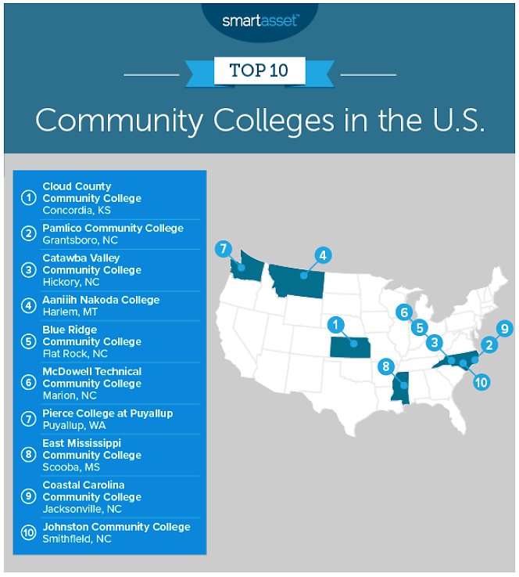
Notes:
According to this survey, six of our North Carolina community colleges made the top-ten list.
Nine of our North Carolina community colleges are listed in the top twenty community colleges.
The top community colleges in North Carolina for 2019 are Pamlico Community College, Catawba Valley Community College, Blue Ridge Community College, McDowell Technical Community College, Coastal Carolina Community College and Johnston Community College.
========
https://smartasset.com/checking-account/best-community-colleges-in-america-2019

Slide 5
Notes:
www.ncperkins.org/presentations

Slide 6
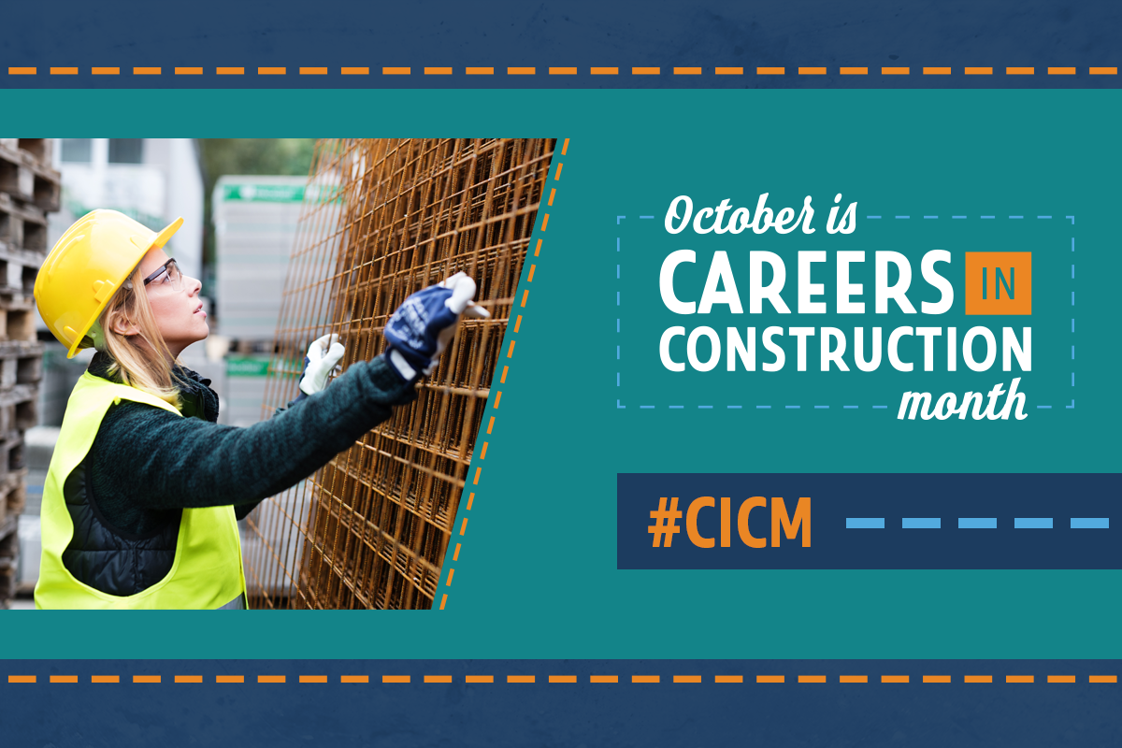
Careers in Construction Month
October is Careers in Construction Month
NCCCER and
Build Your Future (BYF)
Notes:
October is Careers in Construction Month
http://www.byf.org/cicm/

Slide 7
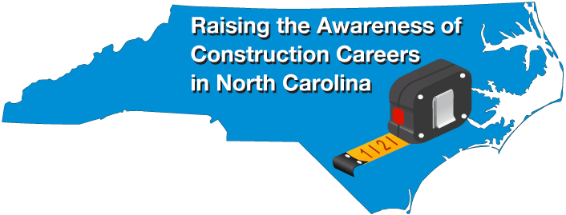
Careers in Construction Month
October is Careers in Construction Month
NCCCER and
Build Your Future (BYF)
Notes:
Careers in Construction Month website
http://www.byf.org/cicm/
Construction resources
http://www.byf.org/resources/
Career Month resources
http://www.byf.org/resources/?filter=Media

Slide 8

WNC Construction Career Day
Notes:
Nathan Ramsey
MAWDB Director
Mountain Area Workforce Development Board
828.251.6622 (x161)
nathan@landofsky.org
Christy Cheek
Education and Work-based Learning Coordinator
Mountain Area Workforce Development Board
Land of Sky Regional Council
339 New Leicester Highway, Suite 140
Asheville, NC 28806
Cell Phone: 828-768-6535 (primary)
Fax: 828-251-6353
www.landofsky.org
www.mountainareaworks.org

Slide 9
WNC Construction Career Day
October 15th -- 8:30 am to 4:00 pm
October 16^{th --} 8:30 am to 1:00 pm
Haywood County Fairgrounds, Waynesville
Over 800 high school students
Open to public Oct 15 from 2:00 to 4:00 pm
Nathan Ramsey , Christy Cheek, Barbara Darby
Mountain Area Workforce Development Board
Notes:
Nathan Ramsey
MAWDB Director
Mountain Area Workforce Development Board
828.251.6622 (x161)
nathan@landofsky.org
Christy Cheek
Education and Work-based Learning Coordinator
Mountain Area Workforce Development Board
Land of Sky Regional Council
339 New Leicester Highway, Suite 140
Asheville, NC 28806
Cell Phone: 828-768-6535 (primary)
Fax: 828-251-6353
www.landofsky.org
www.mountainareaworks.org
Barbara Darby
Mountain Area Workforce Development Board

Slide 10
Notes:
www.ncperkins.org/presentations

Slide 11

Notes:
https://www.mfgday.com/

Slide 12
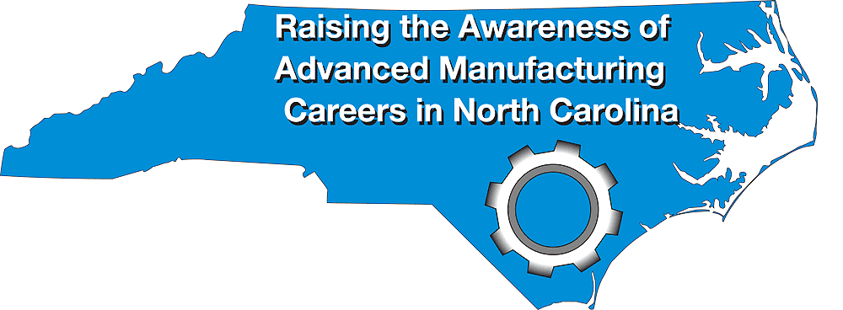
Manufacturing Day
First Friday in October
Host an event: https://www.mfgday.com/user/register
Find an Event in NC:
https://www.mfgday.com/events?country=US&state=NC#filter
Over 60 events across the state
Notes:
Manufacturing Day, or as we like to say "Raising the Awareness of Advanced Manufacturing Careers in North Carolina."
Manufacturing Day is always the first Friday in October. In North Carolina we like to stretch it out to a week, and beyond.
The national calendar lists over 60 evens in North Carolina.. Most are at businesses opening their doors for tours, a look behind the scenes at a manufacturing plant.
Manu of our colleges are hosting open houses to showcase their classrooms and laboratories, and to host many manufacturing businesses in one location.
To find an event near you, click that link or just go to MFG DAY dot com
Some of these events listed are closed tot eh public. They might be just for high school students.
Some of the events require a registration, and some require closed-toe shoes. So check the website carefully to ensure that you have a pleasant and rewarding experience.
https://www.mfgday.com/

Slide 13
Notes:
www.ncperkins.org/presentations

Slide 14
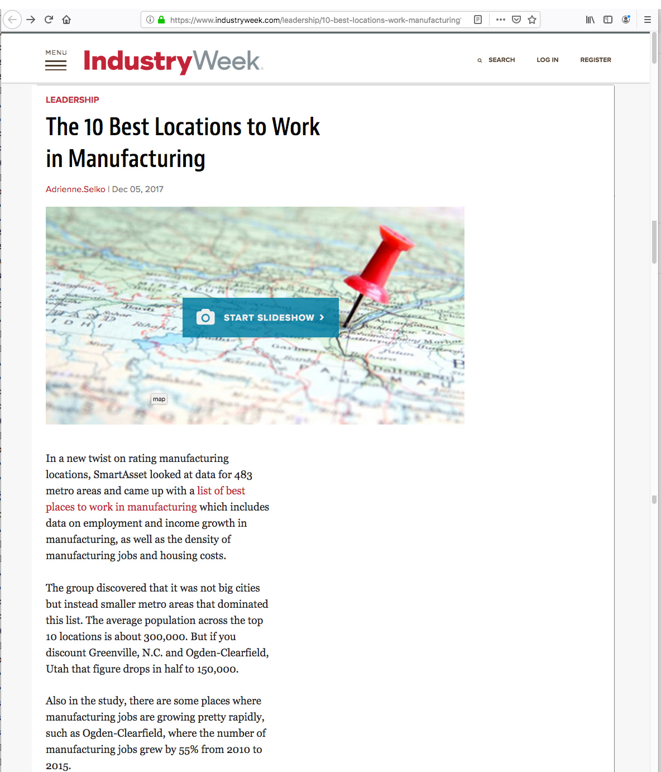
Notes:
This article is a couple of years old, but it has NC in the top ten.
======
https://www.industryweek.com/leadership/10-best-locations-work-manufacturing

Slide 15
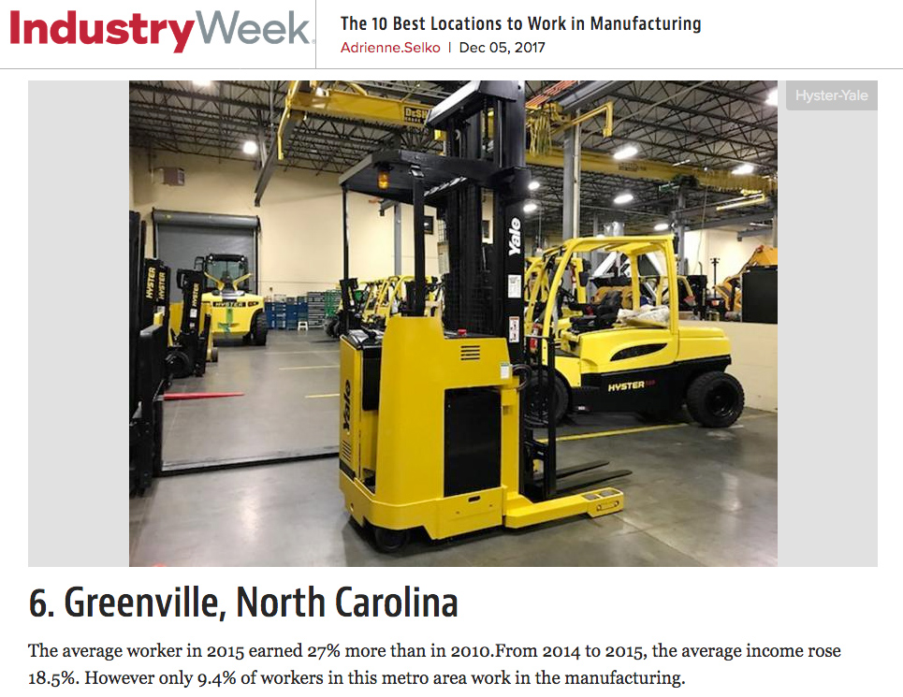
Notes:
The sixth best place in the United states to work in manufacturing is in Greenville NC
======
https://www.industryweek.com/leadership/10-best-locations-work-manufacturing

Slide 16
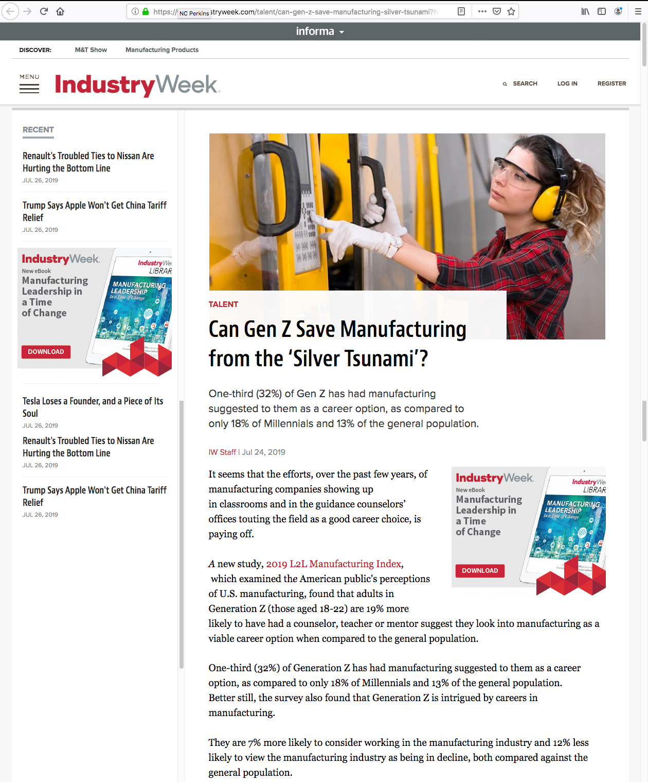
Notes:
Article says that the Manufacturing Industry is doing a great job of letting the young folks know about careers in Manufacturing.
https://www.industryweek.com/talent/can-gen-z-save-manufacturing-silver-tsunami

Slide 17
Top States in Manufacturing
California
Texas
Illinois
Ohio
New York
Pennsylvania
Michigan
Massachusetts
North Carolina
Wisconsin
Notes:
A compilation by Industry Week magazine
based on where the top 500 publicly-held manufactures.
This is a list showing the states with the most headquarters for these manufacturers.
That's North Carolina at number 9.
===
https://www.industryweek.com/resources/2019-iw-us-500-top-manufacturing-states
https://www.industryweek.com/resources/2019-iw-us-500-top-manufacturing-states/gallery?slide=2
9. North Carolina
Seventeen manufacturing companies call North Carolina home.
Manufacturers in North Carolina account for 19.04% of the total output in the state, employing 10.56% of the workforce. Total output from manufacturing was $102.48 billion in 2017. In addition, there were an average of 474,000 manufacturing employees in North Carolina in 2018, with an average annual compensation of $70,701.95 in 2017.

Slide 18
NC is 9th State in Manufacturing
17 of top 500 manufacturing companies call North Carolina home.
Manufacturers are19.04% of total output in state
Employ 10.56% of the state workforce.
Manufacturing output was $102.48 billion in 2017.
474,000 manufacturing employees in 2018
Average compensation of $70,701.95 in 2017.
Notes:
A compilation by Industry Week magazine
===
https://www.industryweek.com/resources/2019-iw-us-500-top-manufacturing-states
https://www.industryweek.com/resources/2019-iw-us-500-top-manufacturing-states/gallery?slide=2
9. North Carolina
Seventeen manufacturing companies call North Carolina home.
Manufacturers in North Carolina account for 19.04% of the total output in the state, employing 10.56% of the workforce. Total output from manufacturing was $102.48 billion in 2017. In addition, there were an average of 474,000 manufacturing employees in North Carolina in 2018, with an average annual compensation of $70,701.95 in 2017.

Slide 19
Notes:
www.ncperkins.org/presentations

Slide 20

Albert Alwang
Economic Development Manager
Wake County Economic Development
Notes:
http://raleigh-wake.org/
NCTAP

Slide 21
Kristin Skiba
Marketing Coordinator
Wake County Economic Development
Notes:
http://raleigh-wake.org/

Slide 22
Anna Mangum
Regional Manager
Industry Expansion Solutions (IES)

Slide 23
Notes:
www.ncperkins.org/presentations

Slide 24
Manufacturing Day Events
Find an Event in NC:
https://www.mfgday.com/events?country=US&state=NC#filter
67 events across the state.
Be sure to check for attire, like closed-toed shoes
Some listed events are only for HS students
Register for each event at mfgday.com
Notes:
Let's ake a look at a few of the 67 events across the state.
I plan to participate in a few of them, but not all of them.
As of now, there are 67 evens listed in North Carolina..
To find an event near you, click that link or just go to MFG DAY dot com
Some of the events require a registration, and some require closed-toe shoes.
So check the website carefully to ensure that you have a pleasant and rewarding experience.
https://www.mfgday.com/

Slide 25

Brunswick Community College
October 4, 2019 9:00am - 1:00pm
In partnership with local manufacturing companies, Brunswick CC will engage with high school juniors and seniors. The purpose of this event will be to expose the students to manufacturing companies and share wage expectations with them.
2045 Enterprise Dr NE, Leland, NC 28451
Greg Bland
Notes:
Brunswick Community College is hosting an open house on October 4.
Greg Bland is here to disccuss
===
For More Event Information
Greg Bland
9107557374
blandg@brunswickcc.edu

Slide 26
Notes:
www.ncperkins.org/presentations

Slide 27

Carteret Community College
September xx, 2019 - Invitation-Only
This event is for middle school students.
Gown Up! presentation from NC BioNetwork
Tour Carteret Community College's MARTEC (Boat Manufacturing Technologies facility).
Shearline Boatworks
Bena Weires
Notes:
Carteret Community College is hosting several open houses for the local middle- and high-school studnewts.
Bena Weires
For More Event Information
Bena Weires
252-222-6156
weiresb@carteret.edu

Slide 28
Carteret Community College
October xx, 2019 - Invitation-Only
High school students only
Tour Veneer Technologies
Veneer Technologies offers pre-apprenticeships
Tour college manufacturing programs
Bena Weires
Notes:
For More Event Information
Bena Weires
252-222-6156
weiresb@carteret.edu

Slide 29
Notes:
www.ncperkins.org/presentations

Slide 30

College of The Albemarle
October 4, 2019 9:00am - 1:00pm
Explore COA’s Aviation Systems Technology, Computer-Aided Drafting, Computer Integrated Machining, Engineering, Welding, HVAC, and Information Technology programs, and hear from area employers about the opportunities available in their businesses for specialists in these fields.
Michelle Waters
Notes:
Michelle Waters
2523350821
michelle_waters@albemarle.edu

Slide 31
College of The Albemarle
Notes:
Michelle Waters
2523350821
michelle_waters@albemarle.edu

Slide 32
Notes:
www.ncperkins.org/presentations

Slide 33

Mitchell Community College
October 3, 2019 11:00am - 2:00pm
Self Guided Tour that showcases the many products Made In Iredell County and how Mitchell Community College can provide training for the many job opportunities.
Meet our local companies: DENSO Manufacturing in NC, NGK Ceramics USA, Doosan Portable Power, Niagara Bottling, deBotech, Inc., EarthKind, Maclean-Curtis, McComb Steel Co., & Roush Yates Manufacturing Solutions.
Tour Mitchell's manufacturing labs on
campus to see hands on training.
Deb Lazenby
Notes:
500 W Broad St
Statesville, NC 28677
For More Event Information
Deb Lazenby
7048783235
dlazenby@mitchellcc.edu

Slide 34
Notes:
www.ncperkins.org/presentations

Slide 35

Marcia E. Weston, Ph.D.
Associate Director for Outreach Grants, Training, and Outreach
NC State Education Assistance Authority
Notes:
Marcia E. Weston, Ph.D.
Associate Director for Outreach
Grants, Training, and Outreach
NC State Education Assistance Authority
P.O. Box 13663
Research Triangle Park, NC 27709-3663
919-248-4686 (office)
919-268-0519 (cell)
919-248-6686 (fax)

Slide 36
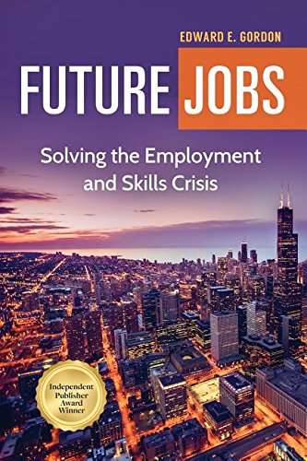
Edward E. Gordon
Imperial Consulting
Corporation
Notes:
http://www.imperialcorp.com/
Gordon is the author or co-author of 21 books including Future Jobs: Winning the Global Talent Showdown, Divided on D-Day, The 2010 Meltdown, Skill Wars, FutureWork, Closing the Literacy Gap in American Business, Opportunities in Training and Development Careers, Literacy in America, The Tutoring Revolution, Peer Tutoring, and Tutor Quest.

Slide 37
Raising the Awareness of Career Pathways in North Carolina
Next meeting is October 17, 2019
www.ncperkins.org/presentations
Notes:
Our next meeting like this one will be on ------.
We will skip June, July and August and be back in September.
We will be talking about the great events happing during Construction Careers Week
You can go to the NCPerkins website to register for that meeting.
We'll also send you a reminder, since you are now on our mailing list.
So go ahead and sign up for all the meetings, and you'll be reminded the day before.

Slide 38
May 23, 2019
Bob Witchger
Chris Droessler
NC Community Colleges
Cheryl Cox
NC Department of Public Instruction
www.ncperkins.org/presentations
Notes:
====
May 23, 2019

