Slide 1
Perkins Mid-Year Review
January 29th, 2020

Slide 2
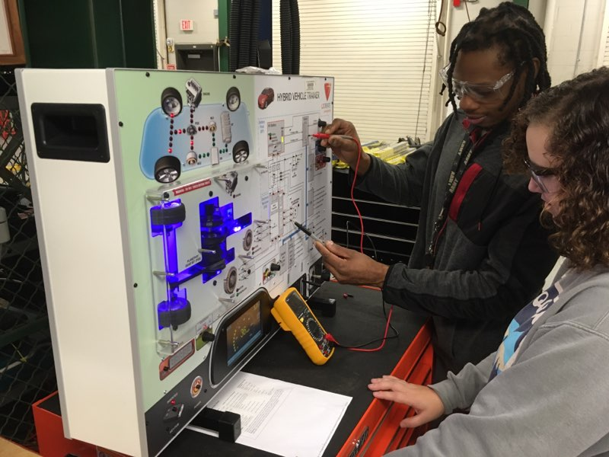
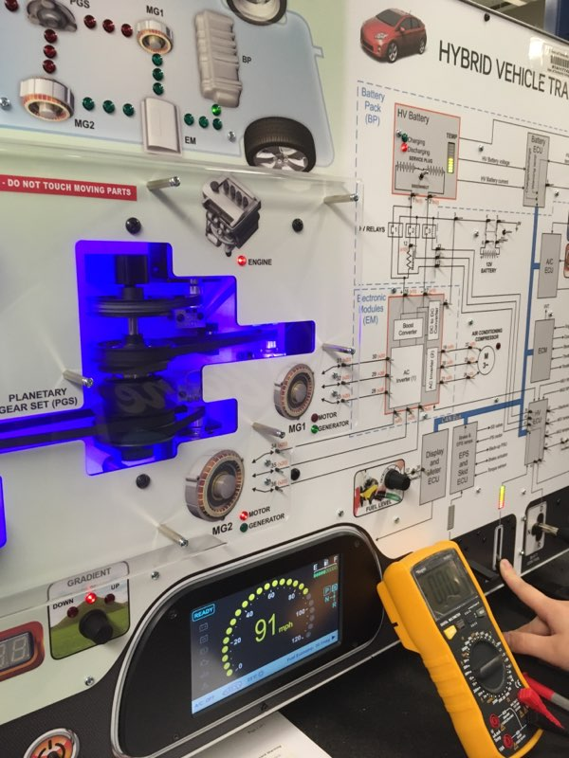
Perkins Funds in Action
Automotive Systems Technology - Hybrid Vehicle Training Panel
Provide students with a safe environment for training to prevent self-harm or damage to an expensive vehicle
Once skills are mastered on the training panel, students move to working on actual hybrid and electric vehicles.
Increases employability

Slide 3
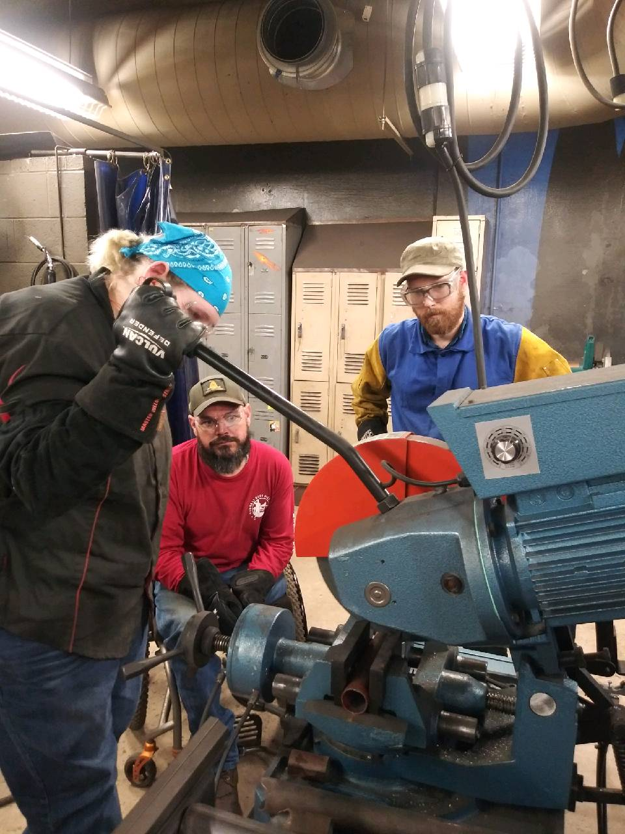
Perkins Funds in Action
Welding Technology – Scotchman Cold Saw
Students make more accurate cuts on metal tubing and make fabricating a faster process
The quality and precision of cut is of much higher quality
Students will not need to spend extra time grinding to make their parts fit a project
Practicing the actual welding process = employability

Slide 4
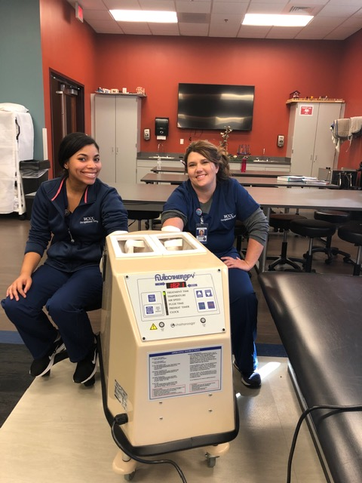
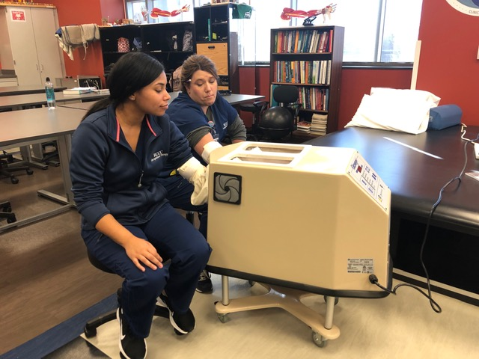
Perkins Funds in Action
Occupational Therapy Assistant & Physical Therapist Assistant – Fluidotherapy Machine
Categorized as a superficial heat physical agent modality, a type of intervention used in both OT and PT
Students are trained to prepare them for use in the clinical environment and in preparation for employment
Allows students to compare and contrast the modality with other physical agent modalities for optimal patient care

Slide 5
CLNA & Gaps Discovered
Program Areas Reviewed:
Business Technologies
Construction Technologies
Engineering Technologies
Health Sciences
Industrial Technologies
Public Service Technologies
Transportation Systems Technologies
Not inclusive but findings included (lowest performers):
1P1: African-American males, Transport Systems Technologies
2P1: African-American males, Construction Technologies & Industrial Technologies
3P1: African-American females & white males, Industrial Technologies & Public Service Technologies
4P1: Hispanic females
5P1: African-American males & Hispanic males
5P2: All groups except white females, all program areas except Business Technologies

Slide 6
Budget Update
Current Spending
Equipment continues to be purchased
Netlab (IT)
Drones (Construction Management)
Much of our professional development spending occurs during spring semester
Spending under the CLNA
Shift focus towards specific student populations and services they may need for success
Low performing program areas as indicated by performance indicators

